Slide 1
Present Status of J-PARC MUSE
NuFact13 20/Aug/2013
Koichiro Shimomura for MUSE
KEK, J-PARC

Slide 2
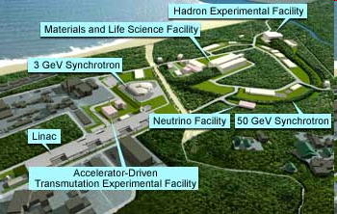
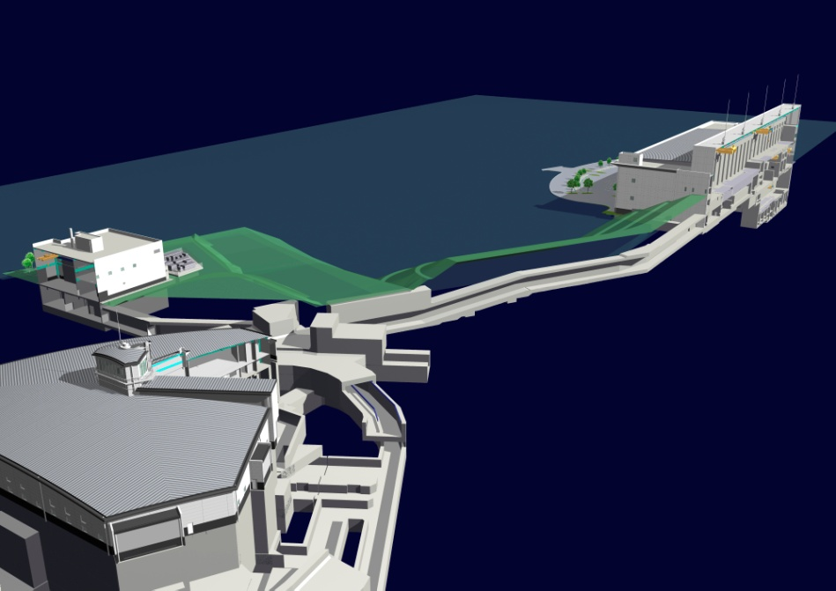
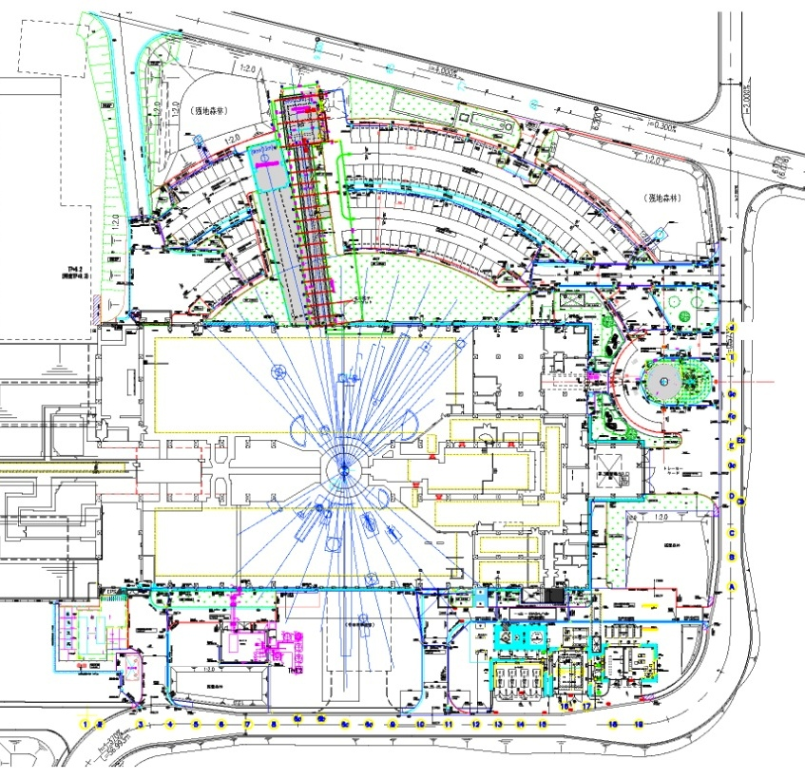
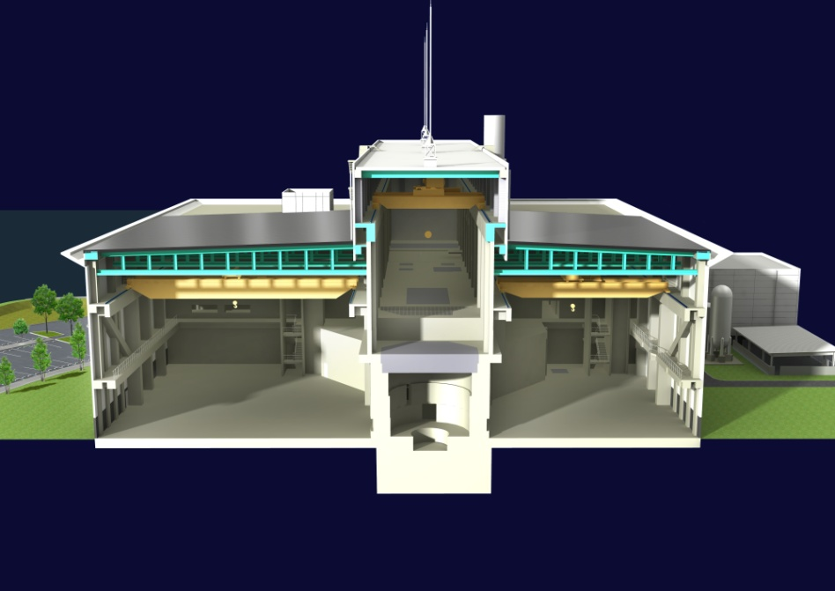
J-PARC MLF
MLF
RCS (3GeV333μA)
Muon target
Spallation neutron target
Exp. Hall #1
Exp. Hall #2
Exp. Hall #1
Exp. Hall #2
High rad. area is separated from exp. hall
Beam transport tunnel

Slide 3
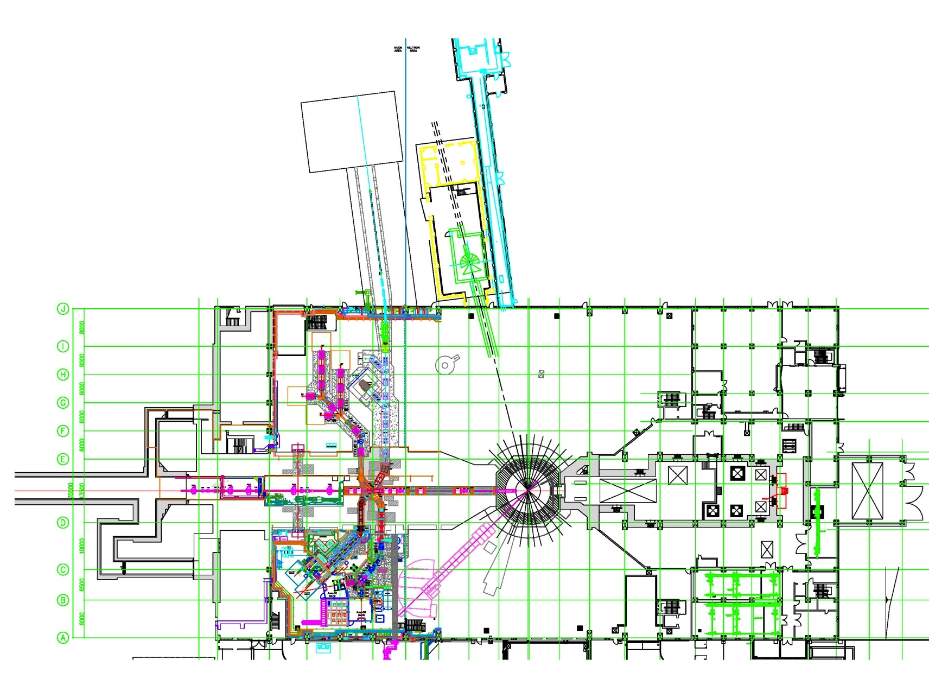
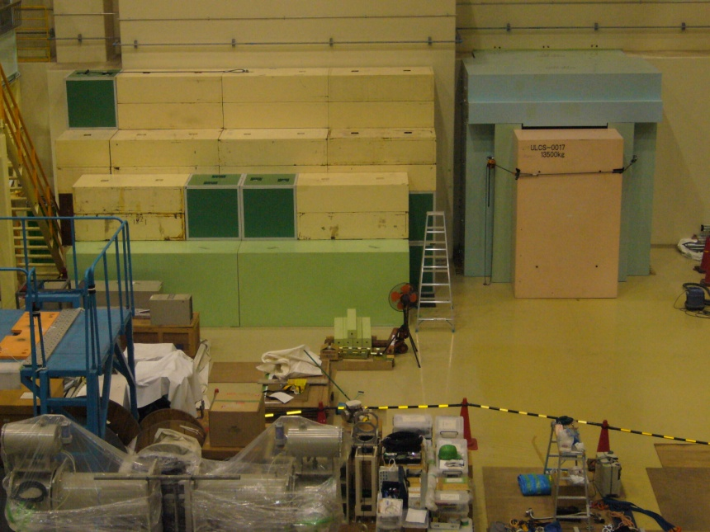
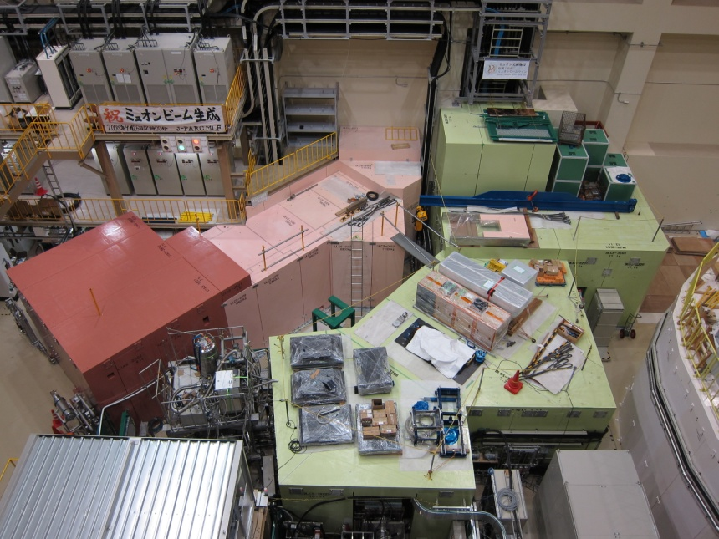
J-PARC MUSE
H
S
U
D
3GeV proton beam
25 Hz repetition rate
333μA, 1MW

Slide 4
4 Beam line
D line (In operation)
μ⁺, μ⁻ (10 ~120MeV/c) ~3×10⁷/s
μSR non-destructive element analysis so on
U line (construction finished in 2013)
μ⁺, μ⁻ (30MeV/c) ~4×10⁸/s
Ultra Slow Muon
S line (In construction, 2104?)
μ⁺ (30MeV/c) ~10⁷/s
4 μSR experiments simultiniusly
H line (In construction, 2104?)
μ⁺ (30MeV/c) ~10⁸/s
Fundumental physics

Slide 5
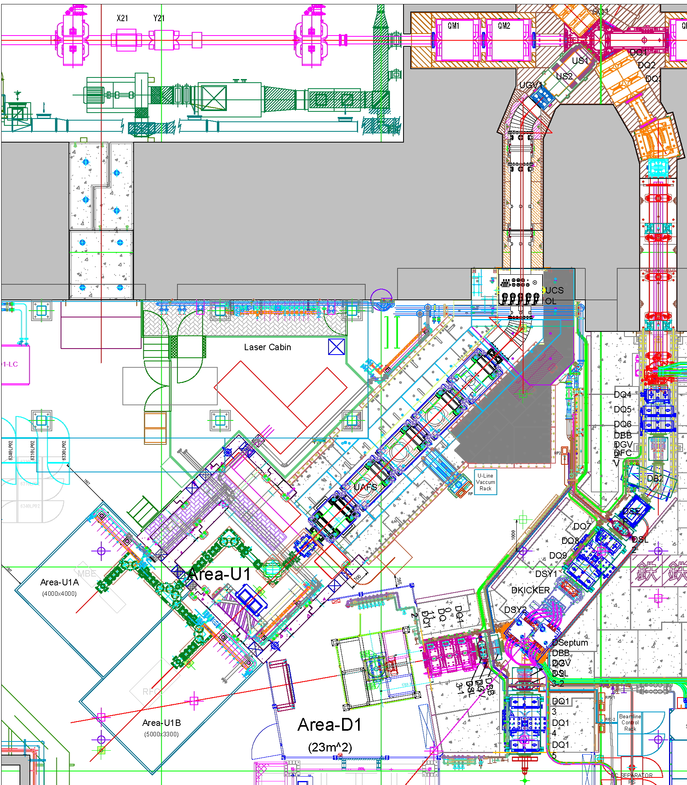
U-line (Ikedo, Shimomura et al. )
Muon Target
Exp. Hall 1
Superomega beamline
The second muon beamline under construction on U-line in MLF/J-PARC.
First aim of Superomega is surface muon source for Ultra Slow muon beam with high intensity and high luminosity.
Proton
beamline
Exp. Hall 2
U-line
Superomega beamline
D-line: In operation.
Decay and surface muon.
Intensity: 1 x 10⁷ μ⁺/s
U-line: Construction finished
  Superomega beamline.
  Design to capture and transport muons up to 45 MeV/c.
D-line
U-line
Ultra slow muon beamline

Slide 6
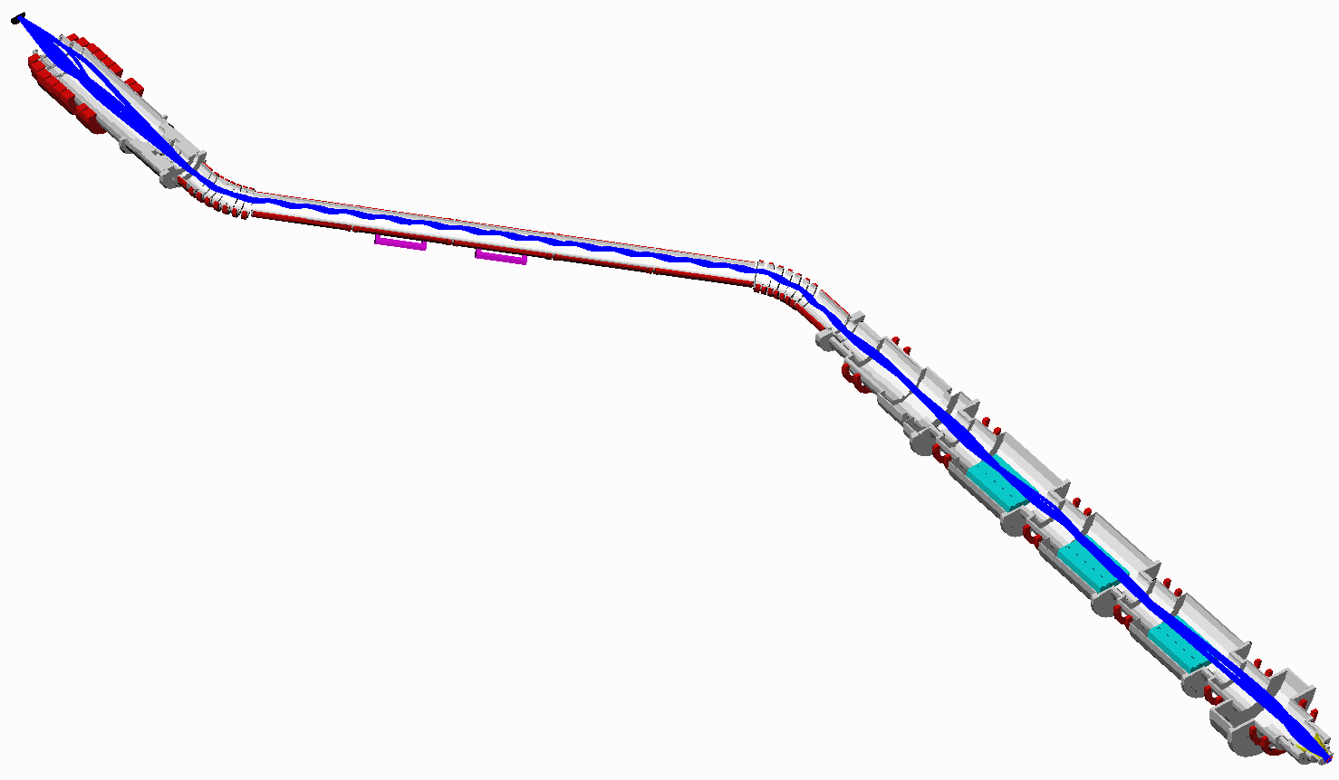
Superomega muon beamline
Muon production target (Graphite, t=20 mm)
US1,2
Superconducting curved transport solenoid
UCS1
UCSSTX
UCSSTY
Superconducting axial
Focusing solenoid
UCS2
Normal conducting
Capture solenoid
UFS1-1, 1-2
UCSDIP
Dipole coils
For charge selection
UFS2-1, 2-2
Features:
All beamline magnets consist of solenoid coil.
High intensity: Large solid angle acceptance of 400 msr
Produce the highest intensity pulsed muon beam in the world.
Simultaneously capture and transport both μ⁺ and μ⁻.
USEP2
USEPCC
Positron
separators
UFS5-1, 5-2
UFS6-1, 6-2
Experimental target

Slide 7
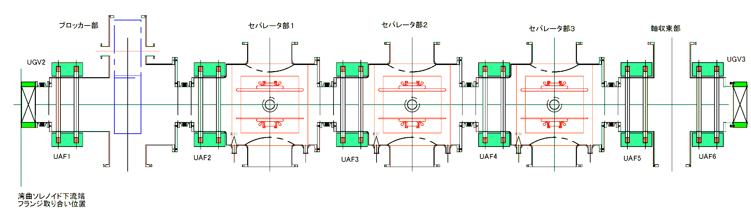
Superconducting Axial focusing solenoid
Exit of curved solenoid
Cryostat
Experimental target
Beam Blocker
Positron separator
Focusing solenoid
Further transports muons and focuses on the experimental target.
Cryostat: A pair of thin superconducting solenoids are placed in a cryostat. The six cryostats are aligned in the beamline to transport muons.
Beam Blocker: Cupper block of 30-cm thickness for stopping muon, neutron and gamma ray.
Positron separator: Three-stage Wien filter type separator.
Focusing solenoids: Focus on the experimental target using two last solenoids.

Slide 8
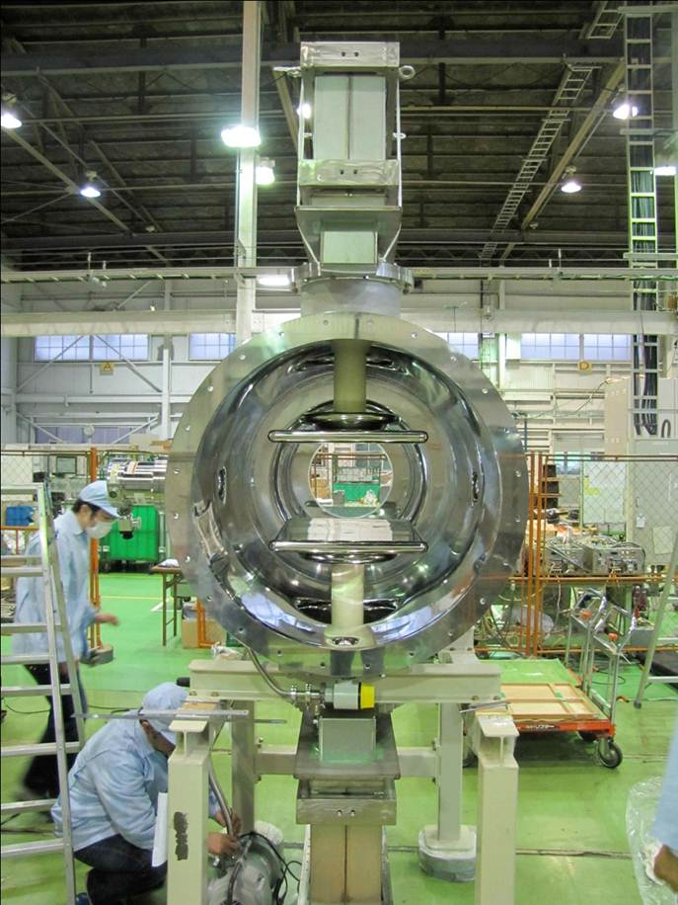
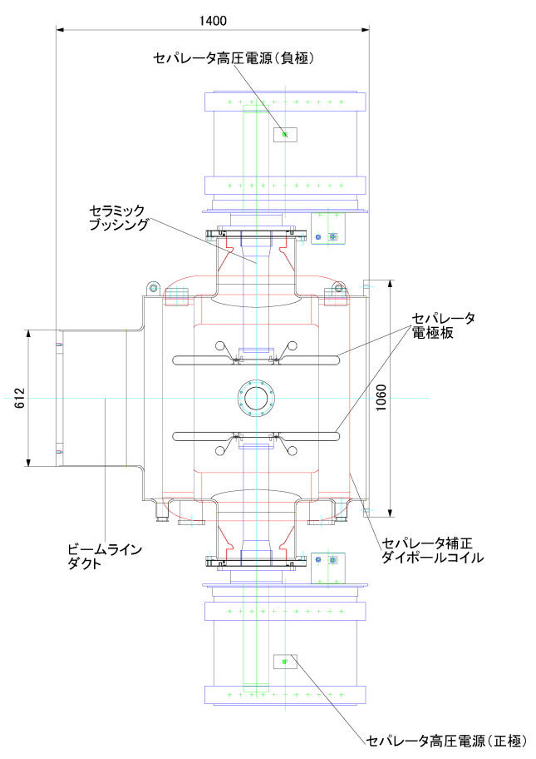
Positron separator
Three-stage Wien filter type separator
High voltage power supply
(Cockcroft-Walton type)
Gap: 300 mm
Electrode: 500 mm (width) x 750 mm (length)
Rating voltage ±400 kV (E = 2.67 MV/m)
Correction magnetic dipole coil (360 A 48 V)
B=0.0456 T (central peak field)
Ar pressure 10⁻³ – 10⁻² Pa
Electrode
Ceramic bushing

Slide 9
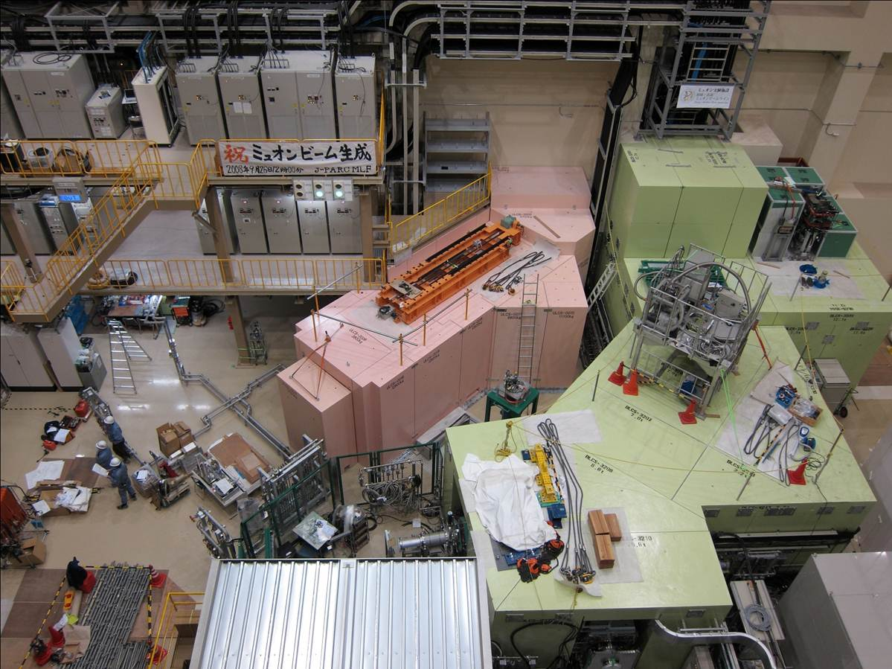
MLF Experimental Hall No.2 (Feb. 2012)
He compressor rack
for GM refrigerator
U-line
D-line
CW pipes
for beamline
magnet
Concrete shielding
Area for
Ultra slow muon beamline

Slide 10
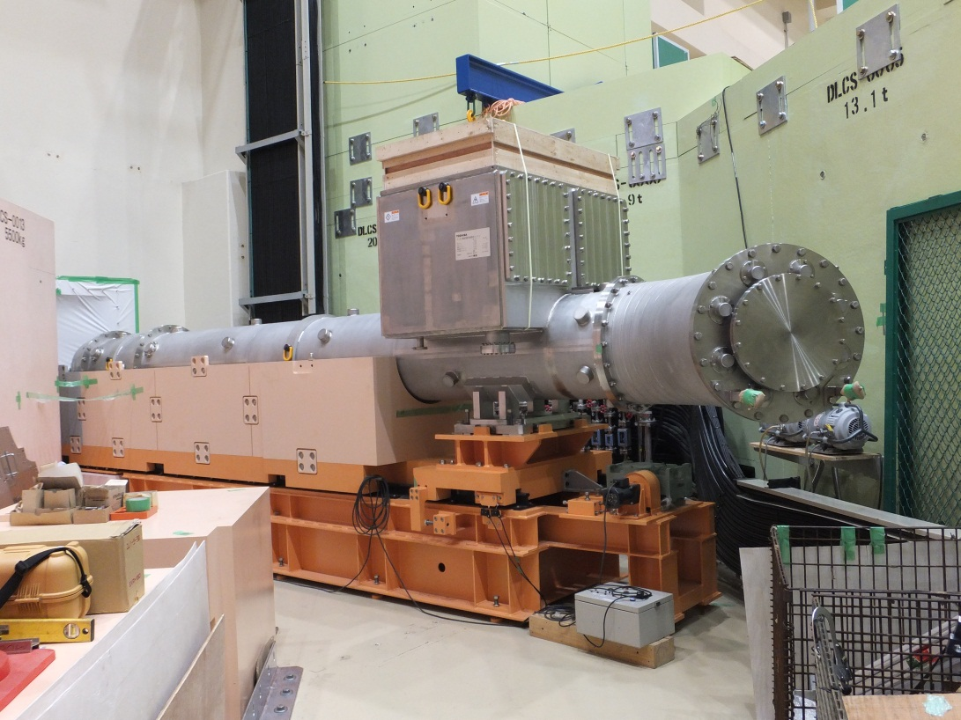
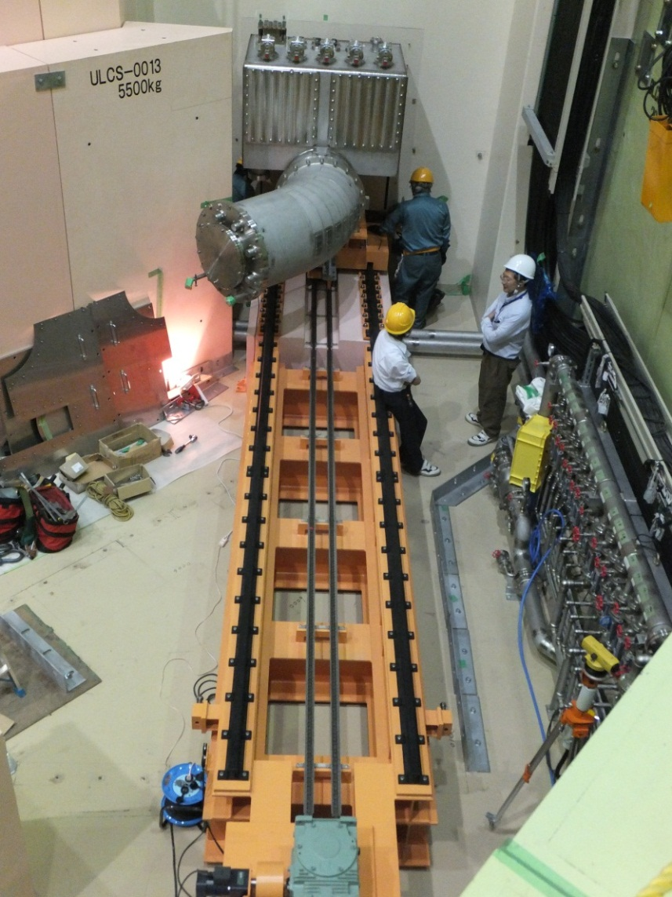
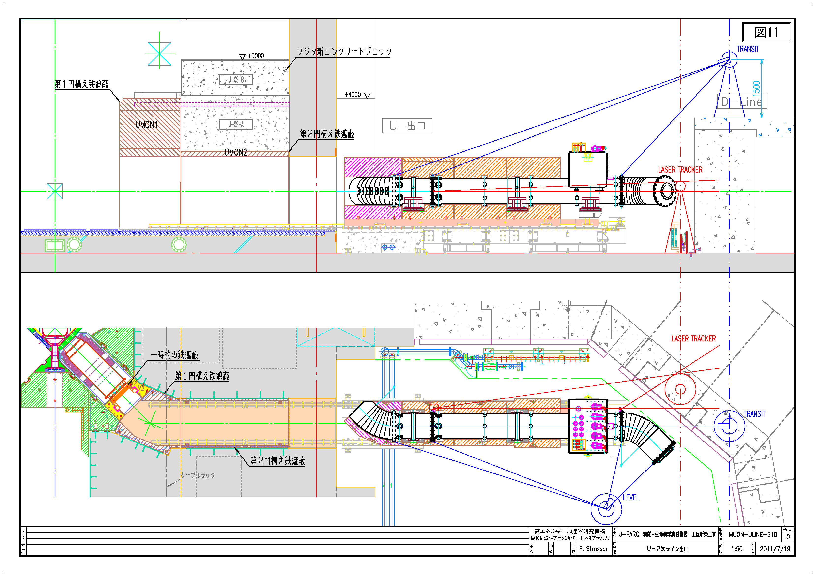
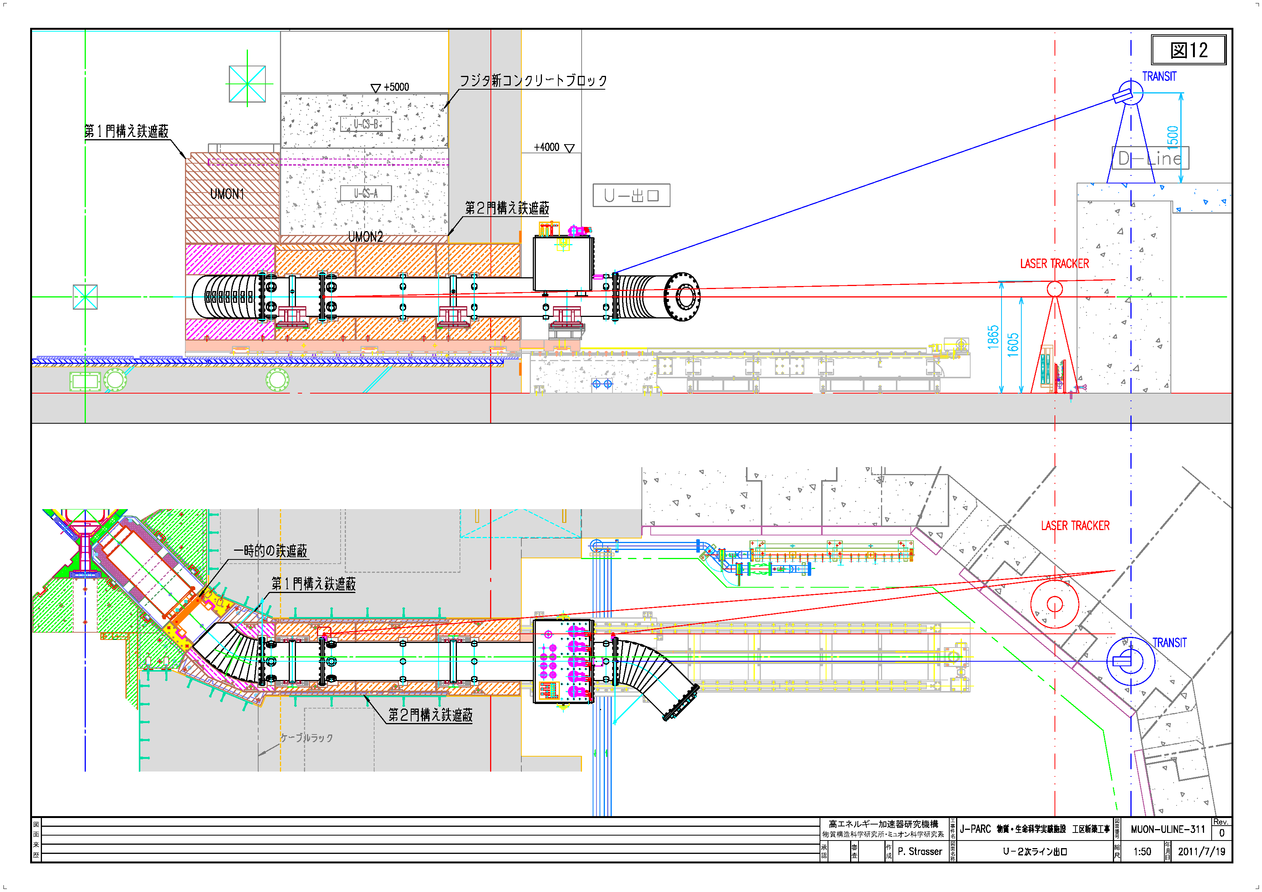
Curved Solenoid
Iron Shield

Slide 11
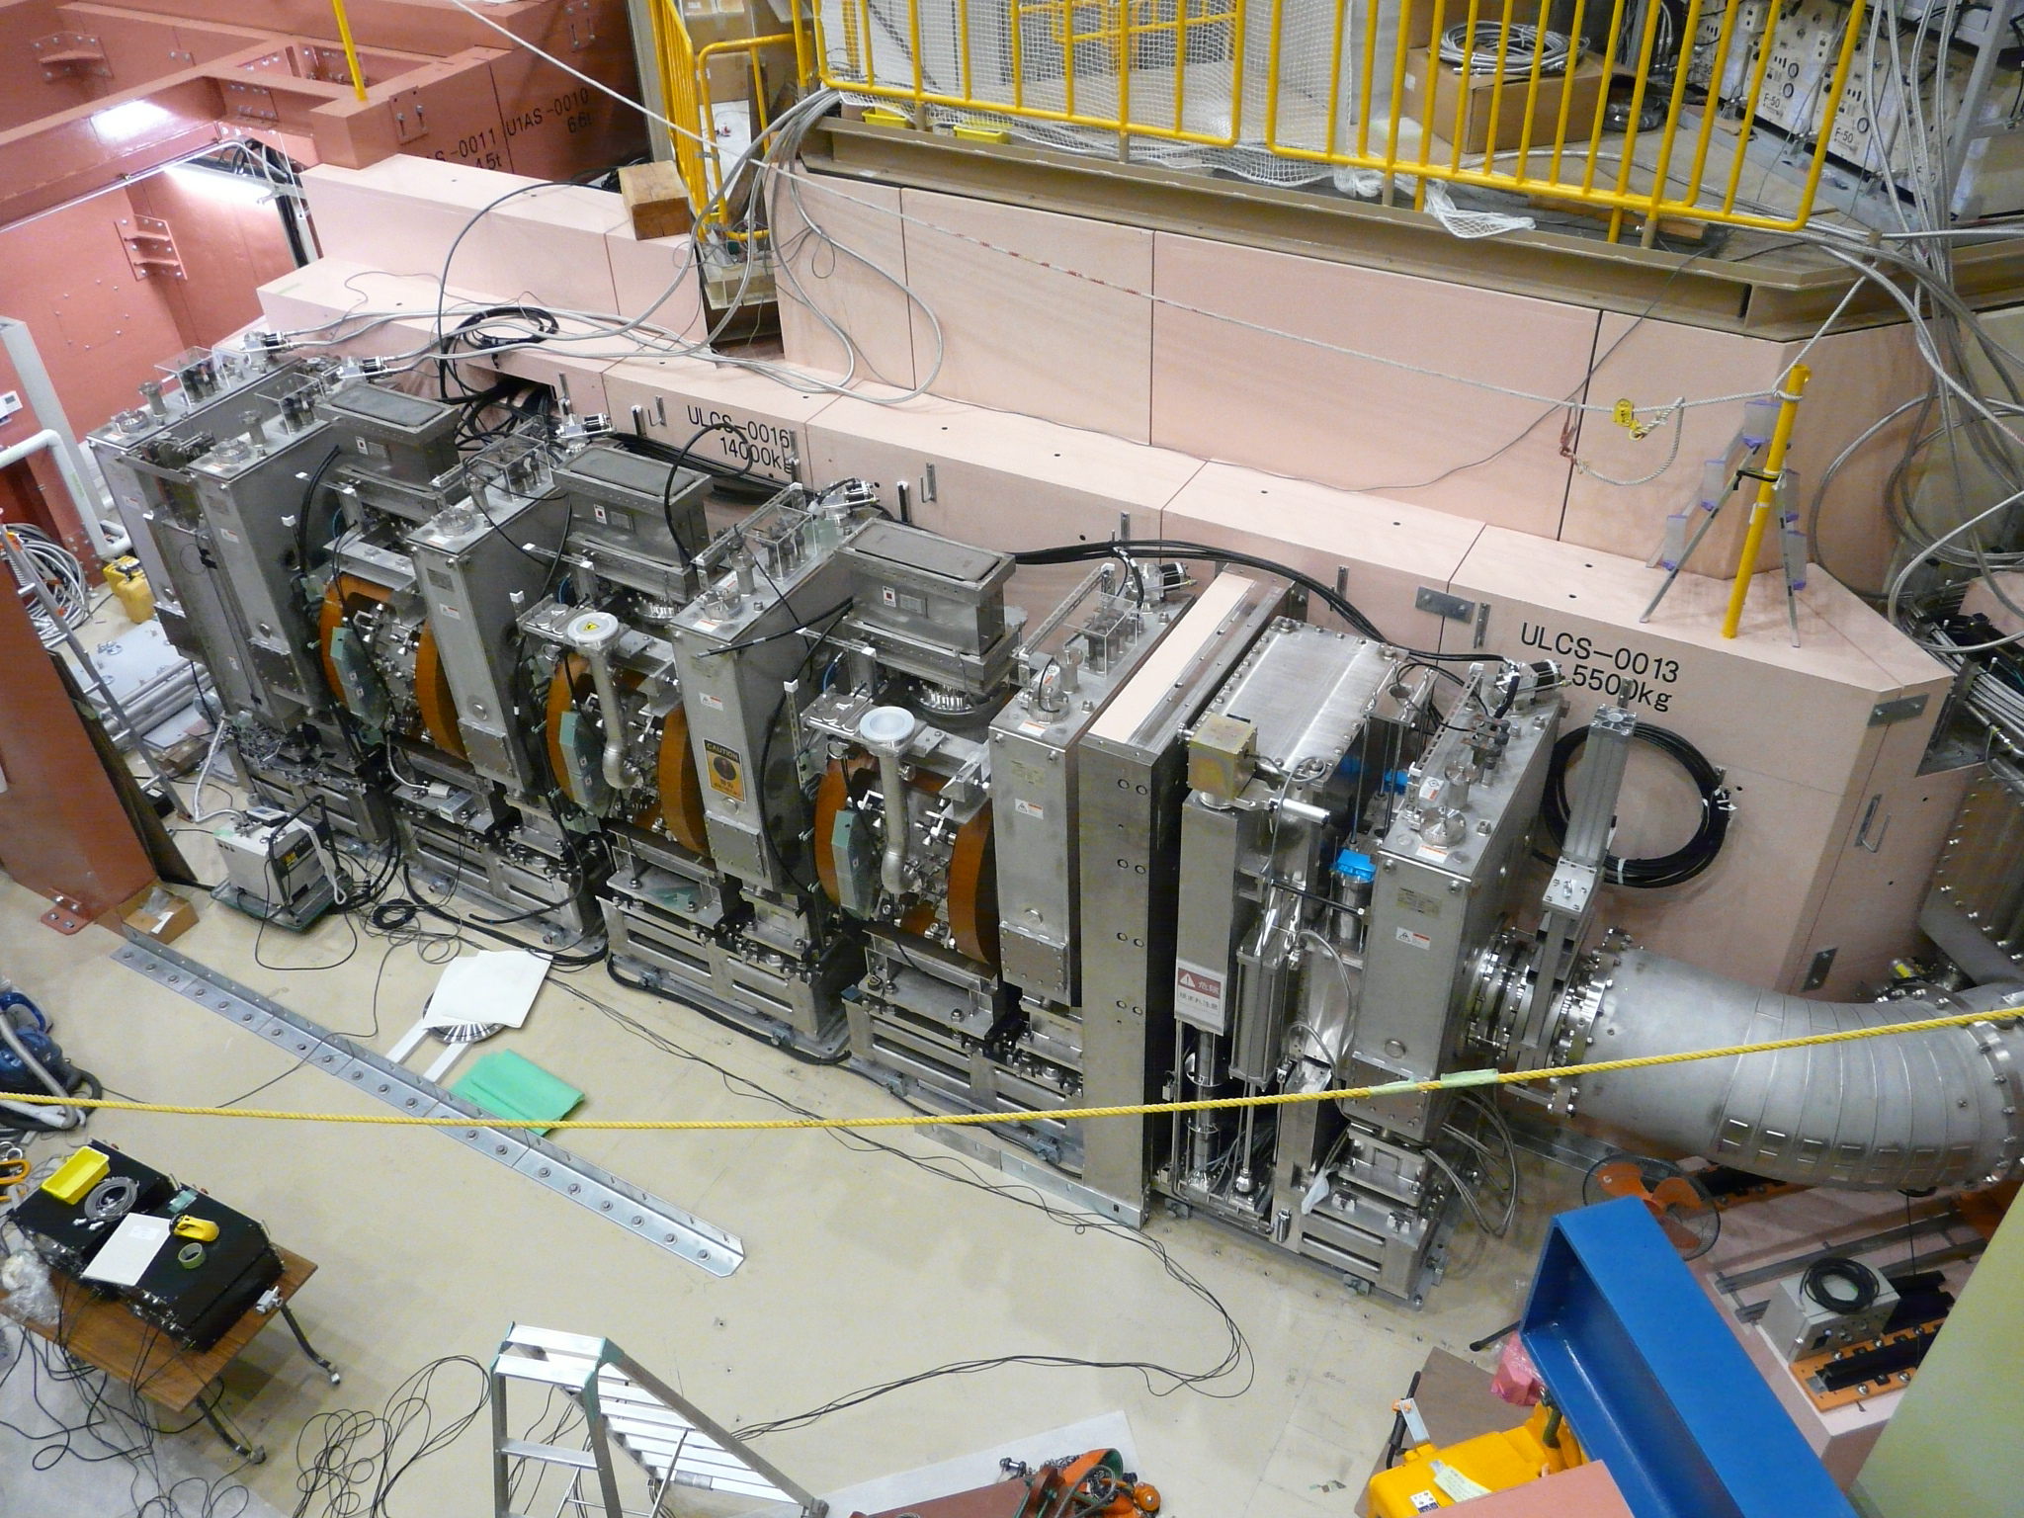
U1 Area
Ultra Slow Muon
2012/9/20
Curved Solenoid
Slit
3 DC Separator
Blocker

Slide 12
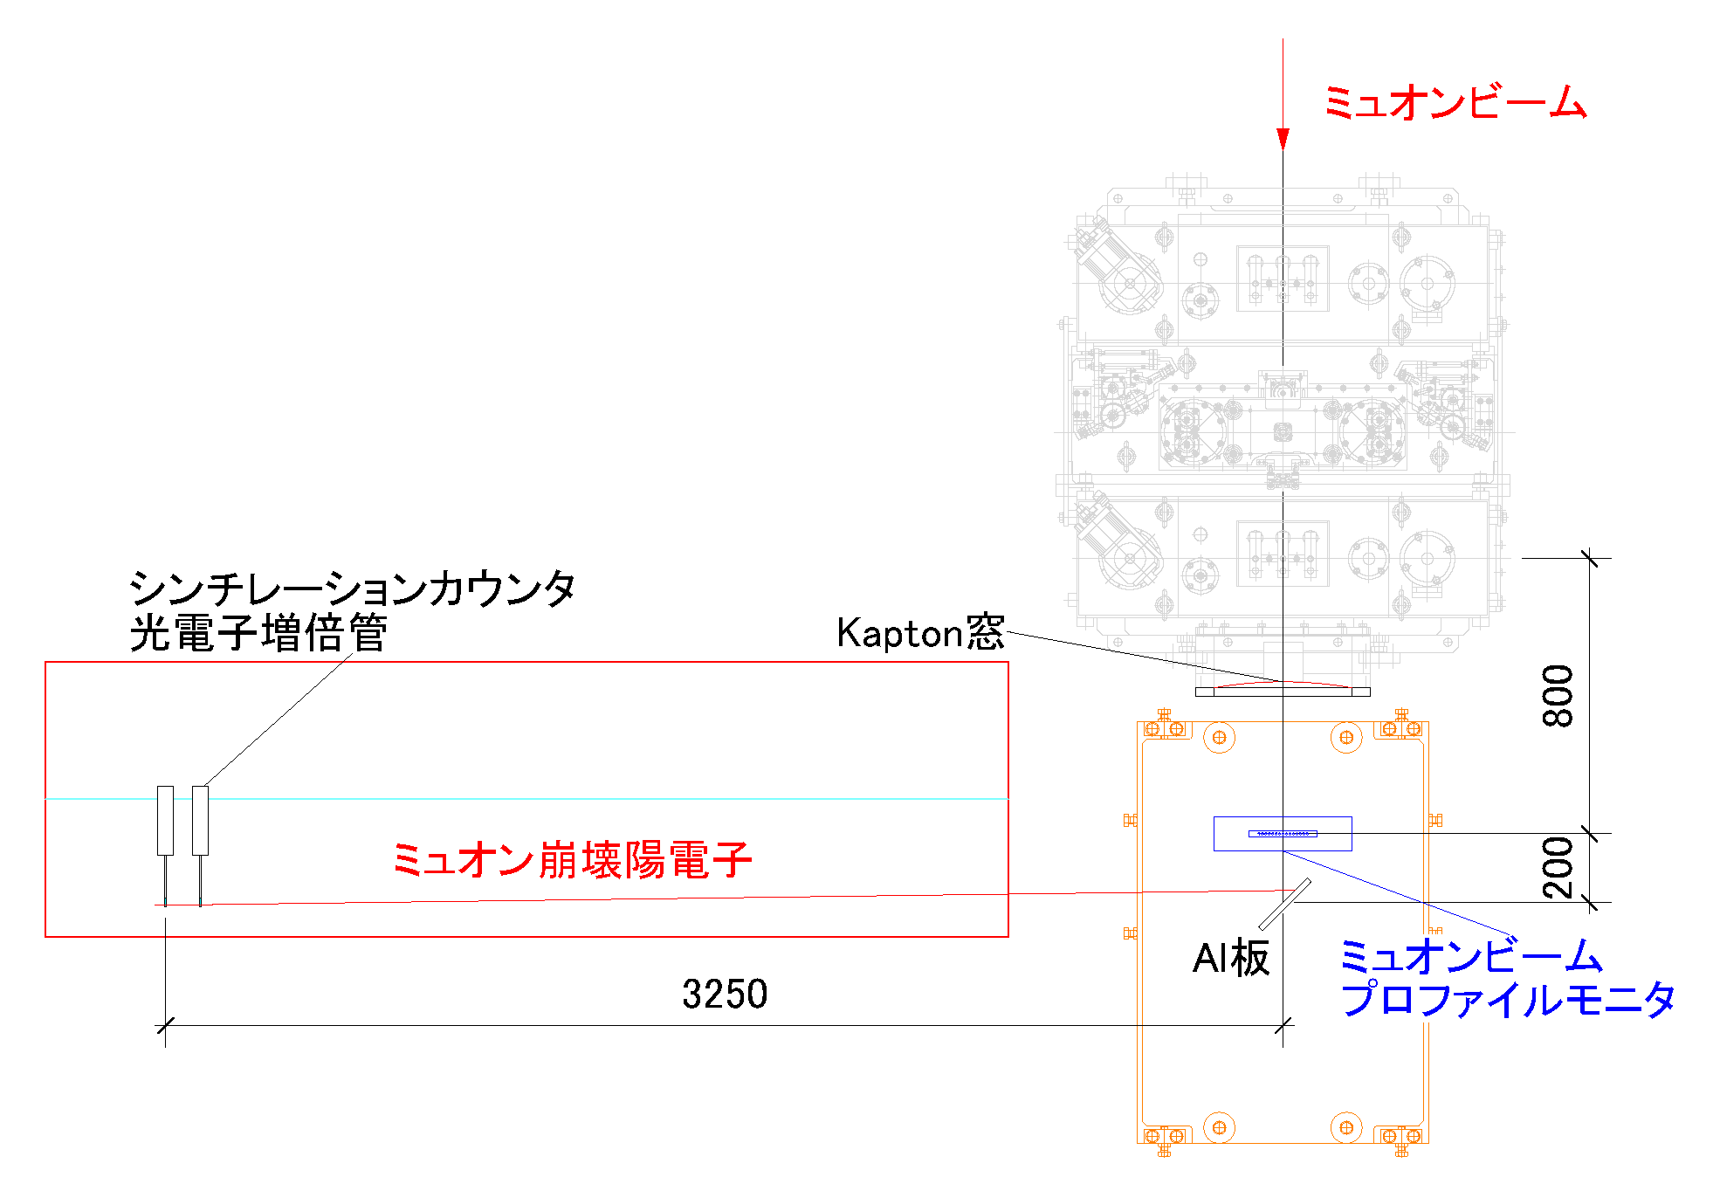
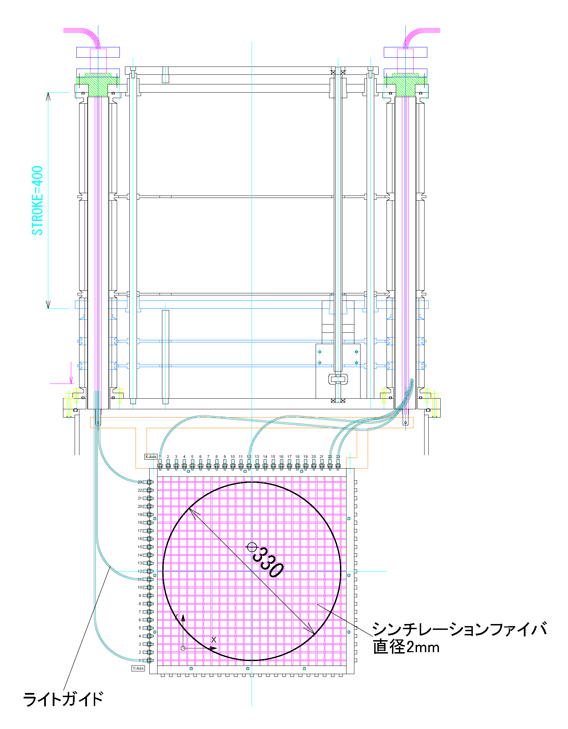
Beam commissioning
Muon beam profile monitor (Blocker PM, slit PM, End PM)
μ-e decay counter
Momentum distribution detector
UFS5
UFS6
IP film
Muon beam profile monitor
(slit)
Experimental setup

Slide 13
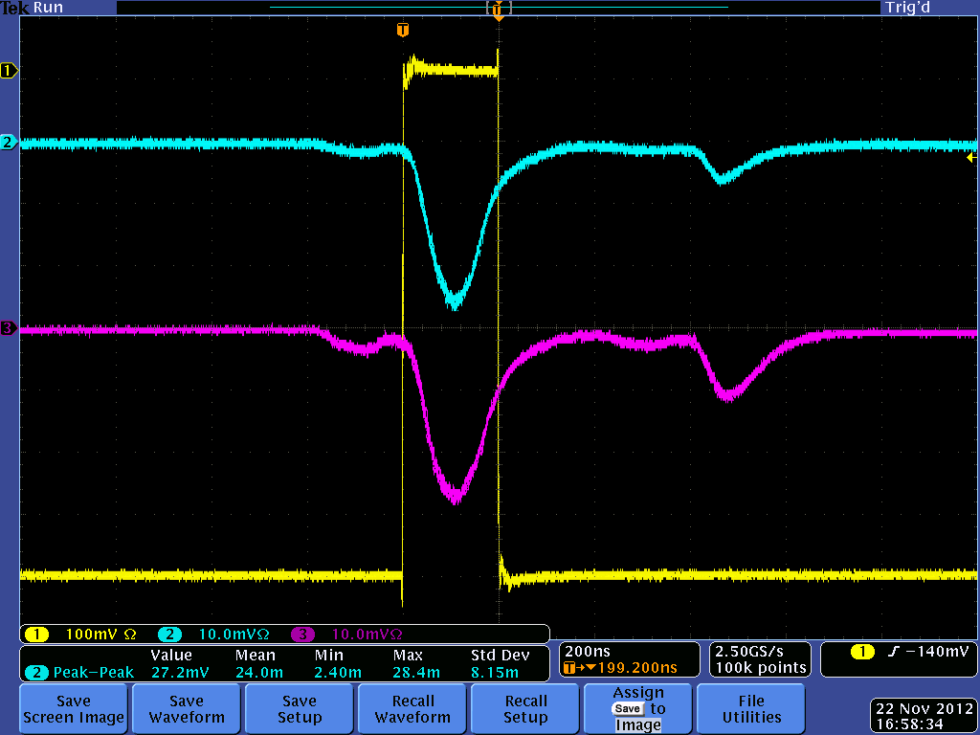
First muon beam extraction experiment
200 mm
IP image of muon beam
muon beam signals of End PM
Muon beam profile

Slide 14
Time spectrum of μ-e decay positron
μ-e decay positron
Number of positron
Prompt of the positron
Time /s
Average life time of muon is 2.2 microsecond.
6.4 x 10⁷ positive muons / s are produced at 200 kW proton beam.

Slide 15
Ultra Slow Muon
Coherent Lyman-α Resonance
Radiation Source
OMEGA 1： High energy 212.556 nm source
Distributed
feedback laser
Fiber amplifier
All-solid-state
amplifier
1062.78 nm (ω₁/5)
Δν = 1 GHz
2 ns
0.1 mJ
Nonlinear
frequency conversion
1 J
212.556 nm
ω₁
4ω₁/5
2ω₁/5
50 mJ
OMEGA 2： 820.649 nm source
Multi-stage optical
parametric osc. and amp.
Diode
laser
820.649 nm (ω₂)
Δν₂ = 230 GHz
50 mJ
Lyman-α Shifter: Krypton gas cell
Kr 4p⁵5p
ω₂
Lyman-α
122.09 nm
ω₁
ω₁
ω_{Ly-α}
100 µJ
Kr 4p⁶

Slide 16
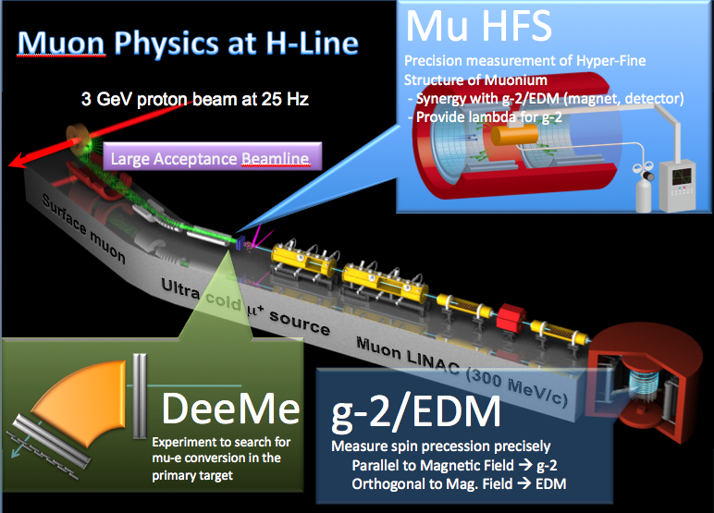
H line

Slide 17
Design concept of H line
(Kawamura, Aoki et al. )
High muon intensity ⇒ capture solenoid
and axial focusing elements
Momentum tunability, install-ability of kicker and wien filter ⇒ long focus
×high field axial focusing elements
Fusion of these two conflict(?) concept:
high field capture solenoid → bend → pair of opposite field solenoids
High intensity, good characteristic beam

Slide 18
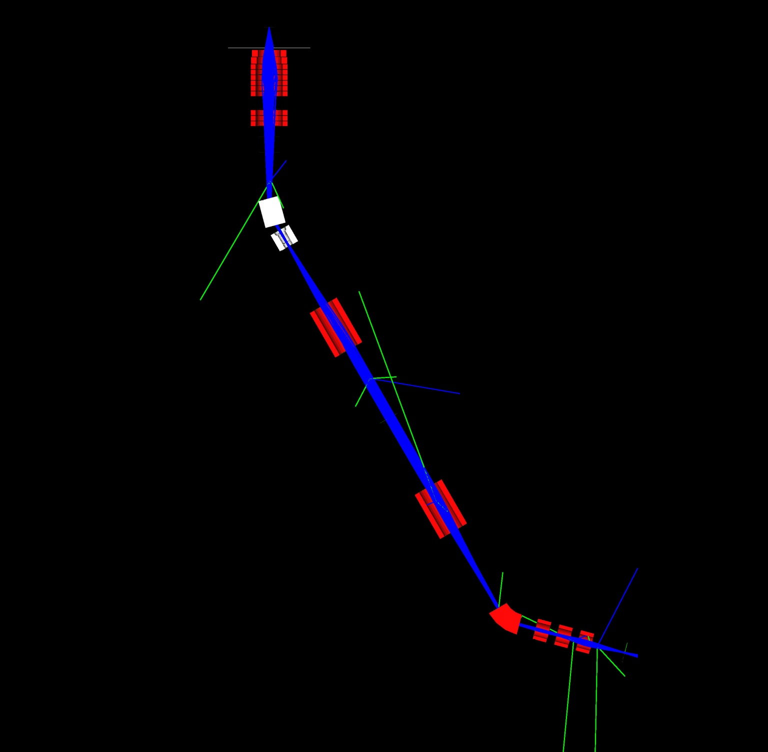
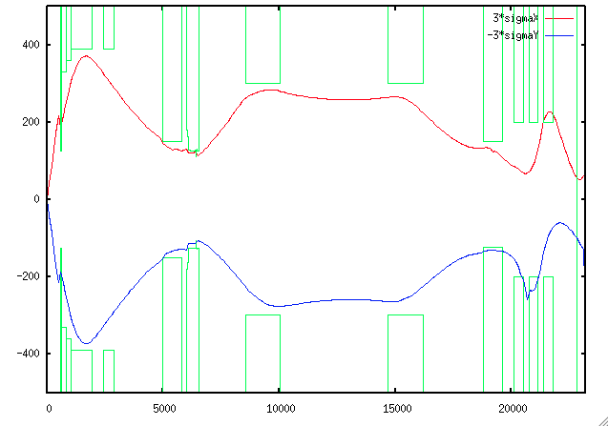
Optics design
3GeV proton
Capture solenoid (HS1)
complete
30 MeV/c mono-chromatic beam calc.
performed by a MC-code (G4beamline)
Large aperture short solenoids do not allow us to use transfer matrix calculation which use near axis assumption.
Bending magnet (HB1)
↑beam transport tunnel
Gate valve (HGV1)
Kicker magnets and/or
wien filers are installable
+B
Transport solenoid
(HS2 and HS3)
-B
design work
Septum or bending magnet (HB2)
Experimental area #1
Conceptual design was proposed by J. Doornbos, TRIUMF.
Experimental area #2 and #3

Slide 19
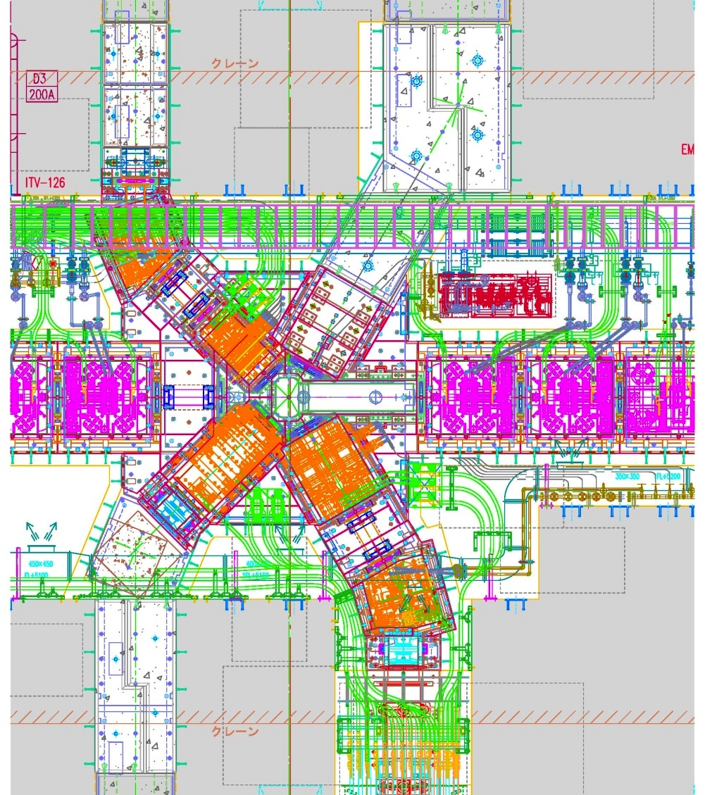
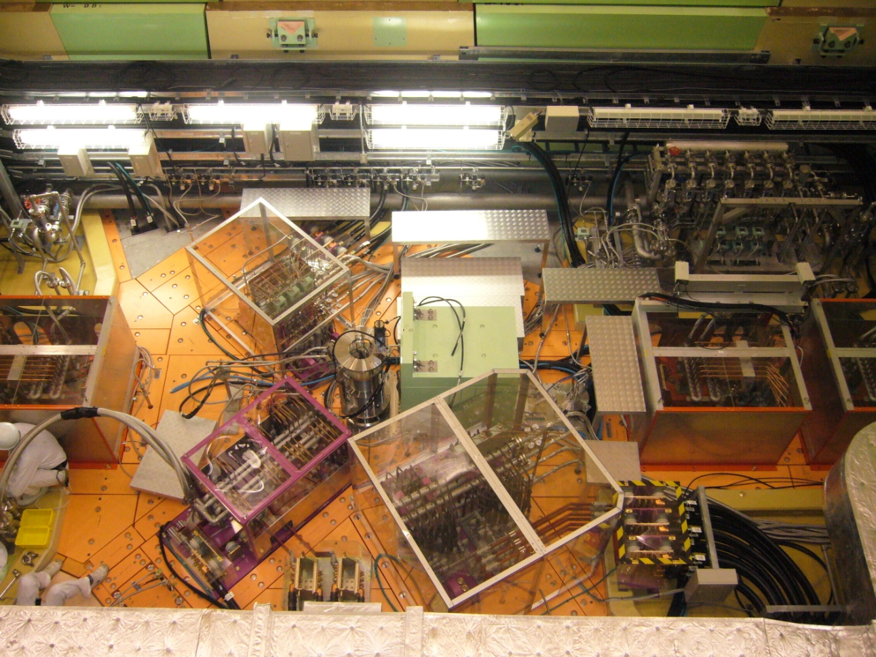
Before summer shutdown 2012
4 secondary beamlines can be extracted.
  D line: complete
  U line: complete and under commissioning.
  S line: only frontend magnet was installed .
  H line: nothing (temporary rad. shield is installed)
4/Jul/2012
S line
H line
Muon target
P
H
U line
D line
S
D
3GeV proton
U

Slide 20
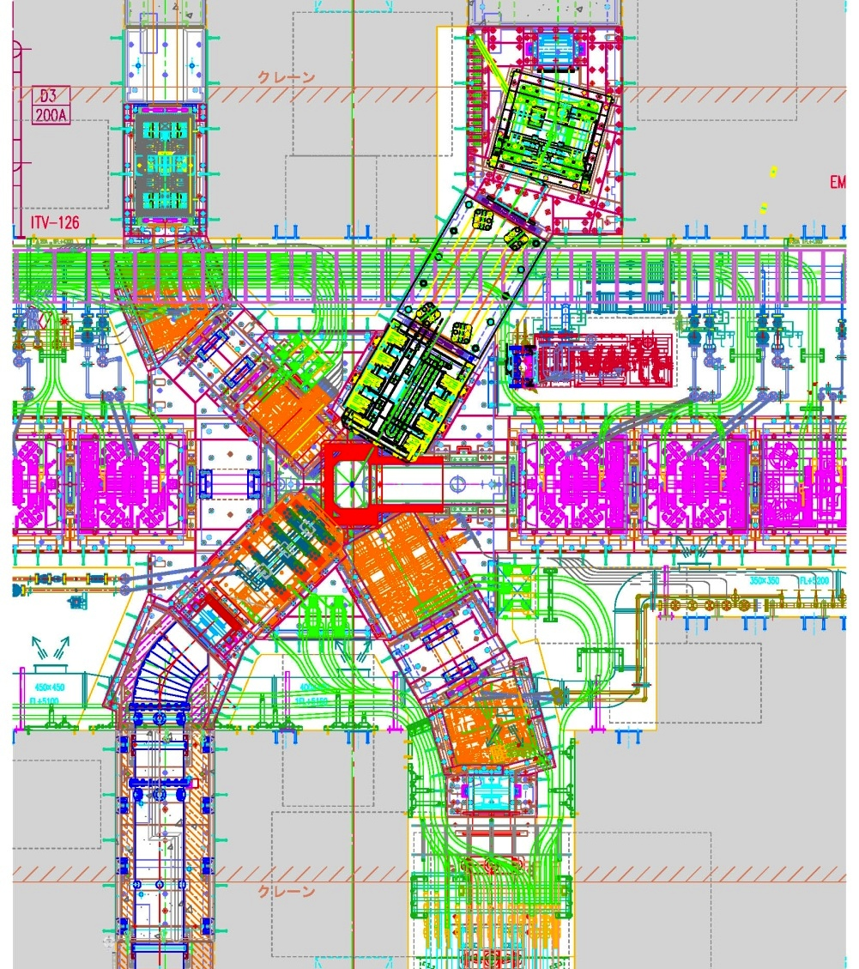
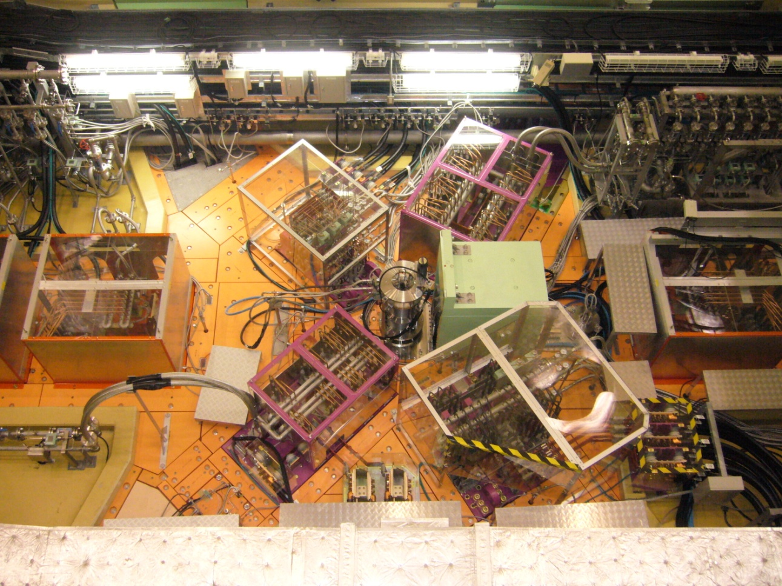
After summer shutdown 2012
Mission in this summer shutdown
  U line: installation of curved solenoid
  S line: installation of SQ456.
  H line: installation of frontend magnets
SQ456
HB1
4/Oct/2012
HS1b
HS1a
Curved solenoid

Slide 21
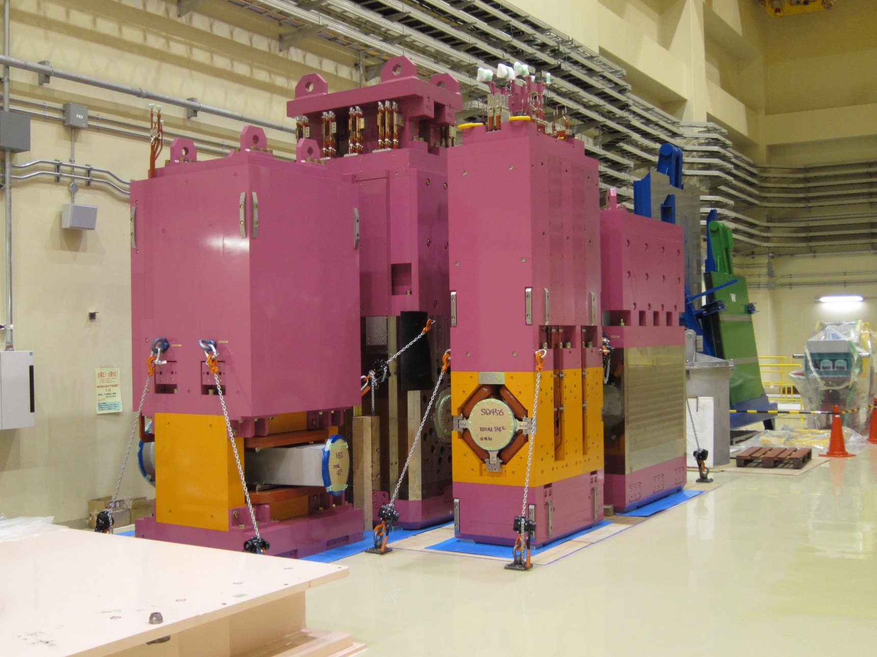
H-line magnets
HS1a
HB1
HS1b
SQ456
All the magnets were ready to be installed at the moment of the last CM in June.

Slide 22
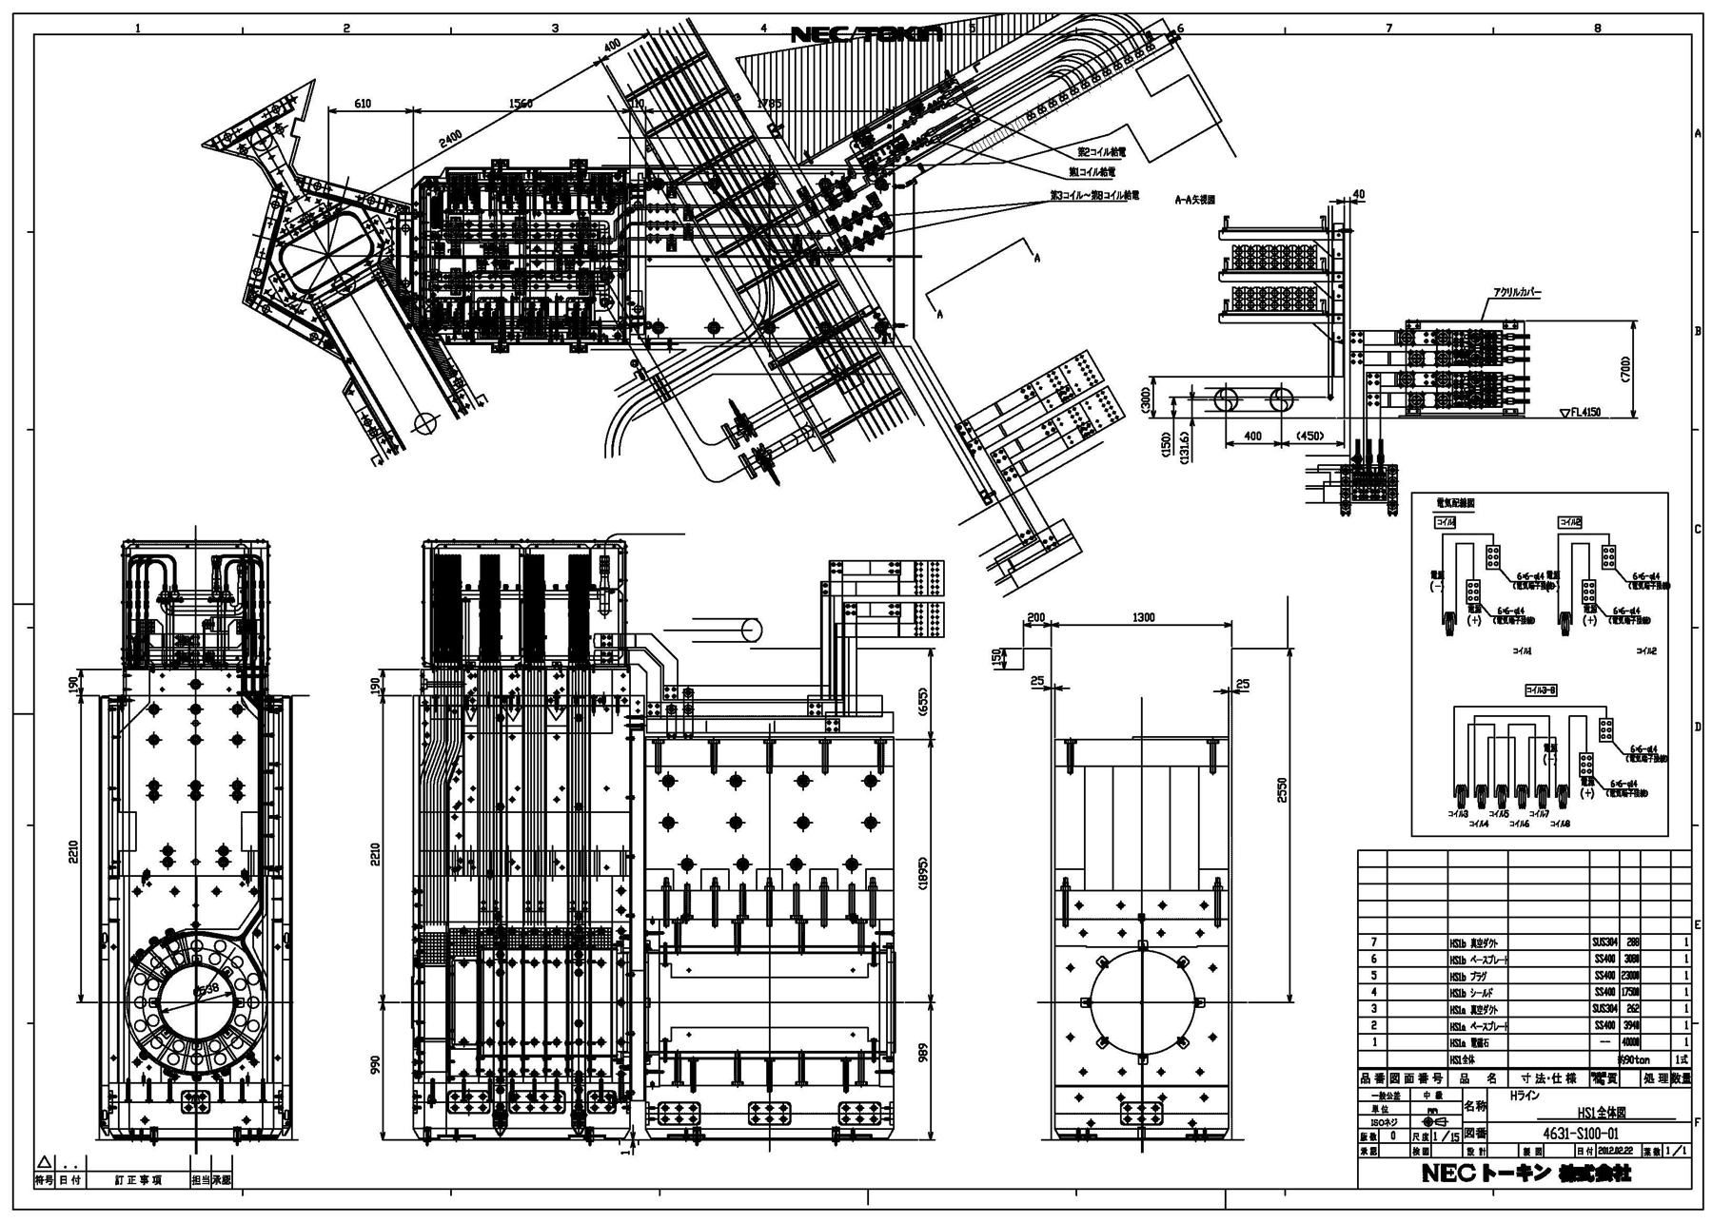
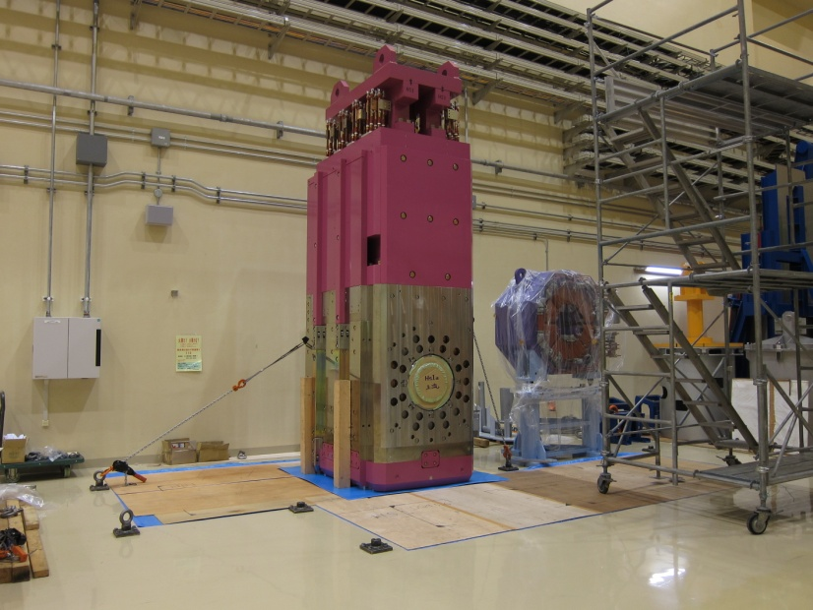
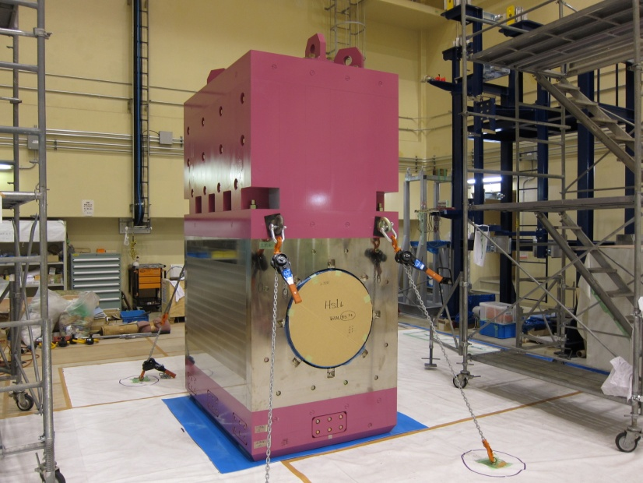
HS1: Capture solenoid
HS1a (45t)
HS1a
HS1b
HS1b (40t)

Slide 23
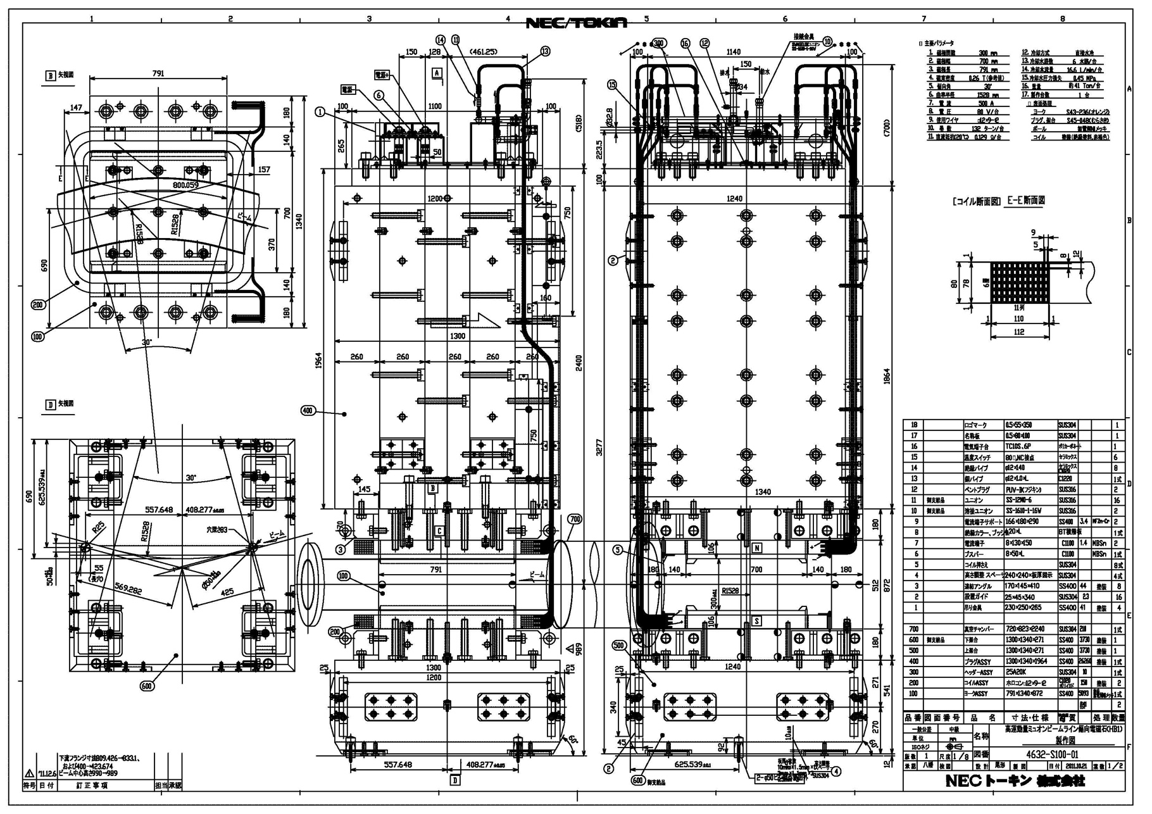
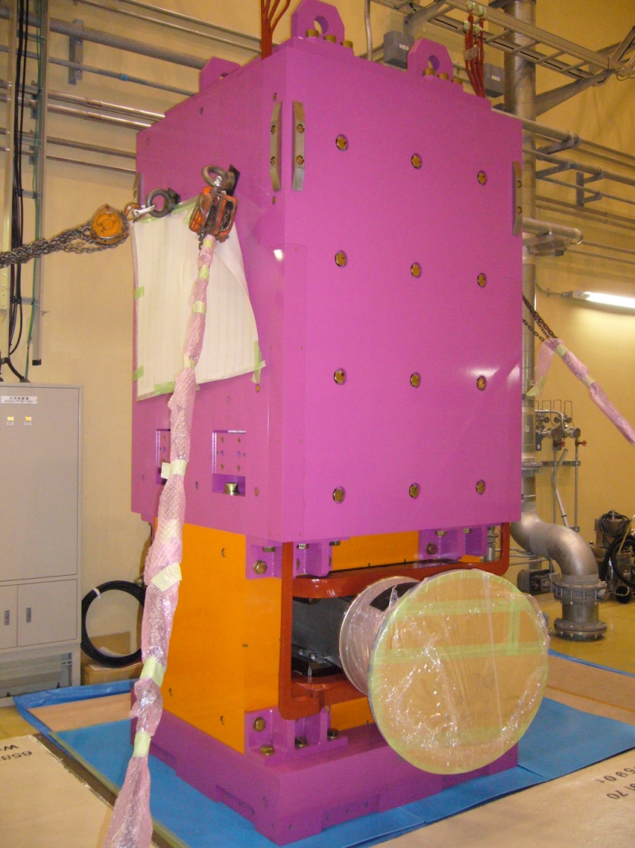
HB1: First Bending Magnet
HB1 (40t)

Slide 24
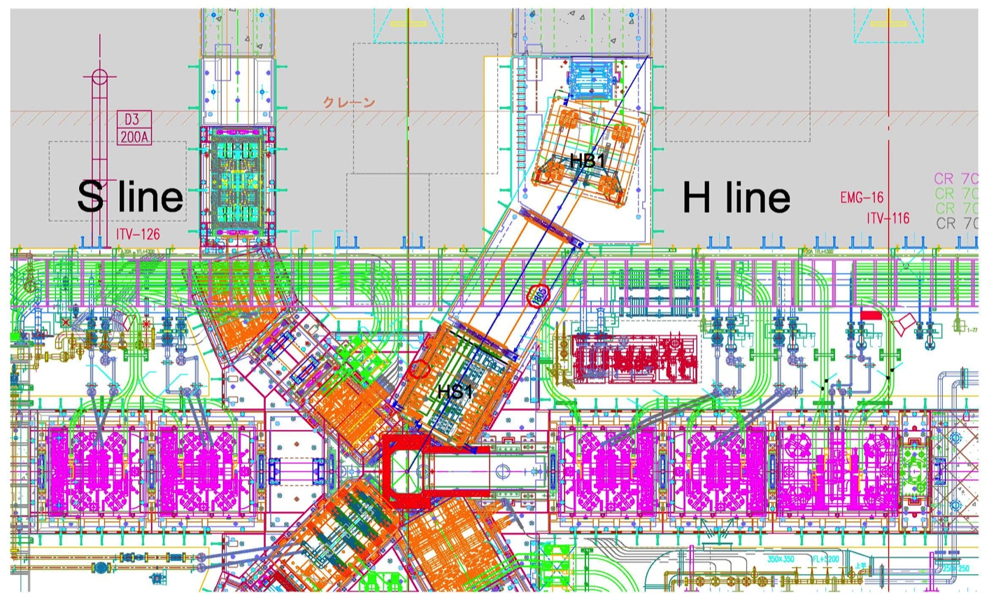
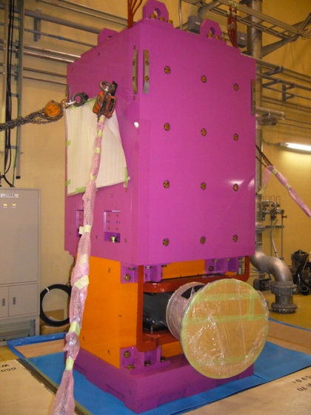
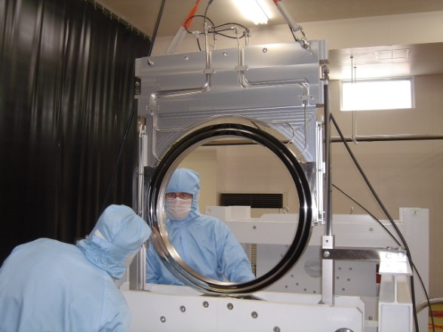
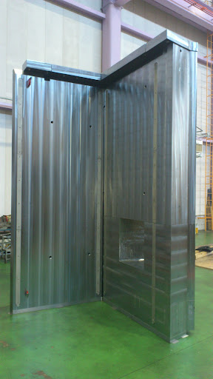
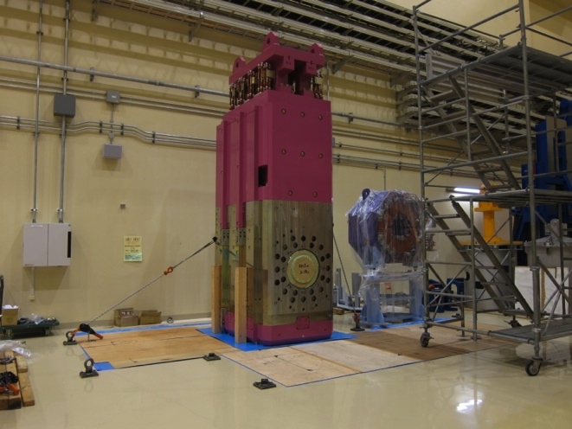
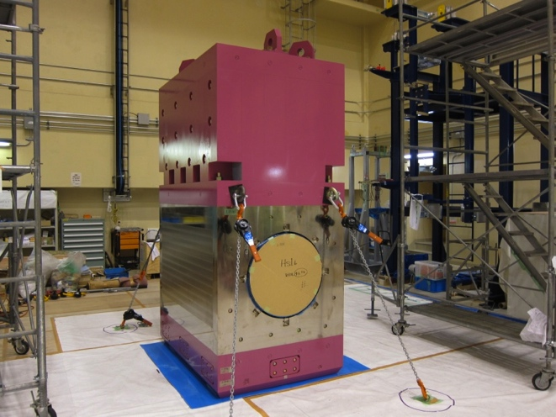
Devices to be installed
HB1
φ600 pillow seal
HS1a
HS1b
Mag. Inst. guide

Slide 25
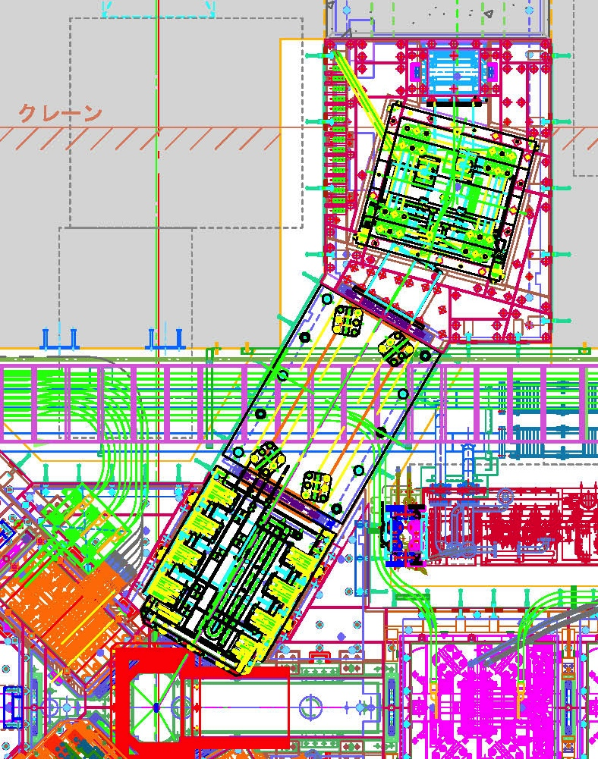
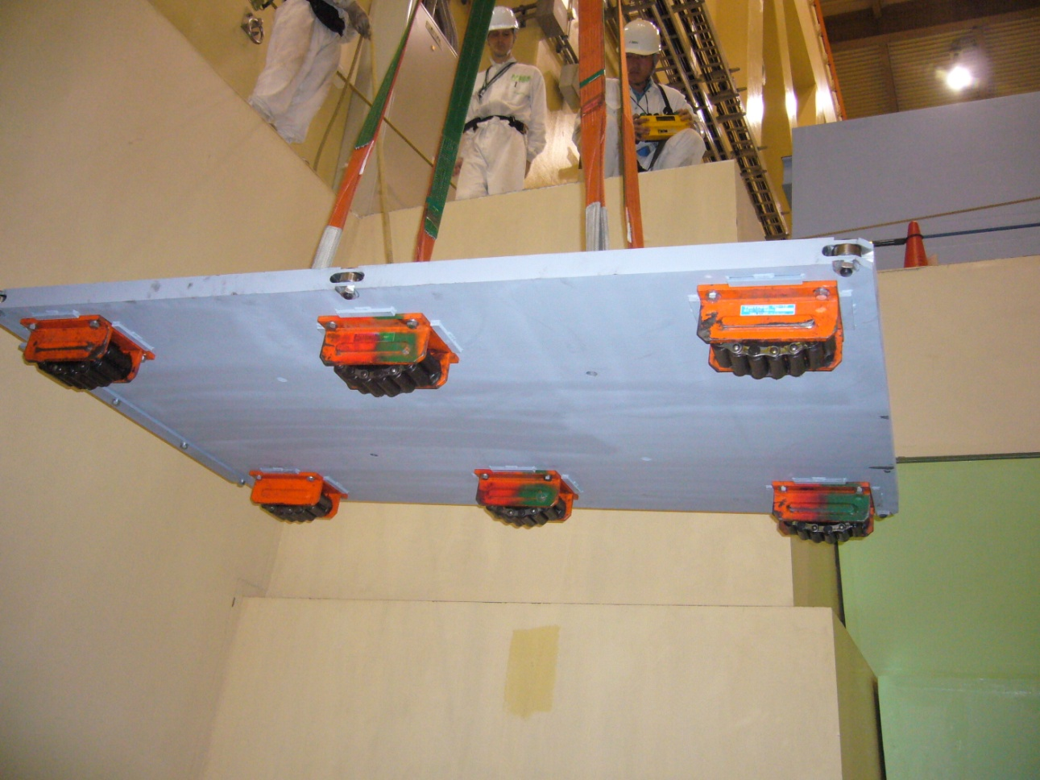
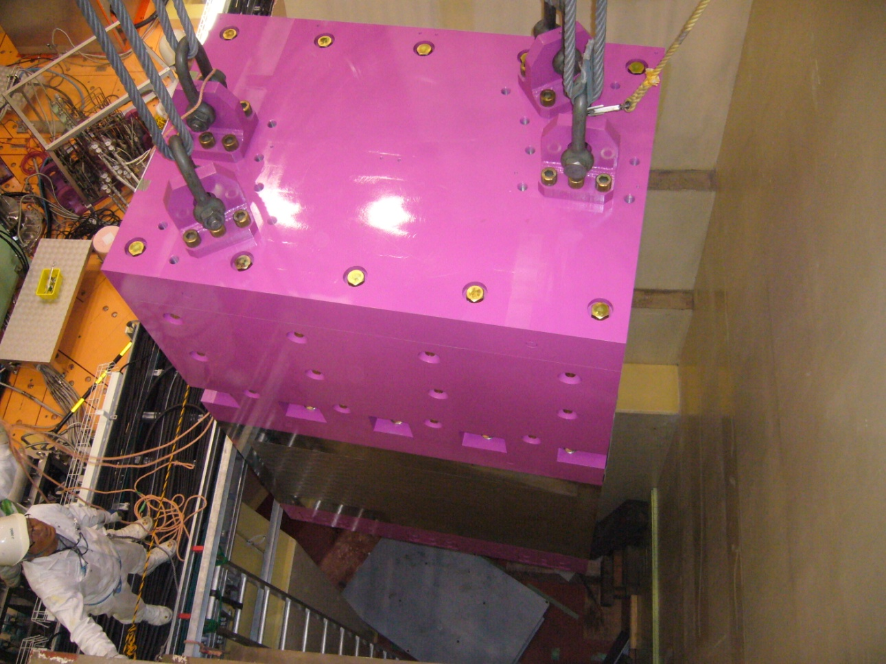
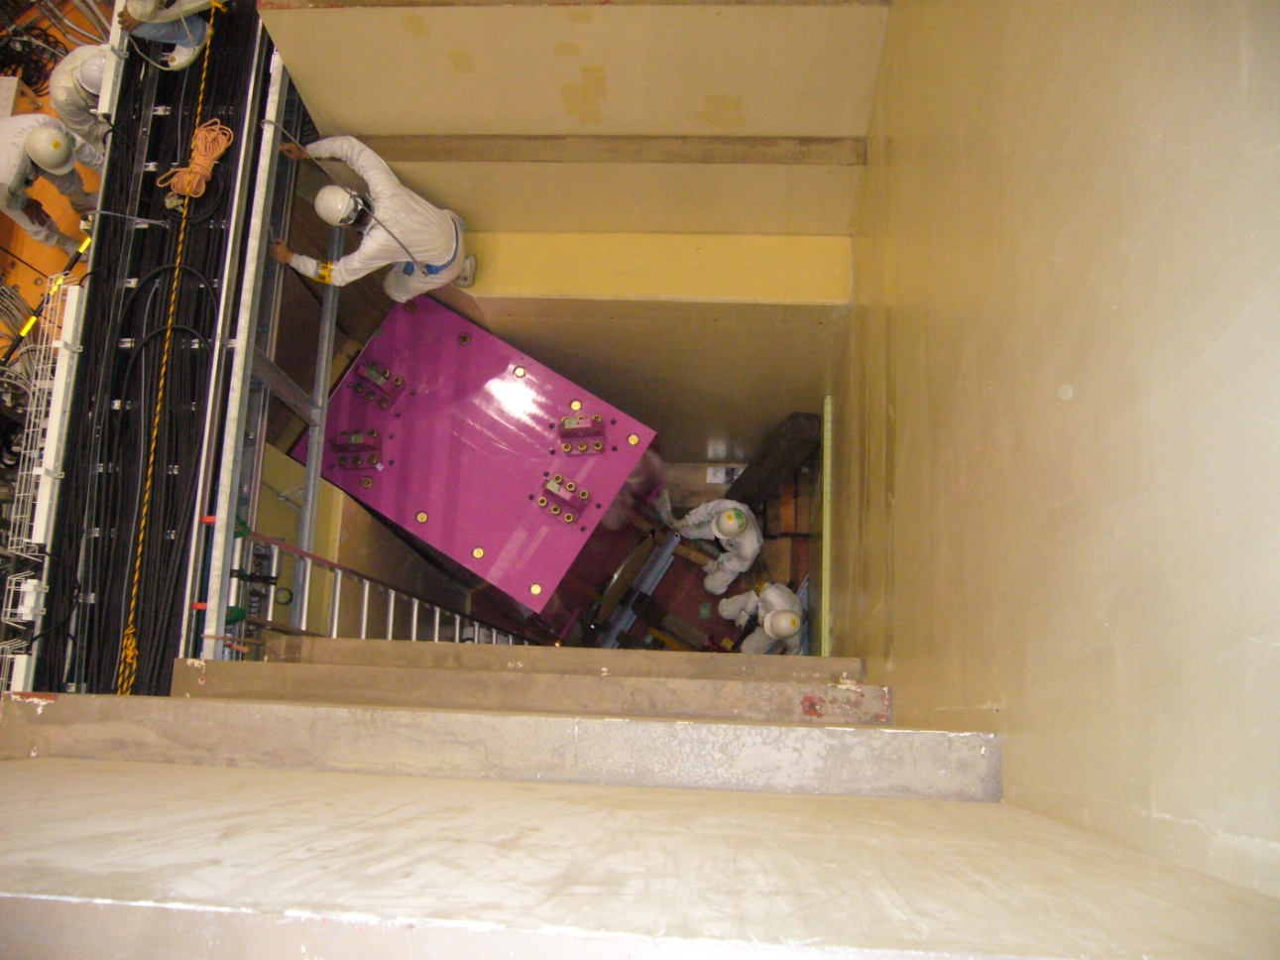
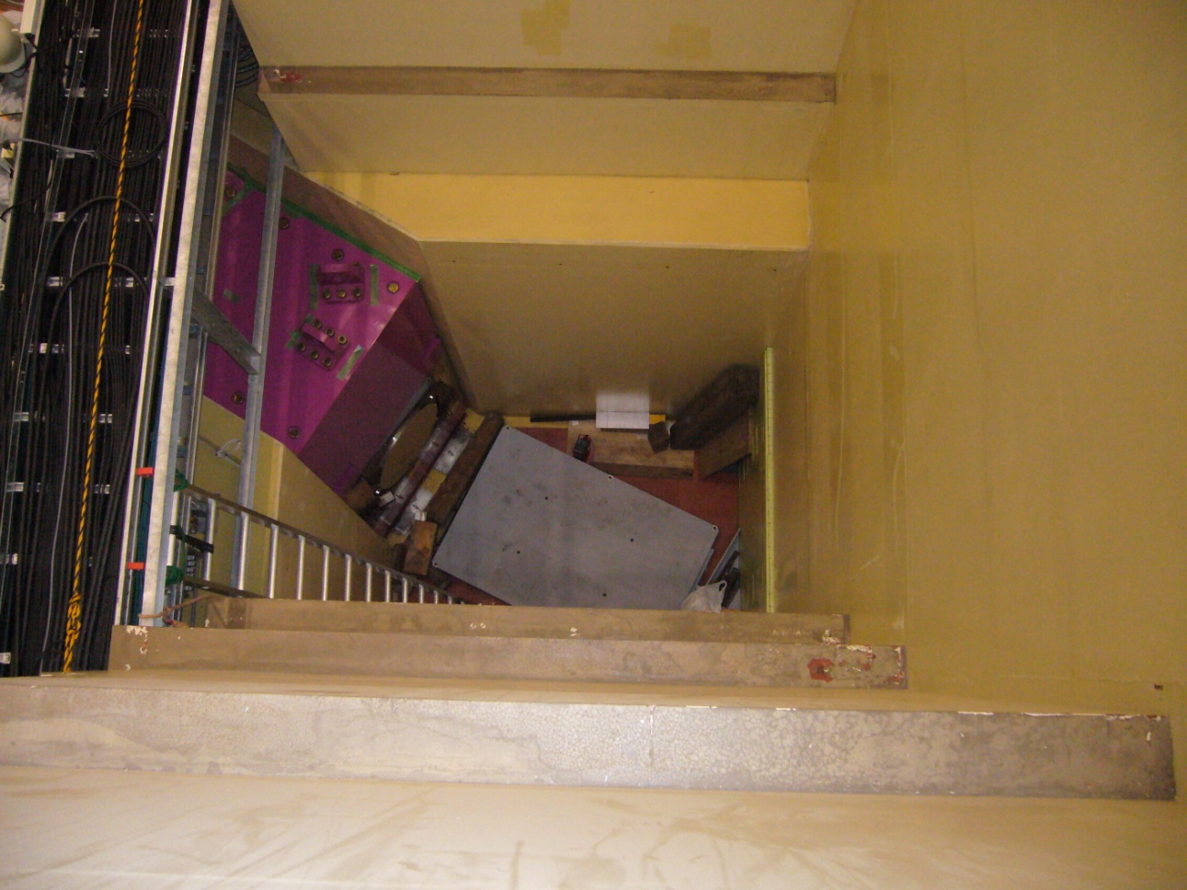
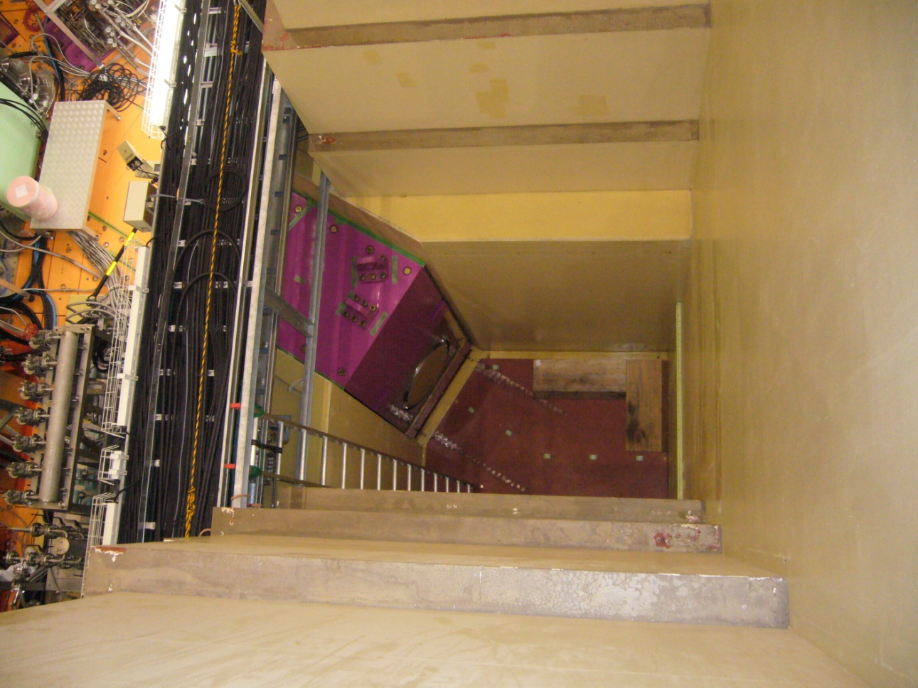
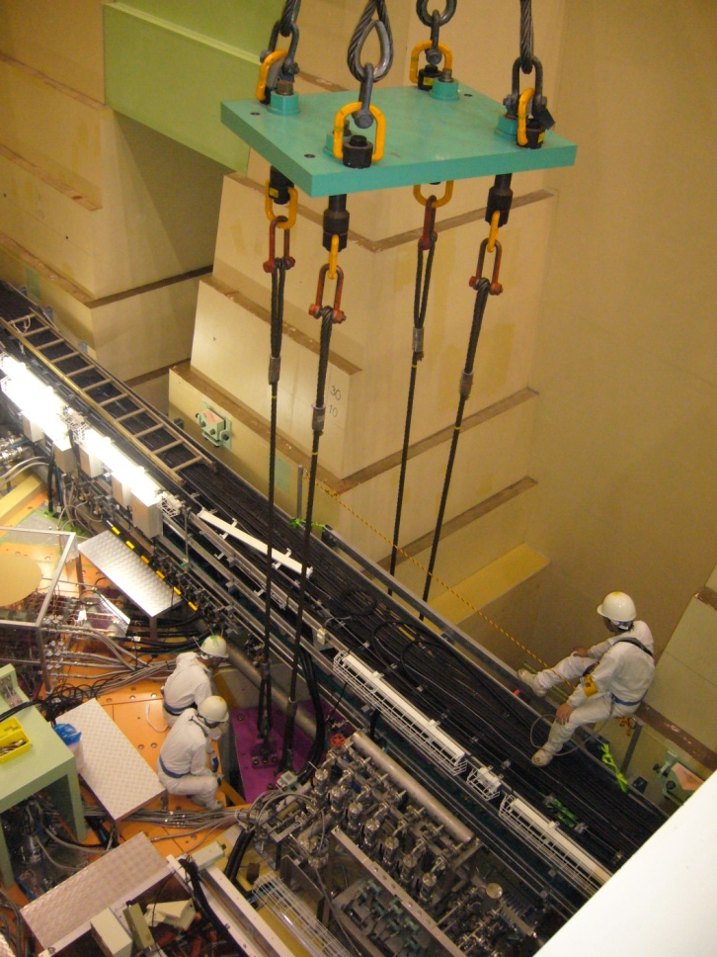
HS1b installation
HS1b must be placed under the irremovable cable rack
⇒ Using a special truck
HS1b

Slide 26
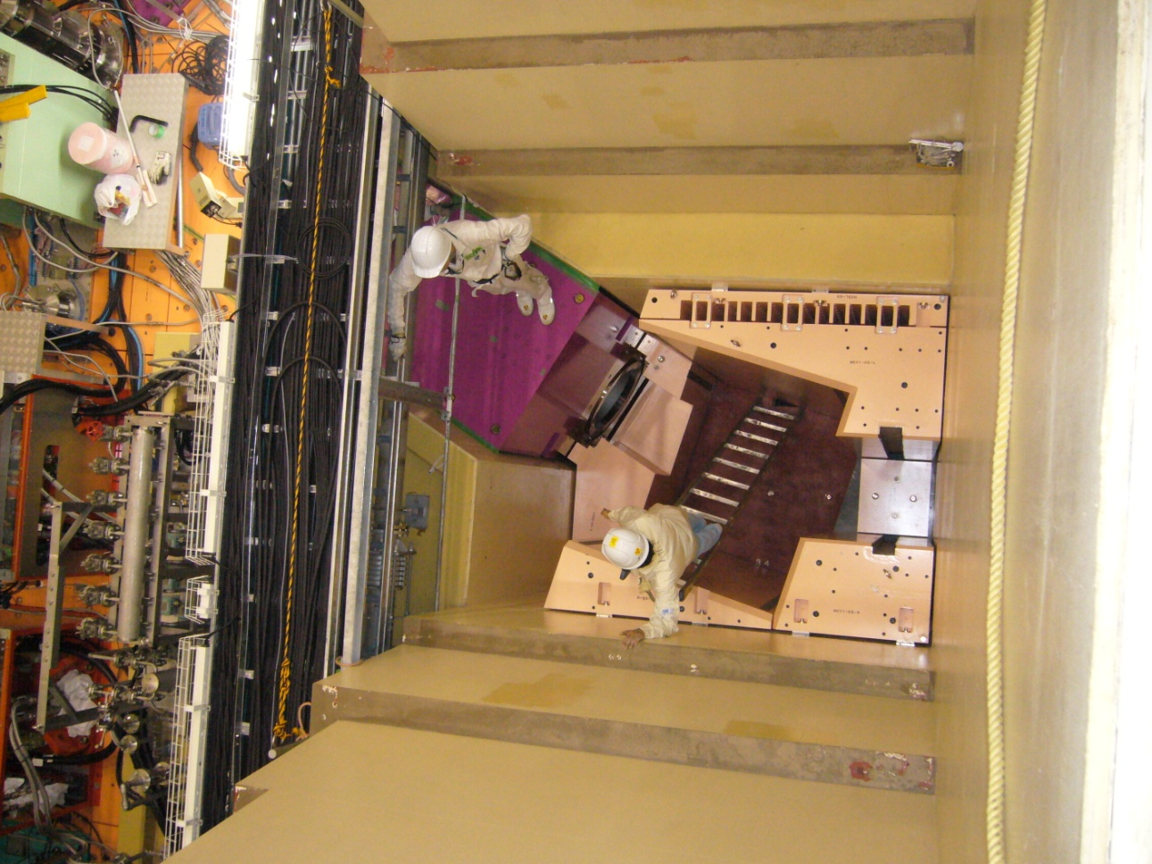
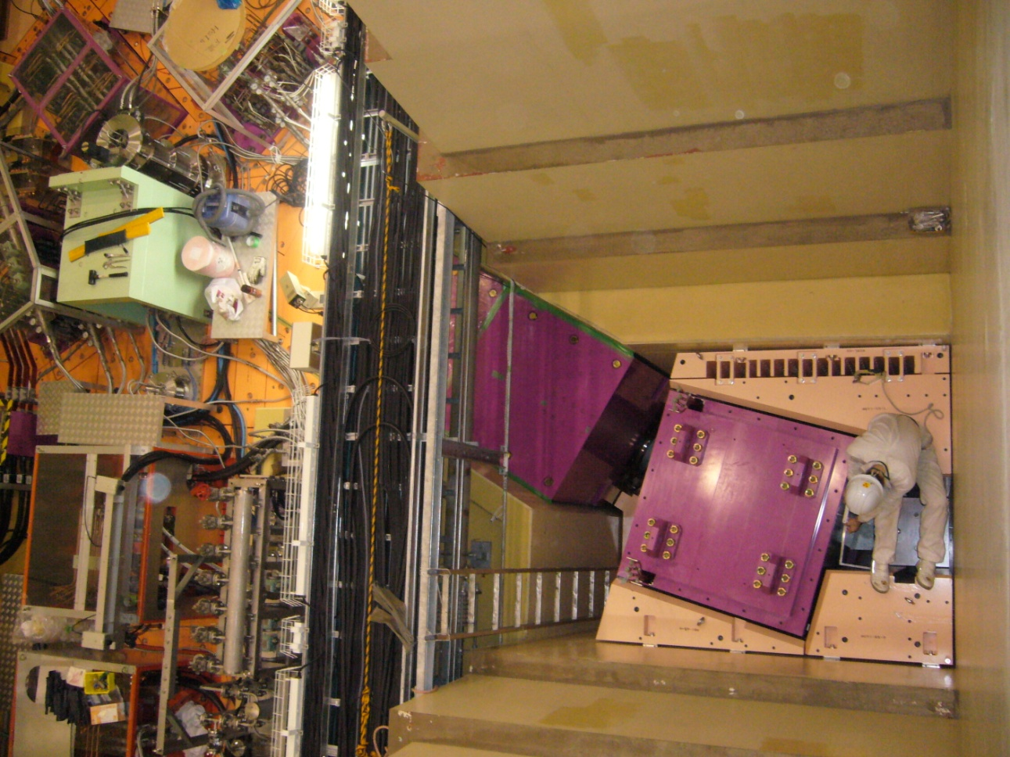
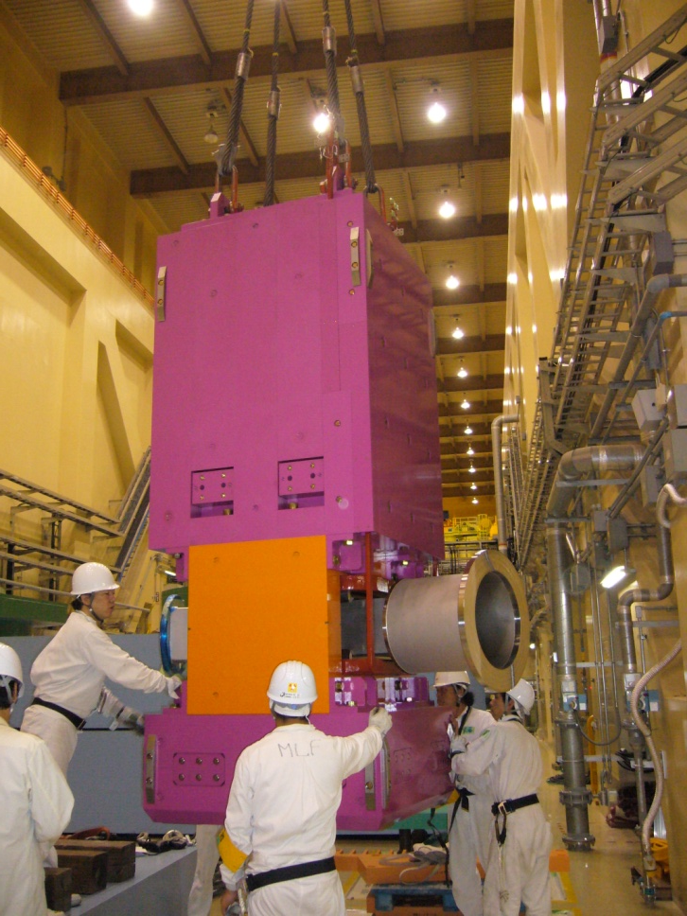
HB1 installation
HB1 installation
Some of guide shield were miss-designed and modified.
HB1

Slide 27





HGV1 installation
HGV1: gate valve with pillow seals must placed at the position with no crane access.
HGV1

Slide 28








HS1a installation
Before installing HS1a, highly activated iron shield must be removed.
2nd shield
3rd shield
4th shield
1st shield
250 mSv/h
HS1a

Slide 29
Optics design
3GeV proton
Capture solenoid (HS1)
complete
30 MeV/c mono-chromatic beam calc.
performed by a MC-code (G4beamline)
Large aperture short solenoids do not allow us to use transfer matrix calculation which use near axis assumption.
Bending magnet (HB1)
↑beam transport tunnel
Gate valve (HGV1)
Kicker magnets and/or
wien filers are installable
+B
Transport solenoid
(HS2 and HS3)
-B
design work
Septum or bending magnet (HB2)
Experimental area #1
Conceptual design was proposed by J. Doornbos, TRIUMF.
Experimental area #2 and #3

Slide 30



Wien filter (e⁺ separator)
HS2
HK12
HS3
HK34
HB2
HSEP
HB2
E=2MV/m (±300 kV, 300 mm gap)
⇒ perfect elimination of e⁺
spin rotation of 16 deg.
E=1MV/m (±150 kV, 300 mm gap)
⇒ 5% of e⁺ reaches at the exp. area
spin rotation of 8 deg.
HK34
HS3
HSEP
HK12
Opposite field separators
HK123
HK4
HS2
HSEP1
HSEP2
E=2MV/m (±300 kV, 300 mm gap)
⇒ less than 1% of e⁺ reaches.
no spin rotation.

Slide 31


Background evaluation
Exp. Area #1
Neutrons after 1 μs
Duct streaming neutron flux was evaluated.
⇒ background estimation for MuHFS

Slide 32

Things to be considered
Mechanical design work of the devices in the downstream, such as HS2, HS3, HB2, Wien filter and radiation shield, should be started A.S.A.P.
Laser cabin?
Transport magnet is under designing.
Optics ⇒ either SC or NC?
Magnet p.s. yard?
Radiation shield should be start to consider.
Frontend magnet was installed
in this summer

Slide 33







Muon beam intensity
π⁺
π⁻
Generation (HARP)
⇒ Surface muon (MC)
±5%⇒120mstr
0.0
0.2
0.4
0.6
0.0
0.2
0.4
0.6
HARP Eur. Phys. J. C 53 177 (2008)
transportable
p^{2.5}
Surface muon yield × transmission efficiency
= 100M/s surface muon @ 1MW

Slide 34
Summary
U line was successfully constructed.
  4×10⁸/s @1MW is expected
  Preparation of Intense ultra slow muon production is almost completed.
  R & D study of muon acceleration is on going.
H line construction is on going.

