Slide 1
Mu2e Extinction Systems
Peter Kasper
NuFACT 2013

Slide 2
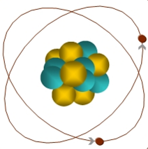
Mu2E
Mu2E goal is to measure the ratio of rates μ⁻ + N → e⁻ + N / μ⁻ + N → ν_{μ} + N⁻ with single event sensitivity of <10⁻¹⁶
Will use a proton beam to create muons that are transported and captured on an Al target
Signal is the delayed production of a 105 MeV mono-energetic electron
μ
105 MeV e⁻

Slide 3
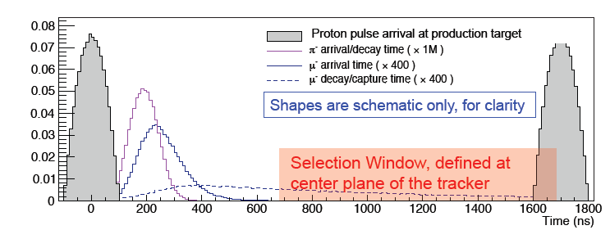
Extinction
Most backgrounds are prompt
So use a pulsed beam and look for the signal candidates between pulses
To maintain sensitivity out-of-time protons must be suppressed at the 10⁻¹⁰ level
Extinction is the out-of-time to in-time ratio
10⁻¹⁰ Extinction

Slide 4
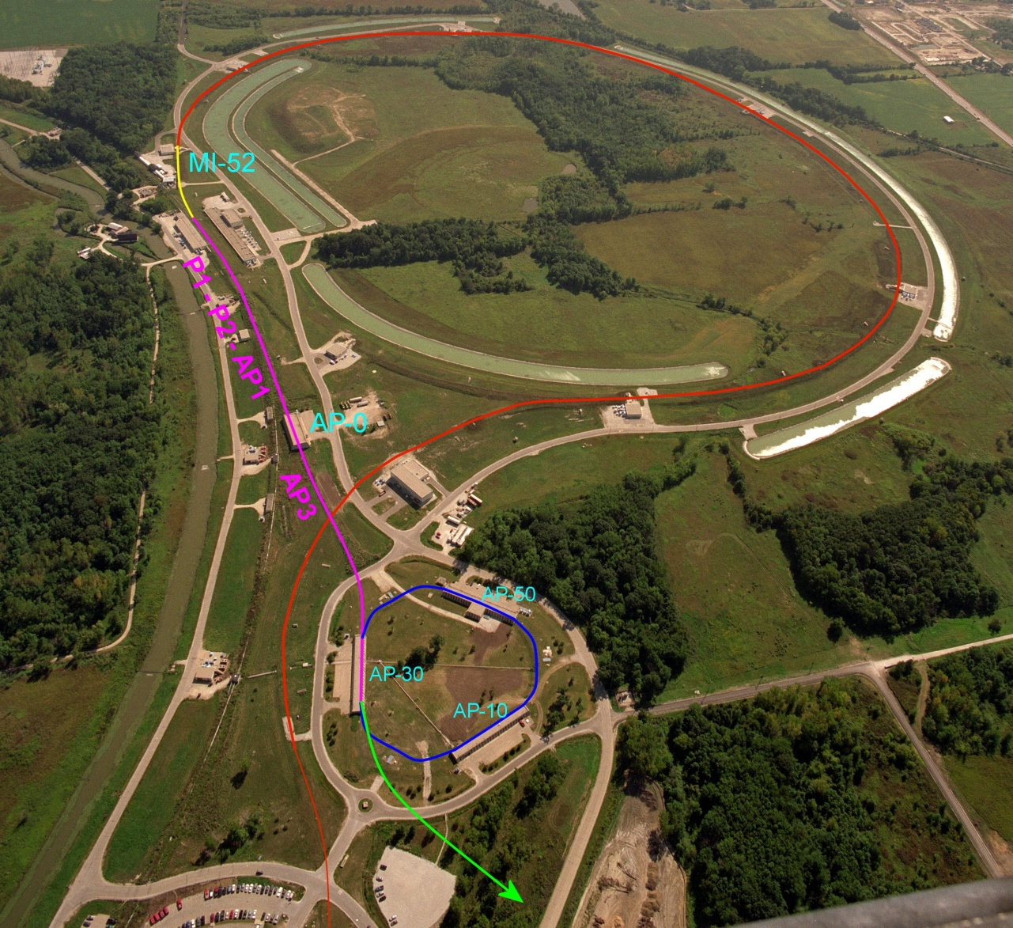
Overview: Proton Delivery
One Booster batch (4x10¹² protons) is injected into the Recycler.
It is divided into 4 bunches.
These are extracted one at a time to the Delivery Ring
  Period = 1.7 μsec
As a bunch circulates, it is resonantly extracted to produce the desired beam structure.
  ~3x10⁷ protons/bunch
Main Injector/Recycler
Delivery Ring
(formerly pBar Debuncher)
Mu2e
Booster

Slide 5
Extinction Systems
In ring
  Beam delivery technique automatically gives good extinction < 10⁻⁵ going into the Delivery Ring
  Studying possible degradation during the spill
In beam line
  System of dipoles and collimators
  Additional factor of 10⁻⁷ should be possible
Monitoring
  Need to show that 10⁻¹⁰ has been achieved

Slide 6
Delivery Ring
Start with < 10⁻⁵ level of extinction going into the Delivery Ring, so the issue is how will it grow during the spill.
Effects considered
  RF noise
  Intrabeam scattering
  Beam loading
  Beam-gas interaction
  Scattering off of extraction septum
Should be possible to maintain an extinction level of 10⁻⁵

Slide 7
Extinction Beam Line
Delivery Ring
Mu2e Experiment
Extinction Beam Line
The proton delivery beam line will contain a system of resonant dipoles (“AC dipoles”) and collimators to eliminate out of time beam

Slide 8
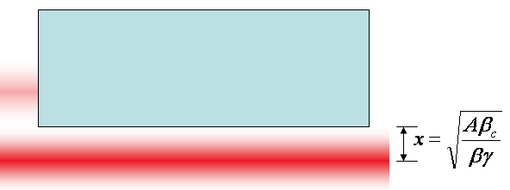
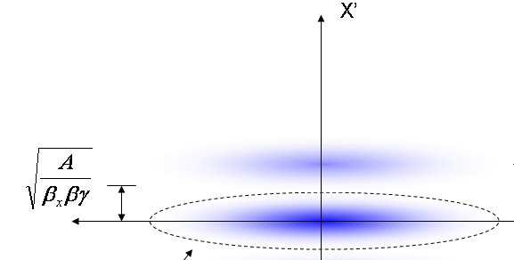
Generic Extinction Analysis
At collimator:
Assume resonant dipole deflects out-of-time beam into a collimation system
Assume that the beam line admittance is equal to the collimation channel’s admittance
Assume beam occupies entire admittance
Beam fully extinguished when deflection equals twice full admittance (A) amplitude
At dipole:
Angle to extinguish beam

Slide 9
Magnet Considerations
Bend strength to extinguish:
Stored Energy:
⇒Large β_{x}, long weak magnets
- Assume β_{x}=250m, L=6m
- Factor of 4 better than β_{x}=50m, L=2m

Slide 10
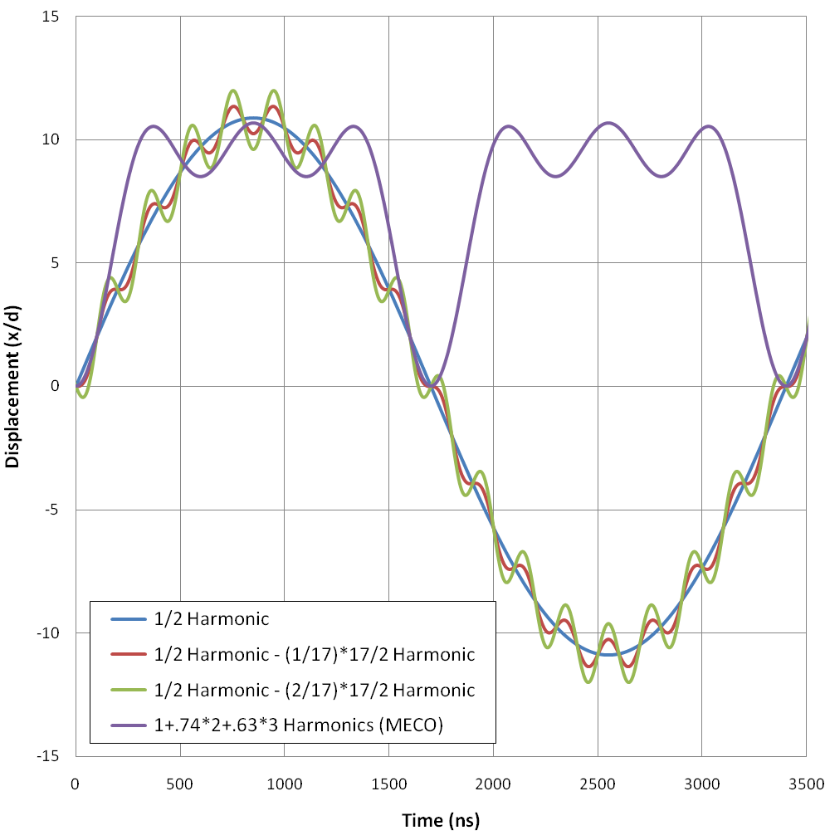
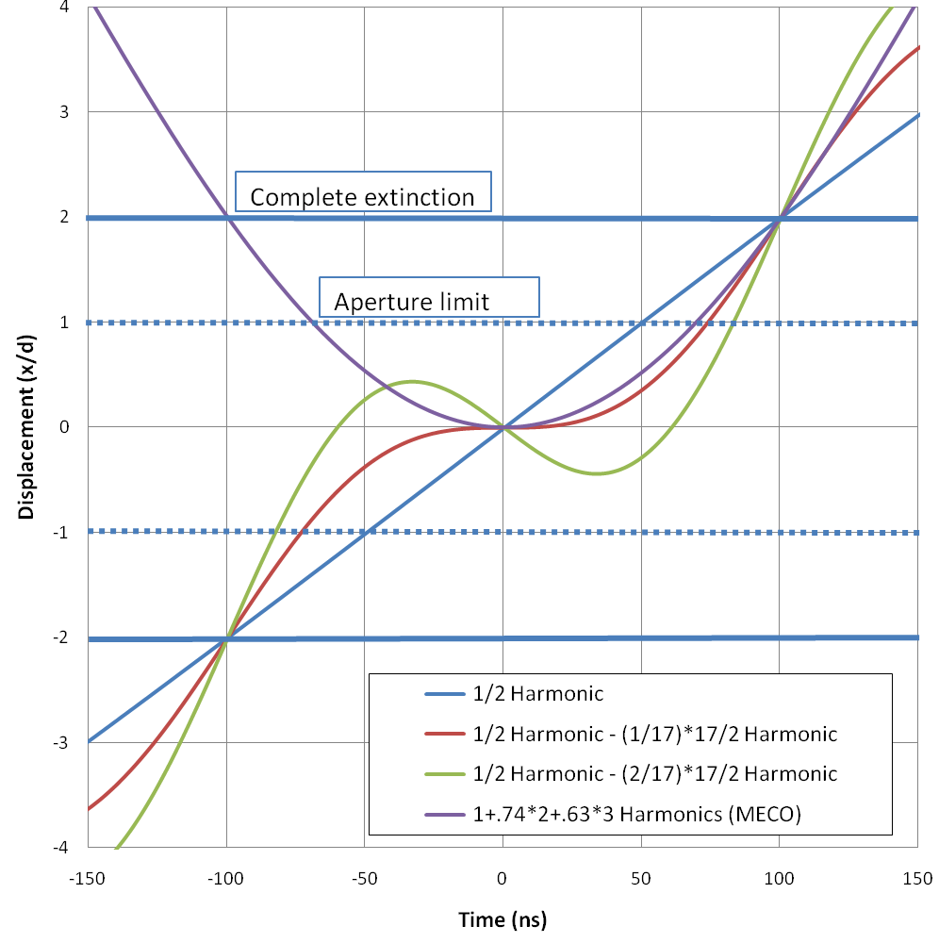
AC Dipole Wave Form
Of the options considered:
½ harmonic – (2/17) * 17/2 harmonic seems most promising
Bunch length
Transmission window

Slide 11
Beam Line Structure
Upstream of extinction dipole
  Collimation to define a 50 π-mm-mr beam line admittance
AC dipole region
  Bend plane: β=250m
  Non-bend plane: waist
Extinction collimation
  Minimize transmission of scraping particles
Post-extinction
  High dispersion region for momentum collimation.

Slide 12
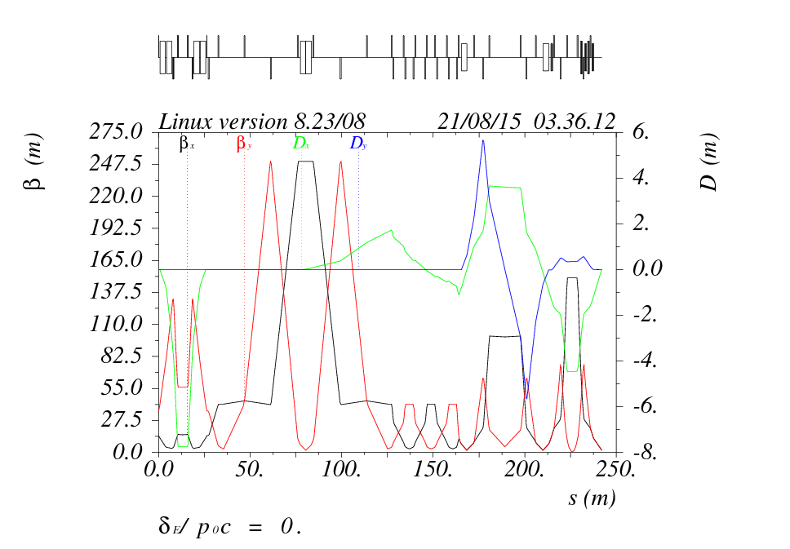
Extinction Beam Line Optics
Momentum collimation
AC Dipole section
Collimation section
Momentum collimation and targeting optics

Slide 13
Proton flux vs time of flight
The extinction beam line was simulated using STRUCT and MARS
Collimator Material:
Extinction Region
Extinction < 5x10⁻⁸ over range of interest for optimized collimators
This is multiplied by the Delivery Ring factor to produce a total extinction of < 5x10⁻¹²
Time (ns)

Slide 14
Monitor Objectives
Demonstrate 10⁻¹⁰ extinction
  Assume ≈ 3 x 10⁷ protons/bunch
  Not possible to measure 10⁻¹⁰ with a single bunch
    ⇒ Integrate over many bunches
  Integration time should be < ≈ 1 hour
Only protons hitting the target can cause backgrounds
  Monitoring beam itself will lead to a potentially large over estimate of the background to the experiment
  ⇒ Monitor target interaction products

Slide 15
Requirements: Signal Rate
Determined from beam intensity
  ~3 x 10⁷ protons/bunch
  Bunch rate: 0.6 MHz @ 33% duty factor
  ⇒ ~2 x 10¹⁶ in-time protons/hr
  10⁻¹⁰ extinction ⇒ ~2 x 10⁶ out-of-time protons/hr
A signal detection rate of ~10⁻⁶ events per proton-on-target will result in ~2 out-of-time events per hour if the extinction is 10⁻¹⁰

Slide 16
Requirements: Background
Out-of-time background << a few events/hr
Background sources
  Cosmic rays
  Late hits from in-time interactions
  Induced radioactivity
  Electronic noise
  Off-target beam interactions
    Potentially the most dangerous source
    Cannot be measured with beam-off running
    Not easily distinguished from real signal

Slide 17
Filter + Detector Strategy
Filter
  Selects a sample of suitable secondaries and delivers them to the detector
  Sets the per proton detector signal rate
  Shields the detector from unwanted interaction products
Detector
  Measure “in-time” and “out-of-time” signal rates with equal or known relative efficiency
  Must have LOW “out-of-time” backgrounds compared to signal rate

Slide 18
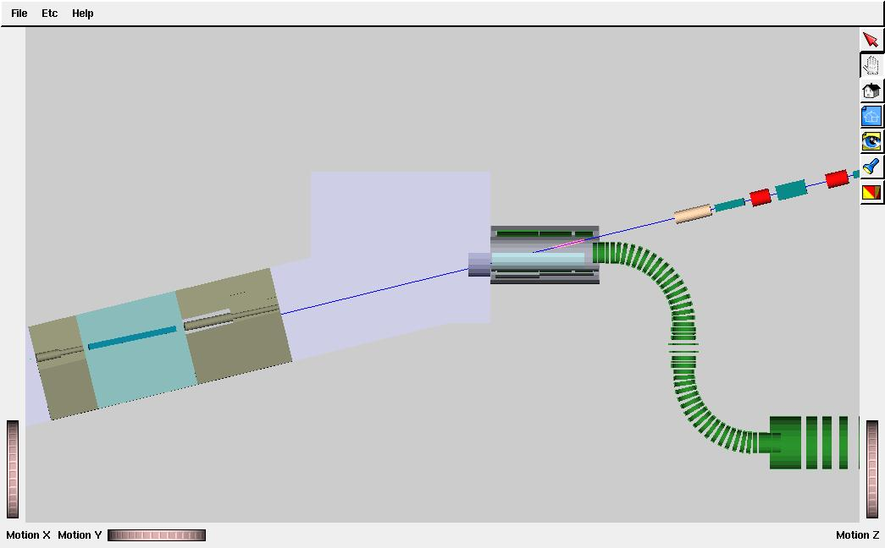
Layout
Extinction monitor is located above and behind primary beam dump
Muon transport solenoid
20 m
Production solenoid
Protection collimator
Proton absorber and extinction monitor filter
Proton beam line
Target
(too small to see)

Slide 19
Filter Design
Locates detector outside target hall
  Easy access for detector maintenance
  Lots of room for shielding
  Low radiation levels for detector + electronics
Entry collimator
  Located in concrete above the primary beam dump
  Access forward produced high momentum secondaries
Filter magnet
  Permanent dipole oriented to transmit ~4.5 GeV/c secondaries
Exit collimator
  Admits signal particles through a 2m thick shield wall

Slide 20
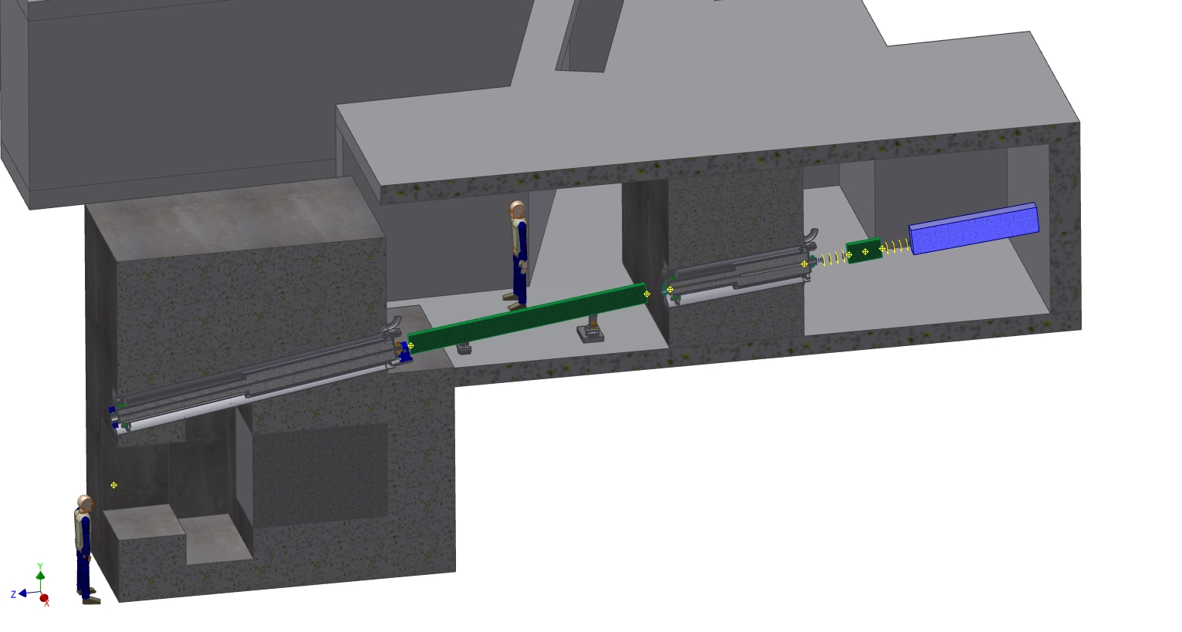
Filter Layout
Entry collimator
Filter magnet
Exit collimator
Primary beam absorber
Detector room

Slide 21
Detector Components
Pixel spectrometer
  Reconstruct and count tracks in 25 ns time bins
  Provides the extinction measurement
6 fast scintillator counters
  Provide a trigger for the pixels
  Also measure the time structure of the beam
Hadron calorimeter / muon range stack
  Measures the muon content of the signal
  Expected to be low
  A higher out-of-time muon fraction would indicate an upstream source

Slide 22
Detector Layout
Pixel detectors
8 planes
Calorimeter
Dipole magnet
Trigger counters

Slide 23
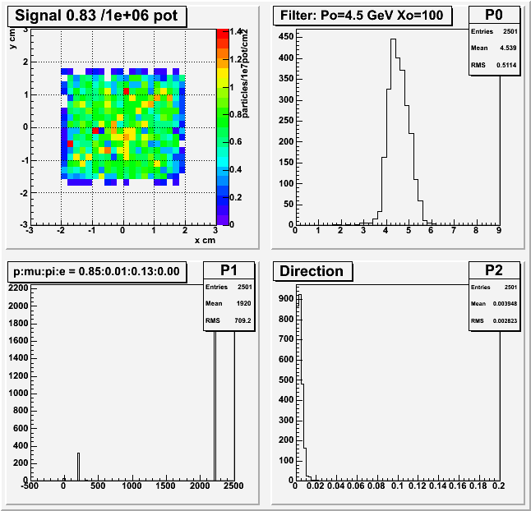
Expected Signal Rate
0.83x10⁻⁶ /p.o.t. tracks pass through all 8 pixel planes
Momentum range 3.5 to 5.5 GeV/c
85% protons and 13% pions
Parallel to within 0.02 radians

Slide 24
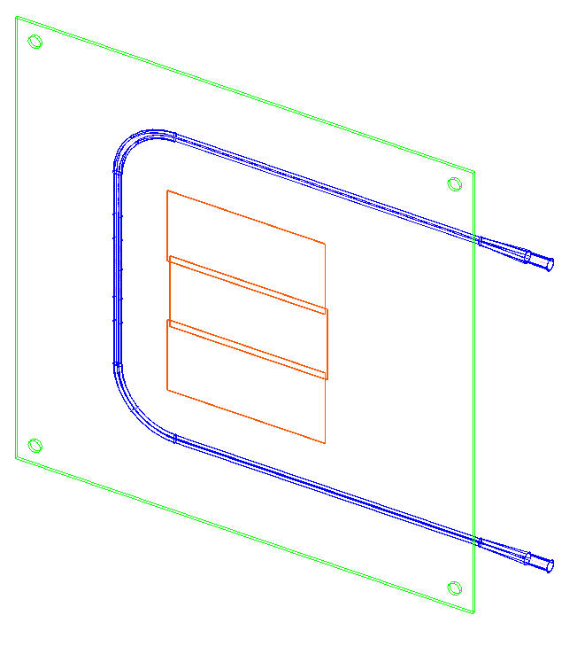
Pixels
Signal/noise = 15,000 / 121 electrons
Radiation hard to 300 Mrad (expect <1 Mrad/yr)
Tracking efficiency >97%
Signal non-linearity <1%
4 upstream planes with 4 x 3.5 cm active area
  Each plane comprised of 4 Atlas style FE-14 sensor chips with 26,880 pixels per chip
  Pixel size is 250 x 50 μm
4 downstream planes with 4 x 5.1 cm active area
  6 chips per plane
Magnet
  Permanent dipole 0.14 T.m.
  Main purpose is to prevent electrons from stopped muon decays from forming tracks

Slide 25
Background Simulations
Cosmic rays < 0.01 tracks/hr
Fake out-of-time track rate << 7x10⁻⁴ /hr
Calculated using hits from any of
  Late hits from in-time interactions
    Spatially correlated
  Radioactive decays (3x10⁻⁴ hits/25ns clock tick)
  Electronic noise (6x10⁻⁵ hits/25ns clock tick)
  Cosmic rays (< 6x10⁻⁸ hits/25ns clock tick)

Slide 26
Off-target Backgrounnd
Interactions where the beam enters the production solenoid generate signals in the extinction monitor
Rate depends on beam structure
Assume out-of-time beam is flat over defining aperture at end of extinction beam line
Simulated beam transport through final focus optics
  Only about 0.2% hit the target
Without the protection the off-target extinction signal would be twice the on-target rate
With the protection it is <5% of the on-target rate

Slide 27
Summary
Looks feasible
Extinction at the 10⁻¹² level seems to be achievable
Monitoring at the 10⁻¹⁰ level on a 1 hour time scale should also work

