Slide 1
Anarchy, Neutrinoless double beta decay and Leptogenesis
NuFact 2013, Aug 22nd
Xiaochuan Lu and Hitoshi Murayama
UC Berkeley

Slide 2
Outline
What is Anarchy Approach
Anarchy approach applied to neutrino physics
Neutrinoless double beta decay
Leptogenesis

Slide 3
What is Anarchy Approach?
A method to study the parameter space
known
unknown
explain
predict
the next-layer model ?
Monarchy
Anarchy
Dimensional analysis
Symmetries
Cuts

Slide 4
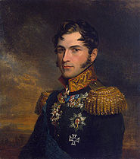
How to understand anarchy
relax
constrain
Anarchy is a kind of Statistics
distribution
check consistency
explain
predict
expectation
correlation
Anarchical model

Slide 5
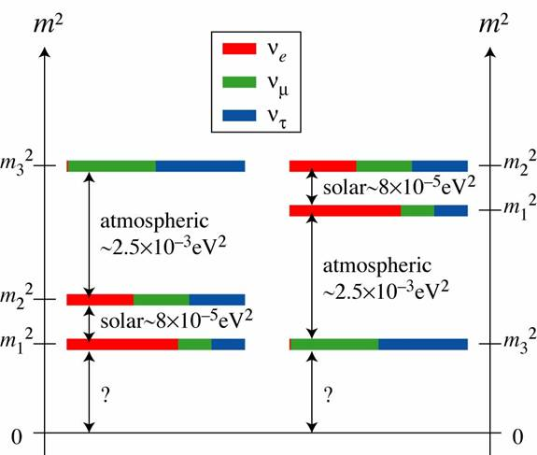
Neutrino Anarchy: model
Seesaw Mechanism, 3 generations
Masses
normal
inverted
Mixings

Slide 6
Neutrino Anarchy: parameters
distribution (measure)
known
unknown
Neutrino mass scale
Sign of
(mass hierarchy)
CP phase
Other physical phases
,
Neutrinoless double beta decay
Leptogenesis

Slide 7
What measure to choose?
A tempting choice: Entry Independence
Each free entry
is
generated independently
A second thought: Basis Independence
No distinction among three generations

Slide 8
Basis Independence
Parameterization
Factorize
Haar measure
invariant
Haar measure
Haar measure
Haar measure

Slide 9
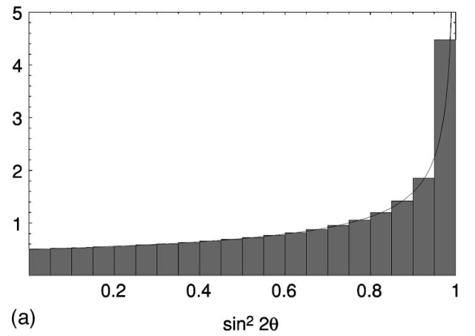
Distribution of mixing angles
completely
consistent

Slide 10
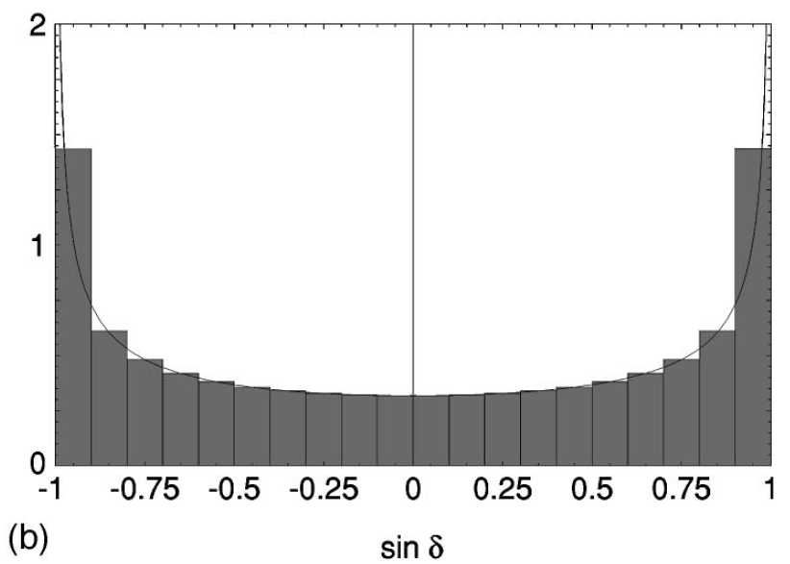
Distribution of phases
uniform distribution

Slide 11
Entry Independence
Parameterization
independent
Basis Independence
Haar measure
Entry Independence
Each free entry Gaussian measure

Slide 12
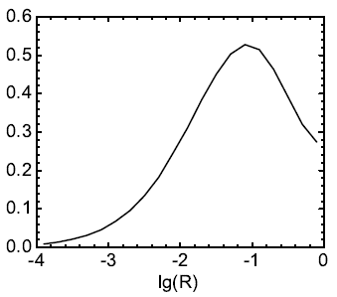
Mass splits and mass hierarchy
The Cuts
completely
consistent
Normal Hierarchy Scenario
without cut 95.9%
with cut 99.9%

Slide 13
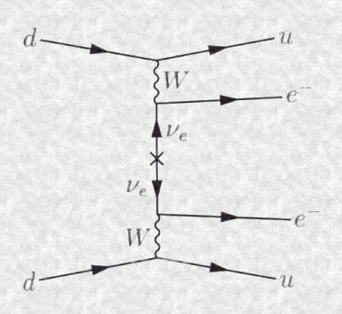
Neutrinoless double beta decay
lepton number violation
light-neutrino mass matrix
is Majorana
Anarchy prediction:

Slide 14
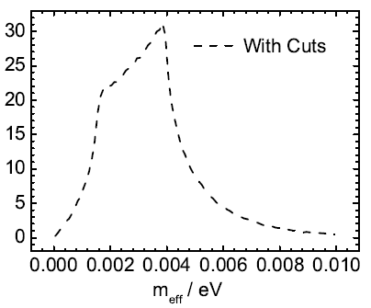
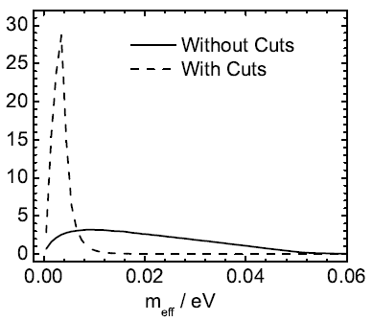
Neutrinoless double beta decay
without cuts
with cuts
experimentally challenging

Slide 15
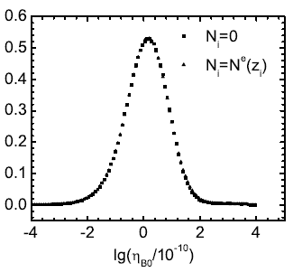
Leptogenesis
Baryon asymmetry today
complex
CP violation

Slide 16
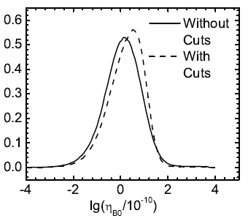
Correlations
Apply the Cuts
light-neutrino parameters
Correlation?
leptogenesis
light-neutrino masses and mixings favor leptogenesis

Slide 17
Correlations
has no correlation with light-neutrino mixings
has no correlations with
or
could have correlations with
and thus

Slide 18
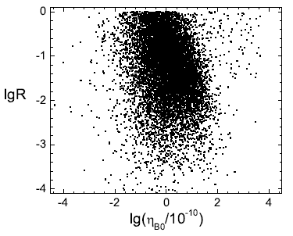
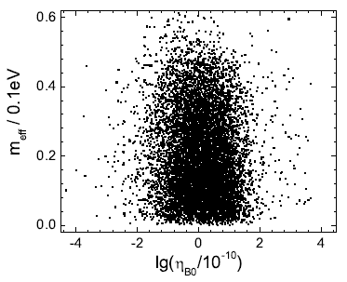
Correlations
scatter plots:
has a weak negative correlation with and

Slide 19
Summary
Completely Consistent
Sign of
99.9% normal hierarchy
CP phase
and
,
uniform, maximal CP violation
very challenging to experimental sensitivity
on the correct order of magnitude
no correlations with
or
weak negative correlations with and

Slide 20
Thank you!

