Slide 1


NuSTORM - μ Storage Ring with Injection
David Neuffer
Liu, A Bross
NuSTORM Collaboration
August 2013

Slide 2
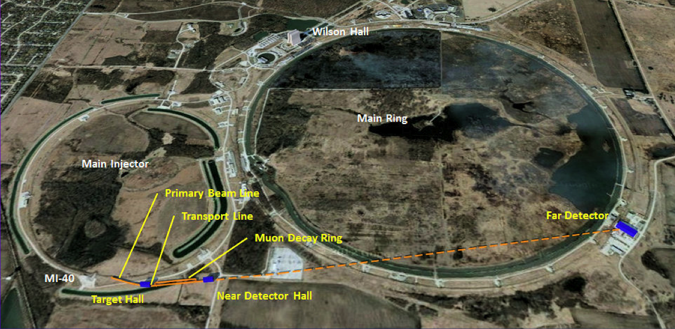
Outline
Scenario Overview
π-production, transport
and injection
  Transport
  Stochastic injection
Storage ring properties
  Acceptance studies
Low Energy Muons from nuSTORM

Slide 3



Neutrinos from μ Storage Ring
Intense Proton beam on π production target
  60-120 GeV protons from Main Injector
Collect forward π’s; transport into ring
  Li lens or horn
π decay in injection Straight Section produces μ’s
  50% of 5GeV π decay in 200m SS
μ’s accepted by ring; circulate for ~100 turns
  Decay : produces neutrino beams
  C =~480m
$$μ^{−}→e^{−}+{\overline{ν}}_{e}+ν_{μ}$$
184m straight section
56m arc
$$μ^{−}→e^{−}+{\overline{ν}}_{e}+ν_{μ}$$
π
$$π^{−}→μ^{−}+{\overline{ν}}_{μ}$$

Slide 4
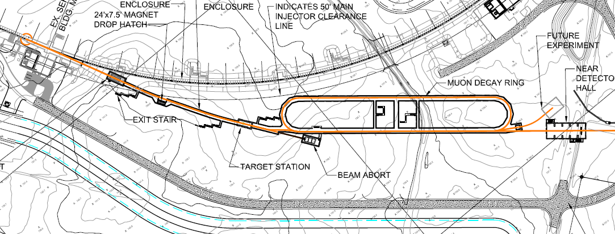


nuSTORM overview
Obtain ν_{e} ,ν_{μ} beams or ν_{e} ,ν_{μ} beams
  for L/E ~1 oscillations at far detector
  precision x-sections at near hall
  Can store $μ^{+}$ or $μ^{−}$
+Bonus low-energy μ beam for future experiments
$$μ^{−}→e^{−}+{\overline{ν}}_{e}+ν_{μ}$$

Slide 5
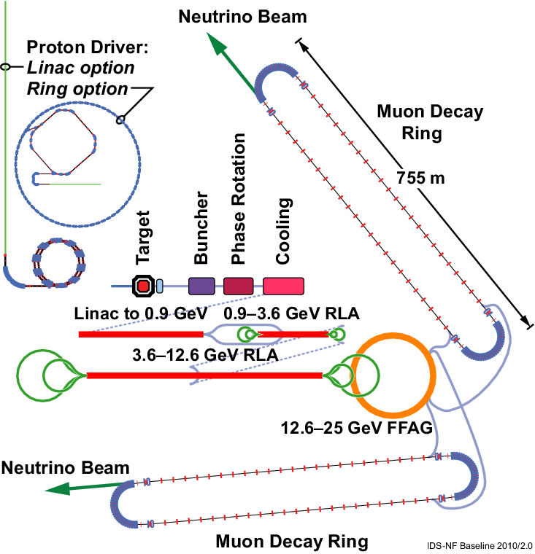
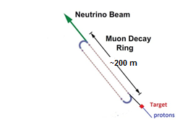
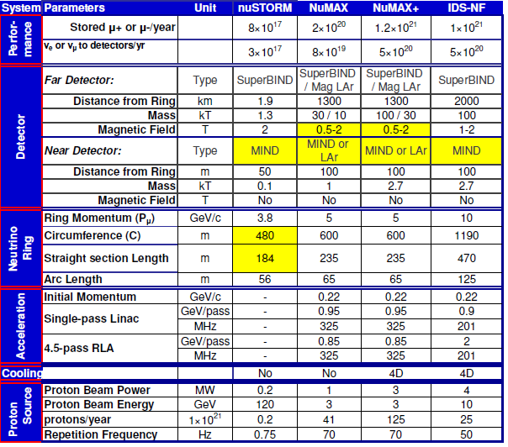
Comparison of facilities
IDS neutrino factory
Low-luminosity Neutrino Factory
nuSTORM

Slide 6
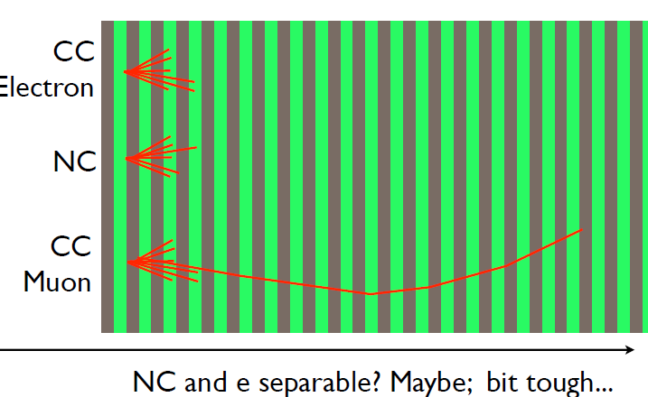
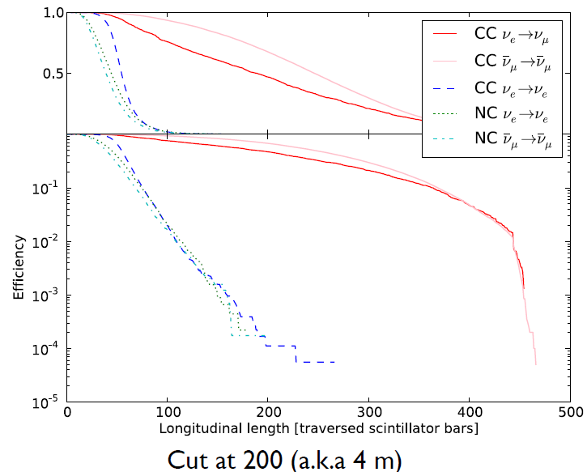

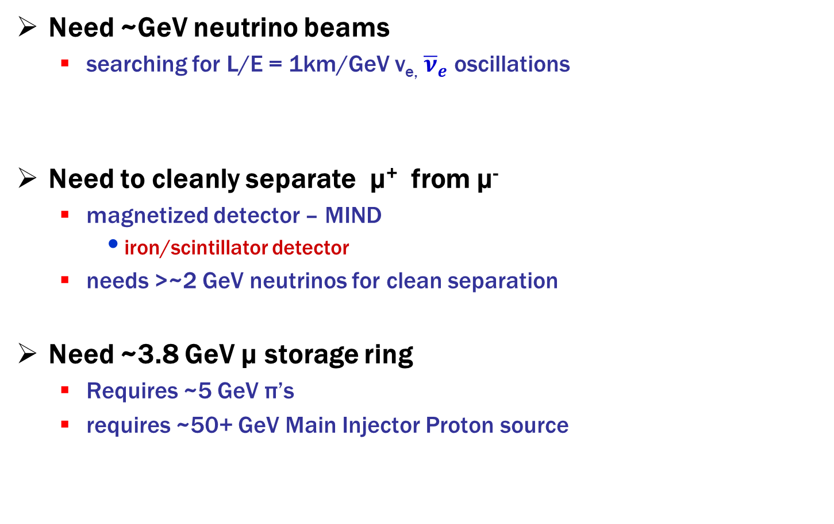

Parameter Choices
Need ~GeV neutrino beams
  searching for L/E = 1km/GeV ν_{e,} ${\overline{ν}}_{e}$ oscillations
Need to cleanly separate μ⁺ from μ⁻
  magnetized detector – MIND
    iron/scintillator detector
  needs >~2 GeV neutrinos for clean separation
Need ~3.8 GeV μ storage ring
  Requires ~5 GeV π’s
  requires ~50+ GeV Main Injector Proton source
$$μ^{−}→e^{−}+{\overline{ν}}_{e}+ν_{μ}$$
$$μ^{+}→e^{+}+{\overline{ν}}_{μ}+ν_{e}$$
C. Tunnell

Slide 7
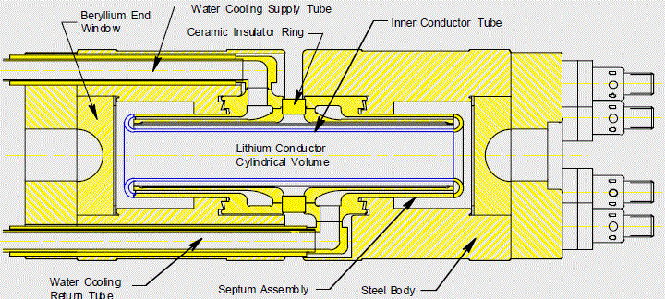
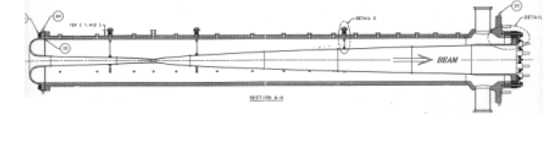
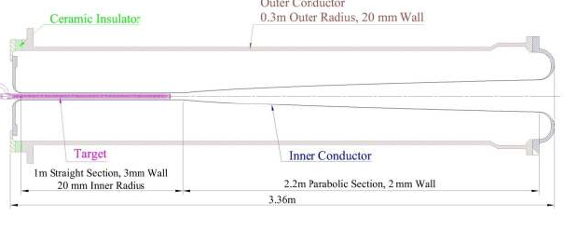
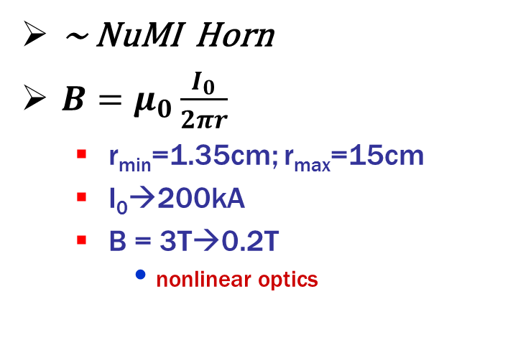
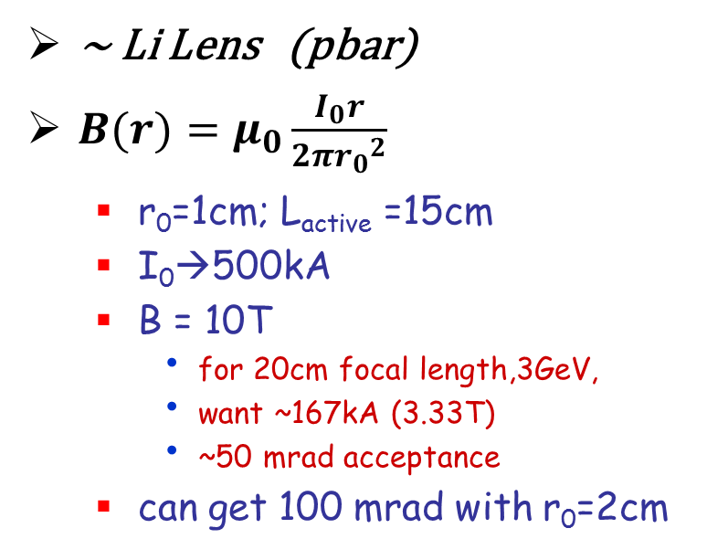
Li lens or magnetic Horn or?
~ Li Lens (pbar)
$B(r)=μ_{0}\frac{I_{0}r}{2π{r_{0}}_{}^{2}}$
  r₀=1cm; L_{active} =15cm
  I₀→500kA
  B = 10T
    for 20cm focal length,3GeV,
    want ~167kA (3.33T)
    ~50 mrad acceptance
  can get 100 mrad with r₀=2cm
~ NuMI Horn
$B=μ_{0}\frac{I_{0}}{2πr}$
  r_{min}=1.35cm; r_{max}=15cm
  I₀→200kA
  B = 3T→0.2T
    nonlinear optics

Slide 8
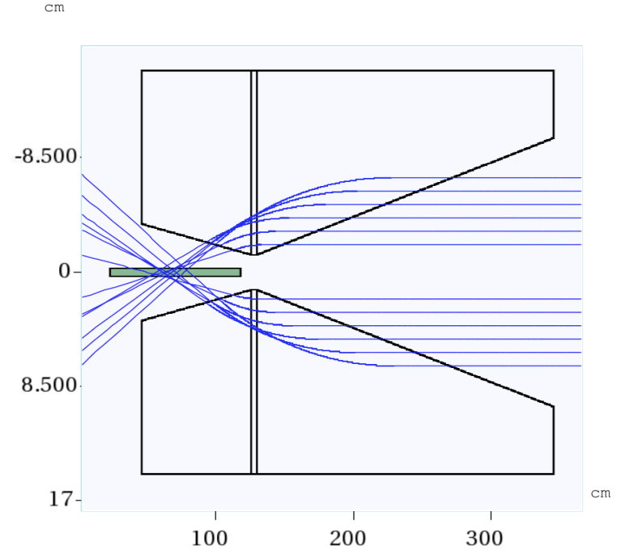
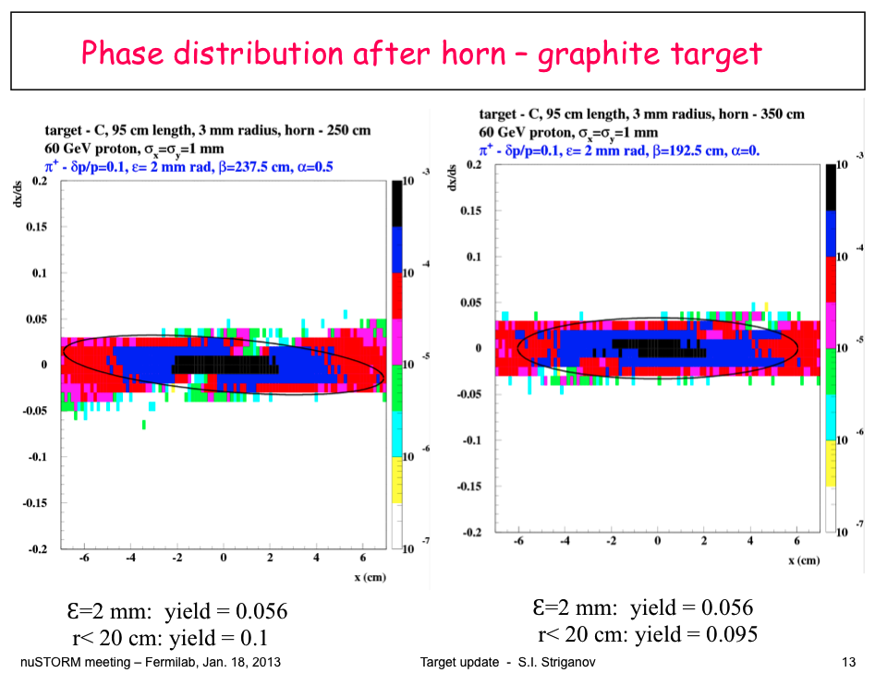
Introduction-π Capture
Use a NuMI-like magnetic horn, after which 0.1 5±0.5 GeV/c pions per POT are collected in 20cm region, 0.056 pions per 60GeV POT in 2000 μm acceptance
Notes:
For Gold Target, 0.116 pions per POT are collected in 20 cm region;
0.09 pions per POT collected in 2 mm rad acceptance;

Slide 9
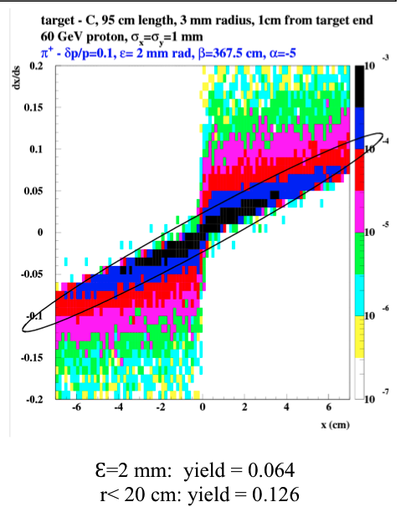
Introduction-π Production
3mm radius, L= 95 cm long graphite target
  or shorter heavy-metal target
π⁺ in 5 ± 0.5 GeV/c bin,
  2 mm emittance ring acceptance
Courtesy of S. Striganov (Fermilab)
Phase space of π᾽s at 1 cm after target

Slide 10
π → μ Injection options
Separate Transport for π →
  kick into storage ring after decay
    Requires fast kicker, can only use part of MI/spill
Injection of π into straight section, accept μ in ring acceptance.
  “stochastic injection”
    stochastic was popular in 1980
    stochastic cooling, stochastic extraction, …
  no kickers; phase space of injected π and circulating μ are separated
  Circumvents Liouville’s Theorem
Could also inject into target inside ring
  π’s within acceptance decay
  μ’s within acceptance stored
    circulating beam passes through target
    collection of beam off target more limited
μ
p
π→μ+ν
π→μ+ν
π
π→μ+ν
p
π→μ+ν
π
p

Slide 11
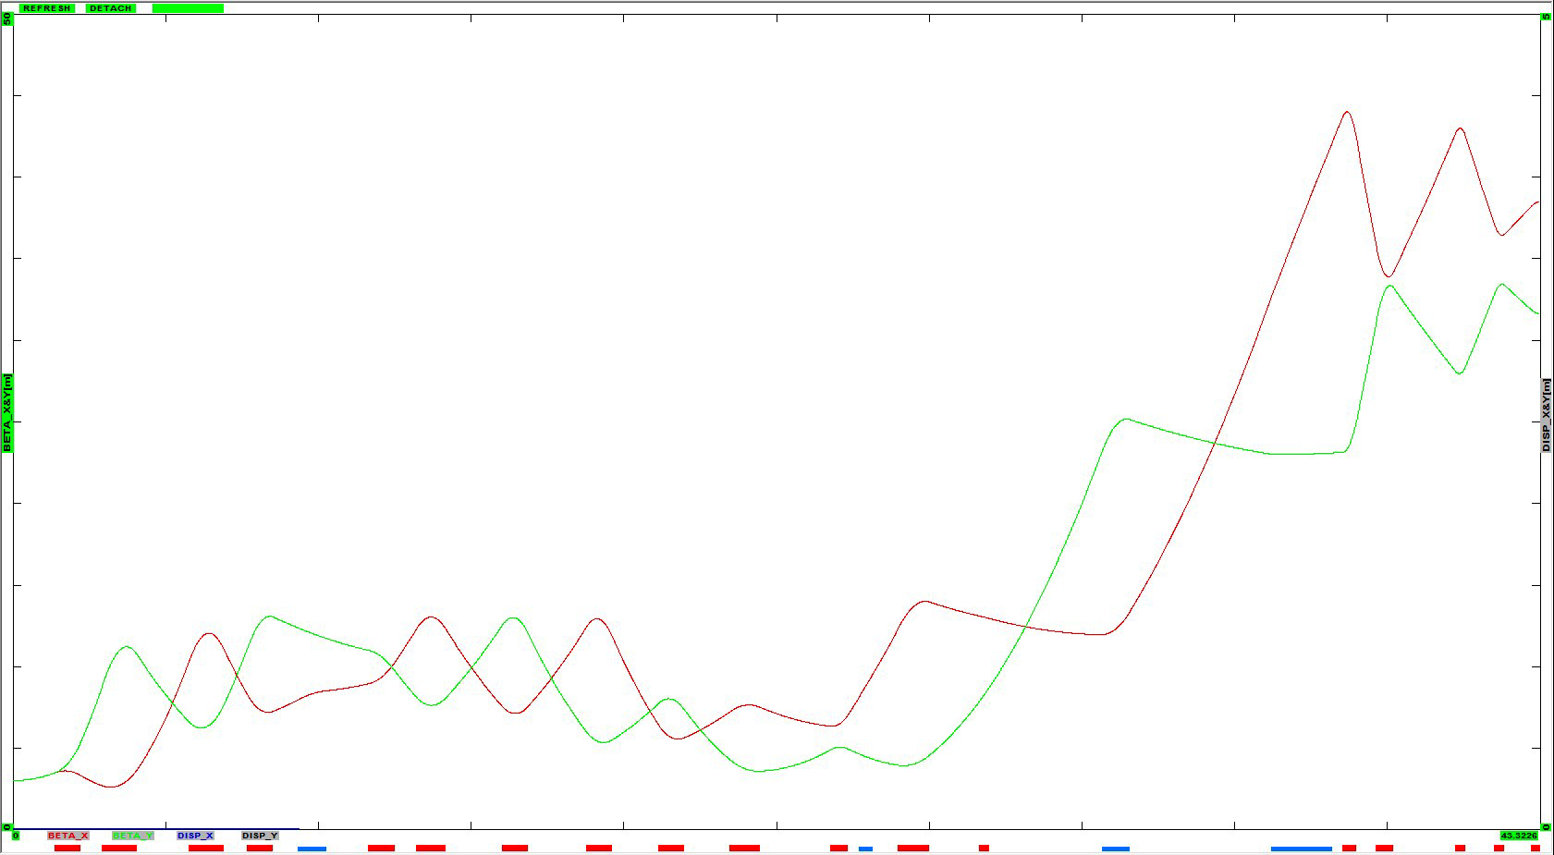
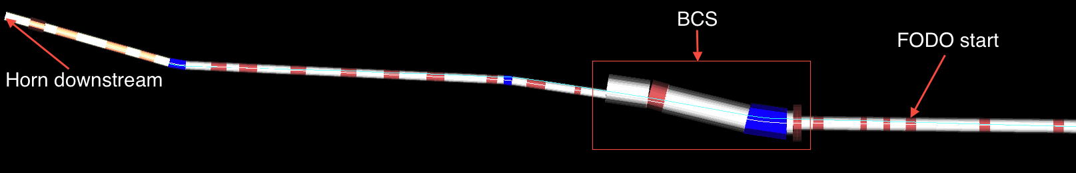
Transport Design – Details(Cont’d)
Reversed Injecting beam direction
Continued by ~180 meters long decay straight FODO cells
Injecting beam direction
Reversed Injecting beam direction
Continued from section above, match to downstream of horn
~16 meters after 1st dipole to gain space for a proton absorber
Notes:
The bend of 1st dipole(4.86 Tesla) for pi is 13.3 degrees, for 120GeV protons, 0.54 degrees;
for 60 GeV protons, 1.08 degrees.
The proton absorber size: Height=Width=4.3 meters; Length=10.668 meters.(Could be shorter)
Decay straight length is 147 meters.

Slide 12
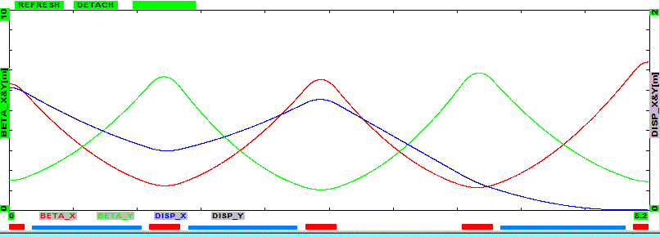
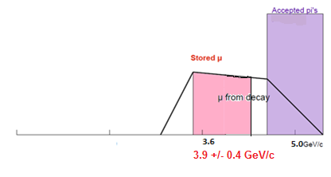
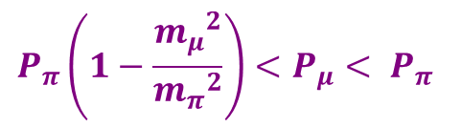

Overview of stochastic injection
π’s are in injection orbit (~5 GeV/c)
  separated by chicane
μ’s are in ring circulating orbit
  lower energy - ~3.8 GeV/c
~30cm separation between orbits
~3.8 GeV/c μ
π
5 GeV/c π
$$π→μ+ν$$
$${P_{π}\left(1−\frac{{m_{μ}}_{}^{2}}{{m_{π}}_{}^{2}}\right)<P}_{μ}< P_{π}$$
Injection Line accepts 5 GeV/c ± 10%
Storage Ring accepts 3.8 GeV/c ± 10%

Slide 13
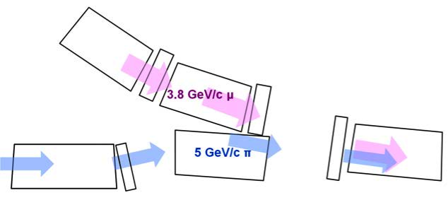
Transport Design - Stochastic Injection
Right: Concept drawing; Bottom: Layout screenshot (White blocks- drift tubes, red-quads, blue-dipoles)
Circled section is beam combination section for two beams

Slide 14
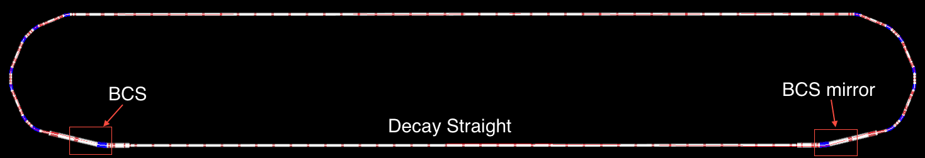
Lattices for storage rings
racetrack Lattices
  Goal: ±10% momentum acceptance, 0.002m “emittance” acceptance
  Beam Combination Section
    matches π’s into decay straight;
    accepts μ’s for storage until decay (~50 turns rms)
straight section
arc
π
$$π^{−}→μ^{−}+{\overline{ν}}_{μ}$$

Slide 15
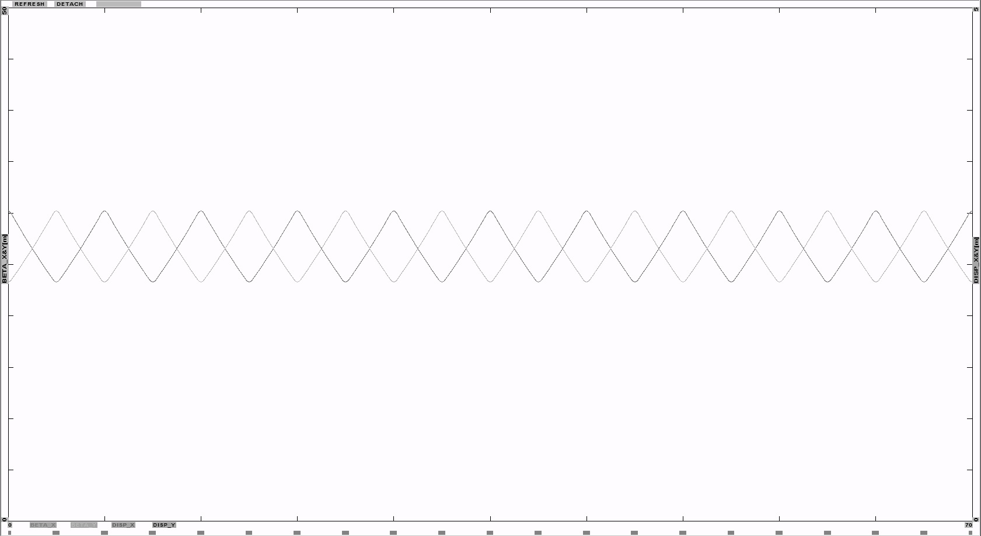
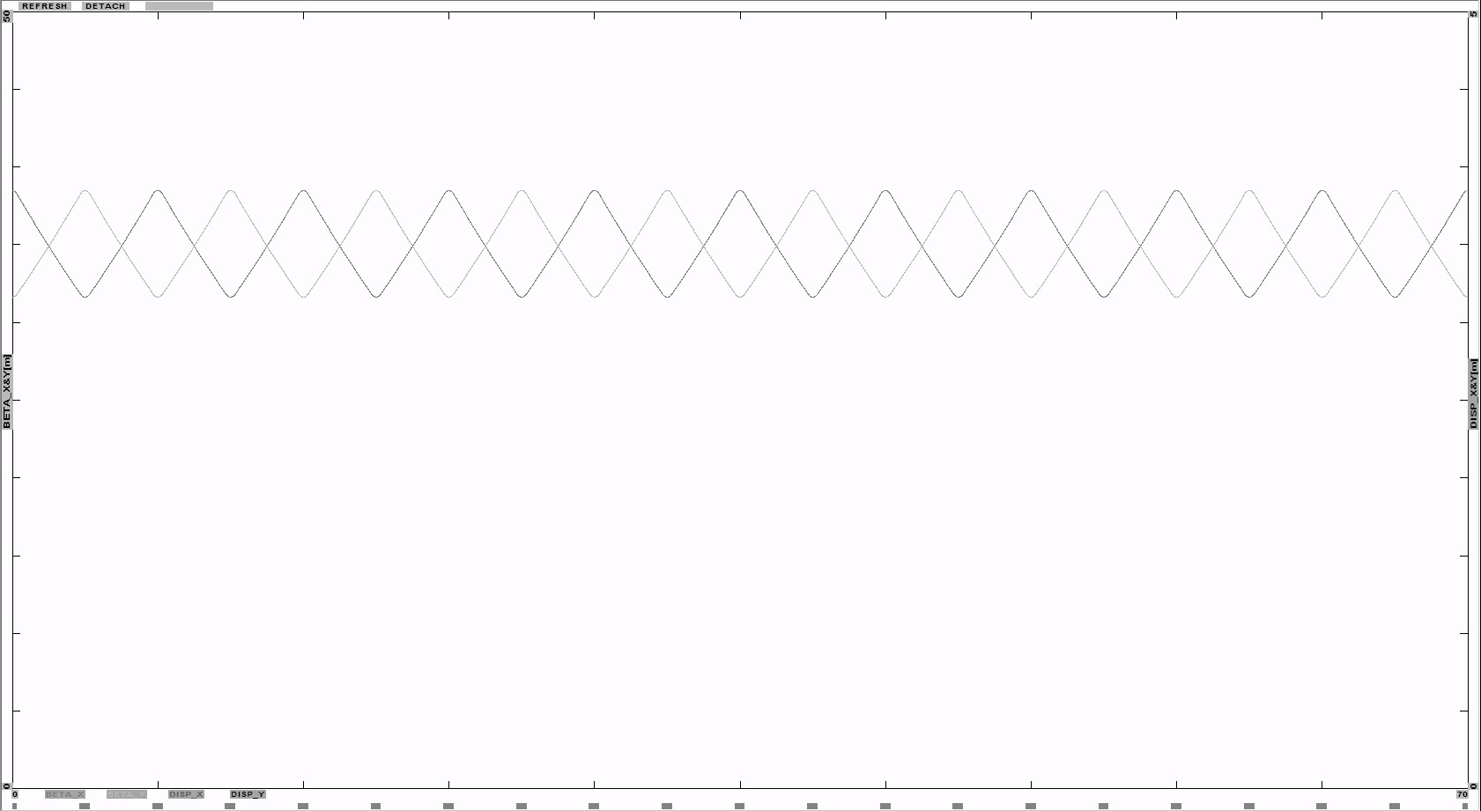
Transport Design – Matched toDetails(Cont’d)
3.8 GeV/c μ： β_{large}~ 30.2 m, β_{small}~ 23.3 m
5 GeV/c π： β_{large}~ 38.5 m, β_{small}~ 31.6 m
Notes:
Pions rigidity: 16.6782; Muons rigidity: 12.6754;

Slide 16
Transport Design – Simulation(Cont’d)
Pions downstream of the horn
Notes:
Total # of pions: 233362;

Slide 17
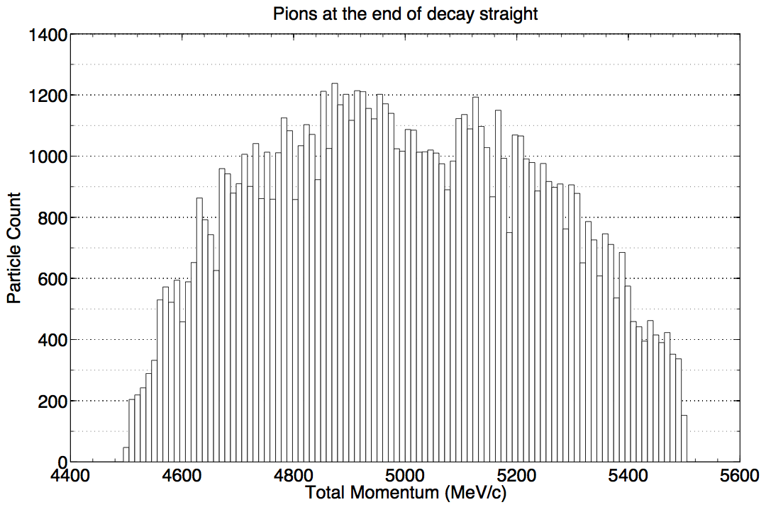
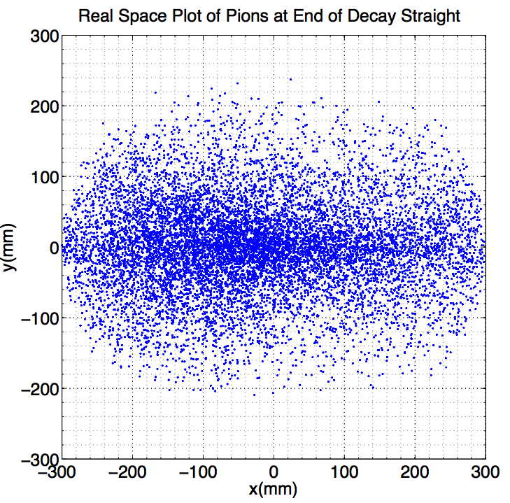
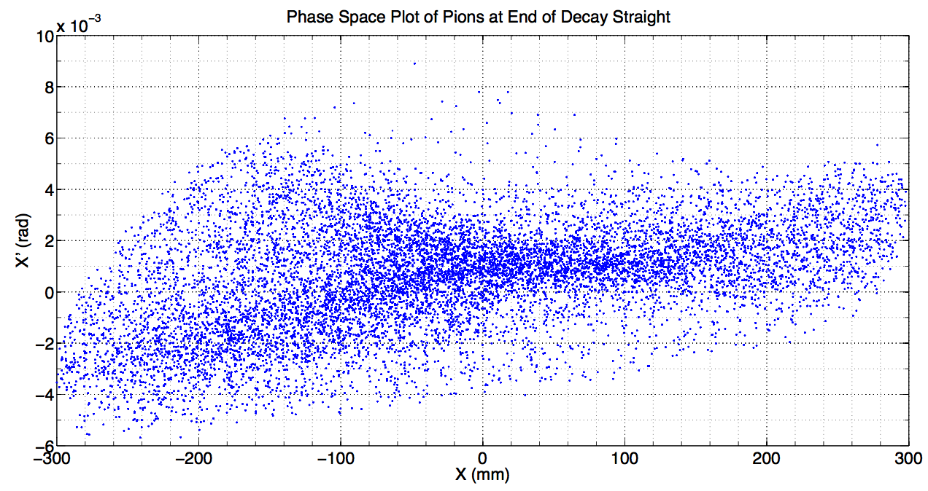
Transport Design – Simulation(Cont’d)
C target
Decay OFF, End of injection straight, 35.5%
Gold Target
Decay OFF, End of injection straight, 54%
Notes:
# of Pions at the end of decay straight: 83663

Slide 18
Lattice Parameters
Parameter | Symbol | Value | Unit
Circumference | C | 480 | m
Tunes | ν_{x}, ν_{y} | 9.72, 7.61
Long Straight | L_{S} | 184 | m
Arc length | L_{arc} | 56 | m
Max β | β_{max} | 34 | m
Dispersion | η_{max}, η_{DBA} | 3.0, 1.2 | m
Quad DBA | B’, L | 12T/m | 0.5m
Dipole | B | 4.5T | 2.0m
β range in straight | β_{ss} | 20/30 | m
β range in arc | β_{arc} | 2/10 | m
β range in returnstraight | β_{ssR} | 6/12 | m
Arc quads would have r~0.20m
  ε_{acc}= 0.15²/10=0.002m
  ε_{acc,N}= ~0.08m
    ε_{acc,N,rms}= ~0.01m
  δp/p = ±10%
  θ_{rms} = ~0.005 (at β⊥= 30m)
  Angle from π-decay
    30 MeV/5000 -~0.006
  Angle from μ-decay
    ~0.03

Slide 19
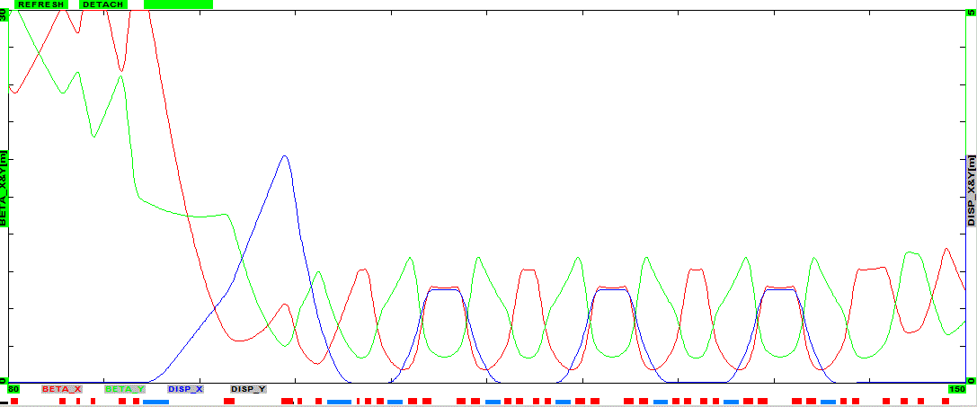
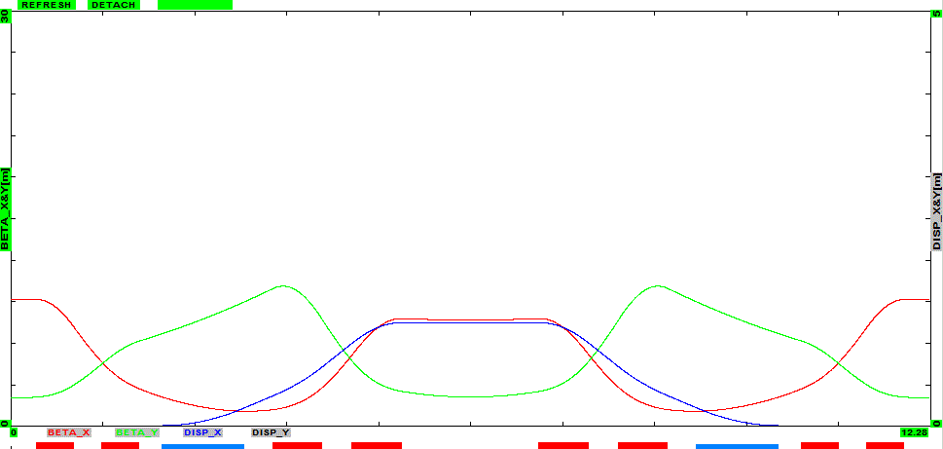
Lattice parameters
Arc structure:
  BCS cell + 3 double-bend achromat cells
    2 dipoles + 8 quads /cell
    B=4.5 T, 1.1m in DBA
    B’= ~12.5 T/m L=0.5, 0.67m,( r =25 cm )
  DBA-style lattice is nearly isochronous
      γ_{t} =30
      bunch structure maintained
  optimization, variation
    sextupole correction

Slide 20
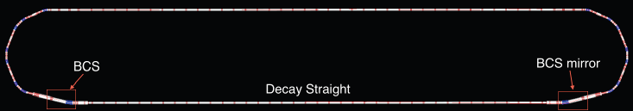
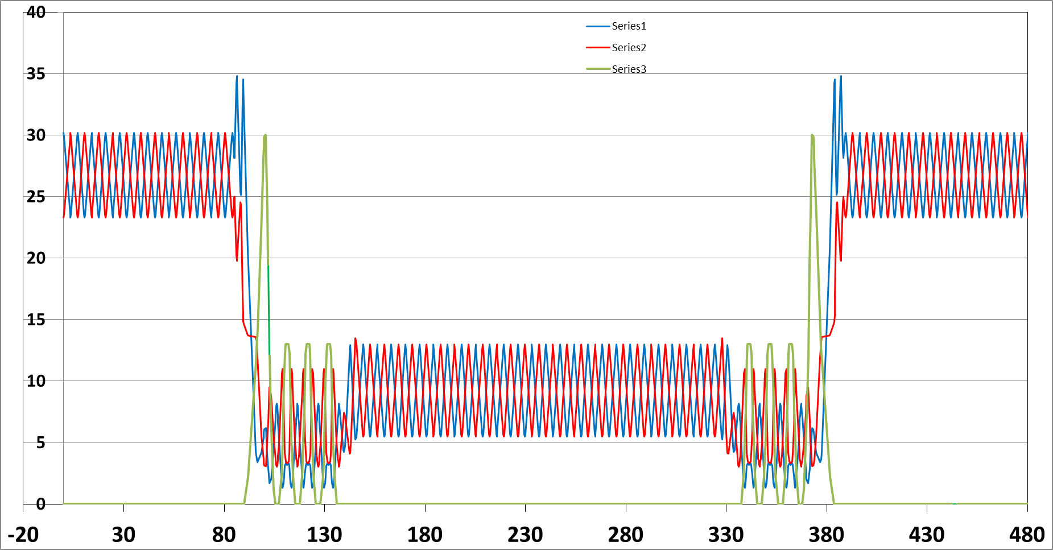
Decay Ring − 3.8 GeV μ
350 meter Racetrack Ring
injection scheme

Slide 21
Transport Design – Simulation(Cont’d)
Decay ON, End of injection straight, 12%
Ring Momentum Acceptance
Extract to Degrader
Notes:
Total # of muons at the end of decay straight: 29520;

Slide 22
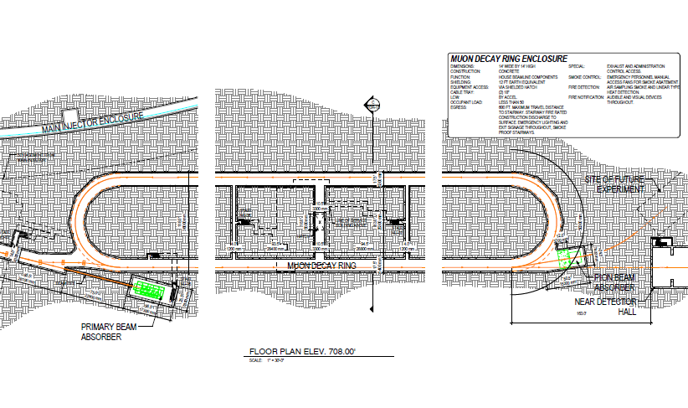
Able to achieve ~ 0.12 muons per 5±0.5 GeV pion after horn in simulation;
  Roughly two times the number νSTORM proposed in LOI paper;
  Injection scheme can also be used to extract, not only π’s but also μ’s

Slide 23
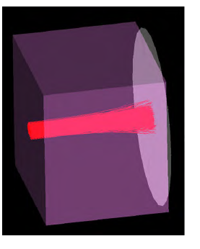
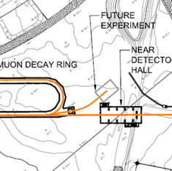
At end of straight have large number of undecayed π’s + μ’s from decay
  5±0.5 GeV/c extract from ring
Need to stop π beam
  Beam stop set to degrade μ to 0.3 GeV/c
  ideal energy for μ cooling experiments

Slide 24
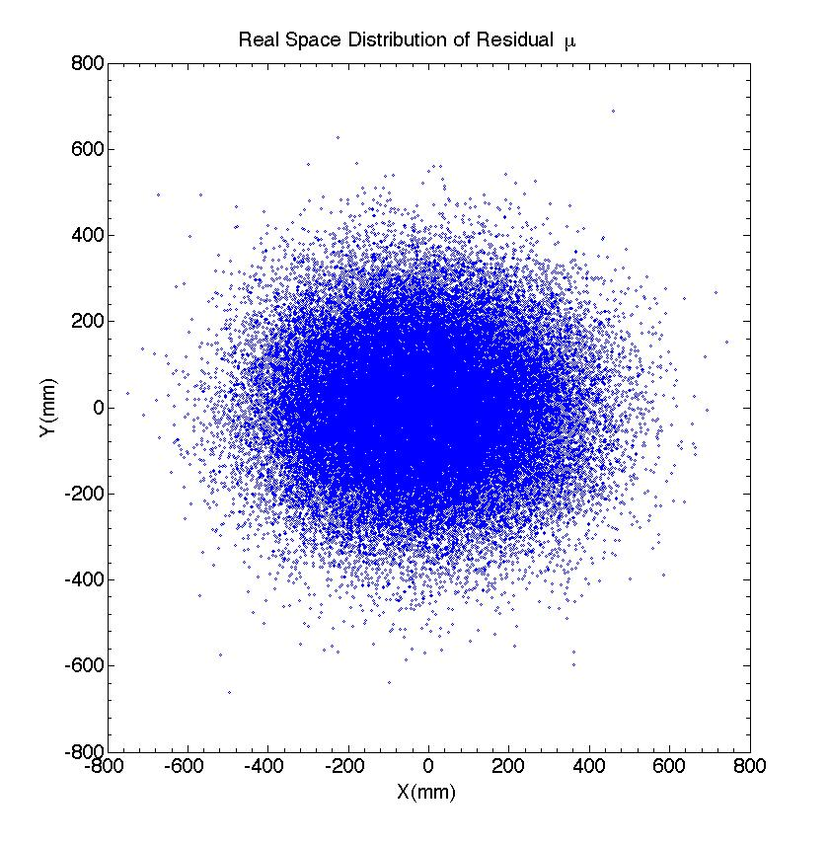
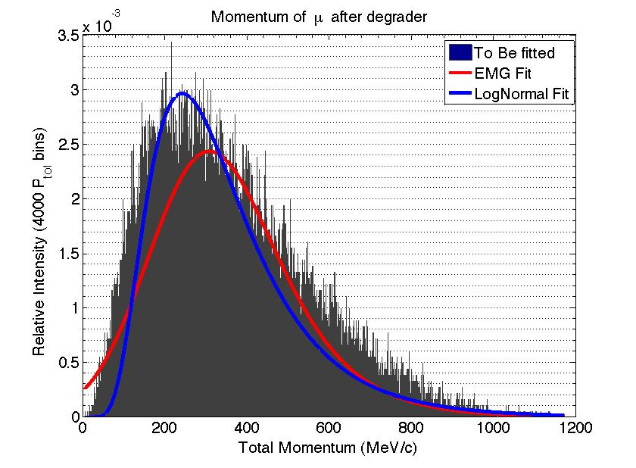
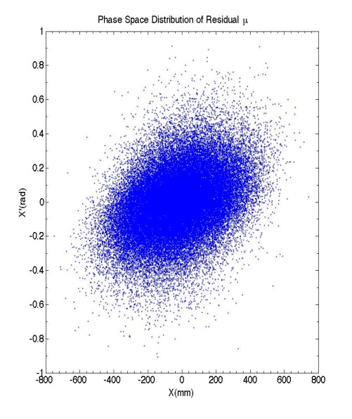
Low Energy Muons from Beam Stop
Obtain ~ 0.002 μ/p from beam stop
  large emittance and energy spread
Assume μ within 5 ± 0.5 GeV/c bin can be extracted
Notes:
EMG: mu=218.4574; sigma=127.8877; exp.Rate = 0.00769;
LogNormal: mu=5.73276, sigma=0.492;
Put in 116645 Muons; Got 61903 after degrader. (~53.07%)

Slide 25
To Do
Optimize lattice
  Study acceptance; variation of lattice parameters
  correct chromaticity
  vary π production, μ collection parameters
  Injection geometry variations
Injection Variations
  Proton beam parameters 60→ 120 GeV,
  Target C → Inconel
  Lens – Horn parameters
Consider Lattice variations
  Double-Bend Achromat → FODO → ?
  Re optimize magnetic field strengths (4T → ?)
  Consider FFAG version

Slide 26

Summary
Presented a nuSTORM Storage ring overview
“stochastic” Injection of muons into storage ring
Questions?

