Slide 1


WG4 – Muon Physics
Summary
Giovanni Signorelli (INFN)
Andrew Norman (FNAL)
Naohito Saito (KEK)
NuFact2013 IHEP-Beijing, 24 Aug 2013

Slide 2
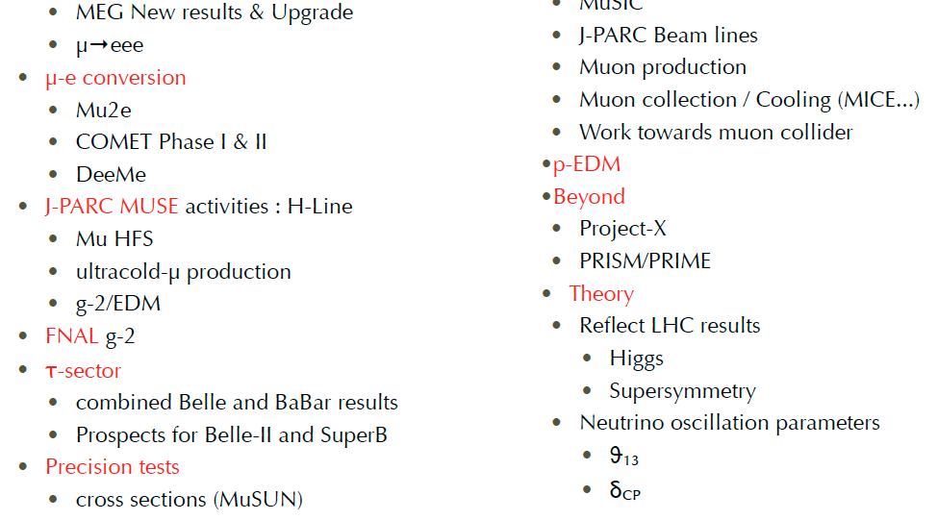
Questions from 2012

Slide 3
Questions moving forward for 2014
Three “Big” questions we want to address:
Expt: What is the ultimate μ→eγ and μ→eee reach once μN→eN has set the limit.
  What are the roles of the ratios of cLFV processes and other precision experiments at this point?
Beams: What are the beam specifications for muon physics? (our requirements)
  Are these compatible with the NuFact?
  Are there other options?
Theory: What else besides cLFV? EDMs?
  What does theory tell us once we observe cLFV?
  How do we relate our results to the models?

Slide 4
Muon Physics
At its heart a Neutrino Factory
is also a Muon Factory
Producing these intense neutrino beams will require new high intensity muon beam lines
This will greatly increase the number of mu’s available to probe for hints of physics beyond the standard Model
Is there a deeper connection between muon physics and neutrino physics?
  Fundamental questions of lepton flavor

Slide 5
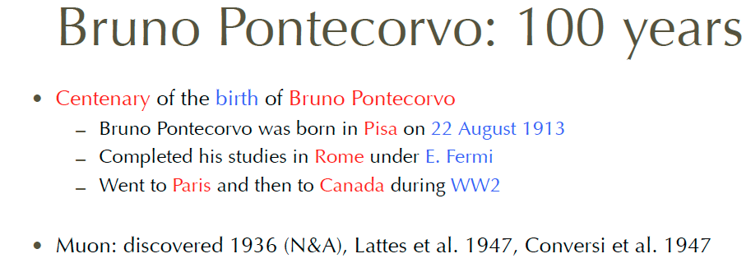
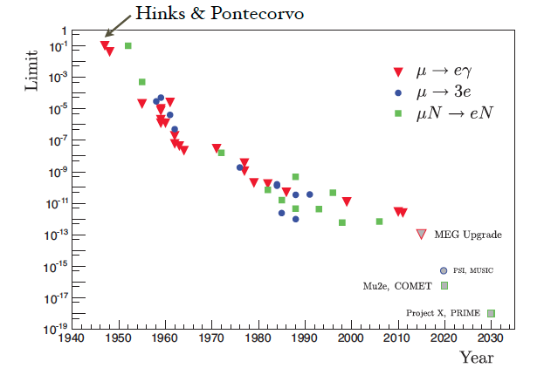
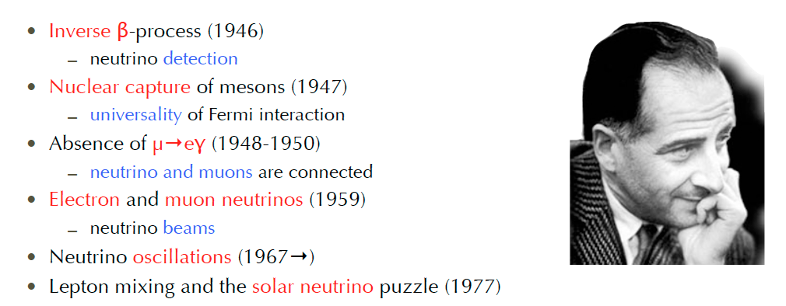
History

Slide 6
Making History

Slide 7
Week in Review
Charged Lepton Flavor
  μ→eγ, μ→eee, μN→eN, τ→cLFV
  Connections to theory
Precision Measurements
  muon g-2
  μ hyperfine spliting
  proton radius
  μ capture
Muon Facilities
  Progress on mu cooling
  New methods for intense mu beams
7 talks
6 talks
13 talks
26 talks total including
3 joint sessions with WG3 and 1 with WG1

Slide 8
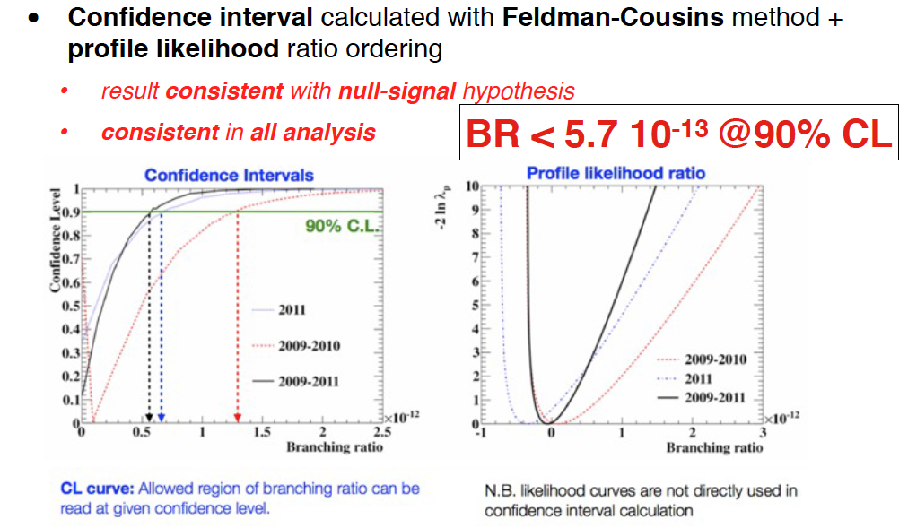
μ→eγ Results (MEG)

Slide 9
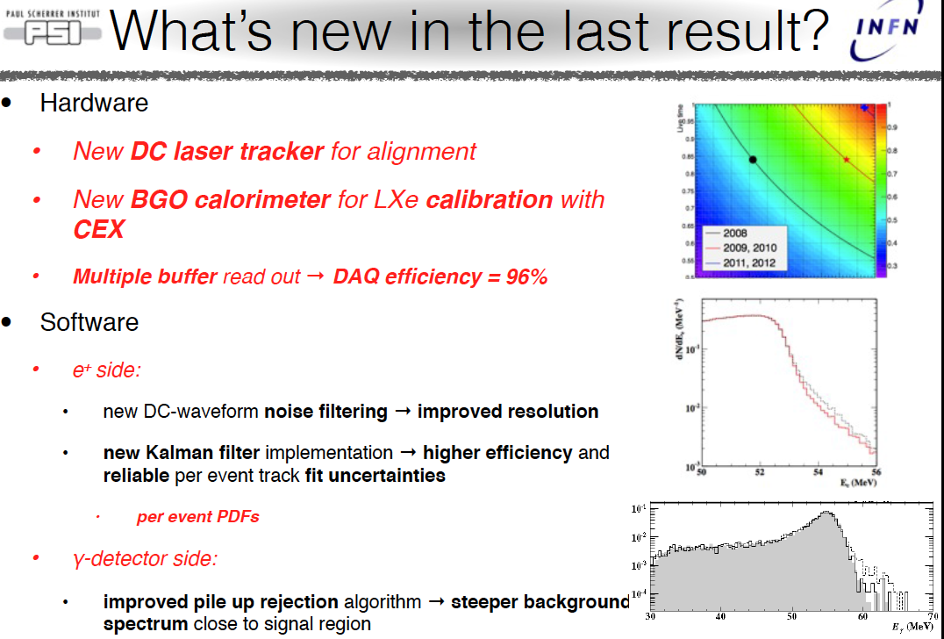
MEG Result

Slide 10
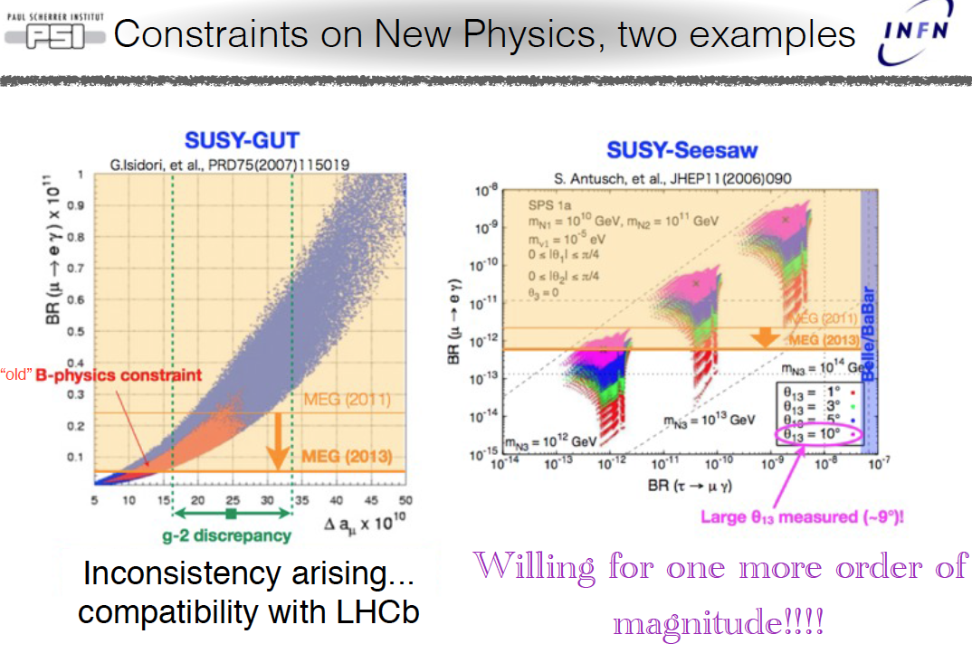
MEG Implications

Slide 11
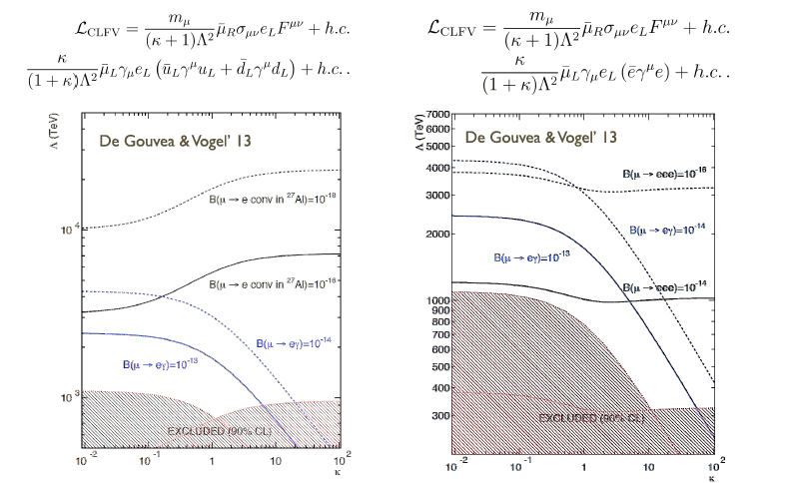
Theory & Experiment

Slide 12
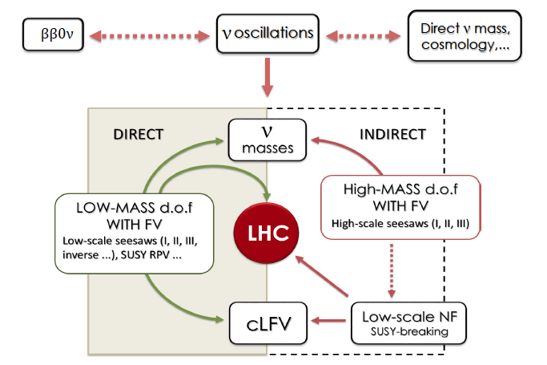
Connection with Seesaw

Slide 13
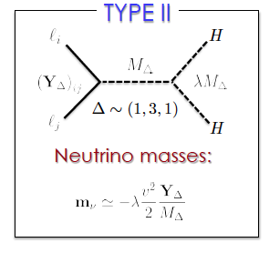

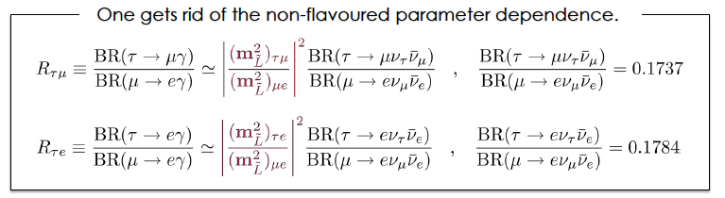
Connection w/ cLFV Expt.
What is Important are the RATIOS of the cLFV channels
These are the perdictions of the model

Slide 14
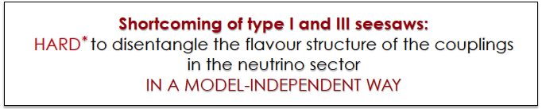
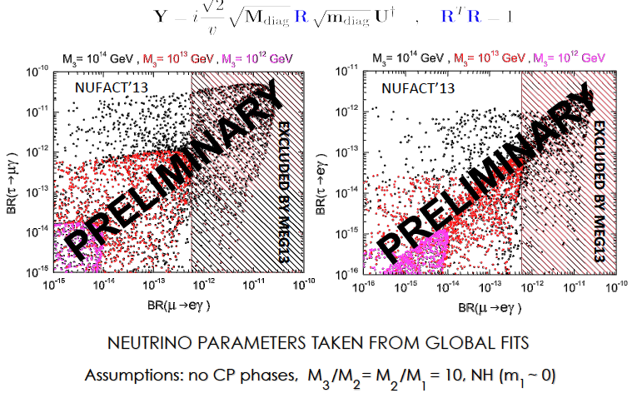
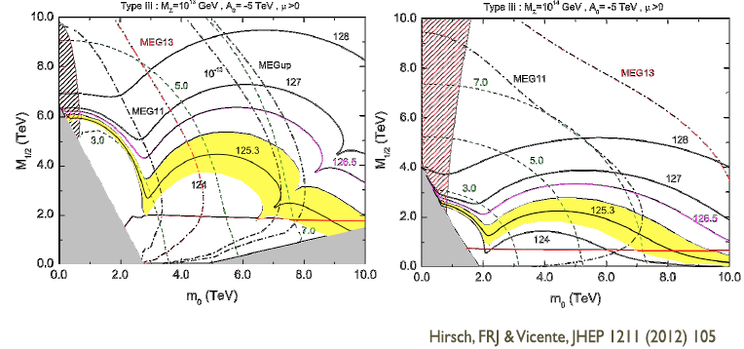
Connection w/ Expt
So you can look at the ratio prediction for differ R matrix parameter space
But there is an instinct dependence on the energy scale that affects whether you are really constraining the model with MEG

Slide 15
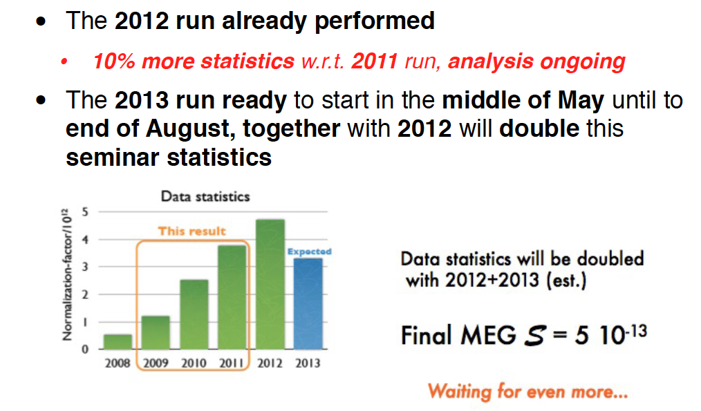
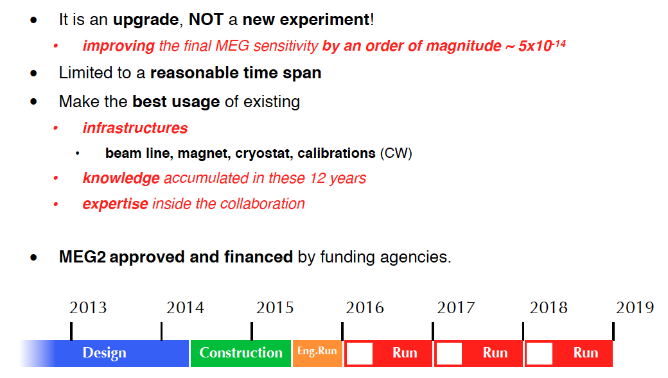
MEG2013 Data and MEG2
Doubling of
current statistics
Pushing to 10⁻¹⁴
Sensitivites

Slide 16
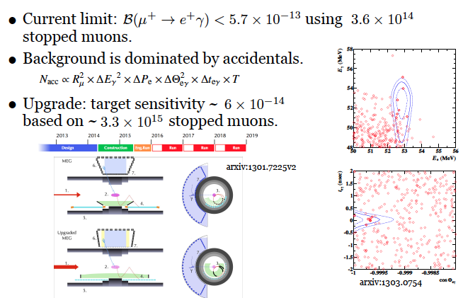
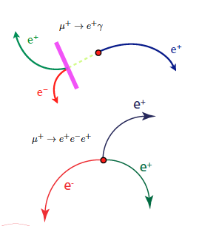
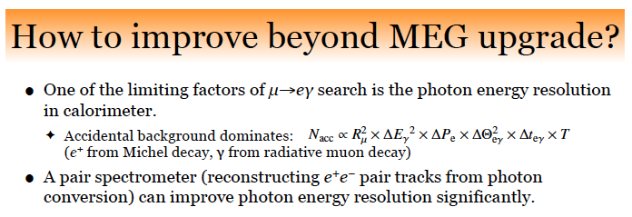
Beyond MEG

Slide 17
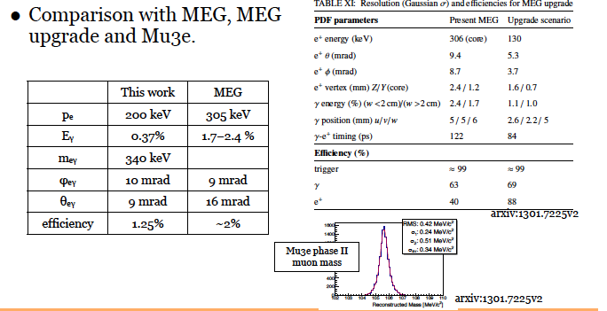
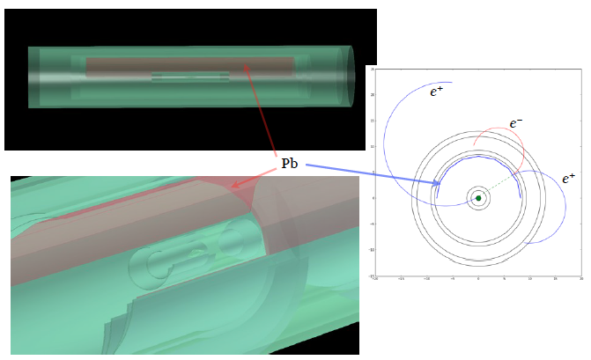
μ→eγ + converter

Slide 18
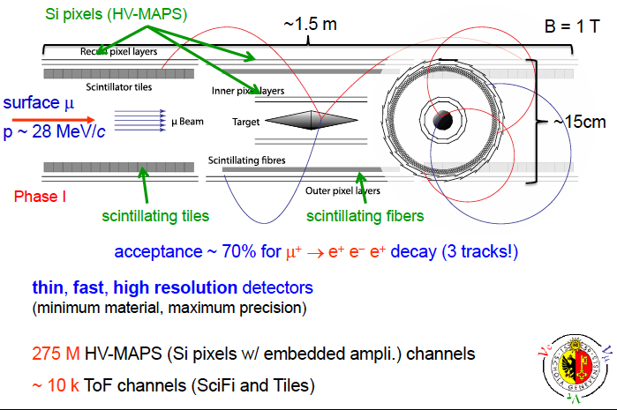
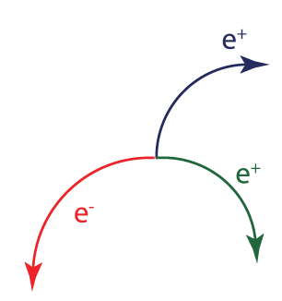
Mu3e
A.Bravar

Slide 19
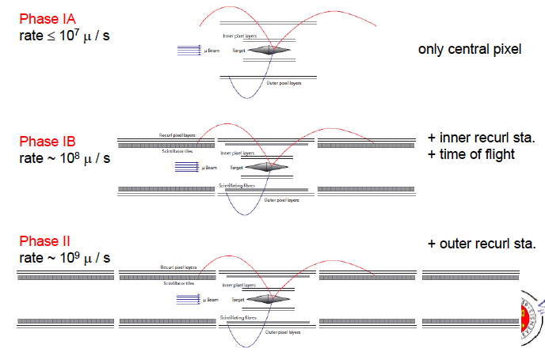
Mu3e Staging
A.Bravar

Slide 20
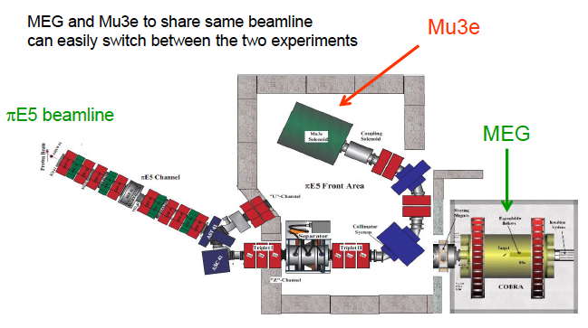
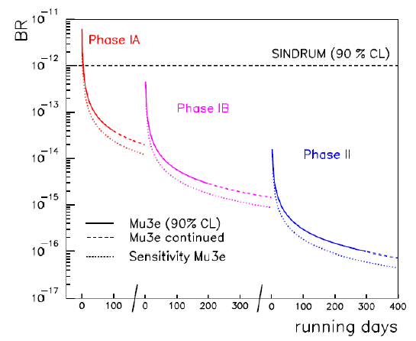
Mu3e Staging
A.Bravar

Slide 21
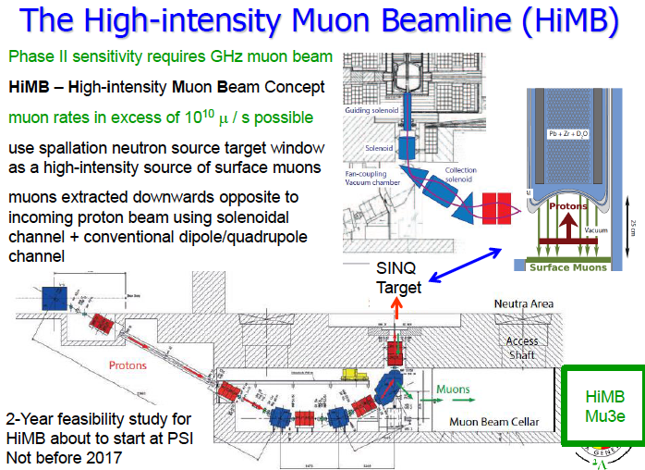
Mu3e Staging

Slide 22
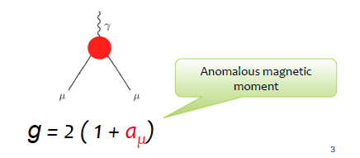
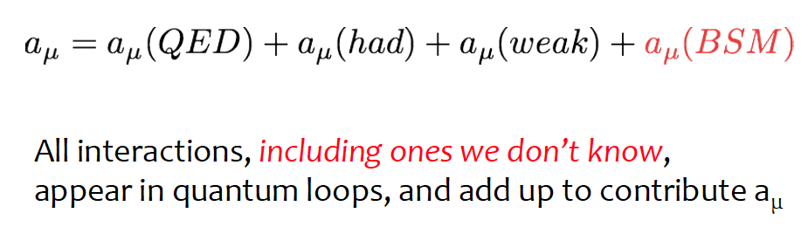
Muon g-2
Requires precision calculations of the standard model contributions to enable the next generation of experiments
Requires higher precision Measurements of uHFS
T.Mibe

Slide 23
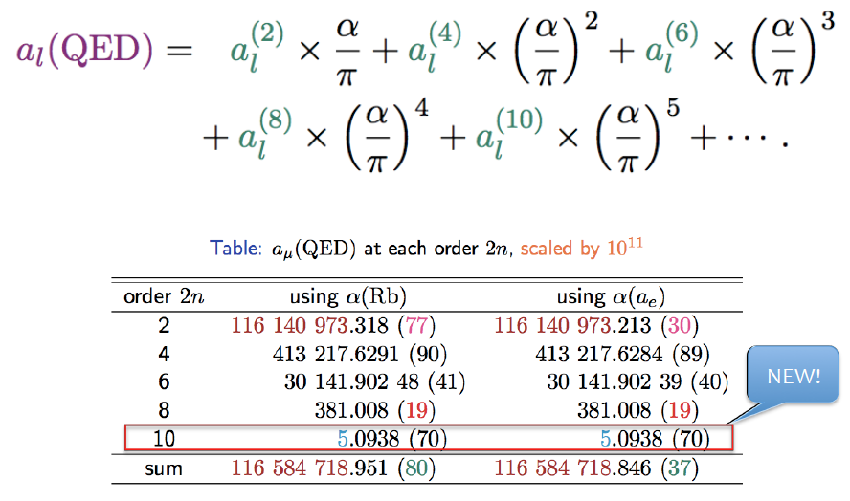
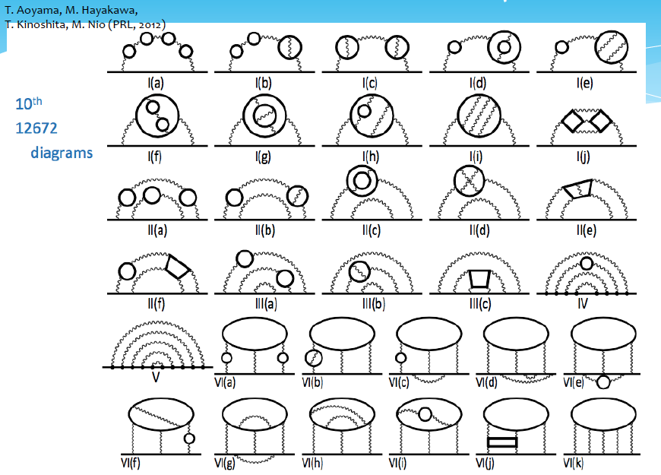
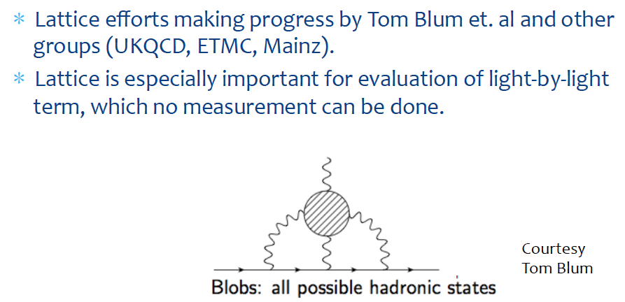
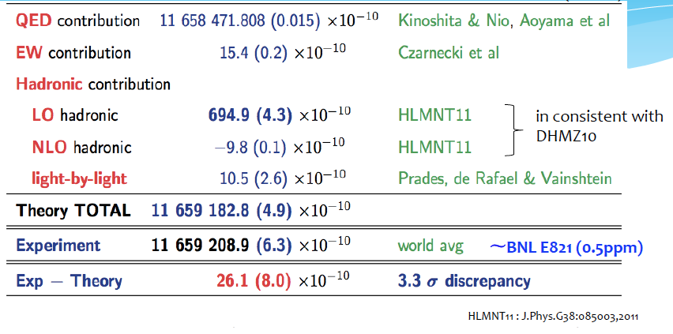
Muon g-2 Theory Improvements
T.Mibe

Slide 24
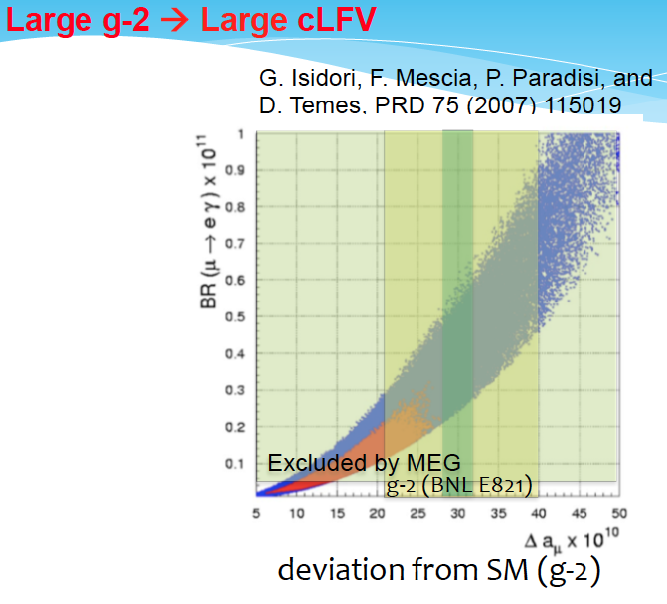
g-2/μEDM SUSY Tension
Tar
Combining g-2 with μ→eγ (cLFV) is already starting to provide tension for SUSY models
T.Mibe

Slide 25
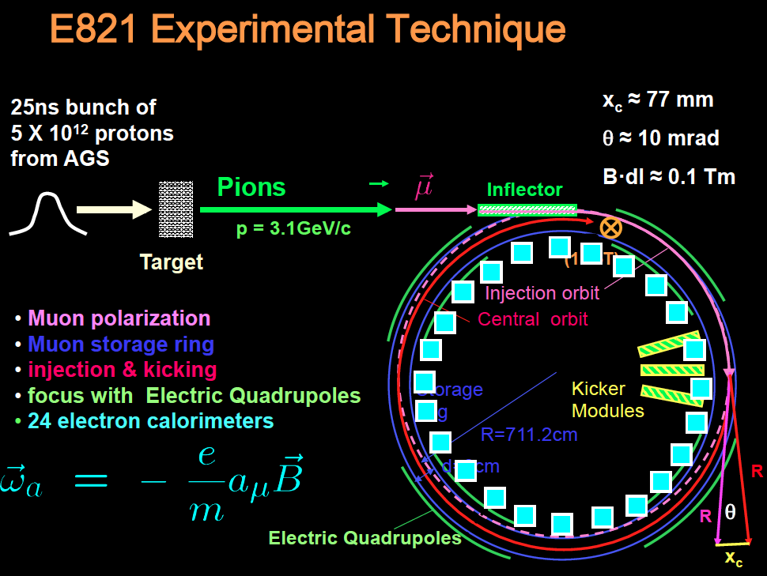
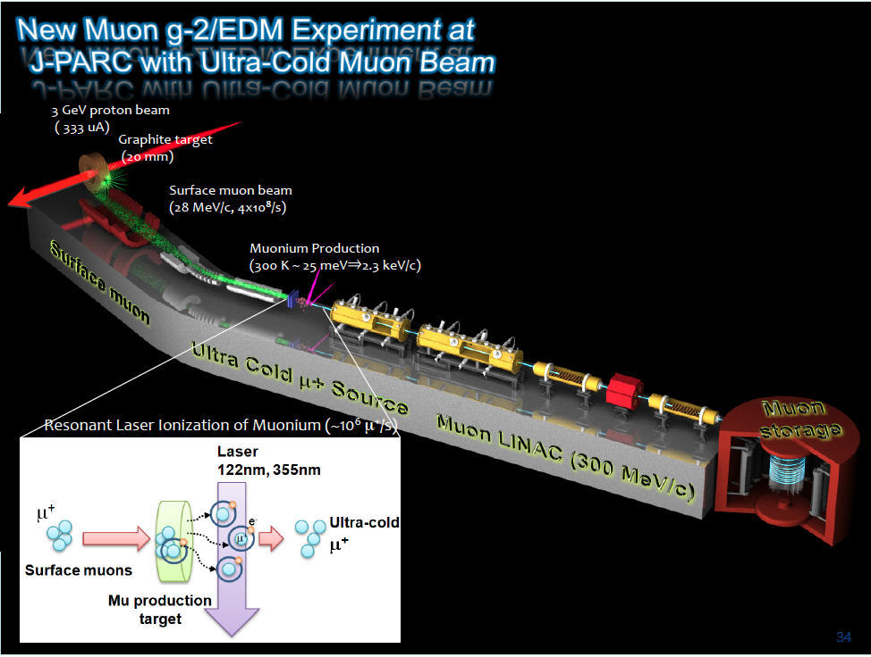
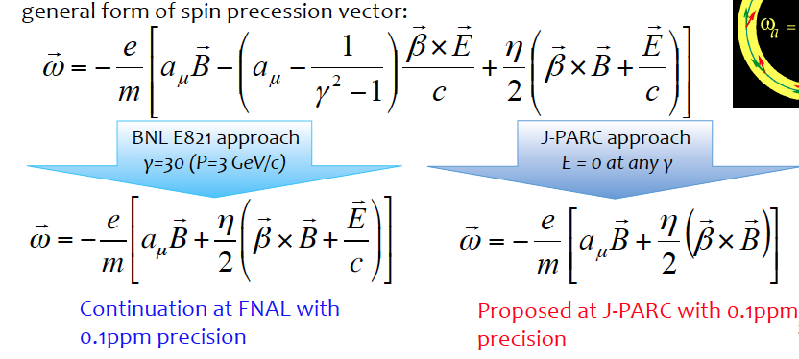
g-2 Techniques
Tar
Brookhaven/FNAL Magic Momentum
J-PARC Ultra Cold E=0
T.Mibe

Slide 26
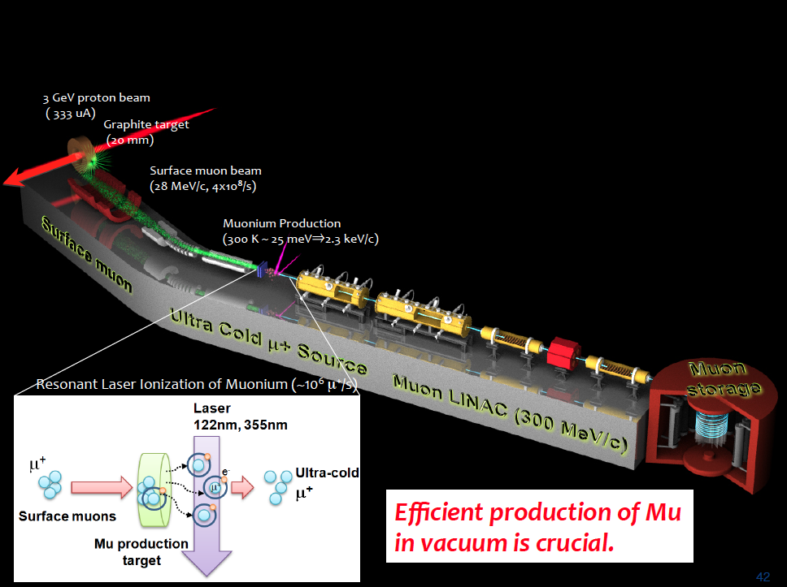
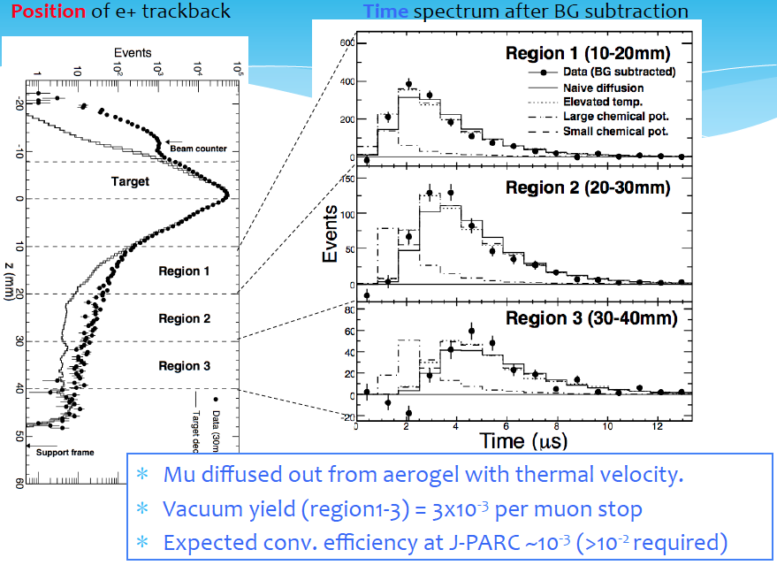
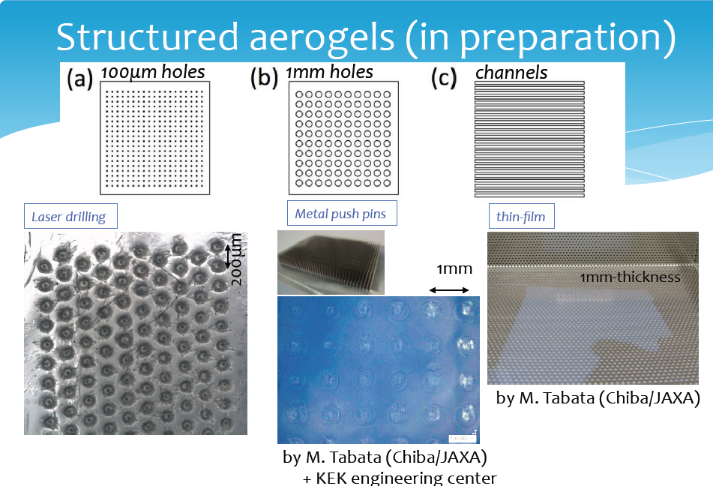
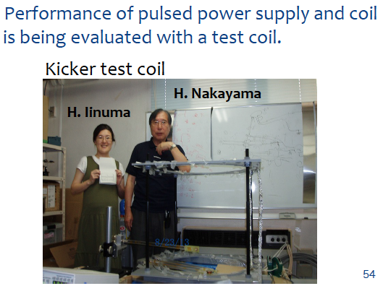
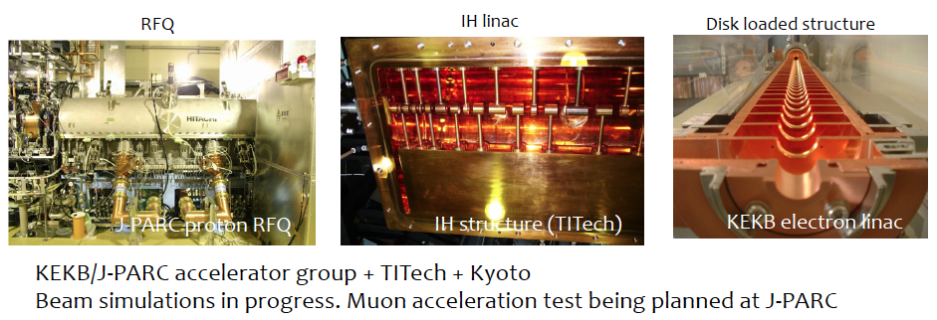
g-2 Cold Technique Progress
Tar
T.Mibe

Slide 27
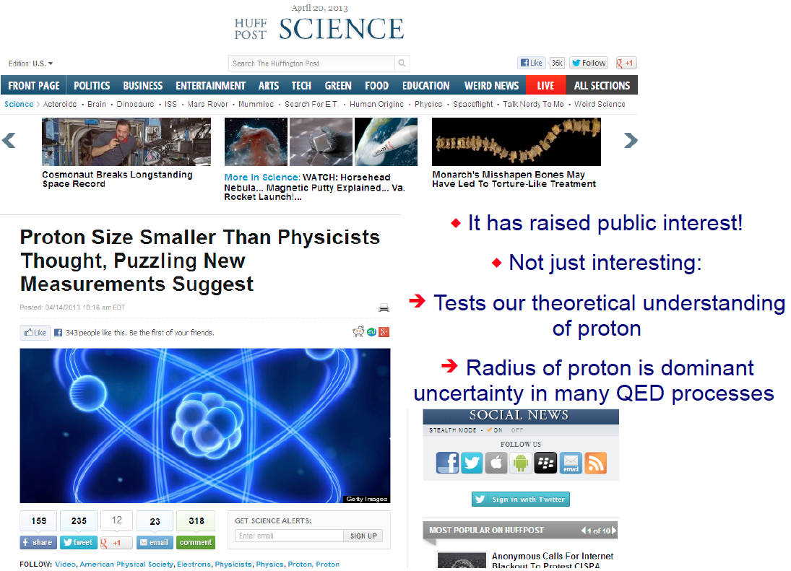
Proton radius problem

Slide 28
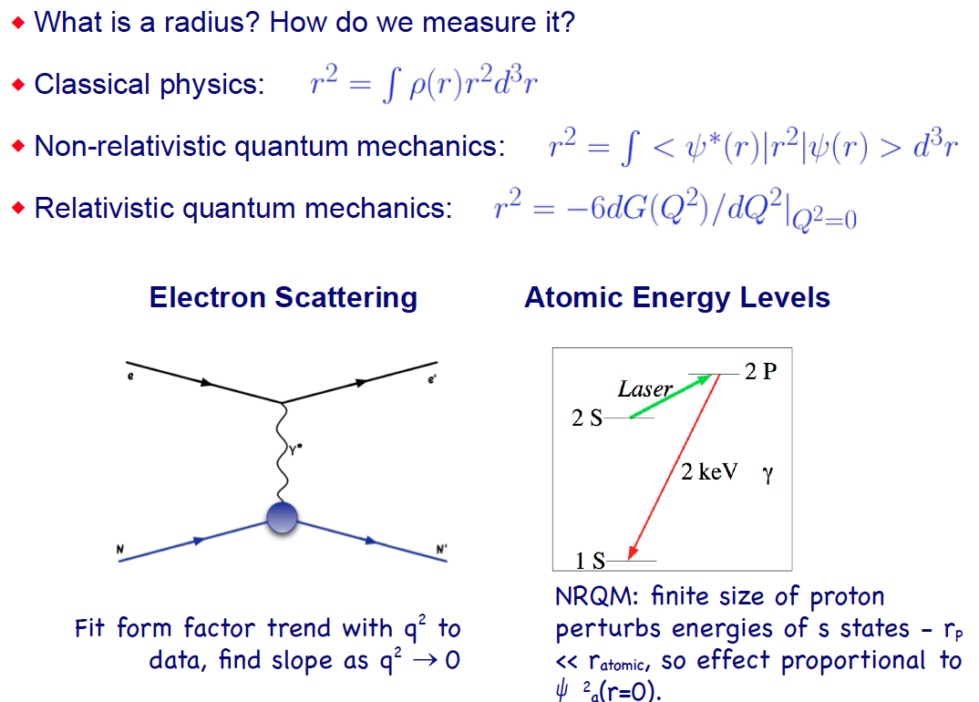
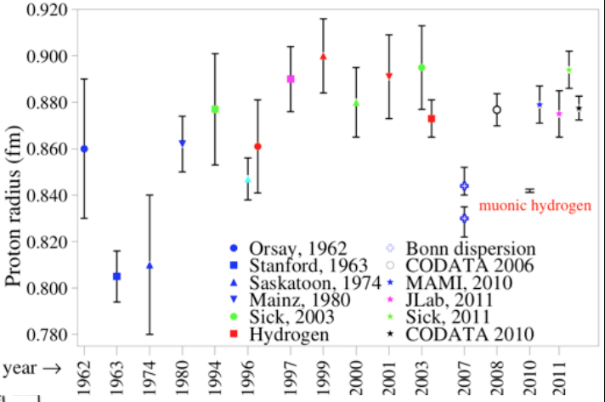
Proton radius problem
Major disagreement between eP scattering data/hydrogen energy levels and muonic hydrogen E levels
Two Distinct Methods for Measuring

Slide 29
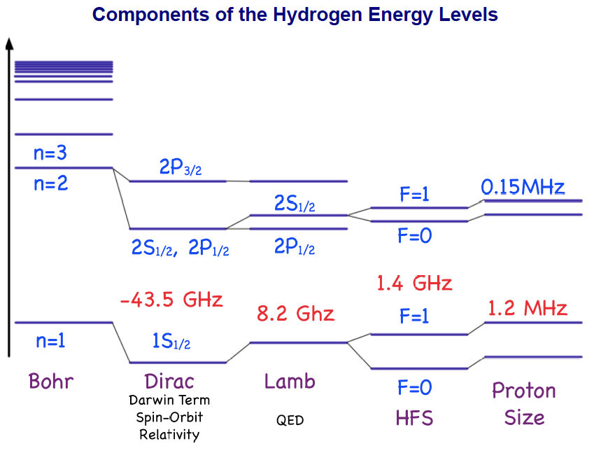
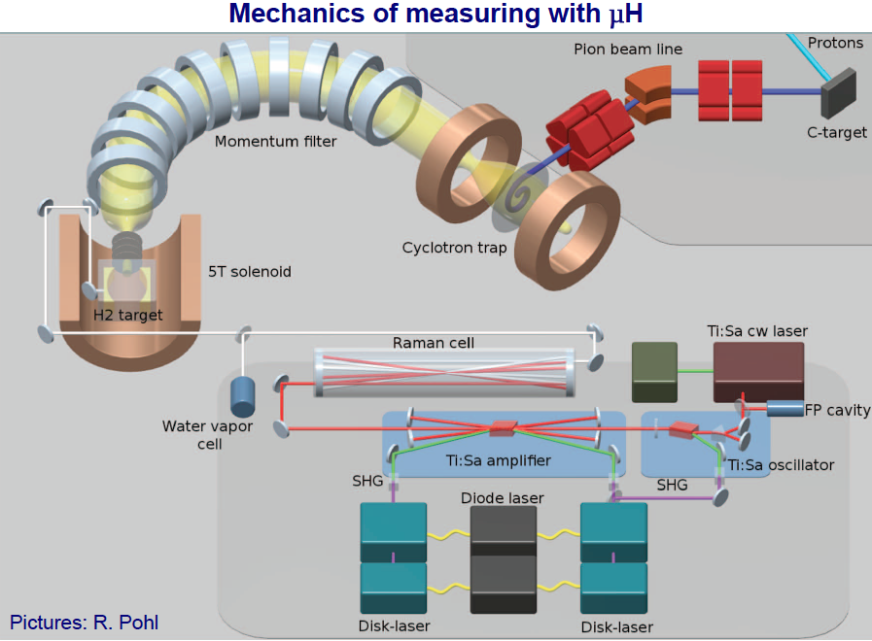
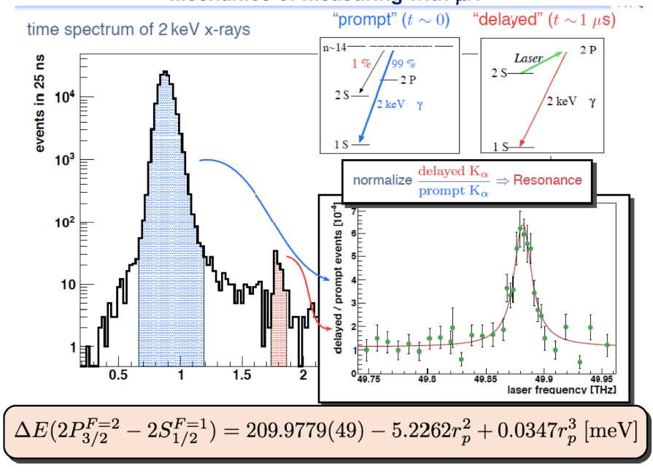
Proton radius problem
Simple, but technically challenging
Form μH
Excite from 2S to 2P
Vary laser freq to find transition peak
Extremely precise

Slide 30
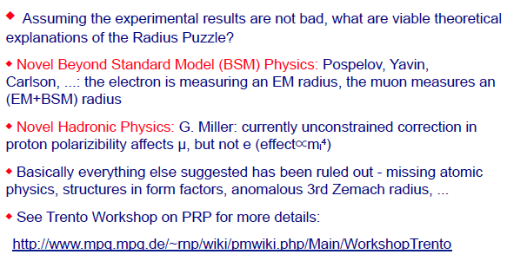
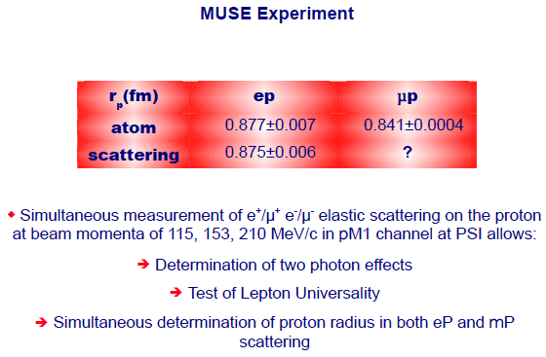

Why do μ’s & e’s give different radii?
Need to do μ p and
e p scattering side by side

Slide 31



JPARC MUSE Program
Multiple intense μ beamlines for cLFV, precsion measurements, ultra cold μ production etc…
K.Shimomura

Slide 32

JPARC MUSE Program Progress
K.Shimomura

Slide 33


JPARC MUSE Program Progress
Tremendous progress on all lines

Slide 34





Muon Hyper Fine Splitting (JPARC)
K.Tanaka

Slide 35



μN→eN Conversion
Z.You
Y.Yuan
A.J.Buras

Slide 36




Mu2e
Z.You
Advanced production solenoid designs
Updated tracking & New calorimeter designs
Charge symmetric calorimeter allows for improved track reconstruction and bkg rejection

Slide 37


Mu2e
Z.You
Improved background estimates and potential sensitivities

Slide 38



COMET
Y.Yuan
Phase I is now under construction
S.E.S ≈3x10⁻¹⁵
Measure real backgrounds
Advanced work detector components (straws & calor)

Slide 39


COMET Phase II
Improves on stage one by two orders of magnitude
S.E.S≈10⁻¹⁷
Significantly reduces backgrounds compared to Phase I detector
Y.Yuan

Slide 40



Prism/Prime

Slide 41

Mu2e & COMET
Y.Kuno

Slide 42

AlCap
Y.Kuno

Slide 43




ALCap
Measuring E spectrum down below current data (<40MeV)
Y.Kuno

Slide 44




DeeMee
Y.Nakatsugawa

Slide 45


DeeMee
Y.Nakatsugawa
Well under way for 2015 data taking

Slide 46


Beam Ideas (using g-2 @ FNAL)
Extract low energy π’s and μ’s from AP0 target without degredation of the π fluxed used by g-2
Beam produces μ’s with momentum up to ∼300 MeV/c
Allows for parasitic running of μ cooling experiments and materials science experiments

Slide 47
Questions moving forward for 2014
Three “Big” questions we want to address:
Expt: What is the ultimate μ→eγ and μ→eee reach once μN→eN has set the limit.
  What are the roles of the ratios of cLFV processes and other precision experiments at this point?
Beams: What are the beam specifications for muon physics? (our requirements)
  Are these compatible with the NuFact?
  Are there other options?
Theory: What else besides cLFV? EDMs?
  What does theory tell us once we observe cLFV?
  How do we relate our results to the models?

