Slide 1
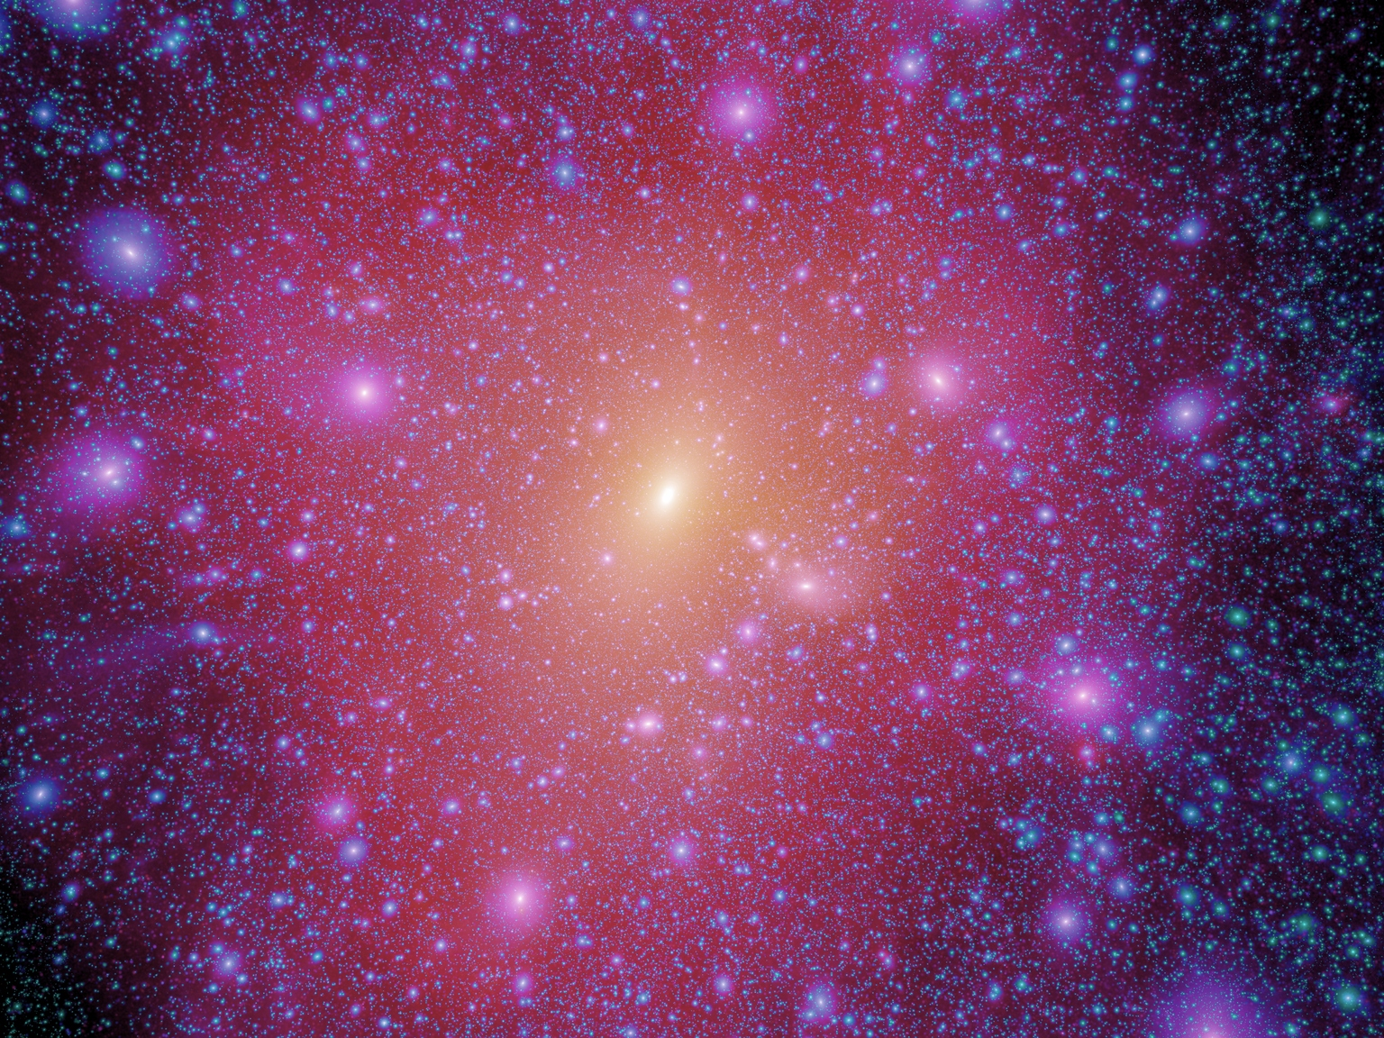

Neutrino Cosmology and Astrophysics
INSS Beijing August 2013
Jenni Adams
University of Canterbury, New Zealand
TexPoint fonts used in EMF.
Read the TexPoint manual before you delete this box.: AAAAAAAAA

Slide 2
Lecture Plan:
Neutrino Cosmology
High Energy Astrophysical Neutrinos
Supernova Neutrinos

Slide 3
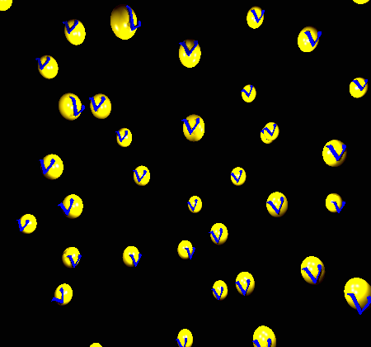
Neutrino Cosmology
There is a cosmic background neutrino
population which is a relic from the
early universe
The neutrino background affects cosmological processes
  Primordial nucleosynthesis
  Cosmic microwave background
  Large structure formation
Observations probing these processes give us information about neutrinos
It is important to include the neutrino background effects to be able to interpret observations and learn about other constituents of the universe

Slide 4
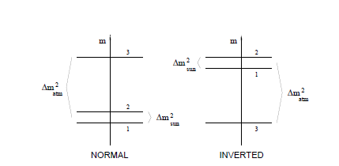
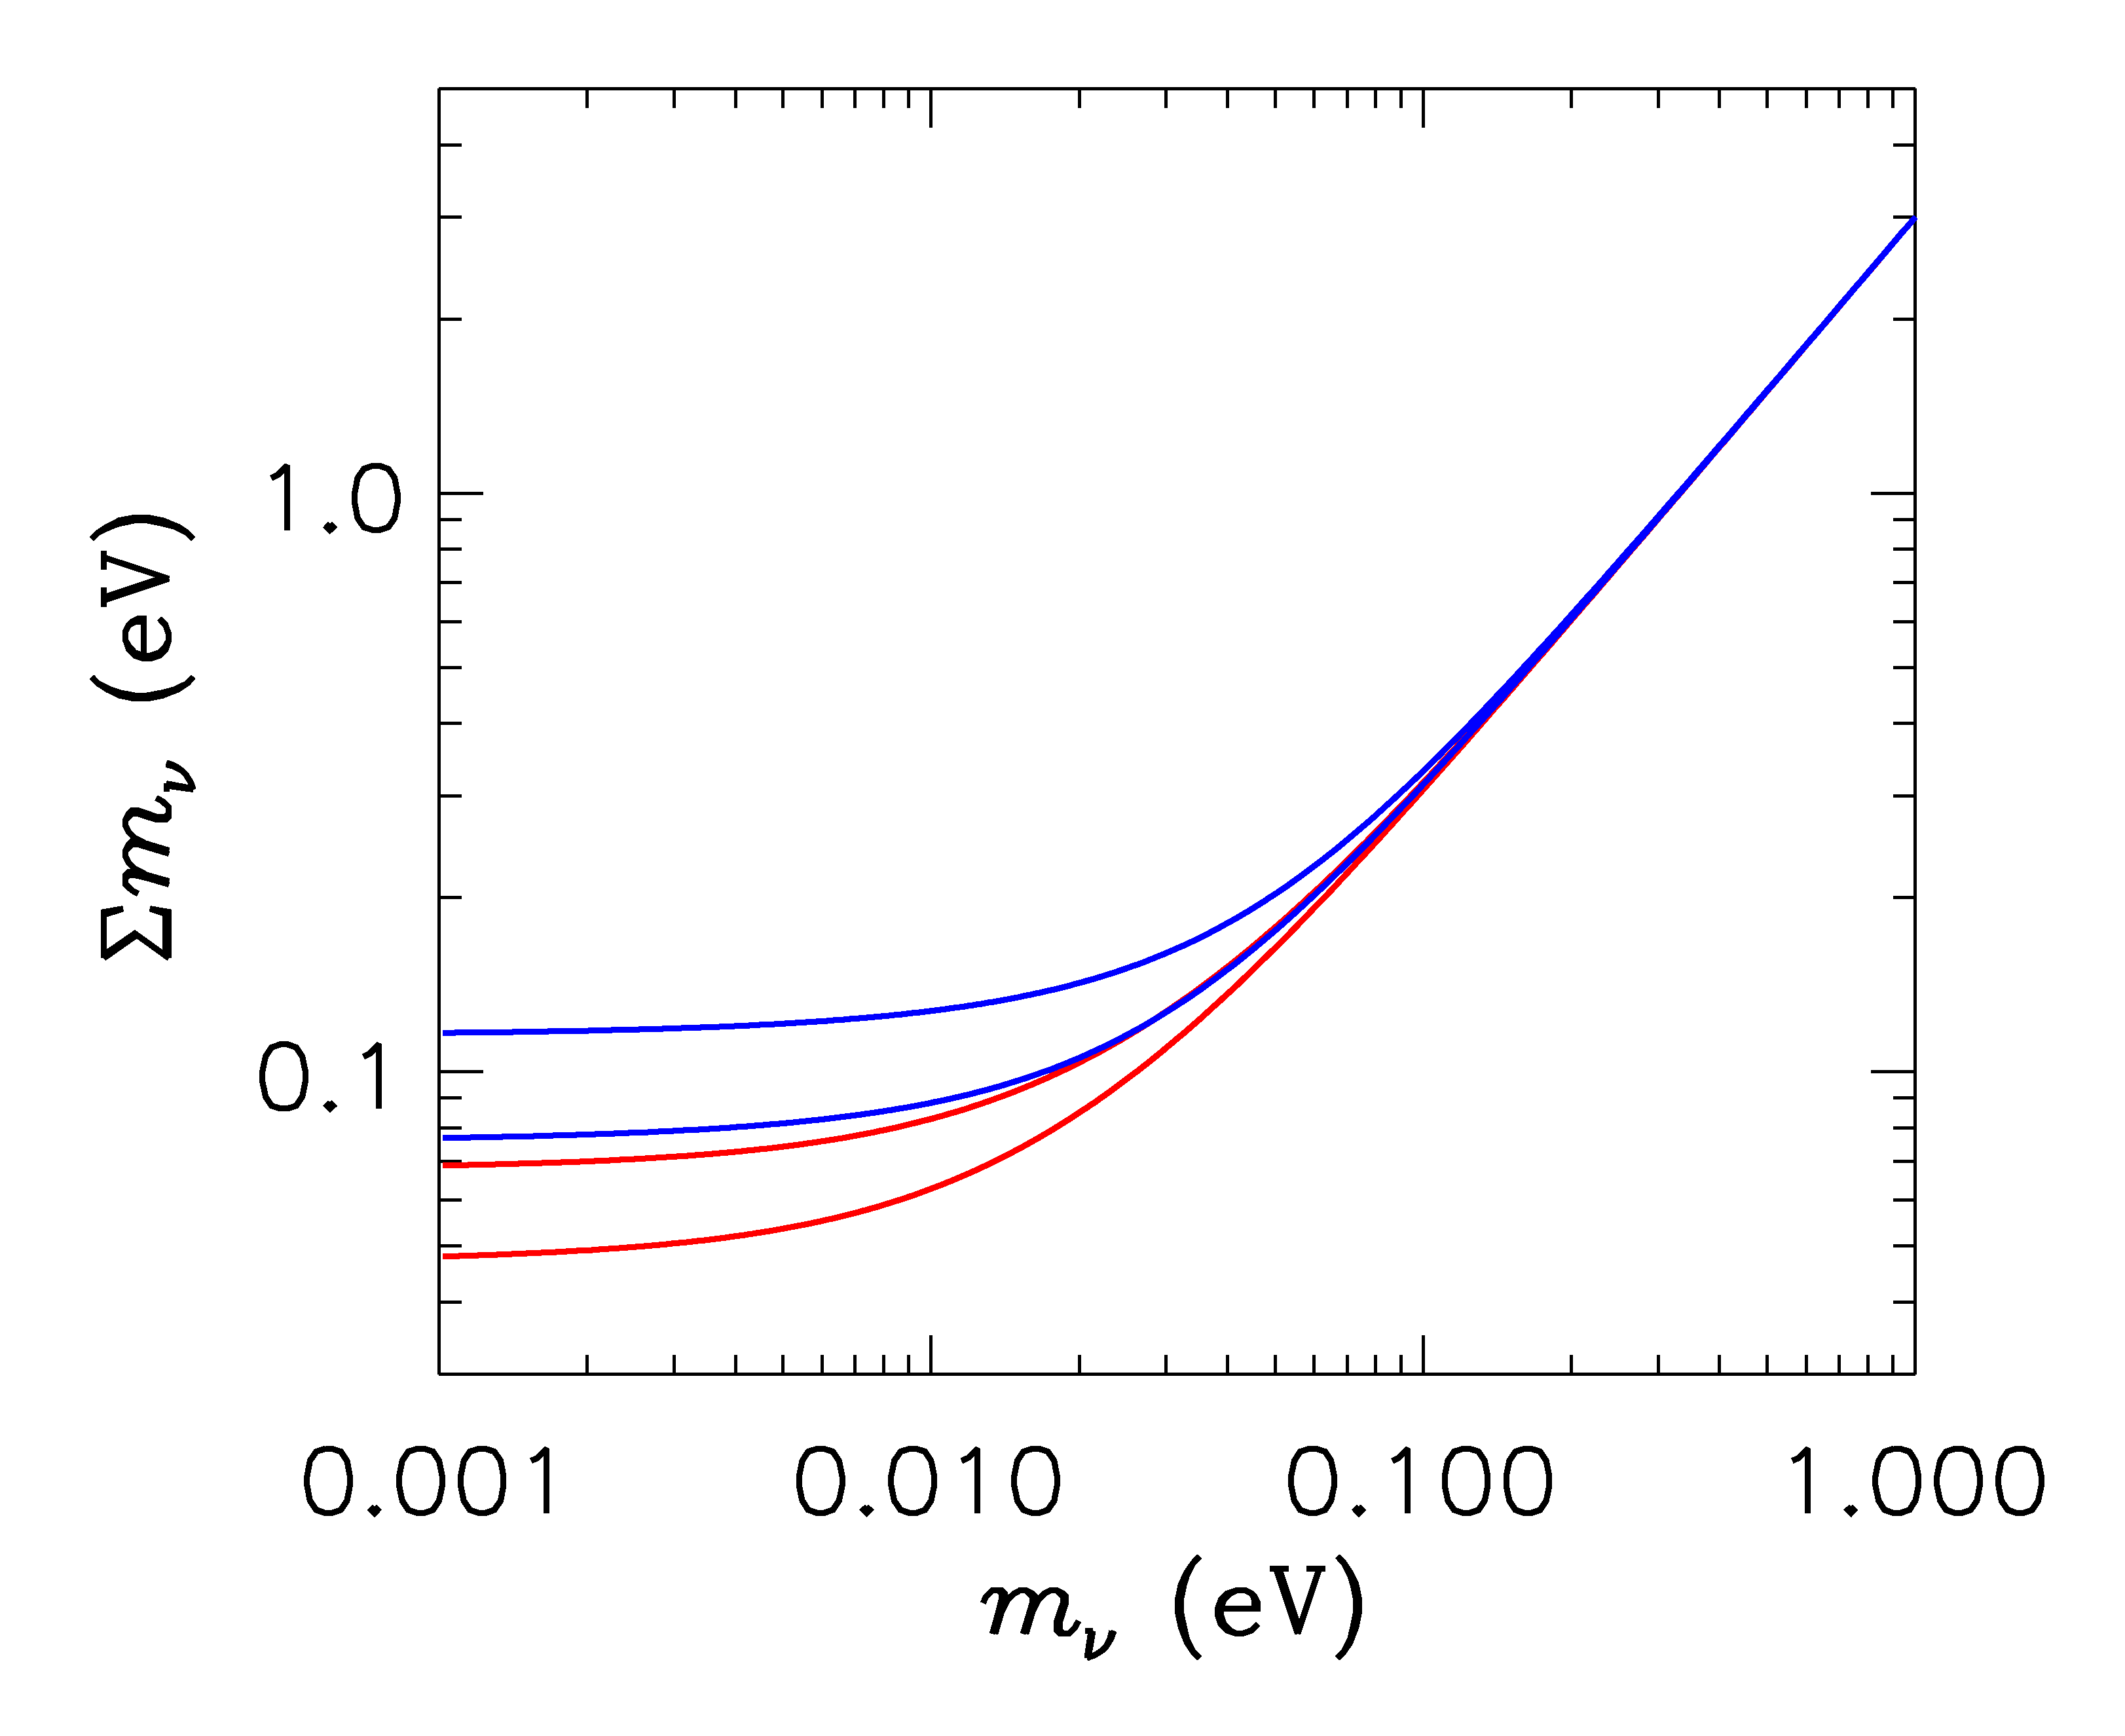
Neutrino mass sum
HIERARCHICAL
DEGENERATE
INVERTED
NORMAL
LIGHTEST
Lesgourgues and Pastor 2006

Slide 5
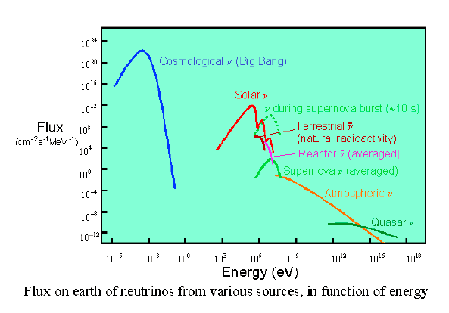
Neutrino Sources

Slide 6
Neutrino Sources

Slide 7
Cosmology Basics

Slide 8
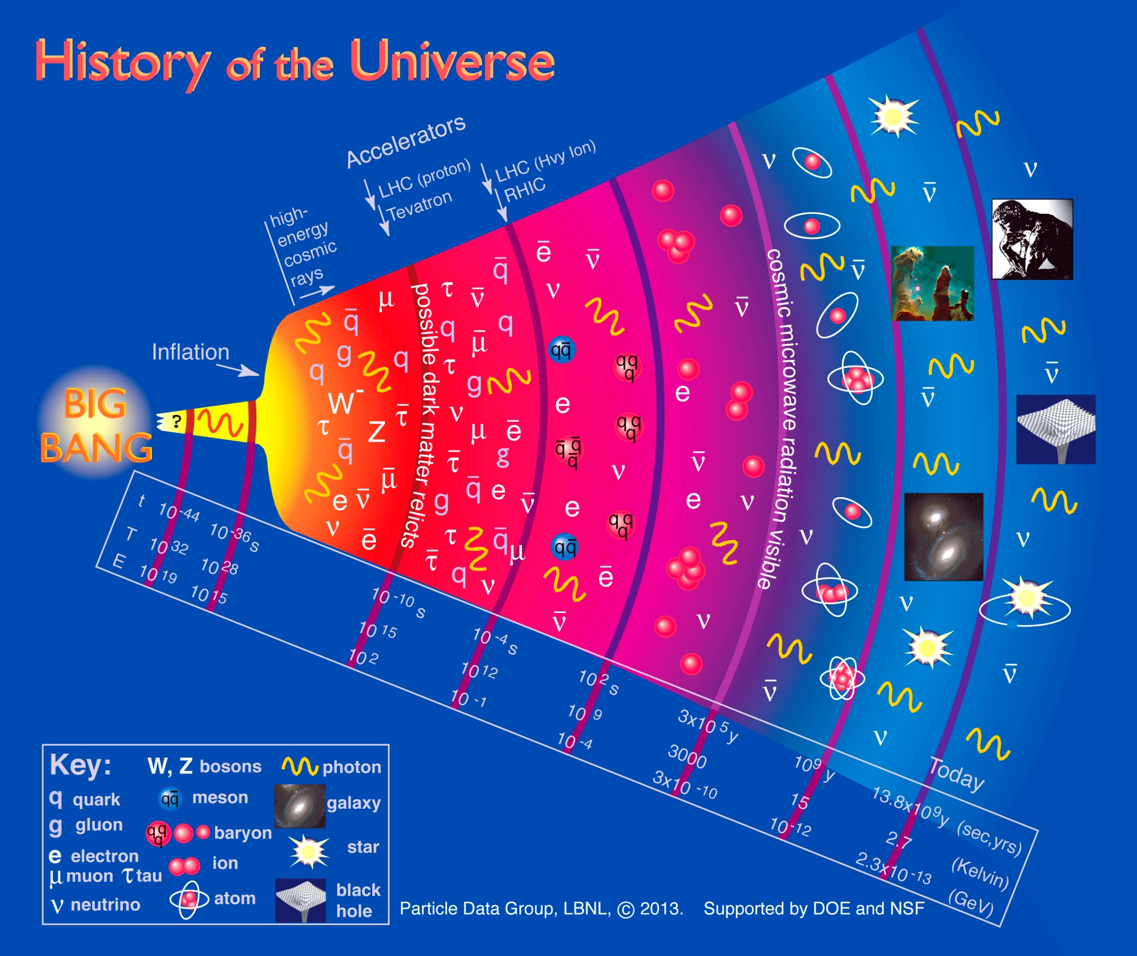

Slide 9
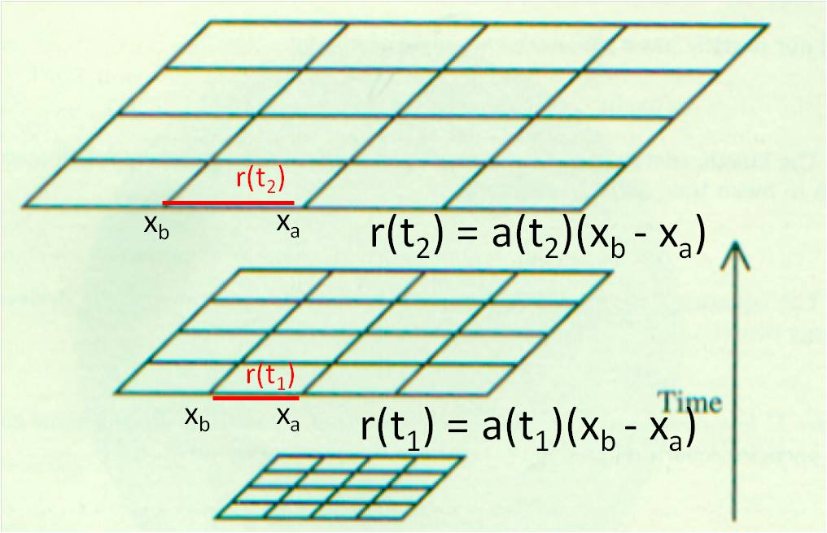
Universe Evolution
Einstein equations
+
Assumption of homogeneity and isotropy
Friedmann equation
=

Slide 10
Universe Evolution
Expansion of the universe “stretches” the wavelength of particles...
Proper momentum of a point particle
measured by a comoving observer
is redshifted:
For photons
t = t₀ today
Observed
wavelength
Redshift parameter
Emitted
wavelength

Slide 11
Critical density k = 0

Slide 12
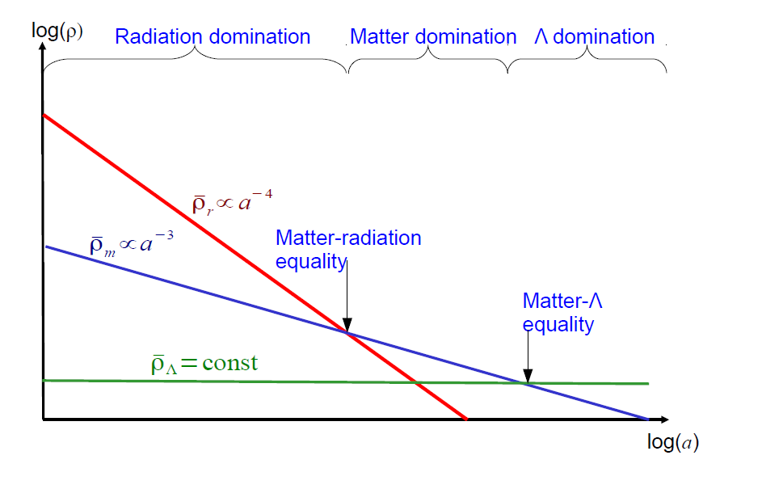
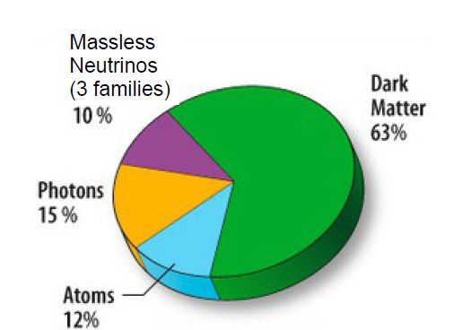
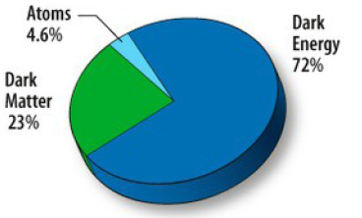
Evolution of the constituent energy densities
At decoupling
today

Slide 13
Early Universe was Hot and Dense

Slide 14
Particle interactions
Equilibrium when

Slide 15
In equilibrium
Participating particles have phase space distributions:
+1 Fermi-Dirac
-1 Bose-Einstein

Slide 16
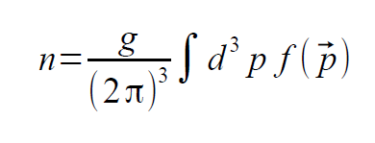
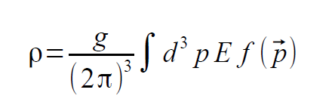
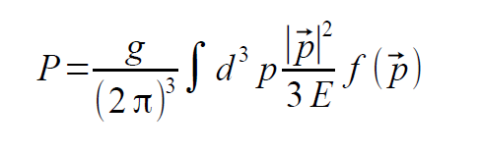
And
Number density
Energy density
Pressure
g is the number of spin states

Slide 17
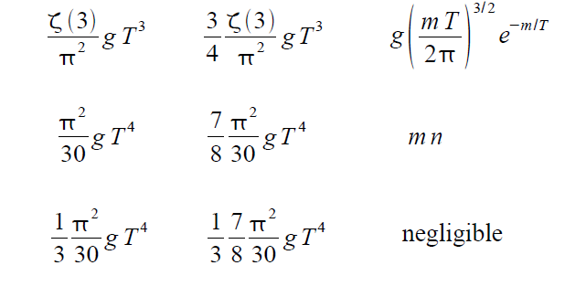
Which yields
Relativistic Non-relativistic
Bose-Einstein Fermi-Dirac
Number density
Energy density
Pressure

Slide 18
Entropy

Slide 19
Freeze-out
As the temperature drops the interaction rate for particle interactions also drops
A particle is said to decouple or freezeout when all of its interactions satisfy
More careful investigations requires tracking processes with a Boltzmann equation

Slide 20
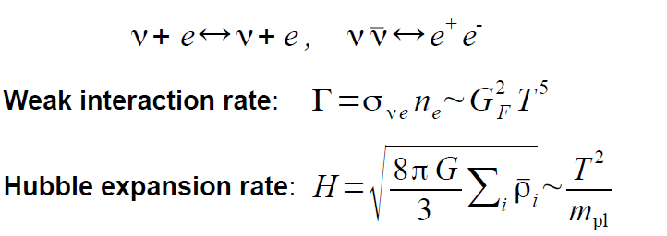
Neutrino Freezeout
Equating these quantities gives

Slide 21
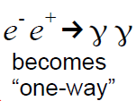
Neutrino temperature
At neutrino decoupling the neutrino bg temperature and the photon bg temperature are the same
Subsequently
which increases the temperature of the photons but not the neutrinos

Slide 22
Photon temperature increase
Entropy
Entropy before electron positron annihilation
Entropy after electron positron annihilation

Slide 23
“Happy is he who gets to know the reasons for things.”
Virgil (70 – 19 BC; Roman poet)

Slide 24
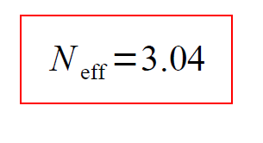
Corrections
Actually some neutrinos are still coupled when the annihilation occurs and
There are finite temperature QED effects
The correction is usually expressed through N_{eff}
Total energy density in radiation

Slide 25
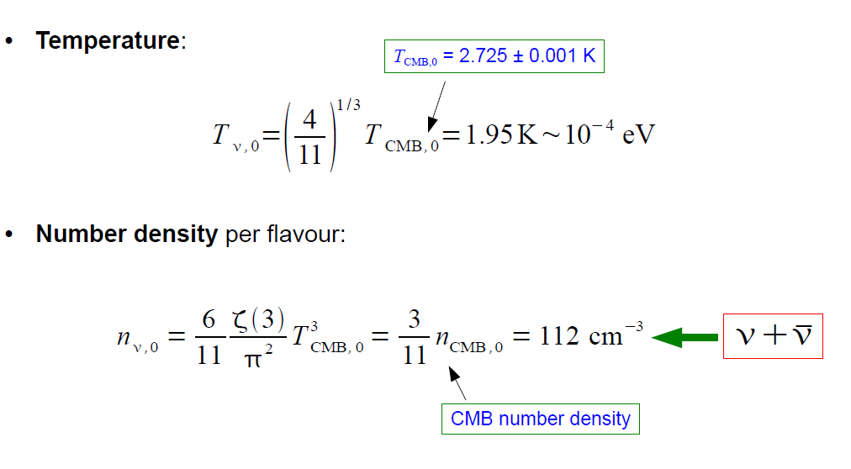
Summary

Slide 26
Evidence for cosmic neutrinos....indirect
Big Bang Nucleosynthesis
Imprint on CMB and large scale structure
Can use observations to constrain N_{eff} and the Σ mass

Slide 27
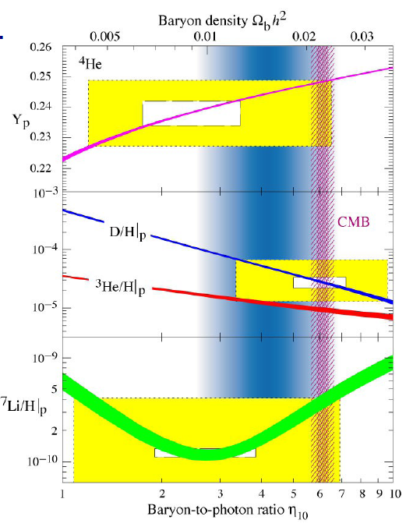
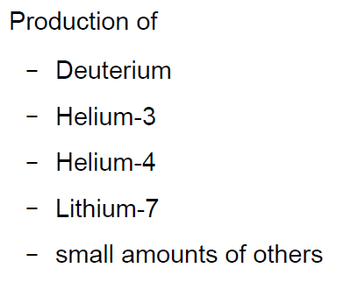

Nucleosynthesis

Slide 28
Two steps
Step 1: Neutron/proton ratio set
Step 2: Nuclei formation

Slide 29
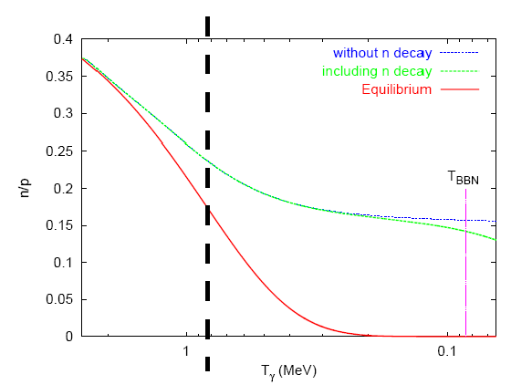
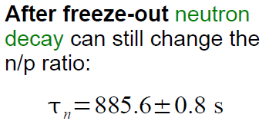
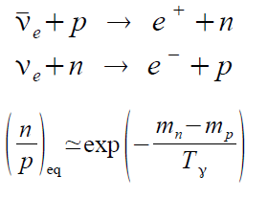
Neutron/proton ratio
Freezeout of interactions

Slide 30
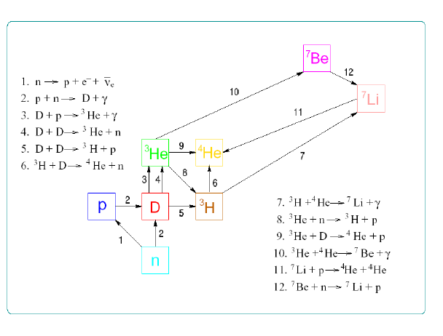
Nuclei Formation
Starting time is set by the baryon-photon ratio η

Slide 31
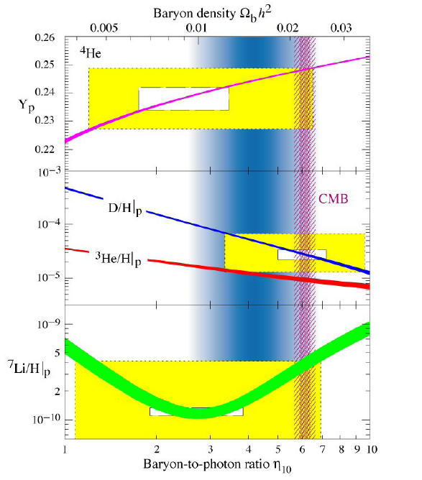
Standard BBN predictions

Slide 32
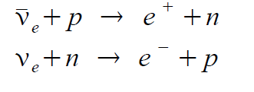
Neutrinos
Affect the expansion rate
Universe is radiation dominated so neutrinos part of dominant component
Higher expansion rate means higher freezeout temperature and greater n/p ratio
Also affect the weak interactions (come back to this)

Slide 33
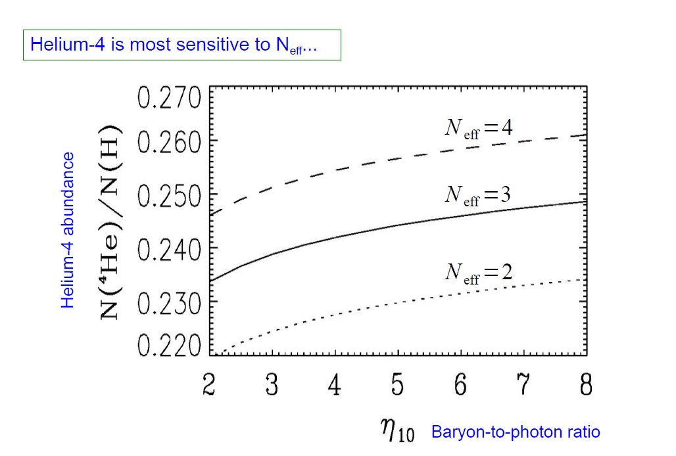

Slide 34
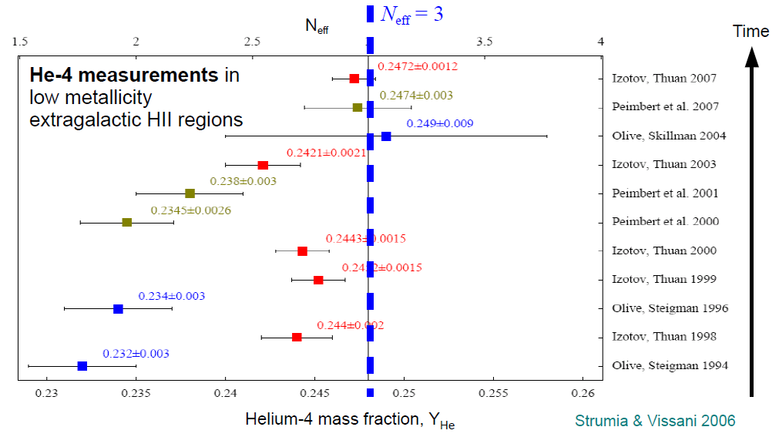

Slide 35
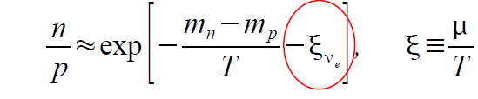
Neutrino chemical potential
If there is an asymmetry in the neutrino-anti-neutrino number density it will affect the n/p ratio through the interactions:
.
n/p decreased

Slide 36

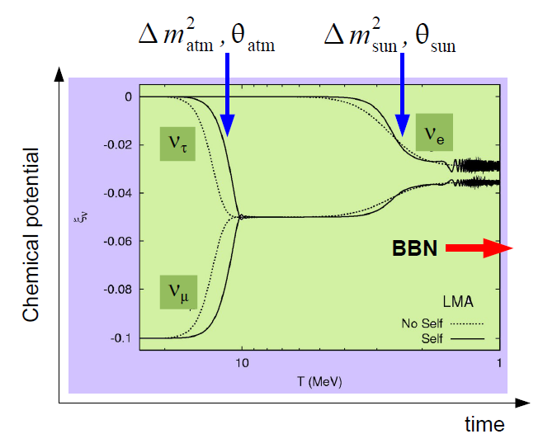
Neutrino chemical potential
.
Raffelt and Serpico 2004
Applies to all flavours
as oscillations
equilibrate all
asymmetries
Dologov et al 2002
Wong 2002
Abazajin et al 2002

Slide 37
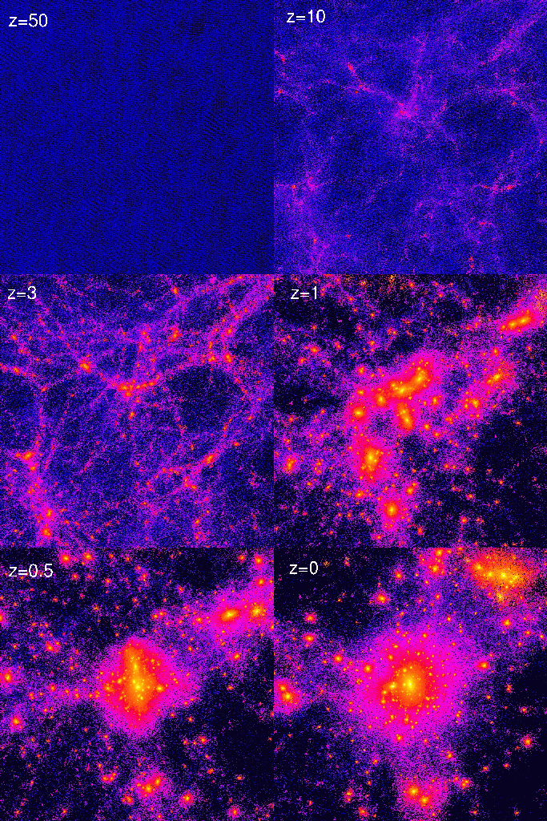
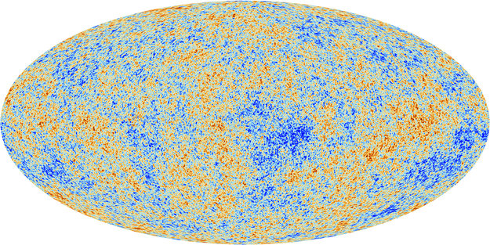
CMB and Large Scale Structure

Slide 38
Inhomogeneities
Obtain equations governing evolution of matter and metric inhomogeneities by perturbing Einstein equation
(yields rate of growth (or not) in different regimes)
Plus Boltzmann equations for various forms of matter/energy
See
J. Lesgourges and S. Pastor, Massive neutrinos and cosmology, Phys. Rep. 429 (2006) [astro-ph/0603494]
for a thorough account specifically highlighting the effect of neutrinos

Slide 39
Descriptive account of structure growth
Inflation leads to the early Universe having tiny random fluctuations in density
Fluctuations only start evolving when they are within the horizon

Slide 40
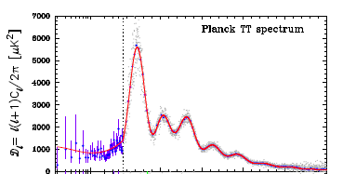
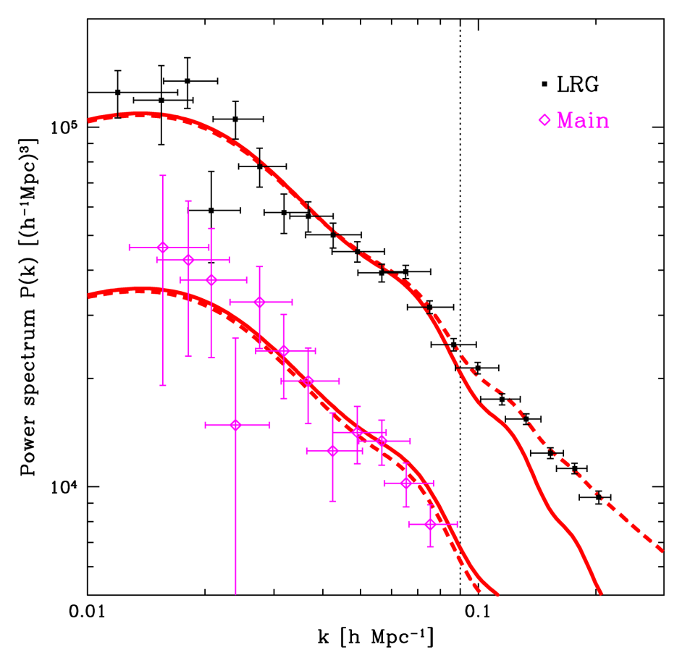
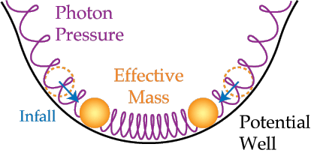
Descriptive account of structure growth
When photons and baryons are coupled, competition between gravitational attraction and radiation pressure leads to acoustic oscillations

Slide 41
After decoupling
Baryons fall into dark matter potential wells
Density contrast grows by gravitational instability

Slide 42
Temperature fluctuations
Denser regions hotter
Photons climbing out of potential wells are redshifted (intrinsic Sachs Wolfe)
Doppler shift for photons scattered from moving electrons
Integrated Sachs Wolfe
Gravitational Lensing
.....

Slide 43

Sachs-Wolfe Effect
The Sachs Wolfe effect refers to the temperature difference in the CMB due to gravitational redshift
  Non-integrated Sachs-Wolfe is the redshift due to the gravitational potential wells at the time of last scattering
  Integrated Sachs-Wolfe occurs between the surface of last scattering and observation and only occurs when the Universe is not dominated by matter. When the Universe is matter dominated gravitational potential wells do not evolve much in the time that photons traverse them (so blueshift as falling in and redshift climbing out cancel)
    Early Integrated Sachs-Wolfe occurs soon
    after last scattering when the radiation
    density of the Universe is non-negligible
    Late-time Integrated Sachs Wolfe occurs
    when the cosmological constant is dominant

Slide 44
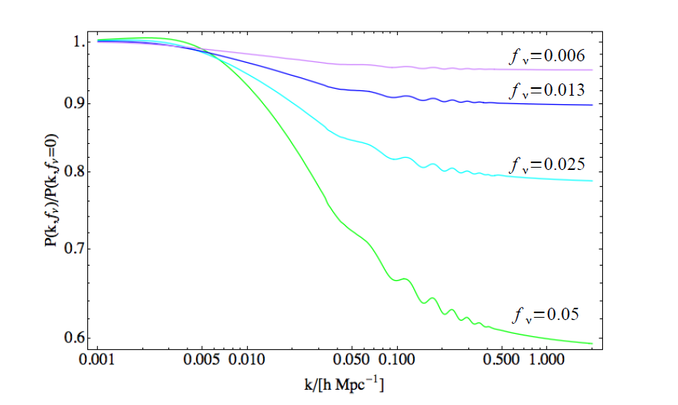
Neutrino effects
Neutrinos free stream – they fly out of overdensities. This damps small scale structure

Slide 45
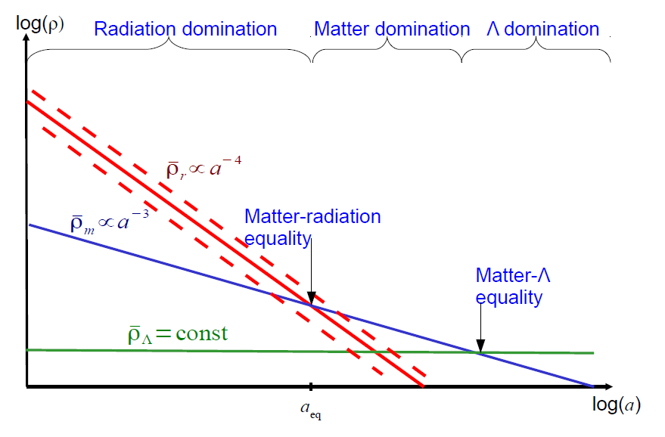
Neutrino effects
Neutrino component affects matter-radiation equality epoch

Slide 46
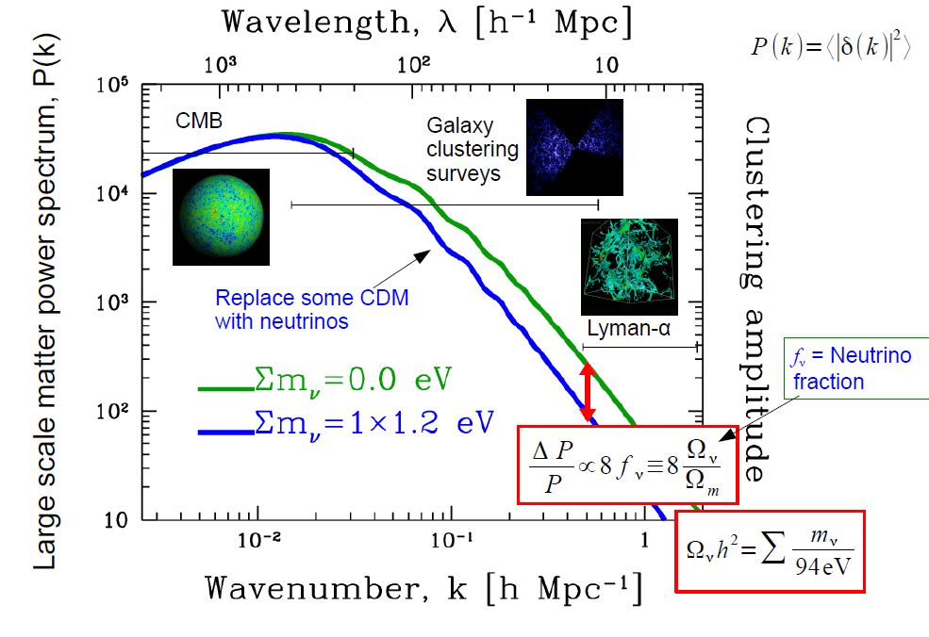
Slide from Yvonne Wong

Slide 47
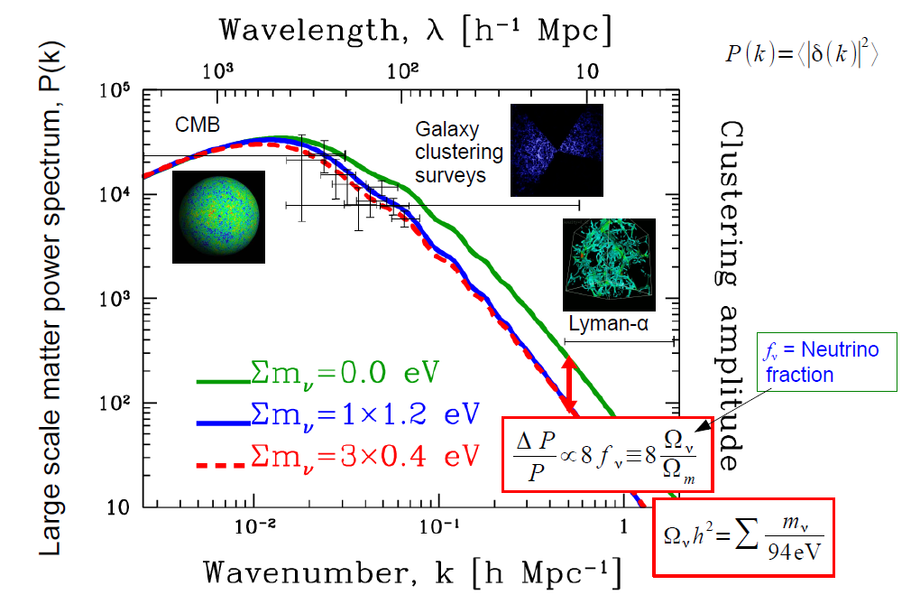
Slide from Yvonne Wong

Slide 48
Neutrino effects
Prior to Planck the dominant effect from neutrino mass on the CMB was on the early integrated Sachs Wolfe effect.
“The Planck data move us into a new regime where the dominant efect is from gravitational lensing.”

Slide 49
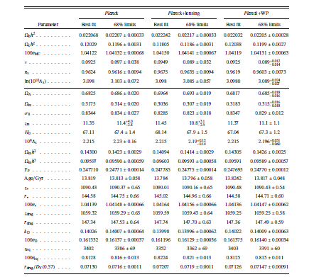
Planck 2013 Results
Planck Collaboration, Planck 2013 results. XVI Cosmological parameters
arxiv:1303.507

Slide 50
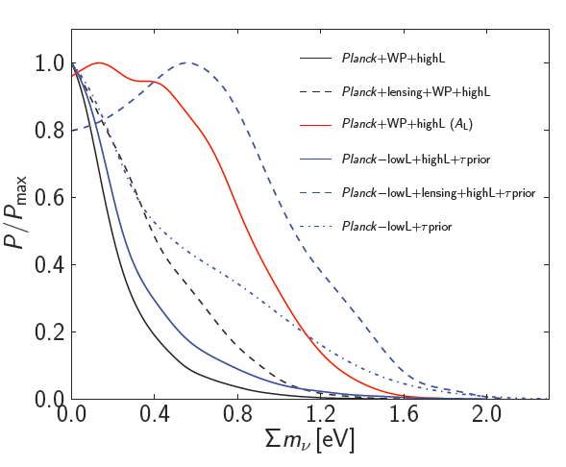

Planck 2013 Neutrino mass

Slide 51
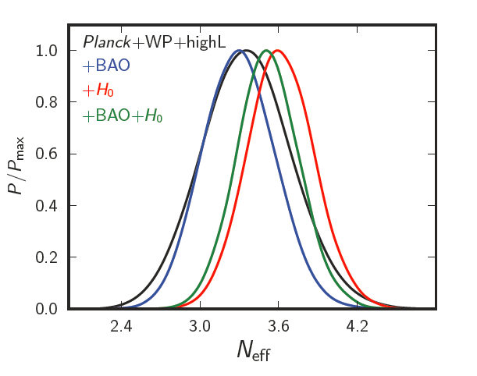

Planck 2013 N_{eff}

Slide 52
References
A.D. Dolgov, Neutrinos in Cosmology, Phys Rept. 370 (2002) 333 [hep=ph/0202122]
J. Lesgourges and S. Pastor, Massive neutrinos and cosmology, Phys. Rep. 429 (2006) [astro-ph/0603494]
S. Hannestad, Primordial neutrinos, Ann. Rev. Nucl. Part. Sci. 56 (2006) 17 [hep-ph/0602058]
Y.Y.Y. Wong, Neutrino mass in cosmology: status and prospects, Ann. Rev. Nul. Part. Sci. 56 (2006) 137 [hep-ph/0602058]

