Slide 1
Tracking Results of
COFFEE3 Beam Test @SPS
XU Zijun, LI Yiming, ZHANG Hui, LIU Kang, WANG Boxin, CAI Yuman, LI Qinze, YUAN Yuan, FU Yisheng, SHI Tianyu
CEPC ITK Group Meeting, 23rd June 2026

Slide 2
Beam Test Introduction
Beam in SPS H6
  Energy: Hadron beam with energy ~ 120GeV
  Time: 13rd to 20th May
Device Setup
  Setup 1: Seperate boxes for beam monitor(BM) and COFFEE3 system
  Setup 2: BM and COFFEE3 system in one box(~6pm on 19th to 7am on 20th)

Slide 3
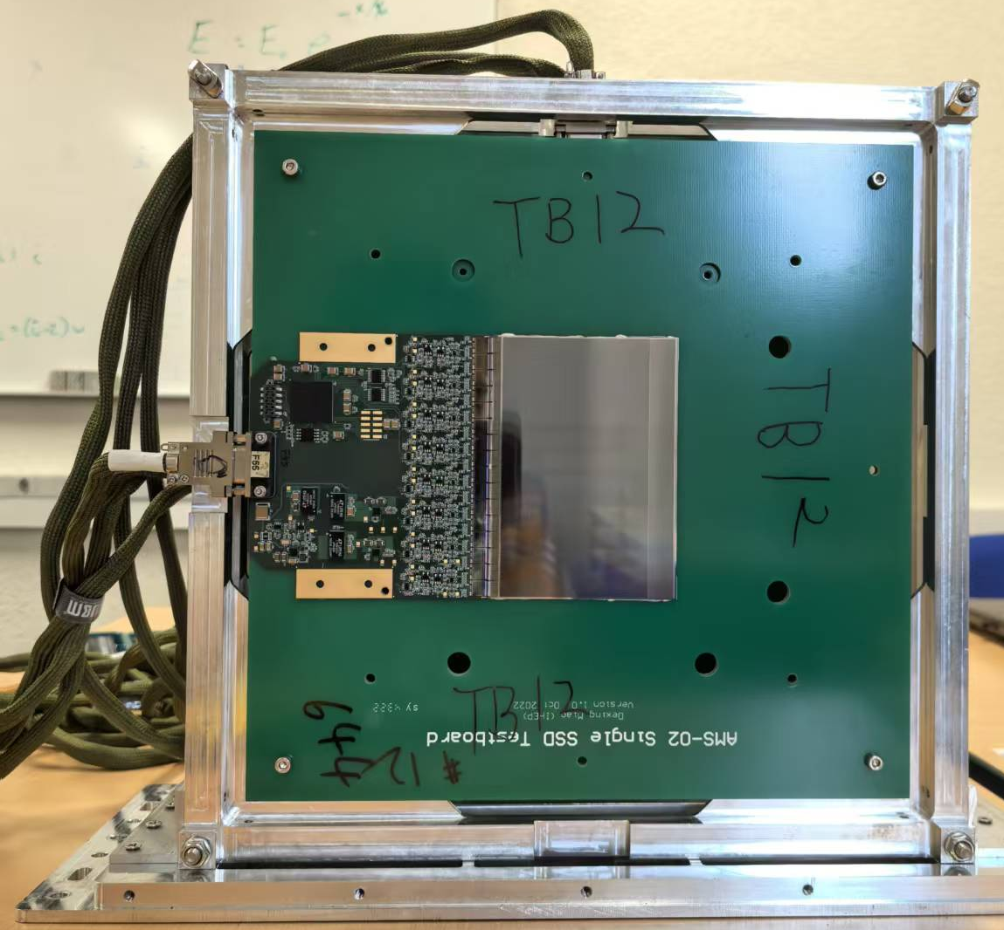
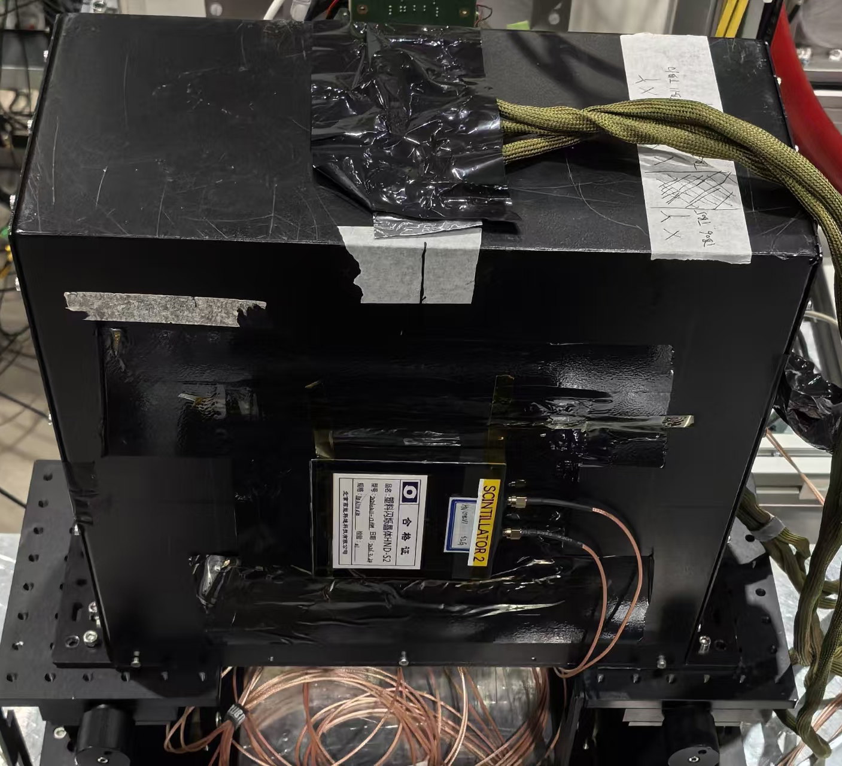
Beam Monitor(BM)
Six Silicon Strip Detector (SSD) test boards:
  Each is composed of an 11.3×8cm² sensor and readout electronics
  With strips perpendicular(parallel) to the ground, horizontal(vertical) position of a track can be measured, referred to X(Y) layer
  Three groups of “vertical + parallel” were used
A “plastic scintillator + pre amplifier” module upstream and downstream the BM
  Scintillator sensitive area of 10×10cm²
  Coincidence of two scintillators as trigger
Y
Not to scale
X
scint
scint
Beam
6cm
Silicon Strip Detector
11.3 × 8 cm²
scintillator module
strips direction now

Slide 4
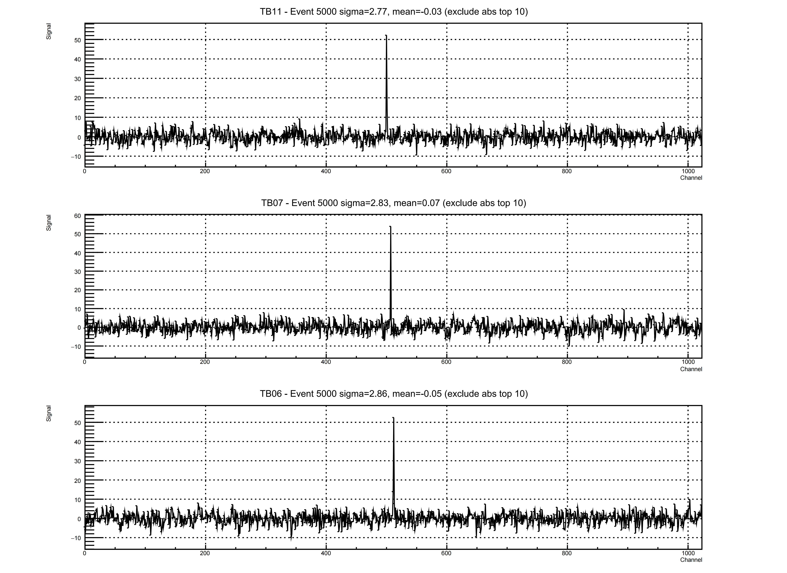
Signal of BM
The signals of three X layers in an event
  Signals of 1024 channels, with common mode noise substracted
  Signals of the channels not fired behave like random noise

Slide 5
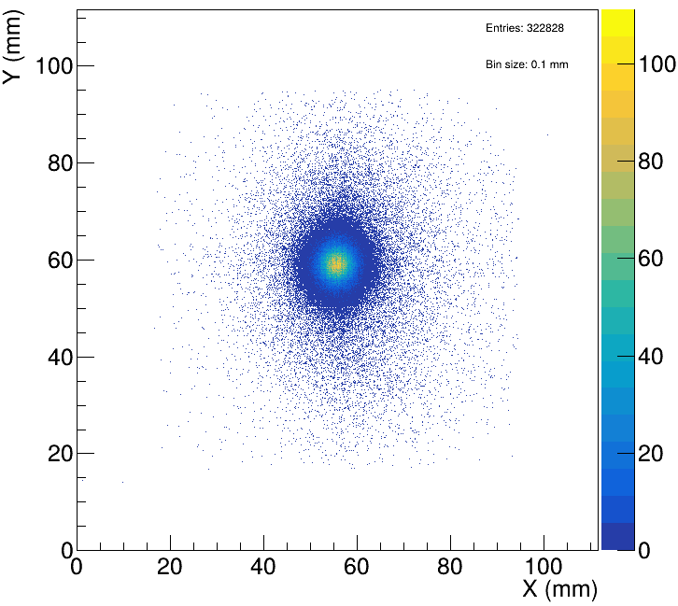
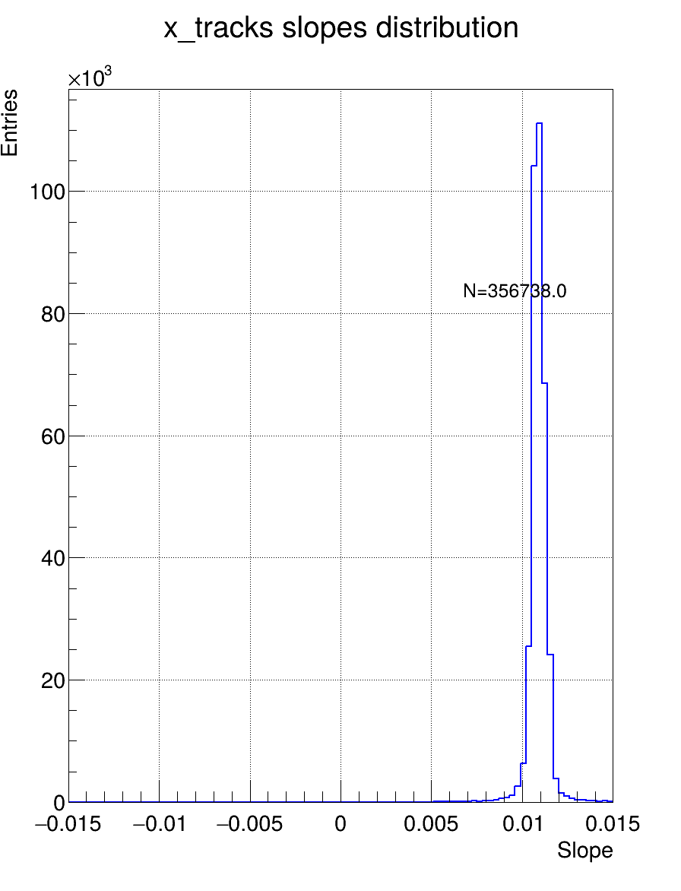
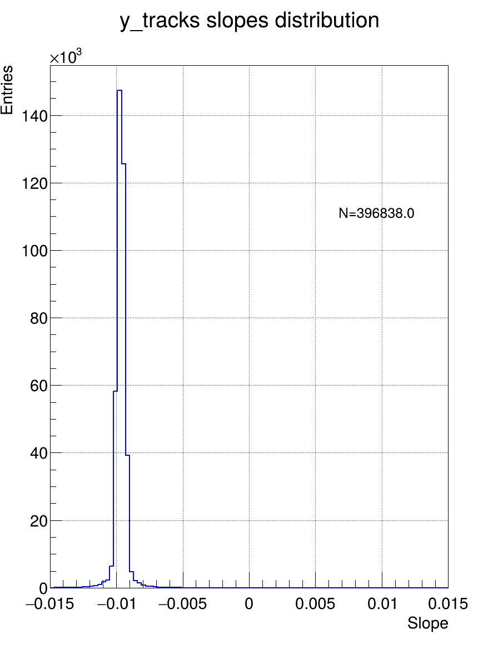
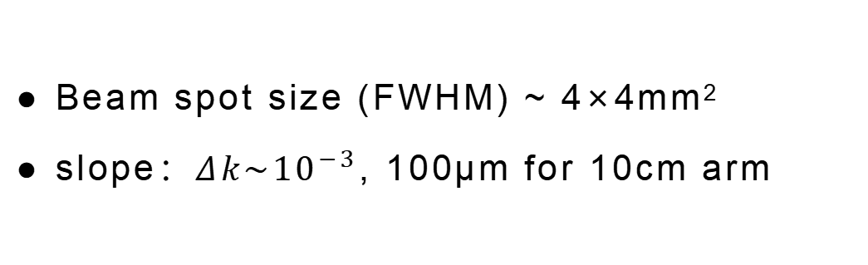
Beam Hit Map
Beam spot size (FWHM) ~ 4×4mm²
  slope：$Δk\sim {10}^{−3}$, 100μm for 10cm arm

Slide 6
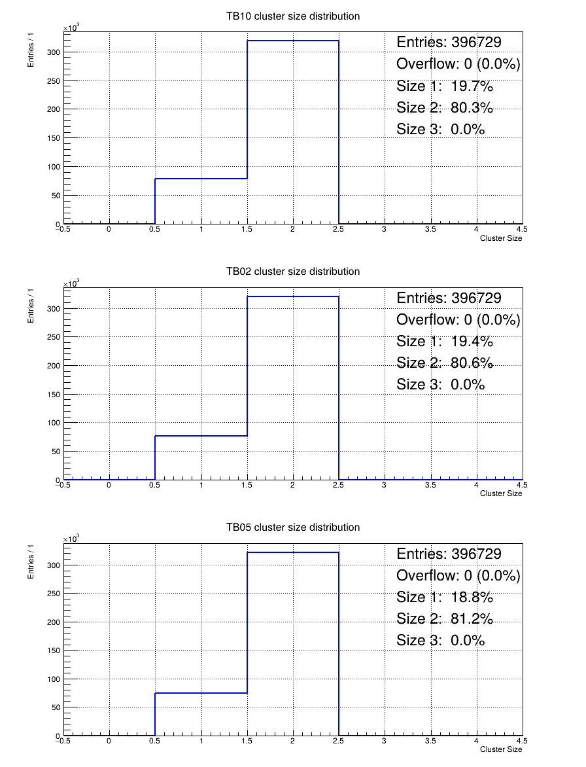
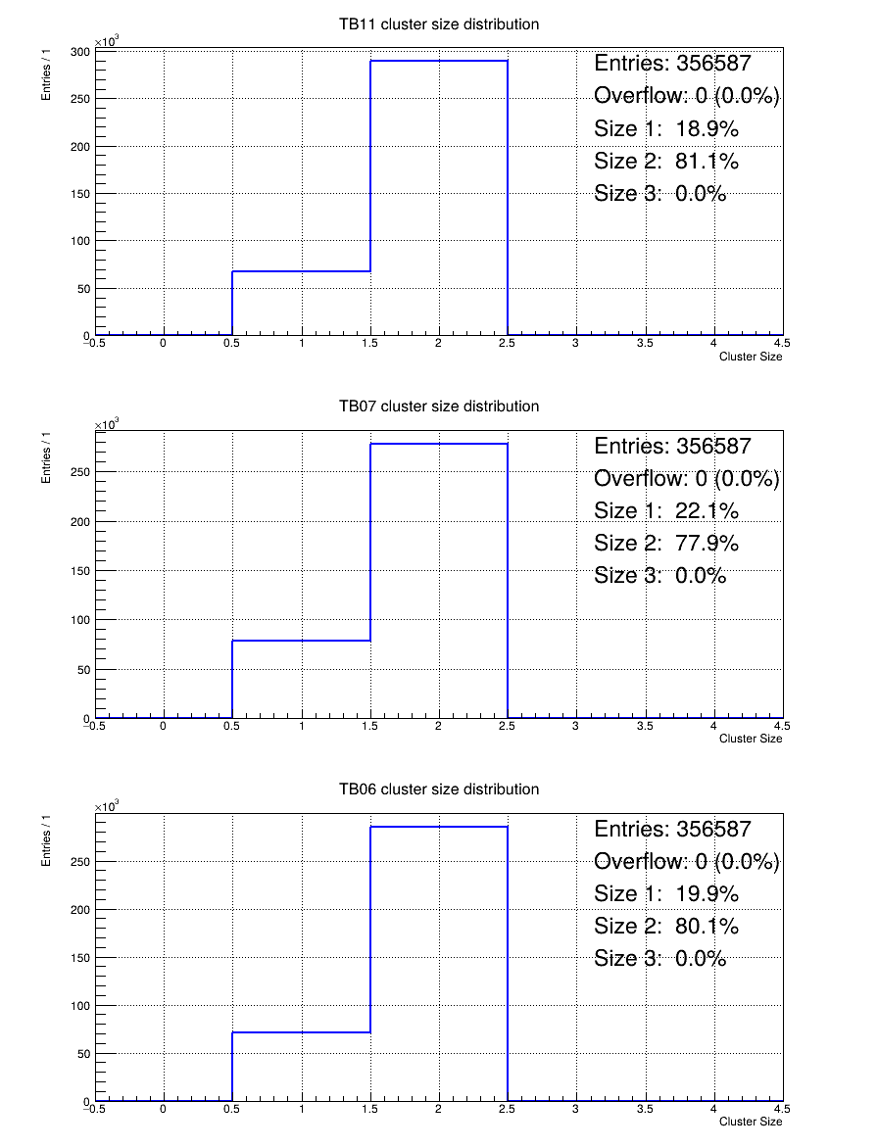
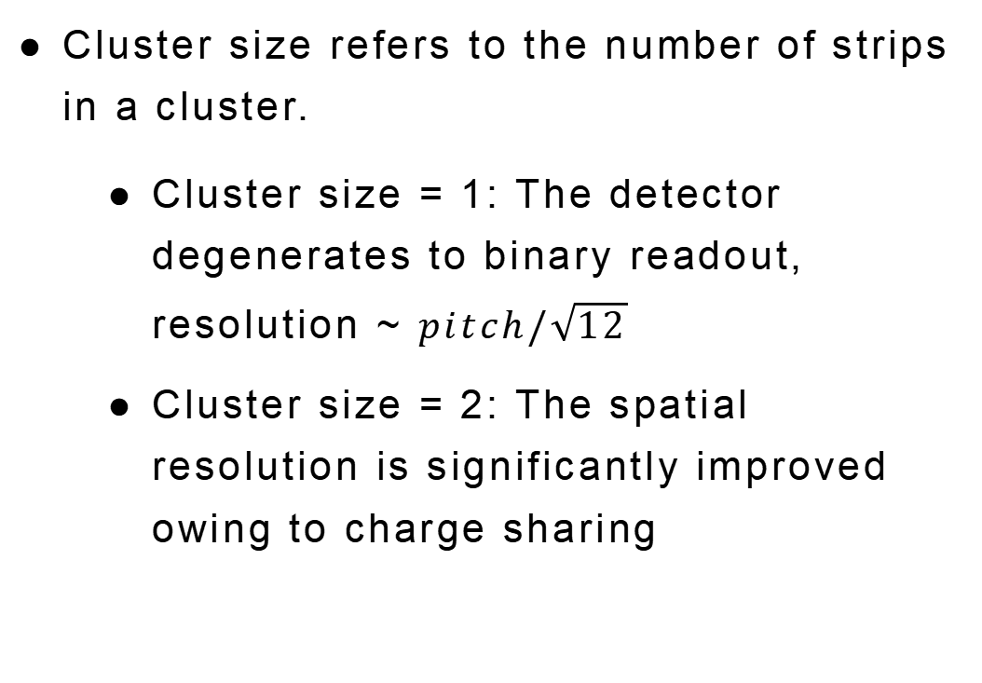
Cluster Sizes
Cluster size refers to the number of strips in a cluster.
  Cluster size = 1: The detector degenerates to binary readout, resolution ~ $pitch/\sqrt{12}$
  Cluster size = 2: The spatial resolution is significantly improved owing to charge sharing
Cluster size for 6 layers
size=1 ~ 20%(seed=5.0, side=2.0)

Slide 7
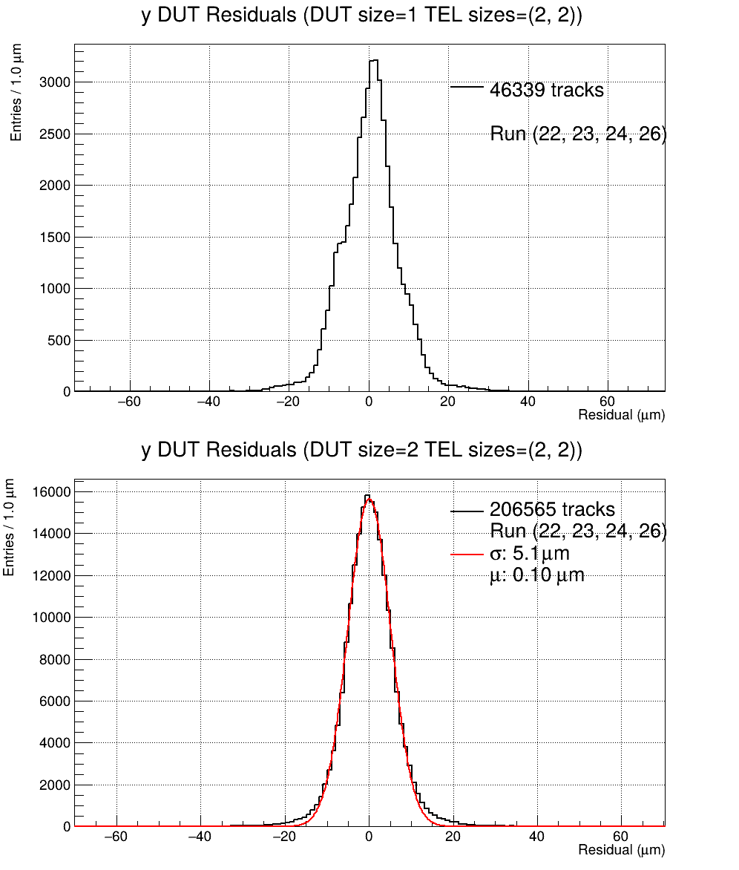
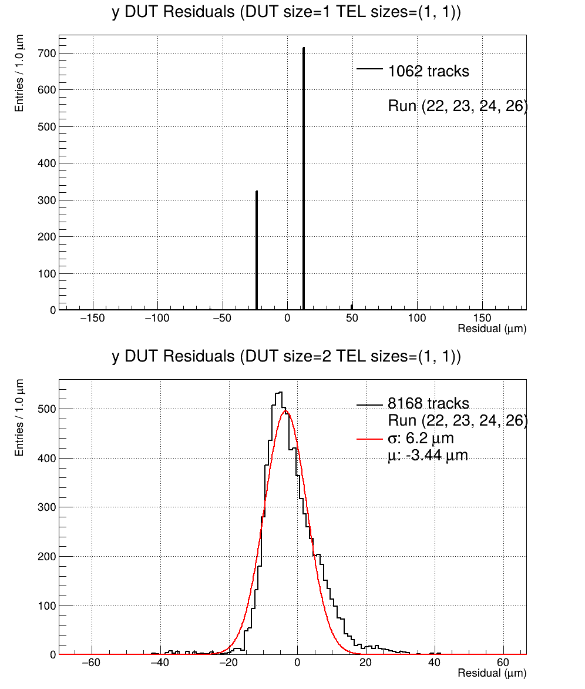
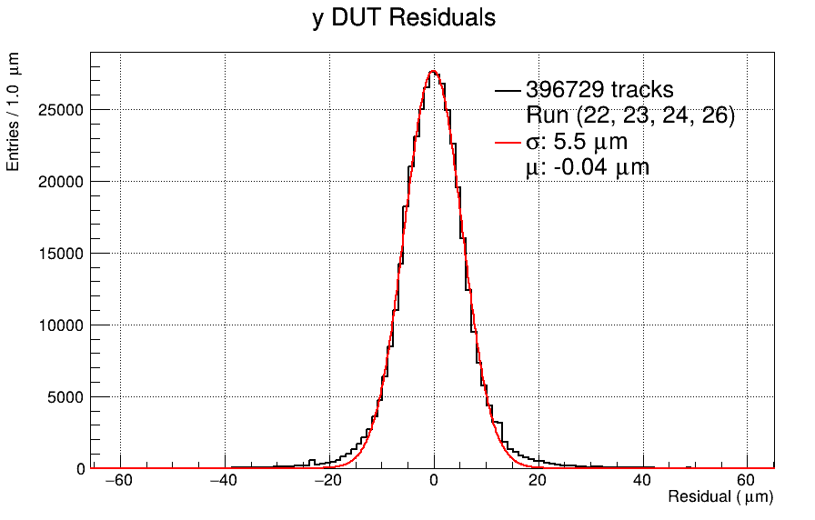
Resolution
The middle layer as DUT:
  5.5μm for all tracks
  5.1μm for tracks whose three cluster sizes are all 2
TO BE CONFIRM
Residuals of the DUT for all tracks
Residuals of the DUT for tracks:
cluster size of telescope layers = 2
Residuals of the DUT for tracks:
cluster size of telescope layers = 1

Slide 8
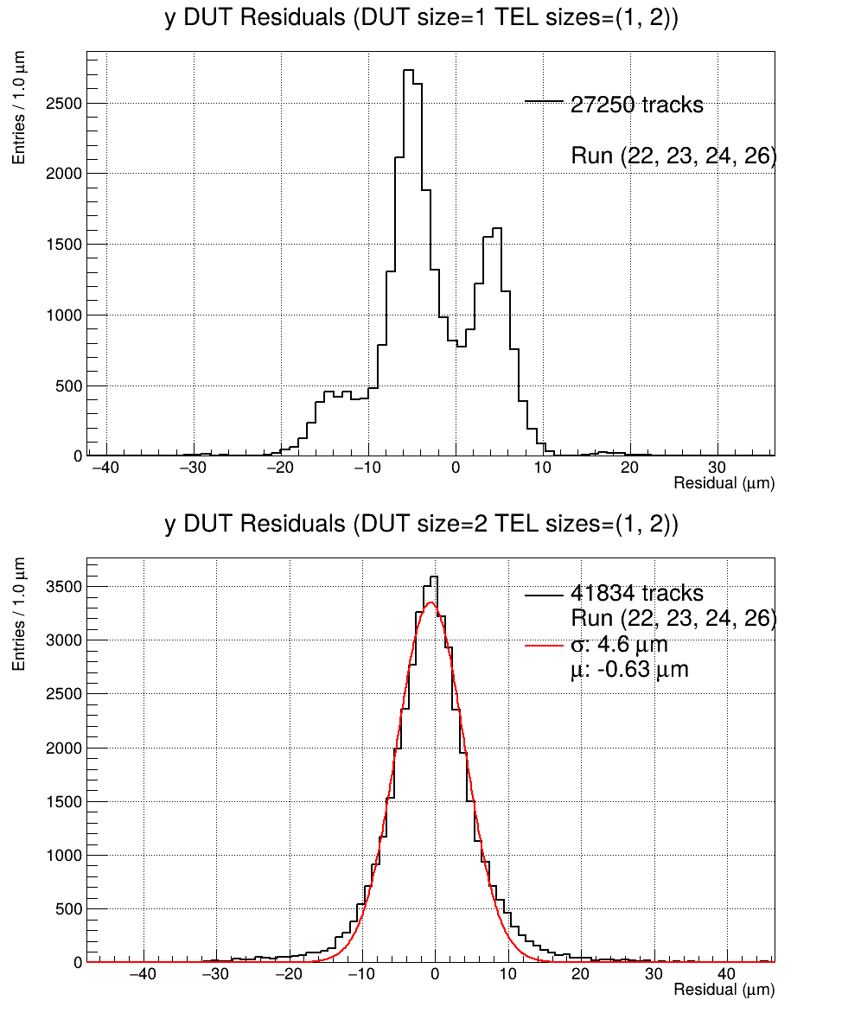
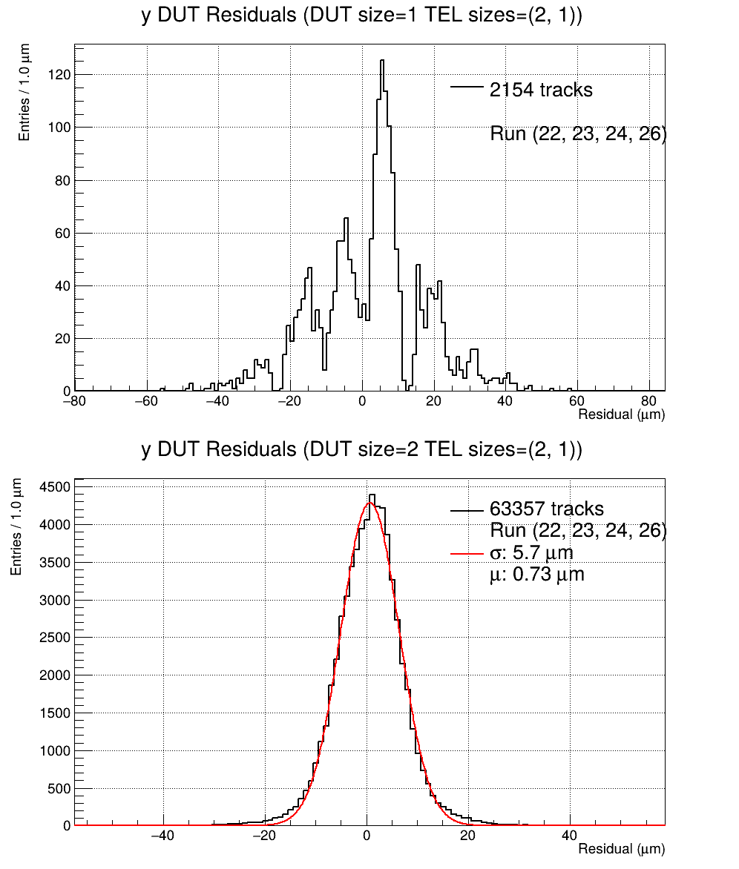
Resolution
Residuals of the DUT for tracks:
cluster size of telescope layers =1, 2
Residuals of the DUT for tracks:
cluster size of telescope layers = 2,1

Slide 9
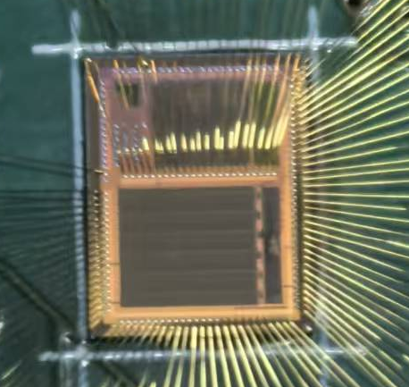
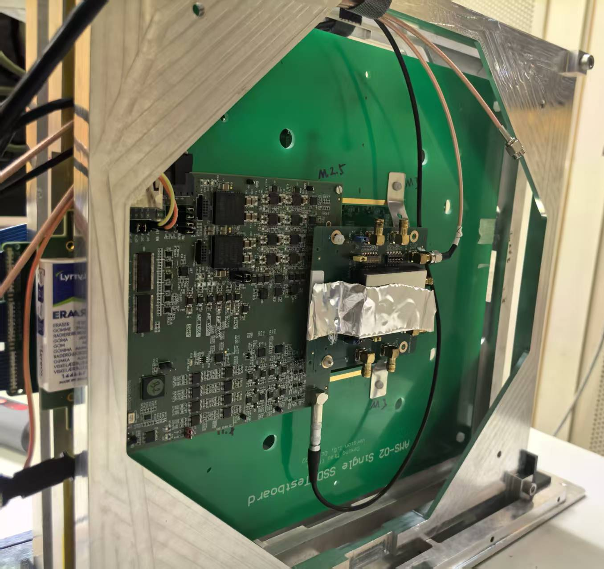
COFFEE3 Test
Not to scale
Y
CaR Board
X
  Six SSD test boards
  Two scitillators
  COFFEE3 system
  CaR Board & Test Board(TB)
  ZCU102
  Raspberry pi
  Same mechanical frame for SSD test boards and COFFEE3 system
scint
scint
TB
Beam
3cm
3cm
6cm
Single pixel
~ 36μm×130μm
CaR Board
TB

Slide 10
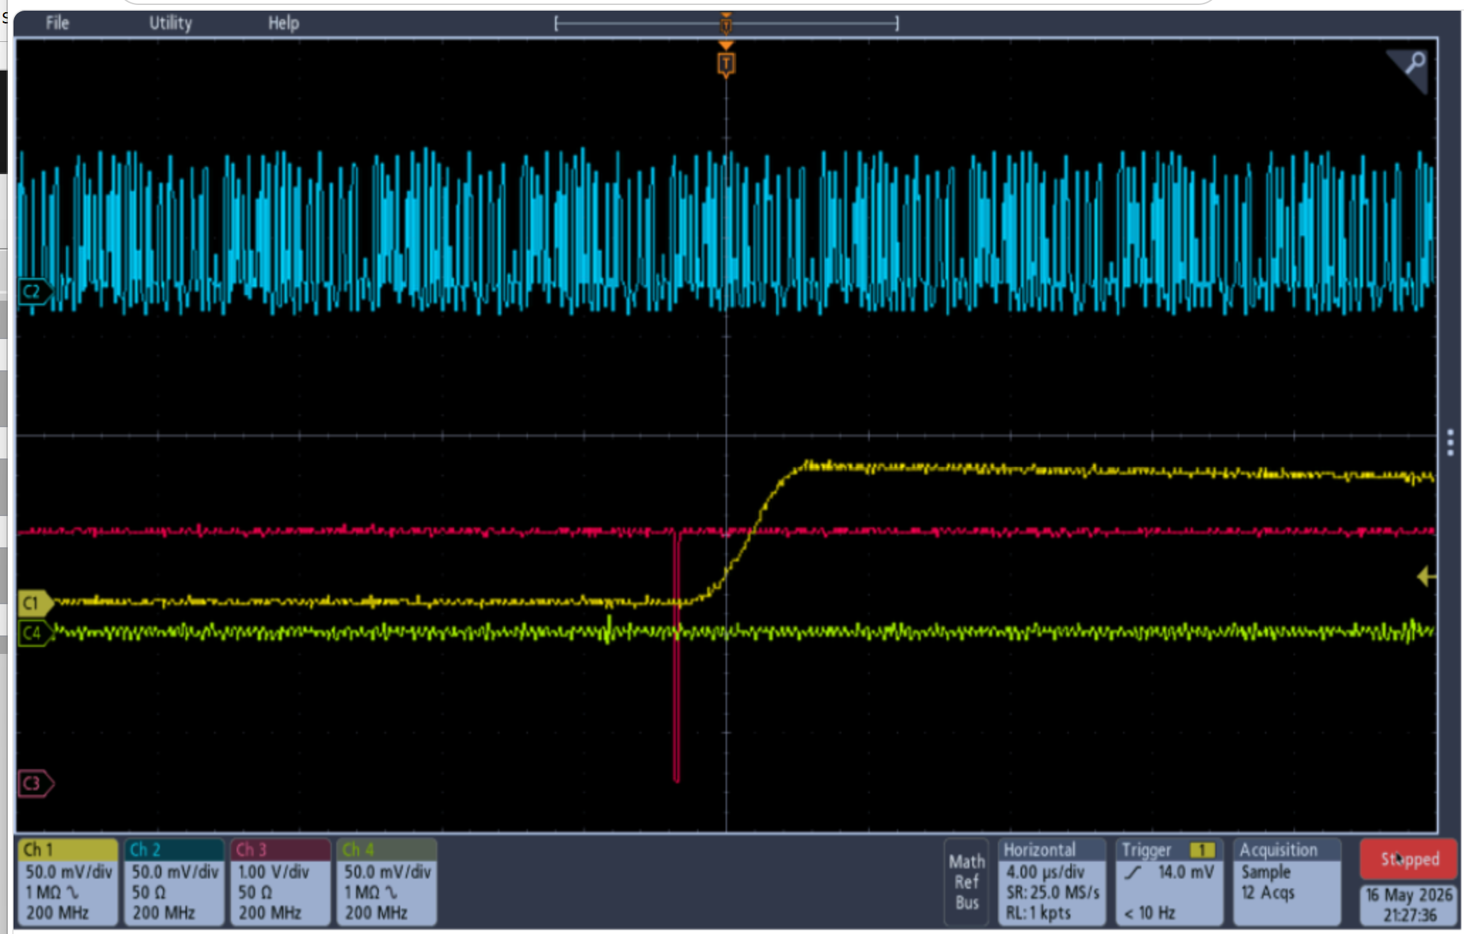
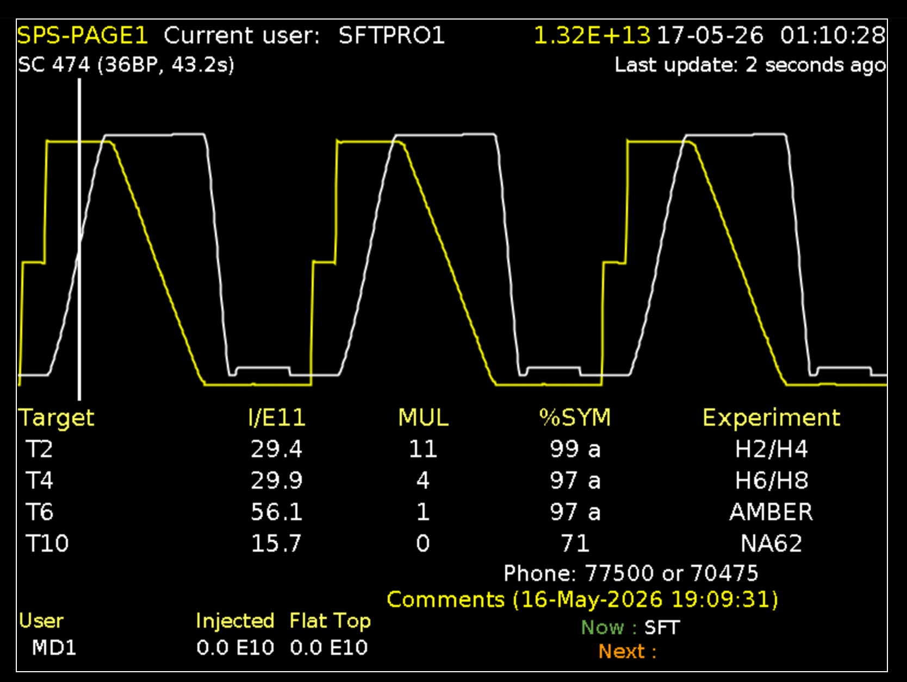
CSA signal of single pixel
The yellow line indicates the relative density of particles in SPS, when it goes down the particles are extracted, beam on
One beam event of CSA
CSA Signal
Scintillators Coincidence
Beam event：Scintillators coincidence appears before CSA signal goes up, in beam period
Noise event：No scintillators coincidence before CSA signal goes up, in no beam period
One super cycle (~ 45s) has 3 sub-cycles, one sub-cycle has 5s of beam period
SPS beam status in real-time

Slide 11
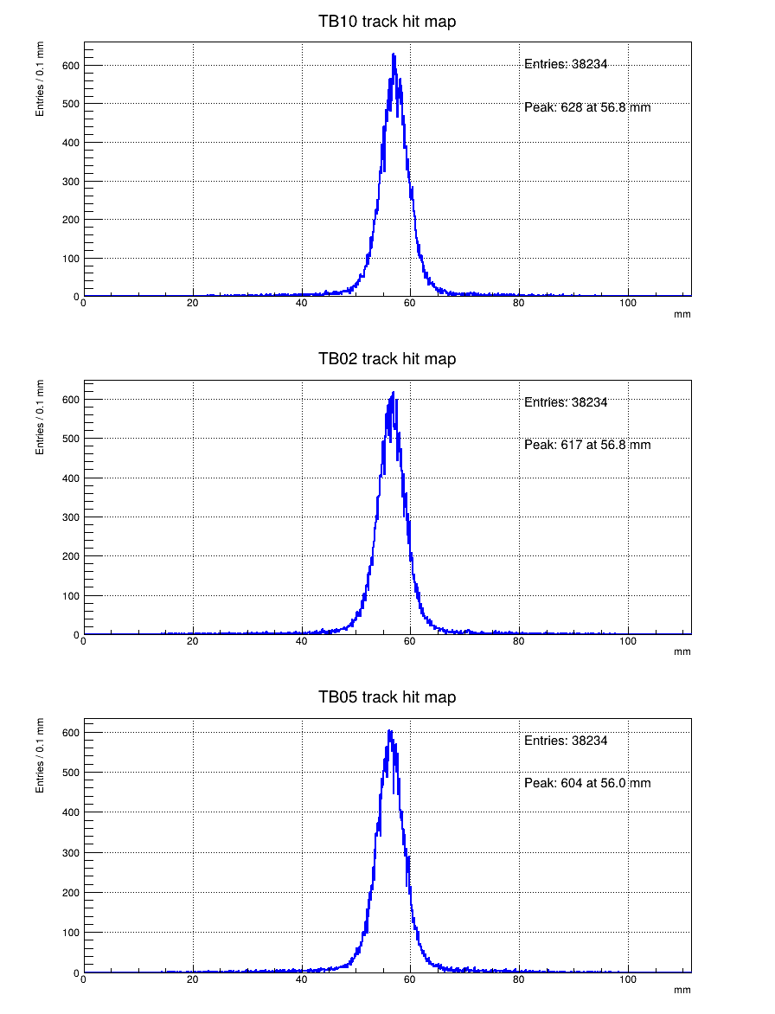
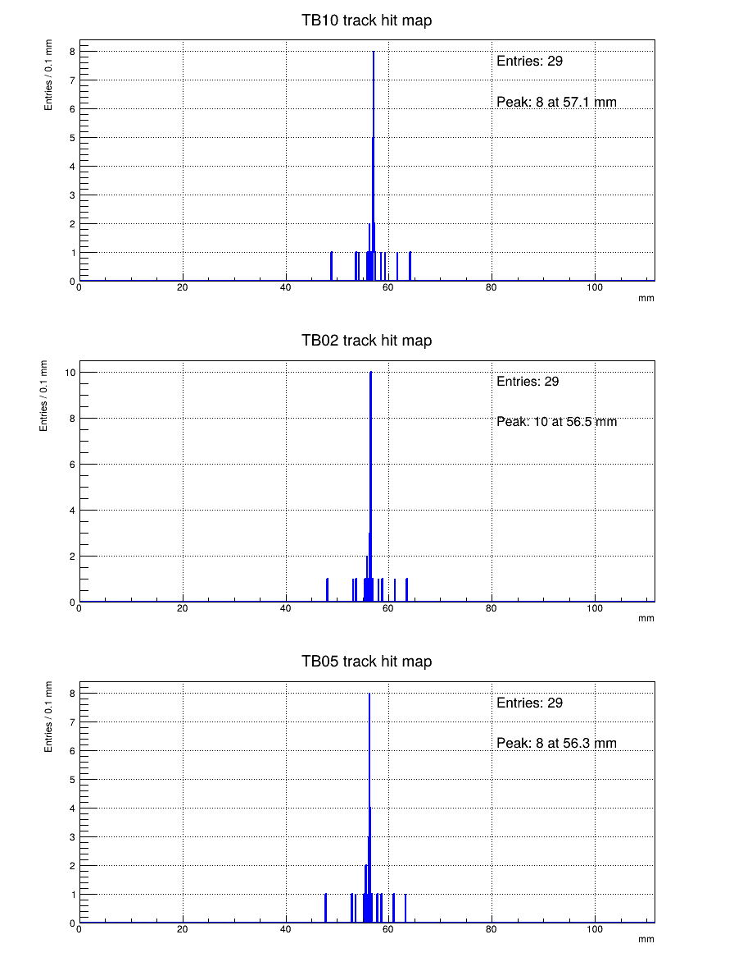
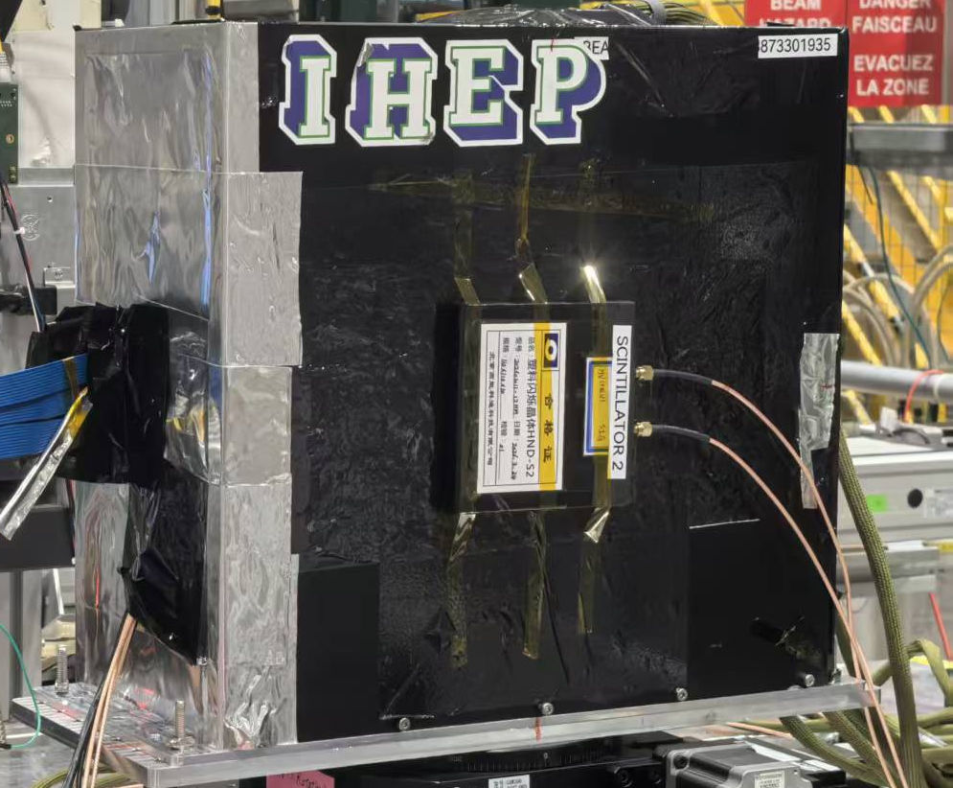
Scintillator v.s. CSA triggered hits of Y tracks
The CSA triggered hits are localized on one strip
10cm×10cm
Scintillator
Single pixel
~ 36μm×130μm
Scintillator triggered hit maps of Y direction
CSA triggered hit maps of Y direction

Slide 12
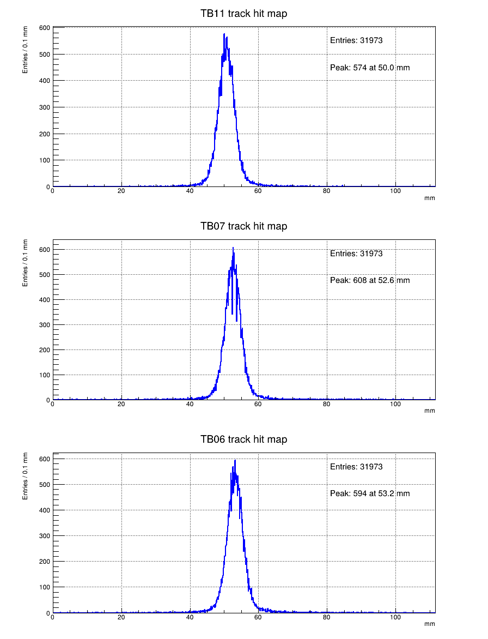
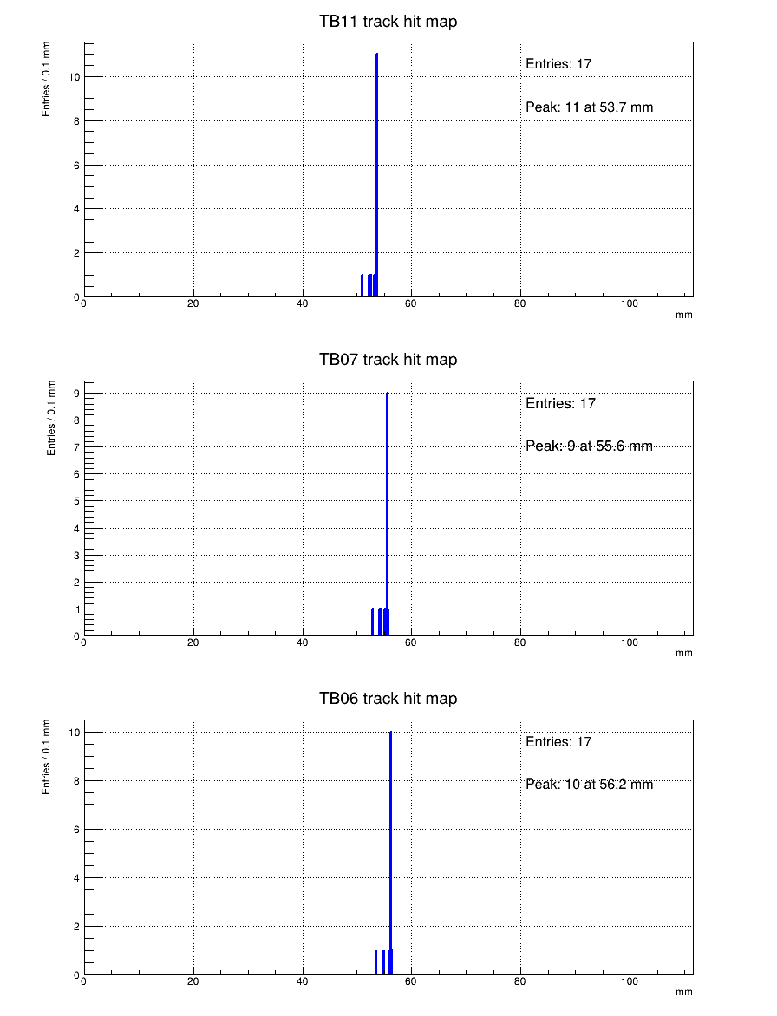
Scintillator v.s. CSA triggered hits of X tracks
Scintillator triggered hit maps of X direction
CSA triggered hit maps of X direction

Slide 13
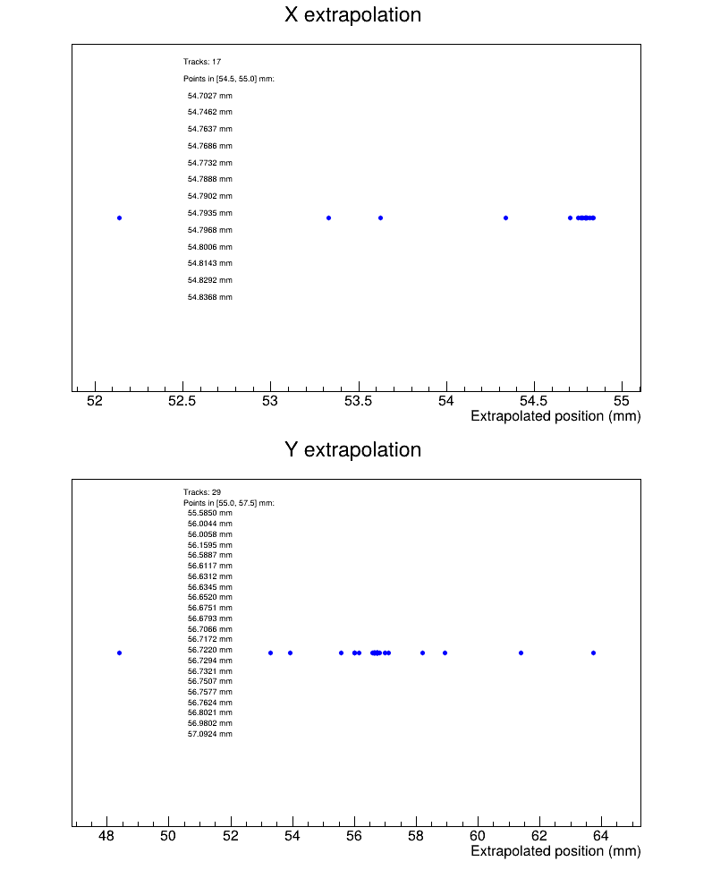
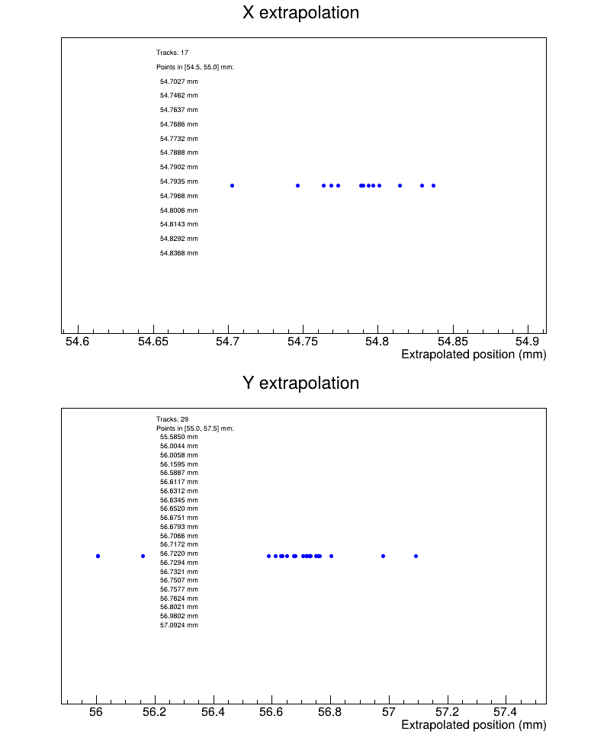
Tracks extrapolated to COFFEE3 plane
Three layers to determine a line for X and Y direction
12 points~90μm
Y
Not to scale
X
14 points~200μm

Slide 14
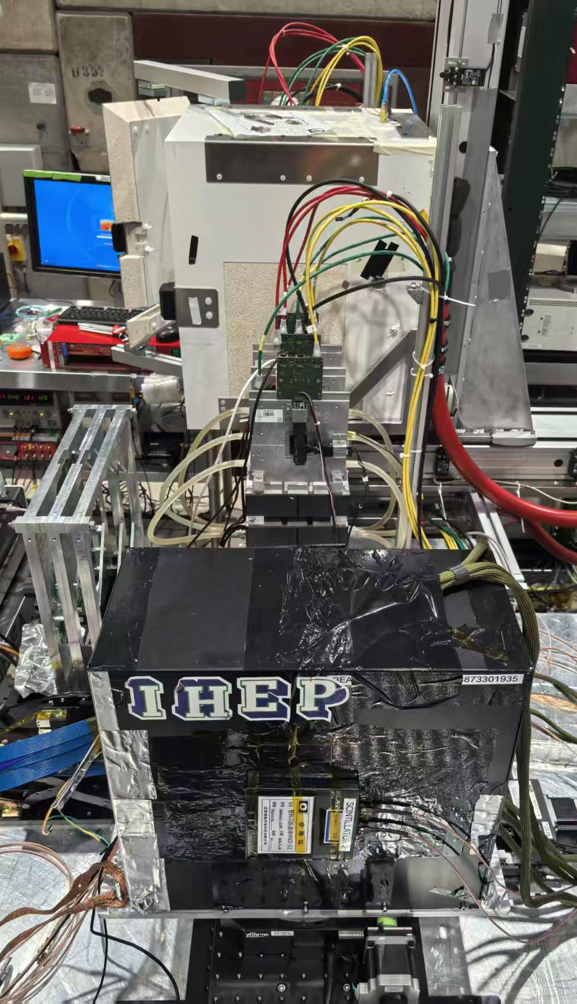
BACK UP
Beam(+Z)

Slide 15
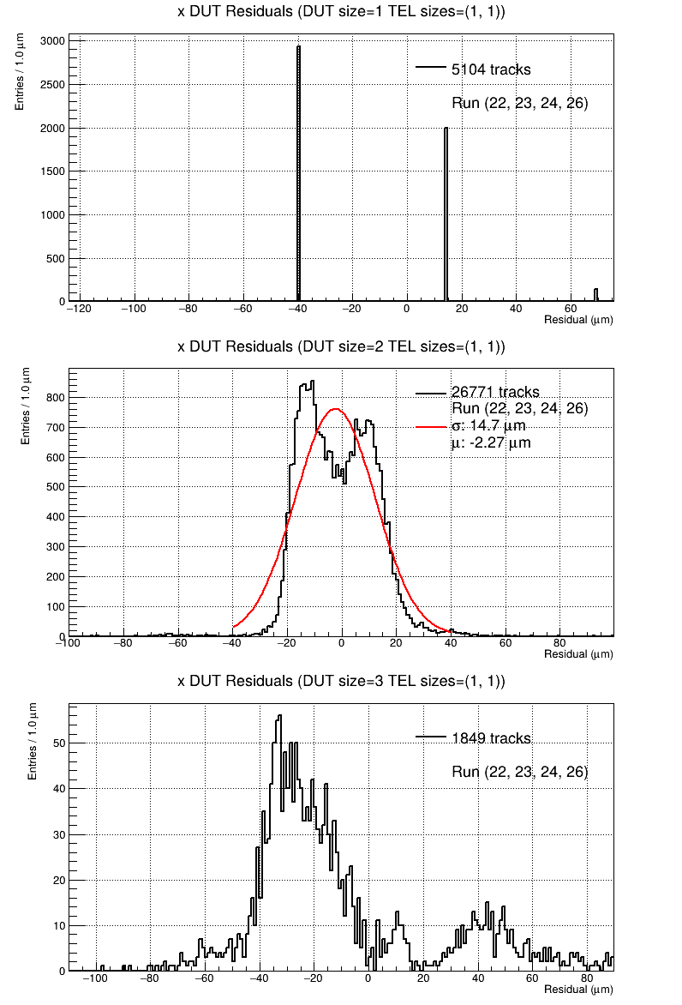
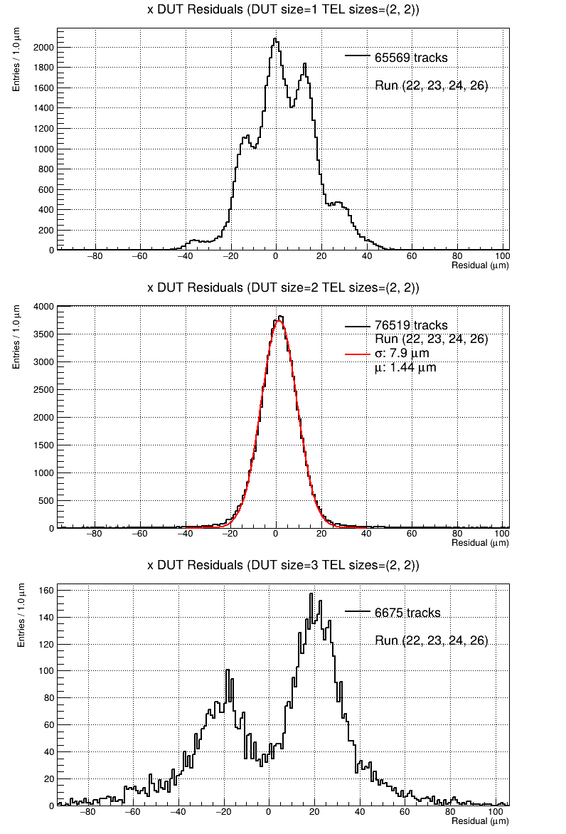
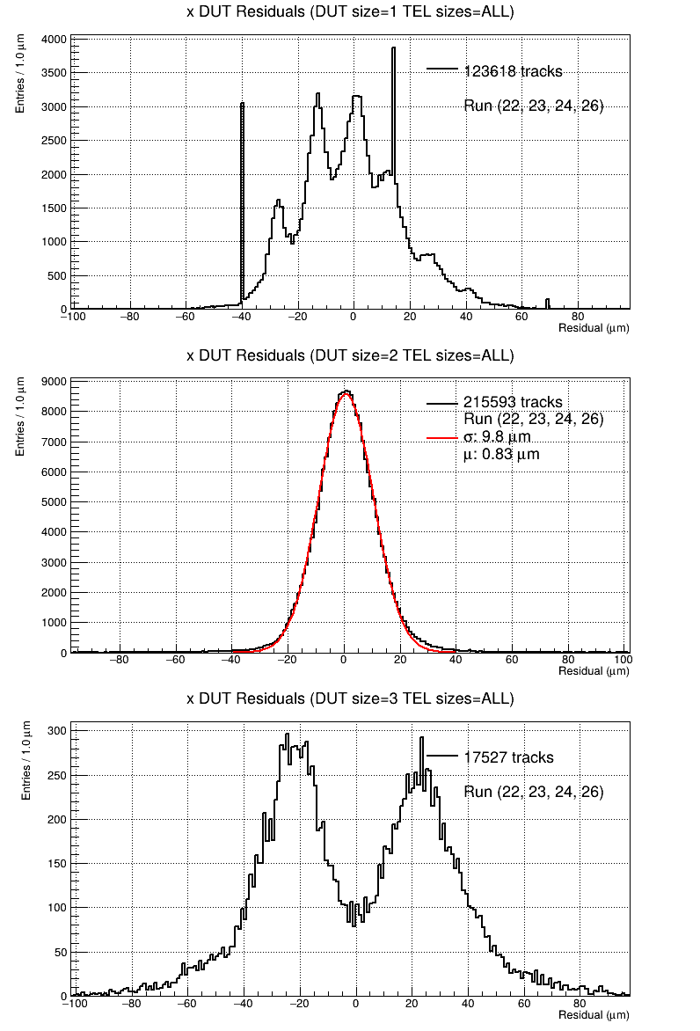
不同Cluster Size下的残差分布

Slide 16
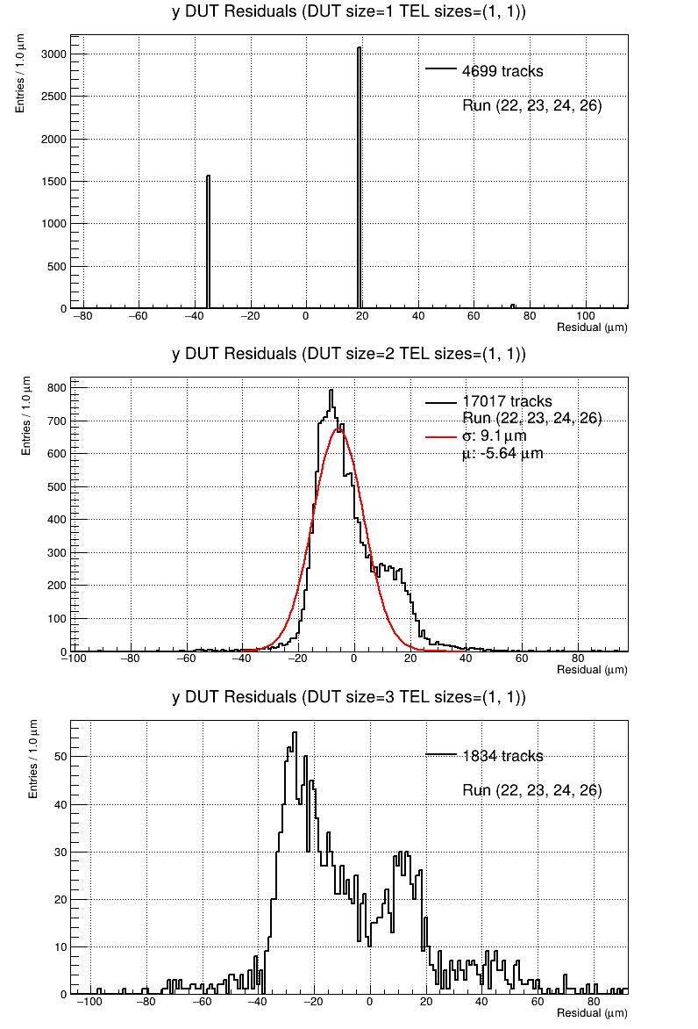
对于三层cluster size全是1的(setup1)
DUT
2
1
0
res = obs - pre
间距1:1
pred = 0.5*X1 + 0.5*X3 = 0、1、0.5
obs = 0、1
res = 0、±0.5、±1
实际只有没有±1的

Slide 17
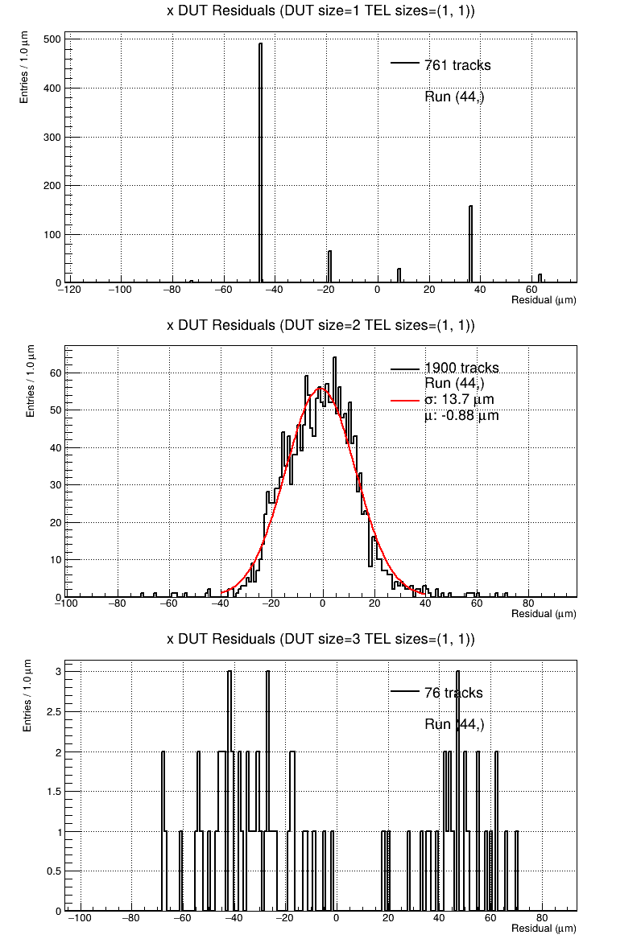
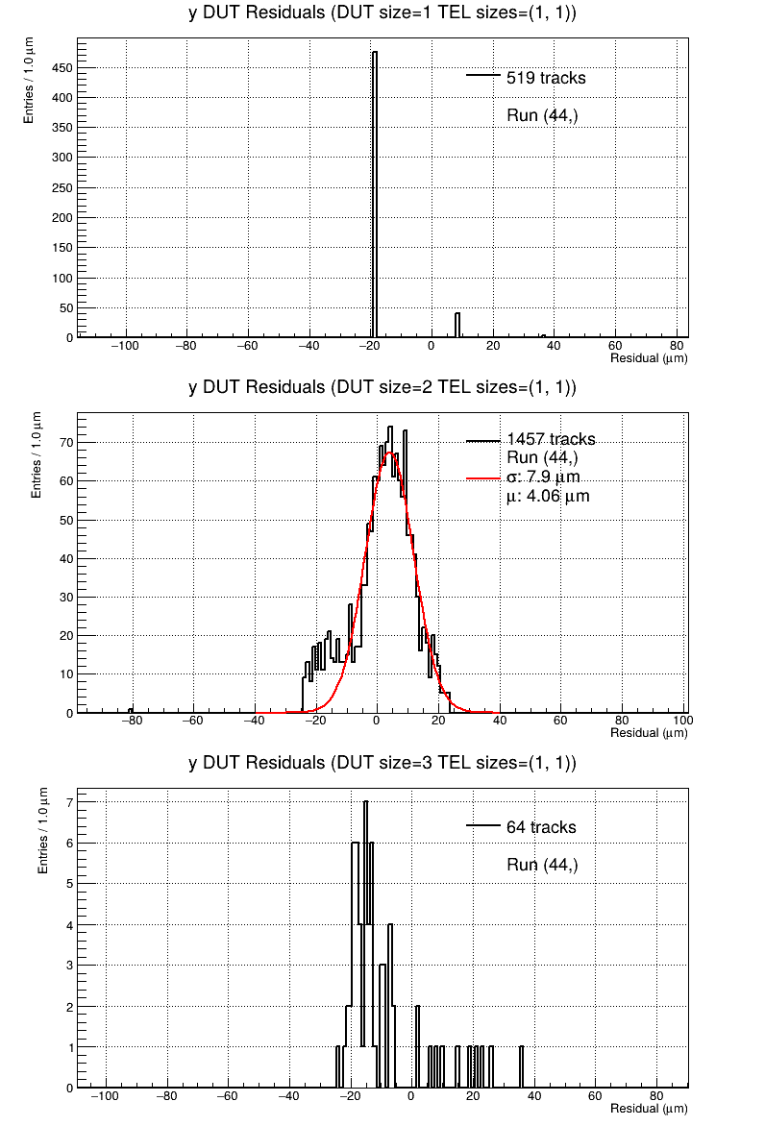
对于三层cluster size全是1的(setup2)
DUT
2
1
0
res = obs - pre
间距3:1
pred = 0.25*X1 + 0.75*X3 = 0、1、0.75、0.25
obs = 0、1
res = 0、±0.25、±0.5、±0.75、±1
实际基本只有0、±0.25、±0.5，和-0.7的一点点

Slide 18
更一般的讨论，考虑粒子斜入射
pred = n/(n+1) * k * pitch
好的情况下obs 是距pre更近的那个条
则res = obs - pred = k*n/(n+1) - round(k*n/(n+1)) 理论上残差范围在±0.5*pitch之间，但是实际读出条可能不是最近的那个，因此也可能超出这个范围。±pitch内有2n+3个分立的值
随着k变化，这些分立的残差值间隔是n/(n+1) * pitch
k大的时候，也就是粒子比较斜时候
k
0
n:1

Slide 19
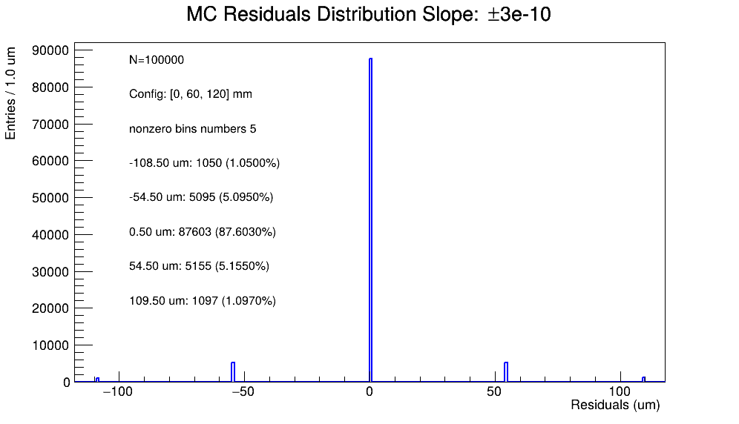
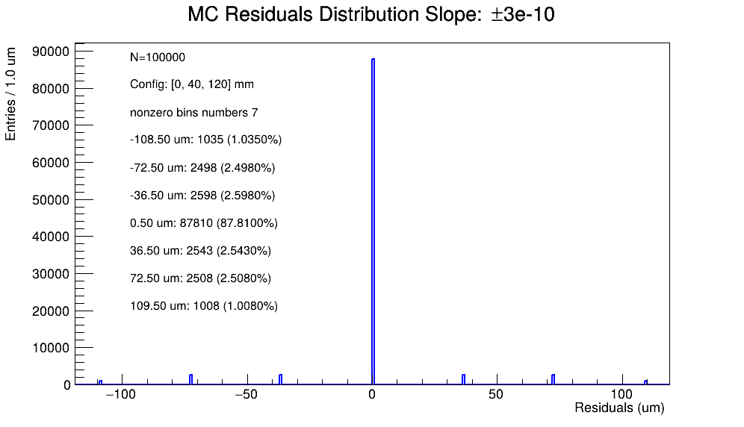

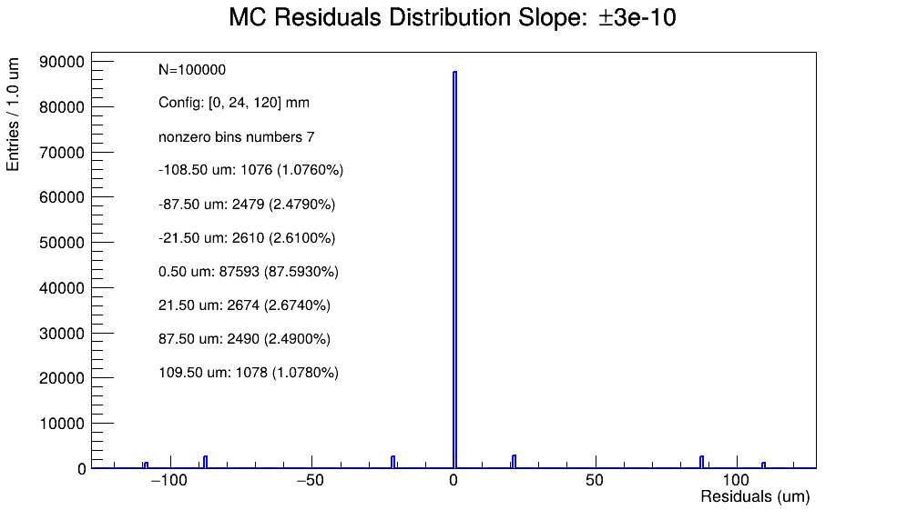


粒子斜率±3e-10

Slide 20
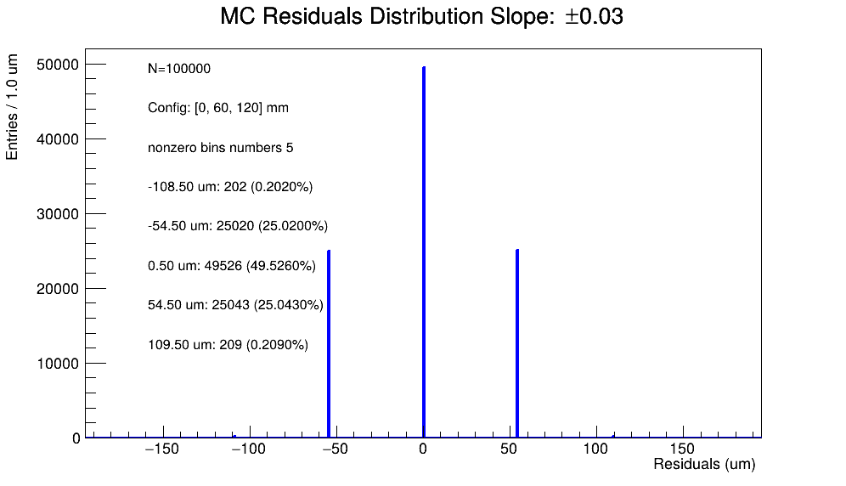
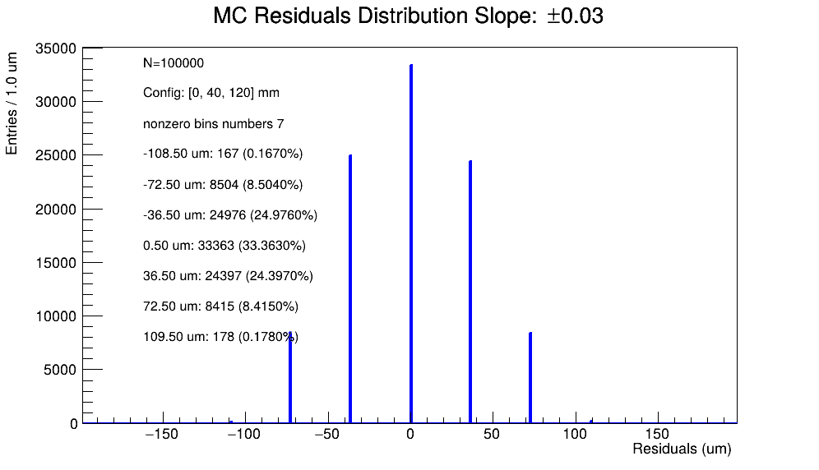
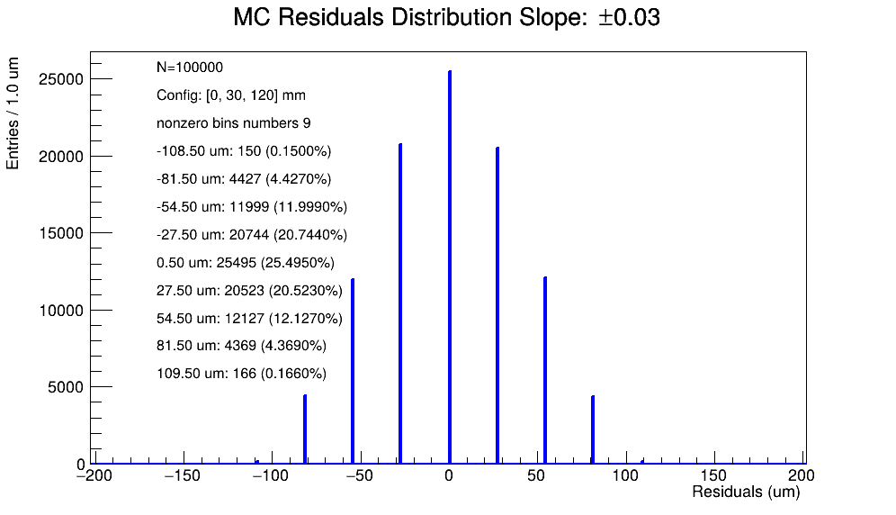
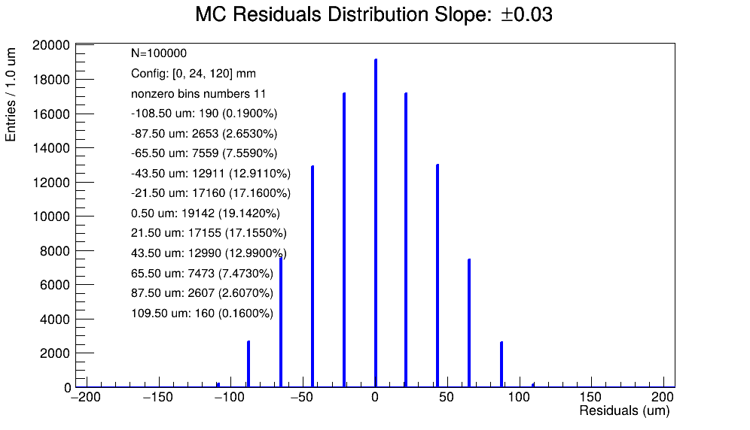
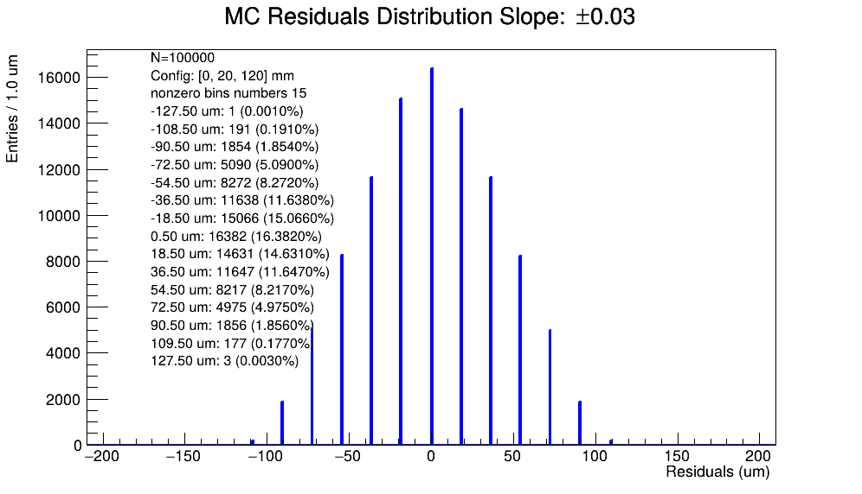
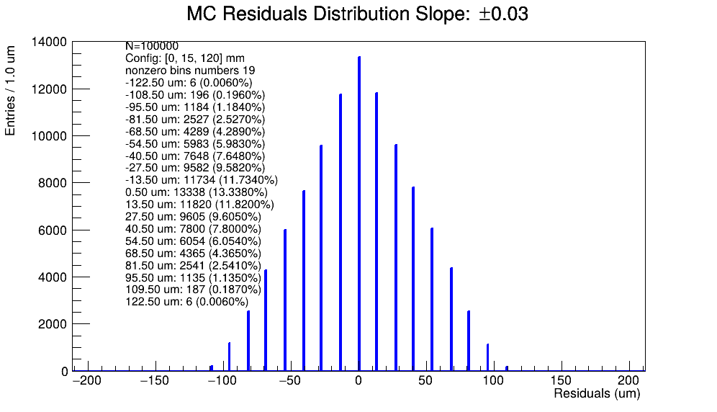
粒子斜率±3e-2

