Slide 1
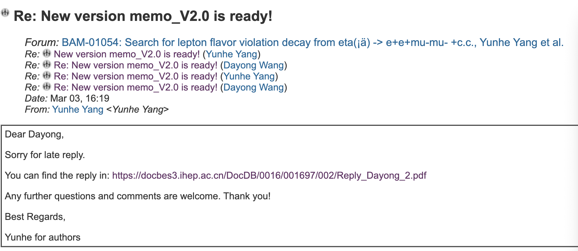
CLFV

Slide 2
CPV
Prepare prof. You’s question.

Slide 3
DC ML tracking
The data cleaning has been completed. Next, start training the GNN model.

Slide 4
2026.3.10
Nankai Group Meeting

Slide 5
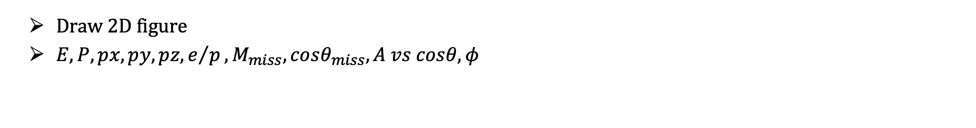
CPV
Draw 2D figure
$E, P, px, py, pz, e/p, M_{miss},cosθ_{miss},A vs cosθ, φ$

Slide 6
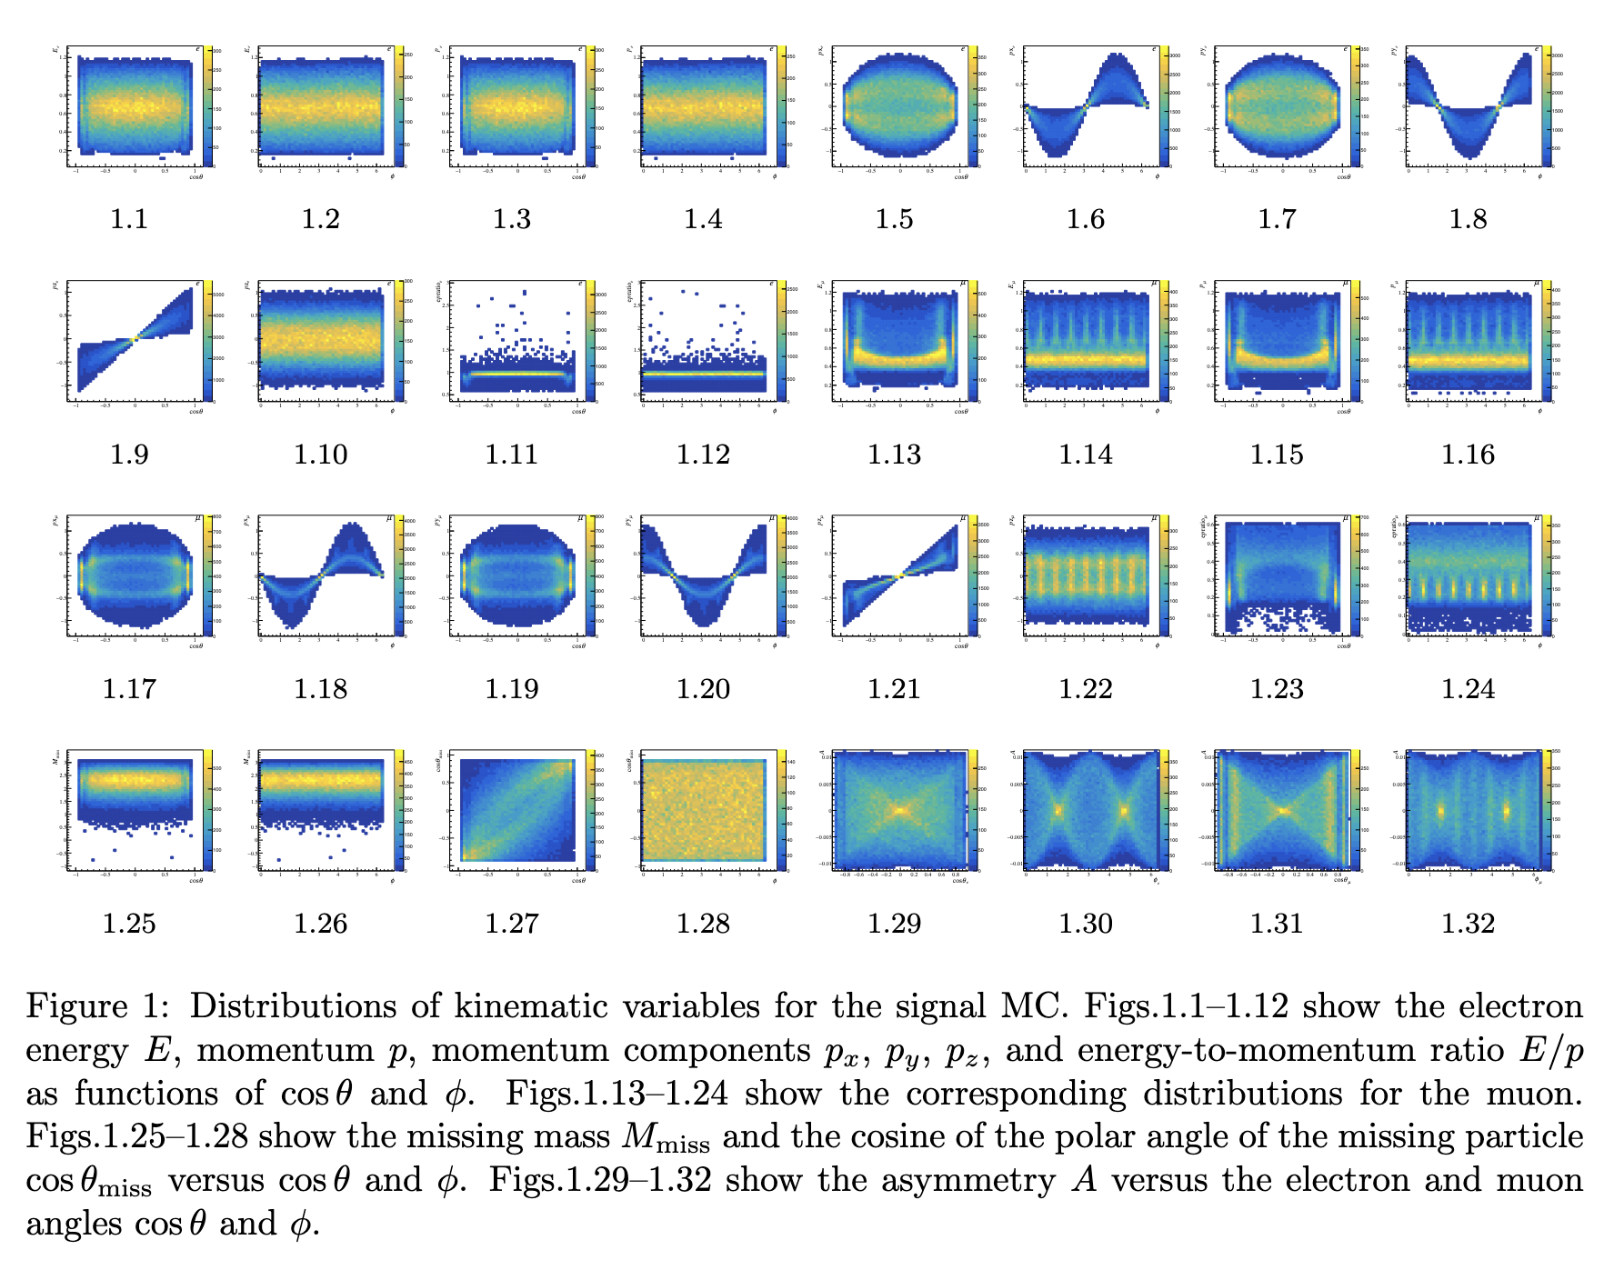

Slide 7
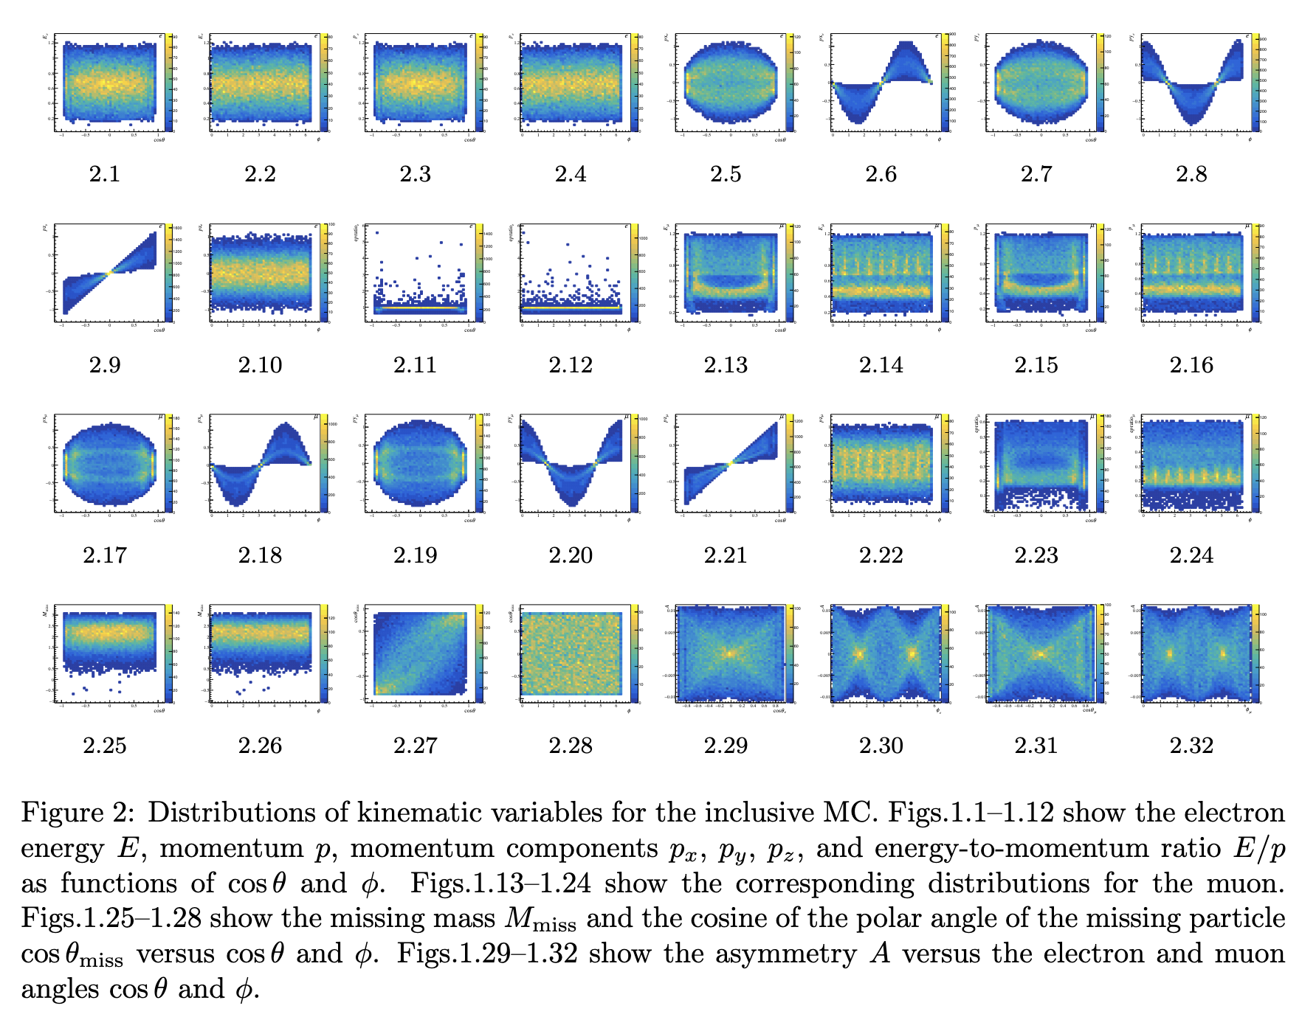

Slide 8
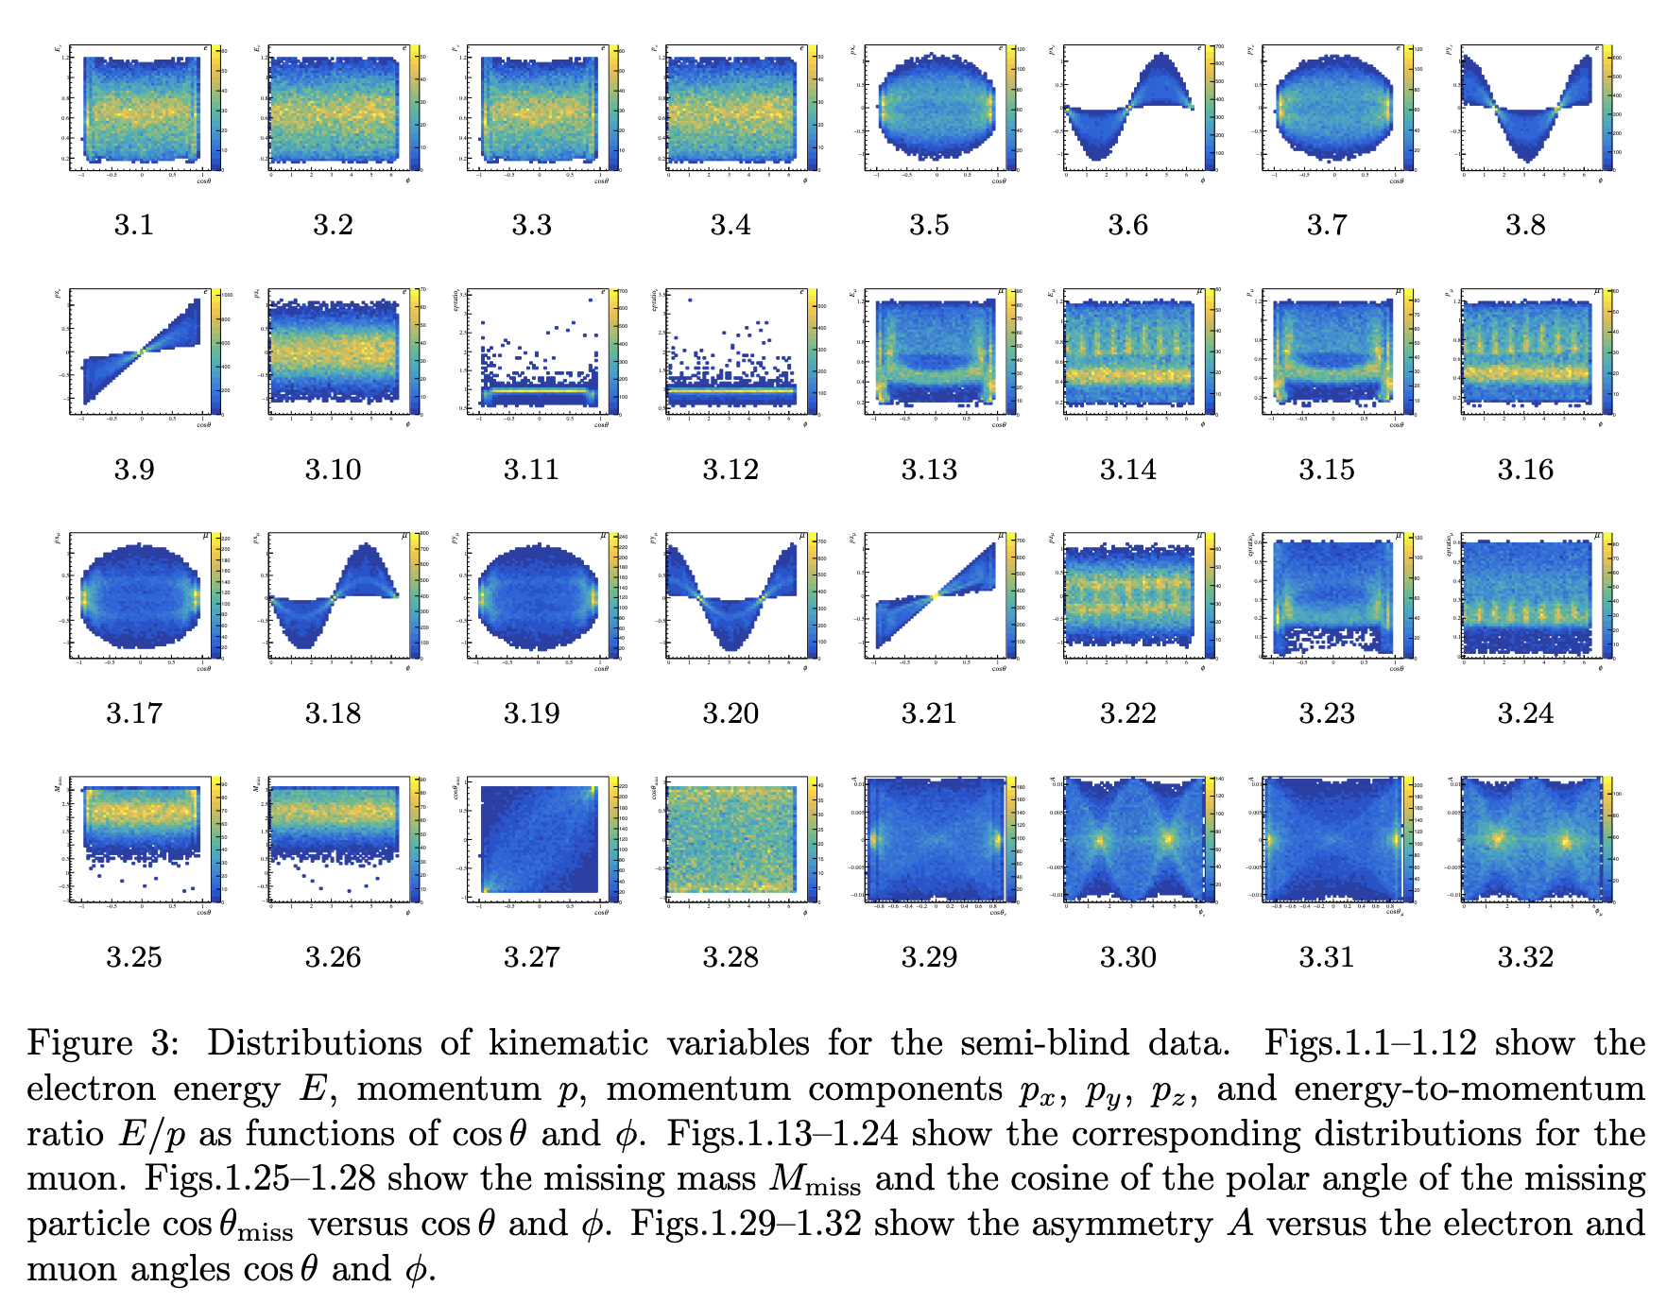

Slide 9
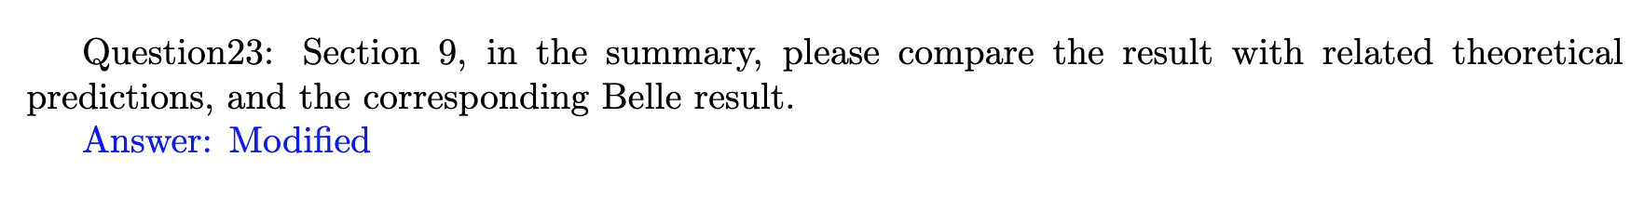
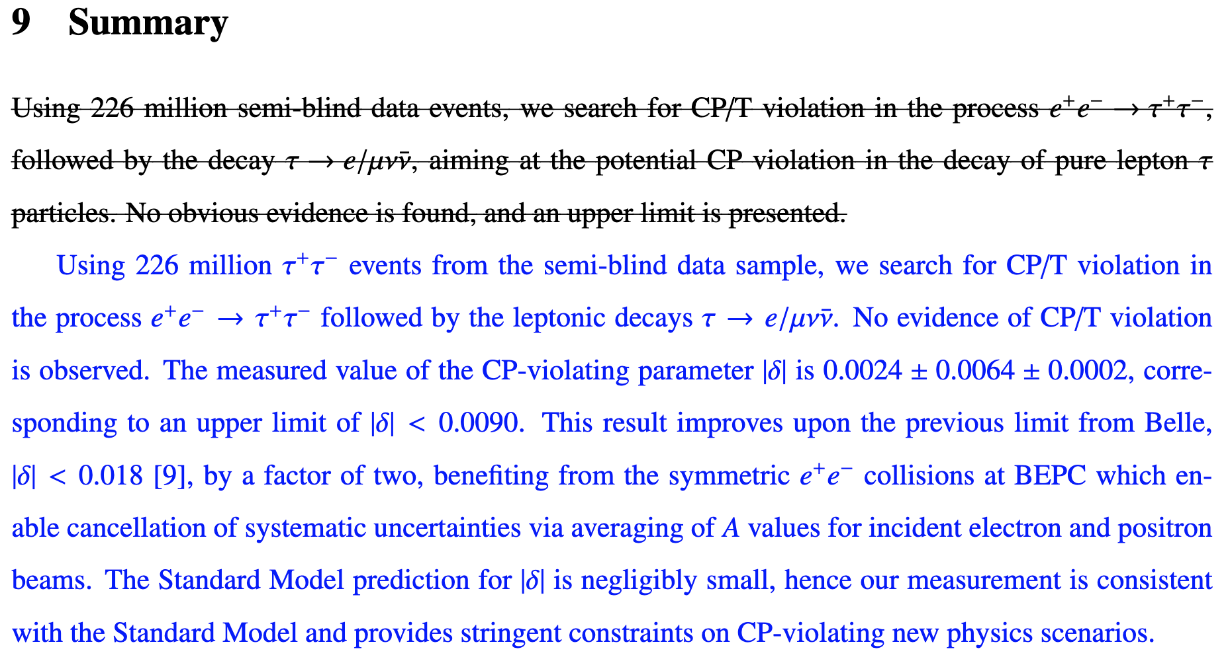
CPV

Slide 10
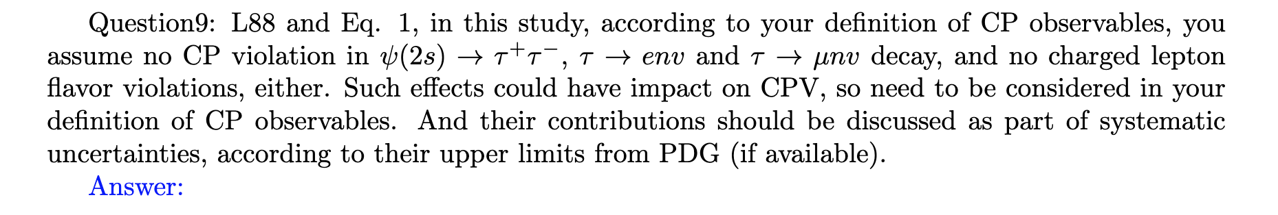
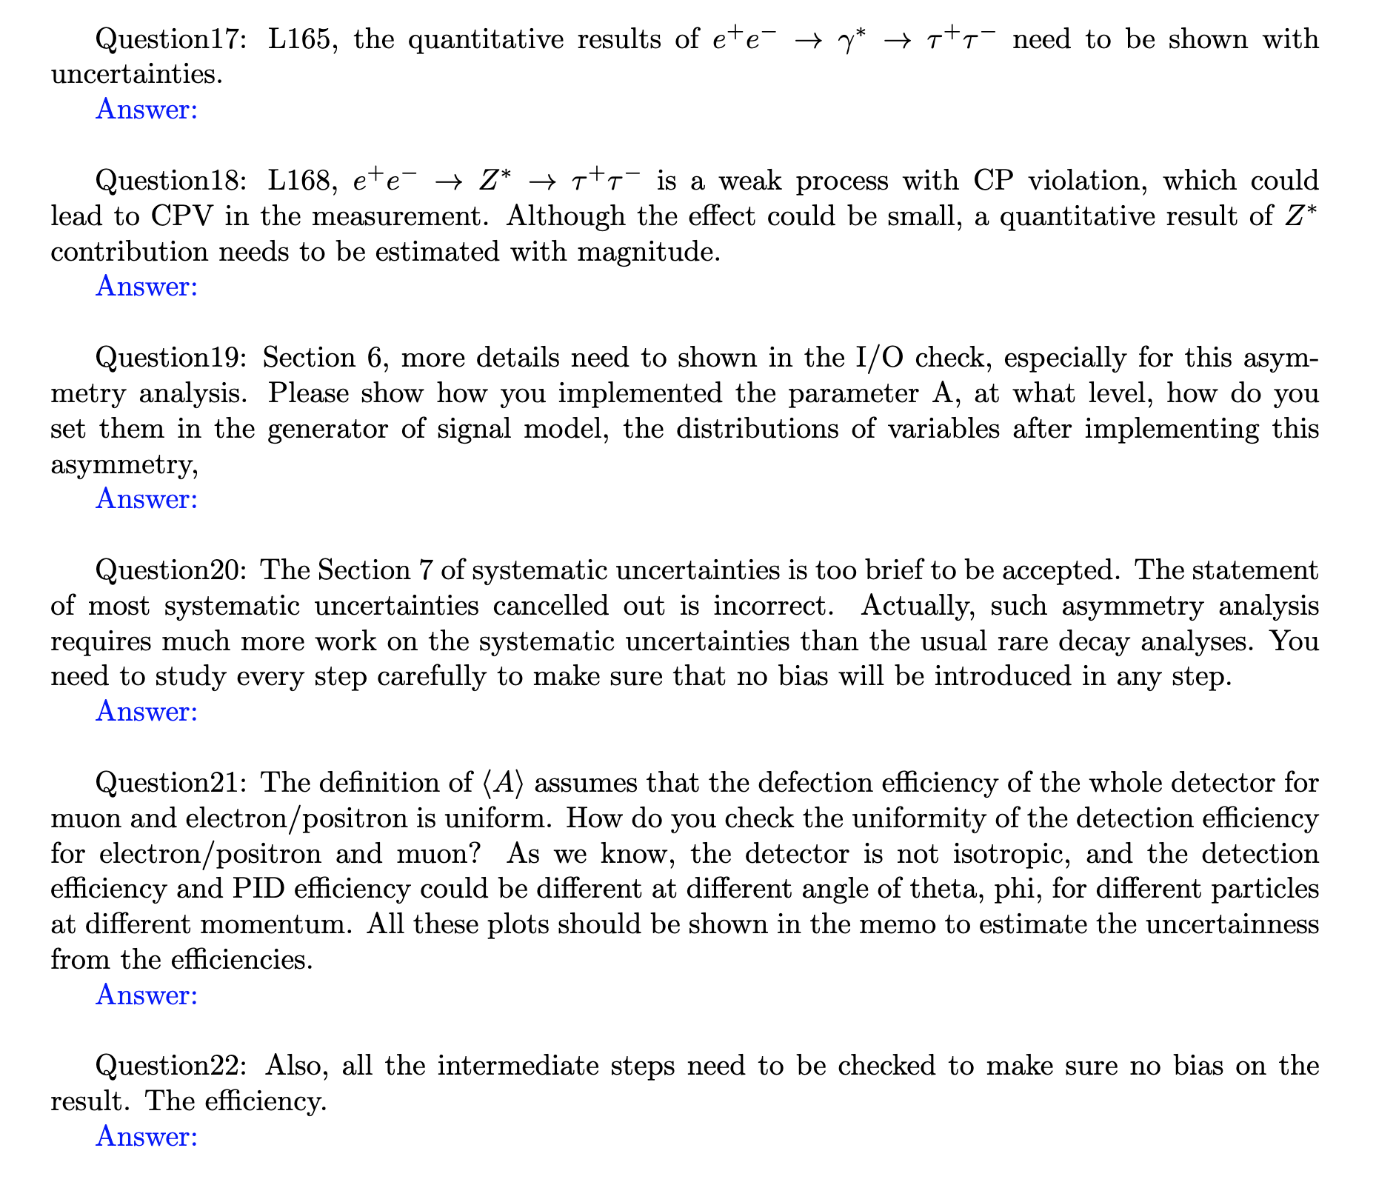
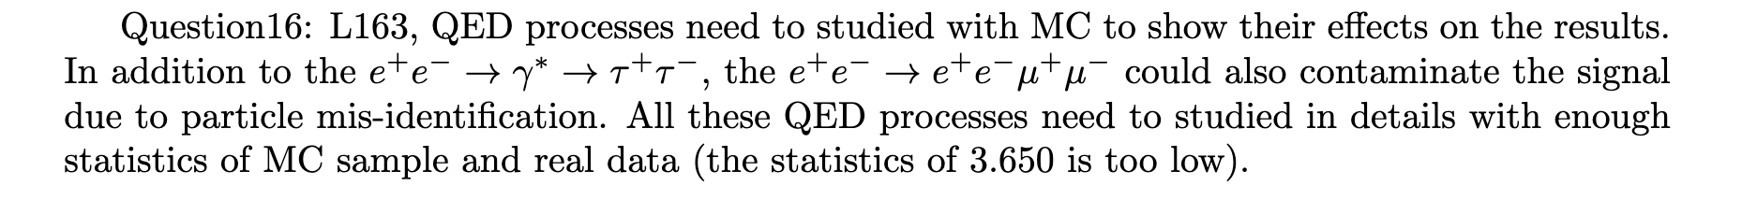
CPV
Next week
There are still 8 questions that we need to respond to.

Slide 11
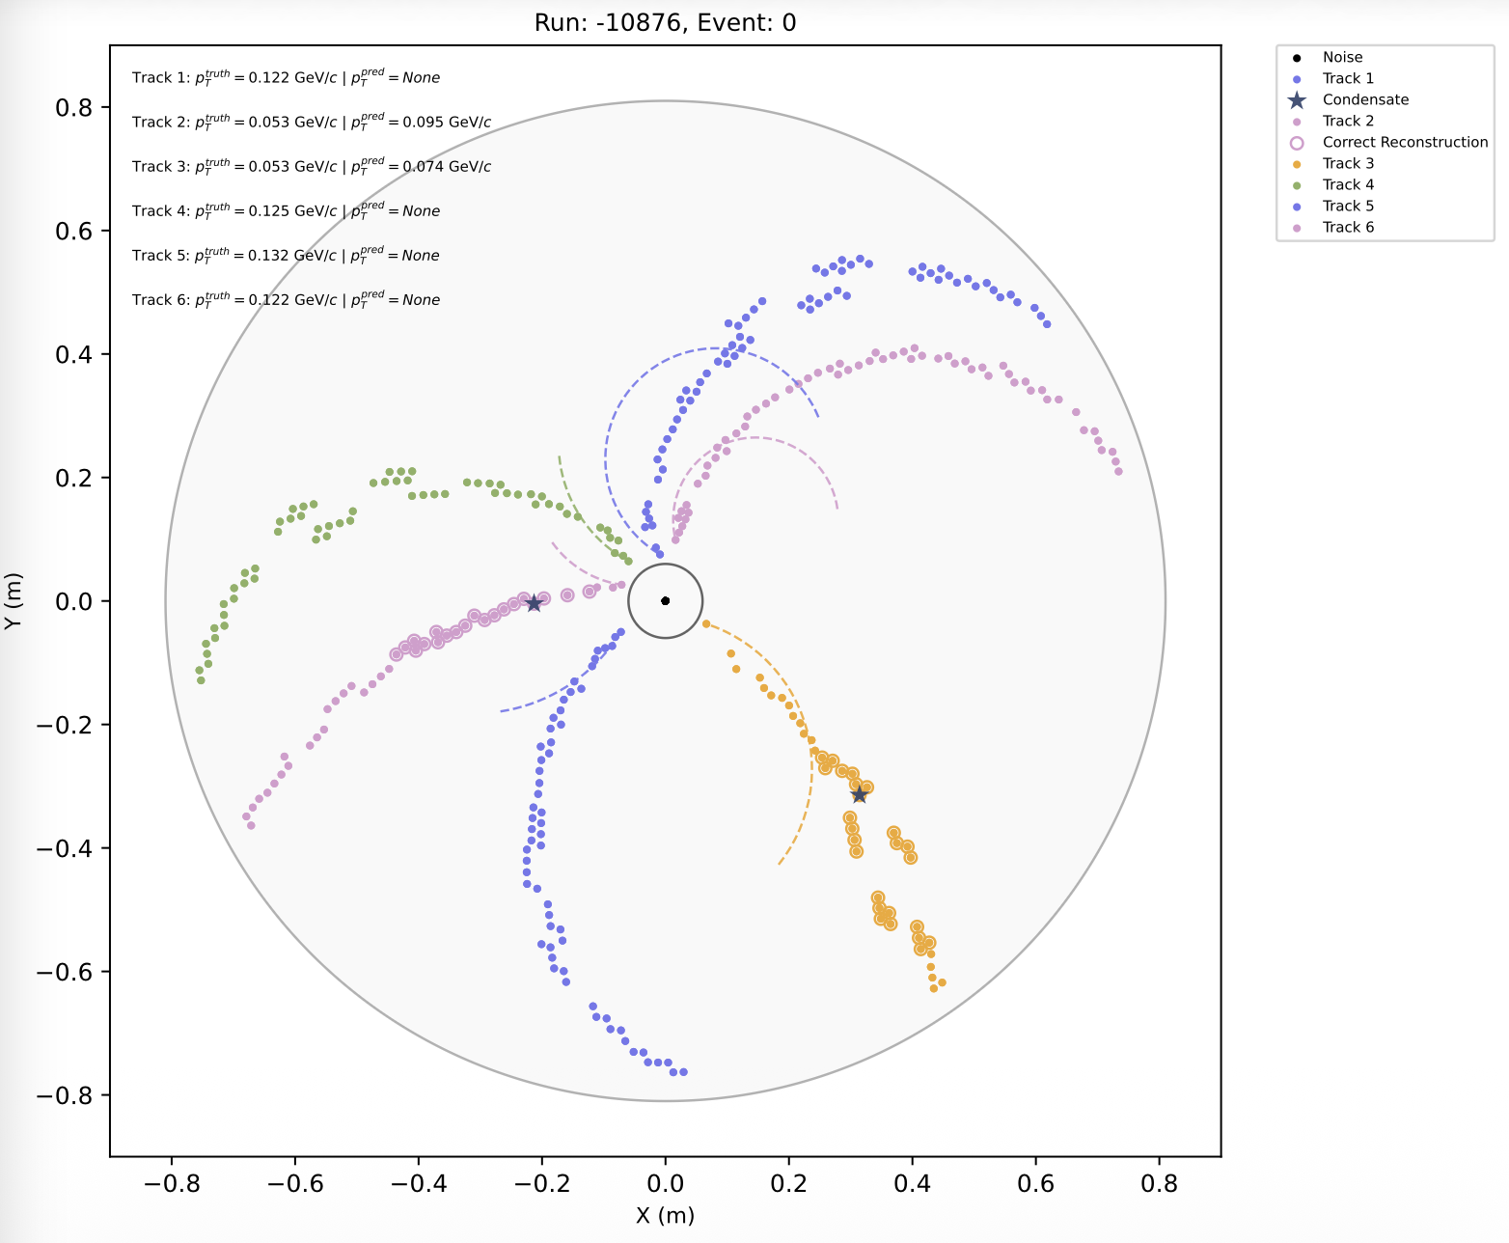
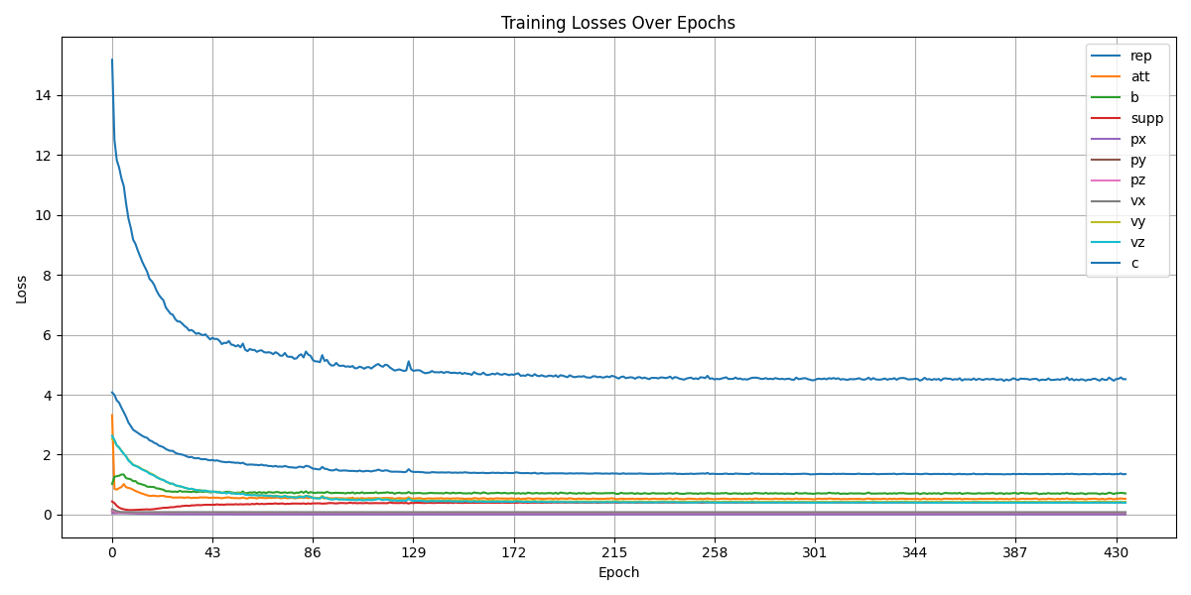
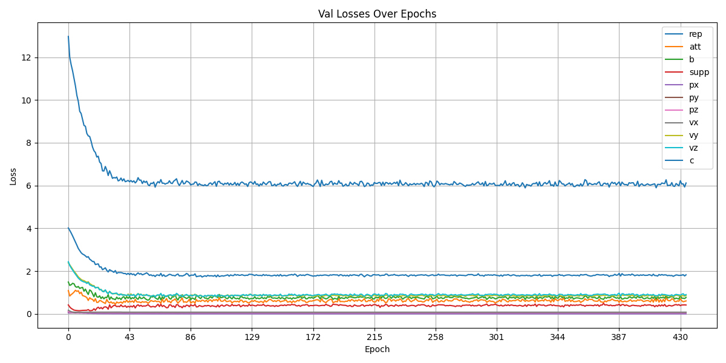
DC ML tracking
Train model: use 9,000 training samples and 1,000 validation samples.
After completing one round of training, the results were not satisfactory.
We think this is due to the small sample size. The high-momentum training used approximately 200,000 samples for training, while the low-momentum samples were more complex, so more samples should be used.

Slide 12
2026.3.17
Nankai Group Meeting

Slide 13
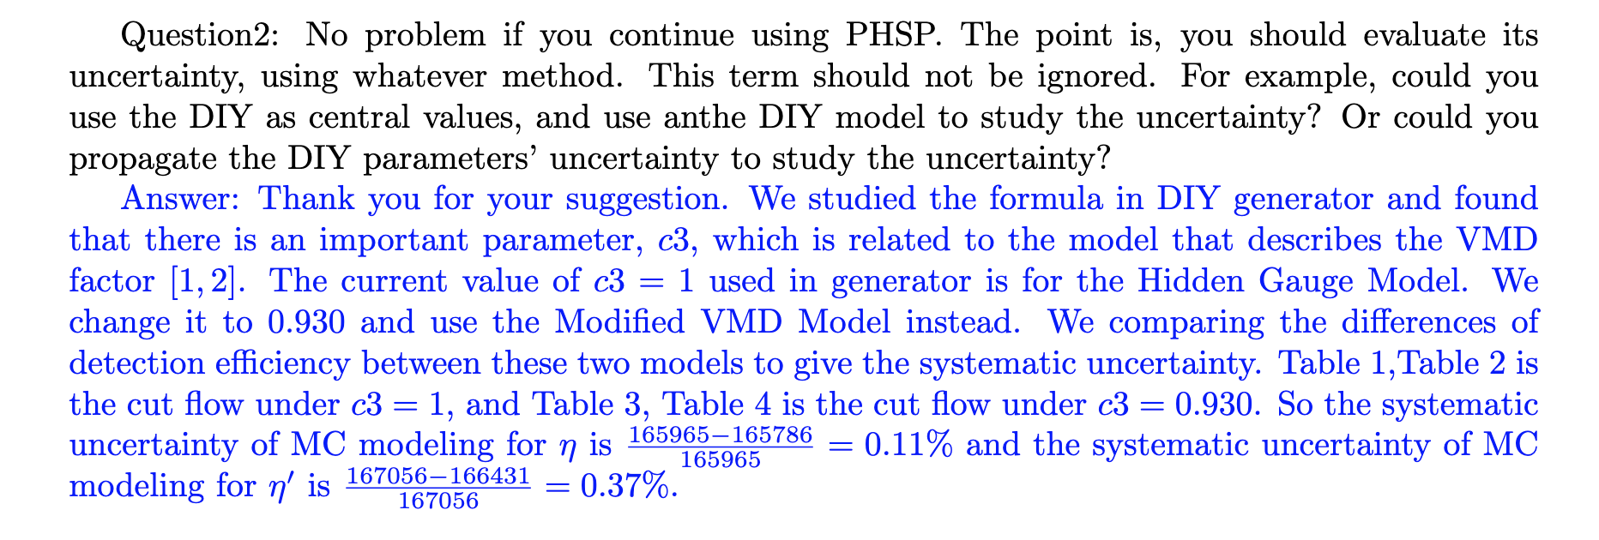
CLFV
After Prof. Wang check it, I will reply it on HyperNews.

Slide 14
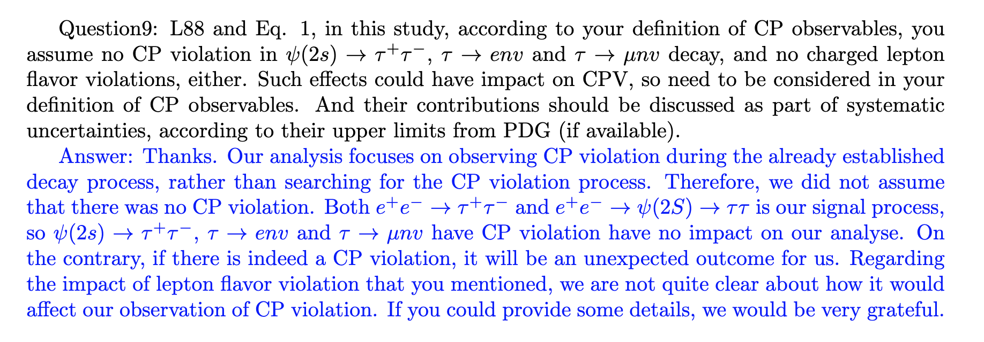
CPV

Slide 15
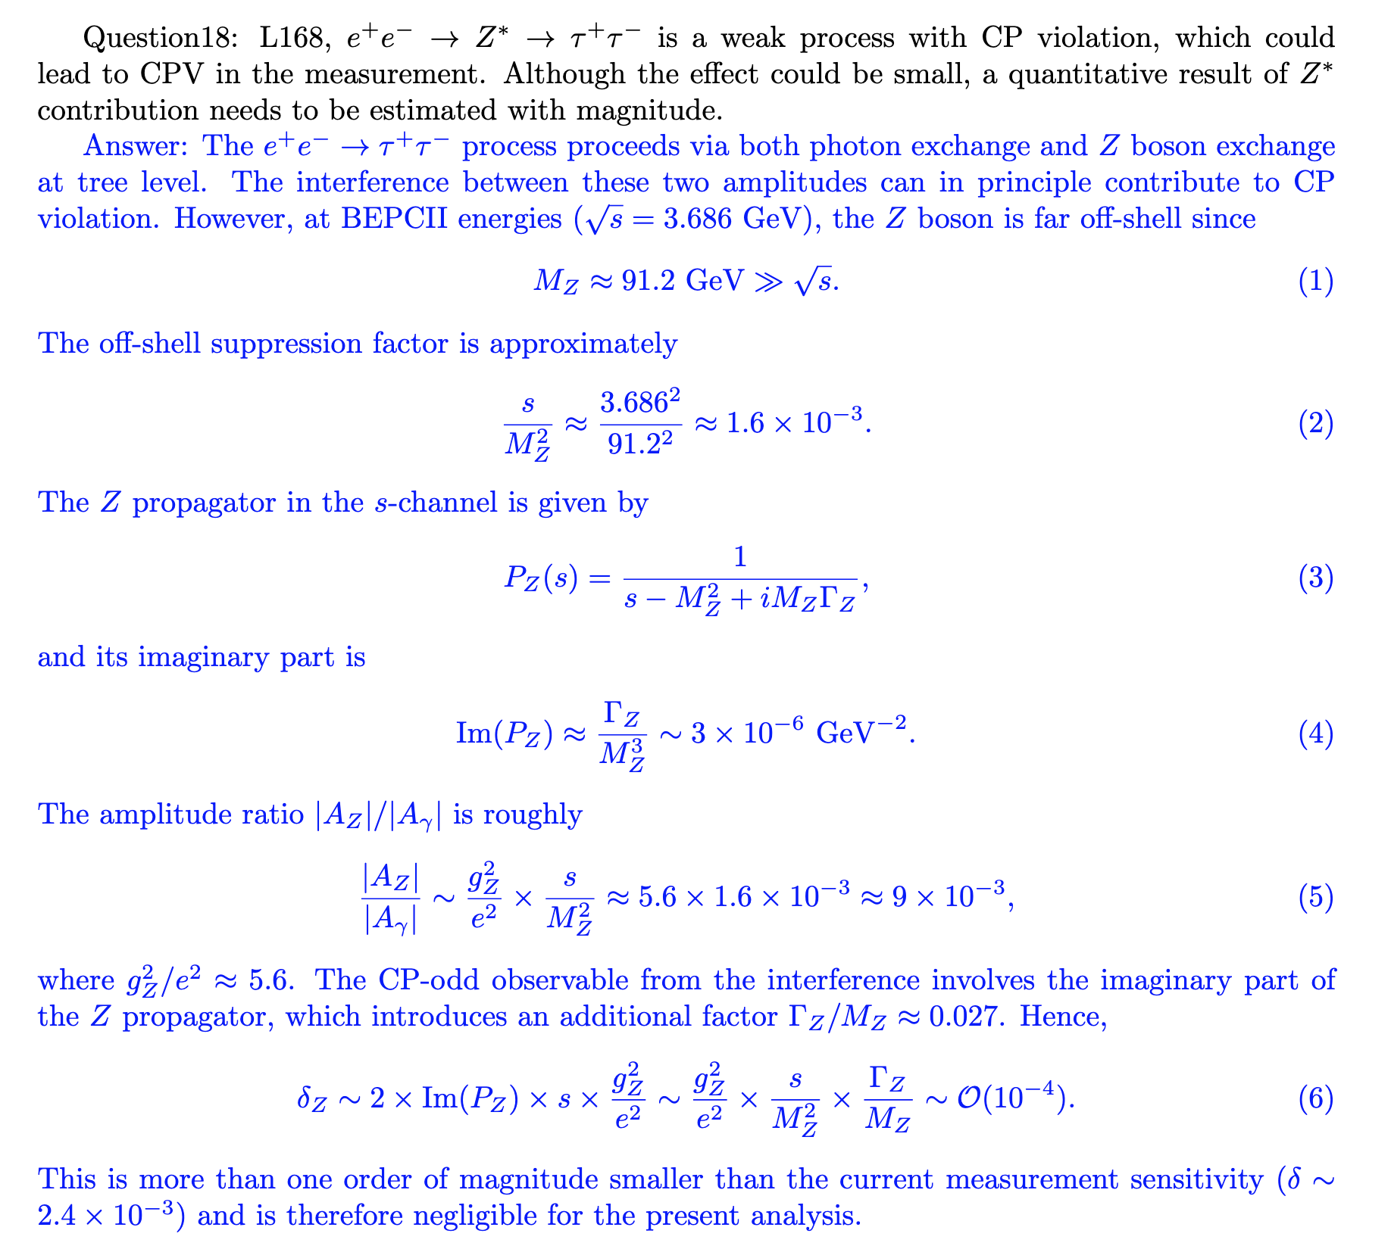
CPV

Slide 16
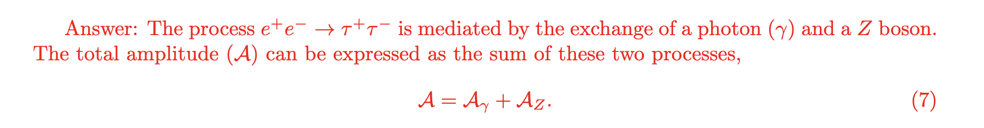
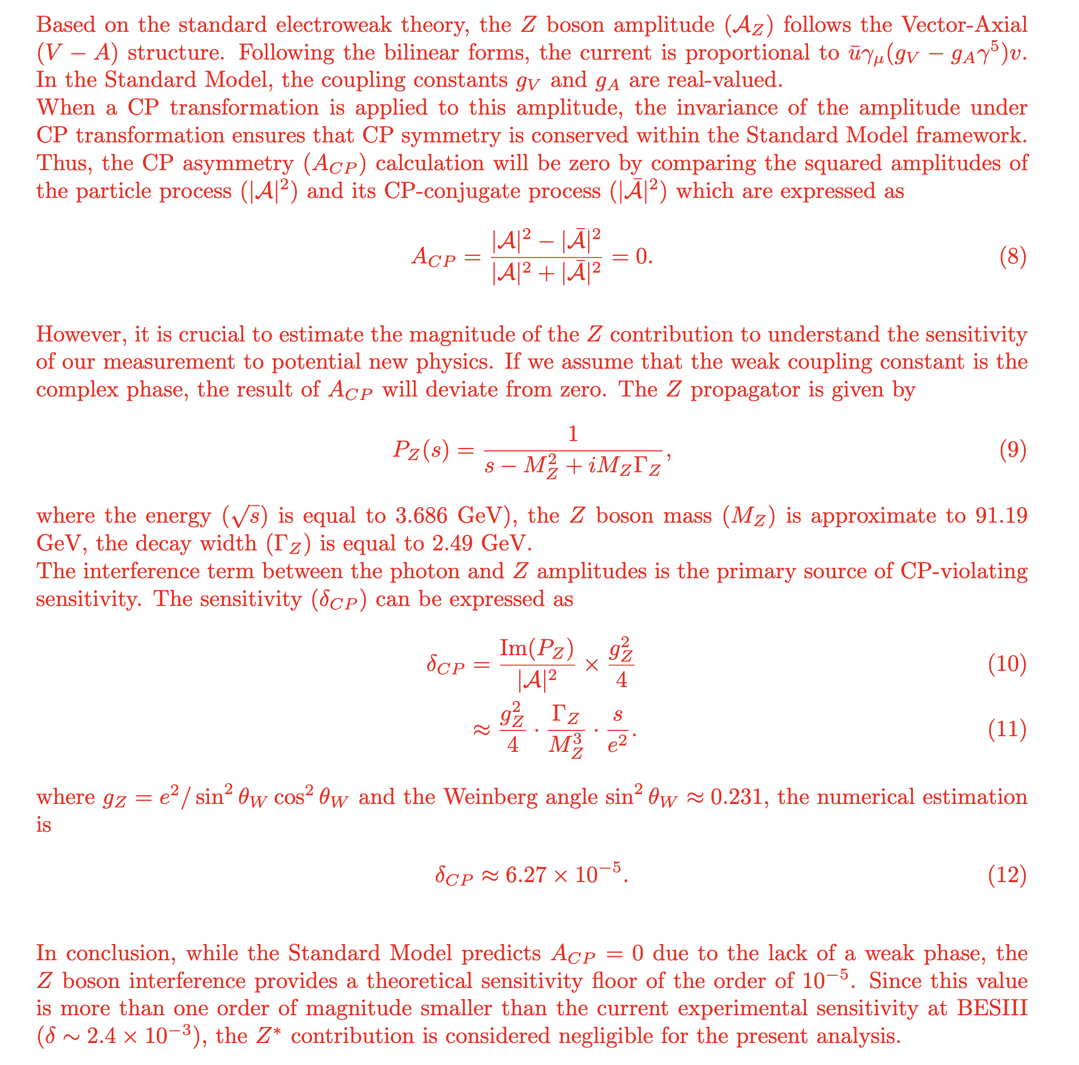

Slide 17
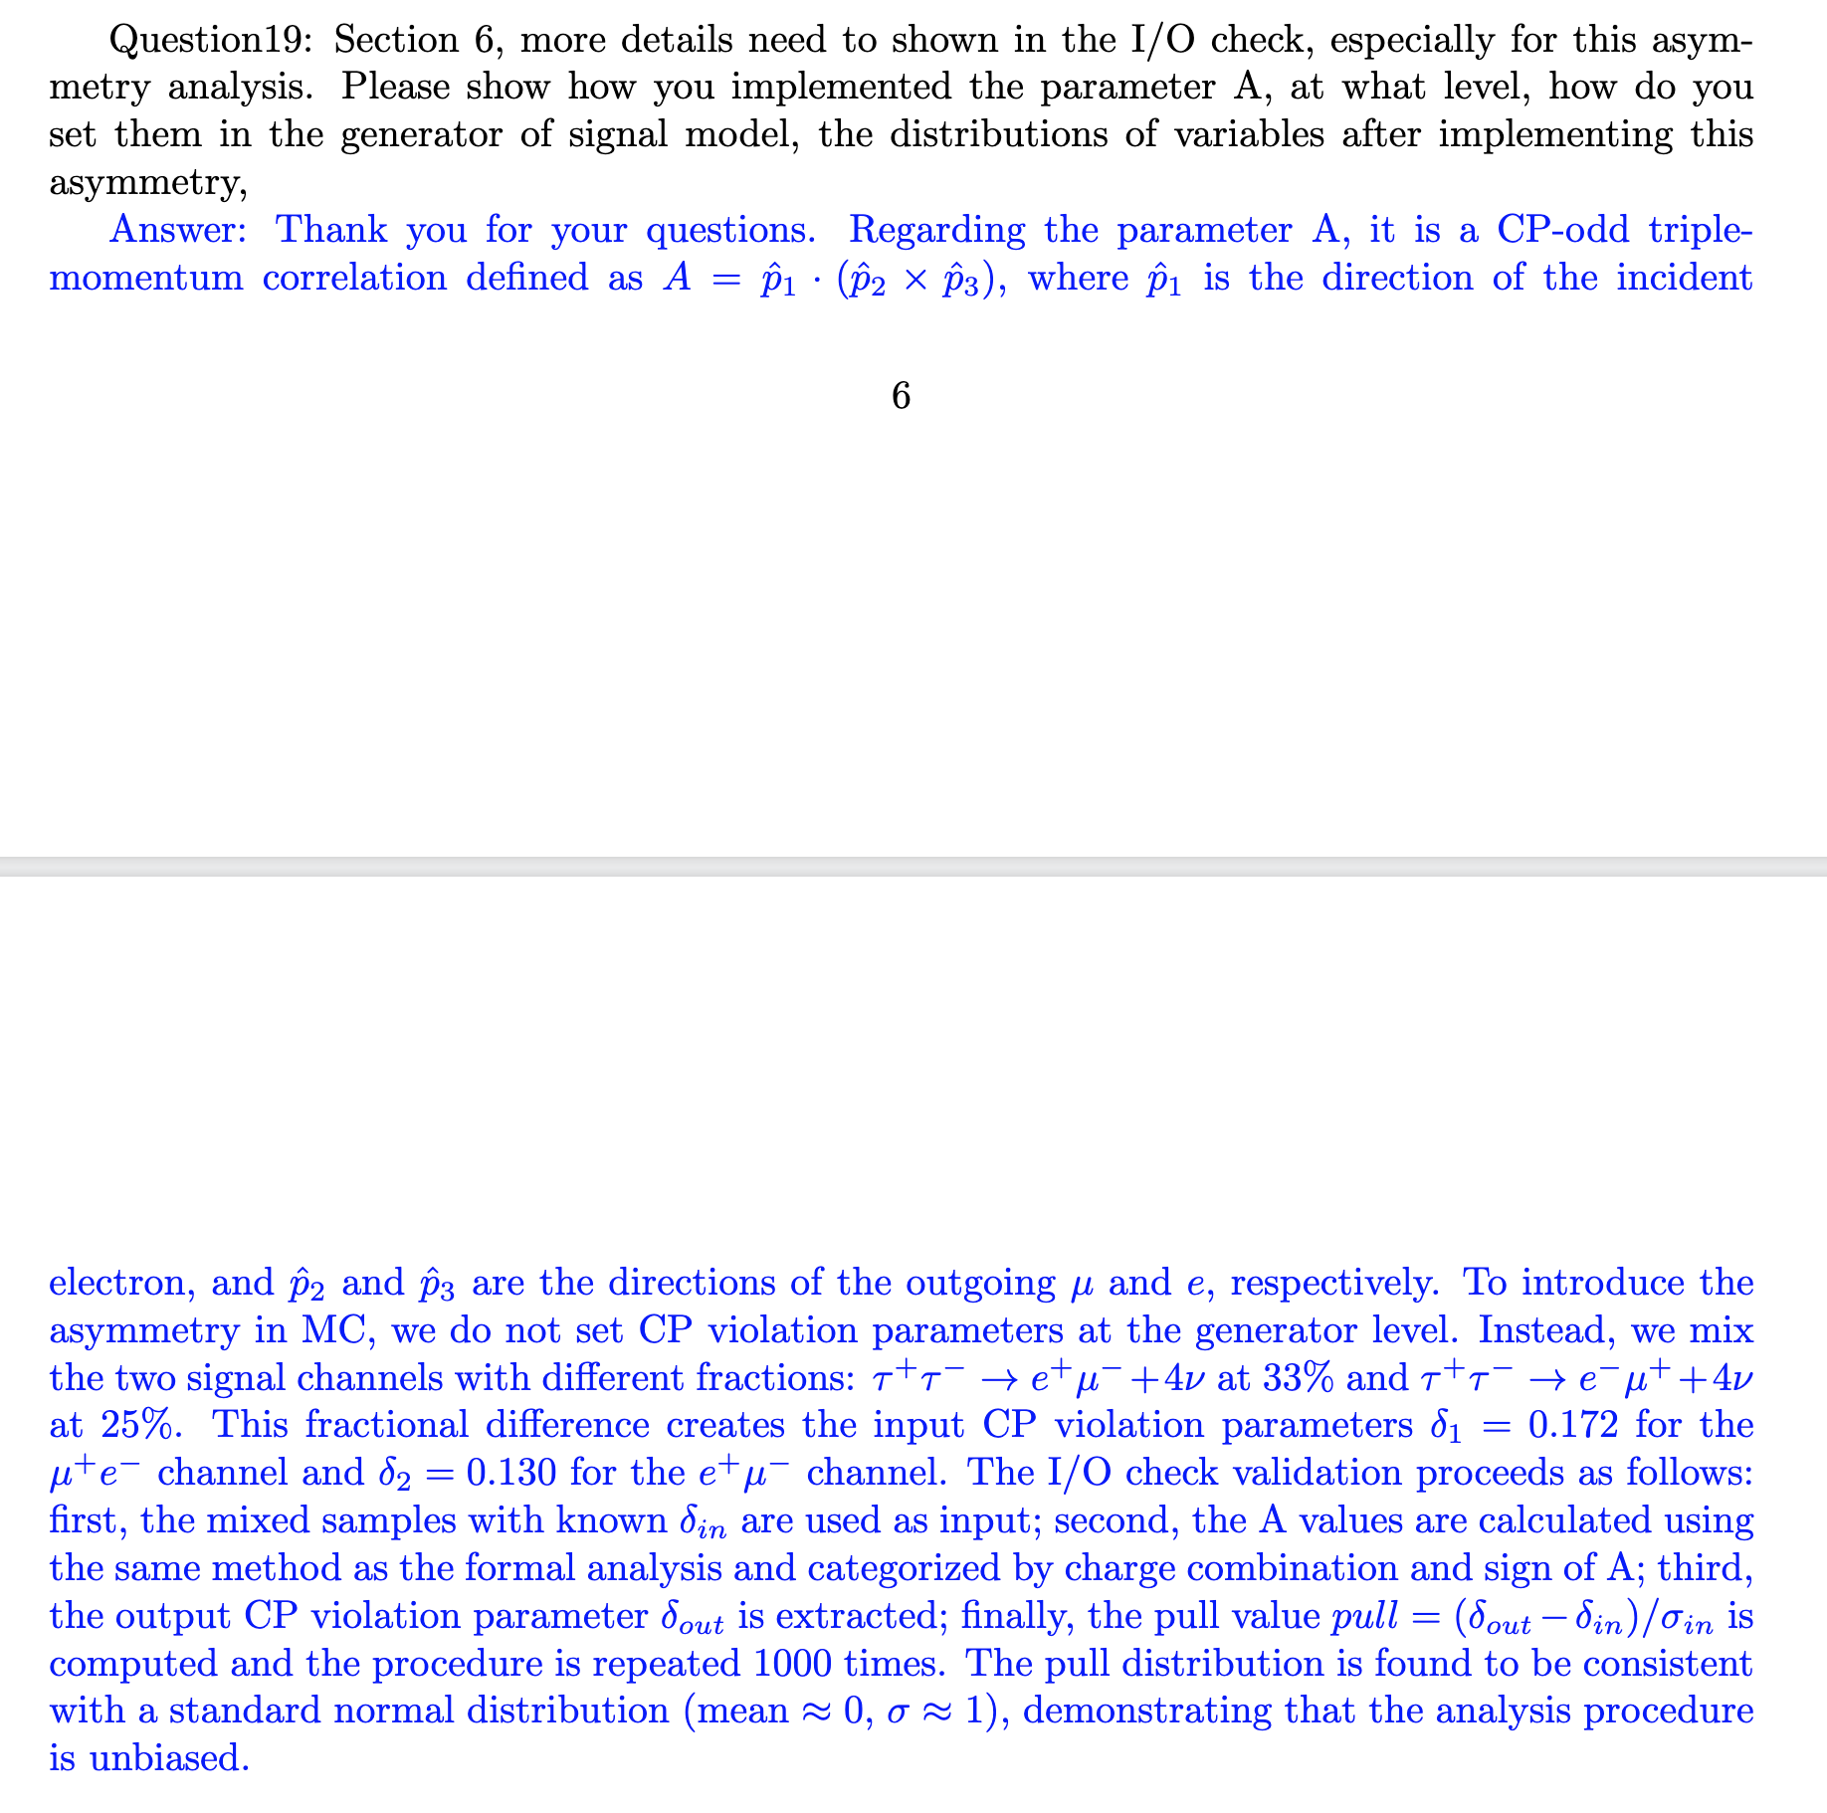
CPV

Slide 18
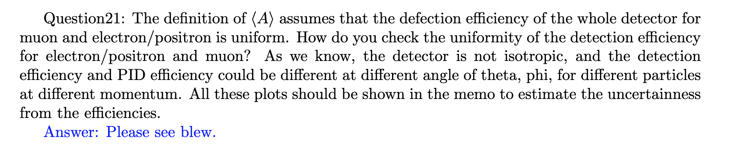
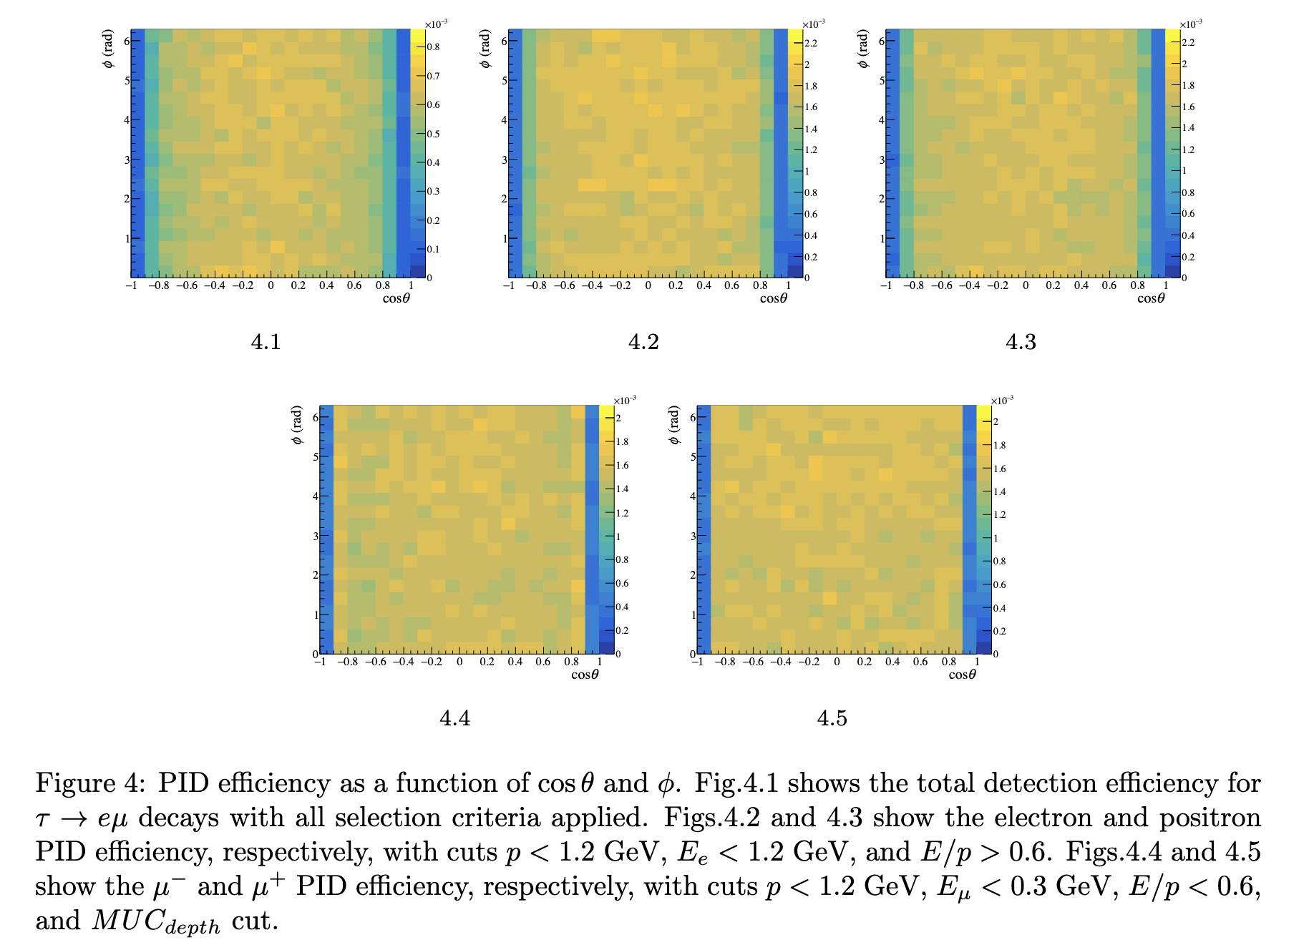
CPV

Slide 19
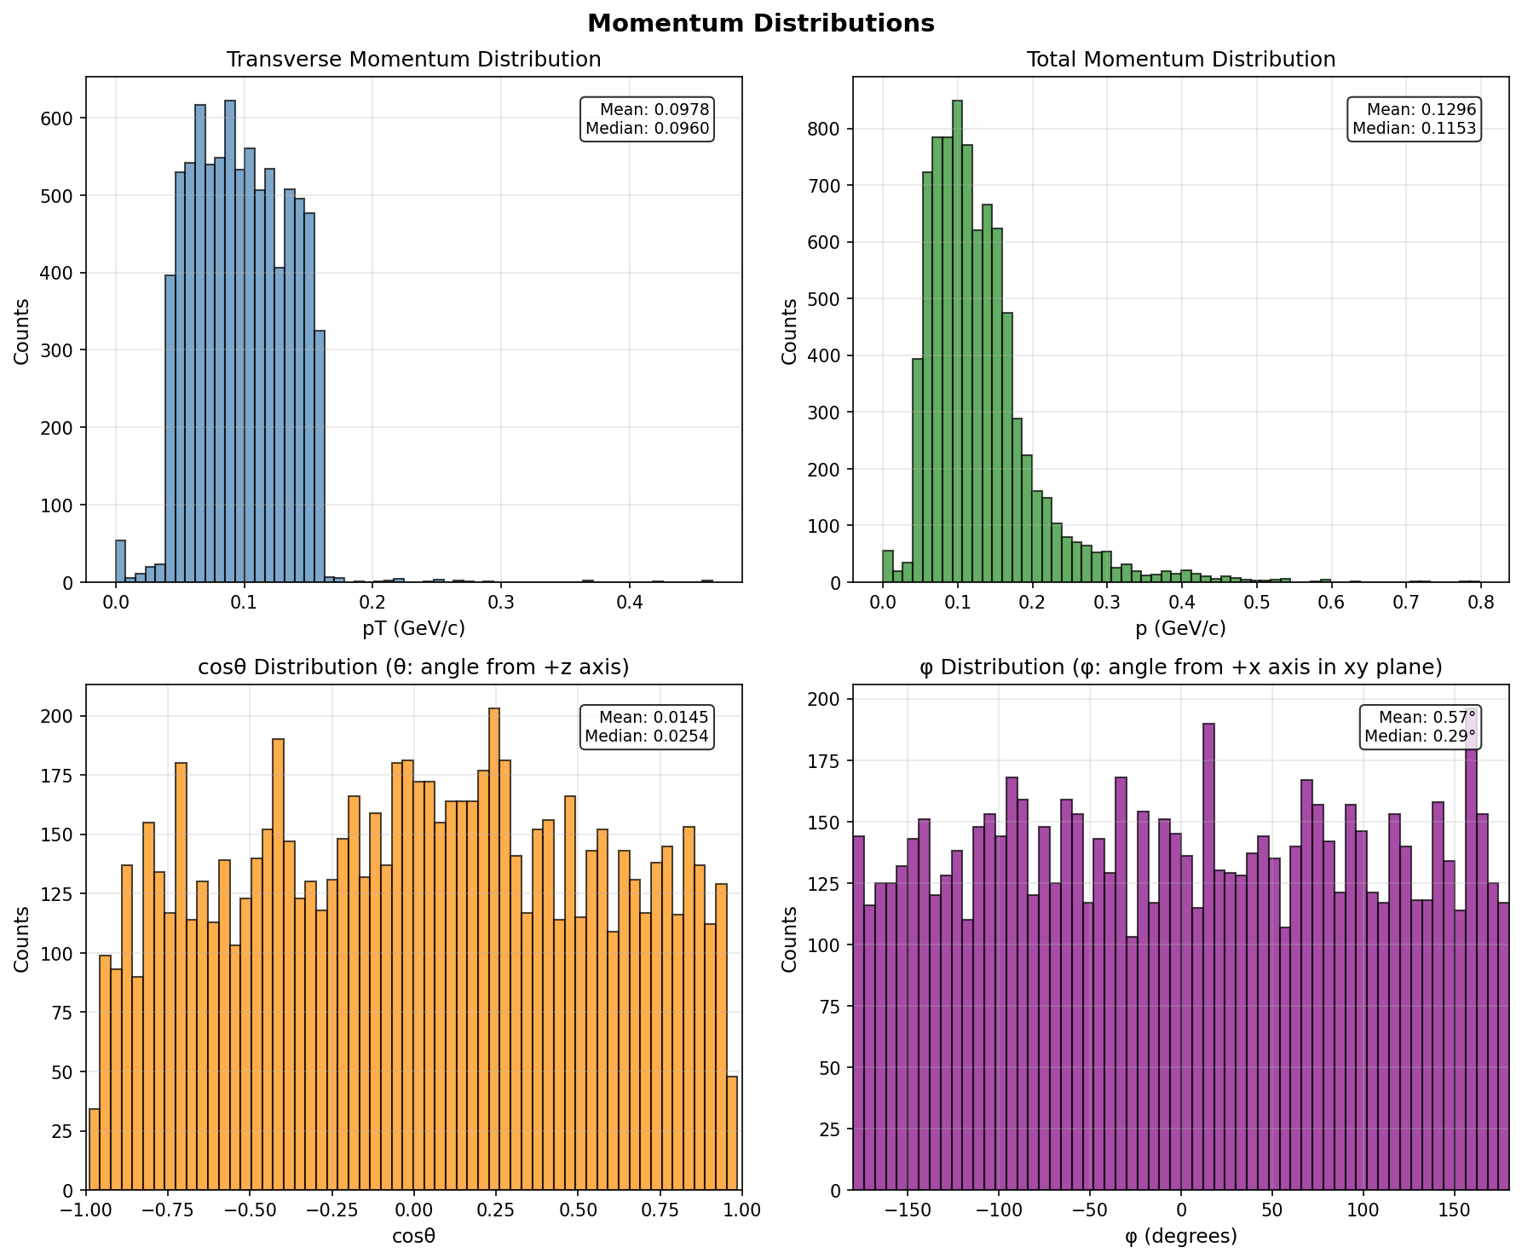
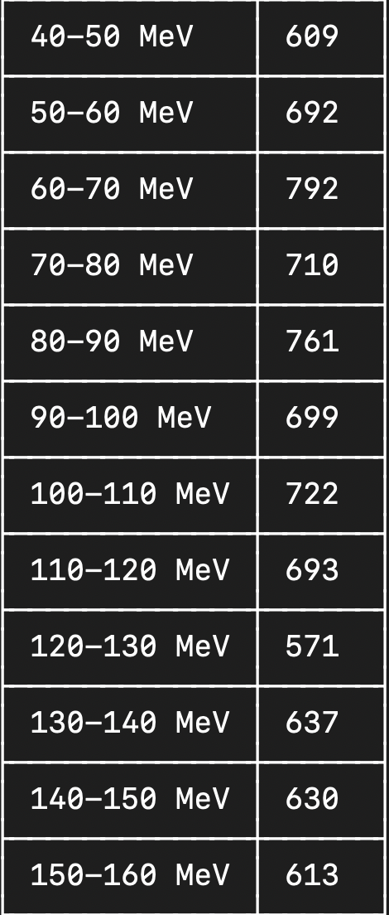
横动量统计（1000个事例中不同横动量track的数量）

Slide 20
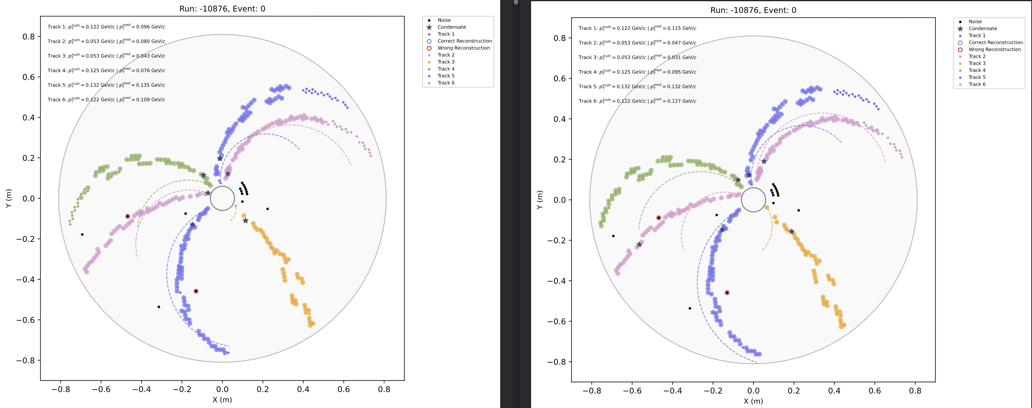
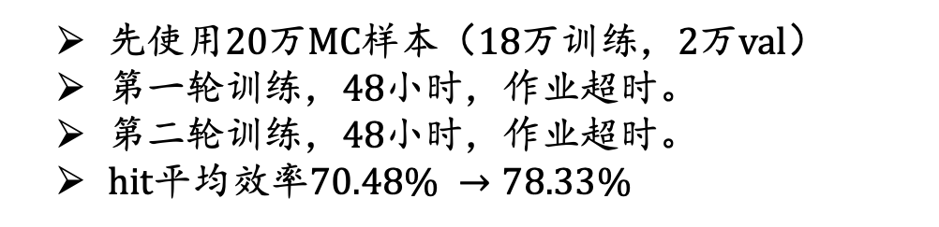
先使用20万MC样本（18万训练，2万val）
第一轮训练，48小时，作业超时。
第二轮训练，48小时，作业超时。
hit平均效率$70.48\% →78.33\%$
Main problem: Modify the model.

Slide 21
2026.3.24
Nankai Group Meeting

Slide 22
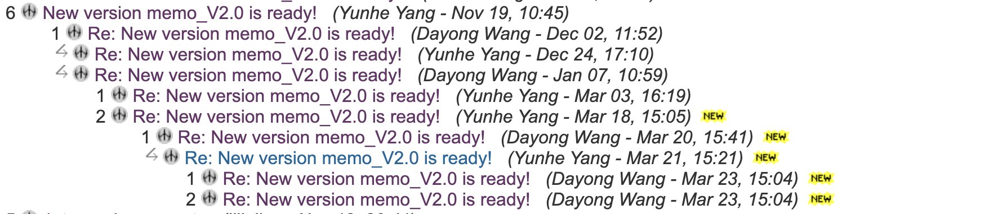
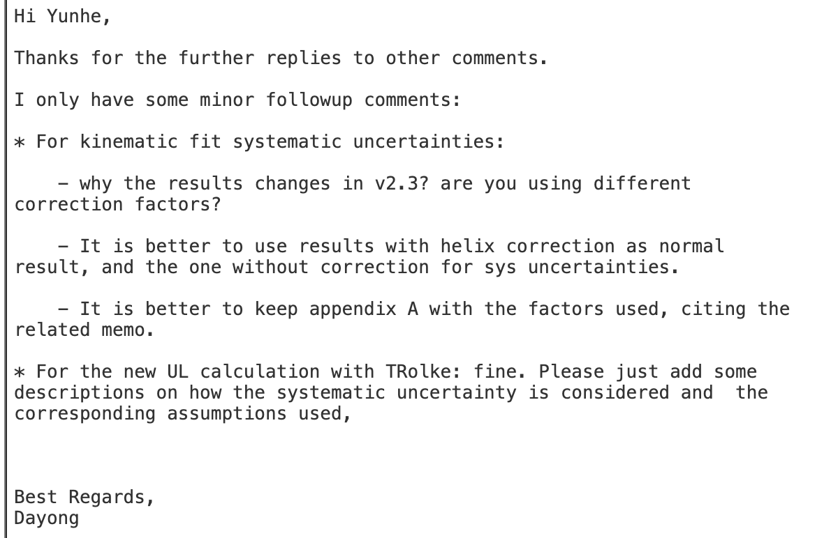
CLFV

Slide 23
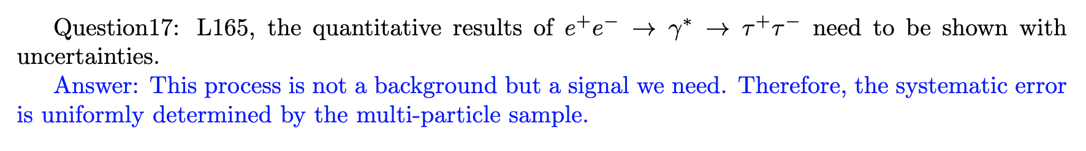
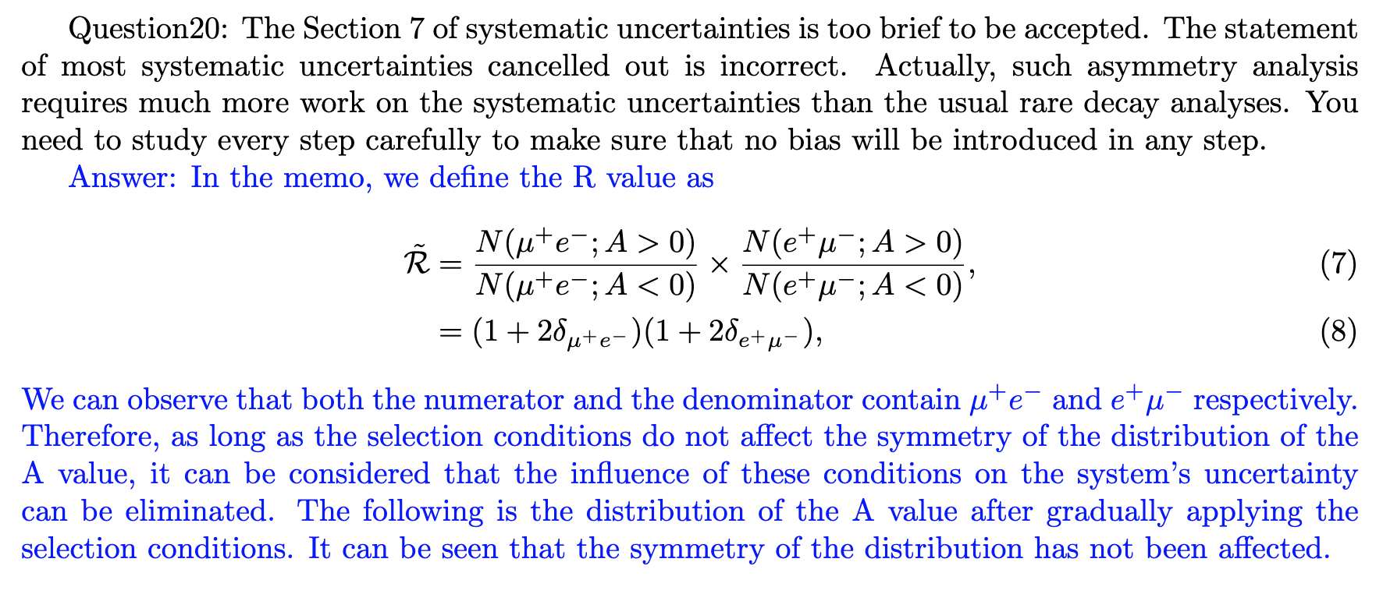
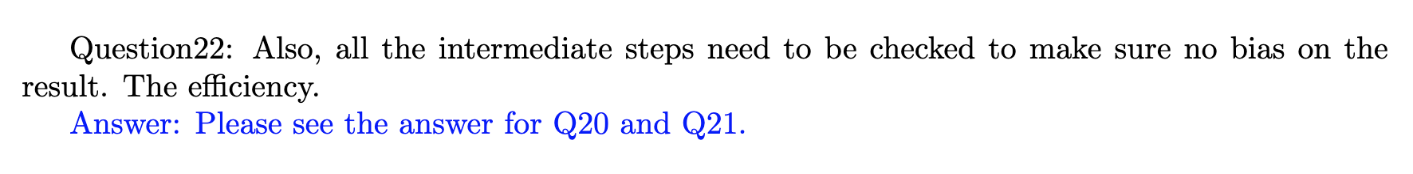
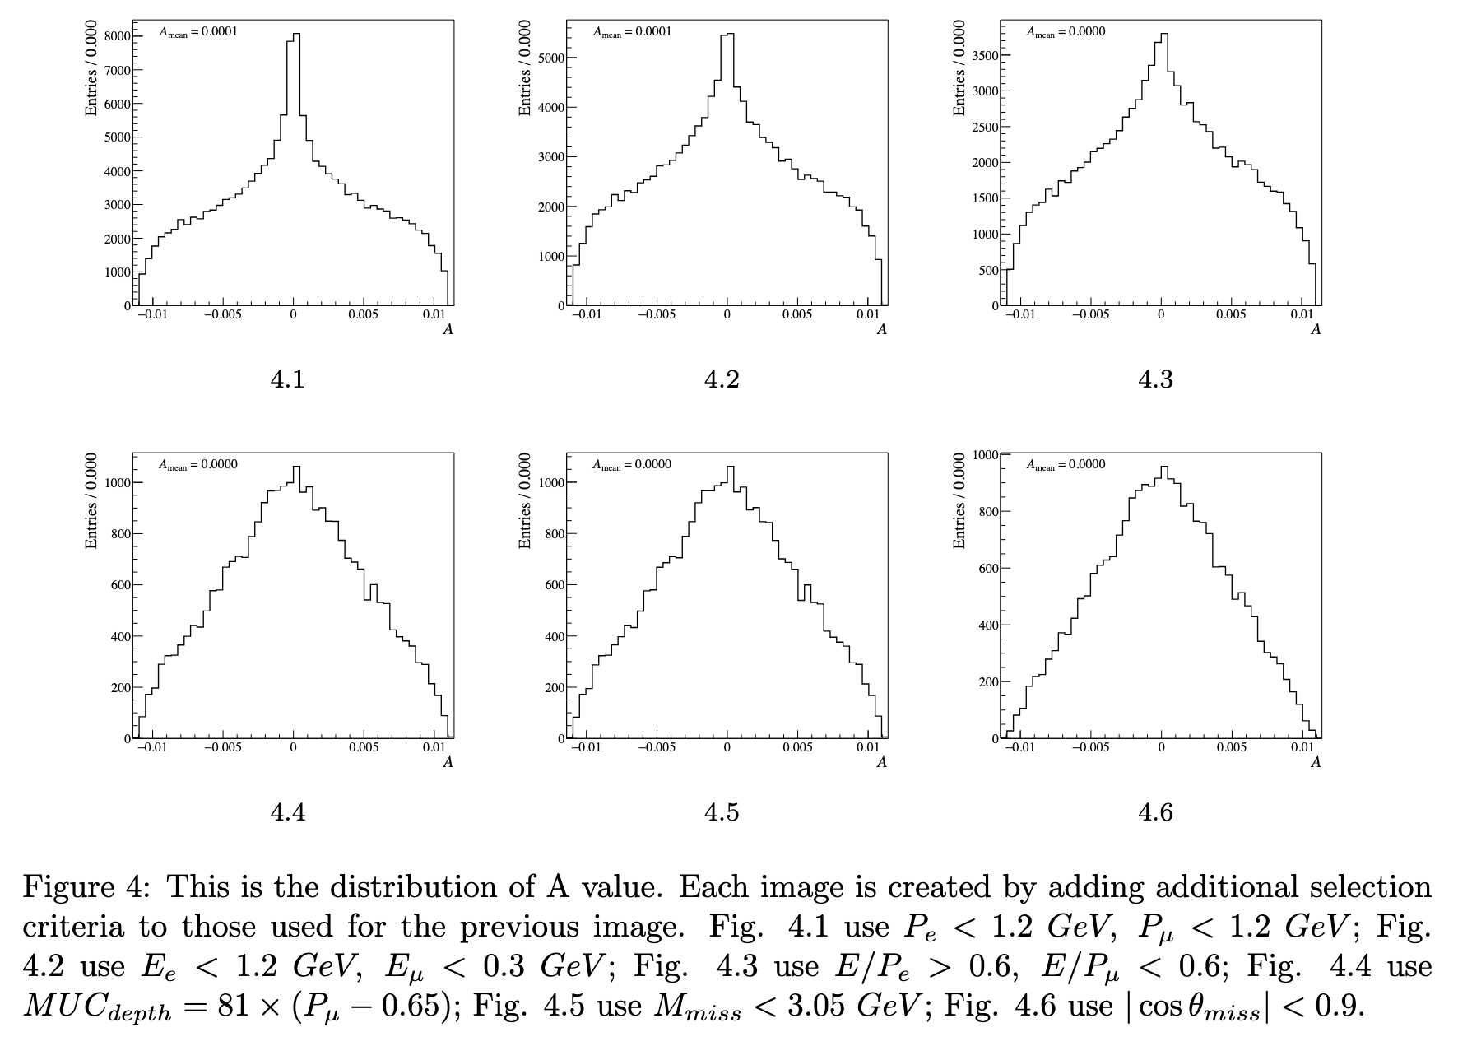
CPV

Slide 24
2026.3.24
Nankai Group Meeting

Slide 25
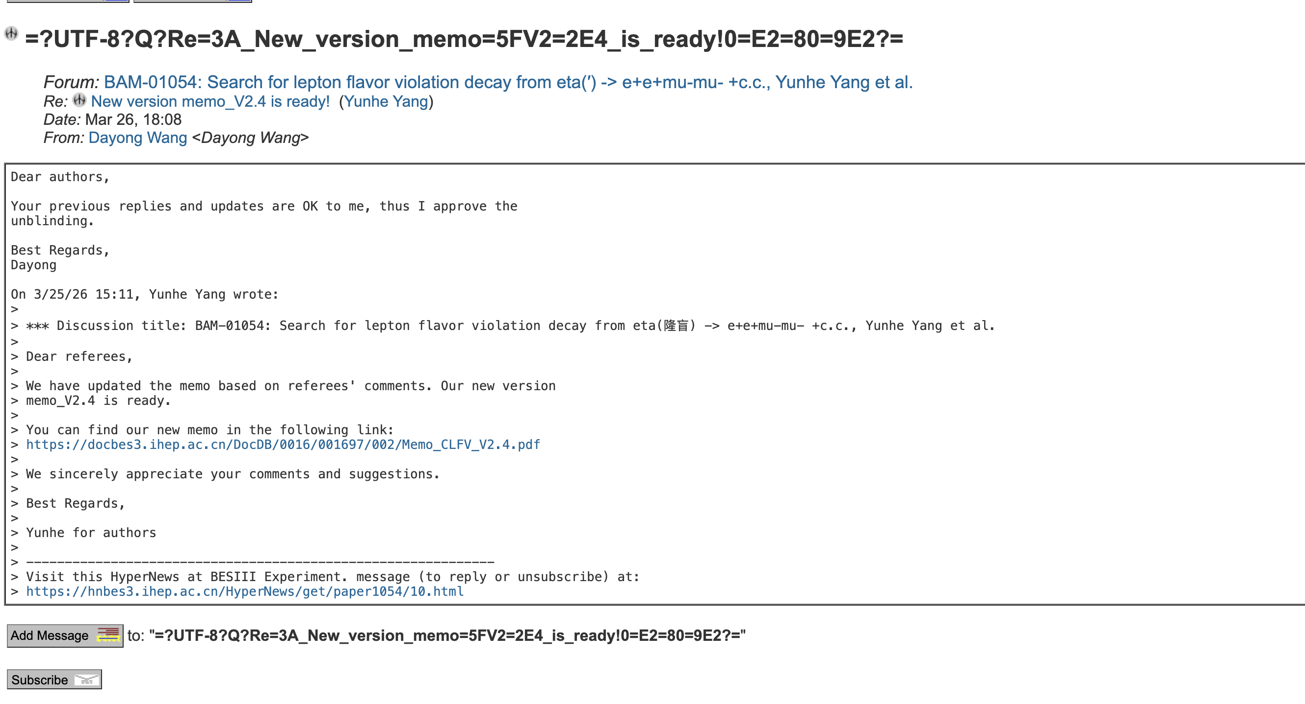
CLFV

Slide 26
2026.4.14
Nankai Group Meeting

Slide 27
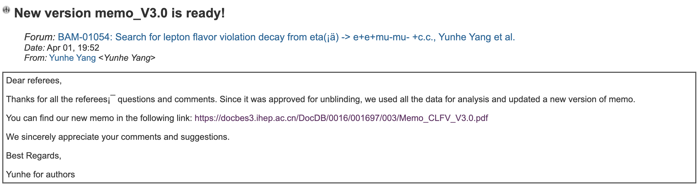
CLFV

Slide 28
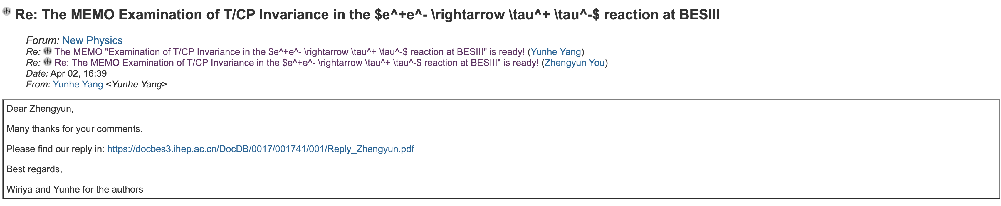
CPV

Slide 29
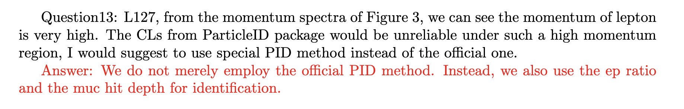
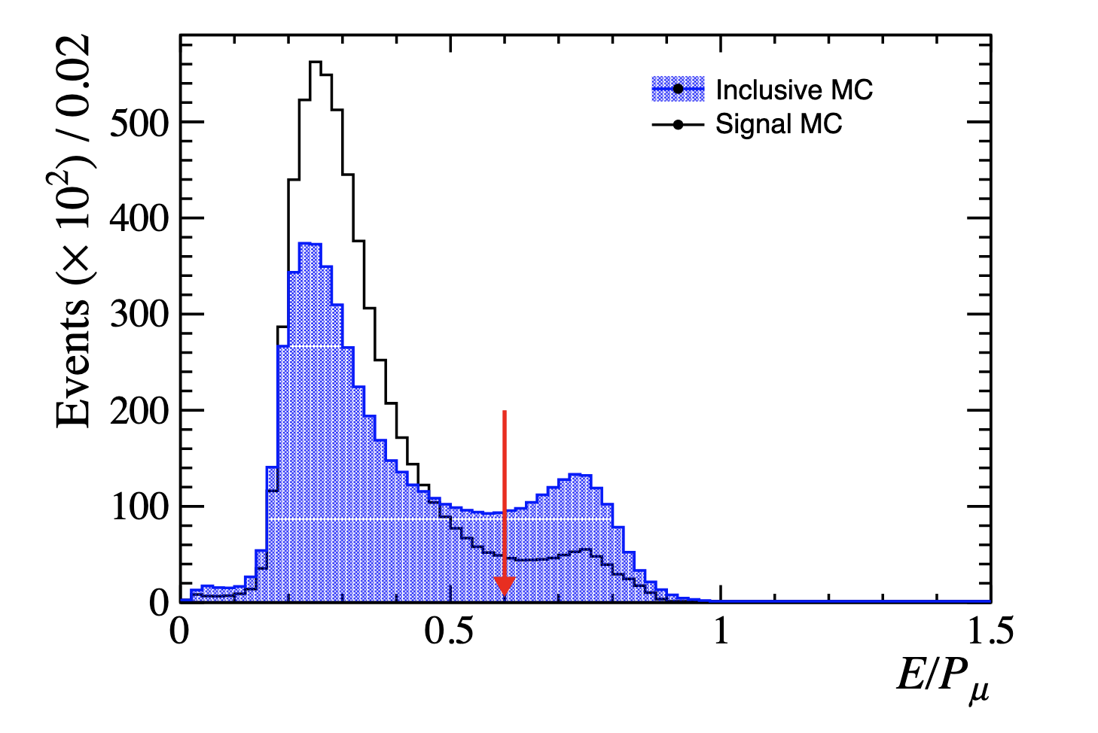
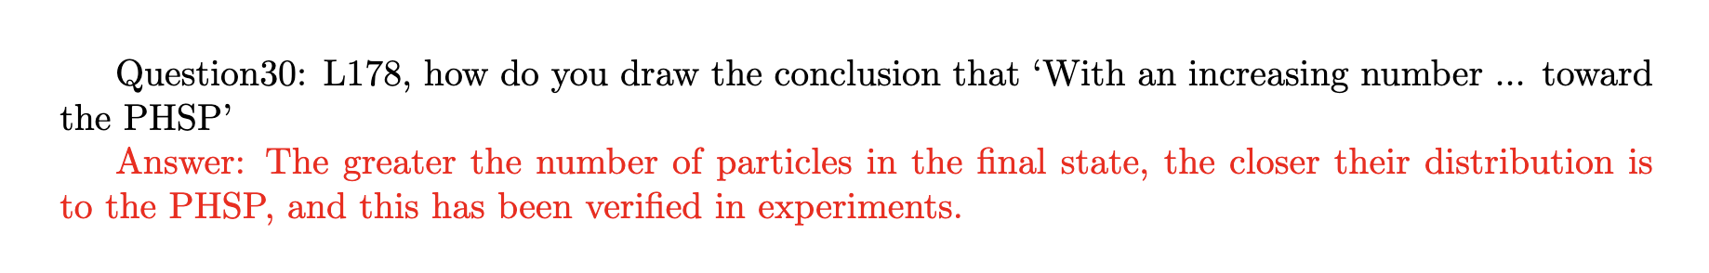
CPV

Slide 30
2026.4.21
Nankai Group Meeting

Slide 31
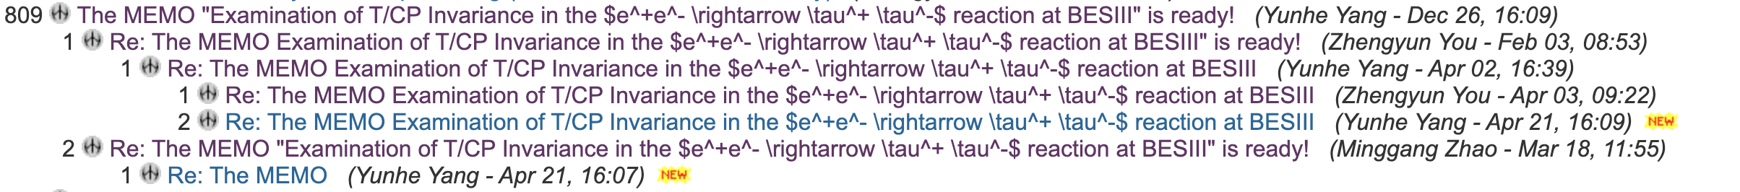
CPV

Slide 33
2026.5.12
Nankai Group Meeting

Slide 34
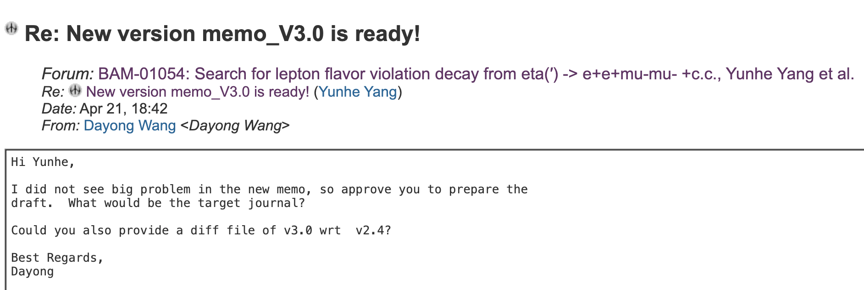
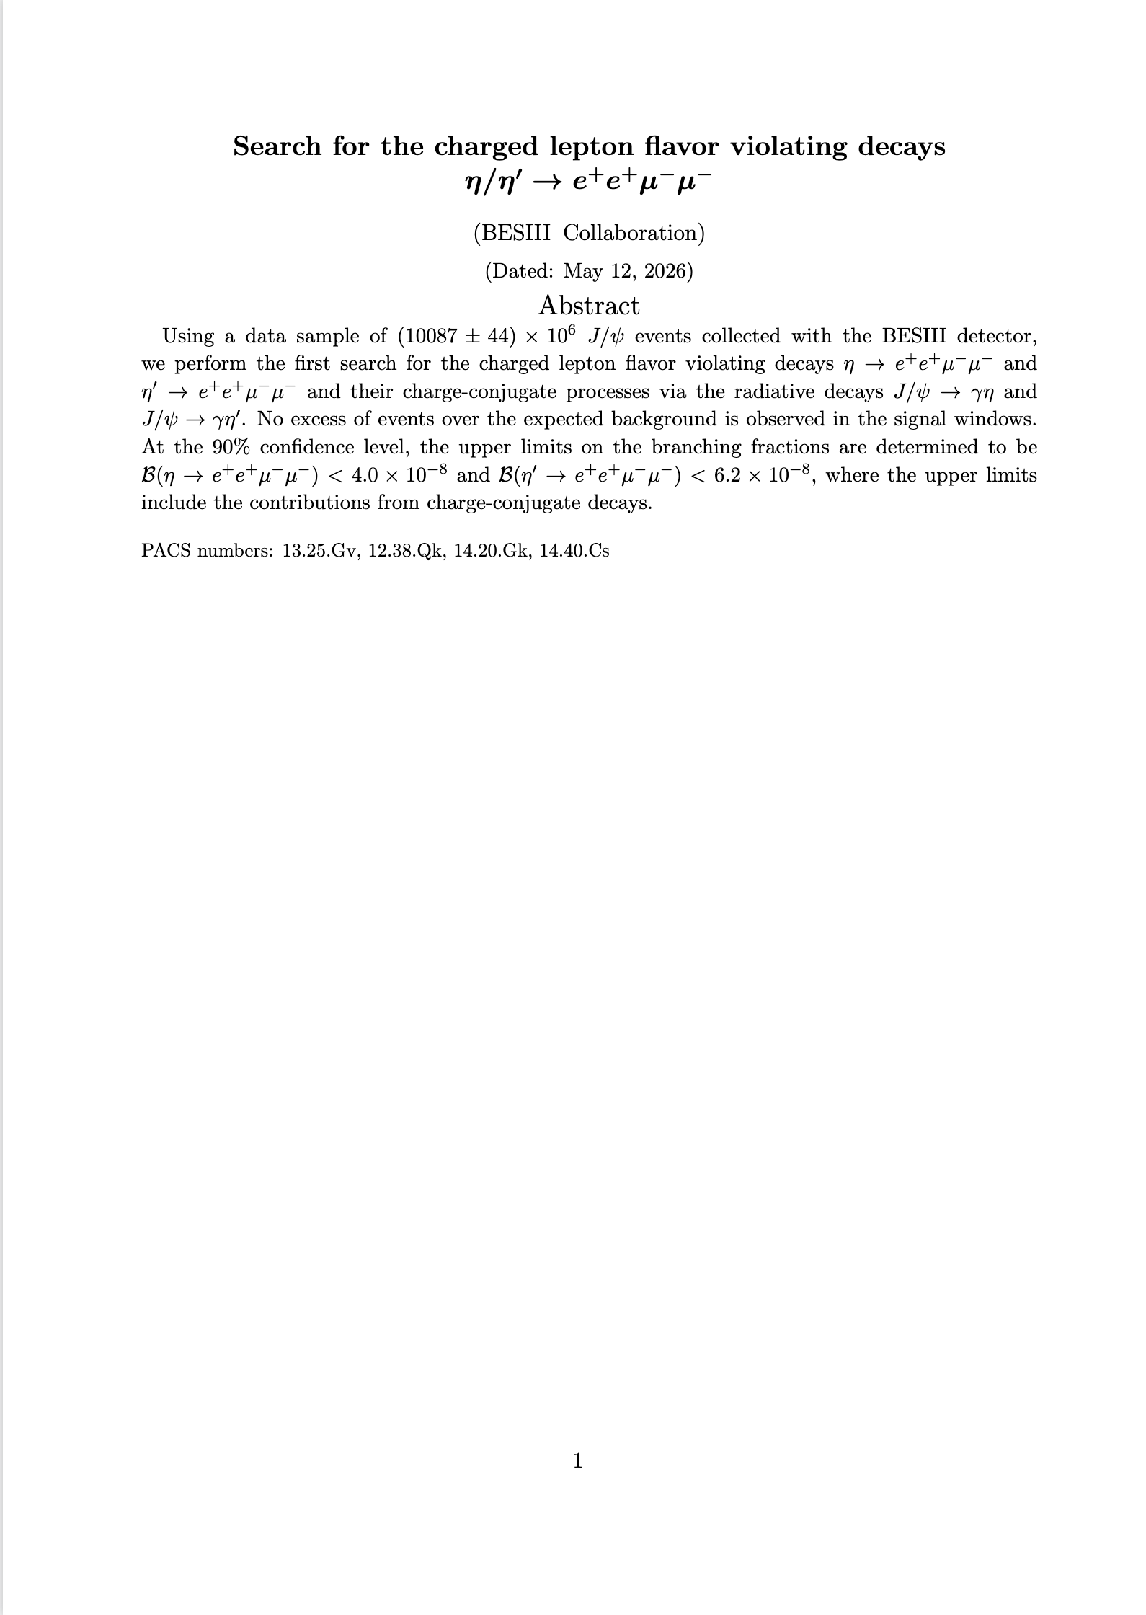
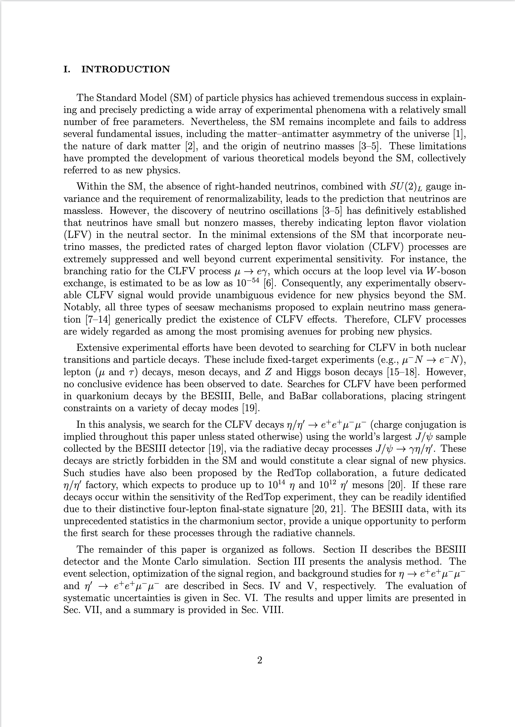
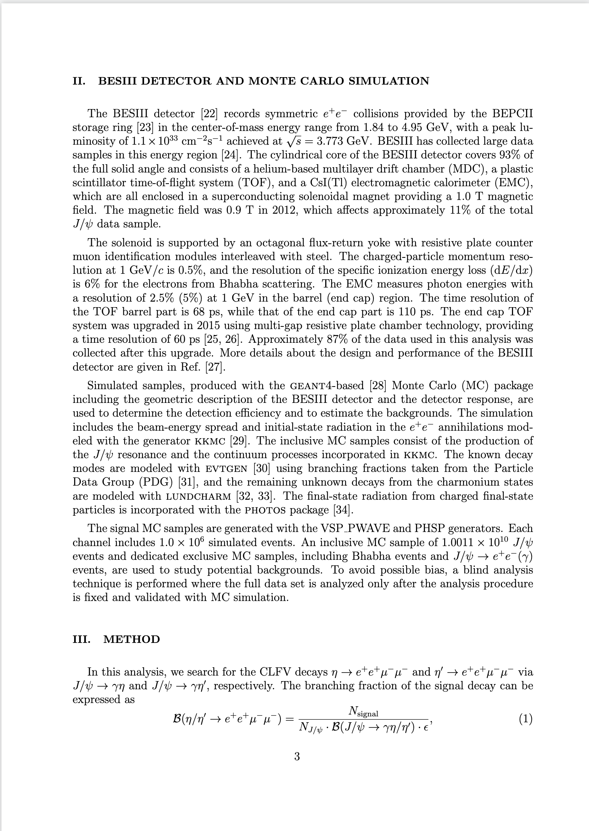
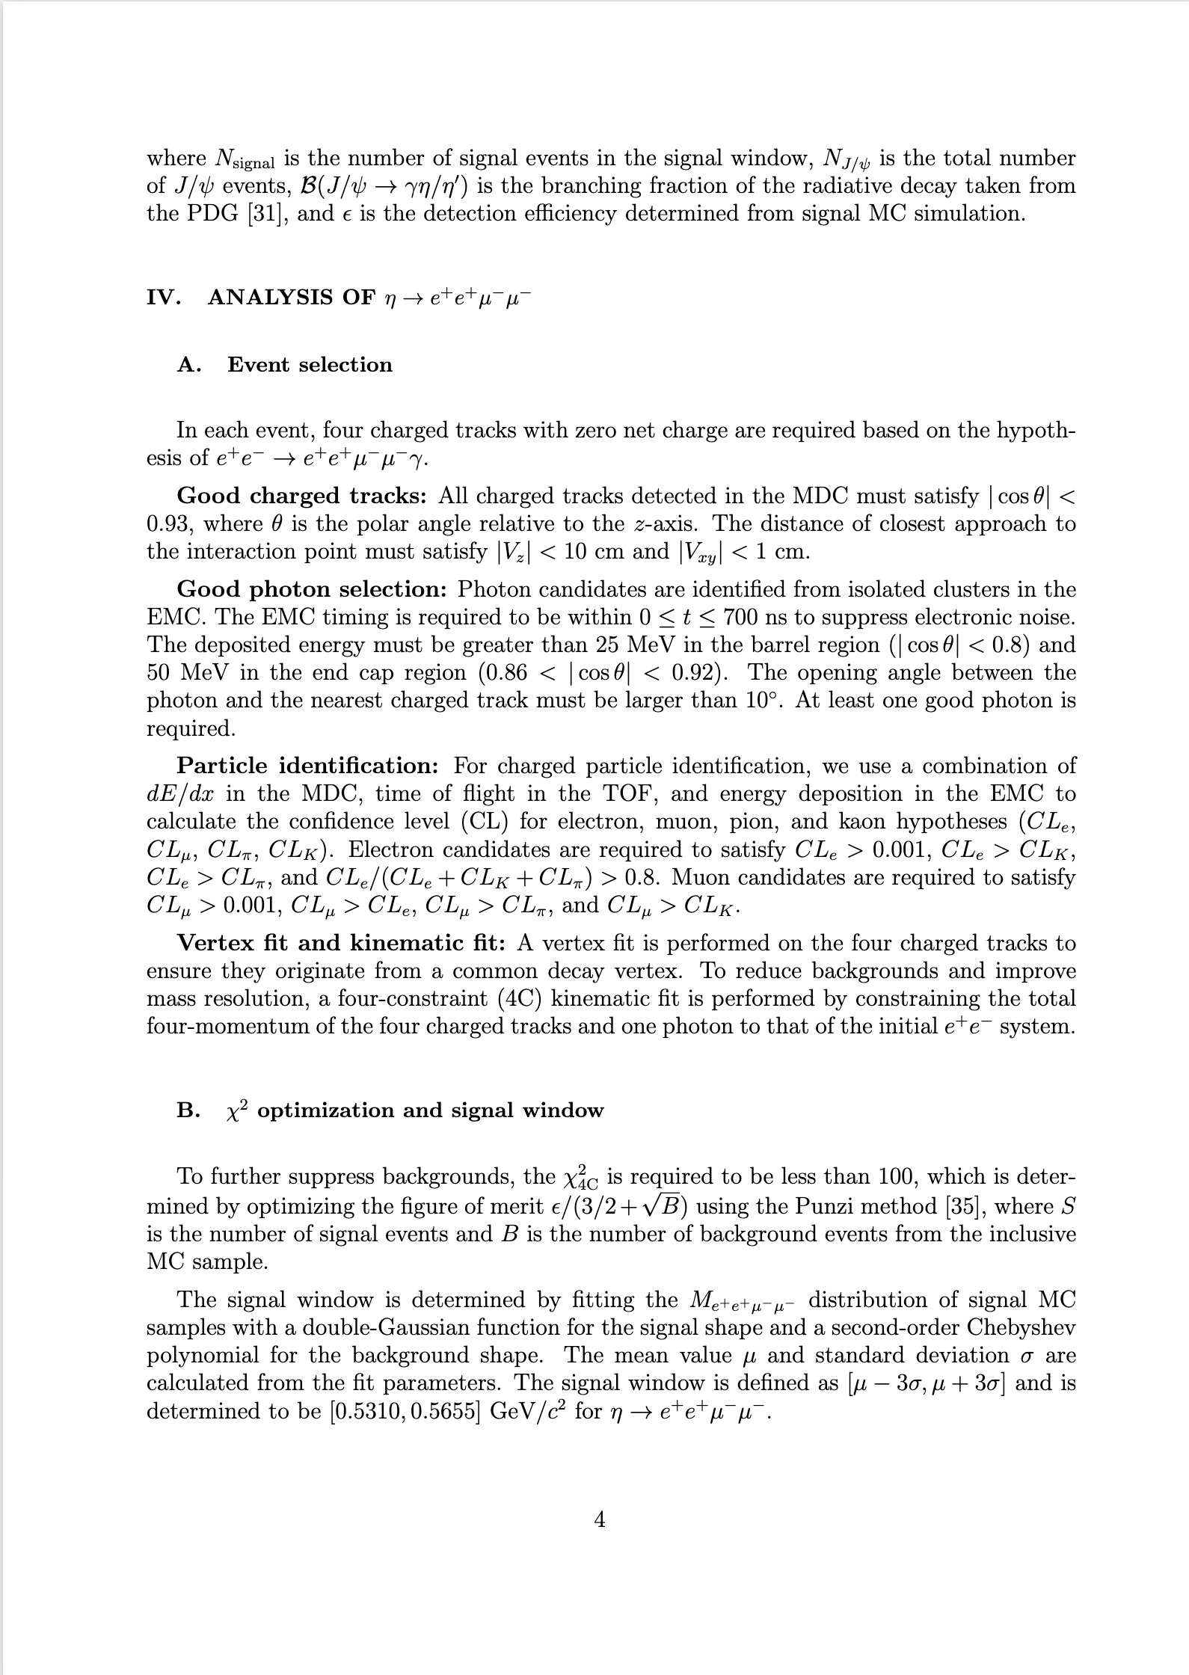
CLFV

Slide 35
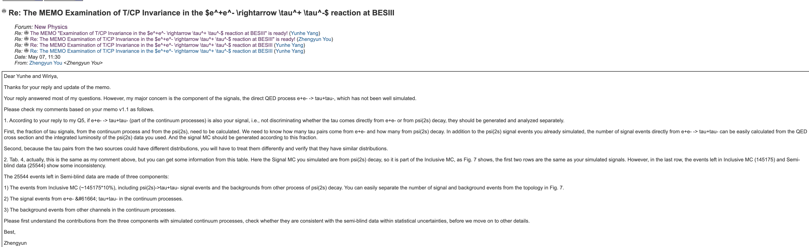
CPV

Slide 36
2026.5.12
Nankai Group Meeting

Slide 37
CLFV

Slide 38
2026.6.2
Nankai Group Meeting

Slide 39
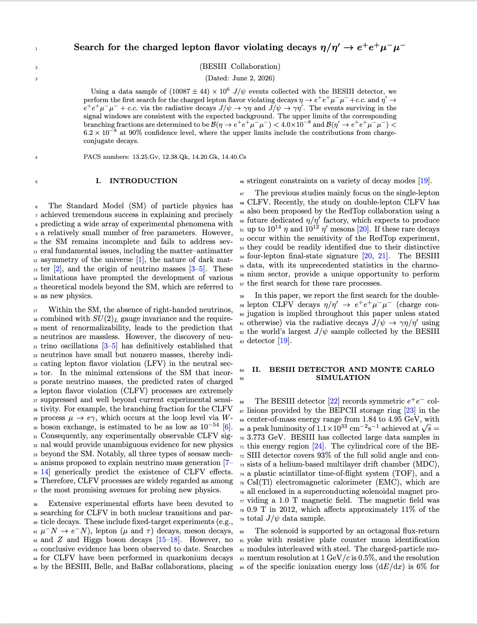
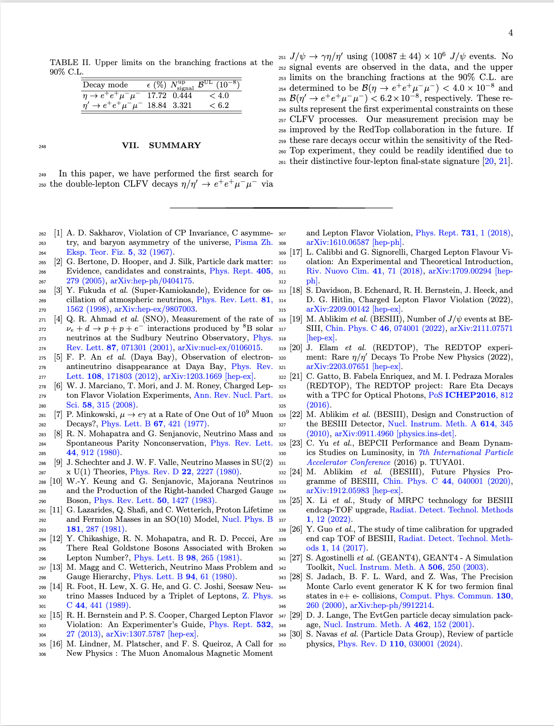
CLFV
Last week
  Modified the LaTeX format of the draft and adopted the official format of PRD.
  Added hyperlinks to the references.
Next week
  Revise the language of the article

Slide 40
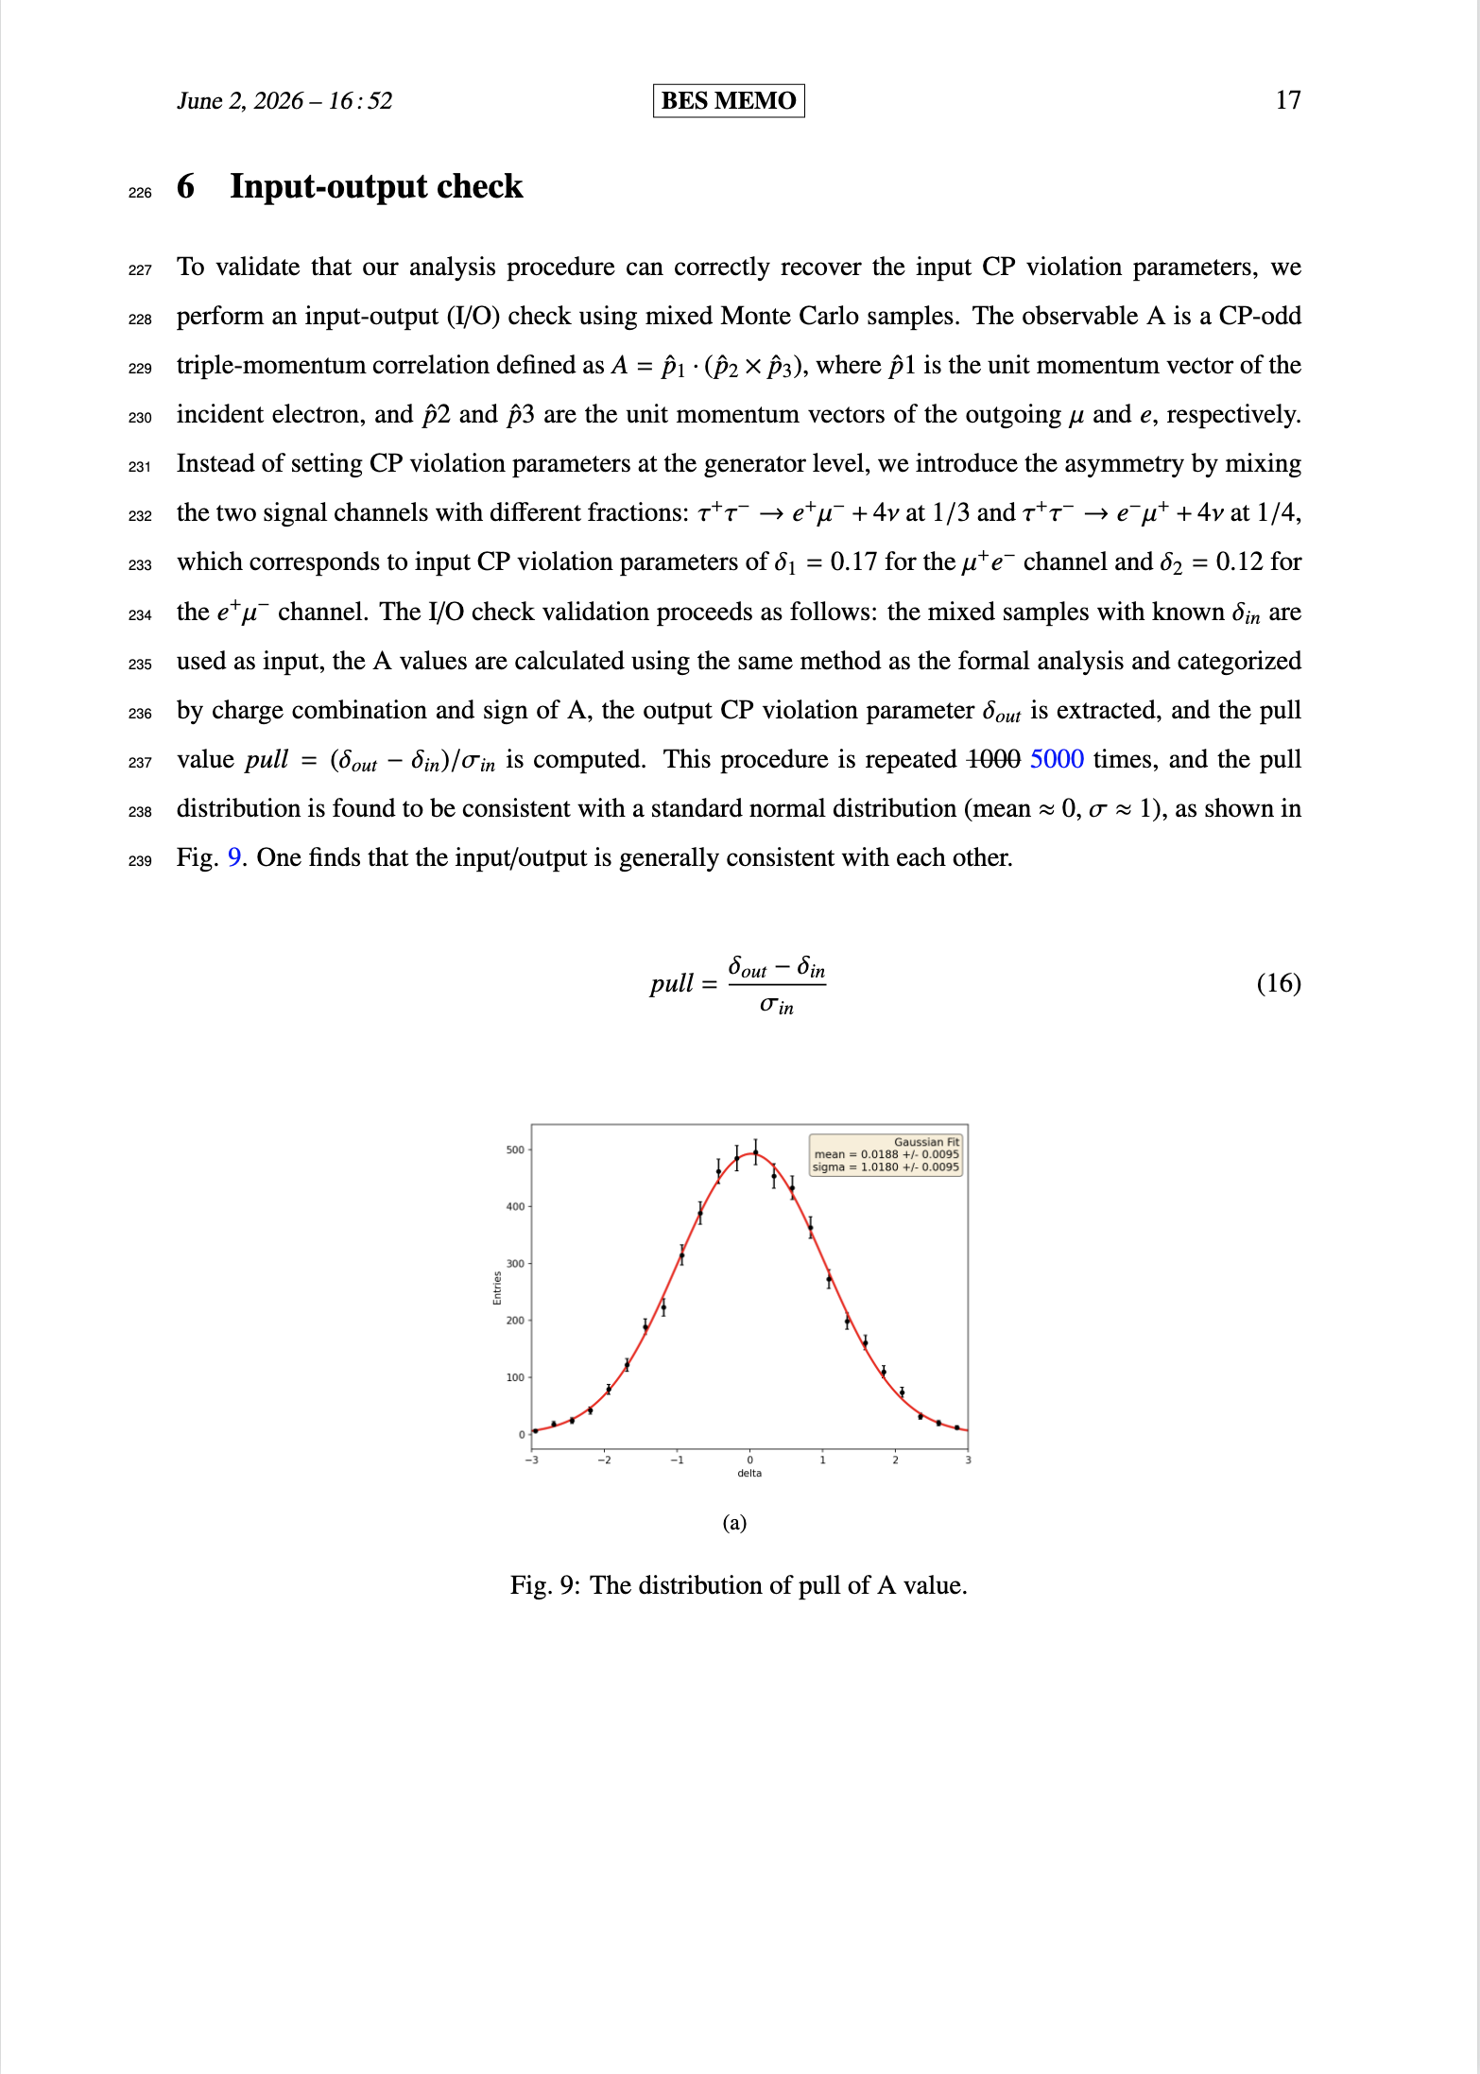
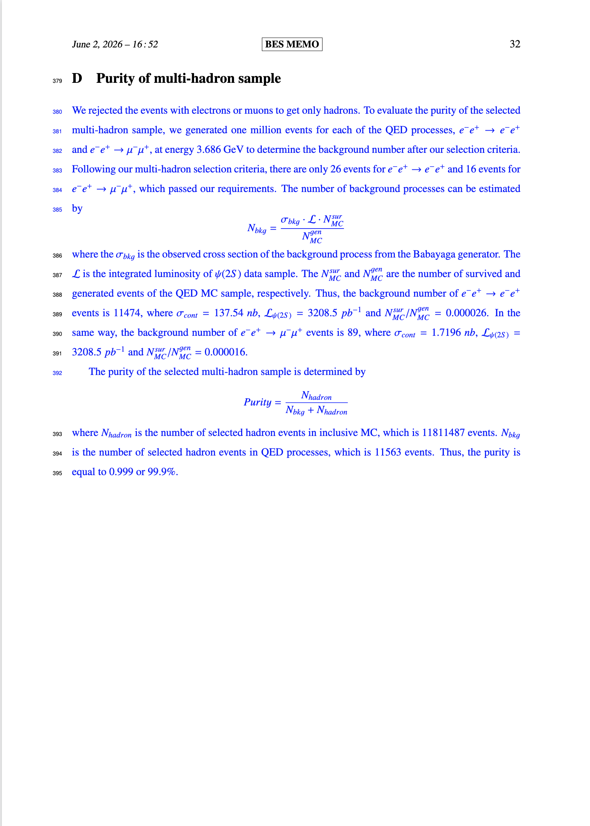
CPV
Last week
  Update memo (IO check and Appendix).
Next week
  Update memo on HyperNews
  Reply Prof. You’s question

Slide 41
2026.6.23
Nankai Group Meeting

Slide 42
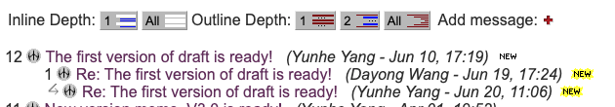
CLFV
First version of draft is ready
Wait for review

Slide 43
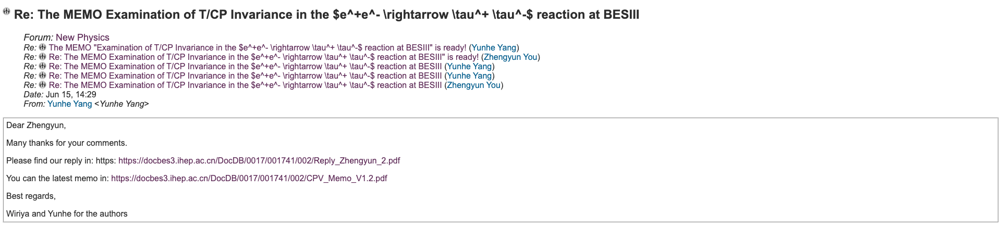
CPV
Last week: update new version of memo on hypernews

Slide 44

CPV
Next week: reply Prof. You’s question

