Slide 1
4D Semiconductor Tracking Detector R&D for CEPC
Vertex 2026

Slide 2
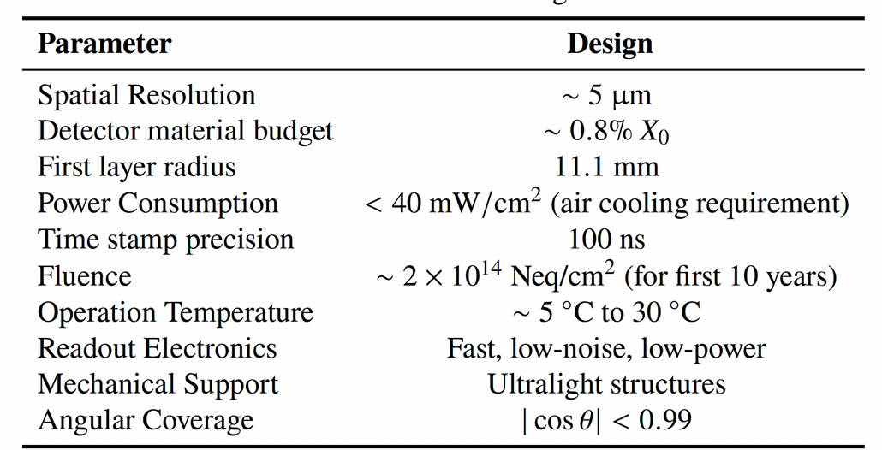
CEPC Vertex Detector Requirement

Slide 3
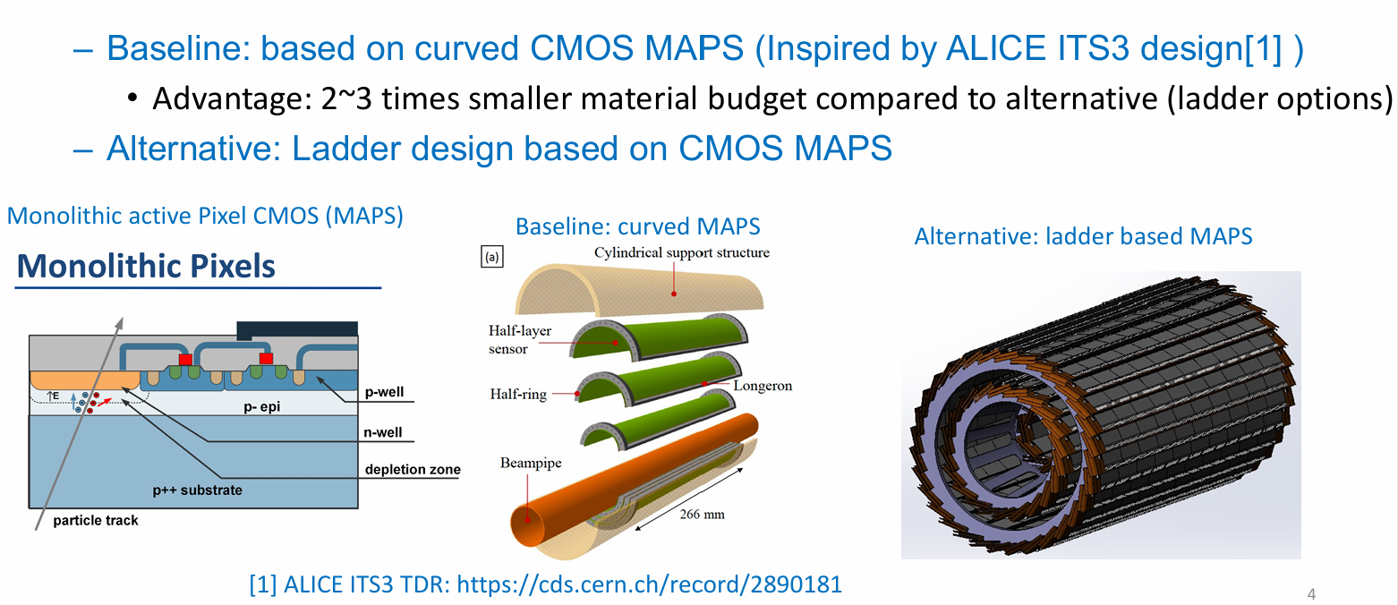
Curved MAPS as baseline for Ref-Dector
TDR: arXiv: 2510.05260

Slide 4
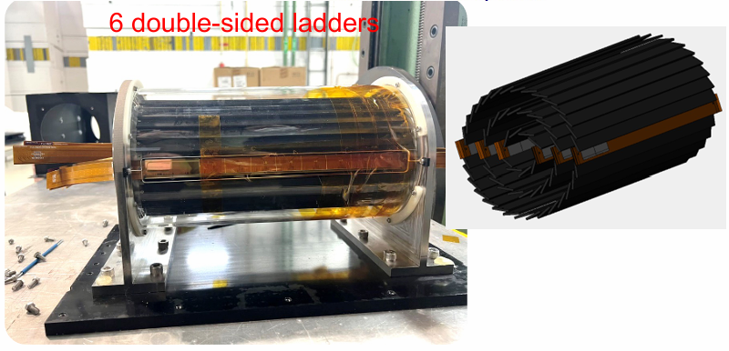
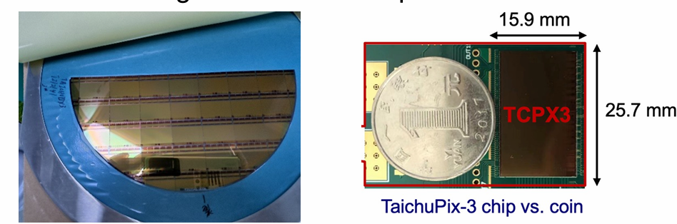
R&D efforts
Full size CMOS chip developed
  1024×512 Pixel array, Chip Size：15.9×25.7mm
  25μm×25μm pixel size with high spatial resolution
  Process: Towerjazz 180nm CIS process, 1st engineering run
  Fast digital readout to cope with ZH and Z runs (support 40MHz clock)

Slide 5
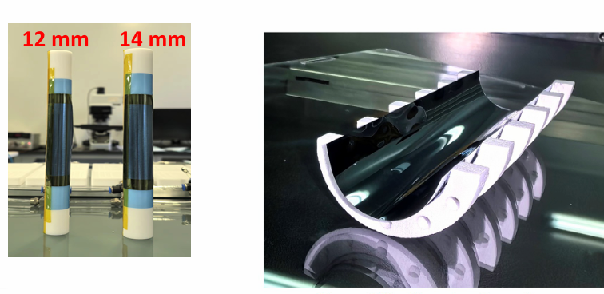
R&D efforts curved MAPS
CEPC b-layer radius(11mm) smaller compared with ALICE ITS3 (radius=18mm)
Feasibility: Mechanical prototype with dummy wafer can curved to a radius of 12mm
  The dummy wafer has been thinned to 40μm

Slide 6
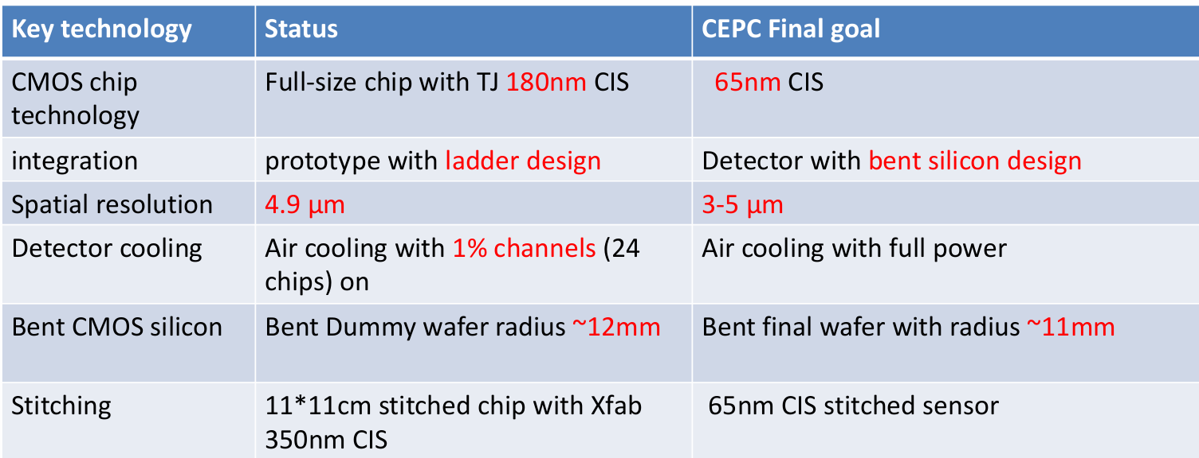
Vertex R&D status and final goal
Next step of R&D is to develop sensor with stitching technology

Slide 7
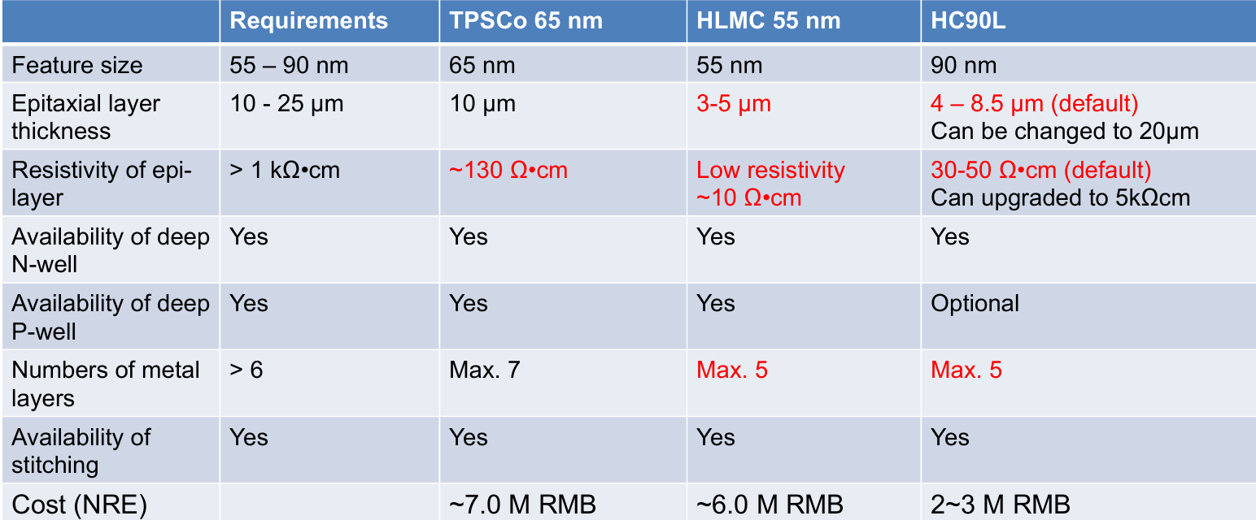
Choice of technology for next R&D
Next step foundry: SK Hynix system fab in Wuxi China
  90nm technology with stitching feasibility

Slide 8
CEPC Vertex detector Working Plan
Development of 1st engineering run using MAPSs with HC90L 90nm technology
  Prototype full size RSU-like sensor
  Validate sensor and electronics performance without stitching
  Expect to finalize the design by the end of 2026
Work together with mechanics group on thermal mockup
  Test air cooling and the vibration
Longer term: Explore CIS stitching MAPSs sensor with HC90L 90nm
Final goal: build prototype close to ref-TDR design

