Slide 1
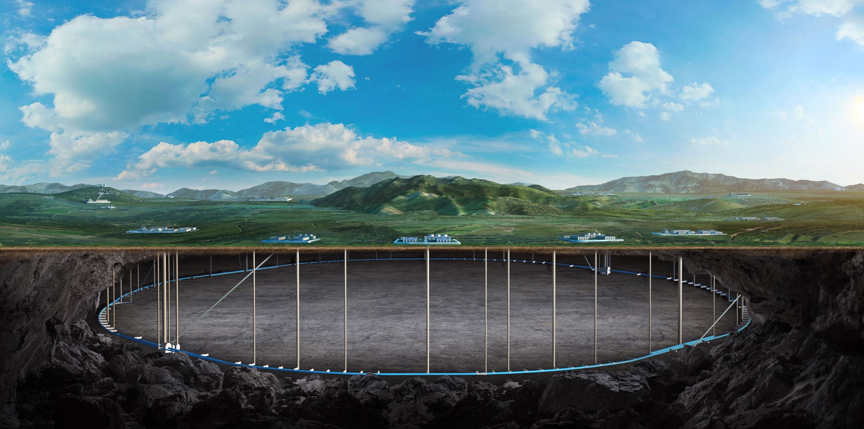


CEPC final focusing SC quadrupole R&D and
cryomodule design status
Yingshun Zhu, Xiangzhen Zhang
On behalf of CEPC IR SC magnet system
July 27, 2026, CEPC Day

Slide 2
Content
Introduction
CEPC final focusing SC quadrupole R&D status
  Direct winding experiment of CCT coil
  Development of Direct winding CCT quadrupole short model
  Preparation of Cryogenic vertical test
Cryomodule design status
Next step plan
Conclusion

Slide 3
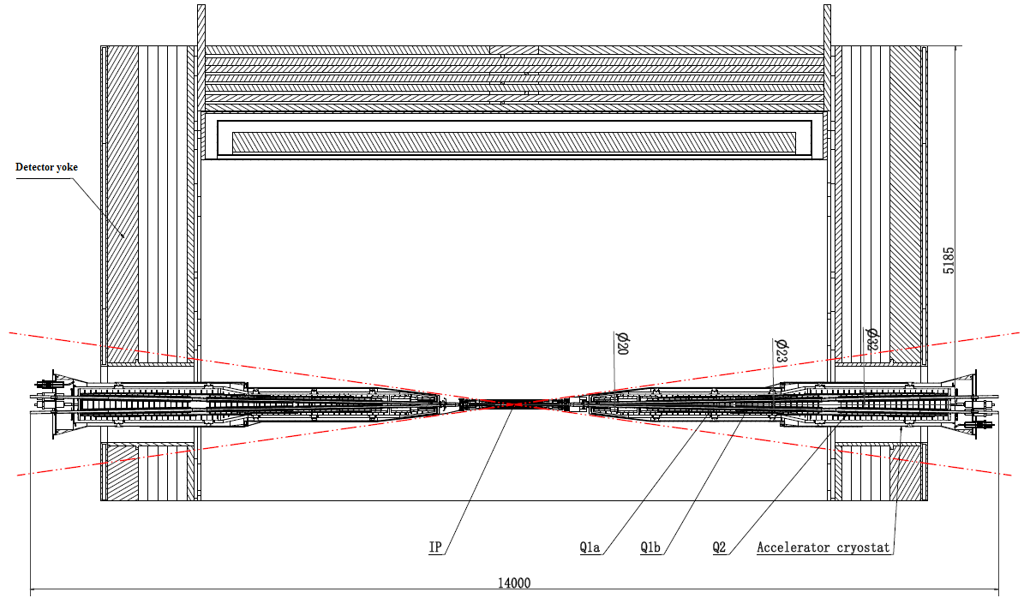
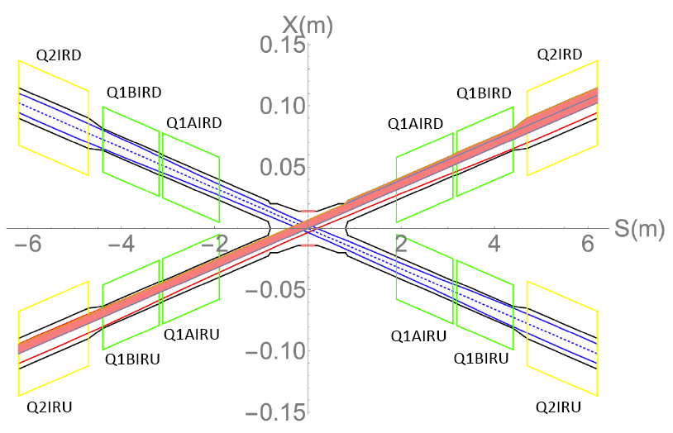
Introduction
There are 2 interaction points in CEPC collider ring
To final focus the beams for high luminosity, compact high gradient double aperture quadrupole magnets (Q1a, Q1b, Q2) are required on both sides of IP point
To cancel the effect of the detector solenoid field (3T) on the beam, anti-solenoids before Quadrupoles and outside Quadrupoles are needed
EDR requirements of CEPC Final Focus quadrupoles are based on L* of 1.9 m, beam crossing angle of 33 mrad

Slide 4
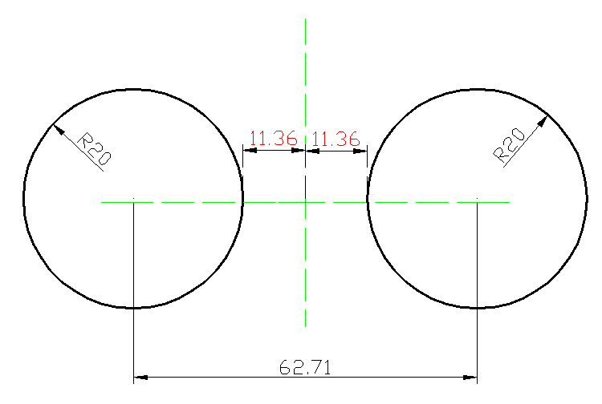
Introduction
The design requirement of Q1a is the most challenging
Minimal distance between two aperture beam lines: 62.71 mm
Radius of single aperture <31.36mm
Leaving space for beam pipe, inner helium vessel, coil support
Quadrupole coil inner radius: 20 mm
Challenging to meet stringent design requirements for Q1a
1) High field gradient: 142.3 T/m
2) Limited magnet radial space
R: [20mm, 31.36mm], 11.36mm
3) Magnetic field crosstalk between two apertures
High order field harmonics ≤ 3×10⁻⁴
Local dipole field: ≤ 300 Gs
FCC-ee FFQ: 100 T/m

Slide 5

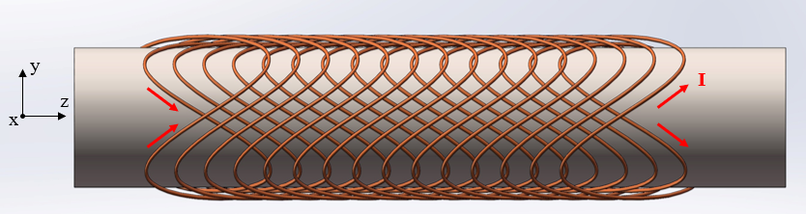
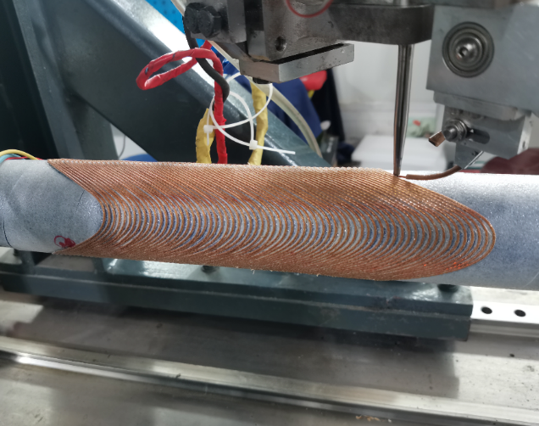
Introduction
High gradient, iron-free compact quadrupole required
Field crosstalk varies with longitudinal position
CCT (Canted cosine theta) coil can locally adjust field distribution
Besides quadrupole, several corrector coils are needed
Dipole corrector coil, Skew quadrupole coil, etc
Direct winding CCT coil is preferred. Baseline design
Wind CCT coil layer by layer on tube surface using Direct winding technology
Advantages of Direct winding CCT coil:
Accurate wire position and high magnetic field precision
No gap between adjacent layers or coils
Compact structure for SC magnets with multiple coils
Coil self correction is used to solve magnetic field crosstalk
Pre-stress can be applied by wrapping fiberglass on coil layers
Field harmonics can be corrected during multi-layer winding process
Direct winding CCT

Slide 6
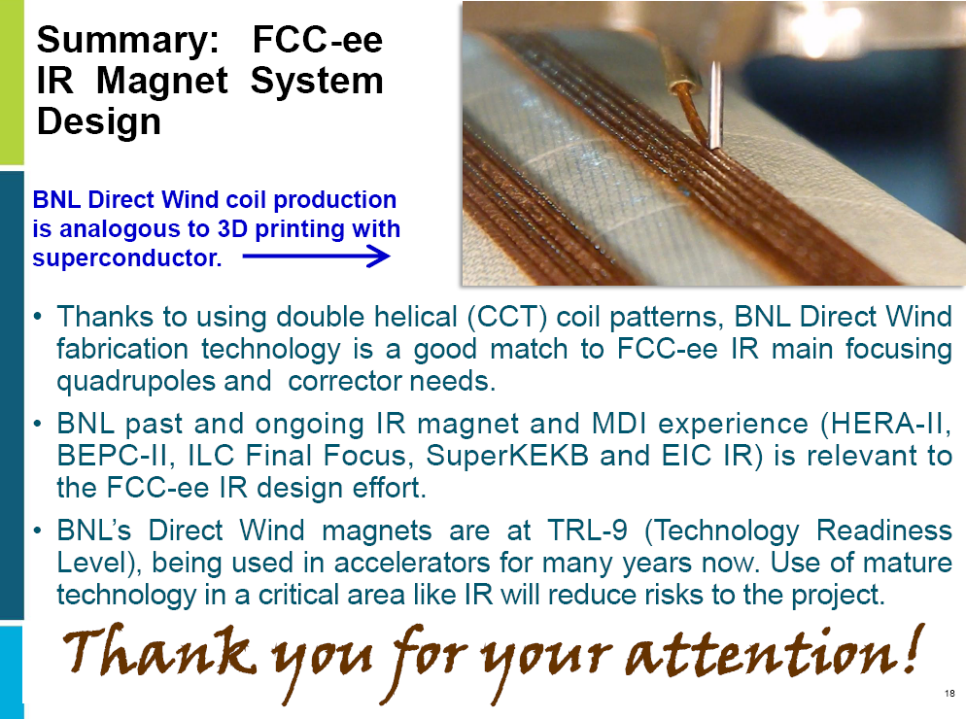
Introduction
FCC-ee is considering adopting direct winding technology in final focus quadrupole
Collaborate with BNL
FCC Week 2026
Magnets for FCC-ee interaction region
Brett Parker, BNL

Slide 7
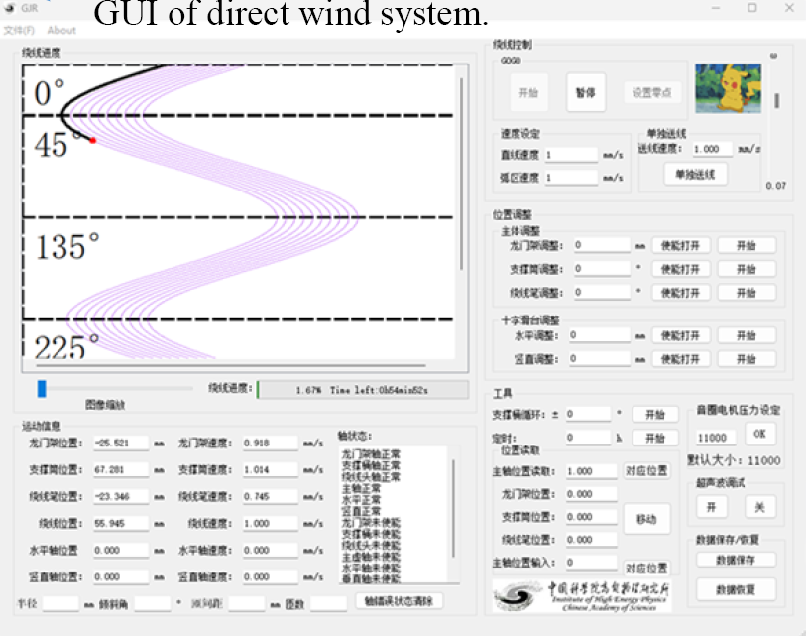
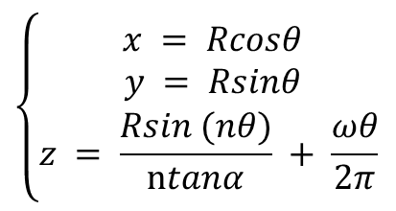
Direct winding experiment of CCT coil
SC quadrupole design was reviewed in Mini-Review of CEPC MDI in June 2025
“The committee fully endorses the plan to build a prototype of a direct wind Q1a CCT quadrupole”
Direct winding experiments of CCT coil has started
According to the quadrupole coil design, data file of CCT coil winding path suitable for the winding machine has been generated
Control system software has been developed for Direct wind CCT quadrupole
n=2: Quadrupole

Slide 8
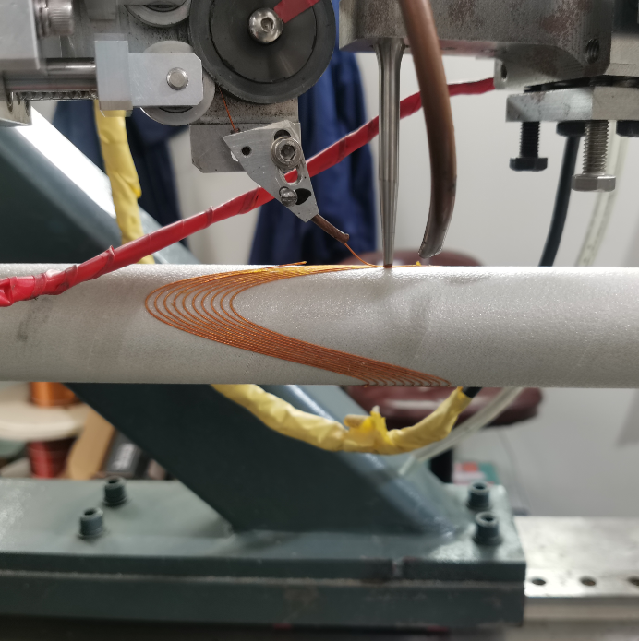
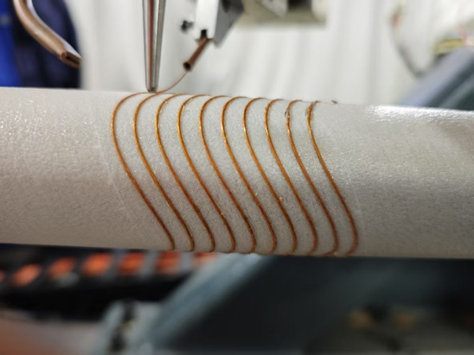
Direct winding experiment of CCT coil
Direct winding experiment of CCT coil has been performed
Firstly use NbTi wire with 0.33mm diameter
Direct winding test:
Pure CCT quadrupole
CCT quadrupole coil with self correction
The shape of the test CCT winding looks good
Pure CCT quadrupole
CCT quadrupole coil with self correction

Slide 9
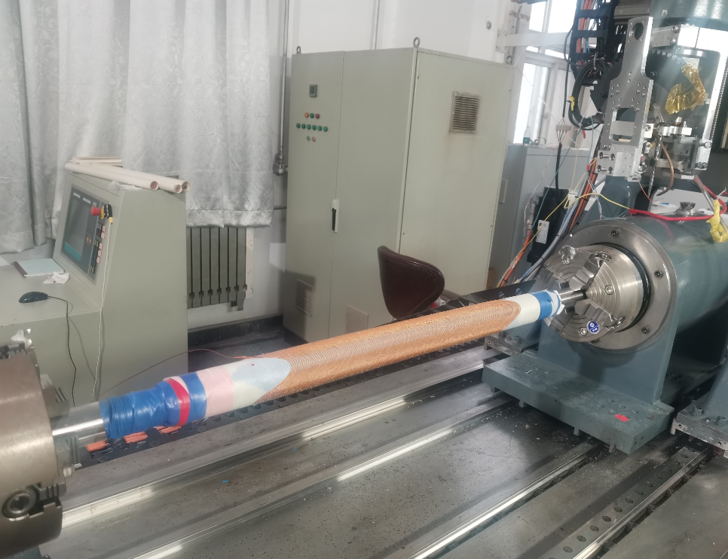
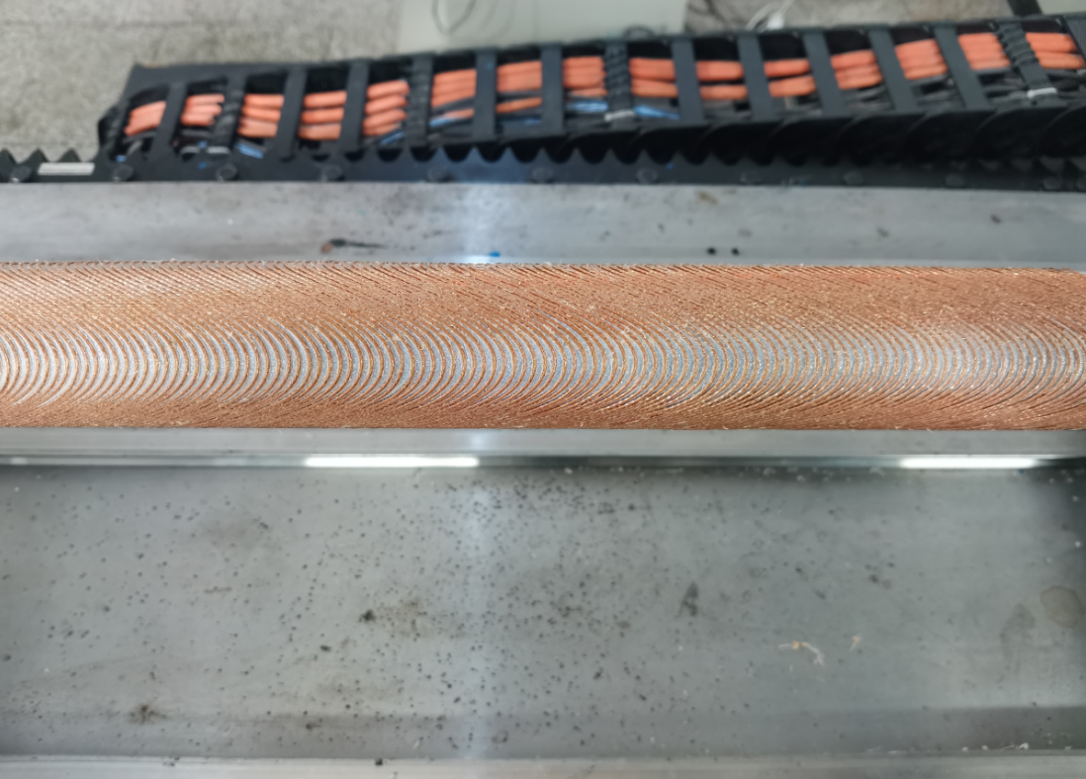
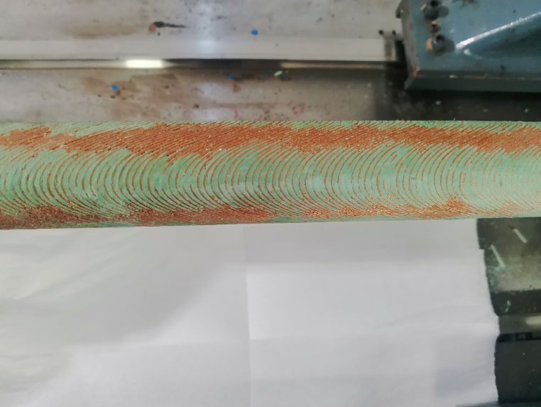
Direct winding experiment of CCT coil
Direct winding experiment of CCT coil
Secondly, use NbTi wire with 1mm diameter
Direct winding test: Pure CCT quadrupole
CCT coil winding is difficult for small aperture
Based on the coil shape, winding software and manufacturing process of the CCT coil have been preliminary improved
4-layer CCT test coil wound

Slide 10
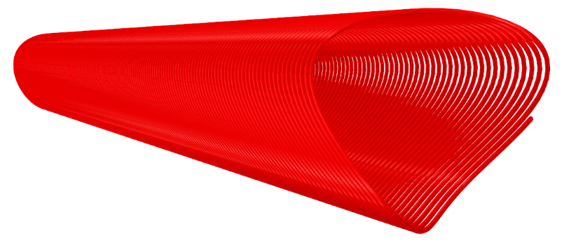
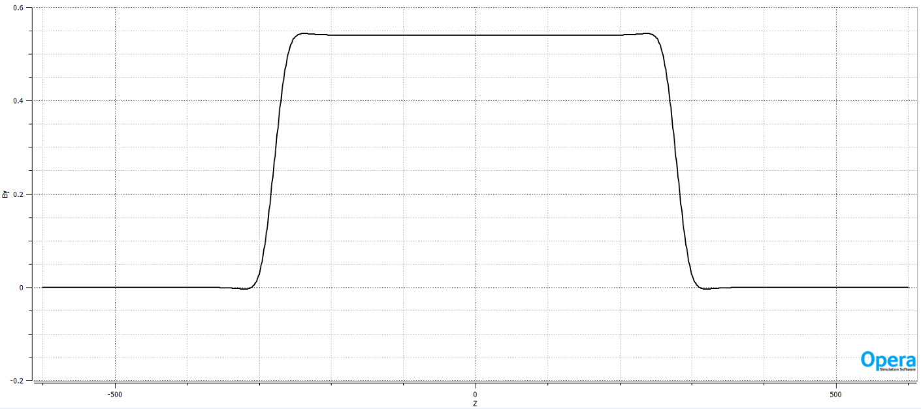
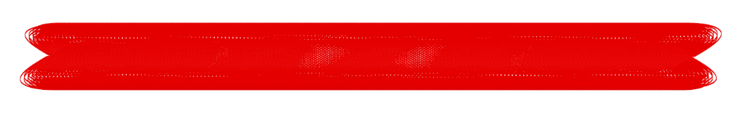
Development of Direct winding CCT quadrupole short model
In EDR, the 1st step: develop a single aperture Direct winding CCT quadrupole model
Main purpose: research and master key technologies of Direct winding CCT quadrupole
Coil aperture: ∅ 40mm, Field gradient: 50 T/m @650A,4.2K, mechanical length: 0.6m
Not enough fund; use existing NbTi wire in the laboratory
Diameter 1mm (not CEPC specification)
Single aperture, a total of 6 layers Direct winding CCT coil
Canted angle: 30 deg, pitch: 3.3 mm
Supported by MOST4
Single aperture quadrupole model

Slide 11
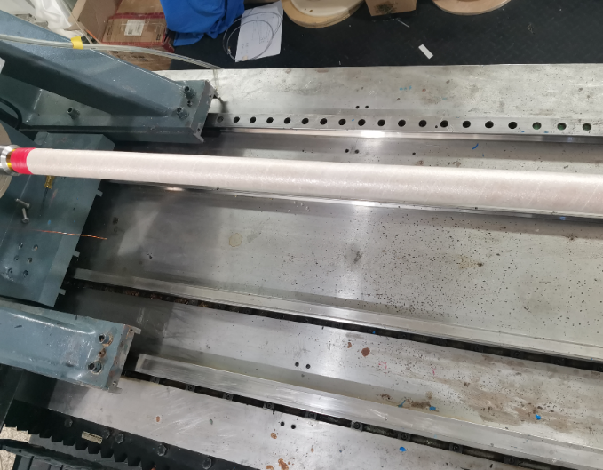


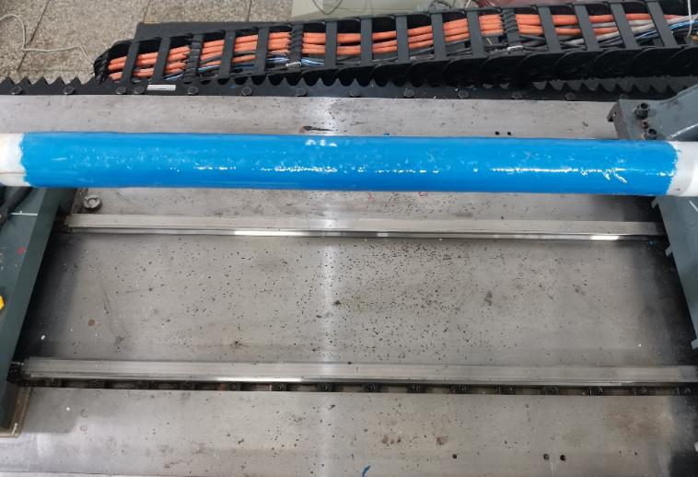
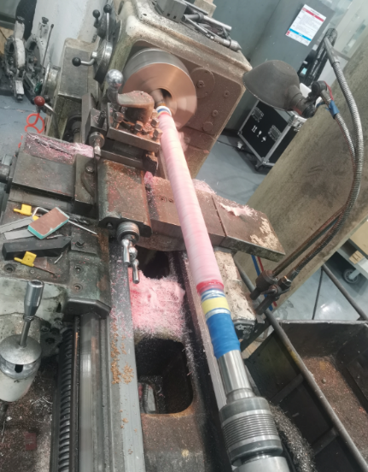
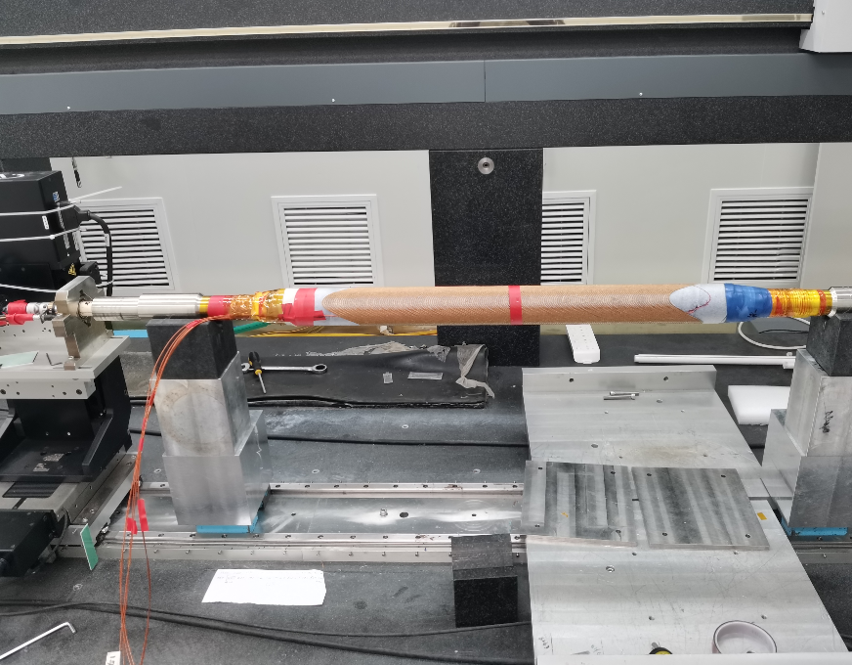
Development of Direct winding CCT quadrupole short model
Main fabrication process of CCT quadrupole using direct winding technology:
Wrap substrate Coil winding Apply epoxy and pre-stress Surface machining
Room temperature magnetic field measurement

Slide 12
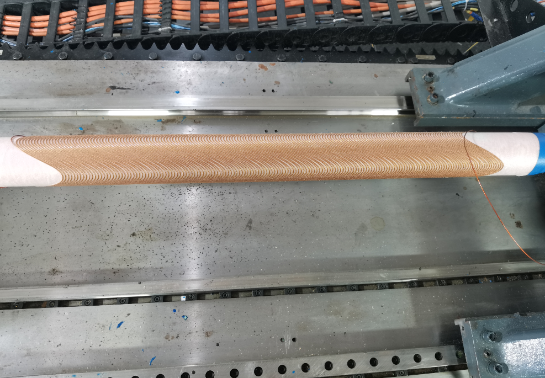
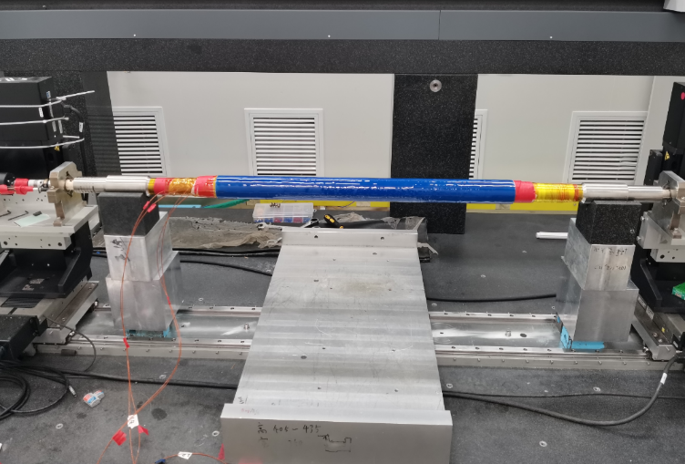
Development of Direct winding CCT quadrupole short model
Winding and fabrication of Direct winding CCT quadrupole short model comprising 6-layer CCT coil have been completed
Room temperature magnetic field measurement was performed at 2A with long rotating coil
The measured sextupole and octupole multipole fields are about 1×10⁻³ @r=7.5mm
The magnetic field quality needs to be improved
We plan to enhance the precision of CCT coil winding in future

Slide 13
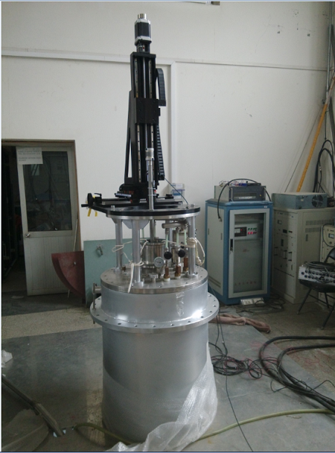
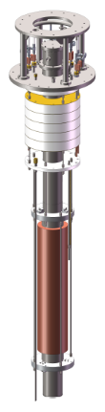
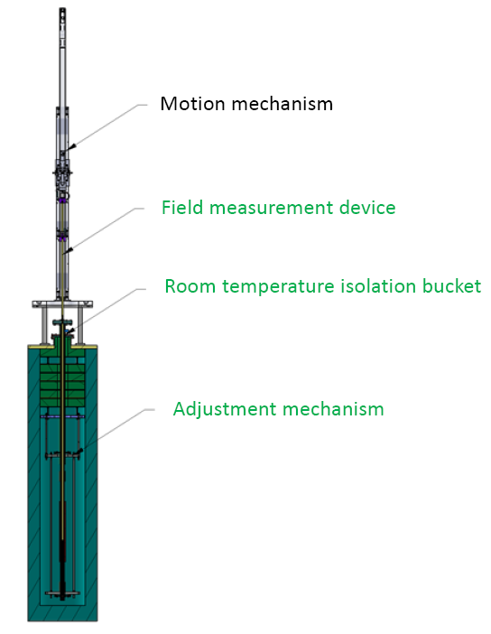
Preparation of Cryogenic vertical test
The single aperture direct winding CCT quadrupole model will be tested at 4.2K at IHEP
Cryogenic vertical test facility needs modification to accommodate small-aperture quadrupole
The design and manufacture of the new mechanical components have been completed
Including magnetic field measurement devices, room temperature isolation buckets, and adjustment mechanism

Slide 14
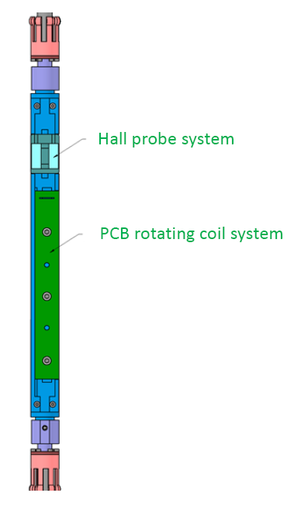
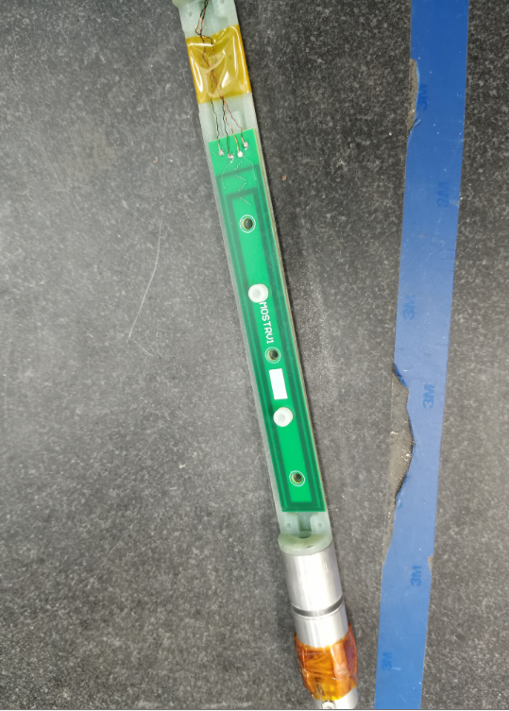
Preparation of Cryogenic vertical test
The update of rotation coil and Hall probe measurement system located in the middle of the Dewar is in progress
To measure the variation of field harmonics along longitudinal direction, short PCB rotating coil is adopted
Two magnetic field measurement systems are integrated into single mechanical component: a rotating coil system and a Hall probe system
PCB rotating coil and Hall probe system have been developed

Slide 15
Cryomodule design status
From Xiangzhen Zhang
In CEPC, there are two combined-function Superconducting magnets in each MDI
Each combined-function magnet includes three high gradient quadrupoles (Q1a, Q1b, Q2) and one anti-solenoid
The cryostat is used to provide the cryogenic environment for SC magnets , which is lower than 5.0 K
ITEM | Q1a | Q1b | Q2 | Anti-solenoid
Central field gradient (T/m) | 142.3 | 85.4 | 96.7
Cooling type | LHe | LHe | LHe | LHe
Operating current (A) | 720 | 640 | 760 | 1300
Magnetic storage energy (KJ) | 16.7 | 15.2 | 36.1 | 630
Cross section parameter (mm) | Φ38~62 | Φ52~78 | Φ62~88 | 100 sections
Magnet length (m) | 1.21 | 1.21 | 1.53 | 5.1
Net weight (Kg) | 25 | 32 | 43 | 302
Total weight of magnets (Kg) |  |  |  | 402

Slide 16
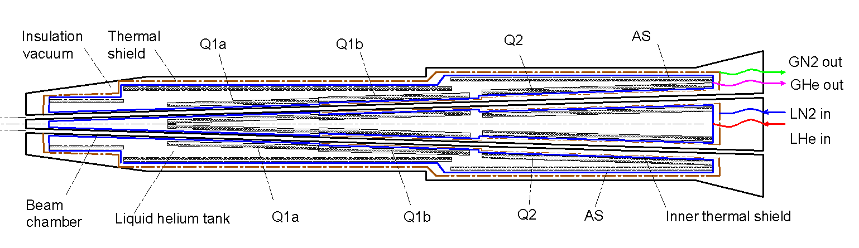
Cryomodule design status
Cryostat scheme
Superconducting magnets are immersed in the helium tank for the low temperature
One thermal shield is set for the heat interruption from the ambient temperature
The shield is extended between the helium tank and the beam chamber
The cold mass can be cooled by supercritical， subcooled，or superfluid liquid helium, and the shield is by liquid nitrogen

Slide 17
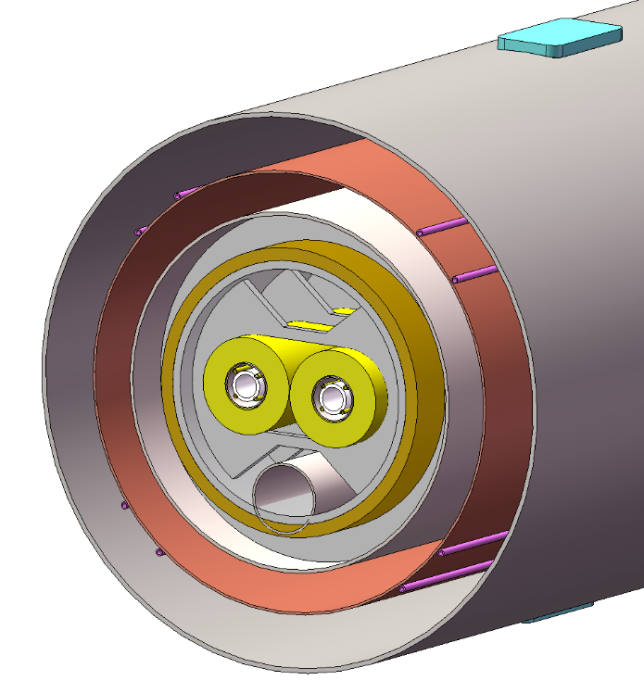
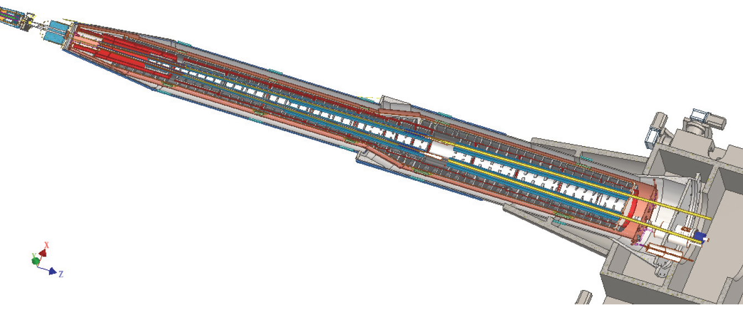
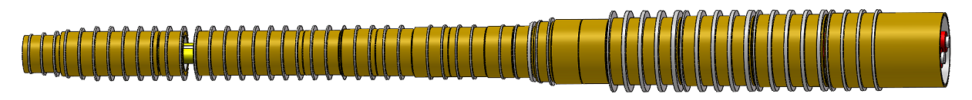
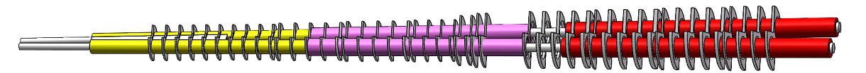
Cryomodule design status
Support of SC magnet
The superconducting magnets Q1a,Q1b and Q2 are supported on the inner wall of the solenoid
The anti-solenoid is supported by a ring on the inner wall of the helium tank
Vacuum
Thermal shield
1985mm
LHe tank
1915mm
Support
Anti-solenoid
2885mm
Anti-solenoid
Q1a
Beam chamber
Q1a
Q1b
Q2
Notes:
标注尺寸

Slide 18
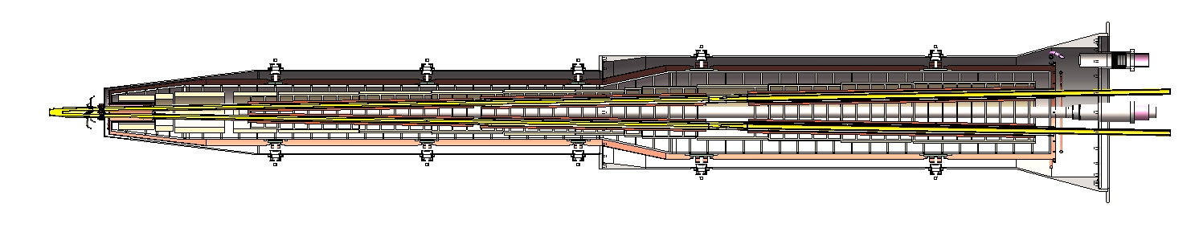
Cryomodule design status
Total weight
Cryostat length: 5.75 m
Total weight: 2.42 ton
Items | Weight (kg) | Main materials
Vacuum vessel | 869 | SS
Helium Vessel | 510 | SS
Thermal shield and pipes | 43 | Aluminum
SC quadrupoles | 100 | Copper & Aluminum
Anti-solenoids | 302 | Copper & Aluminum
Skeleton supports | 92 | Aluminum
Liquid Helium | 504 | Liquid Helium
Total weight | 2420
The vacuum vessel is the primary optimization target for a light weight
The vessel helps to stop radiation so it can’t be too thin
Notes:
标注尺寸

Slide 19
Next step plan
Next step plan
Cryogenic vertical test of Direct winding CCT quadrupole short model
Preparation to improve the precision of CCT coil winding
Preparation to develop a double-aperture Direct winding CCT quadrupole model
Consideration of processing and manufacturing technology for cryostat
Current leads design for the magnets
Lack of fund
Quadrupole magnet specification of MOST4 differ from CEPC

Slide 20
Conclusion
Direct winding CCT quadrupole coil option is highly suitable for the double-aperture quadrupole magnets with crossing angle in CEPC MDI
Direct winding experiment of CCT quadrupole coil was performed
A Direct winding CCT quadrupole short model has been developed, and will be cold tested at 4.2K soon
Basic design of Cryomodule design is finished
Next step plan is proposed

Slide 21
Thanks for your attention!
July 27, 2026, CEPC Day

