Slide 1
BEPCII UP lattice optimization design status
Dou Wang
(On behalf of BEPCII-UP AP group)
CEPC Day, July 27th 2026, A415 IHEP

Slide 2
Outline
Progress of lattice optimization & error effects @1.89 GeV
Beam-beam study & lattice @1.0GeV
Beam-beam study & lattice @0.5GeV
New IR scheme with 40 mrad crossing angle

Slide 3
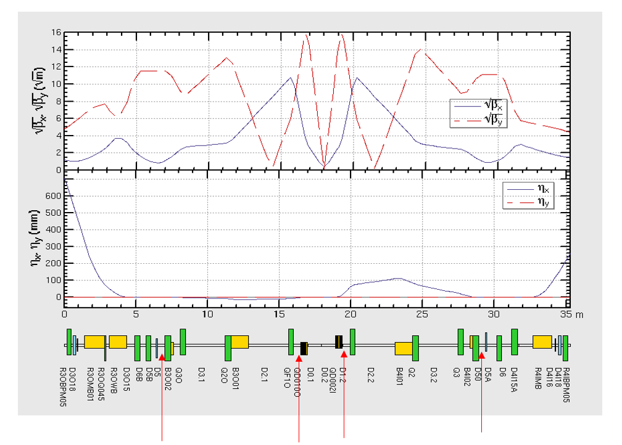
Linear lattice optimization @ 1.89GeV
Reduce the strength of sextupoles
Less B+S
B+S is used in the localized area
赵明阳，张源，耿会平，王逗…
优化线性lattice前后对比
R4IS5 K2从 0.015→-9.12
R4IS1、R3OS1、R3OS5 K2（-22.7→-19.2，-23.7 → -18.4,-26.4 → -14.5）
More practical for engineering realization.

Slide 4
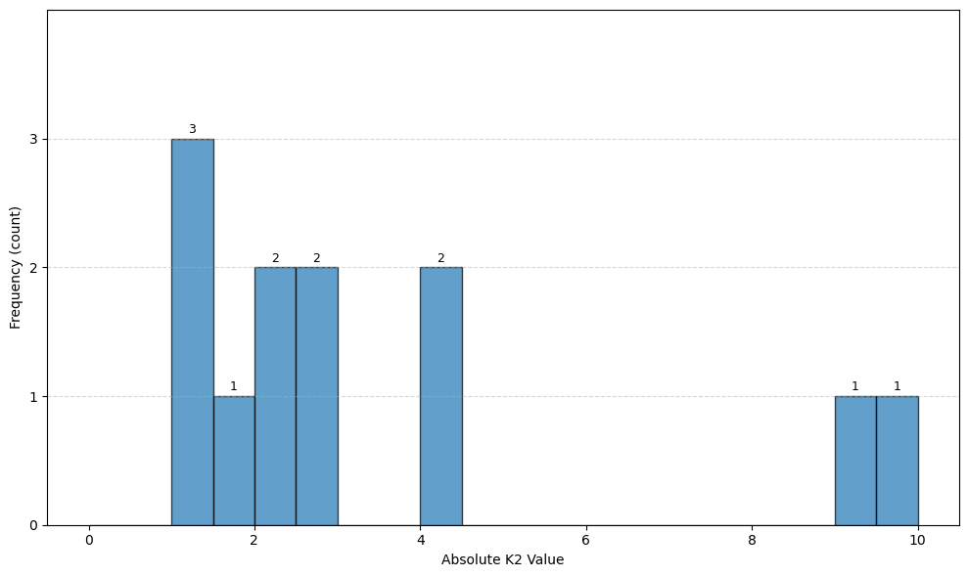
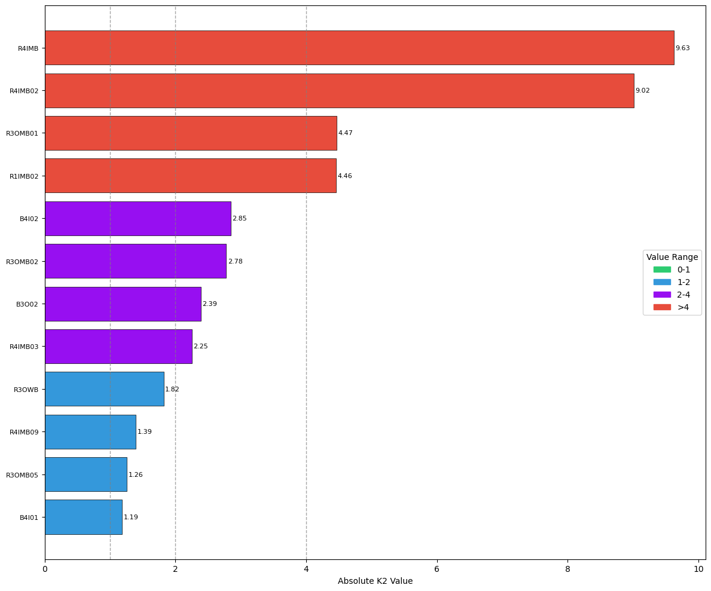
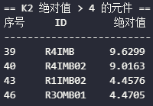
Reduce the number of B+S magnets
赵明阳，张源，耿会平，王逗…
 | B | |K2|
39 | R4IMB | 9.6299
40 | R4IMB02 | 9.0163
43 | R1IMB02 | 4.4576
46 | R3OMB01 | 4.4705

Slide 5
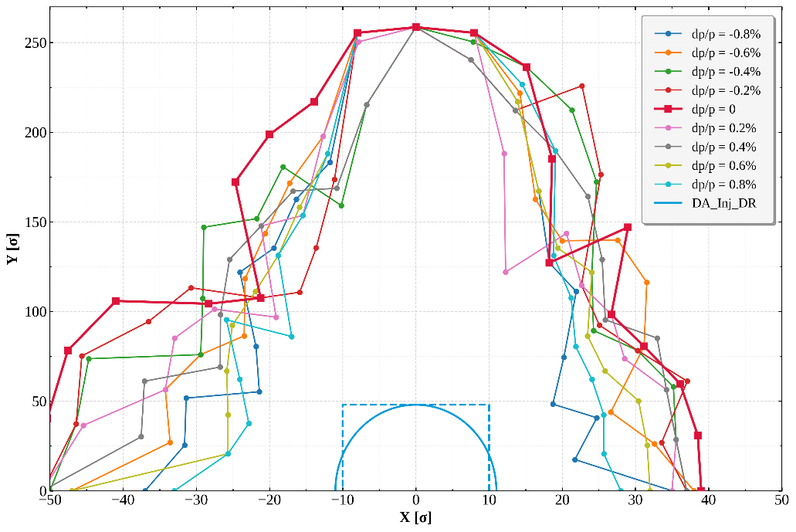
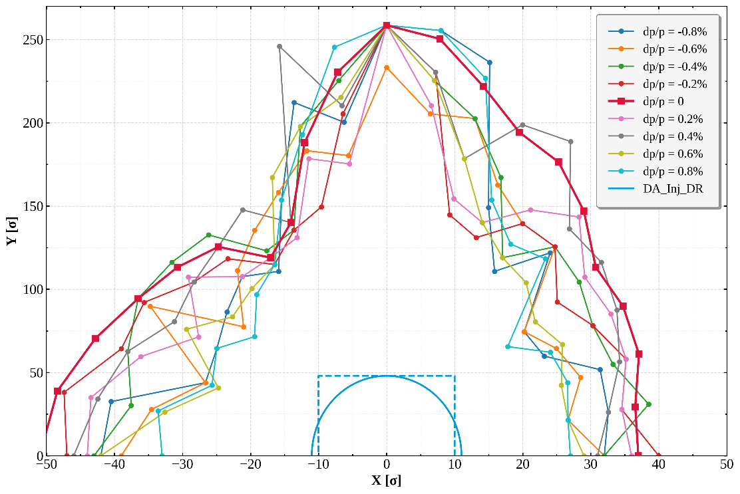
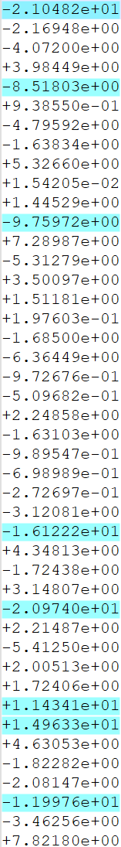
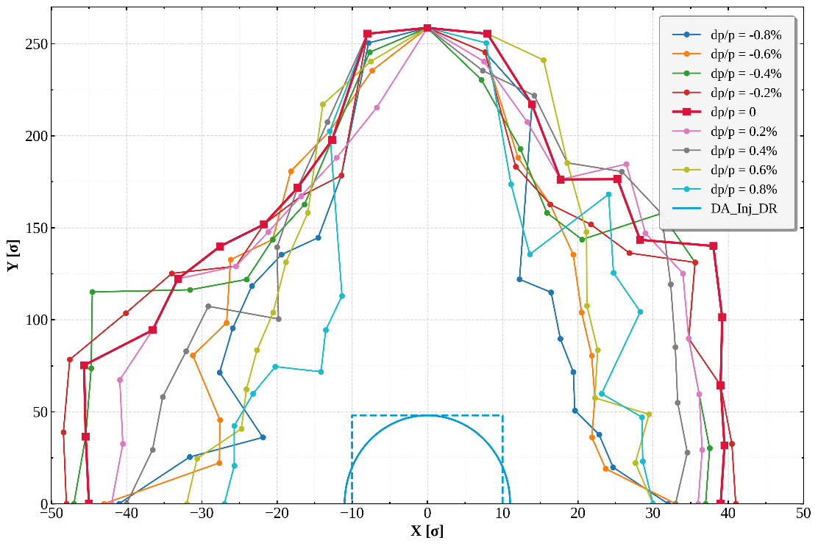
变量90：
六极铁40（36+4）
B+S 50块
变量52：
六极铁40（36+4）
B+S 12块（10+2）
变量44：
六极铁40（36+4）B+S 4块（3+1）

Slide 6
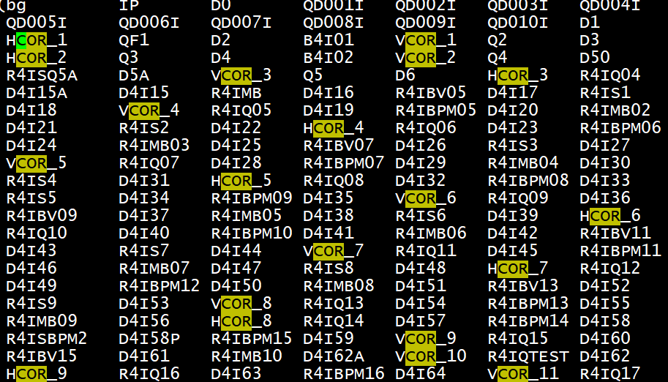
Error settings and Correction scheme
王斌
Error settings:
  The misalignment of 200 microns is applied for all magnets, 10 random lattice seeds with errors are generated for correction.
  77 BPMs are installed in each quadrupole magnets, BPM noise and accuracy issues are not considered.
  The number of horizontal correctors and vertical correctors are 35 and 40, respectively. The newly added correctors are mainly distributed in the interaction point region.

Slide 7
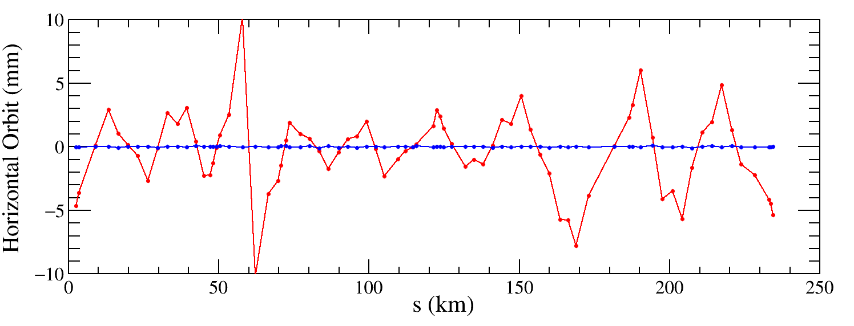
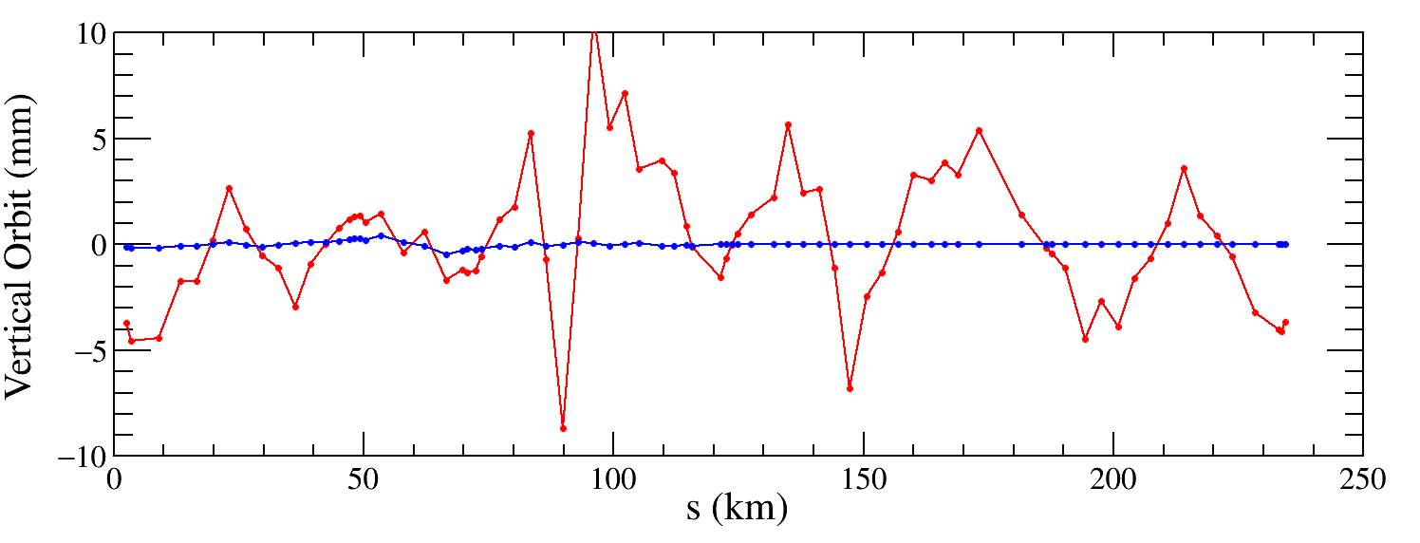

COD correction
王斌
The COD correction algorithm is based on the response matrix. By inverting the response matrix using singular value decomposition (SVD), the steering strengths can be derived to correct the distorted orbits.
The maximum and RMS closed orbit is about 200 μm for both horizontal and vertical closed orbit, respectively.

Slide 8
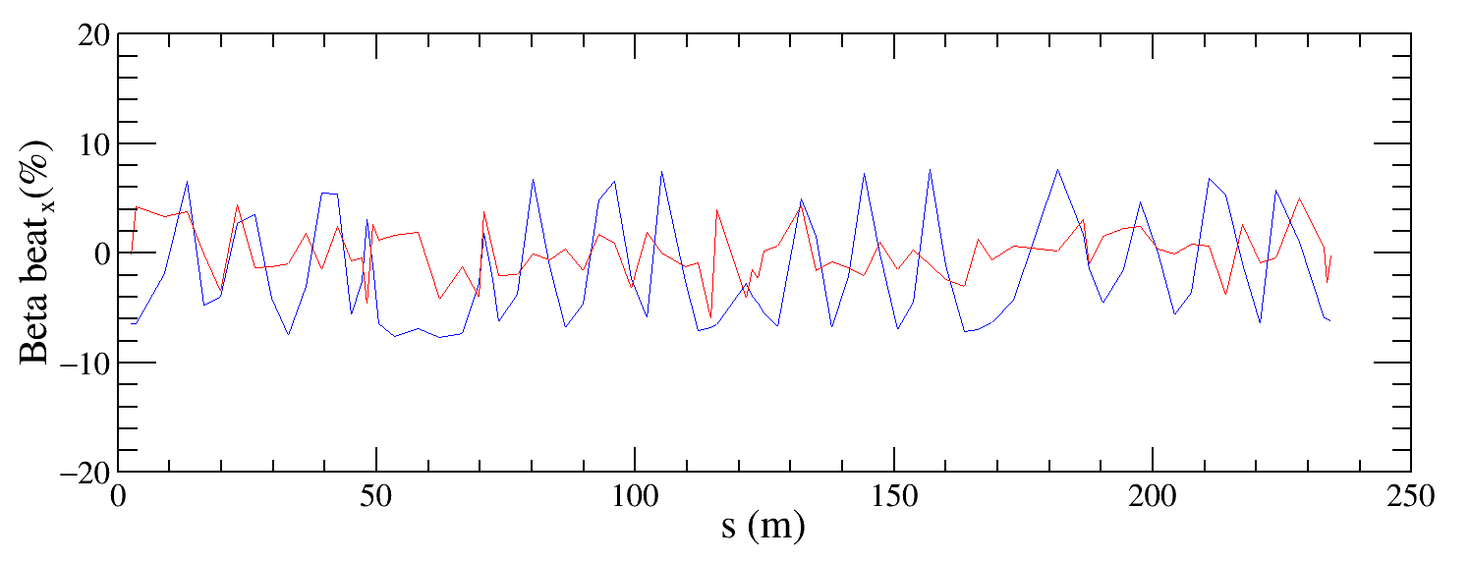
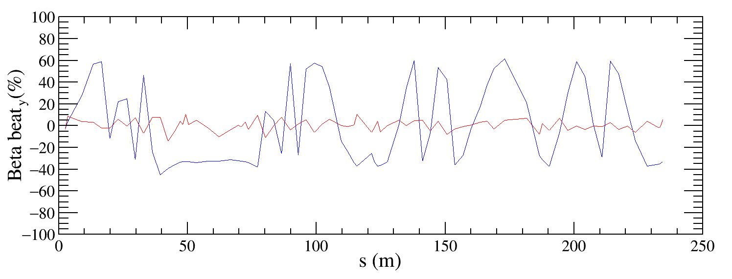
Optics correction
王斌
Correct the beta functions with sextupoles on.
Based on AT LOCO: model based correction
  Establish lattice model M_{mod}, multi-parameter fit to the orbit response matrix M_{meas} to obtain calibrated model:
  Parameters fitted: K, KS …
  Use calibrated model to perform correction and apply to machine.
  Fit the dispersion at the same time.
  Application to correct beta-beating, dispersion and coupled response
  matrix.
Beta beating has significantly decreased, with horizontal and vertical beta beating dropping to 3% and 8% respectively, and continues to be optimized.

Slide 9
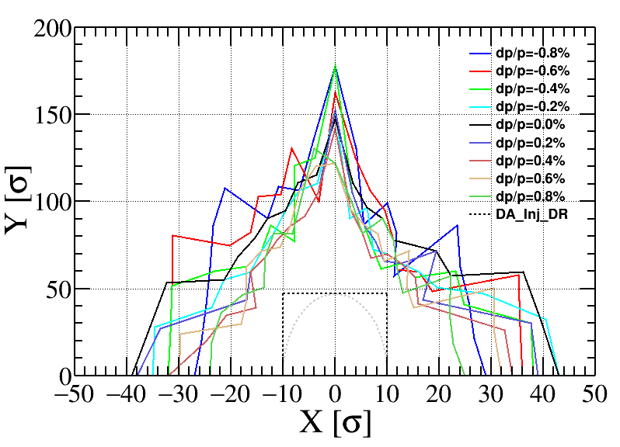
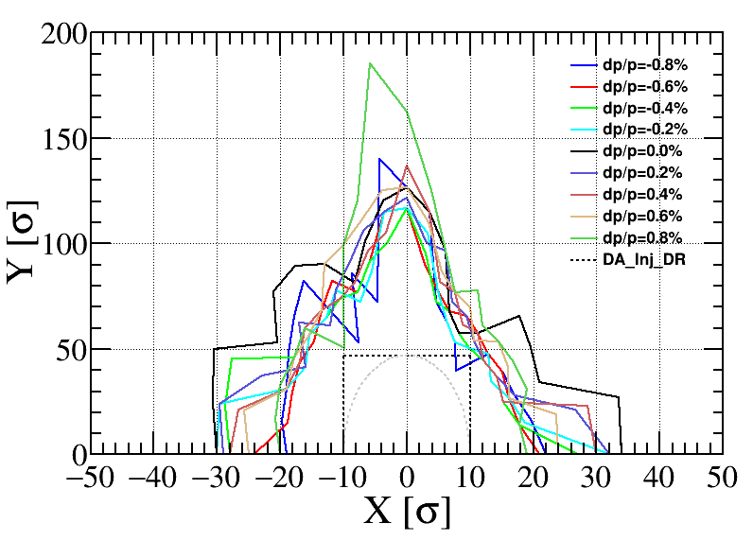
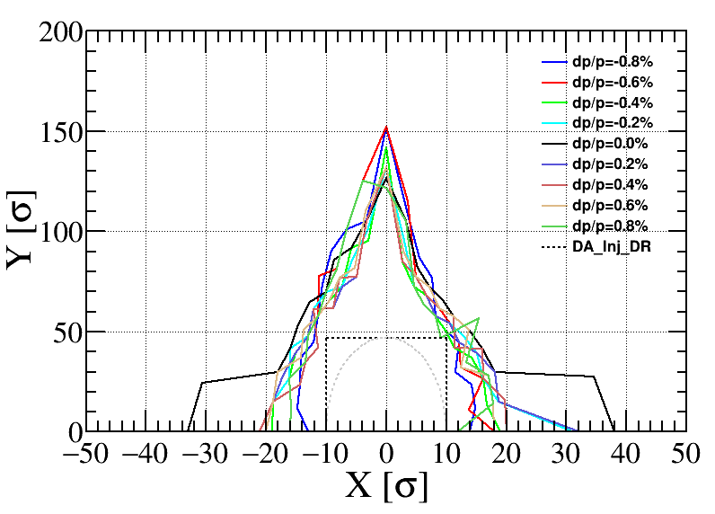
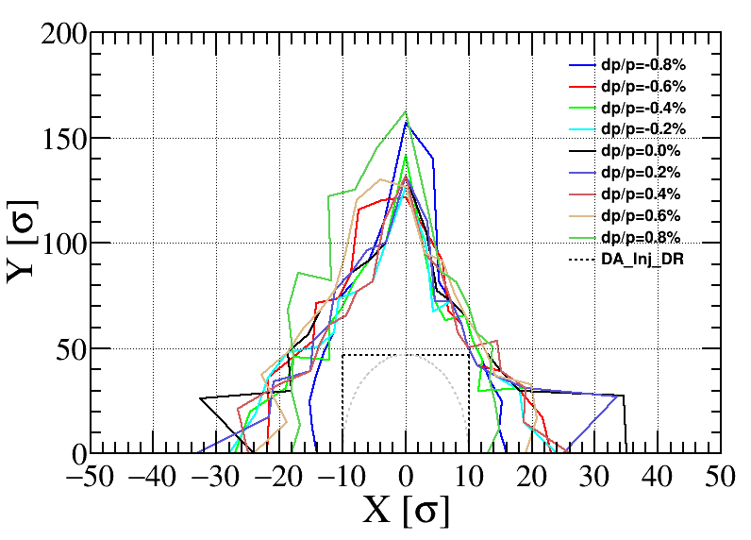
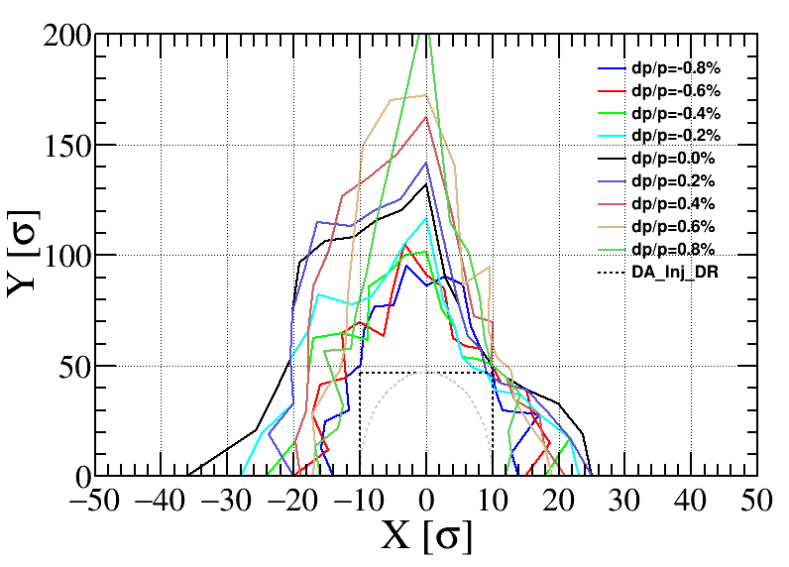
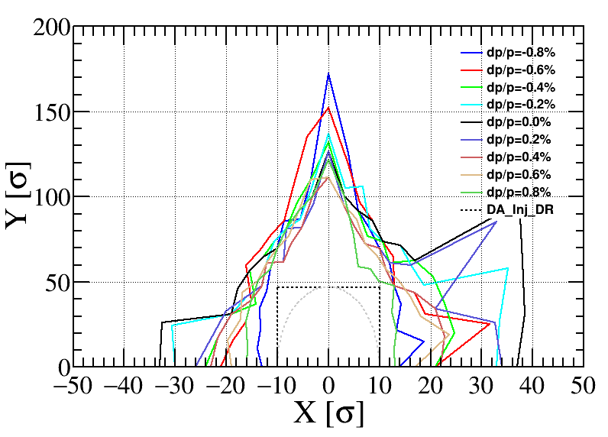
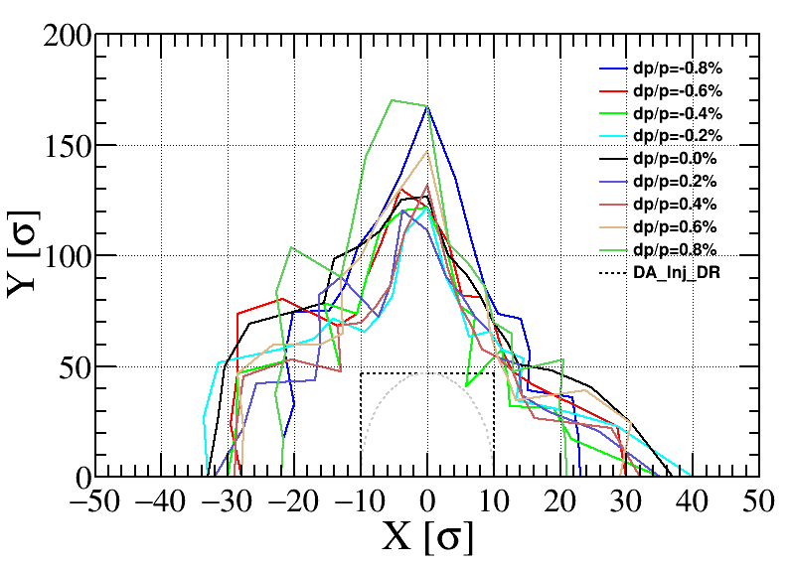
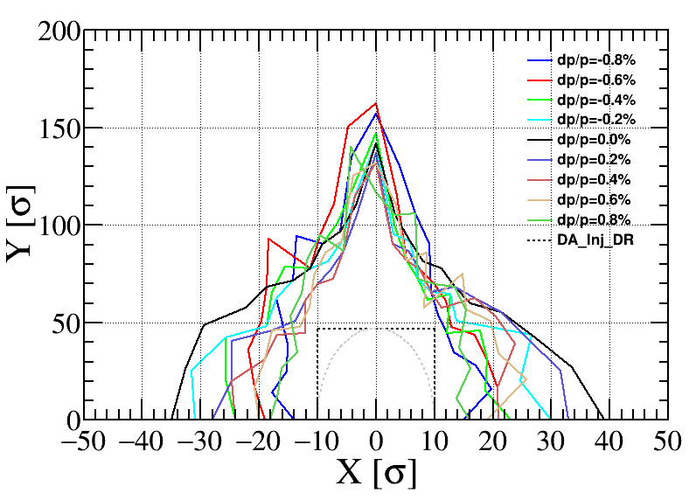
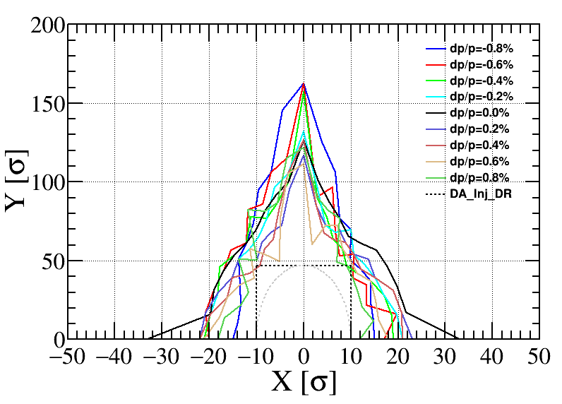
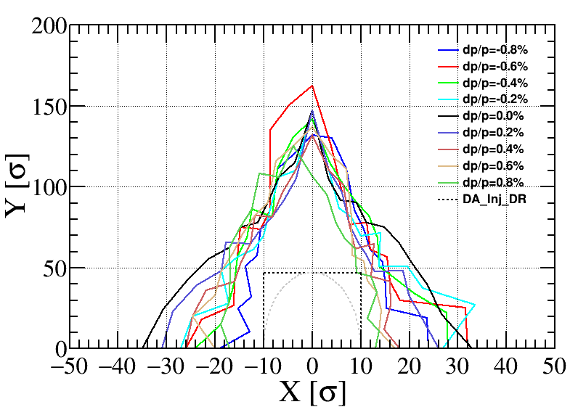
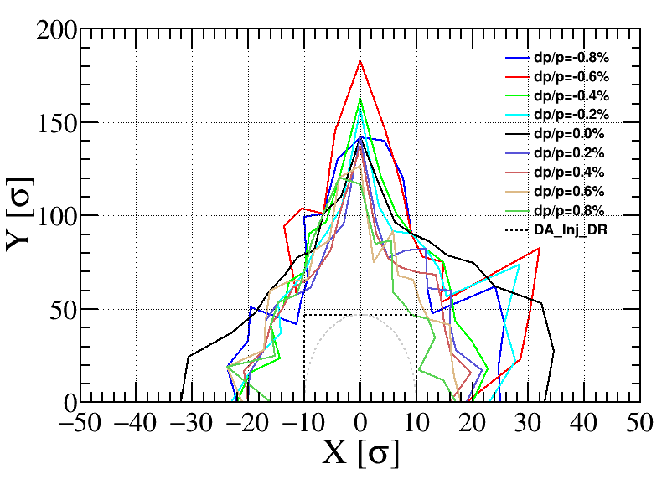
Dynamic aperture with error
Bare lattice
王斌
200 um
The dynamic apertures (DA) of 10 lattice seeds with error correction are completed. The DA satisfies with the injection requirements (dashed box), without considering the effects of higher-order field errors.

Slide 10
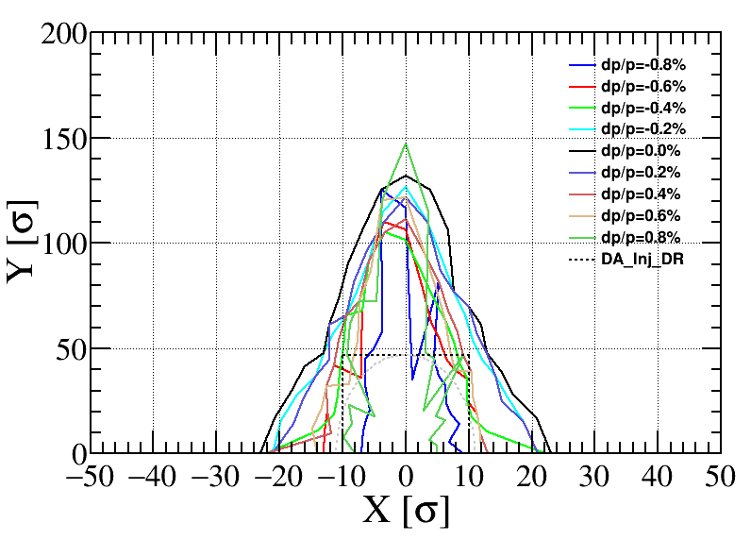

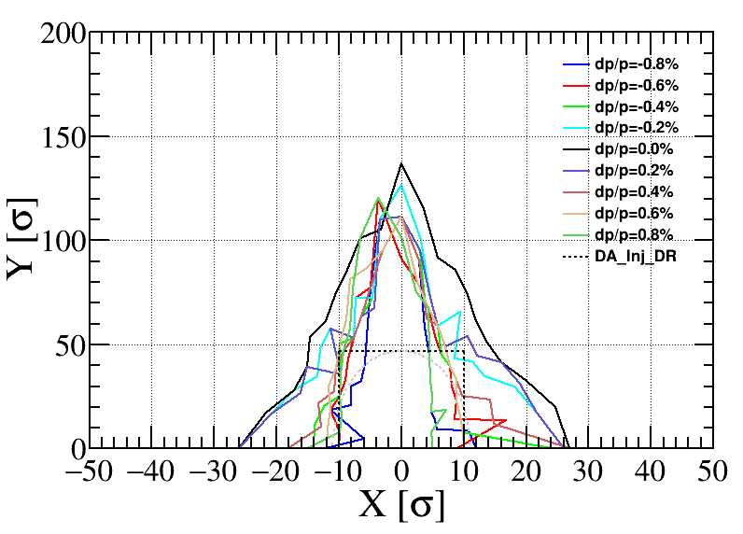
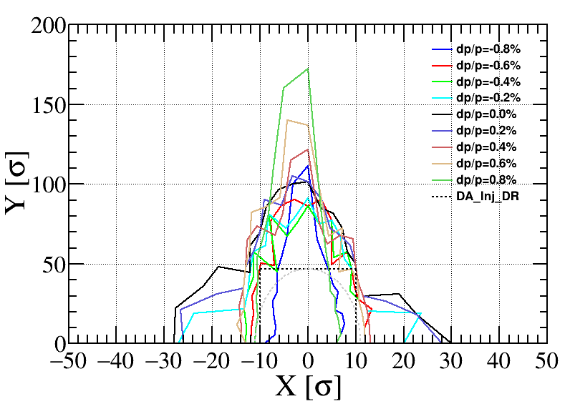
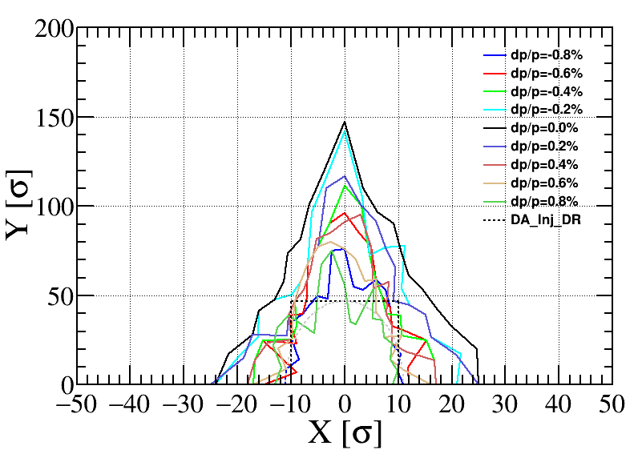
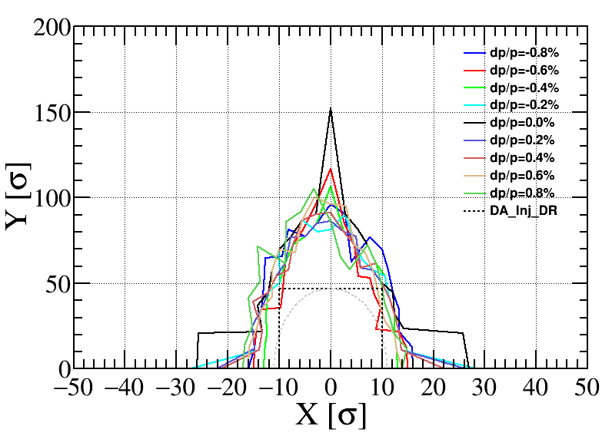
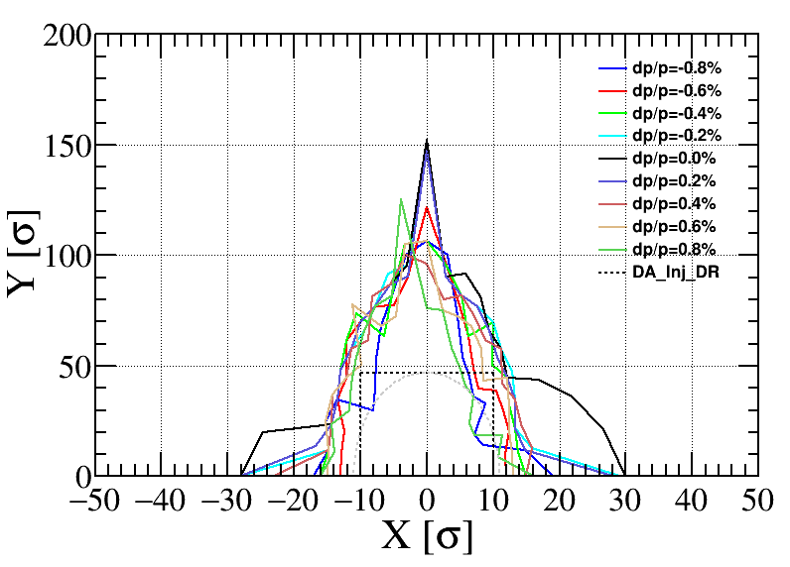
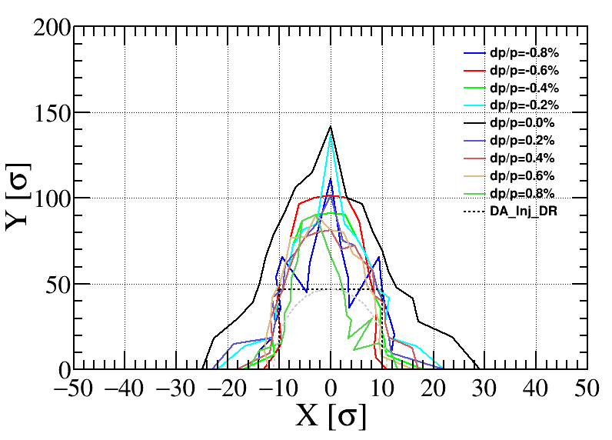
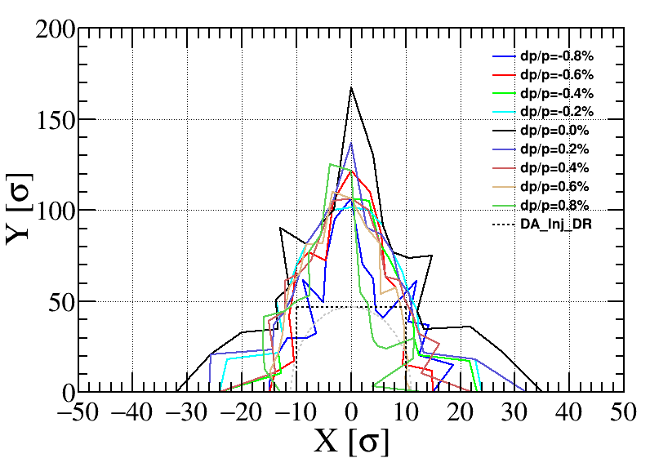
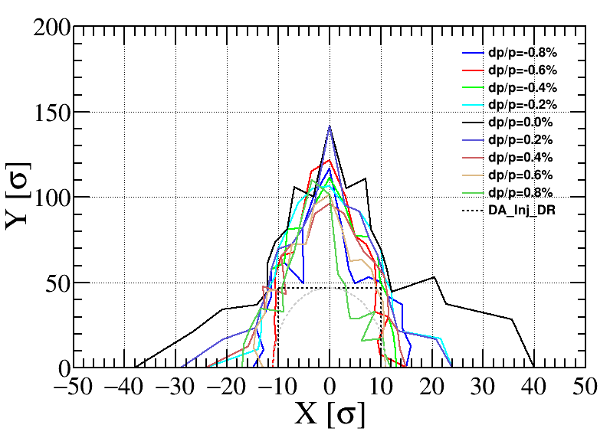
Multipole error
n | BEND | QUAD | SEXT
2 | -5.185E-05 | 0 | 0
3 | 1.530E-04 | 1.36E-04 | 0
4 | -6.900E-05 | 2.32E-05 | 3.82954E-4
5 | 5.261E-05 | 3.47E-05 | 1.06414E-4
6 | 2.130E-05 | 5.81E-05 | 4.91114E-4
7 | -1.917E-04 | 6.07E-05 | 9.69754E-5
8 | 0 | 3.14E-05 | 1.82908E-4
9 | 0 | 4.38E-05 | 6.93930E-4
10 | 0 | 3.44E-04 | 3.81692E-5
11 | 0 | 5.44E-05 | 3.08564E-5
12 | 0 | 4.80E-05 | 5.96229E-5
13 | 0 | 1.26E-05 | 3.48266E-5
14 | 0 | 7.76E-05 | 8.76750E-5
15 | 0 | 2.54E-04 | 4.39130E-3
16 | 0 | 5.58E-05 | 9.41162E-5
17 | 0 | 2.44E-05 | 4.31761E-6
18 | 0 | 4.75E-04 | 1.40759E-5
19 | 0 | 0 | 6.60110E-6
20 | 0 | 0 | 1.32953E-5
21 | 0 | 0 | 6.38161E-4
王斌
The DA is mainly limited by the b2 term of the dipole magnets.

Slide 11
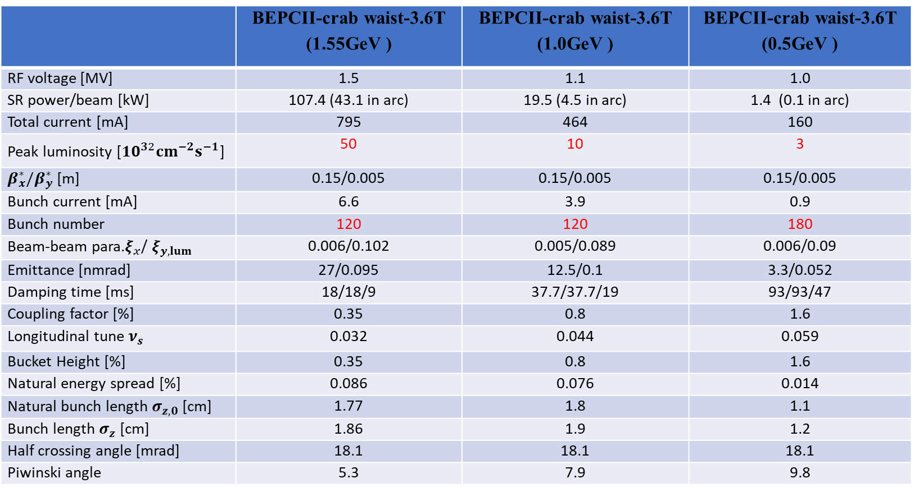
Lower energy parameters @ 1.55GeV/ 1.0GeV/0.5GeV
 | BEPCII-crab waist-3.6T (1.55GeV ) | BEPCII-crab waist-3.6T (1.0GeV ) | BEPCII-crab waist-3.6T (0.5GeV )
RF voltage [MV] | 1.5 | 1.1 | 1.0
SR power/beam [kW] | 107.4 (43.1 in arc) | 19.5 (4.5 in arc) | 1.4 (0.1 in arc)
Total current [mA] | 795 | 464 | 160
Peak luminosity [${10}^{32}cm^{−2}s^{−1}$] | 50 | 10 | 3
$β_{x}^{∗}/β_{y}^{∗}$ [m] | 0.15/0.005 | 0.15/0.005 | 0.15/0.005
Bunch current [mA] | 6.6 | 3.9 | 0.9
Bunch number | 120 | 120 | 180
Beam-beam para.$ξ_{x}$/ $ξ_{y,lum}$ | 0.006/0.102 | 0.005/0.089 | 0.006/0.09
Emittance [nmrad] | 27/0.095 | 12.5/0.1 | 3.3/0.052
Damping time [ms] | 18/18/9 | 37.7/37.7/19 | 93/93/47
Coupling factor [%] | 0.35 | 0.8 | 1.6
Longitudinal tune $ν_{s}$ | 0.032 | 0.044 | 0.059
Bucket Height [%] | 0.35 | 0.8 | 1.6
Natural energy spread [%] | 0.086 | 0.076 | 0.014
Natural bunch length $σ_{z,0}$ [cm] | 1.77 | 1.8 | 1.1
Bunch length $σ_{z}$ [cm] | 1.86 | 1.9 | 1.2
Half crossing angle [mrad] | 18.1 | 18.1 | 18.1
Piwinski angle | 5.3 | 7.9 | 9.8
To test luminosity performance at various Piwinski angles → b-b parameters & CW commissioning experience.

Slide 12
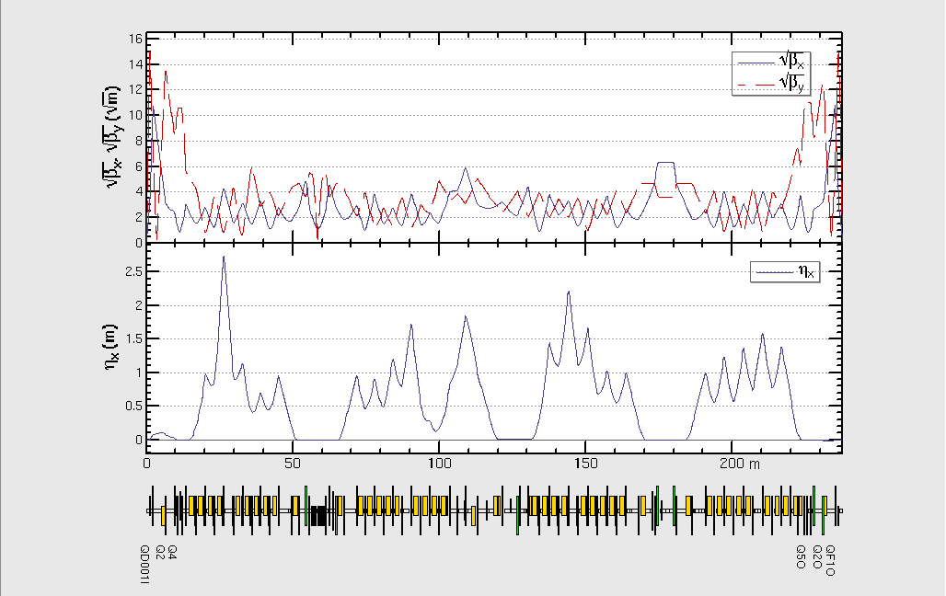
Lattice design @ 1.0GeV
赵明阳

Slide 13
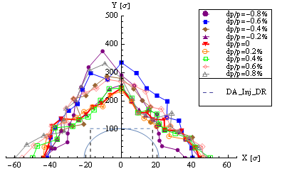
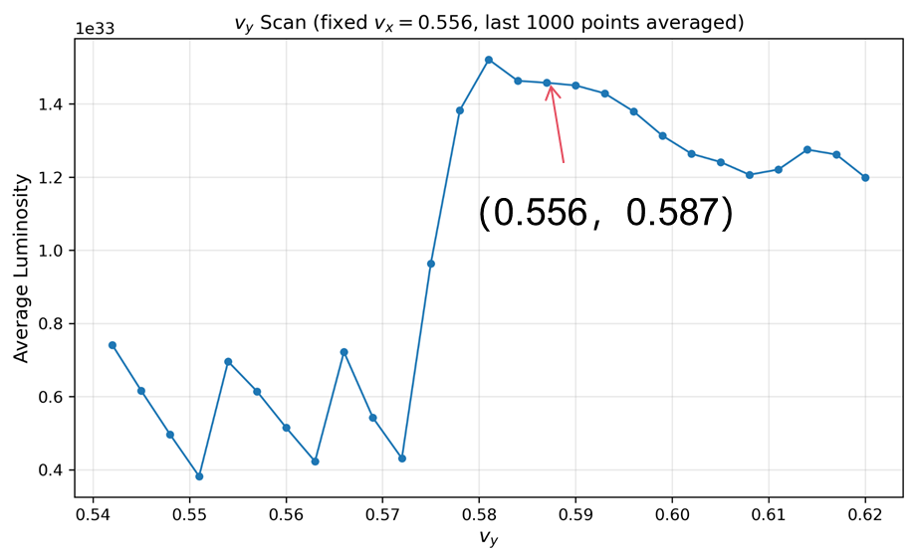
Preliminary beam-beam simulations & DA @ 1.0GeV
林椿涛，赵明阳，王逗，张源
62% crab + 3.6T wiggler
Luminosity with tune scan
Lumi. goal
DA requirement by injection @1.0GeV
I_{b}=4mA with 120 bunches
--With DR : 21σx, 103σy (εy= 0.008εx)
Our luminosity goal @1.0GeV (1× ${10}^{33}cm^{−2}s^{−1}$) seems possible based on b-b simulations.

Slide 14
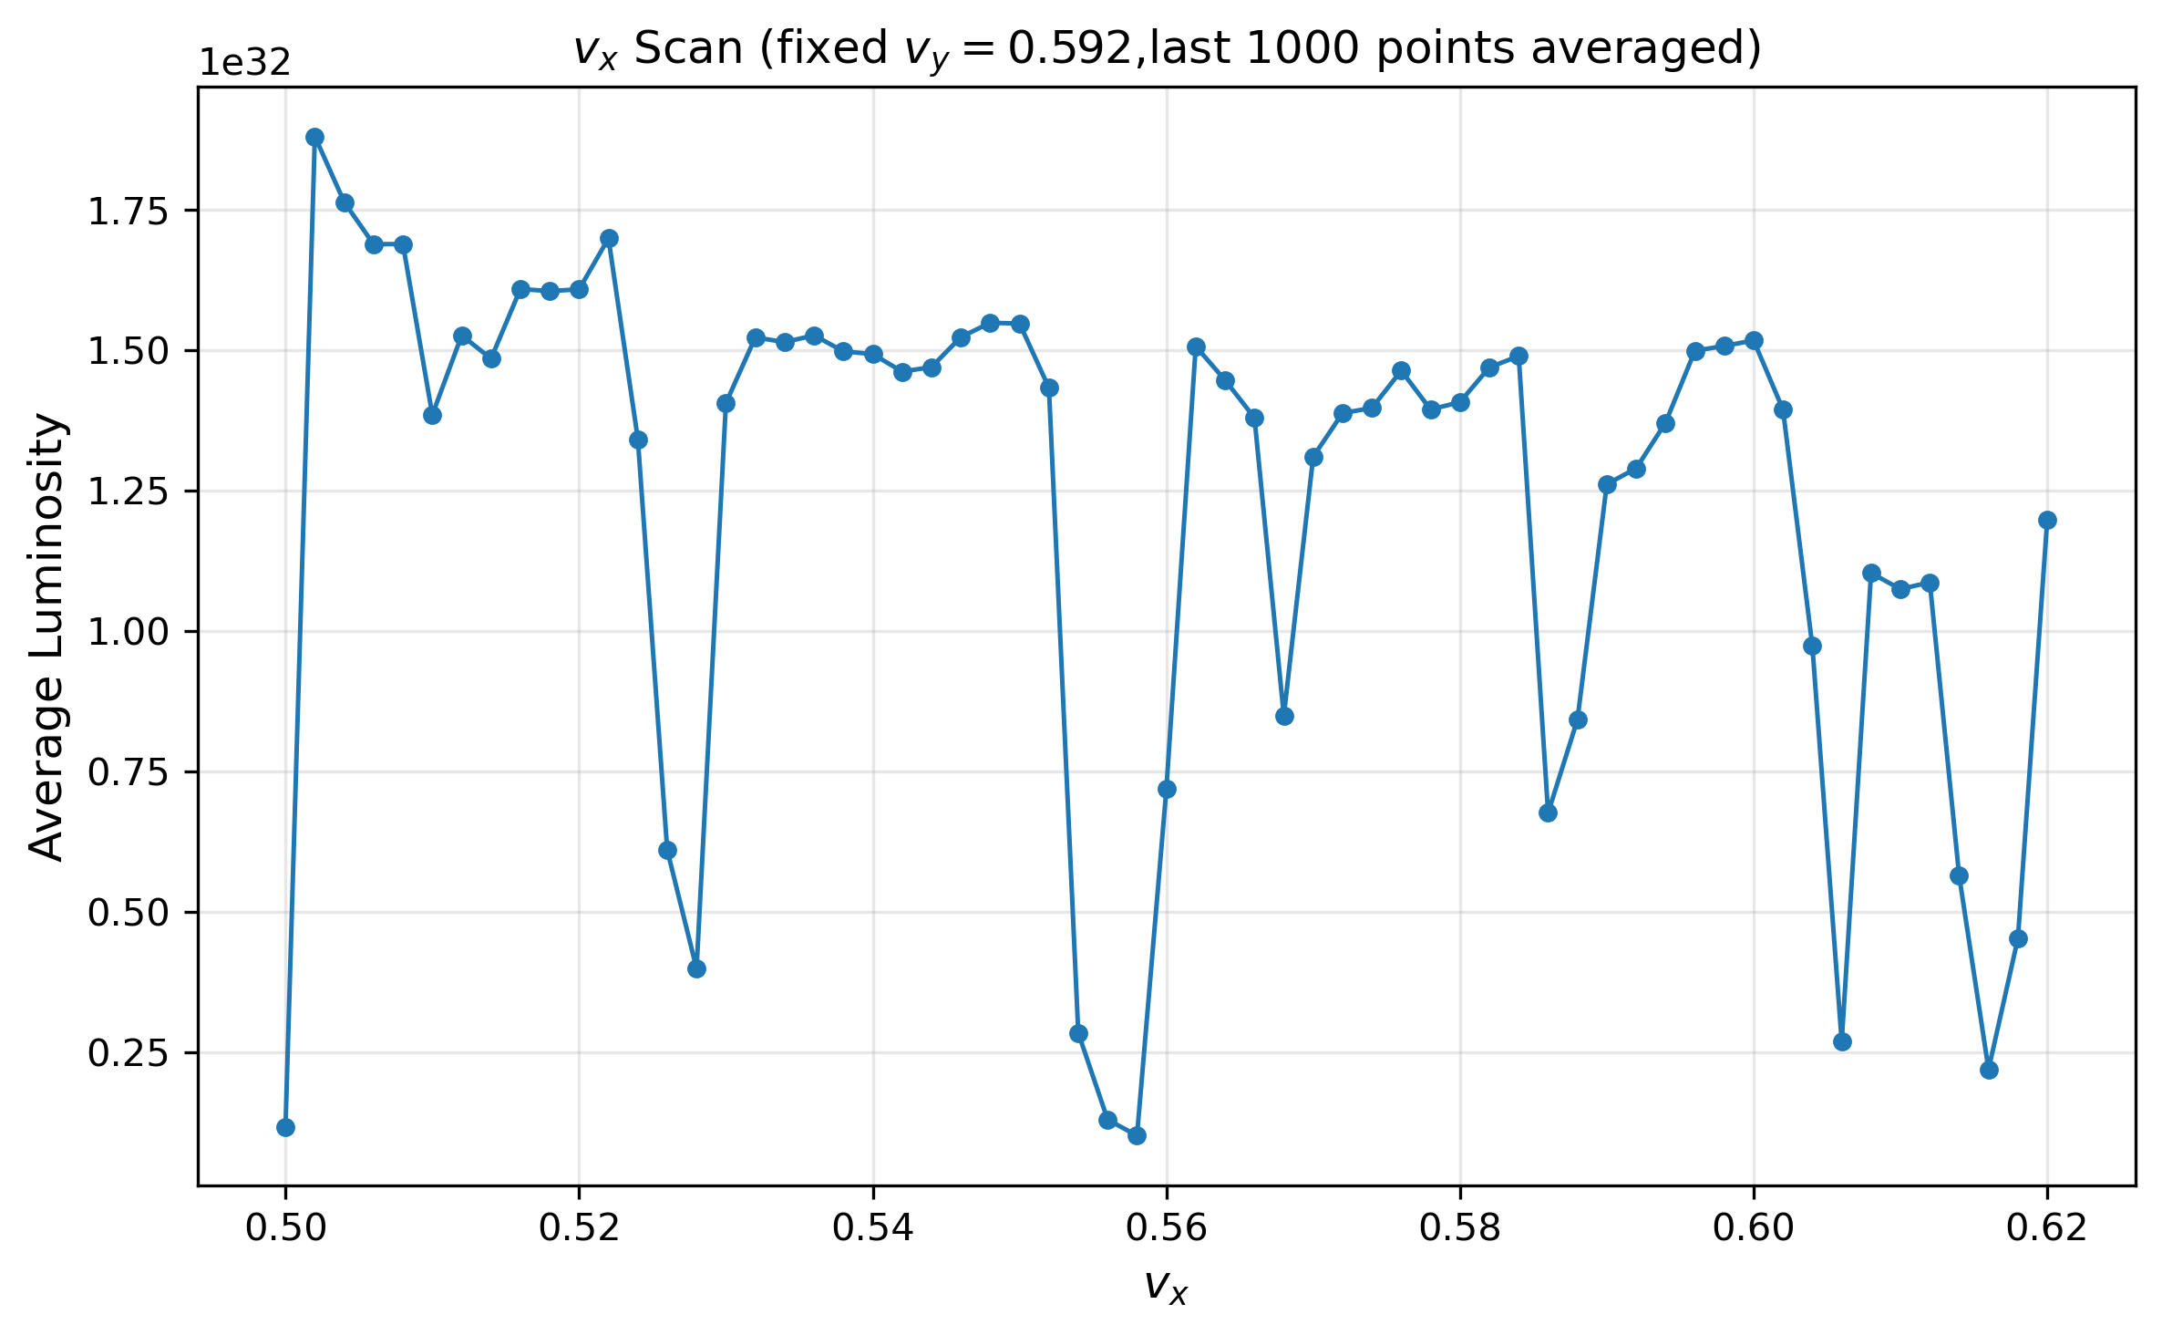
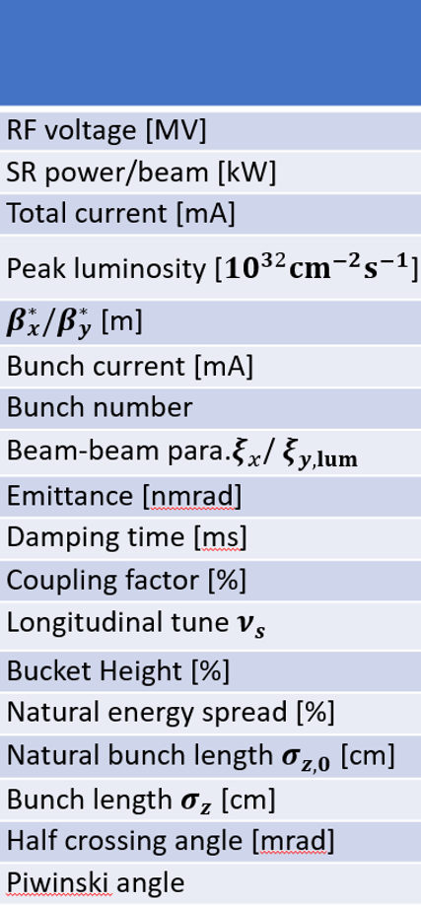
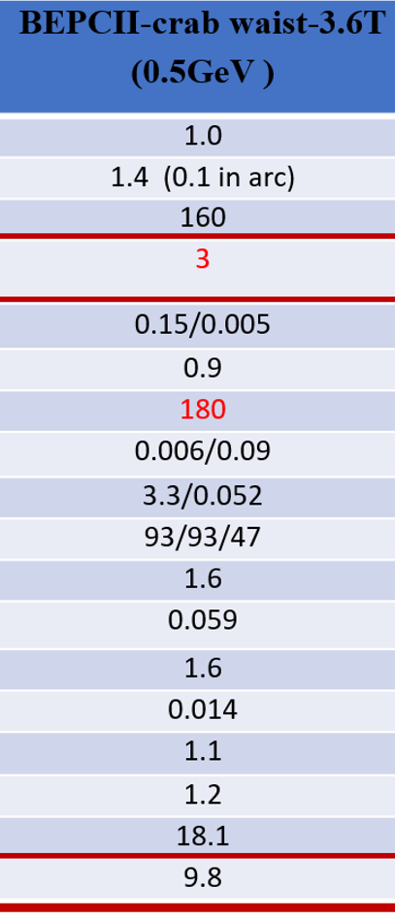
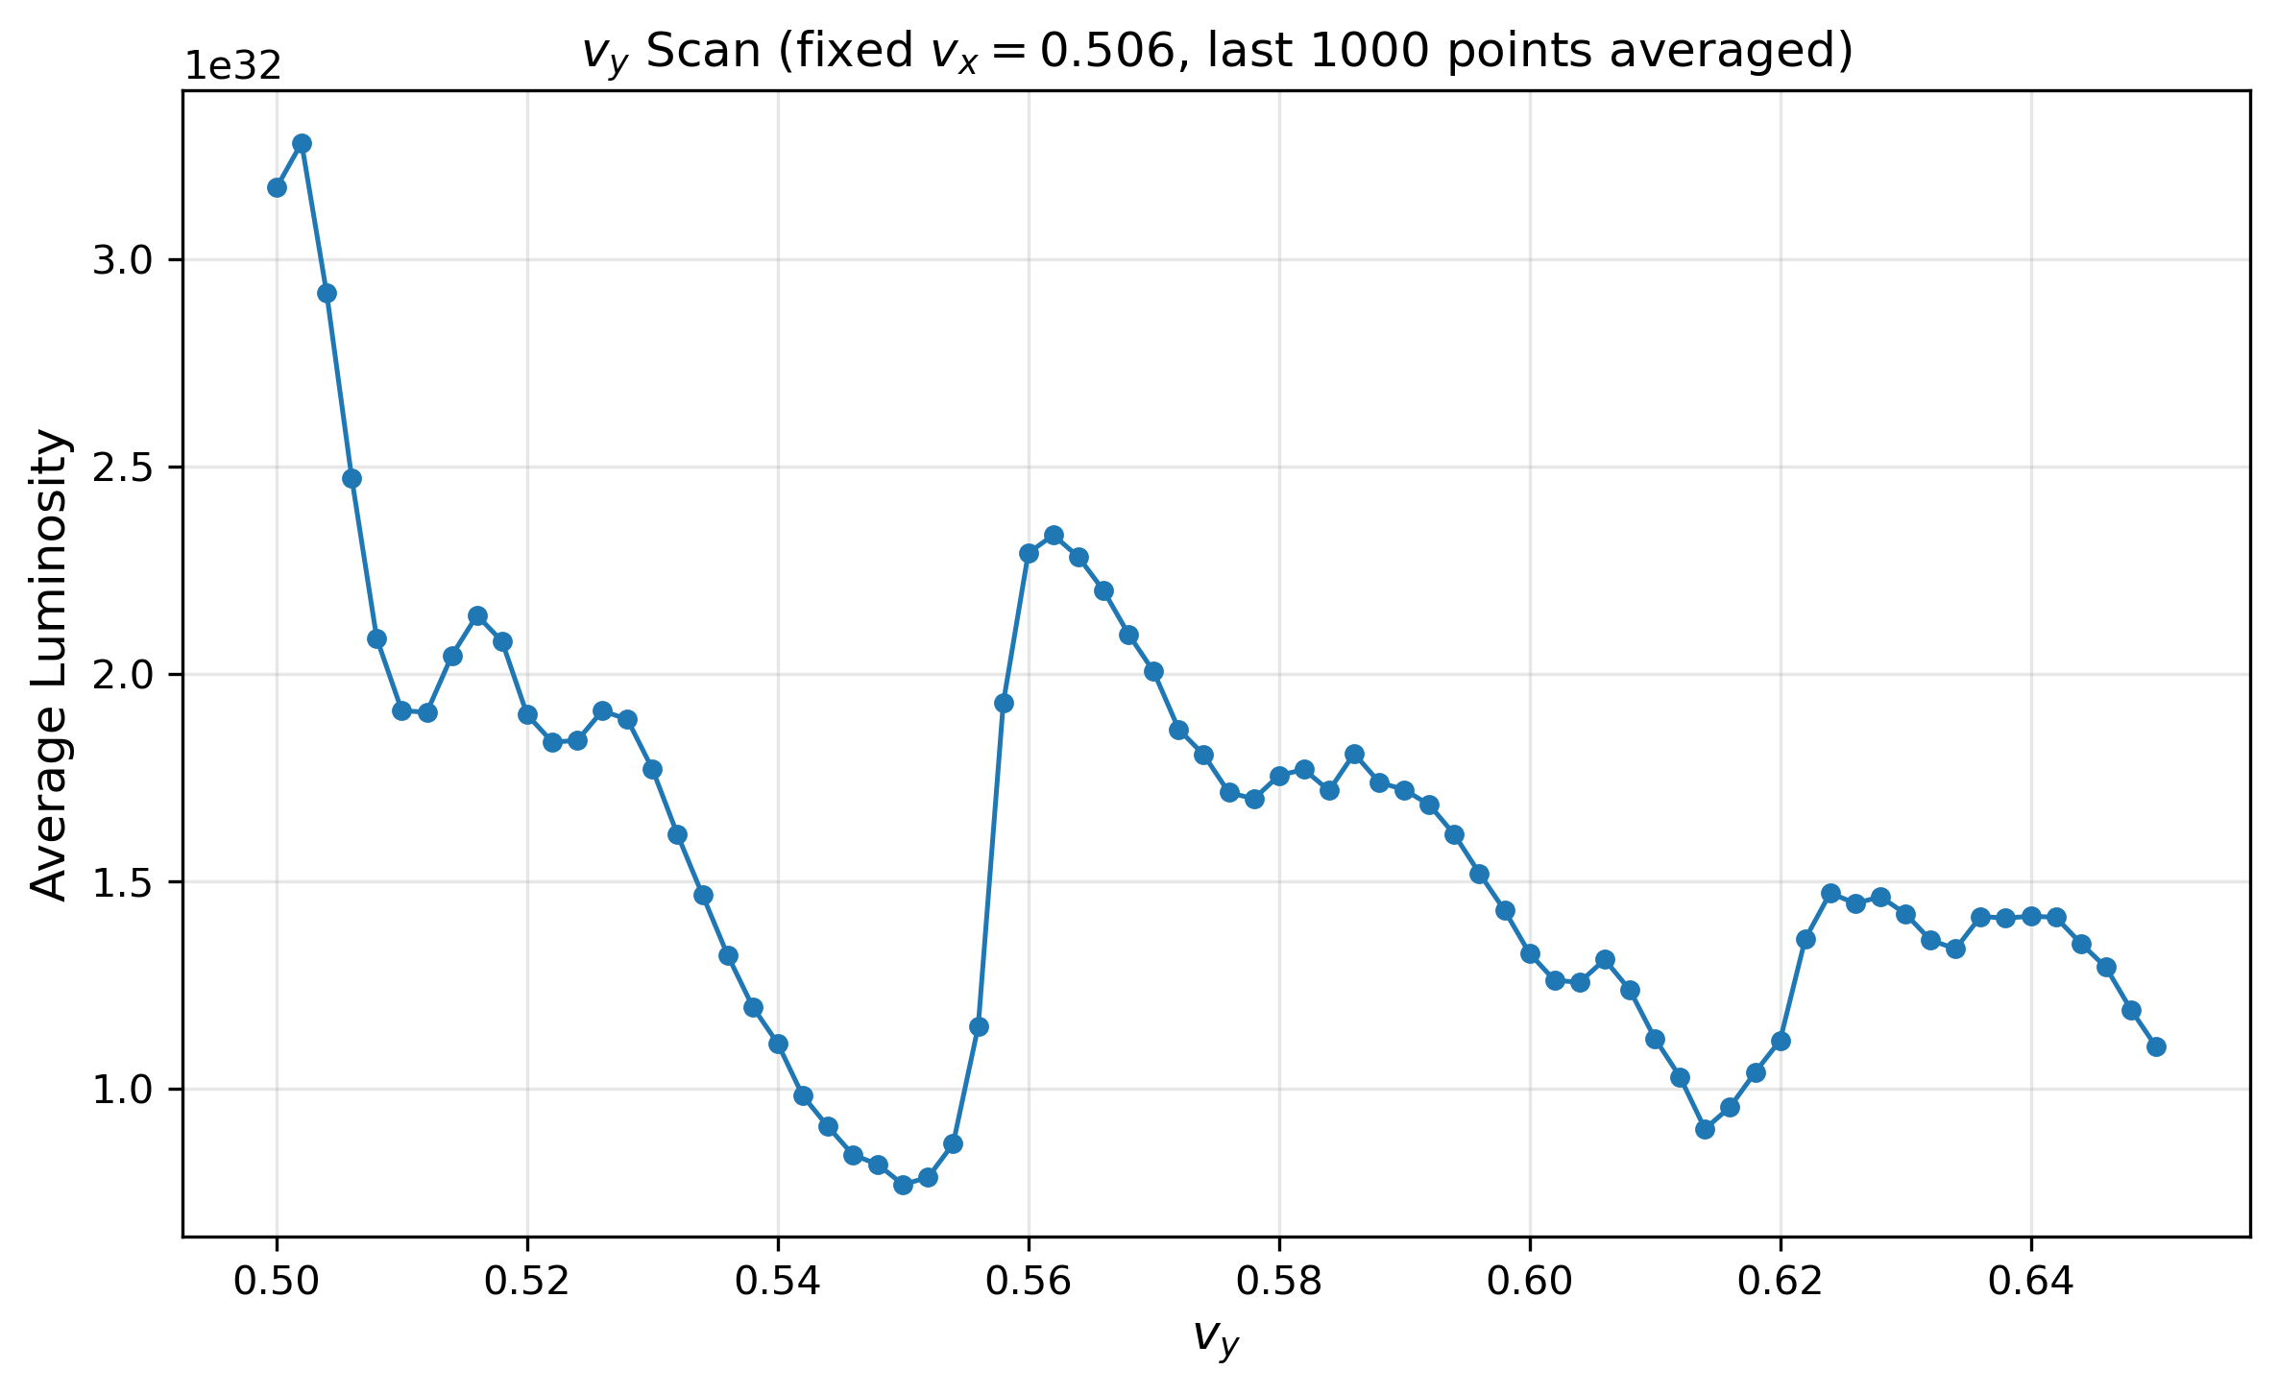
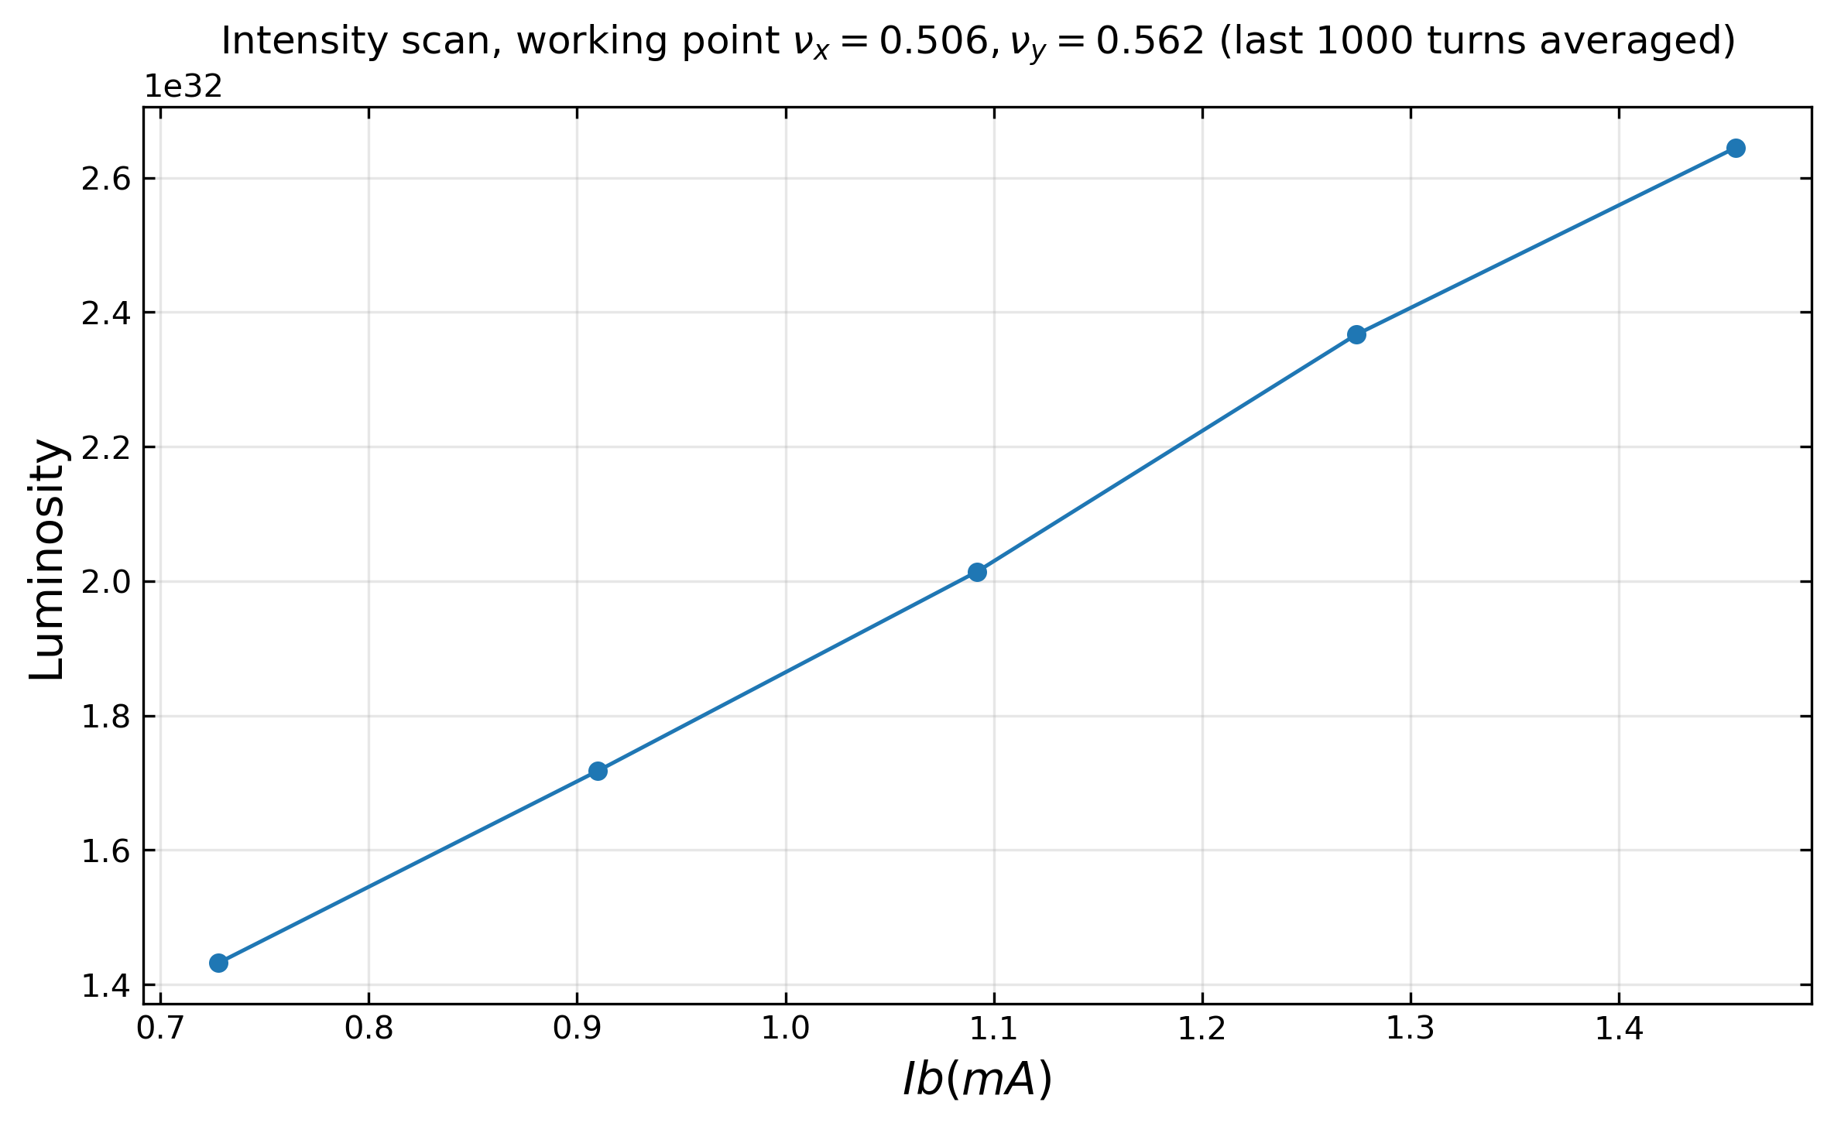
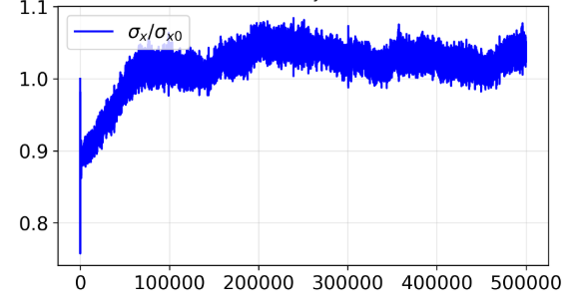
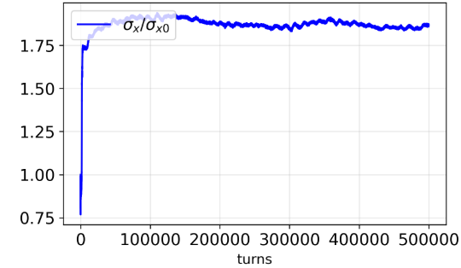
Beam-beam @0.5GeV
弱强
林椿涛
强强
强强模拟亮度亮度约为弱强模拟的70%
弱强模拟水平尺寸没有blow up。强强模拟水平水平blow up，没有x-z不稳定性。
大纵向纵向频率$ν_{s} 0.04→0.059$ , 横向尺寸变化引起的Piwinski角变化对工作点选取有很大影响

Slide 15

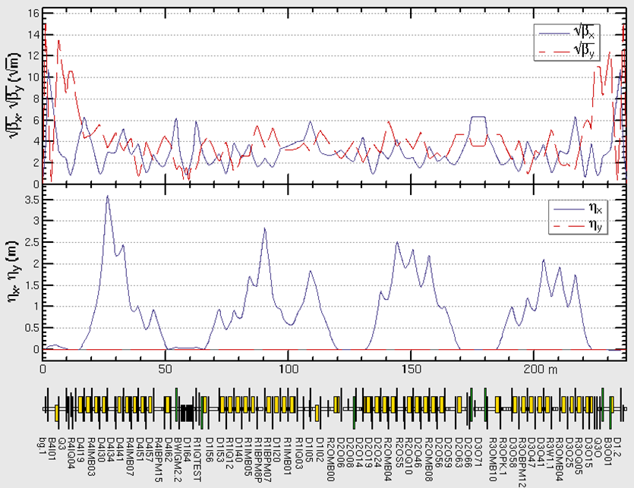
Lattice design @ 0.5GeV
赵明阳
Emittance：2.5nm
Emittance：3.5nm
Working point: 8.55/8.38
Working point: 7.55/7.58

Slide 16
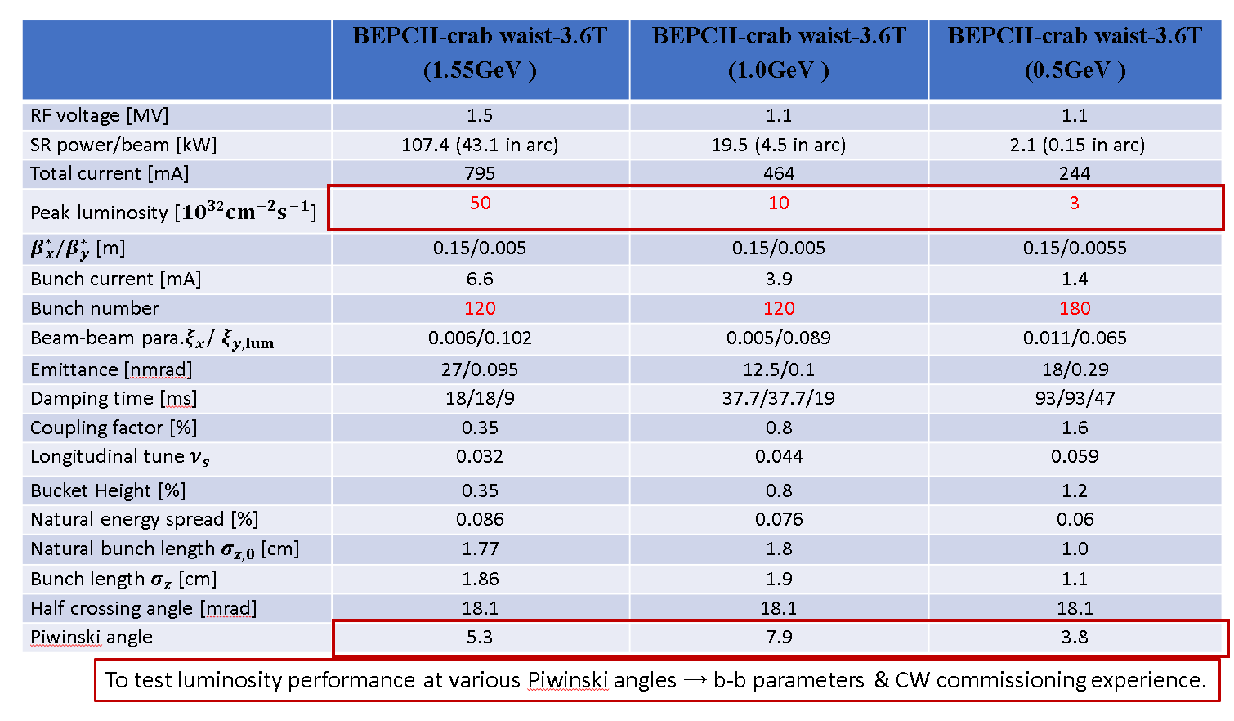
0.5GeV new parameters considering IBS effect

Slide 17
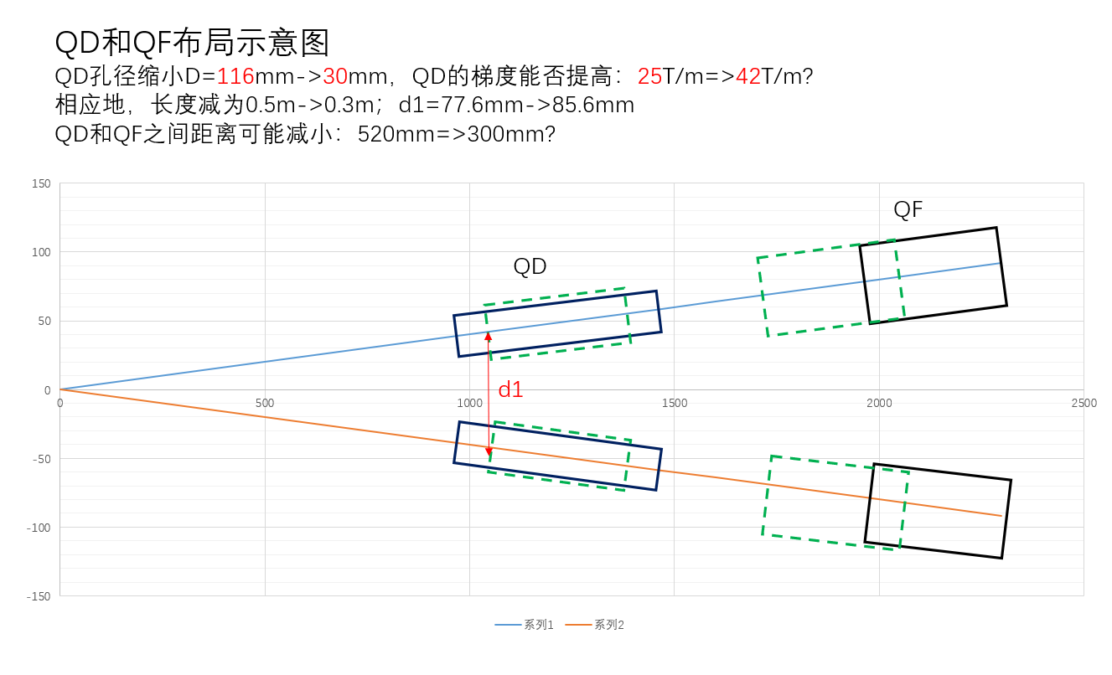
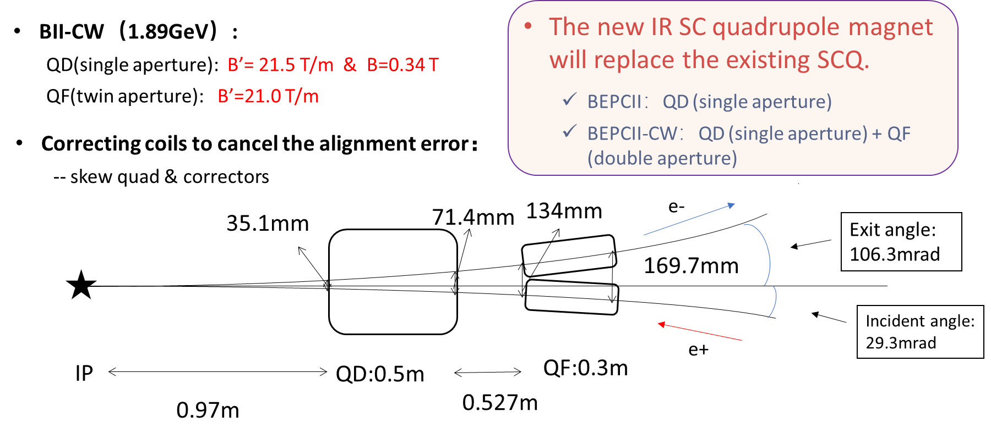
Difficulties of SCQ
王九庆
The superconducting dipole coils experience significant Lorentz forces within the solenoid field.—— hardware risks
Vertical force: ~41kN at both ends of dipole, in opposite directions.
BEPCII-CW Asymmetric IR design
Half crossing angle=18.1 mrad
Half crossing angle=40 mrad

Slide 18
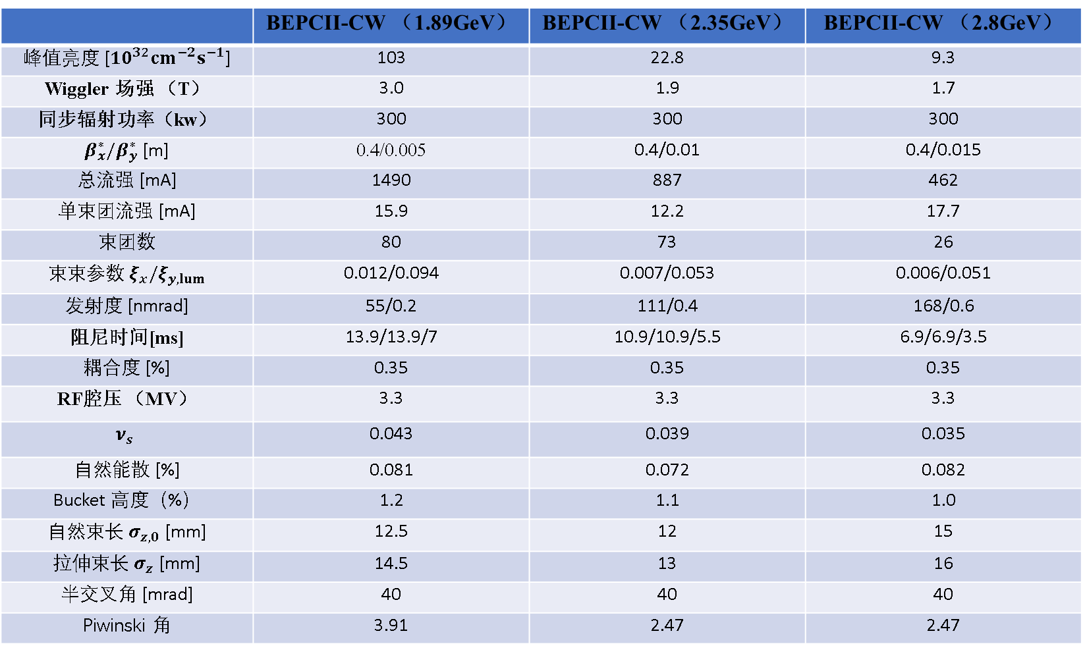
New parameters with 40mrad
 | BEPCII-CW （1.89GeV） | BEPCII-CW （2.35GeV） | BEPCII-CW （2.8GeV）
峰值亮度 [${10}^{32}cm^{−2}s^{−1}$] | 103 | 22.8 | 9.3
Wiggler 场强 （T） | 3.0 | 1.9 | 1.7
同步辐射功率（kw） | 300 | 300 | 300
$β_{x}^{∗}/β_{y}^{∗}$ [m] | 0.4/0.005 | 0.4/0.01 | 0.4/0.015
总流强 [mA] | 1490 | 887 | 462
单束团流强 [mA] | 15.9 | 12.2 | 17.7
束团数 | 80 | 73 | 26
束束参数 ${ξ_{x}/ξ}_{y,lum}$ | 0.012/0.094 | 0.007/0.053 | 0.006/0.051
发射度 [nmrad] | 55/0.2 | 111/0.4 | 168/0.6
阻尼时间[ms] | 13.9/13.9/7 | 10.9/10.9/5.5 | 6.9/6.9/3.5
耦合度 [%] | 0.35 | 0.35 | 0.35
RF腔压 （MV） | 3.3 | 3.3 | 3.3
$$ν_{s}$$ | 0.043 | 0.039 | 0.035
自然能散 [%] | 0.081 | 0.072 | 0.082
Bucket 高度（%） | 1.2 | 1.1 | 1.0
自然束长 $σ_{z,0}$ [mm] | 12.5 | 12 | 15
拉伸束长 $σ_{z}$ [mm] | 14.5 | 13 | 16
半交叉角 [mrad] | 40 | 40 | 40
Piwinski 角 | 3.91 | 2.47 | 2.47

Slide 19
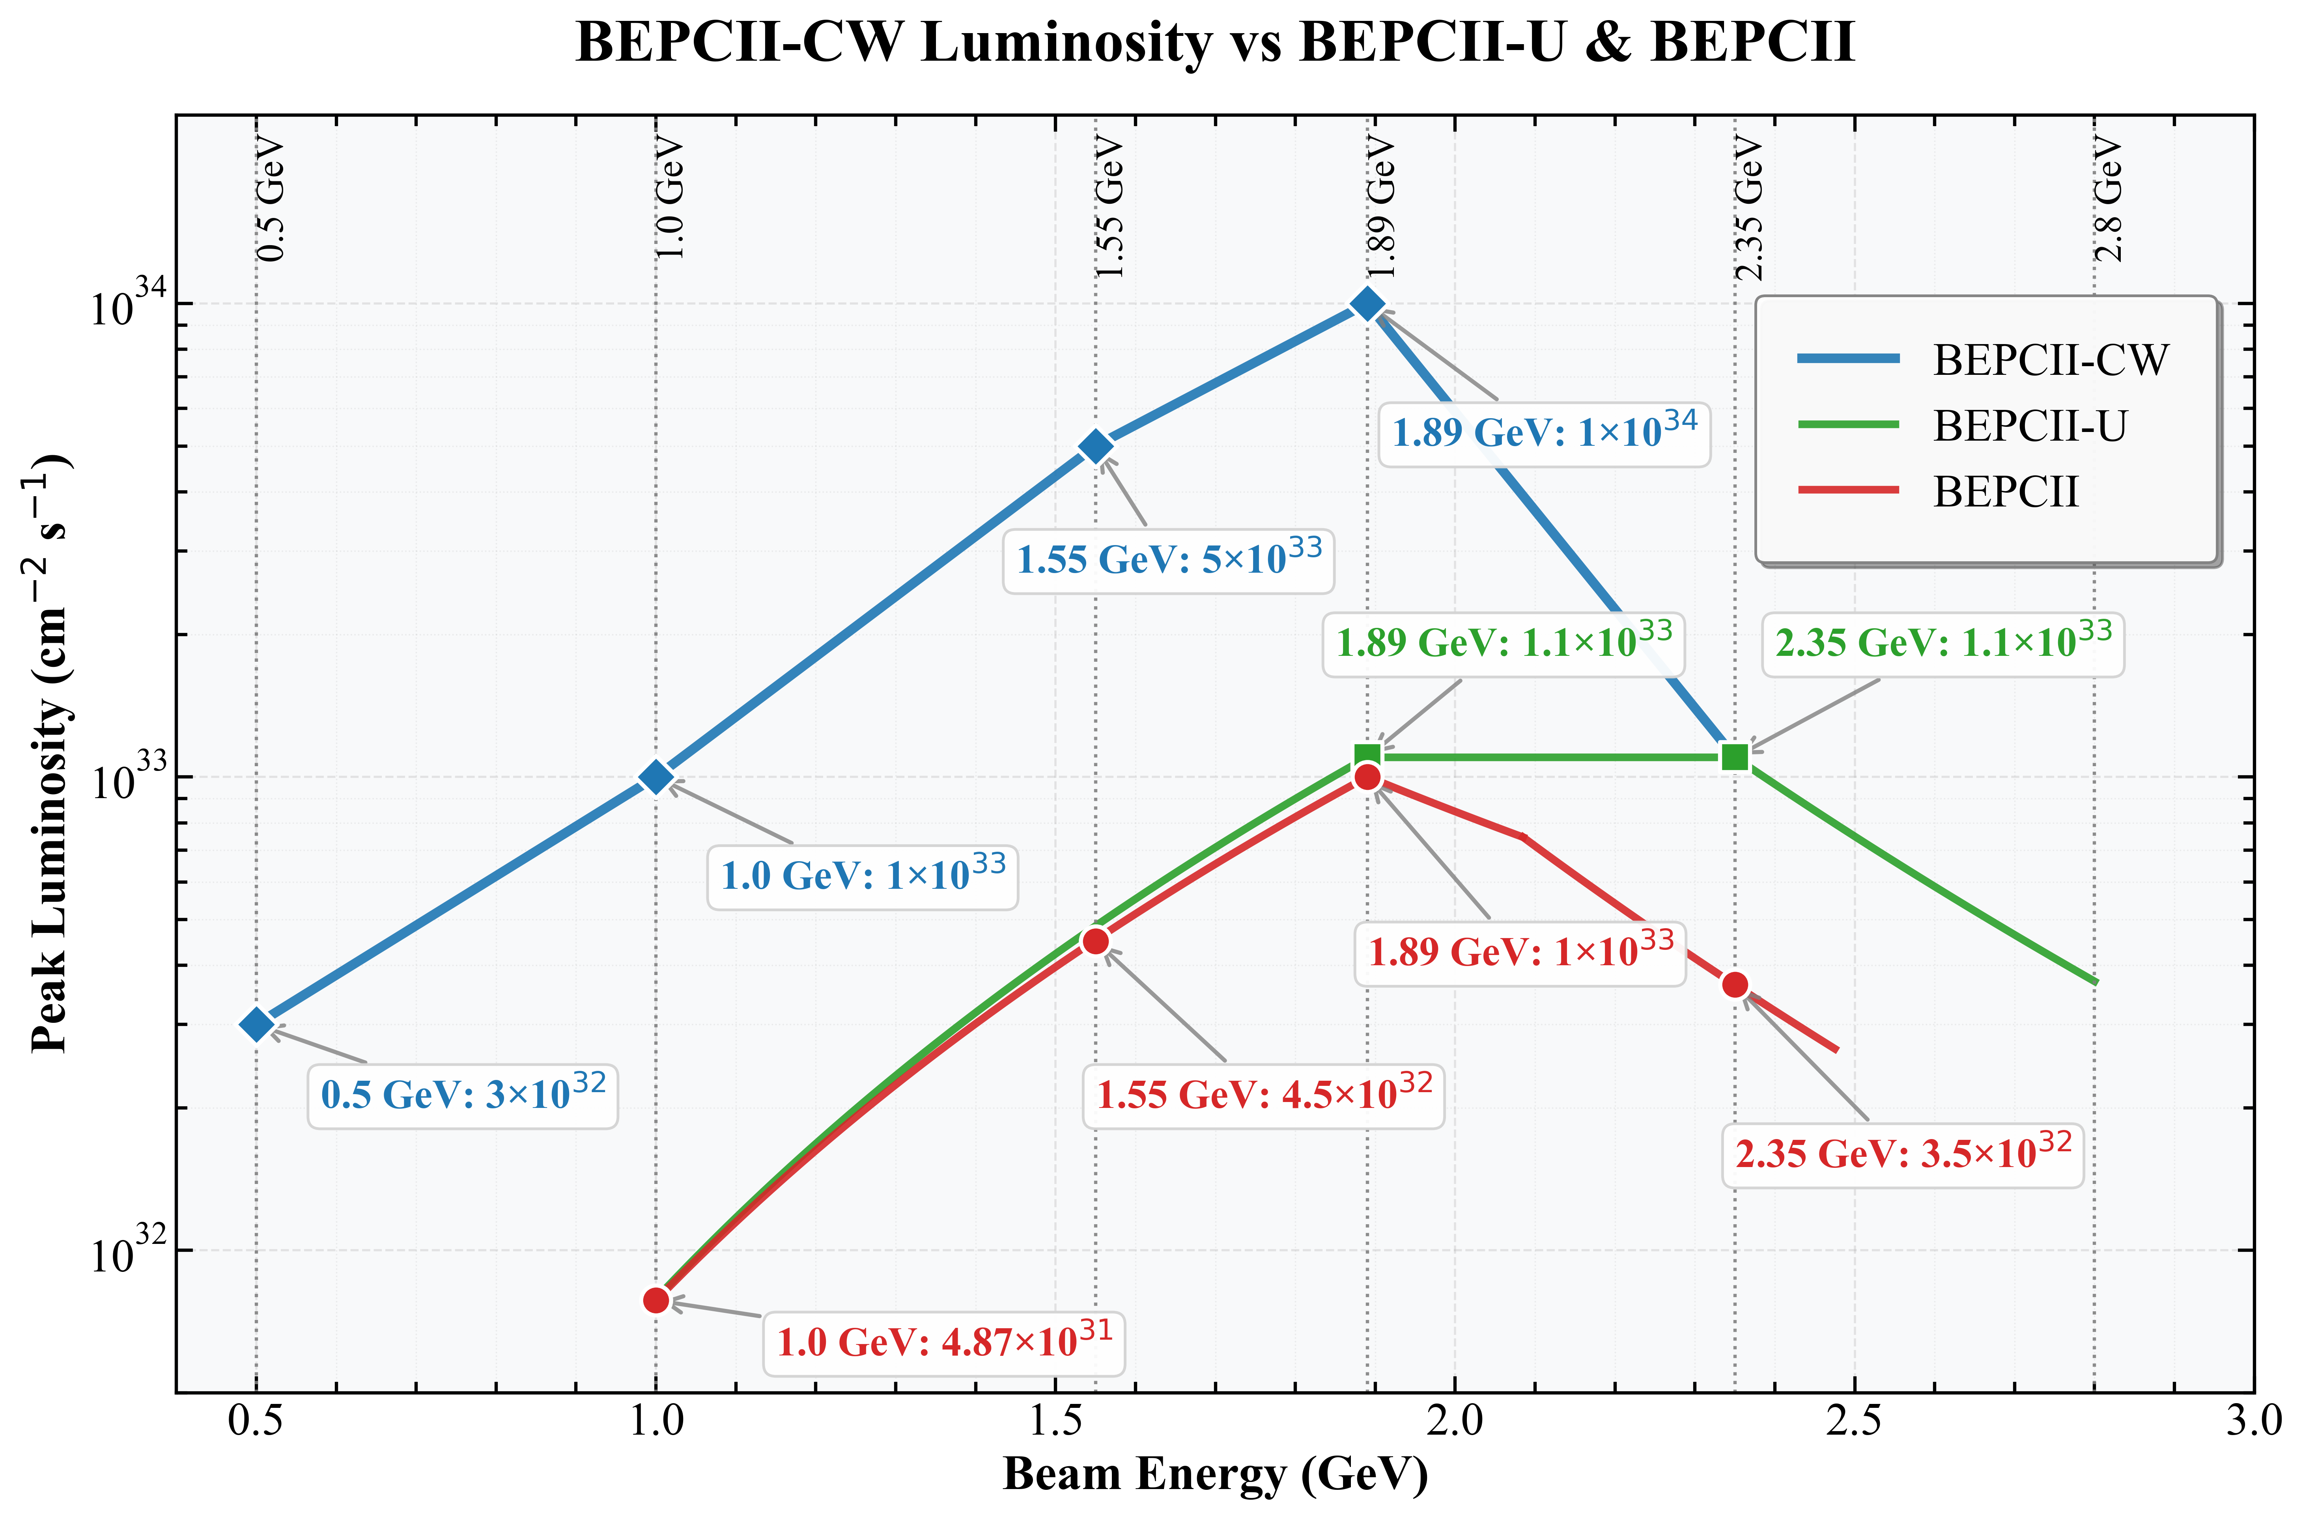
More luminosity potential for higher energy region

Slide 20


Lattice design for 40mrad scheme
赵明阳
 | BII-CW (40mrad)
BX/BY | 0.3m/0.005m
NX/NY | 8.553/7.575
EmittanceX | 54nm

Slide 21




18.1mrad
40mrad
Crab sext.

Slide 22


Natural chromaticity of 40mrad lattice
赵明阳
40mrad
18.1mrad
40mrad的自然色品为（-15.5，-84.2），18.1mrad的自然色品为（-24.9，-82.6）

Slide 23

王九庆，王海静，朱应顺，王逗，杨啸辰
反抵螺线管

Slide 24
Summary
Efforts in accelerator physics at 1.89 GeV are ongoing to further validate the feasibility of achieving the ×10 luminosity goal.
Preliminary studies indicate that no significant bottlenecks have been identified regarding the feasibility at 1 GeV.
The 0.5 GeV feasibility study is just starting. Key focus areas include lifetime and IBS, with the mitigation strategy centered on maximizing emittance and DA.
A new large crossing angle (40 mrad) alternative has been considered to mitigate the technical risks associated with the SCQ. This new SCQ scheme can validate CEPC technologies while offering higher luminosity potential for BEPCII-UP.
A lot of things for accelerator physics need to be done…

