Slide 1
Cygnus X-3: The First Variable PeV Gamma-ray Source
Cong Li， Zhen.Cao, J.S Wang, J.N Zhou, F. Aharonian
licong@ihep.ac.cn
LHAASO Collaboration

Slide 2
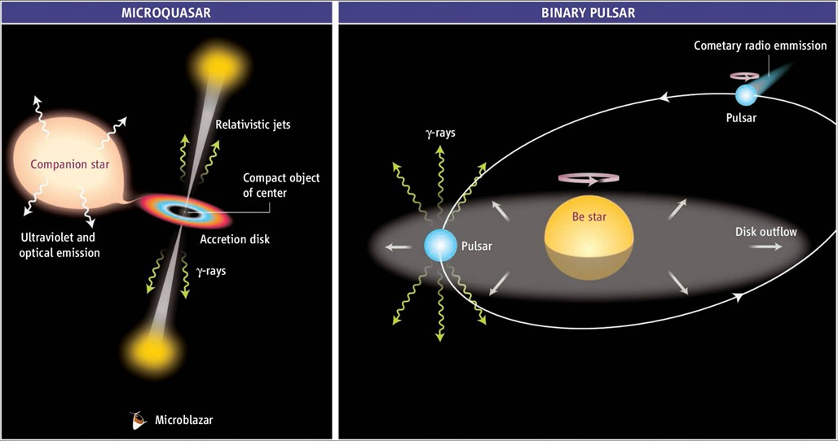
TeV Binary
Binary is a very important kind of TeV source, characterized with unique properties .
colliding-wind binary system

Slide 3
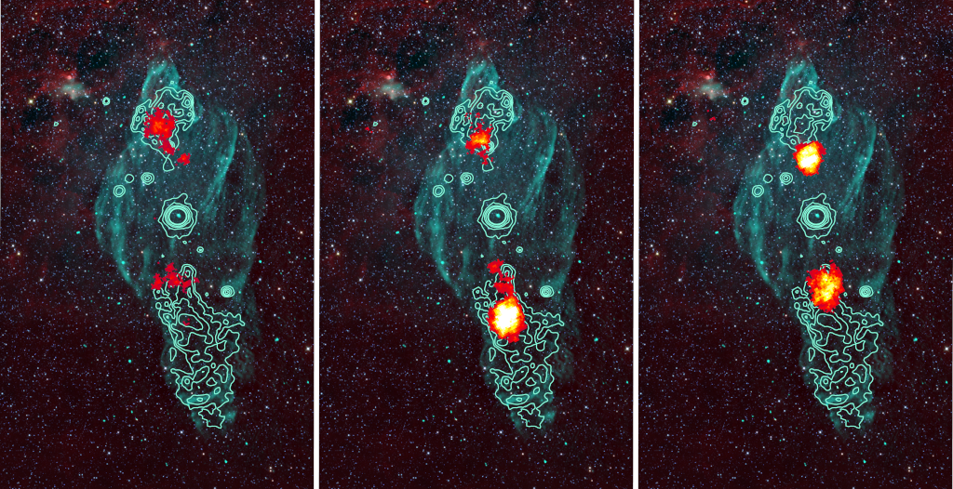
Microquasar “halo”
UHE(>100TeV) emission associated with microquasar was detected recently;
Gamma-ray from center system?

Slide 4
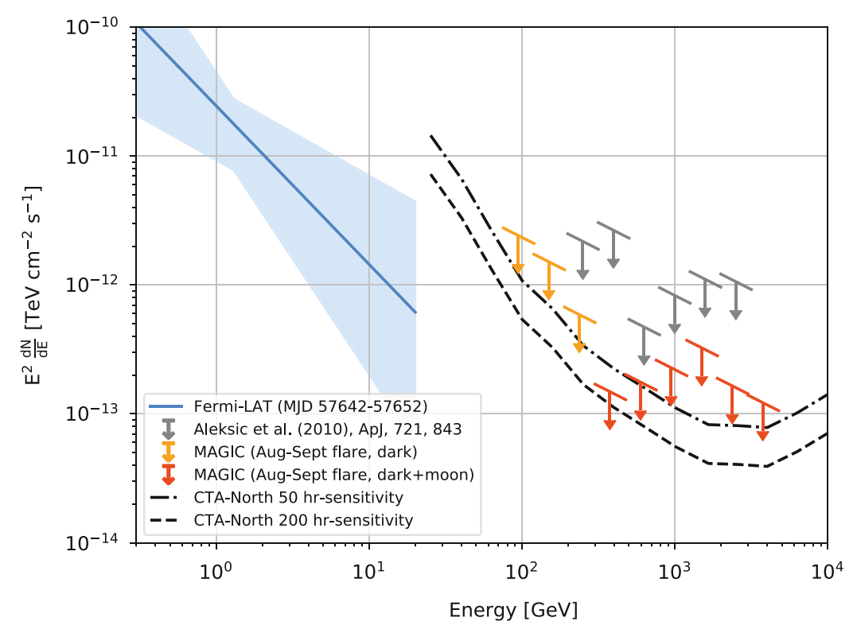
Historical puzzle: Cygnus X-3
1.PeV signals were declared by many experiments at 1980s;
2.Not confirmed by future more sensitive detectors;
1983 APJ

Slide 5
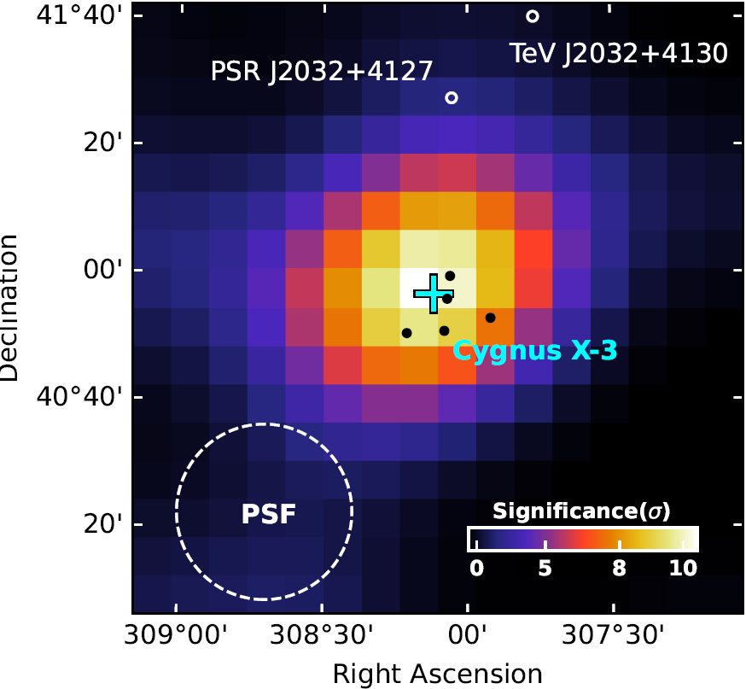
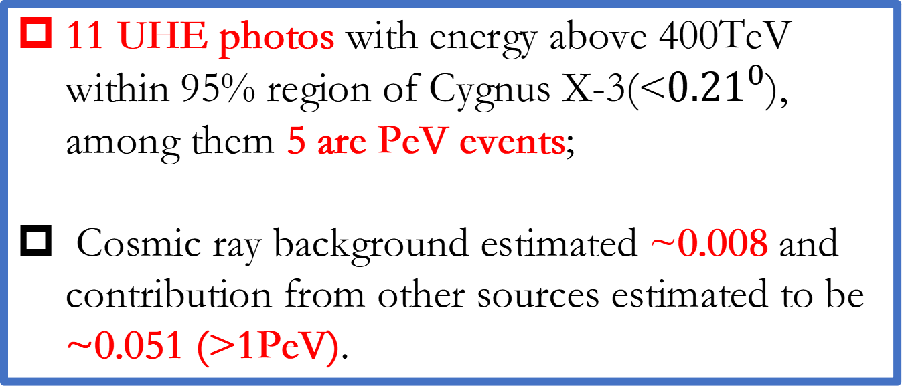
First PeV gamma-ray source
A point source is detected positionally coincident with Cygnus X-3 at a significance of 9.6 sigma assuming stable flux;
11 UHE photos with energy above 400TeV within 95% region of Cygnus X-3(<${0.21}^{0}$), among them 5 are PeV events;
Cosmic ray background estimated ~0.008 and contribution from other sources estimated to be ~0.051 (>1PeV).

Slide 6
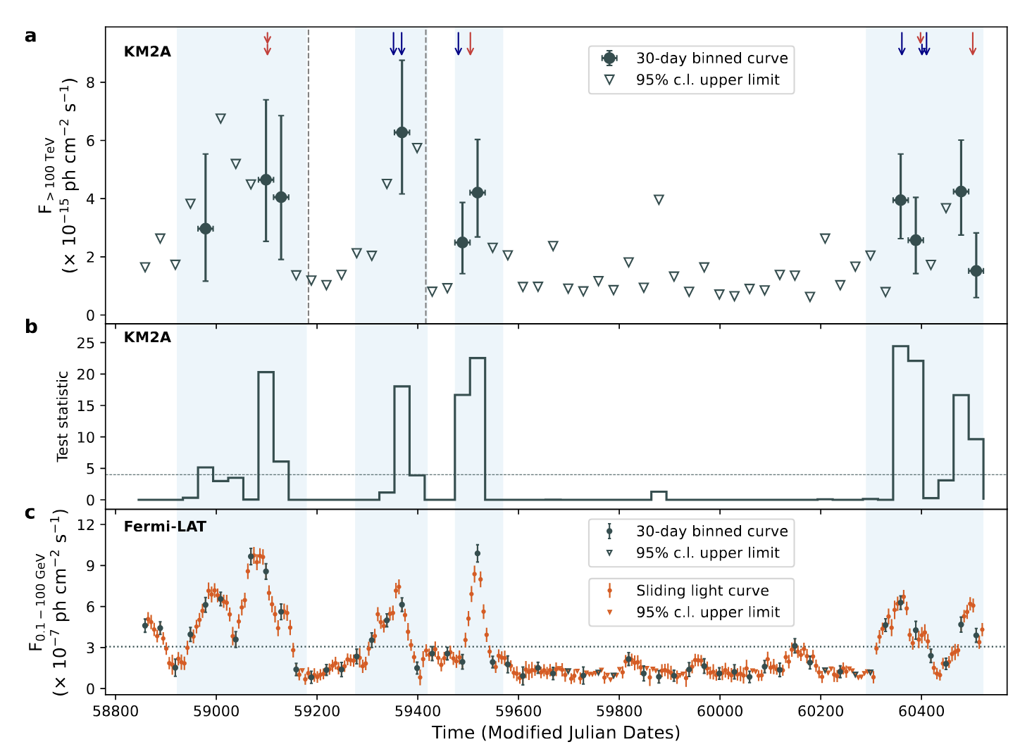

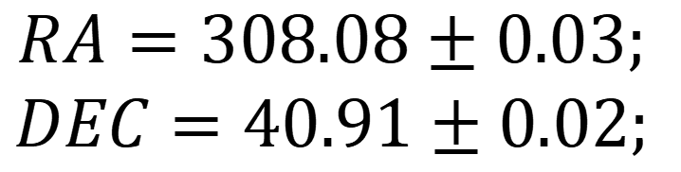
UHE Flares
$$RA=308.08±0.03;$$
$$DEC=40.91±0.02;$$
Divide the data into two parts according to GeV states. Ratio of exposure time: 1:1.6.
$$∆TS=75\sim 8.6 σ$$
Variability test:
H0: Constant flux;
H1: Change of flux at two states.
Flaring UHE emission with time coincidence with GeV flares.
3. Firmly identification of source.

Slide 7
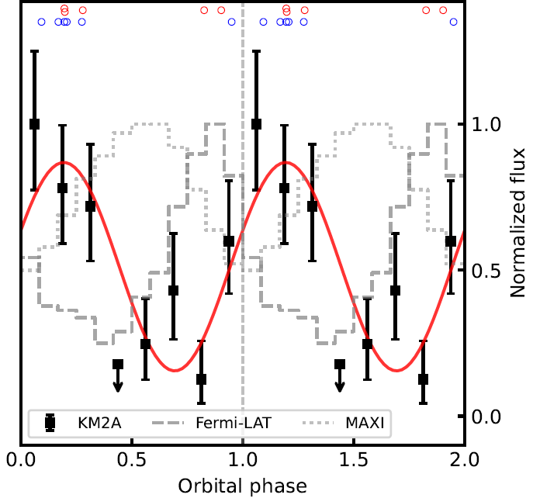
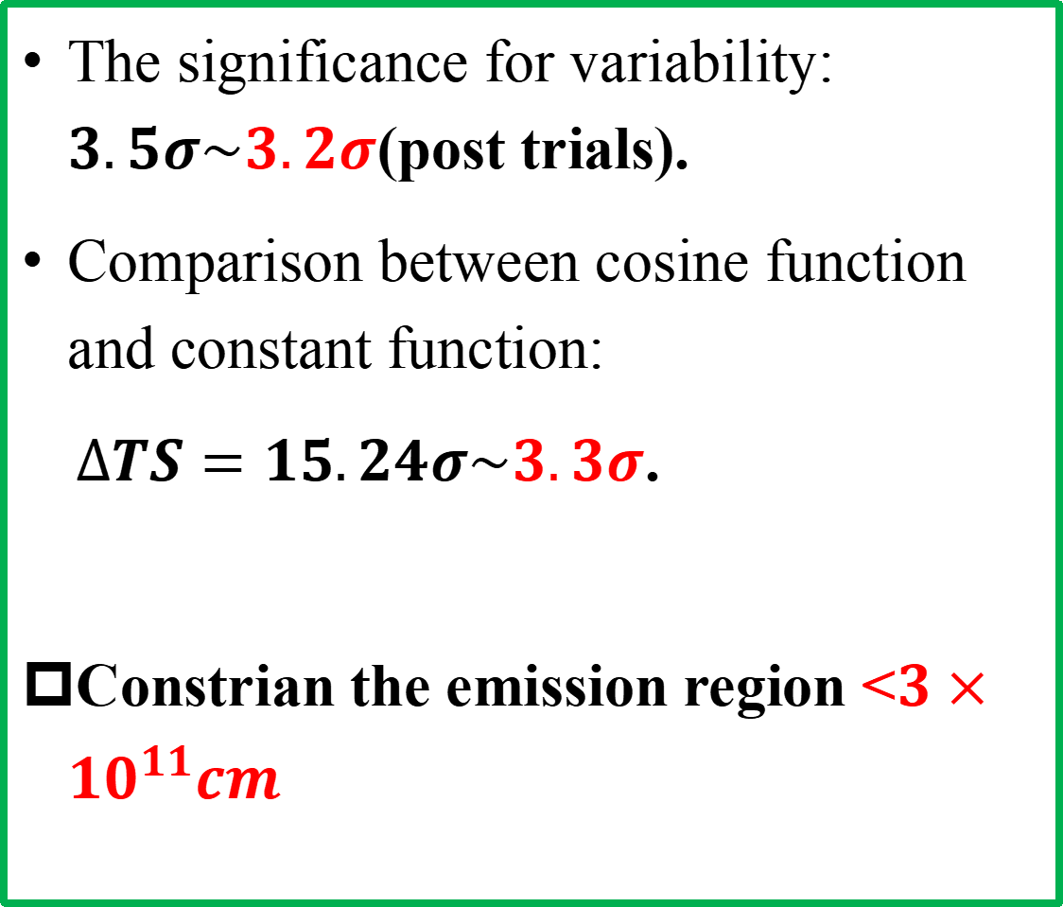
Modulation with orbital phases
The significance for variability: $3.5σ\sim 3.2σ$(post trials).
Comparison between cosine function and constant function:
$∆TS=15.24σ\sim 3.3σ$.
Constrian the emission region <$3×{10}^{11}cm$

Slide 8
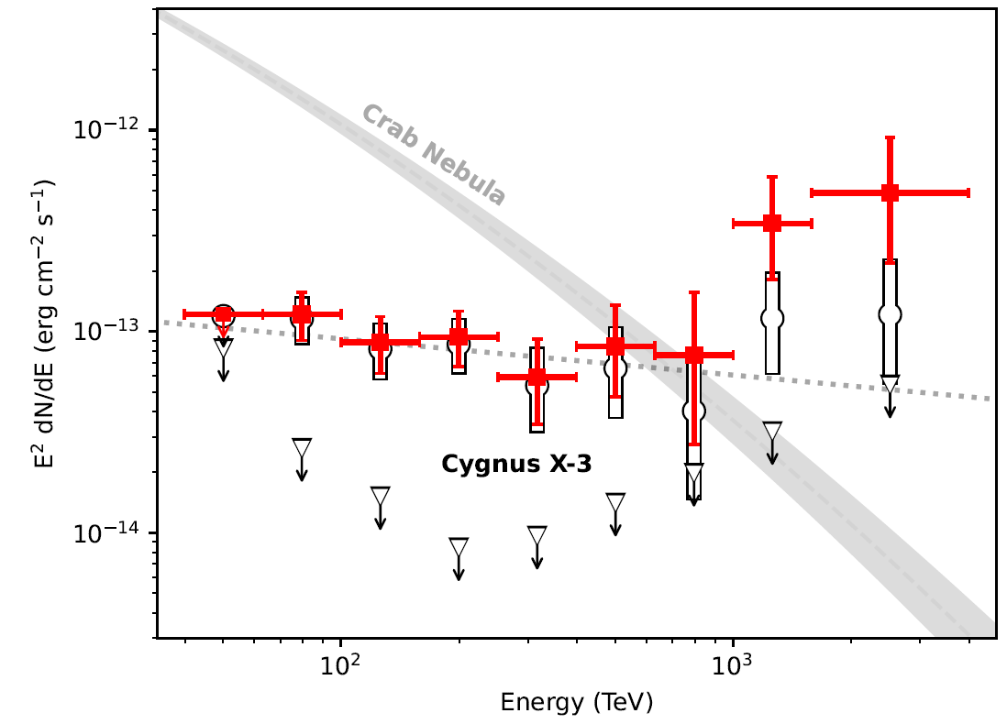
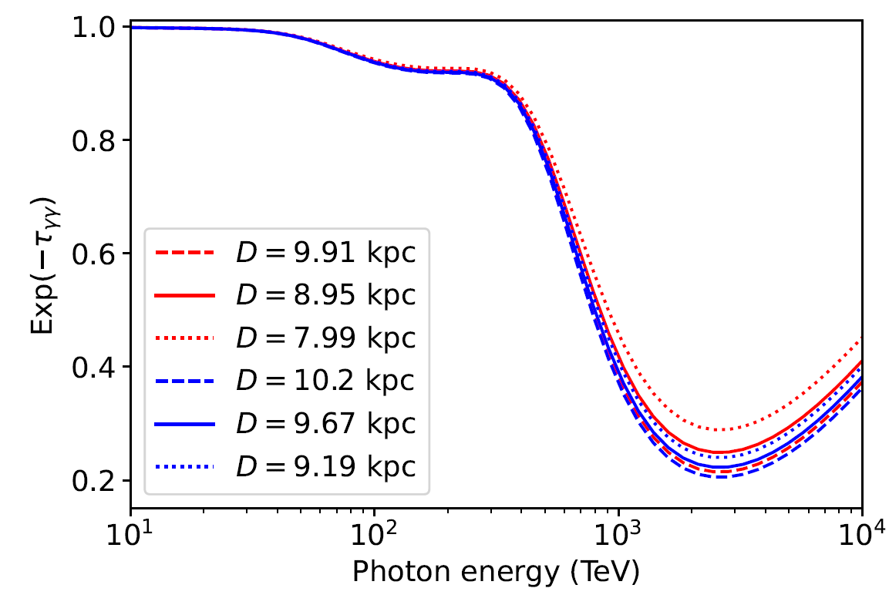
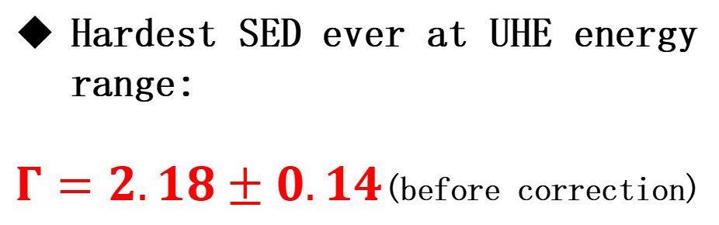
Spectrum
Hardest SED ever at UHE energy range:
$Γ=2.18±0.14$(before correction)

Slide 9
Is Cygnus X-3 the first identied >PeV cosmic-ray accelerator?
To answer this question, we need to adress two questions(personal point of review):
1. Identification of source.
Cygnus X-3 is almost identified at 100% confidence level:
a. Position; √
b. Light curve; √
c. Orbital modulation; √?
2. Rule out of leptonic model from the first principle, or without assumption.

Slide 10

Leptonic or Hadronic?
Constriants of rediation size from orbital Moldulation
It is impossible for electrons to be accelerated to PeV within binary system, and protons are allowed to be accelerated to 100 PeV.
Hillas criterion:
Synchrotron cooling limit:
Is there any special channel?
Combine synchrotron cooling and the Hillas criterion

Slide 11
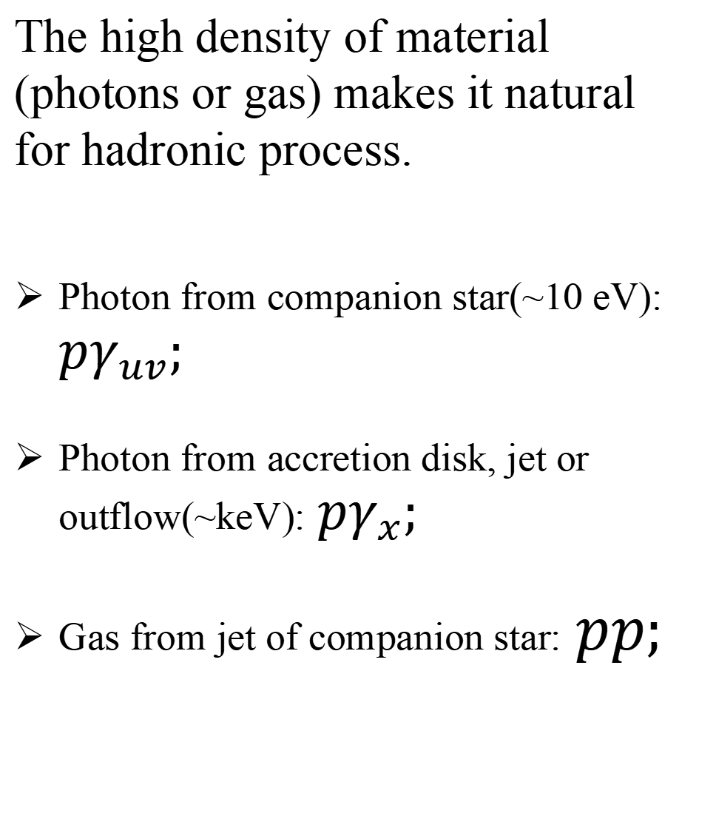
Physical Scenario
The high density of material (photons or gas) makes it natural for hadronic process.
Photon from companion star(~10 eV): $pγ_{uv};$
Photon from accretion disk, jet or outflow(~keV):$pγ_{x};$
Gas from jet of companion star:$pp;$

Slide 12
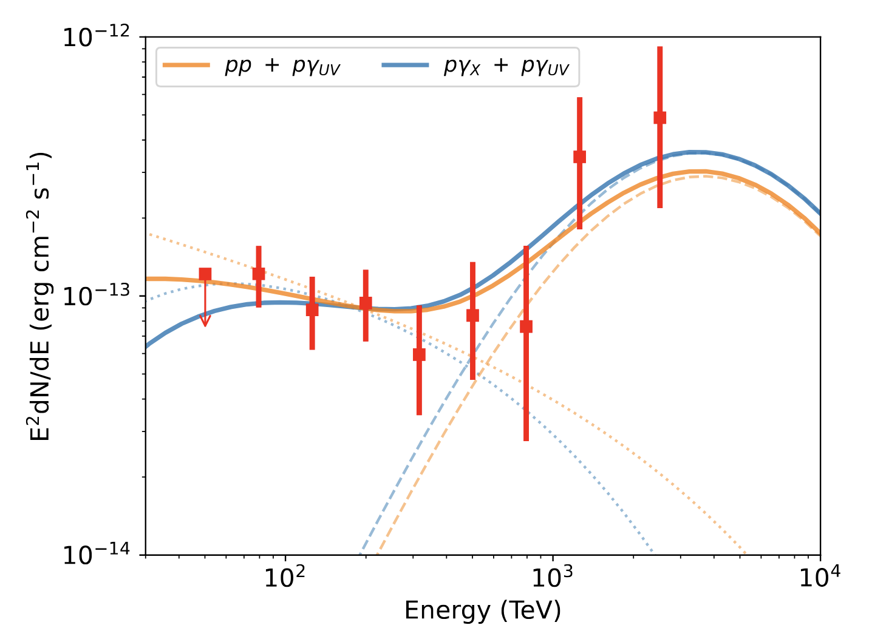
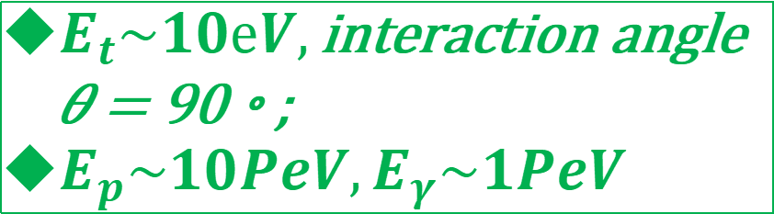
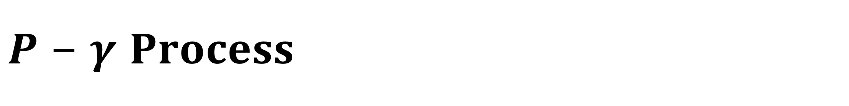
$$P−γ Process$$
$E_{t}\sim 10eV,\text{interaction} \text{angle} \text{θ} \text{= }\text{90}\text{◦}\text{;}$
$E_{p}\sim 10PeV,E_{γ}\sim 1PeV$
Proton needs to be accelerated at least to 10 PeV.
It is a unique stucture that distinguished from other processes.

Slide 13
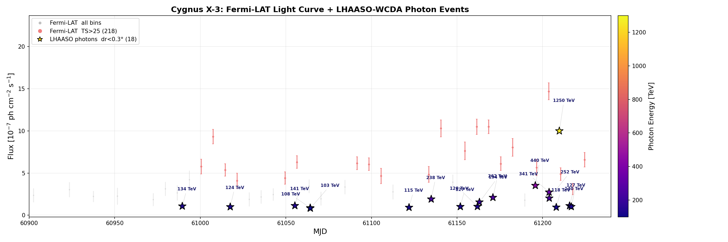
A new flare

Slide 14
What to do next?
A new phonomen bings many questions:
1. Where does the protons accelerated ?
2. How the particles are accelerated?
3. Common mechanism or unique case?
4. Contribution to origin of cosmic rays?
...
What can we do :
Waiting for a huge flare / more than 10 years, or propose a larger array? for example, 10 km²
Muilti-wave study including TeV, X-ray, radio.
Theoretical work.

Slide 15
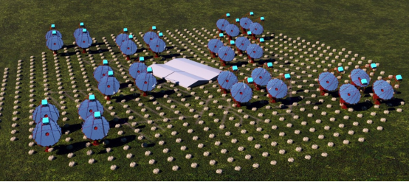
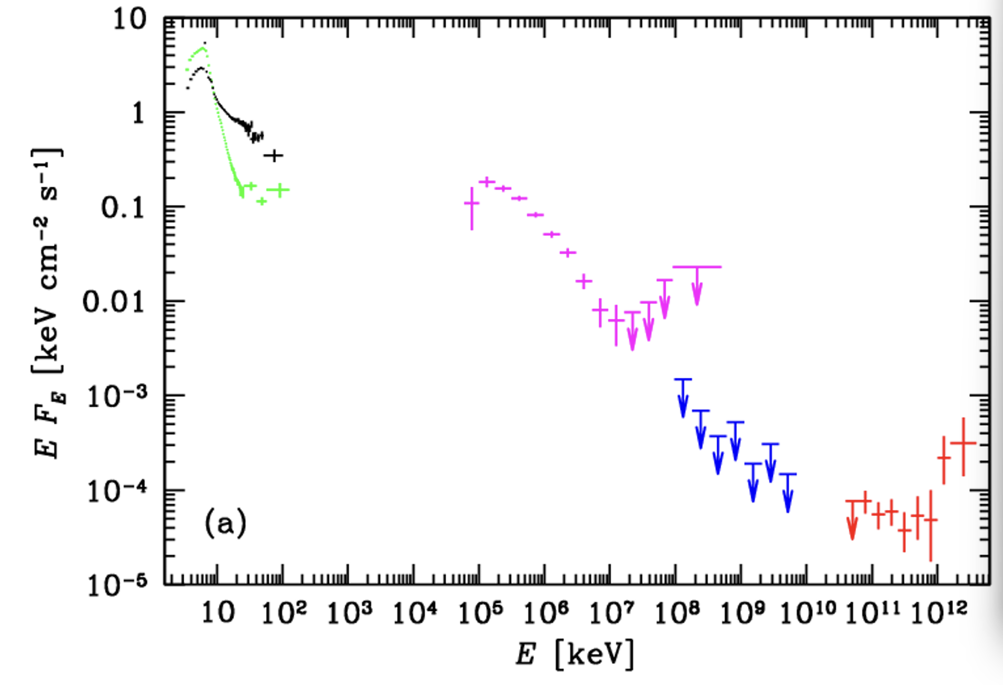
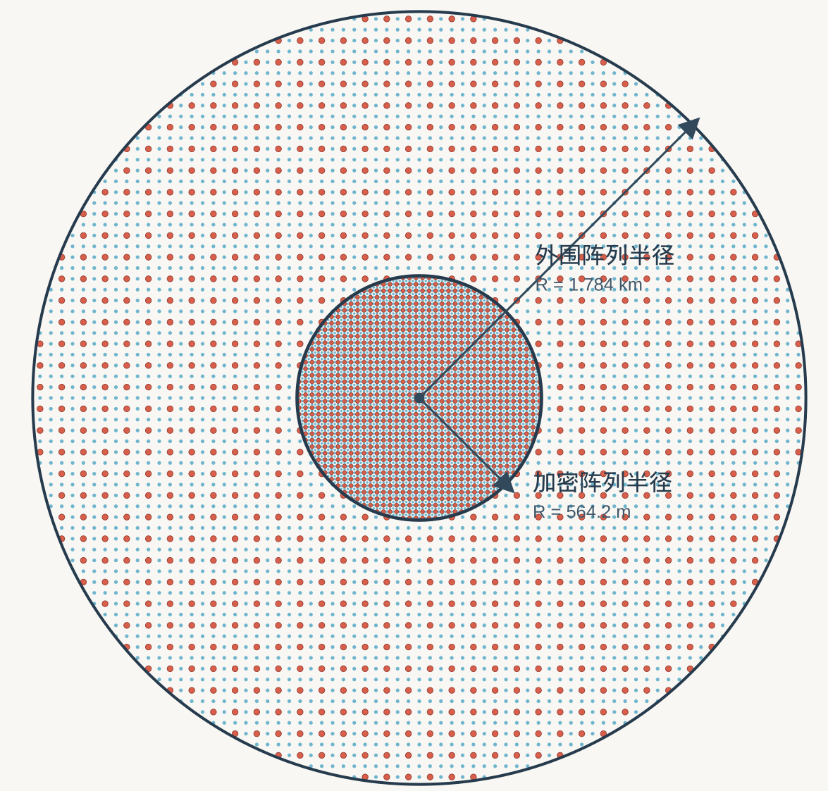
Future observations

Slide 16
Conclusion
Identification of first variable UHE gamma-ray source, suggesting the gamma-ray is from the central system ;
Identification of first PeV gamma-ray source, with energy up to to 3.7 PeV;
Almost rule out the leptonic model and favors a hadronic scenario.

Slide 17
Thanks！
Cong Li
licong@ihep.ac.cn

Slide 18
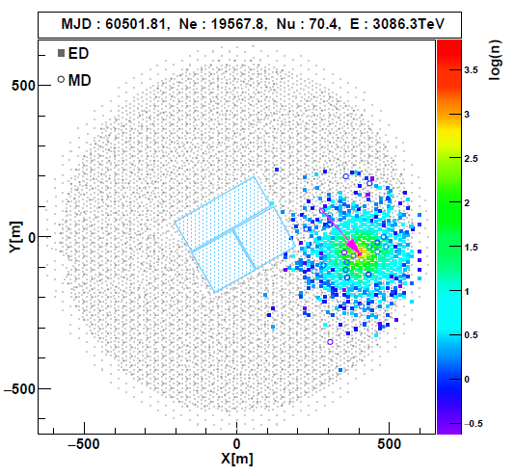
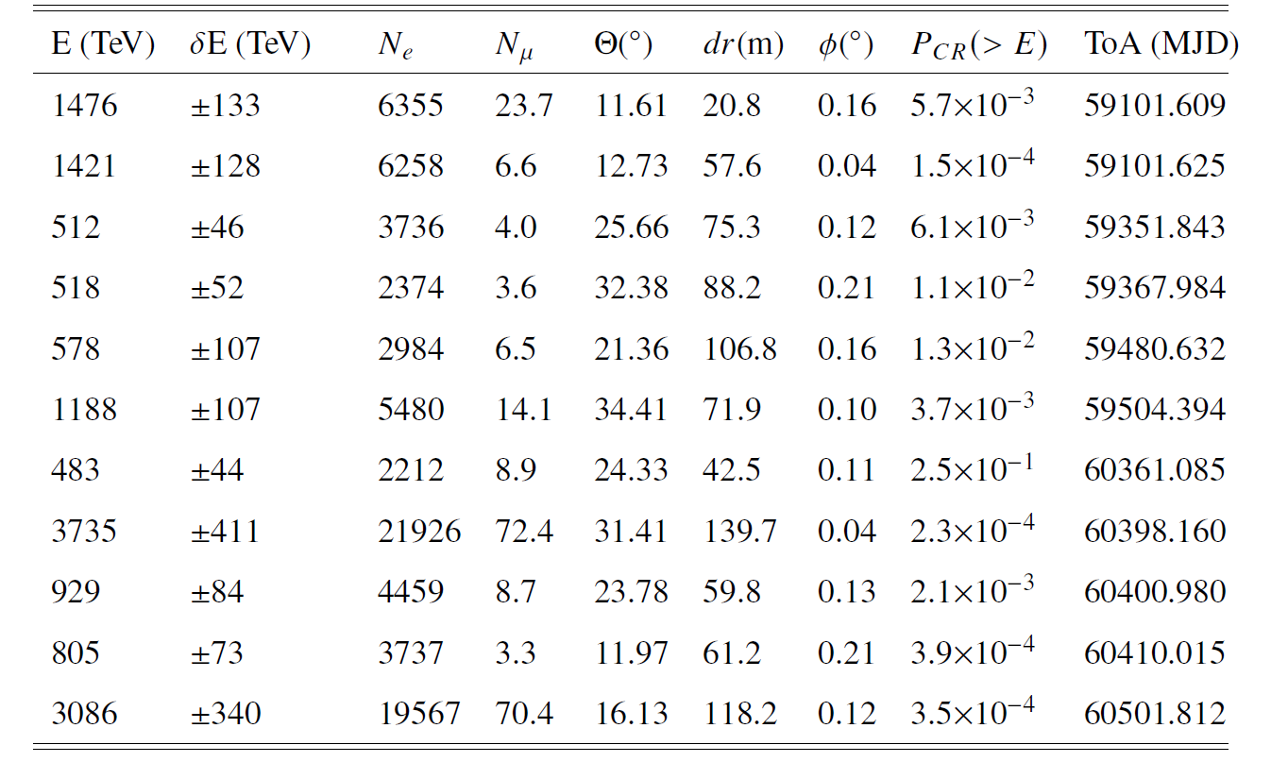
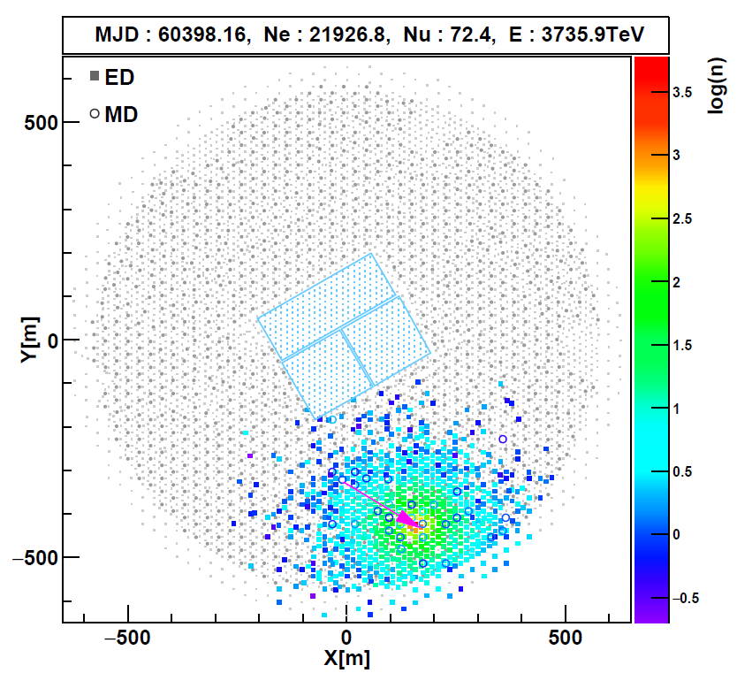
UHE Photons (>400TeV)

Slide 19
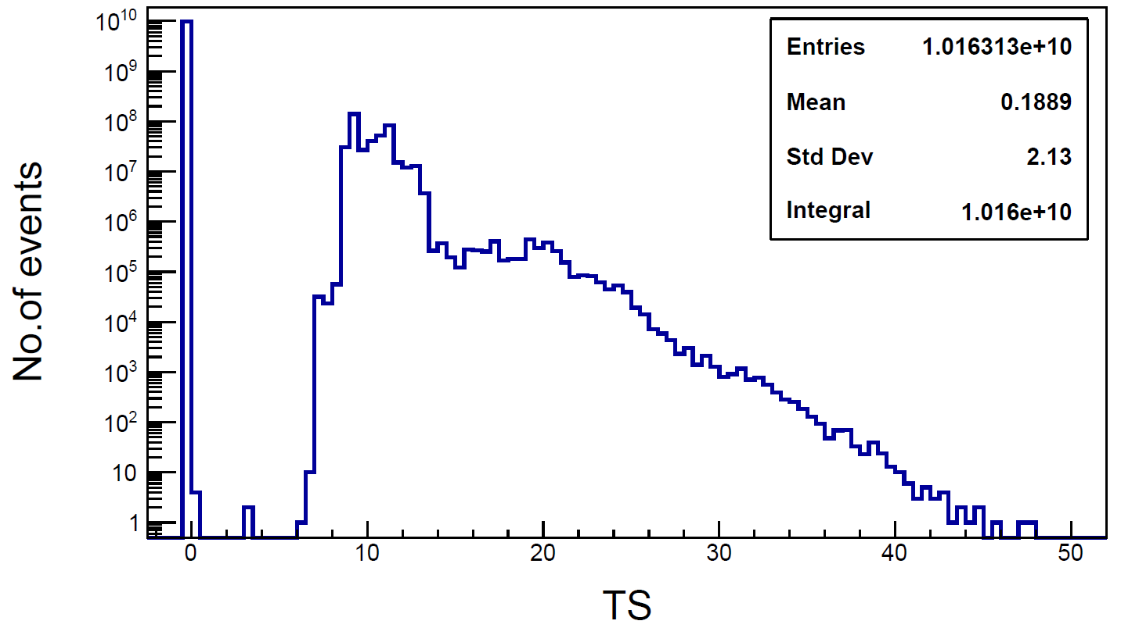
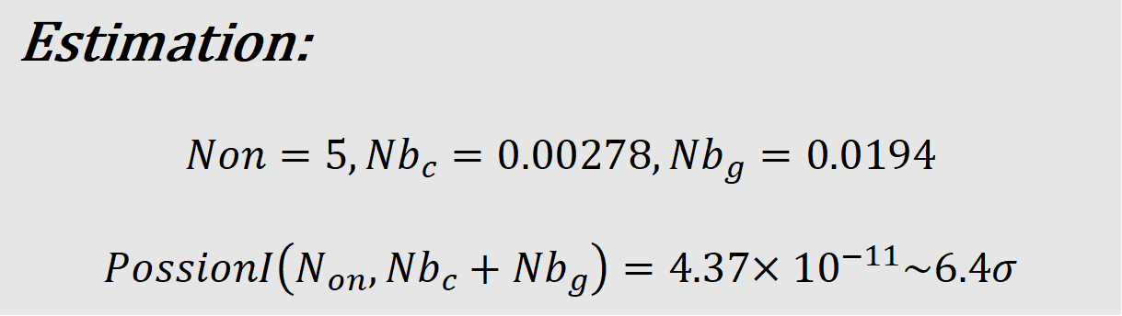
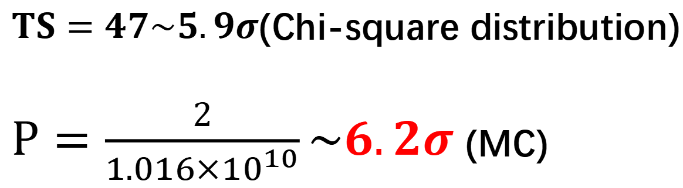
First PeV Gamma-Ray Source
$TS=47\sim 5.9σ$(Chi-square distribution)
$P=\frac{2}{{1.016×10}^{10}}\sim 6.2σ$(MC)
Estimation:
$$Non=5,{Nb}_{c}=0.00278,{Nb}_{g}=0.0194$$
$$PossionI\left(N_{on},{Nb}_{c}+{Nb}_{g}\right)=4.37{×10}^{−11}\sim 6.4σ$$

Slide 20
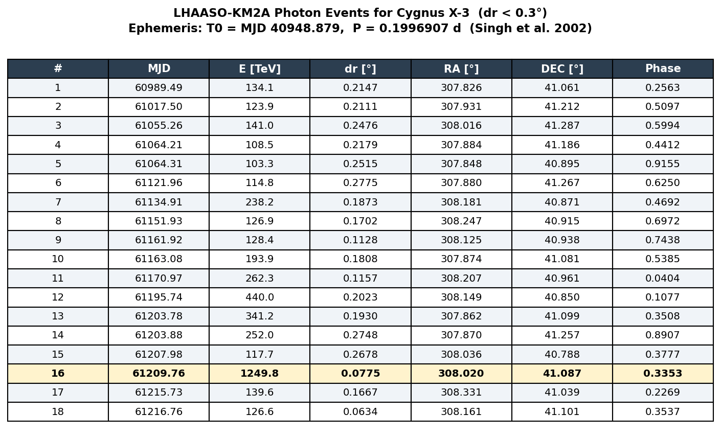

Slide 21
