Slide 1
Extra-Galactic Source Monitoring and Transients Searching in WCDA
Min Zha for IHEP + SHAO + NJU + YNU working group

Slide 2
outline
Scientific target
Extragalactic sky map @ Long-term observation
  Each source status
Real-time monitoring @ transient searching
  Phase-I: selected sources
  Phase-II: full-sky monitoring
    A new TeV emitter source: 4C + 42.22
Outlook

Slide 3
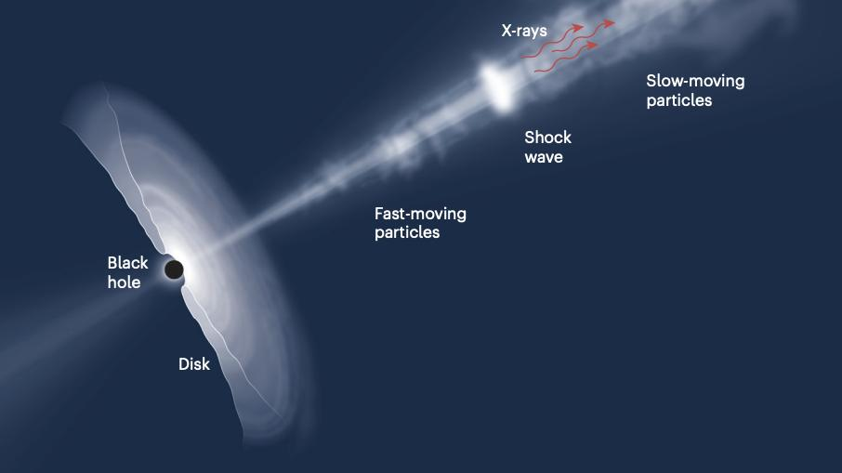
河外源监测：科学目标
核心目标：解析耀变体的极端物理
活动星系核（AGNs）是河外VHE伽马射线的主导源。其中，耀变体（Blazars）因喷流方向几乎正对地球，辐射被相对论效应剧烈增强，成为我们探索宇宙极端物理环境、检验高能物理理论的天然实验室。
辐射可变性
辐射机制解码
宇宙学检验
捕捉从分钟到数年的全波段快速光变，揭示中心引擎的能量释放模式，解析喷流内部的激波传播与粒子加速动态过程。
通过多波段同时性观测构建SED图谱，区分同步辐射与逆康普顿散射模型，厘清高能粒子的加速机制与能量损失过程。
利用VHE光子与宇宙背景光（EBL）的相互作用，精确测量EBL的能谱分布，从而限制宇宙演化与星系形成的理论模型。
图活动星系核（AGN）内部结构示意图，清晰展示了超大质量黑洞、吸积盘系统以及沿自转轴高速喷出的相对论性喷流。这种特殊的天体结构是甚高能（VHE）伽马射线的主要河外来源。
Notes:
接下来我们进入第三部分：河外源监测。我们主要的观测目标是活动星系核，特别是其中的耀变体。通过长期监测这些遥远的宇宙灯塔，我们可以研究它们内部的物理机制，比如喷流是如何产生和传播的，以及物质是如何被加速到极高能量的。

Slide 4
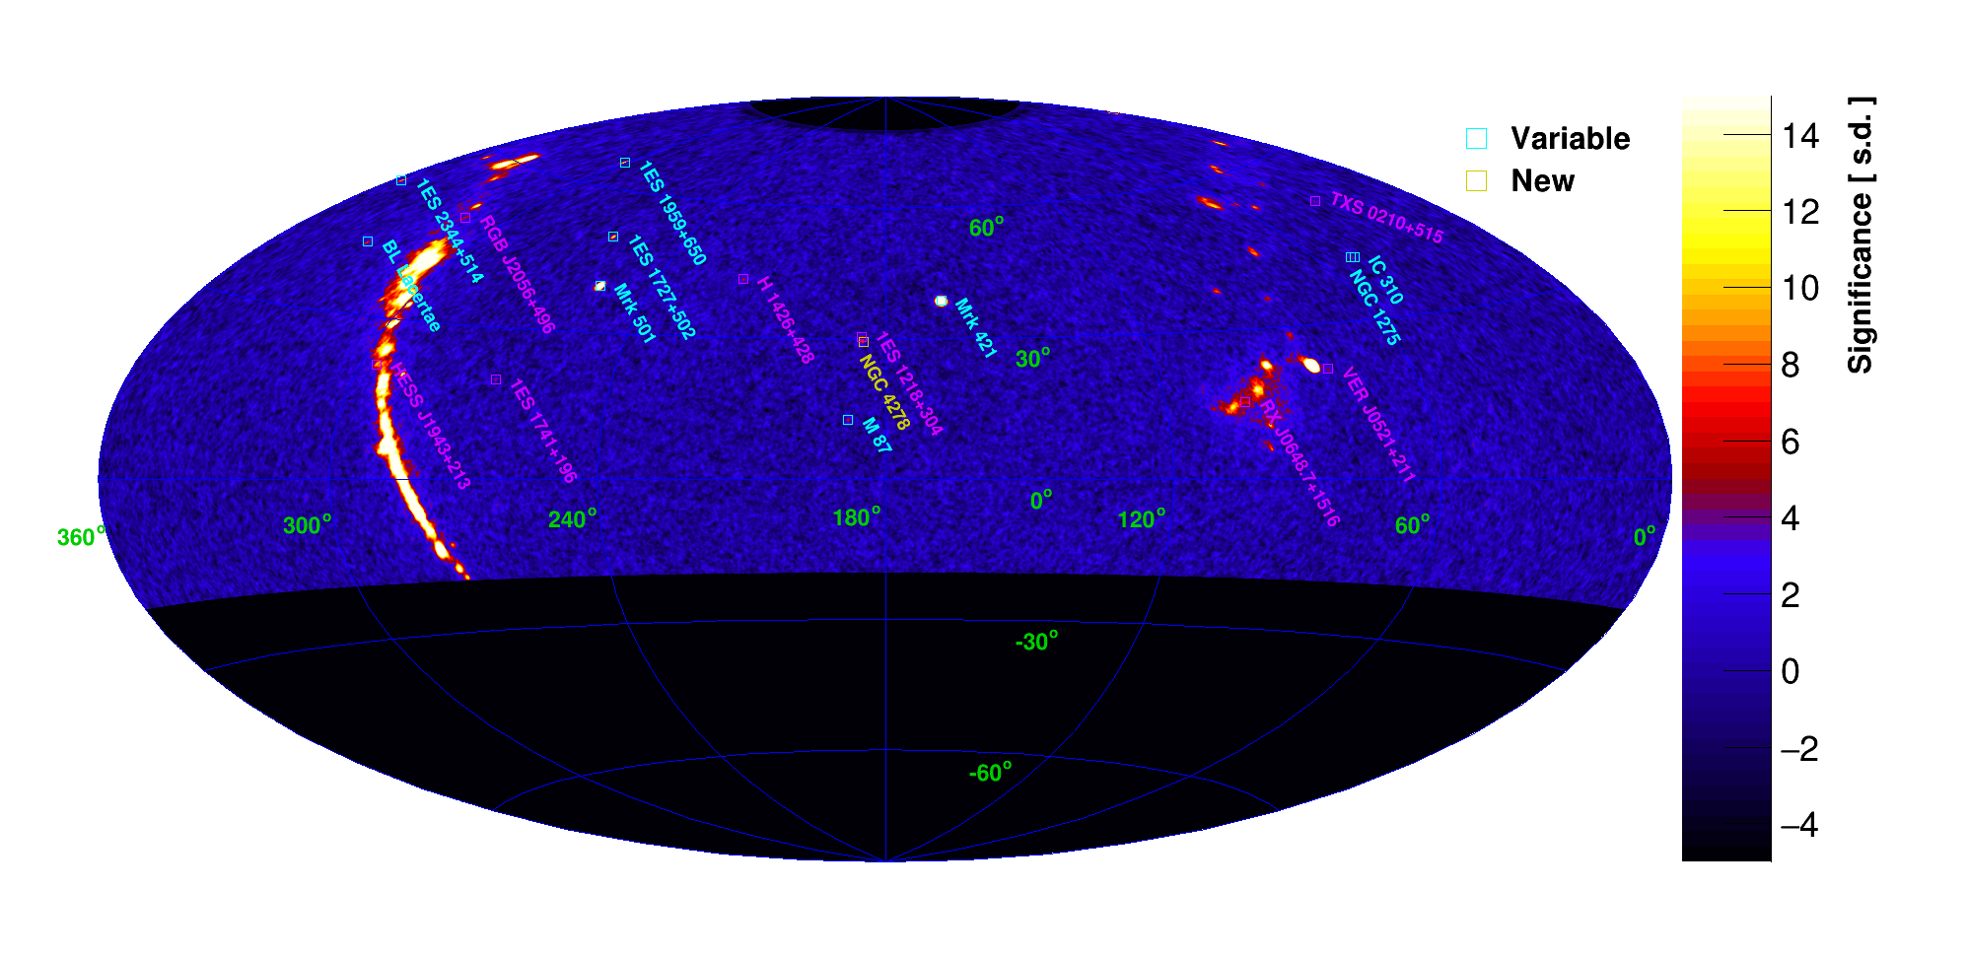
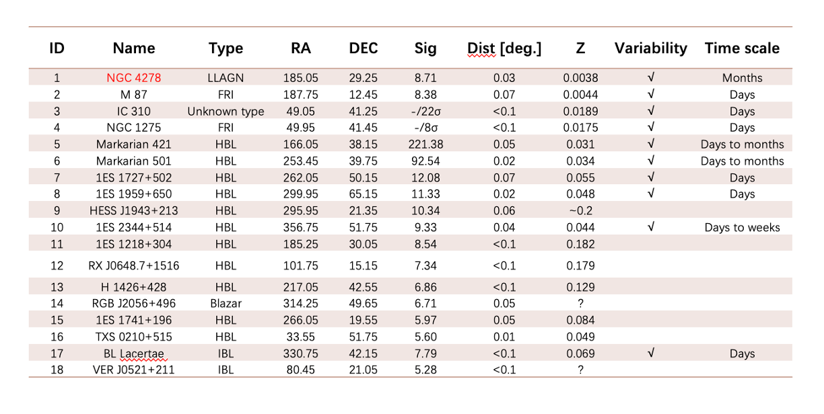
1. extra-galactic sources

Slide 5
--continues: Details about each sources
Published sources
  Mrk 421 (APJS in 2026)
In submission
  1ES 1959 + 650 (APJL)
In preparation
  Mrk 501
    2nd round internal-review
  4C+42.22
    new VHE gamma-ray emitter, draft is ready and will be submitted to PCC soon.
  IC 310
    draft is almost ready, plan to submit PCC in the end of this Aug.
In understudying
  9 single sources are understudying

Slide 6
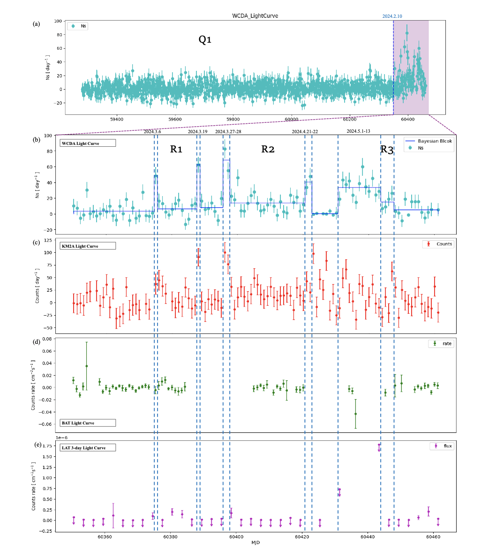
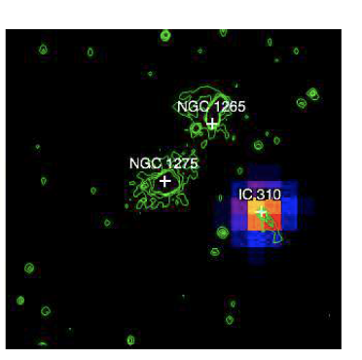
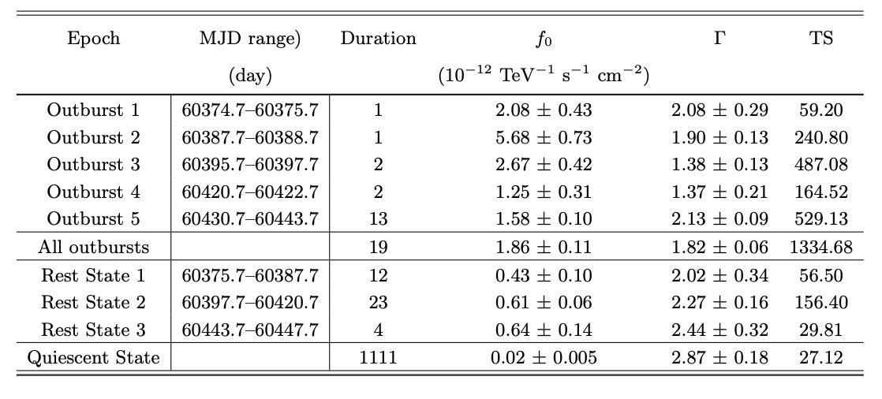
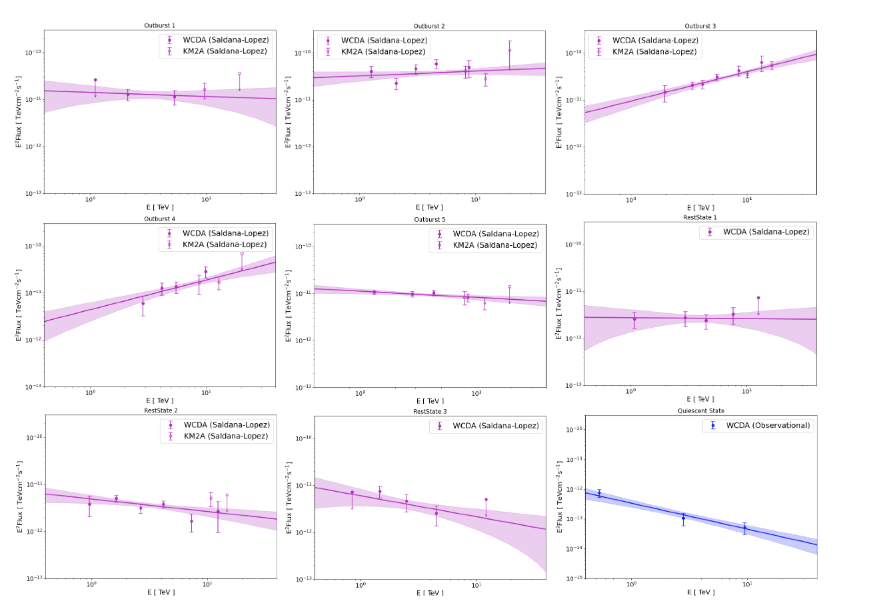
LHAASO observations of extreme spectral variability in IC 310

Slide 7
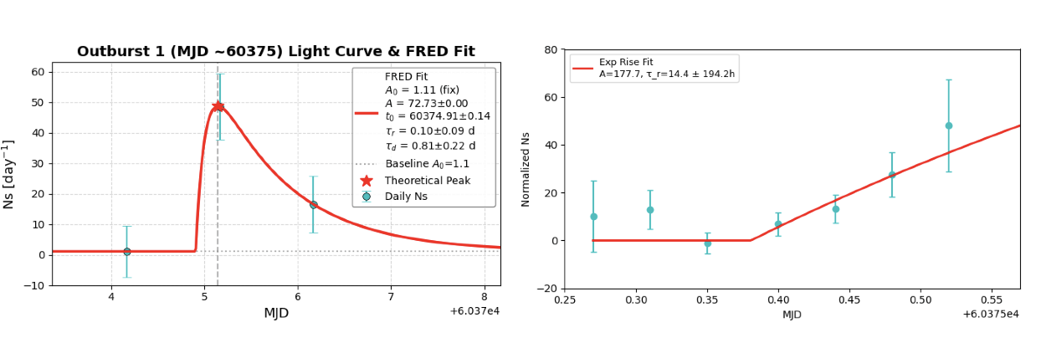
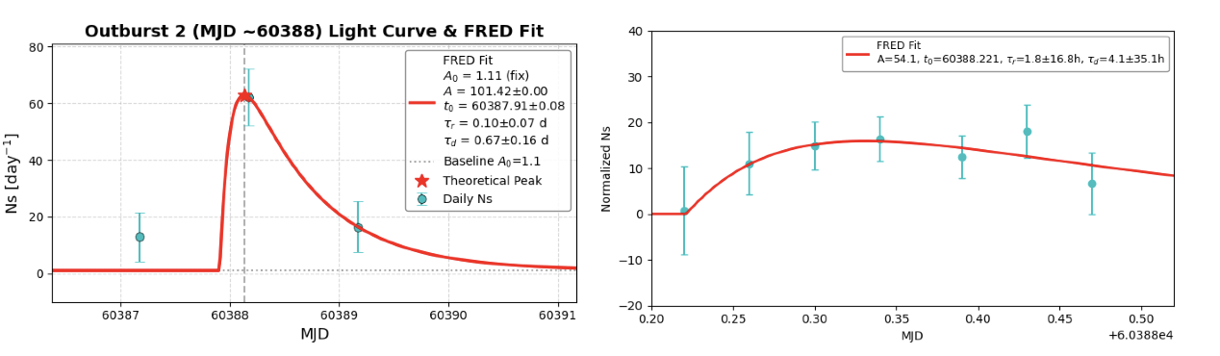
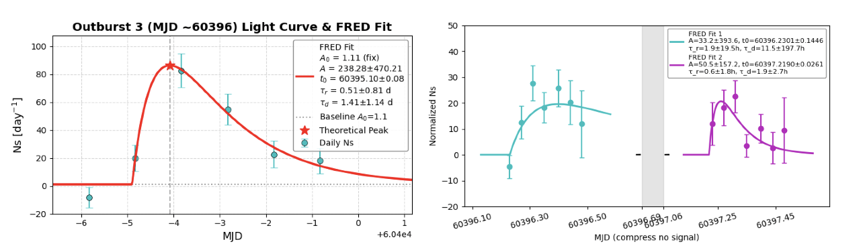
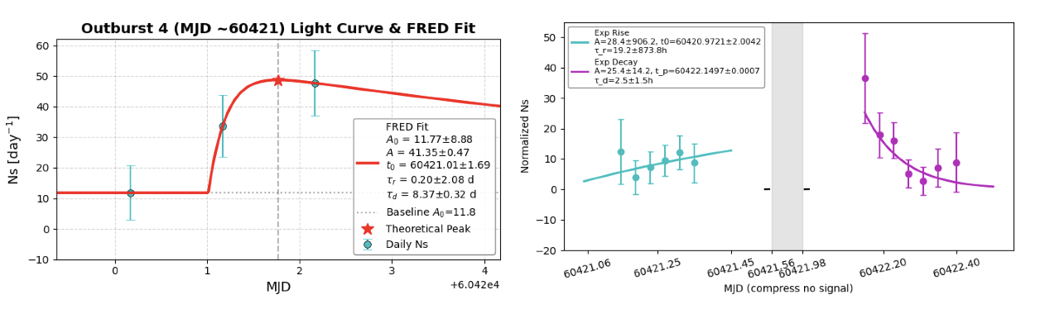
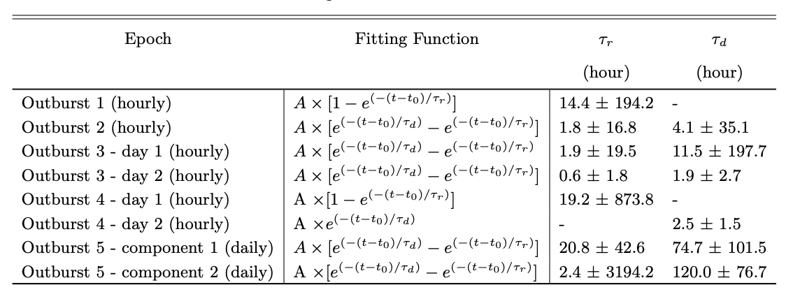
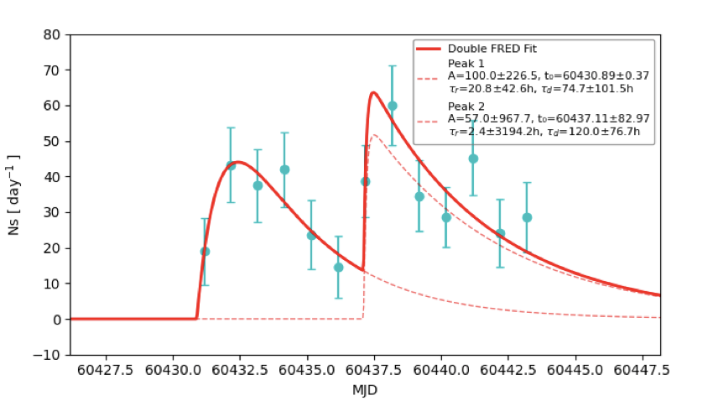
Intra-day Variability

Slide 8
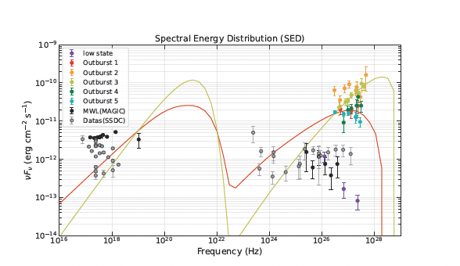
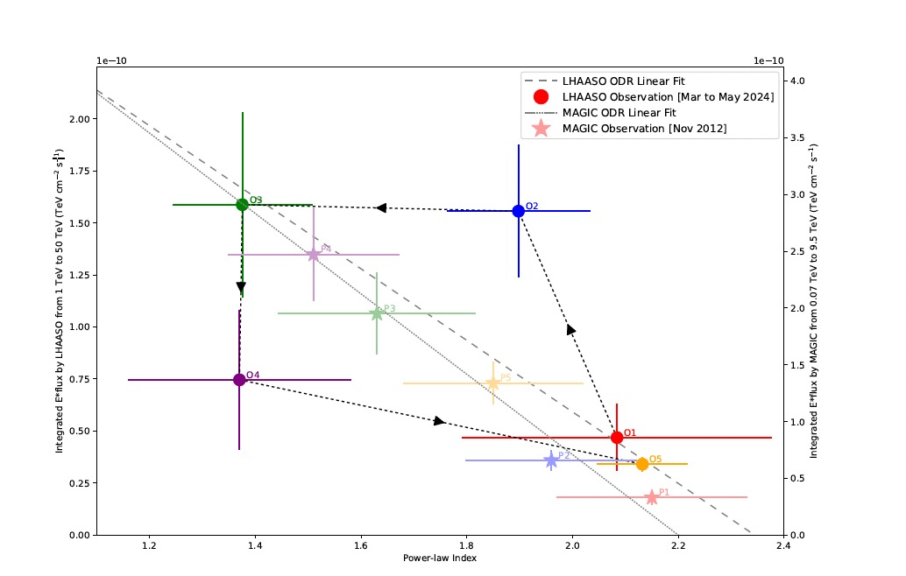
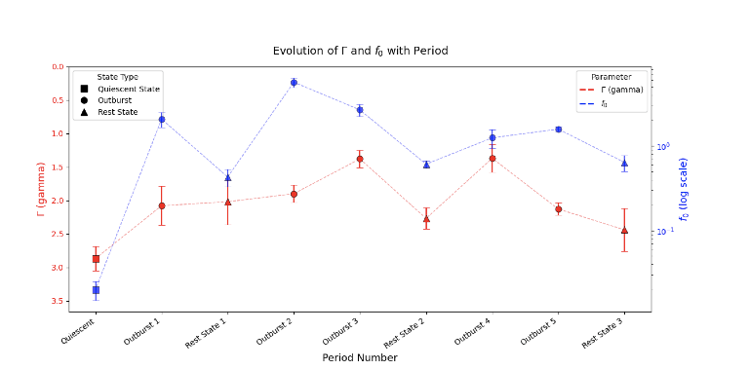
Time evolution & SED modelling
MWL SED Modelling
  Leptonic
  Hardonic
    Proton synchroton
    Proton-proton
    Proton-meson

Slide 9
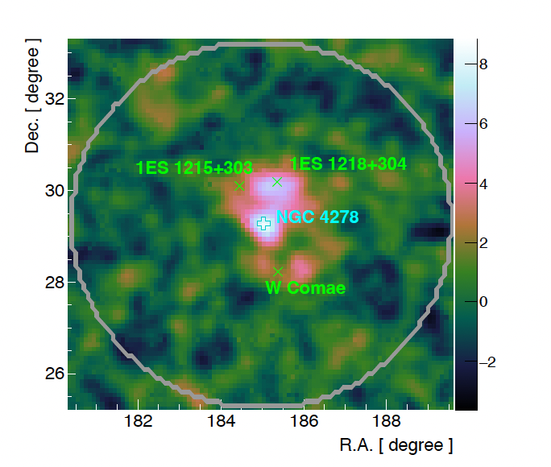
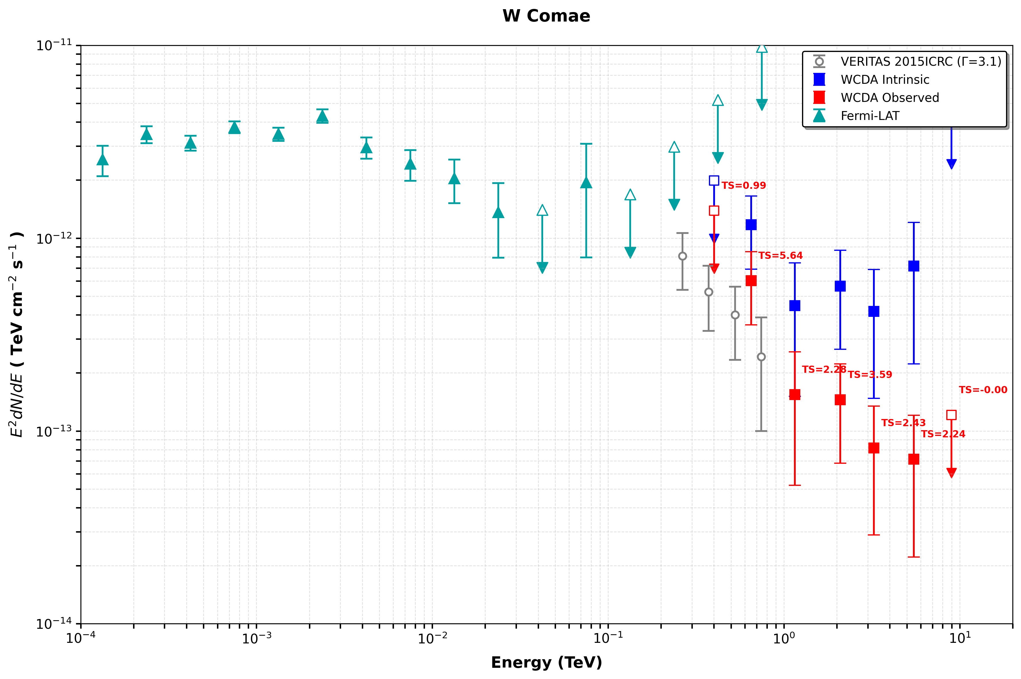
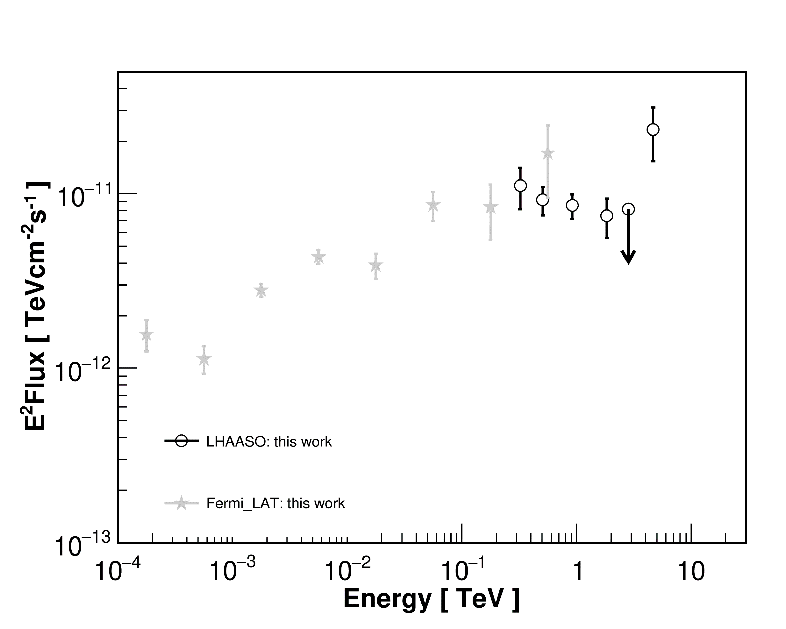
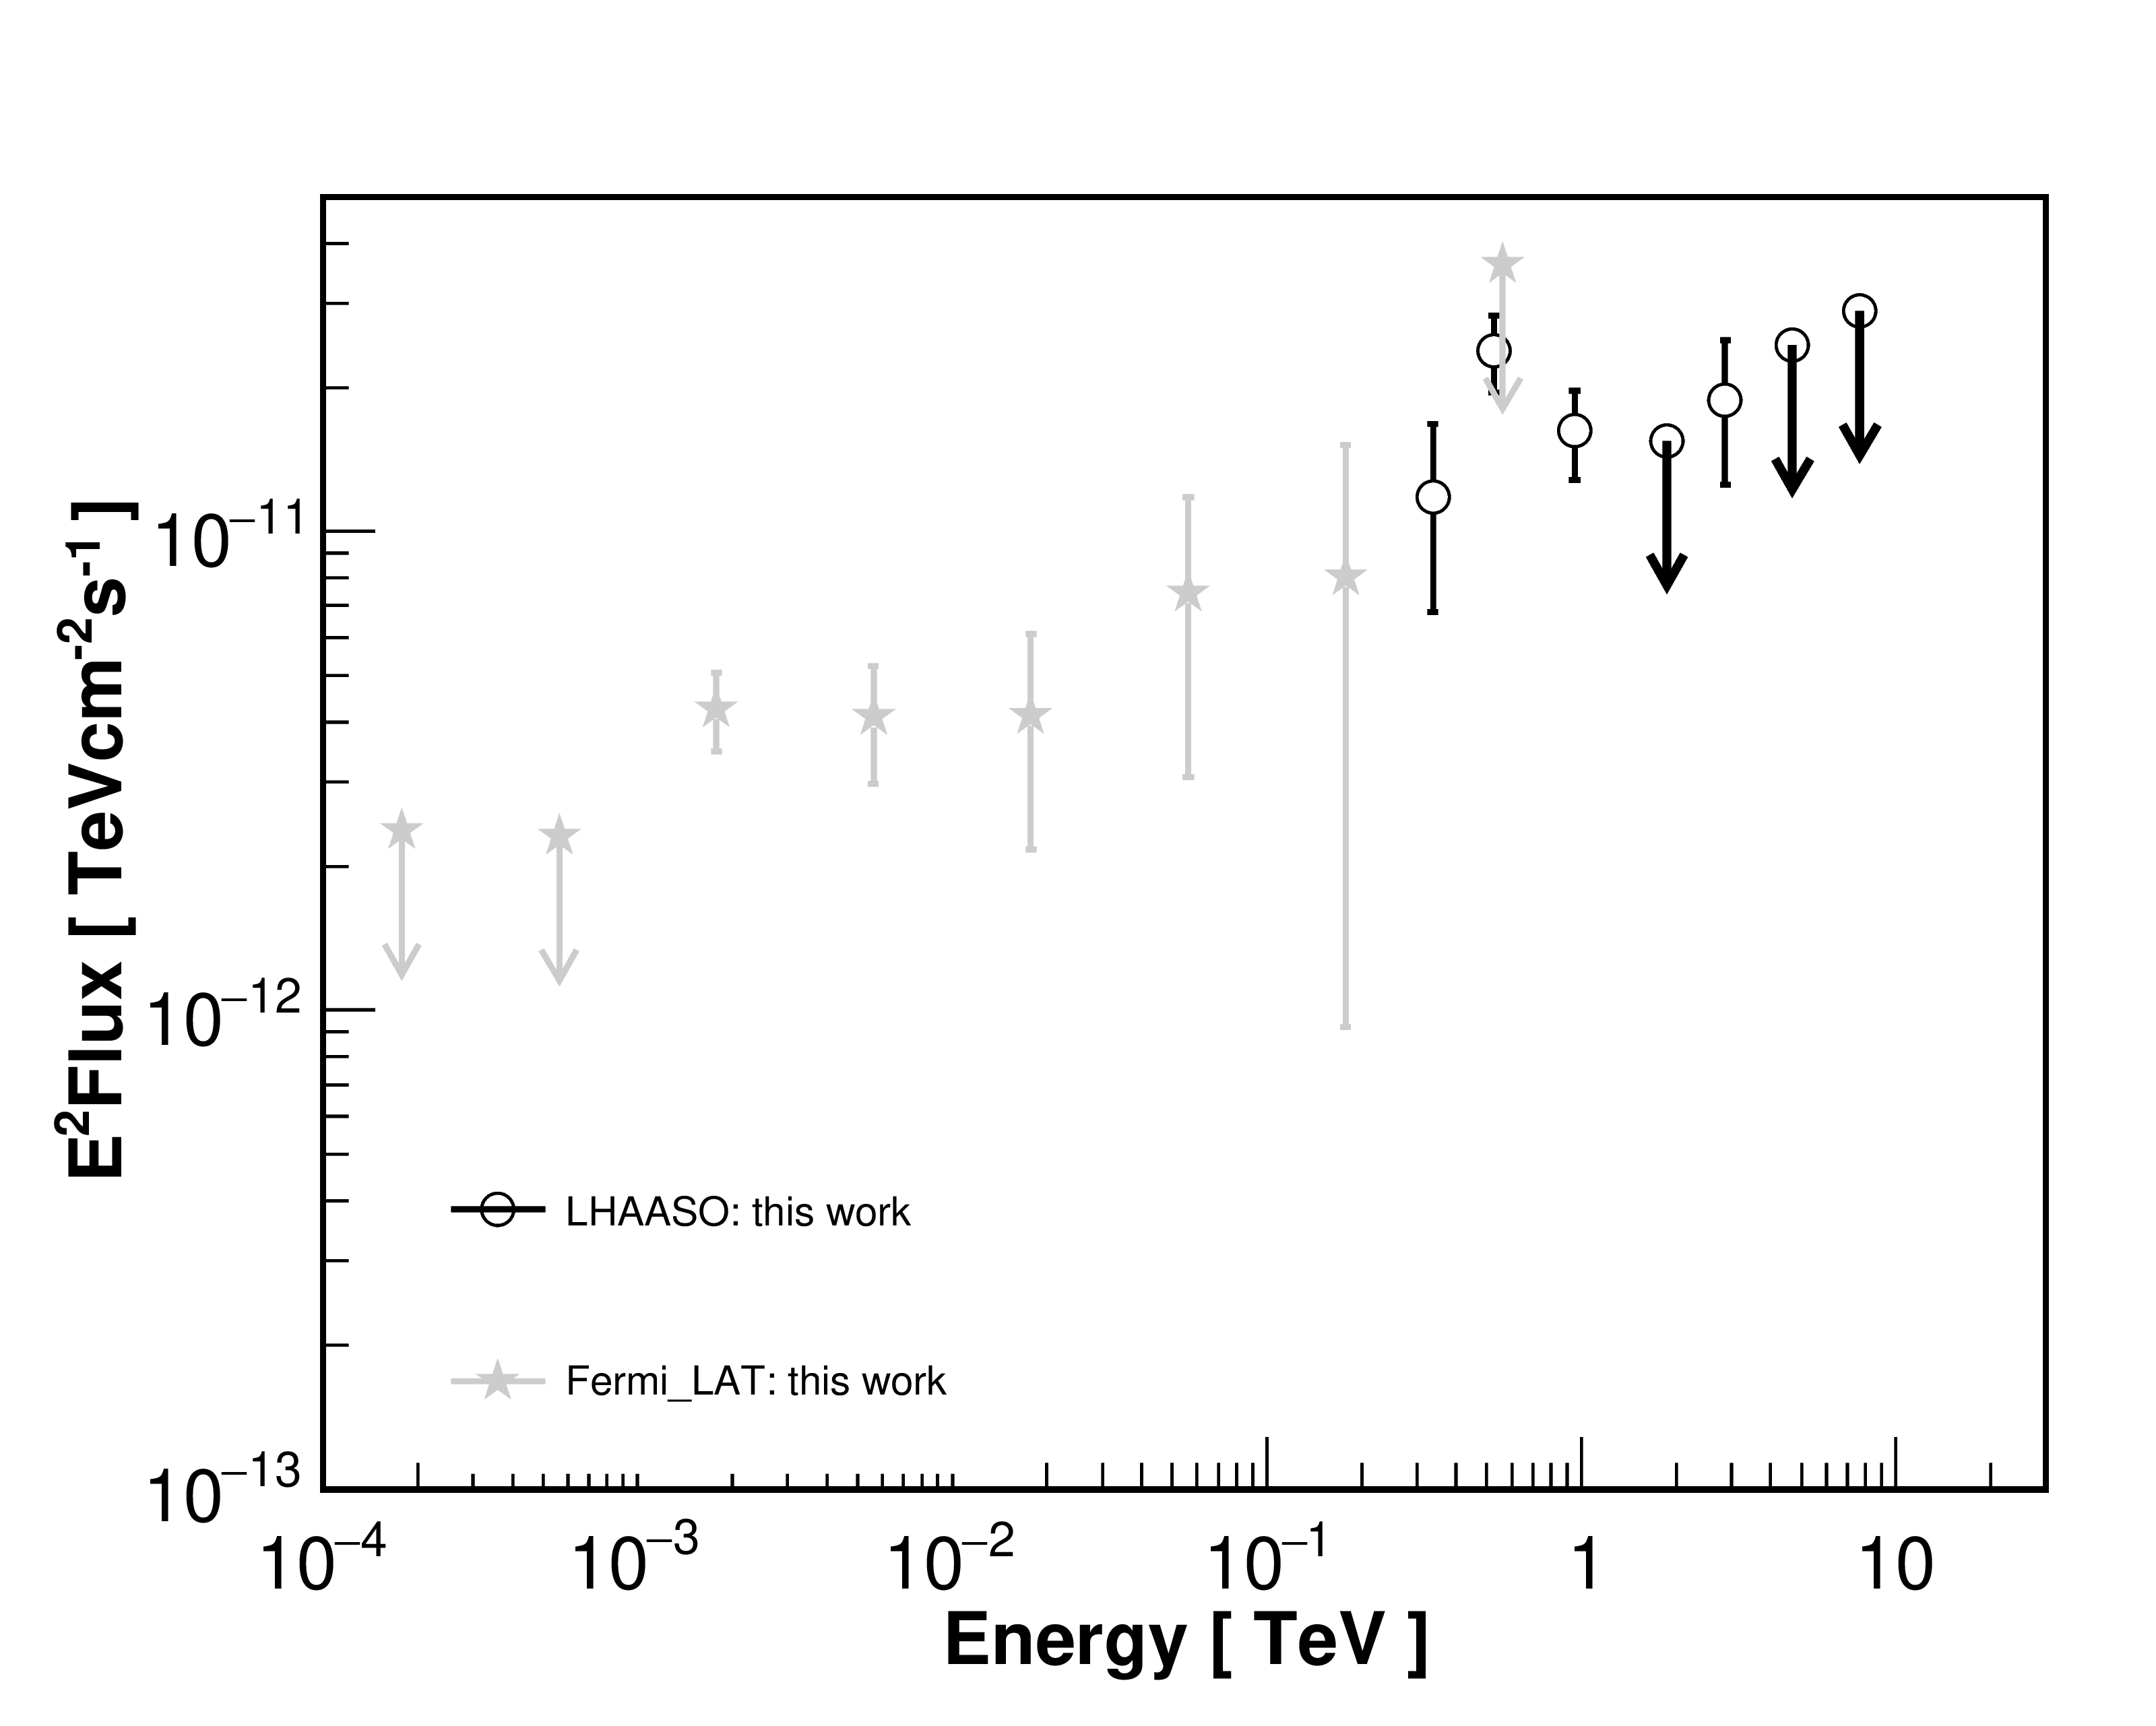
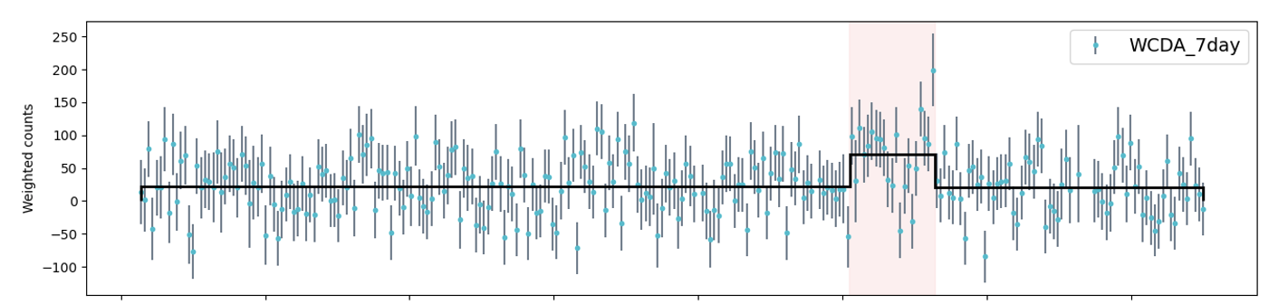
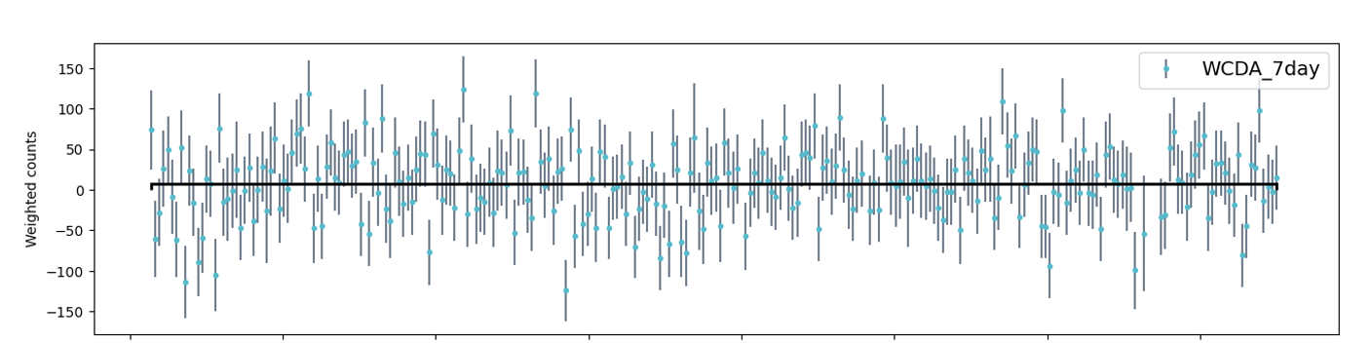
1.1: Deep observation around NGC 4278 region
quiet @ 1ES1218+304
flaring @ 1ES1218+304
1ES1218+304
4 sources:
  1ES 1215+303/
  1ES 1218+304/ HBL → EHBL
  NGC 4278/ LLAGN
  W comae
1ES 1218+304 was observed 14.7 σ by WCAD and one flare phase was detected at 8.3 σ .
W Comae was detected at 4.1 σ, showing an angular separation of 0.23° from the IACT position.
W Comae

Slide 10
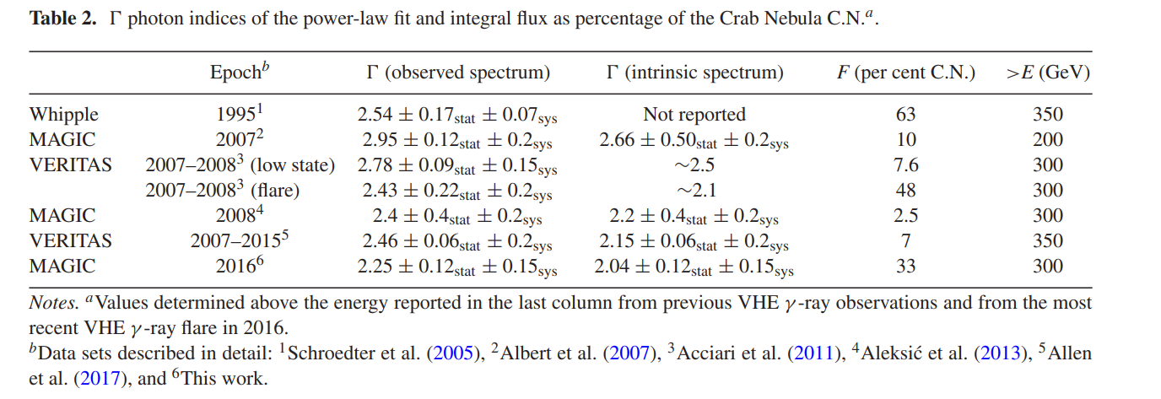
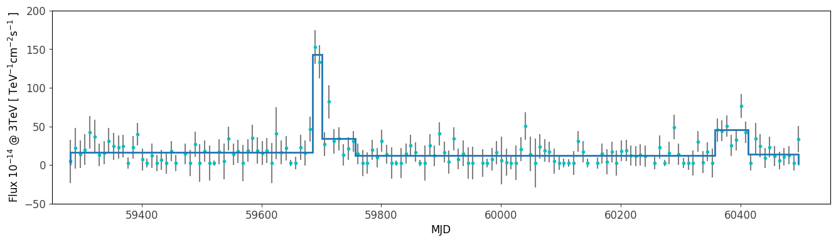
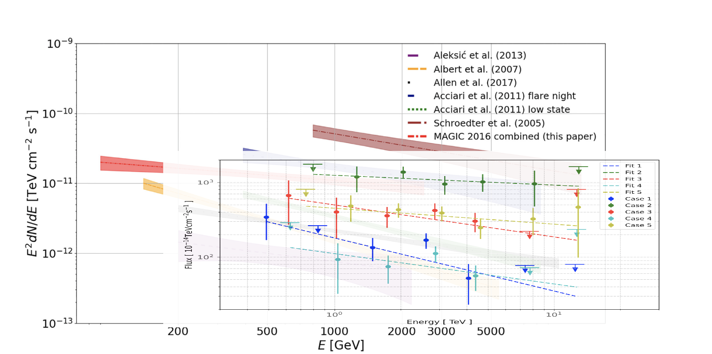
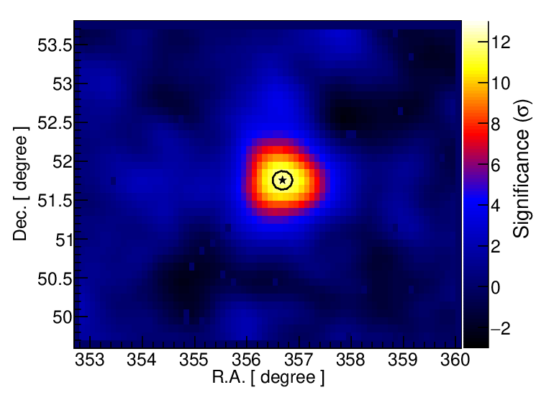
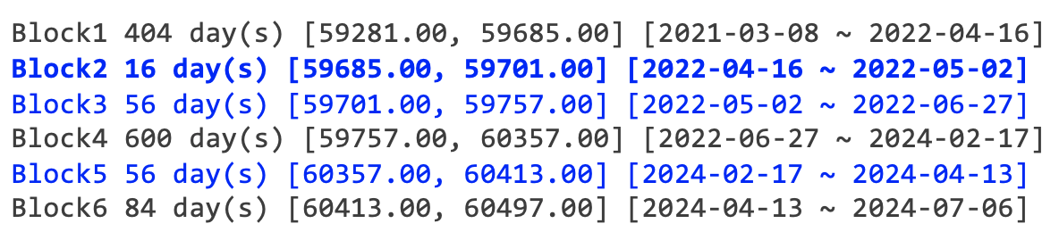
1.2: 1ES 2344+514
WCDA light curve
SED @ WCDA compared with IACTs
Status: Modelling discussion and draft preparation

Slide 11
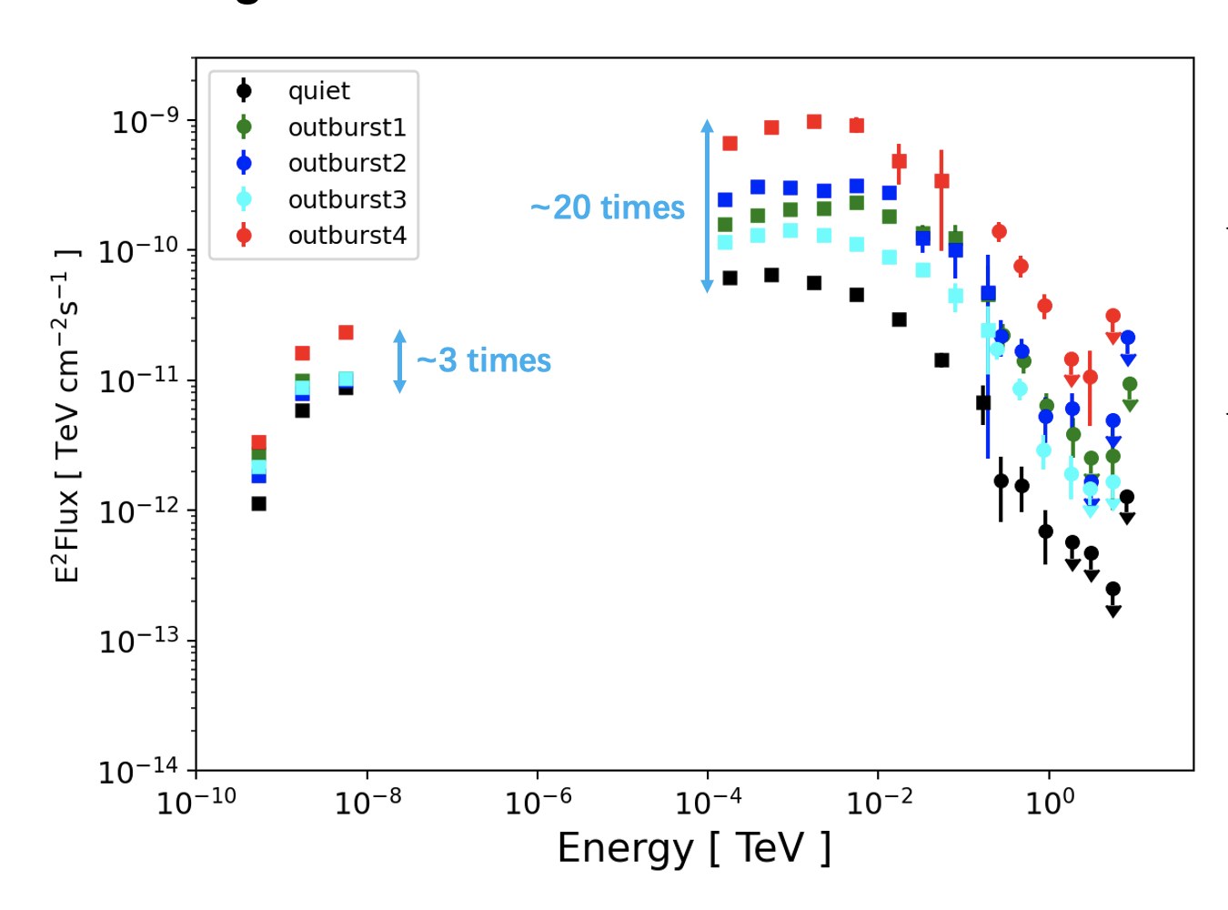
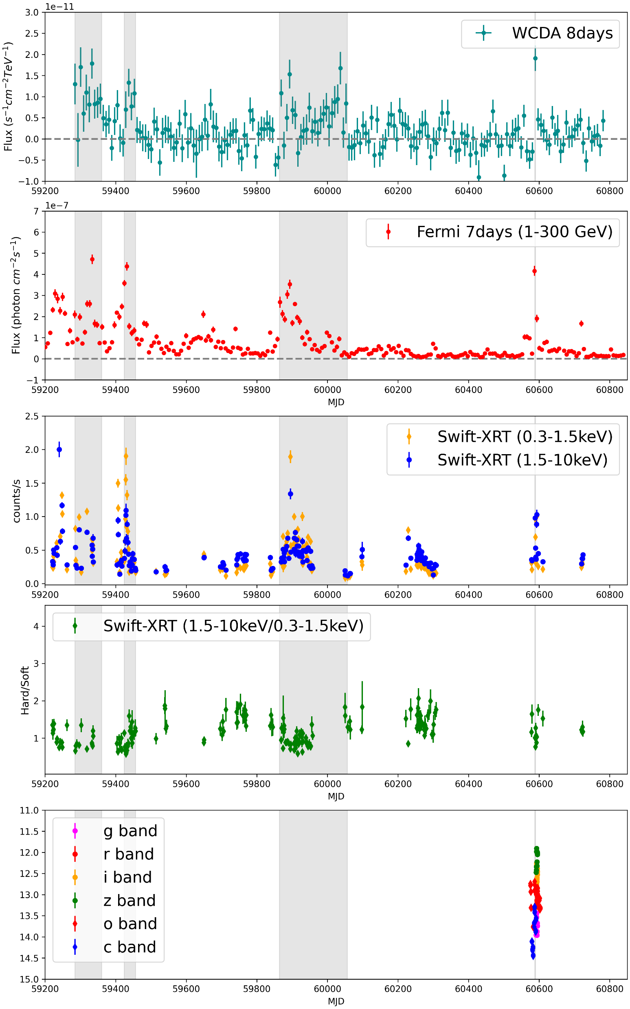
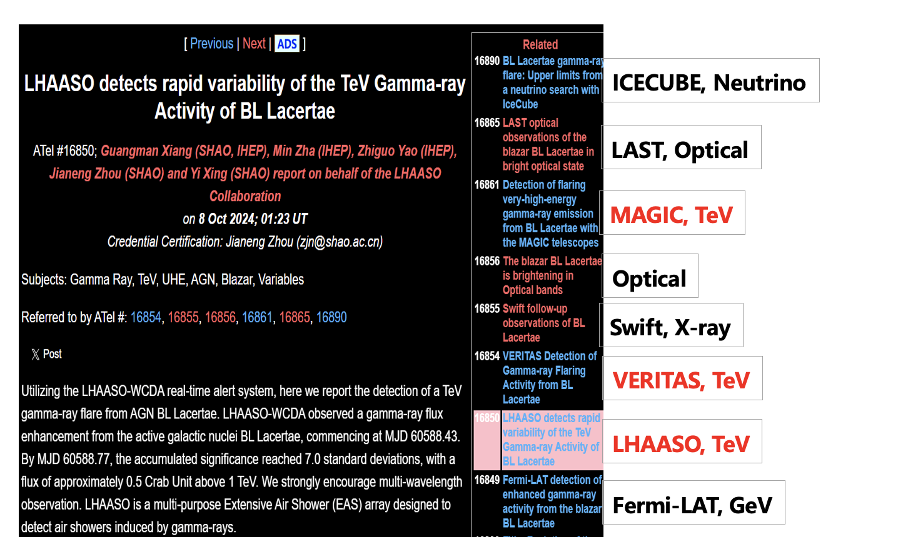
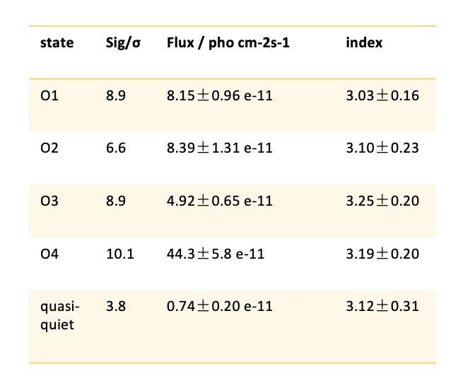
1.3: BL Lacertae
WCDA observation
Using more than 4 years of WCDA data, BL Lacertae is detected with significance of 9 σ.
4 outbursts in total with duration ranging from 2 days to 6 months
The flux of outburst4 is the highest ever.
Multi-wavelength LCs show interesting features
  potential SED evolution in O3
  disappeared TeV flare before O4
Next
Detailed analysis of O3 and O4.
PSD： Deviate from simple power-law?
Multi-wavelength DCF

Slide 12
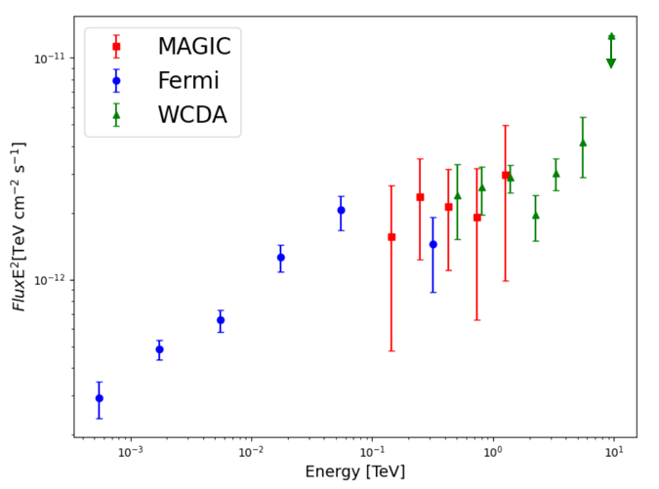
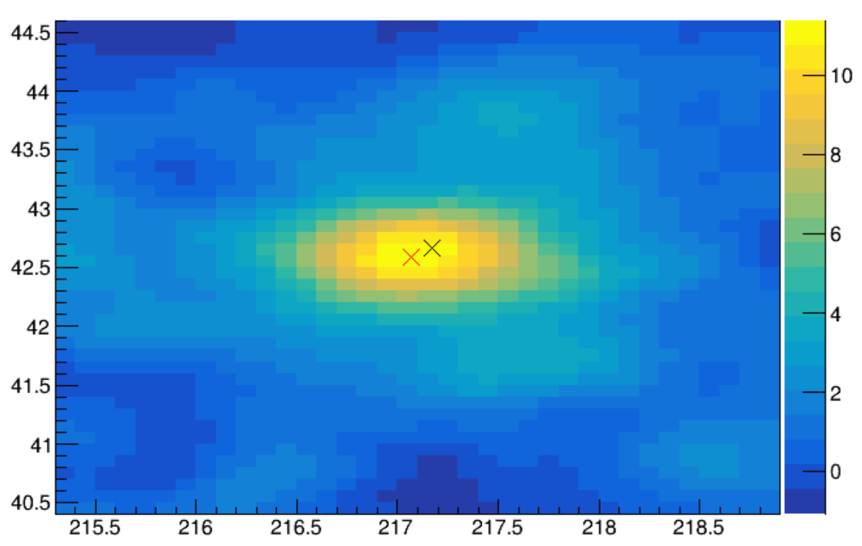
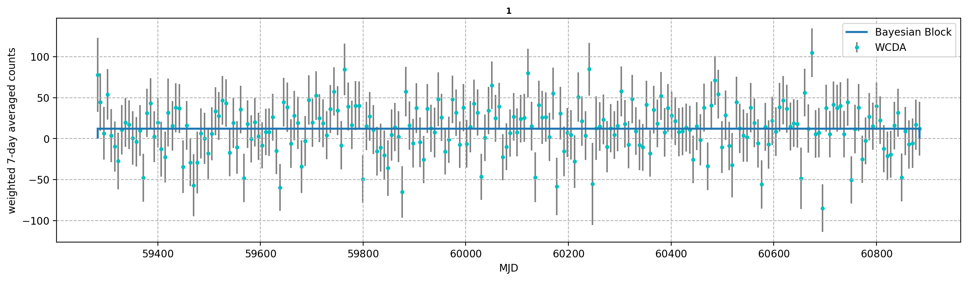
1.4: H 1426+428
Source Type: HBL
    Discovered by Whipple in 2002、
    z = 0.129
Position:
  R.A.: 217.17° Dec.: 42.67°
Spectral Index: 3.5
WCDA observation
  TS=133
  No flaring has been identified.
  No IC peak @ SED

Slide 13
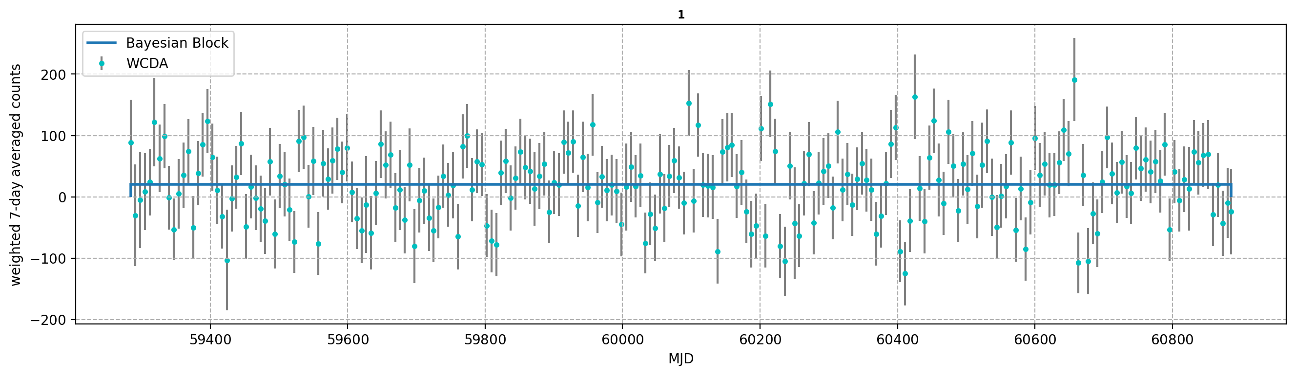
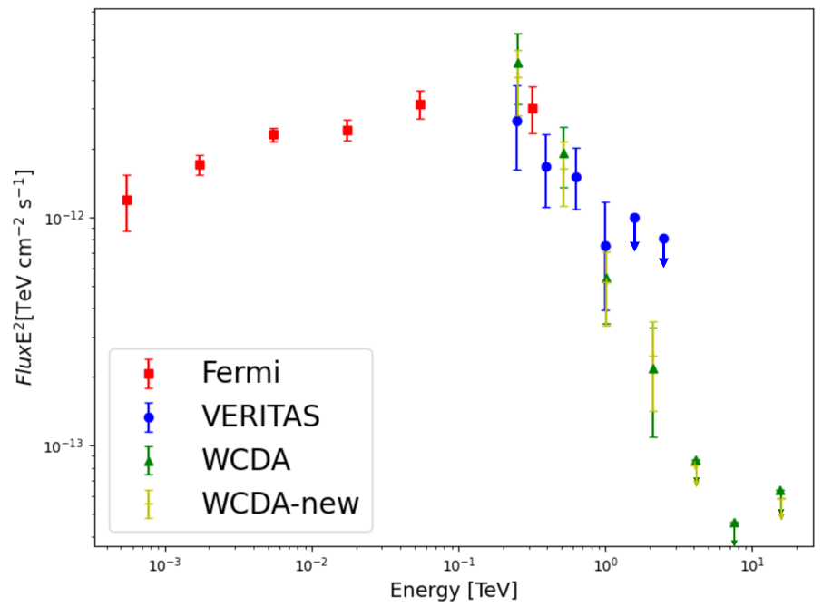
1.5: RGB J2056+496
Source Type:
  Discovered by VERITAS in 2016
  Unknown redshift blazar
Position:
    R.A.: 314.18°, Dec.: 49.67°
Micro-quasar candidate LS III +4913
    RA: 314.175°, DEC: 49.671°
    13 arc-seconds
  WCDA observation
    20210308-20250731
    TS=30
    No flaring behavior has been identified

Slide 14
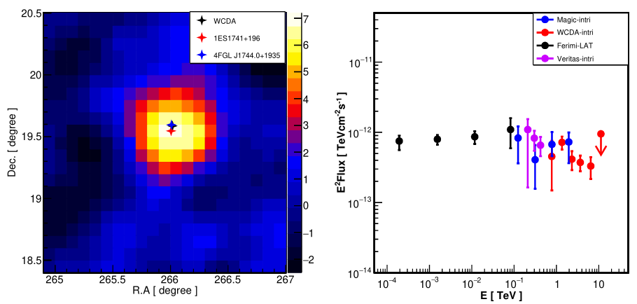
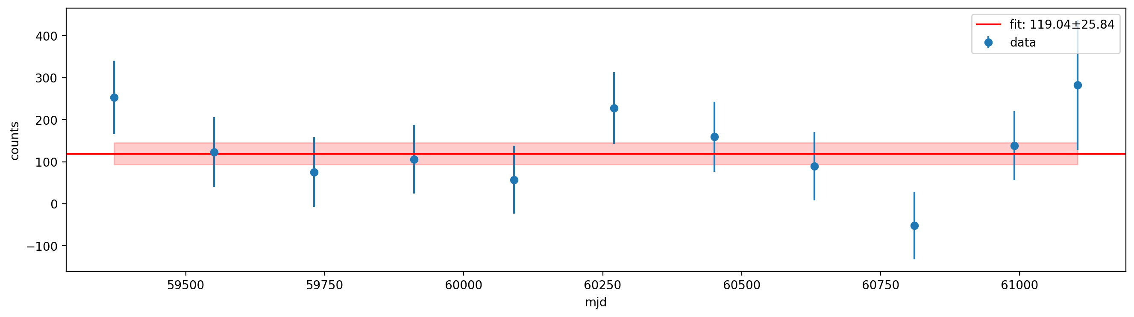
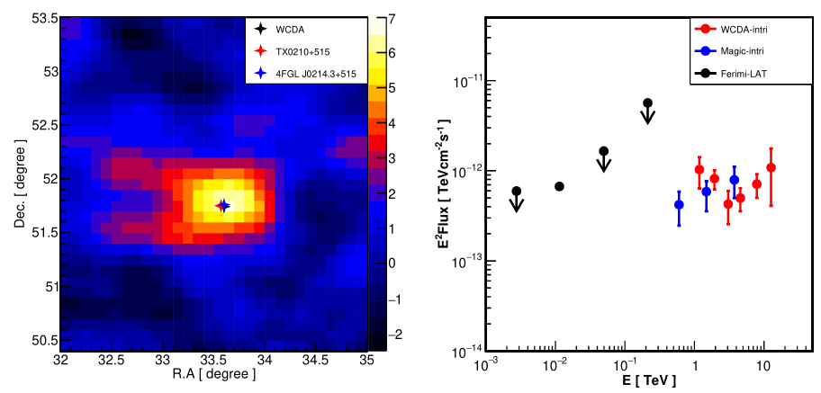
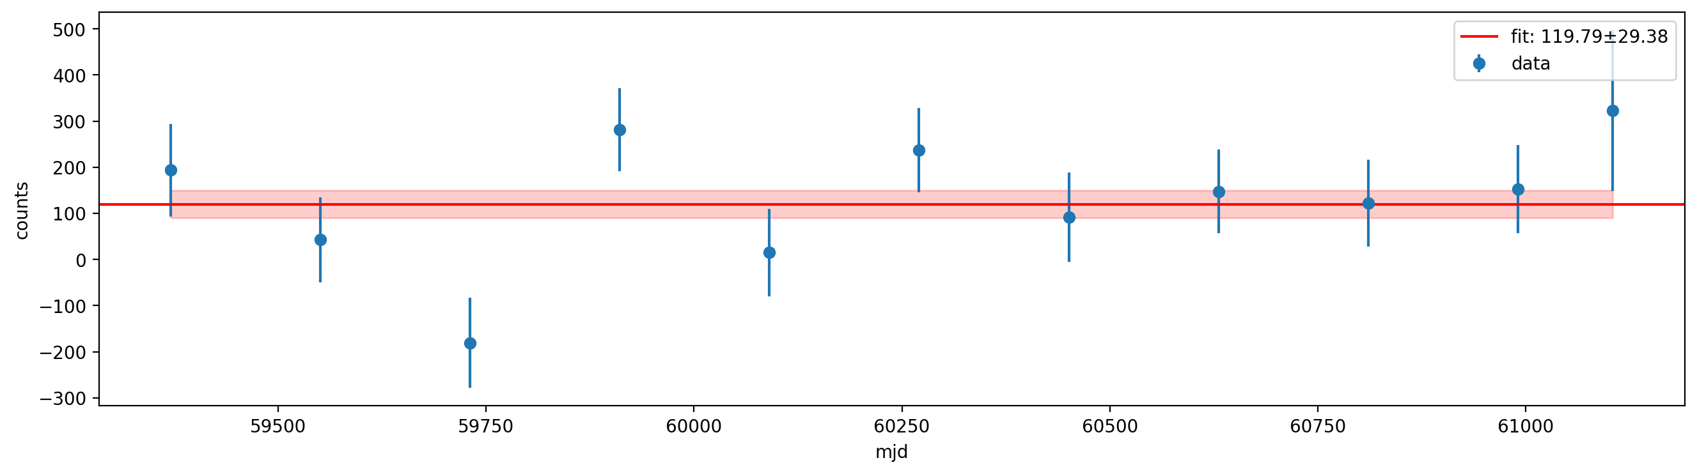
1.6-1.7: HBL 1ES 1741+196 and EHBL TXS0210+515
1ES1741+196
TXS0210+515
Dataset: March 5, 2021 to July 31, 2025, covering an energy range of 1TeV to 20TeV.
Key analysis results are presented in the figures below. VHE gamma-ray emission was detected from two blazars: HBL 1ES 1741+196 (R.A. = 265.99°, Dec. = 19.59°, z = 0.084) and EHBL TXS 0210+515 (R.A. = 33.57°, Dec. = 51.75°, z = 0.049), with statistical significances of 7.0 σ and 6.5 σ respectively (left panel).
The energy spectra of the two sources are shown in the middle panel, with spectral indices of 2.4±0.2 (1ES 1741+196) and 2.2±0.3 (TXS 0210+515).
Notably, no high-flux states (flares) were observed for either blazar during the observation period.

Slide 15
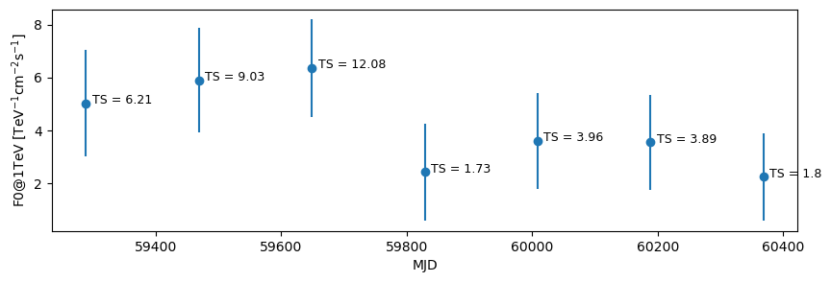
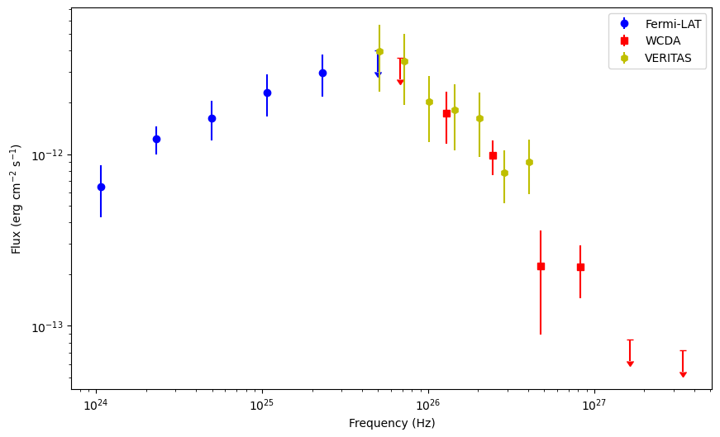
1.8: HESS J1943+213, a mysterious source on Galactic plane
We use WCDA data during 2021-03-09 to 2025-01-31 to analyze HESS J1943+213. The test statistic (TS) of the source is greater than 25, and its global spectral index is 3.19 ± 0.19.
Additionally, the half-year binned light curve reveals no significant variability was found.
Next step @ AI-aid data
  To refine our results.

Slide 16
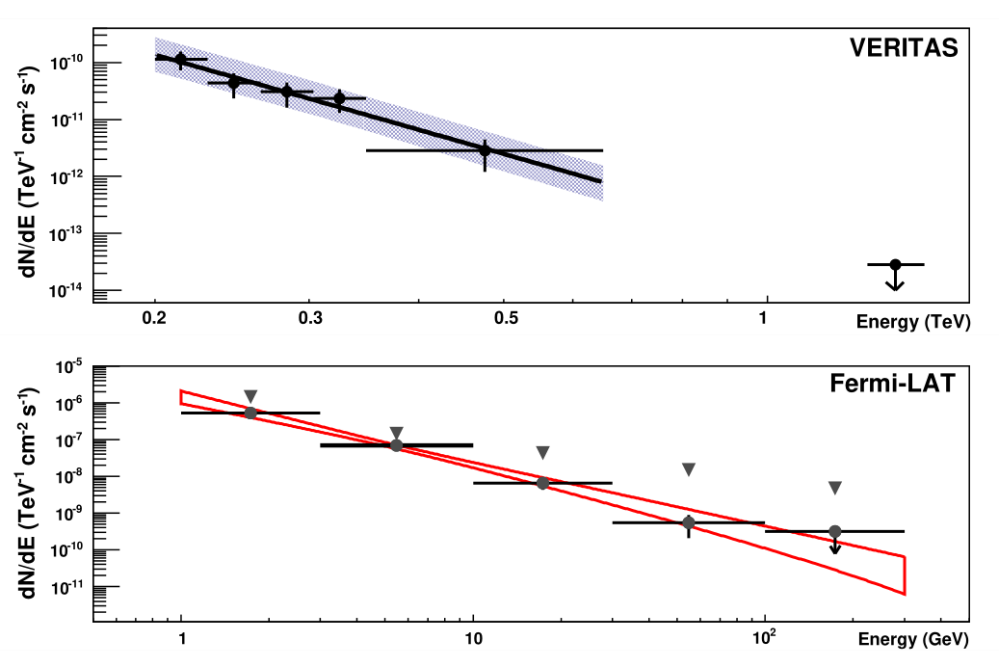
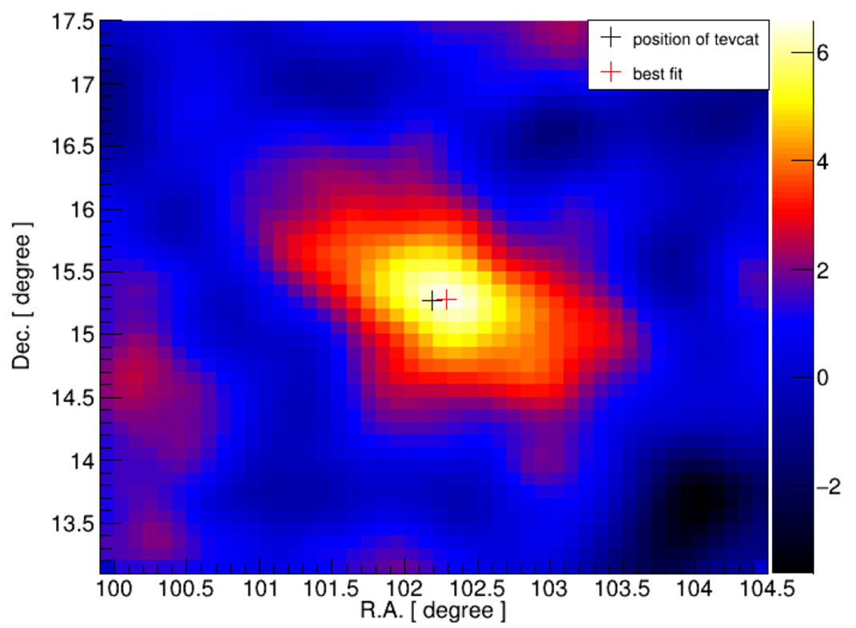
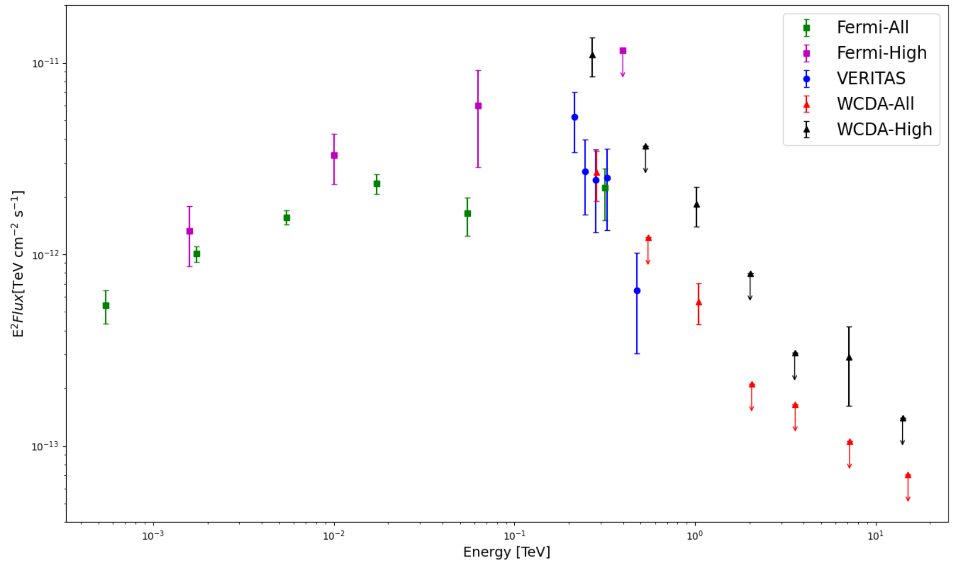
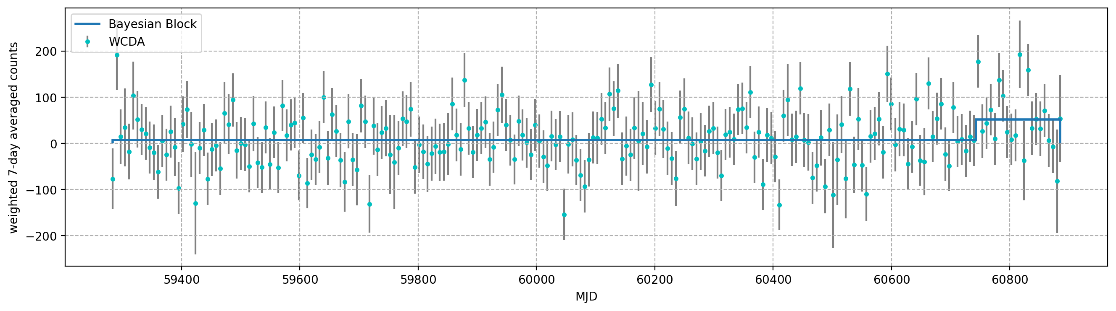
1.9: HBL RX J0648.7+1516
Source Information
  Discovered by VERITAS in 2010
  Position: R.A.: 102.19°, Dec.: 15.27°
  z = 0.179
  located @ Geminga region
WCDA Observation
  Data:202103-202603
  A flaring event is conintuing @ 5 sigma
  Index: 3.3

Slide 17
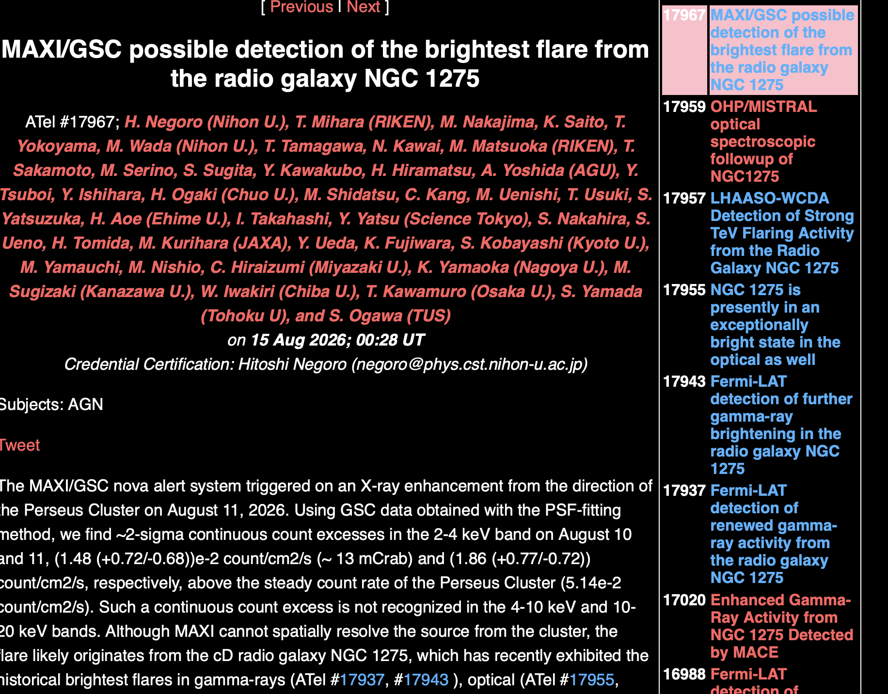
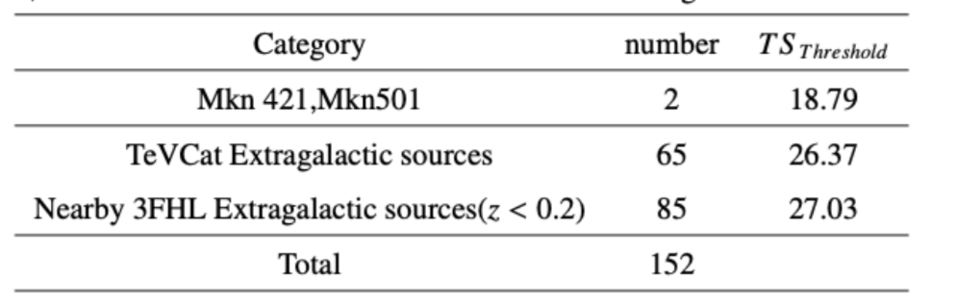
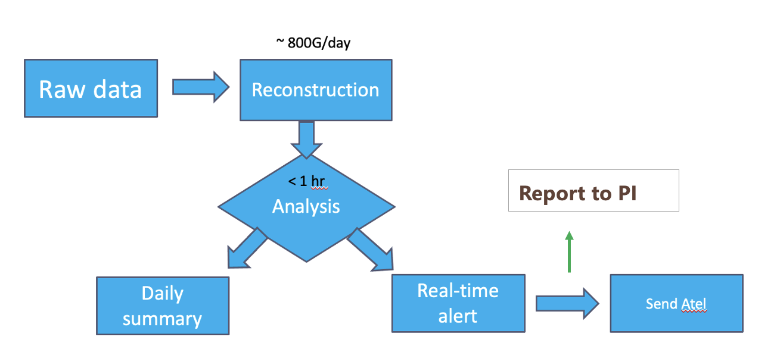
2. real-time monitoring status
Phase I: Selected candidated
Candidate
Duration: 0.5,1,2,4 transits
Alert threshold ←→ the false alarm rate

Slide 18
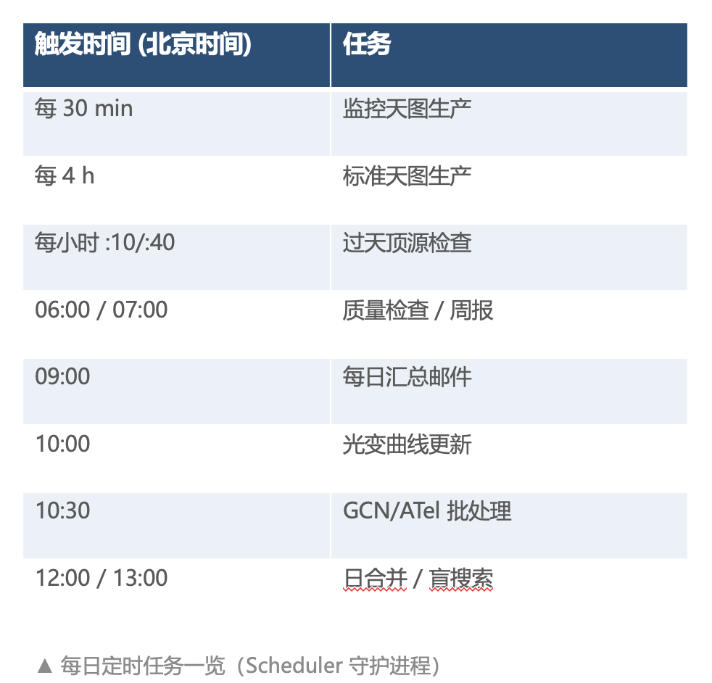


Phase II: full sky monitoring status
▪ 工作方式
– 32 天滑动窗口累加 + 平滑，逐像素计算 TS
– 每日更新，银道面自动掩蔽
– 告警按误报率分两档阈值（≈10 次/年、≈1 次/年）
▪ 可靠性验证
– 1–32 天各窗口：实测 TS 分布与模拟高度吻合
– 误报模型可靠，阈值可定量设定
Phase 1 works very normal, now phase 2 is under test running

Slide 19


LHAASO-WCDA Monitor webpage
http://wcdadqm.ihep.ac.cn/monitor/login

Slide 20




科学亮点：新 TeV 源 4C+42.22
▪ 盲搜索捕获一个持续约 8 天的暂现河外 TeV 源，单点显著性 8.5σ（全局 5.2σ）
▪ 位置与 blazar 4C+42.22（红移 z=0.059）相符，偏差仅 0.03°，流量约 42% Crab
▪ 似然比 + 泊松偶然符合概率完成对应体认证——监测系统实现「数据 → 发现」闭环
草稿已经基本完成，即将提交PCC讨论。
13

Slide 21

Status and outlook
Blind searching @ real-time flaring monitoring;
Further refine the analysis and publish results;
  1ES 2344 / BL Lac / EHBL group
To-do-list
  Further updates on AI-version data;
  ……

Slide 22


