Slide 1
Searching for TeV Quasi-Periodic Oscillations in Markarian 421
with LHAASO-WCDA
G.M. Xiang, J.N. Zhou, M.Zha, D.H.Yan
2026/08/18

Slide 2
Why TeV QPOs Matter
QPOs are nearly periodic modulations in light curves, identified as narrow peaks in the power spectrum.
In blazars, QPOs may originate from:
  jet precession
  binary supermassive black hole systems
  accretion disk instabilities
  magnetohydrodynamic processes in relativistic jets
  …
Detecting QPOs in the gamma-ray band can constrain the geometry, dynamics, and emission mechanisms of these extreme environments.

Slide 3
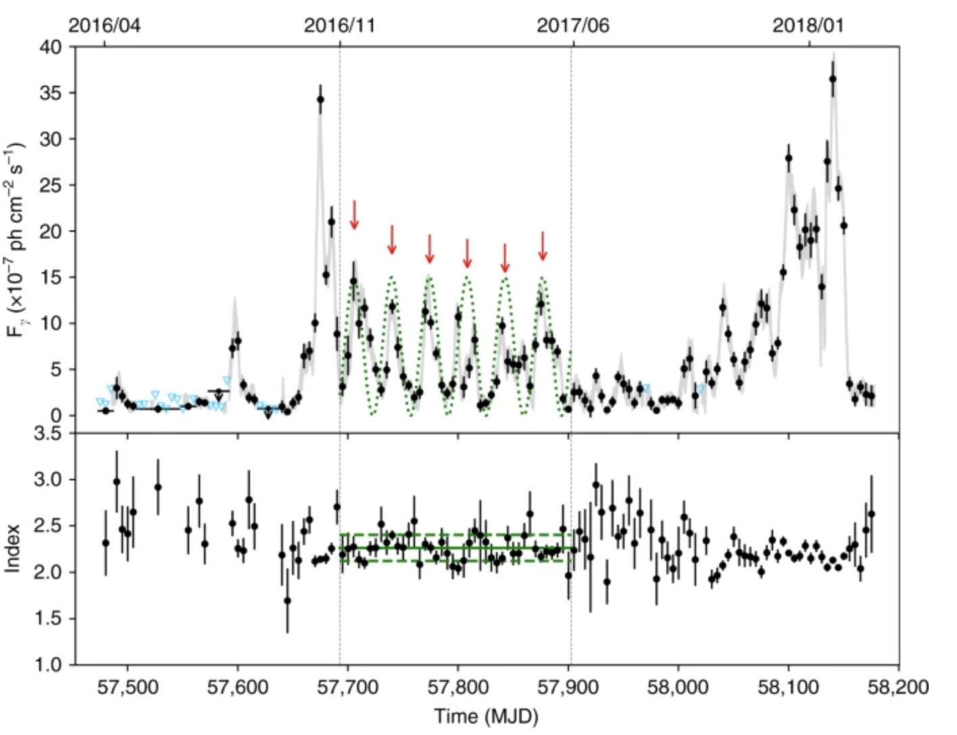
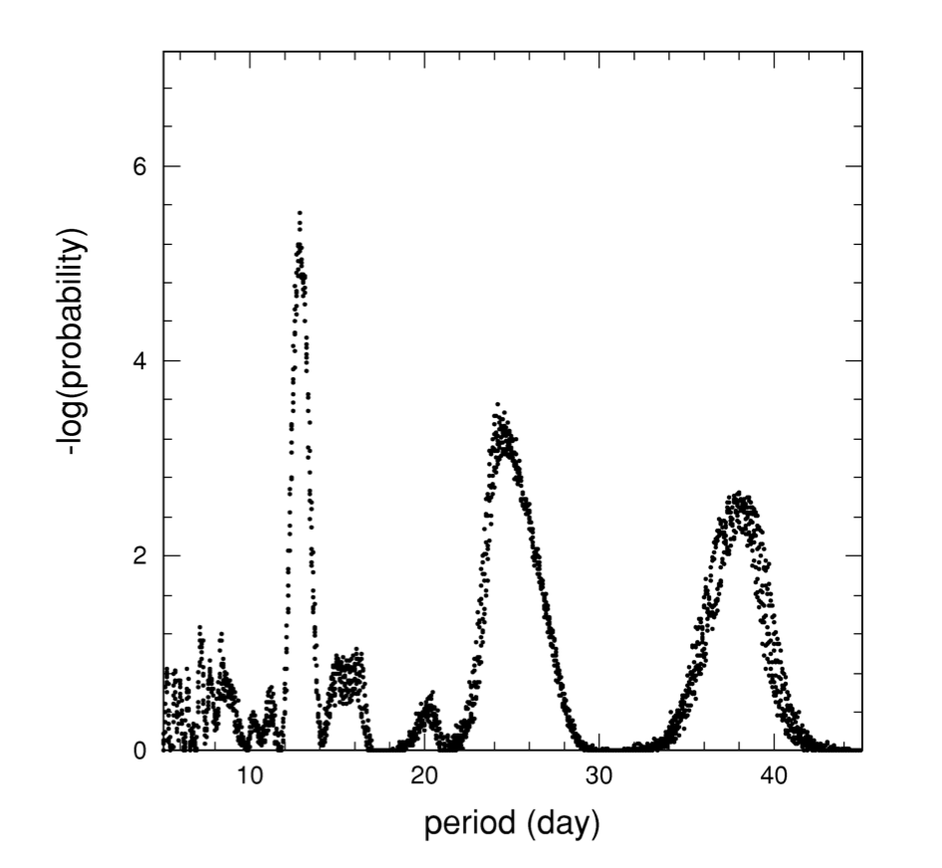
Current Status of Gamma-ray QPO Searches
GeV band (Fermi-LAT):
  PG 1553+113, PKS 2155-304, PKS 1510-089:
  candidates on year-timescales
  PKS 2247-131: 5.2σ QPO at ~34.5 d
  …
TeV band:
  Telescope Array: possible ~12.7 d QPO in Mrk 501 (debated)
  H.E.S.S. / MAGIC: limited duty cycle, not suited for long-term QPO searches
LHAASO-WCDA: wide field, continuous monitoring
→ systematic TeV QPO search possible
J.N.Zhou,2018
N Hayashida · 1998

Slide 4
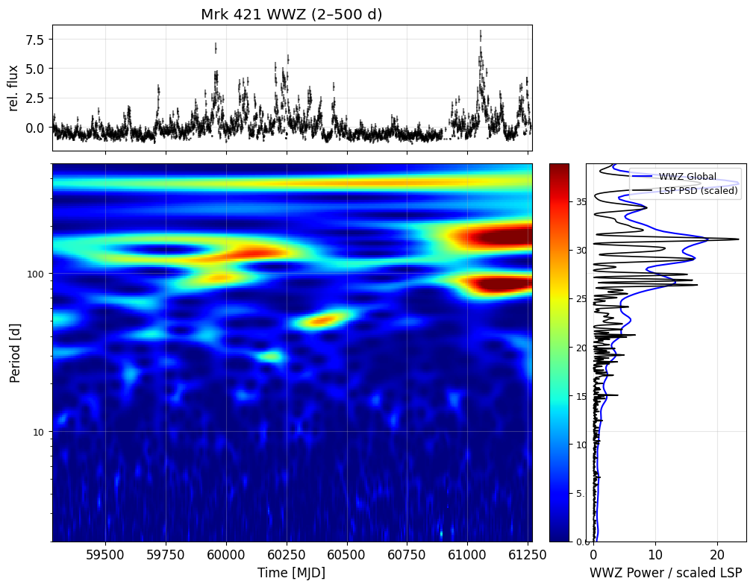
Data & Methods
Data: LHAASO-WCDA daily light curve of Mrk 421 (MJD 59282–61263)
Methods:
  Weighted Wavelet Z-transform (WWZ)
  Gaussian Process (GP) regression: SHO_periodic + SHO_aperiodic + WN, MCMC for posterior sampling
  Red-noise simulations for significance assessment

Slide 5
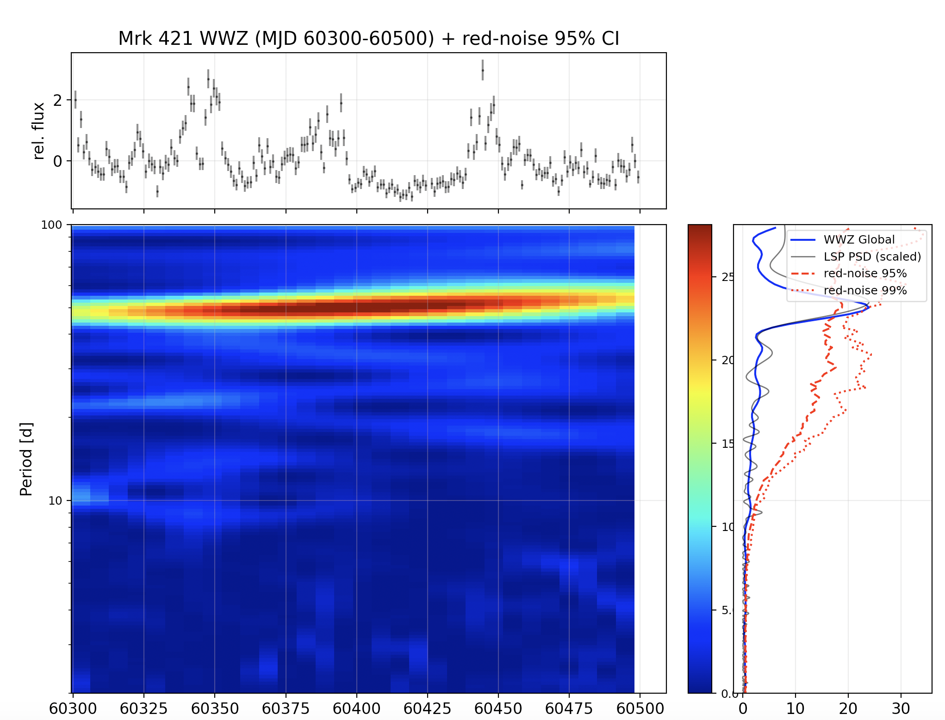
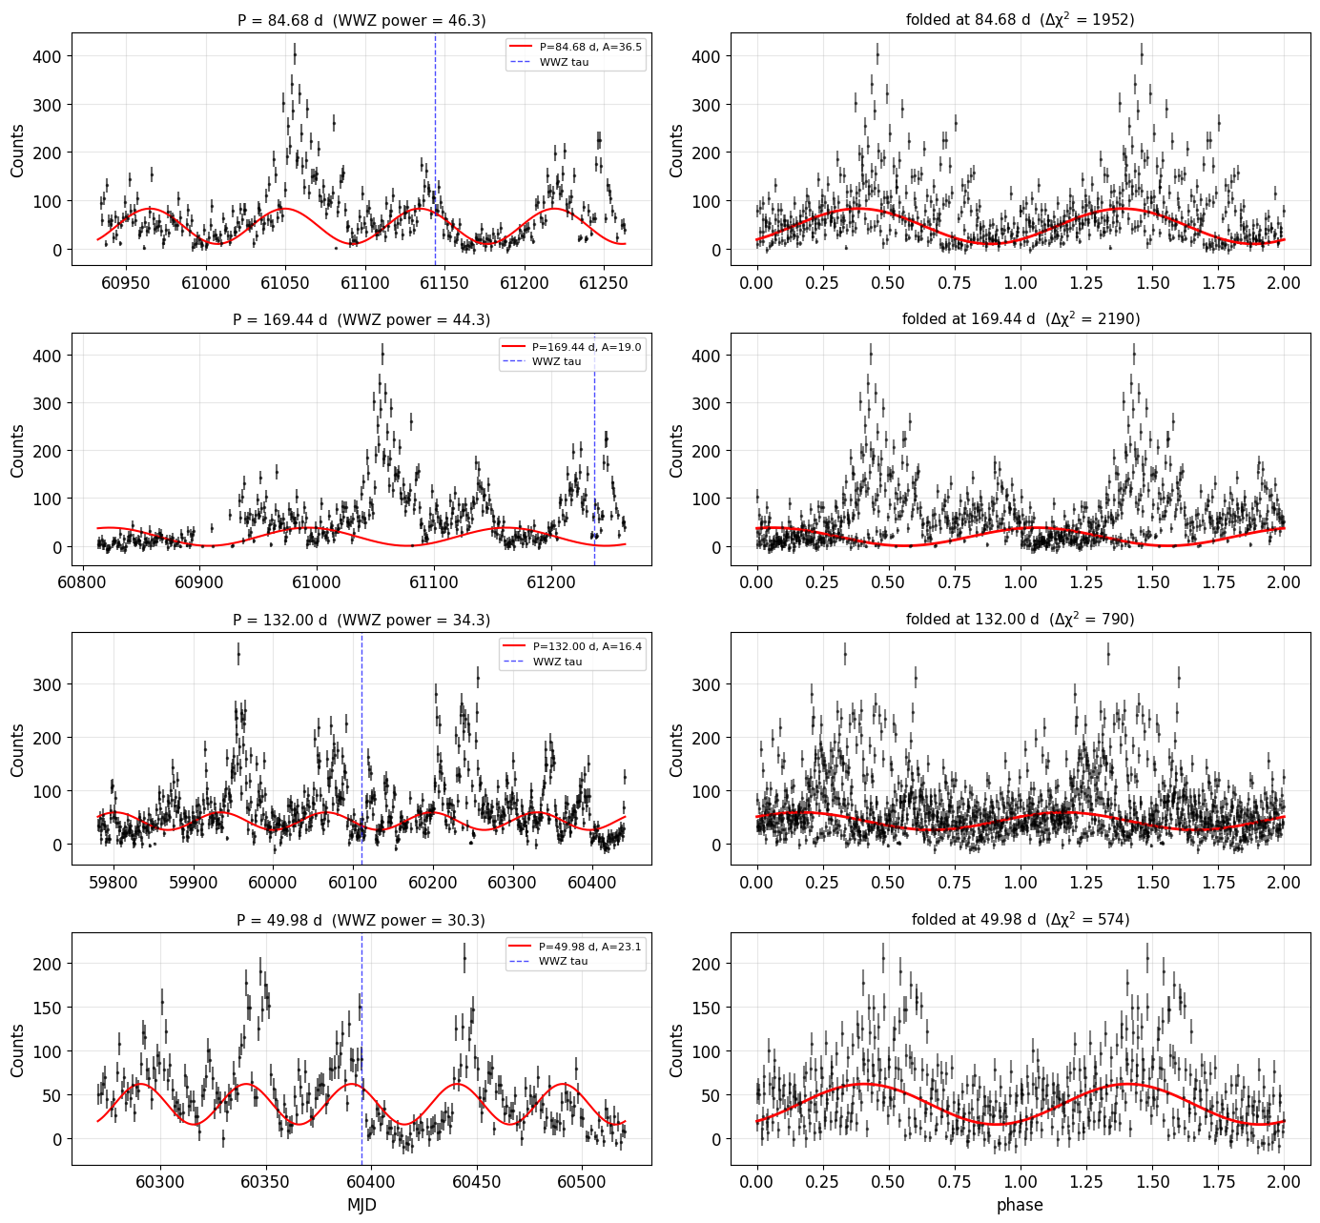
Results : A Local Excess at ~50 d
MJD 60300-60500 window:
  ~50 d WWZ global exceeds the local 95%/99% red-noise curve
BUT:
  local only (no look-elsewhere correction)
  broad 47-54 d band -> red-noise bump, not a narrow line

Slide 6
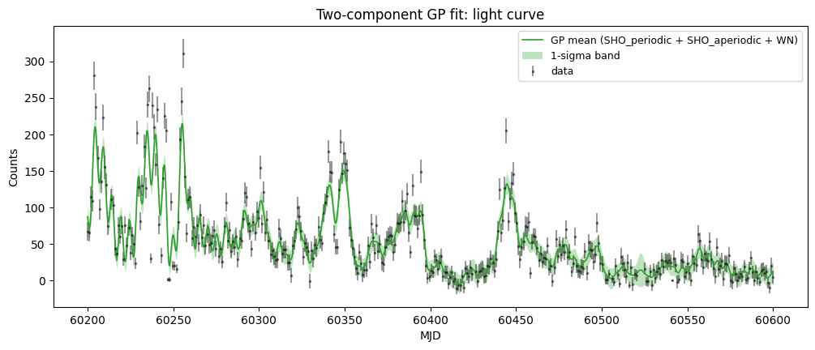
Results：GP candidate: P ≈ 5.09 d in MJD 60200–60600
MJD 60200–60600 window :

Slide 7
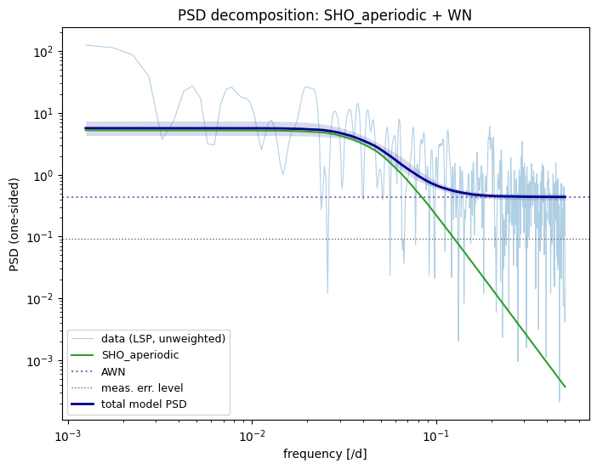
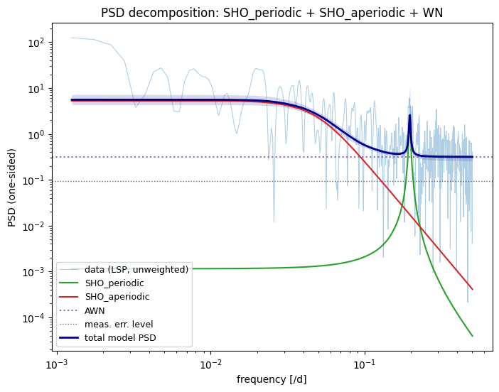
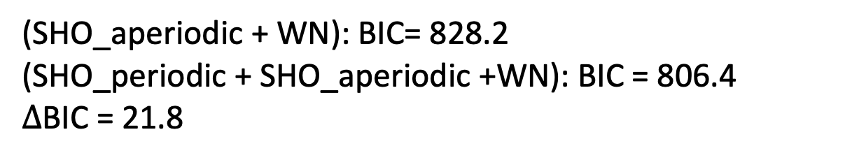
Results: PSD decomposition
(SHO_aperiodic + WN): BIC= 828.2
(SHO_periodic + SHO_aperiodic +WN): BIC = 806.4
$∆$BIC = 21.8
SHO : P = 5.09 d, Q = 94.53

Slide 8
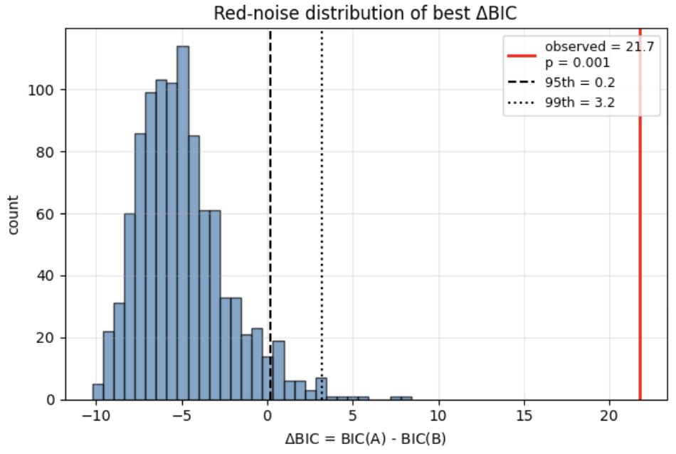
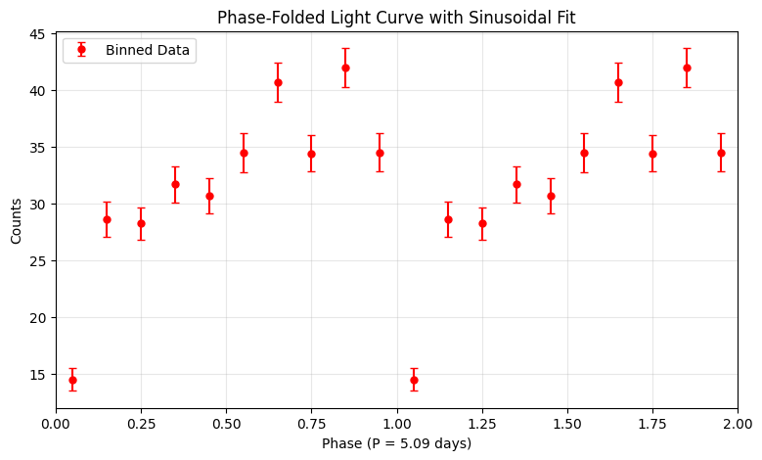
Results： Red‑noise simulations
A quick 1000 times simulation, p-value (ΔBIC >= observed) < 0.001

Slide 9
Summary & Outlook
We searched for TeV QPOs of Mrk 421 using the long‑term daily light curve from LHAASO‑WCDA.
We applied the Weighted Wavelet Z‑transform , Gaussian‑Process regression with SHO kernels, MCMC sampling and red‑noise simulations for significance evaluation.
A tentative signal with ~50 days is identified, marginally exceeding the 99% confidence level.
The 5.09 d signal need further verification.
To do Next
Multi-wavelength cross-check of the candidates (Fermi-LAT, Swift, MAXI)；
Re-run the full pipeline on AI-reconstructed light curves；
Apply the same pipeline to Markarian 501.

Slide 10
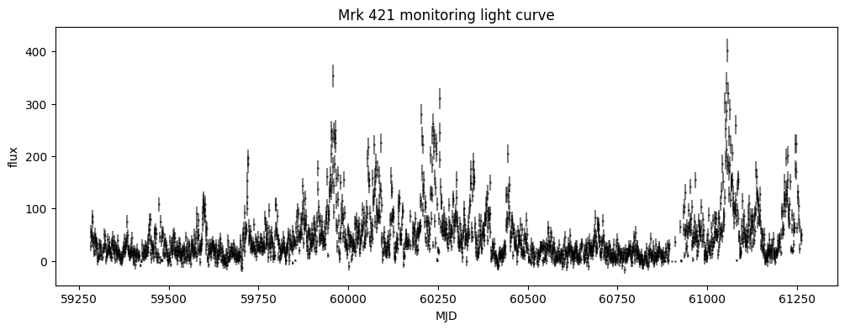
Results : WWZ Candidates
MJD | Period[d]
61143.9 | 84.68
60110.6 | 132.00
60395.4 | 49.98

