Slide 1

Advances in CGEM software migration and track reconstruction
Rong Li and Liangliang Wang
For CGEM software working group
BESIII Collaboration Meeting in Summer 2026
July 8. 2026,YTU(Yantai, China)

Slide 2
Outline
CGEM Software Migration: From BOSS 7.2.0.c to BOSS 8.0.1.pre2
Progress in Cellular Automata: CGEM and ODC joint Circle Finding
Summary

Slide 3
CGEM Software Migration:
From BOSS 7.2.0.c to BOSS 8.0.1.pre2
Full migration of CGEM simulation & reconstruction chain from BOSS720c to BOSS801pre2
CGEM code porting and adaptation: cross-version API, runtime compatibilities, directory restructuring, modular separation, CMT to CMake, CVS to Git and so on
Validation
  Based on MC samples (with CGEM) and ψ(2S) data (Feb 10-24, 2026)
  Benchmark channels analyzed with the two BOSS versions and for three reconstruction configurations:
    ODC old tracking
    ODC new tracking
    CGEM+ODC new tracking
    (w/o CGEM alignment & μTPC yet, so efficiency lower, only for consistency check between two BOSS versions)
Massive underlying stack upgrades in BOSS8 series:
 | BOSS 7.2.0.c | BOSS 8.0.1.pre2
OS | CentOS7 | AlmaLinux9
Version Control | CVS | Git
Build Tool | CMT | CMake
GCC | 4.9.3 | 13.1.0
C++ Version | C++98 | C++20
ROOT | 6.20.02 | 6.36.02
Gaudi | v27r1 | V39r4
Python | 2.7 | 3.12
LCG | 84 | 108
(detailed results in next slides)

Slide 4
e⁺e⁻@ψ(2S)
Wenjing Zheng (IHEP)
MC: CGEM+ODC
Event selection Efficiency
Tracking algorithm | Hit used | 720c | 801pre2 | Relative difference
Old tracking | ODC only | (66.32+/-0.41)% | (66.74+/-0.41)% | -0.23%
New tracking (Global Hough) |  | (64.44+/-0.41)% | (65.08+/-0.41)% | 0.99%
data (CGEM+ODC) Feb 10-24, 2026
Number of Events after selection
Tracking algorithm | Hit used | 720c | 801pre2 | Relative difference
Old tracking | ODC only | 56963058 | 56927460 | -0.06%
New tracking (Global Hough) |  | 53803951 | 53408962 | -0.73%
 | CGEM+ ODC | 54147104 | 54013129 | -0.25%

Slide 5
ψ(2S)→ μ⁺μ⁻
Wenjing Zheng (IHEP)
MC: CGEM+ODC
 |  |  | Event selection Efficiency
Tracking algorithm | Hit used |  | 720c | 801pre3 | Relative difference
Old tracking | ODC only |  | (78.41+/-0.41)% | (78.39+/-0.41)% | -0.02%
New tracking (Global Hough) |  |  | (75.98+/-0.41)% | (76.22+/-0.41)% | 0.3%
data (CGEM+ODC) Feb 10-24, 2026
Number of Events after selection
Tracking algorithm | Hit used | 720c | 801pre2 | Relative difference
Old tracking | ODC only | 2857057 | 2856278 | -0.03%
New tracking (Global Hough) |  | 2789838 | 2772944 | -0.60%
 | CGEM+ ODC | 2644259 | 2643328 | -0.04%

Slide 6

$$ψ\left(2S\right)→p\overline{p}$$
Wenjing Zheng (IHEP)
MC: CGEM+ODC
 |  | Event selection Efficiency
Tracking algorithm | Hit used | 720c | 801pre2 | Relative difference
Old tracking | ODC only | (75.24+/-0.41)% | (75.95+/-0.41)% | 0.90%
New tracking (Global Hough) |  | (74.65+/-0.41)% | (74.88+/-0.41)% | 0.31%
data (CGEM+ODC) Feb 10-24, 2026
Number of Events after selection
Tracking algorithm | Hit used | 720c | 801pre2 | Relative difference
Old tracking | ODC only | 11159242 | 11143449 | -0.14%
New tracking (Global Hough) |  | 11037809 | 10919716 | -1.0%
 | CGEM+ ODC | 13041454 | 13004983 | -0.28%

Slide 7
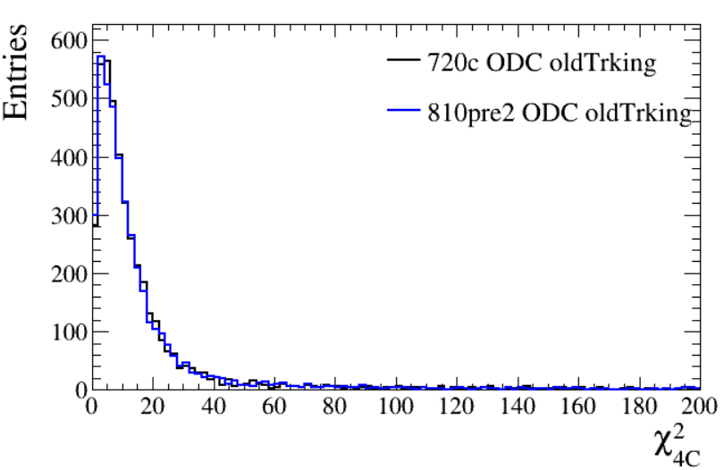
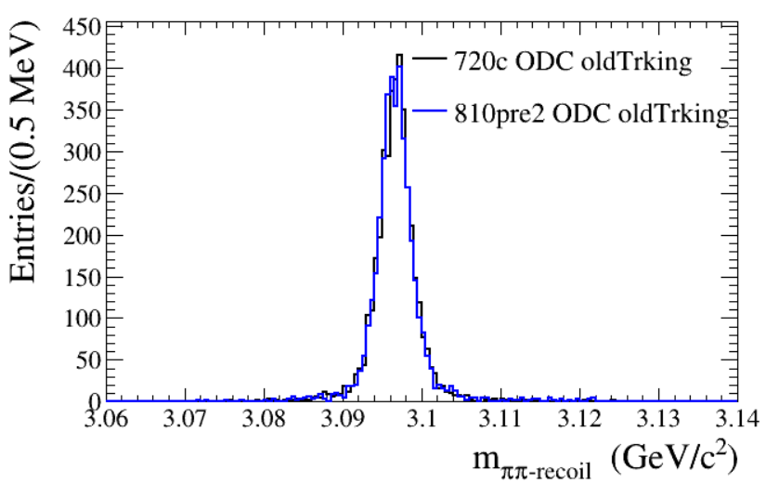
ψ(2S)→π⁺π⁻J/ψ→π⁺π⁻μ⁺μ⁻
Liangliang Wang (IHEP)
MC: CGEM+ODC
 |  | Event selection Efficiency
Tracking algorithm | Hit used | 720c | 801pre2 | Relative difference
Old tracking | ODC only | (40.35+/-0.49)% | (40.09+/-0.49)% | -0.64%
New tracking (Global Hough) |  | (40.95+/-0.49)% | (41.04+/-0.49)% | 0.22%
 | CGEM (toy cluster) + ODC | (46.49+/-0.50)% | (46.96+/-0.50)% | 1.0%

Slide 8
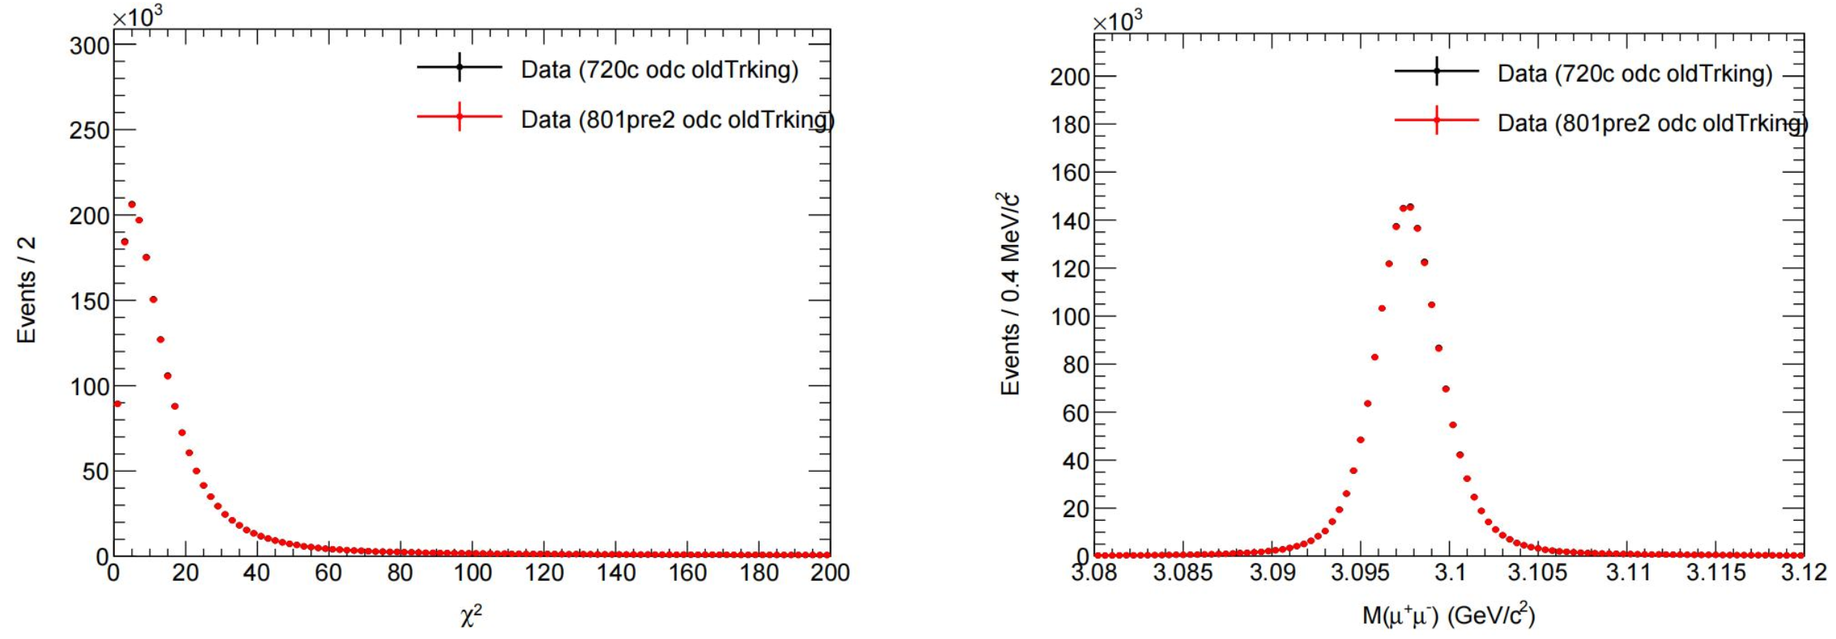
ψ(2S)→π⁺π⁻J/ψ→π⁺π⁻μ⁺μ⁻
Mengting Li, Hang Zhou, Zhiqing Liu (SDU)
data (CGEM+ODC) Feb 10-24, 2026
Number of Events after selection
Tracking algorithm | Hit used | 720c | 801pre2 | Relative difference
Old tracking | ODC only | 1.7407e+06 | 1.73711e+06 | -0.20%
New tracking (Global Hough) |  | 1.73715e+06 | 1.72228e+06 | -0.85%
 | CGEM+ ODC | 1.38114e+06 | 1.37909e+06 | -0.15%

Slide 9
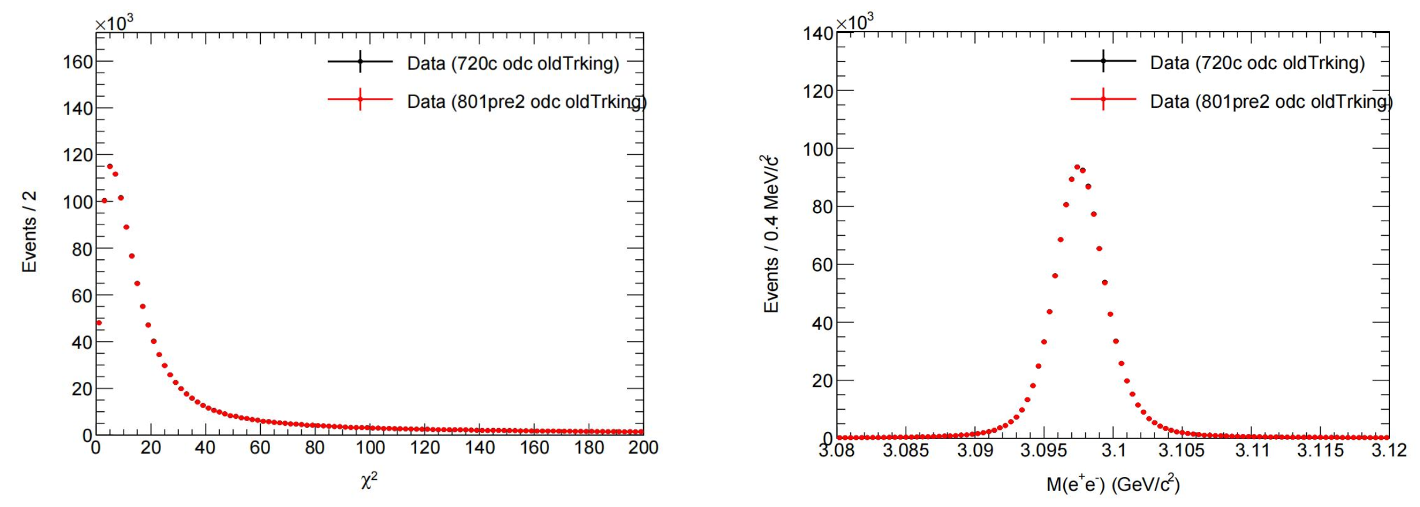
ψ(2S)→π⁺π⁻J/ψ→π⁺π⁻e⁺e⁻
Mengting Li, Hang Zhou, Zhiqing Liu (SDU)
data (CGEM+ODC) Feb 10-24, 2026
Number of Events after selection
Tracking algorithm | Hit used | 720c | 801pre2 | Relative difference
Old tracking | ODC only | 1.12268e+06 | 1.12062e+06 | -0.18%
New tracking (Global Hough) |  | 1.12486e+06 | 1.11529e+06 | -0.85%
 | CGEM+ ODC | 9.43985e+05 | 9.42819e+05 | -0.12%

Slide 10
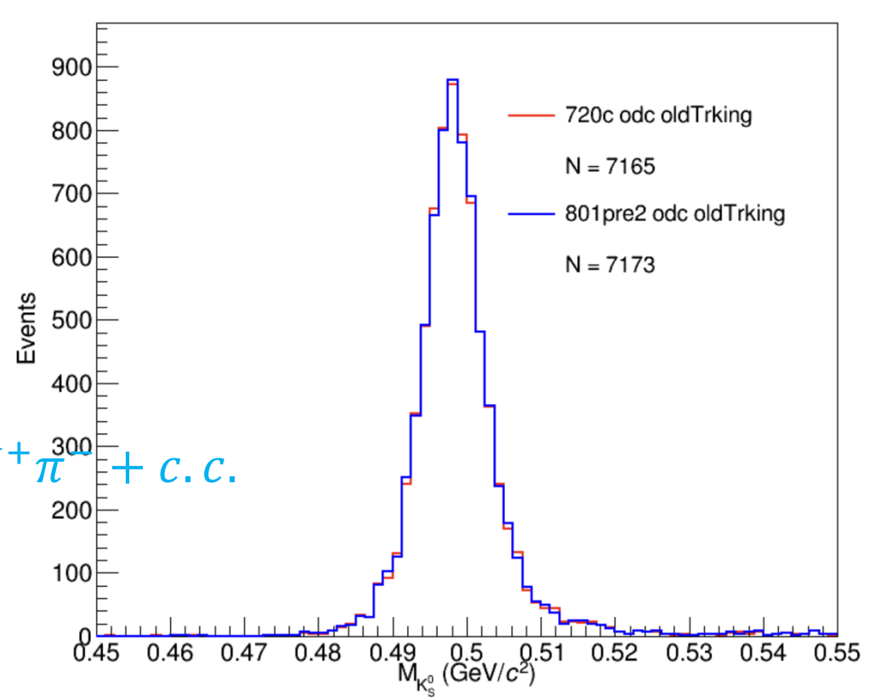
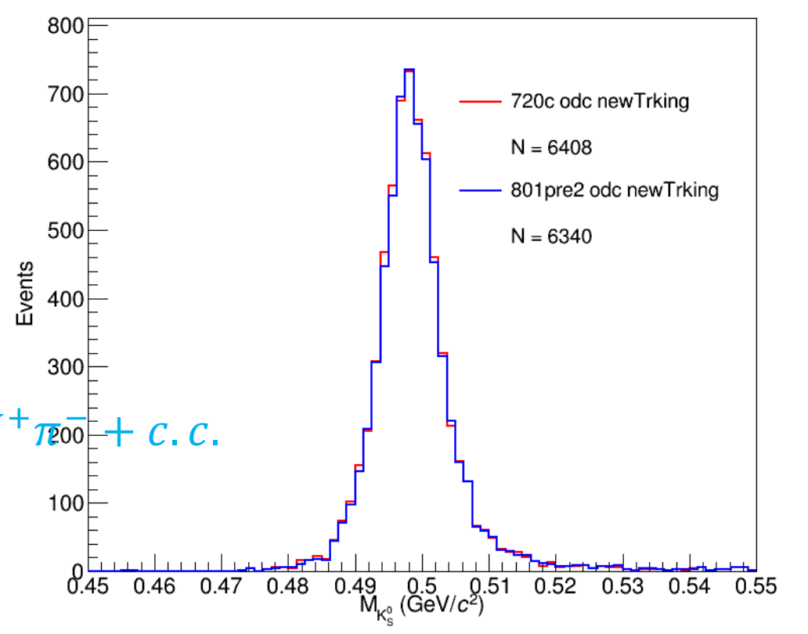
ψ(2S)→K_{S}⁰K⁺π⁻
Dong Wei, Junhui Yang, Kai Zhu (IHEP)
data (CGEM+ODC) Feb 10-24, 2026
Number of Events after selection
Tracking algorithm | Hit used | 720c | 801pre2 | Relative difference
Old tracking | ODC only | 7194 | 7199 | 0.07%
New tracking (Global Hough) |  | 6429 | 6360 | -1.1%
 | CGEM+ ODC | 5636 | 5673 | 0.65%

Slide 11
CGEM Software Migration:
From BOSS 7.2.0.c to BOSS 8.0.1.pre2
Full migration of CGEM simulation & reconstruction chain from BOSS720c to BOSS801pre2
CGEM code porting and adaptation: cross-version API, runtime compatibilities, directory restructuring, modular separation, CMT to CMake, CVS to git and so on
Validation
  Based on MC samples (with CGEM) and ψ(2S) data (Feb 10-24, 2026)
  Benchmark channels analyzed with the two BOSS versions and for three reconstruction configurations:
    ODC old tracking
    ODC new tracking
    CGEM+ODC new tracking
    (w/o CGEM alignment & μTPC yet, so efficiency lower, only for consistency check between two BOSS versions)
Relative differences in efficiency (or selected number of events) between BOSS 7.2.0.c and BOSS 8.0.1.pre2 generally less than 1% (one channel with K_{S}⁰ at 1.1%)
Massive underlying stack upgrades in BOSS8 series:
 | BOSS 7.2.0.c | BOSS 8.0.1.pre2
OS | CentOS7 | AlmaLinux9
Version Control | CVS | Git
Build Tool | CMT | CMake
GCC | 4.9.3 | 13.1.0
C++ Version | C++98 | C++20
ROOT | 6.20.02 | 6.36.02
Gaudi | v27r1 | V39r4
Python | 2.7 | 3.12
LCG | 84 | 108
More check in progress

Slide 12
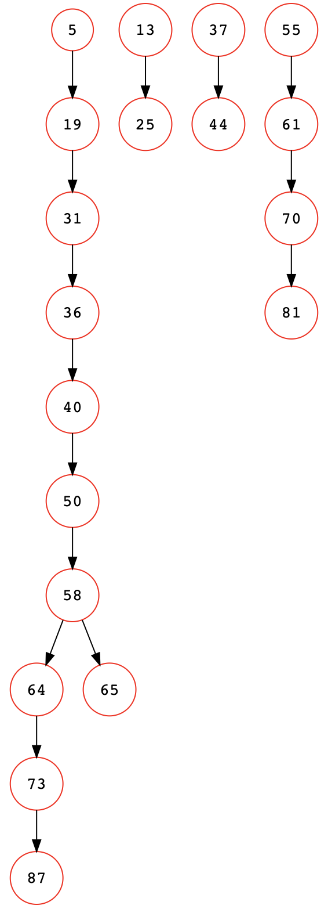
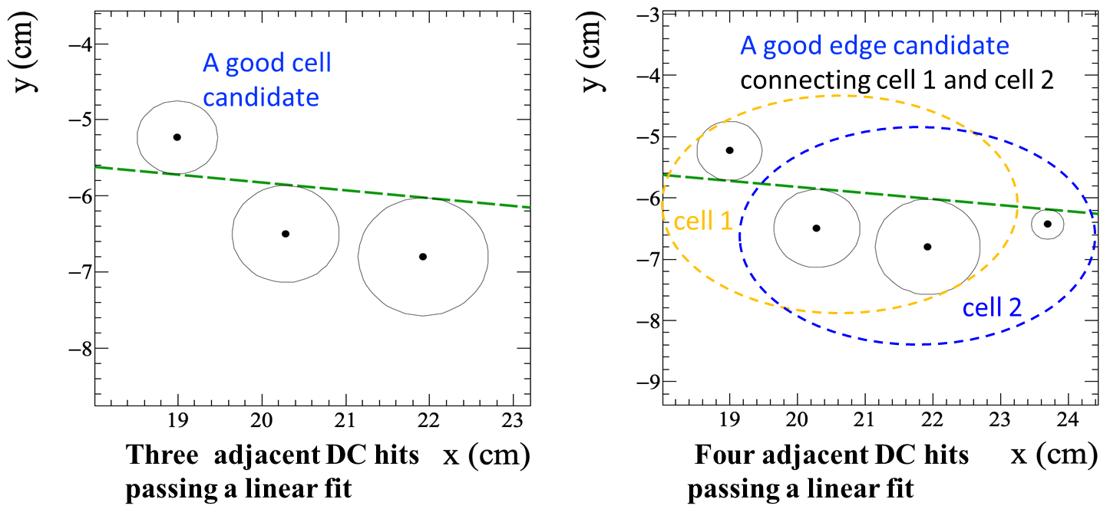
Track Finding with Cellular Automata (CA)
Rong Li, Jin Zhang(SYU), L.L. Wang(IHEP) et al.
Cellular automata (CA): a local track finding method
Local constraints applied to improve track separation and background suppression
No assumption that tracks from IP
(no significant difference between tracks from IP or not)
Cells and edges form
a directed graph
Cell and Edge Building for ODC
Track (segment) finding =>
Longest path on the graph found by CA
The longest path
id
cell
edge
Extension to include CGEM introduces two new cell types:
mixed CGEM+ODC and pure CGEM (more on next slide)

Slide 13
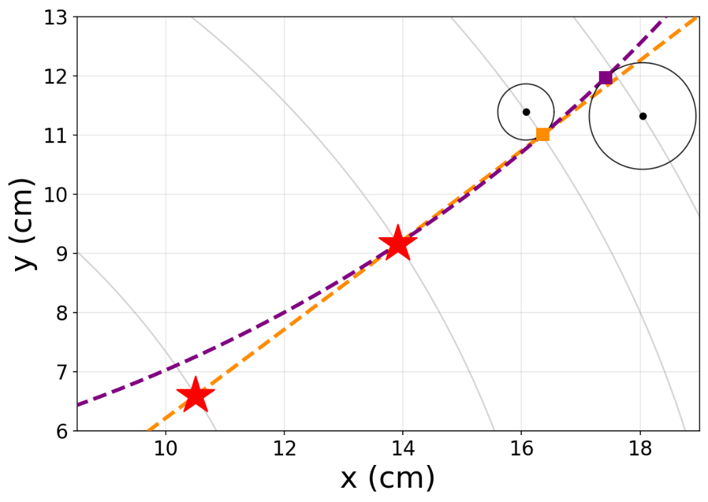
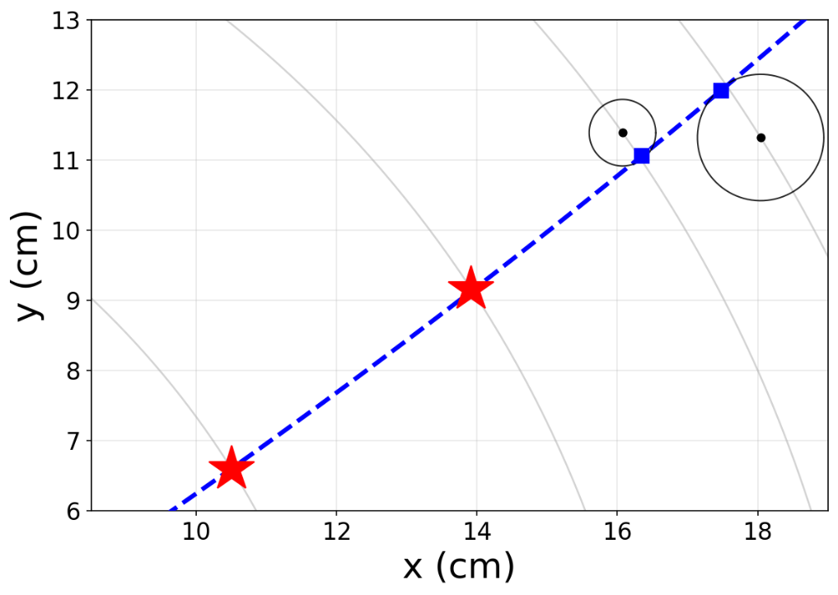
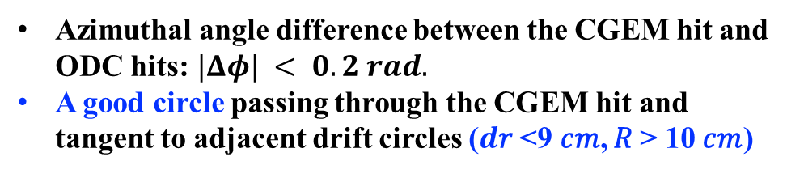
Add CGEM to Circle Track Finding with CA:
Cell and edge building for CGEM+ODC
Type 1 : Cell building for CGEM+ODC
For CGEM, the large gaps between adjacent layers make straight-line fitting unsuitable
for low-momentum tracks
Circle fitting replaces straight-line fitting for cells and edges involving CGEM hits
good cell candidates
A good edge candidate
connecting two adjacent cells
ODC drift circle
cell2
cell1
cell1
cell2
CGEM X_cluster
fitted circle
Azimuthal angle difference between the CGEM hit and ODC hits:$|Δφ| < 0.2 rad.$
A good circle passing through the CGEM hit and tangent to adjacent drift circles ($d$𝑟 <9 𝑐𝑚, 𝑅 > 10 𝑐𝑚)
Sharing two hits
Four adjacent CGEM+ODC hits passing a good circle fitting

Slide 14
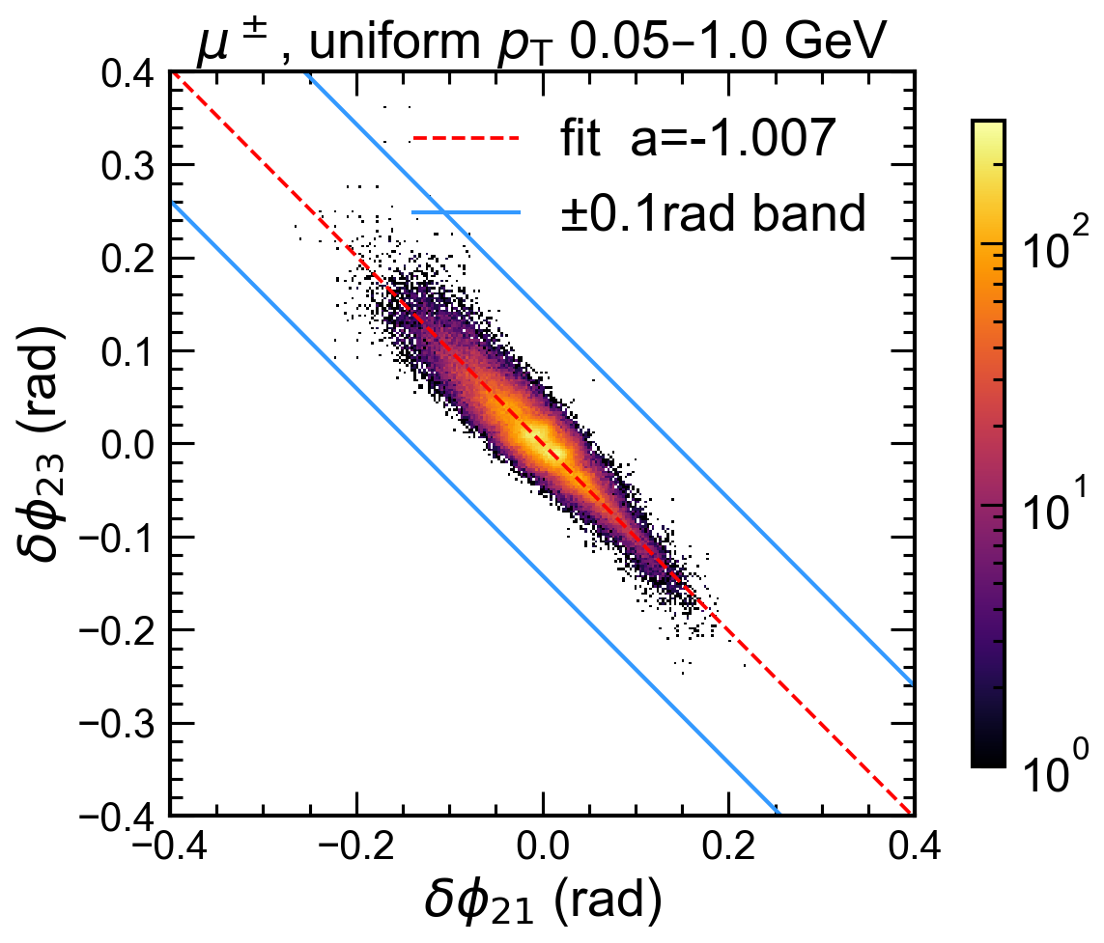
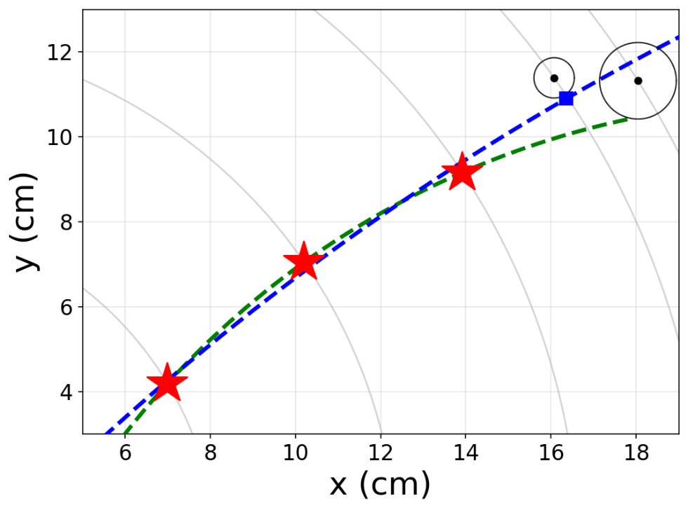
Add CGEM to Circle Track Finding with CA:
Cell and edge building for CGEM+ODC
Type 2 : Cell building for CGEM
The distributions of $\left(δφ_{21}=φ_{1}−φ_{2},δφ_{23}=φ_{3}−φ_{2}\right)$for the same track lie in a band along the anti-diagonal
Using $\left(δφ_{21},δφ_{23}\right)$window reduces the number of wrong combinations in pure CGEM cell building
cell2
CGEM
cell2
A good cell :three adjacent CGEM hits passing a good circle and satisfying $\left(δφ_{21},δφ_{23}\right)$window
A good edge: four adjacent CGEM+ODC hits passing a good circle fitting

Slide 15
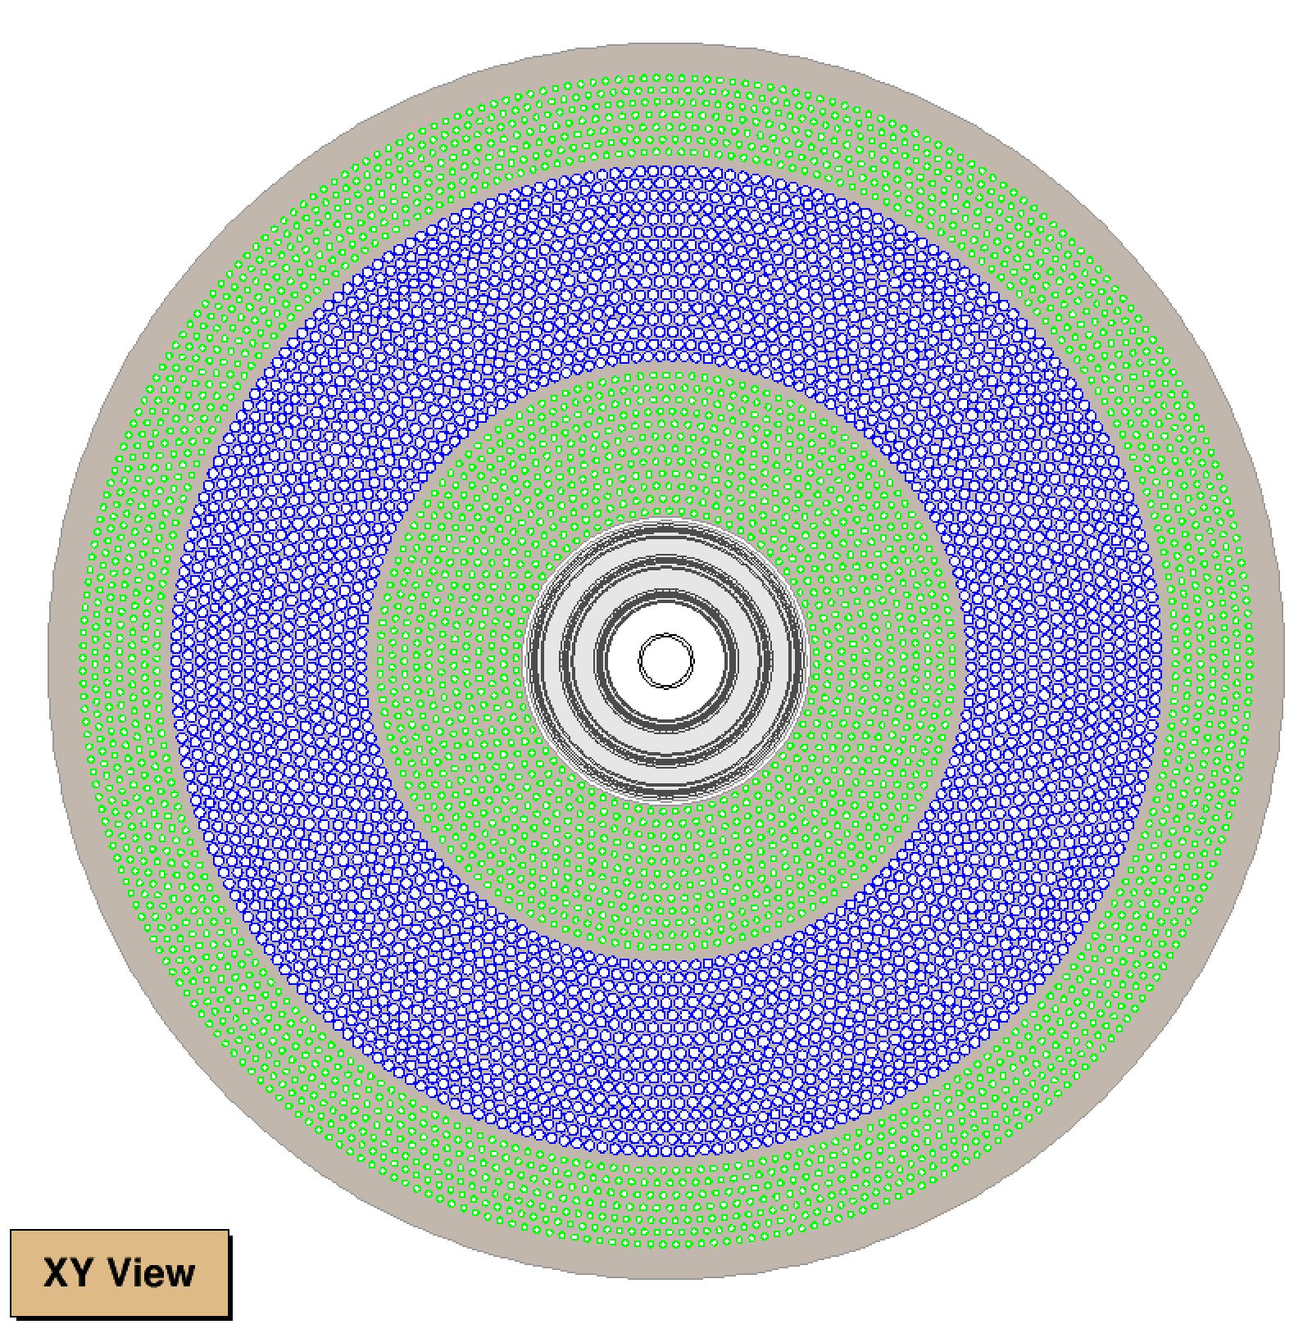
Flow Chat of CA Circle Track Finding for CGEM+ODC
Build “cells” and “edges” in ODC + CGEM
Track segment finding with CA in different areas
Segment connection in an area
Segment connection between areas
Extension to include CGEM
Track segment connection
Missed hits association
Circle fitting
Area1 : CGEM
Outer DC (ODC)
Area2 : axial wires
(12 layers)
CA is applied to the combined area of 1 and 2, and to area 7 , to find circle track segments
(not limited in a super layer)
Possible track segments connections in each area
Area3 : stereo wires (-) Area4 : stereo wires (+) Area5 : stereo wires (-) Area6 : stereo wires (+)
Axial wires
Track segments connection between the combined area (1+2) and area 7, using Taubin circle fitting parameters
Missed hits association in area (1+2) and 7
Stereo wires
Axial wires
Area7 : axial wires
(7 layers)
Tracking system : CGEM+ODC

Slide 16
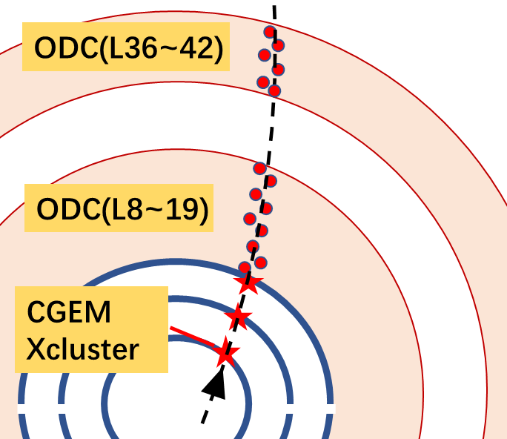
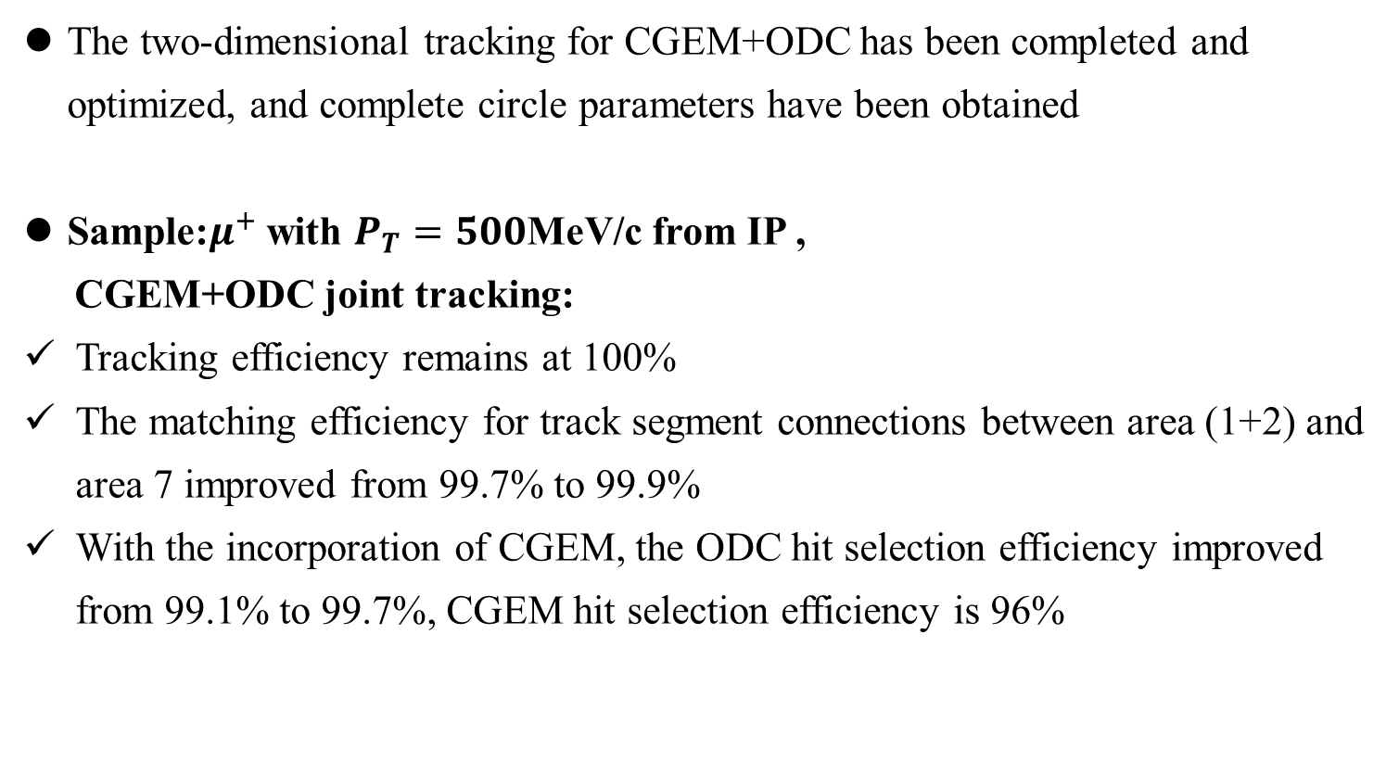
A Quick Test of CA Circle Track Finding for CGEM+ODC
The two-dimensional tracking for CGEM+ODC has been completed and optimized, and complete circle parameters have been obtained
Sample:$μ^{+}$with $P_{T}=500$MeV/c from IP ,
CGEM+ODC joint tracking:
Tracking efficiency remains at 100%
The matching efficiency for track segment connections between area (1+2) and area 7 improved from 99.7% to 99.9%
With the incorporation of CGEM, the ODC hit selection efficiency improved from 99.1% to 99.7%, CGEM hit selection efficiency is 96%

Slide 17
Overall Status of Track finding with CA
Flowchart for the track finding with CA
Build “cells” and “edges”
Track segment finding with CA in different areas of ODC
Segment connection in an area
Segment connection between areas
Save good track candidates
Helix fit
Select V-hits
Circle fitting
CA circle finding in CGEM+ODC: implemented
The ODC hit selection efficiency has improved
in plan : Matching V-hits and others in progress

Slide 18
Summary
Software Migration: The full CGEM simulation and reconstruction chain has been successfully migrated. For most channels, validation shows a reasonable consistency (relative efficiency differences below 1%).
CA Circle Finding Extension: The algorithm now supports joint circle track finding for CGEM+ODC. A quick test shows ODC hit selection efficiency improved
  In Plan: Matching of V‑hits and optimization tasks are in progress
in progress : Incorporate latest CGEM alignment and Lorentz angle corrections into global tracking, circle/helix fitting, and Kalman filter, to improve the accuracy of track reconstruction.
Thank you for your attention!

Slide 19
Backup

Slide 20
Overall Status of
CGEM Simulation and Reconstruction
CGEM Simulation
  Full Geometry and Material of CGEM in Geant4 Simulation
  Full Digitization
    Tuning for ψ(2S) in July 2025
    In progress:
    tuning for 4.680 GeV data
CGEM Reconstruction
  CGEM Cluster Reconstruction
    Charge Centroid
    μTPC (under improvement & calibration, see Hao’s talk)
  CGEM+ODC joint track finding
    Hough Transform + Global circle & Helix fitting + Kalman Filter
    (under optimization)
    Cellular Automata
    (under development)
CGEM software migration: CgemBOSS6 → BOSS7 → BOSS8

