Slide 1
Design and Application of a MicroTCA.4-Based Embedded Event Receiver for CSNS-II
Sinong Cheng*, Peng Zhu, Yuliang Zhang
2026 MicroTCA/ATCA Workshop for Large Scientific Facility Control
Sep.14-Sep.17 2026, HEPS Campus, Huairou, Beijing, China

Slide 2
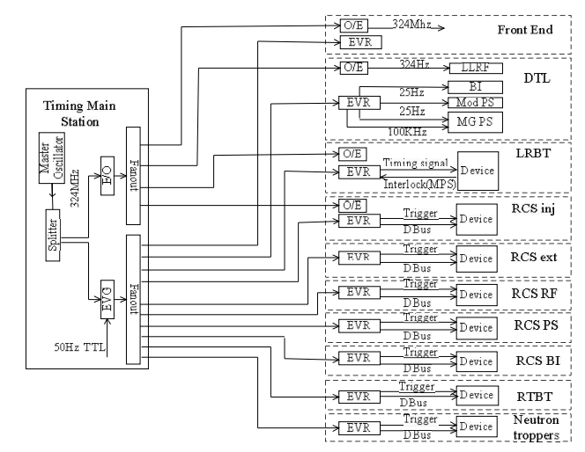
CSNS Timing System
Standard VME architecture @ MRF
The timing system using an Event system, that the event generator (EVG) and event receivers (EVR) as the main structures of a multi-level star structure.

Slide 3

Requirements of CSNS-II Timing System
CSNS & CSNS II
LINAC LLRF → add
80MeV
324MHz Spoke
Cavities
648MHz elliptical
Cavities
303MeV
154MeV
To rise the beam power
RCS LLRF → upgrade
3 additional 2nd harmonic (MA) cavities
1st harmonic cavity
1.6GeV
2nd harmonic cavity
Notes:
CSNS II工程已通过国家审批，今年正式开工建设。直线加速器采用低温超导加速技术将负氢粒子从80MeV提升至300MeV，快同步循环加速器增加多个磁合金腔，进一步提高束流通过率和降低束流损失，由此看出，高频系统的LLRF是CSNS II加速器稳定运行的关键之一，为此，定时系统的顶层方案设计应符合主流架构基础上优先考虑LLRF需求。

Slide 4
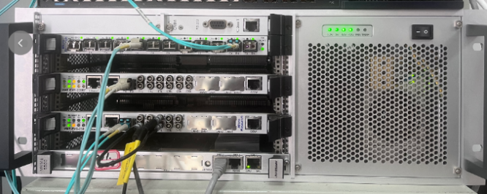
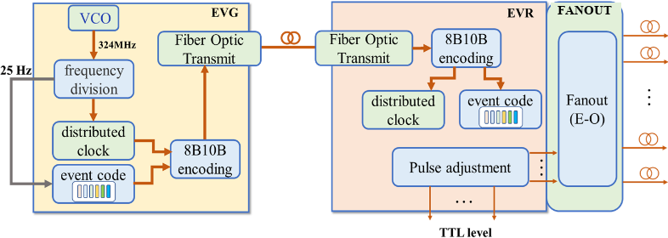
Limitations of Existing Event Receivers
EVG / EVR / Fanout to devices
Existing CSNS timing hardware (VME-based)
Existing EVRs rely on an external CPU / VME controller for register access and control
-> redundant per-station hardware, higher integration & maintenance cost
-> core devices (VME controller) obsolete, supply hard to sustain
Goal: a self-reliant, single-board embedded EVR on an indigenous MicroTCA.4 platform

Slide 5
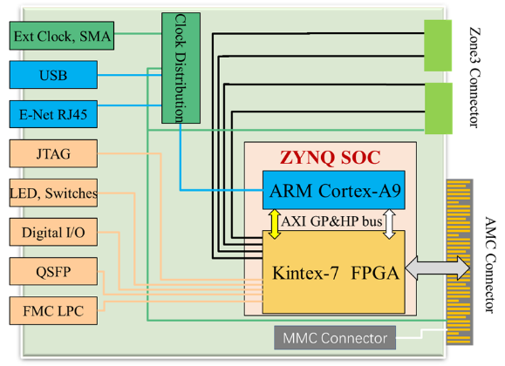
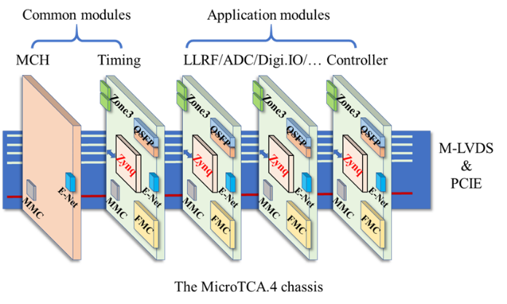
General Design of the Embedded EVR
Xilinx Zynq-7000 SoC (PS: dual-core ARM Cortex-A9 + PL: Kintex-7-class fabric); no dedicated CPU / MCH controller required for the timing function itself
Embedded EVR AMC block diagram (Zynq SoC)
One MicroTCA.4 chassis shared by Timing AMC and device AMCs (M-LVDS & PCIe backplane)

Slide 6
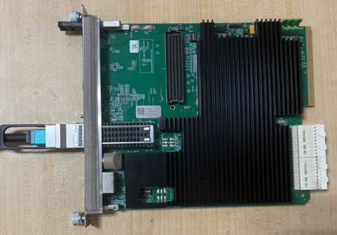
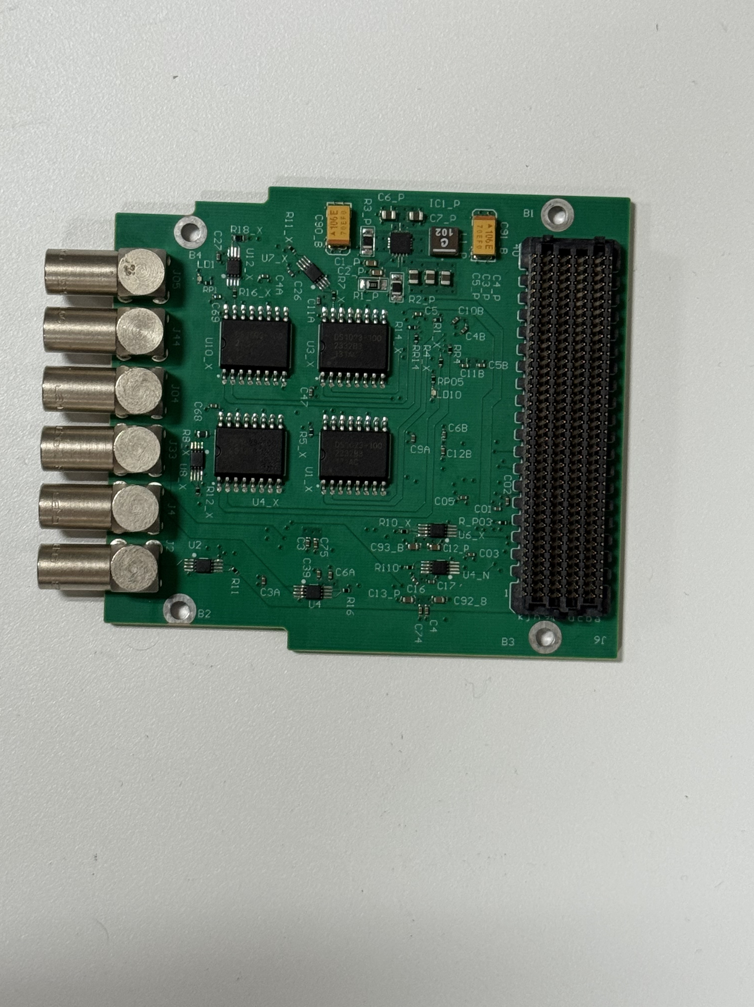
Embedded EVR Hardware
• Core: Xilinx Zynq XC7Z045 SoC (dual ARM Cortex-A9 + programmable logic)
• Optical event input: pluggable QSFP module, 1.62 Gbps line rate; GTX transceiver up to 9.72 Gbps
• Dual 10 GbE ports for network management and data transfer
• FMC (FPGA Mezzanine Card) interface for pulse I/O expansion, and gives 4 out / 2 in
• AMC / MMC compliant with MicroTCA.4 hot-swap and management
Embedded EVR AMC board (Zynq-7045)
Front-panel FMC board: 4 out / 2 in (LEMO), DS1023 delay chips

Slide 7
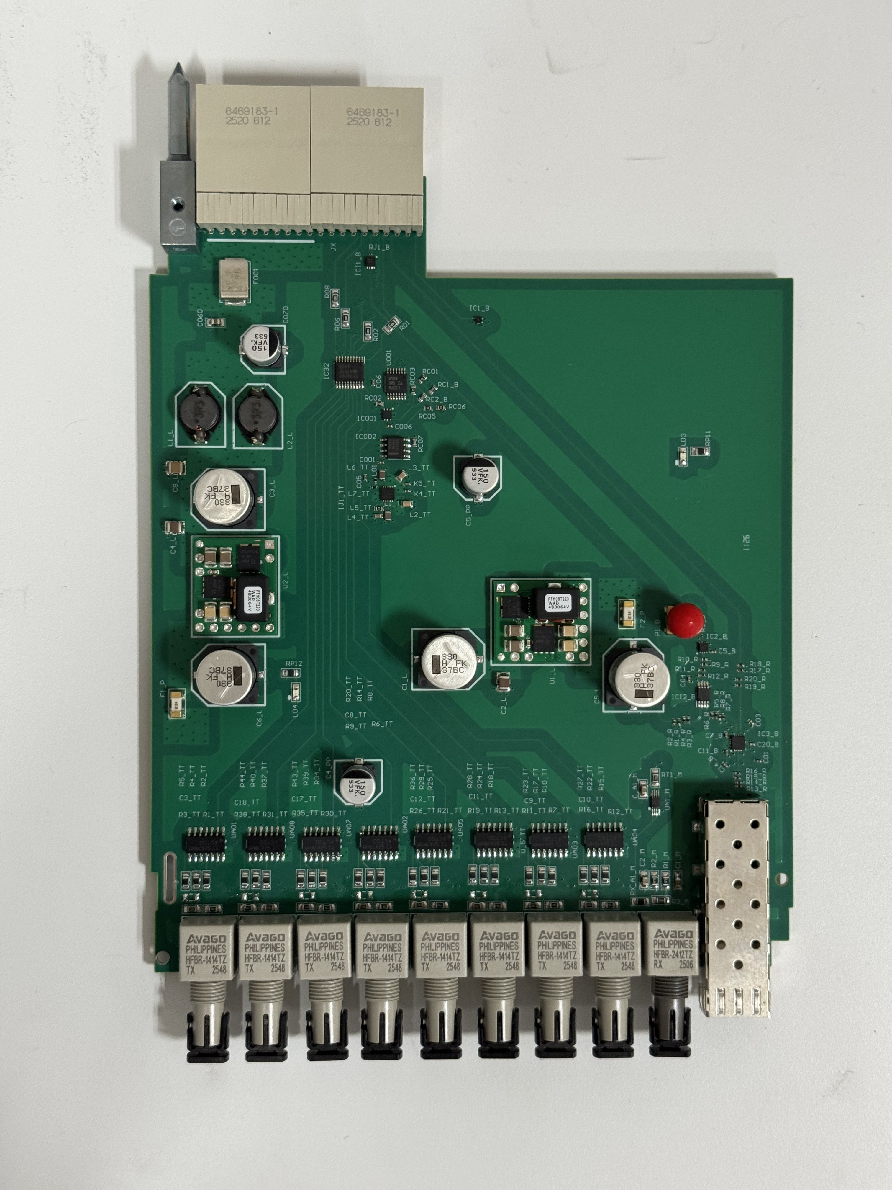
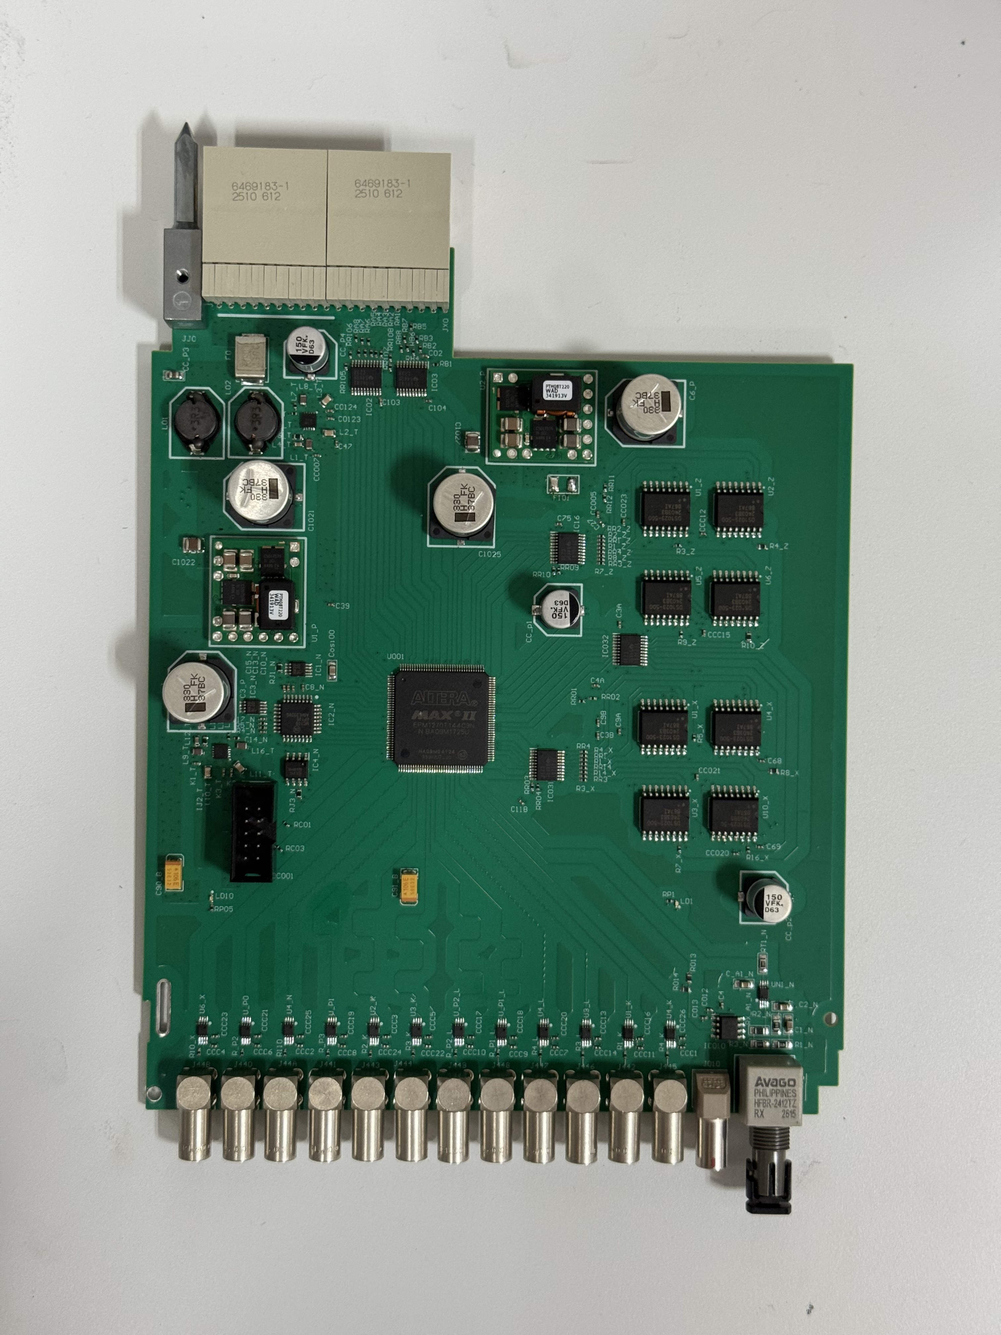
I/O Expansion via the Rear Transition Module (RTM)
• Same AMC, rear backplane connector accepts either RTM variant to scale I/O without redesigning the core board:
• Optical RTM -> 8 optical outputs + 1 optical input
• Electrical RTM -> 12 electrical outputs + 1 electrical input
• Lets one embedded EVR platform serve both fiber-based and coax-based downstream devices
Optical RTM: 8 TX + 1 RX (fiber)
Electrical RTM: 12 out + 1 in (RX fiber)

Slide 8
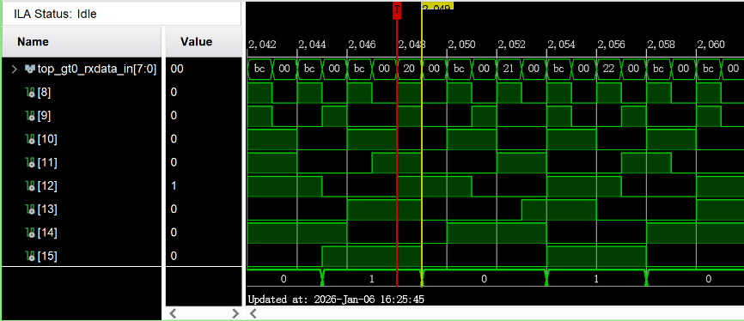
Event Decoding and Trigger Generation Logic
• GTX CDR + byte/word alignment + 8B/10B decode -> recovered event clock & event code
• Event FIFO buffers decoded codes; Mapping RAM converts event code -> channel; Programmable Pulse block generates delay/width-configurable outputs
• FPS Map: dynamic mapping between Distributed Bus (DBus) and pulse channels
• “Reset-relock” phase strategy: repeatedly reset the CDR until the recovered clock locks to the target phase relative to the EVG event clock -> deterministic multi-node sync
On-chip logic analyzer capture of the decoded event-code stream

Slide 9
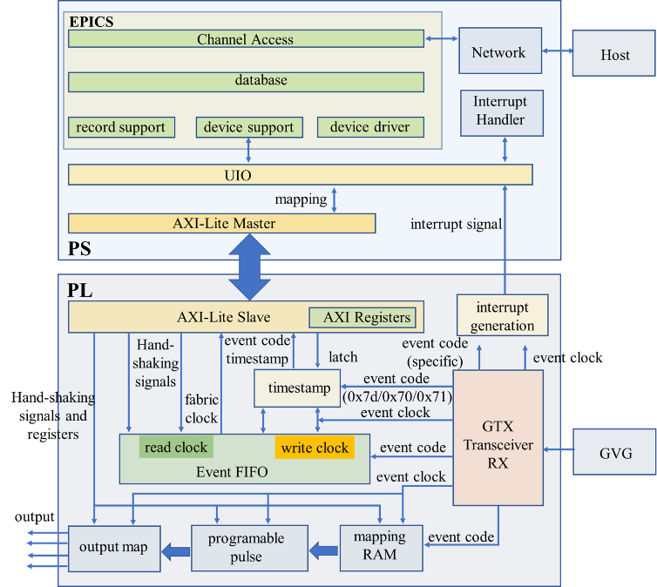
Three-Layer EPICS Software Architecture
Embedded Linux (PetaLinux) on the Zynq PS; UIO maps AXI-Lite registers into user space
Hardware Abstraction Layer
register_read/write, dma_transfer_start - hides UIO/DMA details
Record Adapter Layer
binds EPICS records (ai/ao/waveform) to the HAL API
Application Interface Layer
waveform loading, parameter validation, data read-back
-> a fully standardized, on-board IOC (EPICS Channel Access) in a single MicroTCA.4 slot

Slide 10
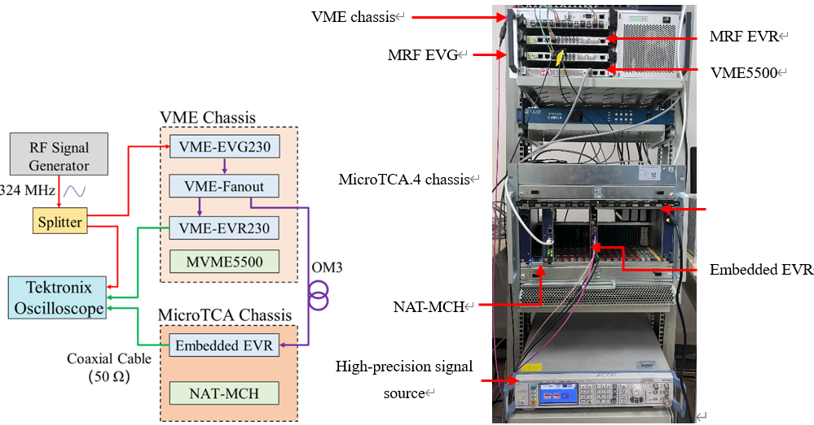
Jitter Test Against the RF Reference
A 324 MHz RF source is split to (1) an oscilloscope reference channel and (2) the VME event-generation chain; the embedded EVR recovers the event clock / trigger pulse from the same optical event stream, so the measured jitter excludes any commercial-EVR intermediate stage.

Slide 11
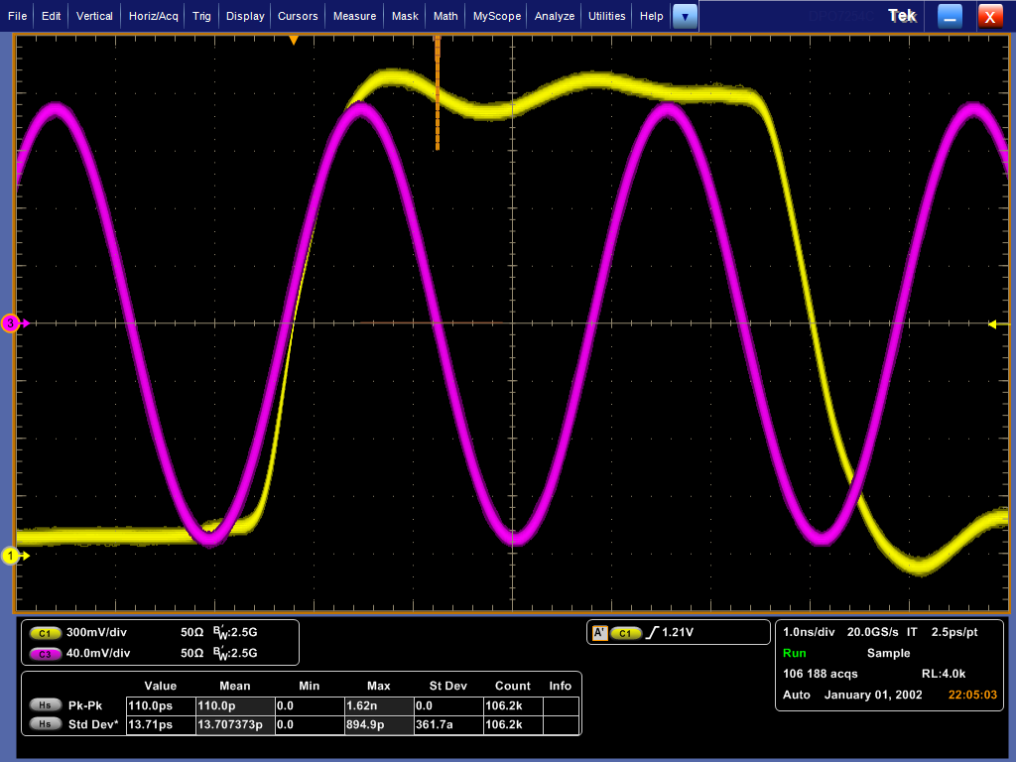
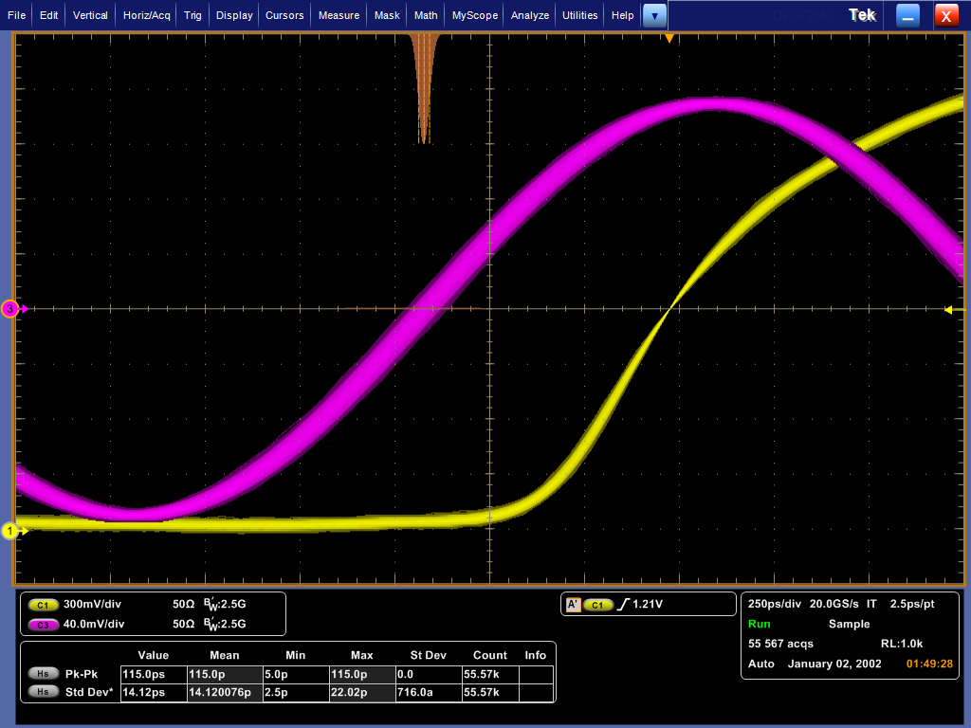
Synchronization Jitter vs. RF Reference
(a) Event clock vs. RF reference - RMS = 13.7 ps
(b) Trigger pulse edge vs. RF reference - RMS = 14.1 ps
RMS synchronization jitter of both the output event clock and pulse signals, relative to the RF reference, is less than 15 ps

Slide 12
Comparison with Commercial Timing Systems
Key metric | MRF timing system | SINAP timing system | Embedded EVR
System architecture | Separate (needs external controller) | Separate (needs external controller) | Highly integrated, single board (SoC runs standalone)
Control method | Remote bus access (PCIe / VME) | Remote bus access (PCIe / VME) | On-board IOC (Linux + EPICS)
Output jitter (RMS) | ~ 10 ps | ~ 8 ps | ~ 14 ps
Serial line rate | 2.5 Gbps | 2.5 Gbps | Up to 9.72 Gbps
Comparable (or better) synchronization precision, without a dedicated CPU controller or remote-bus dependency, at a higher serial line rate.

Slide 13
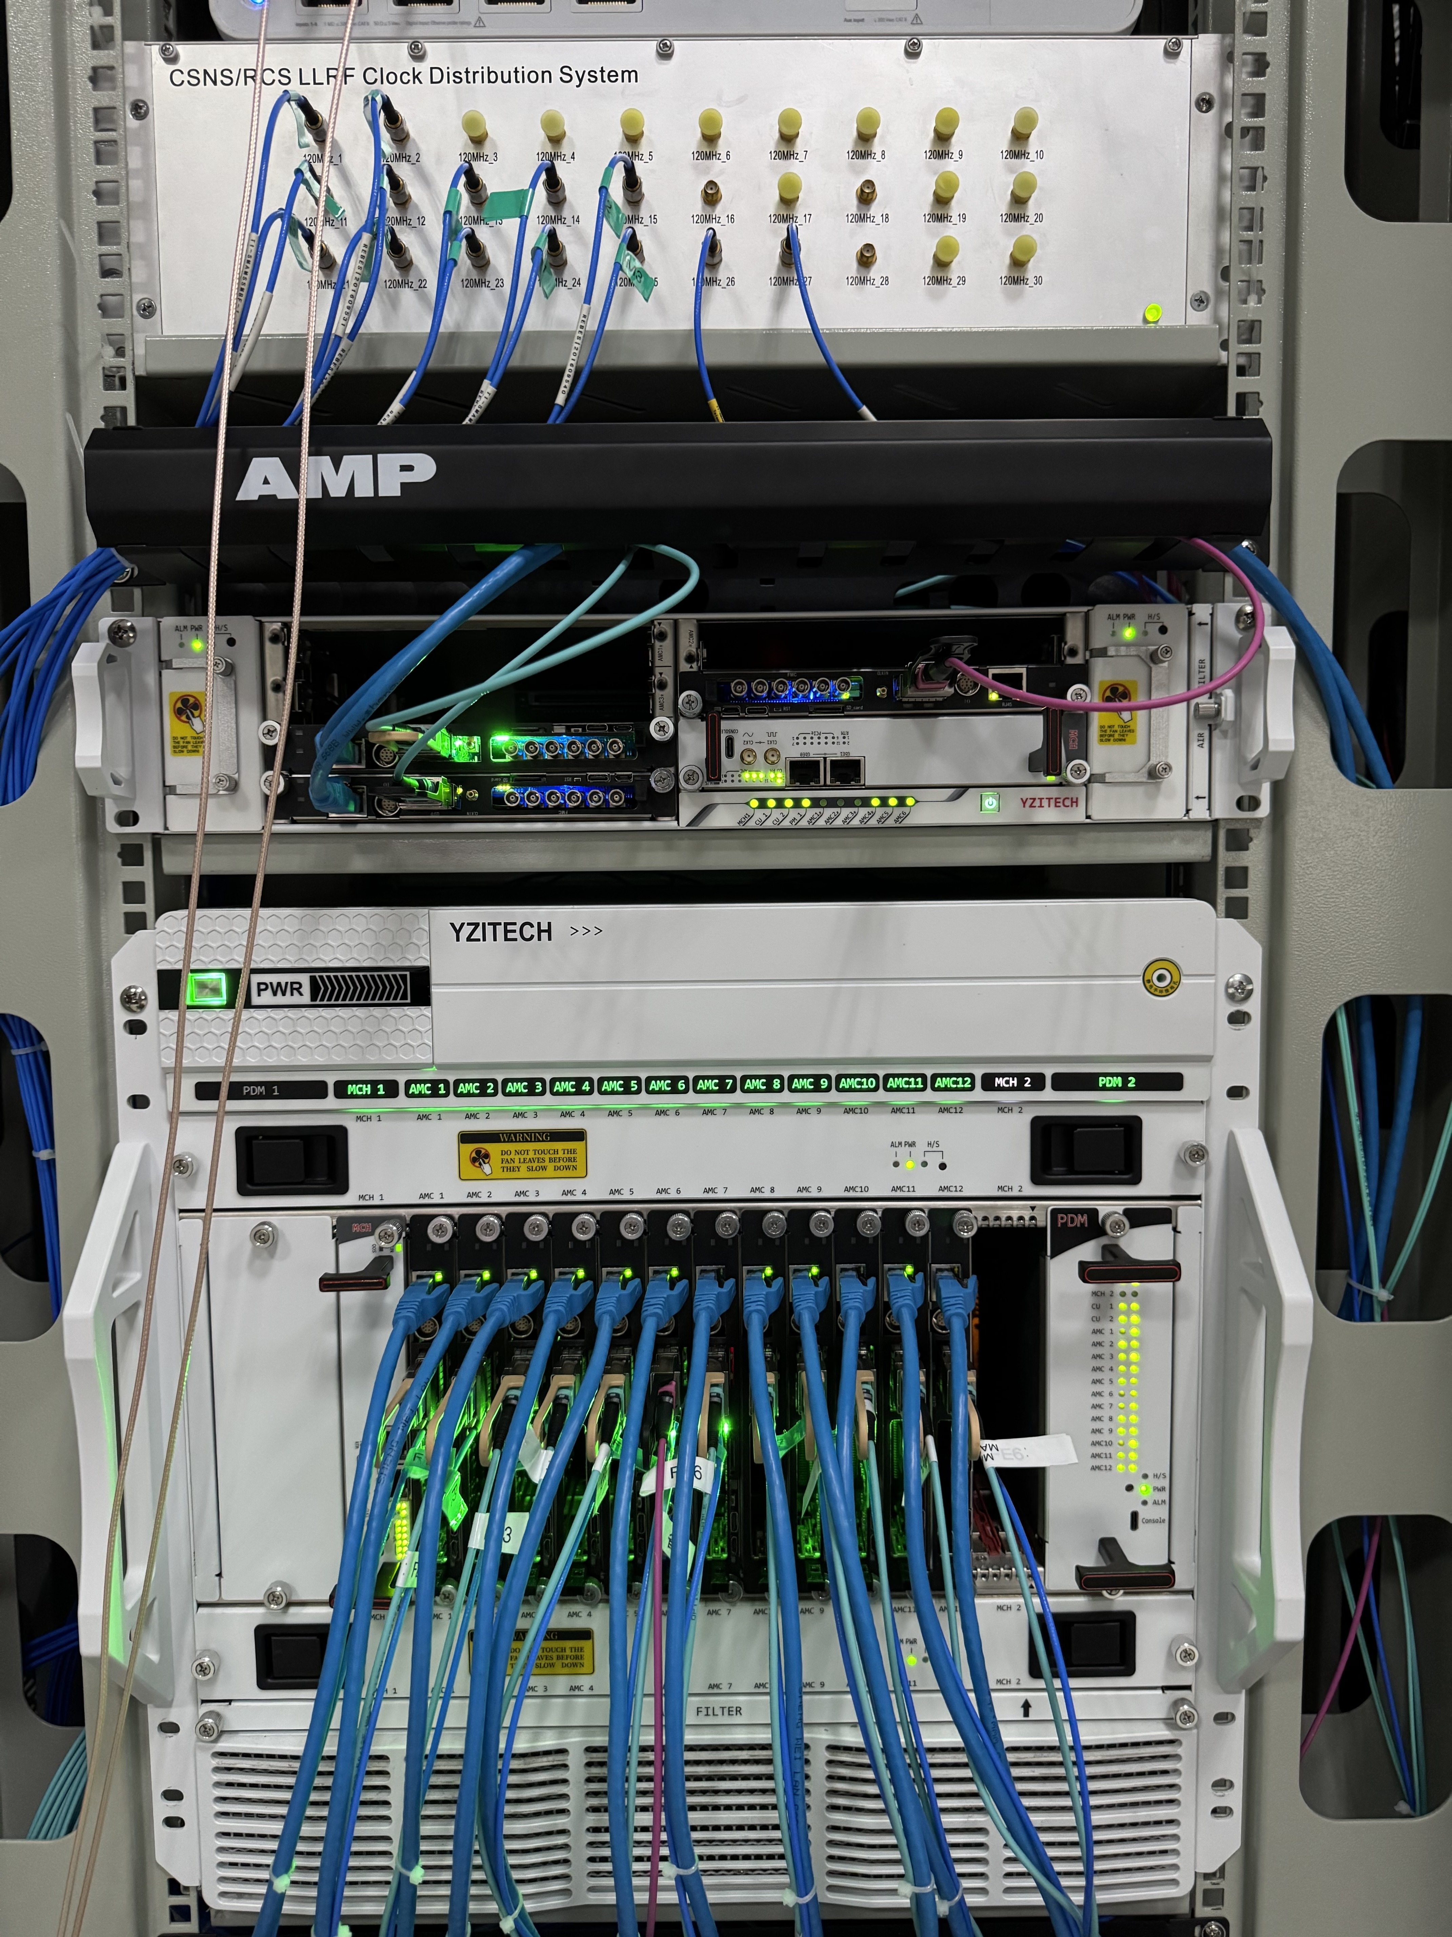
CSNS-II RCS LLRF Timing Substation
• Deployed during the 2025 summer maintenance of CSNS-II: the Timing AMC chassis is co-located, in the same equipment rack, with the RCS ring-RF (LLRF) 12-slot MicroTCA.4 chassis
• Timing-to-LLRF signal interconnect (m-LVDS interface): pk-pk jitter only 270 ps
• Field-measured output after fiber transmission to the device terminal:
• RMS jitter 118 ps, pk-pk jitter 970 ps (req. 1 ns RMS / 5 ns pk-pk)
• delay resolution: coarse 1 ns + fine 10 ps, two-stage tuning
• Continuous online operation for over six months with no functional or performance degradation
Timing AMC
Middle: Timing AMC; Bottom: RCS ring-RF (LLRF) MicroTCA.4 chassis (12 AMC slots)

Slide 14
Summary
• Designed and implemented a highly integrated embedded EVR on an indigenous MicroTCA.4 platform: Xilinx Zynq SoC decodes high-speed optical event frames and generates high-precision triggers without any external controller
• Built a tightly integrated embedded-Linux + EPICS software stack (hardware abstraction / record adapter / application interface layers) implementing a standardized on-board IOC
• Measured RMS synchronization jitter of the output event clock and pulse signals, relative to the RF reference, of less than 15 ps - on par with, or better than, existing commercial MRF / SINAP timing systems
• Deployed in the CSNS-II RCS LLRF timing substation with over six months of continuous, fault-free online operation, fully meeting CSNS-II's timing and synchronization requirements

Slide 15
Thanks for your attention!

