Slide 1

Welcome to IHEP
In a special day: the 40th anniversary of institution
A multidisciplinary center of fundamental research in China: particle physics, astro-particle physics, photon and neutron science, nano science,……
State Key Laboratory of Particle Detection and Electronics
Groups of detector, electronics, trigger and DAQ, slow control, super-conducting magnet, …
Experimental Physics Center (EPC)
Experiments on colliders: BEPCⅡ, LHC
Neutrino experiment: DYB
Dark matter experiments

Slide 2
Introduction of Activities on
Pixel Detectors at IHEP
Qun Ouyang （欧阳群）
OUTLINE
♦ Motivation
♦ Pixels research
♦ Summary

Slide 3
Motivation
Possible projects in the coming years
1. Pixel detectors for SR experiments
BSRF, SSRF, BAPS (planned)
2. ATLAS pixel upgrades for HL-LHC
Phase0: IBL project, 2013-14
Phase2: new pixel detector, ～2021
3. BESⅢ inner MDC upgrade
Feasibility study of Si pixels located in the innermost
layers
4. Experiments at future e⁺e⁻ collider
Factory of Higgs, Z, tau-charm
5. ……

Slide 4
Activities @ IHEP
One of the high priorities in the State Key Laboratory of Particle Detection and Electronics
• MAPS
• SOI pixel
• Hybrid pixel
for PP experiments
for SR experiments

Slide 5
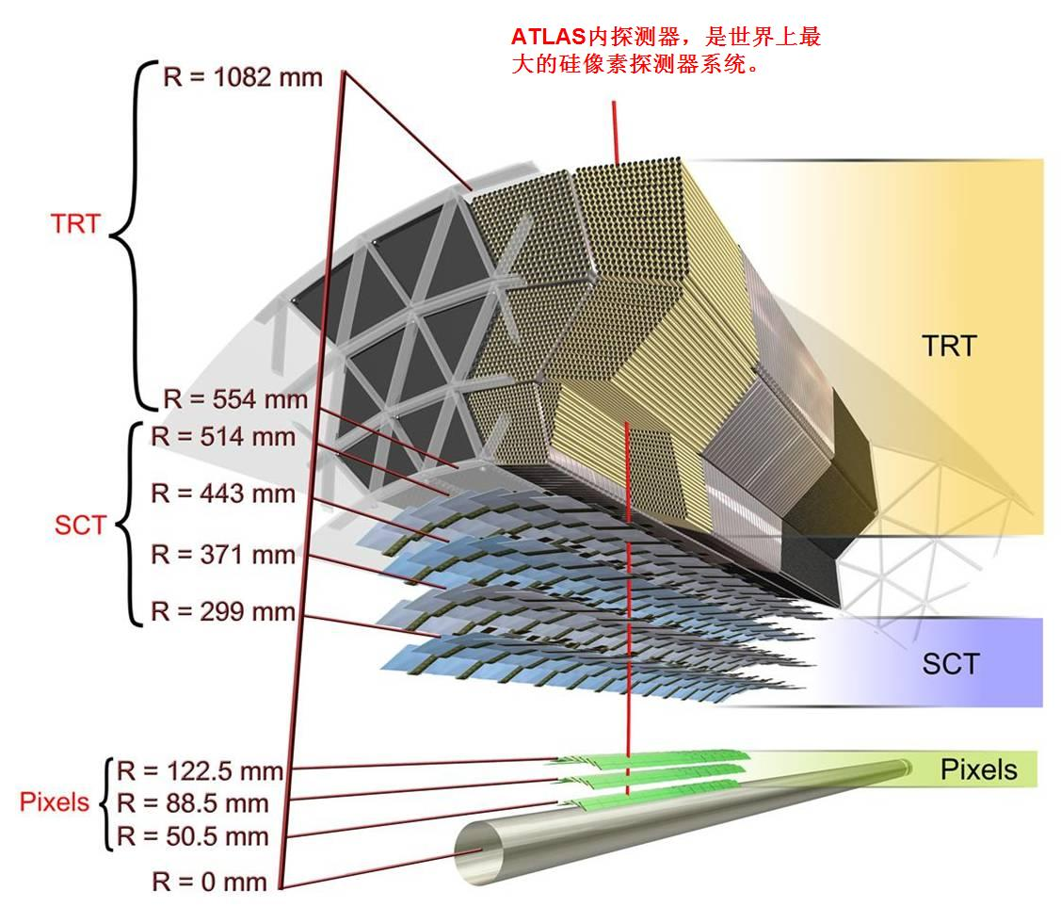
ATLAS pixel upgrade
♦Phase-0 : 2013 — 2014
IBL：Insertable B-Layer
Sensor: planner+3D
RO chip:FE-I4
50μm×250μm
♦ Phase-2 : 2021-22?
All new pixel system
Sensor: planar
3D
Diamonds
RO chip: 3D、65nm CMOS
50μm×125μm

Slide 6
IHEP group
for Phase0
Working on chip (FE-I4)/sensor tests collaboration with CPPM (France) and LBNL (US)
Participating in the installation/commissioning
for Phase2
ASIC chip design (led by Zheng Wang)
collaboration with CPPM: 3D process
LBNL: 65nm CMOS process
Further involvement under discussion, including
simulation, sensor/chip design and testing, …

Slide 7
Collaboration between IHEP and CPPM
IHEP is aiming to fully participate in the collaboration of ATLAS Silicon Pixel Detector Upgrade, especially on 3D approach
Building Blocks Design
  Full-scale in/out range monitoring buffer (by Luo Jiangping)
    Critical analog signal probe in measurement
  On-chip calibration pulse generator (by Wei Wei)
    Fast and uniform calibration pulse generation without external generator
  A updated pixel cell with low power dissipation (by Wei Wei)
    To make the most power consuming block discriminator sleep in idle state, while wakeup it when detector signal is coming
  A power-on-reset block (by Wang Na)
    To generate reset signals on both of the rising and falling edges of power supply during the power-on state
  Others …

Slide 8
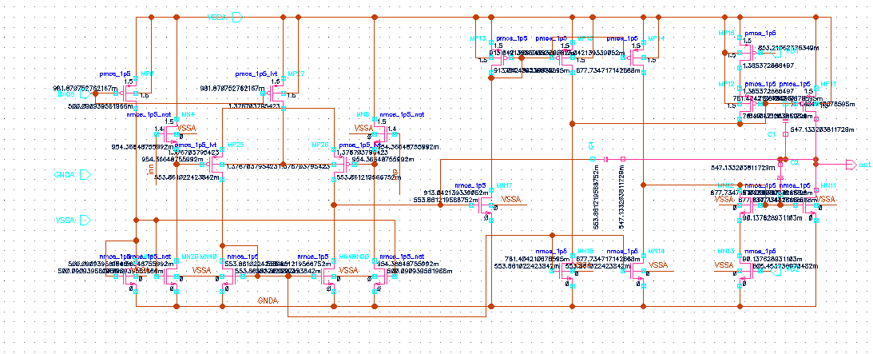
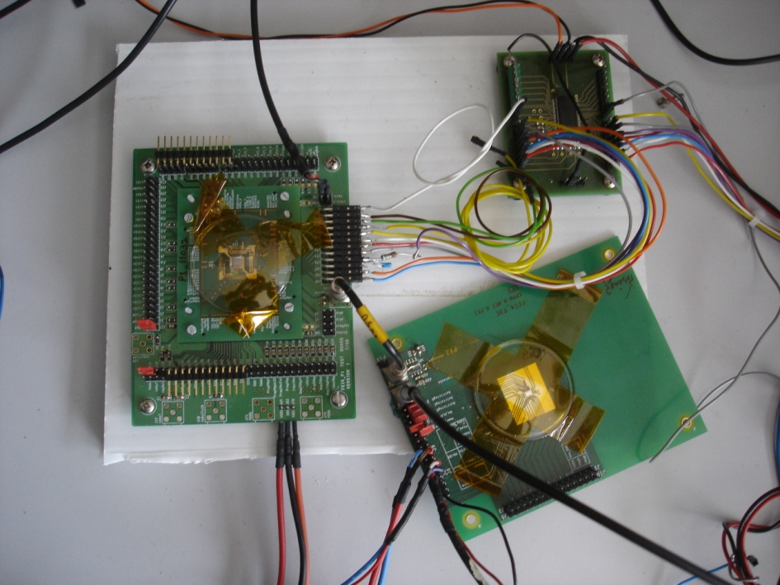
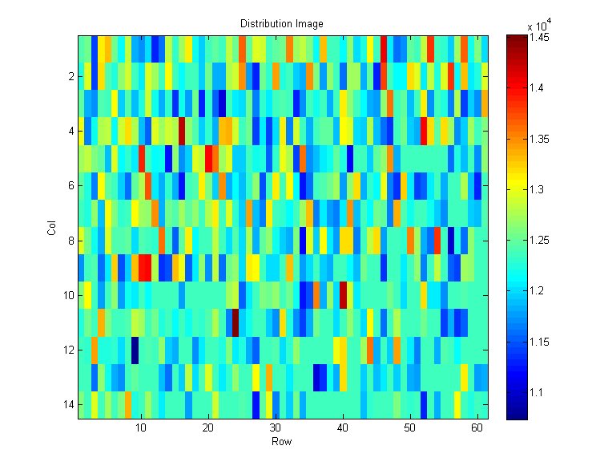
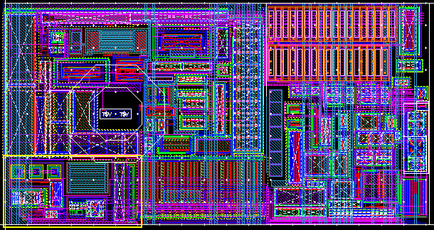
Building Block Designs
USB Interface
Full-scale in/out range buffer design
P1
14*61 pixels
P3C
Calibration pulse generator test setup
Threshold scan of Calibration pulse generator with P1 pixel ASIC
New pixel cell design with power down

Slide 9
Collaboration in ATLAS Pixel Upgrade
Full chip functional verification and power network layout evaluation (by Wei Wei, Luo Jiangping)
  To verify the functionality when the chip works in the real case like power supply setup, configuration loading phase
  To evaluate the power network layout and to minimize the IR-drop effect, so as to improve the chip uniformity
Layout and tapeout preparation (by Wei Wei)
  Process transform, layout modification, functionality updating, and full chip simulation for the new 3D tapeout run
Collaboration with LBNL (by Lu Weiguo)
  Discriminator design in future 65nm process

Slide 10
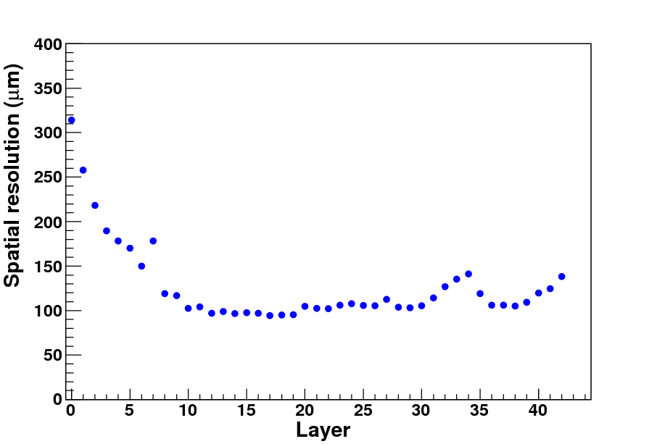
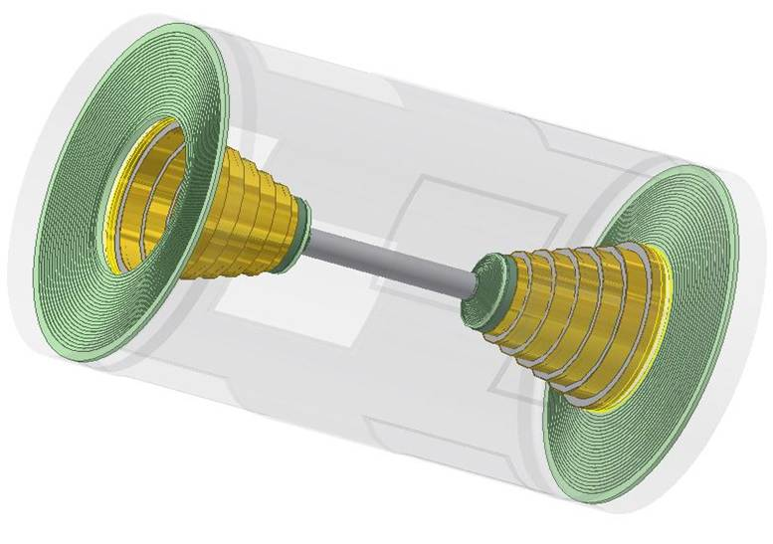
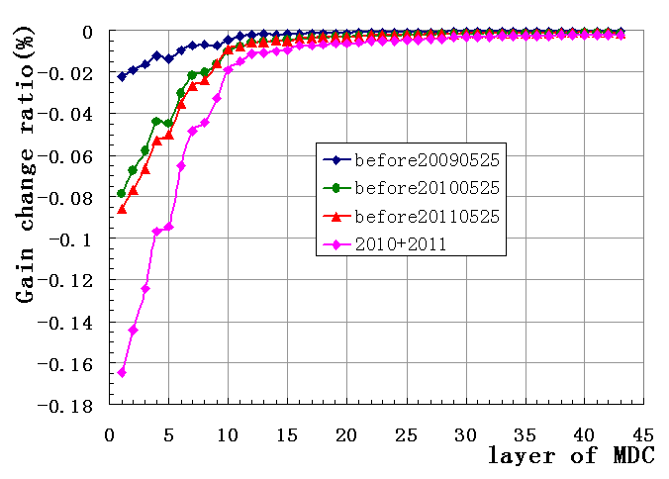
Inner tracker upgrade @ BESⅢ
high background encountered
Inner Chamber
For the first layer, the dark current can be up to 1µA/sense wire.
Reduce the working HV of the first 4 layers, the gas gain was decreased to 31% of normal one.
(1) Performance deteriorated
  σ_{xy} ~ 300µm (the worst case)
  ε_{cell} ~ 70% (the worst case)
(2) Aging effect 2009 — 2011
  maximum accumulated charge for single wire: 74mC/cm
  gain degraded of 1st 5 layers: 10% —15%

Slide 11
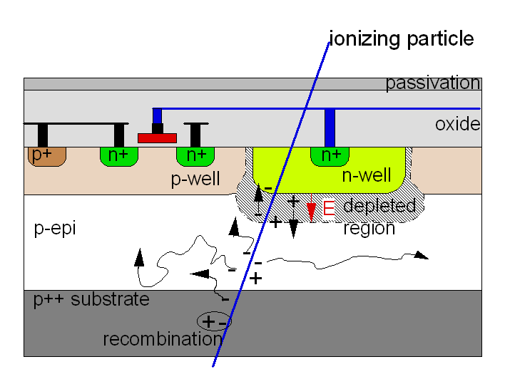
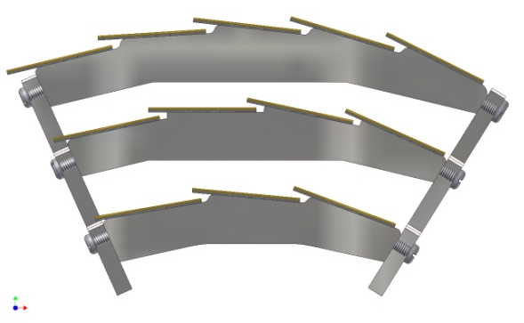
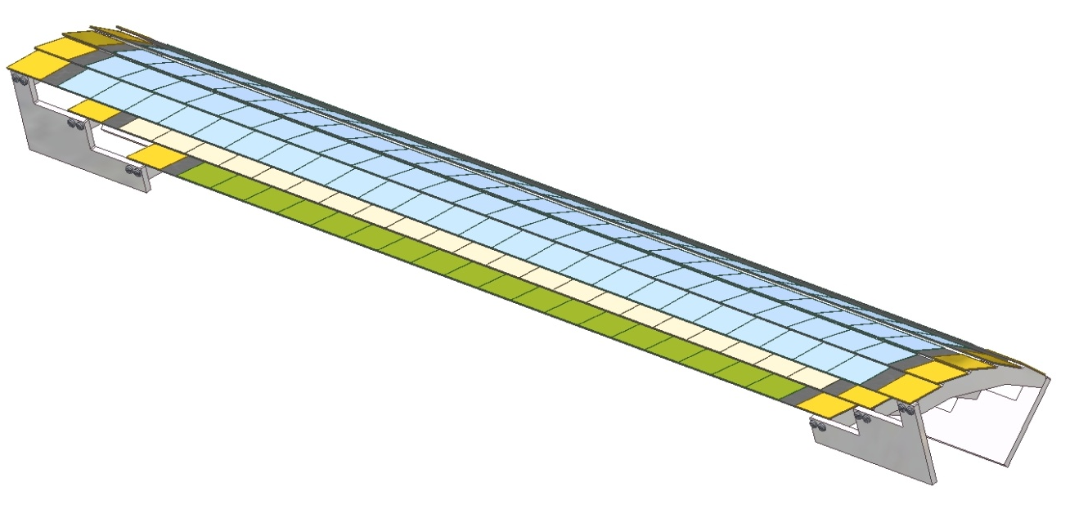
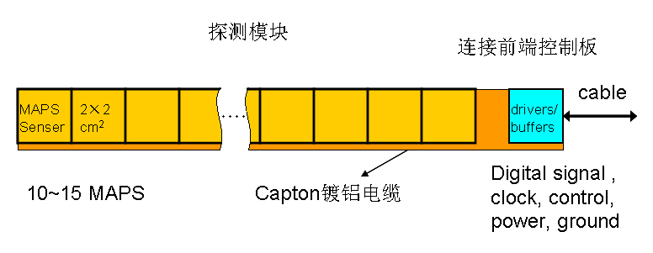
MAPS detector
R&D for BESⅢ inner MDC upgrade, IHEP+SDU
density: ~ 20 µm pixel pitch
~1M pixels/chip
resolution: σ< 10 µm
rating capability: ~ 10⁸Hz/cm²
material budget: ~ 50 µm thick;
radiation tolerance：100kRad /year
10¹³ n_{eq} /cm²
power consumption: ~170mW / cm²
room temperature operation
MAPS ( Monolithic Active Pixel Sensors)
Pixel sensor ladder
Prototype of 1/10 coverage

Slide 12
Collaboration with Strasbourg IPHC
Critical techniques:
  Sensor: pixel size, RO speed, power consumption,
  zero suppression…
  Ladder structure: light material, flex bonding…
  RO elx: 8GB band width, xTCA structure…
  Data transmission: radiation hardness…
  Alignment and reconstruction scheme: …
Almost a whole system of CMOS pixel sensor
The study will benefit not only the BESⅢ
but e⁺e⁻ collider experiments in the future

Slide 13
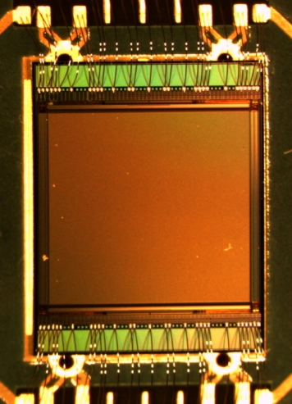
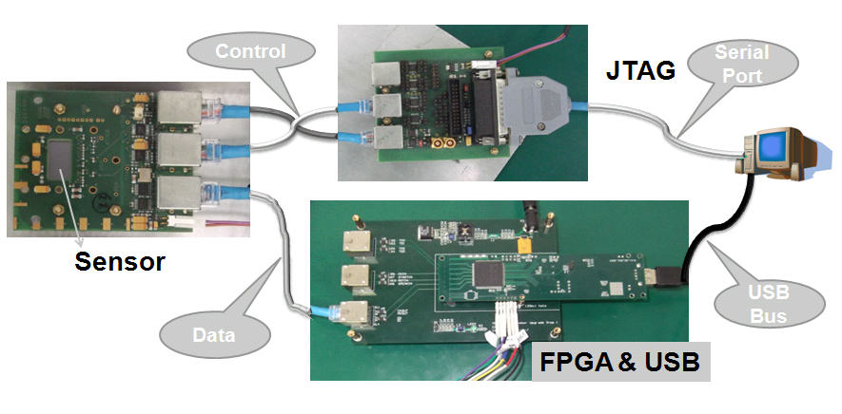
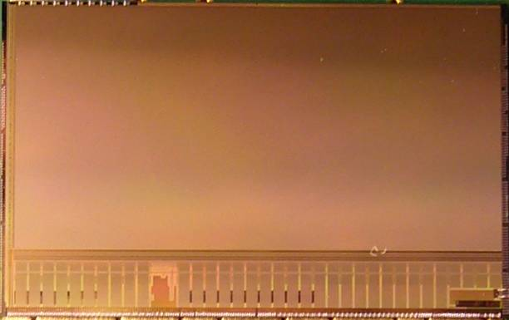
MAPS test
MIMOSA18 (5.5×5.5 mm² thinned to 50μm with analogue output)
Pixel pitch: 10µm×10µm
ENC ～ 13e
S/N ～ 17
Tested with ⁵⁵Fe
MIMOSA26 (with binary output)
MIMOSA26
Active area: ~10.6 x 21.2 mm2
13.7 mm
Temporal and fixed pattern noise
Transfer function of discriminator
Home-made RO board
21.5 mm

Slide 14
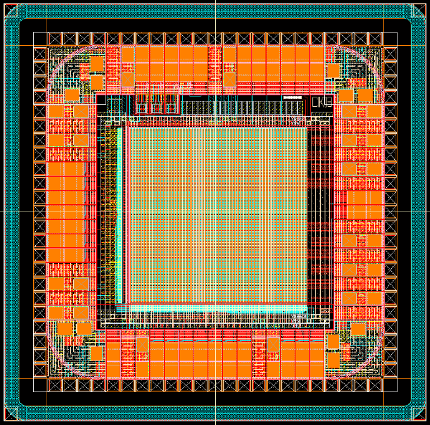
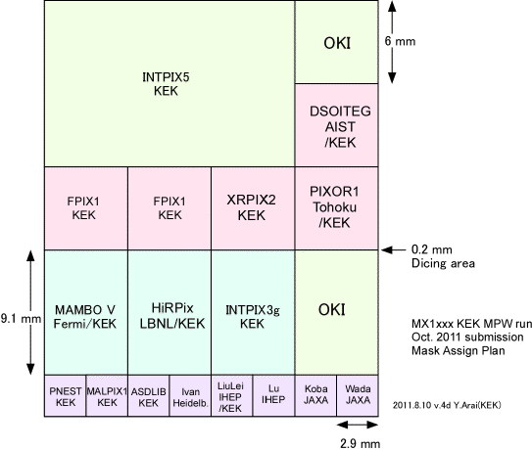
SOI pixel: Collaboration with KEK
Integrated type sensor designed by Yunpeng Lu and elx group
INTPIX2P5
  2.9*2.9mm²
  64*64 pixel array
  19*19μm² pixel size
INTPIX1P5
  2.9*2.9mm²
  32*32 pixel array
  18*18μm² pixel size
first fully functional pixel sensor @ IHEP with very good I-V performance
Layout
future development: counting-type pixels
See Yunpeng’s presentation
MPW in Oct. 2011
Notes:
14

Slide 15
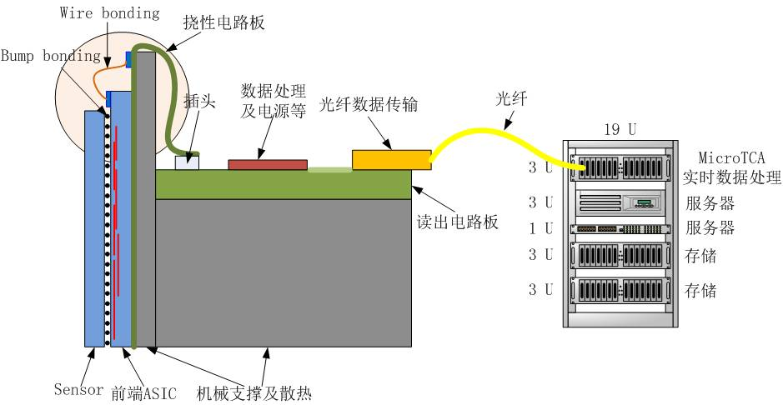
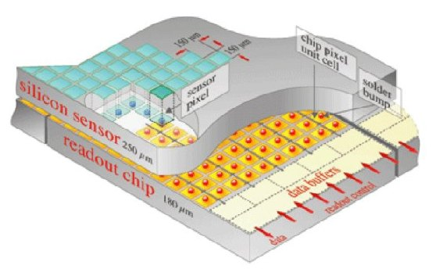
Hybrid pixel detector for SR
State of the art instrumentation for photon science
Counting type pixel 2012-2015
Active area: 80mmx80mm
Pixel size： 200μmx200μm (150μmx150μm) → 100μmx100μm
Frame rates: >100Hz → >1 KHz
Dynamic range: 20bits
Energy range: 10－20keV

Slide 16
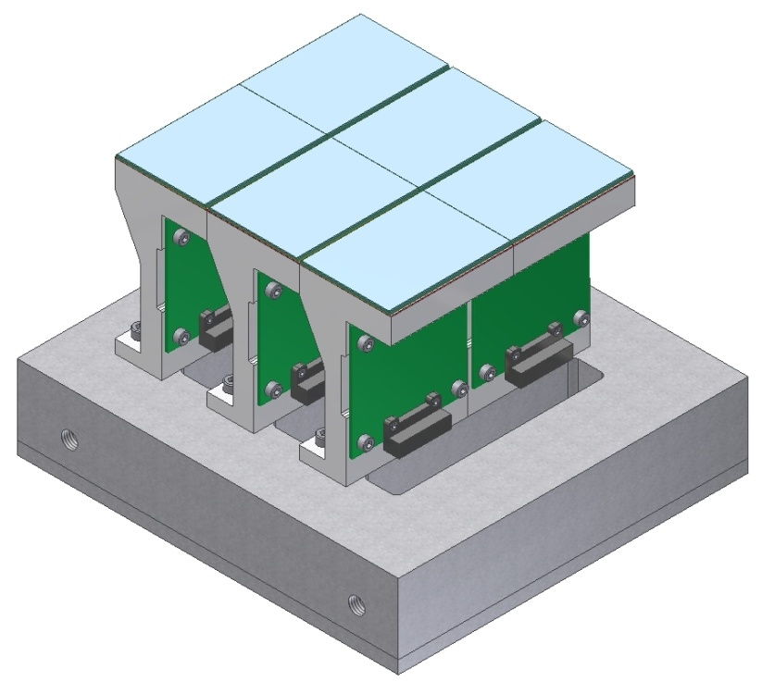
System
Detector module: 3.5cm×4.7cm
Number of modules: 3×2
Number of ASIC/module: 2×4
Pixels/ASIC: 104×72
Critical techniques: via collaboration (foreign/Chinese)
Sensor parameters/simu./process
ASIC chip full function/0.13μm CMOS process
sensor/chip connection Indium bump-bonding/TSV
Data transmission and storage
Cooling…

Slide 17
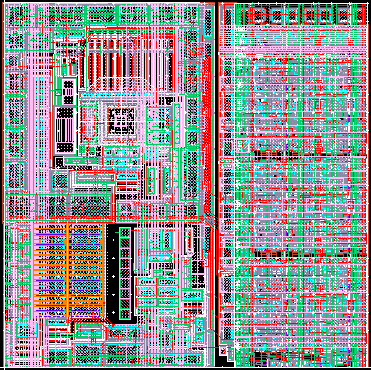
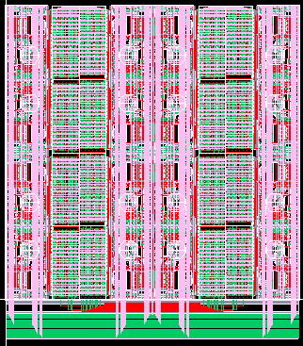
Current ASIC effort
ASIC design since 2012.5
  V01: a single pixel cell and other building blocks
  V02: a small pixel array of 4×4 cells
A pixel cell of 100μm×100μm
A pixel array of 4×4
Full ASIC design to be delivered in early of 2014

Slide 18
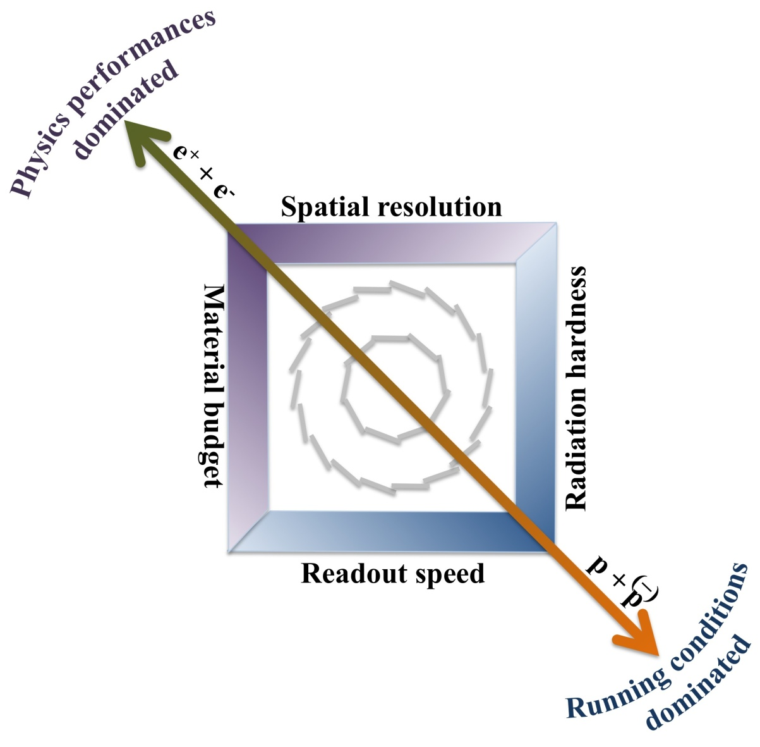
Roadmap for the next 10 years
(my personal point of view)
2012-2016
• SOI development for the counting type x-ray detector.
• MAPS prototype of BESIII inner tracker.
2016-
• Pixels development for the future e⁺e⁻ collider experiments.
• Possible SOI pixel used at light source.
From Christine Hu
Strasbourg IPHC
2012-2015
Pixel development plan for x-ray detector
2015-
• Pixel ready to be used at Light Source.
• a long term project with the Atlas pixel detector upgrade.
2022
Upgraded (phase-2) ATLAS pixel commissioning and operation.

Slide 19
Summary
• Have demands for Si pixel detector research:
SR detectors, ATLAS pixel upgrade, BESⅢ upgrade…
• Make some progress, still lack of expertise
• Hope to collaborate with other institutions, national and international
Thank you!

Slide 20
Back up
Backup Slides

Slide 21
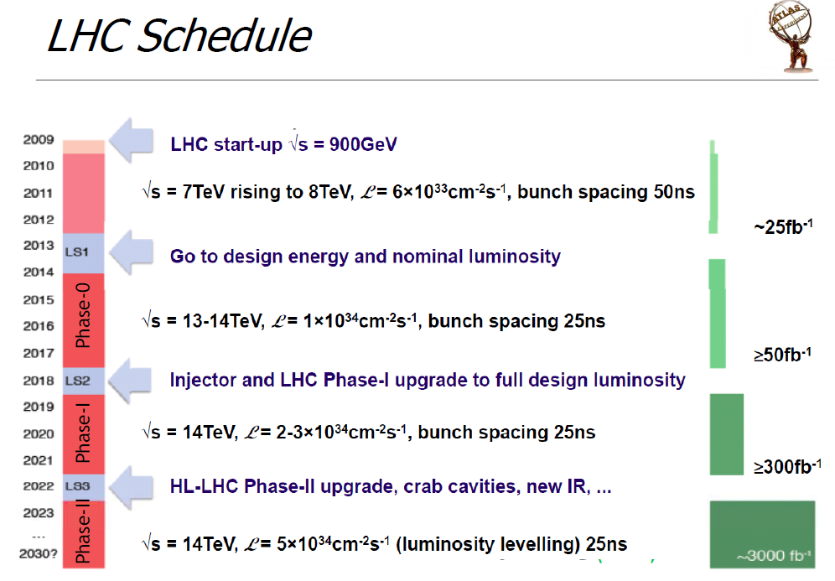

Slide 22
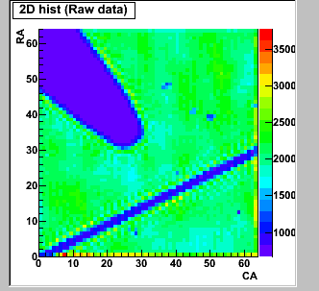
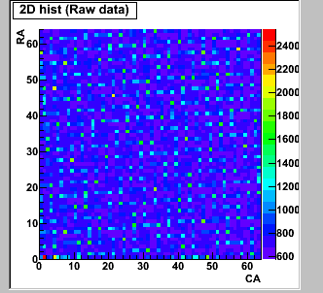
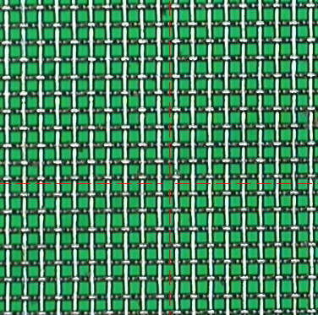
Preliminary test results
Imaging of wire (30μm in diameter) and pin tip under illumination of red laser
V-I curve (up: KEK sensor,
down: IHEP sensor)
Imaging of 400LPI mesh (64μm pitch)
22
Notes:
22

Slide 23
Further study on SOI
(1) Finish the test stand, and study the performance with X-ray and laser source (1064nm, 650nm).
(2) Have further understanding on simulation tool of sensor and circuits, as well as semiconductor physics.
(3) Develop the SR detectors
future development: counting-type pixels: techniques to be solved
Energy resolved pixels: ?
No definite answer, but ……

Slide 24
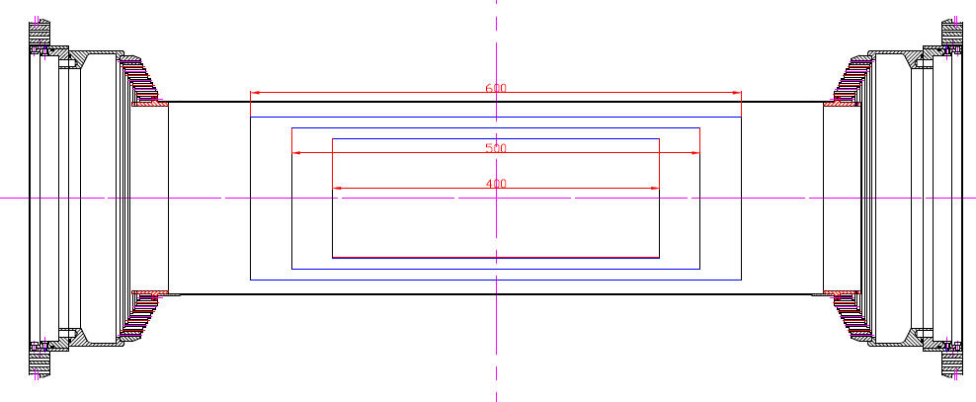
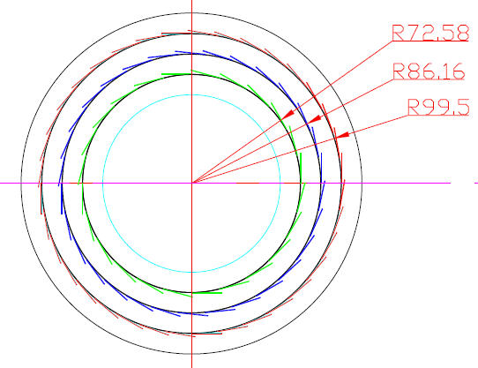
Inner MDC upgrade with MAPS
Baseline design:
3 layers of single sided
or 2 layers of double sided MAPS
Alternative design (?):
1 layer of double sided MAPS
Similar ladder structure as STAR’s

Slide 25
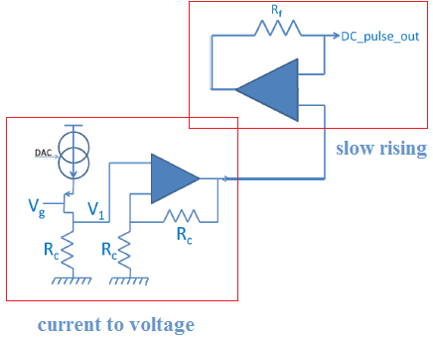
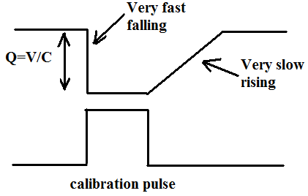

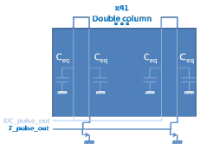
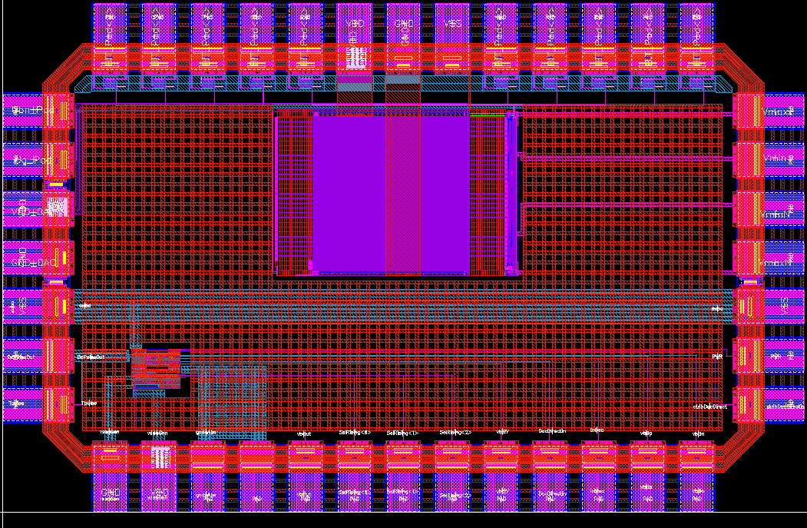
Building blocks design – Calibration block
Provide a very fast and precise calibration pulse to every pixel
Up to 30k pixels (FE-I4 case), parasitic capacitive load up to 40pF~80pF
Fast falling edge & very slow rising edge
Capable of pulse phase tuning and rising time tuning
Building blocks chip FEC4_P3C (with Bonn Univ.)
Submission: Nov. 10, test: March 11, by W.WEI
Specification:
  Dynamic range: 0 ~ 1.5V
  Load capacitance: 40pF ~ 80pF
  Falling time: < 2.5ns@ far end pixel
  Rising time: 20μs~500μs, 3bits tunable
  calibration linearity: 0.5%
10bit DAC
Bonn Univ.
Pulse generator
25

Slide 26
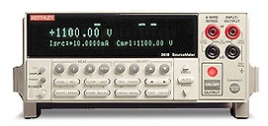
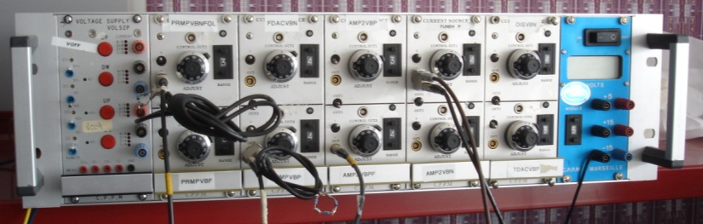

FEC4_P3C & FEC4_P1 combined system
Volt controlled by GPIB
Keithley 2410
V/I SourceMeter
CPPM current source module
USB Interface
Current Output
Controlled by Keithley
Calibration pulses output
P1
14*61 pixels
HP8110A Pattern generator
P3C
26

