Slide 1
Investigation Report on Reflective Films
Jian Wang，Zhonghua Qin，Haojie Dong

Slide 2
About the reflectors
Item | LHCb RICH1 （CFRP+Al+MgF₂） | LHCb RICH2 （Glass+Al+SiO₂/HfO₂） | AMS RICH （CFRP+Al+SiO₂） | ESR film
UV Reflectivity | Excellent（＞85%@200-600nm） | Excellent（＞80%@210-500nm） | > 85%@ λ = 420 nm | Poor（＜60%@＜400nm）
Large-Angle Reflection | High reflectivity at all angles | High reflectivity at all angles |  | Severe light leakage for angles ＞60°
Vacuum/Gas Compatibility | Compatible, no outgassing | Compatible, no outgassing | Compatible, no outgassing | Outgassing, swelling, failure
Surface Figure Precision | High rigidity, stable shape retention | High rigidity, stable shape retention | High rigidity, stable shape retention | Flexible film, deformation, defocusing
Radiation/Temperature Resistance | Excellent, long-term stability | Excellent, long-term stability | Excellent, long-term stability | poor, rapid aging

Slide 3
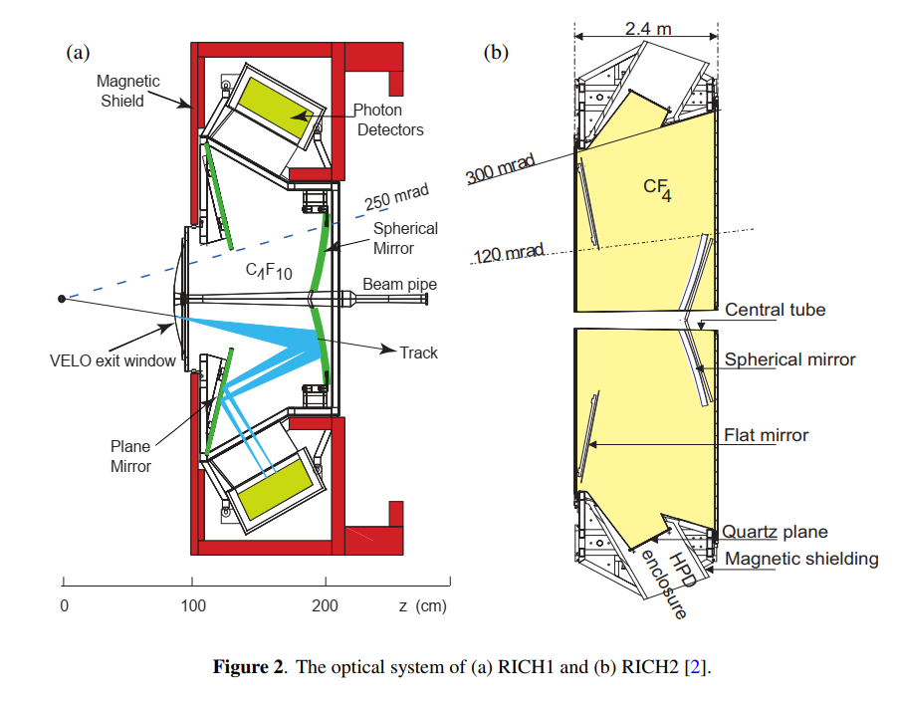
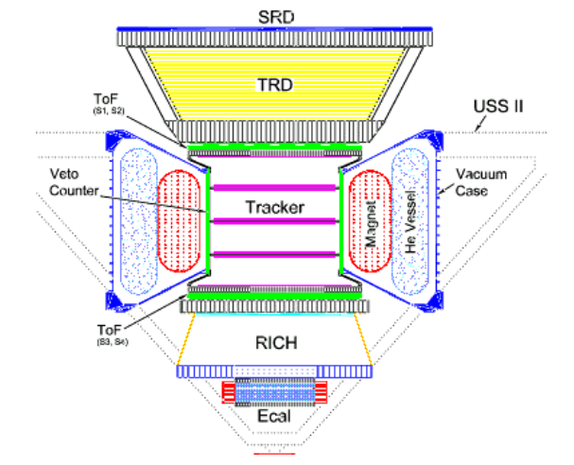
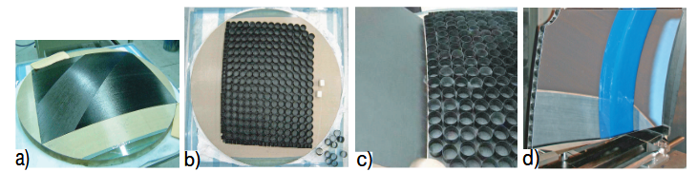
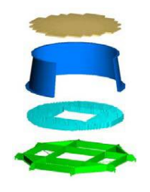
Schematic of the AMS-02 experiment. The RICH is shown in the central lower region of the experiment, with the conical portion being the RICH mirror.
Side view of the RICH 1 detector showing the plane and spherical mirror arrangement.
Fabrication process flow of the RICH1 detector mirrors: (a) laying of CFRP sheets onto the glass mandrel; (b) laying the core structure on top of the front skin; (c) laying the top skin onto the core structure; (d) the completed mirror (Mirror-3) with the reflective coating applied. The circular beampipe cut-out is visible in (c) and (d).
This is an exploded view of the mirror in the experiment

Slide 4
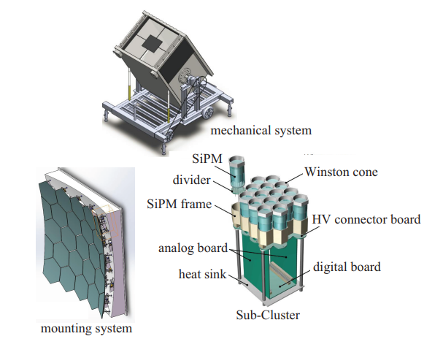
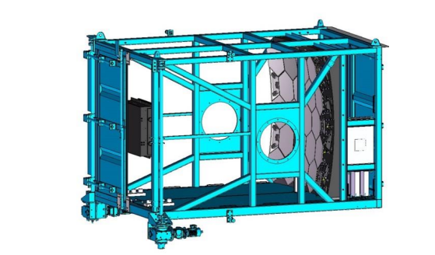
LHAASO-WFCTA Core Parameters of Reflector
Optical Performance | Environment & Process & Lifetime | Materials & Structure
Wavelength Range:300-550 nm, covering UV and visible light bands, suitable for cosmic ray photon detection requirements | Operating Environment:Deployed at an altitude of 4410 m, withstands extreme temperature differences from -35°C to 30°C, adapting to complex alpine climate conditions | Substrate Material:Selecting a highly stable glass substrate to ensure geometric precision and environmental adaptability, providing reliable support for coating deposition
Incident angle: The design range is 0° to 40°, with the working range mainly confined to ≤30°. Incidence beyond this limit is rejected; any such signal that does get through would contribute as noise | Coating Process:Adopts high-vacuum electron beam evaporation technology. Coating deposition is completed after precise cleaning and baking pretreatment to ensure adhesion | Coating Scheme:Al (100-200 nm) film + SiO₂ (≈100 nm) protective layer, balancing high reflectivity and oxidation resistance
Reflectivity:≥85% in 300-550 nm band | Lifetime Design:Full life cycle ≥5 years, during which the total reflectivity attenuation is strictly controlled to ≤10%, ensuring long-term observation stability | Array Mosaic:Single piece is a ⌀800 mm hexagon, 25 pieces are mosaicked into a whole, forming an array with an effective light-collecting area of about 5 m²
Schematic diagram of probe installation position of Cherenkov telescope
Schematic view of WFCTA

Slide 5
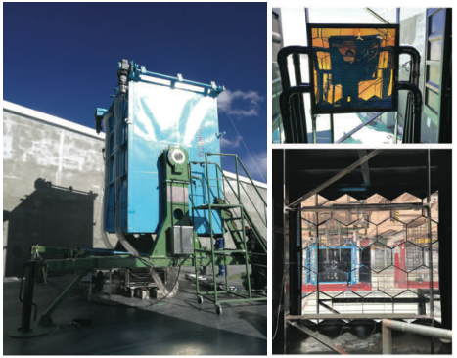
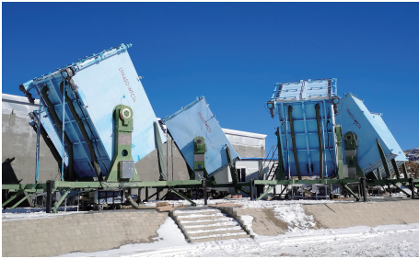
On-site Photographs of LHAASO-WFCTA
Left panel: A photo of the telescope
Right top panel: Photos of the SiPM camera Right bottom panel: mirror
The photo of six telescopes of WFCTA

Slide 6
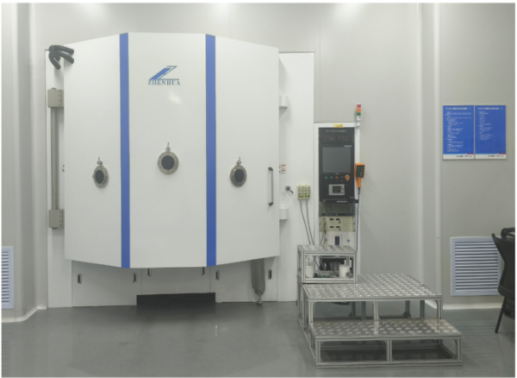
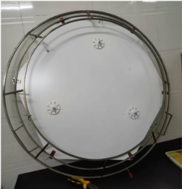
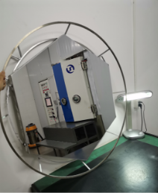
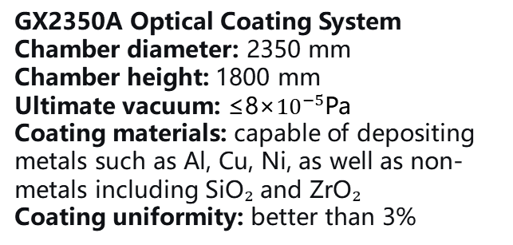
Photos of equipment from LHAASO's coating vendor
GX2350A Optical Coating System
Chamber diameter: 2350 mm
Chamber height: 1800 mm
Ultimate vacuum: ≤8×${10}^{−5}$Pa
Coating materials: capable of depositing metals such as Al, Cu, Ni, as well as non-metals including SiO₂ and ZrO₂
Coating uniformity: better than 3%
Mirror coating mounting jig
After mirror coating
About 2.5 hours per batch, with each batch producing 4 LACT lenses

Slide 7
CEPC Cherenkov Detector – Preliminary Design Parameters
Optical Performance
Environment & Processing
Material Selection
Wavelength range: covering 200–700 nm?
Operating environment: air or nitrogen atmosphere, with radiation resistance required
Substrate material: carbon fiber or other high-reflectivity composite materials?
Reflection angle: Cherenkov angle controlled within 8–30°, corresponding reflection angle calculated as 55–90°
Coating process: film purity, density, roughness, and dimensional tolerances (higher is better)
Coating material: Al + MgF₂ /SiO₂ or other coating materials?
Reflectivity target: >95% in key wavelength bands?
Service life: design life time ≥10 years?

Slide 8
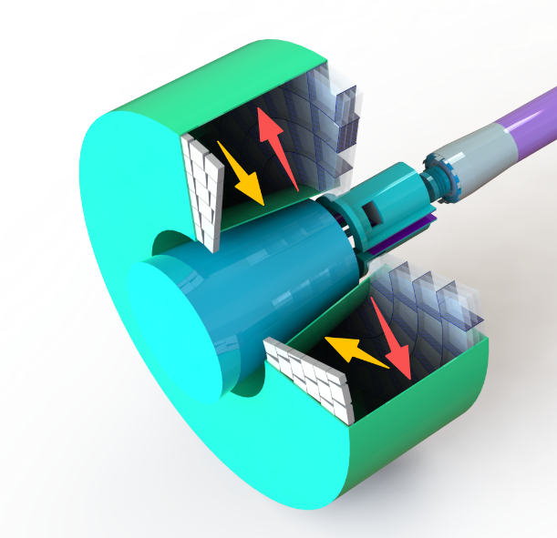
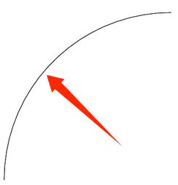
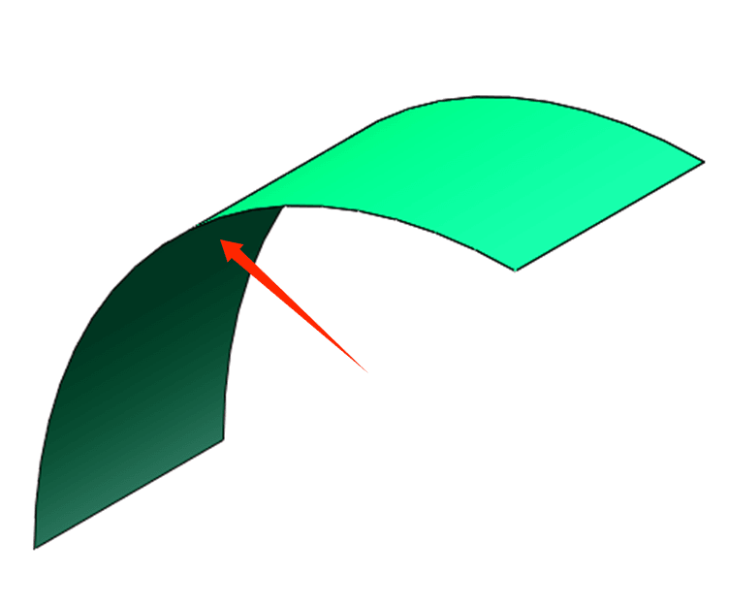
Discussion of barrel inner-wall coating techniques
Surface 2
Surface 1
The yellow arrow in the figure points to the outer side of the inner cylinder wall—Surface 1, and the red arrow points to the inner side of the outer cylinder wall—Surface 2.
According to the existing process ，in the absence of end-face closure, Surface 1 can be directly coated because it is the outer side of a conical surface, whereas Surface 2 is the inner side of the cylinder wall and cannot be directly coated. Moreover, after carbon fiber is formed, it is brittle, and the coated film is also brittle, so it is not feasible to coat a flat cylinder wall and then roll it into a cylindrical shape.
My idea is to divide the outer cylinder wall into four equal arc segments, apply the coating to them, and finally assemble them into the outer cylinder wall through design structural splicing.
This is just my initial thought, and I am not sure about its effectiveness. I would also welcome everyone's suggestions and ideas on whether there are any better methods.
Schematic diagram of the CEPC Cherenkov detector
Surface 2
Surface 2
Schematic diagram of a quarter arc

Slide 9
THANK YOU

