Slide 1
Timing Detectors
I. Laktineh

Slide 2
Outline
Where timing detectors are needed?
What kind of detectors are they?
  Gaseous detectors
  Photodetectors
  Solid state detectors
  Quantum sensors
Conclusion

Slide 3
Disclaimer
It is not possible to mention all detectors which time information is exploited. The list is long
I will limit the list to those with sub-100 ps performances
Even with this, I may miss a few ad I apologize for those working on the forgotten detectors

Slide 4
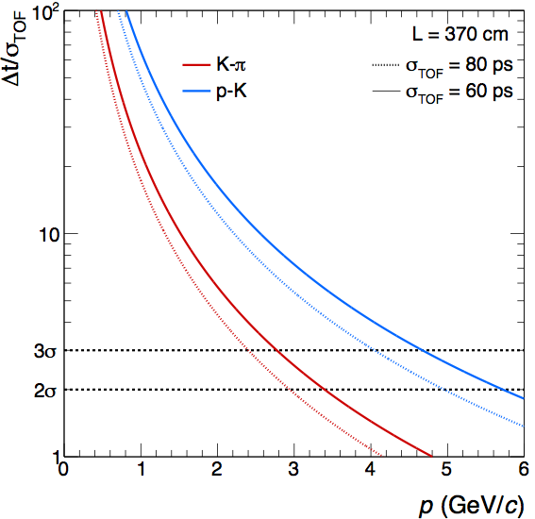
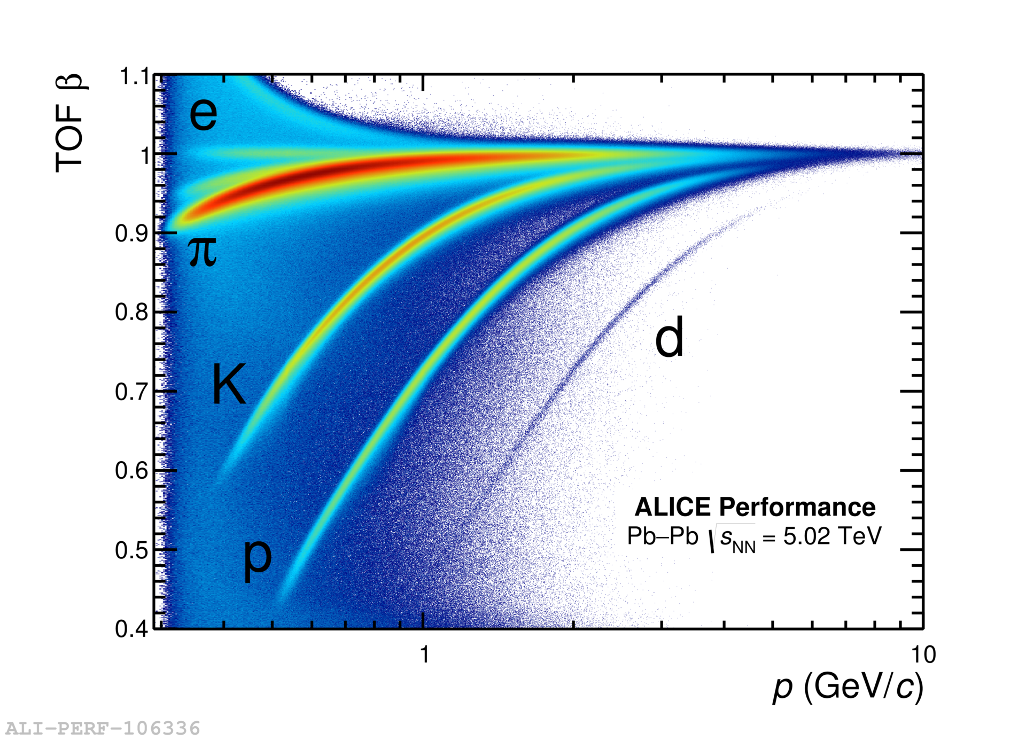
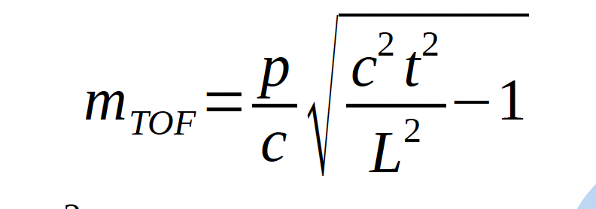
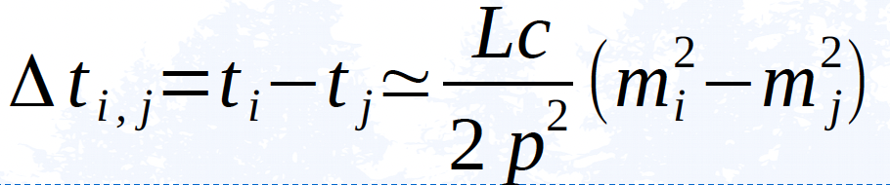
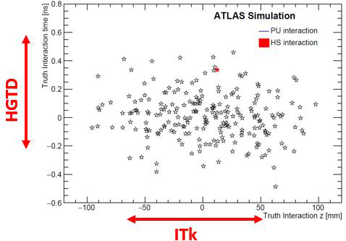
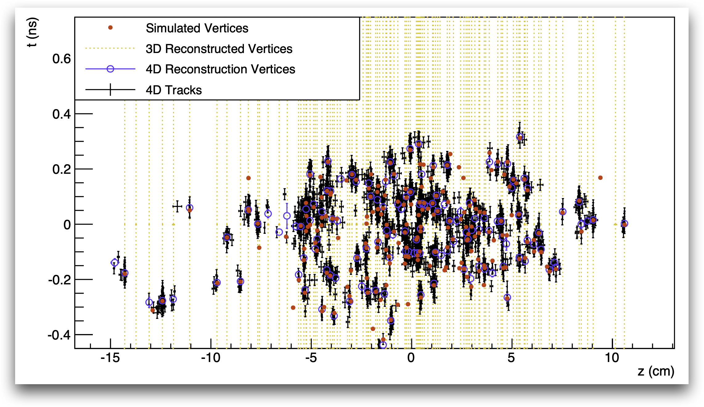
Why timing is useful and where
Particle identification:
Time-of-Flight : Two particles with different masses could be separated using their momentum and their time of arrival. This technique is however limited to a momentum range between a few and ten GeV
Pile up noise reduction: Vertex detectors can efficiently separate tracks and therefore their vertices in the transversal plan but not very efficient on the longitudinal one (Z axis).
Timing can add information on the Z position to reduce the contribution of the pileup events.
Reminder: 30 ps resolution is equivalent to 1 cm dispersion
CMS

Slide 5
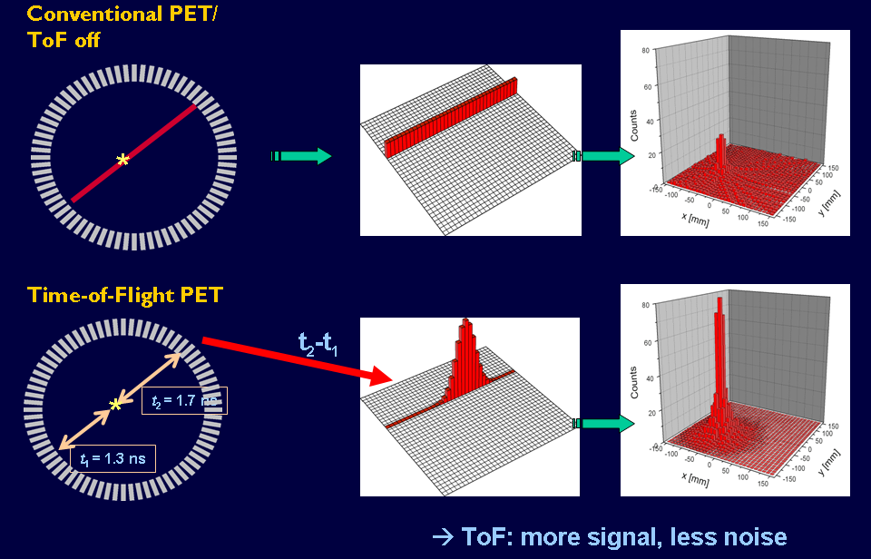
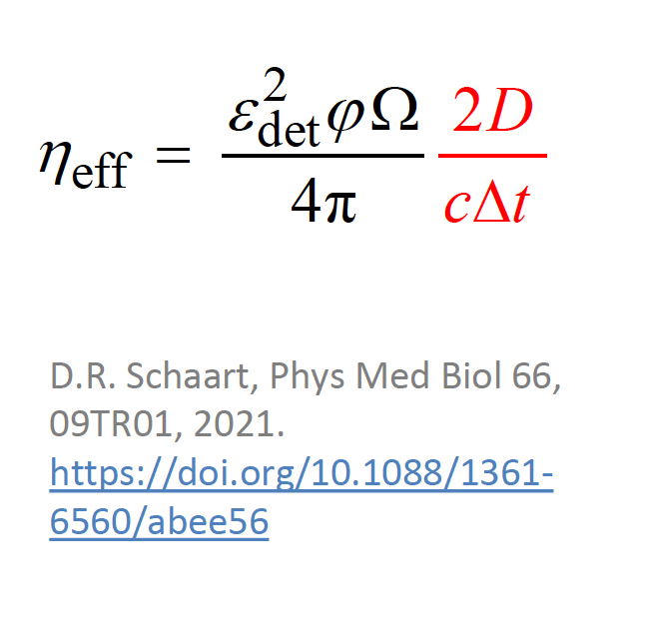
Why timing is useful and where
PET-SCAN : improving the gamma time resolution allows a substantial improvement in image construction, the time exposure and dose injection.

Slide 6
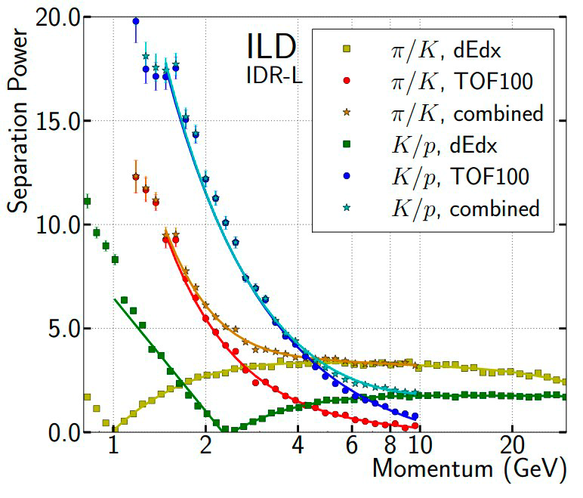
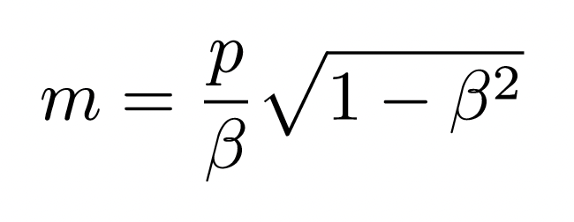
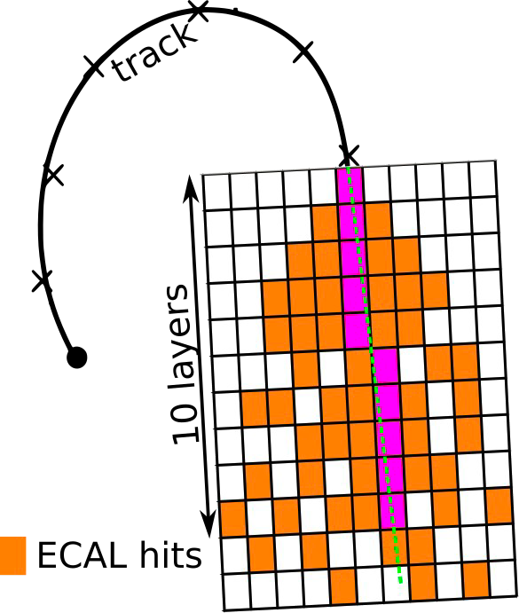
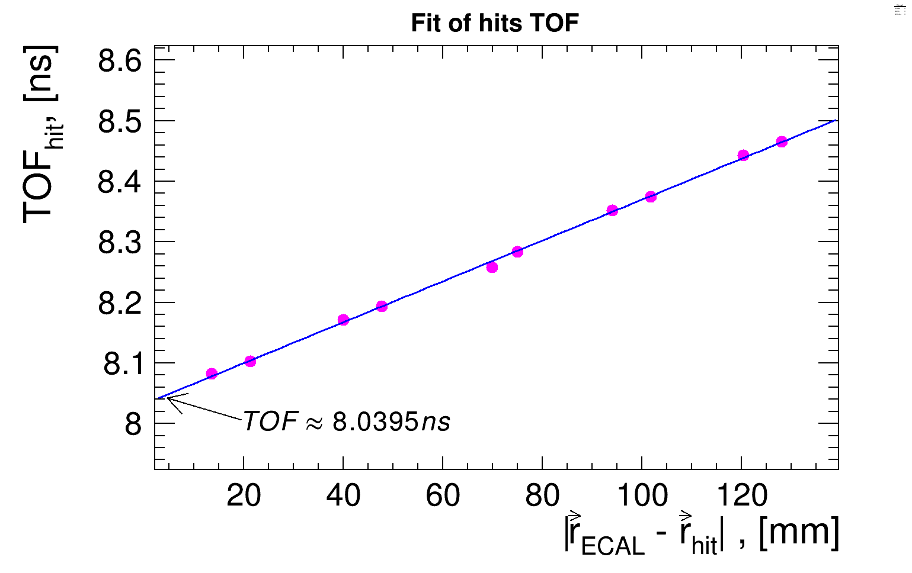
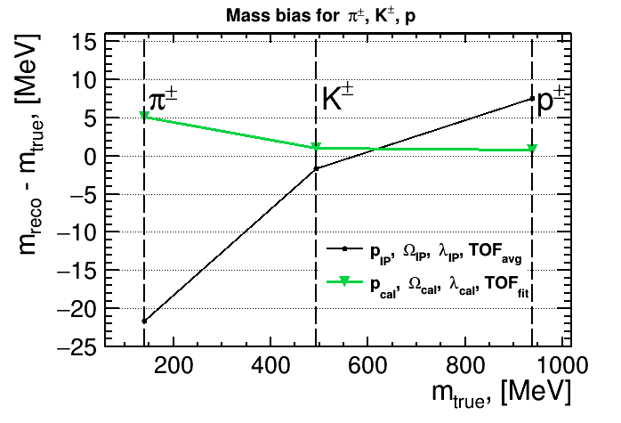
Why timing is useful and where
Particle Identification in calorimeters
In case of charged particles :
P is taken from the tracker at the ECAL entrance and β from ToF
To estimate the ToF in a granular calorimeter like the future ILD ECAL in the
case of charged particles several methods can be used:
Using time of the closest hit to the track
Using time of the fastest hit
Using the average time of hits along the track extrapolation in a few layers in case of longitudinally segmented ECAL (ToF_{Avg})
Using the time information of the hits of the first layers to determine the time at entrance of the ECAL (ToF_{Fit})
B. Dudard et al

Slide 7
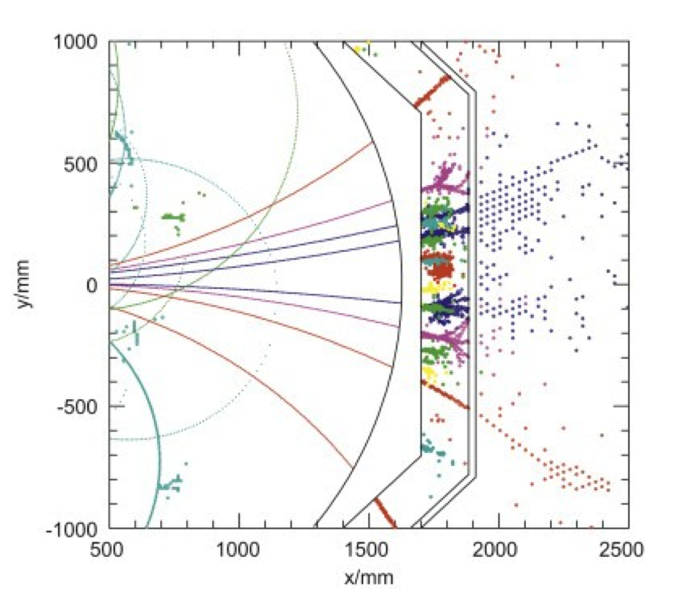
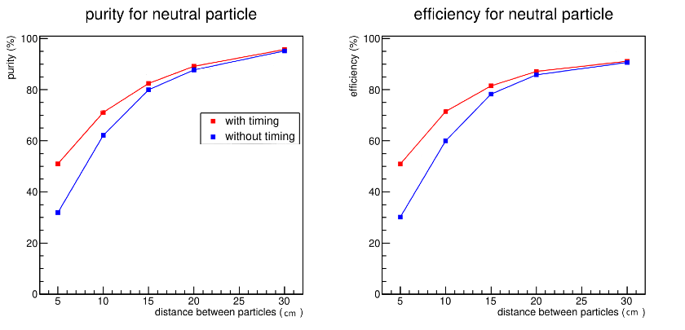
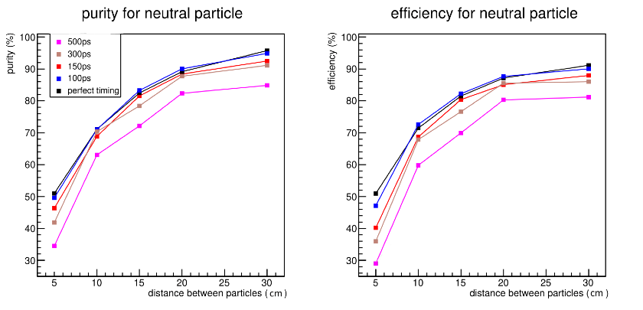
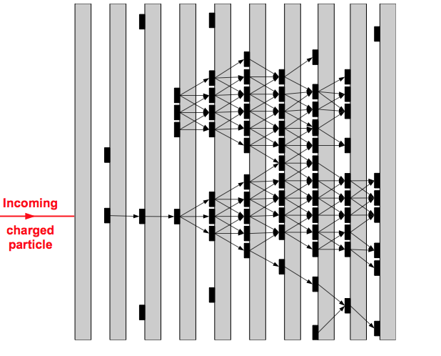
Why timing is useful and where
Time information improves significantly close-by hadronic showers separation for better PFA application
( 10 GeV neutral particle from 30 GeV charged particle) using techniques similar to ARBOR’s ones.
Master work of C Devanne

Slide 8
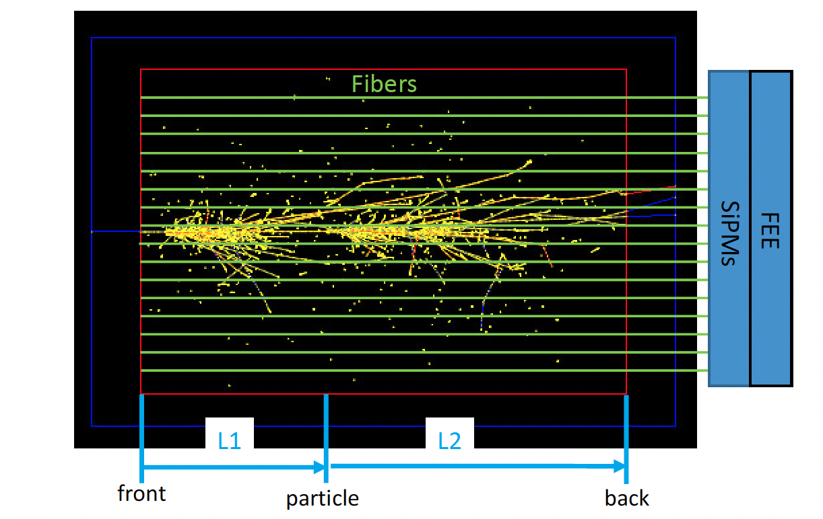
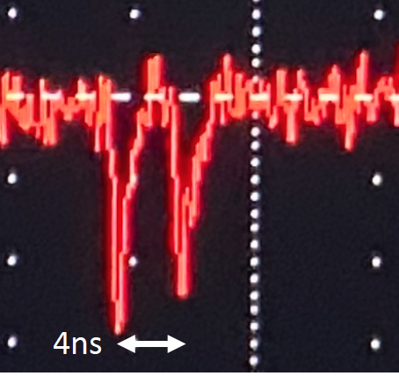
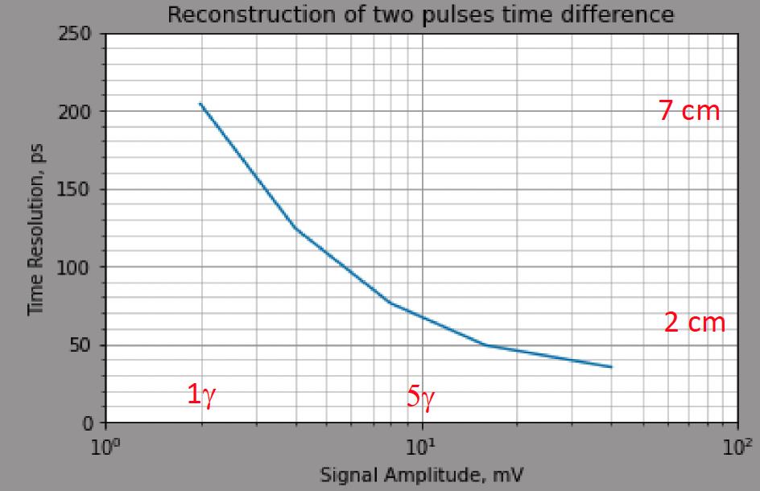
Why timing is useful and where
Longitudinal Granularity
With good time resolution, longitudinal segmentation could be replaced by the signal arrival time measurement and then, Neural Network techniques can be used to extract position information based on the signal shape collected by the fibers and read out by Photodetectors+Fast timing electronics.
Signal Time = L1/c + L2/kc,
c = velocity of particle
kc = velocity of light in fiber (k~0.6)
Courtesy S. Kunori

Slide 9
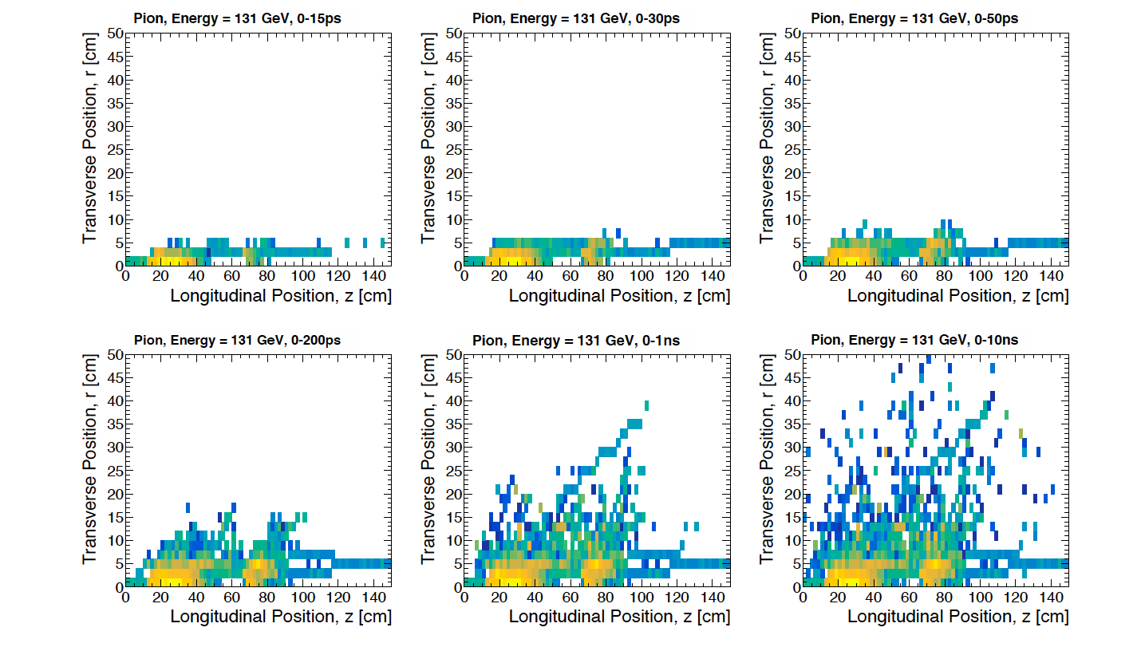
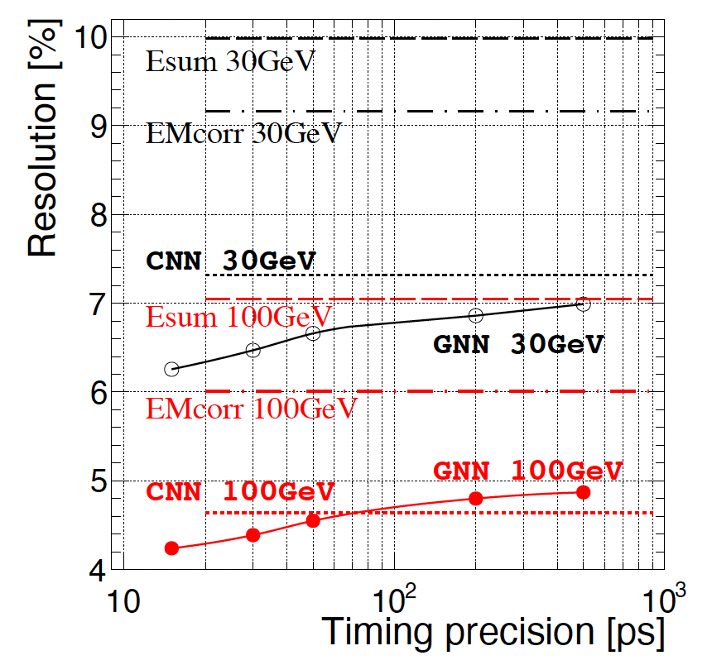
Why timing is useful and where
Energy Measurement
Simulation of electrons and hadrons in 3D calorimeter made of Uranium as absorber and 3 mm Silicon as active medium.
Using GNN with time information improves energy reconstruction
Esum: standardd
EMcorr
DR-based
CNN
uses the shape in addition
GNN
uses shape and timing
arXiv:2107.10207v3

Slide 10
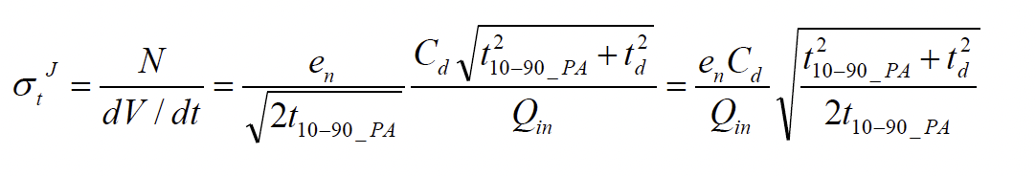
Before to speak about detectors…..
Your timing detector needs to have
Large charge
Small capacitance
Short rising time
Or a good combination of these three…

Slide 11
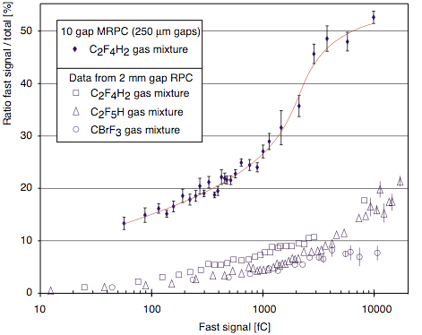
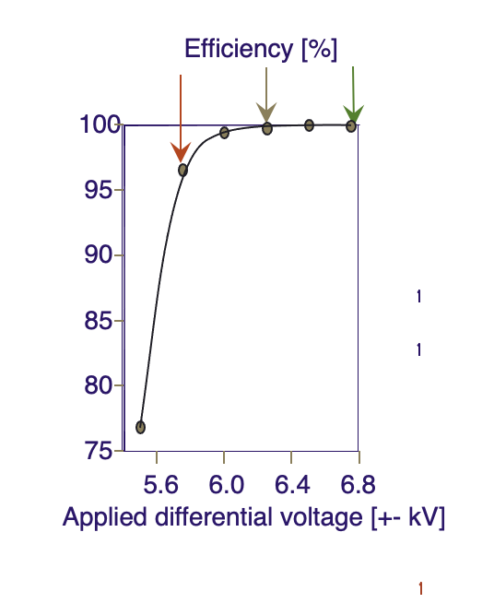
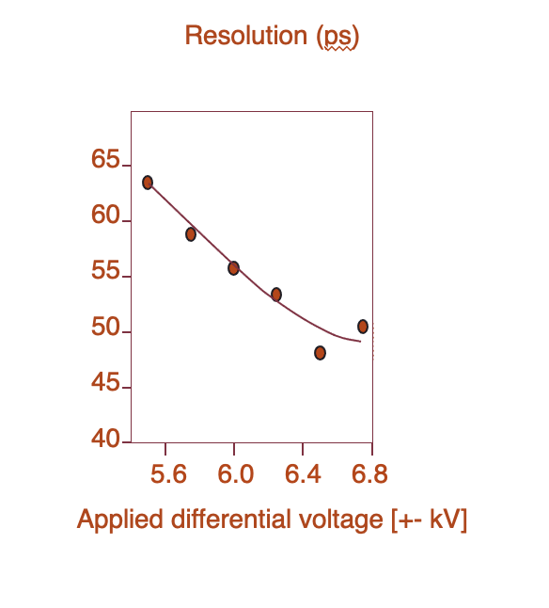
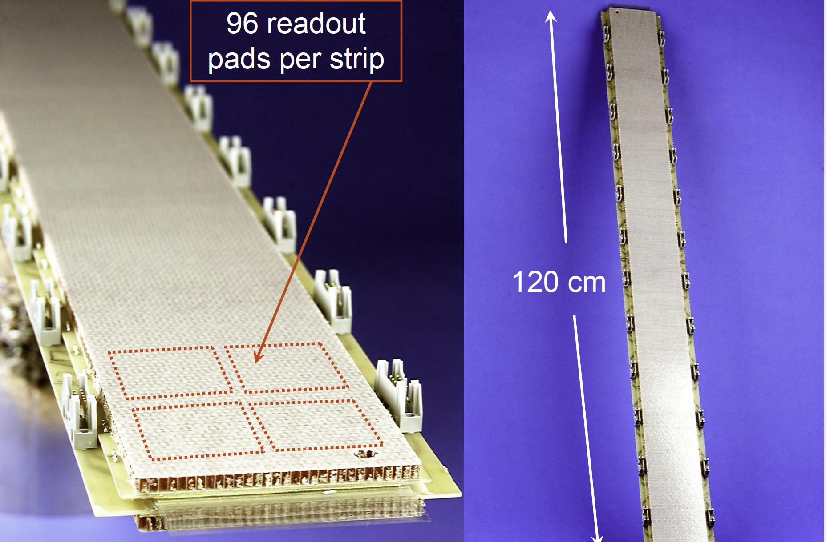
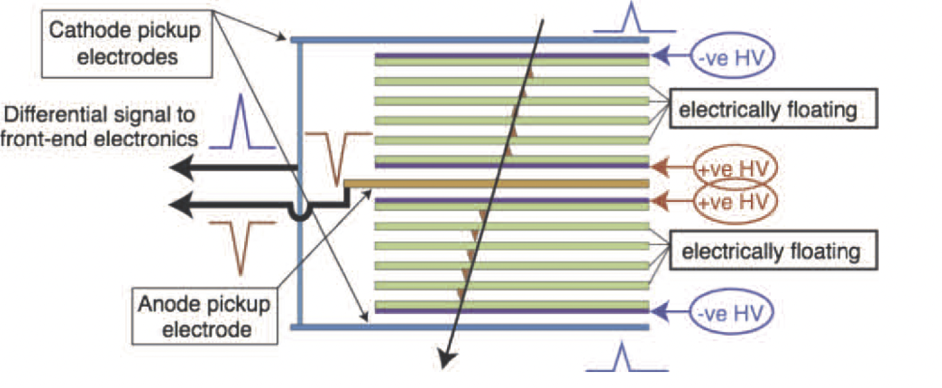
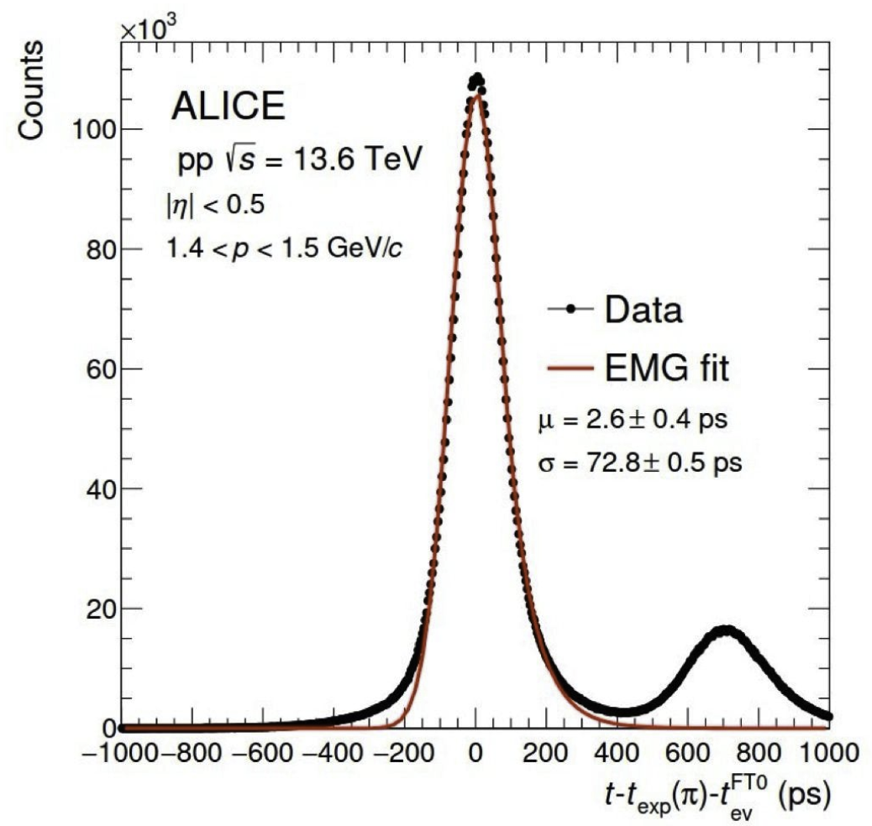
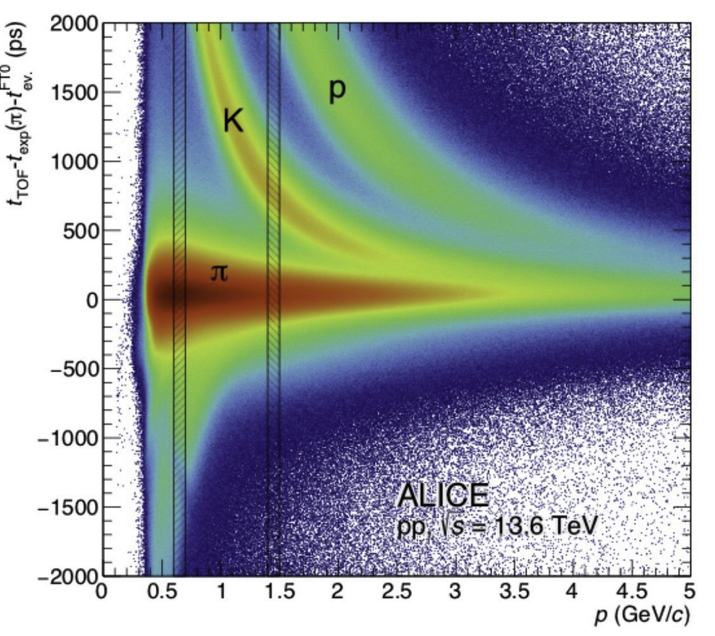
Timing gaseous detectors
Multi-gap RPC
Signal electrode
Cathode -10 kV
(-8 kV)
(-6 kV)
(-4 kV)
(-2 kV)
Anode 0 V
Signal electrode
MRPC
Standard 2 mm gap RPC
Differential readout

Slide 12
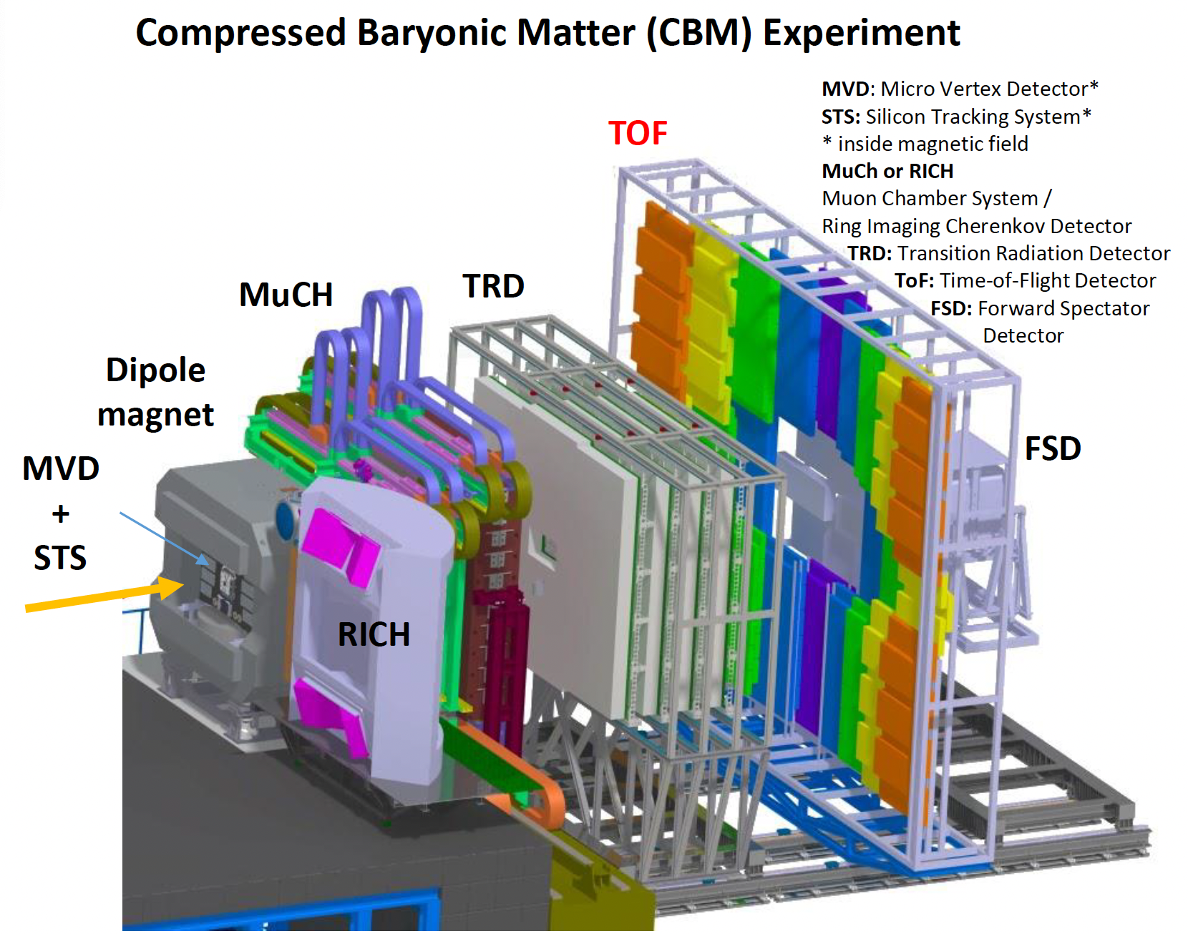
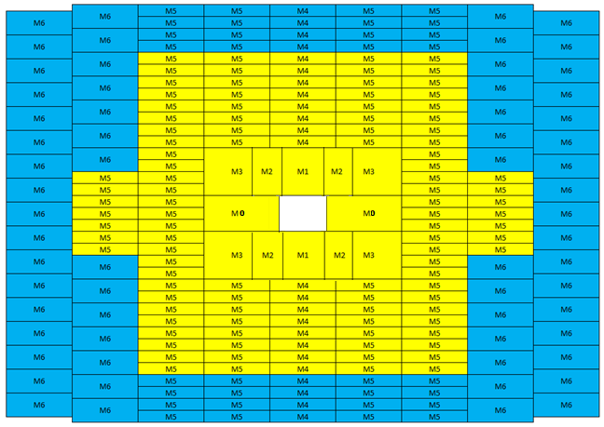
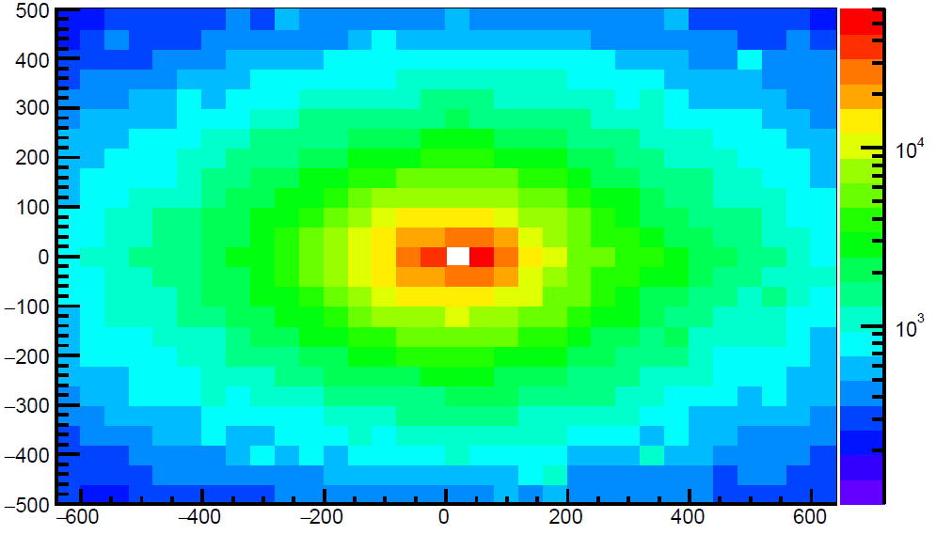
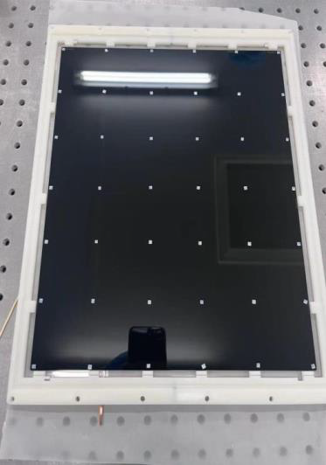
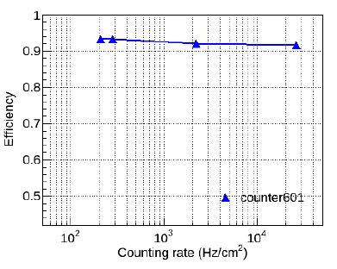
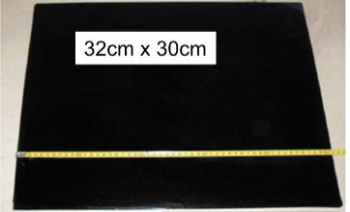
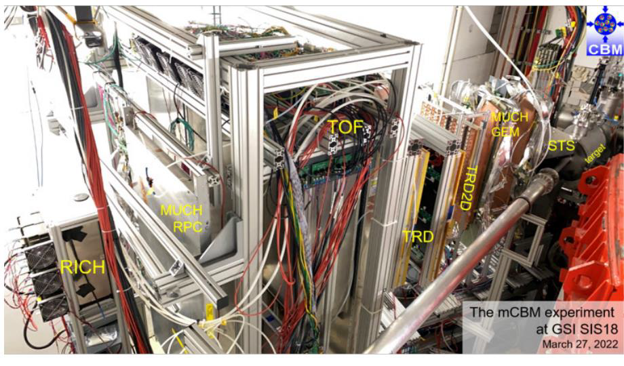
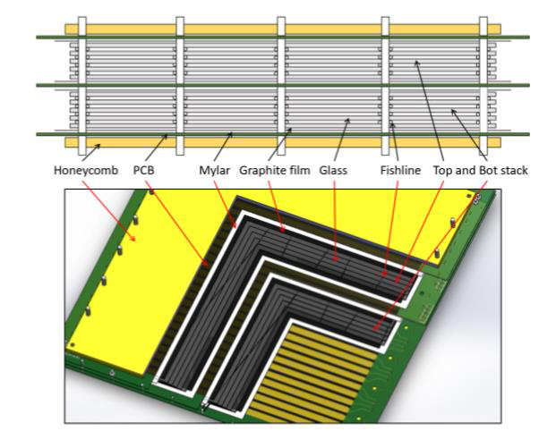
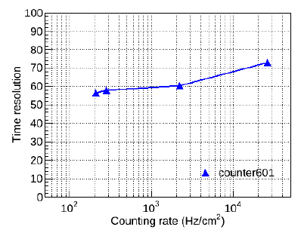
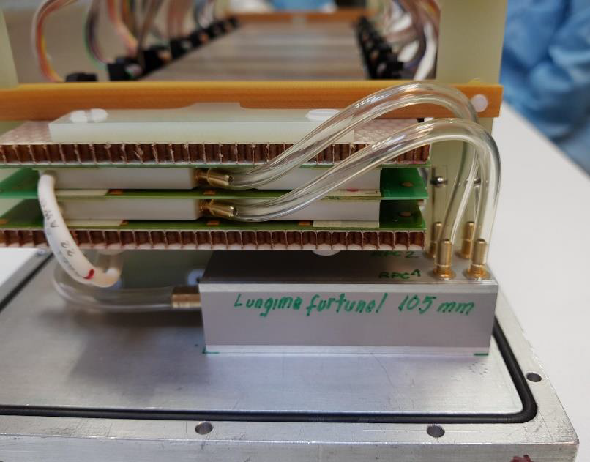
Timing gaseous detectors
Multi-gap RPC
CBM will study the nuclear matter at large density to understand:
partonic phases, chiral symmetry, hyper-nuclei production,
charm production and propagation in rich baryonMatter.
ToF detector is an essential one in the CBM. It will be made of
MRPC that can reach 80 ps (full system) time resolution
while withstanding very high rate at the center.
New doped glass was developed by Tsinghua University with ρ = 10¹⁰⁻¹¹ Ω.cm
Peak Rate 10 MHz for Au+Au
8-10 gaps

Slide 13
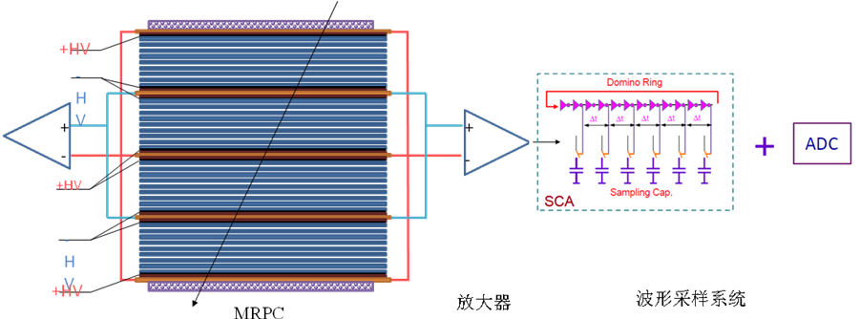
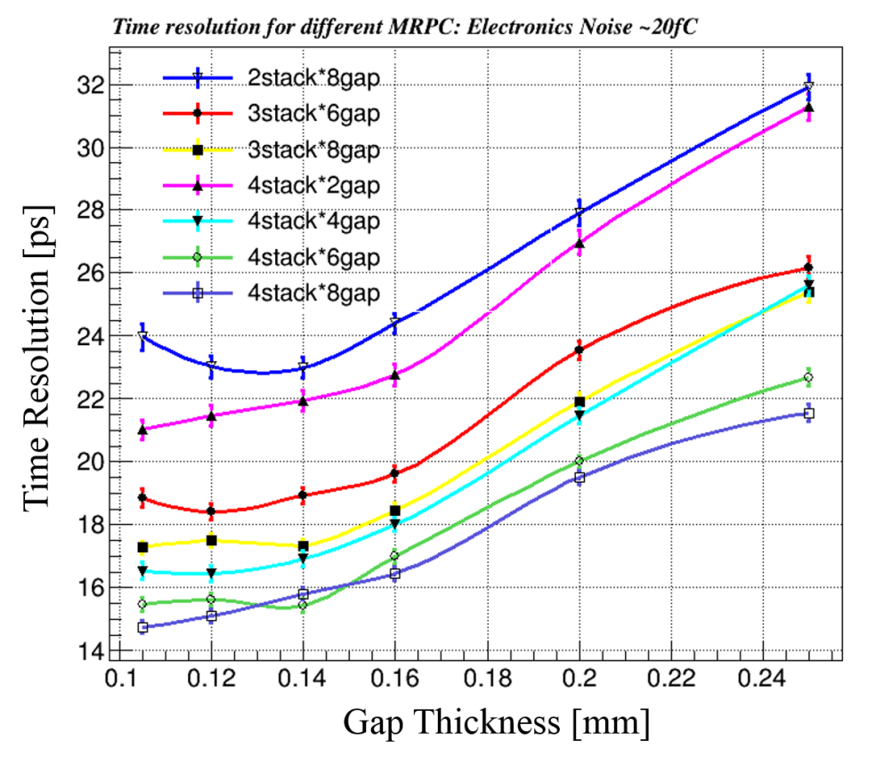
Toward 20ps resolution: narrow gap MRPC
Simulation indicates proper ways to design the gap thickness and arrange the stacks
2
2
Narrower gap thickness required
σ_{TOF} <20 ps， the intrinsic resolution of narrow gaps MRPC is around 15ps，so the time jitter of the readout electronics <13~15 ps。
σ_{MRPC} <20 ps，the gas gap: <0.18mm
gap number: >16
Courtesy: Y. Wang

Slide 14
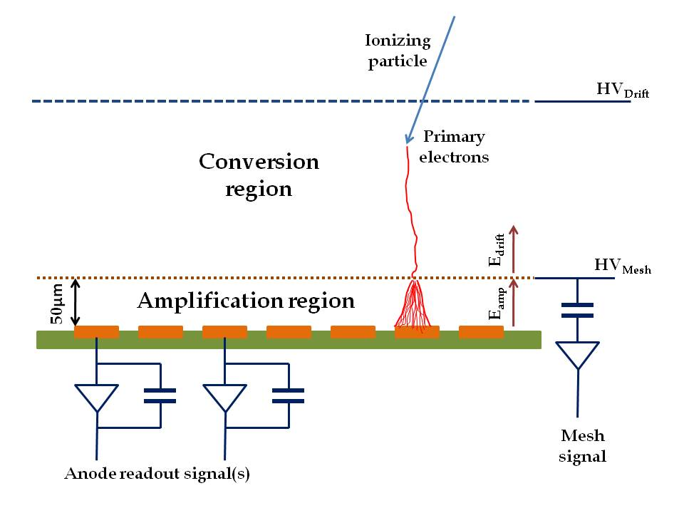
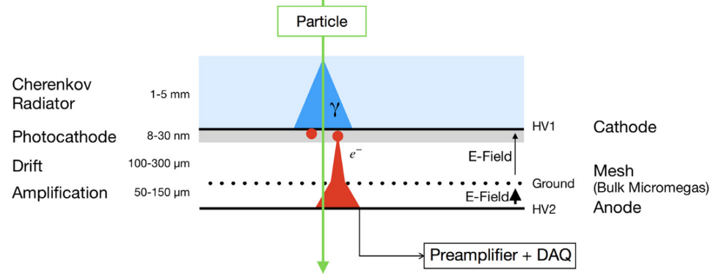
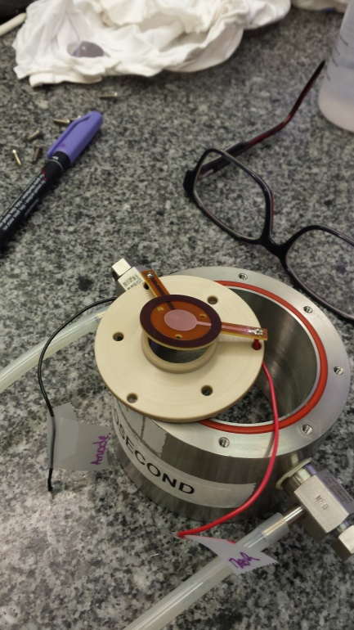
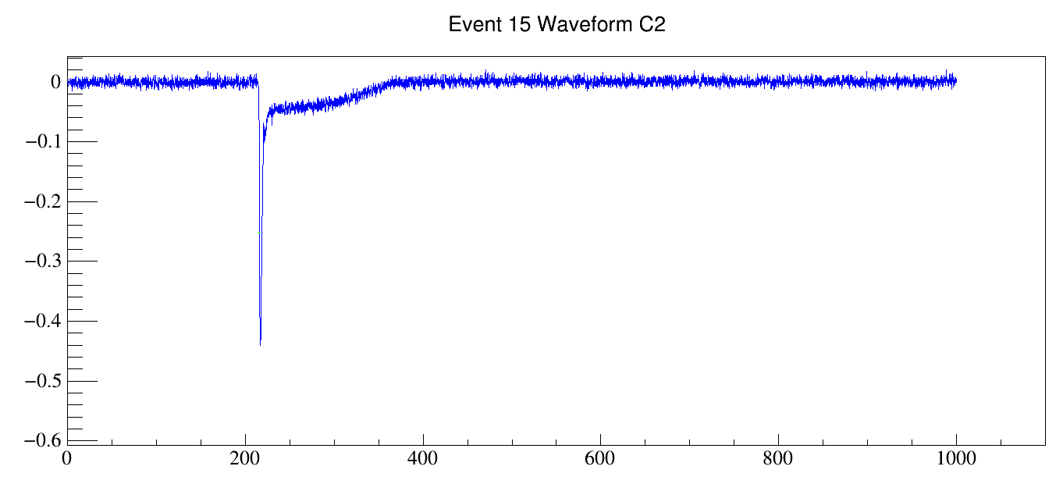
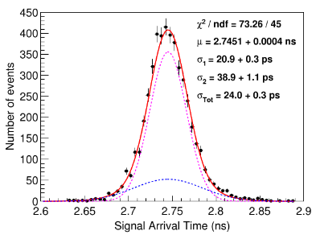
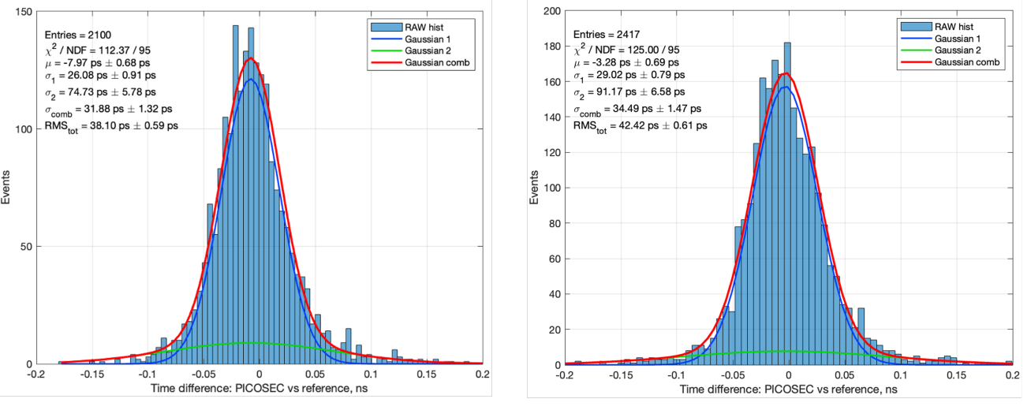


Timing gaseous detectors
PICOSEC concept
Standard MPGD could provide a time resolution of a few ns in the best cases due to the the fluctuations in the drift gas gap. Replacing the drift gap by a radiator + photocathode allows the creation of many electrons exiting the cathode at the same place and thus reducing the impact of fluctuations
V[V]
Ion tail
11 p.e.
DLC
31.9 $±$ 1.3 ps
B4C
34.5 $±$ 1.5 ps
12.5 ps
Electron peak
J.Borteldt, et al. “PICOSEC: Charged particle timing at sub-25 picosecond precision with a Micromegas based detector”, Nuc. Instrum. Meth. A (2021)https://doi.org/10.1016/j.nima.2018.04.033
T[ns]

Slide 15
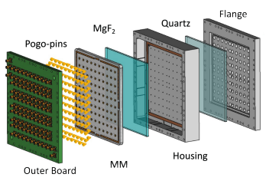
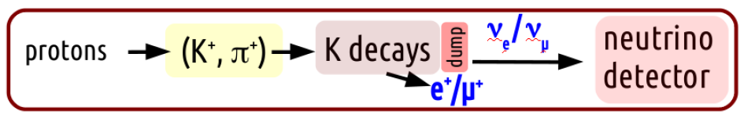


Timing gaseous detectors
PICOSEC concept
CsI
The ENUBET experiment: F. Terranova, F. Acerbi, G. Ballerini, M. Bonesini, A. Branca, C. Brizzolari
https://doi.org/10.22323/1.390.0182
Problem of flatness appear for large area. Solutions with stiff support are being investigated. µWell could be a better solution form this point of view (proposed for EIC).
15

Slide 16




MicroChannel Plate (MCP)
Old detector but still the fastest until now. It is made of a tremendous number of hollow tiny glass tubes
Photo-cathode
200 V
1- 2kV
vacuum
200 V
Anodes (1.6 x 1.6mm² pixels)
Courtesy: J-F. Genat

Slide 17







MicroChannel Plate (MCP)
MCP→ a-MCP
Nanotechnology is used to produce new kinds of MCP with excellent temporal performances but…
EPFL
6 ps
MCP→ NCP
Three technologies are followed by Lyon :
Anodized Aluminium Oxide AAO (with IMP→ ANR NanoPolyPad)
Silicon electrochemical etching (with INL →ANR NCP)
Femto-laser digging (with LabHC)
SiNCP
AAO
Femto-laser

Slide 18






Silicon Photo-Multiplier (SiPM)
A simple P-N junction operated in a reverse biased Geiger mode with a quenching system

Slide 19


Silicon Photo-Multiplier (SiPM)
SiPM are an excellent device to exploit scintillating light, providing an excellent time measurement when they are associated to appropriate scintillators.
Many efforts to find the best scintillating materials that combine high light yield and fast time decay

Slide 20





Silicon Photo-Multiplier (SiPM)
SiPM+Lyso in CMS BTL: exploiting the knowledge from PET-SCAN-ToF experience

Slide 21



Photo-Multiplier Tube
PMT are still an option as an excellent timing photodetector. It is the base option for LHCB ECAL upgrade
Shashlik structure is proposed for the LHCB ECAL upgrade aiming at time resolution of few tens of ps
Scint
Several Scintillators are
Being studied:
-YAG
-GAGG
-GFAG
Photodetector
Use better PMT (small transit time spread and transit time uniformity over the photocathode)
•R7899-20 (TTS ≈ 1-2 ns)
•R7600U-20 (TTS ≈ 0.35 ns)
WLS fibers
•Use WLS fibers with shorter decay time
•Y11 decay time ≈ 7 ns
•Research work is ongoing in KURARAY aiming to
develop faster WLS fibers with good light yield
•New KURARAY WLS: YS-2 (≈ 2.7 ns)
Courtesy of A.Schopper

Slide 22


2D Silicon sensors : LGAD
Timing performances of standard planar silicon sensors are limited due to the fluctuations of the number of charges and their diffusion. LGAD provides the tool to improve on timing by the creation of a limited zone with moderate gain.

Slide 23





2D Silicon sensors : LGAD
LGAD in HGTD : 2 layers in each endcap with 1.3 mm x 1.3 mm pixels

Slide 24





2D Silicon sensors : LGAD
The spatial resolution of the LGAD is limited by the current size of PADs (1.3 mm x 1.3 mm) that was optimized to reduce the dead zone. Continuous gain layer is obtained in a new scheme (AC-LGAD) allowing both excellent time and position resolutions.
DC-LGAD
AC-LGAD

Slide 25



2D Silicon sensors : standard
Although LGAD performances are the best among the 2D Si sensors when it comes to measure MIPs, the others can achieve very good time resolution when used in calorimetry.
The thickness is a very important parameter in this case
Courtesy: M. Van Beuzekom
CMS-HGCAL

Slide 26






3D Silicon Sensors
The limitation of timing performance of standard “planar” silicon sensors is overcome by adopting 3D geometries that reduce significantly the time jitters by reducing the distance the charges have to cross.
3D trench offers better uniformity in terms of field and charge velocity than the column based one.
Courtesy A. Loi
Courtesy A. Lampis
TimeSPoT project
Time resolution ∼10 ps (25 ps leading edge w/o Time Walk correction)

Slide 27




2D Silicon sensors : LGAD
Trans-Impedance-Amplifier, HBT low-noise Si-Ge, P ≈ 70 mW per channel
Results obtained with charge deposit eq. of 10 MIP
Ignite project
Courtesy A. Lay

Slide 28





Superconductor Nanowire Single Photon Detector (SNSPD)
SNSPD is a fully digital sensor operated at very low temperature and using the fact that the copper pairs are broken when a photon hit the superconductor wire increasing locally the resistance and leading to a perturbation of the bias current that circulates in the wire. It has excellent efficiency and very low noise and time jitter
Courtesy: B. Korzh

Slide 29








Superconductor Nanowire Single Photon Detector (SNSPD)
Intrinsic dark counts can be <10⁻⁵ cps
SNSPD is currently used for quantum applications but it is now tested with charged particles (8-120 GeV) at Fermilab
2 mm
≈ 3-5 nm-thick WSi
Courtesy: B. Korzh

Slide 30
Superconductor Nanowire Single Photon Detector (SNSPD)
Advances in superconducting nanowire detectors
Timing jitter | Intrinsic photon number resolution | Efficiency | Array size | Maximum count rate | Dark count rate | Active area | Cut-off wavelength
18 ps | None | 93% | 64 | 1 Gcps | 4 /s/mm² | 0.001 cm² | 5 μm
1 ps | 10 | 99 % | 10⁷ | 10 Gcps | 1x10⁻⁶ /s/mm² | 1 cm² | 100 μm
Records in 2016
[4,5]
3-5 photons
1.5 Gcps
Current records for isolated devices
4x10⁵
[3]
[6]
[3]
[7]
[1]
[2]
0.1 cm²
29 μm
2.6 ps
98%
4x10⁻⁵ /s/mm²
Expected performance by 2030
Courtesy: B. Korzh

Slide 31





PICMIC : a new way of measuring time and position
PICMIC to exploit the excellent MCP intrinsic spatial and temporal resolution
To be used for photodetection but also for charged particle tracking
Develop a new sensor NCP with much better performances
Patented concept:
PCT/EP2020/050058
2024_JINST_19_C05015

Slide 32



PICMIC : a new way of measuring time and position
First setup with two MCP of 2.5 cm diameter to validate the delay plane principle
Delay-plane readout
SAMPIC: a waveform digitizer
σ_{Τi-Tj}=30 ps → σ_{T}= 8 ps

Slide 33









PICMIC : a new way of measuring time and position
PICMIC concept is validated on MCP
Position: σ=15 µm
σ_{Τi-Tj}=50 ps → σ = 10 ps
This is the first attempt. With the second version we think we can reach better than 10 µm

Slide 34
Conclusion
The 4th dimension is becoming very important in the detection field
Several detectors are able to reach a few tens of ps resolution and the trend is to go to 1 ps
For the time being the readout electronics is not the show stopper but efforts will be needed in the near future to reach the 1 ps time resolution for large systems

Slide 35





Scintillator/Crystal-based
SiPM is becoming an important piece of the
scintillator/crystal detectors/calorimeters
Associated to fast Scintillator/crystals
it can provide excellent time resolution
Time resolution of ~30 ps for single MIPs with
single LYSO layer is expected from MTD (CMS, Barrel)
Efforts to go for small pixels < (10 µm) are to be carefully
followed since the smaller the pixel the faster
the time response.
Developments of the so-called Nano crystals (such as
Perovskite sensitizer, CsPbBr3) that feature sub-nanosecond scintillation
with good LY as well as colloidal quantum dot technology
are ongoing and could lead to a breakthrough
In addition, revisiting known material (doping) to better
distribute scintillation in favor f fast component→ PWO-III
Array of LYSO crystals (CMS MTD)
MTD Barrel
30 ps time
resolution
Courtesy
M. Lucchini
Courtesy of M.Korjik
and G.Tamulaitis

Slide 36




Electronics For time measurement
Role of electronics of time precision:
A few ASICS as examples
Courtesy Ch. De la Taille

Slide 37
TDC
Several TDC (either on ASICS or FPGA) are now able to provide time resolution lower than 10 ps
ASICs present more stability and less power consumption
SAMPIC (Waveform digitizer) -> 3.5 ps
AARDVVARC V3 (waveform digitiser) -> 4-6 ps
PicoTDC (PLL) → 1.5-3 ps
Of course, for large systems the synchronization of all the electronics is challenging but systems like White Rabbit + Local distribution system (lpGBT) can achieve excellent time precision.

