Slide 1
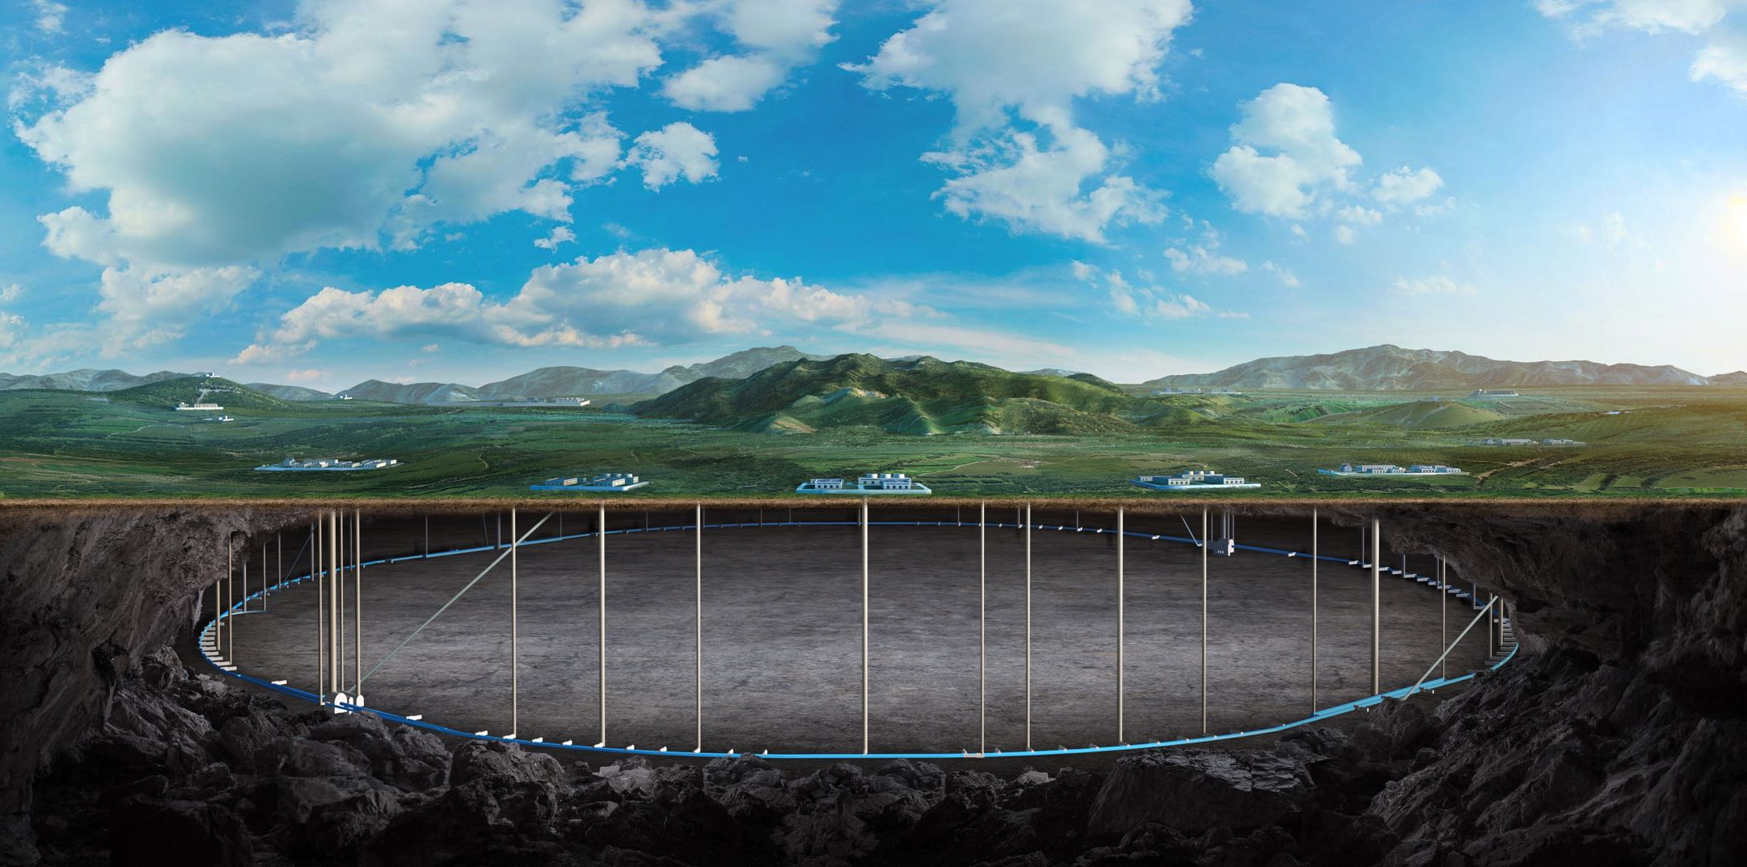
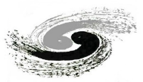
Institute of High Energy Physics, CAS
Summary of “International Kick off workshop on FCC-ee detector solenoids” and developing progress
Feipeng Ning
On behalf of Detector Magnet Team
2026-07-29

Slide 2
Outline
Summary of “International Kick off workshop on FCC-ee detector solenoids”
Progress of Box type conductor
Summary

Slide 3
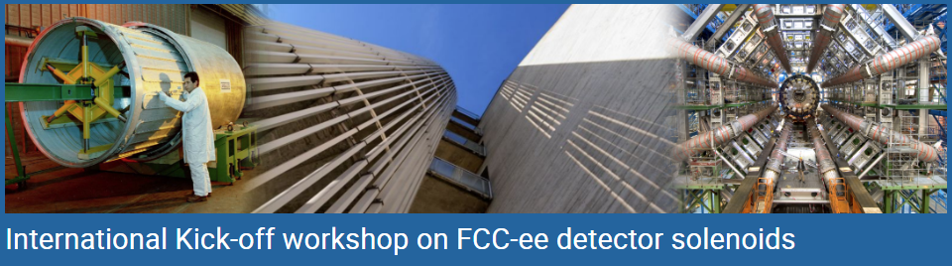
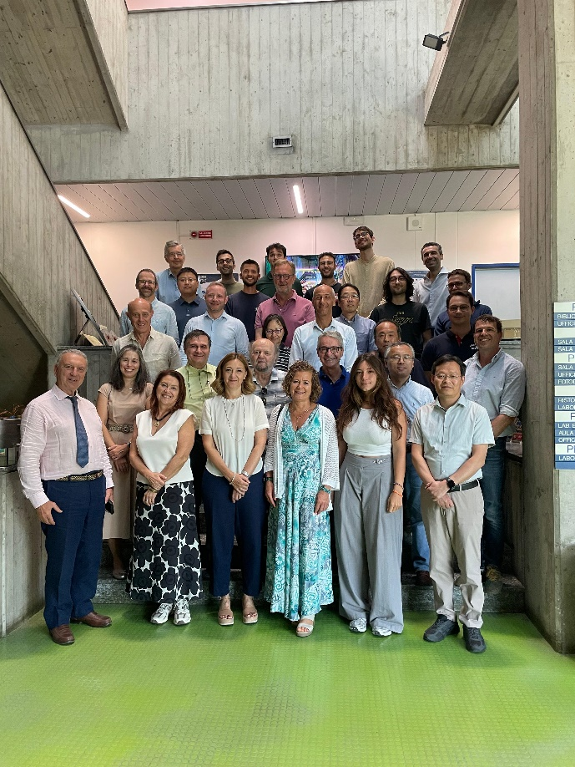
The workshop took place in Milan, Italy from 2 to 3 July 2026, at the Laboratorio Acceleratori e Superconduttività Applicata (LASA) of the Istituto Nazionale di Fisica Nucleare (INFN) and Università degli Studi di Milano.
https://indico.cern.ch/event/1671000/
Prof. Lucio Rossi (Chair)
Email: lucio.rossi@mi.infn.it
Prof. Paolo Giacomelli (Chair)
Email: paolo.giacomelli@bo.infn.it
2–3 Jul 2026
Milano LASA

Slide 4
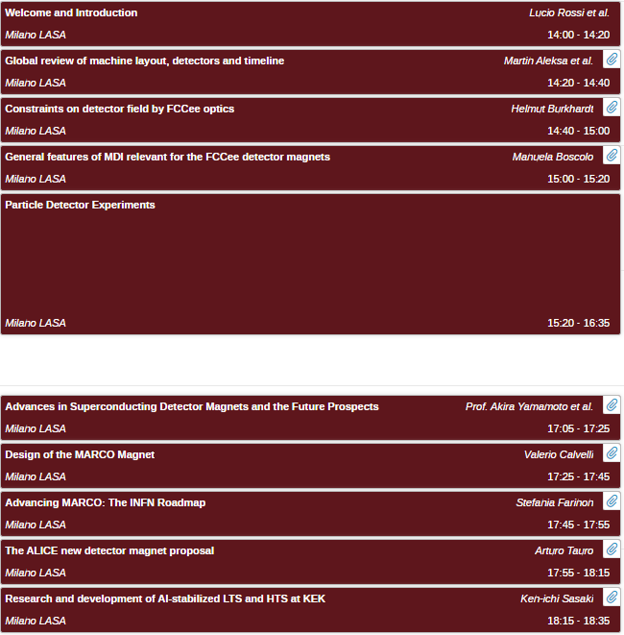
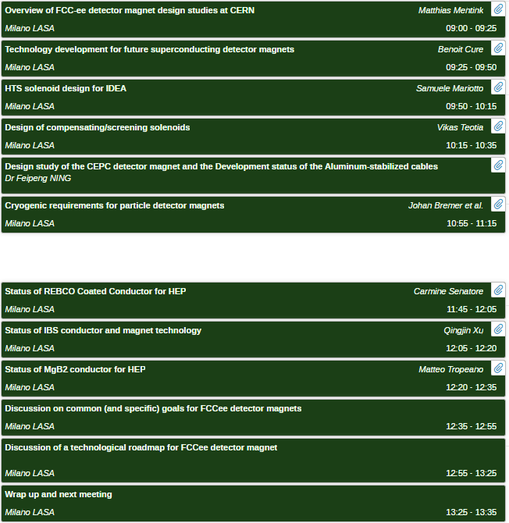
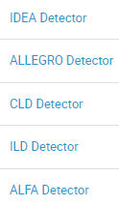
42 participants, 23 oral reports

Slide 5
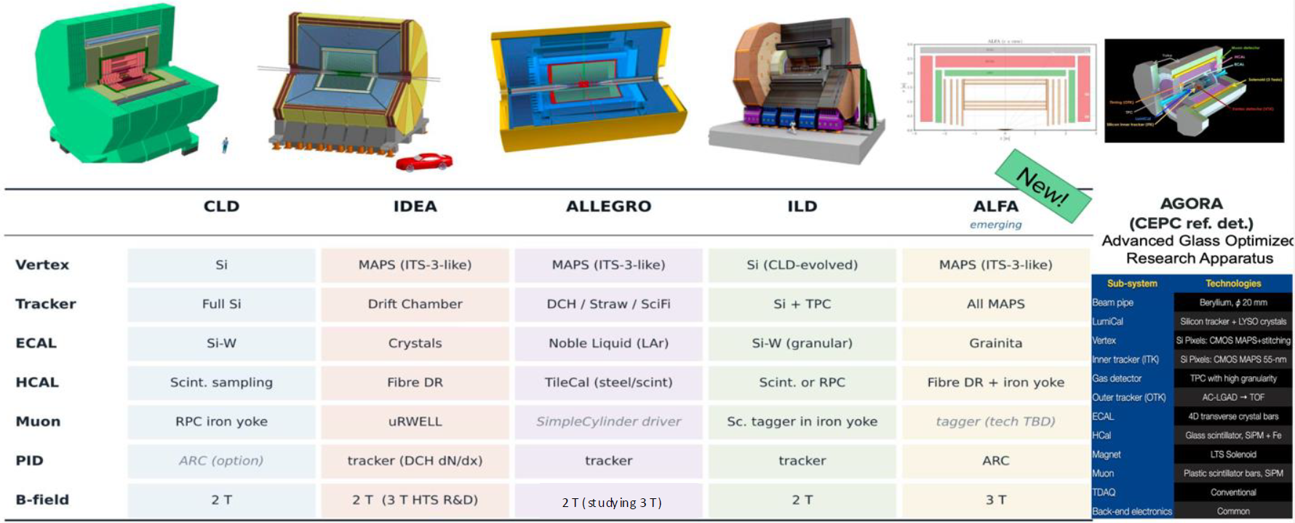
FCC-ee Detectors
The FCC-ee has a total of 6 detector proposals, and the previous 2T superconducting magnets are all moving toward 3T magnet designs.

Slide 6
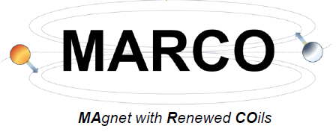
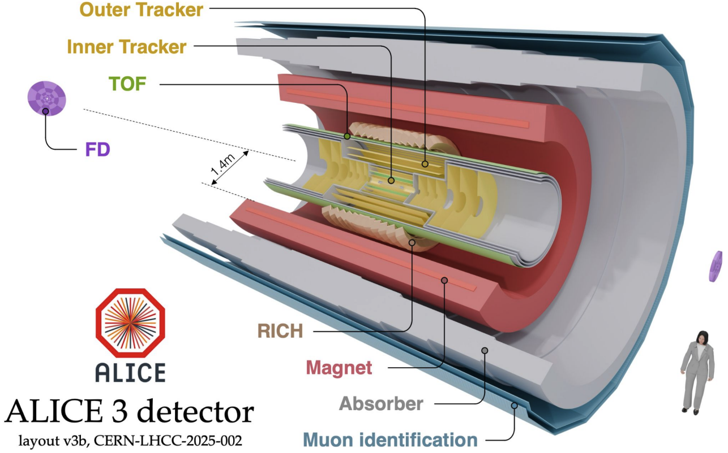
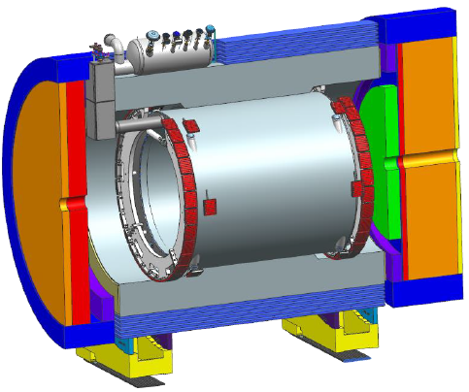
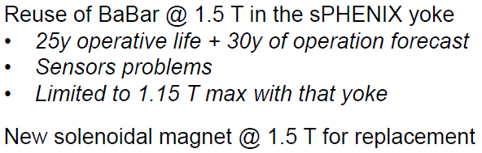

Other detector magnets
ALICE 3
Other reports:
MDI
Cryogenic requirements
Superconducting materials
  REBCO
  IBS
  MgB2
The Electron - Ion Collider @ BNL
2 T, r = 1.4 m, l = 7 m
CNPEM, CEA and CERN
~30 tons
E = 79 MJ
Brazilian Center for Research in Energy and Materials (CNPEM) leading magnet design & construction

Slide 7
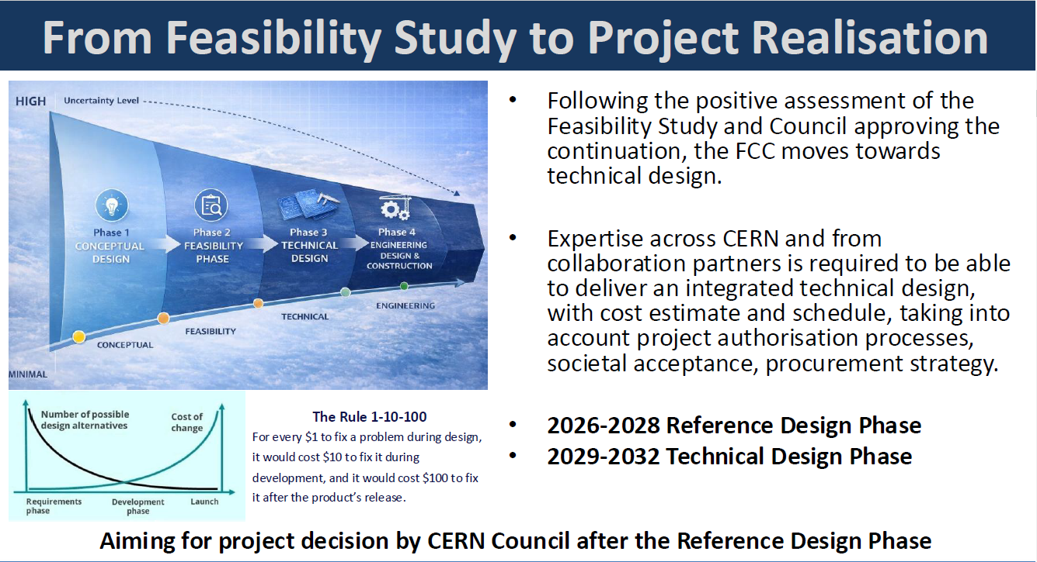

Slide 8
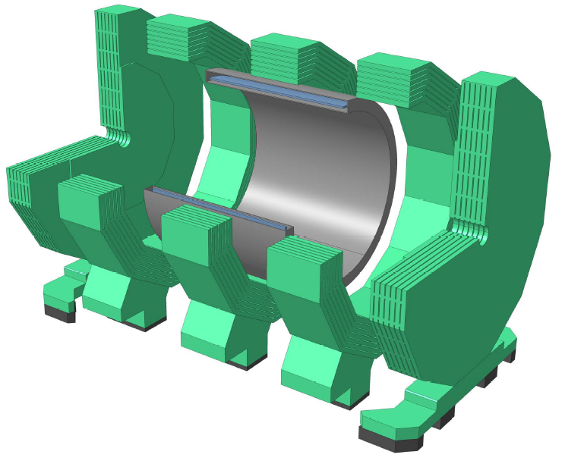
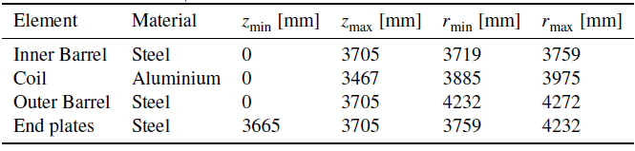
CLD
Superconducting Solenoid with 2 Tesla Field
Material budget of the solenoid corresponds to about 0.7λ
CLIC-Like Detector (CLD) Concept
Reported by Jinlong Zhang @ Argonne National Laboratory

Slide 9
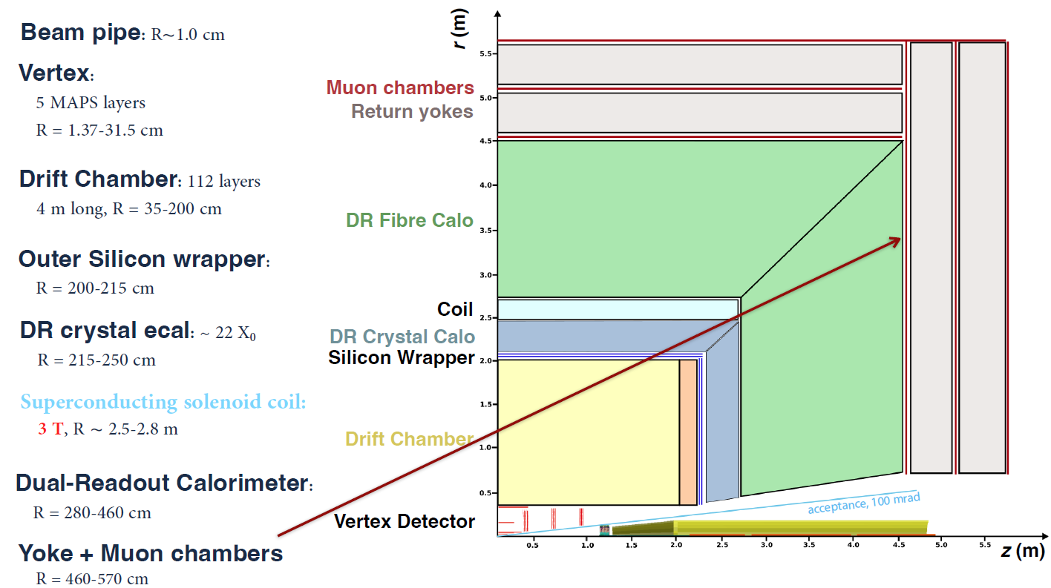
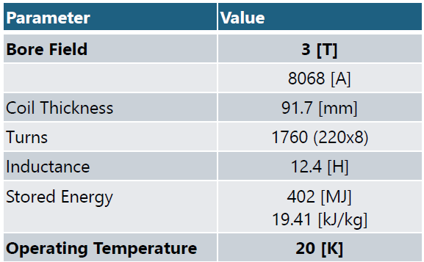
IDEA
Innovative Detector for E+e- Accelerator (IDEA)
Reported by Paolo Giacomelli and S. Mariotto, INFN
It was originally optimised for a 2 T field
A bit more than a year ago we decided to use a HTS solenoid providing a field up to 3 T, but still operating at 2T at the Z0 peak
If we decide to operate at 3 T at every c.m point we will have to optimise differently the dimensions if the detector
We would almost certainly want to reduce the outer radius of the drift chamber, and consequently bring the outer wrapper close to the IP
HTS magnet:

Slide 10
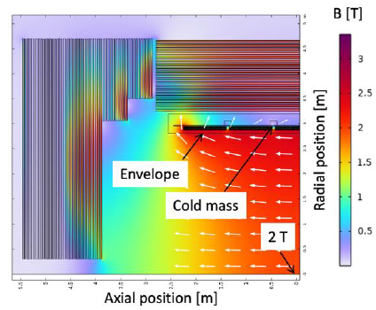
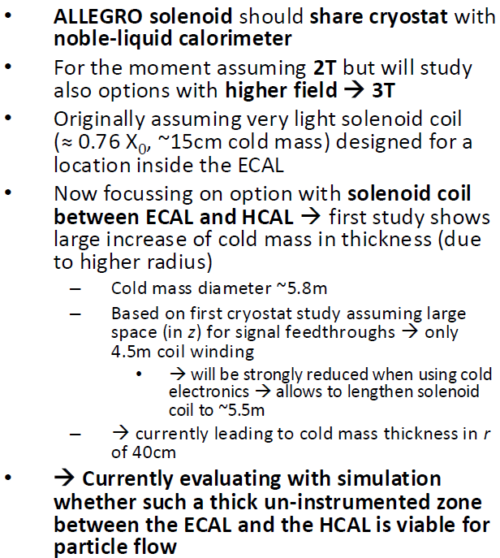
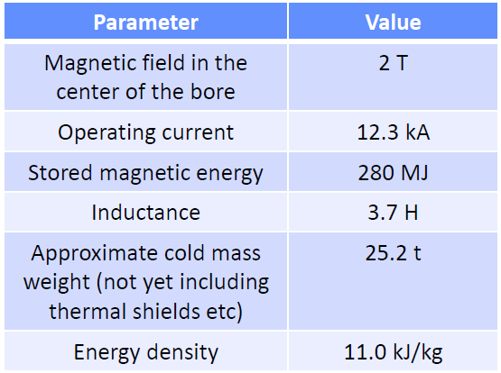
ALLEGRO
A Lepton Lepton collider Experiment with Granular Read-Out
Reported by Martin Aleksa (CERN)
A detector concept in its very beginnings

Slide 11
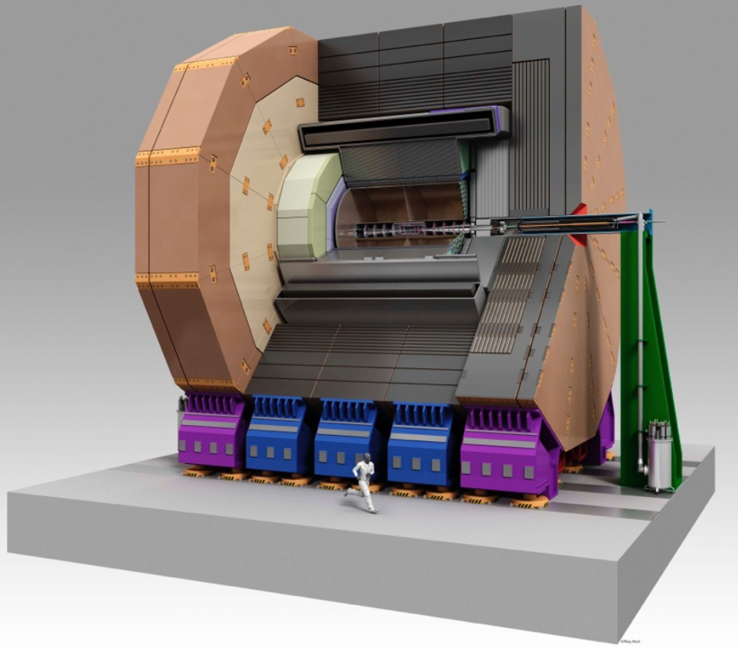
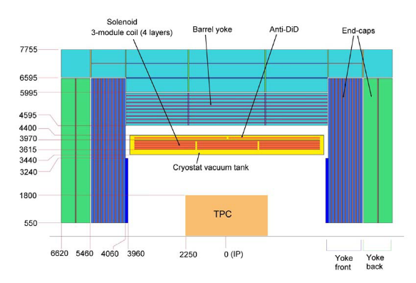
ILD
International Linear Collider
Reported by Ties Behnke
Coil Inner Radius (mm) | 3615
Coil Outer Radius (mm) | 3970
Coil Length (mm) | 7350
Cold Mass Weight (ton) | 170
Turn × Layer | 309 X 4
Nominal Current (kA) | 22.4
Current Density (A/mm²) | 10.6
Central Field (T) | 4.0
Maximum Field (T) | 4.6
Inductance (H) | 9.2
Stored Energy (GJ) | 2.3
S.Energy / Cold Mass (kJ/kg ) | 13
Support Shell Thickness (mm) | 50
Cryostat I. R. (mm) | 3440
Cryostat O. R. (mm) | 4400
Solenoidal magnet field of 3.5 T and 4 T in maximum central field in a warm aperture of 6.88 m in diameter and 7.35 m length.
Anti-DID (Detector Integrated Dipole) horizontal magnetic field of 0.035 T in maximum in Z=0.3 m
Conductor consists of a superconducting Rutherford cable, sheathed in a stabilizer and mechanically reinforces.
  It has the overall dimensions of 74.3 X 22.8 mm². Length demand is 32 km, breakdowns 2.6 km x 12 spools.
  Two solutions, CMS type, ATLAS CS type, has been considered.

Slide 12
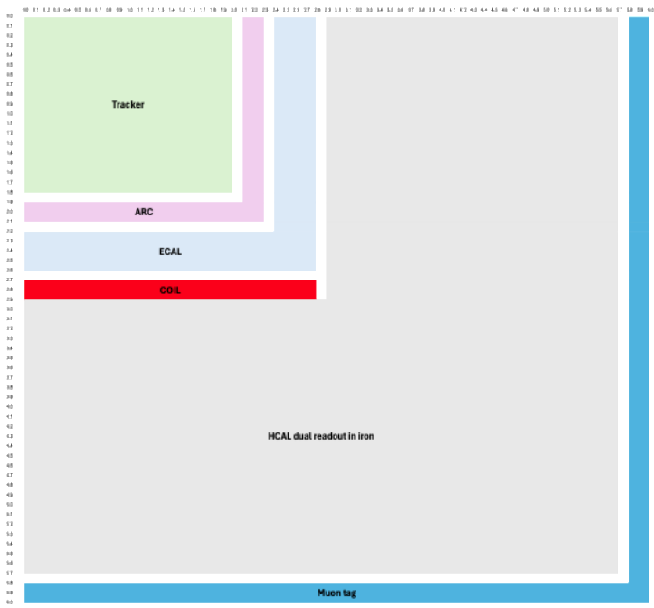
ALFA
Advanced, Lightweight and Fine-grained Apparatus
The detector concept is still evolving
• High -performance all -MAPS Tracker
• ARC ( Array of RICH Cells)
  Good particle ID over large momentum range
• ECAL based on GRAiNITA
  Excellent energy (and position) resolution with a cost -effective technology
• Coil for 3T field
  3T not guaranteed for the Z run
  Coil dimensions are reasonable
• Dual Readout HCAL in iron
  Best option for hadronic energy resolution
  Iron absorber keeps the overall detector dimension relatively compact
• Muon tag
  No compelling case for precise muon tracking
  Simple and cost-effective
The dimensions of the coil are
  R = 2.8 m
  L = 5.6 m
•Nominal magnetic field: 3 T, with the possibility of operating at lower field if necessary or desirable.
•The hadron calorimeter is located outside the coil. Therefore, there is value in selecting a magnet technology that minimizes the coil mass for the required magnetic field strength.
•All other requirements on the magnetic field are driven by the FCC-ee physics and are not ALFA-specific

Slide 13
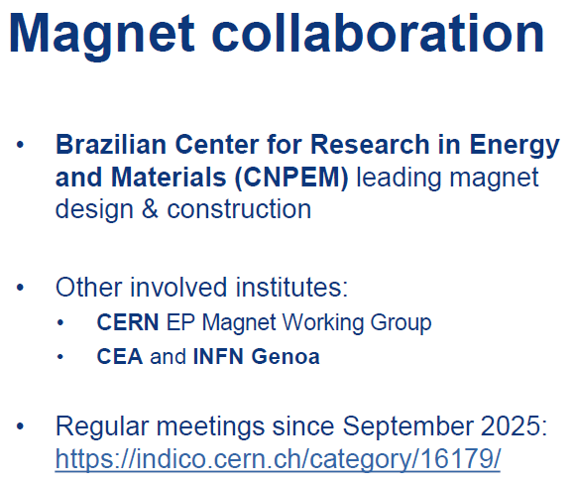
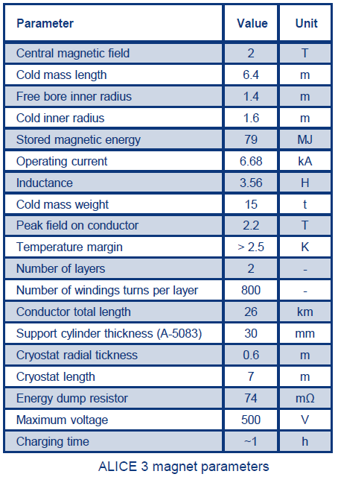
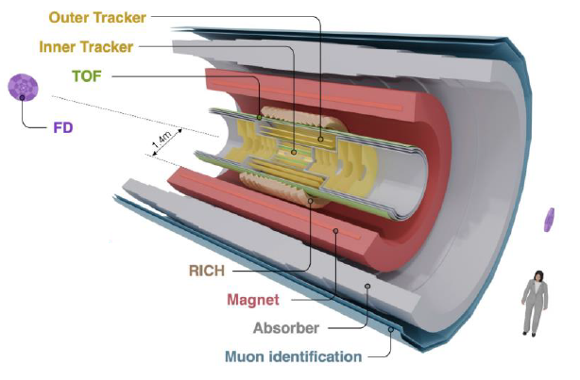
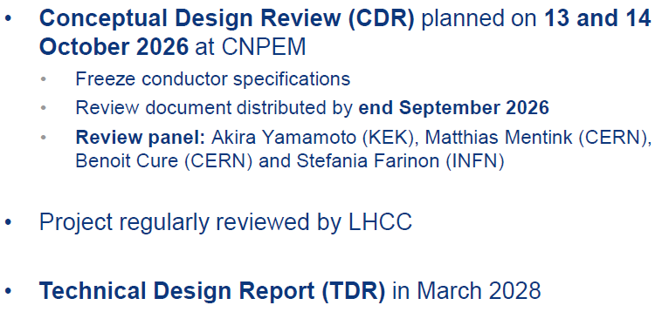

ALICE 3
Reported by A. Foussat, C. Gargiulo, W. Riegler, A. Tauro
➠ALICE 3: a novel detector for precision QCD
  •Ultra-light all-silicon tracker
  •Retractable vertex detector(Rmin= 5 mm)
  •Extensive particle identification
  •Large acceptance (|η| < 2.5)
  •2 T superconducting solenoid magnet
  •Continuous read-out and online reconstruction

Slide 14
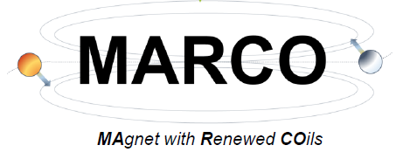
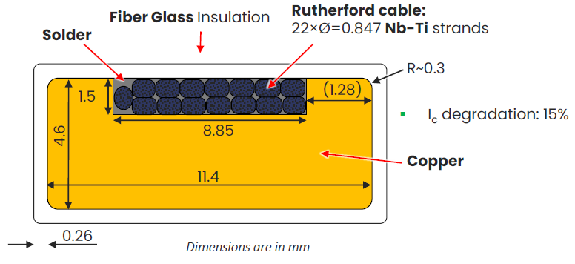
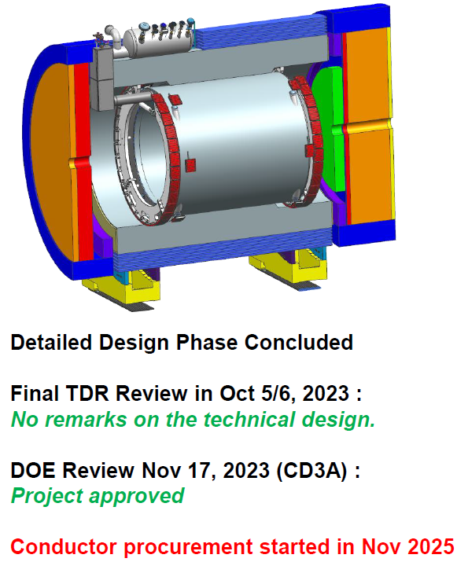
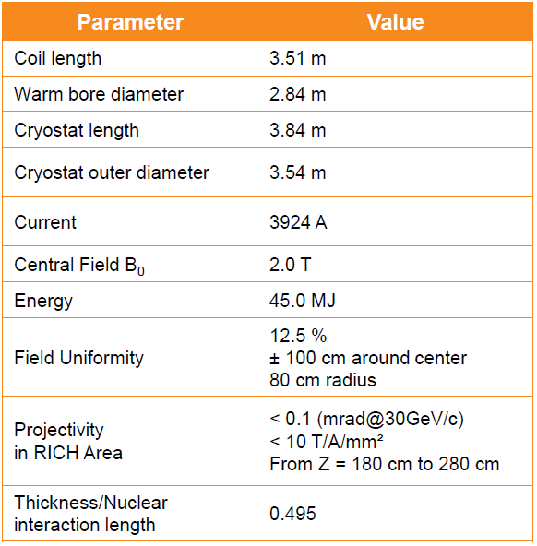
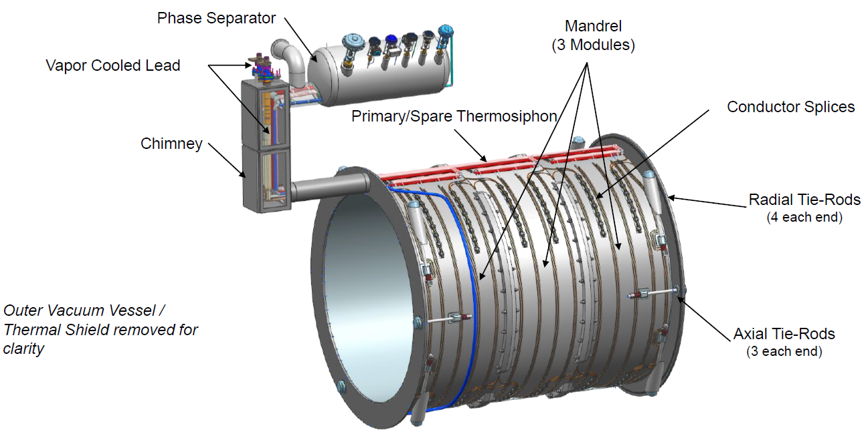
MARCO
The Electron –Ion Collider @ BNL
Reported by V.Calvelli

Slide 15
Magnet Parameters
 | CLD | IDEA | ALLEGRO | ILD | ALFA | AGORA | ALICE 3 | MARCO
Central field | 2T(study 3T) | 3T | 2T(study 3T) | 3.5T(max 4T) | 3T | 3T | 2T | 2T
Warm Bore Diameter(m) | 7.438 | 5 | 5.8 | 6.88 | 5.6 | 7.07 | 2.8 | 2.84
Length(m) | 7.41 | 6 | 4.5 | 7.35 | 5.6 | 9.05 | 7 | 3.84
Characteristic | Calorimeter inside the magnet | Magnet inside the calorimeter | Magnet sharing the cryostat with ECAL, between ECAL and HCAL | Detector Integrated Dipole | between ECAL and HCAL | Calorimeter inside the magnet
Design Maturity | Conceptual | Conceptual | Early conceptual | Conceptual | design forming | TDR complete | CDR 2026 | TDR Oct 2023
For FCC-ee they are all changed to higher field (3T). These need higher strength superconducting conductors. The current conductor designs cannot meet the requirements.
15

Slide 16
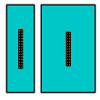
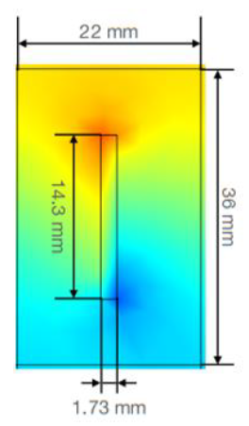
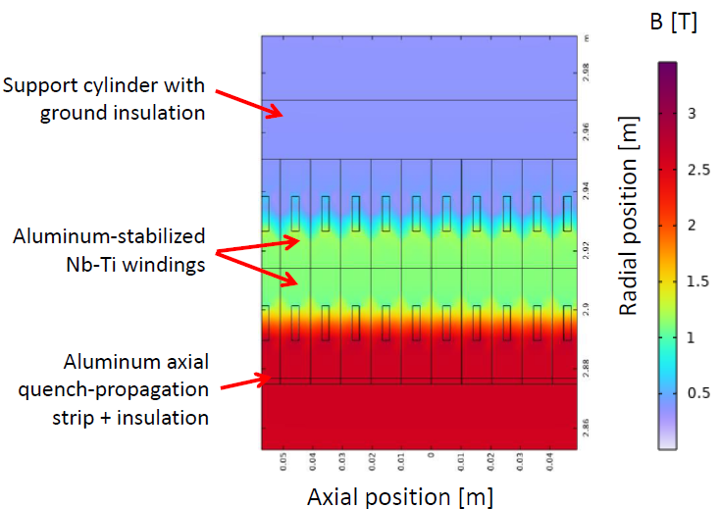
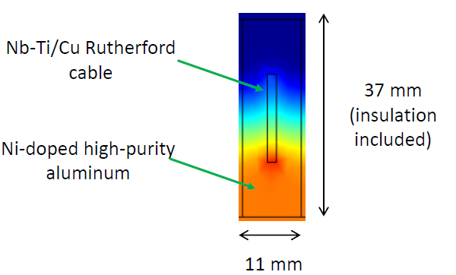
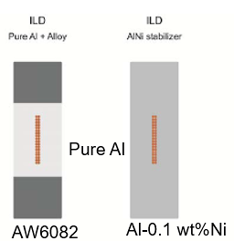
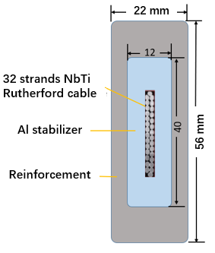
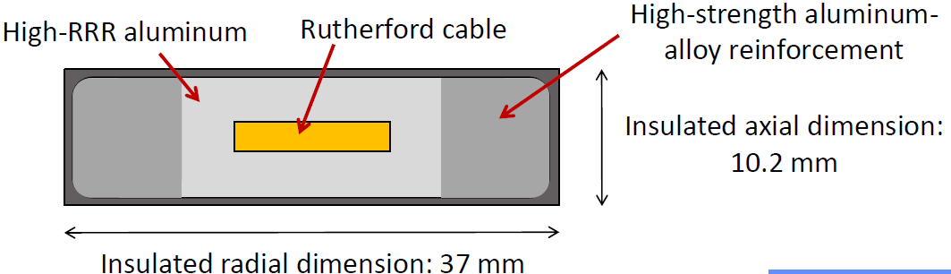
Conductors
Aluminium-stabilized Nb-Ti/Cu Rutherford Cable types
CMS
High Strength Pure Aluminum
IDEA
CLD
ALLEGRO
IDEA
CLD
CLD and IDEA
ILD
AGORA

Slide 17
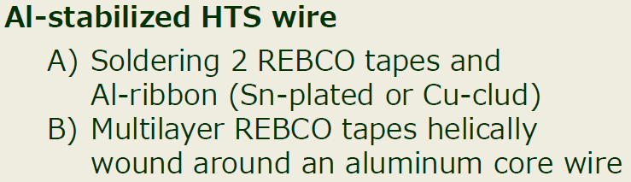
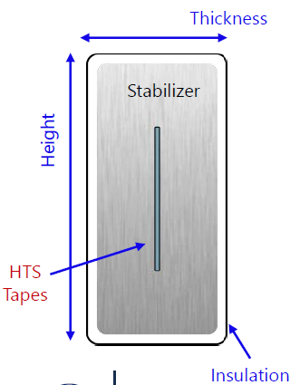
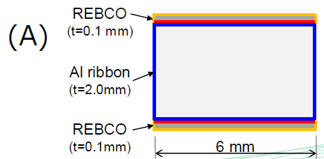
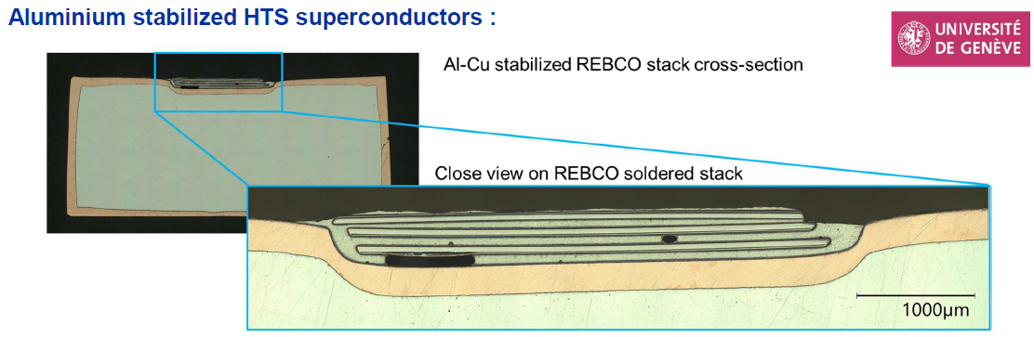
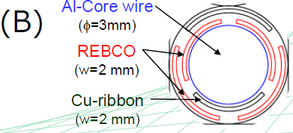
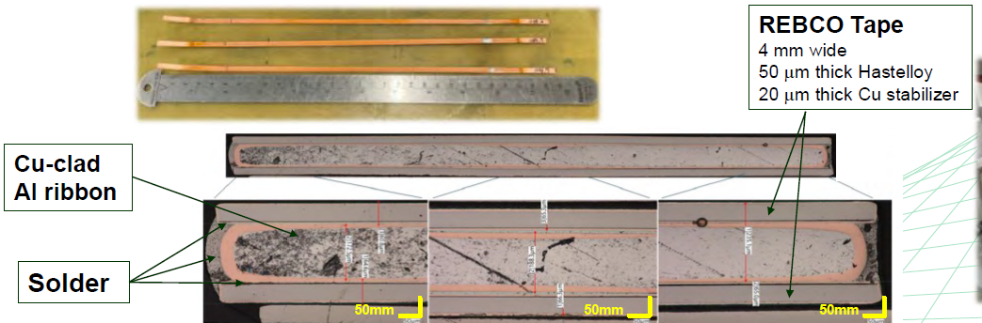
Conductors
HTS
IDEA proposed
CERN proposed
KEK proposed
IDEA is currently mainly promoting HTS solutions.

Slide 18
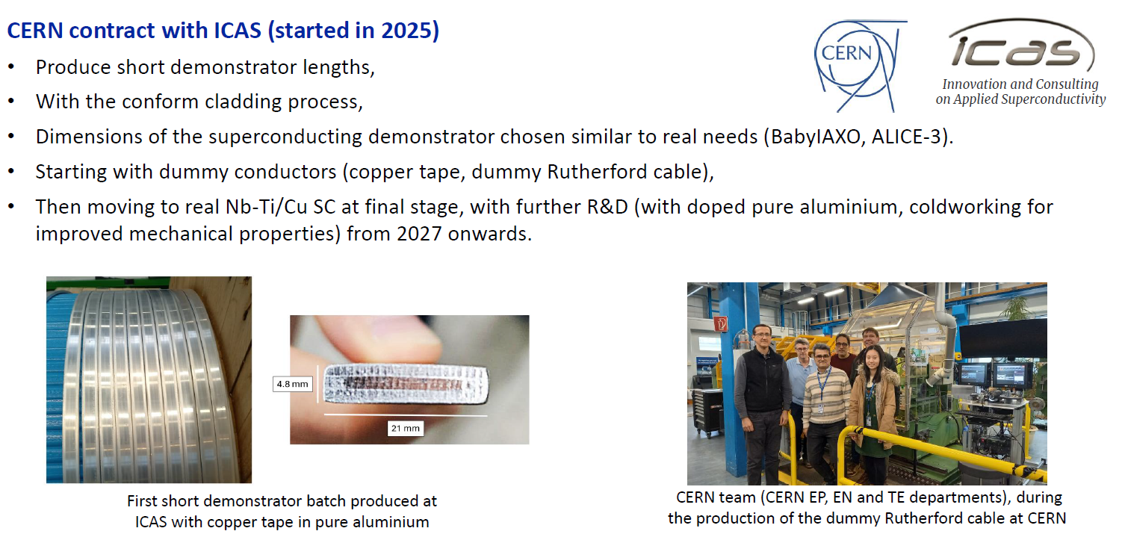
Conductors
Due to the importance of aluminum-stabilized superconducting cables, CERN contracted with ICAS to start the R&D of aluminum-stabilized superconducting cables.
With support from experts of CERN TE, EN and EP departments, and experts from KEK.

Slide 19
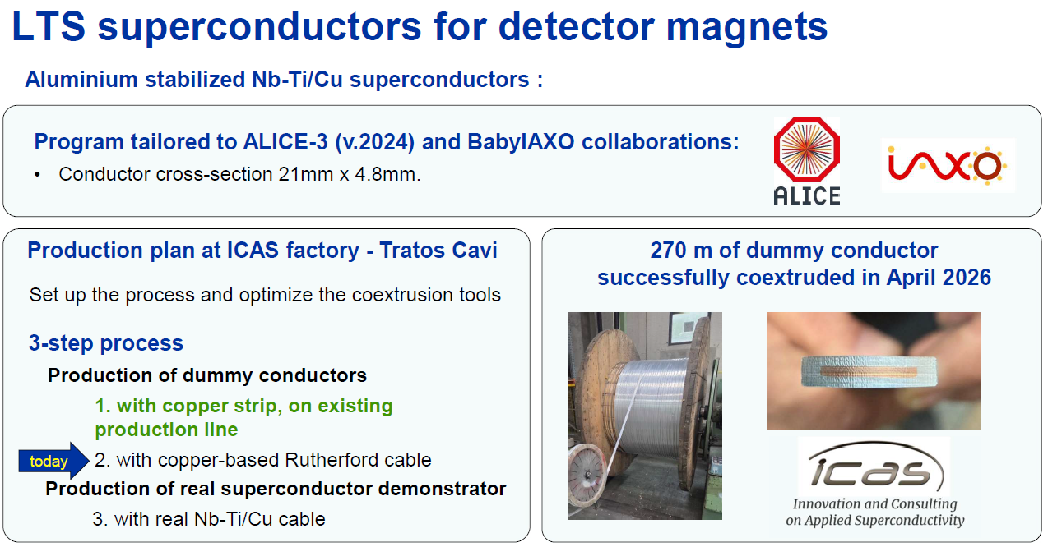
Conductors

Slide 20
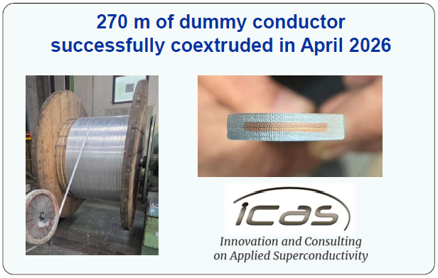
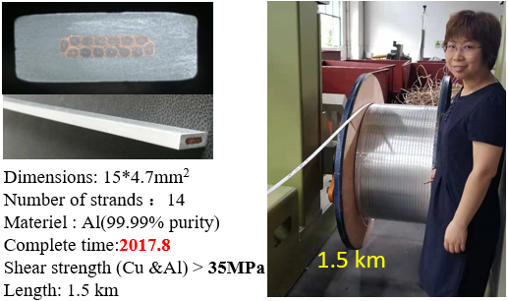
Conductors
CERN & ICAS
IHEP & Toly

Slide 21

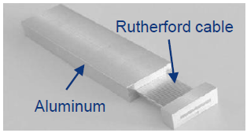





Conductors
(Baby)IAXO
Multiple rounds of discussions were held on the cable details for these two projects, followed by quotations. The contracts are now awaiting signing.

Slide 22












Progress of Box type conductor
2026.1.4
2025.12
Split mold: continuous production, incomplete upper/lower cladding, excessive flash，2025.10
Improvement: Mold gap adjusted → No significant improvement. 2026.01
Improvement: Milled insert thickness by 2mm → still incomplete cladding on upper/lower surfaces2025.11；
upper surface
Improvement: Mold modified.
cladding basically complete;
Excessive flash after 1m production；
insert deformation
2025.11
Improvement: Mold modified.
Completed 5m dummy cable;
Obvious gaps still on upper/lower surfaces.
Al-Al bonding strength only 4.5MPa
2025.12
lower surface
Improvement: mold
replaced;
Continuous production achievable (6m);
Surface voids occurred.
2026.4
Improvement: Mold design updated.
Upper/lower cladding improved;
Core breakage reoccurred;
2026.3
Improvement: Replaced worn extrusion wheels + adjusted mold gap → No significant improvement.
2026.01.09
Zhao Ling’s talk

Slide 23












Progress of Box type conductor
Dummy cable
Dummy cable
Dummy cable
upper surface
lower surface
2026.06.26
2026.06.17
Improvement: shimming;
Optimized lower surface;
Upper surface no improvement.
2026.06.05
Used Cu Rutherford cable+ 6061 Alloy, optimized mold, Overflow material stopped the processing (3m)，2026.06.17
Used Cu Rutherford cable+ 6061 Alloy Improvement: Mold gap adjusted → No improvement. 2026.06.26
Full-size Box type Superconducting Cable
2026.07.24
Superconducting cable
Improvement: Mold design updated.
No gap and the surface quality is good.
Overflow material stopped the processing (1.5m)， 2026.07.24
NbTi Rutherford Cable + pure Al coating 2026.07.22
Solve the scale-up issue from short sample to long cable.

Slide 24
Summary
Kick-off workshop of Fcc-ee solenoid
  6 detector magnets for Fcc-ee and 2 another magnets are reported.
  Due to the importance of aluminum-stabilized superconducting cables, CERN has partnered with ICAS (an Italian company, Innovation and Consulting on Applied Superconductivity) to start the R&D of aluminum-stabilized superconducting cables.
Box type conductor developing progress
  The development of Box-type cables has been continuously advancing, with significant recent progress. The challenge of scaling from short sample to long cable is currently being addressed.
  The performance testing of the cables is also being conducted simultaneously.

