Slide 1

The Physics at BESIII
Weimin Song (宋维民)
weiminsong@jlu.edu.cn
2026年10月1日-10月8日，山东理工大学

Slide 2
Outline
The Standard Model of Particle Physics and its problems
Physics processes at √s=2-5 GeV and the kinematics
General introduction to accelerator and detector
The results from BESIII and how they help to solve the problems
Prospect for next 10 years of BESIII
Some suggestions for new comers

Slide 3
The Standard Model of Particle Physics and its Problems

Slide 4
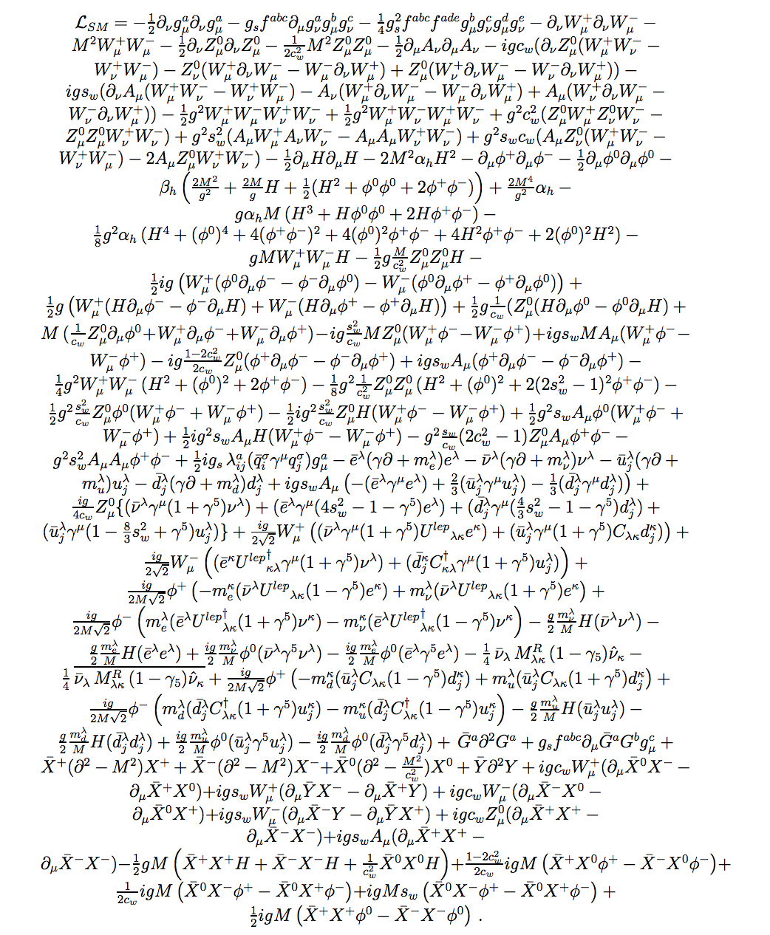
Everything is on one piece of A4 Paper!

Slide 5
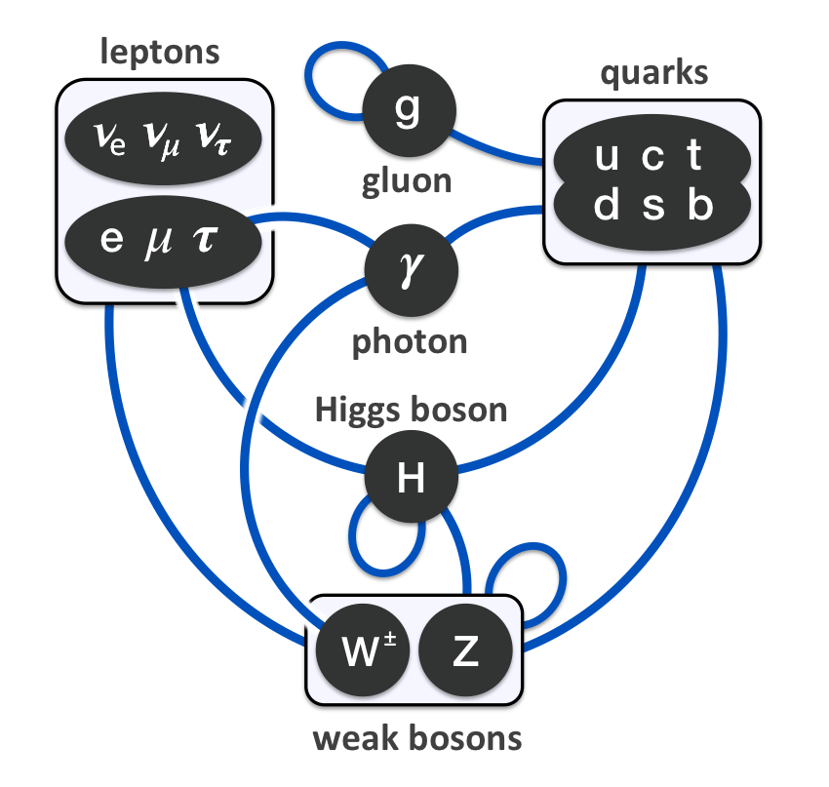
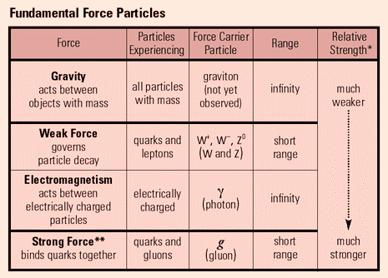
The particles and interactions

Slide 6
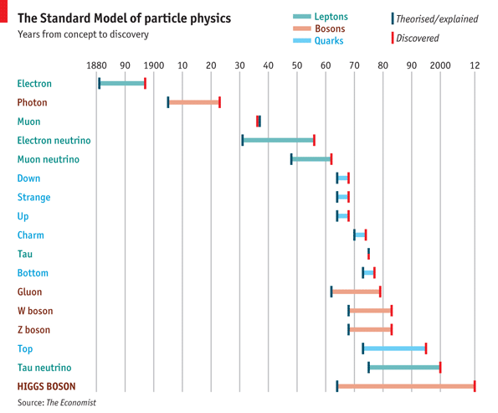
A brief history of SM
100 years with a lot of heroes!

Slide 7
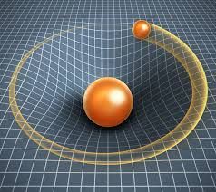
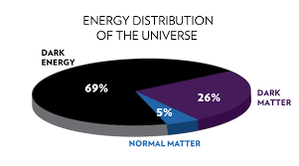
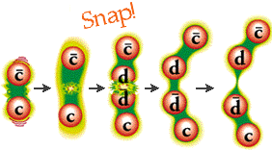
The known unknown of SM
BESIII not only focus on QCD, also on electroweak, for example, charmed hadron decays!
There are of course of unknown-unknown!

Slide 8
The physics processes at √s=2-5 GeV and the kinematics

Slide 9
Events in detector: trigger fired and data saved
e+e- annihilation
Synchrotron radiation
Beam-gas
Beam wall (e-p, e-n, …)
Beam-beam interaction
Lost beam particles
Electronic noise (junk event)
Nuclear interaction (final state particle + detector)
Cosmic rays (angular distribution, rate)
……
Non-Physics processes should be considered in the experiment design also!

Slide 10
Physics processes at Ecm=2-5 GeV
QED
  Bhabha
  Di-mu
  Di-tau (above threshold)
  Di-gamma
Hadrons at continuum
  Continuum production of hadrons
  Two-photon processes
  Resonances and their decays
  ISR
  Beam energy spread
Luminosity measurement, detector calibration and so on
R-value measurement, form factor measurement ……
The working horse of BESIII!

Slide 11
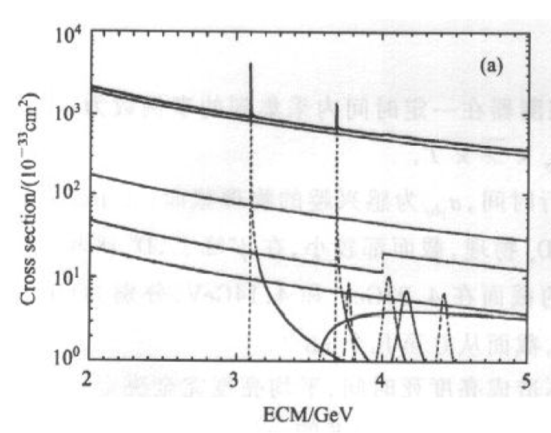
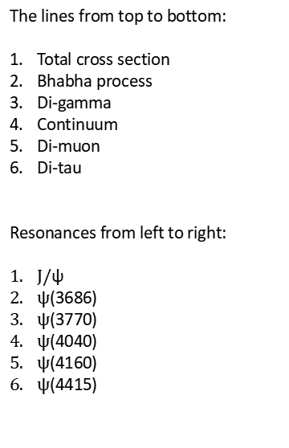
Cross sections
The lines from top to bottom:
Total cross section
Bhabha process
Di-gamma
Continuum
Di-muon
Di-tau
Resonances from left to right:
$J/$ψ
$\text{ψ}$(3686)
$\text{ψ}$(3770)
$\text{ψ}$(4040)
$\text{ψ}$(4160)
$\text{ψ}$(4415)
Except for $J/$ψ and ψ(3686) peaks, the Bhabha is the dominant process in this energy region!

Slide 12
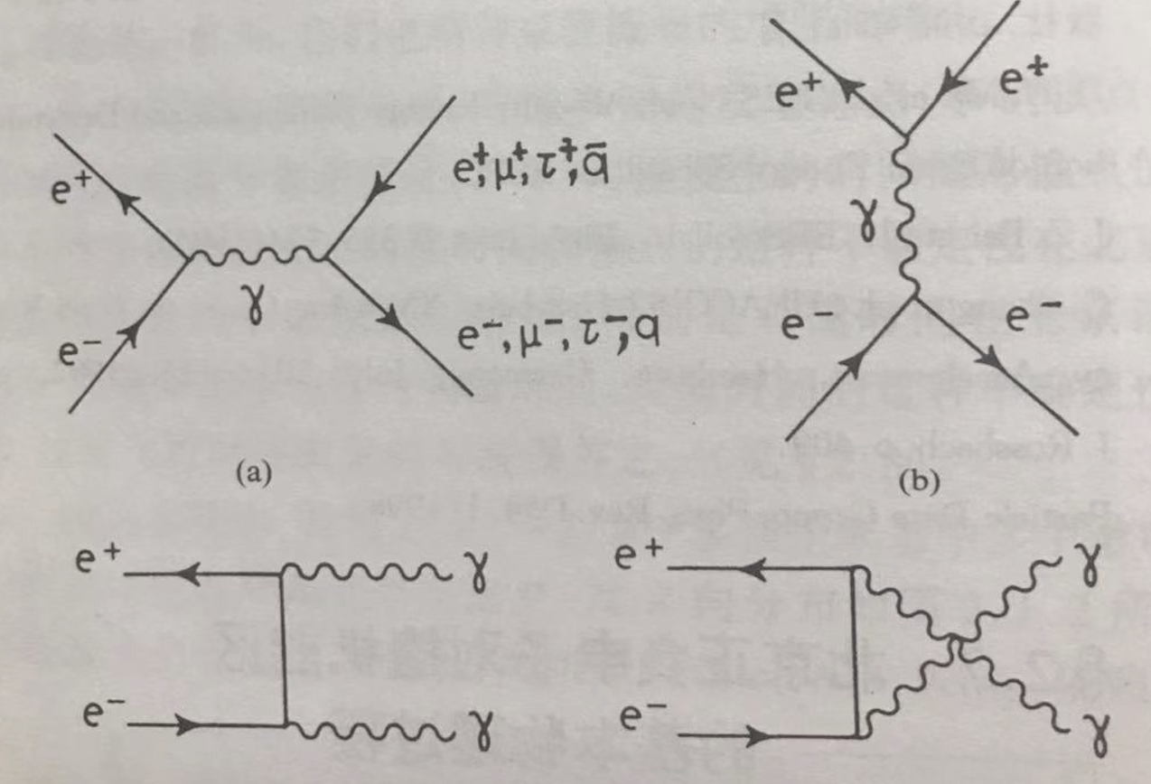



QED processes kinematics (1)
Leading order differential cross section for Bhabha:
$$\frac{dσ}{dΩ}={\frac{α^{2}}{4S}\left(\frac{3+\cos^{2}θ}{1−cosθ}\right)}^{2}$$
Leading order differential cross section for Di-muon and Di-tau:
$$\frac{dσ}{dΩ}=\frac{α^{2}}{4S}β\left(\left(1+\cos^{2 }θ\right)+\left(1−β^{2}\right)\sin^{2}θ\right)$$
$$β=\frac{P}{E}$$

Slide 13
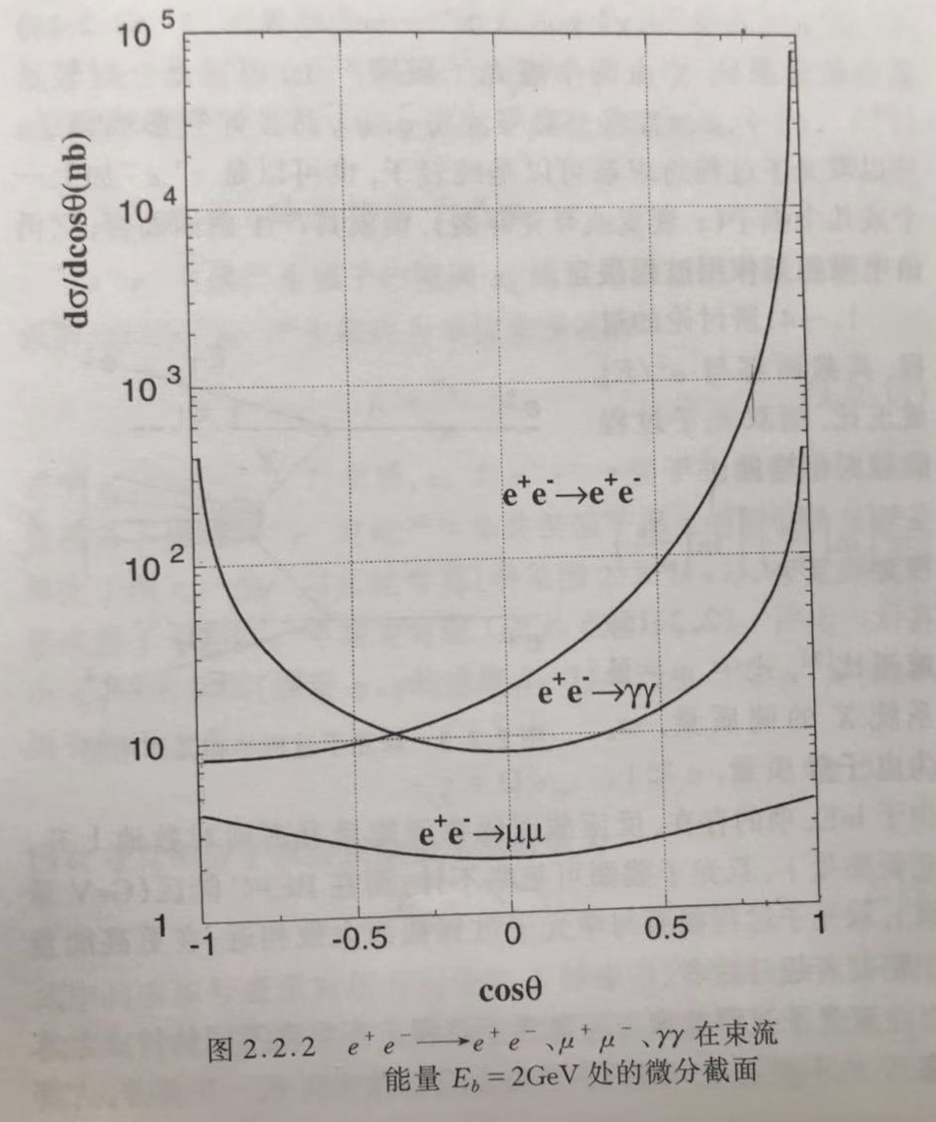



QED processes kinematics (2)
For muon, whose mass is small, P=E, then
$$\frac{dσ}{dΩ}=\frac{α^{2}}{4S}\left(1+\cos^{2 }θ\right)$$
$$σ=\frac{4πα^{2}}{3S}=\frac{86. 8 nb}{S}$$
Leading order differential cross section for Di-gamma:
$$\frac{dσ}{dΩ}={\frac{α^{2}}{S}\left(\frac{1+\cos^{2}θ}{1−\cos^{2}θ}\right)}^{}$$

Slide 14
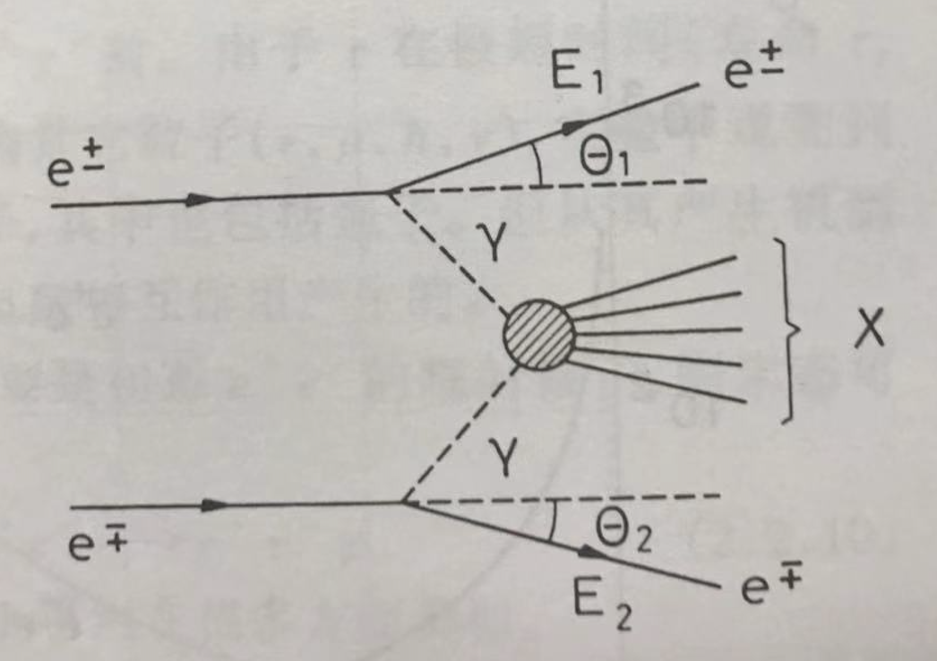
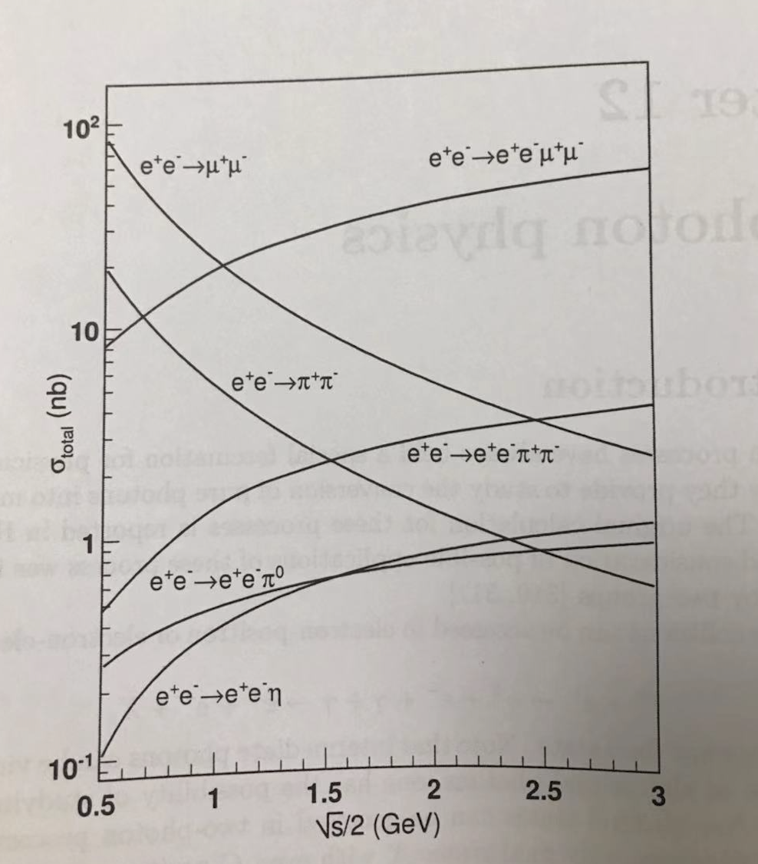

Two-photon process
The cross section roughly proportional to:
$$\frac{α^{4}}{m_{X}^{2}}{(ln⁡(\frac{E_{b}}{m_{e}}))}^{2}ln{(\frac{E_{b}}{m_{X}})}^{n}$$
The cross section at BESIII energy region is not small!
But the X and its decay products are close to the beam line!

Slide 15
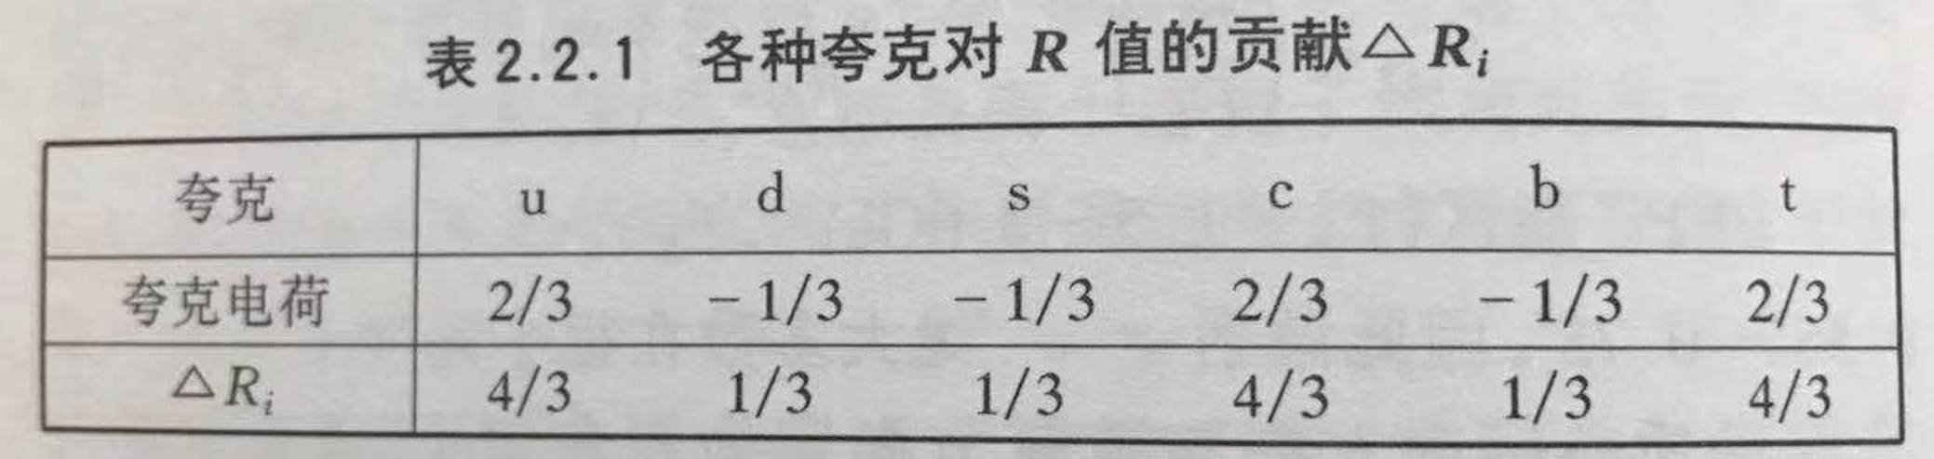


Continuum hadron production
The process is similar to Di-muon, but change the muon to quark, and the quark will form the hadron based on the fragmentation function, thus we define the R value:
$$R=\frac{σ_{h}}{σ_{uu}}=\sum_{i}{3{Q_{i}}^{2}}$$
3 is from the color of quark!
With the correction from gluon:
$R=Rq(1+\frac{α_{s}}{π}+C2{(\frac{α_{s}}{π})}^{2}$+……

Slide 16
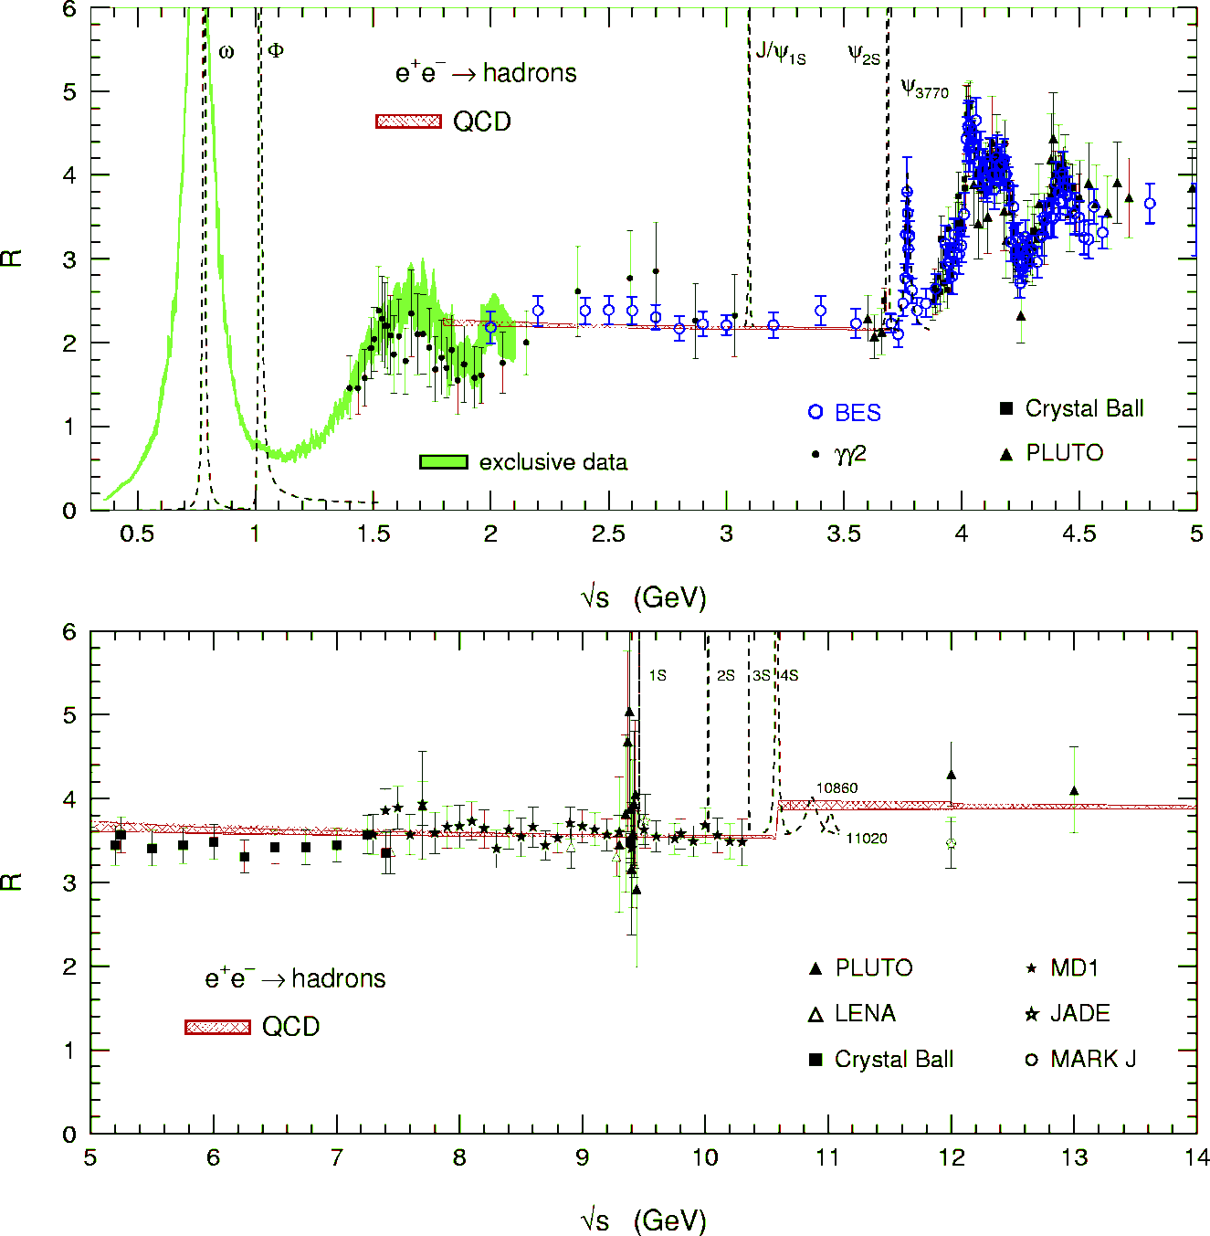
R value
Agreement between Data (BES) and pQCD (within correlated systematic errors)

Slide 17
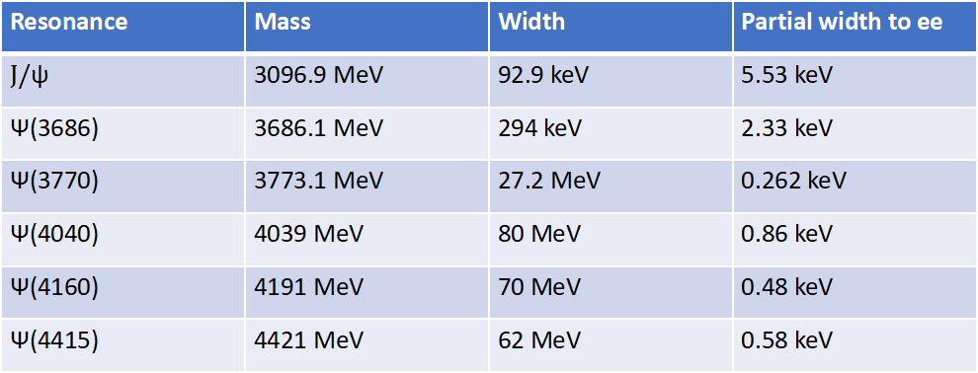

Resonance production
$$σ=\frac{4π(2J+1)ΓΓ_{e}}{{(s−M^{2})}^{2}+M^{2}Γ^{2}}$$
J=1
Resonance | Mass | Width | Partial width to ee
$J/$ψ | 3096.9 MeV | 92.9 keV | 5.53 keV
Ψ(3686) | 3686.1 MeV | 294 keV | 2.33 keV
Ψ(3770) | 3773.1 MeV | 27.2 MeV | 0.262 keV
Ψ(4040) | 4039 MeV | 80 MeV | 0.86 keV
Ψ(4160) | 4191 MeV | 70 MeV | 0.48 keV
Ψ(4415) | 4421 MeV | 62 MeV | 0.58 keV
For narrow peak, the production cross section is heavily affected by beam energy spread;
Initial state radiation and vacuum polarization correction are important also!

Slide 18
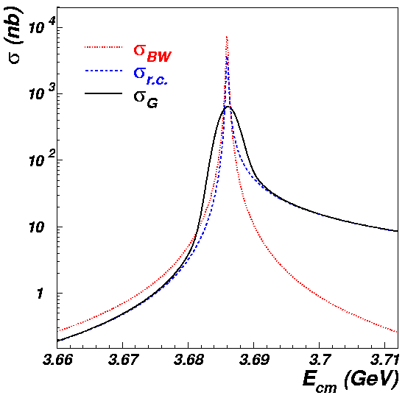

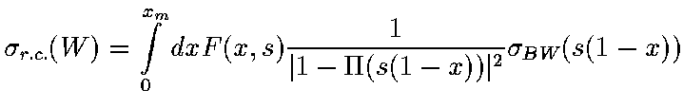
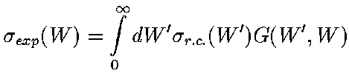

At resonance peak
At ψ(2S) | Born | ISR | Δ=1.3MeV
σ_{RES} (nb) | 7887 | 4046 | 640
σ_{CON} (nb) | ~14 | ~14 | ~14
Continuum contribution becomes larger after considering ISR and beam spread!

Slide 19
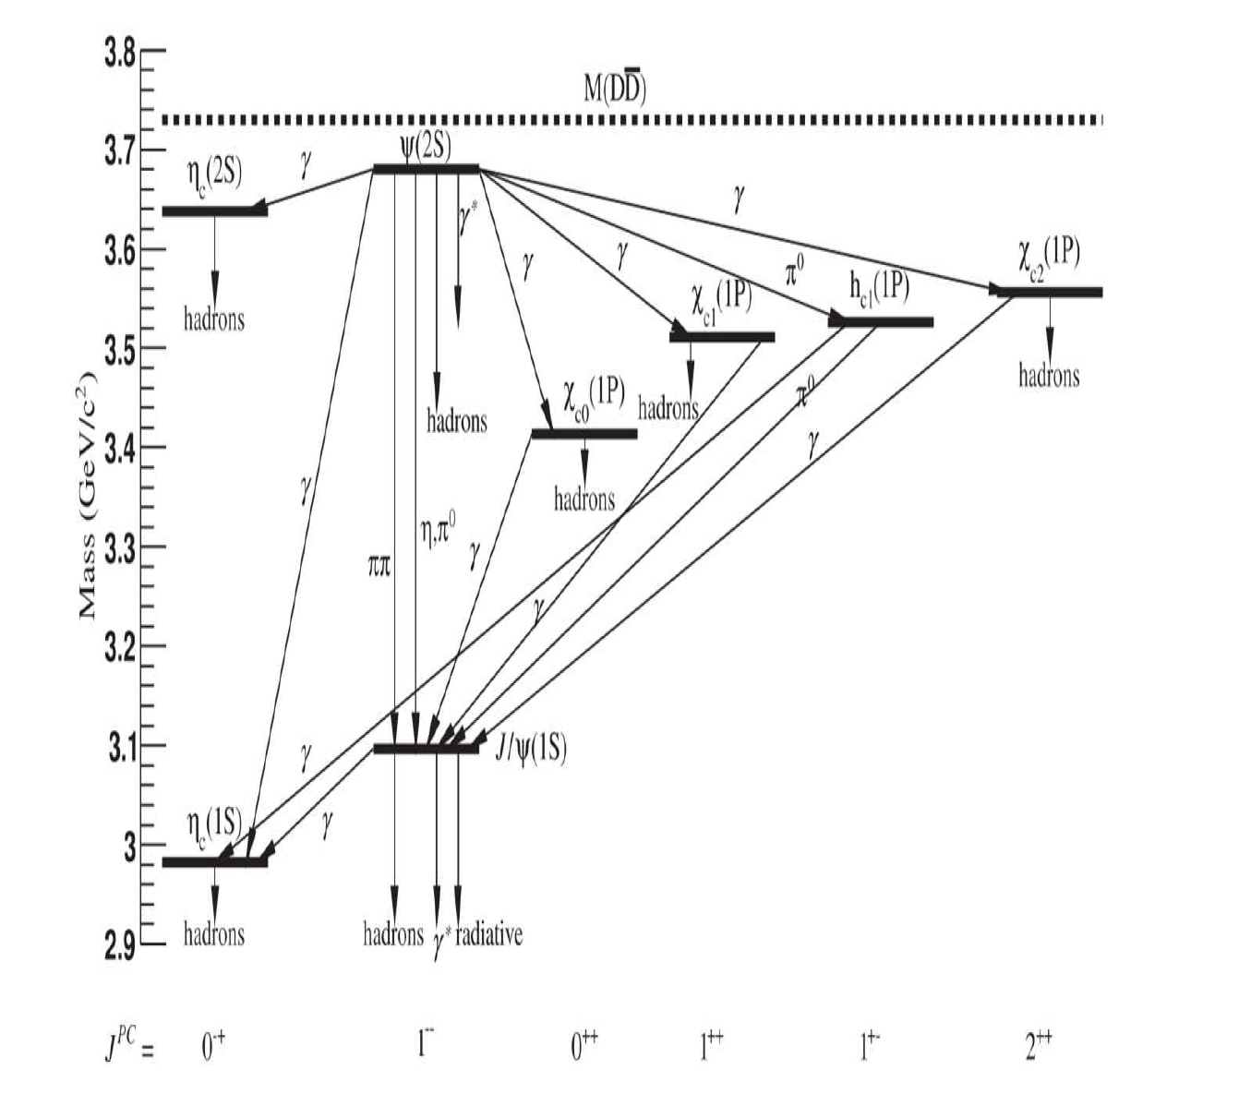
Charmonium states
P=(-1)^{L+1}
C=(-1)^{L+S}
J^PC | L | S | J
0-+ | 0 | 0 | 0
1-- | 0 | 1 | 1
0++ | 1 | 1 | 0
1++ | 1 | 1 | 1
1+- | 1 | 0 | 1
2++ | 1 | 1 | 2
Weimin Song

Slide 20
Charmonium states
J^PC | L | S | J
0-+ | 0 | 0 | 0
1-- | 0 | 1 | 1
0++ | 1 | 1 | 0
1++ | 1 | 1 | 1
1+- | 1 | 0 | 1
2++ | 1 | 1 | 2
2-+ | 2 | 0 | 2
3-- | 2 | 1 | 3
2-- | 2 | 1 | 2
1-- | 2 | 1 | 1
3+- | 3 | 0 | 3
4++ | 3 | 1 | 4
3++ | 3 | 1 | 3
2++ | 3 | 1 | 2
P=(-1)^{L+1}
C=(-1)^{L+S}
So 0+1, 0--, 1-+, 2+-…… are missing!

Slide 21
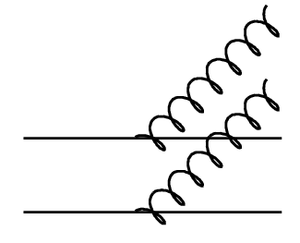
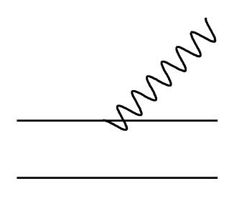
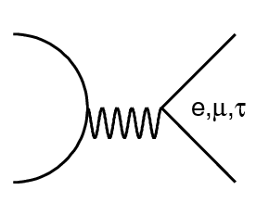
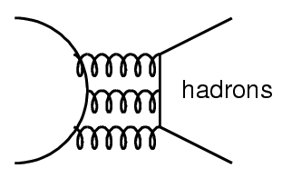
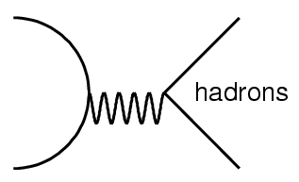
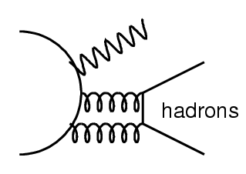
ψ’ decays
Transitions (~82%)
  Hadronic transitions (~54%)
  Radiative transitions (~28%)
Leptonic decays (~ 2%)
Hadronic decays (~15%)
  Strong decays (~13%)
  EM decays (~ 2%)
Radiative decays (~ 1%)
Rare decays and beyond SM (<<1%)
Similar for J/ψ decays, but BR different.

Slide 22
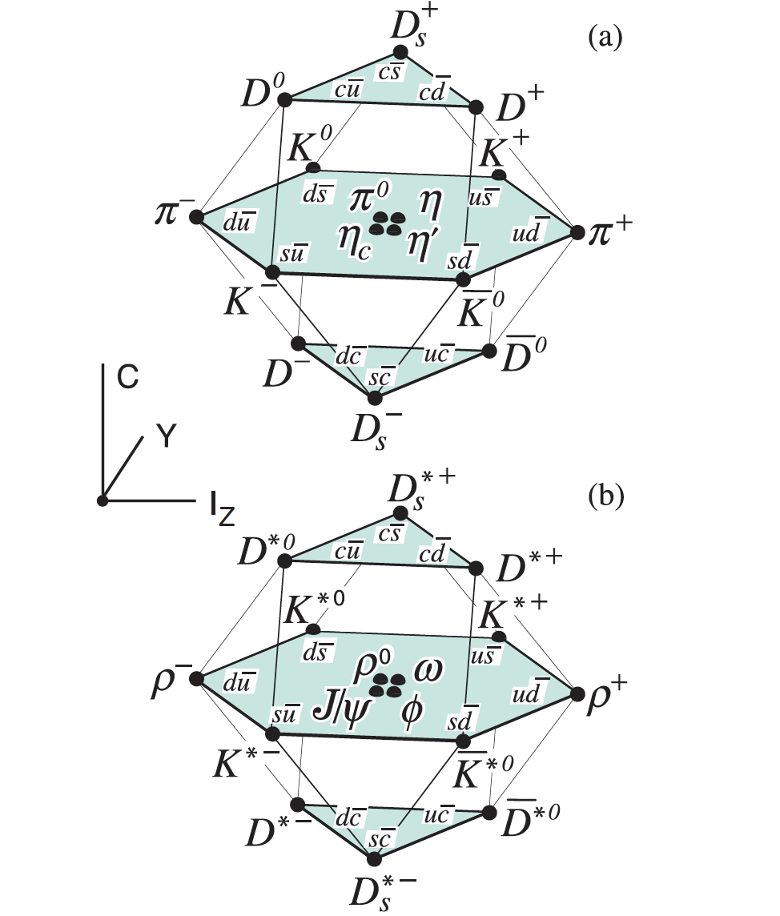
Charm mesons
P=(-1)^{L+1}
C=(-1)^{L+S}
0-+
1--

Slide 23
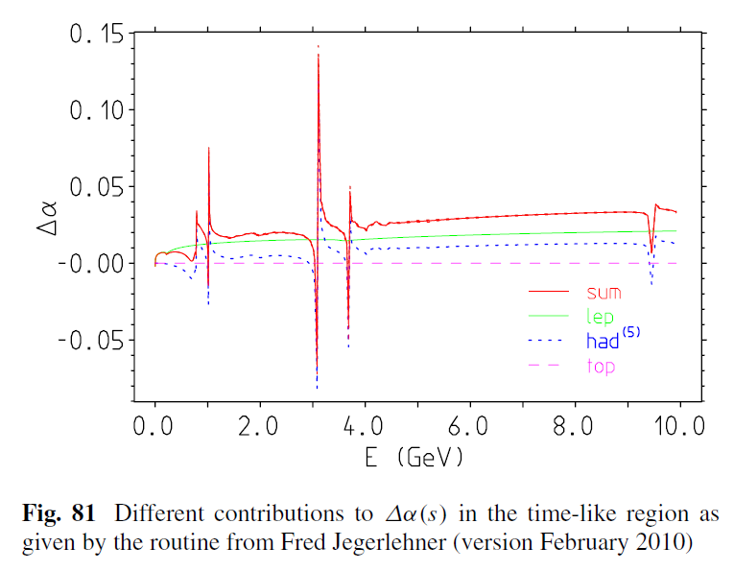
Vacuum polarization

Slide 24
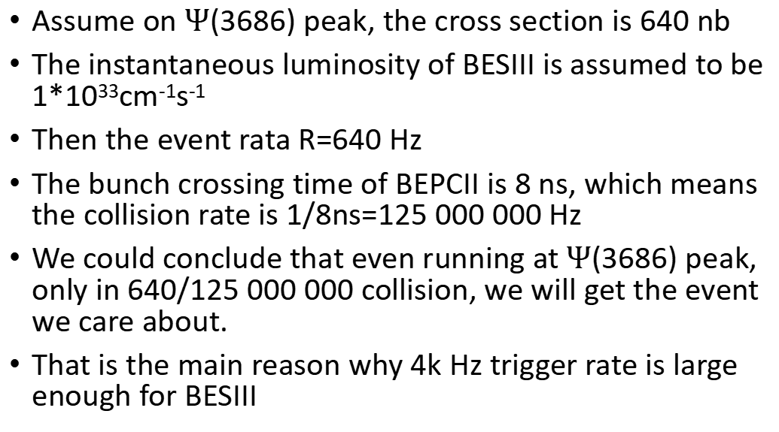
How often we will get a physics event on BESIII?
Assume on $Ψ$(3686) peak, the cross section is 640 nb
The instantaneous luminosity of BESIII is assumed to be 1*10³³cm⁻¹s⁻¹
Then the event rata R=640 Hz
The bunch crossing time of BEPCII is 8 ns, which means the collision rate is 1/8ns=125 000 000 Hz
We could conclude that even running at $Ψ$(3686) peak, only in 640/125 000 000 collision, we will get the event we care about.
That is the main reason why 4k Hz trigger rate is large enough for BESIII

Slide 25
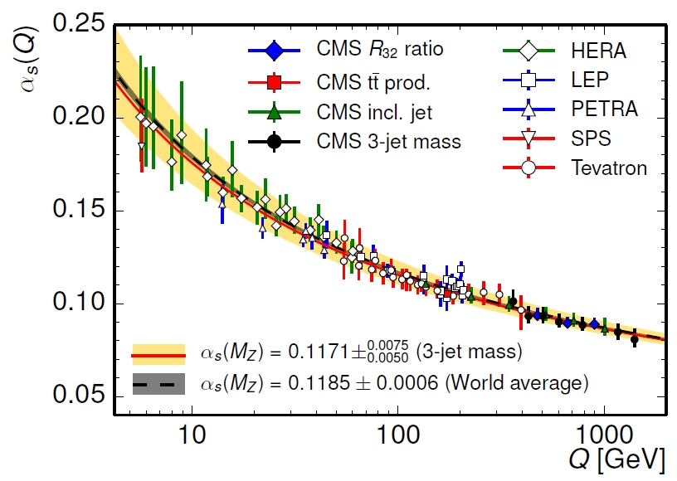
Introduction to QCD
QCD is short for quantum chromodynamics, is the accepted theory for strong interaction
In the high energy regime, perturbation theory works well; in very low energy regime, chiral perturbation theory works well; well in the energy region between, we need Lattice QCD or QCD-inspired models, such as NRQCD
BESIII or charm quark is in this special region

Slide 26
Introduction to accelerator

Slide 27
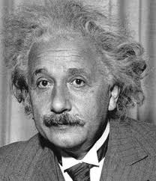
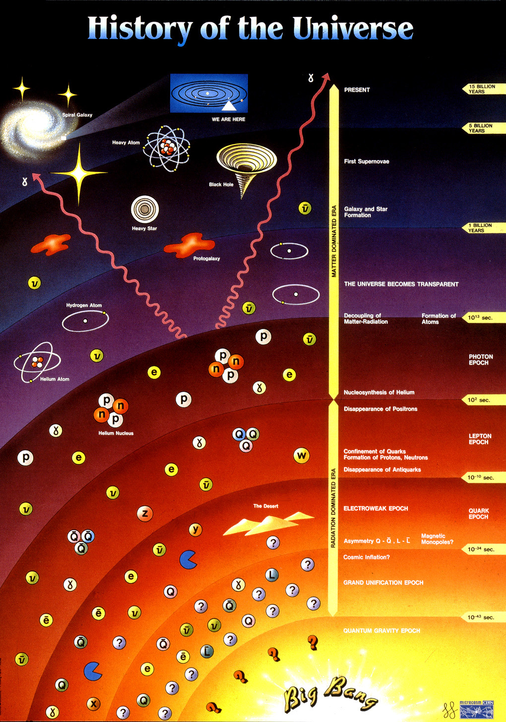
Matter versus Energy
E = m c²
During the Big Bang Energy was transformed in matter
In our accelerators we provide energy to the particle we accelerate.
In the detectors we observe the matter

Slide 28
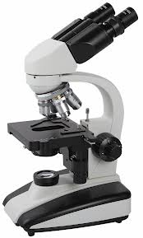
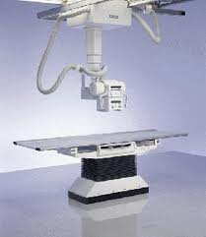
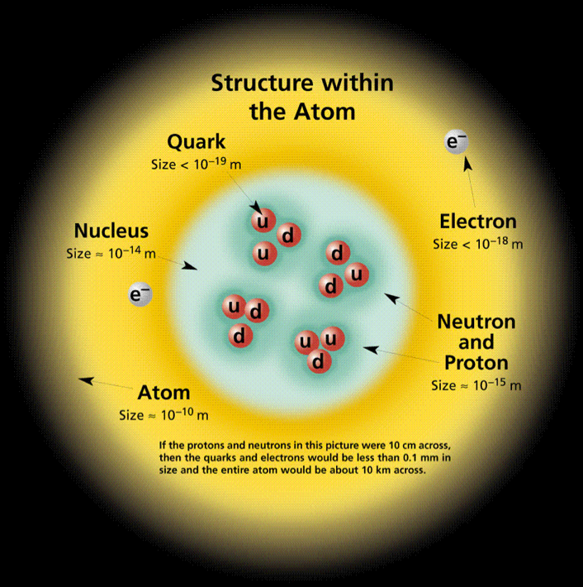
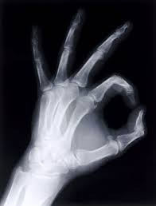
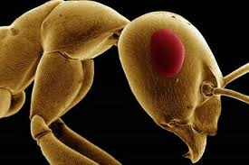
Looking to smaller dimensions
Visible light
λ = 400 ➔ 700 nm
X-ray
λ = 0.01 ➔ 10 nm
Particle accelerators
λ < 0.01 nm
λ =
h c
Increasing the energy will reduce the wavelength
E

Slide 29
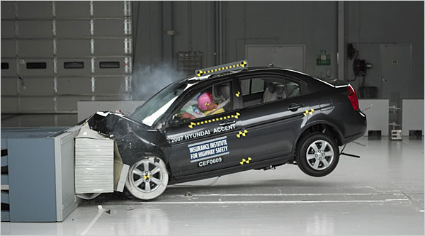
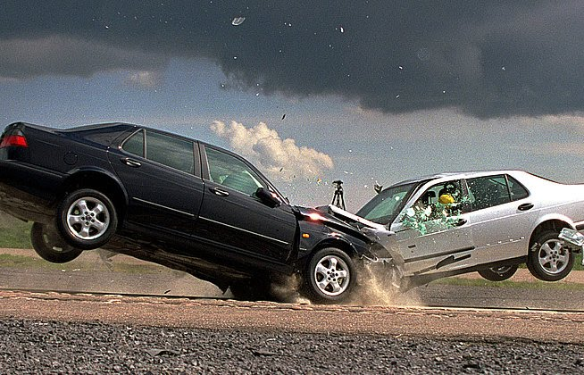
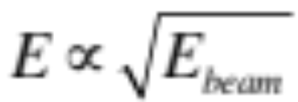
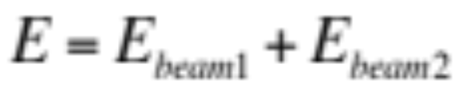
Fixed Target vs. Colliders
Fixed Target
Collider
Much of the energy is lost in the target and only part results in usable secondary particles
All energy will be available for particle production

Slide 30

Accelerators and Their Use
Today: ~ 30’000 accelerators operational world-wide*
The large majority is used in industry and medicine
Les than a fraction of a percent is used for research and discovery science
Industrial applications: ~ 20’000*
Cyclotrons
Medical applications: ~ 10’000*
FFAG
Synchrotrons
*Source: World Scientific Reviews of Accelerator Science and Technology
A.W. Chao
Synchrotron light sources (e⁻)
Lin. & Circ. accelerators/Colliders

Slide 31
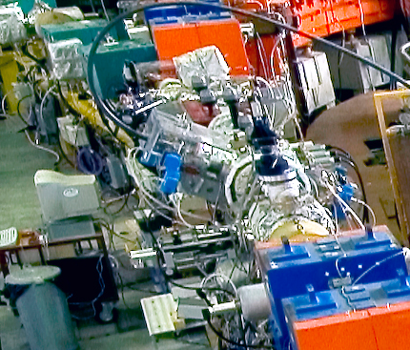
Injecting & Extracting Particles
Incoming beam
Magnetic field
No magnetic field
Circulating beam
Injected beam
Septum Magnet
Kicker Magnet

Slide 32
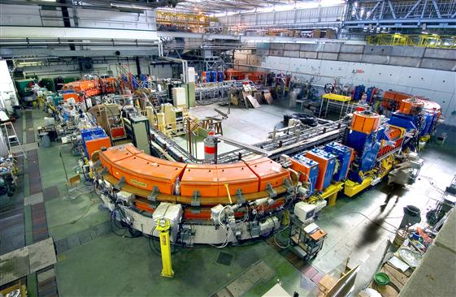
Make Particles Circulate
Main Dipoles
Main Dipoles
Main Dipoles
Main Dipoles

Slide 33
Focusing the Particles
Main Dipoles
Main Dipoles
Main Dipoles
Quadrupoles

Slide 34
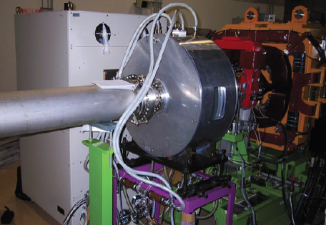
Accelerating Particles
Accelerating
Cavity

Slide 35
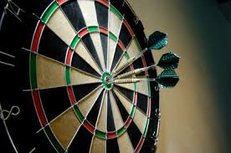

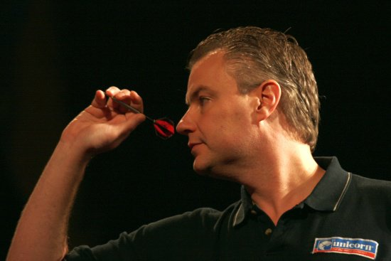
Figures of Merit in accelerators
For different accelerators and experiments different beam characteristics are important. However, a major division can be made between:
Fixed Target Physics:
Light Sources:
Collider Physics:

Slide 36
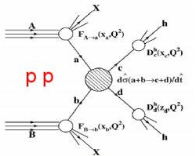
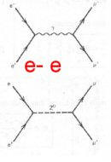
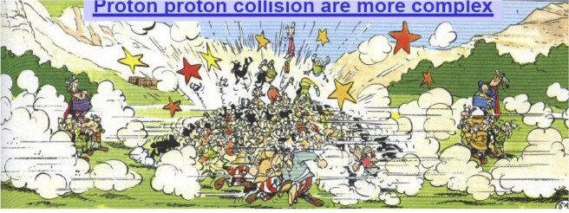
Main parameters: particle type
Hadron collisions: compound particles
  Mix of quarks, anti-quarks and gluons: variety of processes
  Parton energy spread
  Hadron collisions ⇒ large discovery range
Lepton collisions: elementary particles
  Collision process known
  Well defined energy
  Lepton collisions ⇒ precision measurement
  “If you know what to look for, collide leptons, if not collide hadrons”

Slide 37
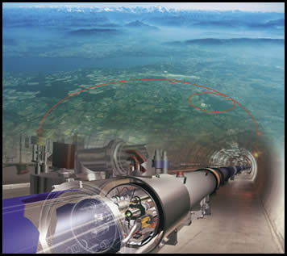

Main parameters: particle type
Discovery Precision
LHC/SPPC
LEP / ILC/CEPC

Slide 38


Main parameters: luminosity
High energy is not enough !
Cross-sections for interesting processes are very small (~ pb = 10⁻³⁶ cm² ) !
  σ(gg → H) = 23 pb [ at s²_{pp} = (14 TeV)^{2,} m_{H} = 150 GeV/c² ]
  We need L >> 10³⁰ cm⁻²s⁻¹ in order to observe a significant amount of interesting processes!
L [cm⁻²s⁻¹] for “bunched colliding beams” depends on
  number of particles per bunch (n₁, n₂)
  bunch transverse size at the interaction point (σ_{x}, σ_{y} )
  bunch collision rate ( f)

Slide 39



Ways to Increase Luminosity
Increase the beam brightness from the injectors (N and σ)
  More particle in smaller beams (increase brightness)
Increase number of bunches
  Higher harmonic RF systems
Reduce the β* (σ)
  Stronger focusing around the interaction points
Use crab cavities to reduce the crossing angle effect (s)
  Tilt the bunches to have more head-on collision effect
Beam 1
Beam 2
Beam 1
Beam 2
Without crabbing
With crabbing

Slide 40
Introduction to detector

Slide 41
Just to get started…
p = momentum
m = mass
E = energy
c = speed of light in vacuum
v = speed of the particle we are observing
β = v/c = p/E
γ = (1-β²)^{-1/2} = E/m
n = index of refraction
  Light speed in the medium is c/n

Slide 42

Interactions of Particles with Matter - Photoemission
Excitation (followed by de-excitation)
  Atomic Electron (energy E₁)
  Promoted to higher energy state (E₂)
    Energy comes from Charged Particle passing nearby
  a. Electron falls back to ground state (E₁)
  b. Released energy is carried by a Photon
Photoemission
E₂
E₁
E_{photon} = E₂ – E₁
After:
The initial Charged Particle
An Emitted Photon
Atom/Molecule (possibly in excited state)
Energy: conserved
Before:
Fast-moving charged particle or photon.
Detector Atom/Molecule, at rest.

Slide 43
Interactions of Particles with Matter - Ionization
Ionization
  Atomic electron is knocked free from the atom.
  The remaining atom now has a net charge (it is an ion).
  The atom may also be left in an excited state and emit a photon as it returns to its ground state.
  In a crystal lattice such as Silicon, the ionized atom is called a “hole”.
Ionization
Ion
Free Electron
Charged
Particle
Electric Field
After:
The initial particle or photon.
A Free Electron
Ionized atom (possibly in excited state)
Photon (sometimes)
Energy: conserved
Before:
Fast-moving charged particle or photon.
Detector Atom/Molecule, at rest.

Slide 44



Interactions of Particles with Matter - Collective Effects
The electric field of a particle may have a long-range interaction with material as it passes through a continuous medium.
Cerenkov Effect:
Critical Parameter is β
Turns ON when particle speed is greater than light speed in the medium: v = βc > c/n
β
1/n

Slide 45

Interactions of Particles with Matter - Collective Effects
Transition Radiation:
Critical Parameter is γ
The sudden change in electric field as an ultrarelativistic charged particle passes from one medium to another results in ~keV photons (x-rays).
Ultrarelativistic: γ >~ 1000
γ ≡ (1- β²)^{-1/2} = E/m
Light is emitted at the angle
θ ~ 1/γ
(1 milliradian or less)
6 | GeV/c
 | electron | pion | proton
mass | 0.000511 | 0.139 | 0.939
beta | 0.999999996 | 0.999731761 | 0.987974331
gamma | 11741.7 | 43.2 | 6.5
θ
X±

Slide 46
Interactions of Particles with Matter - Radiation Damage
Particles can have lasting effects on the detector materials.
  Nuclear Collision
    Particle undergoes interaction directly with atomic nucleus.
    May transmute the element (radiation damage).
    May generate secondary particles which themselves are detectable (neutron detector).
  Lattice Dislocation
    Crystalline structure of a material may be disrupted (diode leakage current increases).
  Chemical Change
    Photographic Film (photos fogged at airports) or Emulsion (visible particle tracks).
    Changed molecular bond in a clear material may create color centers
While these effects can be exploited for particle detection,
they may also cause permanent damage to detector components resulting in a detector which stops working.
This is sometimes referred to as “aging”.

Slide 47
Interactions of Particles with Matter
Summary: When charged particles pass through matter they usually produce either free electric charges (ionization) or light (photoemission).
Ahead: Most “particle” detectors actually detect the light or the charge that a particle leaves behind.
Next: In all cases we finally need an electronic signal which is big enough to use in a Data Acquisition System.

Slide 48

Particle Detectors: Avalanche Multiplication
We need devices that are sensitive to the few electron charges coming from a ionization.
But, typical electronic circuits are sensitive to
~1µA = 6.2x10¹² e⁻/s which is >> “a few”
We need to amplify the ionization electrons.
By giving them a push, we can make them move fast enough so that they ionize other atoms when they collide. Push those new electrons and each one ionizes more atoms, releasing more electrons. After this has happened several times we have a sizeable free charge that can be sensed by an electronic circuit.

Slide 49

Particle Detectors: A Single-wire Gas Chamber
Low Electric Field far from the wire.
High Electric Field near the wire.

Slide 50

Particle Detectors: Multi-Wire Gas Chamber
Multiwire Chamber:
      WHICH WIRE WAS NEAREST TO THE TRACK?

Slide 51

Particle Detectors: tracking
“Why does he want all those wires??”
If we make several measurements of track position along the length of the track, we can figure out the whole trajectory.
It would be even nicer to know what part of each “wire” was struck…

Slide 52

Particle Detectors: better position information
Readout Options for Improved Resolution
  And for flexible design
    Charge Division
    Time Division
    Charge Interpolation
  Wire Position gives “x”
  Measurement along wire
  length gives “y”.
2D Readout by determining
1: x from seeing which wire was struck;
2: y: position along the wire either from
-comparing charges arriving at the ends of the wire, or
-comparing time of arrival of the pulses at the two ends.
y
x
It would be nicer still if we knew the distance between the particle and the struck wire…
Compare Times of Arrival
-or-
Compare Pulse Heights

Slide 53


Particle Detectors: higher resolution tracking
Drift Chambers…
HOW FAR TO THE NEAREST WIRE?
Particle ionizes gas; the “trigger” starts the timer.
2. Electrons drift from track to wire, stopping the timer.
x
3. We measure the time required to drift to the wire and obtain the distance X.
stop
start
“trigger” detector(s)
drift time

Slide 54





Particle Detectors: TPC, 3D position information
Time Projection Chamber (TPC): Drift through a Volume
Just a box of gas with
  Electric Field and
  Readout Electrodes
Readout elements only on one surface.
Ionization Electrons drift to Surface for
  Amplification
  Charge Collection
Readout Electrode Position gives (x,y)
Time of Arrival gives (z).
Particle
track
Readout
electrodes
E
y
Cathode
Anode
(gain)
Electronics
To DAQ
z
x

Slide 55

Detector system example: ATLAS

Slide 56
The results from BESIII and how they help to solve the problems

Slide 57

Beijing Electron Positron Collider
(BEPCII)
Beam energy:
1-2.5 GeV
Design luminosity:
1×10³³ cm⁻²s⁻¹
Optimum energy:
1.89 GeV
Energy spread:
5.16 ×10⁻⁴
Bunch length:1.5 cm
Total current: 0.91 A
Linac: ~200 m
Circular:~240 m
Double rings with tiny crossing angle

Slide 58

BESIII detector
Charged-particle momentum resolution@1GeV: 0.5%
Photon energy resolution@1 GeV: 2.5% (5%) for barrel (endcap); position resolution 6mm
dE/dx resolution: 6% for electrons from Bhabha process
Time resolution of TOF: 68 ps (60 ps) for barrel (endcap)
SC magnetic: 1 T
Trigger and DAQ: 4 kHz, with event size 12 Kbytes

Slide 59
Physics program @ BESIII
Light hadron physics
-meson & baryon spectroscopy
-glueballs & hybrids
Charm physics:
- f_{D} & f_{Ds} decay consts.
- CKM matrix: V_{cd}, V_{cs}
- strong phase
New physics:
- rare decays
- dark sector
Charmonium physics:
- precision spectroscopy
- transitions and decays
- charmoniumlike states
QCD & 𝜏-physics:
- precision R-measurement
- 𝜏 lepton mass
- two-photon physics
QCD
New Physics

Slide 60

Light hadron
physics

Slide 61


Amplitude analysis of J/Ψ → 𝛾K_{S}K_{S}
PRD 98, 072003
Production rate for f₀(1710) is 10 times larger f₀(1500)⇒the former has larger overlap with glueball;
Production of f₂(2340) is consistent with the pure gauge tensor glueball prediction made by LQCD.

Slide 62

Charmoniumlike
states

Slide 63

Charmonium spectroscopy

Slide 64
Hadrons：traditional & exotic
Hadrons are composed of 2 quarks (meson) or 3 quarks (baryon) in Quark Model
QCD does not forbid hadrons with N_{quarks}≠2, 3
  glueball： N_{quarks} = 0 (gg, ggg, …)
  hybrid： N_{quarks} = 2 (or more) + excited gluon
  multiquark state： N_{quarks} > 3
  molecule： bound state of more than 2 hadrons
  …
BESIII@BEPCII is collecting data to study this.

Slide 65

Charm physics

Slide 66





Leptonic & semileptonic decays
Leptonic and semileptonic decays of charmed hadrons (D⁰, D⁺, D_{s}⁺, Λ_{c}⁺) provide ideal testbeds to explore weak and strong interactions
|V_{cs(d)}|: better test on CKM matrix unitarity
(Semi-)leptonic D_{(s)} decays allow for LFU tests
f_{D(s)+}, f₊^{K(π)} (0): test of LQCD

Slide 67










f_{D+}|V_{cd}| from D⁺→l⁺v
2.93 fb⁻¹ data@ 3.773 GeV
New inputs from PDG2018:
PRD89, 051104 (2014)
BESIII preliminary
409±21
$$f_{D^{+}}\left|V_{cd}\right|=45.75±1.20±0.39 MeV$$
$$f_{D^{+}}\left|V_{cd}\right|=50.4±5.0stat MeV$$
statistical error dominant

Slide 68

𝜏 and R -QCD

Slide 69







Precision measurement of the 𝜏 mass
PRD 90, 012001
A fundamental parameter of the SM!
Check the universality of the leptons!
Near threshold scan method:
* 4 scan points with well optimization
* 13 decay modes of the t pair
The most precise single measurement!
* With beam energy measurement system

Slide 70

New Physics

Slide 71



Slide 72
How to choose a new topic to work on？

Slide 73





Scattering experiments shed light on matter structure
Rutherford experiment
Electon-nucleon DIS
Quark
Nucleus

Slide 74

Particle sources
Three elements of scattering experiment：particle source, target, and detector
High quality particle source：long lifetime、easy to produce and control、low background、high intensity、good resolution……
charged：electron/positron，muon，pion，kaon，proton，heavy ion
neutral：photon，neutron，neutrino
detector
source
target
For more details: D.C. Faircloth, Particle Sources, 2103.13231 (Proceedings of the CERN–Accelerator–School: Introduction to Accelerator Physics )
Beams of other neutral particles, such as antineutrons, K⁰ and‾K⁰, long-lived hyperons (Λ, Σ±, Ξ^{0/−}) and their antiparticles (‾Λ, ‾Σ±, ‾Ξ^{0/+}) have great physics potential, but they are typically much more difficult to produce and control.

Slide 75




Antineutron in history
‾pp→‾nn @ E-767@BNL & OBELIX@CERN
50k tagged evts
Limited statistics
36‾n per 10⁶‾p
[2x10⁷ collected in 5 years]
Limited momentum range
Uncertainty in flux~7%
σp_{‾n} = 3% @ 50 MeV/c
= 5% @ 400 MeV/c
20M tagged evts

Slide 76


Antineutron in history
Anti-neutron is neutral
Hard to control and select
VS
No coulomb interaction, easy to get the physics amplitute
OBLIX experiment at CERN：$p\overline{p}→n\overline{n}$
About 40 publications [Physics Report 383, 213-297]

Slide 77


Sources of Λ & other hyperons
Bubble chamber experiments with hyperons from K⁻+target
Emulsion experiments with K⁻+target → K⁺+X, K⁺+K⁺+X, …
A few to about 10⁴ events (typical O(100) tagged events)
No anti-hyperon sources!
SLAC HBC, Nuclear Physics B125 (1977) 29-51
KEK, K⁻ + SCIFI →Ξ⁻ X

Slide 78


Many unsolved problems
Dip on the cross section: Initial-Final State Interaction？
f₀(1500)：glue ball？

Slide 79


Many unsolved problems
Large Kaon pair production：OZI Violation？
Paticle with Isospin=2?

Slide 80

How could we obtain antineutron/hyperson sources with better resolution, wider momentum range and lower cost?

Slide 81


Do fixed target experiments @ a super J/ψ factory
The idea

Slide 82





Why J/ψ decays: huge cross section of e⁺e⁻→J/ψ
Γ_{J/ψ}=93 keV
at J/ψ peak | Born | ISR | Δ=1 MeV
σ (nb) | 9.1×10⁴ | 4.4×10⁴ | 3,100
Formulas from PLB 557 (2003) 192
Numbers & plot from Yuping Guo
L = 0.5 nb⁻¹s⁻¹ @ BEPCII

Slide 83

Hyperons and anti-hyperons at BESIII experiment
The Ω hyperons are produced from 3 billion ψ(2S) event sample.
All these particles can also be produced in decays of other charmonia.

Slide 84



$\overline{n}$p → 2π⁺π⁻(π⁰)
arXiv 2511.21462, submitted to PRL
10B $J/ψ$ at BESIII
Huge number of antiproton from $e^{+}e^{−}→J/ψ→{pπ}^{−}\overline{n}$ by tagging $p$.

Slide 85

$\overline{n}$p → 2π⁺π⁻(π⁰)
arXiv 2511.21462, submitted to PRL
Energy difference between the final states and the initial states is used to subtract the signal.

Slide 86

$\overline{n}$p → 2π⁺π⁻(π⁰)
arXiv 2511.21462, submitted to PRL
Clear 𝝆 and 𝝎 are observed in the intermediate states.

Slide 87

$\overline{n}$p → 2π⁺π⁻(π⁰)
arXiv 2511.21462, submitted to PRL
Cross sections are measured as function of anti-neutron momentum, and the part above 800 MeV is measured for first time.

Slide 88


$\overline{n}$p → K⁺K⁻ π⁻(π⁰)
arXiv 2603.24272, submitted to PRL
Energy difference between the final states and the initial states is used to subtract the signal.

Slide 89

$\overline{n}$p → K⁺K⁻ π⁻(π⁰)
arXiv 2603.24272, submitted to PRL
Due to limited statistics, it is difficult to extract the contributions of intermediate states.

Slide 90






$$Ξ^{0}n→Ξ^{−}p$$
PRL 130, 251902 (2023)
Reaction chain :
$J/ψ→Ξ^{0}{\overline{Ξ}}^{0}$, ${\overline{Ξ}}^{0}→\overline{Λ}π^{0}$, $\overline{Λ}→\overline{p}π^{+}$, $π^{0}→γγ$,
$Ξ^{0}n→Ξ^{−}p$, $Ξ^{−}→Λπ^{−}$, $Λ→pπ^{−}$.
10 billion $J/ψ$ data
Two-body decay, $P_{Ξ^{0}}≈0.818 GeV/c$,
a very small horizontal crossing angle of 11 mrad for $e^{+}$ and $e^{−}$ beams.
Analysis method :
Using ${\overline{Ξ}}^{0}$ to tag the event and requiring the recoiling mass in $Ξ^{0}$ region. Then reconstructing $Ξ^{−}$ and $p$ in the signal side.

Slide 91






$$Ξ^{0}n→Ξ^{−}p$$
$R_{xy}$ is distance from reconstructed $Ξ^{−}p$ vertex to $z$ axis
Inner wall of MDC
Beam pipe
$$Ξ^{0}n→Ξ^{−}p$$
$$N=22.9±5.5$$
$$S=7.1σ$$

Slide 92





$$Ξ^{0}n→Ξ^{−}p$$
The measured cross section of the reaction process $Ξ^{0}+{}_{}^{9}{Be}→Ξ^{−}+p+{}_{}^{8}{Be}$ is $σ\left(Ξ^{0}+{}_{}^{9}{Be}→Ξ^{−}+p+{}_{}^{8}{Be}\right)=\left(22.1±5.3stat±4.5sys\right)$ $mb$ at $P_{Ξ^{0}}≈0.818$ $GeV/c$.
If we take the effective number of reaction neutrons in ${}_{}^{9}{Be}$ nucleus as $3$, the cross section of $Ξ^{0}n→Ξ^{−}p$ for single neutron is determined to be $σ\left(Ξ^{0}n→Ξ^{−}p\right)=(7.4±1.8stat±1.5sys)$ $mb$, consistent with theoretical predictions.
No significant H-dibaryon signals are seen
This work is the first study of hyperon-nucleon interaction in electron-positron collisions, and opens up a new direction for such research.

Slide 93





$Λp→Λp$ and $\overline{Λ}p→\overline{Λ}p$
PRL 132, 231902 (2024)
Cross sections in $−0.9≤cosθ_{Λ/\overline{Λ}}≤0.9$ are measured to be
$σ\left(Λp→Λp\right)=(12.2±1.6stat±1.1sys)$ mb and $σ\left(\overline{Λ}p→\overline{Λ}p\right)=(17.5±2.1stat±1.6stat)$ mb
Total cross sections are determined to be
$σ_{t}\left(Λp→Λp\right)=(14.2±1.8stat±1.3sys)$ mb and $σ_{t}\left(\overline{Λ}p→\overline{Λ}p\right)=(27.4±3.2stat±2.5sys)$ mb
First measurement of antihyperon-nucleon reaction

Slide 94






$Λp→Λp$ and $\overline{Λ}p→\overline{Λ}p$
PLB 862, 139321 (2025)
EPJA 60, 119 (2024)
$$\overline{Λ}p→\overline{Λ}p$$
PLB 871, 140004 (2025)

Slide 95







Study of $Λp→Σ^{+}n$
PRC 109, L052201 (2024)
Reaction chain :
$J/ψ→Λ\overline{Λ}$, $\overline{Λ}→\overline{p}π^{+}$, $Λ+N(nucleus)→Σ^{+}+X(anything)$, $Σ^{+}→pπ^{0}$, $π^{0}→γγ$.
$$Λp→Σ^{+}n$$
$$N_{DT}=795±101$$
The measured cross section of the reaction process $Λ+{}_{}^{9}{Be}→Σ^{+}+X$ is $σ\left(Λ+{}_{}^{9}{Be}→Σ^{+}+X\right)=\left(37.3±4.7stat±3.5sys\right)$ $mb$ at $P_{Λ}≈1.074$ $GeV/c$. This work represents the first attempt to investigate $Λ$-nucleus interaction at an $e^{+}e^{−}$ collider.

Slide 96









$Σ^{+}n→Λp$ and $Σ^{+}n→Σ^{0}p$
PRC 113, L032201 (2026)
Reaction chain :
$J/ψ→Σ^{+}{\overline{Σ}}^{−}$, ${\overline{Σ}}^{−}→\overline{p}π^{0}$, $π^{0}→γγ$,
$Σ^{+}n→Λp/Σ^{0}p$, $Σ^{0}→γΛ$, $Λ→pπ^{−}$.
$$Σ^{+}n→Λp/Σ^{0}p$$
$$Σ^{+}n→Σ^{0}p$$
$$N_{Λ}=77.6±20.8$$
$$ε_{Λ}=14.44\%$$
$$N_{Σ^{0}}=14.1±4.6$$
$$ε_{Σ^{0}}=3.98\%$$
The measured cross sections of the two reactions $Σ^{+}+{}_{}^{9}{Be}→Λ+p+X$ and $Σ^{+}+{}_{}^{9}{Be}→Σ^{0}+p+X$ are $σ\left(Σ^{+}+{}_{}^{9}{Be}→Λ+p+X\right)=\left(45.2±12.1stat±7.2sys\right)$ $mb$ and $σ\left(Σ^{+}+{}_{}^{9}{Be}→Σ^{0}+p+X\right)=\left(29.8±9.7stat±6.9sys\right)$ $mb$ at $P_{Σ^{+}}≈0.992$ $GeV/c$.

Slide 97







$$Ξ^{0}n→ΛΛX$$
Reaction chain :
$J/ψ→Ξ^{0}{\overline{Ξ}}^{0}$, ${\overline{Ξ}}^{0}→\overline{Λ}π^{0}$, $\overline{Λ}→\overline{p}π^{+}$, $π^{0}→γγ$,
$Ξ^{0}n→ΛΛX$, $Λ→pπ^{−}$.
arXiv: 2512.04701
$$N=24.6±5.9$$
$$S=6.4σ$$
No significant H-dibaryon signals are seen
The measured cross section of the reaction $Ξ^{0}+{}_{}^{9}{Be}→Λ+Λ+X$ is $σ\left(Ξ^{0}+{}_{}^{9}{Be}→Λ+Λ+X\right)=\left(43.6±10.5stat±11.1sys\right)$ $mb$ at $P_{Ξ^{0}}≈0.818$ $GeV/c$. The reaction $Ξ^{0}n→ΛΛX$ is mainly composed of the reaction $Ξ^{0}n→ΛΛ$ and $Ξ^{0}n→ΛΣ^{0}→ΛΛγ$.

Slide 98




$$\overline{Λ}p→light mesons$$
arXiv: 2602.04276
A similar behavior is found for the reactions $\overline{Λ}p→ΚNπ$ and $\overline{n}p→πNπ$ $(N≥1)$, the results are useful to understand antibaryon-baryon interaction in a unified perspective.

Slide 99





$$\overline{Λ}p→K^{+}π^{+}π^{−}(k)π^{0}$$
arXiv: 2602.01282
Reaction chain :
$J/ψ→Λ\overline{Λ}$, $Λ→pπ^{−}$, $\overline{Λ}p→K^{+}π^{+}π^{−}(k)π^{0}$.

Slide 100


Precision Y N and $\overline{n}$N measurements with an LH2/LD2 target in the BESIII detector
arXiv 2603.16075, submitted to PRD
How to increase the statistics? 1. More target material

Slide 101

Precision Y N and $\overline{n}$N measurements with an LH2/LD2 target in the BESIII detector
arXiv 2603.16075, submitted to PRD
How to increase the statistics? 1. More target material

Slide 102
A super J/ψ factory with 10¹² J/ψ events per year
Design luminosity = O(100) × L @BESIII ~ 10³⁵ cm⁻²s⁻¹
  Existing proposals: STCF (China), SCTF (Novosibirsk)
Detector improvements vs. BESIII: tracking, PID, γ detection
(1-3)×10¹² J/ψ events/year = 100 × BESIII sample
Further improvements to expand range of physics topics
  Reduce the diameter of the beam pipe
  Interchangeable custom targets inside the detector
  Subdetector for specific final states, e.g. deuteron, triton, …
How to increase the statistics? 2. Higher beam luminosity

Slide 103



STCF in China
CM Energy : 2-7 GeV
Peaking $ℒ$ : >5×10³⁴ cm⁻² s⁻¹
Potential to further improve the $ℒ$_{peak} and realize polarized beam
Double storage ring：~800 m，injection： ~ 300m
BESIII-Like detector
Cost 4.5B RMB
STCF workshop, Guangzhou, 2022

Slide 104

A hyper J/ψ factory with 10¹³ J/ψ events?
Two ways of improving J/ψ production rate:
Increase luminosity
Reduce energy spread
Energy spread (MeV) | Cross section (nb)
1 | 3,100
0.5 | 5,700
0.1 | 20,000
0.05 | 29,000
0.01 | 42,000
Γ_{J/ψ}=93 keV=0.093 MeV
Numbers & plot from Yuping Guo

Slide 105




A new scheme of monochromatization?
V. I. Telnov, 2008.13668v3
Monochromatization of e⁺e⁻ colliders with a large crossing angle
θ_{c} ≥ 17°~30°
Existing monochromatization scheme for head-on collisions will reduce luminosity significantly
New scheme: Provide the beams with an angular dispersion such that a beam particle arrives to the IP with a horizontal angle that depends on its energy.
σW=10-15 keV @ J/ψ peak
and J/ψ is moving!

Slide 106
We have 10 years of running for BESIII
Even though we have so many publications, we do not solve the problems we mentioned in the beginning totally, but we either find some hints to the solutions or find more problems. That is the reason we want to continuum the running of BESIII detector for an other 10 years;
With the next 10 years, we will upgrade the detector, and the luminosity/energy of BEPC will be expanded also; we will get more data sample, which means that we could perform more precision measurement; at the same time better understanding of the detector will be reached, which means smaller systematic uncertainty;

Slide 107


From BEPC to CEPC

Slide 108
Tips for First-Time Learners
Love lxslc: stay with it as long as you can; Familiarize yourself with the BESIII software platform and contribute improvements if you have innovative ideas. Develop your own operational scripts, whether by adapting existing ones or creating new ones from scratch. Maintain an organized and efficient personal folder

Slide 109
Tips for First-Time Learners
Participate in meetings: train your ears and mouth to become familiar with English and the jargon used in BESIII. Familiarize yourself with the BESIII publication procedure. Gain a comprehensive understanding of the physics and techniques discussed in the presentations. Make an effort to ask questions and offer suggestions.

Slide 110
Tips for First-Time Learners
Regularly report your results and take care in preparing your slides. Clearly explain how you obtained your results, allowing others to assess their accuracy. It's your responsibility to ensure others understand your findings, rather than simply attributing any misunderstandings to their intelligence.

Slide 111
Tips for First-Time Learners
Begin writing the analysis note as soon as possible. In the introduction section, ensure you thoroughly read and comprehend the references you've cited. Seek input from your supervisor for refining the analysis note, but put in your best effort before seeking their assistance.

Slide 112
Tips for First-Time Learners
Continue to cherish life even if you encounter challenges you can't immediately resolve.

Slide 113
GOOD LUCK!

