Slide 1

Higgs pair production @ future colliders
IHEP, Beijing, PRC
July 17, 2026
Enkhbat Tsedenbaljir
Institute of Physics & Technology,
Mongolian Academy of Sciences

Slide 2
OUTLINE
Introduction :
Experimental results
Higgs pair production in SM & beyond
Single & Pair Higgs productions
At the LHC
At linear colliders
Conclusions

Slide 3
Introduction
2012 discovery of a Higgs particle
G. Aad et al. [ATLAS Collaboration], Phys. Lett. B 716 (2012) 1
S. Chatrchyan et al. [CMS Collaboration], Phys. Lett. B 716 (2012) 30

Slide 4
Introduction
2012 discovery of a Higgs particle
G. Aad et al. [ATLAS Collaboration], Phys. Lett. B 716 (2012) 1
S. Chatrchyan et al. [CMS Collaboration], Phys. Lett. B 716 (2012) 30
What are the implications & questions ?
Scalar particle h for
  EW symmetry breaking.
Substantially couples to top quark
  Yukawa – New, 5th force of nature (gg->h)
  Particle mass generation
Q: Is it a probe to new physics at TeV scale
  via portal interactions with a dark sector?
  via scalar potential through non perturbative new physics?

Slide 5
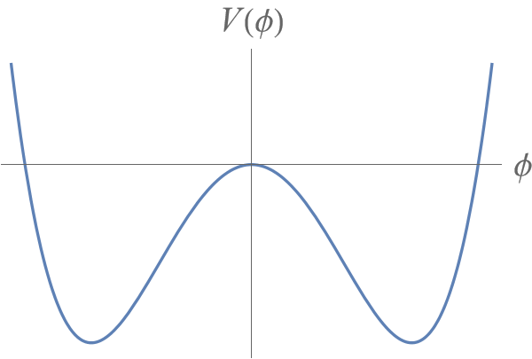
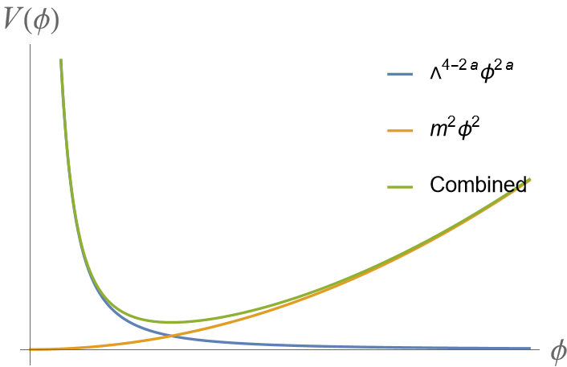
Higgs potential
Renormalizable potential
Nonperturbative potential
,
,
The shape of the potential is probed by Higgs pair production.
Vacuum expectation value (vev)

Slide 6
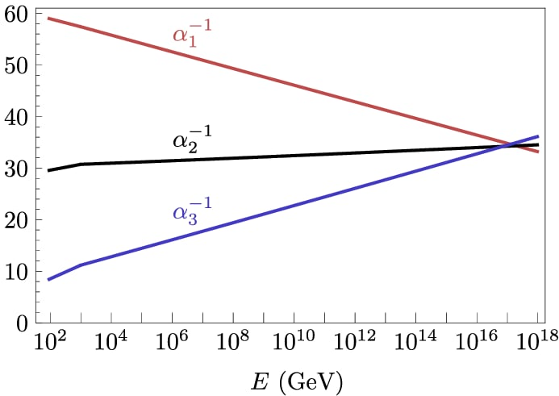
Higgs potential
Renormalisable potential
Nonperturbative potential
,
,
Desrt paradigm: The renormalizable SM remains valid upto GUT scale
Will we uncover a new dynamics in TeV scale.

Slide 7

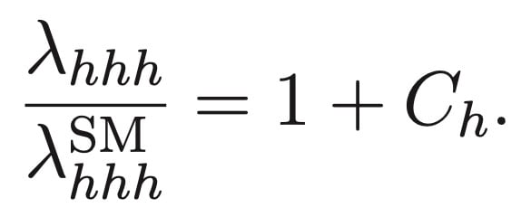
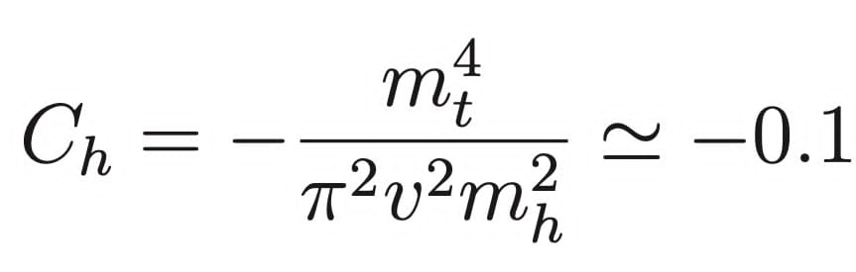
General Higgs potential
Let Higgs potential is a generic function of|H|^2=x
Expansion around the minimum
Expand around vev
The minimum @ Higgs mass
Trilinear & Quartic couplings
-tree level
-quantum correction
The Standard Model correction

Slide 8
Nonperturpative Higgs potential
Simple example:
Minimum:
Higgs mass
Nonperturbative runaway potential (NP)
Renormalizable & effective
Mass term etc

Slide 9
Higgs pair production @LHC
gg-fusion
Effective operators & amplitudes:
Distractive if
Enhanced is negative

Slide 10
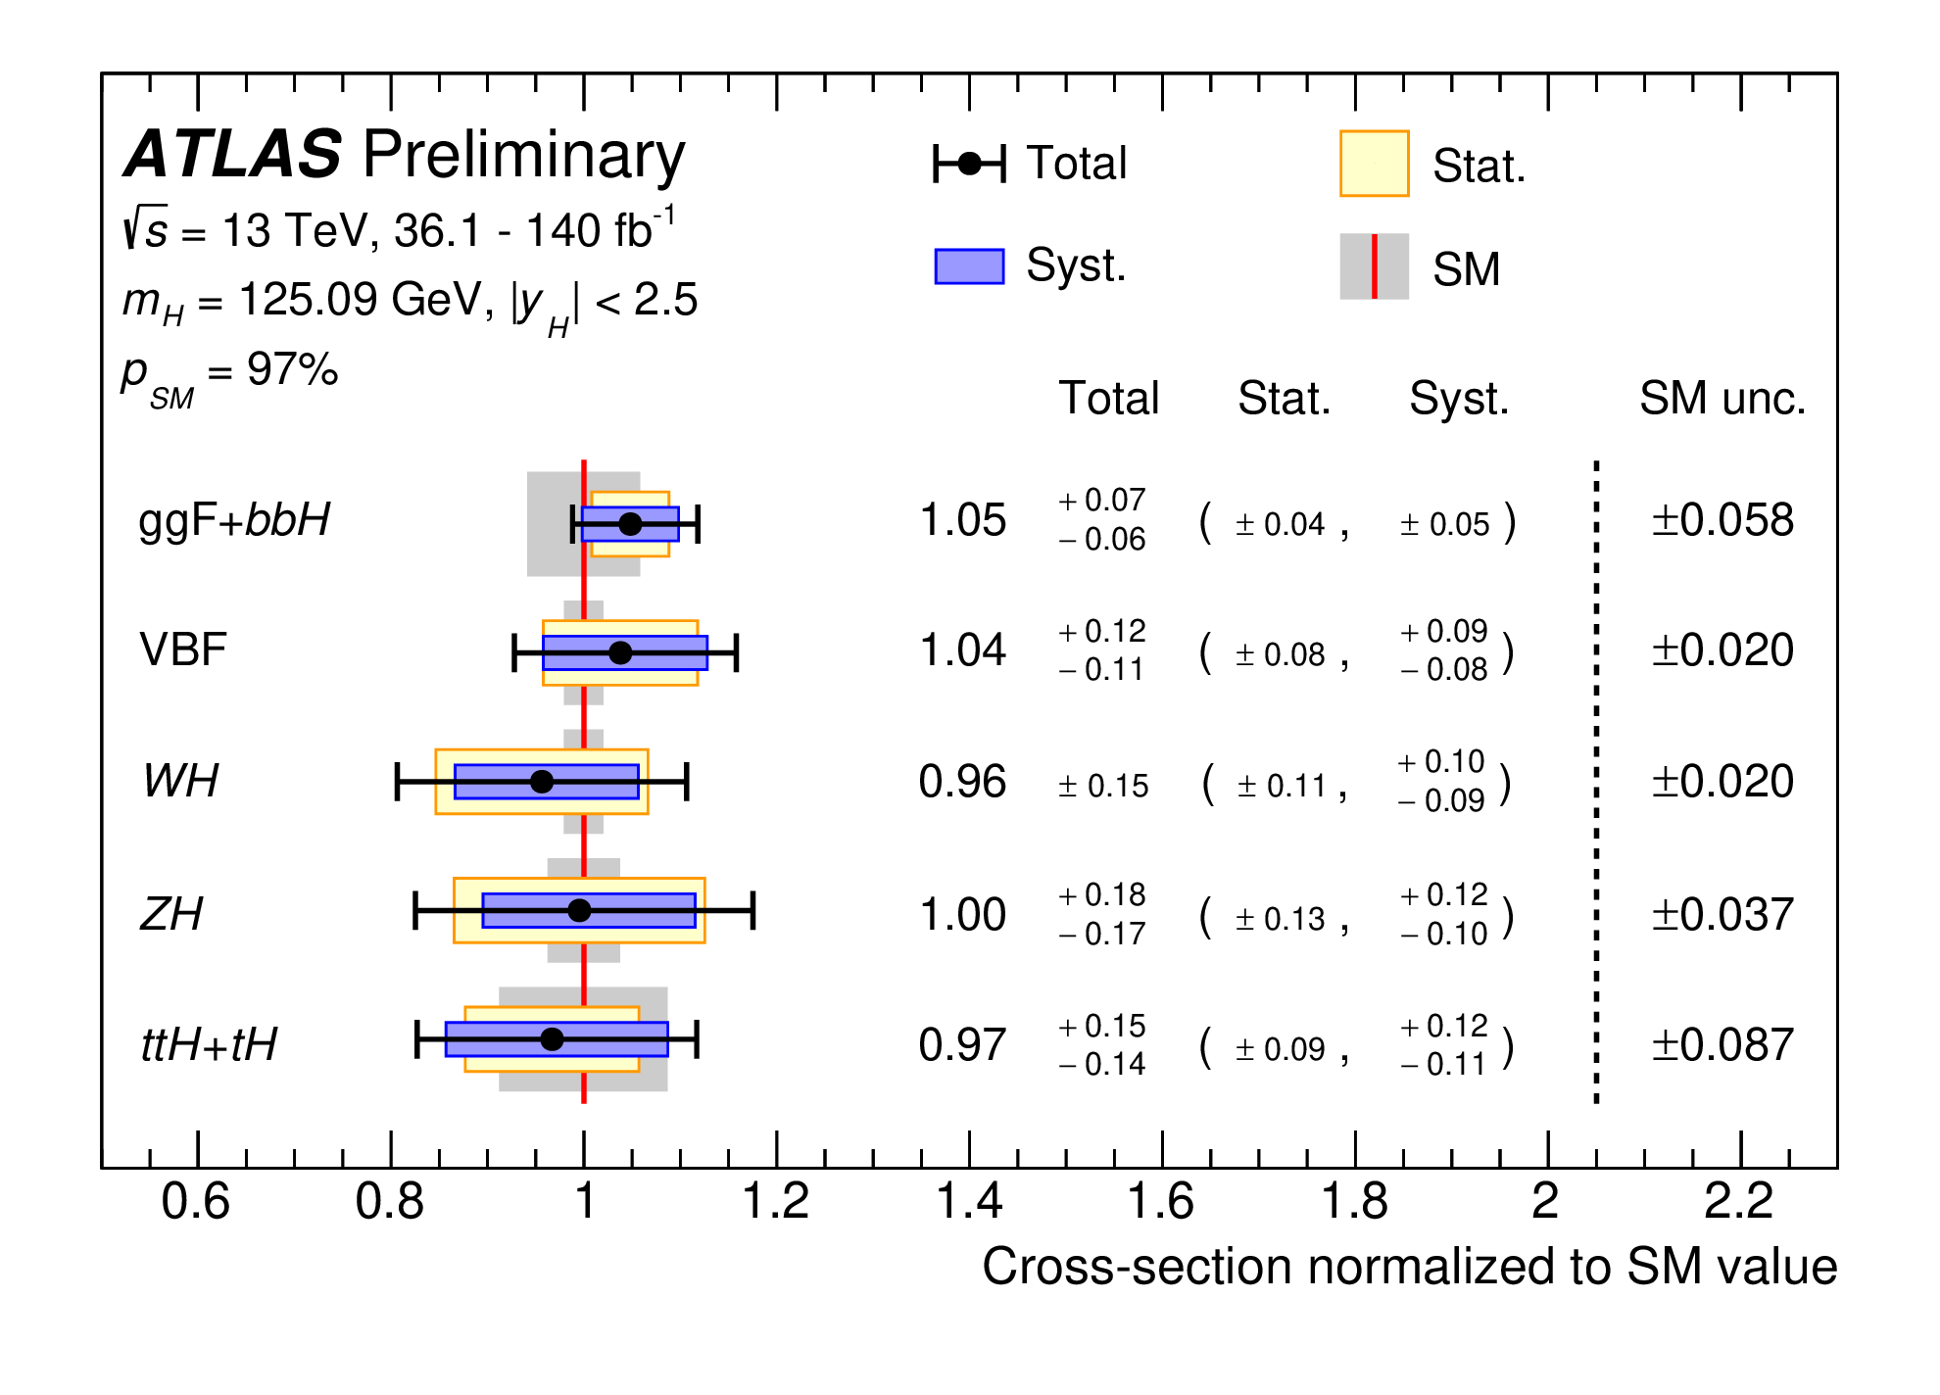
Non-canonic kinetic term
Non-canonic kinetic factor arise theories with strong dynamics:
for the SM.
R. S. Chivukula and V. Koulovassilopoulos, Phys. Lett. B 309, 371 (1993); Phys. Rev. D 50, 3218 (1994).
Not to conflict with Single Higgs production.
General kinetic form

Slide 11
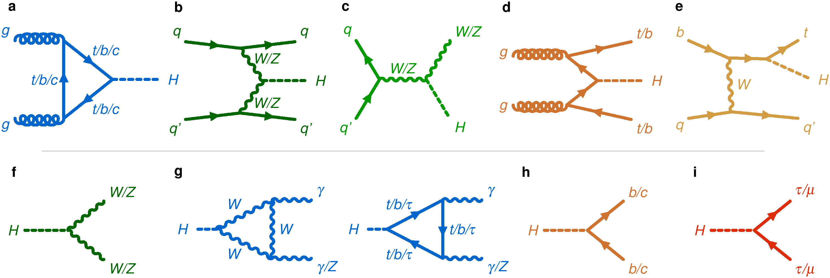
Single Higgs production
The latest results from the LHC (Public 2022)
Higgs production and decay channels.

Slide 12
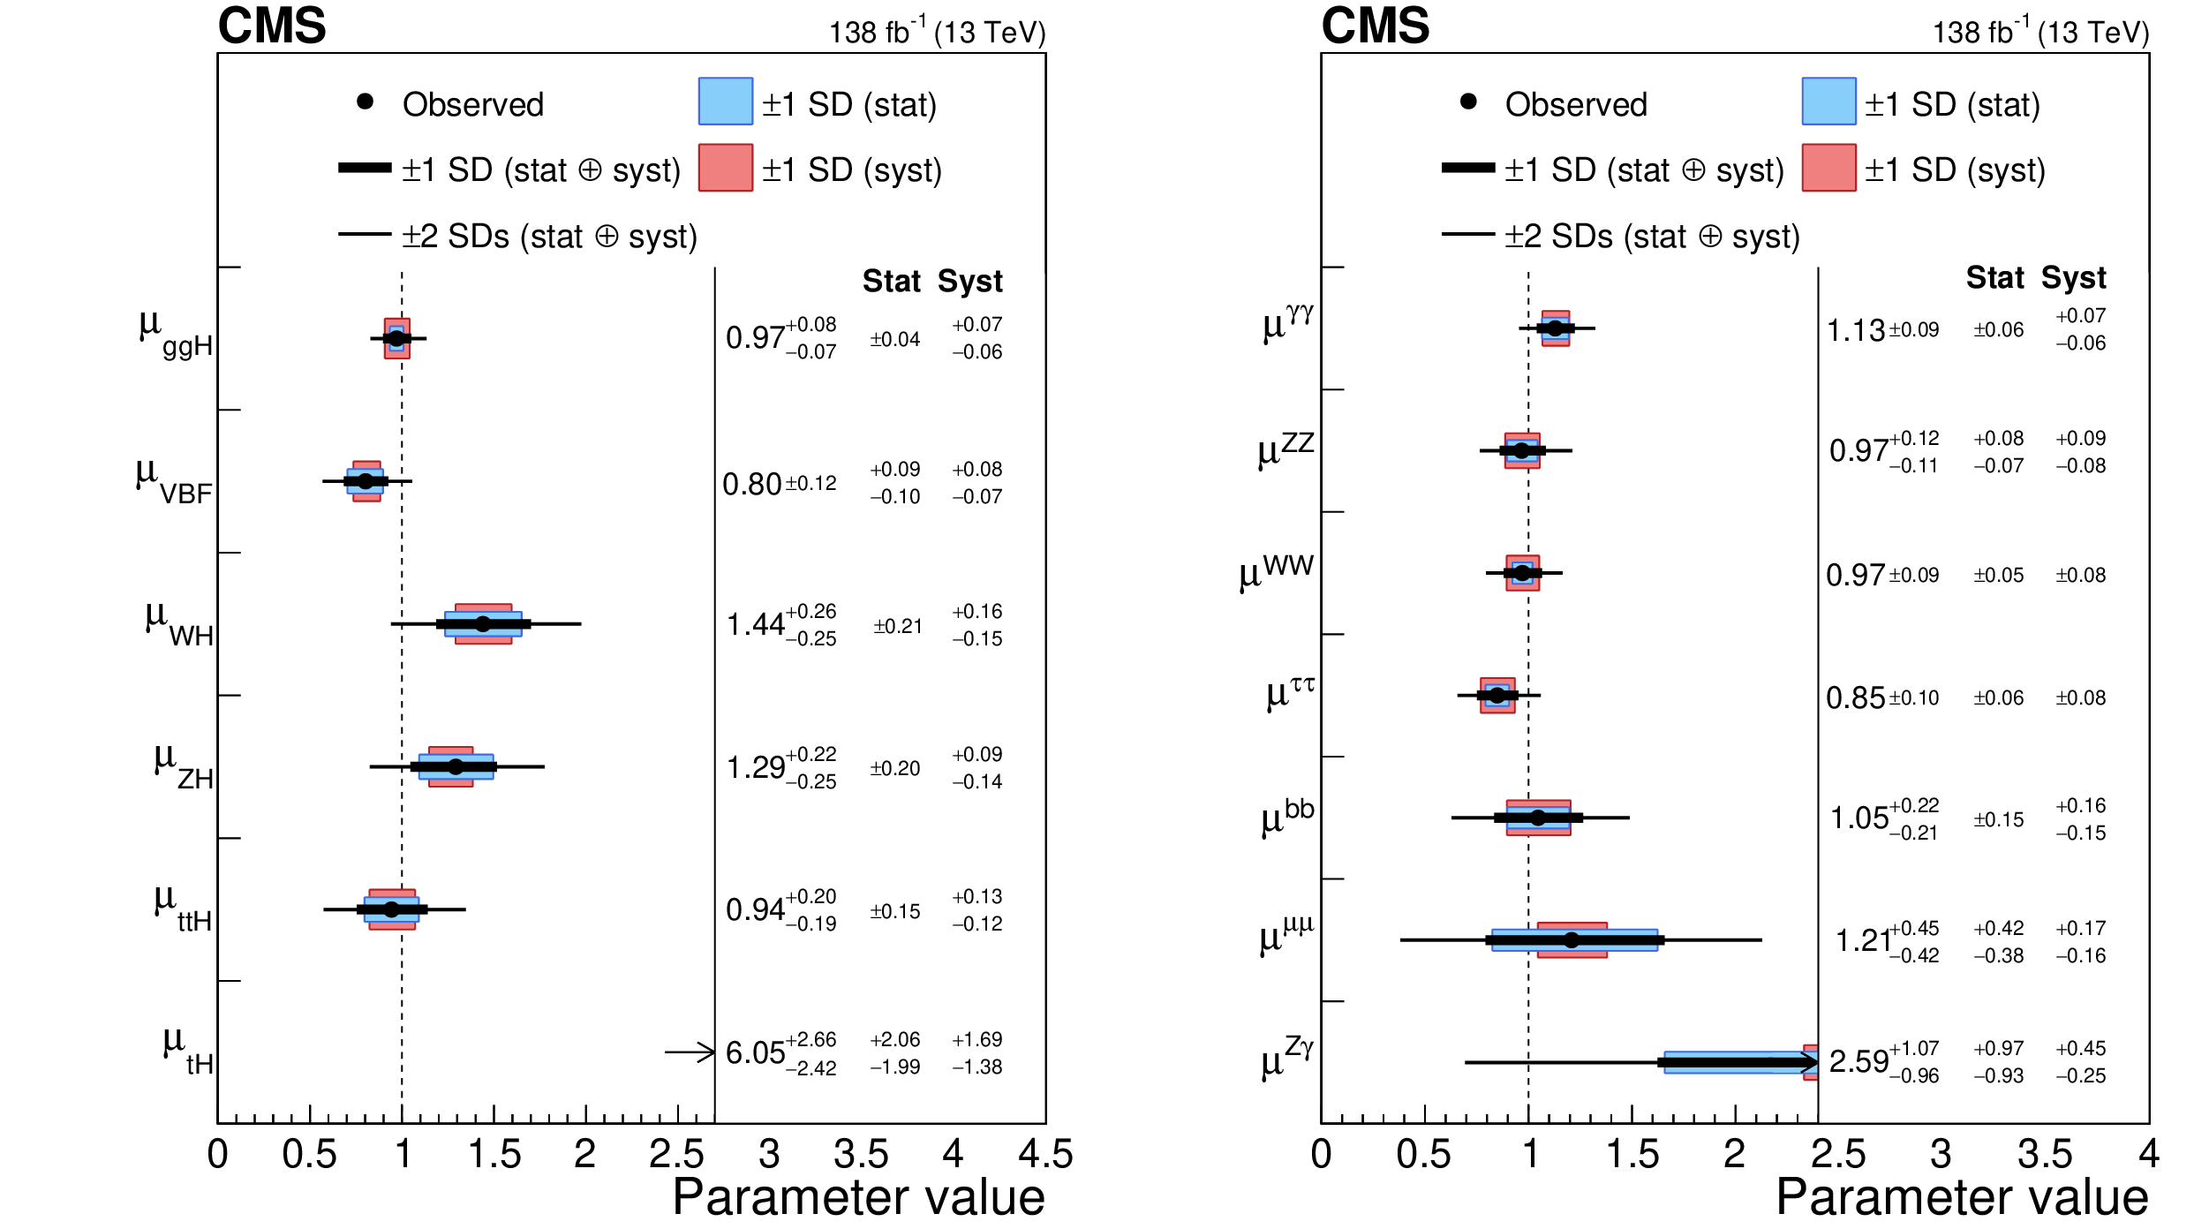
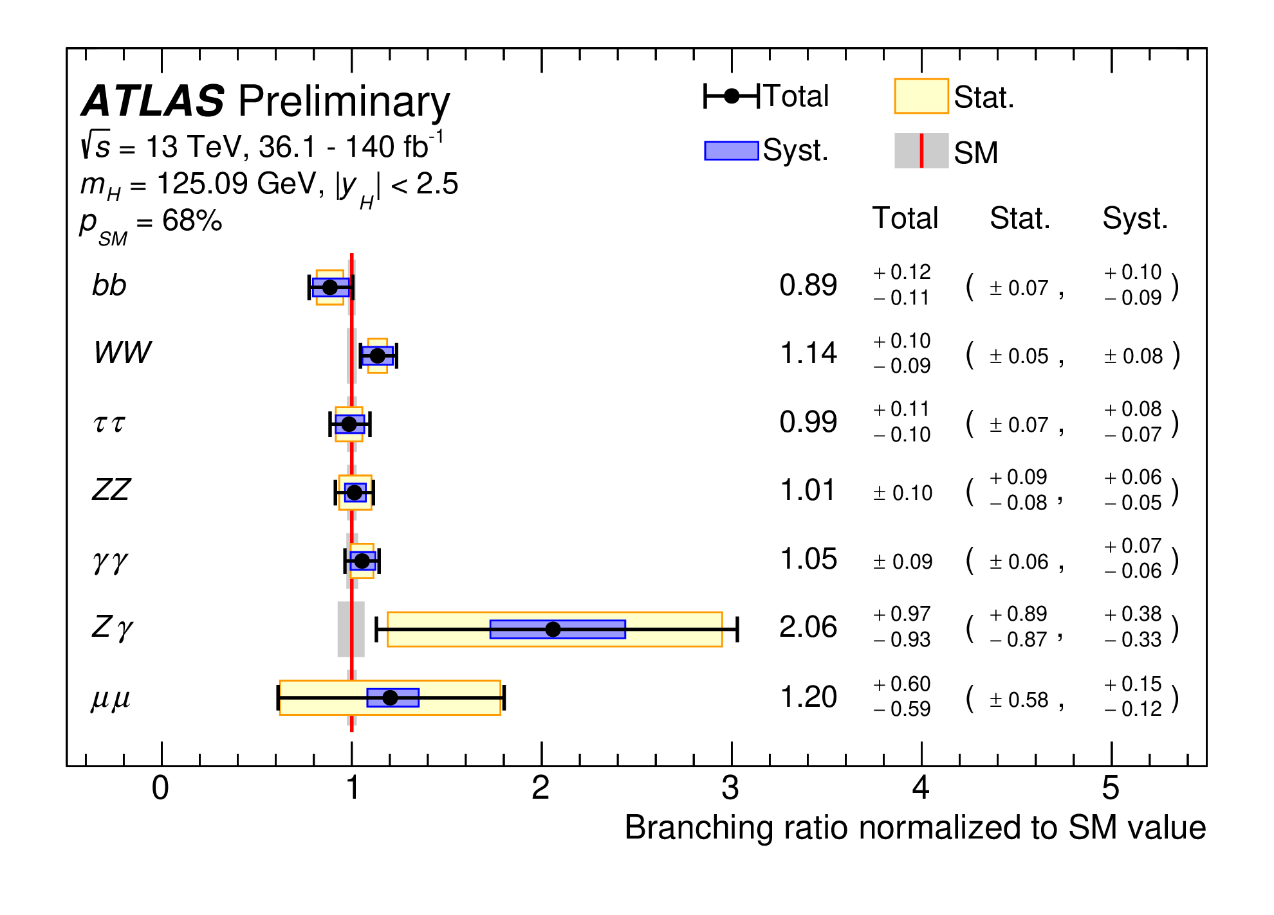
Experimental results from CMS & ATLAS
The latest results from the LHC (Public)
Higgs interactions with Gauge sector and top quark largely agree with the SM within exp. error.
μ_{ggH}=0.97+0.06-0.07
CMS Collaboration
Nature 607 (2022) 60-68
μ_{ggH+bbH} = 1.05±0.07-0.06
ATLAS Collaboration
Public results (2026)

Slide 13
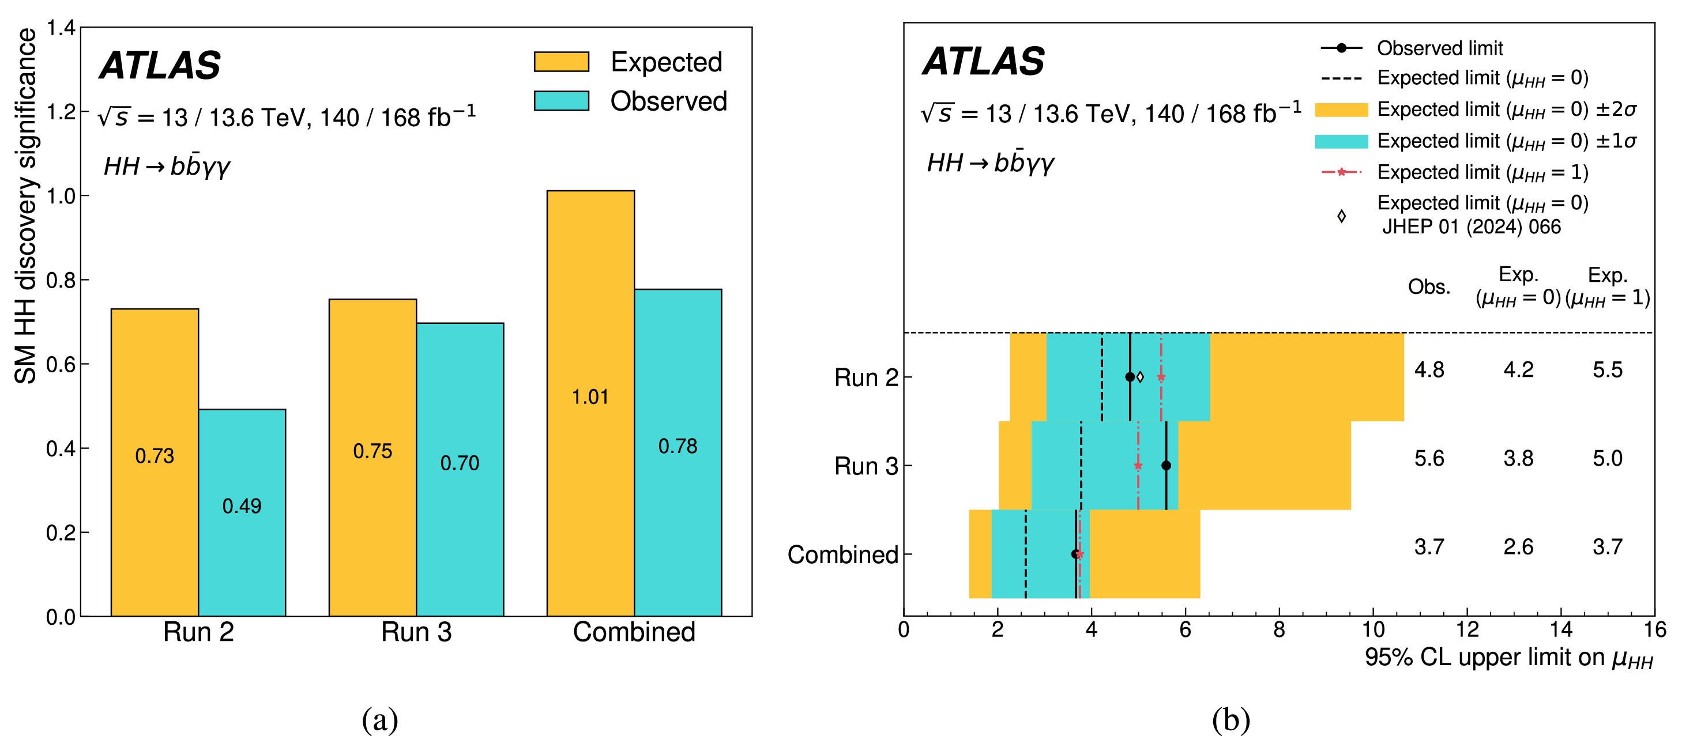
Upper bound on HH production
The latest results for HH production from the LHC (Public 2026)
Higgs interactions with Gauge sector and top quark largely
agree with the SM within exp. error.
Upper bound
R_{combined} = 3.7±0.38
ATLAS Collaboration
Phys.Lett.B 876 (2026)

Slide 14
Models with modified Higgs interactions
Modified Higgs Potential
Higgs coupling to new particles
Extension of the Higgs potential
Extra Higgses
Higher-Dim. terms in the Potential
General potential beyond
renormalizibility
Extra Higgses (doubly charged), singlets, dilaton, GUT remnants, coloredparticles: SUSY, LQs, Extra family, composite particles
A.V. Manohar, M.B. Wise PLB 786 (2006)
M. I. Gresham & M. B. Wise PRD 76 (2007)
D. Lopez-Val, J. Sola PRD 81 (2010)
R. Boughezal,
E.Asakawa etal, PRD 82 (2010)
B. A. Dobrescu etal, PLB 670 (2008)
G. Kribbs, A. Martin
J. Alwall etal PRD 86 (2012)…..
F. Boudjeama & E. Chopin Z. Phys. 73 (1996)
R. S. Chivukulla & V. Koulovasilopoulos
PLB 309 (1993), PRD 50 (1994)
H.-J. He etal, PLB 554 (2003), PRD 67 (2003)
N. Haba etal, PRD 89 (2014)..

Slide 15
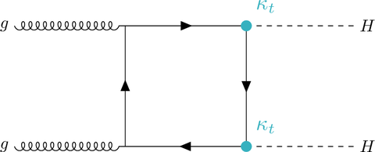
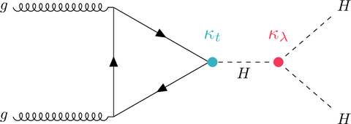

Higgs pair production via gluon fusion at LHC
$$C_{h}$$
Distractive interference which makes the rate very small
Very high luminosity required
Sensitive to new physics
Higgs pair production in the SM
O. J. P. Eboli et al, Phys. Lett. B 197, 269 (1987).
E. W. N. Glover and J. J. van der Bij, Nucl. Phys. B 309, 282 (1988)
D. A. Dicus, C. Kao and S. S. D. Willenbrock, Phys. Lett. B 203, 457 (1988)
G.V. Jikia Nucl. Phys. B 412 (1994)
A. Djouadi, W. Kilian, P.M. Zerwas, EPJ C10 (1999) 45-49
S. Dawson, S. Dittmaier, M. Spira, Phys.Rev. D58 (1998) 115012
T. Plehn, M. Spira, P.M. Zerwas, Nucl.Phys. B479 (1996) 46-64
QCD corrections
Many recent works on NLO & NNLO…

Slide 16

Higgs pair production via gluon fusion at LHC @14TeV
In the SM vanishes at the threshold
$$ℳ\left(gg→hh\right)=\frac{α_{s}}{3πv^{2}}\left(−1+\frac{3m_{h}^{2}(1+C_{h})}{\hat{s}−m_{h}^{2}}\right)$$
N. Haba, K. Kaneta, Y. Mimura, Enkhbat Ts.
Phys. Rev. D 89, 015018 (2014)

Slide 17
Higgs pair production via gluon fusion at LHC @14TeV
The ratios of cross sections R:
Vector boson fusion(blue)
Gluon fusion/Vector boson fusion (red).
σ(pp → hhjj)SM=1.6 fb @ 14 TeV LHC

Slide 18
Higgs pair production via vector boson fusion in pp->hhjj @LHC

Slide 19
@ILC
The contour plots of the ratio of the cross section, σ(Ch , C2 )/σ(Ch = C2 = 0) of e+ e− → hhν ν̄. Left (√s = 500 GeV), and right (√s = 1 TeV).

Slide 20
@ILC
The count√our plots of the ratio of the√cross section, σ(Ch , C2 )/σ(Ch = C2 = 0) of e+ e− → Zhh. Left ( s = 500 GeV), and right ( s = 1 TeV).

Slide 21
Differential cross section for Double Higgs strahlung
The differential cross section (in fb) of e +e − → Zhh.
x is a scaled energy of Z boson in the final state : xZ = 2EZ/ √ s.
(Ch, C2) = (0, 0),(−2, 2),(0, 2) from below to top in each graph

Slide 22
Conclusions
Higgs pair production probes the shape of the Higgs potential
Modifications can enhance the rate significantly
Hi-Lum LHC & 500 GeV, 1 TeV e+ e- machine can probe such effects
FCC & CEPC remain challenging

Slide 23

THANK YOU FOR THE ATTENTION!

Slide 24
Backgounds (hh nu nubar)
Irreducible background: e+ e- -> hh Z (Z-> nu nubar)
For the final state h->b bbar, h->gamma gamma:
  nu nubar h Z, (Z-> gamma gamma)
Reducible background:
  nu nubar b bbar gamma gamma without Higgs
  nu nubar H (H-> b bbar) with two gammas from ISR, bremsstrahlung, energetic neutral mesons
  t tbar -> W+ b W- bbar

Slide 25
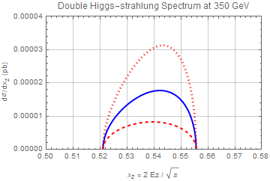
Differential cross section for Double Higgs strahlung @350GeV

Slide 26
Example model
SUSY QCD
Chiral multiplets:
I. Affleck, M. Dine, and N. Seiberg, 1983&1984
Higgs doublet identified as mesons with N_f=2
N. Haba and N. Okada, Acta Phys. Pol. B 39, 2921 (2008)
N. Haba et al, Phys. Lett. B 718, 1441 (2013).
Kahler potential:

Slide 27
Scalar potential
The mass eigenstates
VVhh-vertices
For

Slide 28
Colored vector boson contribution
G. V. Jikia, Nucl.Phys. B412 (1994) 57-75

Slide 29
Calculation: Gluon fusion @LHC
Colored scalar & vector bosons MG5
Higgs pair production rate scanned over
  m_{S} & m_{V}
& their portal couplings to Higgs
  λ_{S} & λ_{V}
Three cases:
  Real S & V
  Complex S & V
  Real V & complex S
Constraint from single Higgs prod from LHC CMS, ATLAS

Slide 30
Scan over vector & scalar octet masses:
SM ggH expectation: 1

Slide 31
Scan over vector & scalar octet masses:
ATLAS ggH: 1.32±0.38

Slide 32
Scan over vector & scalar octet masses:
CMS ggH: 0.85+0.19-0.17

Slide 33
Scan over vector & scalar octet masses: Real S & V
Portal Couplings:
λ_{s}=1.5
λ_{V}=0.5
The SM NLO expect.:
σ_{s}=30-40fb at 14 TeV

Slide 34
Scan over vector & scalar octet masses: Real S & V
Portal Couplings:
λ_{s}=1.5
λ_{V}=1.5

Slide 35
Scan over vector & scalar octet masses: Real S & V
Portal Couplings:
λ_{s}=0.5
λ_{V}=1.

Slide 36
Scan over vector & scalar octet masses: Complex S & V
Portal Couplings:
λ_{s}=1.5
λ_{V}=1.5

Slide 37
Scan over vector & scalar octet masses: Complex S & V
Portal Couplings:
λ_{s}=1.5
λ_{V}=0.5

Slide 38
Scan over vector & scalar octet masses: Complex S & V
Portal Couplings:
λ_{s}=0.5
λ_{V}=1.

Slide 39
Scan over vector & scalar octet masses: Real V & Complex S
Portal Couplings:
λ_{s}=1.5
λ_{V}=1.5

Slide 40
Scan over vector & scalar octet masses: Real V & Complex S
Portal Couplings:
λ_{s}=1.5
λ_{V}=0.5

Slide 41
Scan over vector & scalar octet masses: Real V & Complex S
Portal Couplings:
λ_{s}=0.5
λ_{V}=1.

Slide 42
Scan over portal couplings: Real V & S
Masses:
m_{s}=300 GeV
m_{V}=700 GeV

Slide 43
Scan over portal couplings: Complex V & S
Masses:
m_{s}=300 GeV
m_{V}=700 GeV

Slide 44
Scan over portal couplings: Real V & Complex S
Masses:
m_{s}=300 GeV
m_{V}=700 GeV

