Slide 1
TID test of COFFEE2
Yihang Guo, Tianyu Shi, Congcong Wang, Hui Zhang

Slide 2
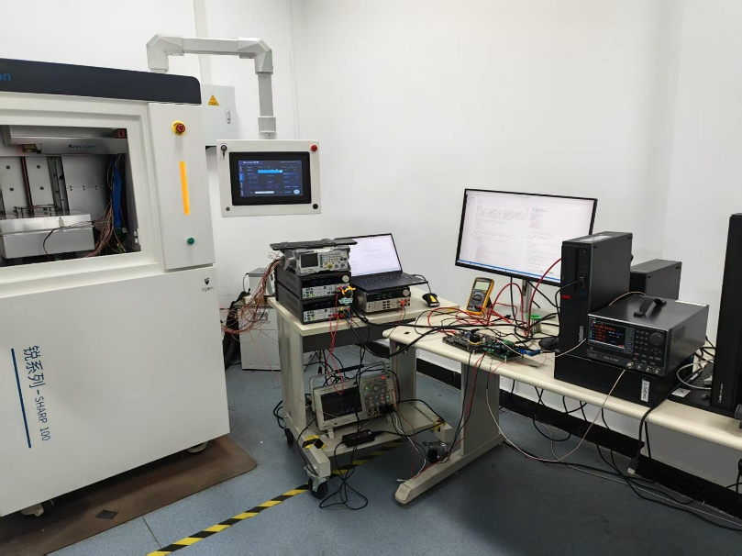
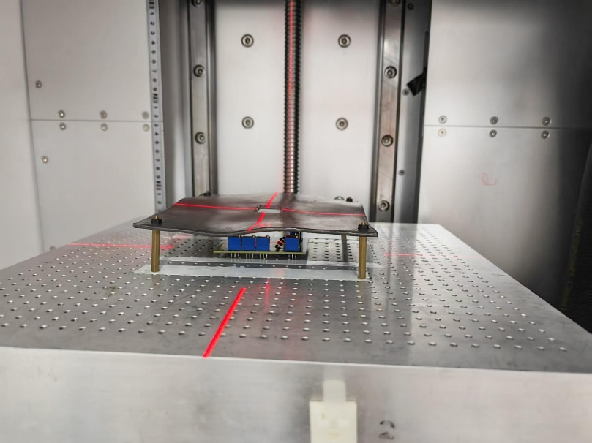
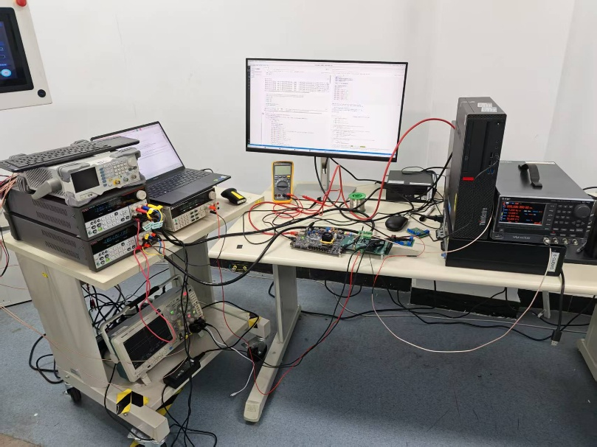
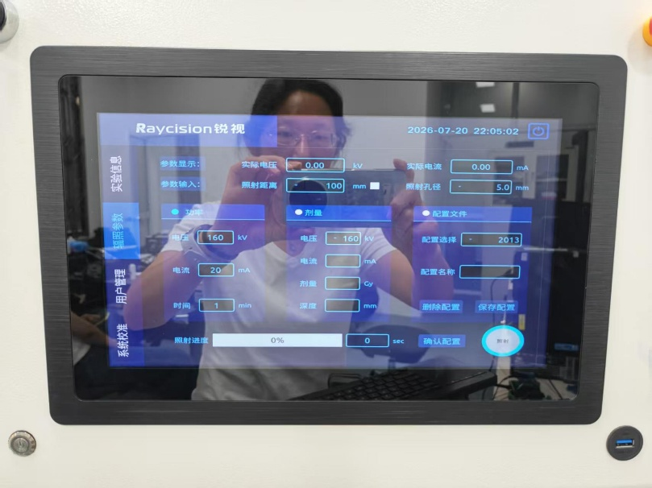
Set up a test platform
Vtube = 40 keV or 160 keV
Current
Time
Unit: 2Mrad/h or 6Mrad/h
Offline test: 26 min

Slide 3
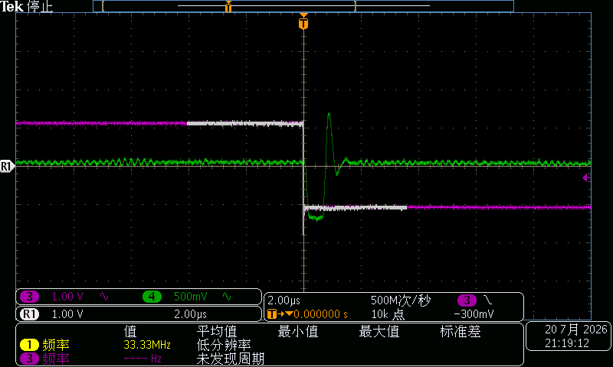
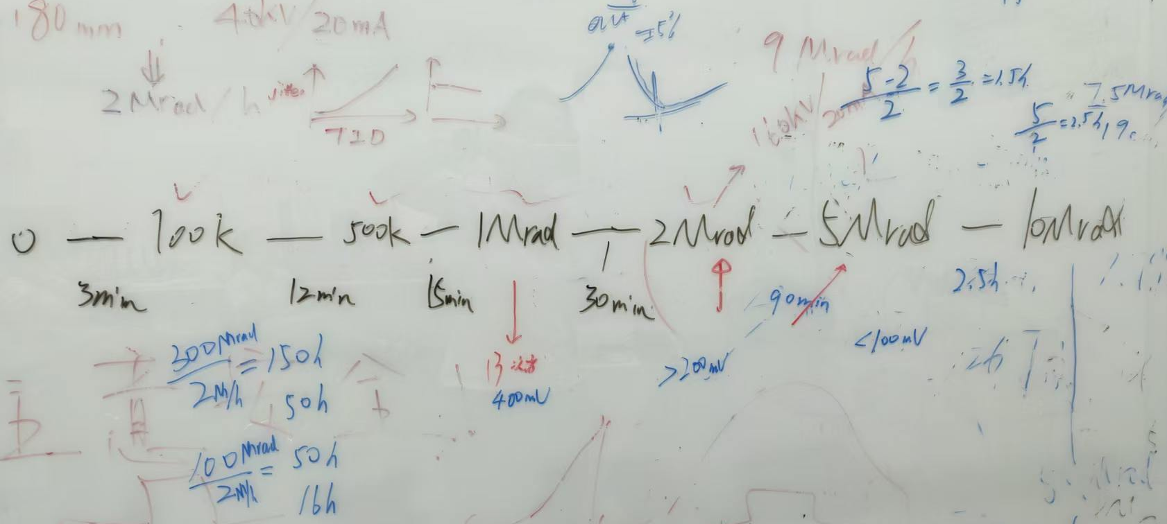
TID dose
10^13 neq/cm2
10^14 neq/cm2
Non-irradiated
10^14, 1Mrad

Slide 4
致谢
感谢浙江大学朱宏博老师团队提供的实验仪器、实验场所，以及人力支持！！

