Slide 1

Study of $ψ\left(3686\right)→φηη$
Zhuang Xinyu
Nankai University
2025.11.25

Slide 2
Outline
Motivation
Decay chain
Data sets and MC simulation
Initial event selection criteria
Other event selection criteria
Topology analysis
2-body combinations
Next to do

Slide 3
Motivation

Slide 4
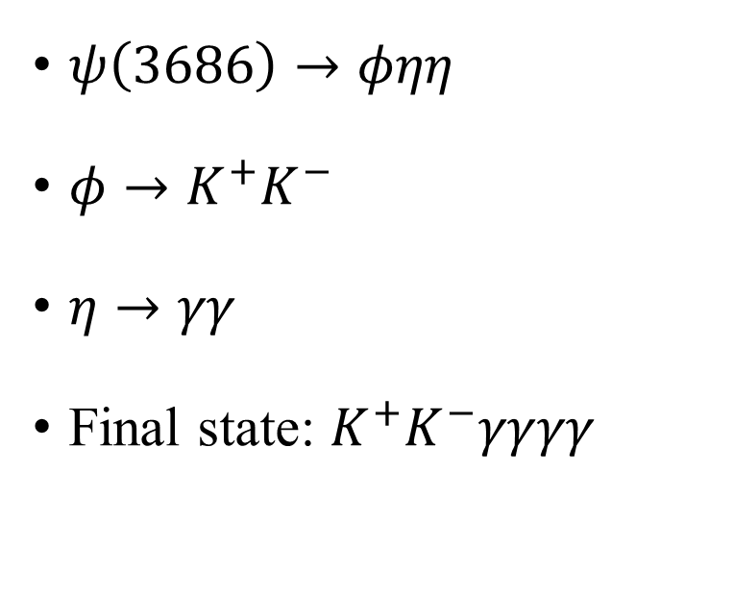
Decay Chain
$ψ\left(3686\right)→φηη$
$φ→K^{+}K^{−}$
$η→γγ$
Final state: $K^{+}K^{−}γγγγ$

Slide 5
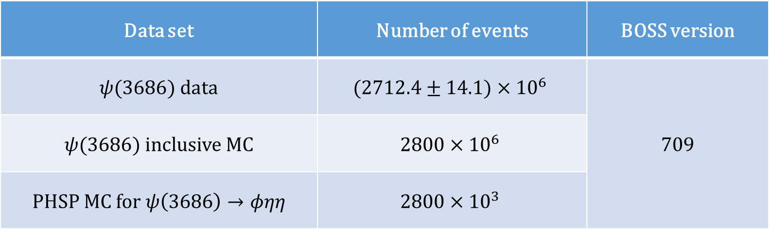
Data Sample and MC Simulation
Data set | Number of events | BOSS version
$ψ(3686)$ data | $$(2712.4±14.1)×{10}^{6}$$ | 709
$ψ(3686)$ inclusive MC | $$2800×{10}^{6}$$
PHSP MC for $ψ\left(3686\right)→φηη$ | $$2800×{10}^{3}$$

Slide 6

Initial Event Selection Criteria
Charged tracks:
  $\left|V_{xy}\right|<1 cm, \left|V_{z}\right|<10 cm$ (not from $\overline{Λ}/Λ$ decay)
  $\left|cosθ\right|≤0.93$
  $N_{good}=2, N_{charge}^{tot}=0$
PID:
  $N_{K^{+}}=1, N_{K^{−}}=1$
  The tracks are assigned to the particle type with the highest confidence level
Good photons:
  $0≤TDC≤14$
  Barrel: $E>25 MeV, \left|cosθ\right|<0.8$
  End cap: $E>50 MeV, 0.86<\left|cosθ\right|<0.92$
  $N_{γ}≥4$
Vertex fit:
  The $K^{+}K^{−}$ pair is fitted to a common vertex
$η$ reconstruction:
  Combining pairs of photons by kinematic fit with $η$ mass constraint
  $χ_{η}^{2}<20, N_{η}≥2$
Kinematic fit:
  4-momentum conservation constraint (4C) + $η$ mass constraint (1C×2) kinematic fit under hypothesis of $ψ\left(3686\right)→φηη$

Slide 7
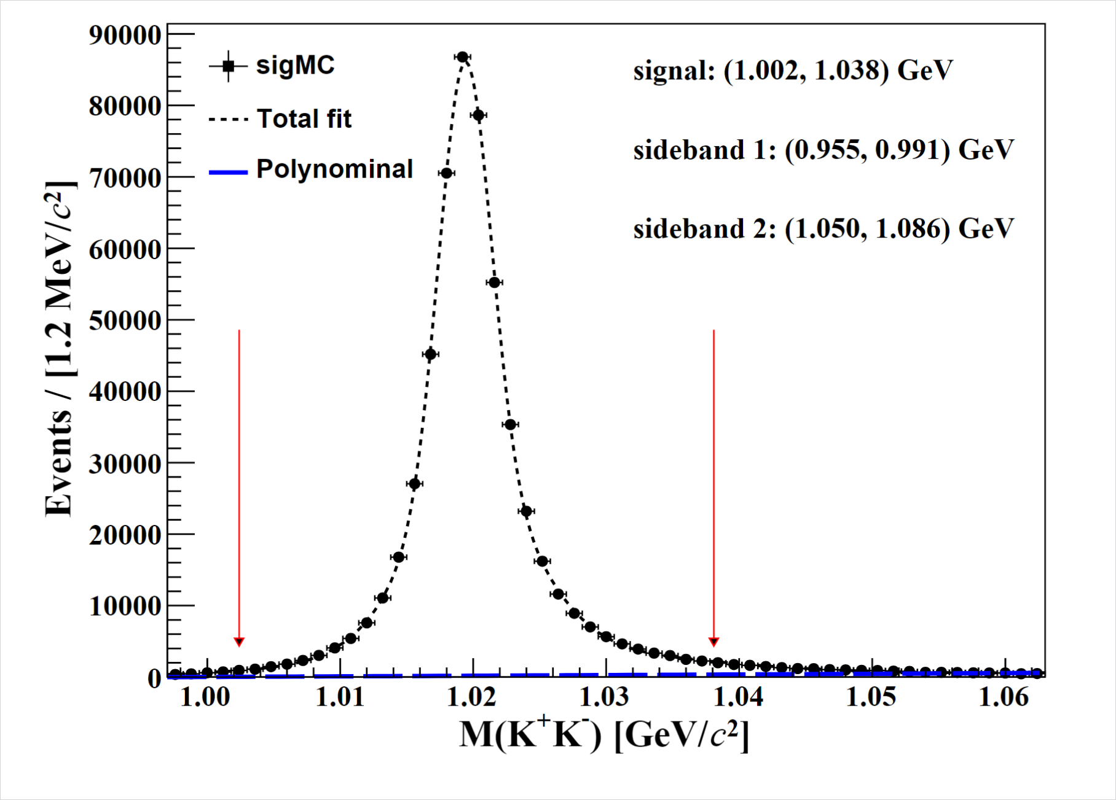
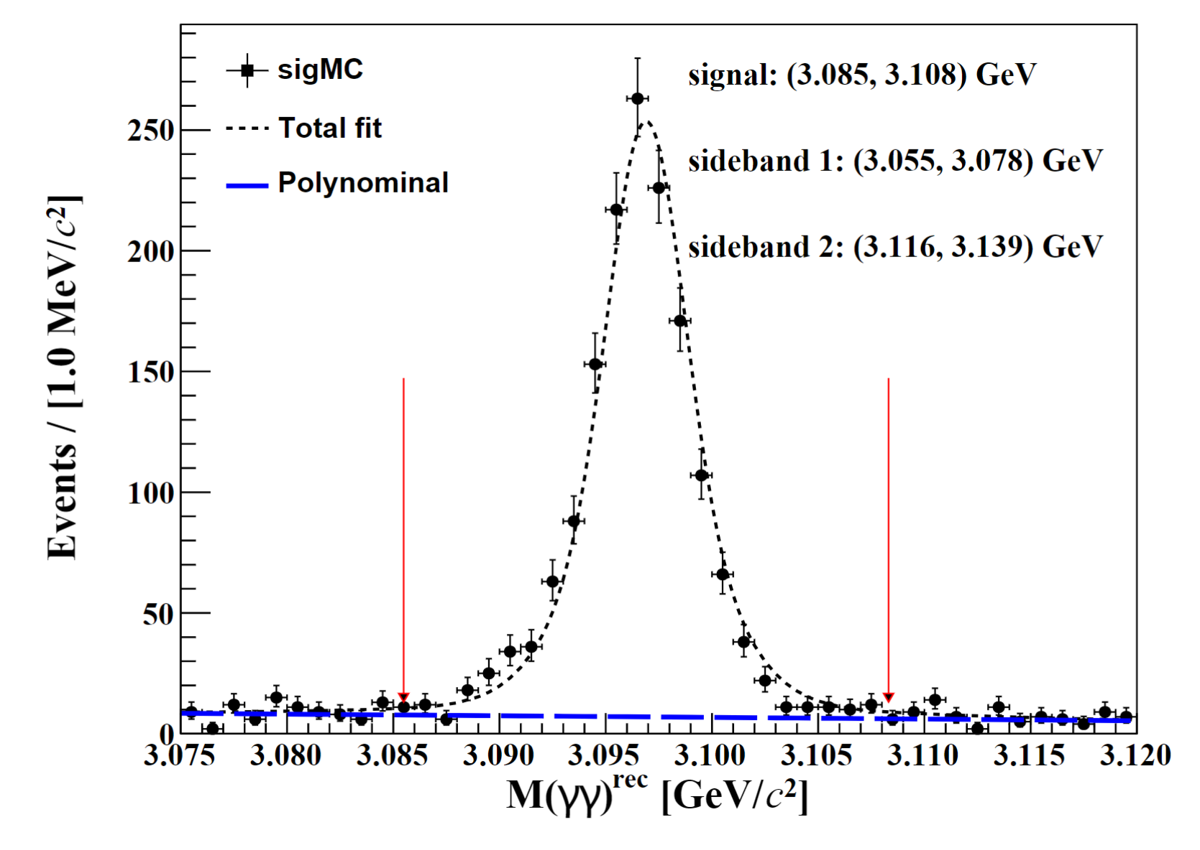

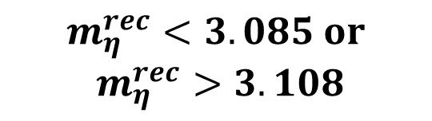
Other Event Selection Criteria
$$m_{η}^{rec}<3.085 or$$
$$m_{η}^{rec}>3.108$$
$$1.002< m_{φ}<1.038 GeV$$

Slide 8
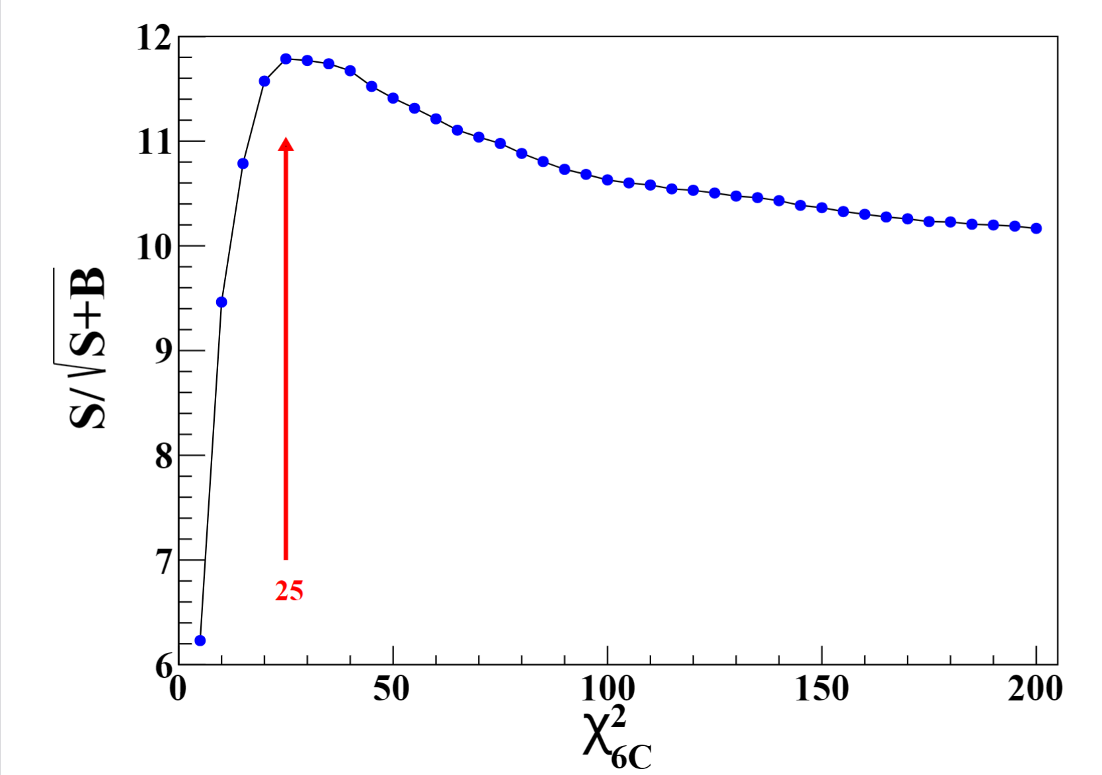
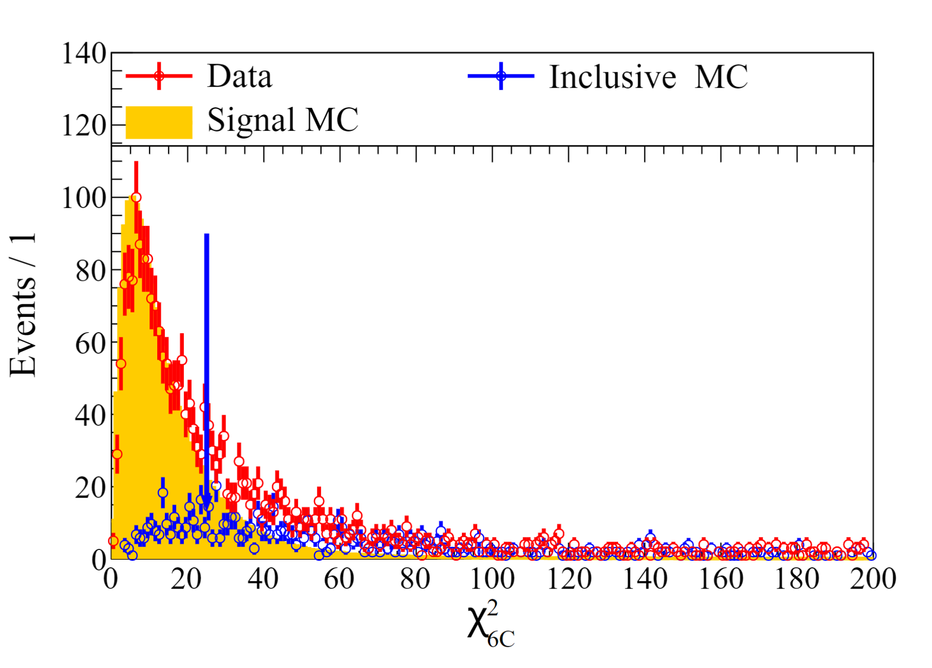


Other Event Selection Criteria
$$FOM=\frac{S}{\sqrt{S+B}}$$
$$χ^{2}<25$$

Slide 9
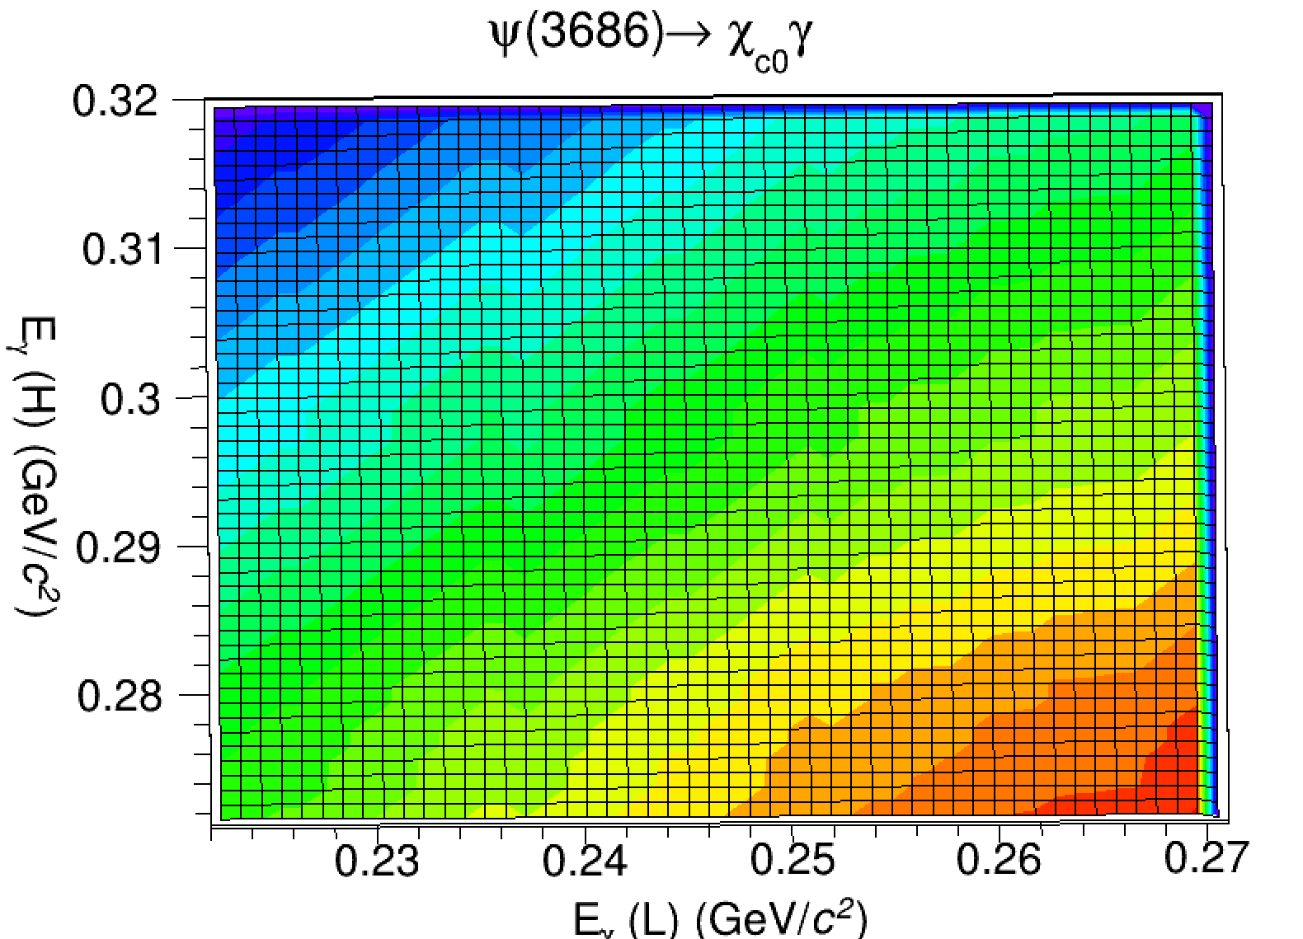
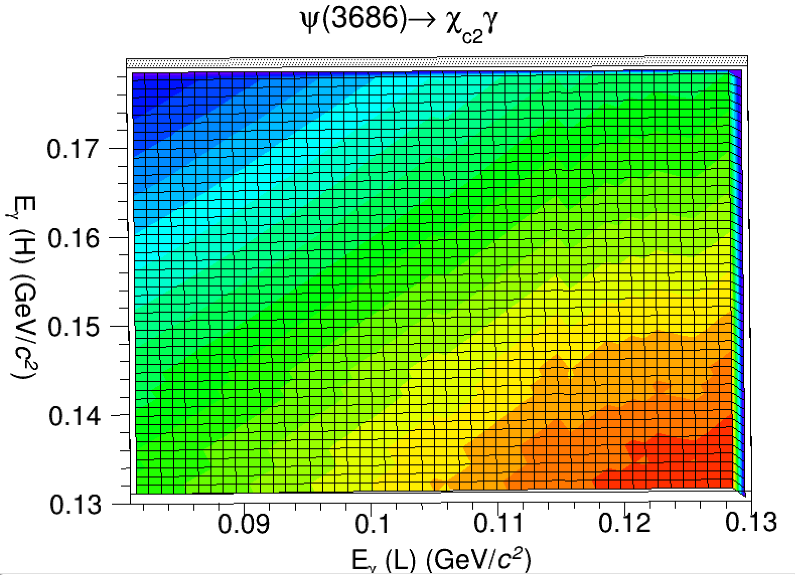

Other Event Selection Criteria

Slide 10
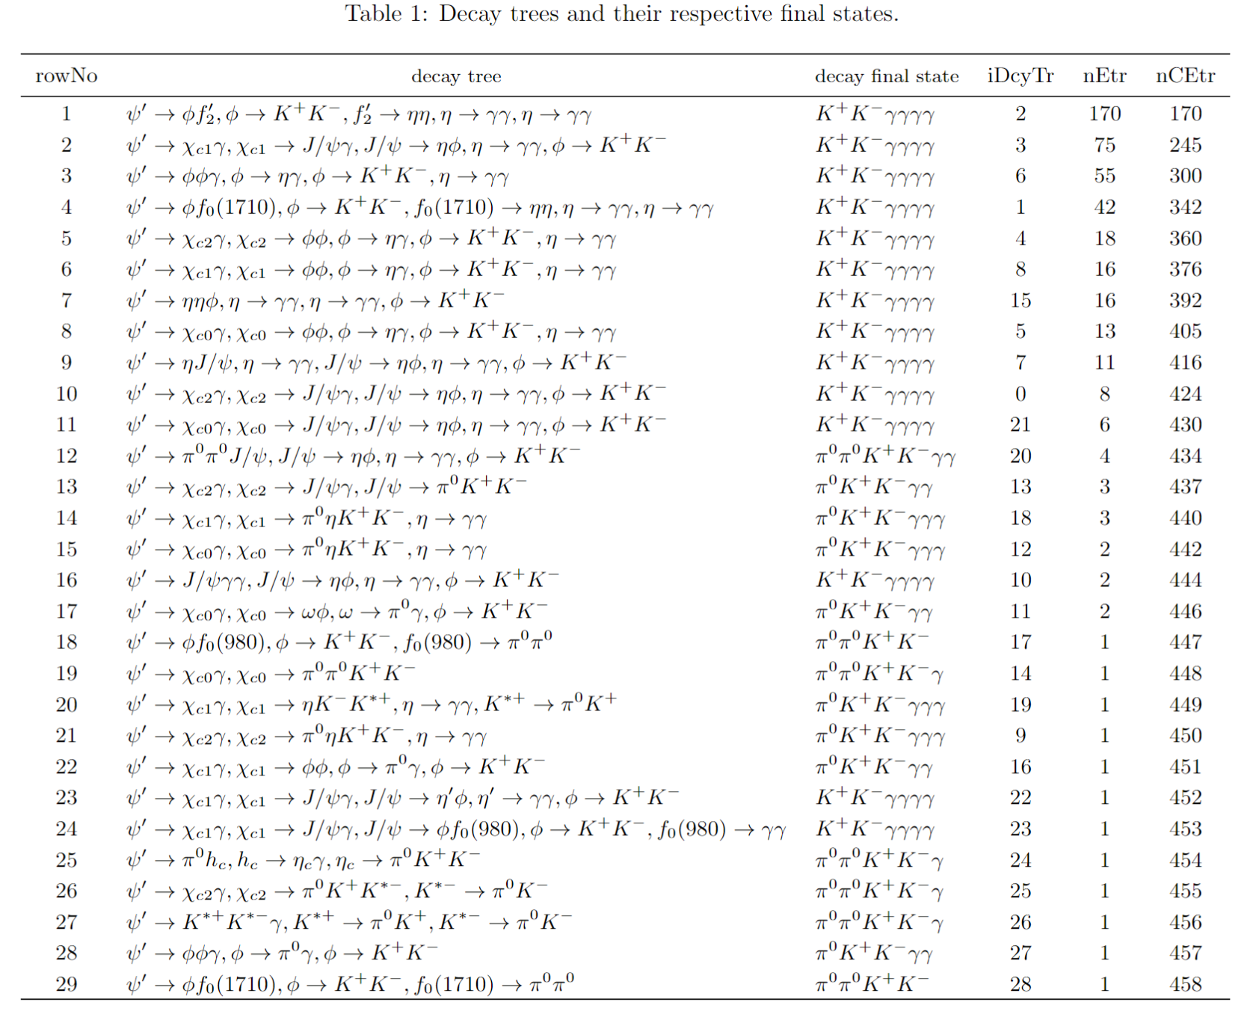
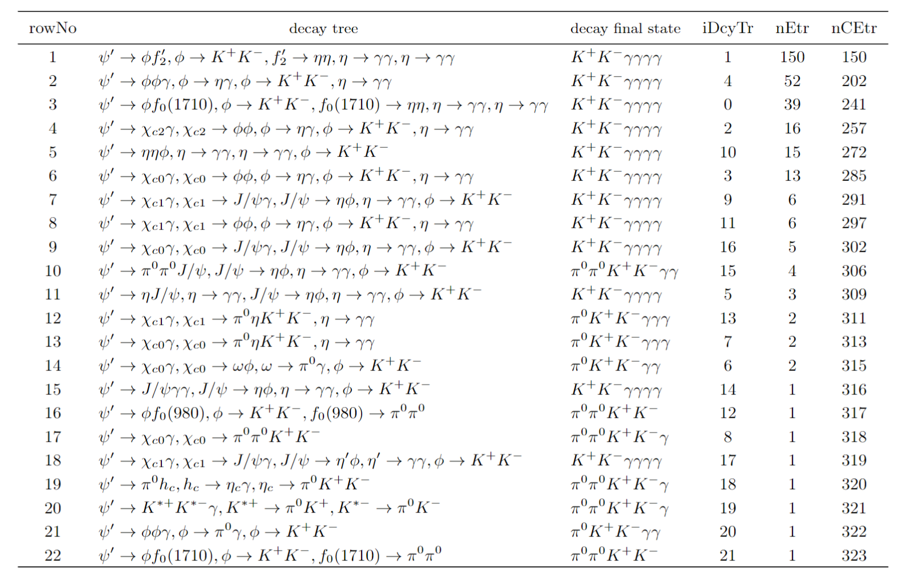
Topology Analysis

Slide 11
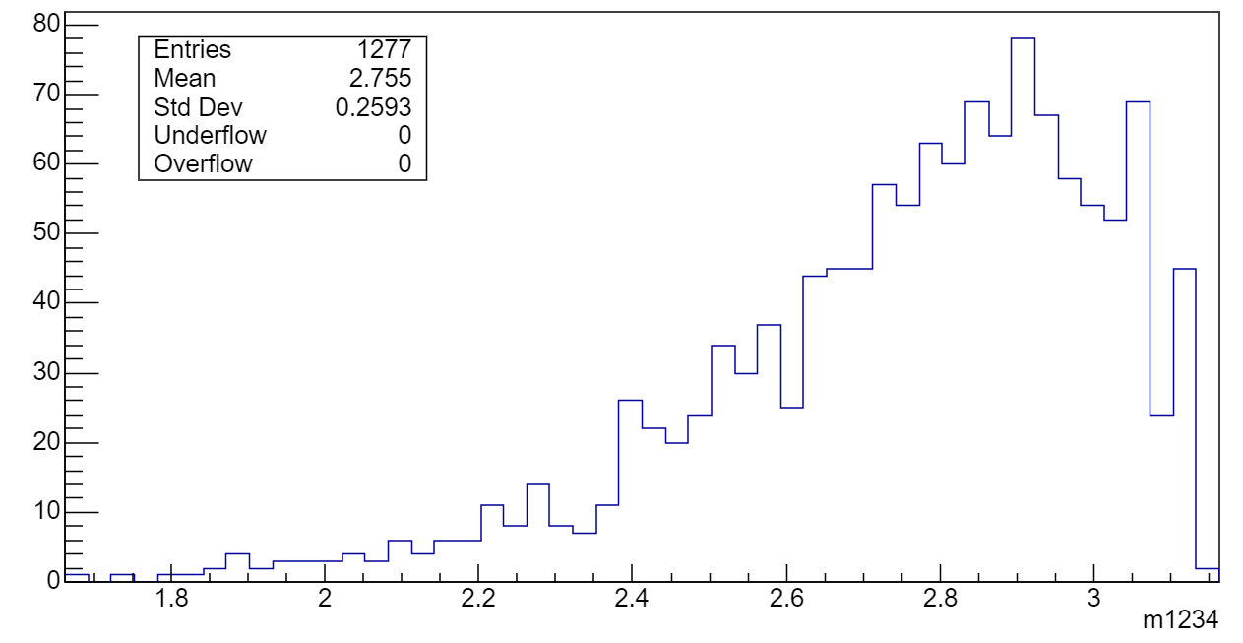
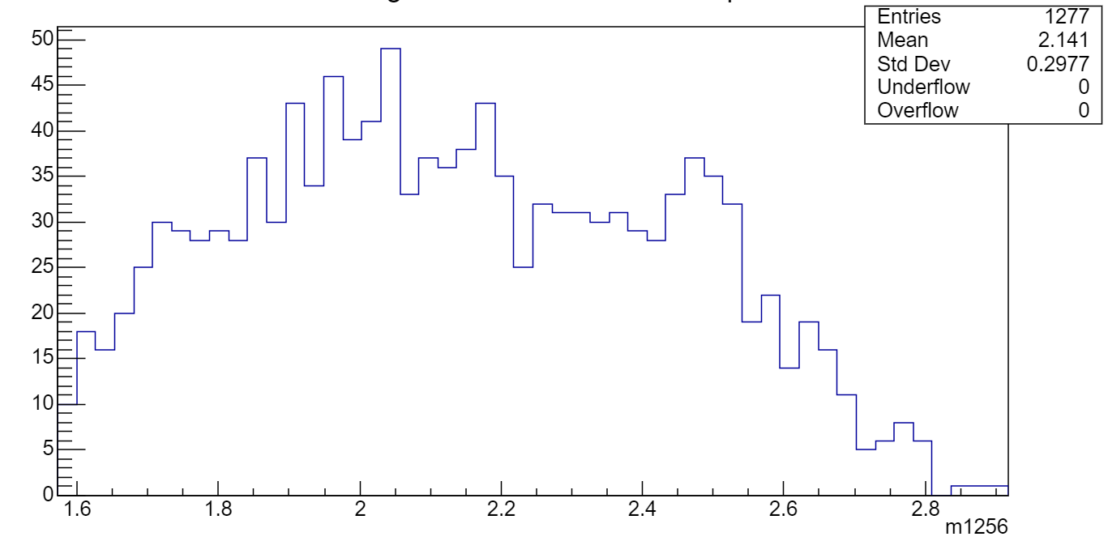
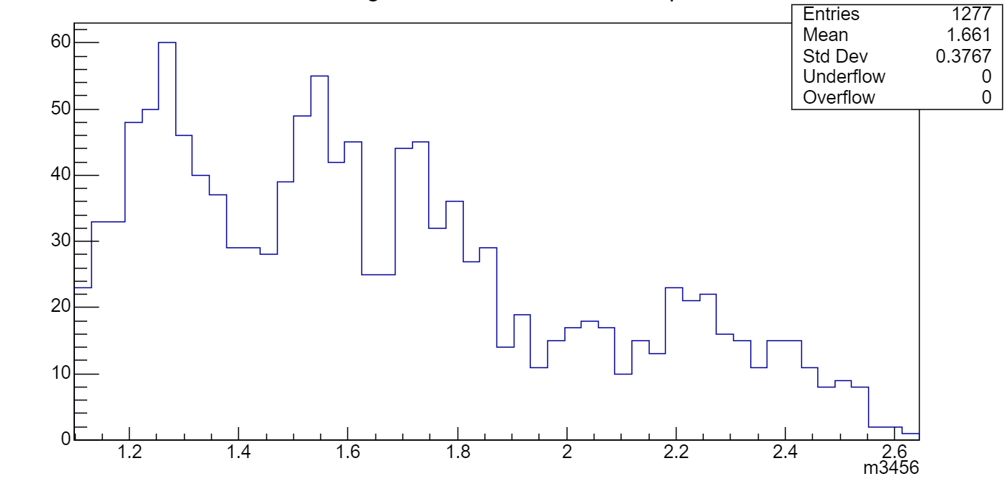



Data Distribution
$$M(φη_{1})$$
$$M(φη_{2})$$
$$M(η_{1}η_{2})$$

Slide 12
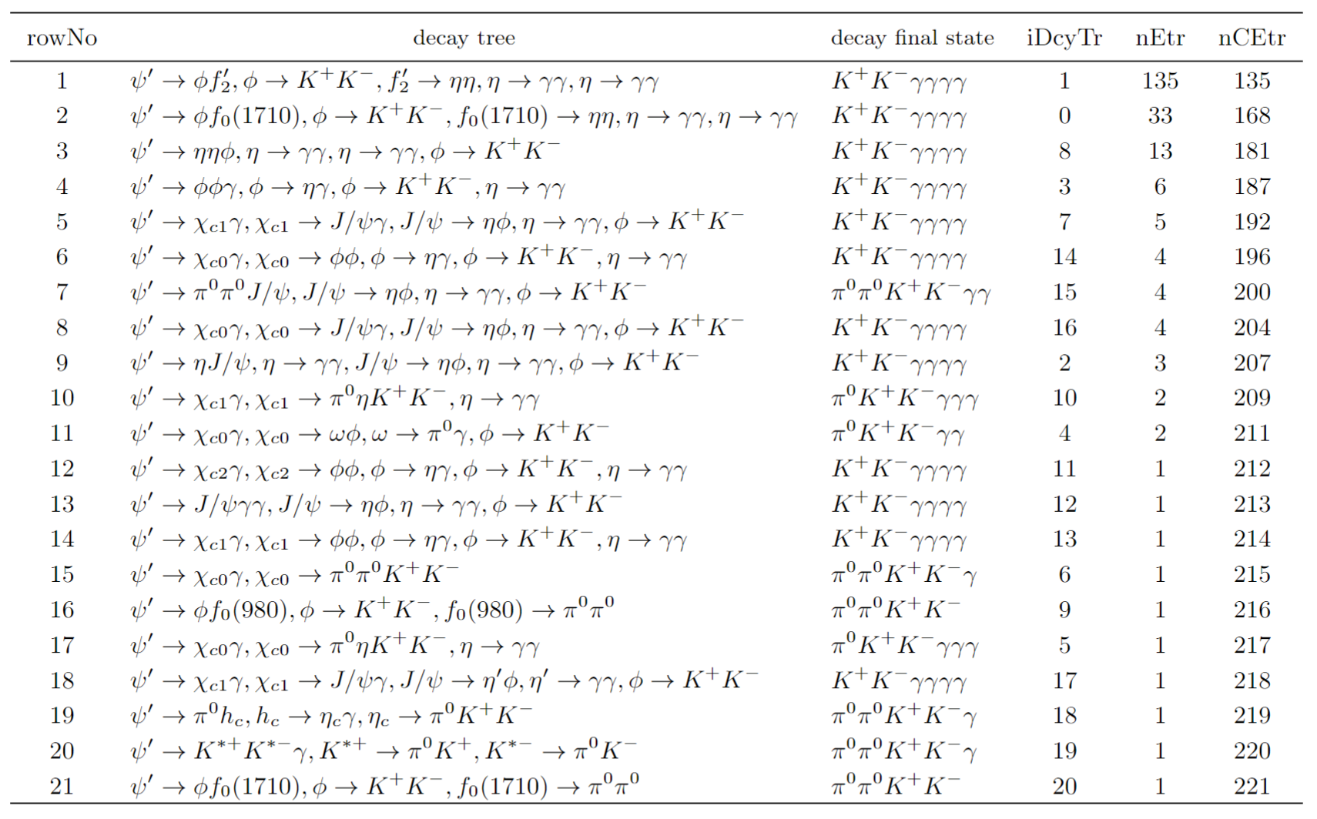
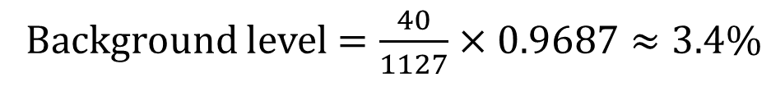
Topology Analysis
Background level $=\frac{40}{1127}×0.9687≈3.4\%$

Slide 13
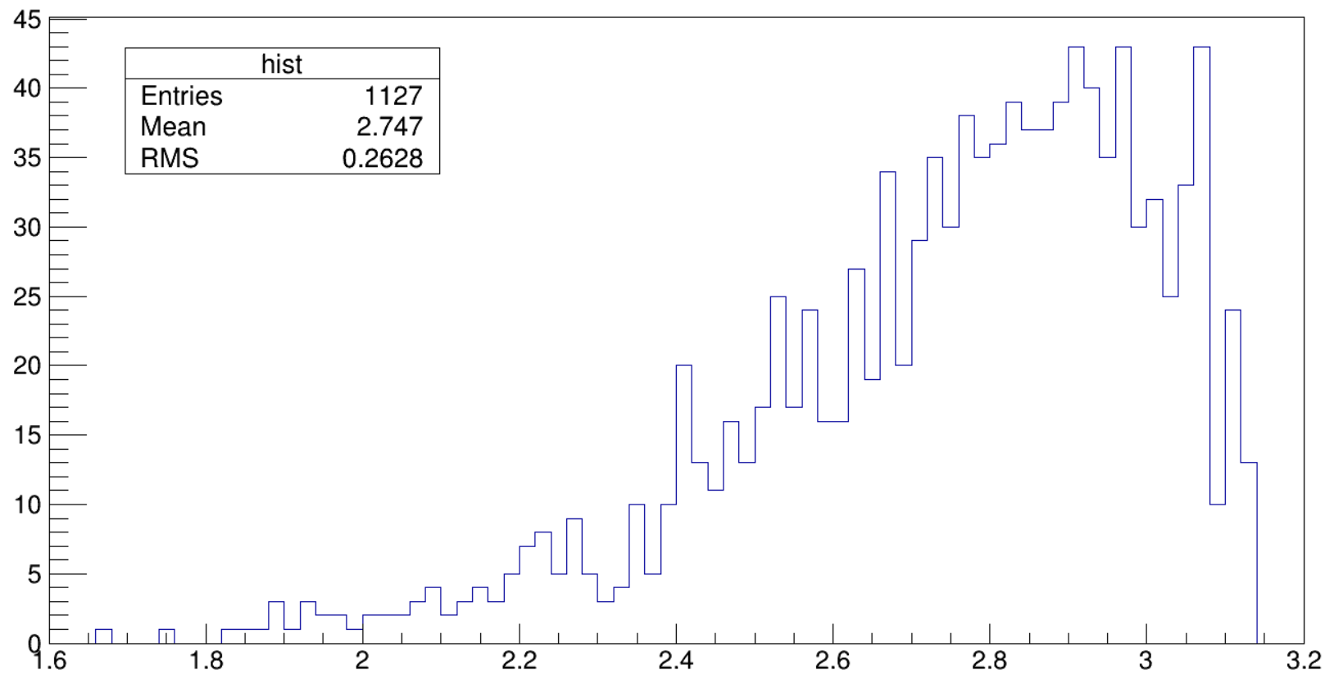
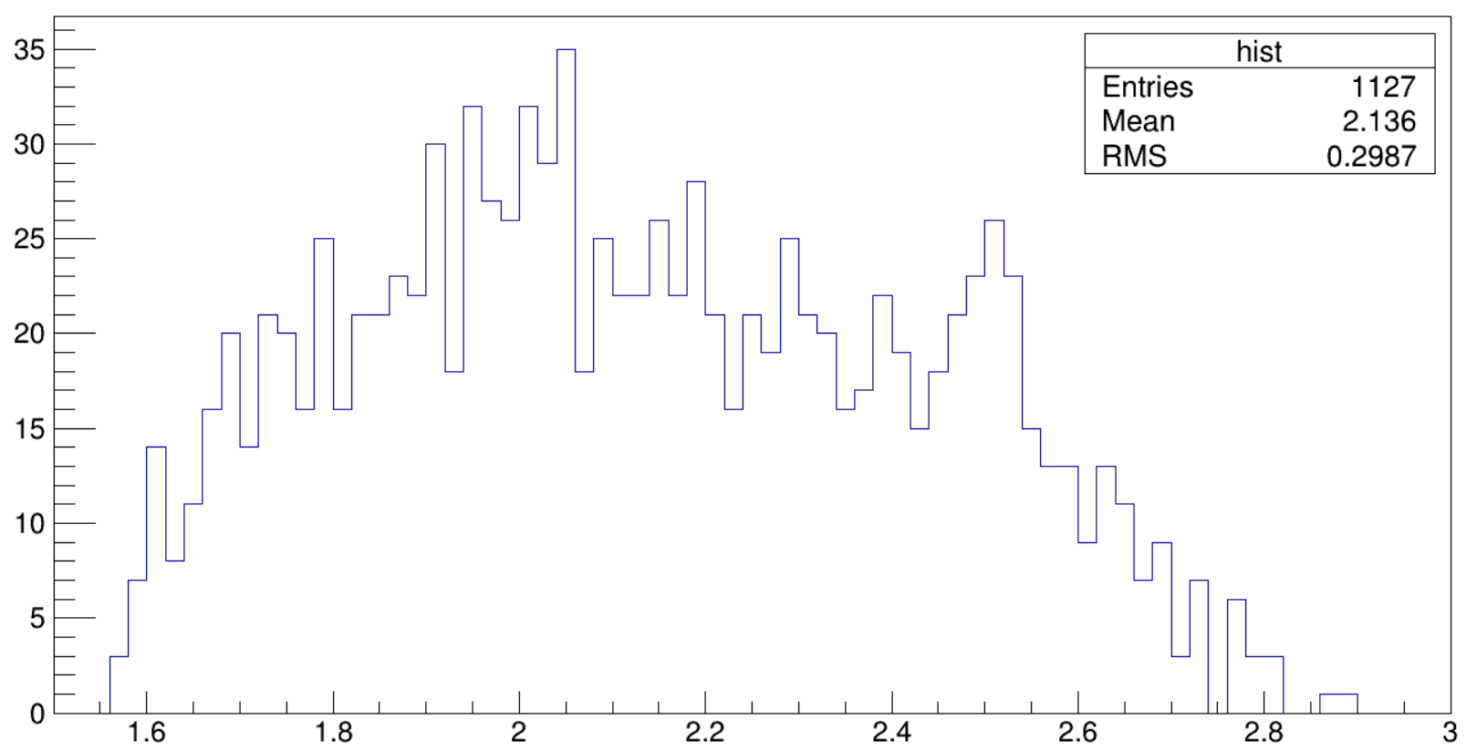
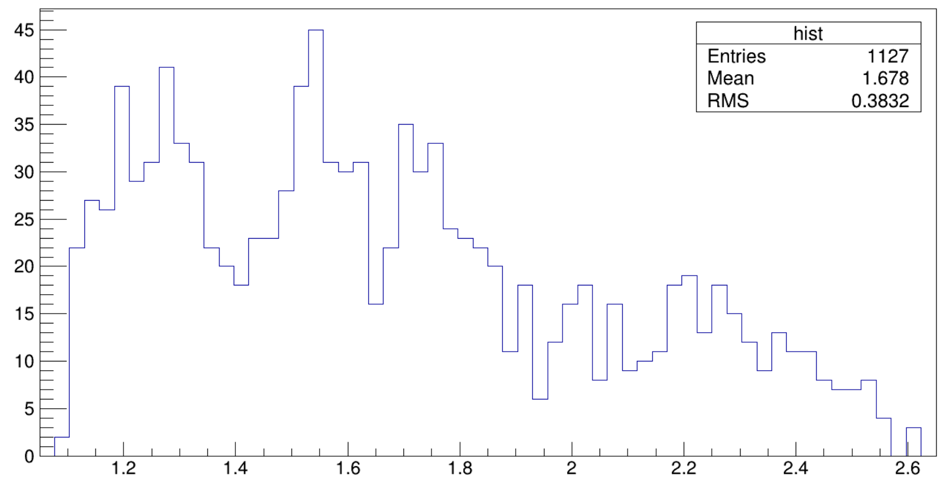


Data Distribution
$$M(φη_{1})$$
$$M(φη_{2})$$
$$M(η_{1}η_{2})$$

Slide 14
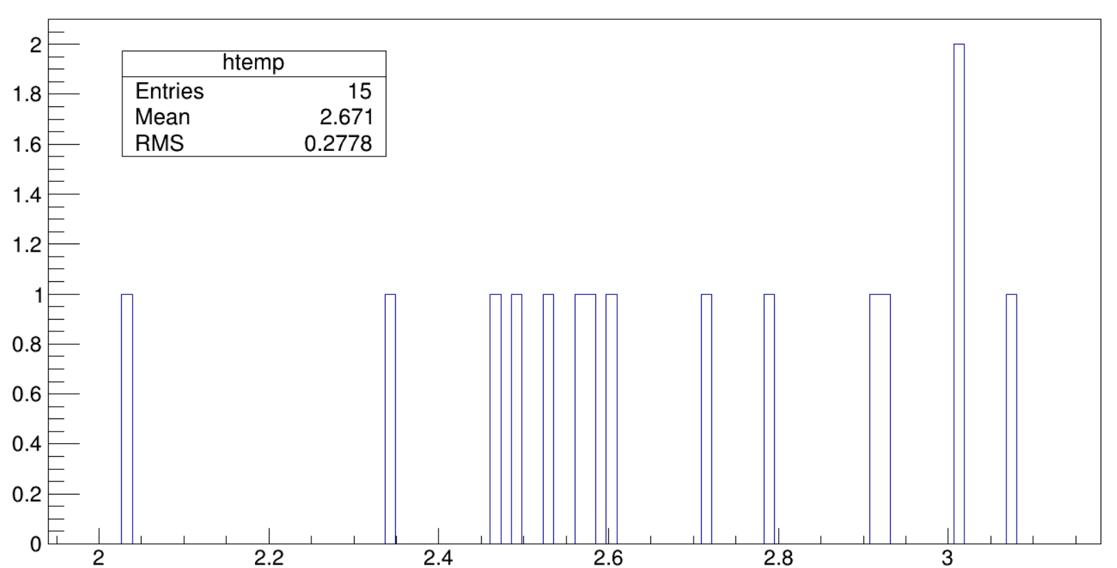
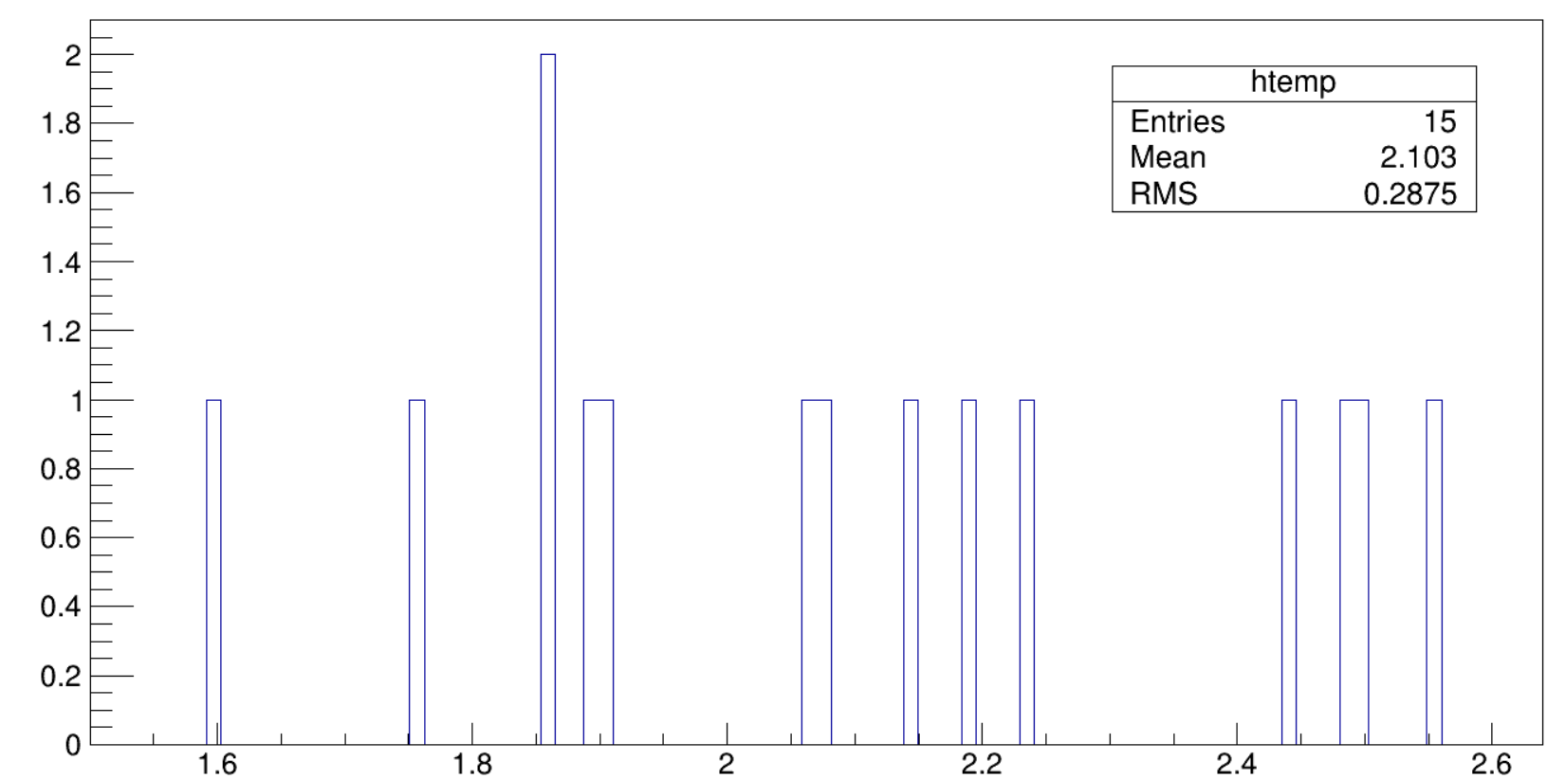
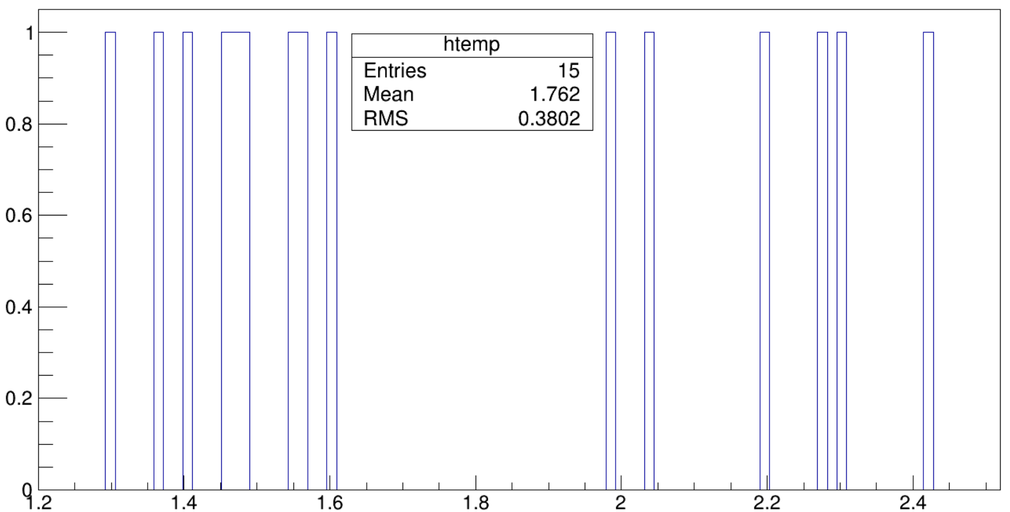



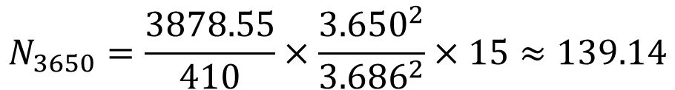
Continuum Background
$$M(φη_{1})$$
$$M(φη_{2})$$
Estimation from 3.650 GeV.
No obvious structure is observed.
$$N_{3650}=\frac{3878.55}{410}×\frac{{3.650}^{2}}{{3.686}^{2}}×15≈139.14$$
$$M(η_{1}η_{2})$$

Slide 15
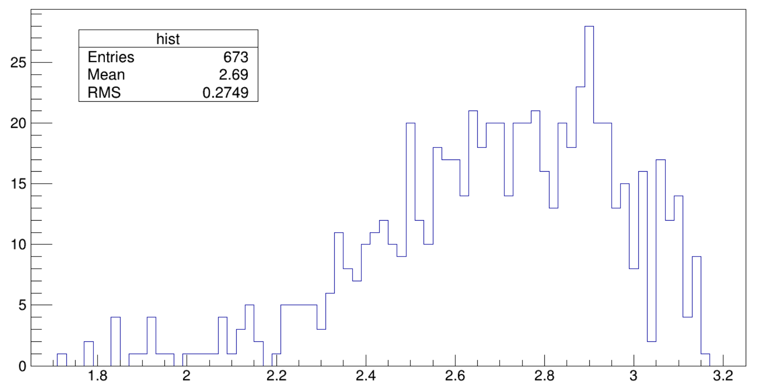
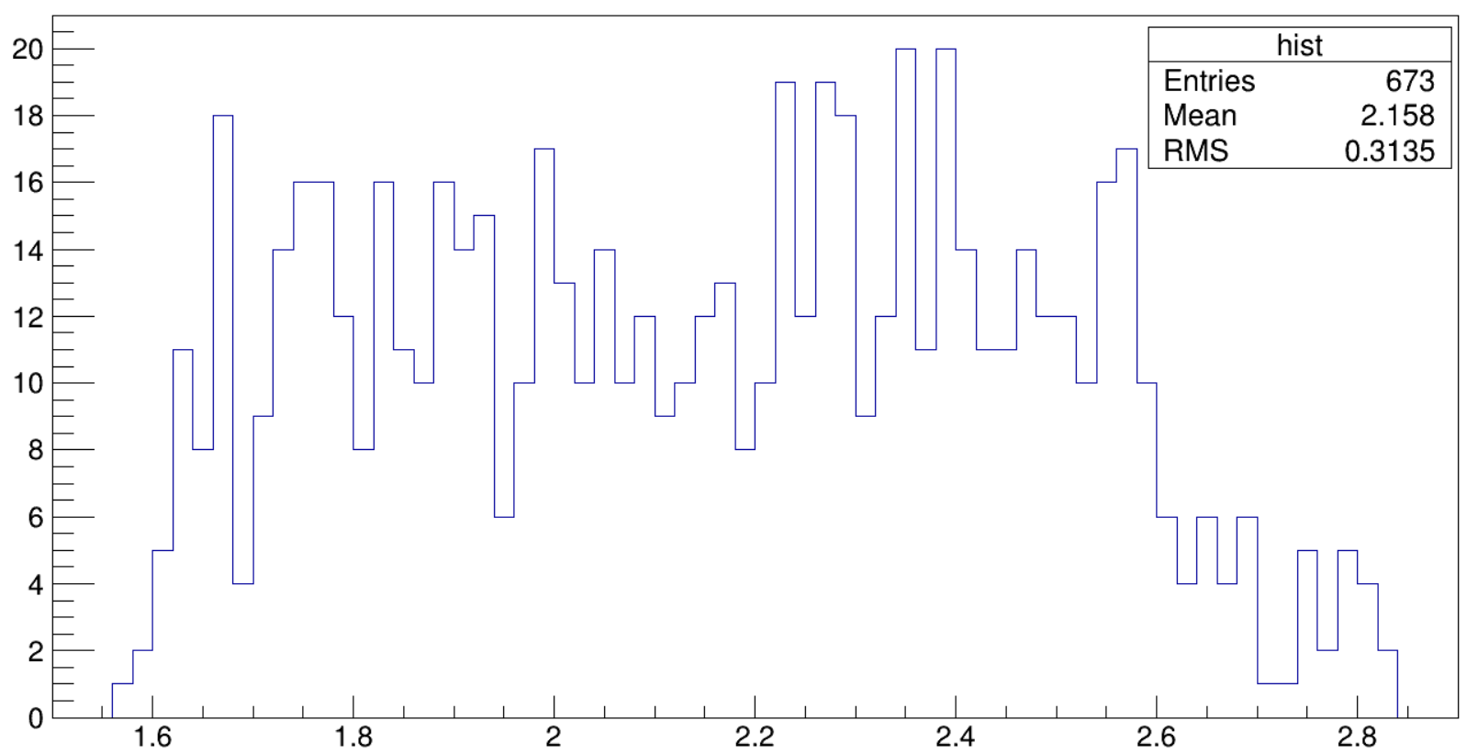
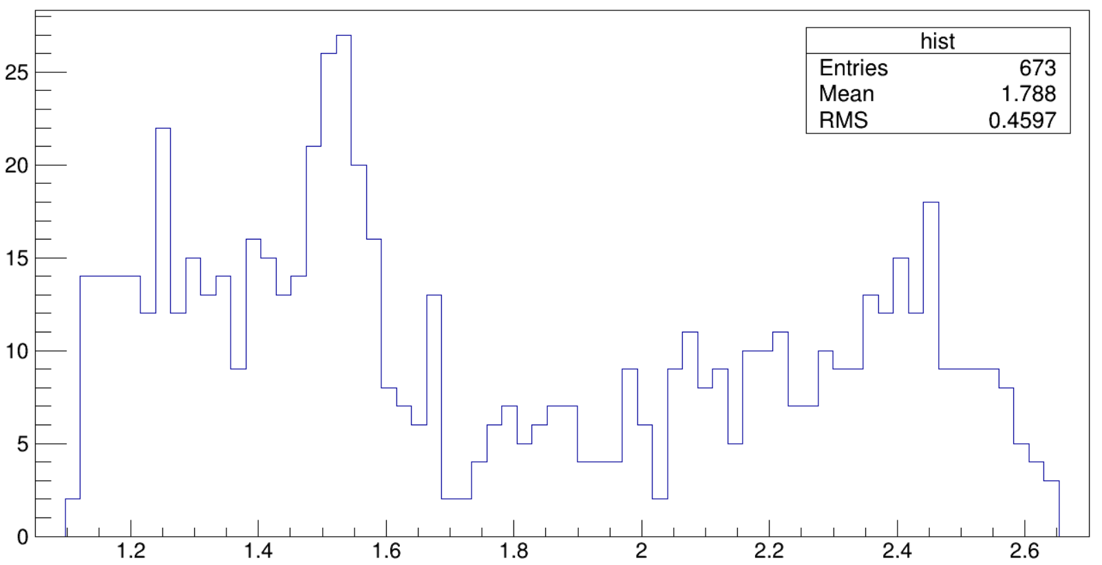
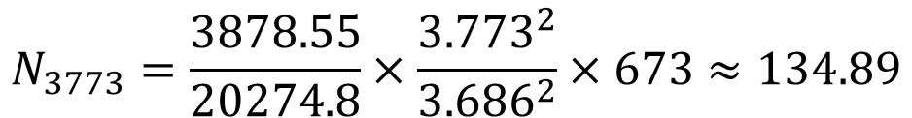
Continuum Background
$$M(φη_{1})$$
$$M(φη_{2})$$
Estimation from 3.773 GeV. Obvious structure is observed.
$$N_{3773}=\frac{3878.55}{20274.8}×\frac{{3.773}^{2}}{{3.686}^{2}}×673≈134.89$$
$$M(η_{1}η_{2})$$

Slide 16
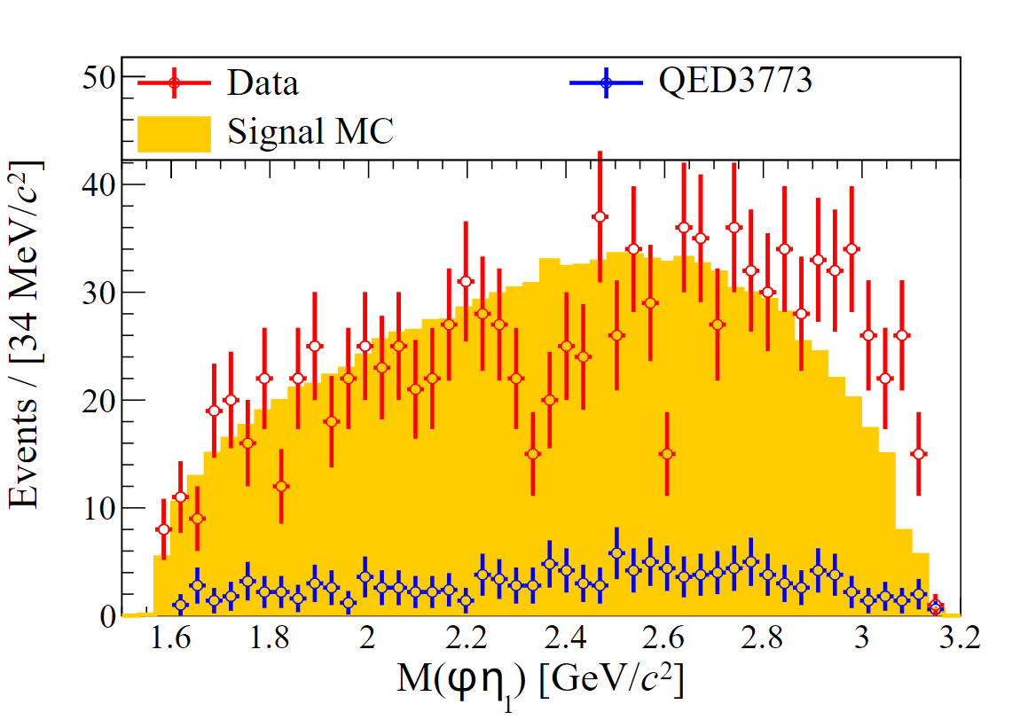
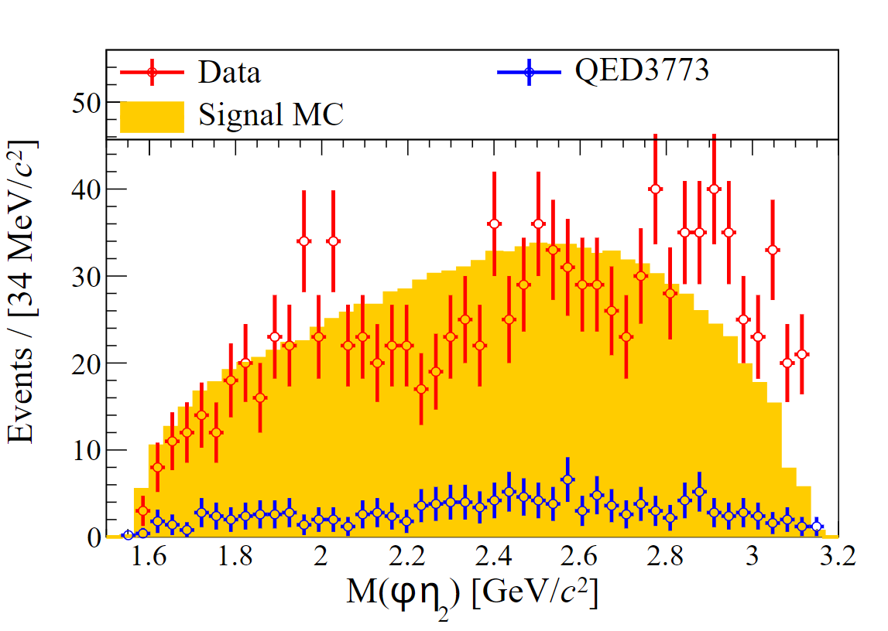
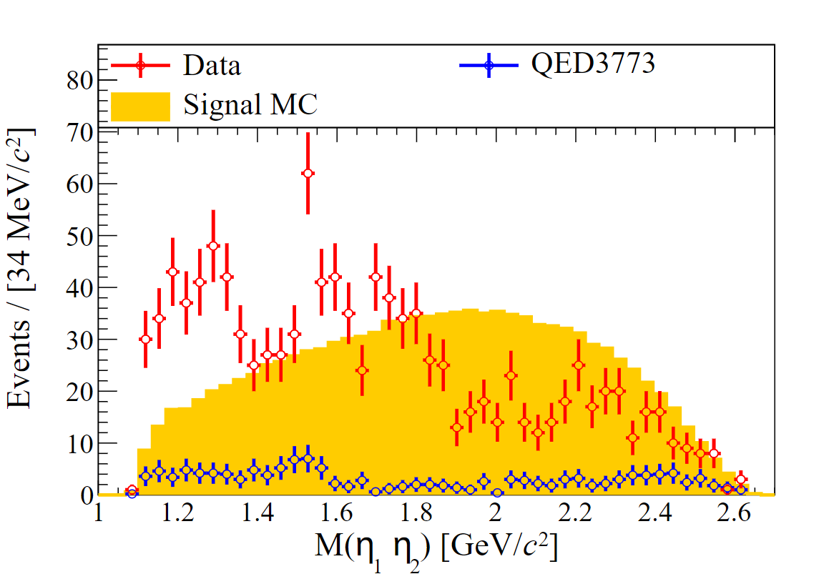
Data Distribution

Slide 17
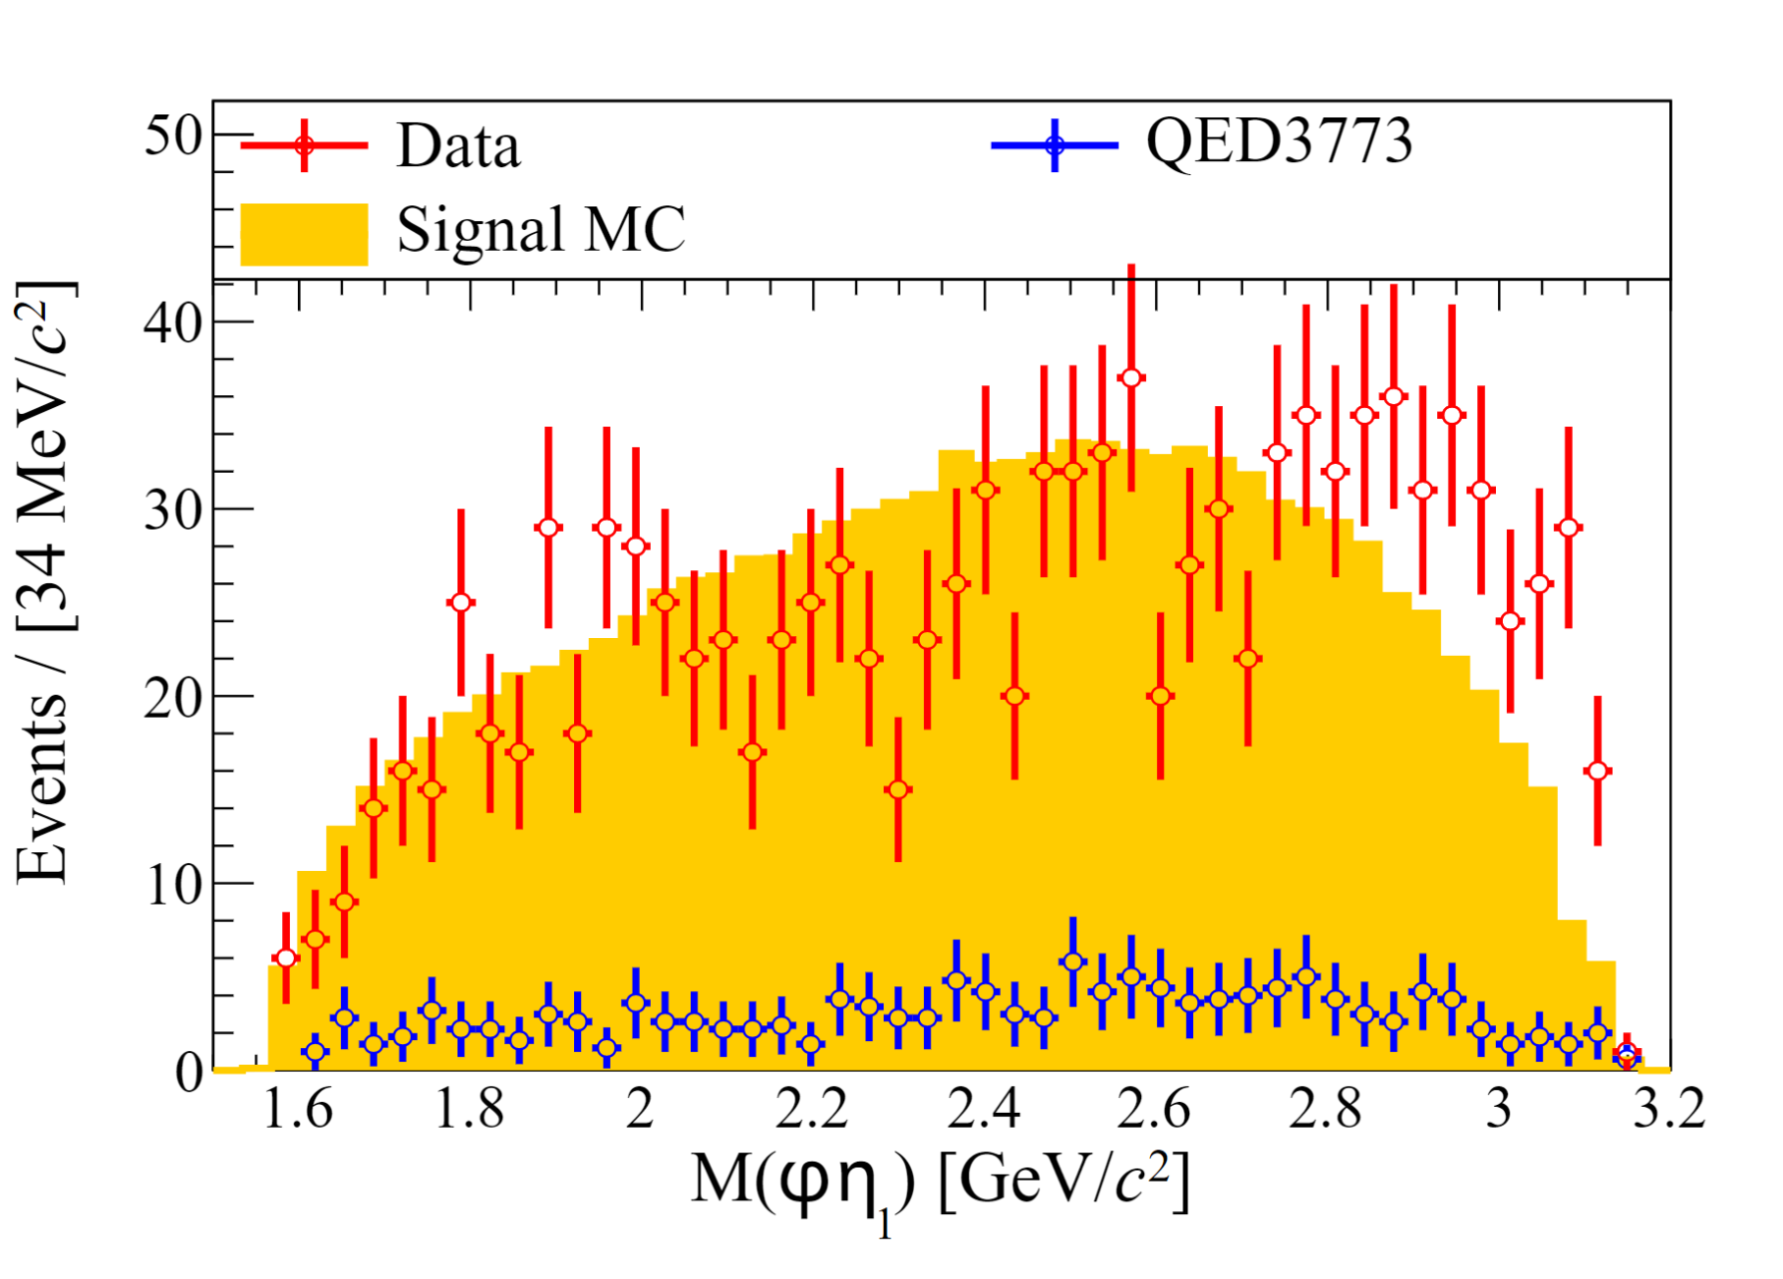
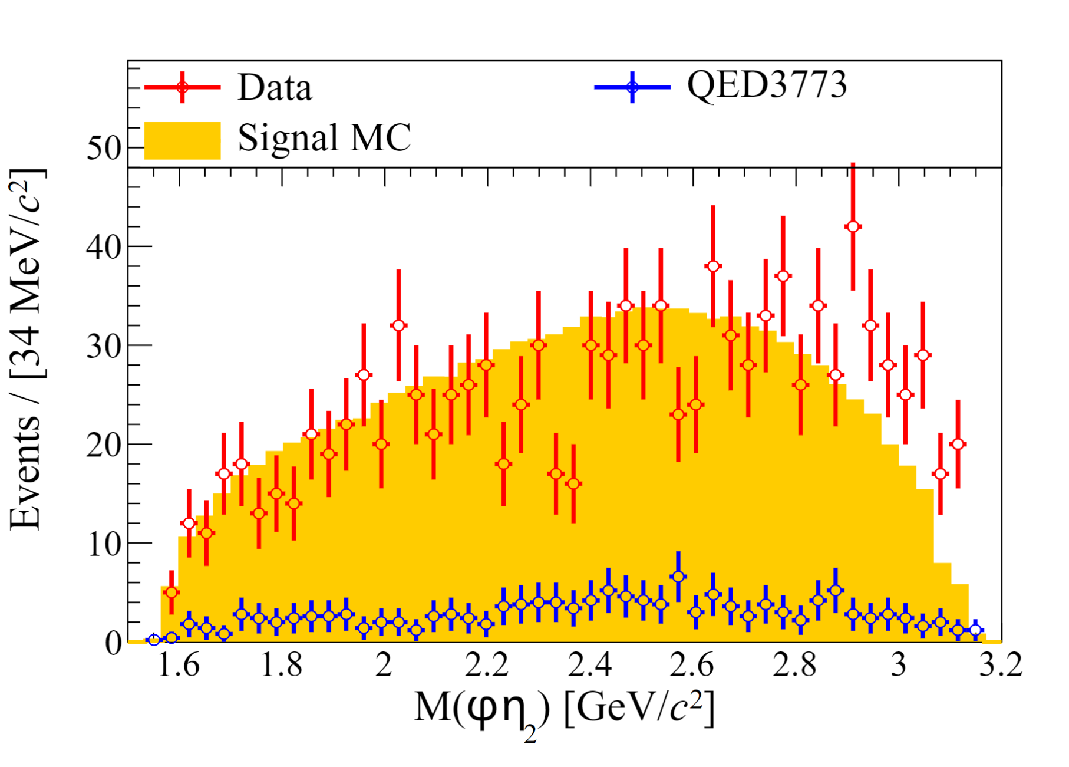
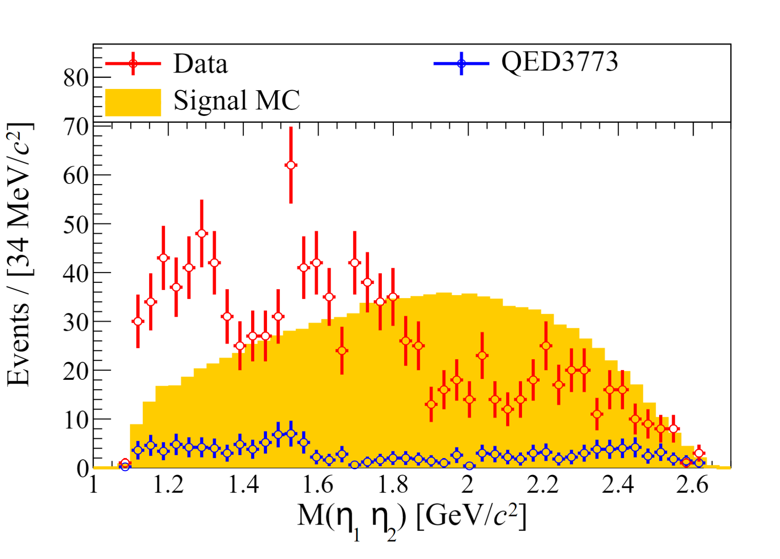
Data Distribution
Iterate 10w times on mixing 4-momentum of $η_{1}$ and $η_{2}$.

Slide 18
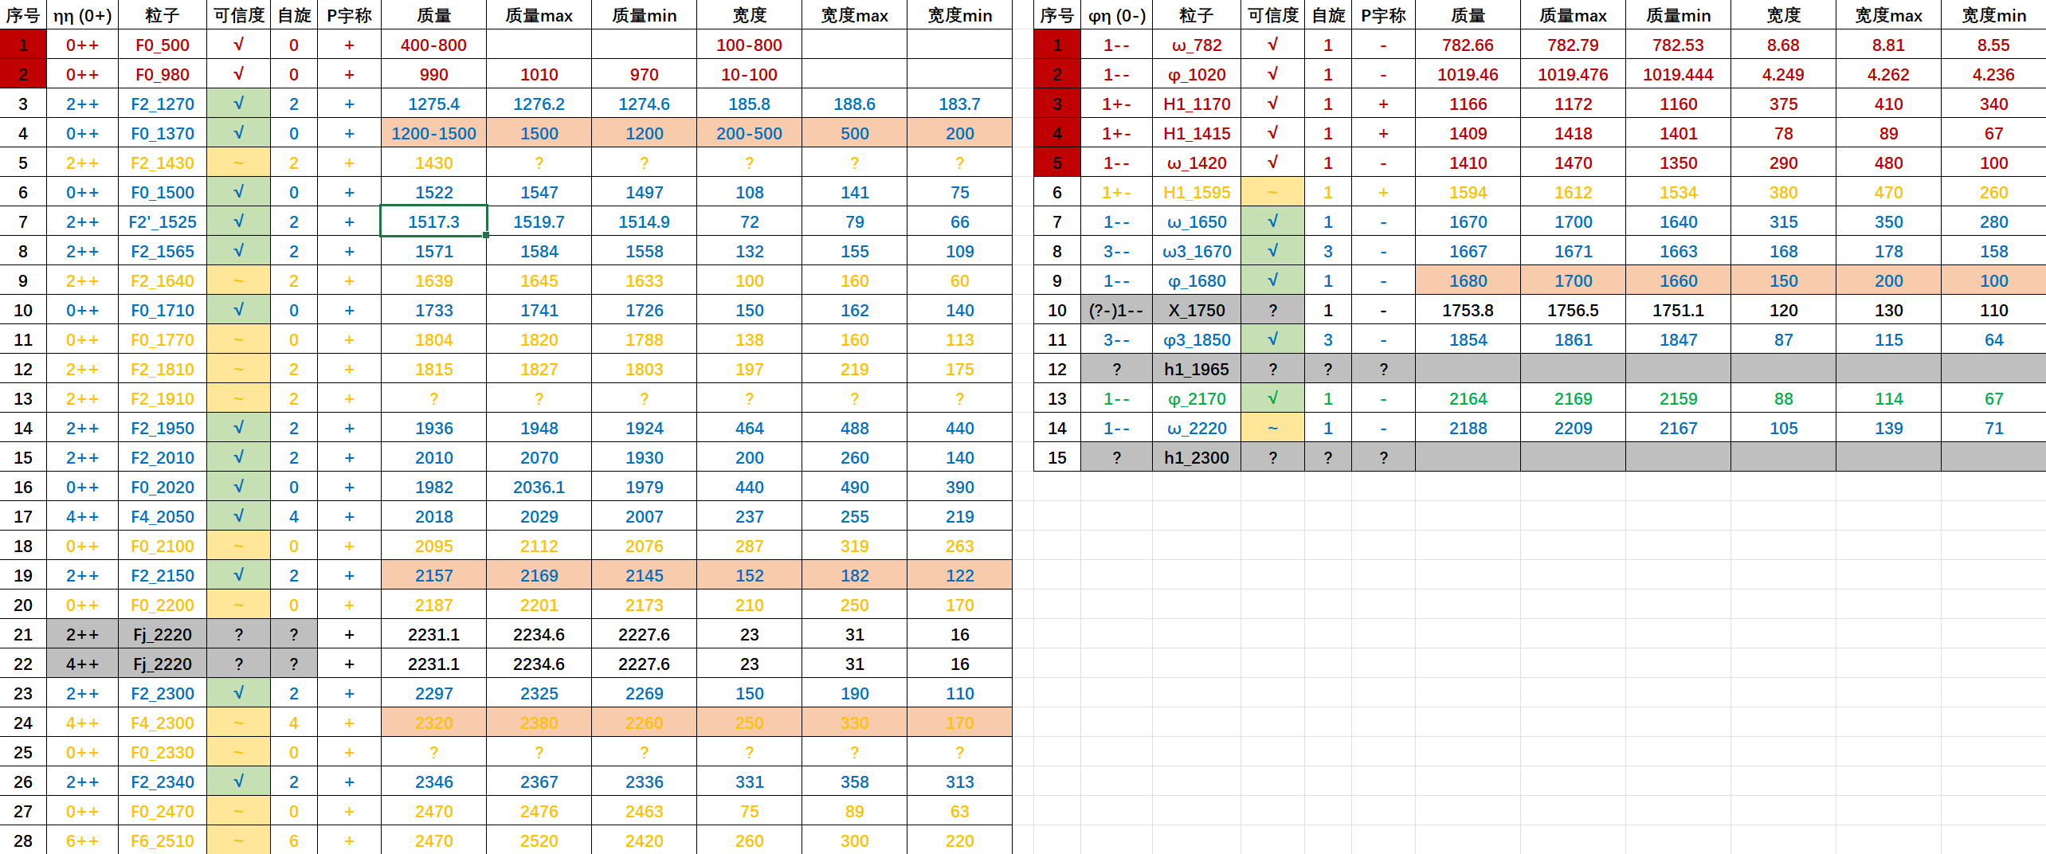
Candidate States

Slide 19
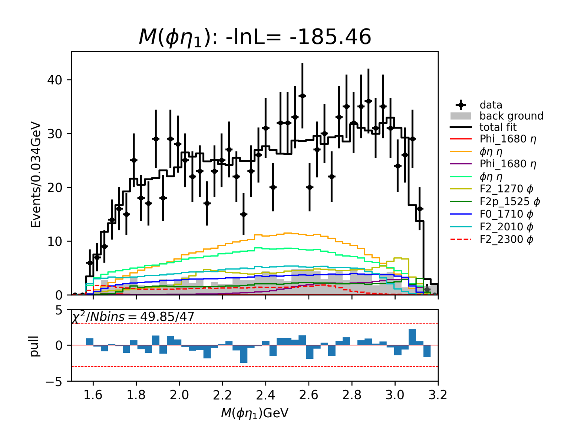
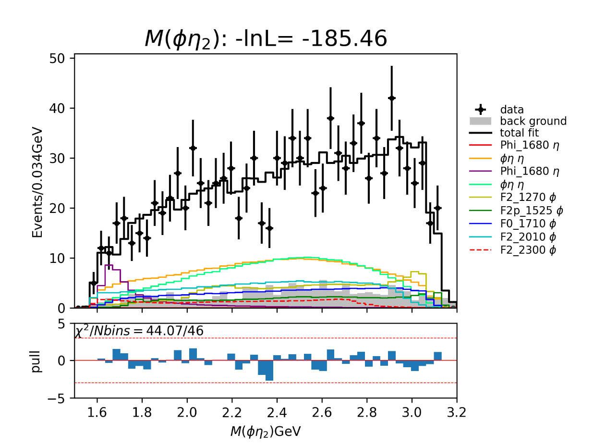
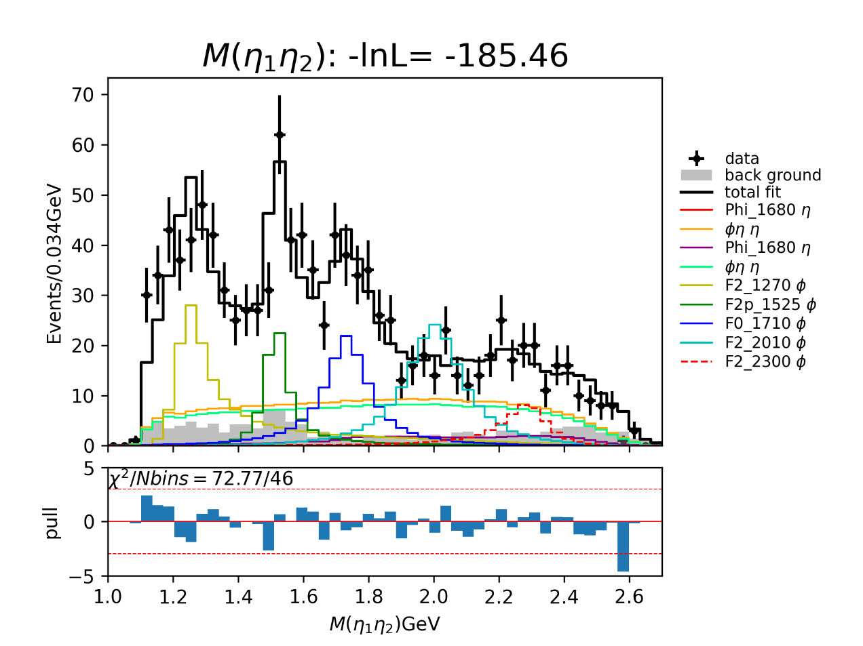
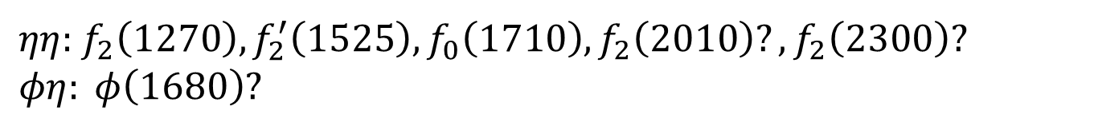
Partial Wave Analysis
Temporary solution.
$ηη$: $f_{2}\left(1270\right), f_{2}^{′}\left(1525\right), f_{0}\left(1710\right), f_{2}\left(2010\right)?, f_{2}\left(2300\right)?$
$φη: φ\left(1680\right)?$

Slide 20
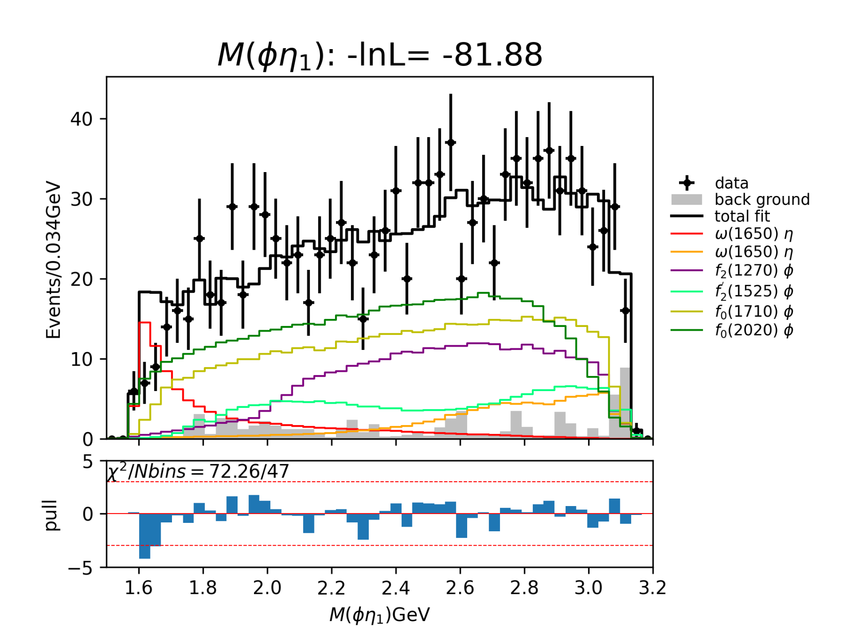
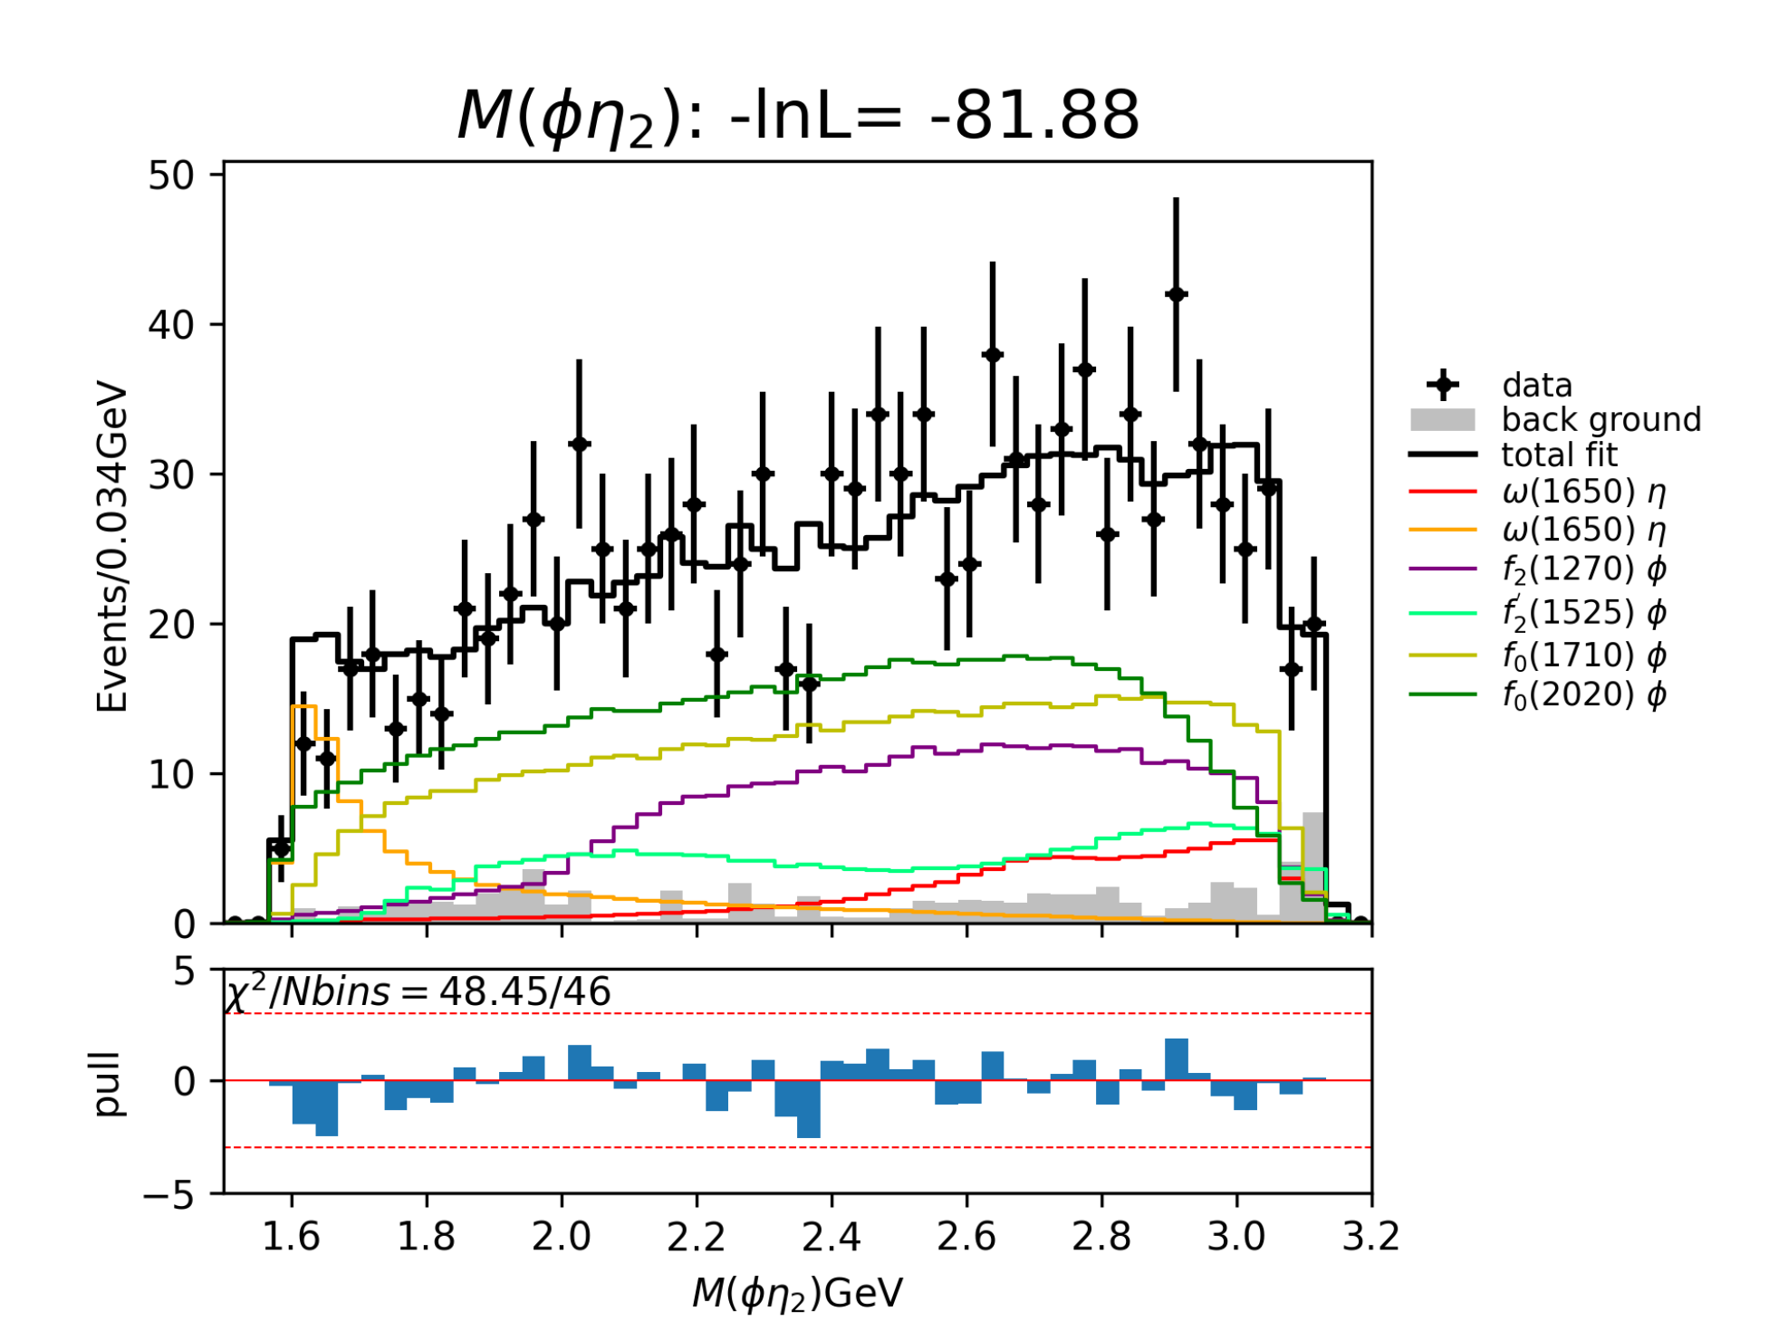
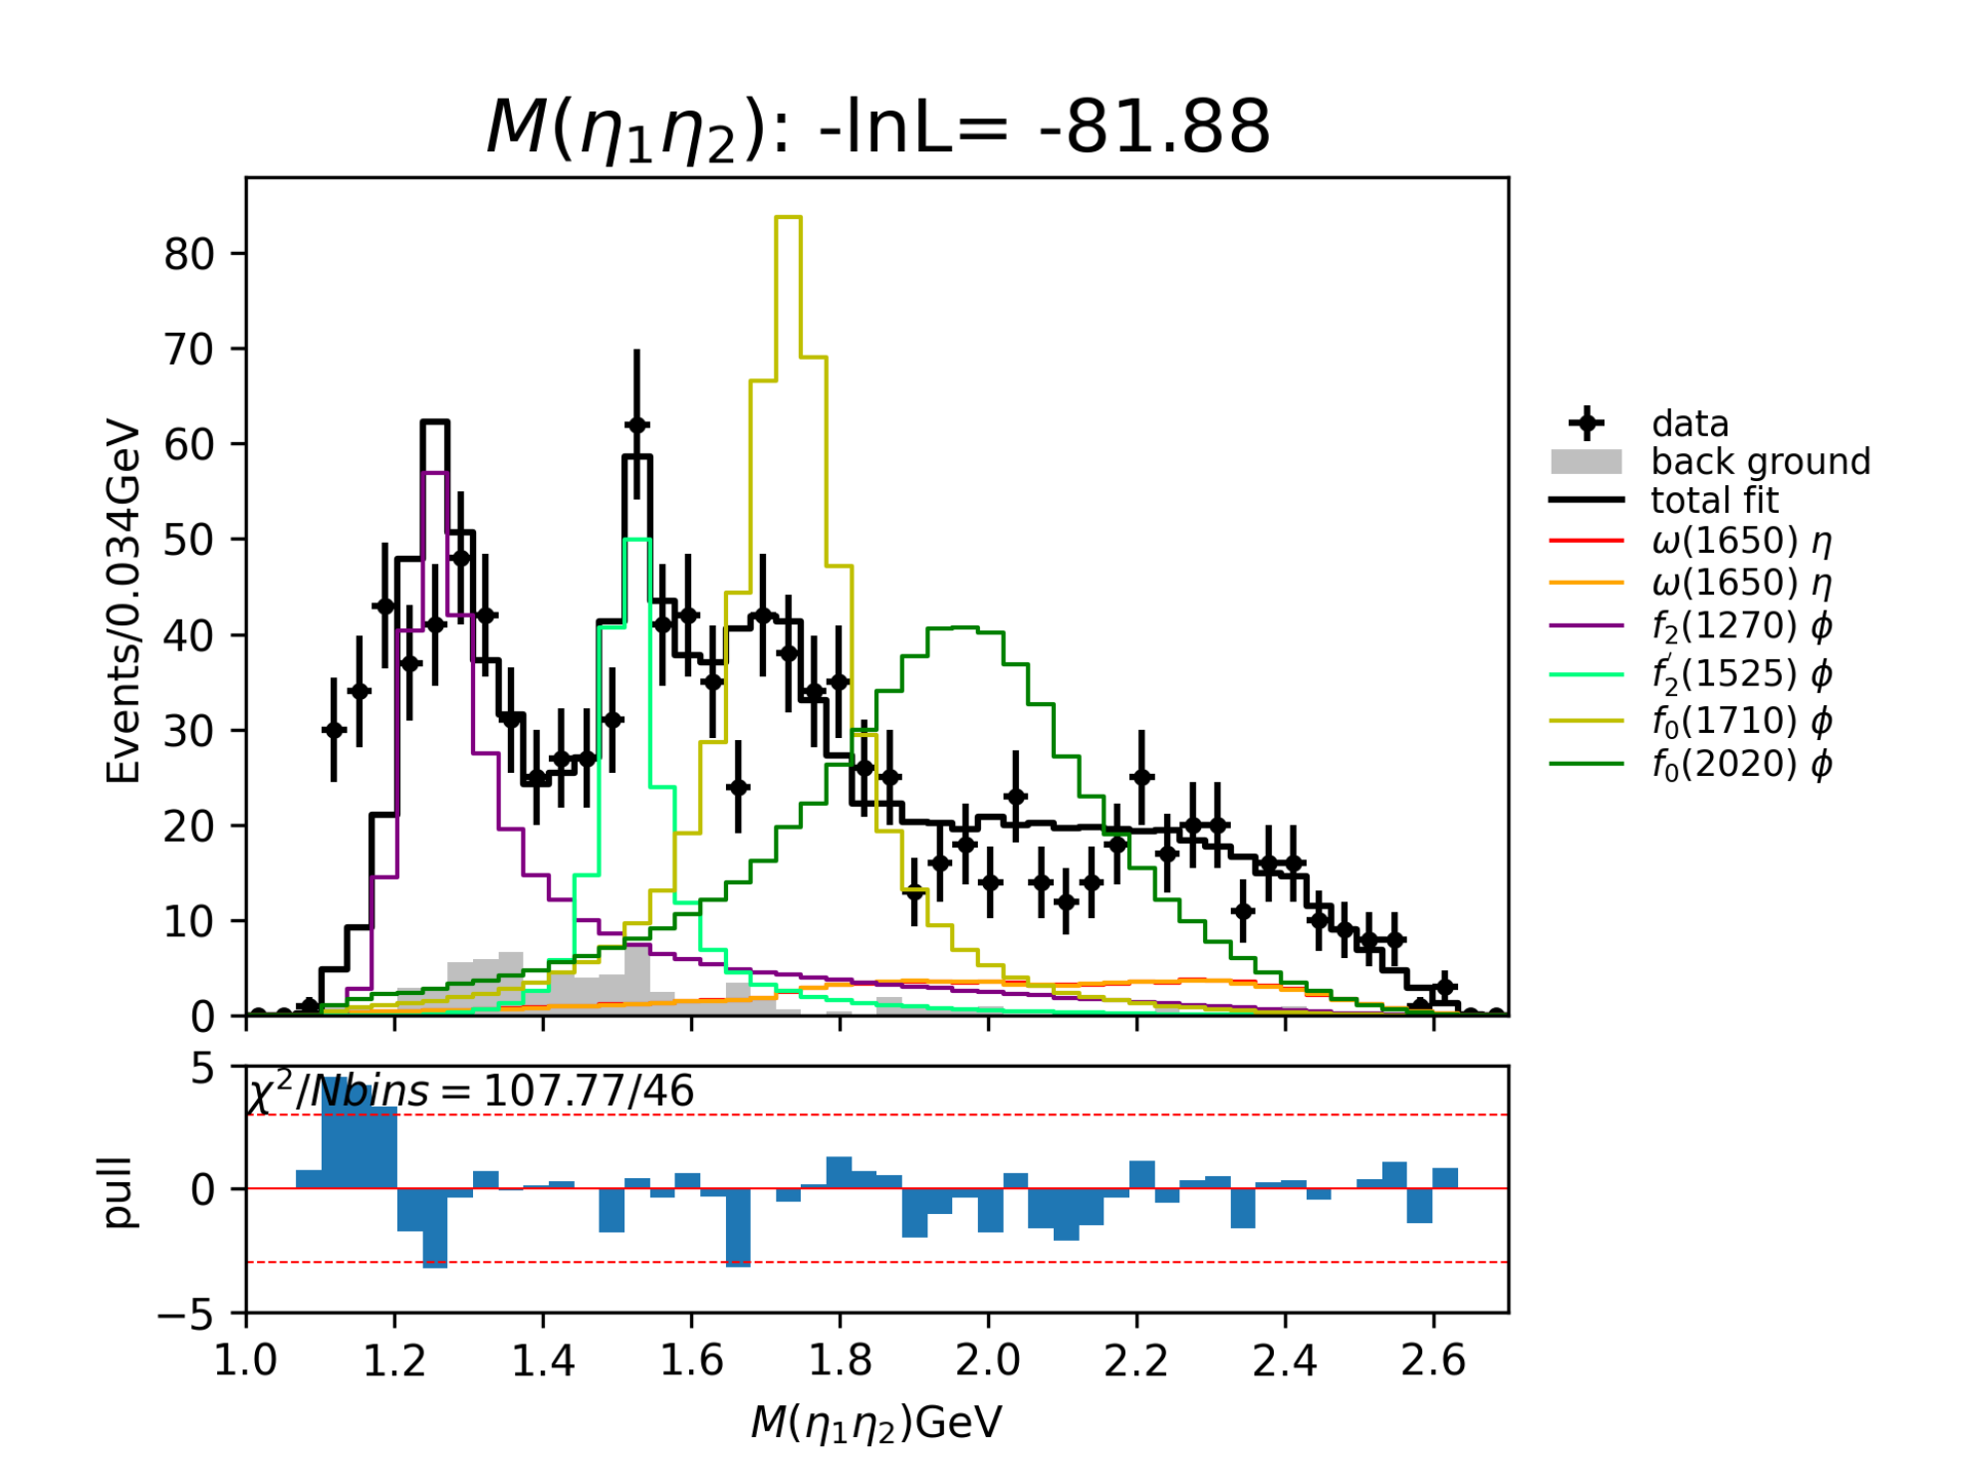
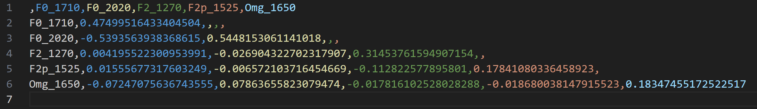
Partial Wave Analysis
Former: Interference between $F_{0}(1710)$ and $F_{0}(2020)$ is very large.

Slide 21
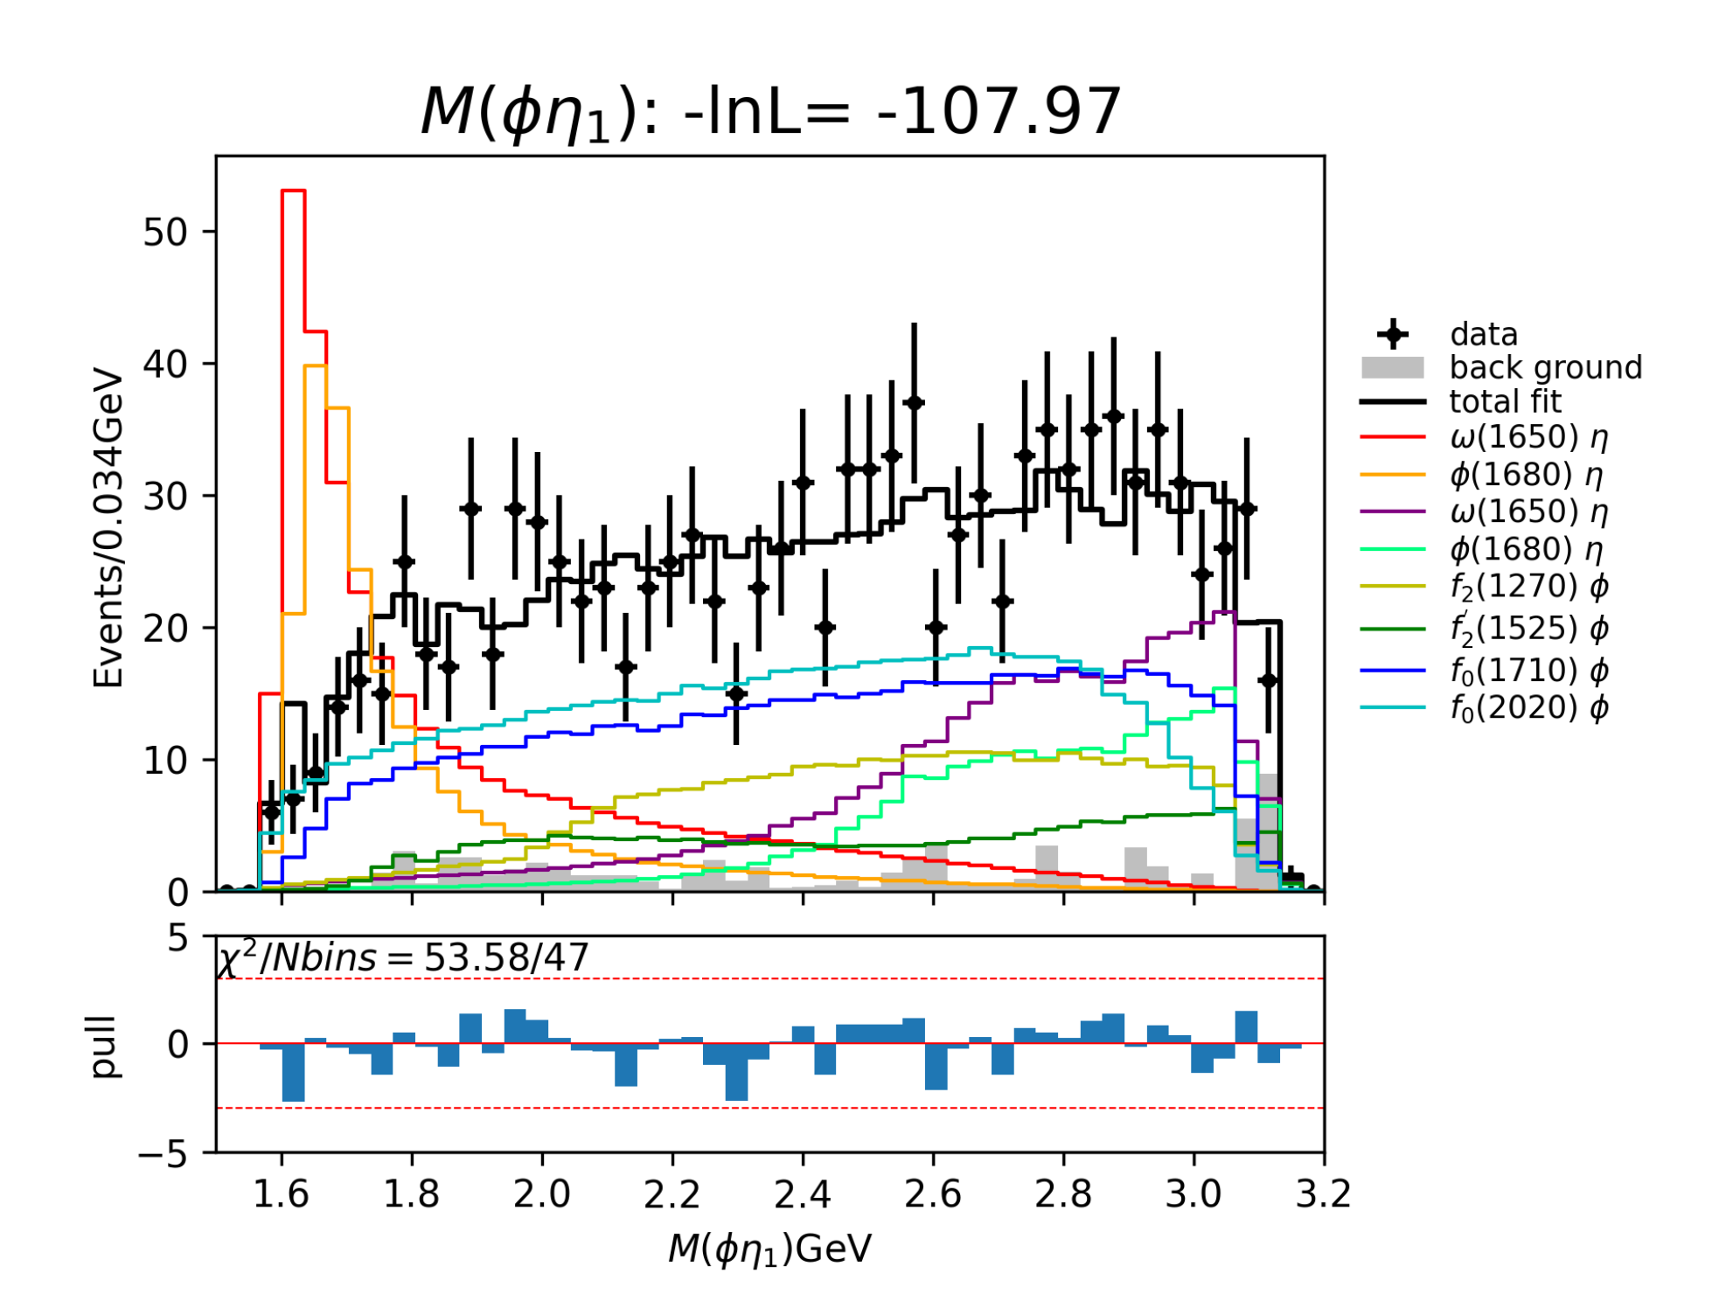
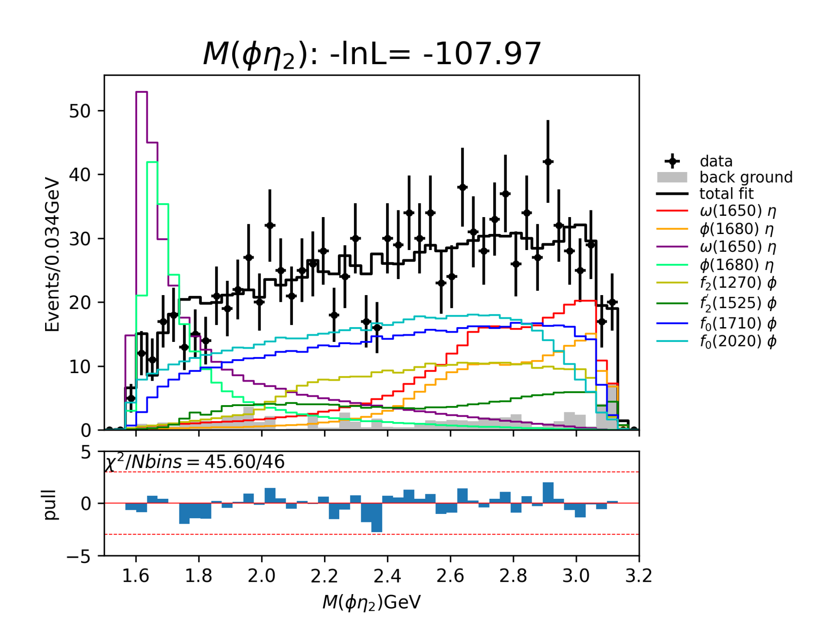
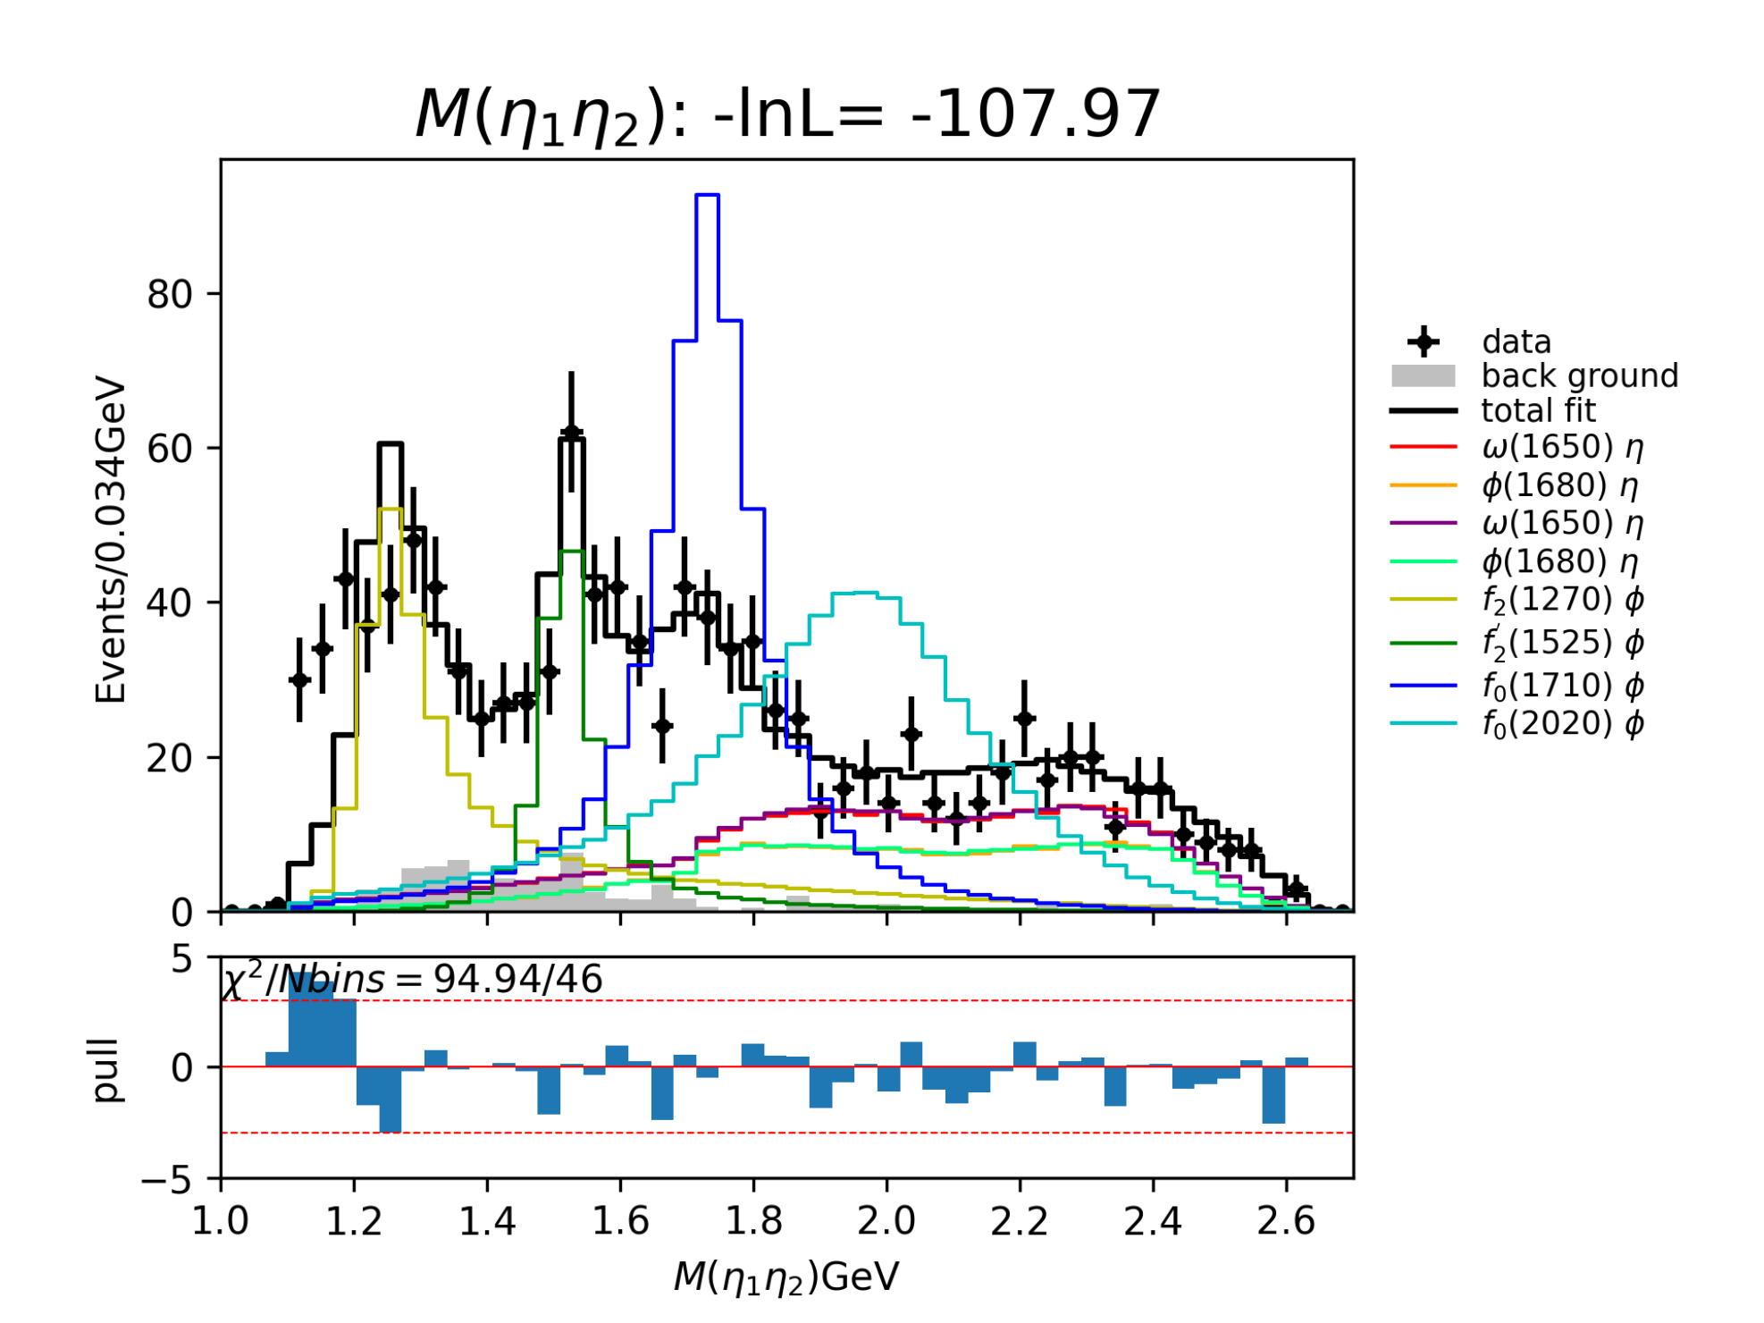
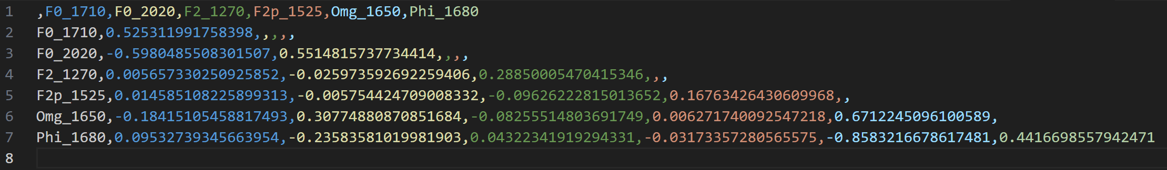
Partial Wave Analysis
Later-1: Interference between $F_{0}(1710)$ and $F_{0}(2020)$, $ω(1650)$ and $φ(1680)$ are very large.

Slide 22
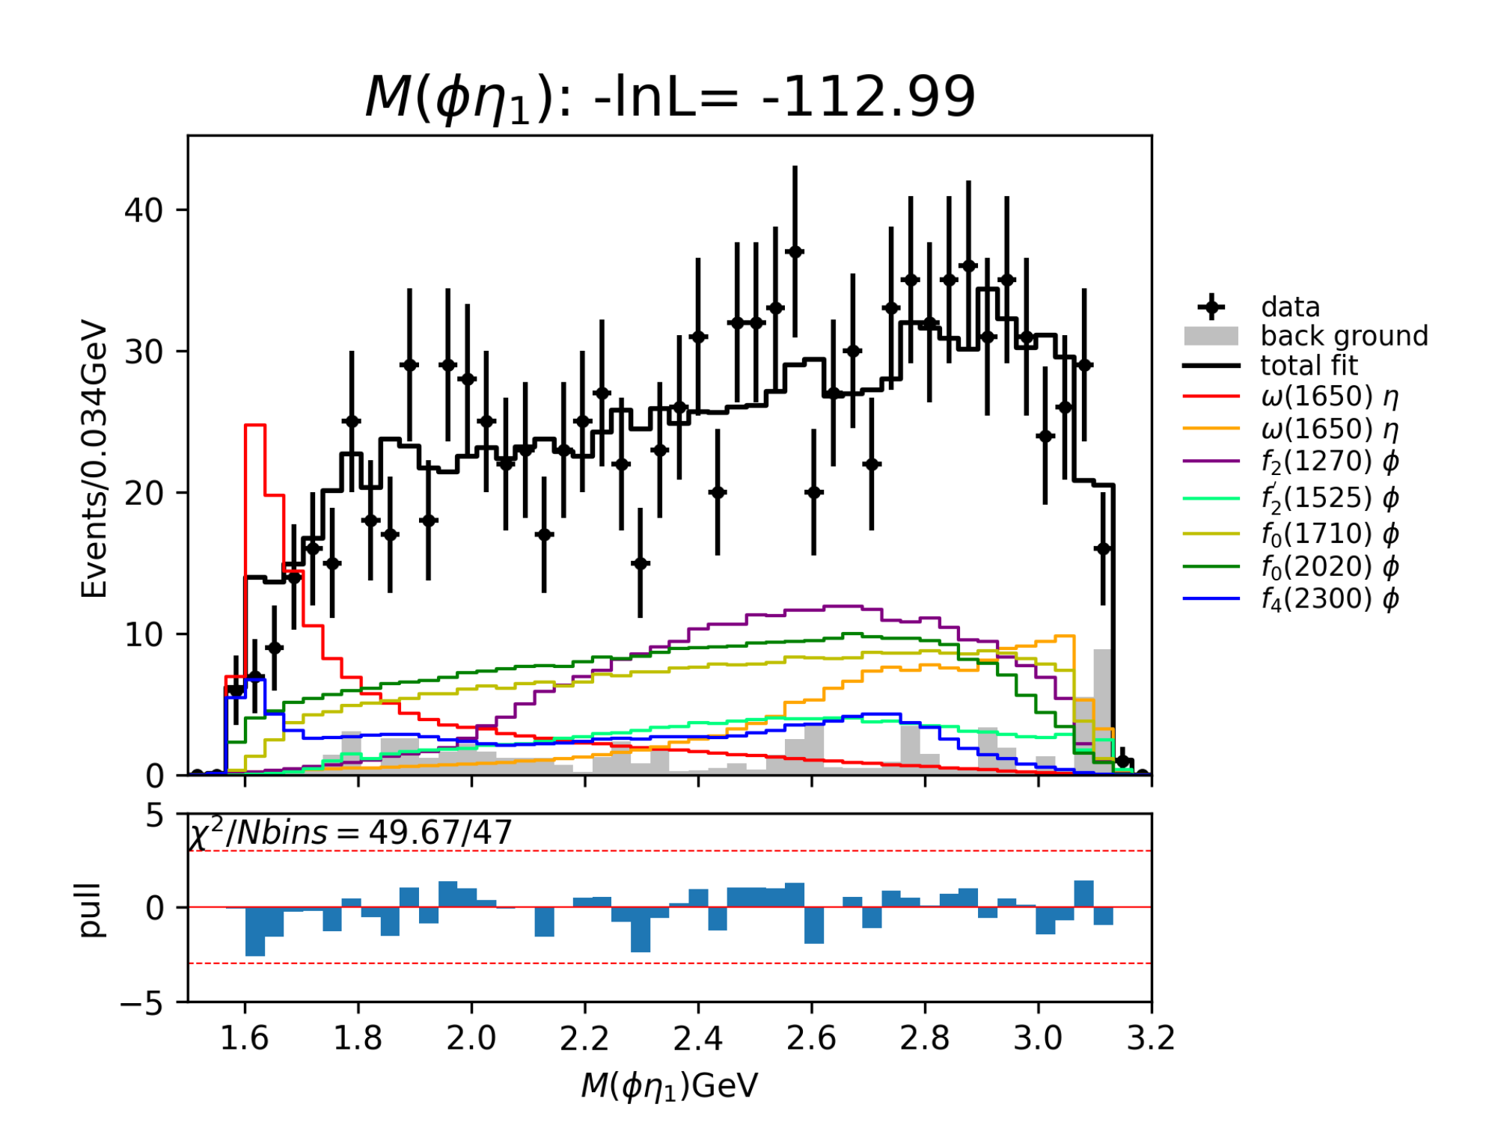
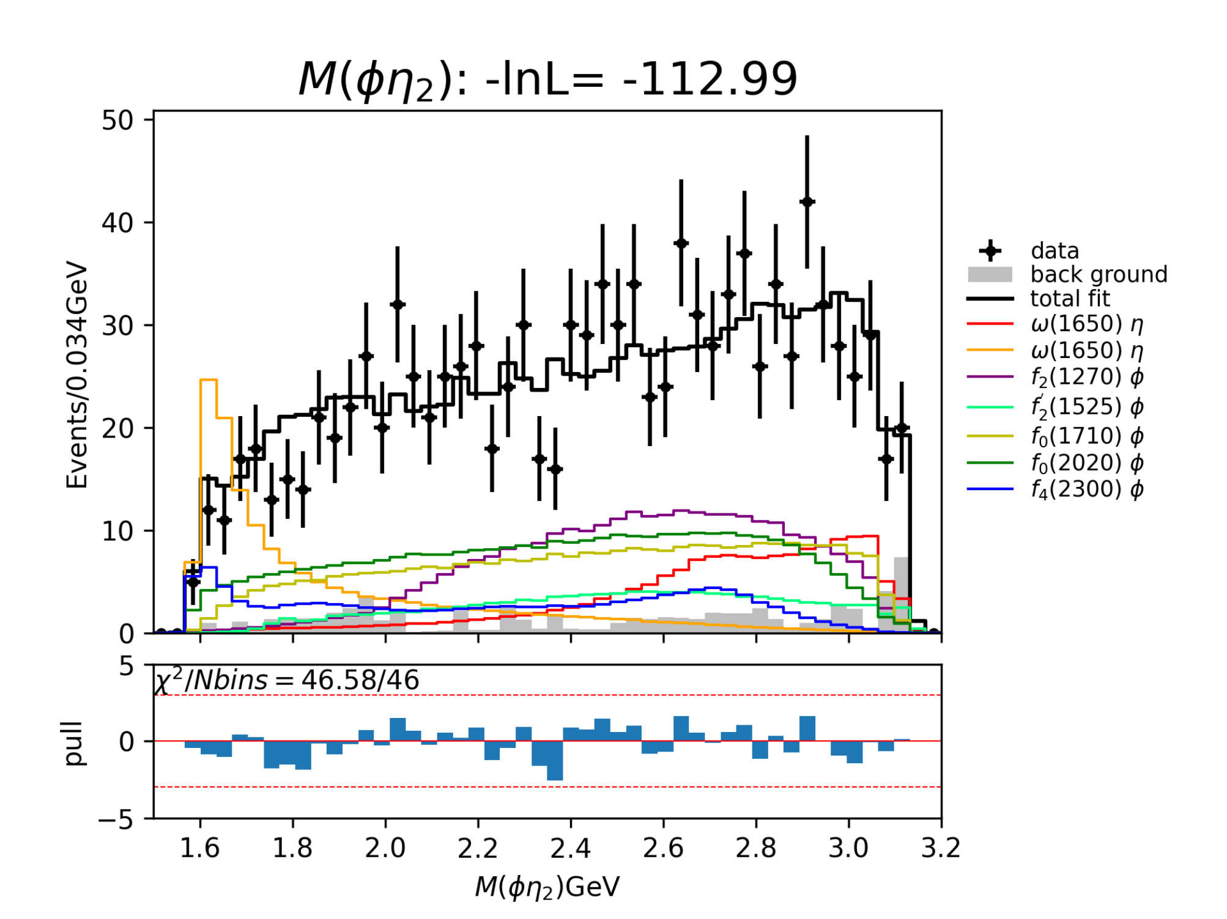
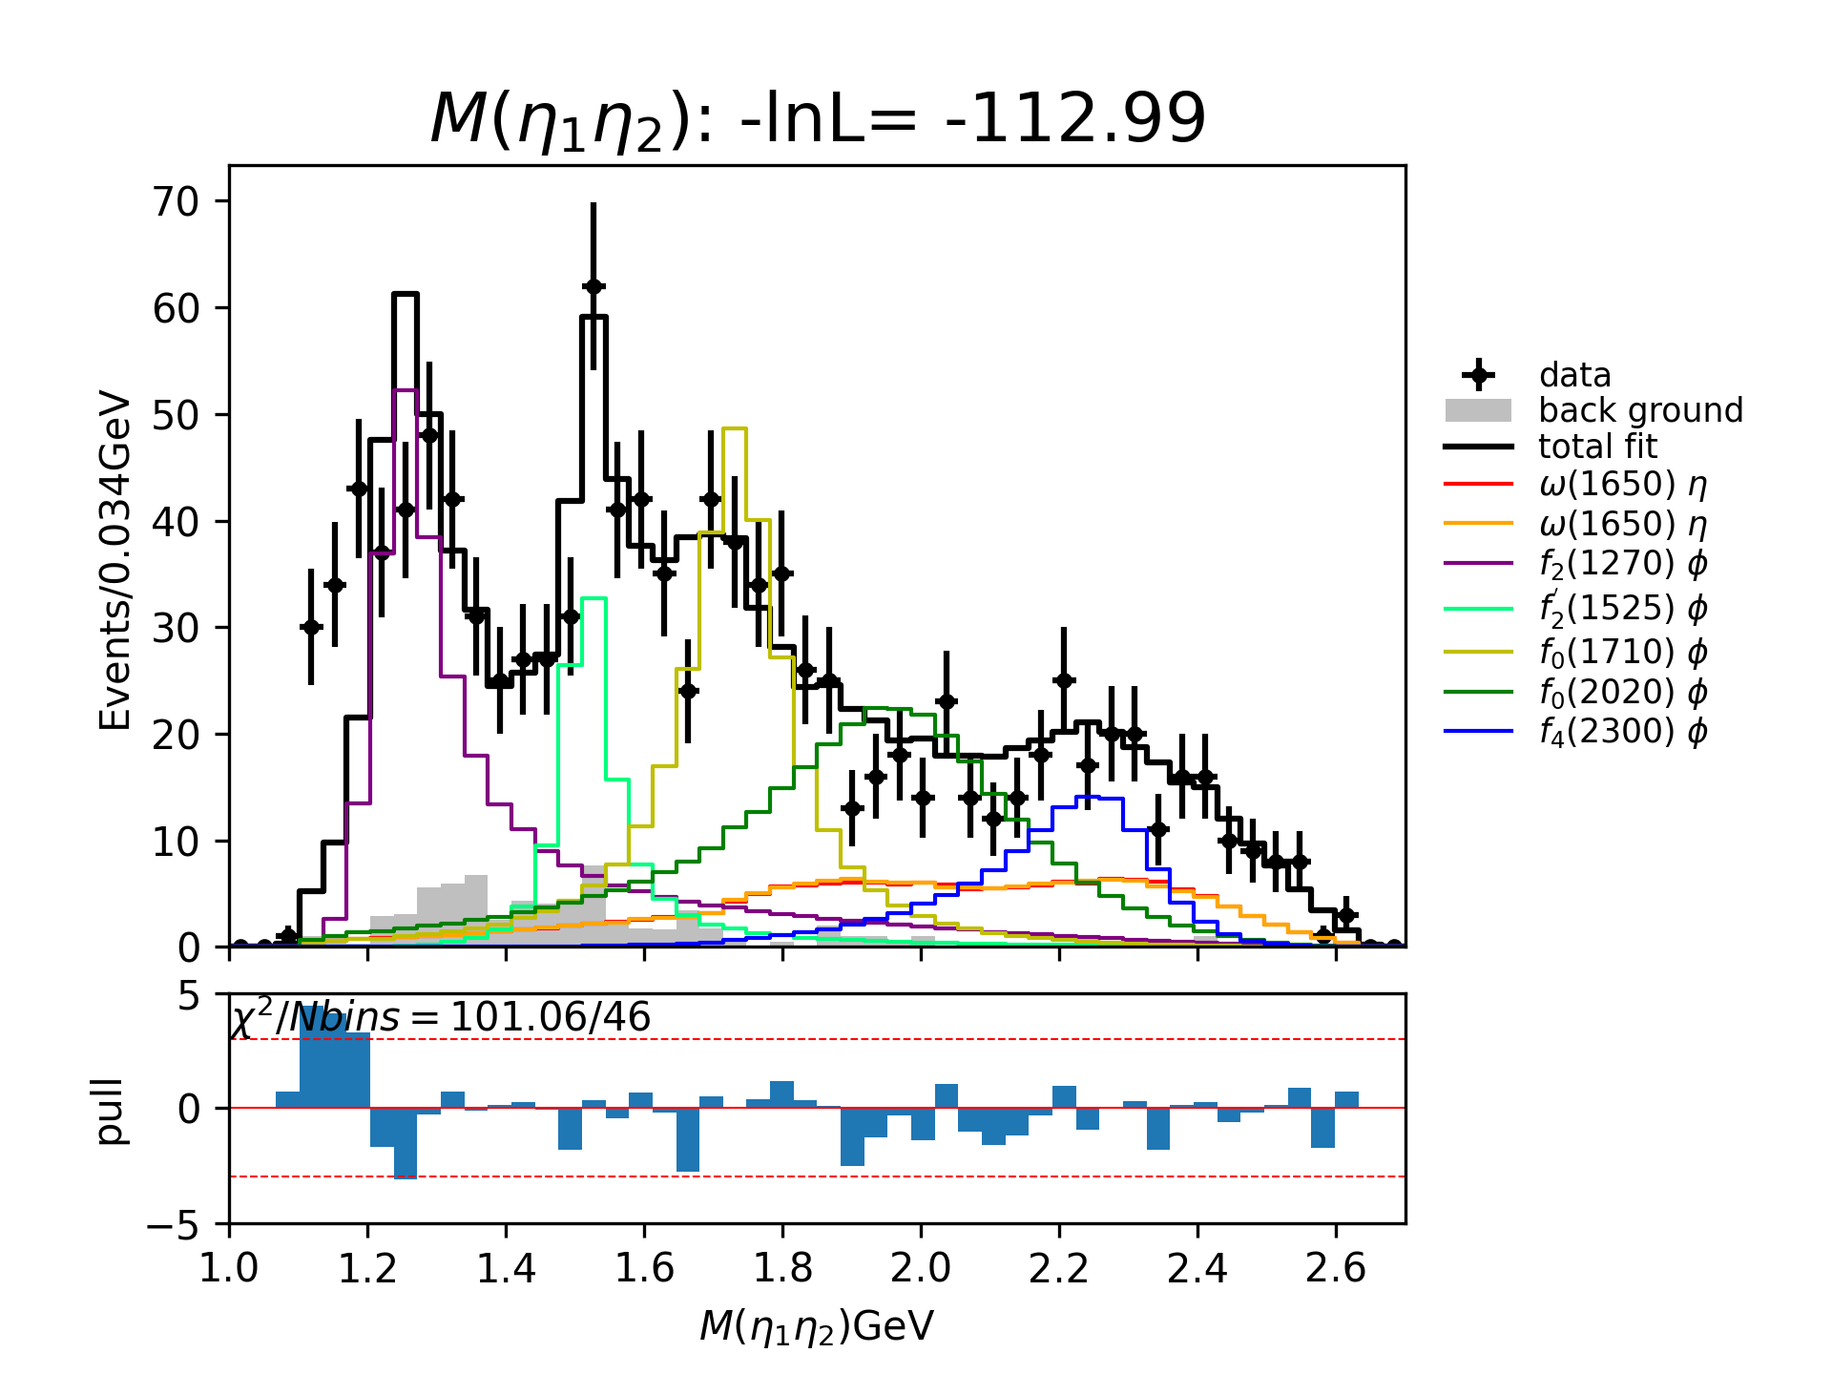


Partial Wave Analysis
Later-2: Interference between $F_{0}(1710)$ and $F_{0}(2020)$ is still relatively large, but less than former.
However, the significance of this state is relatively small than that in “Later-1”.

Slide 23




Partial Wave Analysis

Slide 24



Partial Wave Analysis

Slide 25


Partial Wave Analysis

Slide 26





Partial Wave Analysis
$f_{0}(1370)$ : mass : 1370 MeV width : 350 MeV
$f_{2}\left(1270\right)$ : mass : 1275.4 MeV width : 185.8 MeV

Slide 27

















$$φη(0^{−})$$
$$φη(1^{+})$$
$$φη(1^{−})$$
$$φη(2^{+})$$
$$f_{0}(1370)$$

Slide 28

















$$φη(2^{−})$$
$$ηη(0^{+})$$
$$ηη(2^{+})$$
$$ηη(4^{+})$$
$$f_{0}(1370)$$

Slide 29














$$φη(0^{−})$$
$$φη(1^{+})$$
$$φη(1^{−})$$
$$φη(2^{+})$$
$$f_{2}(1270)$$

Slide 30












$$φη(2^{−})$$
$$ηη(0^{+})$$
$$ηη(2^{+})$$
$$ηη(4^{+})$$
$$f_{2}(1270)$$

Slide 31













$$φη(0^{−})$$
$$φη(1^{+})$$
$$φη(1^{−})$$
$$φη(2^{+})$$
$$f_{2}(1270)$$
$$f_{0}(1370)$$

Slide 32












$$φη(2^{−})$$
$$ηη(0^{+})$$
$$ηη(2^{+})$$
$$ηη(4^{+})$$
$$f_{2}(1270)$$
$$f_{0}(1370)$$

Slide 33





Slide 34





Slide 35





Slide 36







Baseline solution (rejected)
$$f_{0}(1370)$$
$$f_{2}^{′} (1525)$$
$$PHSP(2^{+})$$
$$PHSP(2^{+})$$
$$f_{0}(1710)$$
$$f_{2}(2340)$$
Fit fraction (%) | $$f_{0}(1370)$$ | $$f_{2}^{′}(1525)$$ | $$f_{0}(1710)$$ | $$f_{2}(2340)$$ | $$NR(φη)(2^{+})$$
$$f_{0}(1370)$$ | 21.1±9.0
$$f_{2}^{′}(1525)$$ | -0.8±0.3 | 18.7±3.0
$$f_{0}(1710)$$ | -5.9±11.2 | 0.5±0.3 | 17.2±5.8
$$f_{2}(2340)$$ | -0.5±0.3 | 4.2±2.6 | 0.1±0.4 | 26.4±3.7
$$NR(φη)(2^{+})$$ | 14.3±1.5 | -0.9±2.3 | 1.1±2.2 | -22.6±6.2 | 27.2±6.4
Total yields$≈$110.6$\%$

Slide 37














$$f_{0}\left(1710\right)$$
$$f_{0}\left(1500\right)$$
$$f_{2}\left(1810\right)$$
$$f_{0}\left(1500\right)$$
$$f_{2}\left(1810\right)$$
$$f_{0}\left(2020\right)$$
$$f_{2}^{′}\left(1525\right), f_{0}\left(1370\right),$$
$$f_{2}\left(2340\right)$$
Total yields$>$150$\%$

Slide 38








$$f_{2}^{′}\left(1525\right), f_{0}\left(1370\right), f_{0}\left(1710\right), NR(ηη)(0^{+})$$
Total yields$>$150$\%$
$$f_{2}^{′}\left(1525\right), f_{0}\left(1370\right), f_{2}\left(1810\right), NR(ηη)(0^{+})$$
Total yields$>$150$\%$

Slide 39






Begin with f2’(1525) + NR(ηη(0+)), total fit fractions > 150%, can’t be used as baseline solution.

Slide 40


Summary of current status of PWA:
  $f_{2}^{′}\left(1525\right) \text{√}$
  States and PHSP on $φη ×$
  $f_{2}^{′}\left(1525\right)+f_{2}\left(1270\right) ×$
  $f_{2}^{′}\left(1525\right)+PHSP(ηη\left(0^{+}\right)) ×$
  $f_{2}^{′}\left(1525\right)+f_{0}\left(1370\right)$
    Previous: $f_{0}\left(1370\right)$: mass: 1370 MeV, width: 350 MeV ×
    Now: $f_{0}\left(1370\right)$: mass: 1370 MeV, width: 250 MeV ?
$f_{2}\left(1270\right)$ or $f_{0}\left(1370\right)$

Slide 41




Total fit fraction: 149.7%

Slide 42


f0(1370) | BW (MeV) | Fit (MeV)
mass | 1200 – 1500 | 1276.76
width | 200 – 500 | 250 (fix)

Slide 43



Slide 44




Slide 45



Slide 46









Slide 47
boss_dcmltracking algorithm package update status :
( Green : Already done ; Red : Not now ; Yellow : Ongoing )
Generator : (1) BesEventGen , (2) MultiParticleGun(new) , (3) SingleParticleGun .
Reconstruction : (1) GenFitAlg(new) , (2) KalFitAlg , (3) MLTrackingAlg(new) , (4) T0Dummy .
Simulation : (1) BesEventMixer(part new) , (2) BOOST/BesSim , (3) BOOST/MdcSim , (4) BOOST/PrintMcInfo(+cgem) , (5) BOOST/CgemSim(add) .
Mdc : (1) MdcTrackHelper(part new)
Cgem : (1) CgemTrackHelper(new)
FileFilterAlg(new)
Utilities : (1) DumpEventAlg(new) , (2) MLTrackingUtils(new)

Slide 48
R(MidDrift)
2DClusterPosX
+2DClusterPosY+2DClusterPosZ
2DClusterPhi+2DClusterZ
RecCgemClusterCol
2DClusterId
XStripIdRange
+VStripIdRange
1DClusterId
Search in range
Combine by distance
CgemDigiCol
StripId
TrackIndex
PositionX
+PositionY
+PositionZ
CgemMcHitCol
PdgId
MotherId
MomentumX
+MomentumY
+MomentumZ

Slide 49


Training Loss

Slide 50

Track efficiency and purity

Slide 51


Hit efficiency of MDC & CGEM

Slide 52

  Introduction of GNN
Graph Neural Network (GNN)
  An optimizable transformation over all attributes while preserving the symmetries of the graph
GNN for tracking
  Detector hits are naturally a set of points irregularly distributed in space
    Nodes → hits
    Edges → hit-hit associations
  Graphs are permutation-invariant and can handle variable numbers of hits
Source: IRIS-HEP, “Accelerated GNN Tracking,” accessed June 13, 2025, https://iris-hep.org/projects/accel-gnn-tracking.html.

Slide 53

  GNN Model

Slide 54


  GNN Model

Slide 55




  Detector - CGEM + ODC
CGEM
Outer Drift Chamber (ODC)
Outer DC (ODC)
axial wires
stereo wires
CGEM+ODC in X-Y view
CGEM in 3D view

Slide 56


  Tracking Quality Metrics
  Hit efficiency
$$ε_{hits}=\frac{N_{hit}^{matched}}{N_{hit}^{detectable}}$$
  $N_{hit}^{matched}$ is the number of hits on the track that match the truth, and $N_{hit}^{detectable}$ is the number of detectable hits on the truth track associated with this reconstructed track.
  Hit purity
  $$p_{hits}=\frac{N_{hit}^{matched}}{N_{hit}^{assigned}}$$
  $N_{hit}^{assigned}$ is the number of hits on the reconstructed track.
  Track criteria
  $$p_{hits}>50\%,N_{hit}^{matched}>6$$
  MDC track efficiency
$$ε_{track}=\frac{N_{track}^{matched}}{N_{track}^{detectable}}$$
  $N_{track}^{matched}$ is the number of reconstructed tracks that match the truth, and $N_{track}^{detectable}$ is the number of detectable tracks in the sample.
  CGEM + ODC track efficiency
$$ε_{track}=\frac{N_{ ODC_track}^{matched}}{N_{ODC_track}^{detectable}}$$
  $N_{ODC_track}^{matched}$ is the number of reconstructed ODC tracks that match the truth, and $N_{ODC_track}^{detectable}$ is the number of detectable tracks in the sample.
Notes:
此页不必详细介绍

Slide 57

Event display

Slide 58

  Optimization of post-processing thresholds
  t_b: track candidate selection threshold
  t_d: inter-track separation threshold
  t_h: hit-to-track assignment distance threshold
Choose this
Optimization for CGEM + ODC

Slide 59




Track / CGEM hit / MDC hit - Efficiency

Slide 60



CGEM hit / MDC hit - Purity

Slide 61

  Event Display - CGEM + ODC

Slide 62





Slide 63


Slide 64


Slide 65


Slide 66


Slide 67
DCMLTracking work:
Modify dcmltracking algorithm package and mske it able to use with CGEM √
Fix bugs of the package and release it under BOSS800 √
Generate single particle datasets for further analysis ongoing
……Further analysis

