Slide 1



Search for the $τ^{−}→K^{−}η^{′}ν_{τ}$ decay
Wanyi Zhuang¹, Xiantao Hou², Xiaolong Wang¹ , Changzheng Yuan²
¹Fudan University
²Institue of High Energy Physics
Tau group meeting
13.07.2026

Slide 2
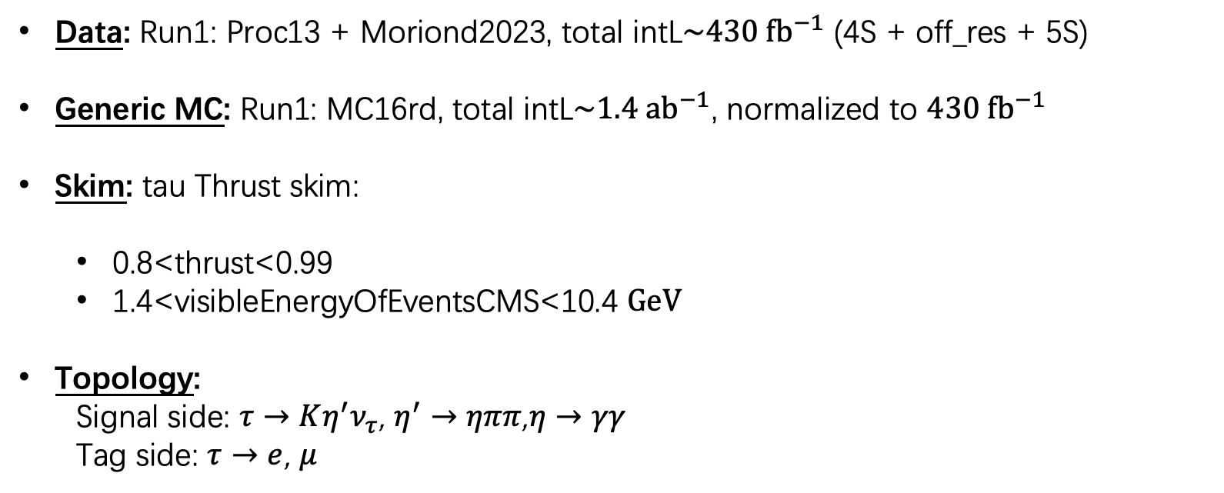
Data and MC Sample
Data: Run1: Proc13 + Moriond2023, total intL$\sim 430 {fb}^{−1}$ (4S + off_res + 5S)
Generic MC: Run1: MC16rd, total intL$\sim 1.4 {ab}^{−1}$, normalized to $430 {fb}^{−1}$
Skim: tau Thrust skim:
  0.8<thrust<0.99
  1.4<visibleEnergyOfEventsCMS<10.4 $GeV$
Topology:
  Signal side: $τ→{Kη^{′}ν}_{τ}$, $η^{′}→ηππ$,$η→γγ$
  Tag side: $τ→e$, $μ$

Slide 3
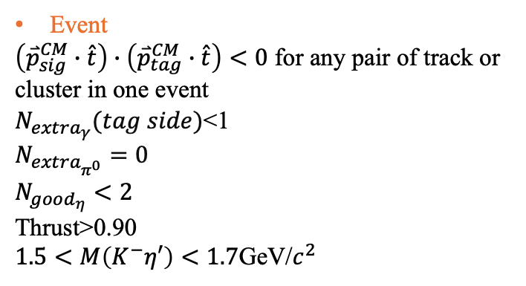
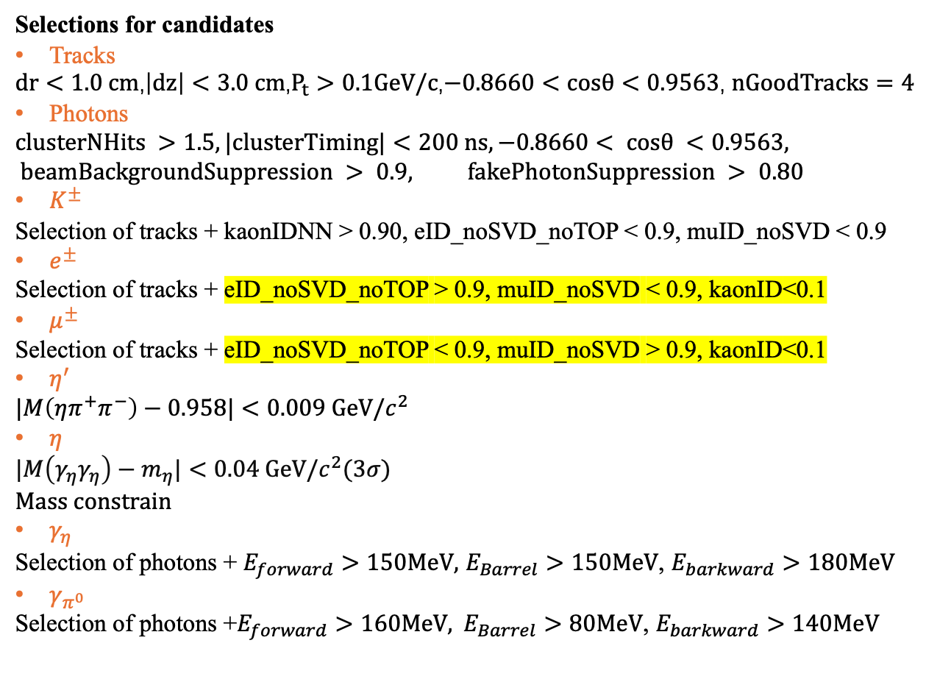
Selection Criteria
Selections for candidates
Tracks
$dr<1.0 cm$,$\left|dz\right|<3.0 cm$,$P_{t}>0.1GeV/c$,$−0.8660<cosθ<0.9563$, $nGoodTracks=4$
Photons
$$clusterNHits >1.5, |clusterTiming|<200 ns, −0.8660< cosθ <0.9563, beamBackgroundSuppression > 0.9, fakePhotonSuppression > 0.80$$
$K^{±}$
Selection of tracks + kaonIDNN > 0.90, eID_noSVD_noTOP < 0.9, muID_noSVD < 0.9
$e^{±}$
Selection of tracks + eID_noSVD_noTOP > 0.9, muID_noSVD < 0.9, kaonID<0.1
$μ^{±}$
Selection of tracks + eID_noSVD_noTOP < 0.9, muID_noSVD > 0.9, kaonID<0.1
$η^{′}$
$$|M\left(ηπ^{+}π^{−}\right)−0.958|<0.009 GeV/c^{2}$$
$η$
$|M\left(γ_{η}γ_{η}\right)−m_{η}|<0.04 GeV/c^{2}$(3$σ$)
Mass constrain
$γ_{η}$
Selection of photons + $E_{forward}>150MeV,$ $E_{Barrel}>150MeV$, $E_{barkward}>180MeV$
$γ_{π^{0}}$
Selection $\text{of} \text{photons}\text{ +}E_{forward}>160MeV, E_{Barrel}>80MeV\text{,} E_{barkward}>140MeV$
Event
$\left({\overset{⃑}{p}}_{sig}^{CM}∙\hat{t}\right)∙\left({\overset{⃑}{p}}_{tag}^{CM}∙\hat{t}\right)<0$ for any pair of track or cluster in one event
$N_{extra_{γ}}(tag side)$<1
$$N_{extra_{π^{0}}}=0$$
$$N_{good_{η}}<2$$
Thrust>0.90
$1.5<M\left(K^{−}η′\right)<1.7$GeV/$c^{2}$

Slide 4
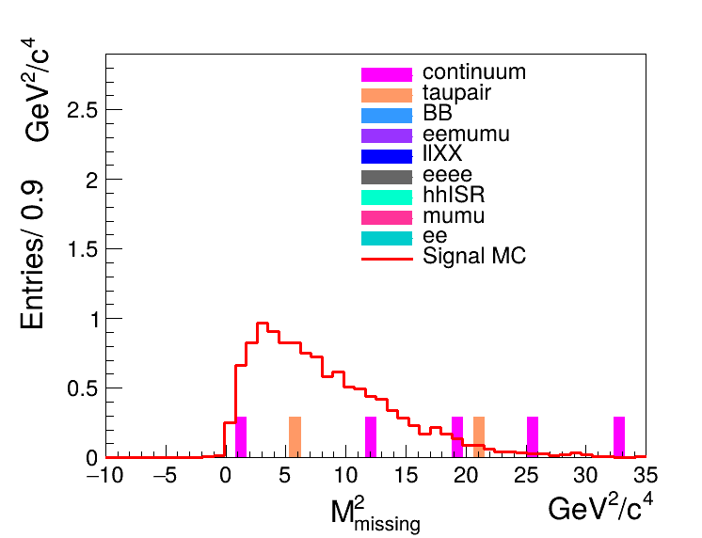
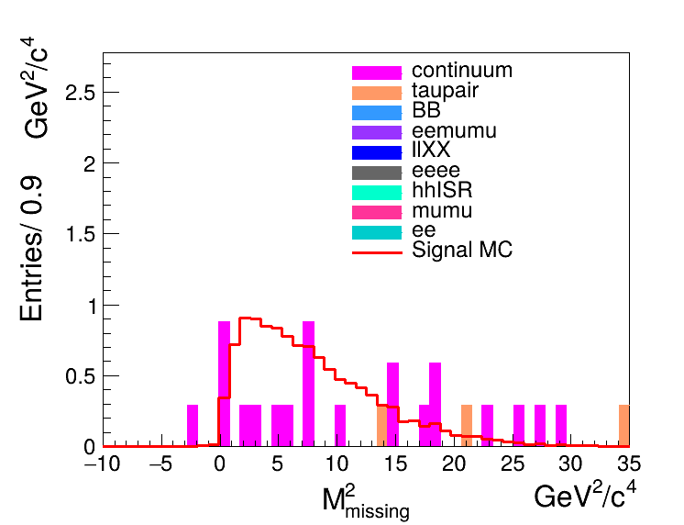
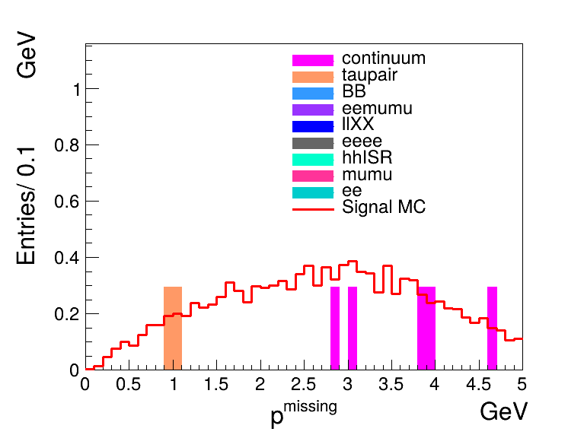
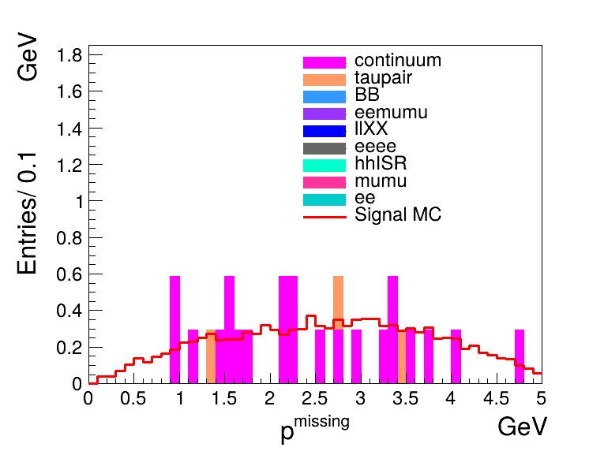
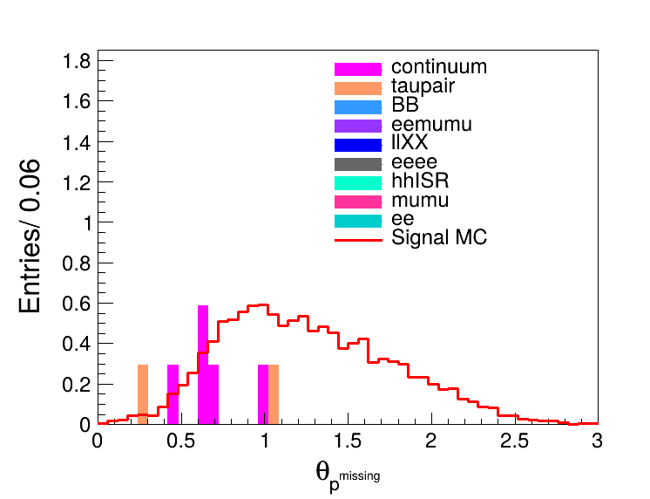
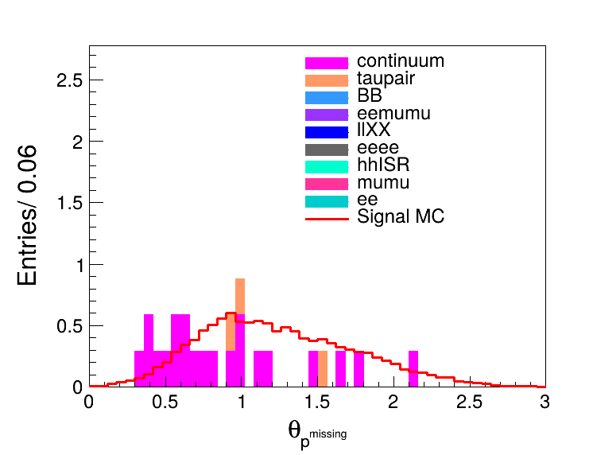
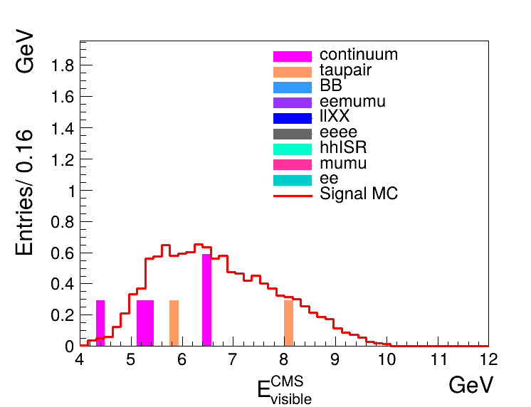
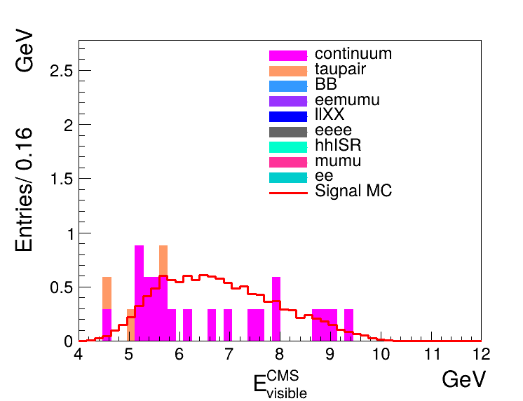
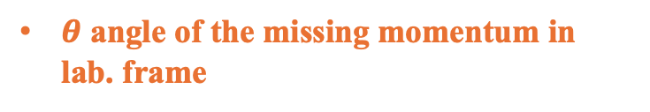
Background Study
eTag
muTag
eTag
muTag
Missing mass squared
Missing momentum in lab. frame
eTag
muTag
eTag
muTag
$θ$ angle of the missing momentum in lab. frame
Visible energy in c.m.s

Slide 5
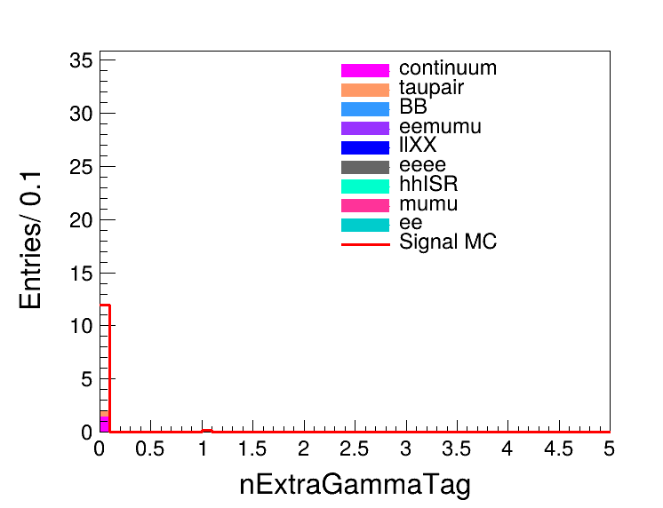
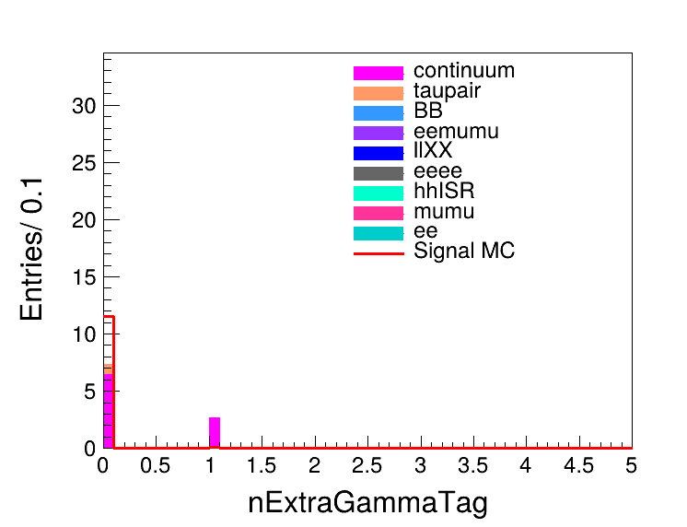
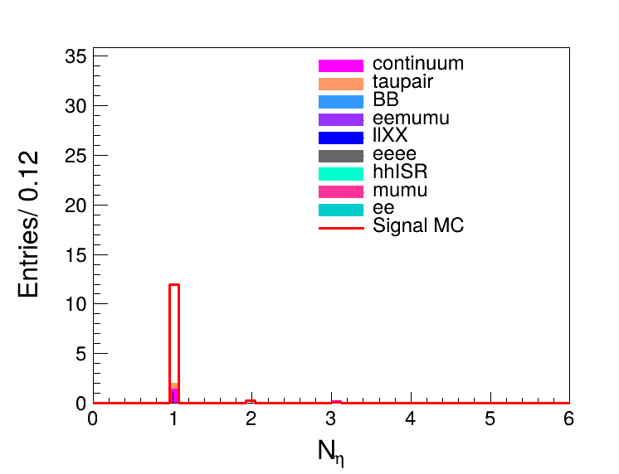
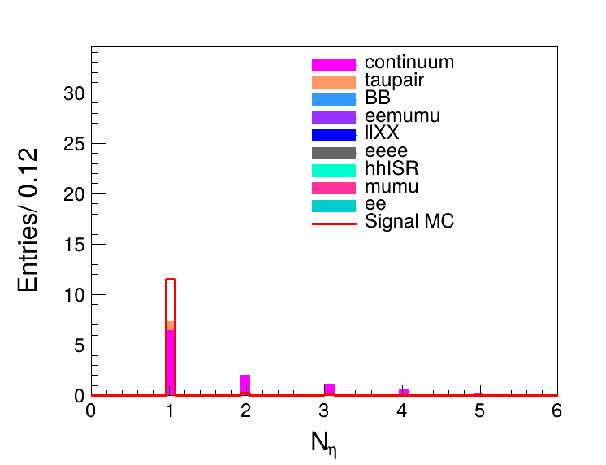
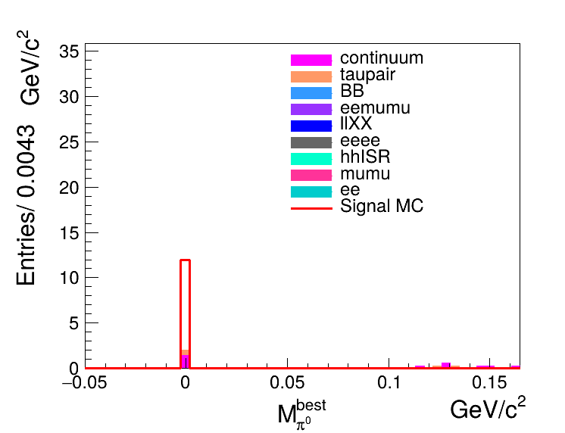
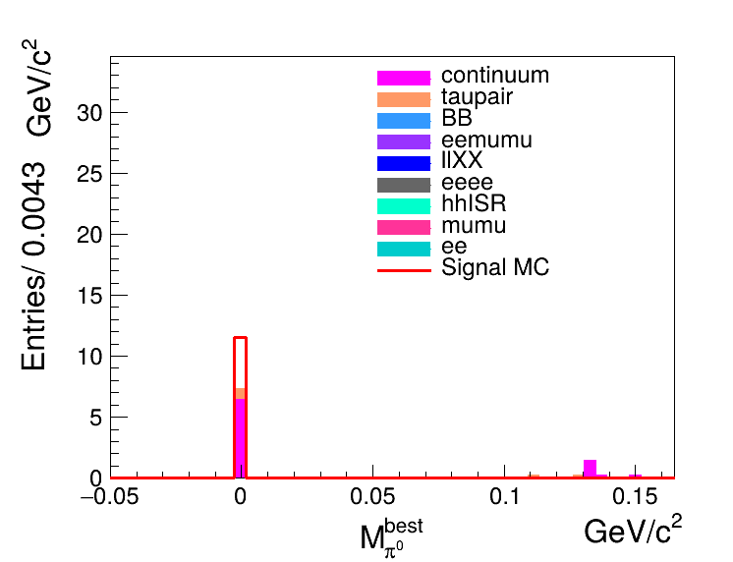
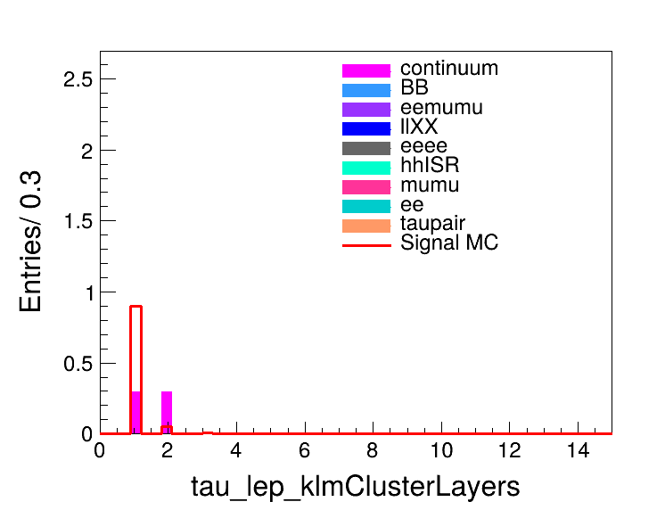
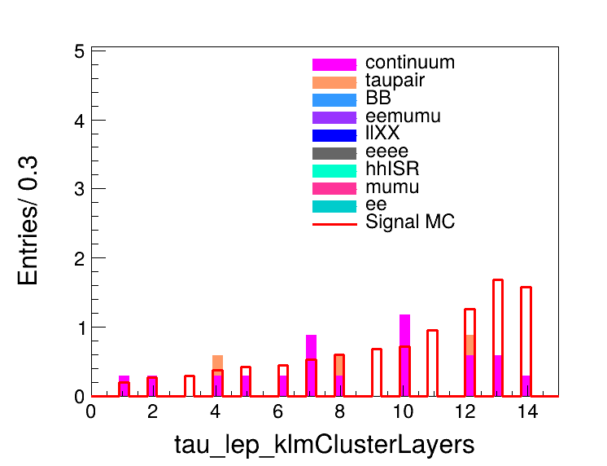



Background Study
eTag
muTag
eTag
muTag
Number of extra $γ$ on tag side
Number of $η$
eTag
muTag
eTag
muTag
Mass of extra $π^{0}$ on tag side(?)
Number of KLM layers

Slide 6
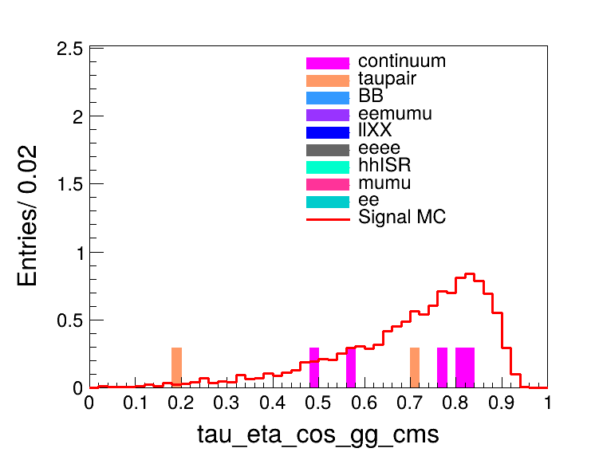
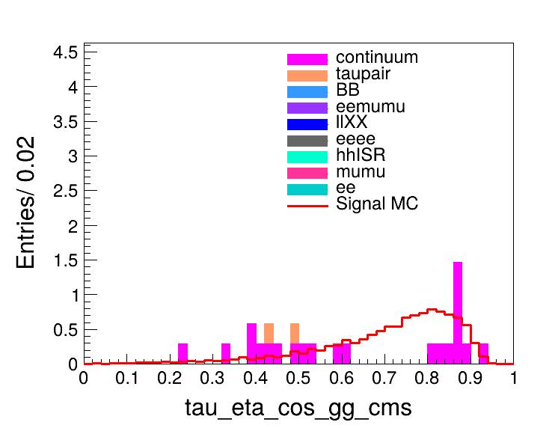
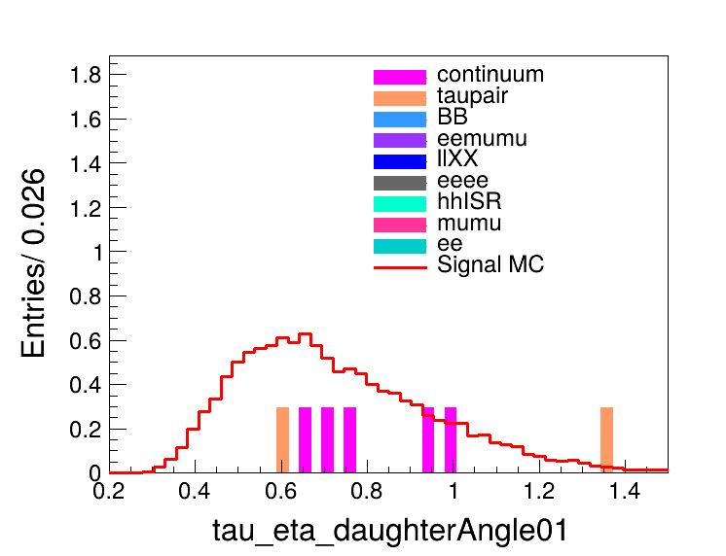
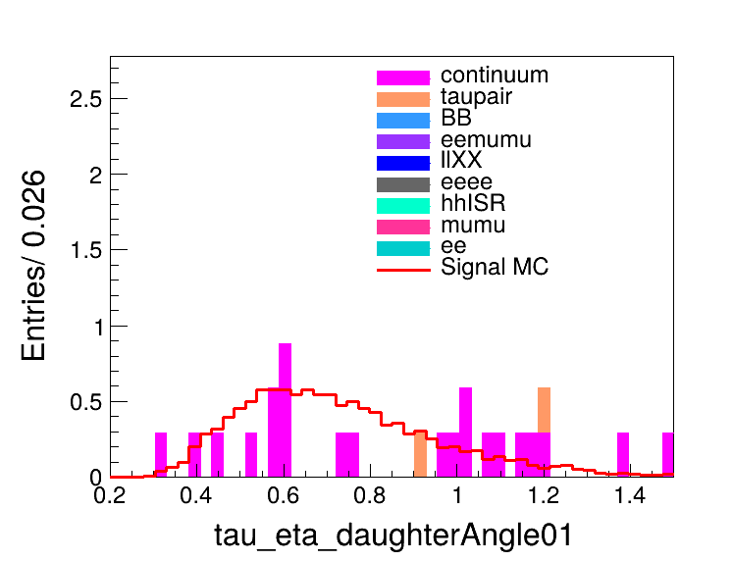
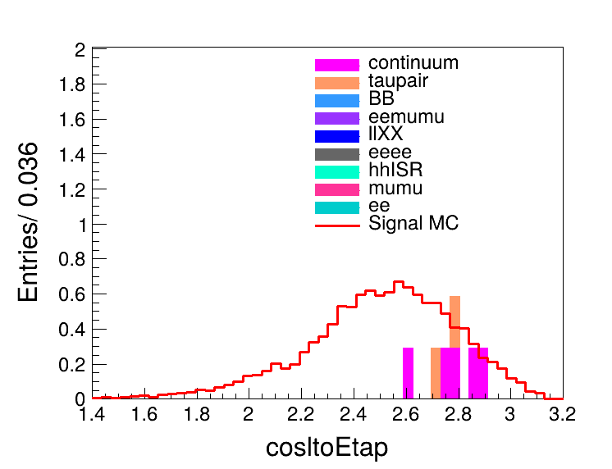
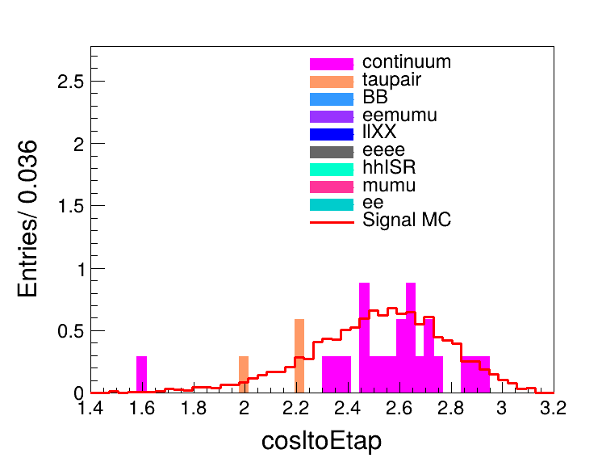
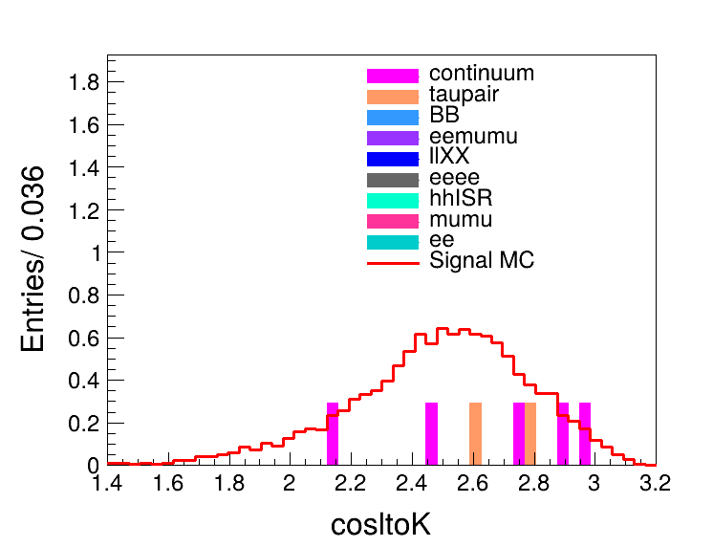
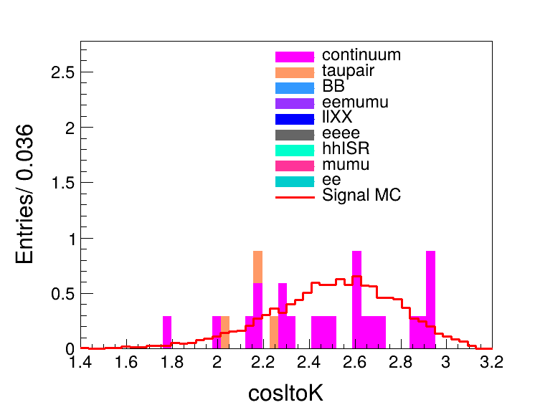
Background Study
eTag
muTag
eTag
muTag
eTag
muTag
eTag
muTag

Slide 7
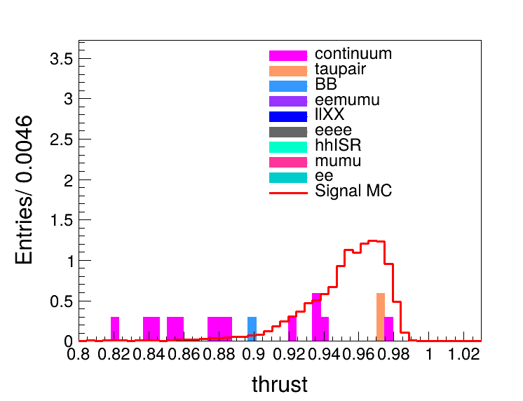
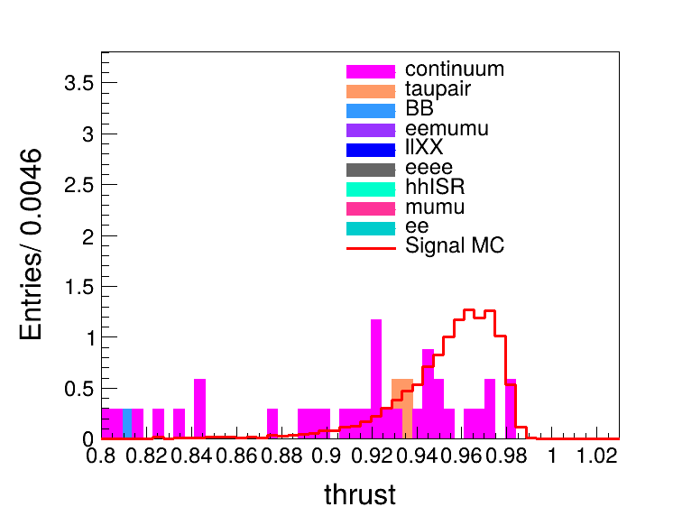
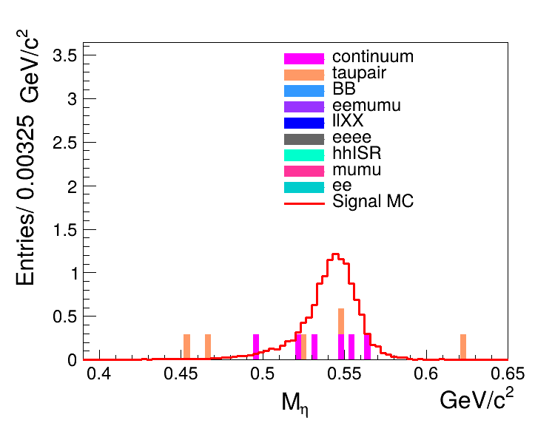
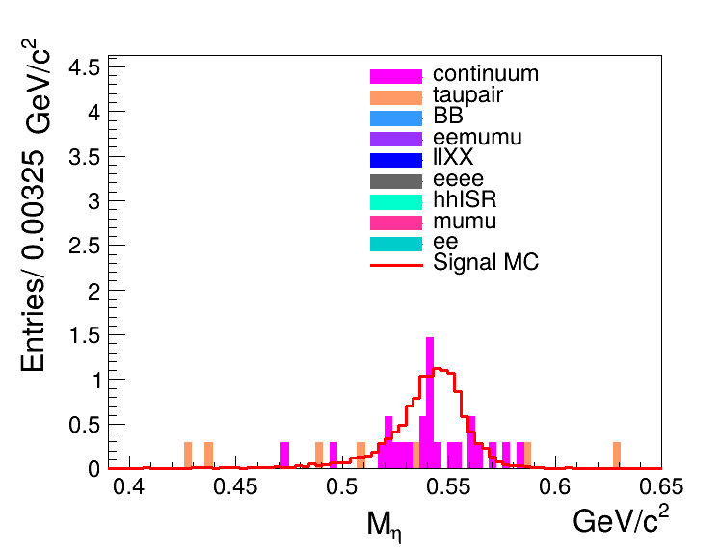
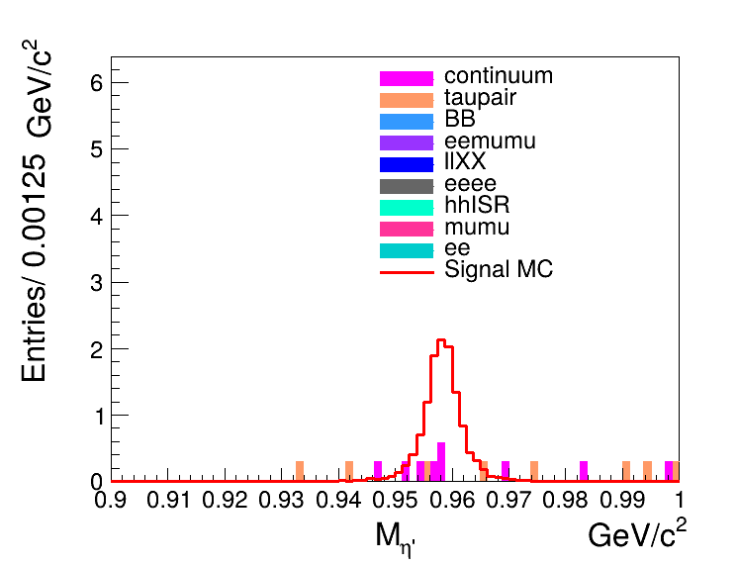
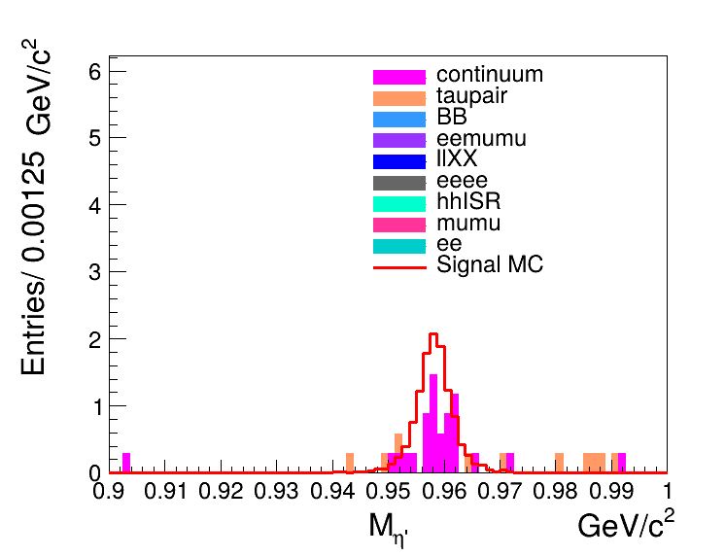
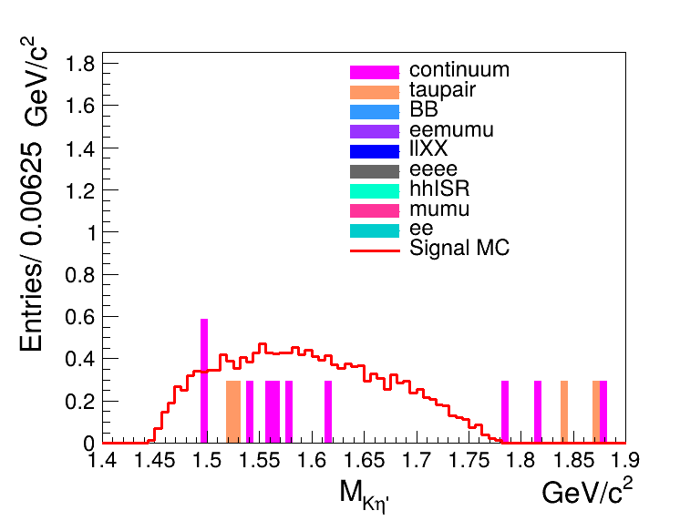
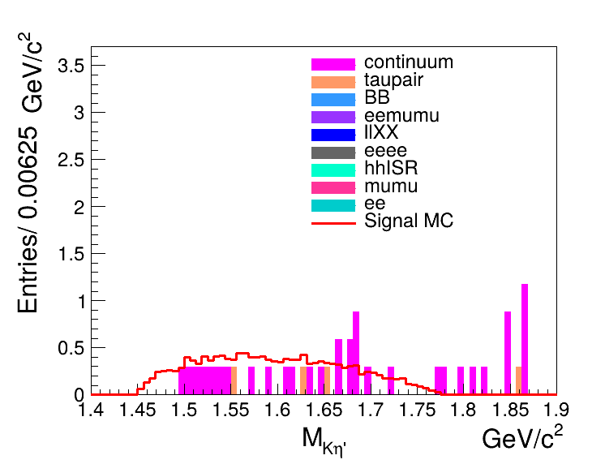



Background Study
eTag
muTag
eTag
muTag
Thrust
Mass of $η$
eTag
muTag
eTag
muTag
Mass of $η′$
Mass of $Kη′$

Slide 8
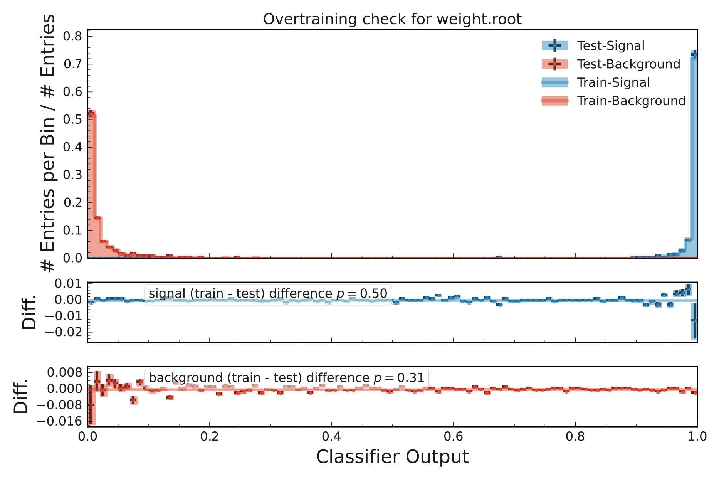
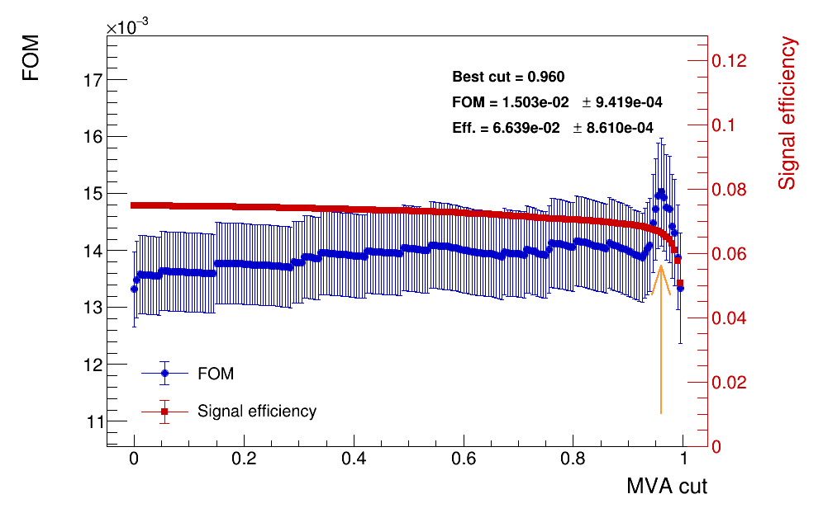

Continuum Suppression for eTag
MVA > 0.96. $→$ $ε_{sig}$=6.657%

Slide 9
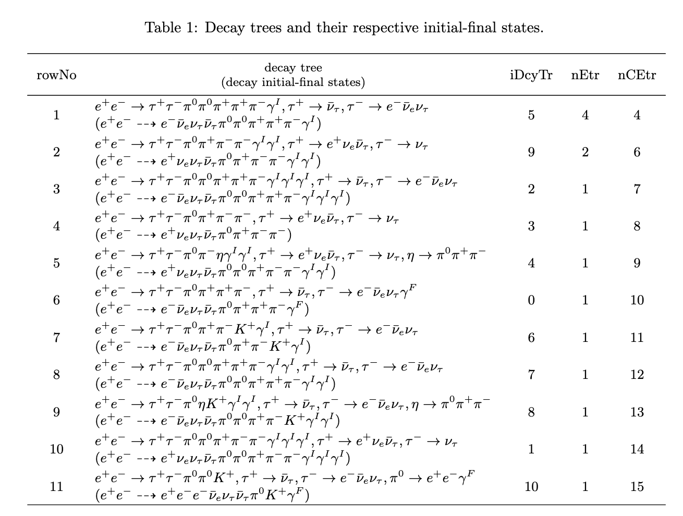
Background Study
Only taupair background remains:

Slide 10
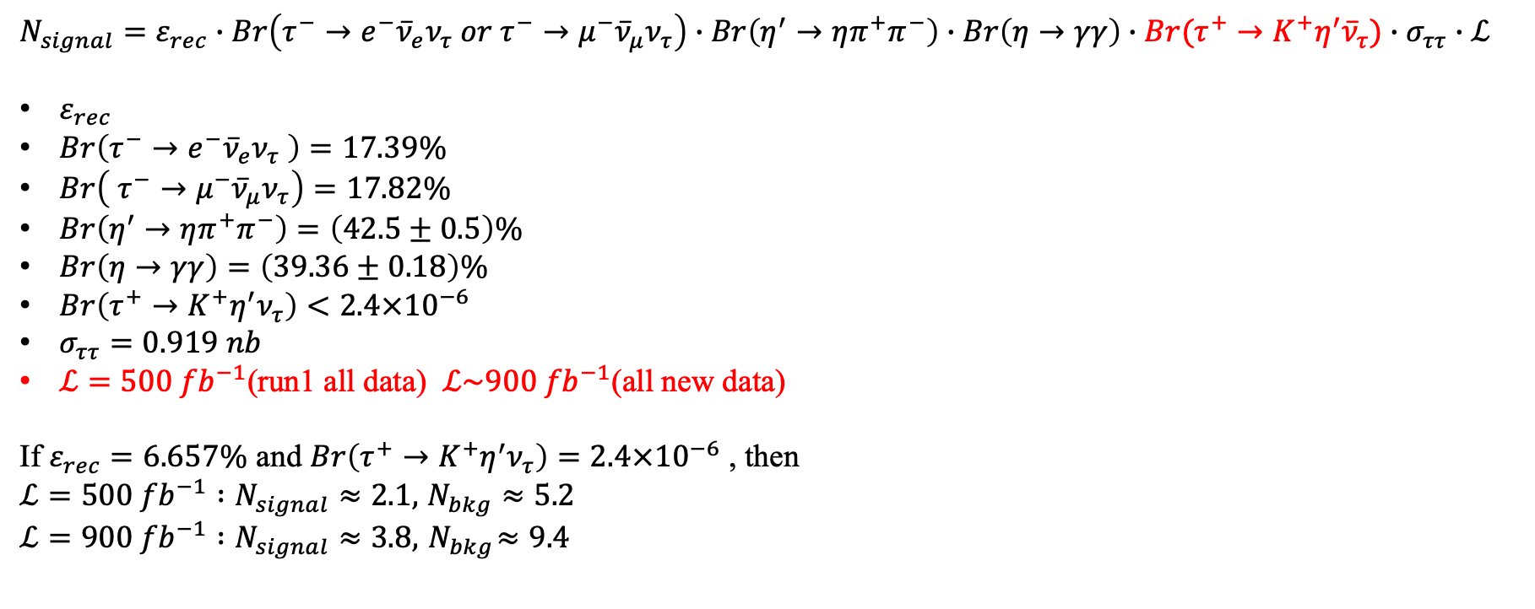
Evaluation of signal yield-eTag
Under the requirement of MVA>0.60
$$N_{signal}=ε_{rec}∙Br\left(τ^{−}→e^{−}{\overline{ν}}_{e}ν_{τ} or τ^{−}→μ^{−}{\overline{ν}}_{μ}ν_{τ}\right)∙Br\left(η^{′}→ηπ^{+}π^{−}\right)∙Br\left(η→γγ\right)∙Br(τ^{+}→K^{+}η^{′}{\overline{ν}}_{τ})∙σ_{ττ}∙ℒ$$
$ε_{rec}$
$Br\left(τ^{−}→e^{−}{\overline{ν}}_{e}ν_{τ} \right)=17.39\%$
$Br\left( τ^{−}→μ^{−}{\overline{ν}}_{μ}ν_{τ}\right)=17.82\%$
$Br\left(η^{′}→ηπ^{+}π^{−}\right)=\left(42.5±0.5\right)\%$
$Br\left(η→γγ\right)=\left(39.36±0.18\right)\%$
$Br\left(τ^{+}→K^{+}η^{′}ν_{τ}\right)<2.4×{10}^{−6}$
$σ_{ττ}=0.919 nb$
$ℒ=500 {fb}^{−1}$(run1 all data) $ℒ\sim 900 {fb}^{−1}$(all new data)
If $ε_{rec}=6.657\%$ and $Br\left(τ^{+}→K^{+}η^{′}ν_{τ}\right)=2.4×{10}^{−6}$ , then
$ℒ=500 {fb}^{−1} :N_{signal}≈2.1,$ $N_{bkg}≈5.2$
$$ℒ=900 {fb}^{−1} :N_{signal}≈3.8, { N}_{bkg}≈9.4$$

Slide 12
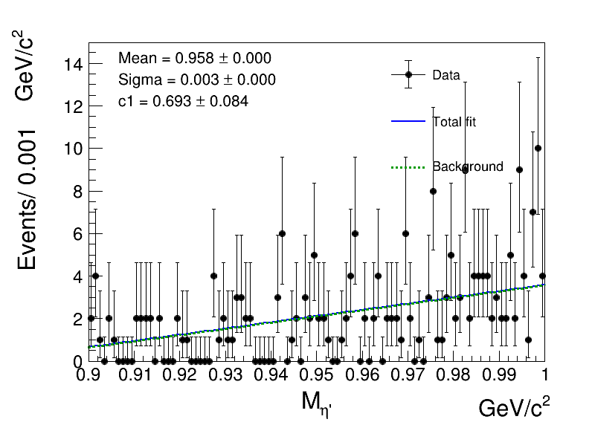
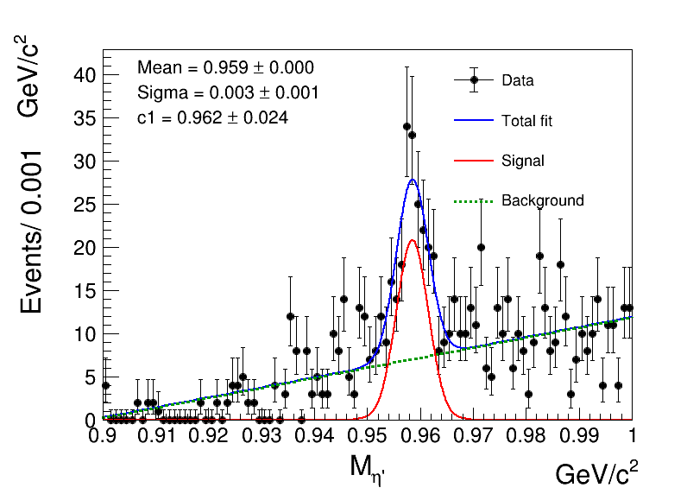
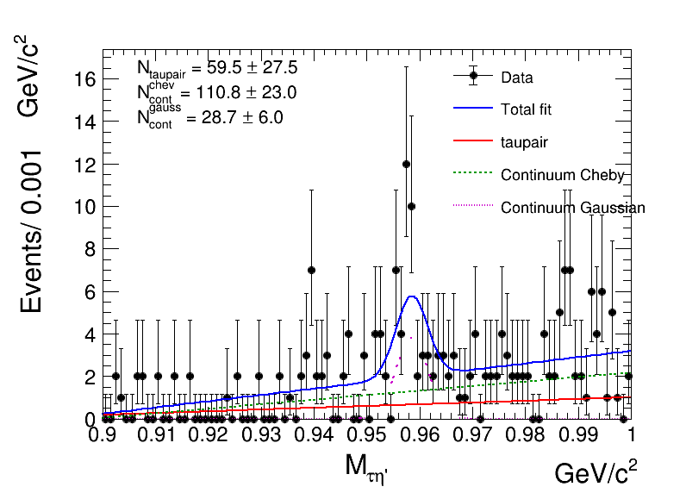
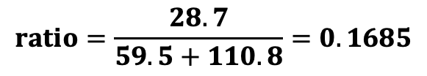
若不加MVA这个selection，则对于continuum本底有peaking background存在：
我们反选lepID小的事件，并且删掉eta不变质量的选择条件(?)
For taupair background
For continuum background
For real background
$$ratio=\frac{28.7}{59.5+110.8}=0.1685$$

