Slide 1


重离子碰撞中的稀有粒子产生
庄鹏飞

Slide 2
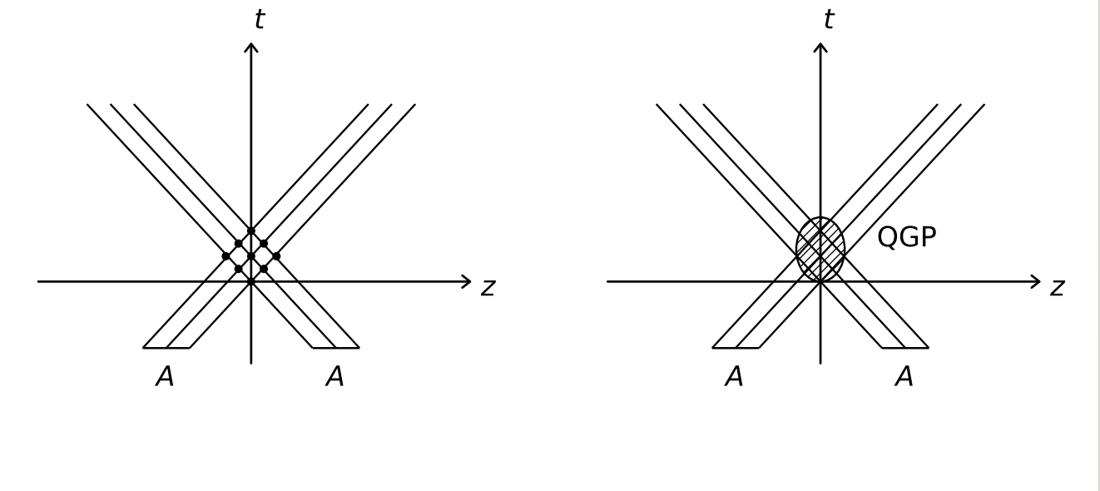
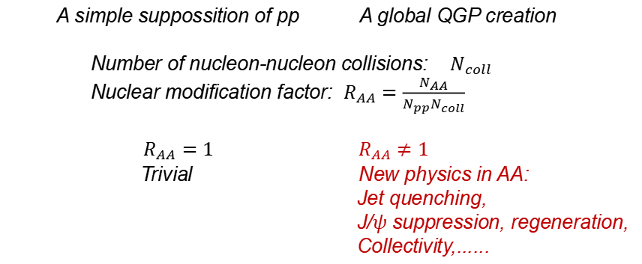
New physics in AA
A simple suppossition of pp A global QGP creation
Number of nucleon-nucleon collisions: $N_{coll}$
Nuclear modification factor: $R_{AA}=\frac{N_{AA}}{N_{pp}N_{coll}}$
$R_{AA}=1 R_{AA}≠1$
Trivial New physics in AA:
Jet quenching,
J/$ψ$ suppression, regeneration,
Collectivity,......

Slide 3
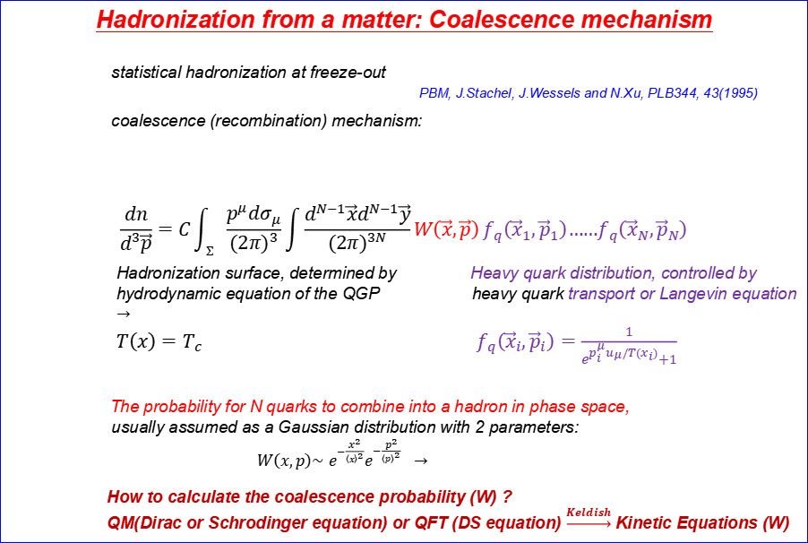
Hadronization from a matter: Coalescence mechanism
statistical hadronization at freeze-out
PBM, J.Stachel, J.Wessels and N.Xu, PLB344, 43(1995)
coalescence (recombination) mechanism:
$$\frac{dn}{d^{3}\vec{p}}=C\int_{Σ}{\frac{p^{μ}dσ_{μ}}{{\left(2π\right)}^{3}}\int{\frac{d^{N−1}\vec{x}d^{N−1}\vec{y}}{{\left(2π\right)}^{3N}}W\left(\vec{x},\vec{p}\right)}f_{q}\left({\vec{x}}_{1},{\vec{p}}_{1}\right)……f_{q}\left({\vec{x}}_{N},{\vec{p}}_{N}\right)}$$
Hadronization surface, determined by Heavy quark distribution, controlled by
hydrodynamic equation of the QGP heavy quark transport or Langevin equation
$→$
$T\left(x\right)=T_{c} f_{q}\left({\vec{x}}_{i},{\vec{p}}_{i}\right)=\frac{1}{e^{p_{i}^{μ}u_{μ}/T(x_{i})}+1}$
The probability for N quarks to combine into a hadron in phase space,
usually assumed as a Gaussian distribution with 2 parameters:
$W\left(x,p\right)\sim$ $e^{−\frac{x^{2}}{{\left\langle x\right\rangle }^{2}}}e^{−\frac{p^{2}}{{\left\langle p\right\rangle }^{2}}} →$
How to calculate the coalescence probability (W) ?
QM(Dirac or Schrodinger equation) or QFT (DS equation) $\underset{→}{Keldish}$Kinetic Equations (W)
V.Greco, C.Ko and R.Rapp, PLB595, 202(2004)
D.Molnar and S.Voloshin, PRL91, 092301(2003)
R.Fries, B.Muller, C.Nonaka and S.Bass. PRC68, 044902(2004), ……
no prediction !

Slide 4
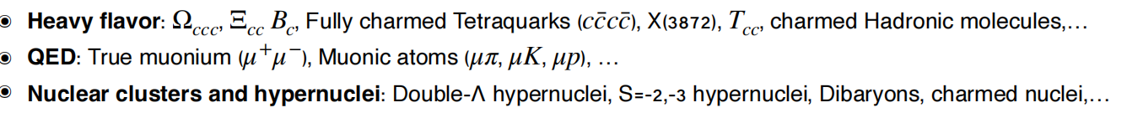
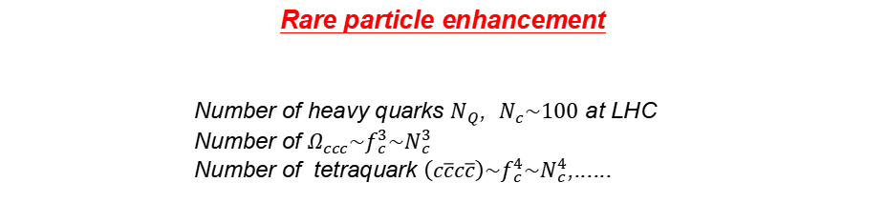
Rare particle enhancement
Number of heavy quarks $N_{Q}$, $N_{c}\sim 100$ at LHC
Number of $Ω_{ccc}\sim f_{c}^{3}\sim N_{c}^{3}$
Number of tetraquark $\left(c\overline{c}c\overline{c}\right)\sim f_{c}^{4}\sim N_{c}^{4}$,......

Slide 5
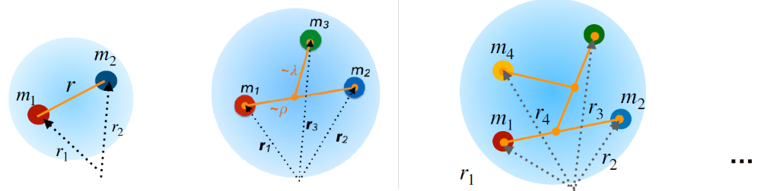

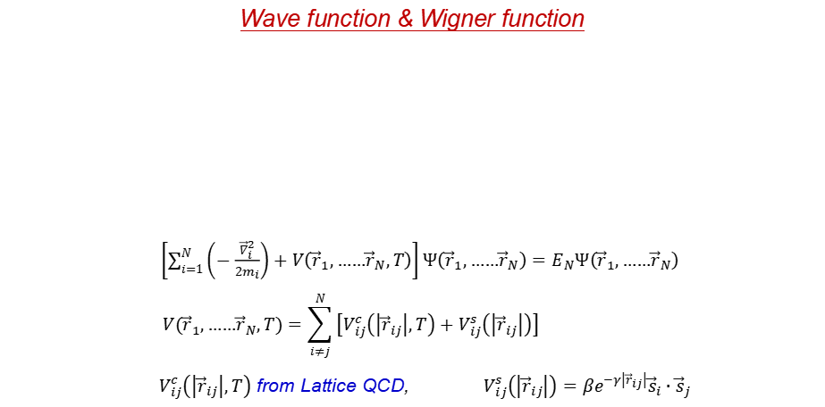
Wave function & Wigner function
$\left[\sum_{i=1}^{N}{\left(−\frac{{\vec{∇}}_{i}^{2}}{2m_{i}}\right)+V\left({\vec{r}}_{1},……{\vec{r}}_{N},T\right)}\right]Ψ\left({\vec{r}}_{1},……{\vec{r}}_{N}\right)=E_{N}Ψ\left({\vec{r}}_{1},……{\vec{r}}_{N}\right)$
$$V\left({\vec{r}}_{1},……{\vec{r}}_{N},T\right)=\sum_{i≠j}^{N}{\left[V_{ij}^{c}\left(\left|{\vec{r}}_{ij}\right|,T\right)+V_{ij}^{s}\left(\left|{\vec{r}}_{ij}\right|\right)\right]}$$
$V_{ij}^{c}\left(\left|{\vec{r}}_{ij}\right|,T\right)$ from Lattice QCD, $V_{ij}^{s}\left(\left|{\vec{r}}_{ij}\right|\right)=βe^{−γ\left|{\vec{r}}_{ij}\right|}{\vec{s}}_{i}∙{\vec{s}}_{j}$
J.Zhao, S.Shi and PZ, PRD102, 114001 (2020)

Slide 6
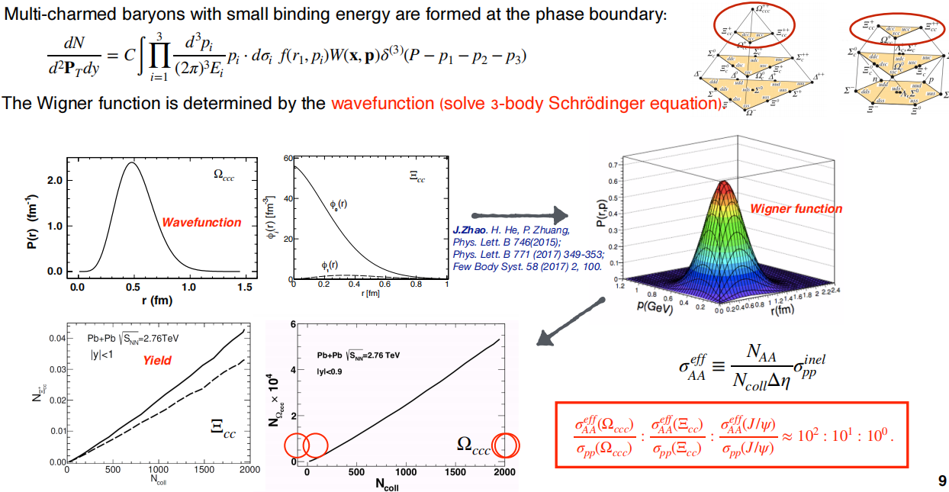
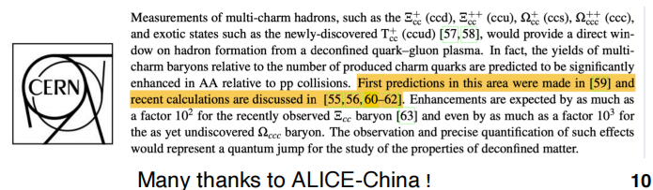
$Ω_{ccc}$ & $Ξ_{cc}$

Slide 7
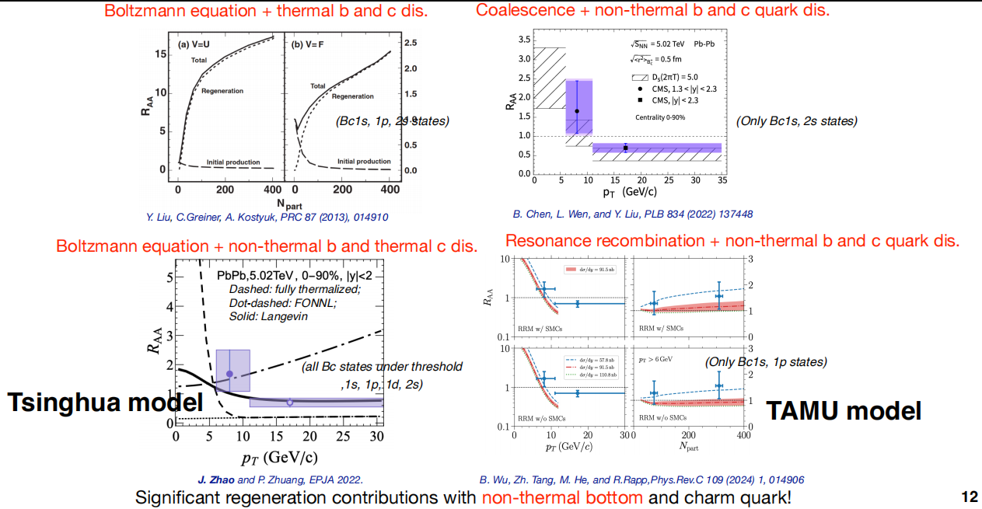
$$B_{c}$$

Slide 8
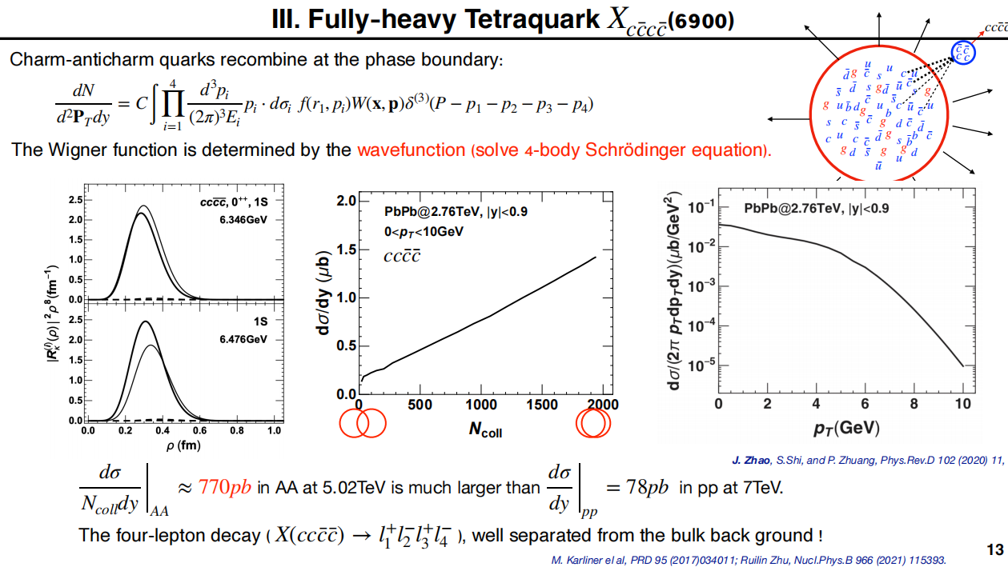

Slide 9
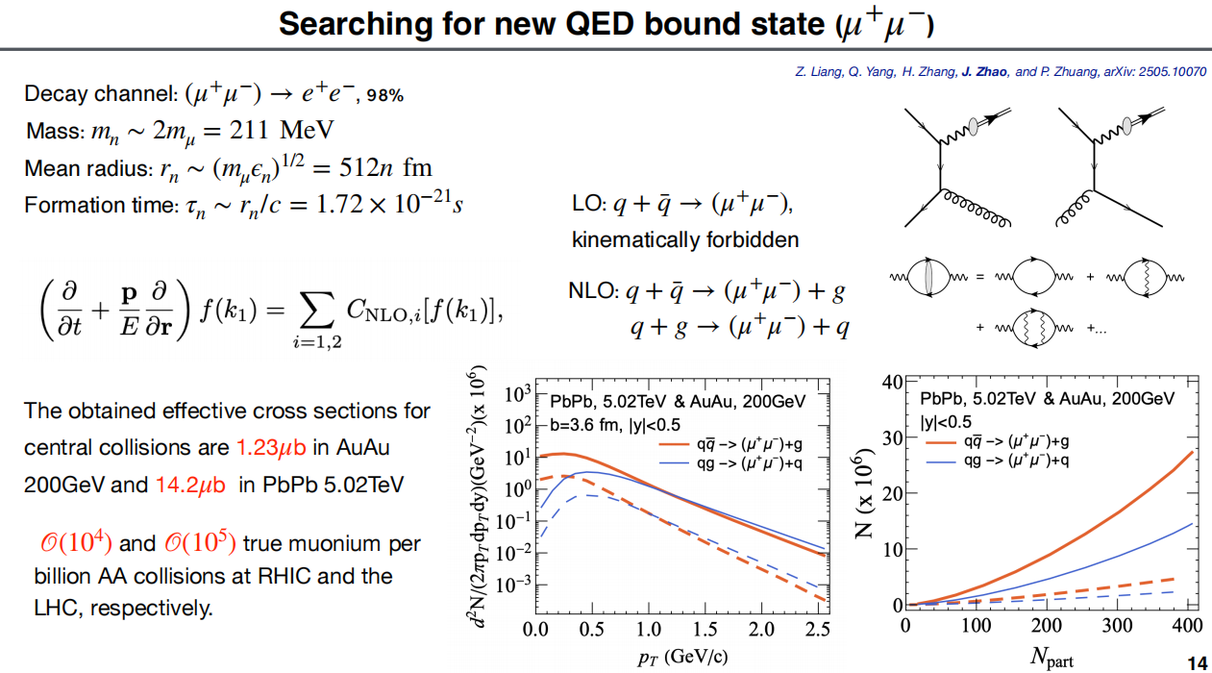

Slide 10
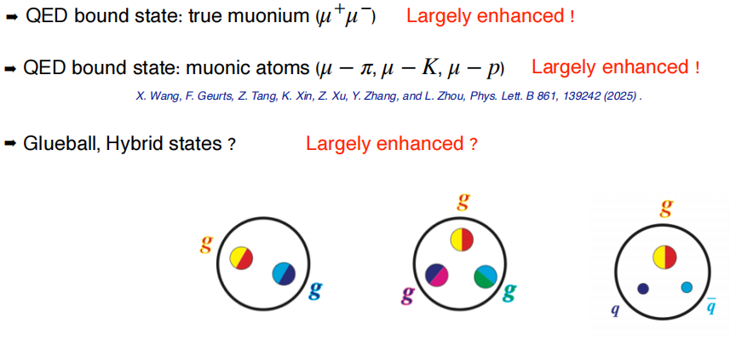
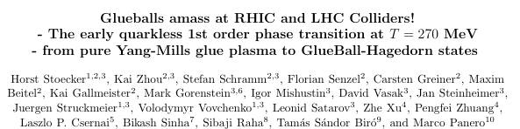

Slide 11
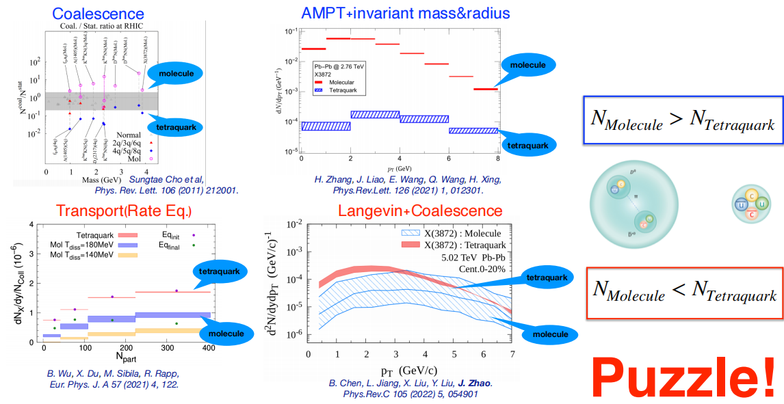


Slide 12
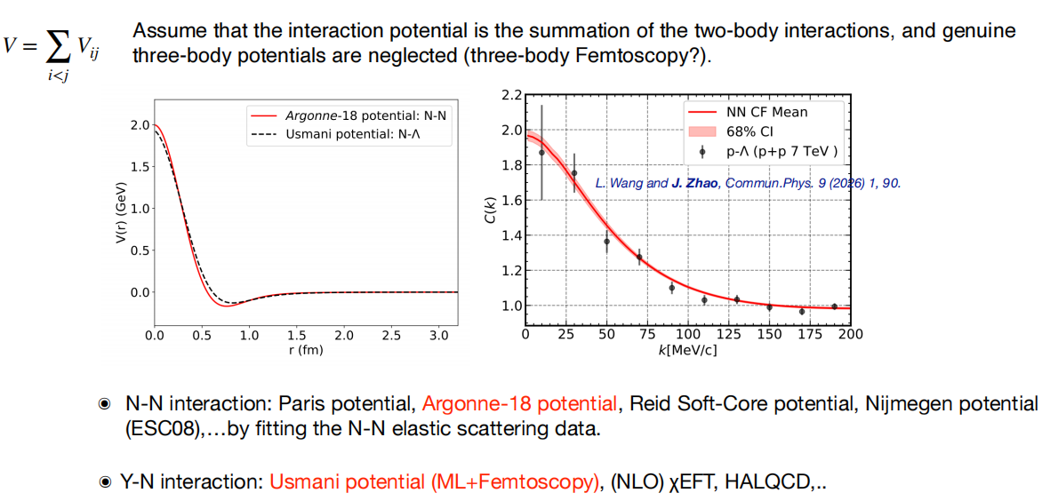
N-N and Y-N interaction potential

Slide 13
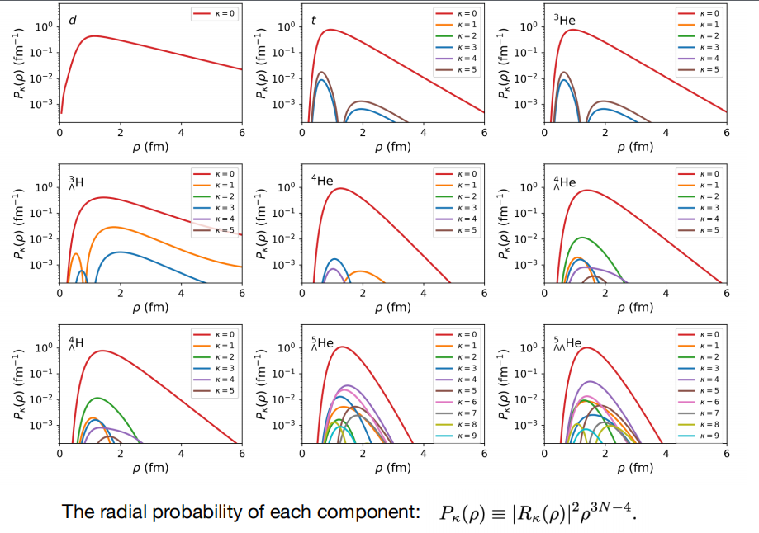
Hypernuclei wave function

Slide 14
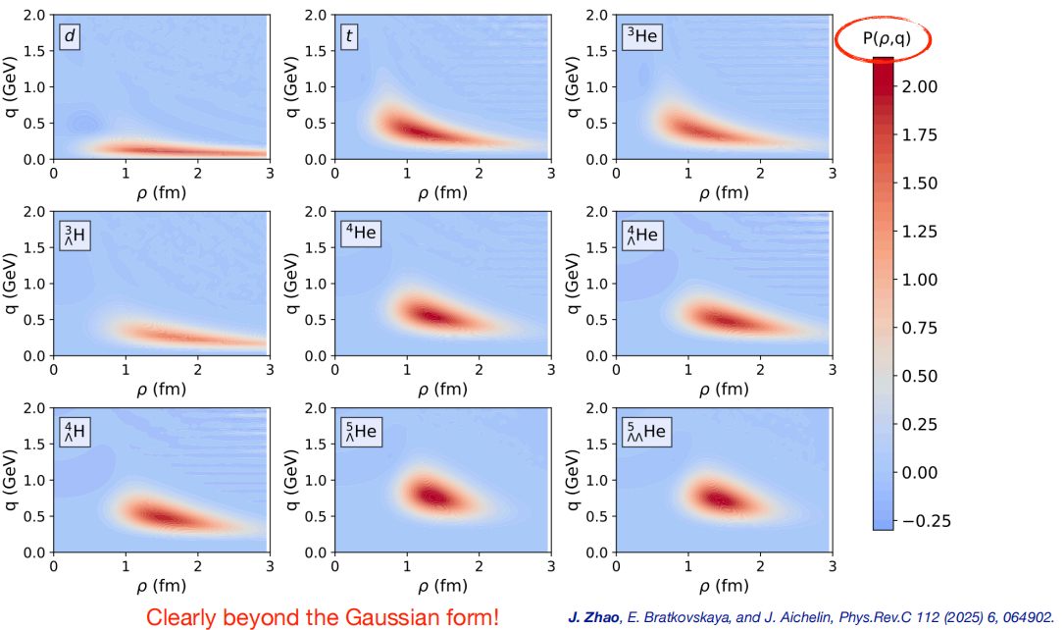
Hypernuclei Wigner function

Slide 15
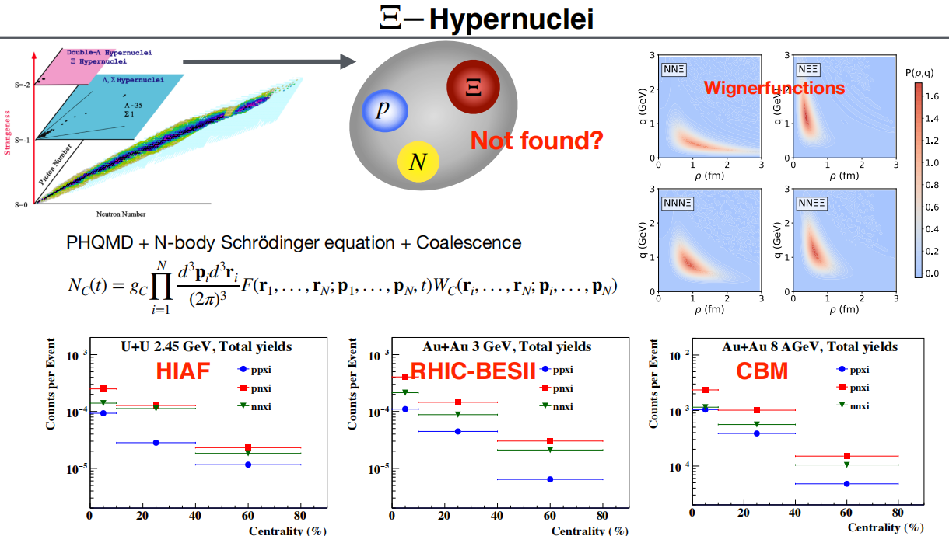

Slide 16

由于热密物态（夸克物质，强子物质）的形成，描述重离子碰撞中物质的集团化（强子化，核化）：
Coalescence 机制
需要动力学W(x,p;T,$μ$)才有预言性！
物质强子化 $→$ 稀有粒子产额剧烈增加！

