Slide 1
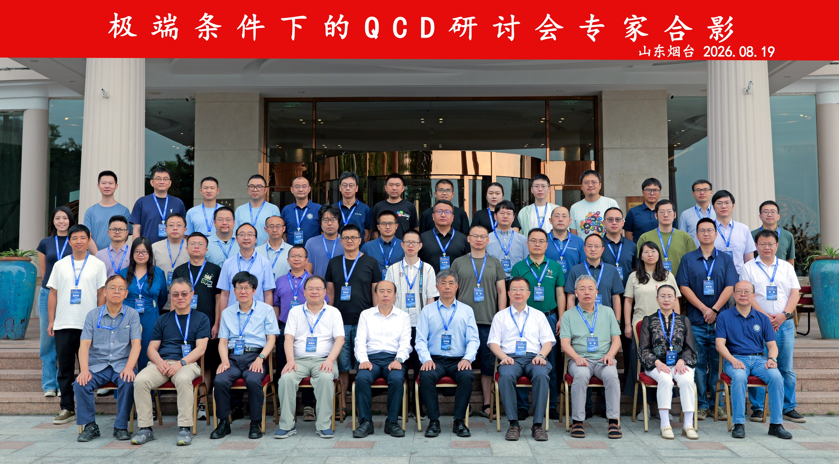

Slide 2

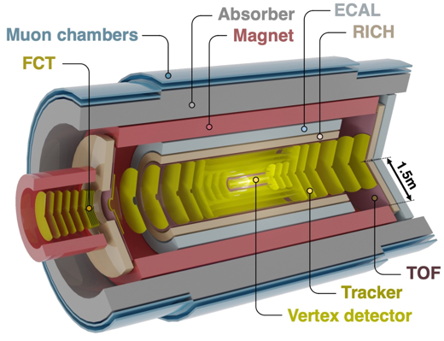
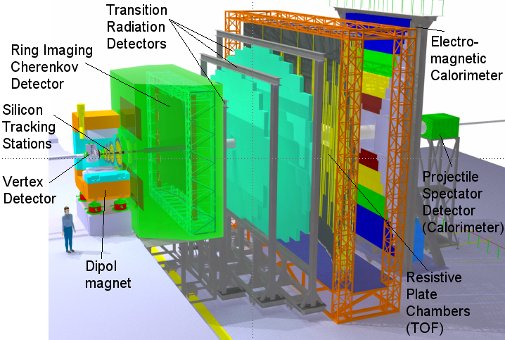
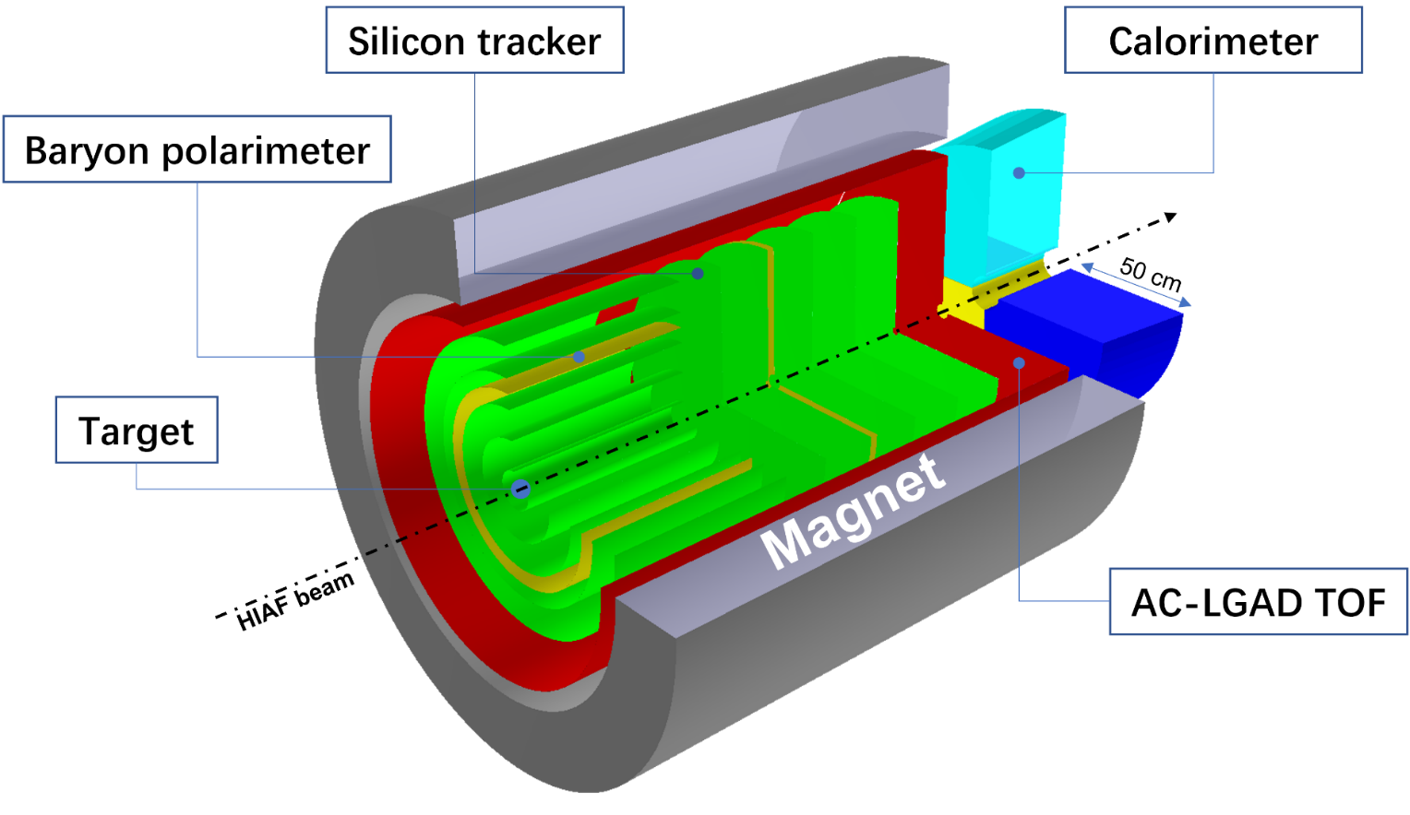
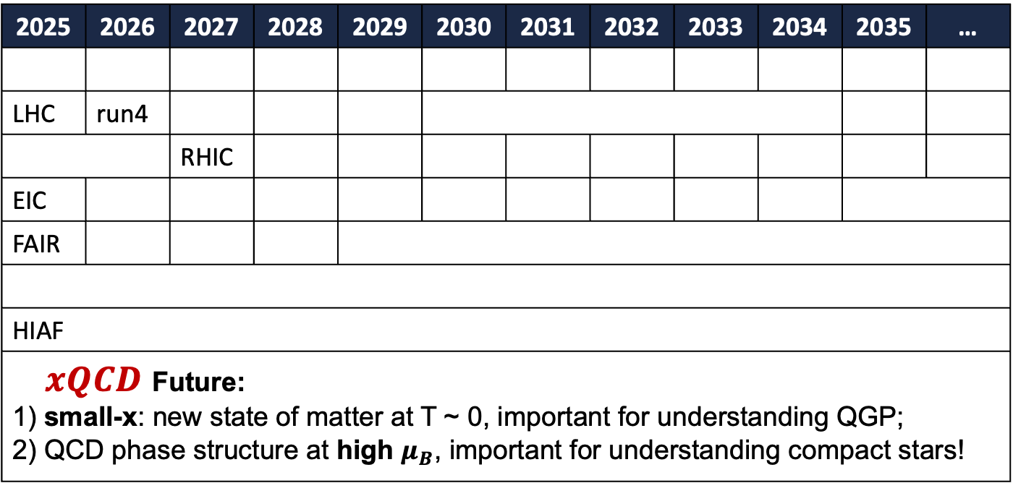
极端条件下的QCD研讨会
2025 | 2026 | 2027 | 2028 | 2029 | 2030 | 2031 | 2032 | 2033 | 2034 | 2035 | …
LHC | run4
 |  | RHIC
EIC
FAIR
HIAF
$xQCD$ Future: 1) small-x: new state of matter at T ~ 0, important for understanding QGP; 2) QCD phase structure at high $μ_{B}$, important for understanding compact stars!
ALICE FoCAL / CMS / LHCb
ALICE3
CBM
H-NS

Slide 3


$xQCD$ 2027
2027年8月 一楼丽景海湾听

Slide 4
感谢庄鹏飞老师、李营院长和物理与电子信息学院团队！

