Slide 1
Jet Flavor Tagging for CEPC
Quark / gluon separation and gluon-splitting-mode identification for ZH → H(gg), H(qq̄)
Status update — ParticleTransformer jet tagger, CEPC IHEP

Slide 2
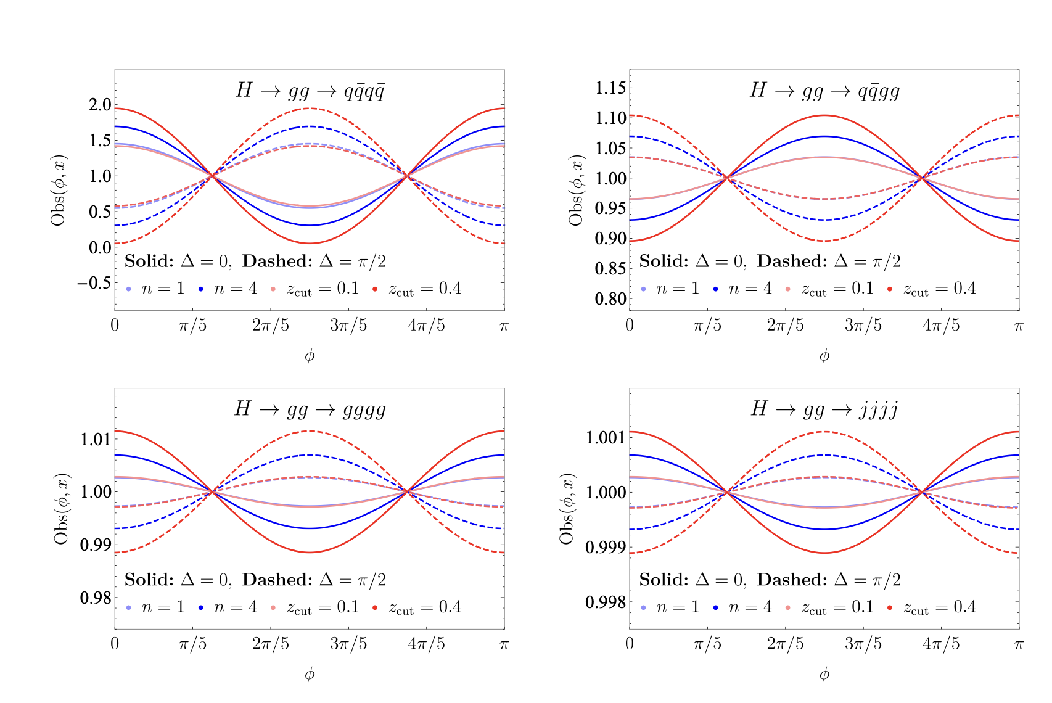
1. MOTIVATION
Why measure H → gg and the gluon splitting mode
Gluon spin correlations in H→gg probe the CP structure of the Hgg coupling
The Higgs-gluon effective interaction can be CP-even, CP-odd, or a mixture, parametrized by a mixing angle θ
Spin correlations between the two gluons from H→gg are only accessible through jet substructure, observables like the Lund variable and four-point energy correlator (E4C)
Sensitivity to θ depends critically on identifying how each gluon splits: to two gluons (g→gg) or to a quark pair (g→qq̄)
With ideal splitting-mode discrimination, CEPC at √s = 240 GeV can exclude θ ≈ 0.03π at L = 20 ab⁻¹ via the qqq̄q̄ channel
Source: Wang, Gao, Li, Zhu — “Parton spin correlations and CP properties in H→gg decay at future lepton colliders” (arXiv:2601.22248)
CEPC Jet Flavor Tagging — Status Update
2

Slide 3
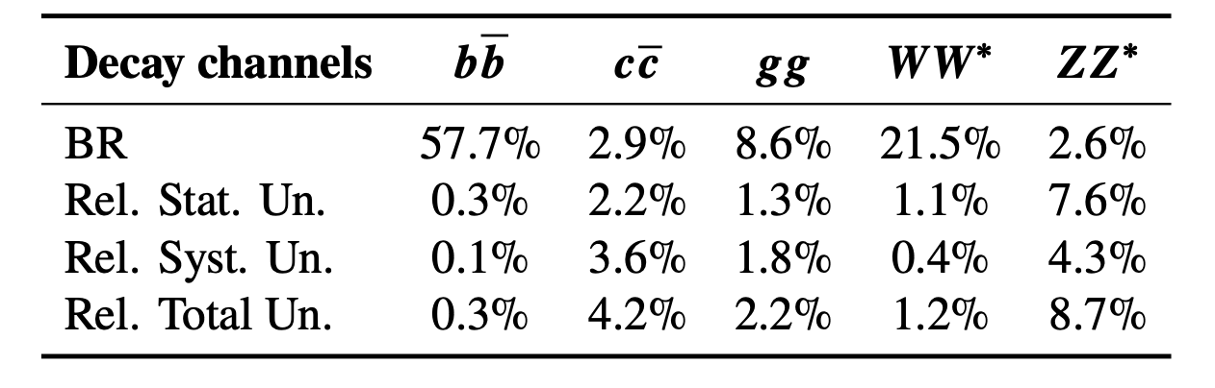
1. MOTIVATION (CONT.)
H hadronic branching-ratio measurement in the CEPC TDR
The CEPC Reference TDR performs a simultaneous, event-level 7-class measurement of Higgs hadronic decay modes (bb̄, cc̄, ss̄, gg, WW*, ZZ*, plus (ZZ)sl background) using a ParticleTransformer
This is an event-level classification (whole ZH → μμH event) — distinct from, and complementary to, jet-level flavor/gluon tagging
TDR result: H→gg is correctly identified 77.4% of the time in this 7-class event classifier (see matrix, right)
Our jet tagger targets the complementary, finer-grained question: given a jet is from H→gg, which quark/gluon flavor is it, and did the parent gluon split to gg or qq̄?
TDR Table 15.7 reference matrix (7-class, event-level)
true \ pred | bb | cc | gg | zz | ww | ss
Hbb | 92.9 | 1.3 | 1.7 | 3.7 | 0.1 | 0.3
Hcc | 1.1 | 85.2 | 4.3 | 2.0 | 3.3 | 3.6
Hgg | 1.8 | 2.6 | 77.4 | 4.2 | 6.0 | 7.8
Hzz | 3.3 | 2.9 | 9.0 | 65.7 | 15.9 | 3.1
Hww | 0.1 | 2.2 | 9.6 | 10.6 | 75.2 | 2.2
Hss | 0.0 | 2.1 | 14.2 | 2.9 | 2.0 | 78.3
Source: CEPC Reference TDR, §15.2.3 & Table 15.7 (ZH→μμH, ParticleTransformer)
CEPC Jet Flavor Tagging — Status Update
3

Slide 4
2. SAMPLE PRODUCTION
Simulation chain and datasets used
Generation: Whizard 3 + Pythia 8, e⁺e⁻ → ZH, Z→μμ, √s = 240 GeV
Detector: CEPCSW (modified TDR 25.8, multi-thread workflow_hive branch)
Pipeline: Sim → Rec → flat ntuple (per-jet) → dataset split (train/val/test)
gg-splitting-mode samples (gggg, qqqq) generated separately in MadGraph5 — used only for the 2-class gg-split-mode study (kept isolated from the 6-class quark/gluon training)
Samples used — 6-class quark/gluon tagger
Samples used — 2-class gg-split-mode study
Class | Process | Generator | Files | Jets
Hbb | ZH, H→bḇ | Whizard3+Pythia8 | 299 | ~150k
Hcc | ZH, H→cc̄ | Whizard3+Pythia8 | 299 | ~150k
Hss | ZH, H→ss̄ | Whizard3+Pythia8 | 292 | ~146k
Huu | ZH, H→uū | Whizard3+Pythia8 | 297 | ~149k
Hdd | ZH, H→dd̄ | Whizard3+Pythia8 | 299 | ~150k
Hgg | ZH, H→gg | Whizard3+Pythia8 | 300 | ~150k
Class | Process | Generator | Files
gggg | H→gg→gggg (g→gg) | MadGraph5+Pythia8 | 50
qqqq | H→gg→qqq̄q̄ (g→qq̄) | MadGraph5+Pythia8 | 50
Note
Kept as a separate 2-class study since these two classes share a generator (matched kinematics), independent of the 6-class quark/gluon training set.
CEPC Jet Flavor Tagging — Status Update
4

Slide 5
3. JET TAGGER TRAINING
Model, inputs, and training setup
Architecture: ParticleTransformer
Key input variables
Embedding dims | [128, 512, 128]
Pair embedding dims | [64, 64, 64]
Attention heads | 8
Layers / class-attn layers | 8 / 2
Activation | GELU
Particle input dim | 20 features + 4 vectors
Max particles / jet | 50 (padded)
Particle kinematics: p_T, energy fraction, Δη, Δφ, ΔR relative to jet axis
Track/vertex: d0, z0 (+ errors), charge
Calorimeter shape: ECAL/HCAL energy fraction, cluster size
PID: best-hypothesis particle ID flags (e / μ / π / K / p)
4-vector: px, py, pz, E per particle
Training setup
Optimizer | Ranger, start LR 1e-3
Batch size | 512
Samples / epoch (train, val) | 65,536 / 16,384
Epochs | 50
Split (train/val/test) | 80 / 10 / 10 %
Two results, two setups
6-class (b, c, s, u, d, g): dedicated model, trained from scratch on the clean Whizard samples
2-class (g→gg vs. g→qq̄): derived from an earlier 7-class checkpoint, restricted to its two gluon output columns — not an independently trained model
CEPC Jet Flavor Tagging — Status Update
5

Slide 6
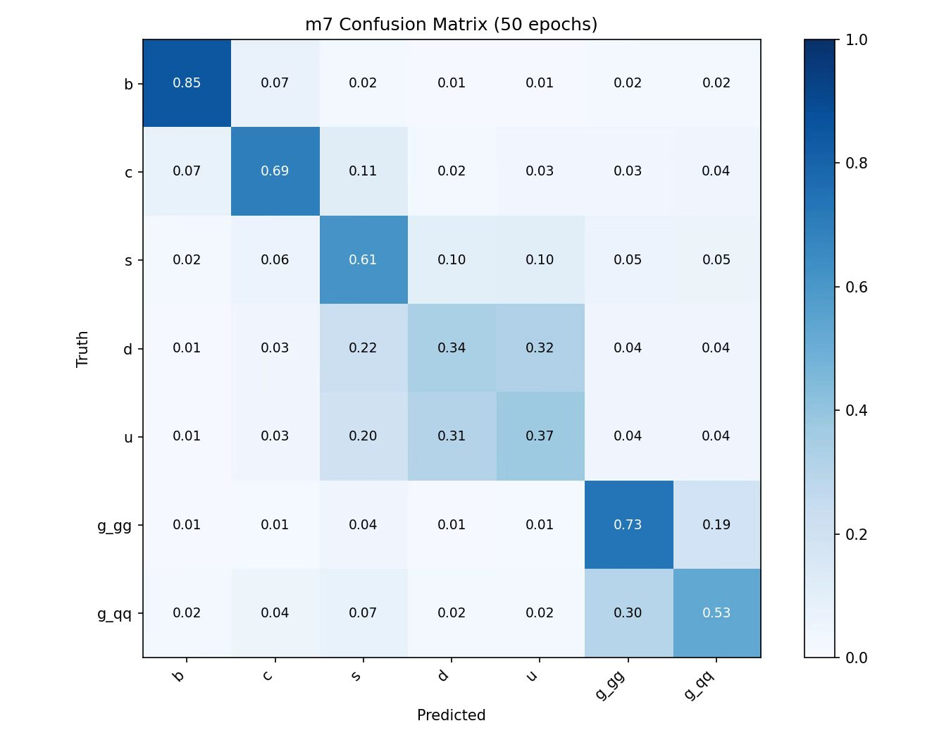
4. PERFORMANCE
7-class confusion matrix (b, c, s, u, d, g-gg, g-qq)
Seperation between gluon/quark jets is too good to be true
Probably due to difference between Madgraph (H-gg) and Whizard (H-qq), investigating
CEPC Jet Flavor Tagging — Status Update
6

Slide 7
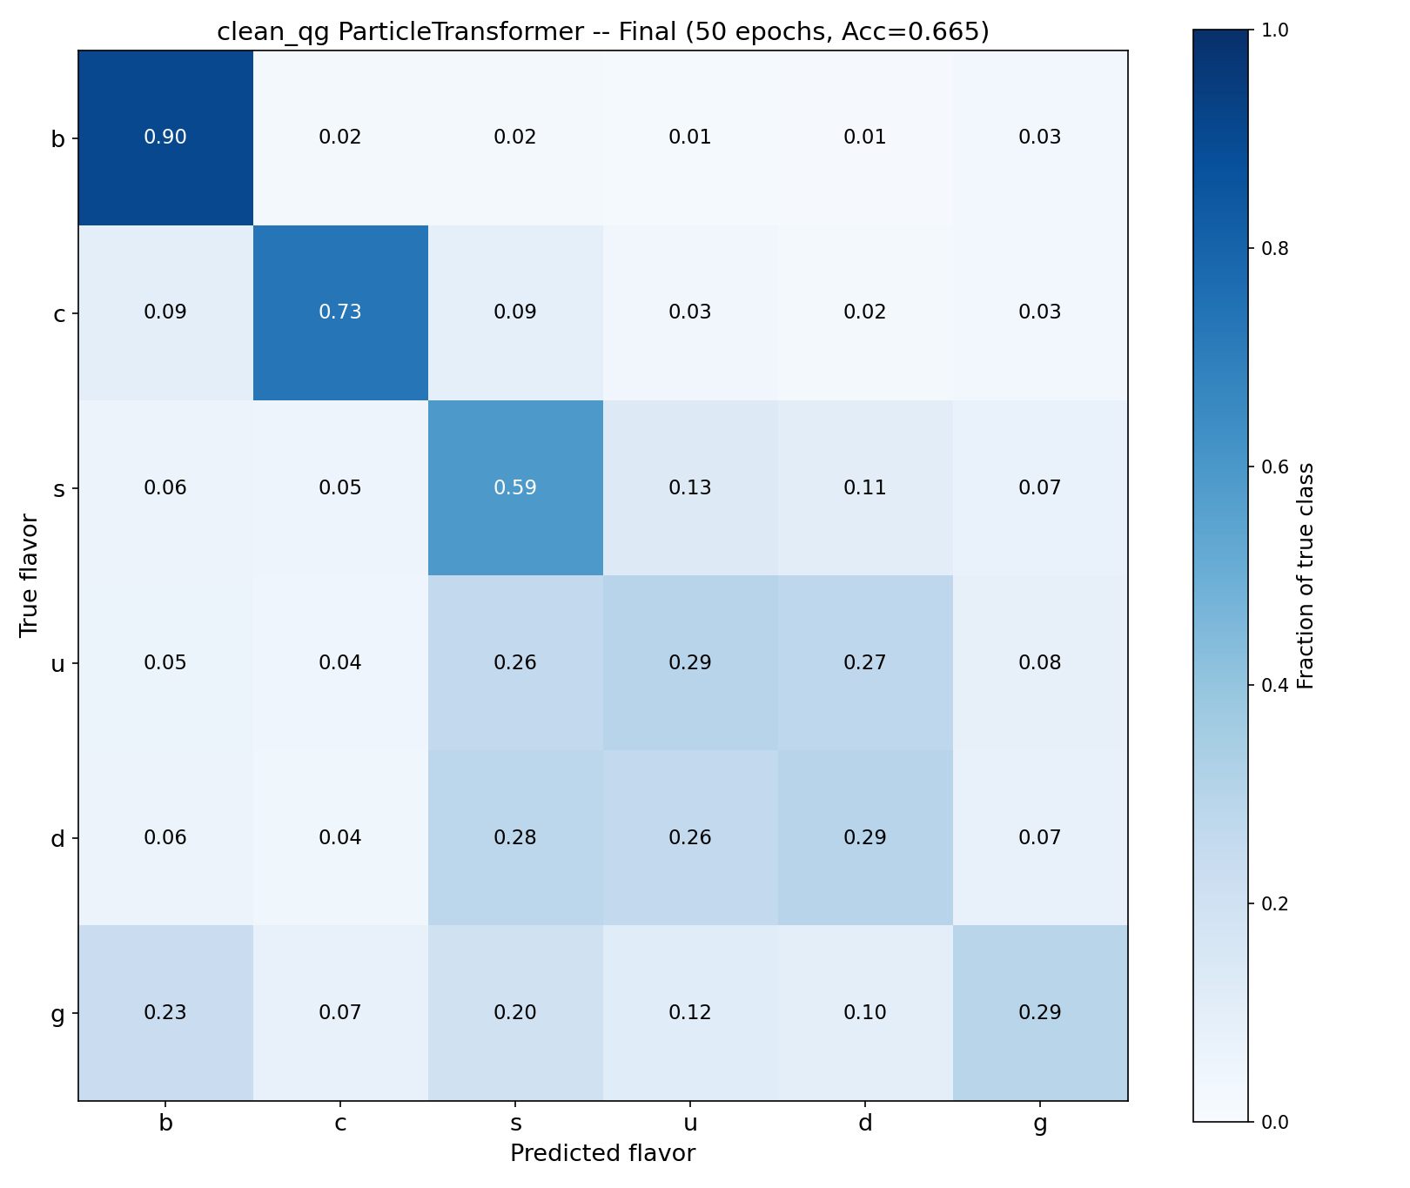
4. PERFORMANCE
6-class confusion matrix (b, c, s, u, d, g)
Evaluation of the similar model with Whizard H-gg
CEPC Jet Flavor Tagging — Status Update
6

Slide 8
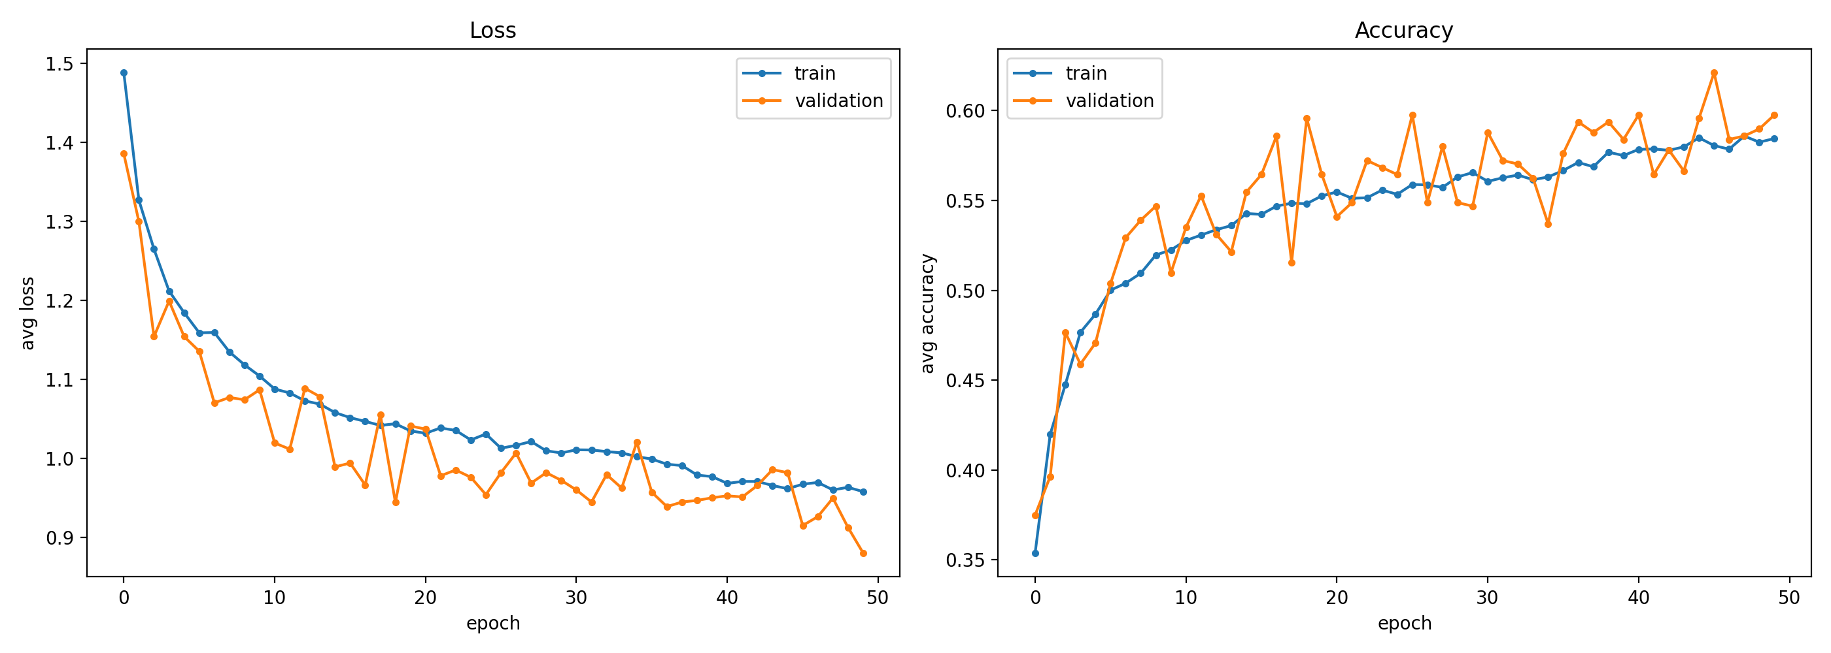
4. PERFORMANCE (CONT.)
Training vs. validation
CEPC Jet Flavor Tagging — Status Update
8

Slide 9
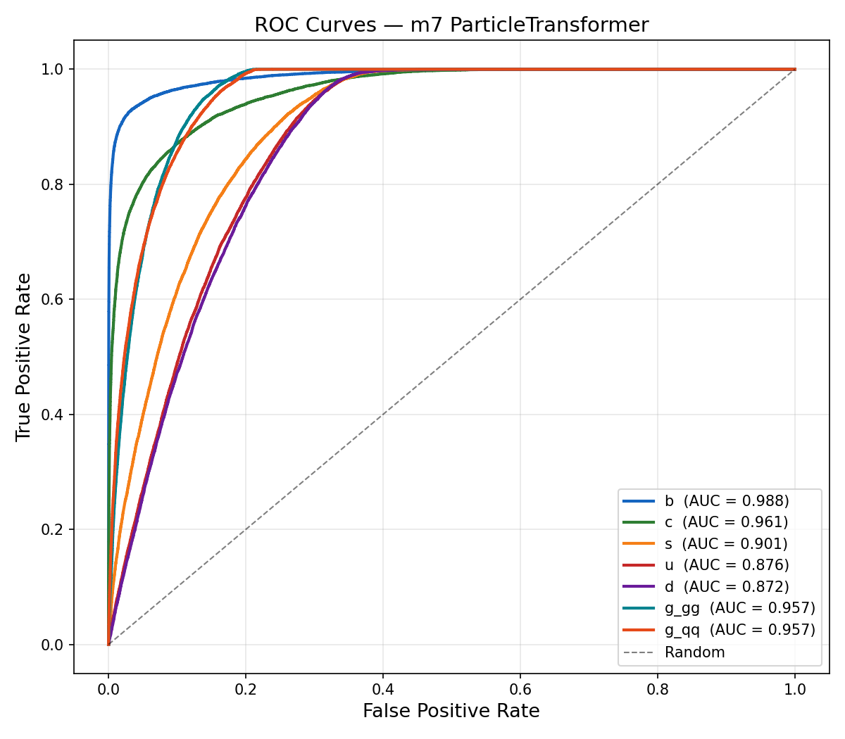
4. PERFORMANCE (CONT.)
ROC curves, per class
CEPC Jet Flavor Tagging — Status Update
9

Slide 10
5. NEXT STEPS
Next steps: closing the gluon-tagging gap
1
Regenrate the gggg/qqqq samples using whizard
Generating the samples required for the Gluon-splitting-mode identification
2
CP Analysis — Angular Observables
Apply trained tagger to select clean H→gg events. Measure Δφ distribution and extract CP mixing angle f_CP.
CEPC Jet Flavor Tagging — Status Update
11

