Slide 1
LOCld – The fastest VCSEL driver in optical link for ATLAS
Futian Liang
ftliang@mail.ustc.edu.cn
USTC-IHEP, May. 3rd, 2013

Slide 2
Outlines
ATLAS and radiation
VCSEL driver in optical links
Oops, we got company: GBLD
LOCld -- The fastest VCSEL driver in ATLAS
Challenges and targets
Designs &Simulations
Tests
Summary / Q & A

Slide 3
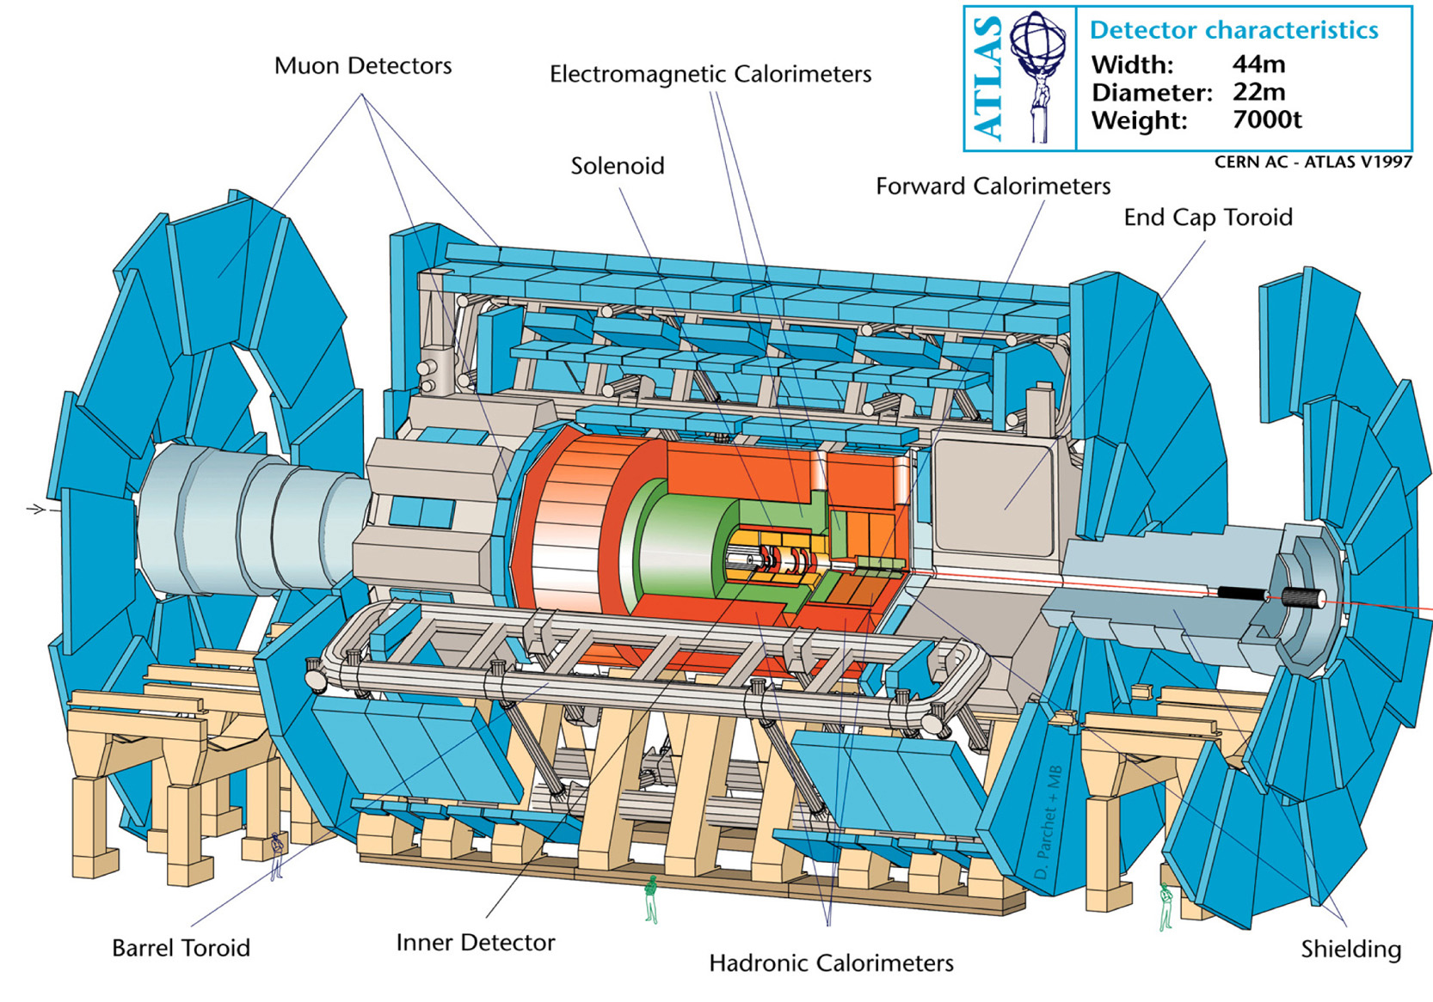
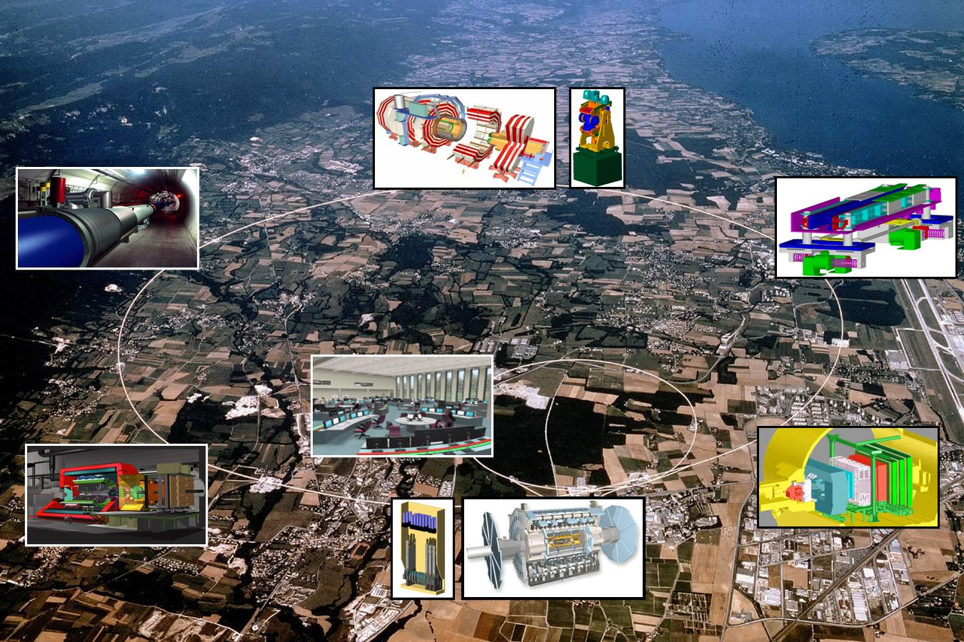
ATLAS and radiation

Slide 4
ATLAS and radiation
ATLAS
One of the LHC’s detectors.
High energy particles collide w/ high luminosity
… Higgs boson?
Very very very very … strong RADIATION
Most of the commercial products CANNOT survive in the radiation environments.
The radiation tolerant / hardened ASIC designs are required.

Slide 5
Radiation hard optical link

Slide 6
VCSEL driver in optical links -- GBLD
Process: 0.13 um CMOS
Max bit rate: 5 Gbps
Bias current: 2 mA ~ 43 mA
Modulation current: 2 mA ~ 12 mA
Deterministic jitter: 12 ps ~ 25ps
Pre-emphasis/de-emphasis
Emphasis width: 60 ps ~ 90 ps
Programmable: hardwired pin/I²C interface

Slide 7
Optical link in LAr in ATLAS
Eg. Optical links for the ATLAS liquid Argon calorimeter upgrade (cooperate w/ Southern Methodist University in USA)
All on-detector parts required radiation tolerant

Slide 8
LOCld - The fastest VCSEL driver
Challenge
0.25 um Silicon-on-Sapphire (SoS) CMOS
Goal(Requirements from LOCsx and VCSEL)
2 mA current input
8 mA modulation AC coupled to VCSEL
8 mA bias current
8 Gbps transmission data rate
Emphasis and programmable ability
radiation tolerant / hard
Notes:
http://en.wikipedia.org/wiki/VCSEL
The vertical-cavity surface-emitting laser, or VCSEL ( /ˈvɪksəl/), is a type of semiconductor laser diode with laser beam emission perpendicular from the top surface, contrary to conventional edge-emitting semiconductor lasers (also in-plane lasers) which emit from surfaces formed by cleaving the individual chip out of a wafer.

Slide 9
General topology -- GBLD

Slide 10
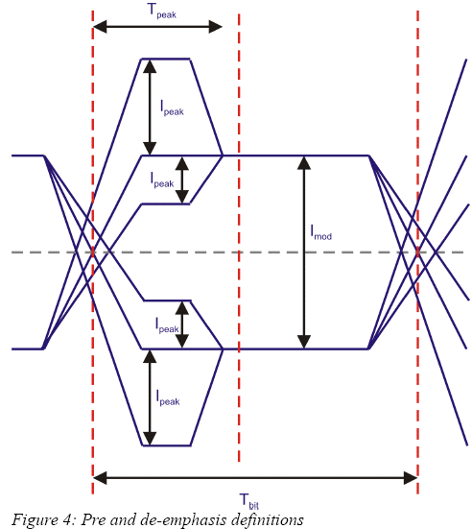
Emphasis
The process should be fast enough to generate the peaking pulse.
0.13 um V.S. 0.25 um ?

Slide 11
Active shunt peaking (1)
 | Passive inductor peaking | Active shunt peaking
Performance | Best | Good
Area | Very large | Small
Adjustable | No | No
Notes:
Let’s begin to talk about the techniques in our design. The first is the peaking. In figure a and b, there are passive inductor peaking and active shunt peaking in a text book. The passive inductor peaking has the best peaking, but it really takes a large area because of the on chip inductor. And it is difficult to adjust the strength because of the inductor. In the active shunt peaking, the peaking performance is good, and takes a small area. However, the resistance of resistors in the Peregrine GC process varies more than 100% in different process corners and at different temperatures. As a result, the peaking performance is sensitive to process variation and temperature. In our design, we use a structure in figure c. We use a pMOS with a gate voltage control to replace the resistor. The pMOS here response like a resistor. With the control of the gate voltage, the equivalent resistance changes, and the peaking strength changes. We can easily adjust the peaking strength.

Slide 12
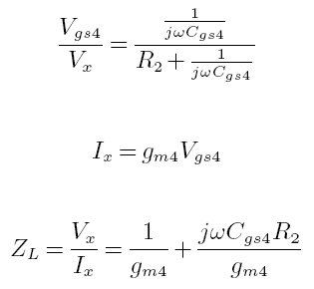
Active shunt peaking (2)
Conventional active shunt peaking:
topology;
high frequency small signal model;
(c) passive equivalent circuit.
R
L

Slide 13
Active shunt peaking (3)
 | Passive inductor peaking | Active shunt peaking | Used in our design
Performance | Best | Good | Good
Area | Very large | Small | Small
Adjustable | No | No | Yes
Notes:
Let’s begin to talk about the techniques in our design. The first is the peaking. In figure a and b, there are passive inductor peaking and active shunt peaking in a text book. The passive inductor peaking has the best peaking, but it really takes a large area because of the on chip inductor. And it is difficult to adjust the strength because of the inductor. In the active shunt peaking, the peaking performance is good, and takes a small area. However, the resistance of resistors in the Peregrine GC process varies more than 100% in different process corners and at different temperatures. As a result, the peaking performance is sensitive to process variation and temperature. In our design, we use a structure in figure c. We use a pMOS with a gate voltage control to replace the resistor. The pMOS here response like a resistor. With the control of the gate voltage, the equivalent resistance changes, and the peaking strength changes. We can easily adjust the peaking strength.

Slide 14
LOCld: Structure details
4. AC coupled VCSEL with bias current
6. 3.3 V power & peaking strength control
5. Differential output, 8 mA max modulation
7. Input impedance match & common voltage
8. Input CML, 2 mA minimum
9. Tail current reference
3. Bias current with control
1. Six pre-drive stages with active shunt peaking
2. Differential output stage with 50 Ω pull-up
Notes:
Here is the block diagram of LOCld1.

Slide 15
LOCld: simulation
Condition: *
Nominal, 27°C, 8Gbps
Dj: 4.1 ps;
Eye opening: 7.7 mA;
Modulation: 8.7 mA
Power:
V33: 172 mW (52.3 mA);
V25: 2.7 mW (1.0 mA);
VDD (VCSEL): 20.3mW (6.1 mA);
Total: 24.4mW/Gbps.
Notes:
This is a post-layout simulation in nominal corner and 27 centigrade. The test bench is in Figure 10 in page 10.

Slide 16
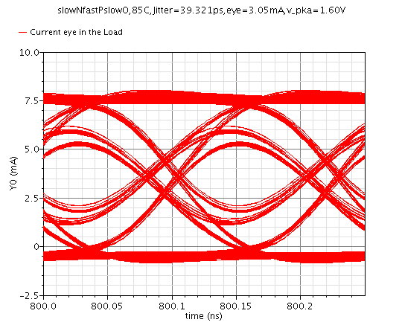
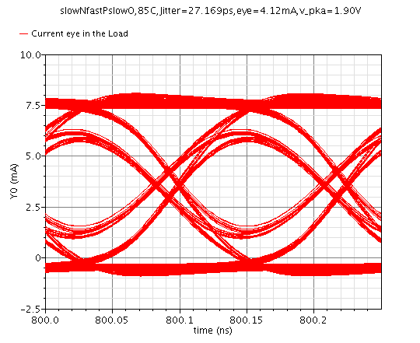
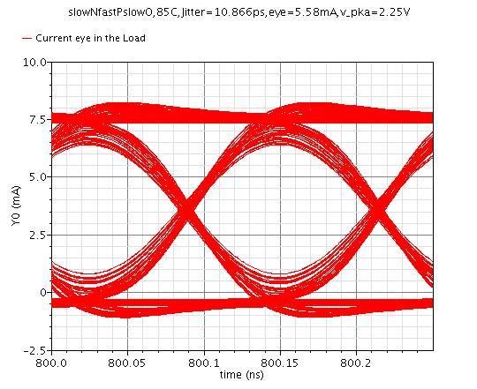
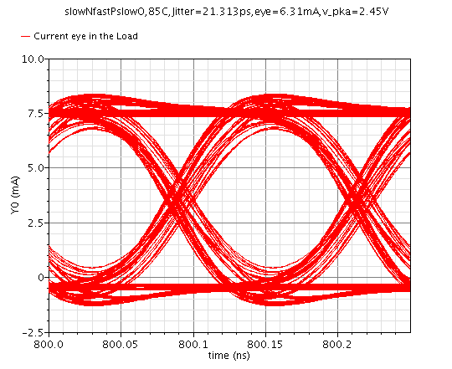
Peaking strength
Notes:
This slide shows the effect of adjust the peaking strength. The plot is the result in slowNfastPslowO corner and 85 centigrade with is the worst condition in our simulation. With the change of the control voltage, the Dj and eye opening change. We can optimize the Dj and eye opening.

Slide 17
On chip electrical tests
Input:
200 mV differential 8-Gbps PRBS-7 pattern
AC coupled to the test PCB
Output:
Current
AC coupled to sampling oscilloscope

Slide 18
Electrical test eye diagram and jitter
Eye and Jitter w/ 200 mV differential 8-Gbps PRBS-7 pattern input
Notes:
http://en.wikipedia.org/wiki/Eye_pattern
In telecommunication, an eye pattern, also known as an eye diagram, is an oscilloscope display in which a digital data signal from a receiver is repetitively sampled and applied to the vertical input, while the data rate is used to trigger the horizontal sweep. It is so called because, for several types of coding, the pattern looks like a series of eyes between a pair of rails.

Slide 19
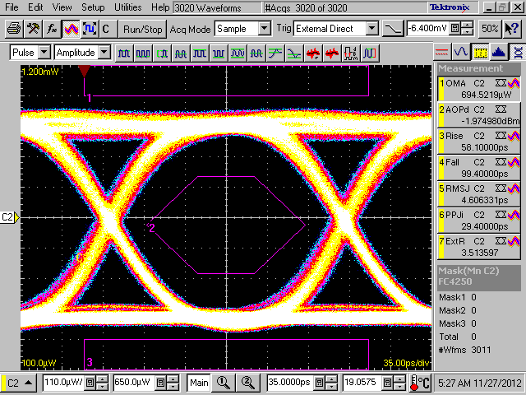
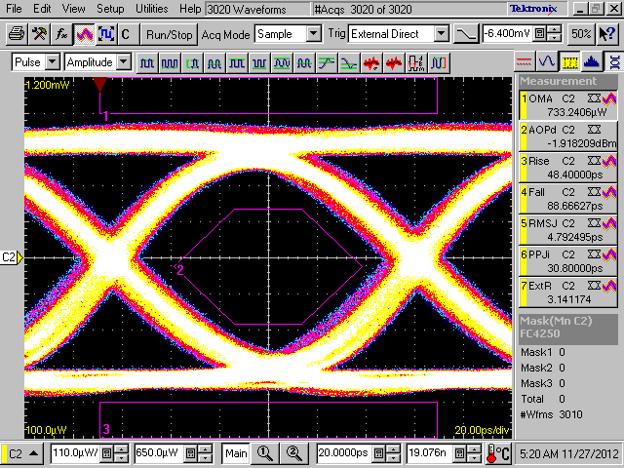
Optical test
Our design has margins from the eye diagram
Above: 5 Gbps with
4.25 Gbps Eye mask
Left: 8 Gbps with
4.25 Gbps Eye mask
No hit in 3 mask areas with 3000 waveforms.

Slide 20
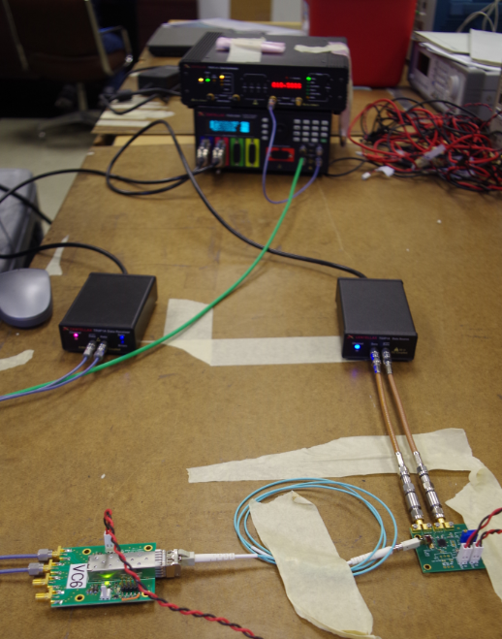
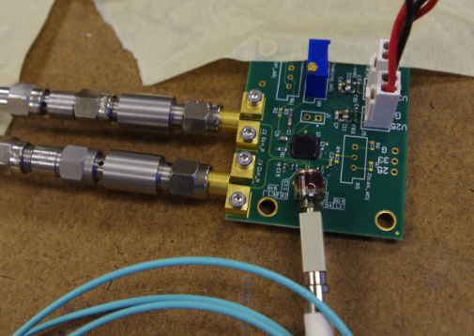
LOCld optical Bit Error Ratio Test
LOCld Chip
Bit error ratio tester
VCSEL
Receiver

Slide 21
Optical Bit Error Ratio Test (10⁻¹²)
300s@5Gbps, pass, BER<6.667x10⁻¹³
300s@8Gbps, pass, BER<4.167x10⁻¹³
300s@10Gbps, pass, BER<3.33x10⁻¹³
54000s@10Gbps, pass, 6 errors in 5.4x10¹⁴bits, BER=1.11x10⁻¹⁴
300s@10.5Gbps, pass, 3 errors in 3.15x10¹²bits, BER=9.524x10⁻¹³
The design target is 8Gbps
Unpublished
Under review by Chinese Physics C

Slide 22
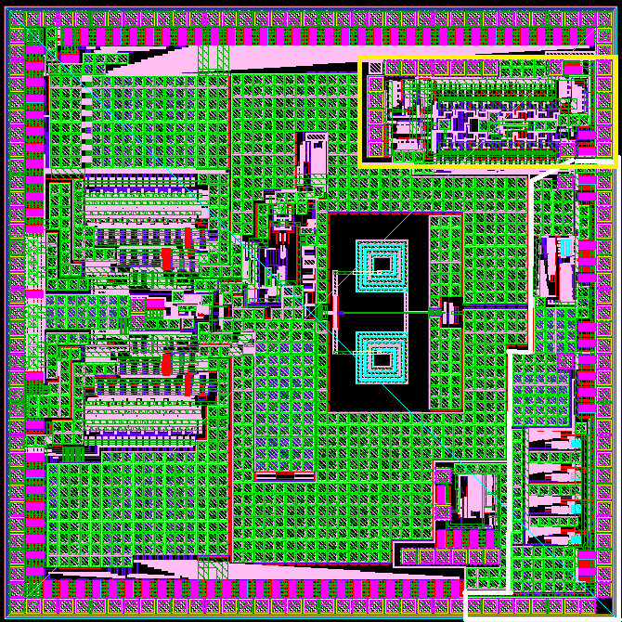
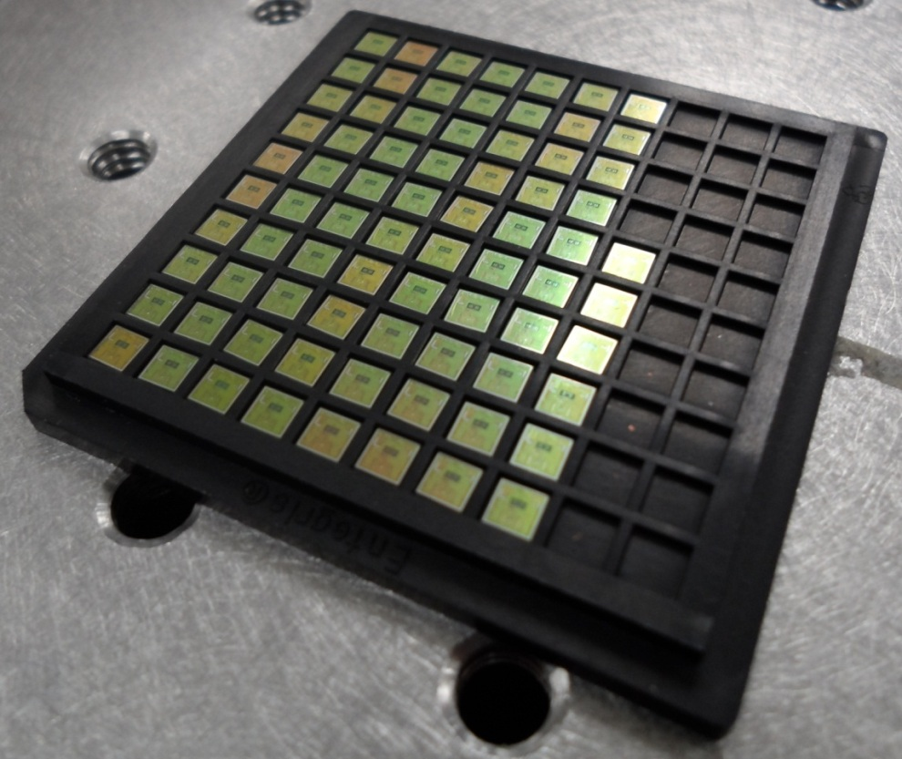
3mm X 3mm
144 round pins
TRNG(Yellow)
550um X 1150um
LOCld (White)
LOCld1
320um X 500um
LOCld4
450um X 1200um
I took
1.33mm² (15%) area and
42 (30%)
round pin
Notes:
看电感的面积。

Slide 23
Summary
Radiation tolerant VCSEL driver is required.
8-Gbps radiation tolerant VCSEL driver
The fastest VCSEL driver in ATLAS
Active shunt peaking
Modulation and bias are configureable
10 Gbps data rate ability
… to be continued(Digital control version).
Questions & Answers

Slide 24
Questions & Answers

