Slide 1
Observation of the Z_{c}(3900)
— a charged charmoniumlike structure —
Changzheng Yuan [ 苑长征 ]
(for the BESIII Collaboration)
March 27, 2013

Slide 2
Outline
Conventional & exotic hadrons
How to study exotic hadrons
BESIII analysis & results
Summary & perspectives

Slide 3
Hadrons：normal & exotic
Hadrons are composed from 2 (meson) quarks or
3 (baryon) quarks
Quark model
QCD allows hadrons with N_{quarks}≠2, 3
  glueball： N_{quarks} = 0 (gg, ggg, …)
  hybrid： N_{quarks} = 2 + excited gluon
  multiquark state： N_{quarks} > 3
  molecule： bound state of more than 2 hadrons

Slide 4
A bit history on exotics hunting
“The absence of exotics is one of the most obvious features of QCD” – R. L. Jaffe, 2005
Deuteron ➔ H state, Ω⁻Ω⁻ bound state, …
No solid signature of glueballs
Pentaquark state appeared and disappeared
(“The story of pentaquark shows how poorly we understand QCD” – F. Wilczek, 2005)
There are lots of new states from low to high mass in various experiments! Are they normal or exotic?

Slide 5

Why hard to identify exotic state?
Which dwarf was named “Happy”?
I donot know … No solid signature!

Slide 6

Why hard to identify exotic state?
Which beauty is “Snow White”?
Yes, I know! “Hair black as ebony [乌木, 黑檀]”.
Very clear signature!

Slide 7
How to identify an exotic meson?
Find a clear signature for exotic state!
Decays to charmonium thus has a ‾cc pair!
With electric charge thus has two more light quarks!
➔ N_{quark} ≥ 4 !
Do searches in π±J/ψ, π±ψ(2S), π±χ_{cJ}, …

Slide 8
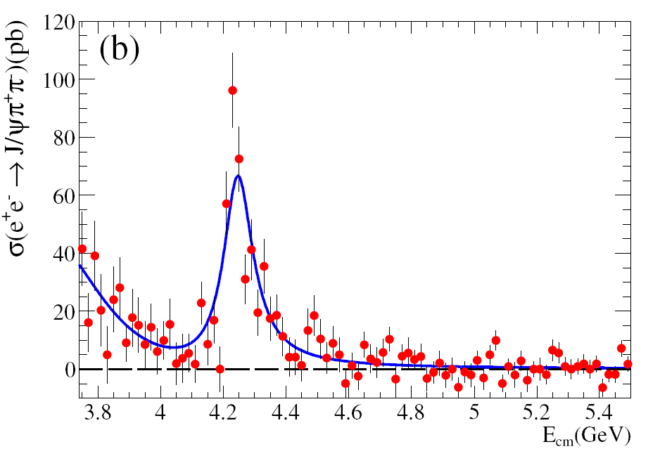
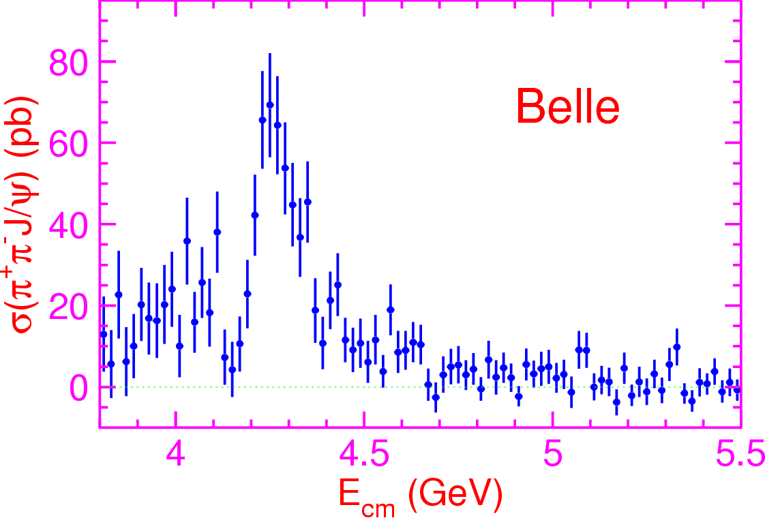


What do we do at BESIII
We may search for such state if it decays into π±J/ψ !
σ(e⁺e⁻ → π⁺π⁻J/ψ) reaches maximum at ~4.26 GeV
We proposed a 45 days’ data taking for 500 pb⁻¹ data at peak
~1500 reconstructed events are expected [3xB-factories]

Slide 9
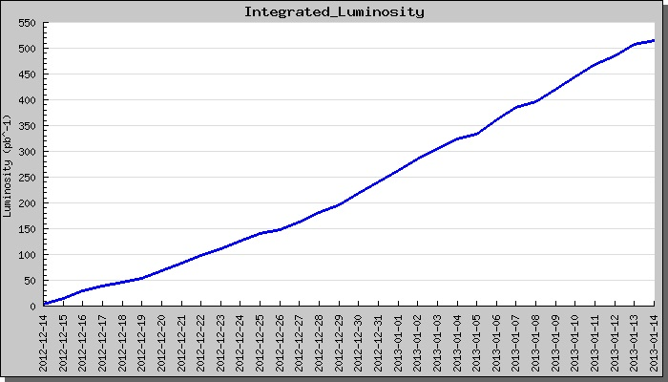
Data taking at BESIII
Accumulated 525 pb⁻¹ in 30 days!
40 times of CLEO-c data!
Highest energy BEPCII ever reach, L_{peak} ~ 5.3x10³²/cm²/s !
BEMS measures Ecm at 1 MeV level !
Low background, low noise, all sub-detectors excellent !

Slide 10
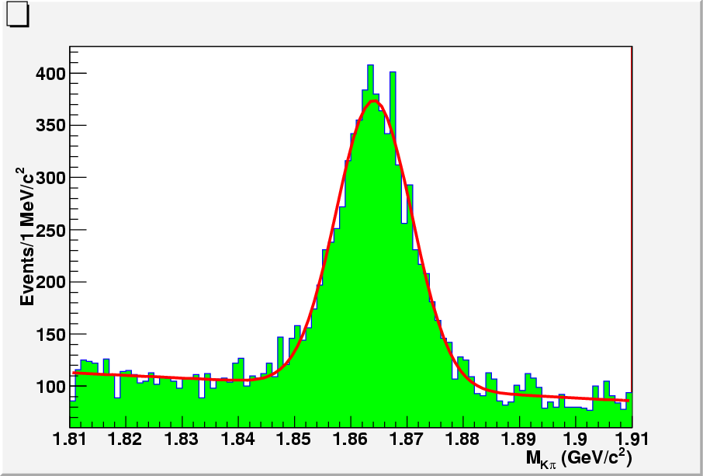
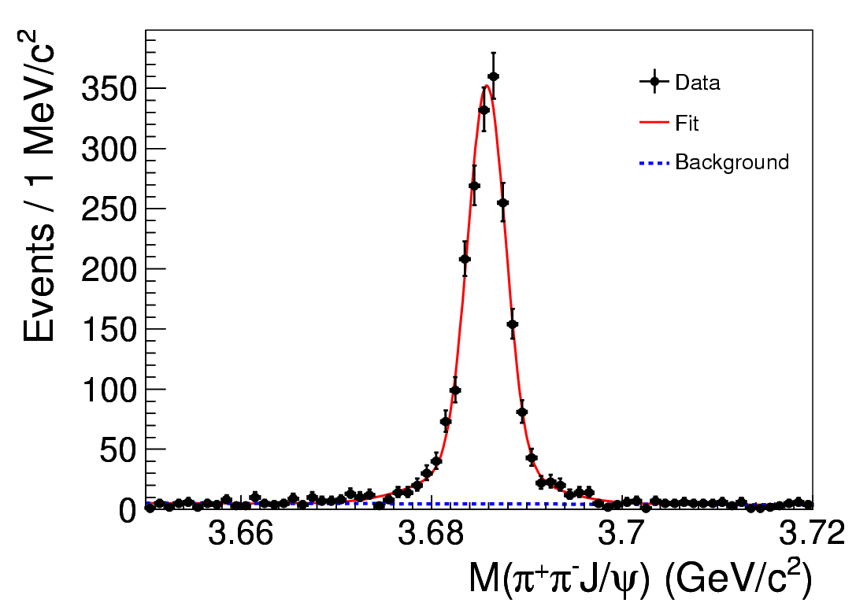
Data quality is excellent
D⁰→Kπ
ISR ψ’
ΔM_{D} = 0.5 ± 0.2 MeV
σM_{D} = 6.0 ± 0.1 MeV
ΔM_{ψ’} = 0.2 ± 0.1 MeV
σM_{ψ’} = 2.0 ± 0.1 MeV
Data calibration, reconstruction, MC simulation were finished shortly after the data taking …
Production version was ready earlier March …

Slide 11
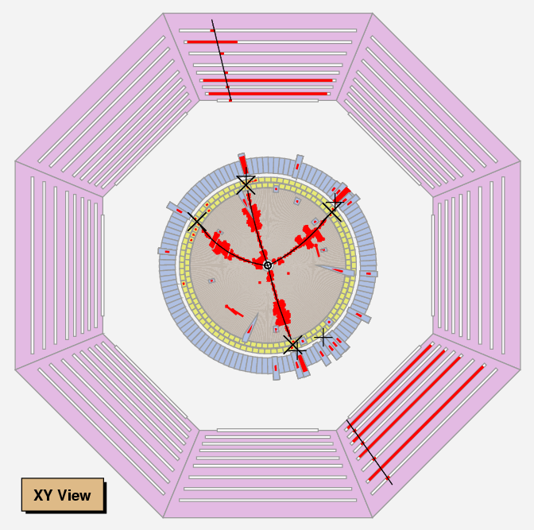
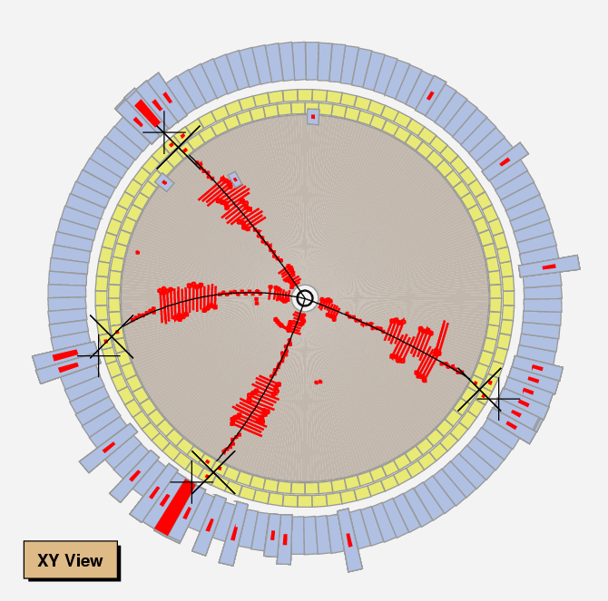
Select e⁺e⁻→ π⁺π⁻J/ψ events
Typical
J/ψ →μ⁺μ⁻
Typical
J/ψ →e⁺e⁻
Select 4 charged tracks and reconstruct J/ψ with lepton pair.
Very clean sample, very high efficiency. Use kinematic fit.
Only use MDC & EMC information, MC simulation reliable.

Slide 12
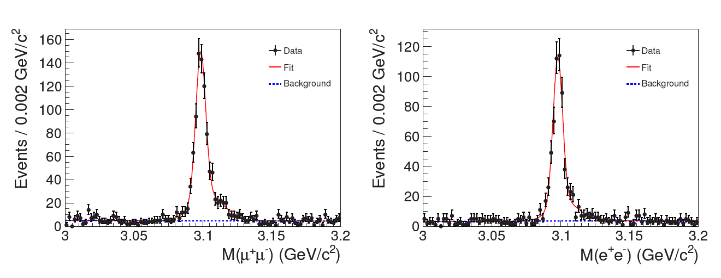
The J/ψ signals
BESIII: arXiv:1303.5949
882±33
J/ψ →μ⁺μ⁻
595±28
J/ψ →e⁺e⁻
Dominant background e⁺e⁻→π⁺π⁻π⁺π⁻
J/ψ signal: [3.08,3.12] GeV
J/ψ sideband: [3.0,3.06] GeV or [3.14,3.20] GeV, 3xsignal
At least 4 independent analyses, all get similar results !

Slide 13
Cross section of e⁺e⁻→ π⁺π⁻J/ψ
Belle: PRL99, 182004 (2007)
BaBar: PRD86, 051102 (2012)
BESIII: σ(e⁺e⁻→ π⁺π⁻J/ψ)
= (62.9±1.9±3.7) pb
Agree with BaBar & Belle!
Best precision!
BESIII: arXiv:1303.5949

Slide 14
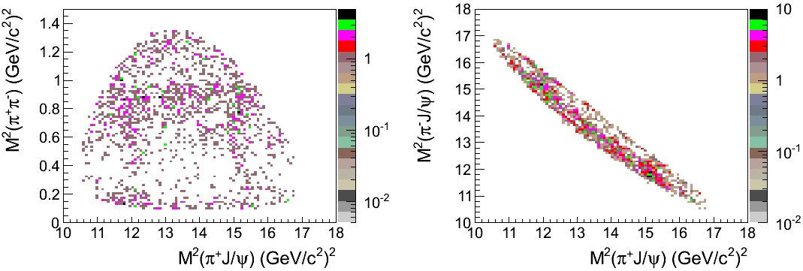
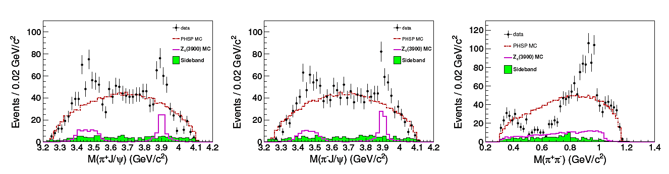
Dalitz plots & 1D projections
BESIII: arXiv:1303.5949

Slide 15
Is it a real signal?
Is it due to π⁺π⁻ S-wave states, like σ, f₀(980), …? N
Is it due to π⁺π⁻ D-wave states, like f₂(1270), …? N
Are there two states, one at 3.4, the other 3.9 GeV? N
Exist in both e⁺e⁻ & μ⁺μ⁻ samples? Y
Exist in both π⁺π⁻ low mass and high mass samples? Y
Background fluctuation? N

Slide 16
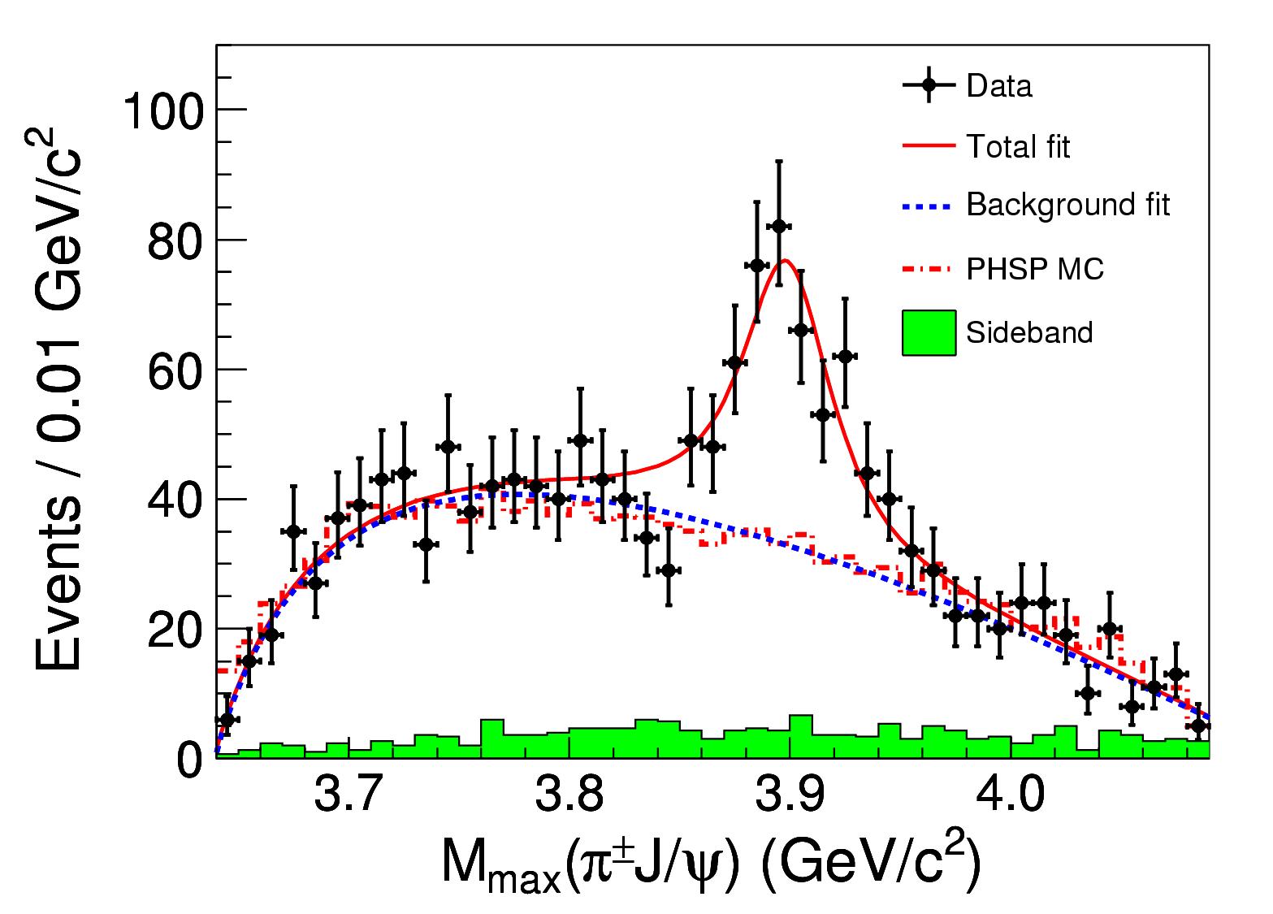
The Z_{c}(3900) signal
BESIII: arXiv:1303.5949
Significance
>8σ
Couples to‾cc
Has electric charge
At least 4-quarks
What is its nature?
S-wave Breit-Wigner with efficiency correction
Mass = (3899.0±3.6±4.9) MeV
Width = (46±10±20) MeV
Fraction = (21.5±3.3±7.5)%

Slide 17
What next?
We are accumulating 3x more data
Precise resonant parameters
Spin-parity [PWA on going]
More decay modes
Production mechanisms, production rate
Test various theoretical models
Neutral partner of Z_{c}
Other Z_{c} states? Z_{c}’ states?
…
XYZ group expanding rapidly since Jan., but more are welcome
B424 (40.96 m²)➔ B410 (95.04 m²)
Everyone is working excitedly and passionately!

Slide 18
Summary
We observed a charged charmoniumlike structure, Z_{c}(3900), in its π±J/ψ decays
It is not a charmonium
The nature is yet unknown
We are working very hard to understand it better …
We thank the staff of BEPCII and the computing center, thank the funding agencies, and all the friends of BES!

Slide 19
Thanks a lot!

Slide 20
Thanks a lot!

Slide 21
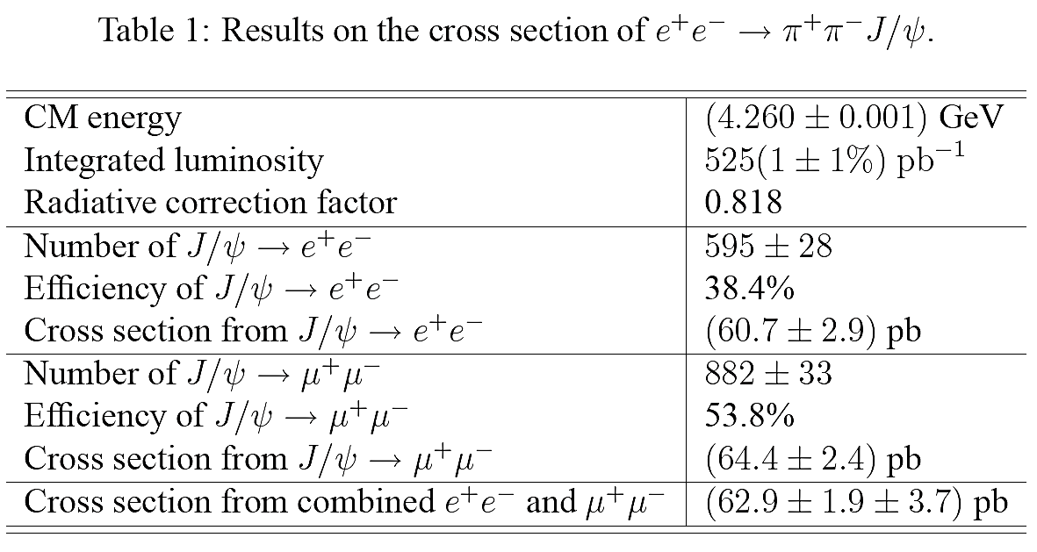

Slide 22
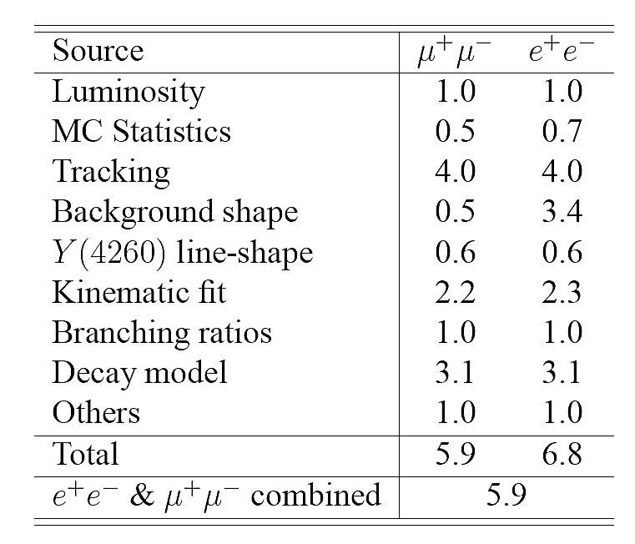

Slide 23
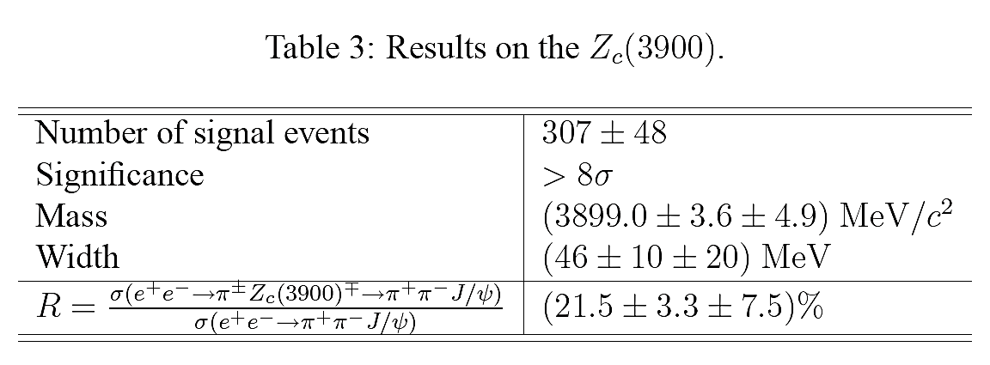
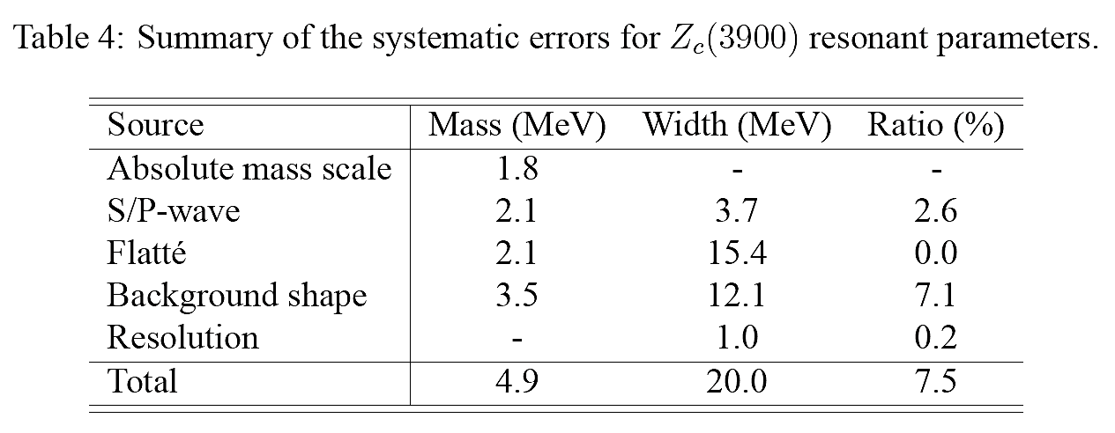

Slide 24
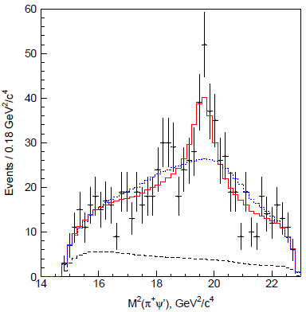
Belle observed Z(4430)±→ψ(2S)π±
PRL100, 142001
(2008)
Found in ψ(2S)π⁺ from B→ψ(2S)π⁺K. Z parameters from fit to M(ψ(2S)π⁺)
Confirmed through Dalitz-plot analysis of B→ψ(2S)π⁺K
B→ψ(2S)π⁺K amplitude: coherent sum of Breit-Wigner contributions
Models: all known K*→Kπ⁺ resonances only
all known K*→Kπ⁺ and Z⁺→ψ(2S)π⁺ ⇨ favored by data
[cu][cd] tetraquark? neutral partner in ψ’π⁰ expected
D*D₁(2420) molecule? should decay to D*D*π
Significance: 6.4σ
Z⁺(4430)
657M BB
–̶̶̶̶̶̶ –̶̶̶̶̶̶ fit for model with K*’s only
–̶̶̶̶̶̶ –̶̶̶̶̶̶ fit for model with K*’s and Z
M²(ψ(2S)π⁺)
K₂*(1430)
K*(890)
M²(Kπ⁺)
M²(ψ(2S)π⁺) after K* veto
PRD80, 031104 (2009)

Slide 25
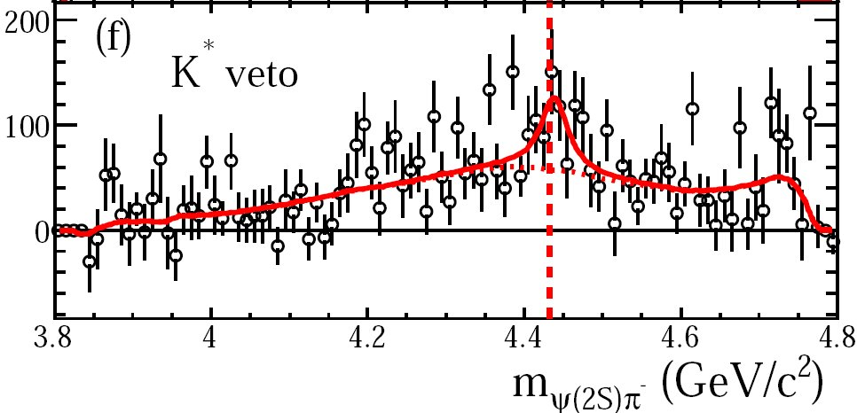
BaBar doesn’t see a significant Z(4430)⁺
PRD79, 112001 (2009)
“For the fit … equivalent to the Belle analysis…we obtain mass
& width values that are consistent with theirs,… but only ~1.9σ
from zero; fixing mass and width increases this to only ~3.1σ.”
Belle PRL: (4.1±1.0±1.4)x10⁻⁵

Slide 26
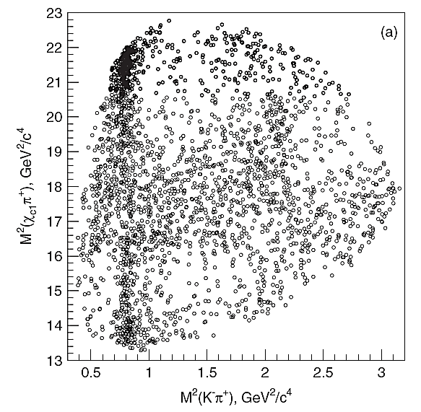
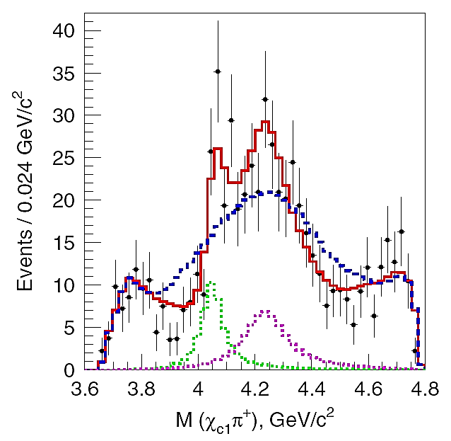
Belle observed Two Z±→χ_{c1}π±
Dalitz-plot analysis of B⁰→χ_{c1}π⁺K⁻ χ_{c1} →J/ψγ with 657M BB
Dalitz plot models: known K*→Kπ only
K*’s + one Z →χ_{c1}π±
K*’s + two Z± states ⇨ favored by data
PRD 78, 072004 (2008)
Significance: 5.7σ
–̶̶̶̶̶̶ –̶̶̶̶̶̶ fit for model with K*’s
–̶̶̶̶̶̶ –̶̶̶̶̶̶ fit for double Z model
–̶̶̶̶̶̶ –̶̶̶̶̶̶ Z₁ contribution
–̶̶̶̶̶̶ –̶̶̶̶̶̶ Z₂ contribution
M(χ_{c1}π⁺)
for 1<M²(K⁻π⁺)<1.75GeV²

Slide 27
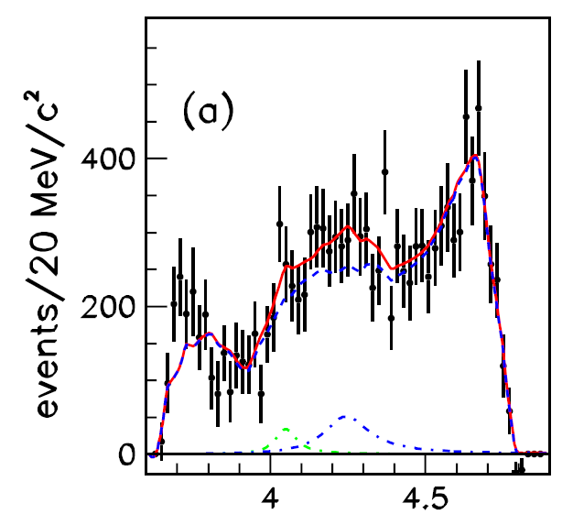
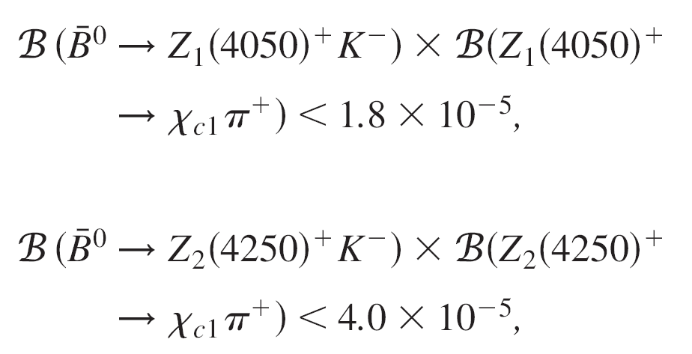
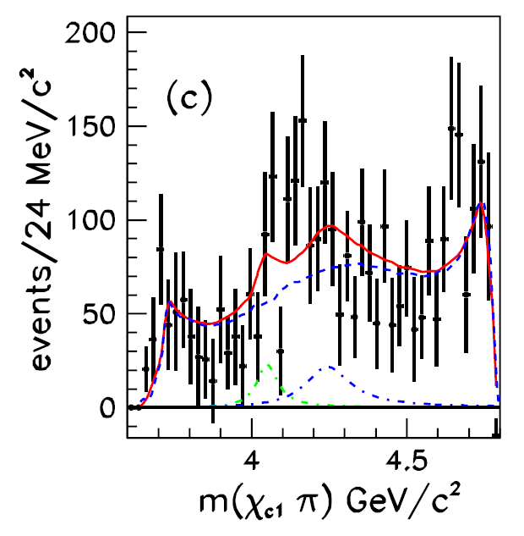
BaBar doesn’t see significant Z±→χ_{c1}π±
PRD85, 052003 (2012)
Belle: (3.0^{+1.5}_{-0.8}^{+3.7}_{-1.6})x10⁻⁵
Belle: (4.0^{+2.3}_{-0.9}^{+19.7}_{-0.5})x10⁻⁵
“We find that it is possible to obtain a good description of our data without the need for additional resonances in the χ_{c1}π system.”

Slide 28
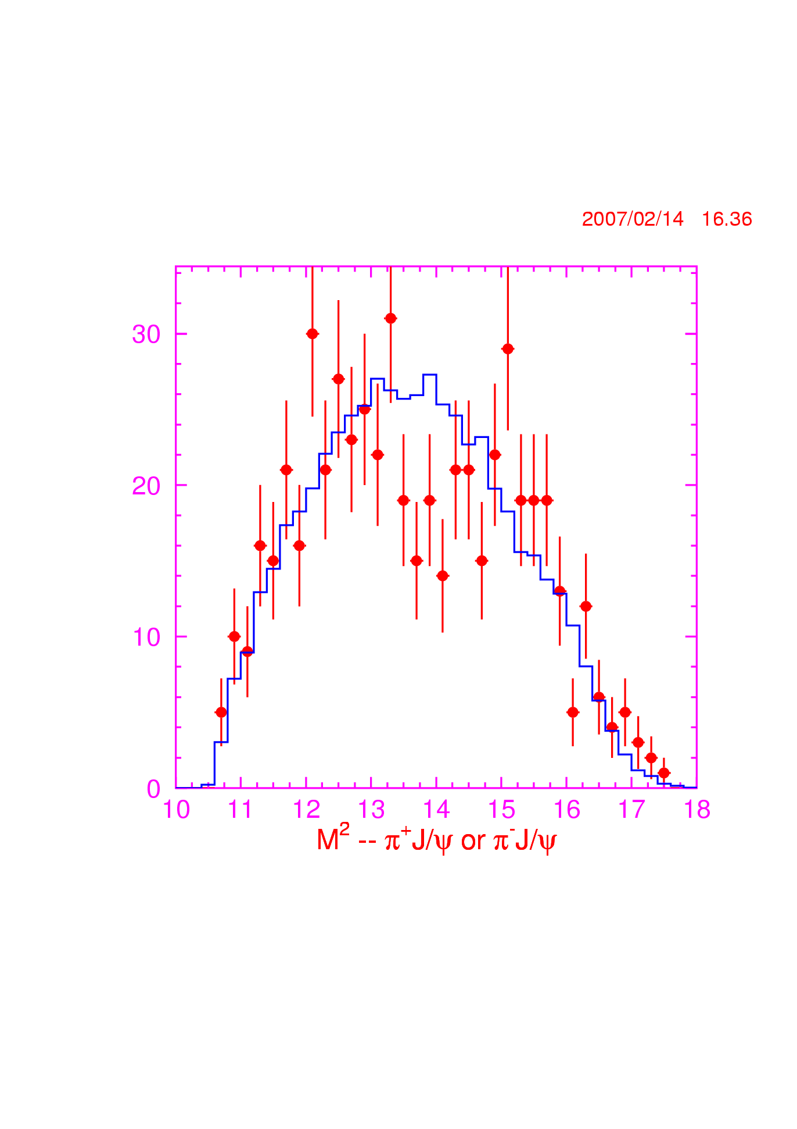
M(ππJ/ψ)∈[4.2, 4.4] GeV via ISR
550/fb at 10.58 GeV
Peaks at 12 & 15 GeV²?
Shown at QWG’2011

