Slide 1
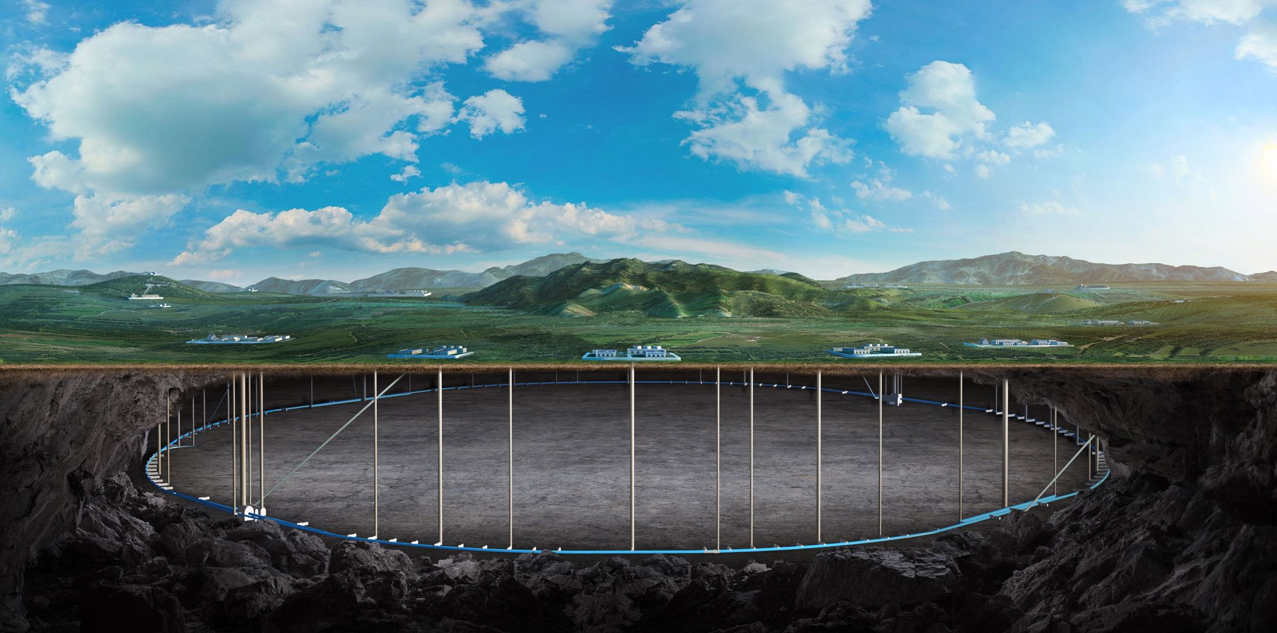


CEPC SRF region design status
Yiwei Wang, Haijing Wang, Mei Yang, Guangyi Tang
CEPC day, 21 Sep 2026

Slide 2
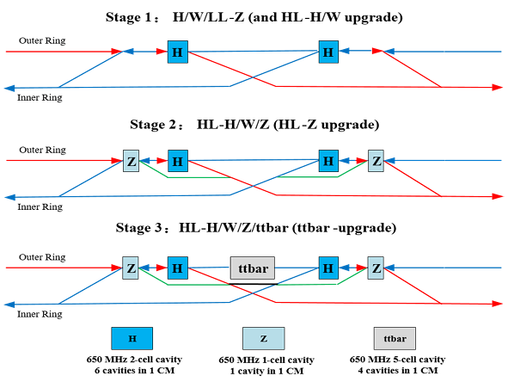
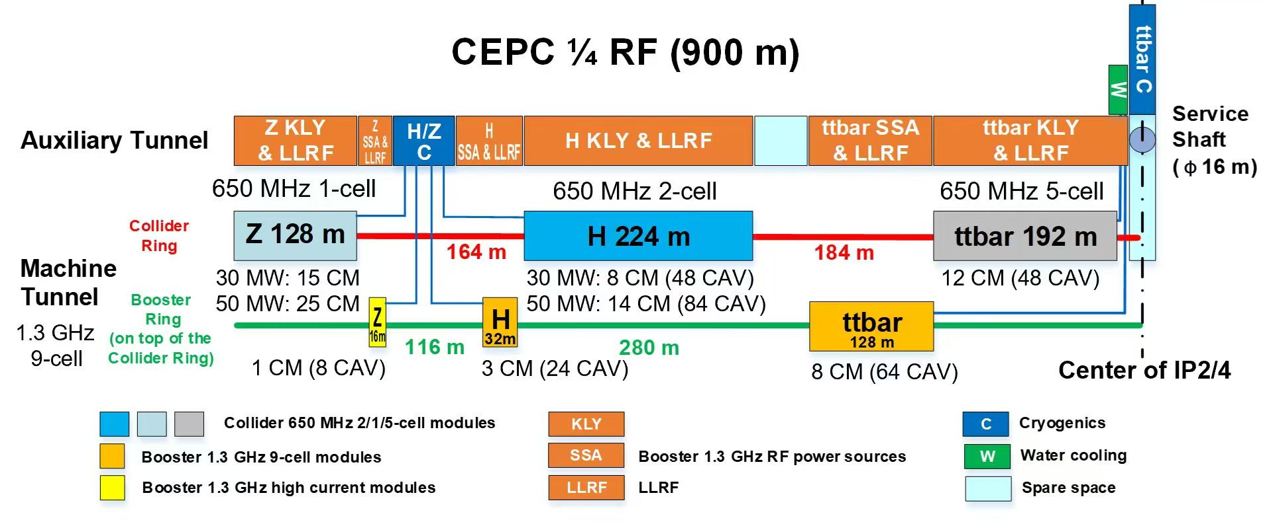
The CEPC SRF region layout

Slide 3
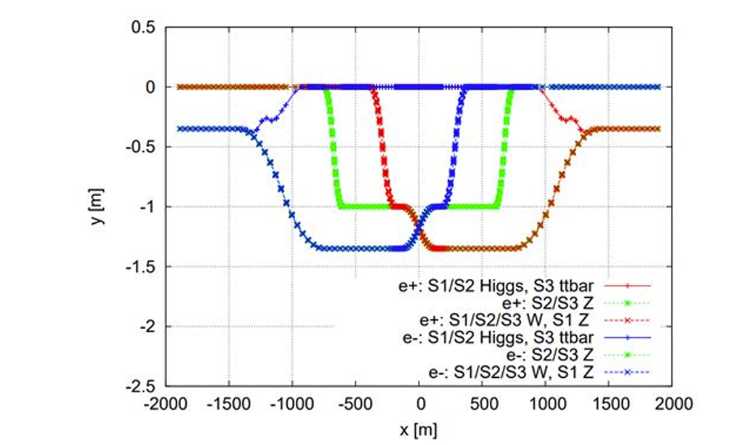
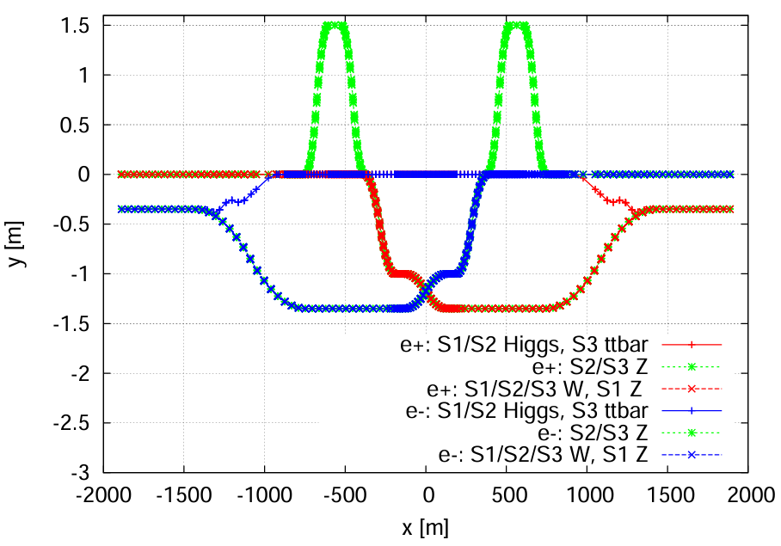
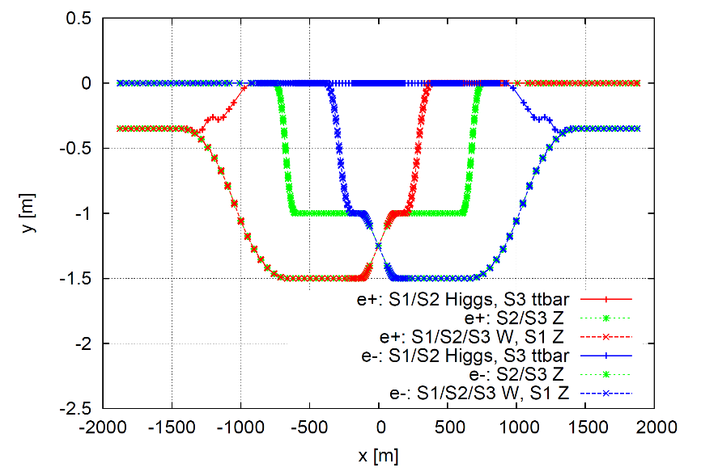
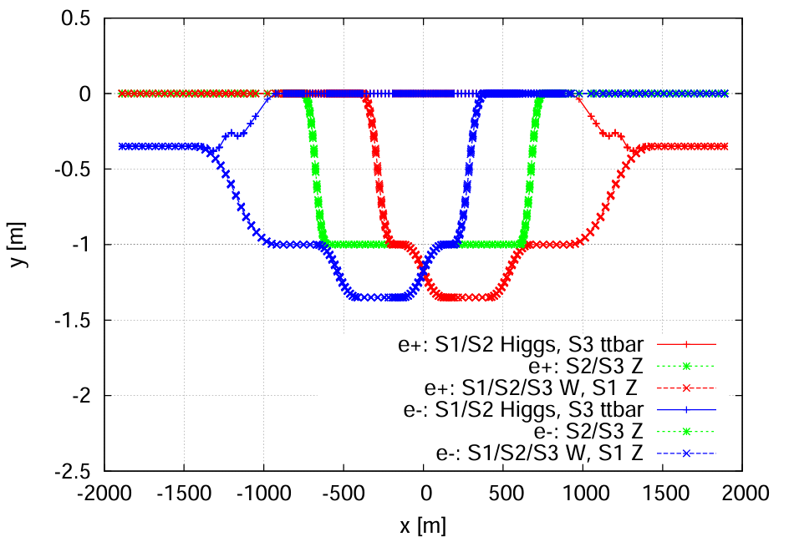
CEPC survey and layout status
Spatial interferences at RF region of collider:7 beam lines.
  Through many negotiations on the RF update strategies, beam performance, space, magnet parameters, three survey versions have been considered.
  Model of RF module has been updated.
  More details are still under-design.
TDR strategy
Intermediate version 1
EDR strategy
Intermediate version 2

Slide 4
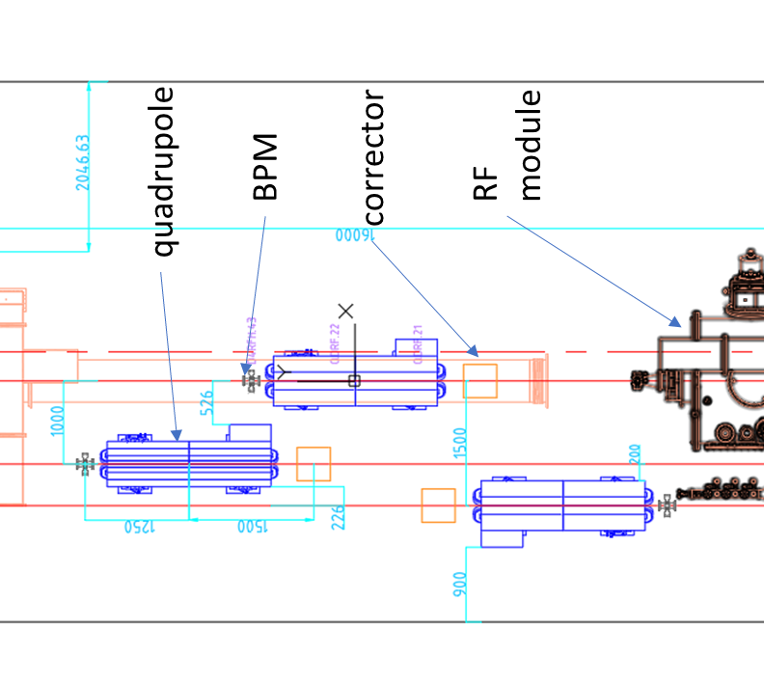
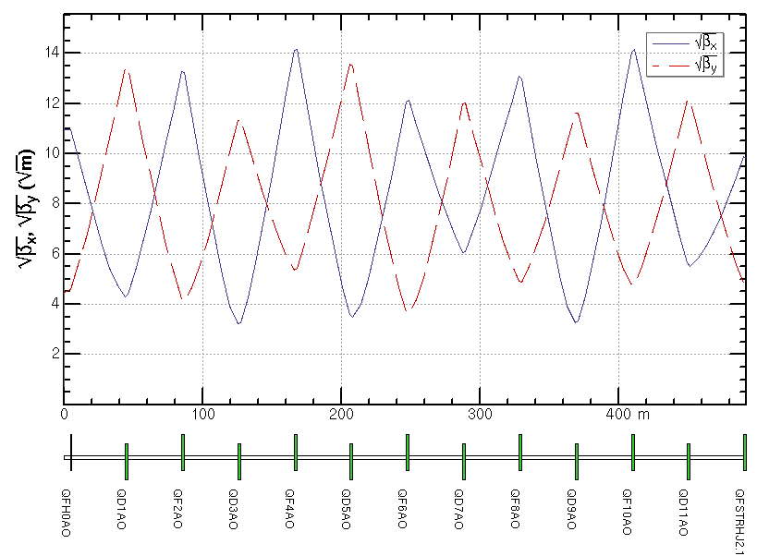
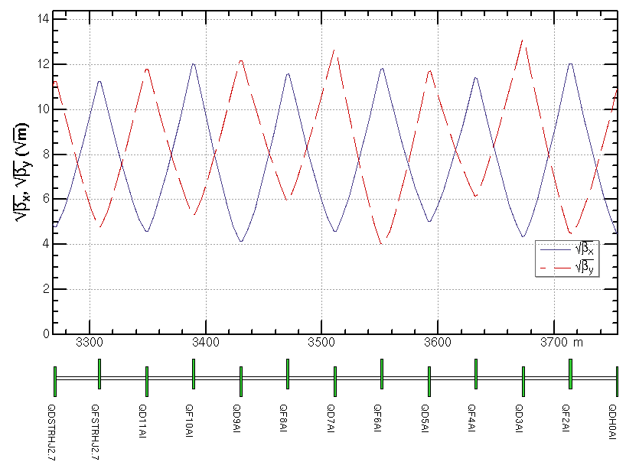
SRF cavity region and matching section
Higgs SRF cavity region, three parallel beamlines
  quadrupole magnets are longitudinally staggered.
Space arrangement at RF module location
With a beamline spacing of 0.35 m, the magnets of the two beamlines are longitudinally staggered by 4 m to avoid interference between the two beamlines.

Slide 5
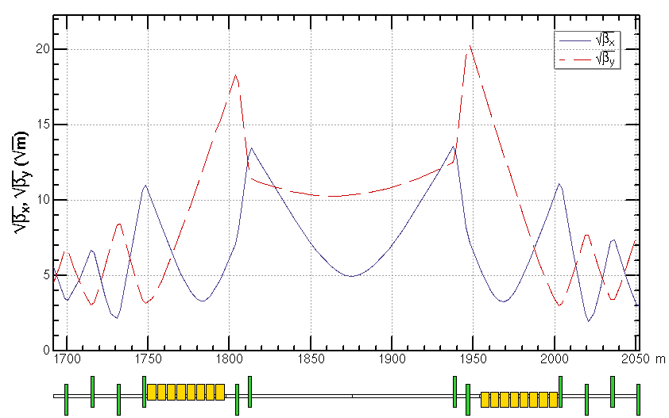
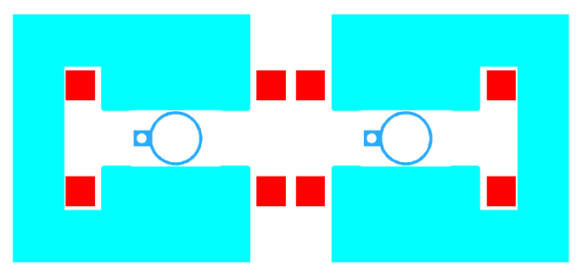
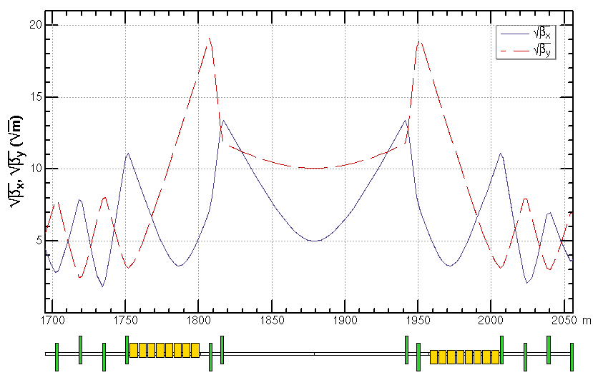
Crossing region
The crossing point is shifted away from the midpoint of the entire high-frequency region to avoid collision of the two bunches at that point.
The dipole magnets in the crossing-point region are placed at the two ends of the region, and the quadrupole magnets are longitudinally staggered to avoid transverse interference.
2 C-type dipoles near cross point

Slide 6
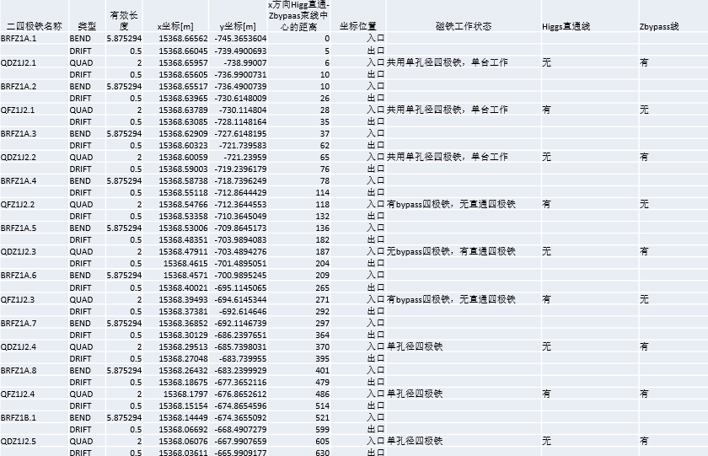
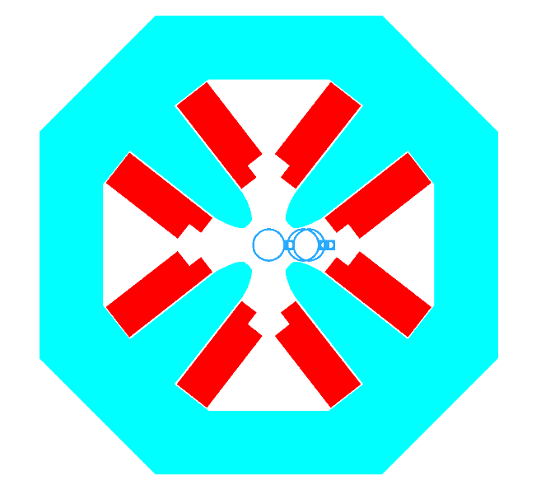
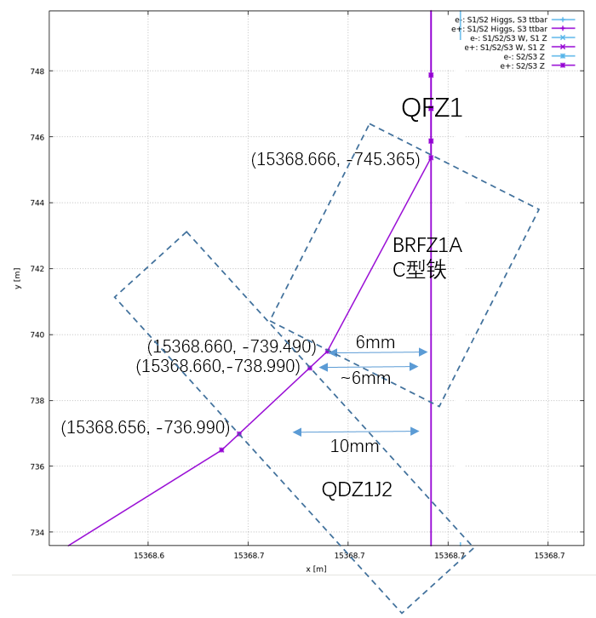
Bypass region 1
To resolve the interference between the quadrupole magnets on the straight line and the dipole and quadrupole magnets on the bypass line
  quadrupole magnets enclose the vacuum chambers of both beamlines
  Considering that the two beamlines do not operate simultaneously, the dipole magnets are of C-type
0.35m
Fmax[T/m] | Leff[mm] | Rgf[mm] | Harm.er | With trim coil | Aper | 备注
磁铁估算极头孔径后，梯度按极头强度0.8T给定 | 2000 | 14.8 | 0.0003 | NO | 真空盒外孔径可改为56mm | 除出入口坐标要求外，该区域的磁铁要求均相同

Slide 7
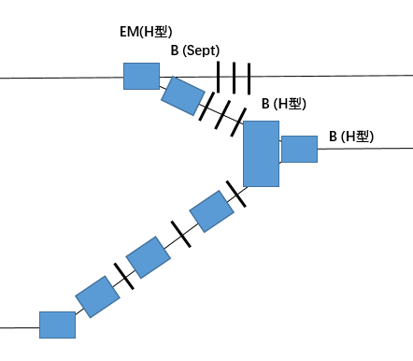
Bypass region 2
Transverse interference between the quadrupole magnets of the straight line and the dipole/quadrupole magnets of the bypass line
  Higgs/ttbar bypass line is planned to be changed to a DBA structure
  corresponding W/Z bypass also needs to be modified (undergoing)
0.35m

Slide 8
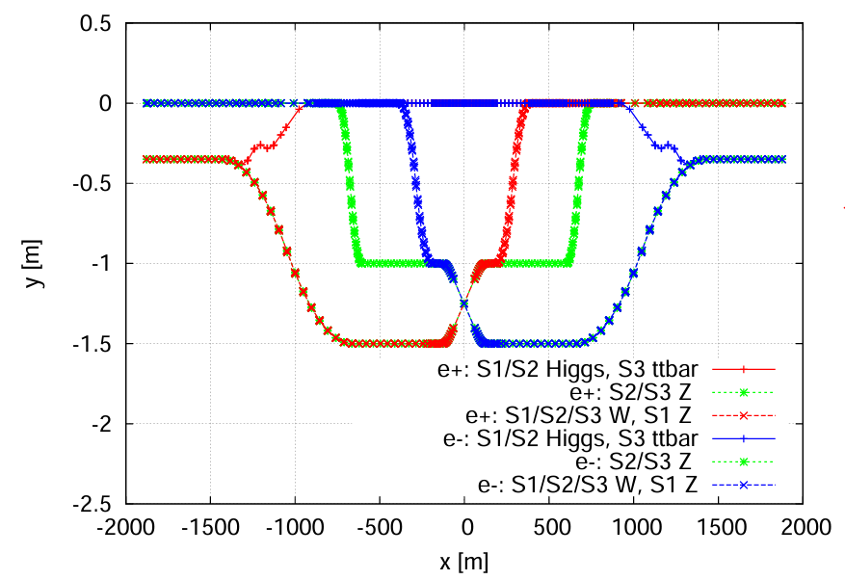
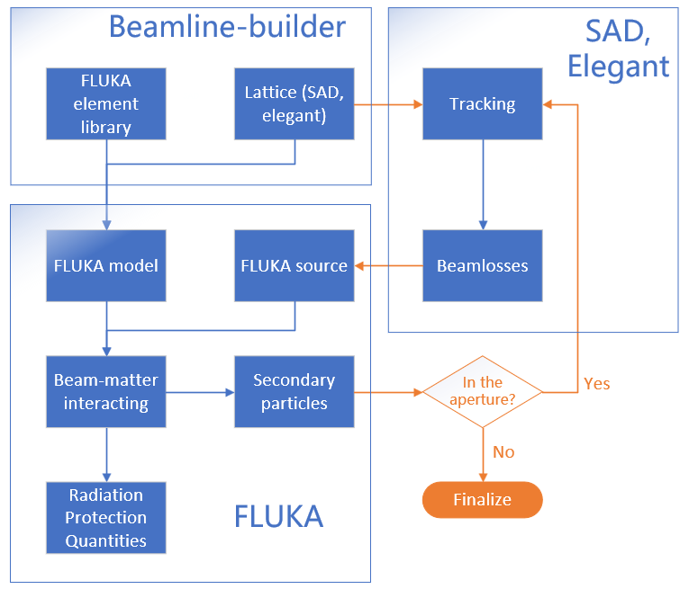
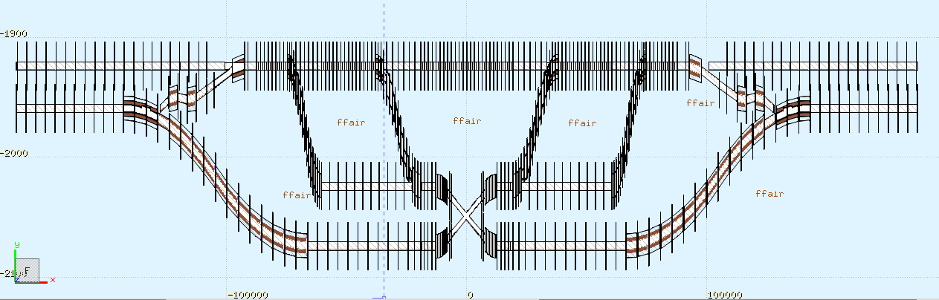
Modeling for the dose simulation
Building FLUKA model according to RF region lattice.
  To estimate dose to magnet insulation and RF cavities (undergoing)
RF region geometry
RF region in FLUKA

Slide 9
Summary and further work
  Through many negotiations on the RF update strategies, beam performance, space, magnet parameters to solve the spatial interferences at RF region of collider
  The geometry of the SRF region is update
    Survey is undergoing for the bypass region 2.
  Model of RF module has been updated.
  Magnets design is undergoing.
  FLUKA model according to RF region lattice has been built and estimation of the dose to magnet insulation and RF cavities is undergoing.

