Slide 1
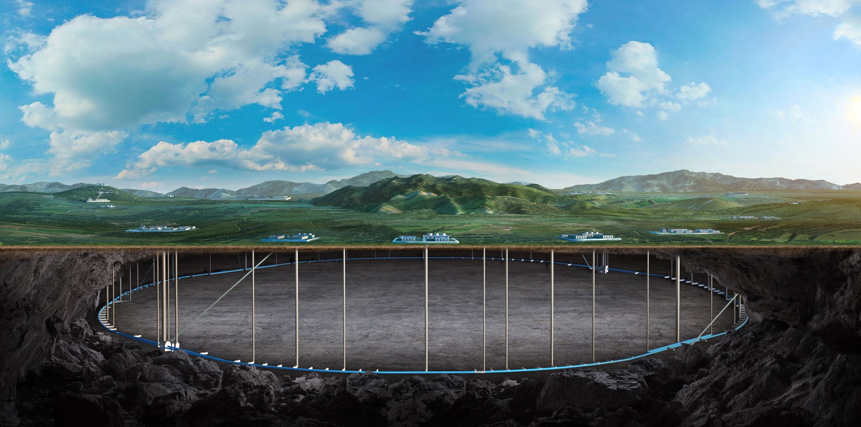


CEPC vacuum chamber production line development
Yongsheng Ma
On behalf of Vacuum group, IHEP,CAS
22th Sep, 2026
CEPC day Sep 21 2026

Slide 2
Content
Structure of vacuum chamber for CEPC collider rings
Preview of production line
Procedure of NEG coating & spraying of production line
Production line development of NEG coating/ Spraying for heating film
Prototype of Spraying heating-layser and testing results
Summary

Slide 3
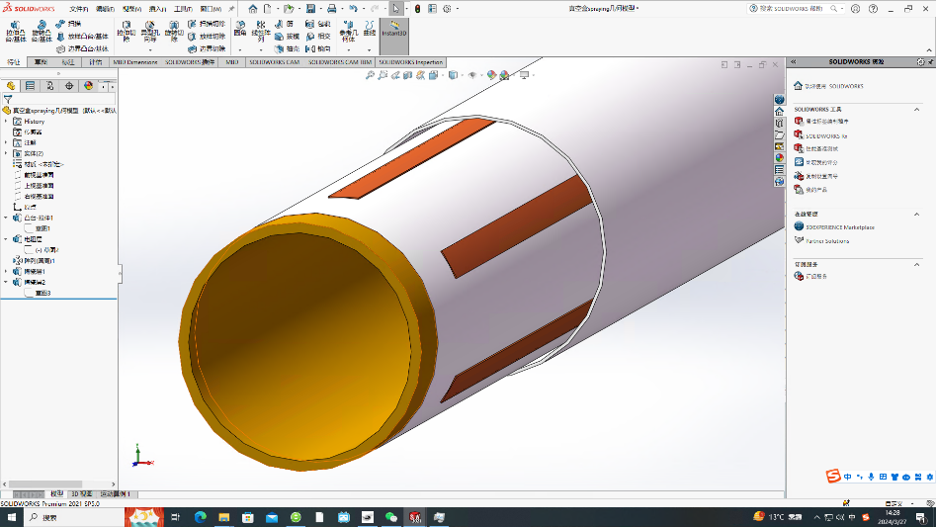
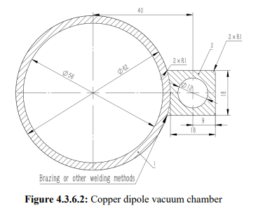
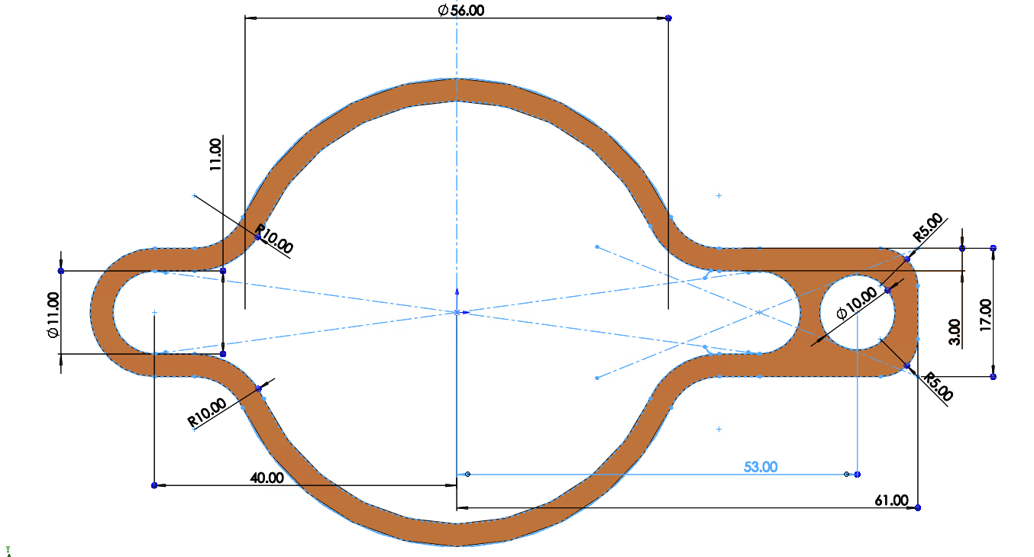
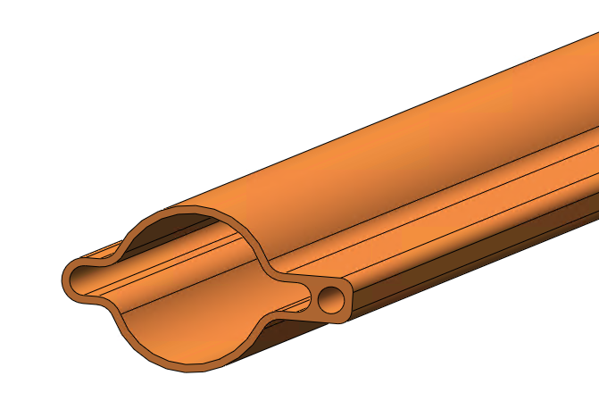
Structure of vacuum chamber for CEPC collider rings
NEG coating is employed to suppress the e-cloud and provide pumping for residual gases in both e&e+ collider rings. And activated by radiation-resistant heating layer. NEG coating and spraying will be implemented by production line.
One perfect vacuum chamber as follows:
Ceramic layer
Convection
Radiation
Heating layer
Conductivity layer
I
Alloy copper
Conduction
Ceramic layer
NEG coating
Cu/ceramic transition layer
The total length of the VC of CEPC are 190km.
Vacuum chamber
56
SR deposited on VC wall (CEPC EDR plan)
VC with photon absorber (FCC plan)
Notes:
A thorough comparison of the advantages and disadvantages of the proposed distributed approach versus
the photon stopper approach is necessary for effective management of synchrotron radiation;

Slide 4
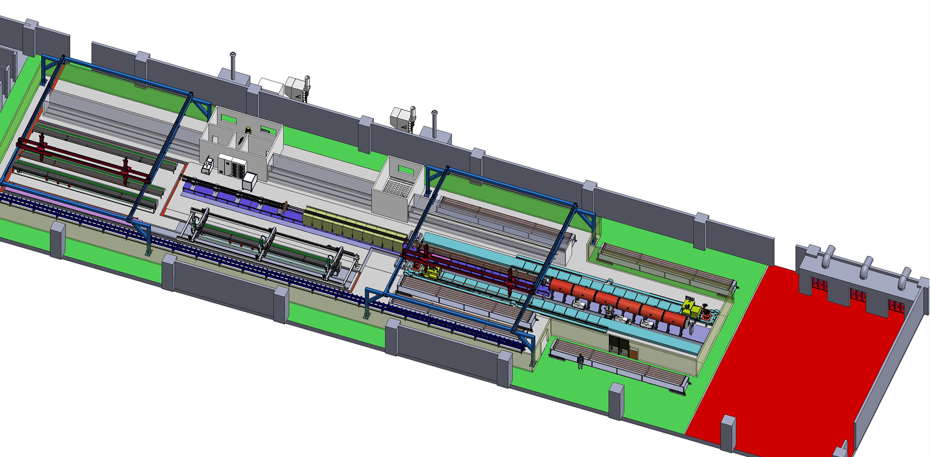
Preview of NEG coating/ Spray for heating film production line
Requirement
Due to the difference in length, two production lines will be used to complete the production of vacuum chambers for the CEPC collider. The quantity of NEG coating and spraying facilities for the two lines varies to match the production speed.
The full quantity of vacuum chambers for the collider will be manufactured within five years, utilizing two production lines operating at a combined capacity of 4,500 units per year.
Advantages
More stable process, less manpower, less NEG coating facility, more adaptive capacity in production, etc.
Heating layer spraying
Items | Specifications
Dimension | L 11400-d56-D62
Weight | 50~100kg
NEG coating | Thickness：200nm±30% SEY<1.1 S、Q、life-times
Spraying heating | Thickness<0.5mm Heating temperature <300℃
Cleaning (not include)
NEG coating

Slide 5
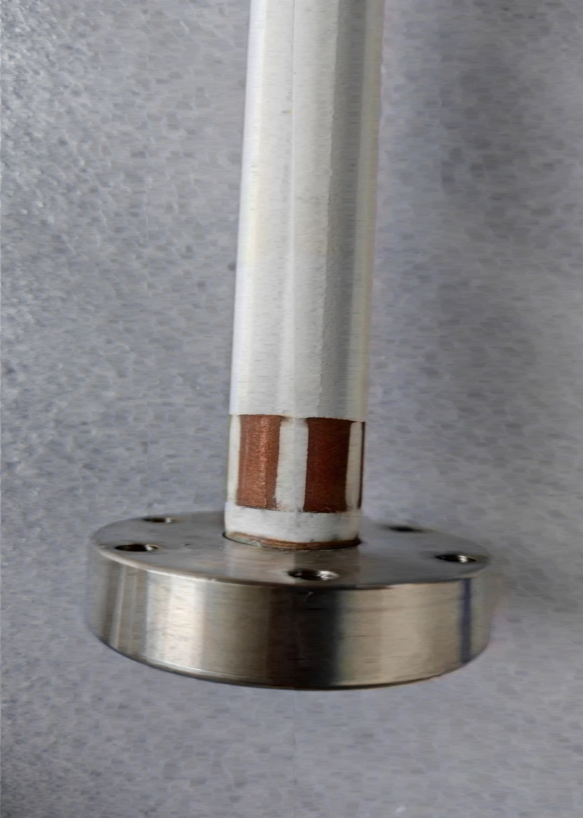
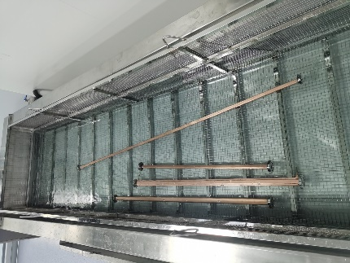
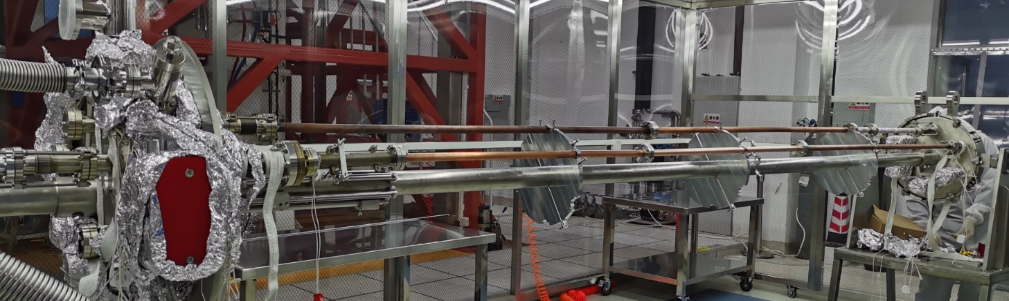
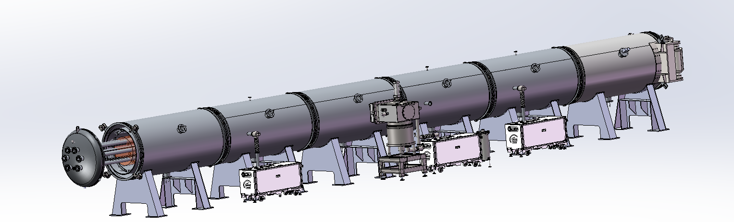
Procedure of NEG coating & spraying of production line
Spraying (Air plasma spraying)
Sandblasting
Spraying_Isolation_layer
Spraying_Conductivity-layer
Spraying_Isolation-layer
Spraying_Contactor-layer
Cleaning
Outside
Inside
NEG coating
vacuum chambers, cathodes assembling by mechanical arms (flanges sealing).
Leakage testing.
Deliver the assembles to vacuum oven/ baking/ NEG coating;
Disassembly the vacuum chambers
Function | Materials | Thichness/um
Transition-layer | MCrAlY alloy | 50~100
Isolation-layer | Al2O3 cermic | ~200
Conductivity-layer | NiCr alloy | 50~100
Isolation-layer | Al2O3 cermic | ~200
Contactor-layer | Copper | ~50
Notes:
Atmosphere plasma spray

Slide 6
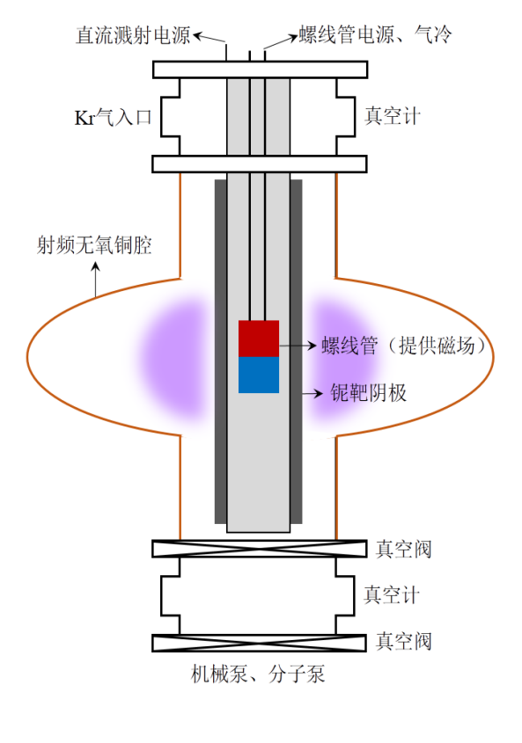
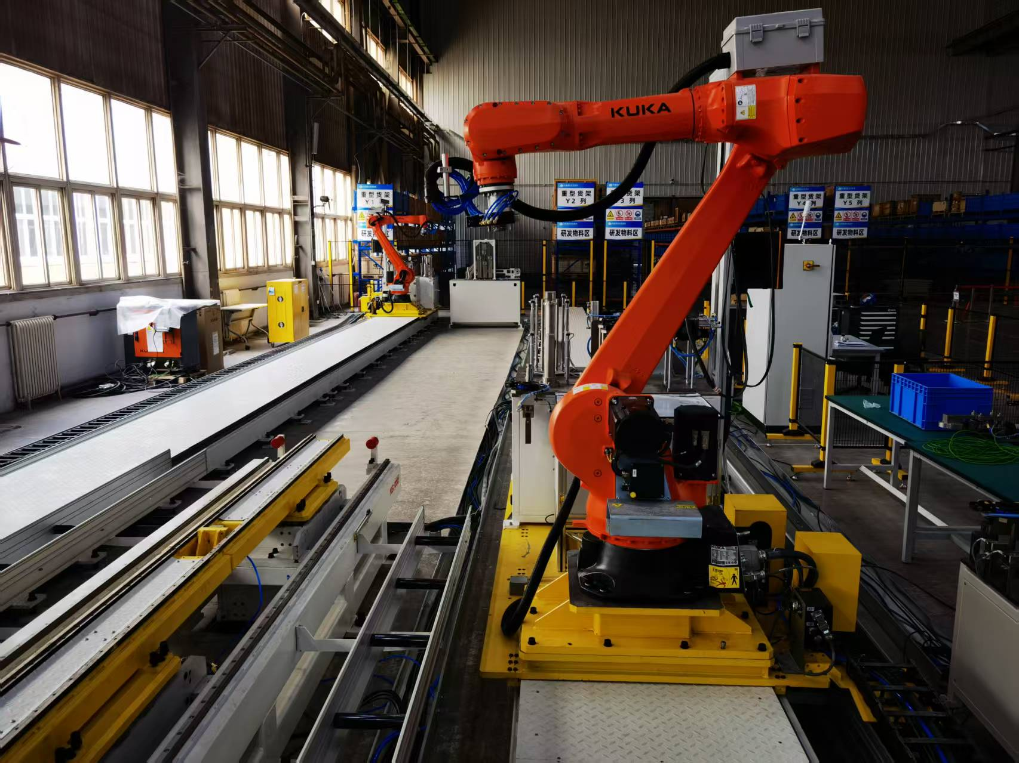
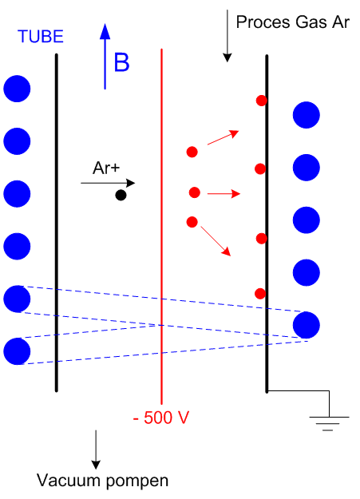
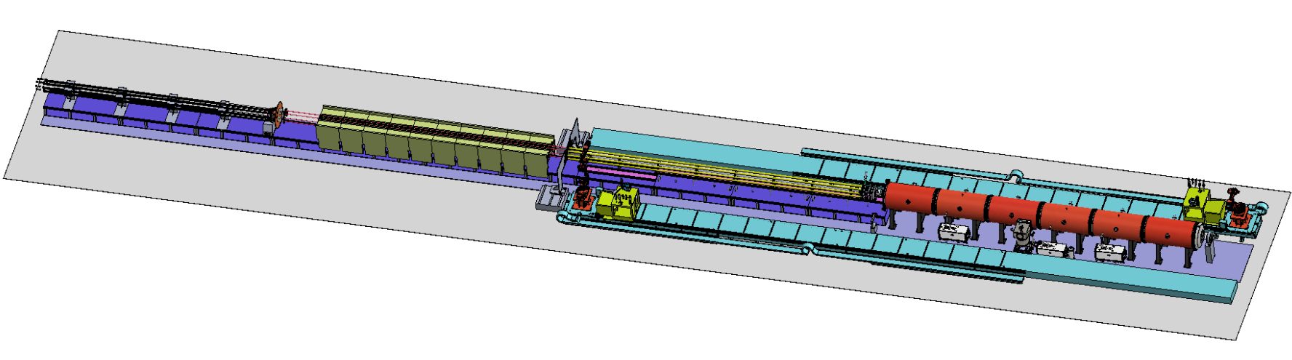
Layout & composition of NEG coating facility
NEG coating, VC assembly and disassembly with automatic robot arms.
DCMS for NEG coating
Kr+
磁环
Magnet (coating) driven
Inside magnet
Cathodes
VC assembly
Vacuum oven

Slide 7
Process of NEG coating
STAGE | MAIN OPERATIONS | PROCESS TARGET / RELEASE GATE | TIME(h)
01 Assembly & leak testing | Assemble vacuum chambers and perform the first helium leak test. Load into furnace, connect an other chamber and repeat the leak test. | Both helium leak tests pass Leak-rate limit: TBD | 8*
02 Pump-down & bakeout | Coolant on. Rough-pump, then start the turbopump. Bake for 48 h after the workpiece reaches T_bake. | Turbo start: ≤ 5 Pa* Bake start: ≤ 5 × 10⁻⁴ Pa* | 50
03 Base-vacuum qualification | Cool to 100 °C. Enable the ion pump within its limits. Hold at 100 °C for 4 h with continuous pumping. | ≤ 5 × 10⁻⁷ Pa at 120 °C Valid gauge and stable reading | 4.5*
04 Gas & pressure stabilization | Ion pump OFF and isolated. Keep substrate at 100 °C. Set MFC flow and throttle the turbopump inlet. | 0.5–2 sccm and ~1 Pa Stable for ≥ 5 min | 0.5
05 Magnetron sputtering | Soft-start magnetron power and scan the magnetic ring. Deposit to a validated time / scan-pass recipe. | 10–50 A and 0.1–0.2 m/min 100 °C and ~1 Pa | 5*
06 Cool, vent & unload | Stop power, gas and heating. Pump while cooling. At room temperature, isolate pumps and backfill with N₂. | Equalize both vacuum spaces to local atmosphere, then unload | 4*
*The time needs to be experimentally determined and verified, the total NEG coating time for one stack is about 72 hours.
01 Assembly & leak testing is the most tough work, the robots will save 2 workdays and 2~3 workers

Slide 8
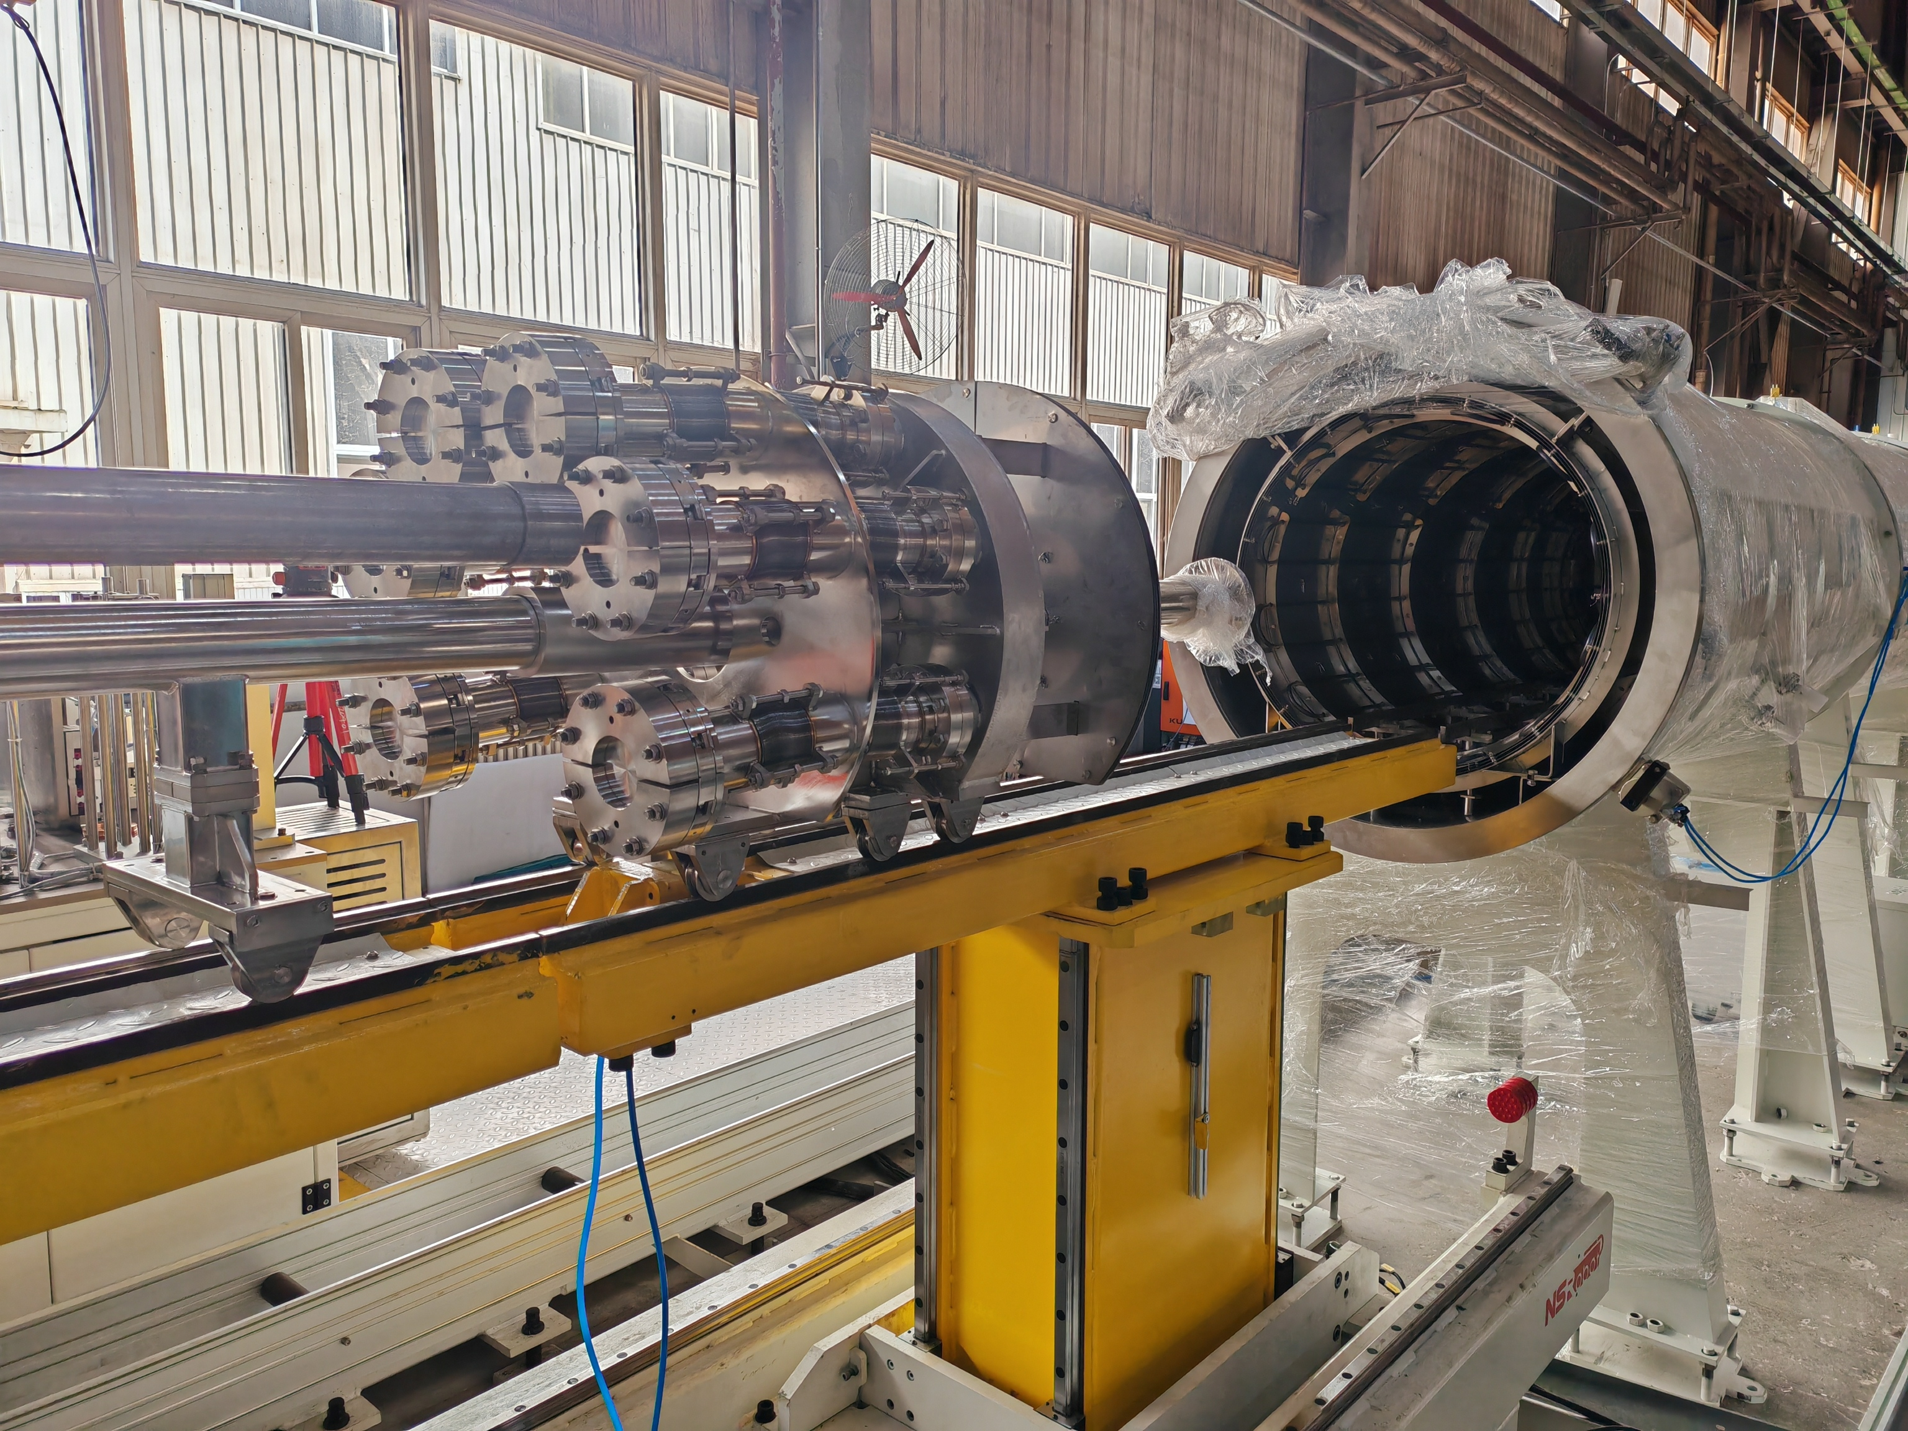
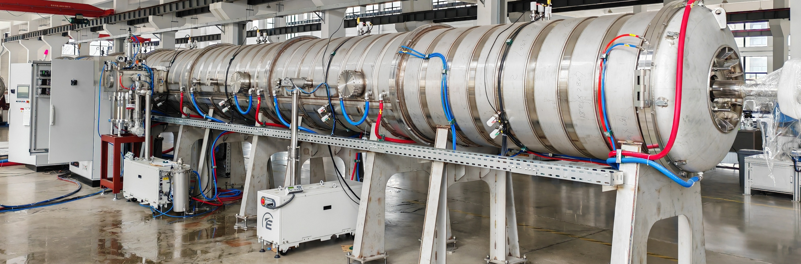
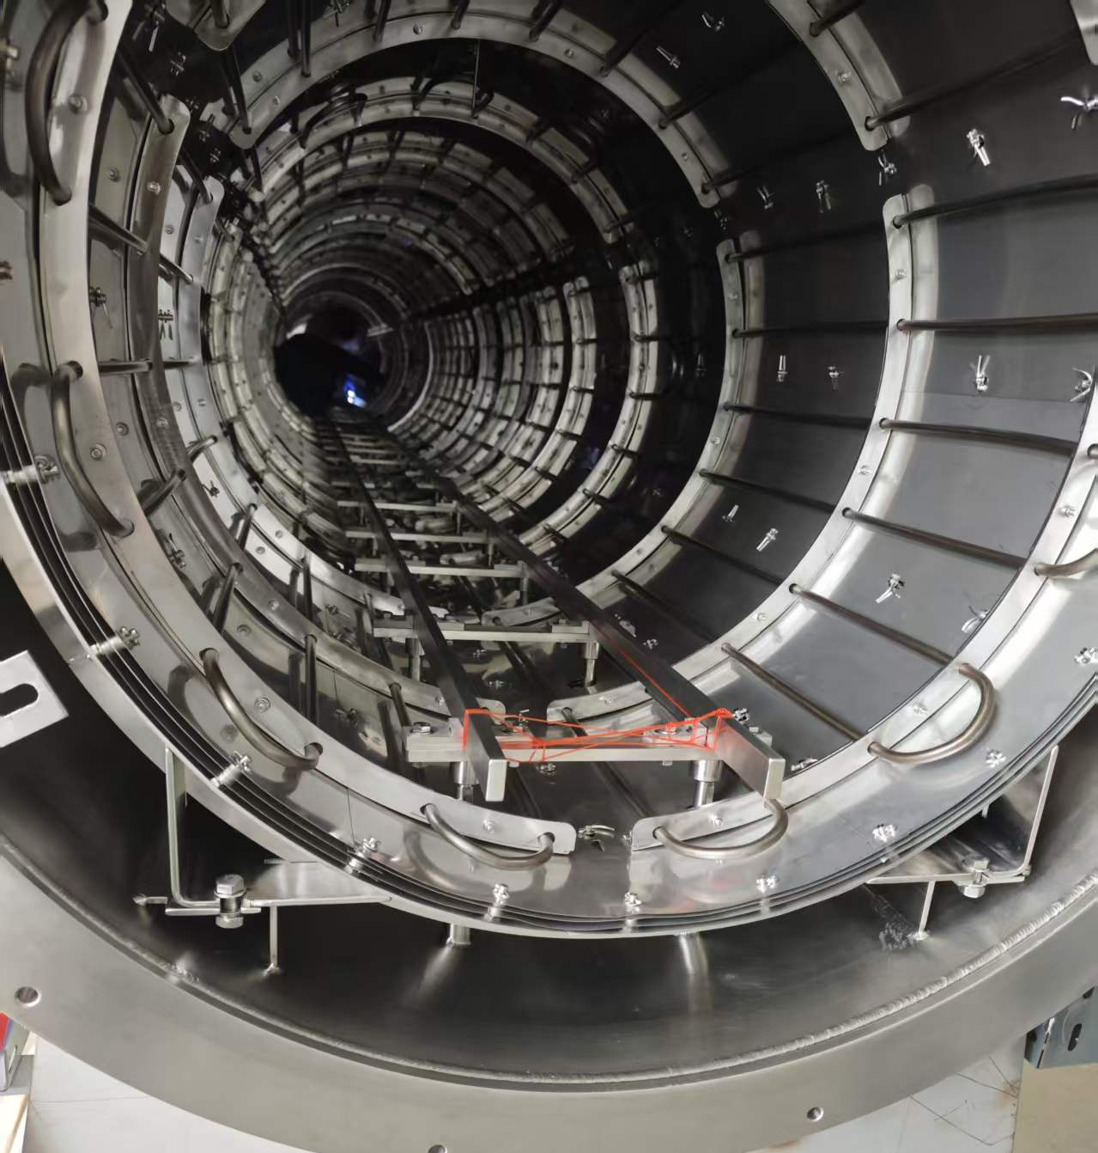
Vacuum furnace for NEG coating
The NEG coating vacuum system is divided into two parts:
High vacuum and low vacuum. The high-vacuum part provides an ultraclean environment with an ultra-low gas-impurity background for NEG coating. The low-vacuum part is created by a vacuum furnace. While the furnace provides baking for the NEG coating, it also keeps the flanges at both ends of the vacuum box—flanges that need to be repeatedly disassembled—in a low-vacuum environment. The interior of the vacuum box remains under high vacuum, thereby reducing the sealing requirements for these flanges and more friendly for robots assembly.
High vacuum in vacuum chambers
5×10⁻⁷ Pa
Vacuum furnace
Low vacuum in vacuum furnace
5×10⁻² Pa

Slide 9
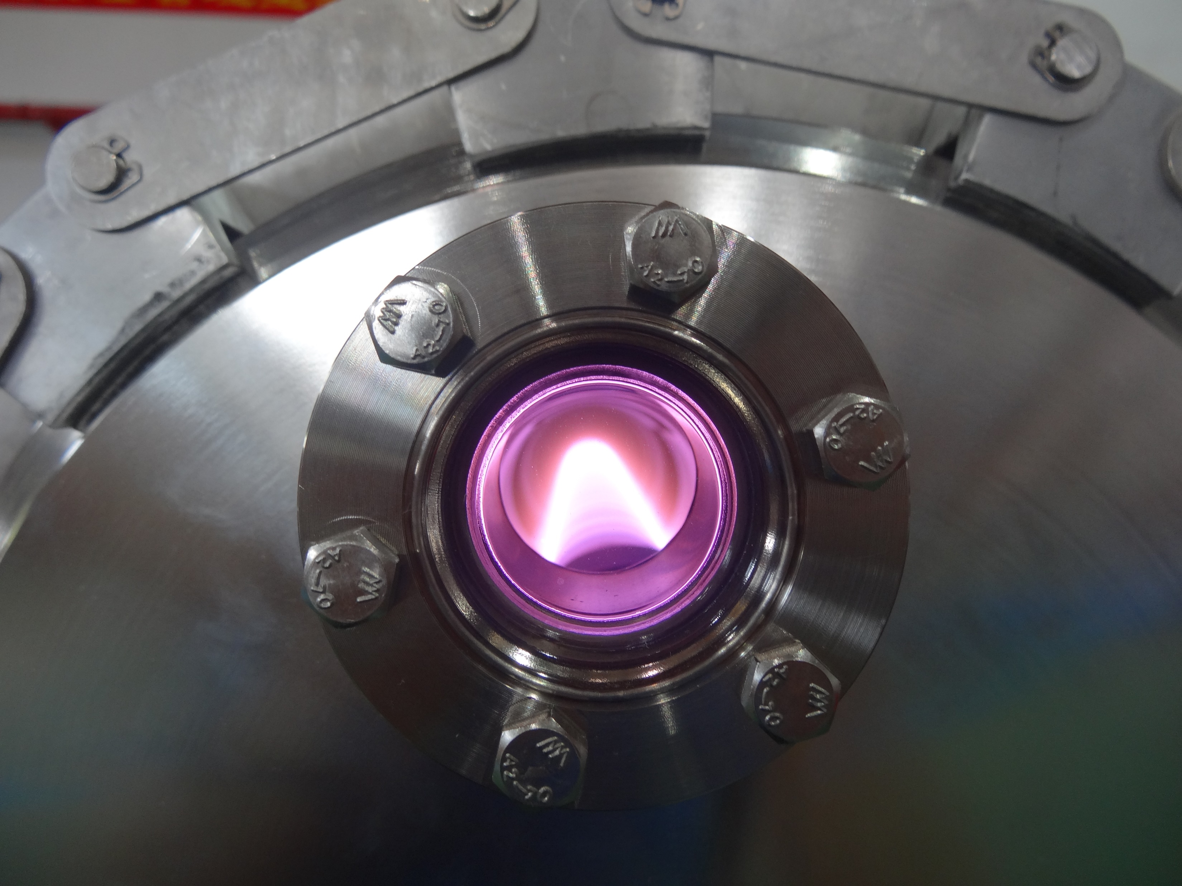
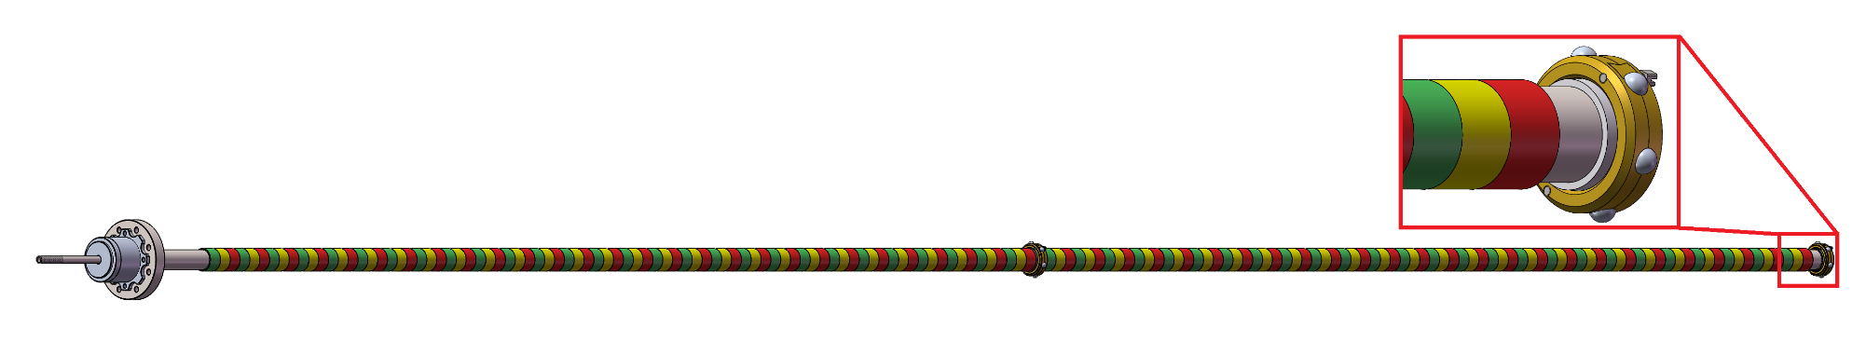
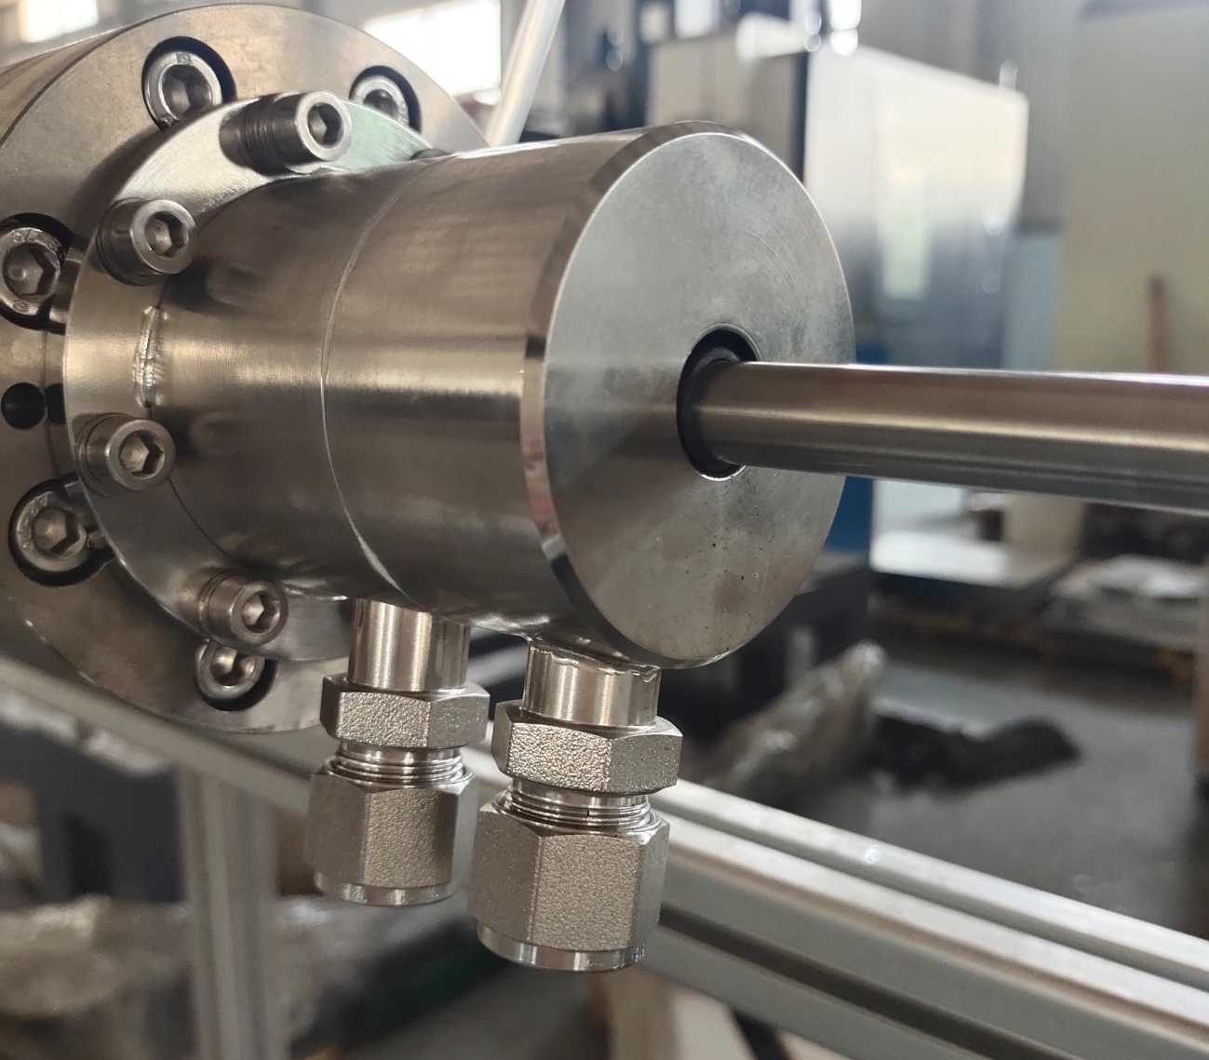
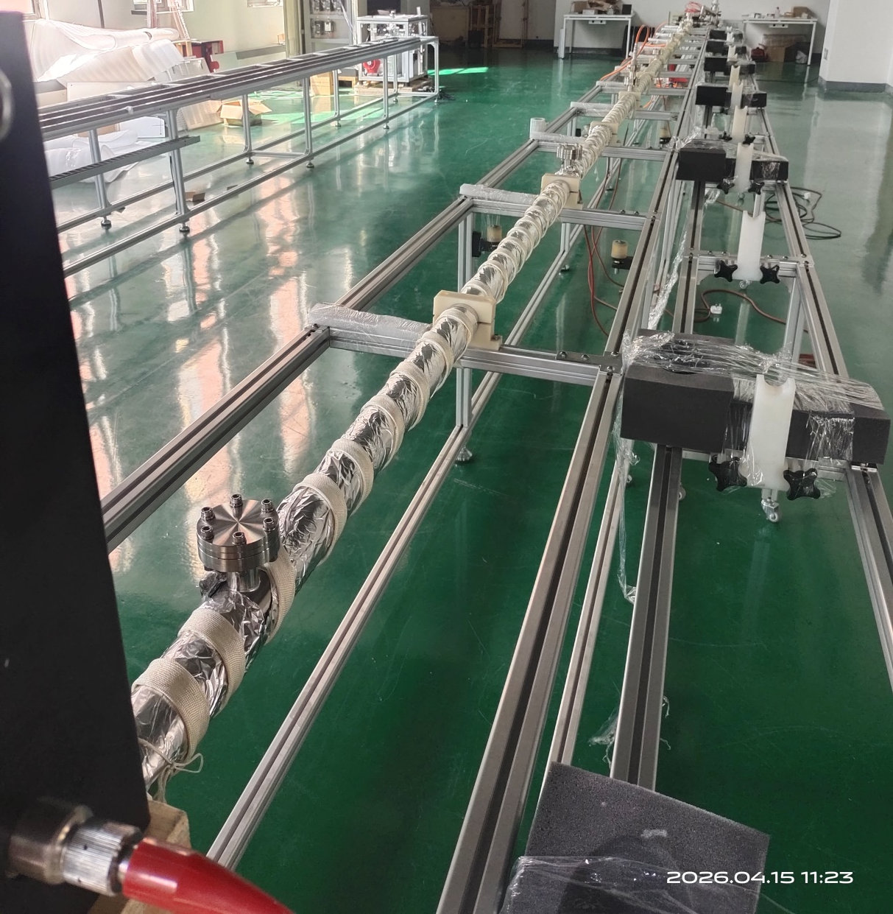
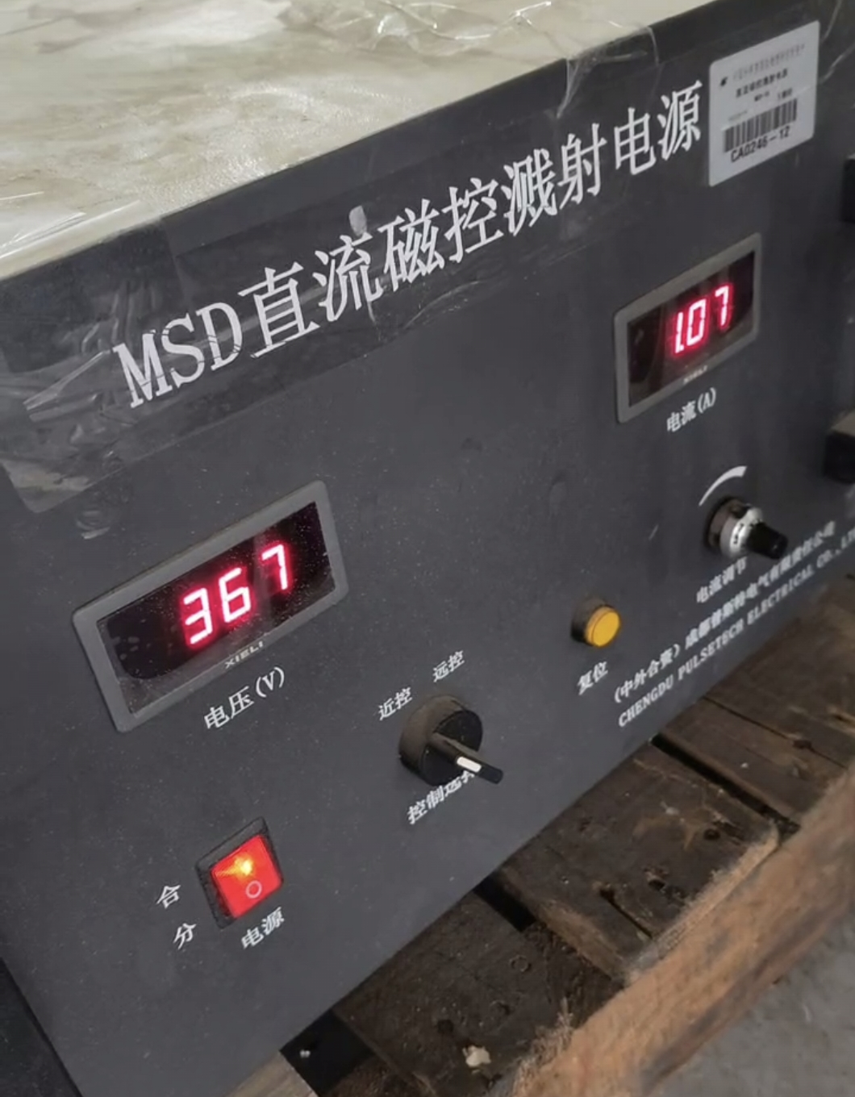
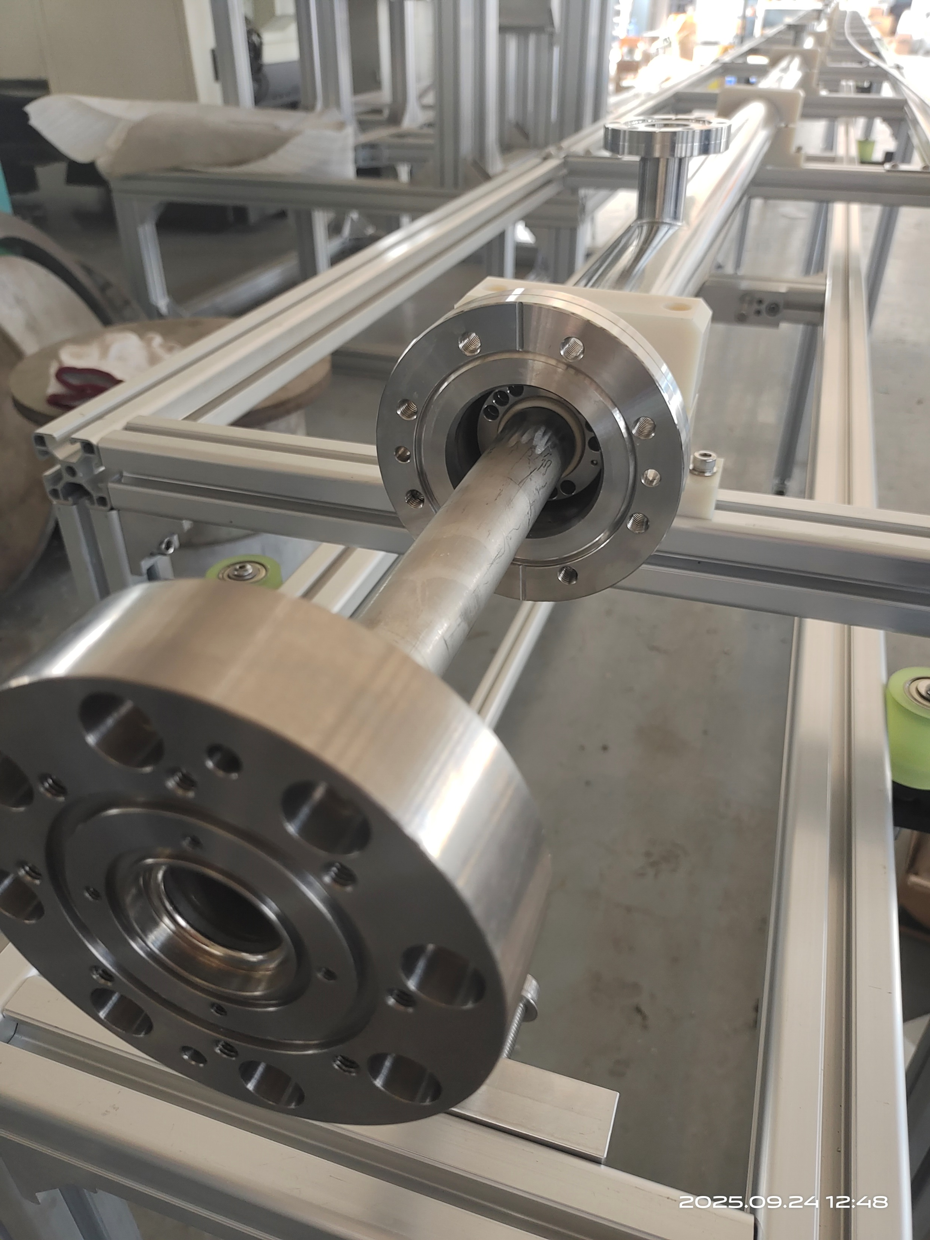
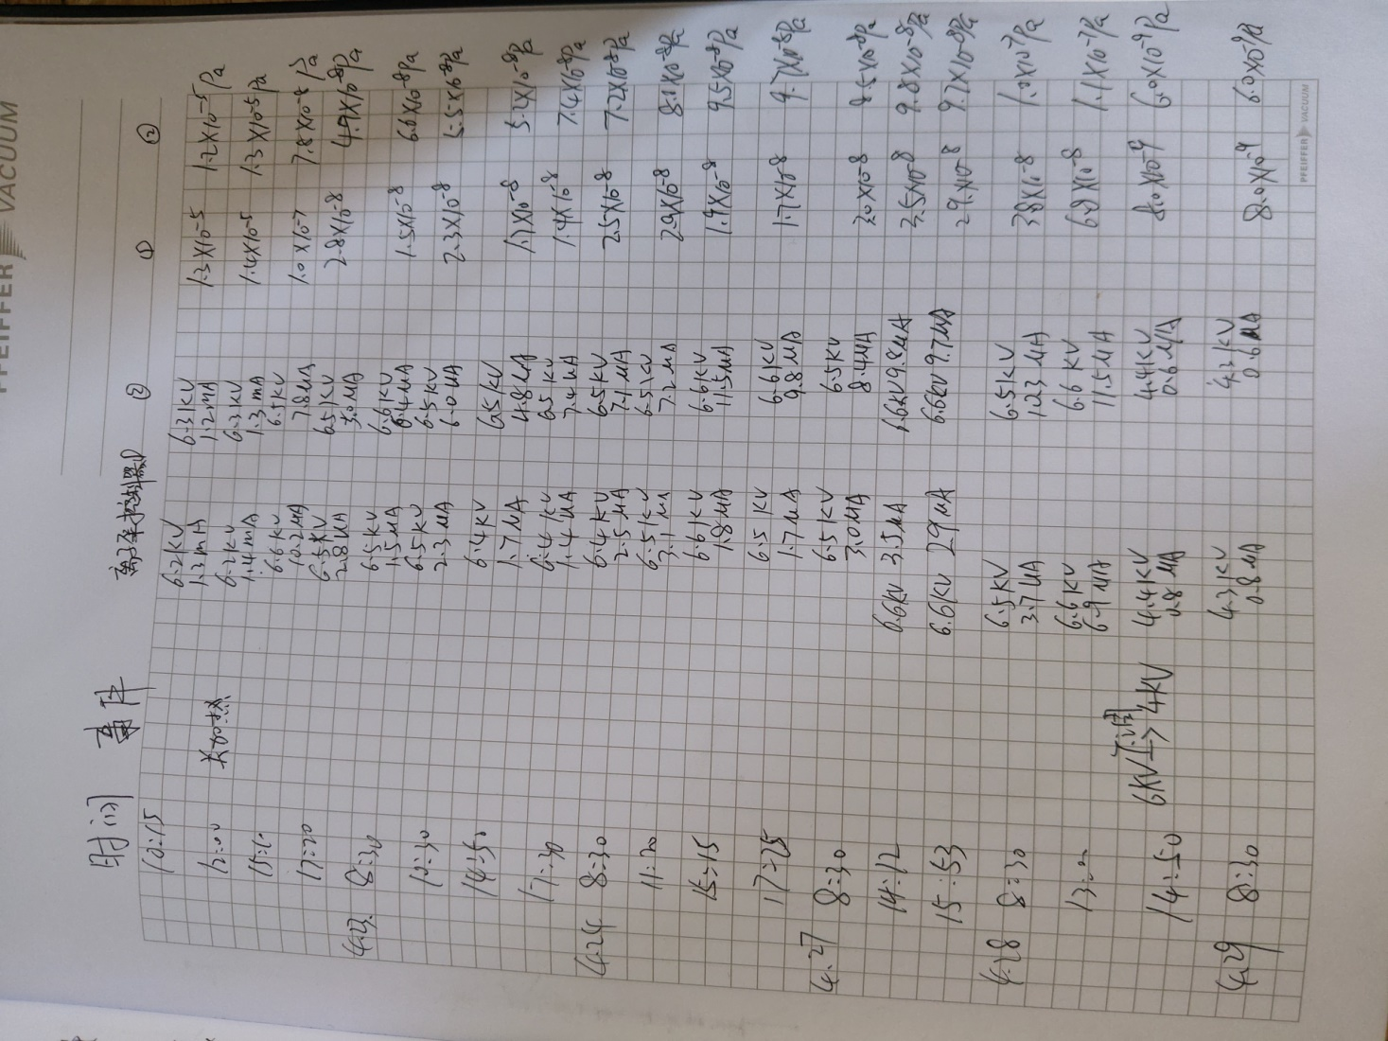
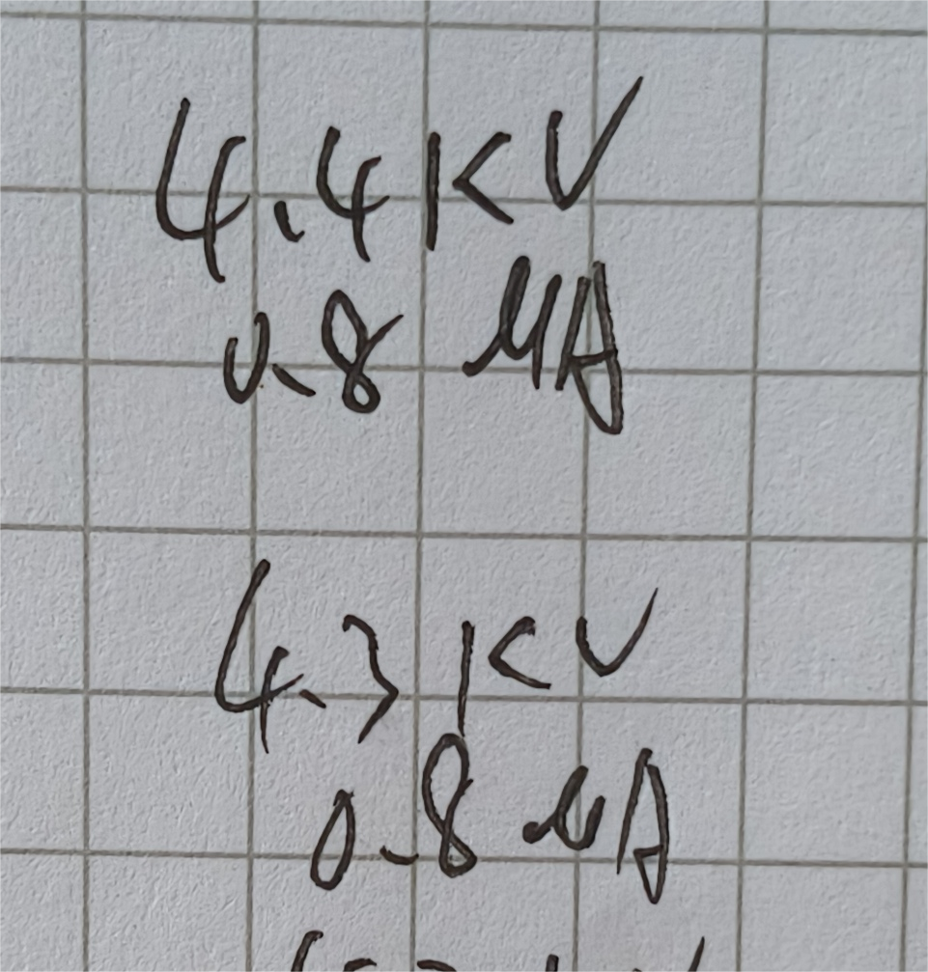
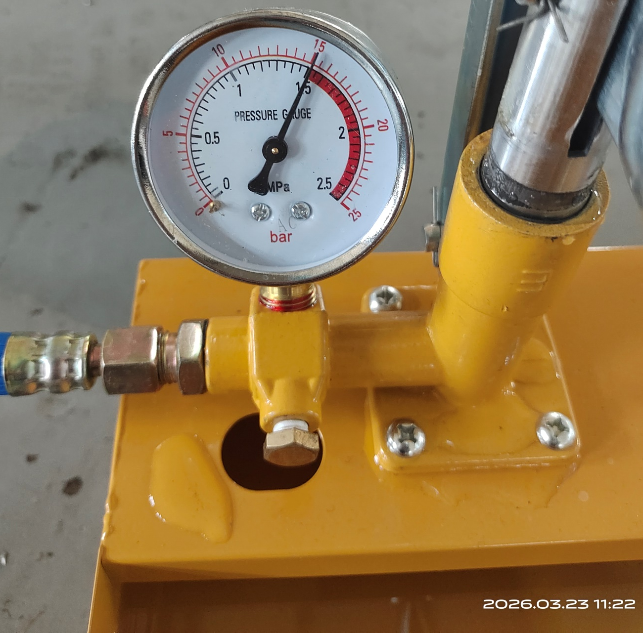
DCMS for massive NEG coating
DCMS （direct current magnetron sputtering）for NEG coating
Several magnets will move automatically to control the plasma discharge, thereby controlling the NEG coating area and thickness on the wall of vacuum chamber
Kr+
磁环
~12000mm(12 meters)
Magnetron Cathode vacuum chamber
Inside magnet
DCMS for NEG coating
9

Slide 10
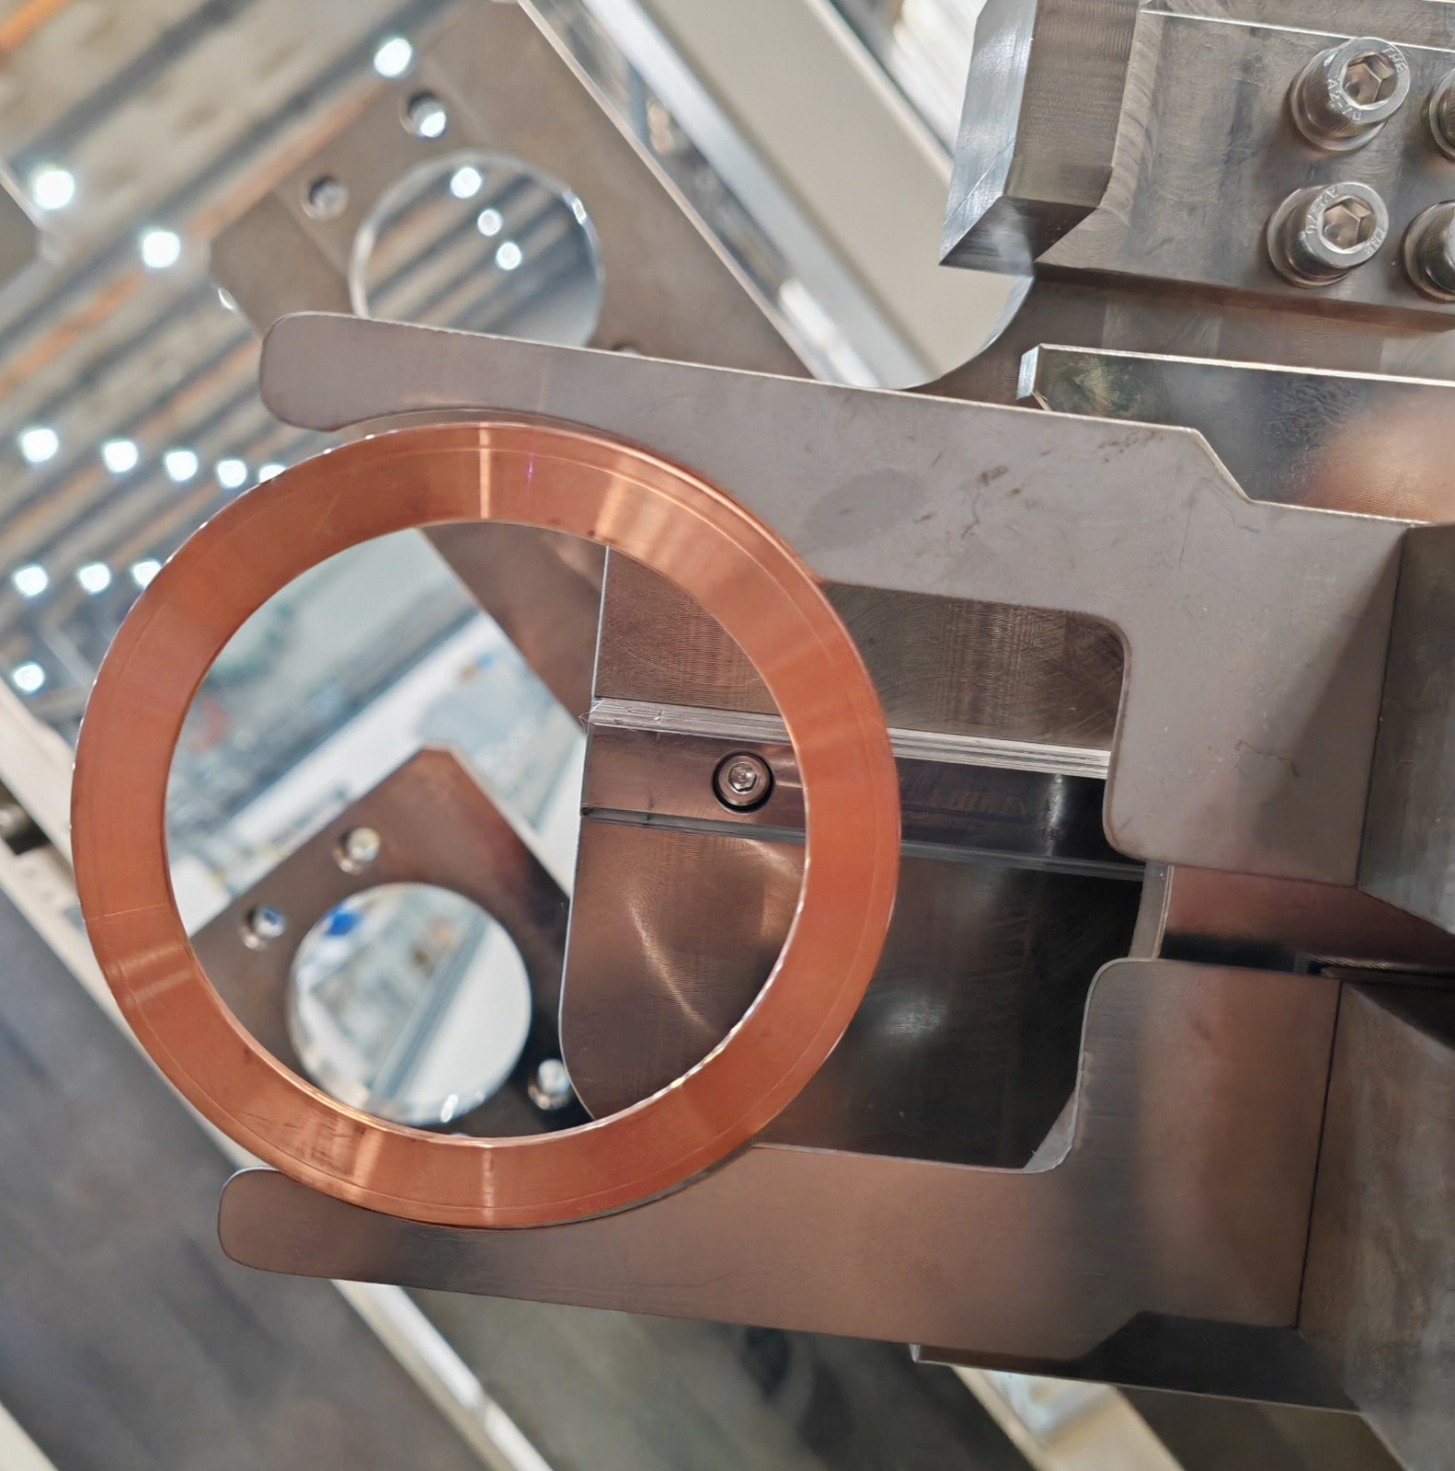
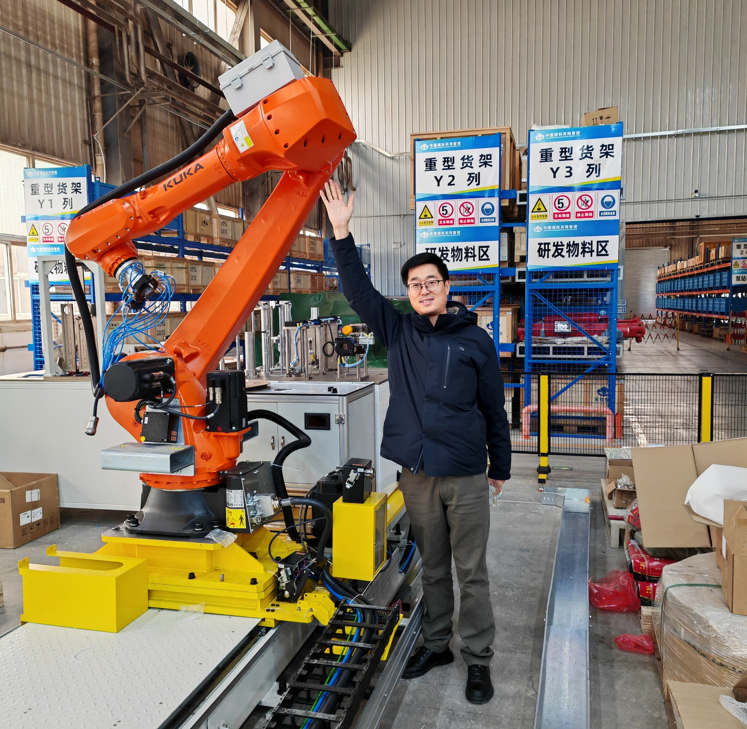
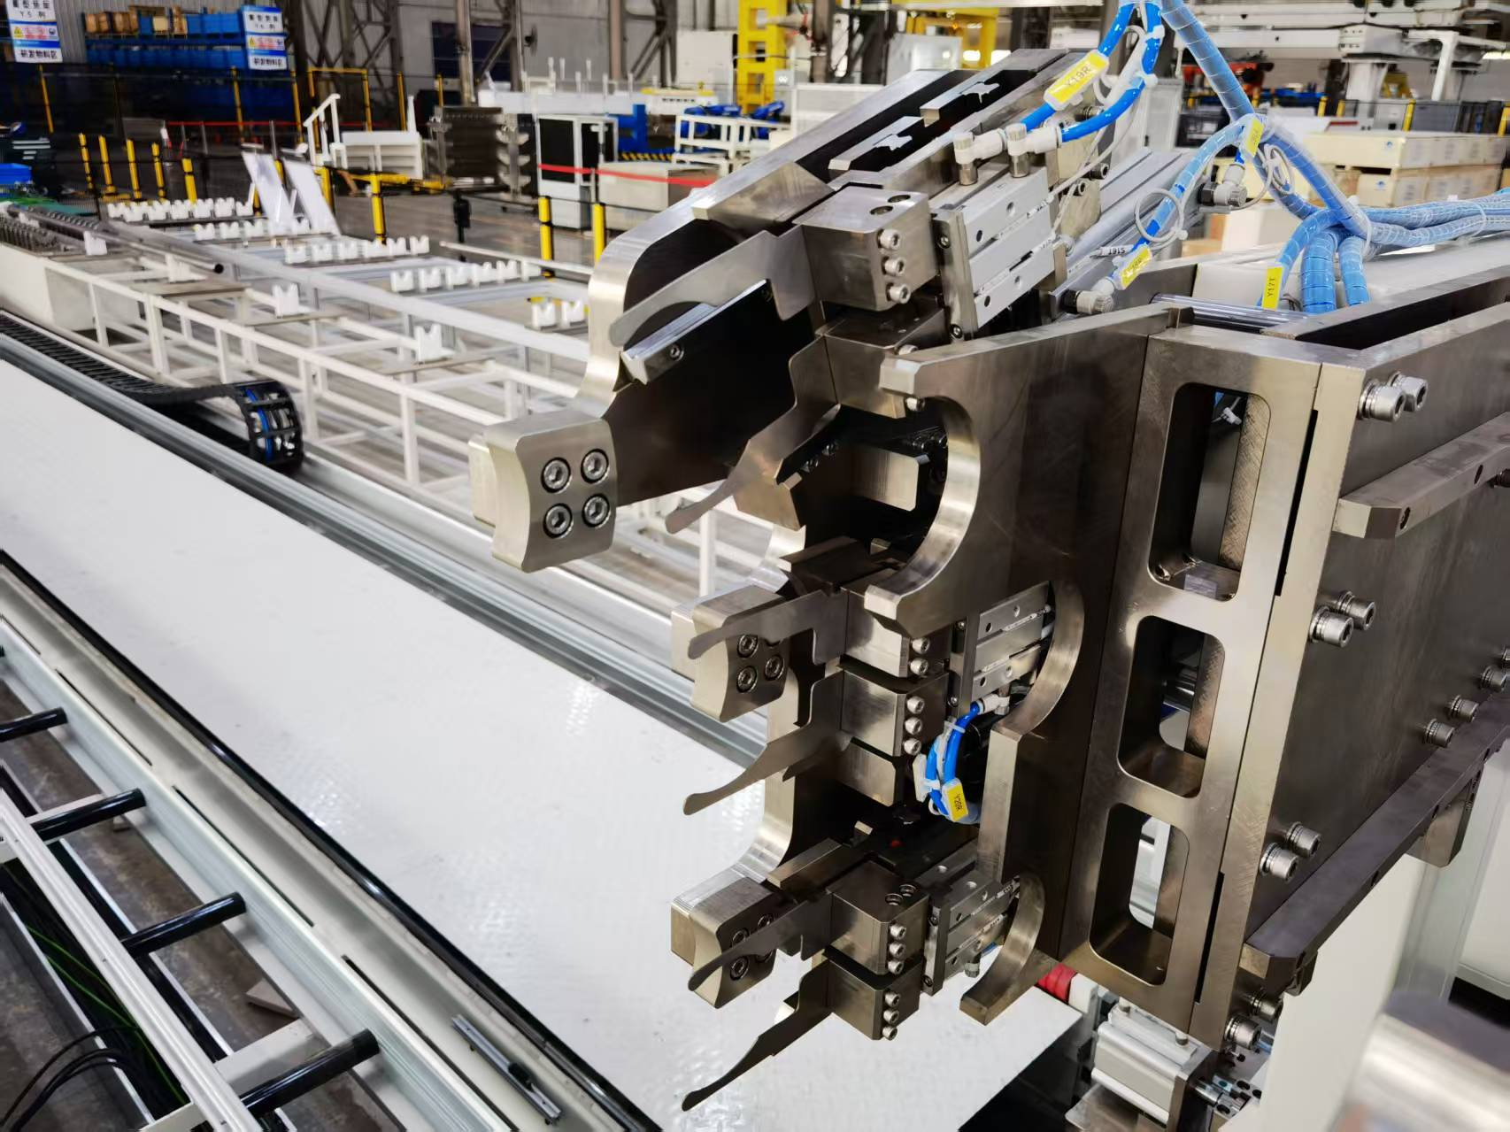
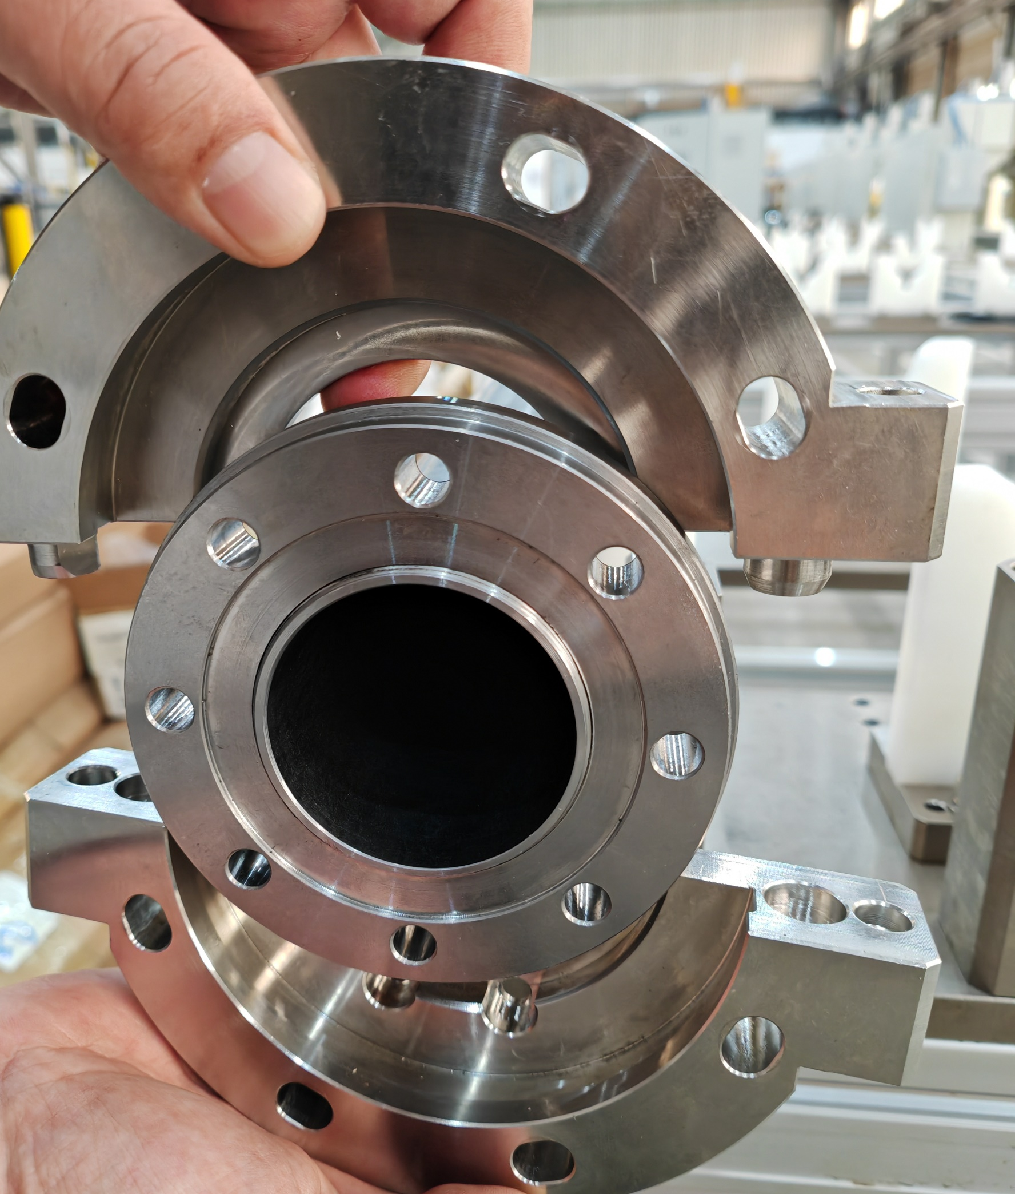
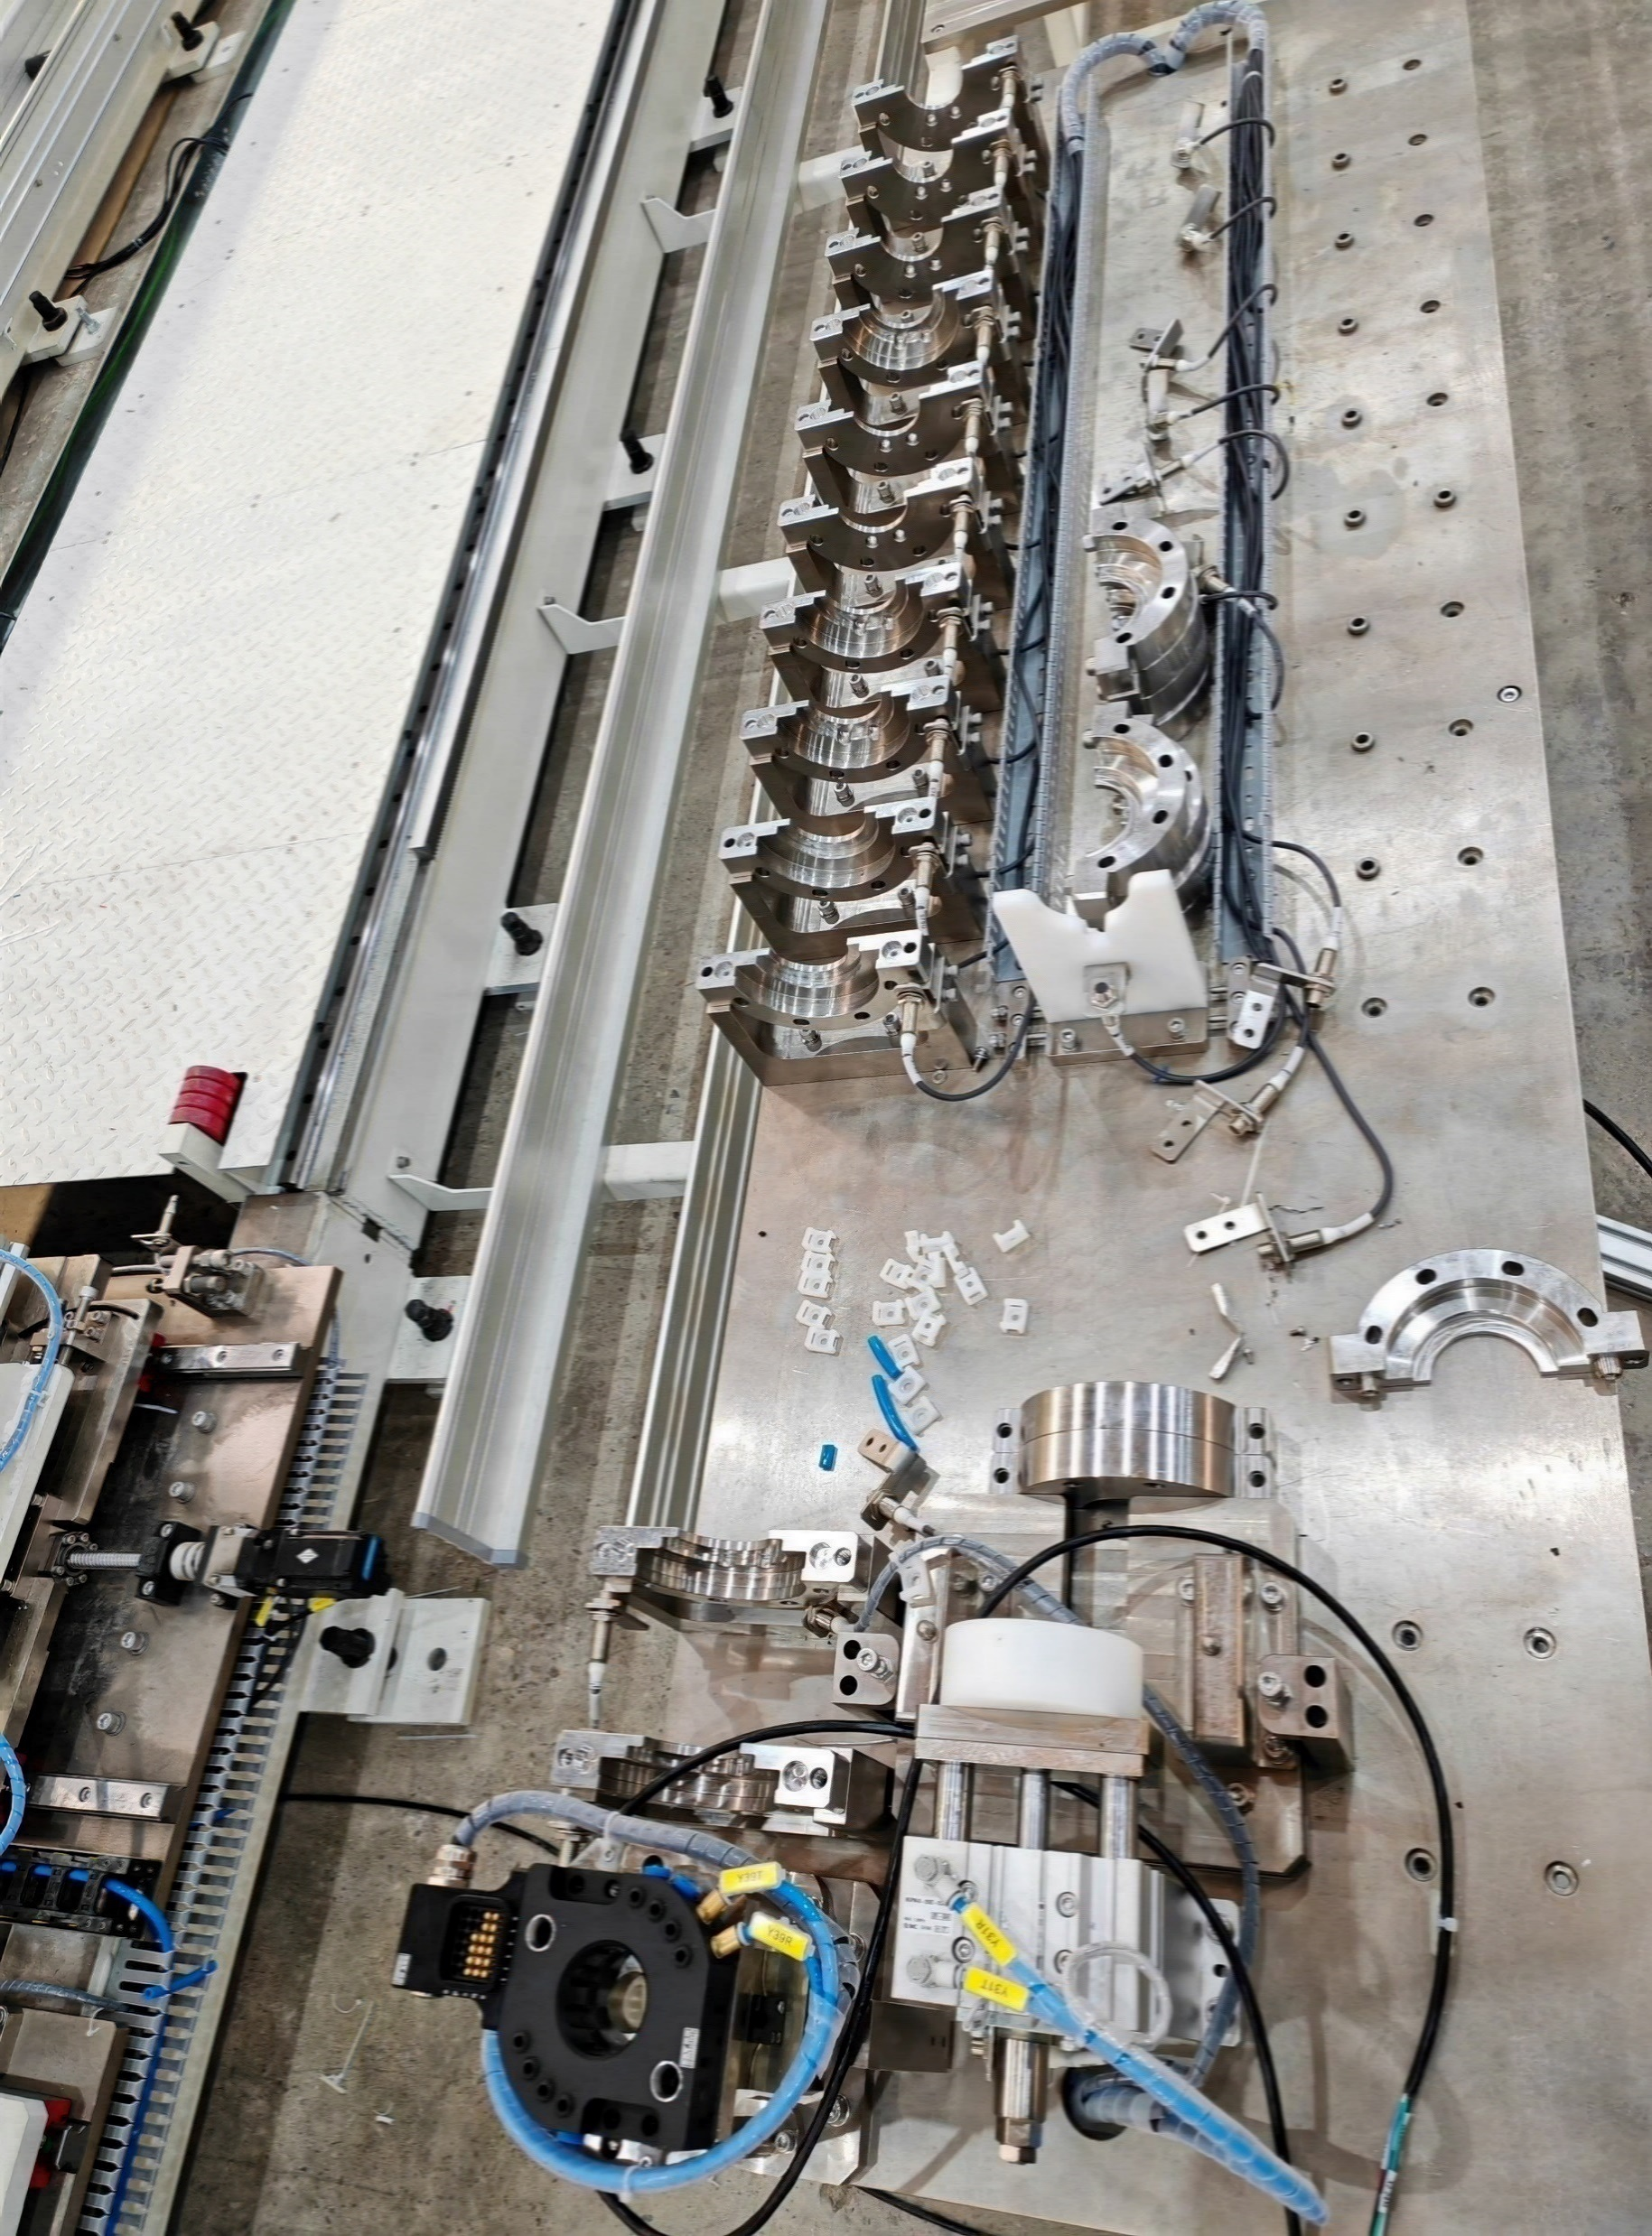
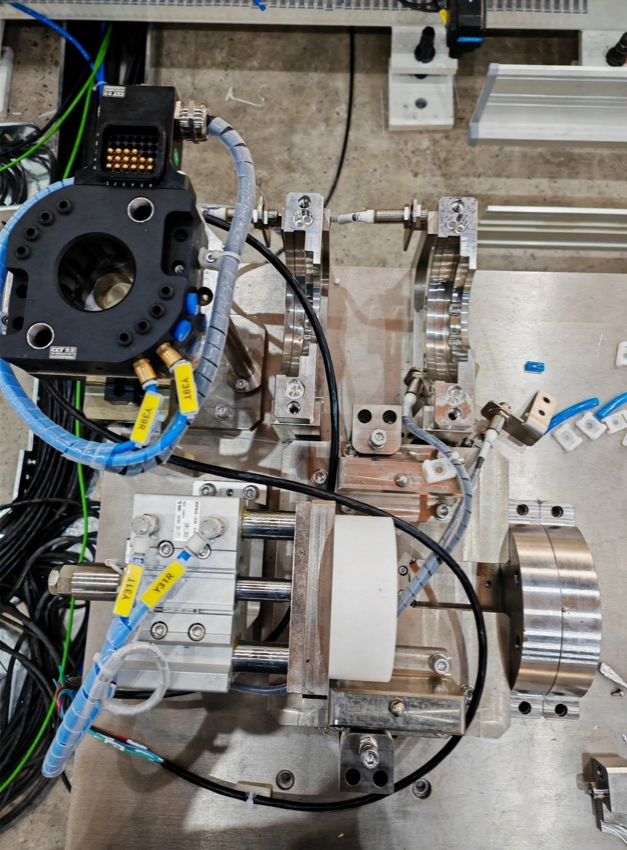
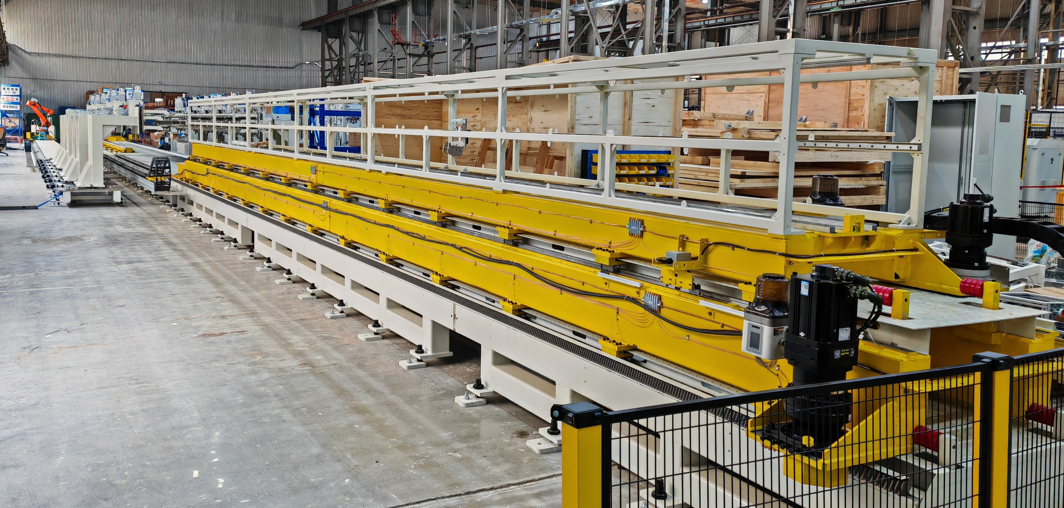
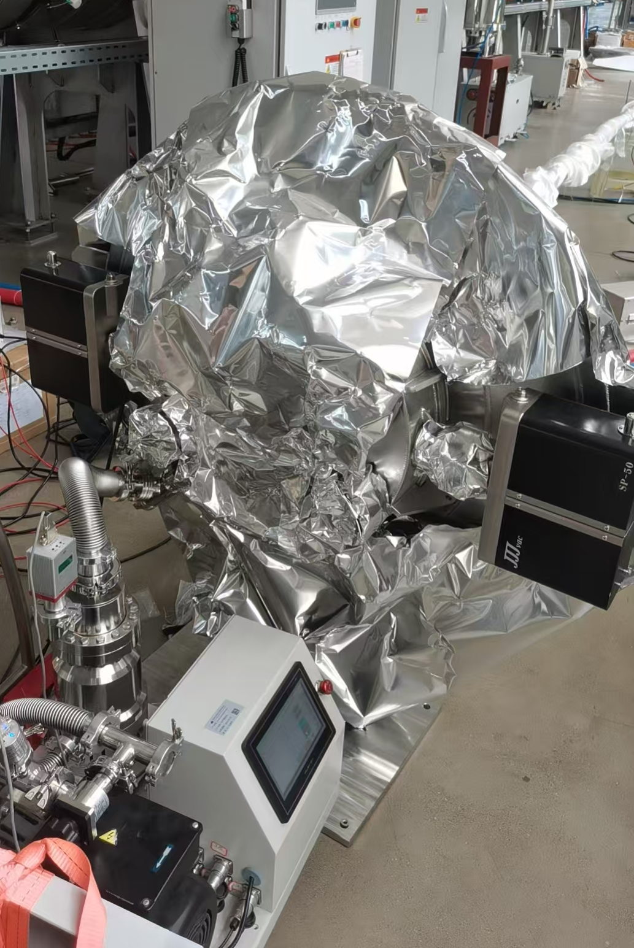

Layout & composition of NEG coating facility
The assembly of the vacuum chamber to the NEG coating system, as well as its preparation, is tough work that will be taken over by robots.

Slide 11
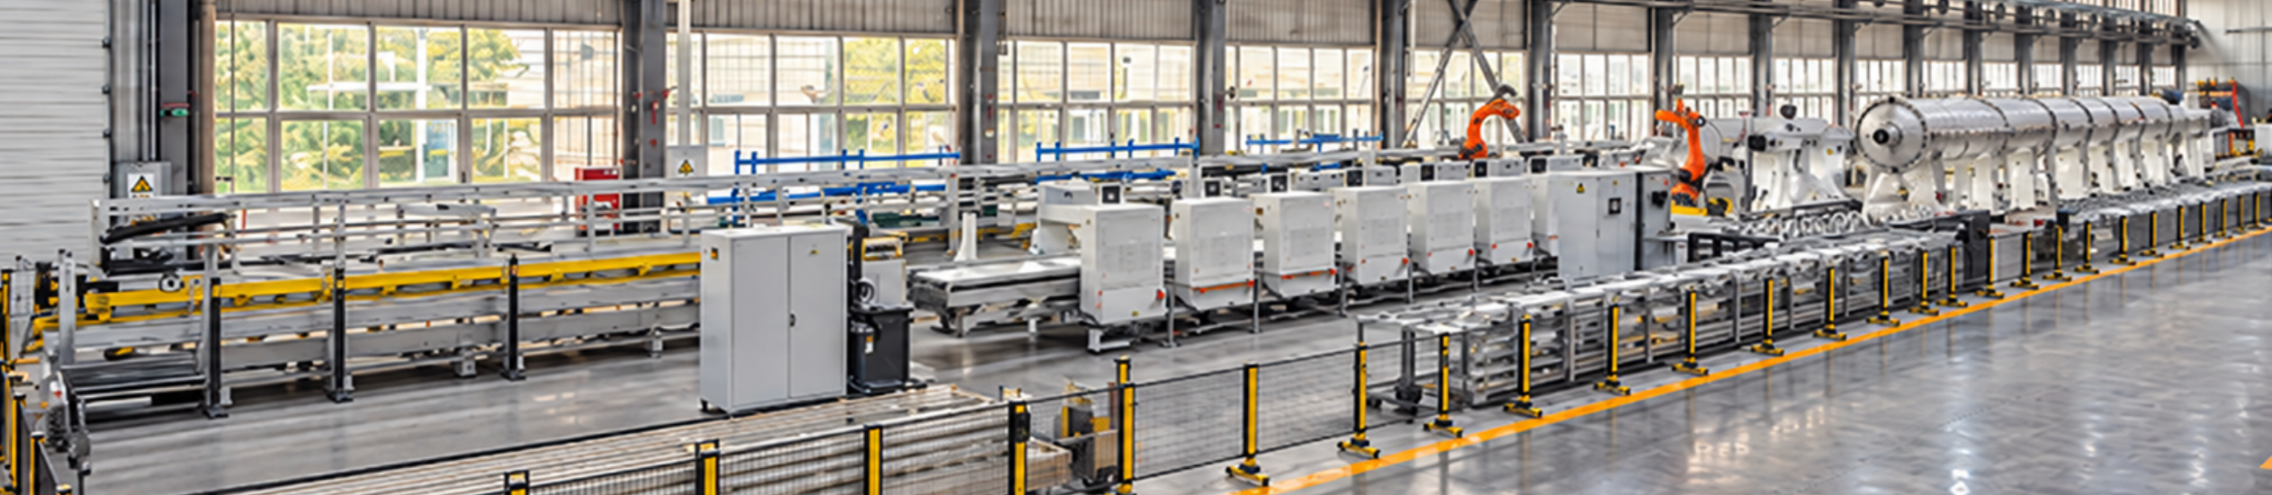
Layout & composition of NEG coating facility
The part of NEG coating facility has being installed and conditioning in factory.
*The picture revised by AI

Slide 12
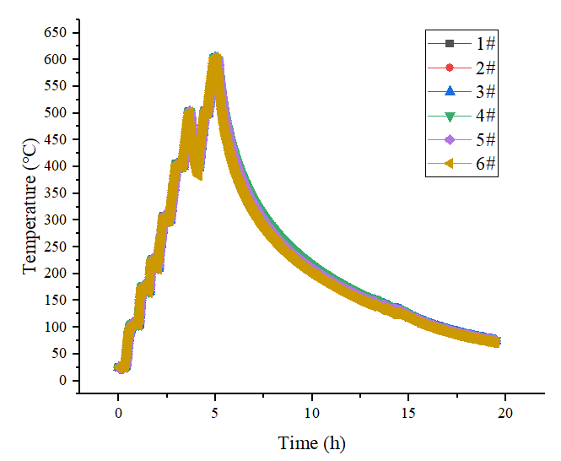
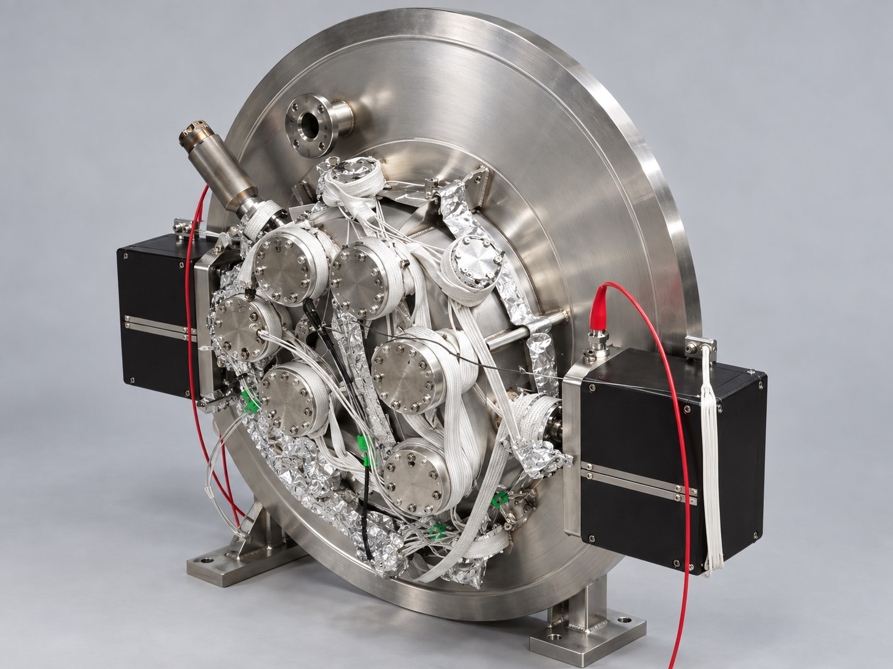
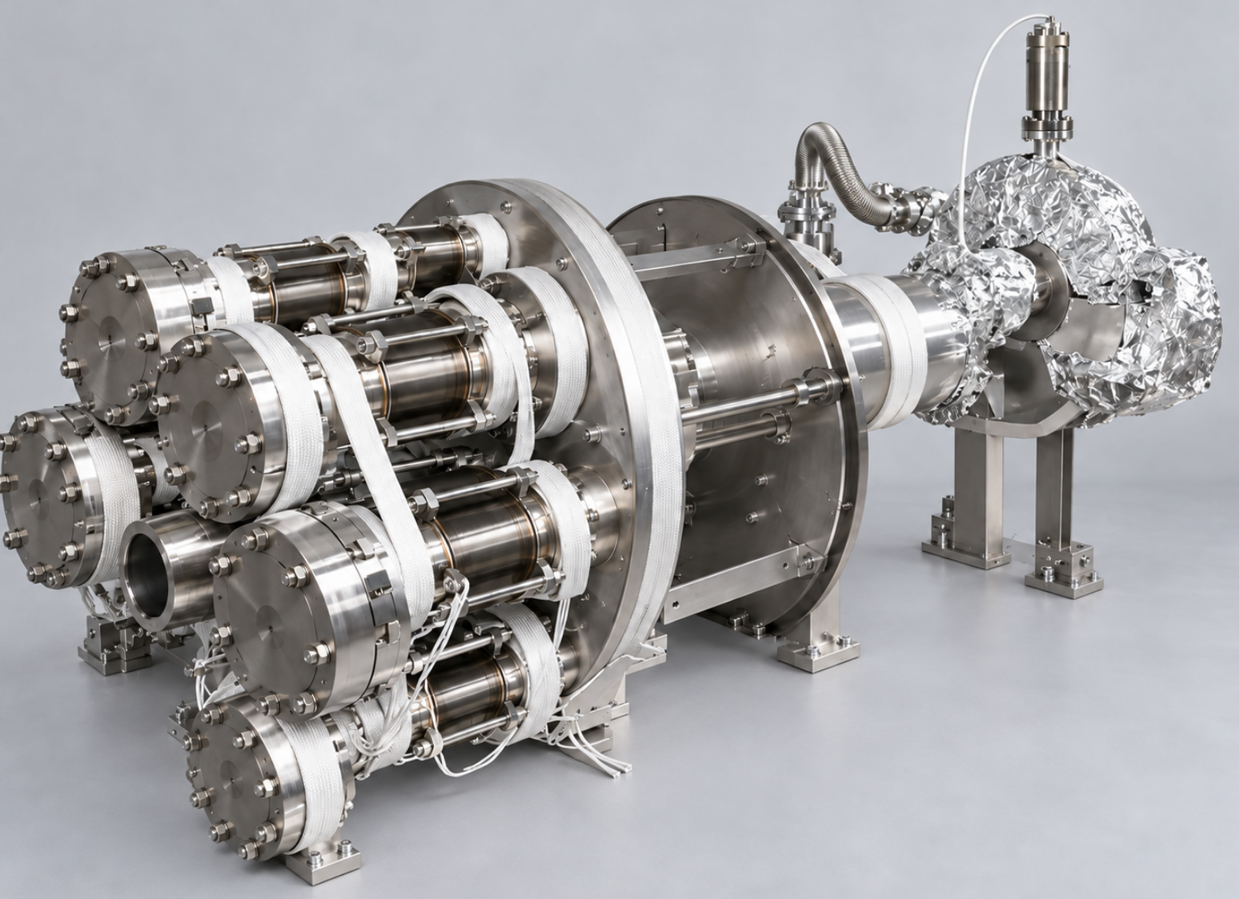
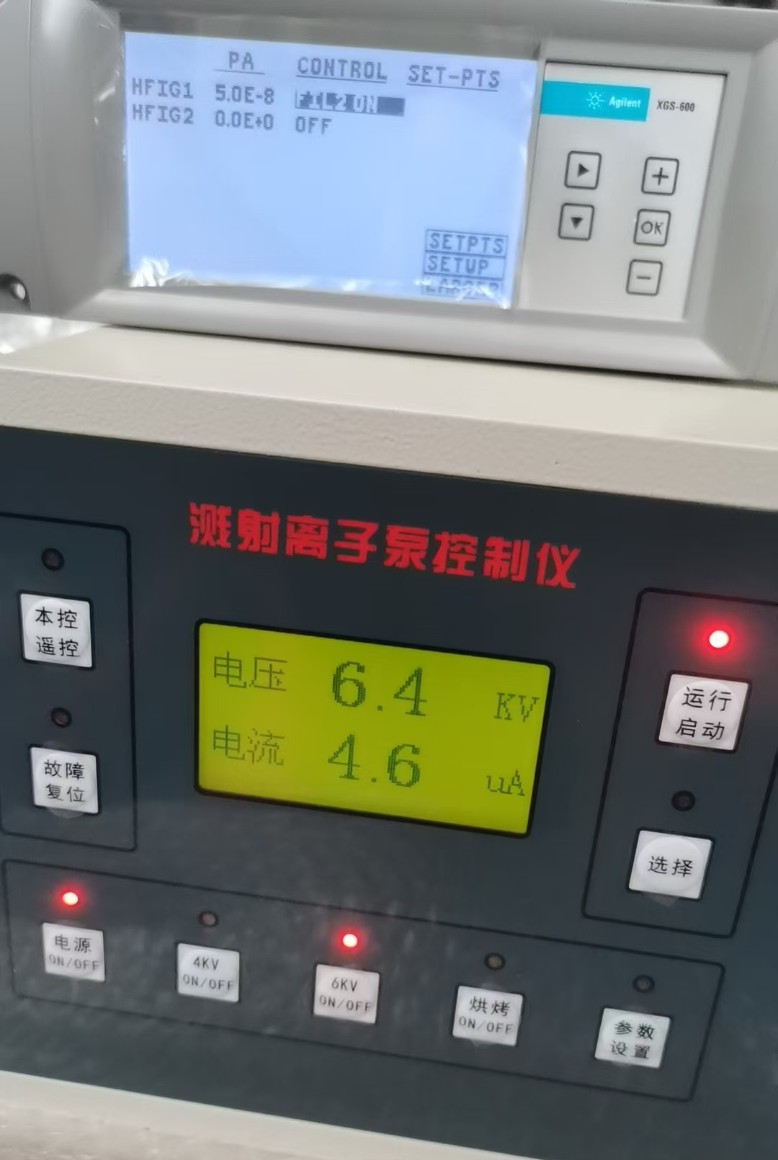
Sub-devices conditioning and testing
Vacuum furnace baking temperature reaches to 600℃ and the vacuum of NEG coating chamber reaches to 5×10⁻⁸Pa, these conditions can provide a good vacuum background for NEG coating.
Vacuum furnace
Assembly chamber for NEG coating

Slide 13
Flange assemble & sealing
The alignment, connection, copper sealing-ring positioning, screw insertion, and tightening between the vacuum chamber tube and the coating chamber flange are major challenges currently being addressed on the production line.
Supporting structure for flange and sealing-ring in automatic assembly
The most challengeable issues are:
There is limited space available for robots, since six vacuum chambers must be assembled together.
Mechanical deformation of the vacuum chambers and bellows caused by gravity is currently being studied as a key issue affecting robot positioning, and solutions are under development.

Slide 14
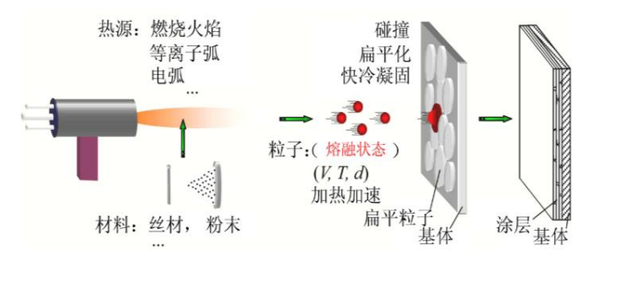
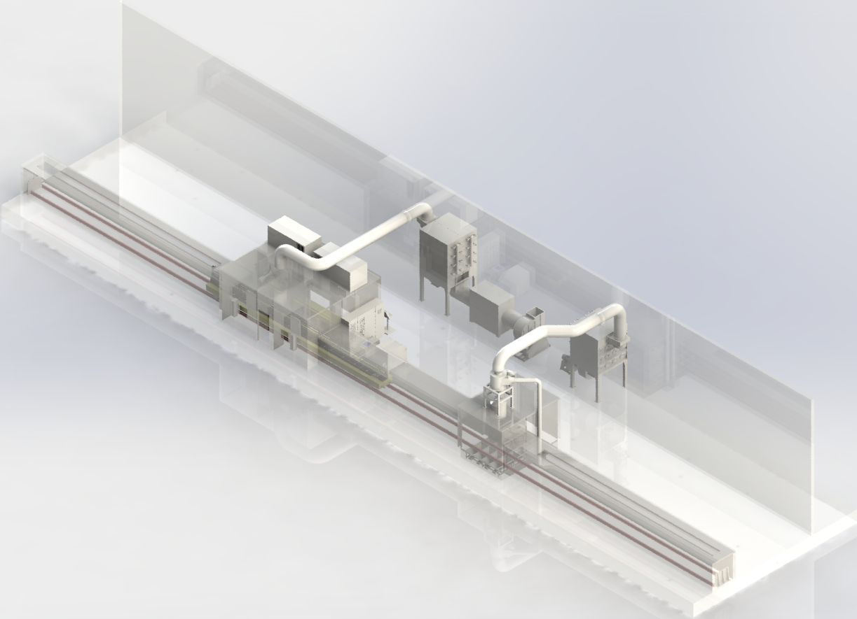
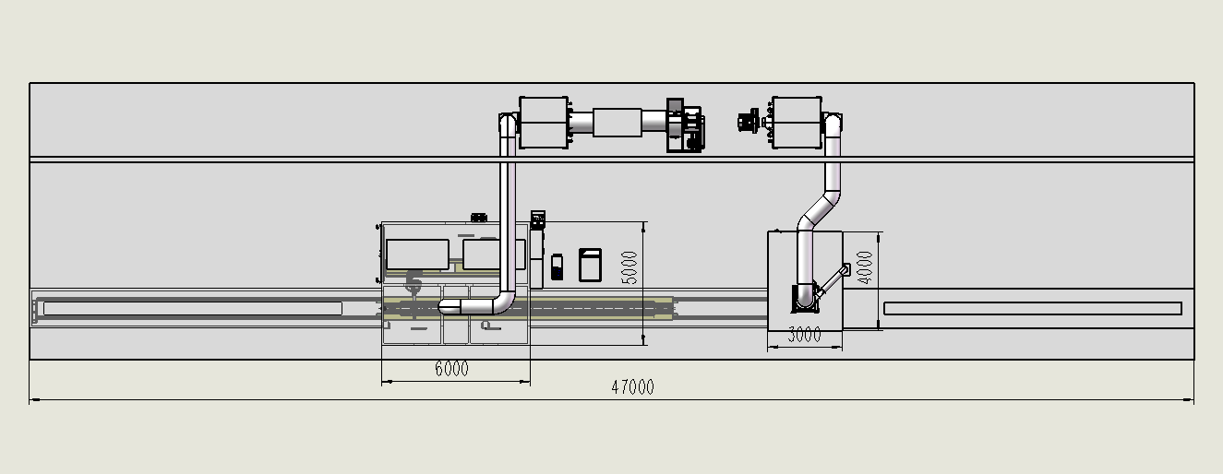
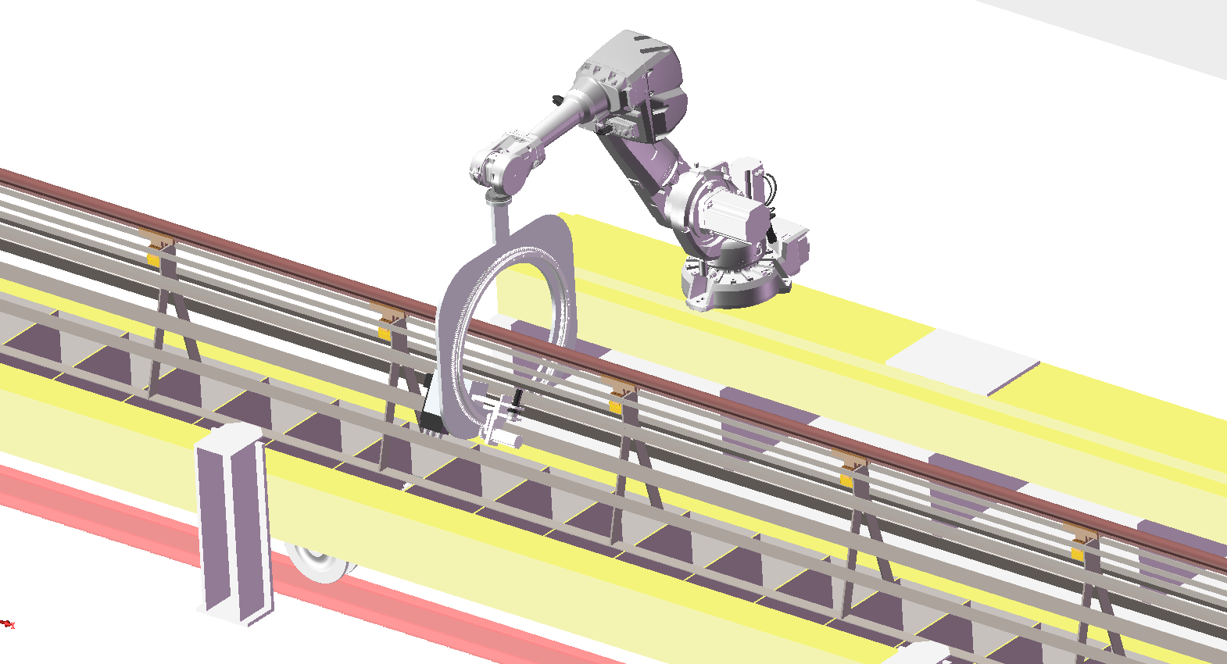
Plasma Spraying system
Plasma Spraying
& Laser etching room
Sandblasting room
The vacuum chamber will be transferred by motorized conveyance（length21.1m, width 1m ） to the coating station, where a robotic arm will execute multi-layer deposition using an automated spray un.
Notes:
Reciprocating motion

Slide 15
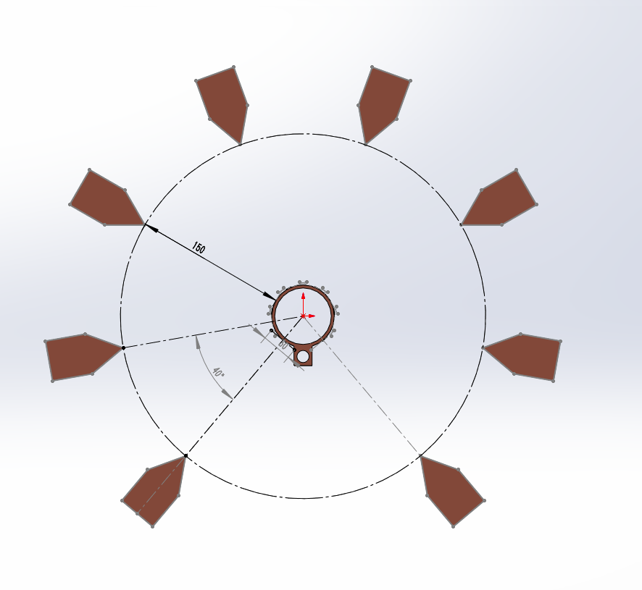
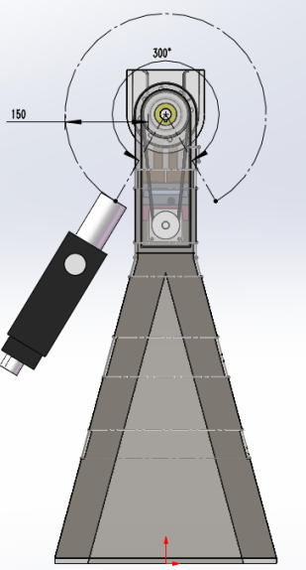
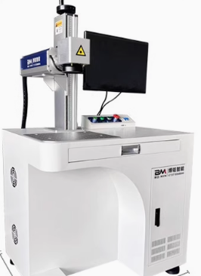
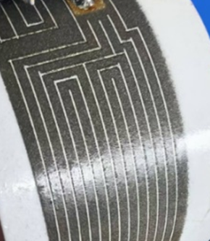
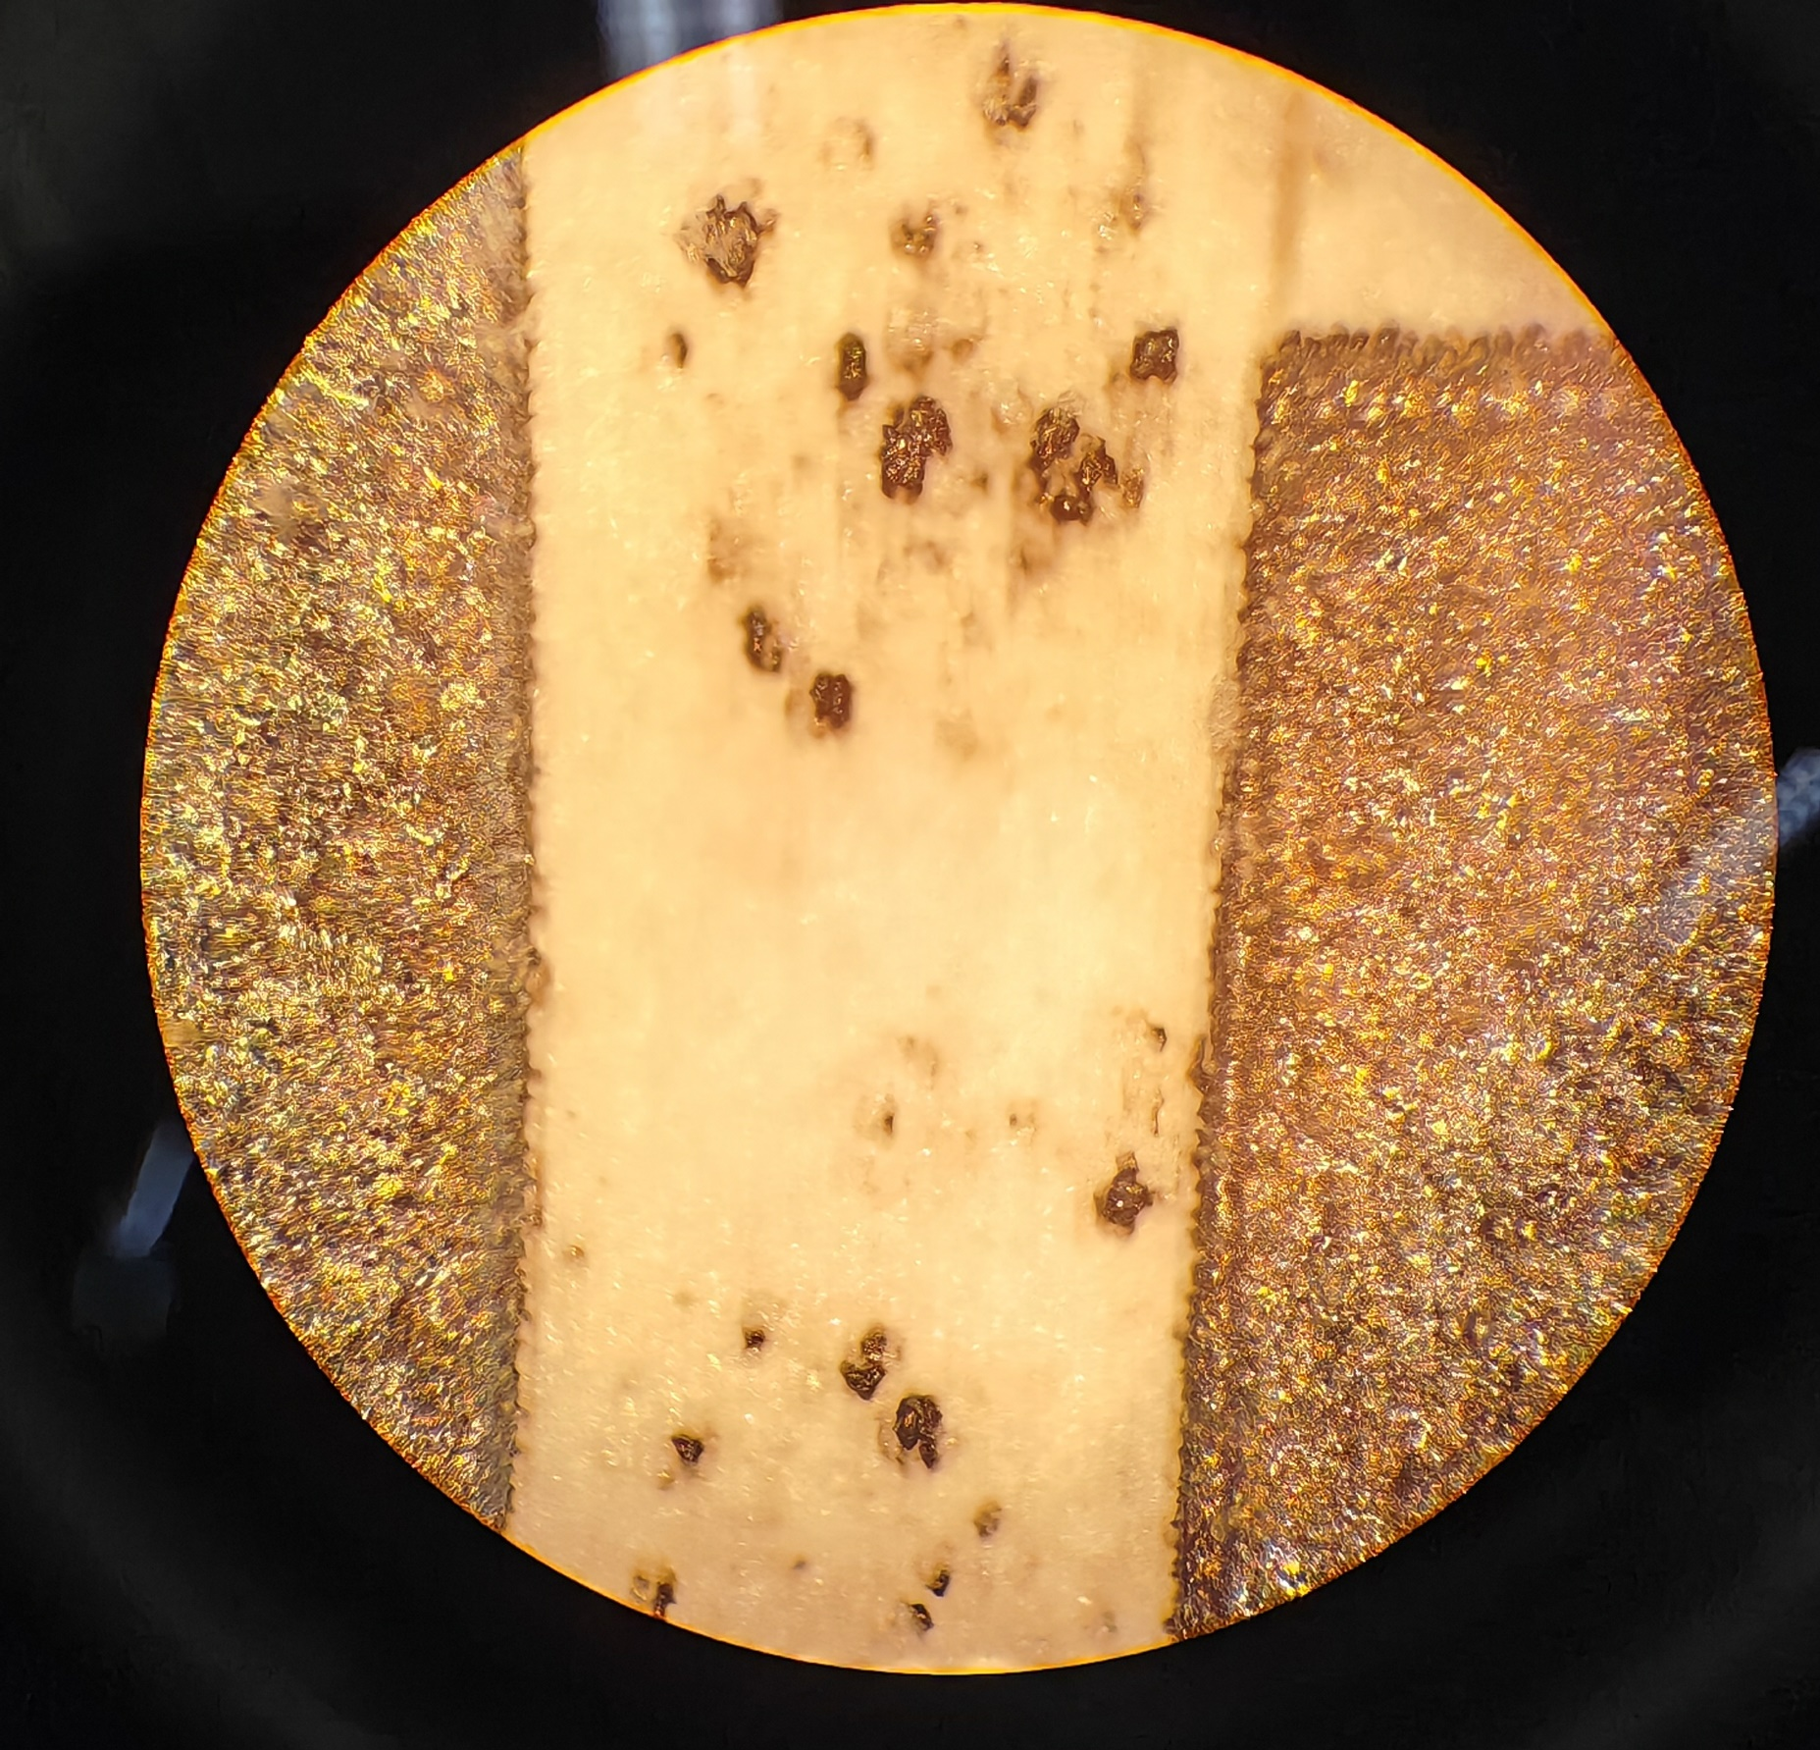
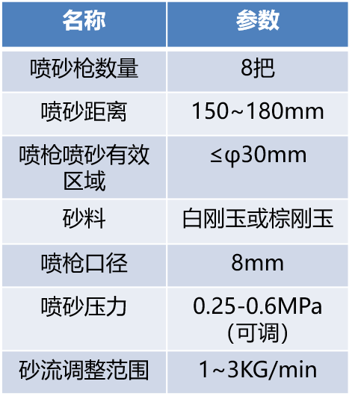
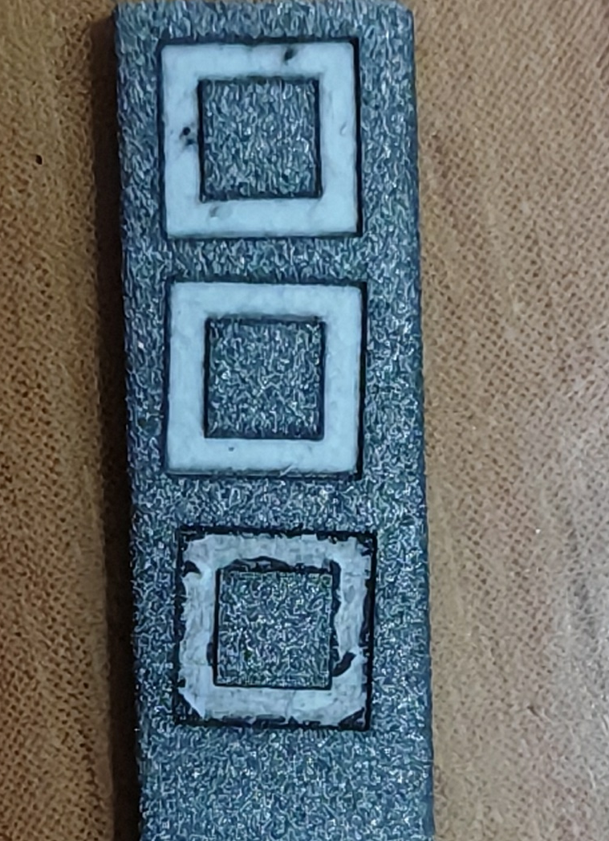
Heating-layer spraying
The processing step for the heating-layer spraying
Sandblasting
Plasma Spraying
Etching by laser
项目 | 参数
驱动方式 | 旋转气缸驱动
遮蔽材质 | 不锈钢
轴向可调节范围 | 100mm

Slide 16







Length of 1.5m prototype_II of Spraying
A 1.5-meter prototype has been developed to validate key process steps that will be implemented in the production line.
Installation
Sandblasting
Spraying
Spraying_Isolation-layer
Spraying_Conductivity-layer
Spraying_Isolation_layer

Slide 17











Elements and thickness of thermal-spray heating layer
NiCr Conductivity-layer
Al₂O₃ isolation layer
NiCr Transition-layer
Al₂O₃ isolation layer
Thickness
Ni
Cr
Al₂O₃：174um
NiCr：64.5um
Al₂O₃：173um
=471um
Al
O
NiCr：59.5um
＜0.5mm
Cu

Slide 18







Prototype_II of thermal-spray heating layer and testing
Process trials have been successfully performed on a 1.5‑meter‑long coated vacuum‑chamber prototype, subject to 65 cyclic heating reliability tests. The prototype consistently delivers a baking‑activation temperature of 300 °C, demonstrating stable performance for both spraying deposition and high‑temperature activation.
Constant V=110V
Contact points burn out
Dimension: L1500*D60 Substrate: copper
65 recycles times reheating tests which shows a good lifetimes and performance, except one of the contact points burn out.

Slide 19
All recorded heating runs since 28 January 2026
67 runs
558 h 40 min
Summed recorded intervals
(558.7 h)
Reference: runs 13–62
303.9 ± 4.1 °C
50 runs / 422.8 h
Notes:
Source: supplied heating log and 04_长期稳定性 rows 11–77, cross-checked to 加热测试 rows 181–745. 67 recorded batches, 66 distinct recorded dates, 28 January–19 August 2026. Sum of each batch last minus first timestamp: 33520 minutes = 558 hours 40 minutes. Initial 12 batches: 5562 min. Reference batches 13–62: 25367 min. August 5 batches: 2591 min. Two blocks dated 5 June have overlapping intervals (08:22–17:17 and 08:21–17:21) and different readings. They are retained as separate recorded batches pending verification, not confirmed separate physical cycles. No time between runs is counted. The sum is not verified energization or dwell time. Plateau estimator retains the existing mean of last up to three readings above initial mean +30 °C. Run 65 (13 August) spans the contact failure and is not steady state. Reference mean 303.859 °C and sample SD 4.089323 °C describe only batches 13–62. The chart deliberately extends the original subset to all 67 source batches and replaces elapsed calendar days with sequential run number. Early differing conditions and post-failure runs must not be pooled for a single stability claim.

Slide 20

Axial temperature profiles at the 300 °C setting
Central range
The measured profile is warmer toward the center.
Nominal setting: 300 °C. IR-L and IR-S identify the two source instruments, not calibrated standards.
Notes:
User-supplied test workbook D-60-1500-2号管测试(2).xlsx, with 20 additional records supplied in this conversation. Updated workbook: C:/Users/Ma/Documents/ChatGPT/Pd NEG 薄膜/outputs/pd_heater_analysis_20260904/Pd_NEG_涂层加热管_D60-1500_2号_更新至2026-08-19.xlsx
Source: axial temperature scan, nominal 300 °C setting. IR-L denotes the instrument labeled 大温枪, IR-S denotes 小温枪. The exact instrument model and spot size are unknown. The central window is 200–1300 mm. Original 750 mm and 800 mm positions lack data. Markers show observations without interpolating the gap.

Slide 21
Equivalent resistance increases with temperature
R = V / I
可以用电阻层进行测温
I₁ = 6.22 A
I₂ = 6.17 A
At the 110 V sweep point
Notes:
User-supplied test workbook D-60-1500-2号管测试(2).xlsx, with 20 additional records supplied in this conversation. Updated workbook: C:/Users/Ma/Documents/ChatGPT/Pd NEG 薄膜/outputs/pd_heater_analysis_20260904/Pd_NEG_涂层加热管_D60-1500_2号_更新至2026-08-19.xlsx
Zhou, Y.-Z. et al. Microstructure and Property of MoSi2-30Al2O3 Electrothermal Coating Prepared by Atmospheric Plasma Spraying. Journal of Inorganic Materials 34(6), 646–652 (2019). DOI: 10.15541/jim20180394. User-supplied PDF.
Source: 13 final points from the voltage sweep. R1=V1/I1, R2=V2/I2. Least-squares fits against channel-mean temperature: slopes 0.0130376375 and 0.0142732518 Ω/°C, R²=0.9450617 and 0.9085116. Apparent coefficient α20=b/(a+20b)=0.000902756 and 0.001018972 K−1. These are circuit-level quantities, not intrinsic coating resistivity or calibrated material TCR.

Slide 22







  Site of production line installation
It will be installed in Guan, Hebei Province, which is 75 km from IHEP, in a few months；
Equipment moving guide rails, sand boxes and other equipment require site foundation construction that has been completed；
Vacuum chamber NEG coating, thermal spraying and some testing will be finished in this lab.
July 2026
25m
Indoor
Sept 2026
65m

Slide 23
Production line conditioning plan and timetable
NEG coating system
Aug ~ Sem. 2026: Foundation construction, rail laying, cable laying （Finished）
Otc ~ Nov. 2026: Flange assembly and sealing are performed automatically by robots.
Dec. 2026 ~ Jan.2027: The production line will be relocated from the development factory to the Gu'an site.
Feb. 2027: Production ability
Thermal-spray system
Aug ~ Sem. 2026: Foundation construction, rail laying, cable laying （Finished）
Otc ~ Nov. 2026: Installation & conditioning
Dec. 2026: Production ability

Slide 24
Summary
The production line for vacuum chamber NEG coating and thermally sprayed heating layers is currently under installation and conditioning.
It is capable of handling vacuum chambers with a minimum dimension of 56 mm and a maximum length of 11.5 meters for NEG coating applications. There are no dimensional restrictions for the thermal-sprayed heating layer process.
Additionally, a 1.5-meter prototype of the thermally sprayed heating layer has been fabricated, with relevant performance tests successfully completed. 65 recycles times reheating tests which shows a good lifetimes and performance, except one of the contact points burn out.
Thermal-spray heating layer: compatible all size of vacuum chambers.

Slide 25
Thanks for your attention!

