Slide 1
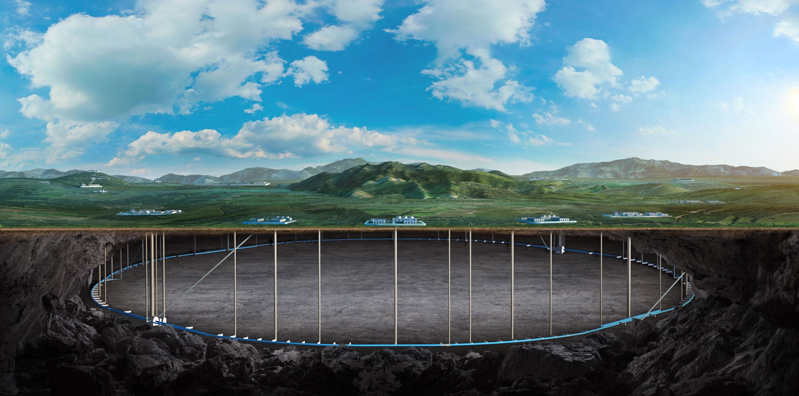


Summary of CEPC-FCC Joint Workshop on Electro-magnetic Separators
Jinhui Chen
Sept 21 2026 , CEPC day

Slide 2
Content
Introduction
Review of presentations
  P1：Electromagnetic separator design and experiment results in CEPC (Bin Chen, IHEP)
  P2：Alternative option of EMS in CEPC: Separation Kicker (Jinhui Chen, IHEP)
  P3：Electromagnetic separator design and its alternative option in FCC (L. Porta, CERN)
  P4：Impact of EMS Failures on FCC-ee beam (A. Potet, CERN)
Open discussion

Slide 3
Introduction

Slide 4
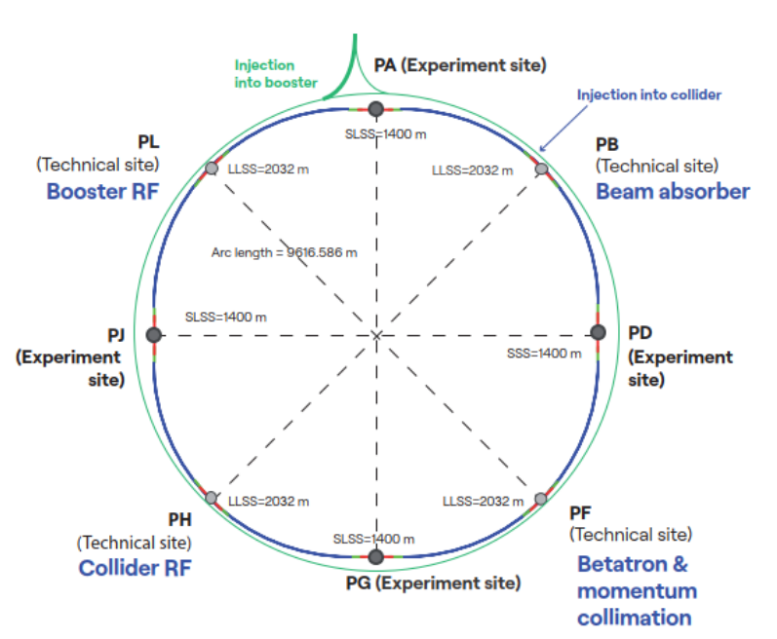
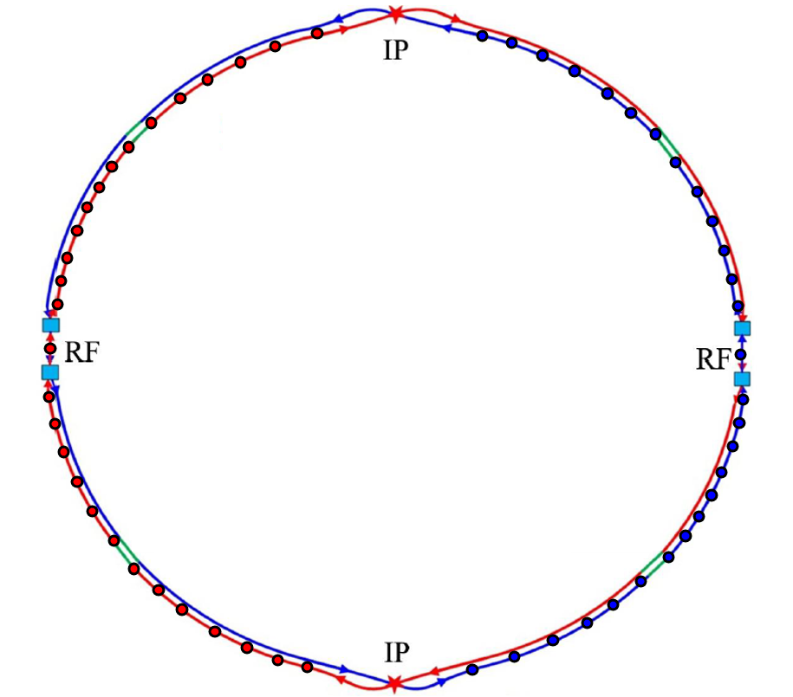

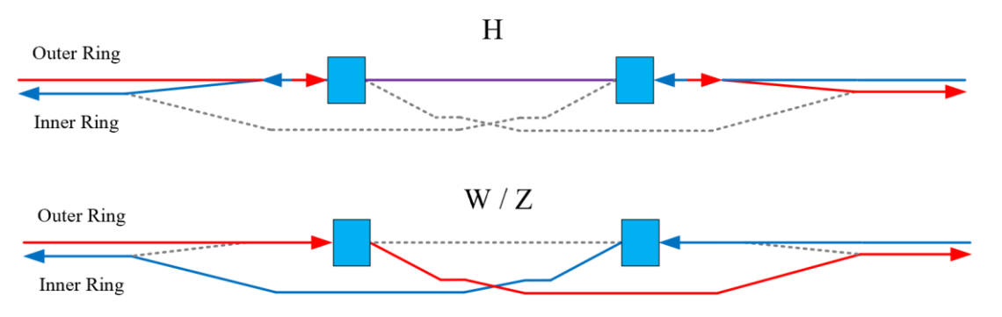
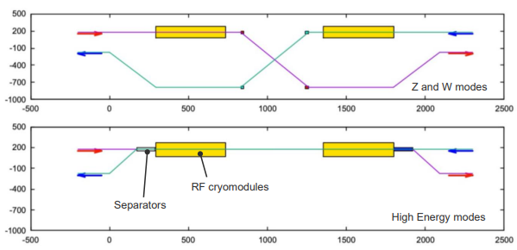
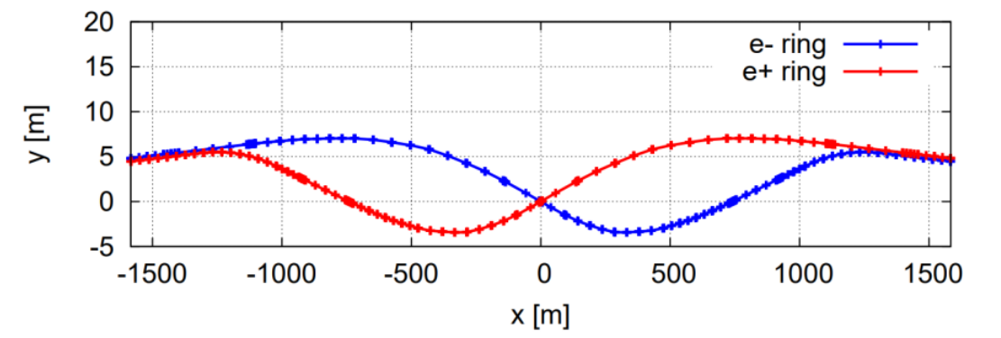
Background
The EMS is one of the common interests between CEPC and FCC, and this workshop should be a good trigger to start the discussion.
Facility | CEPC | FCC-ee
Circumference (km) | 100 | 90.66
Number of IPs | 2 | 4
Number of RF regions | 2 (accommodate both RF systems) | 2 (respectively for CR and BST)
Number of EMS | 4 groups | 2 groups
FCC-ee
CEPC

Slide 5
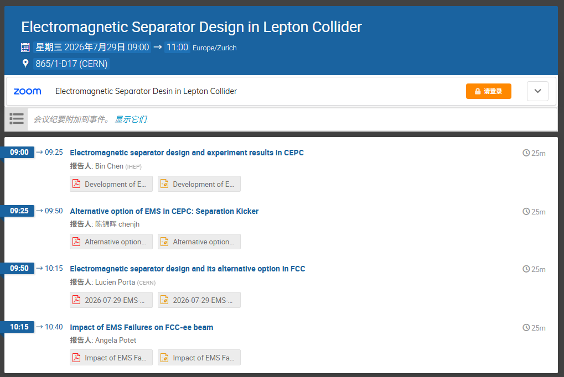
Join workshop on EMS
Subject:
Electromagnetic Separator Design in Lepton Collider
Time: Wednesday 29 Jul 2026, 15:00-17:00 Asia/Shanghai Room: 865/1-D17 (CERN) / on ZOOM
Participants:
E.Belli, C.Bracco, B.Chen, J.H.Chen, L.Ducimetiere, Y.Dutheil, G.Favia, J.Gao, H.Pommerenke, L.Porta, A.Potet, J.Ruf, I.Ruiz, G.Sergentanis, D.Standen, P.Trappen, N.Wang, Y.W.Wang, G.J.Wu, S.Yue, J.Y.Zhai
Presentations:
Electromagnetic separator design and experiment results in CEPC (Bin Chen, IHEP)
Alternative option of EMS in CEPC: Separation Kicker (Jinhui Chen, IHEP)
Electromagnetic separator design and its alternative option in FCC (L. Porta, CERN)
Impact of EMS Failures on FCC-ee beam (A. Potet, CERN)

Slide 6
Presentation 1：
Electromagnetic separator design and experiment results in CEPC
Bin Chen, IHEP

Slide 7
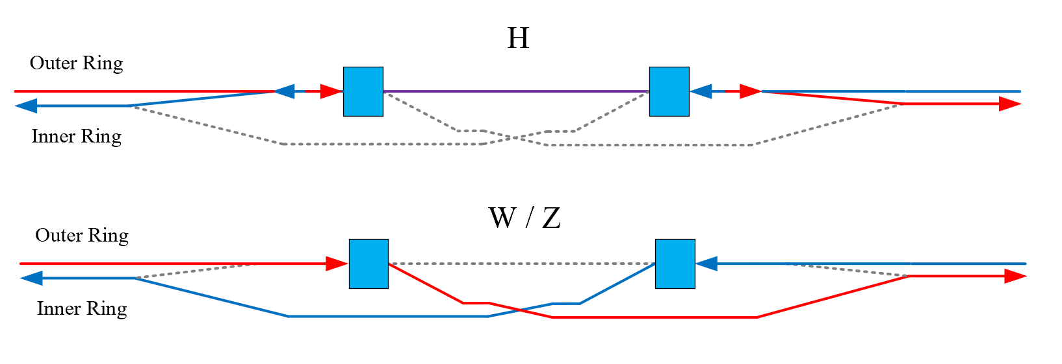
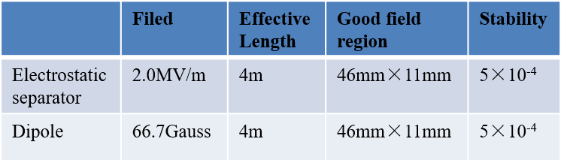
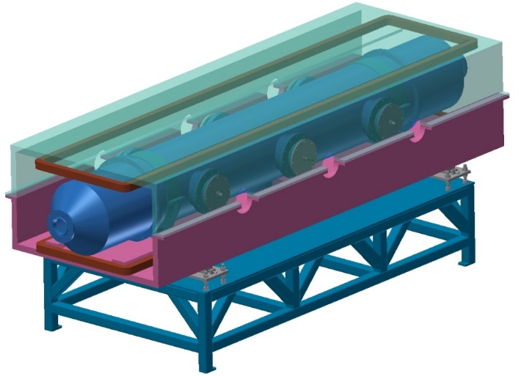
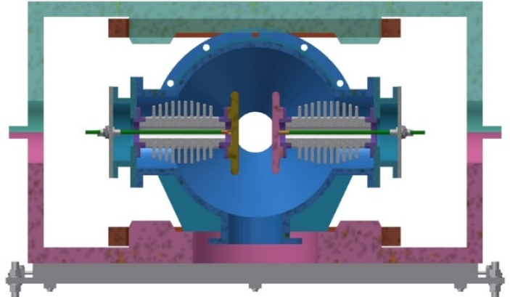
P1. Electromagnetic separator design and experiment results in CEPC (Bin Chen, IHEP)
The EMS has 50 m of available space, can provide 1.07 mrad deflection, and the beam separation at the EMS exit is 21.2 mm
  There are two collider RF sections in CEPC, and thus 4 sets of EMS are required
E field from the electrode is 2 MV/m, B field from the dipole is 66.7 Gauss
  The electrode gap is 75 mm
  Pure titanium is used to make the electrode due to its good vacuum performance
  A wider electrode has a larger field uniformity region
  The maximum E field is 7 MV/m around the ground plate
Metal-ceramic support
UHV tank
High voltage feedthrough
Support
Magnet
Coil
Electrode

Slide 8
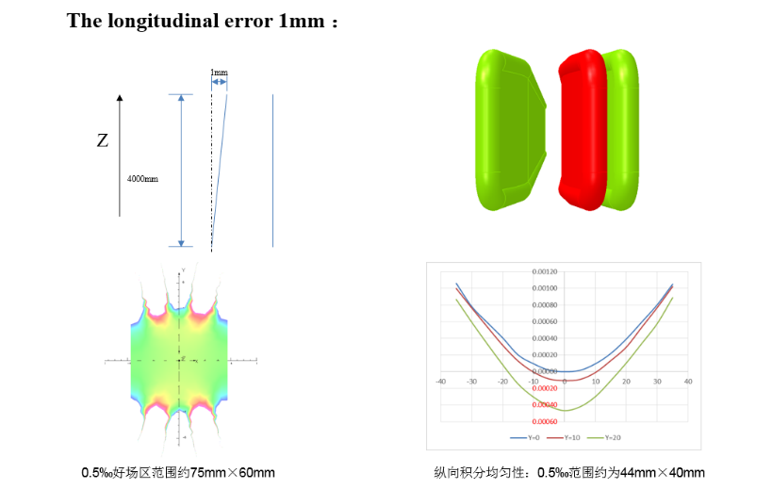
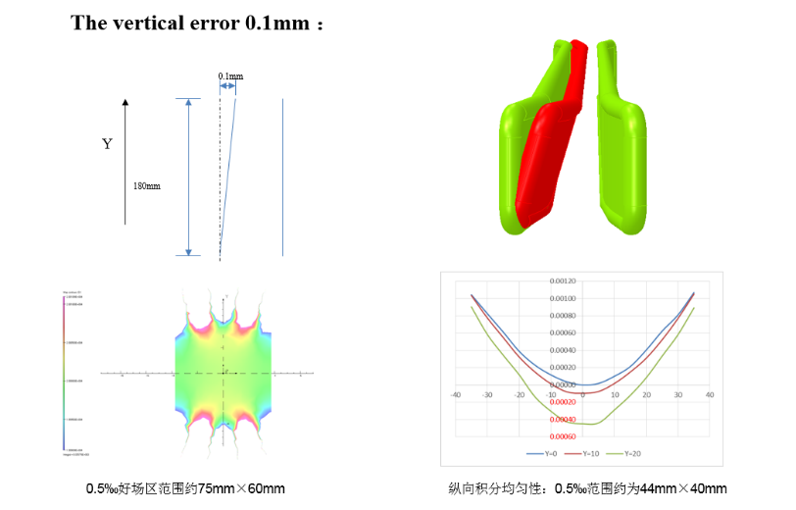
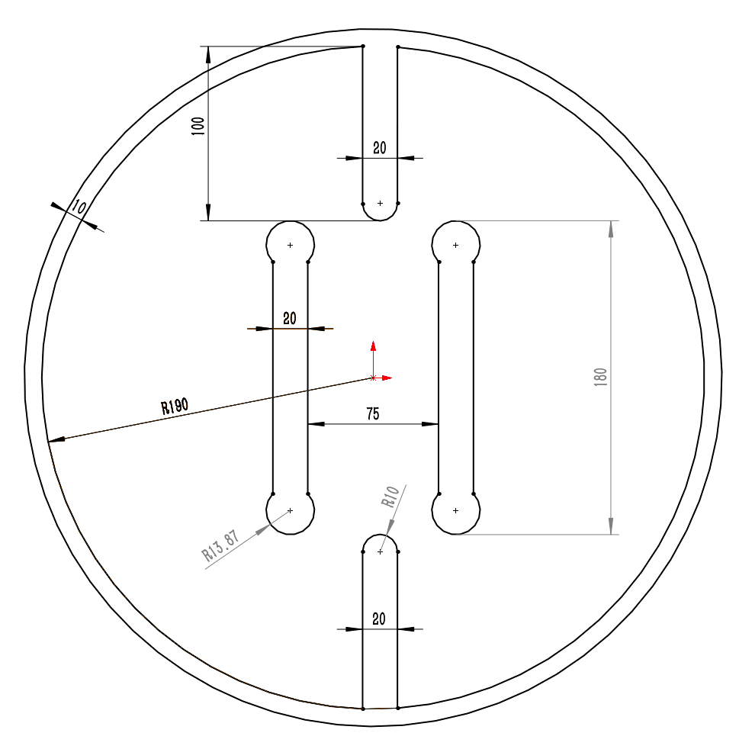
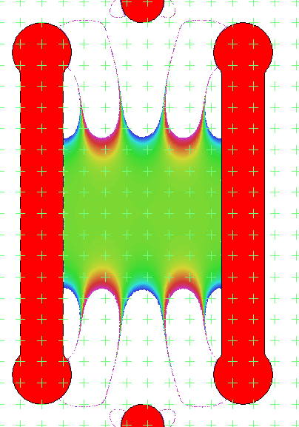
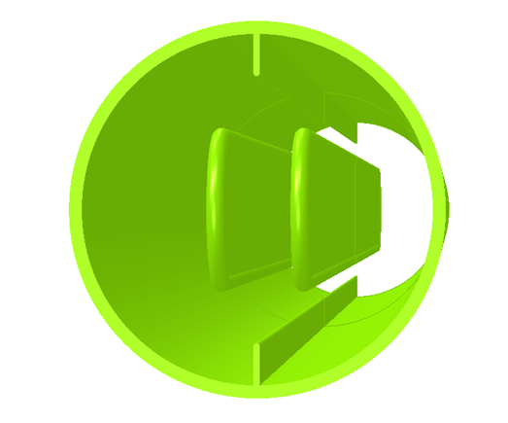
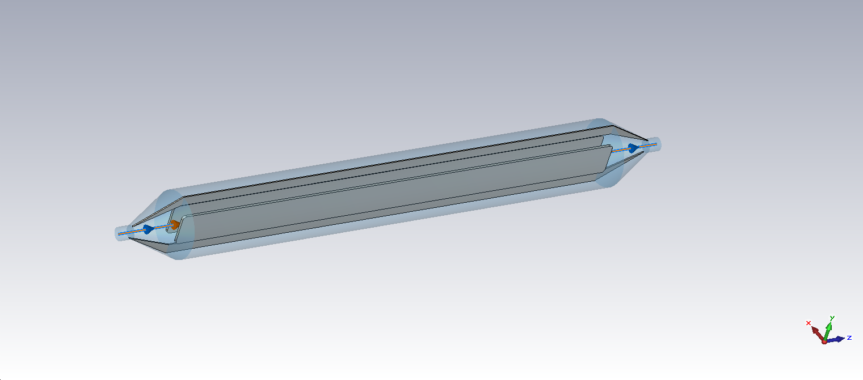
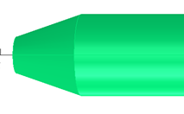
P1. Electromagnetic separator design and experiment results in CEPC (Bin Chen, IHEP)
The installation error requirements：1 mm in the longitudinal plane ，0.1 mm in the vertical plane
Impedance mitigation measures
  Ground electrodes
    Made of aluminum
  Tapered ends
  A cooling system is designed for the electrode to handle the parasitic beam power loss

Slide 9
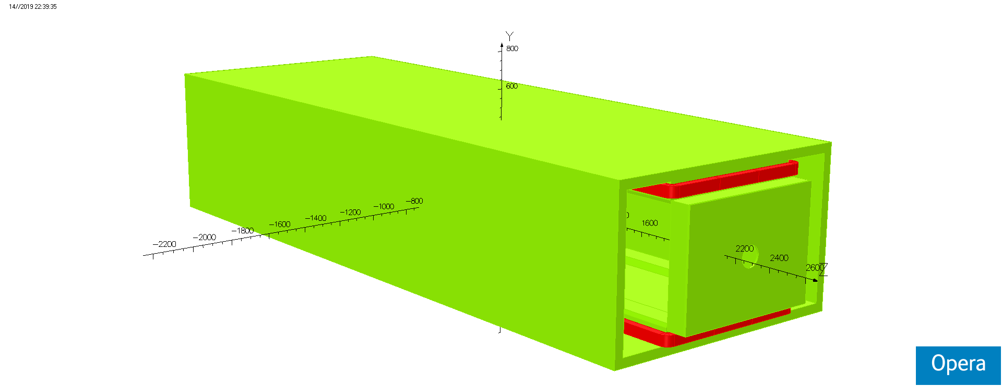
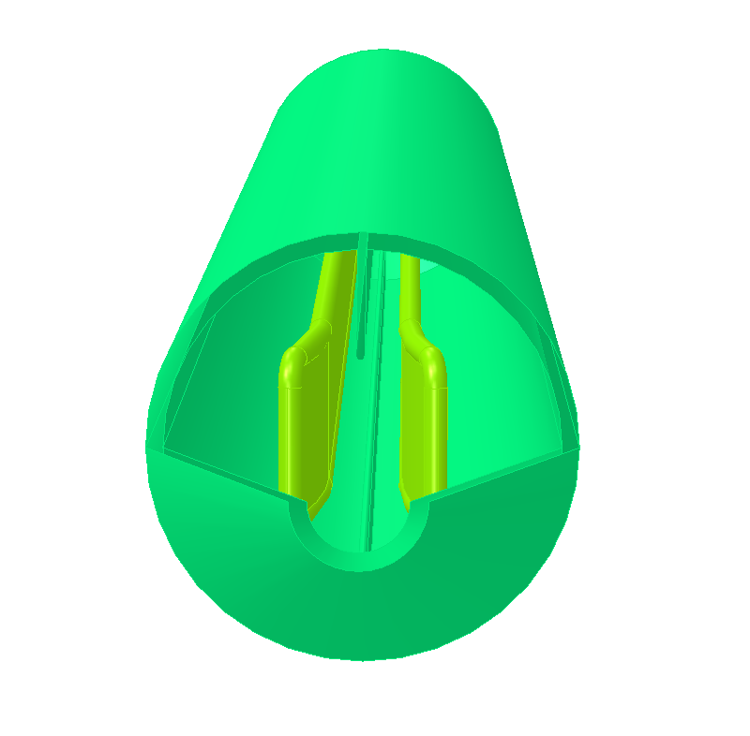
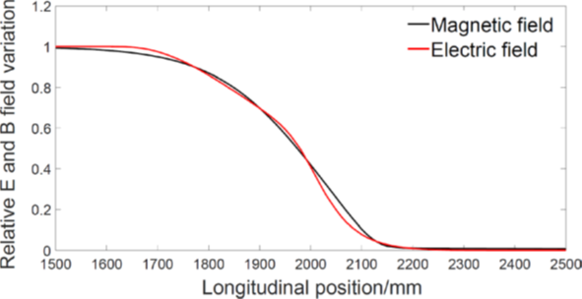
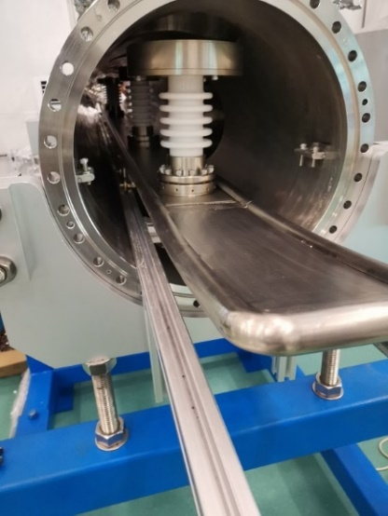
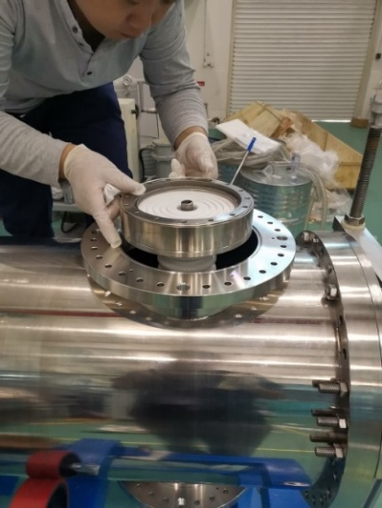
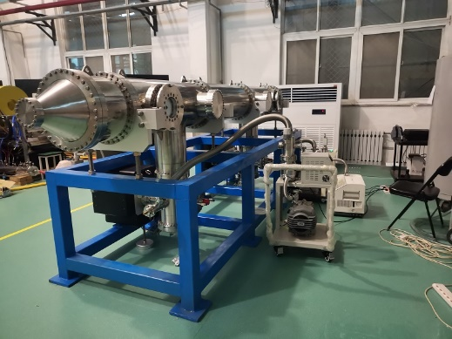
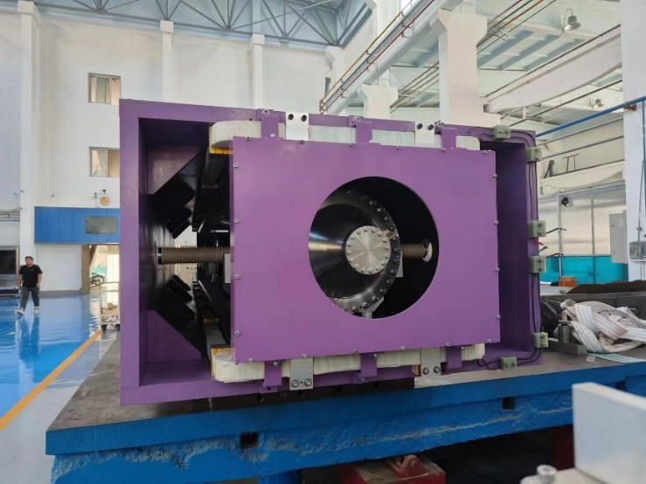
P1. Electromagnetic separator design and experiment results in CEPC (Bin Chen, IHEP)
Fringe field matching
  B field: addition of field clamps
  E field: open the electrode ends progressively
Prototype
  The electrode is divided into three parts
    Electrochemical polishing treatment to reduce sparking
  Double support design for the high insulation requirements
  Cooling liquid inside
  Vacuum requirement: 2×10-10 Torr
    Baking for high vacuum
    Measured vacuum level < 2.7×10-8 Pa, and the E field is 3.15 MV/m
  Electrode sparking happens 10 times per hour？
ﬁeld clamp
mirror plate

Slide 10
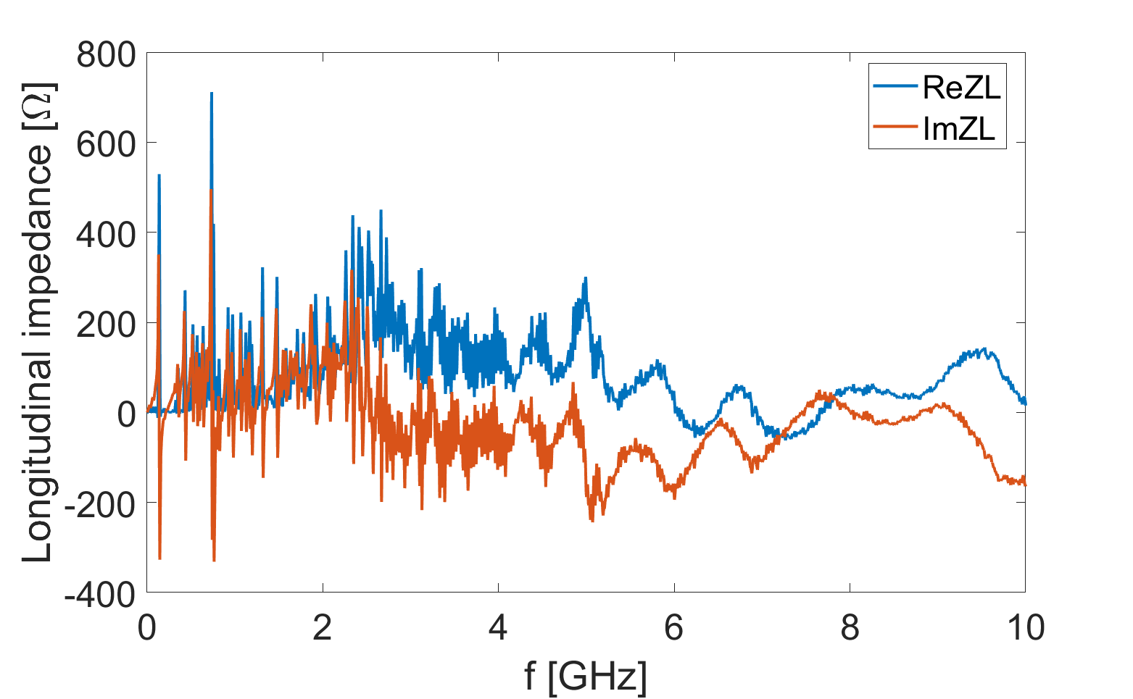
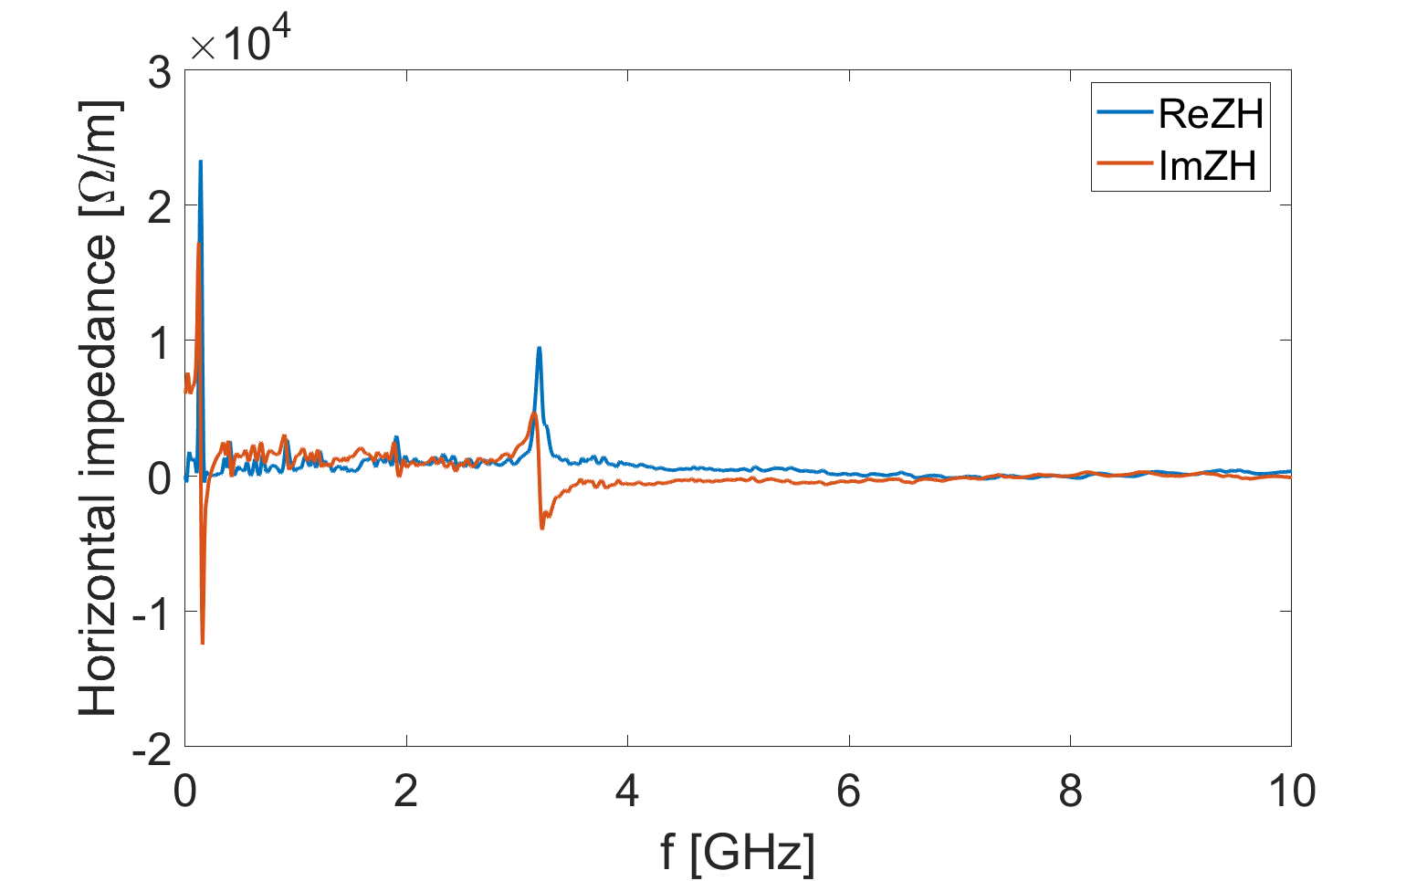
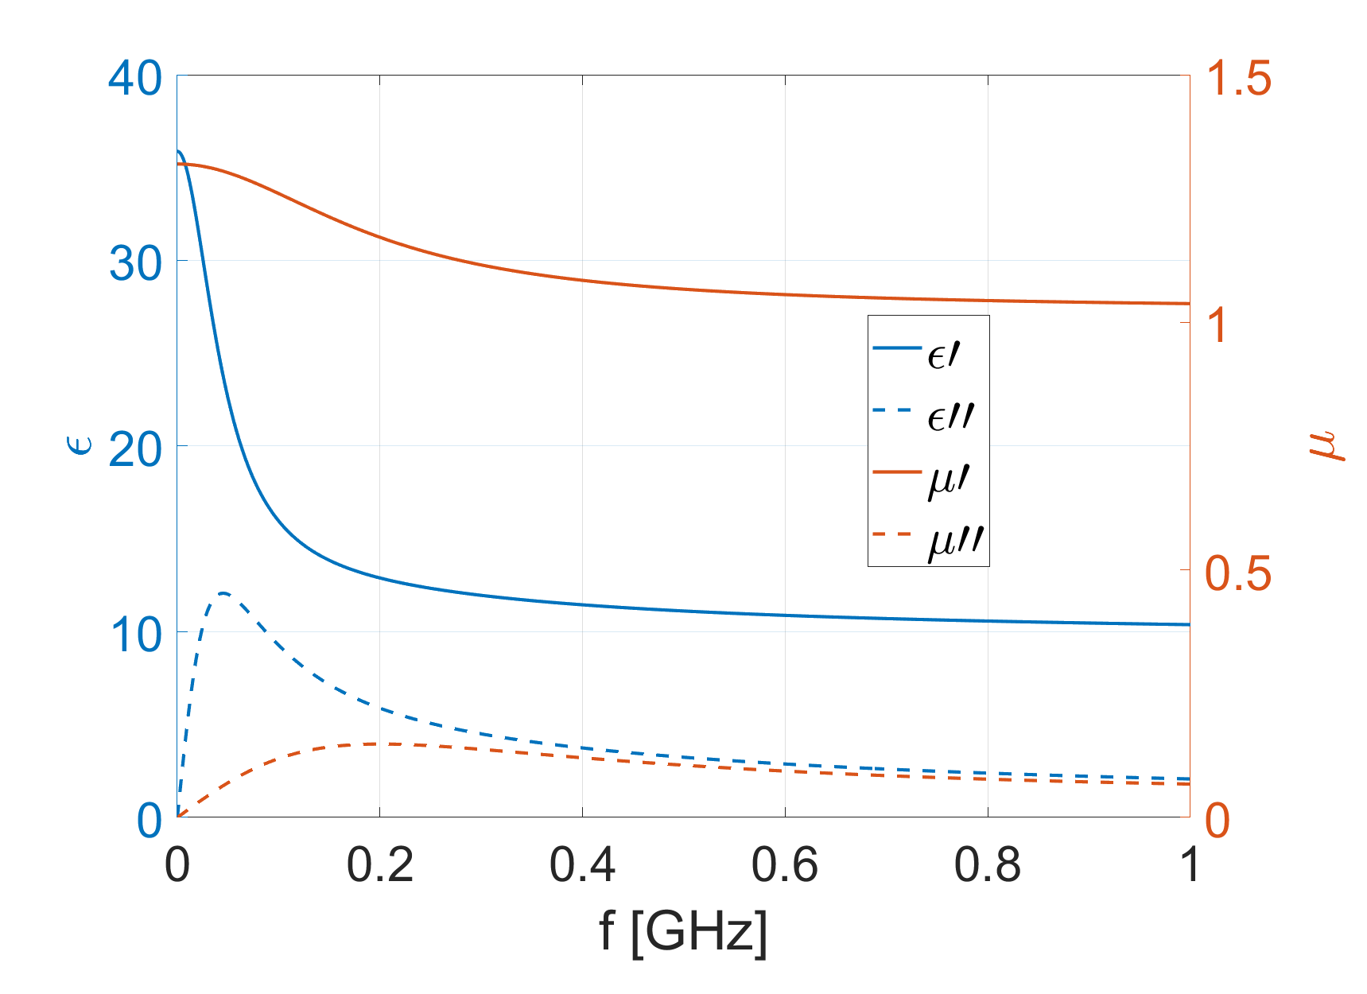
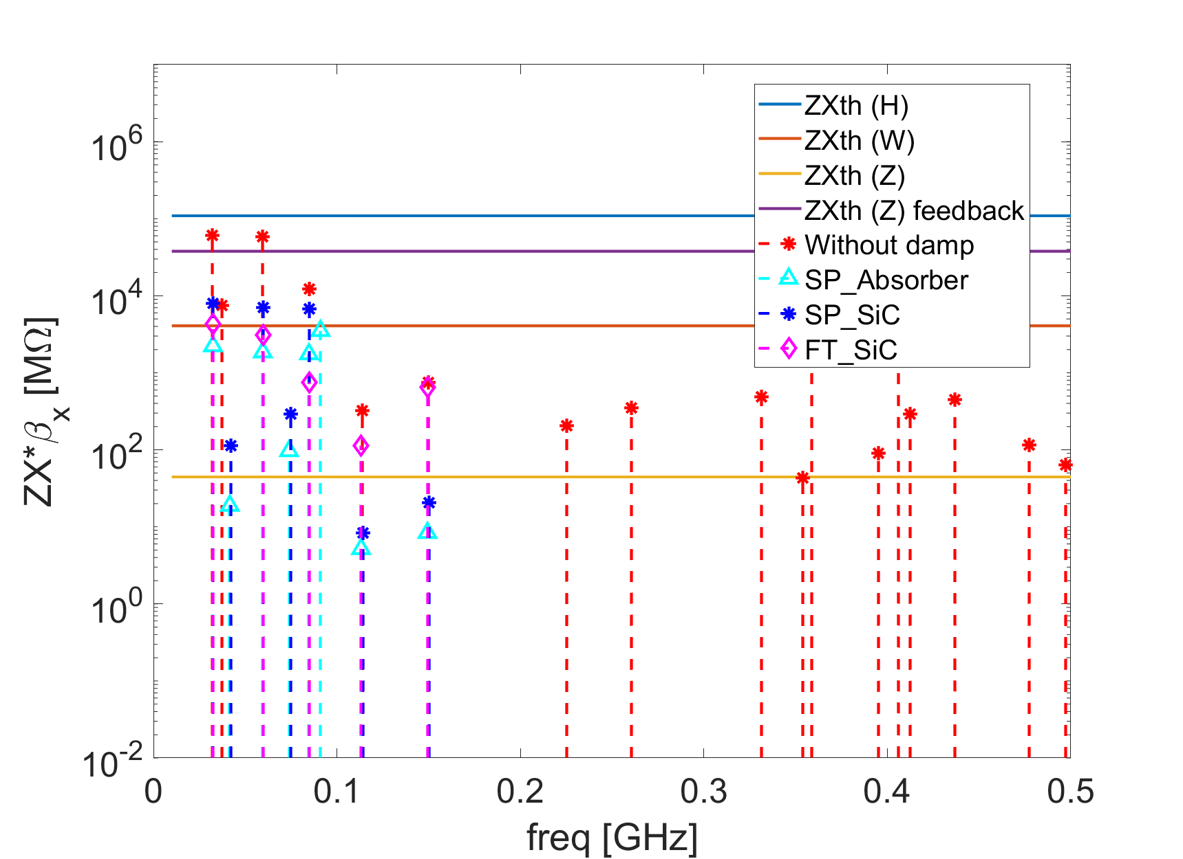
Impedance characteristics of Electrostatic separator（by Na Wang）
Parasitic beam power loss dissipation for the Z operation mode. A cooling system is designed for the electrodes to avoid any heating damages.
For single beam with impedance
  Total beam power loss: 13 kW /unit
  Power loss on the electrodes: 850 W /unit
For two beam with collision
  Total beam power loss: 22 kW /unit
  Power loss on the electrodes: 1.4 kW /unit
Broadband impedance contributions are less than 1%, but rich of HOMs due to poor matching at the high-voltage feedthrough terminations, addition damping is needed.
Longitudinal
Horizontal
The proposed damping schemes can effectively suppress the HOMs, with the amplitudes of the dominant HOMs reduced by approximately one order of magnitude.
Permeability and permittivity of the SiC
Shunt impedance of horizontal modes

Slide 11
Presentation 2：
Alternative option of EMS in CEPC: Separation Kicker
Jinhui Chen, IHEP

Slide 12
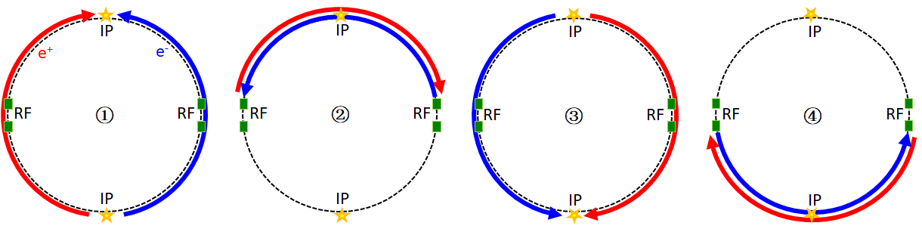
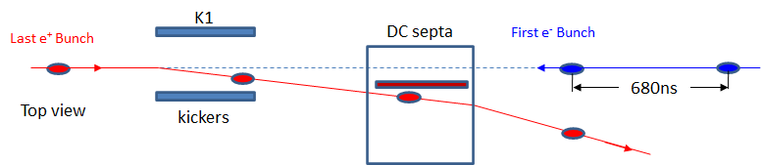
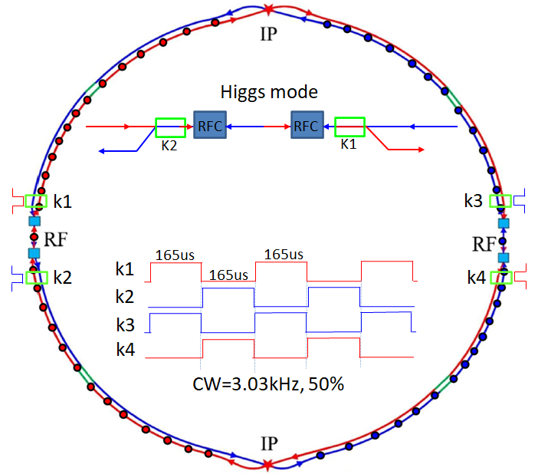
P2. Alternative option of EMS in CEPC: Separation Kicker (Jinhui Chen, IHEP)
A separator has been used in BEPC, and the beam impedance issue also exists there
The alternative scheme was first proposed at the CEPC Workshop 2019, and a similar concept can also be found in an ILC report from 2006
Timing requirements of the kicker:
  Pulse width is 165 µs, and the repetition frequency is 3.03 kHz
  The timing requirements are highly related to the beam filling scheme
Parameters | Kicker | Septa
Integrated strength BL [T*m] | 0.1624 | 1.4
Strength B [Guass] | 203 | 1000
Effective length Leff [m] | 8 | 14
Half width of good field region Hgf/Vgf [mm] | 10.1/3.8 @ 5E-4 | 18.9/3.8 @ 5E-4
Half width of beam stay clear Hbsc/Vbsc [mm] | 9.6/3.6 | 9.2/3.6
Septum width [mm] | - | 10

Slide 13
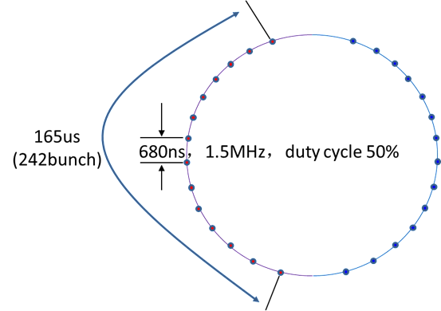
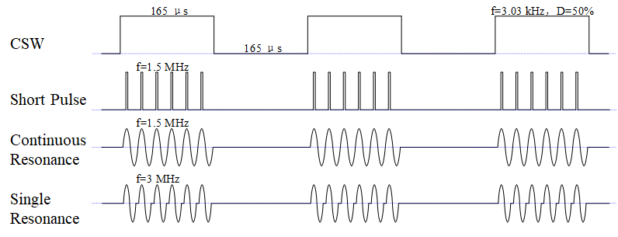
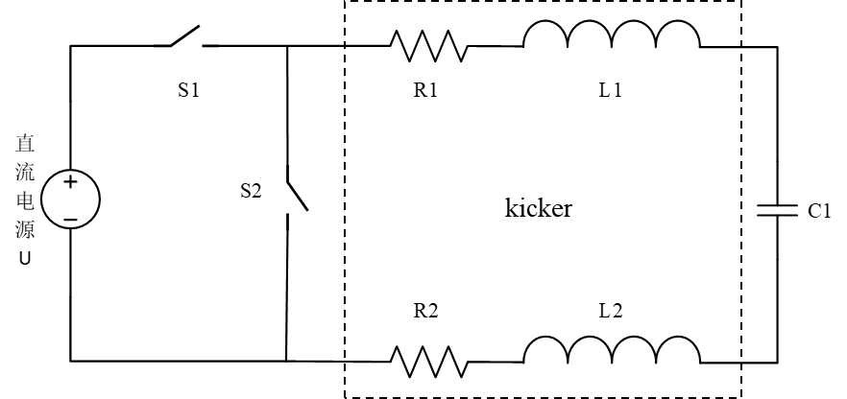
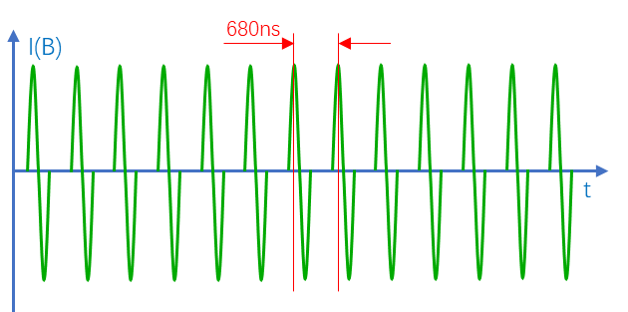
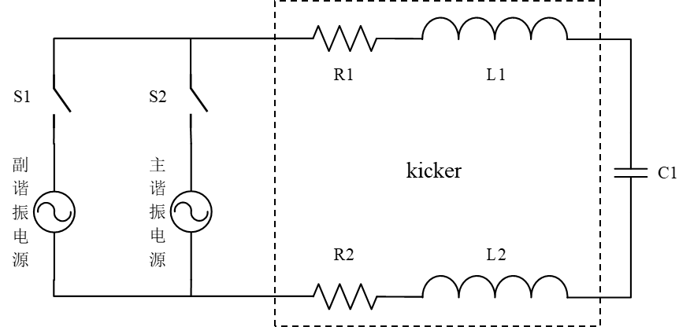
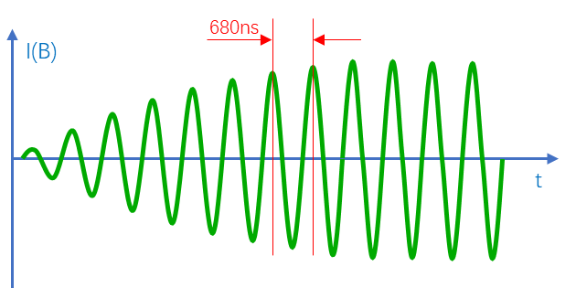
P2. Alternative option of EMS in CEPC: Separation Kicker (Jinhui Chen, IHEP)
Potential topologies
  Stripline kicker system
  Resonance kicker system
  CSW kicker system
Resonance kicker system
  2 pulse solutions: continuous and single-shot resonance
  Air-core kicker design
    Current is very high: 2176 A
  Ferrite-core kicker design
    Higher magnetic excitation efficiency
    Better field uniformity
Kicker type | Air-core / in-vacuum |  | Ferrite-core / in-vacuum |  | Ferrite-core / in-air
Operation mode | Single-shot | Continuous | Single-shot | Continuous | Single-shot | Continuous
Excitation Current（I） | 2176A | 2176A | 905A | 905A | 1292A | 1292A
Resonance impedance (Z) | 7.4Ω | 3.7Ω | 11.1Ω | 5.5Ω | 11.1Ω | 5.5Ω
Voltage across capacitor (U) | 16.4kV | 8.1kV | 10.1kV | 5kV | 14.4kV | 7.2kV
Kicker inductance (L1) | 400nH | 400nH | 600nH | 600nH | 600nH | 600nH
Coil resistance (R1) | 8mΩ | 5.6mΩ | 2.9mΩ | 2mΩ | 2mΩ | 1.4mΩ
Resonance capacitor (C1) | 7.32nF | 29.28nF | 4.88nF | 19.52nF | 4.88nF | 19.52nF
Source level (V1/V5) | 16.4kV | 367/37.2V | 10.1kV | 223/14.2V | 14.4kV | 318/18V
Resistance of switch (S2/S3) | 850/21.2mΩ | 11.3/11.3mΩ | 550/25mΩ | 13.6/13.6mΩ | 750/23.4mΩ | 12.5/12.5mΩ
Power loss on kicker coils | 4.8kW | 6.8kW | 299W | 413W | 419W | 585W
Power loss on switches | 13.1kW | 13.6kW | 2.6kW | 2.8kW | 5.1kW | 5.23kW
Power of source | 18kW | 20.9kW | 2.9kW | 3.3kW | 5.5kW | 6.07kW
Single
Continuous

Slide 14
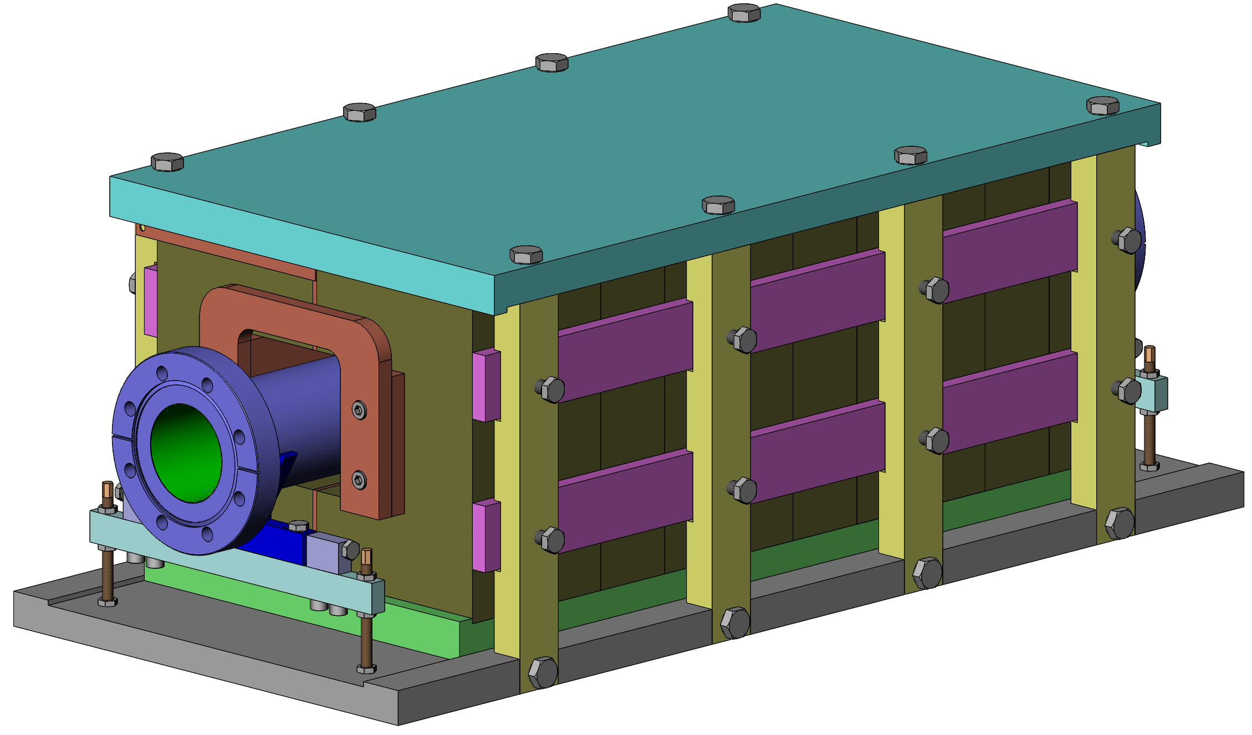
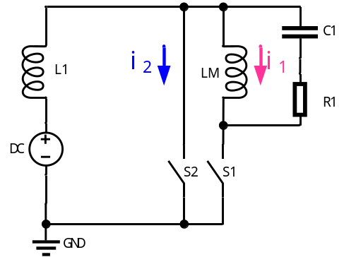
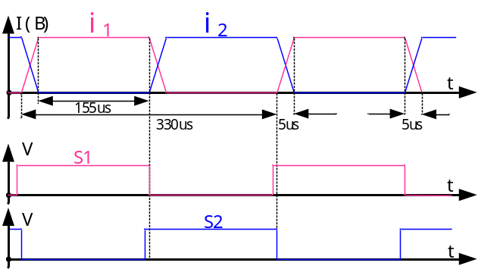
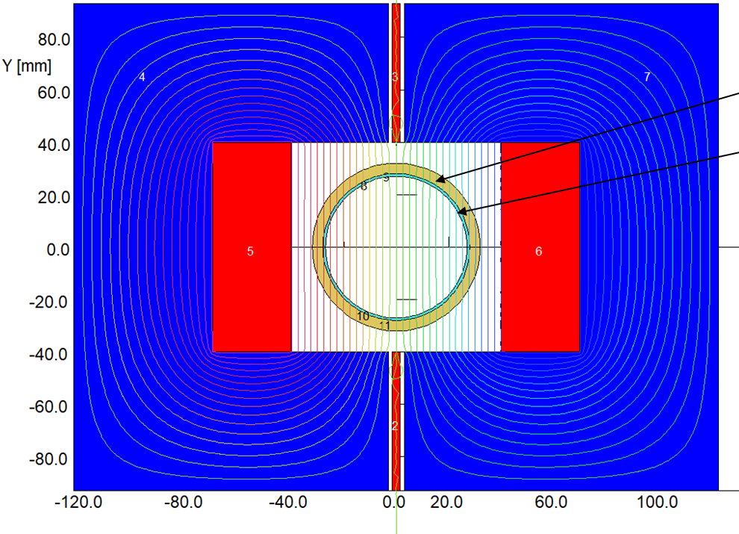
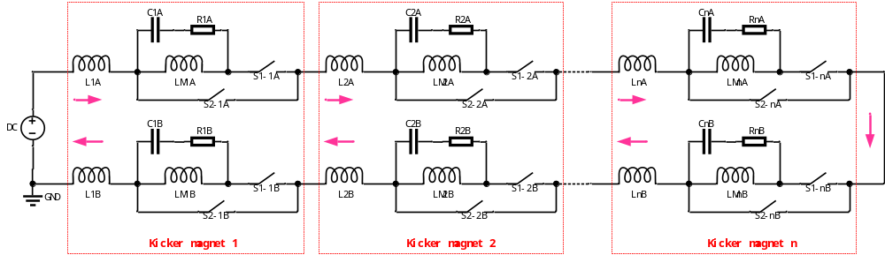
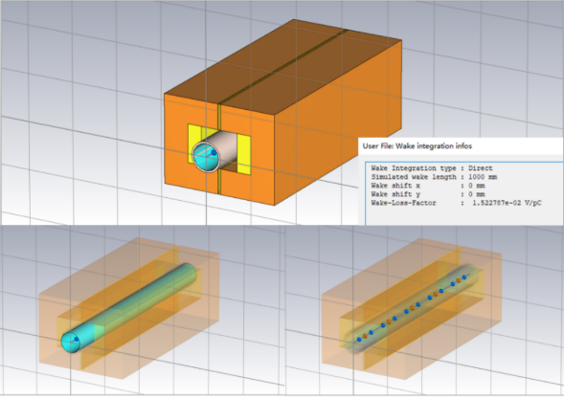
P2. Alternative option of EMS in CEPC: Separation Kicker (Jinhui Chen, IHEP)
CSW kicker system
  Generator: alternating switching + conventional DC current source
  Kicker: in-air ferrite core kicker + ceramic vacuum chamber with TiN coating (2 µm)
  The in-air CSW kicker solution is preferred
    It has very good field uniformity: 0.05%
Beam impedance
  Beam-induced heating power is 489 W for a total of 16 kickers
    Much lower than the EMS
Ceramic chamber
Coating

Slide 15
Conclusion of alternative scheme： kicker systems
We prefer the in‑air CSW kicker with a DC source and alternating switches, based on technical maturity, complexity, cost, and beam impedance.
Ceramic vacuum chambers with TiN coating are impedance components that contribute to electron and positron beams.
Item | Unit | Resonance kicker |  | CSW kicker
Operation mode | - | Single-shot | Continuous | DC source + Alternating Switch
Type of kicker | - | Ferrite core | Ferrite core | Ferrite core
Structure of kicker | - | In-vacuum | In-vacuum | In-air ( TiN coated ceramic chamber)
Turn of coil | - | Single | Single | Single
Quantity | set | 16 | 16 | 16
Magnetic effective length | m | 0.5 | 0.5 | 0.5
Magnetic field strength | T | 0.0203 | 0.0203 | 0.0203
Good field region (H×V) | mm | [-10.1,10.1]×[-3.8,3.8] | [-10.1,10.1]×[-3.8,3.8] | [-10.1,10.1]×[-3.8,3.8]
Field uniformity | - | Better than±1‰ | Better than±1‰ | Better than±5‱
Inductance of magnet | nH | 600 | 600 | 600
Resonance capacitance | nF | 4.88 | 19.52 | -
Resonance impedance | Ω | 11.1 | 5.5 | -
Peak current | A | 905 | 905 | 1292
Charging voltage | V | 10100 | 223/14.2 | 700 (inductive) @ edge=10us
Frequency | Hz | 3M/3.03K | 1.5M/3.03K | 3.03K
Pulse bottom width | ns | 340 | 680 | 165000

Slide 16
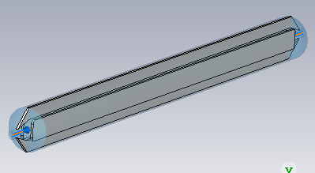
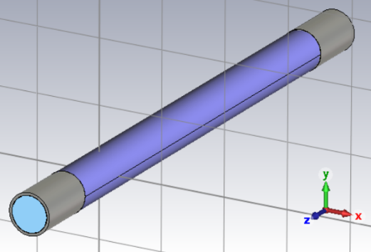
Beam power deposition comparison: EMS vs Kicker
EMS
Kicker
Ceramic Vacuum chamber with continuous TiN coating：
Length=600mm/unit
Inner aperture=⌀56mm
Outer diameter=⌀64mm
Wall thickness=4mm
Coating thickness=2μm
TiN Conductivity =5.8×10⁶ S/m
vs
 | EMS | CSW kicker
Total deflection @Higgs mode (mrad) | 1 | 0.406
Maximum operation voltage (V) | ±75k | 700 （inductive @10us edge）
Total effective length per group (m) | 32 | 8
Quantity of unit per group (set) | 8 | 16
Total beam power deposition per group in Higgs mode (W) | 8*486=3888 | 16*12.6W=201.6
Total beam power deposition per group in Z mode (W) | 8*14436=115488 | 16*30.6W=489.6
CEPC

Slide 17
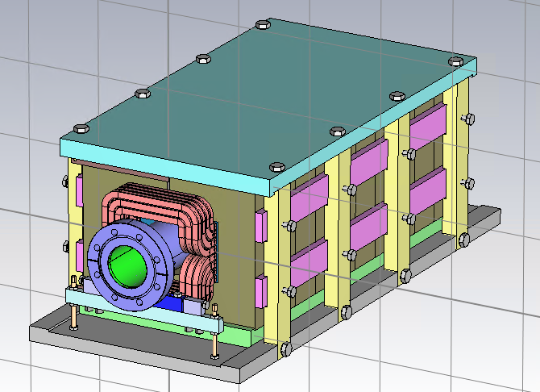
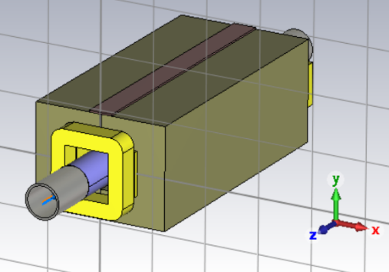
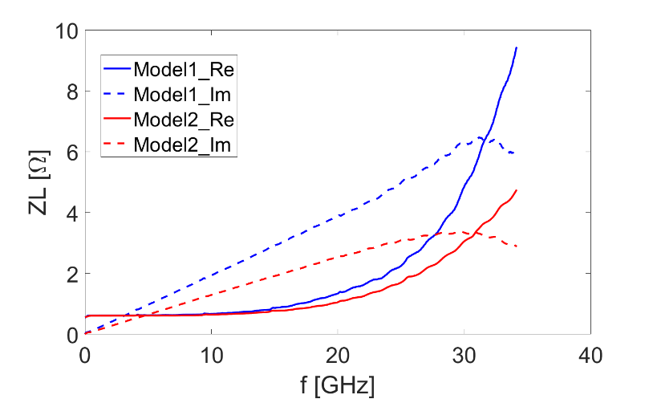
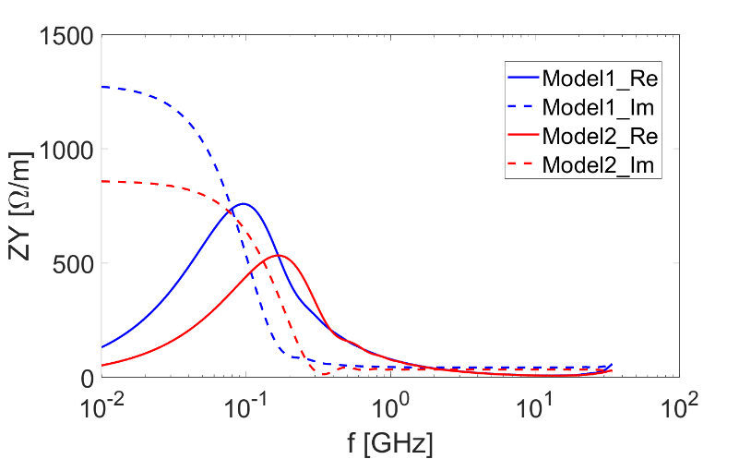
Impedance studies of the alternative kicker （by Na Wang）
Two simplified models are considered. Preliminary simulations indicate that the impedance is dominated by broadband contributions, without any dangerous HOMs.
Their total contributions to both longitudinal and transverse broadband impedances are less than 1%.
Model1
Model2
The two models give considerably consistent impedance evaluations.
Mainly resistive wall impedance from the TiN coating.
The heat-load dissipation is not a critical issue.
The divergence between the impedance of the two models (bunch length=3mm)：
    Model1: kloss=0.024 V/pC, ky=1.478 V/pC/m
    Model2: kloss=0.021 V/pC, ky=1.220 V/pC/m

Slide 18
Presentation 3：
Electromagnetic separator design and its alternative option in FCC
L. Porta, CERN

Slide 19



P3. Electromagnetic separator design and its alternative option in FCC (L. Porta, CERN)
To avoid Synchrotron Radiation (SR) toward the RF cryomodules.
Deflection or transverse perturbation on the incoming beam → SR power toward superconducting RF cryomodules.
Quantitative requirements about allowed SR toward the RF are not known yet, we aim at evaluating different separators concepts with various levels of residuals SR productions.
Equipment protection and SR shielding require dedicated studies at Septa and Separators locations and toward the RF.
HV circuit is decoupled between units to contain faults to individual unit.
1
$$e^{+}$$
2
3
4
5
6
7
Comparisons | CEPC | FCC-ee
RF region for collider | 2 | 1
Total quantity of EMS unit (set) | 4×8=32 | 2×11=22
Operation HV (kV) | ± 75 | ± 86.4
Nominal gap (mm) | 75 | 120
E₀ (MV/m) | 2 | 1.44
Effective length of unit (m) | 4 | 3
Length of EMS unit (m) | 4.5 | 3.5
Total of deflection @Higgs mode (mrad) | 1 | 0.44
Septa | Without | With
9
8
Septa
Separators
RF system
Septa magnets (under-vacuum) continuously exposed to SR !

Slide 20





P3. Electromagnetic separator design and its alternative option in FCC (L. Porta, CERN)
E field and B field matching is very good, and the peak error is less than 4%
  In-vacuum electrode
  Out-of-vacuum dipole with multi-turn coil

Slide 21








P3. Electromagnetic separator design and its alternative option in FCC (L. Porta, CERN)
Identified uncertainties under study:
  High voltage breakdown test in the presence of X-rays is conducted by Izan Valencia Ruiz
    EMS electrodes potentially exposed to SR from upstream arcs
    SR → potentially increase breakdown rate and impact machine protection
    Quantitative dependence on SR dose
  Beam impedance is studied by Hermann Pommerenke
    LEP separator impedance is measured as a benchmark
    Each EMS unit is exposed to high beam induced heating (20 to 30kW): a major engineering challenge
  Machine protection study is made by Angela Potet
Multiple EMS concept under investigation
Small-scale under-vacuum electrodes irradiation test bench. Monitoring breakdown rate & field emission to quantify dependence on SR.
LEP electrostatic separator as a future test platform.
Some propositions from Hermann about mitigation technics

Slide 22

P3. Electromagnetic separator design and its alternative option in FCC (L. Porta, CERN)
An alternative kicker solution is also studied：
  Since the beam filling scheme has a very large influence, this is at a very preliminary stage
Comparisons | CEPC | FCC-ee
IP | 2 | 4
RF region for collider | 2 | 1
Bunch train per ring | 1 | 2
Length of bunch train | T/2 | T/4

Slide 23
Kicker | Requirements
Kicker requirements depend on:
filling scheme (baseline and alternative options have been investigated)
how beams are deflected (train by train, batch by batch or bunch by bunch)
Deflection method | Train by Train
Filling scheme | Baseline (feasibility report)
Maximum repetition rate | 6618 Hz
Flat-top time | 58 μs
Rise time | 25 μs
Fall time | 9 μs
Flat-top stability (Higgs) | Approx. < 0.04% (0.1 𝜎𝑥)
Flat-top stability (ttbar) | Approx. < 0.06% (0.1 𝜎𝑥)
Train by Train
Short batch spacing 25 ns | Long batch spacing H : 850, ttbar : 4600 ns
6618Hz
3.75 μs | 64.78 μs
79.6 μs | 18.6 μs
63.6 μs | 2.6 μs
Approx. < 0.04% (0.1 𝜎𝑥)
Approx. < 0.06% (0.1 𝜎𝑥)
Batch by Batch | Bunch by Bunch
25 to 4600 ns batch spacing | 25 ns bunch spacing
215kHz - 20 MHz | 40 MHz
25 ns | 0.1ns
12.5 ns - 2300 ns | 12.5 ns
12.5 ns - 2300 ns | 12.5 ns
Approx. < 0.04% (0.1 𝜎𝑥)
Approx. < 0.06% (0.1 𝜎𝑥)
Alternatives filling schemes explored by ABT
RF technology more suitable ?
Most feasible case for a kicker,
because of short flat-top and long rise/fall time compared to other cases
[2]
FCC Week 2025

Slide 24
Presentation 4：
Impact of EMS Failures on FCC-ee beam
A. Potet, CERN

Slide 25

P4. Impact of EMS Failures on FCC-ee beam (A. Potet, CERN)
Two types of failure
  E field failure: total loss (instantaneous, one module HV breakdown)
  B field failure: partial (slow) loss
  RF Cavity----------Minimal aperture: +/- 60 mm
  EMS-----------------Electrode aperture: +/- 60 mm
  Quadrupole------Aperture: +/- 38 mm
  Septa--------------Minimal aperture of first septa: +/-12.5 mm
  Under discussion, depend on blade thickness

Slide 26




P4. Impact of EMS Failures on FCC-ee beam (A. Potet, CERN)
Simulation of failures:（1/11 unit error, deflection of 1 unit: 40 µrad , total deflection: 0.40 mrad）
Influence of EMS failure on beam dynamics EMS failure can happen in the RF section upstream or downstream
  The beam didn’t touch the RF cavity, EMS, and Quadrupole within 3 turns
  Need to be careful about septa
SR produced in the RF section in case of EMS failure
  SR can touch the RF cavity and other equipment in the RF section
    Protection elements need to be installed at precise locations
  The RF cavity’s threshold for SR is important for determining the protection measures

Slide 27
Open discussion

Slide 28
Meeting minutes (Sen Yue)
The EMS is one of the common interests between CEPC and FCC, and this workshop should be a good trigger to start the discussion
  The CEPC and FCC teams did a lot of work at different stages such as a full EMS prototype and EMS machine protection
A comparison report may be necessary to decide which one is better for the collider, EMS or separation kicker
Sparking 10 times per hour is unacceptable in FCC
  Due to the strong beam-beam effect, both beams will be dumped when a spark happens
  The spark location may be worth studying
    It can be the feedthrough, or the gaps between different segments
Electrode spark test
  The FCC team also did some small-scale electrode tests, but mainly focused on the influence of photons
  The CEPC team’s test may only consider the electrode under high voltage (2 or 3 MV/m?) and vacuum environment?
Separation kicker
  The field uniformity is important, and the field repeatability is also important
  The influence of the radiation environment in the tunnel on the kicker electronics can be important
    It’s good to put the switch in the alcove, otherwise additional shielding is required
  The filling pattern of beam is critical for kicker design
  Independent power supply for each kicker unit helps mitigate impact of hardware failure
J. Gao thanked the participants and supported the organization of future discussion where necessary, Y. Dutheil concurred that technical future discussion between teams would be very relevant

Slide 29
END
Thank you for attentions!

Slide 30
Backup

Slide 31


FCC-ee filling pattern of Z/H/tt mode

