Slide 1
Introduction
LI Yiming
AGORA / CEPC Inner Tracker meeting, 1st Sep 2026
https://indico.ihep.ac.cn/event/30588/

Slide 2
AGORA
FCC integration:
  FCC detector concepts list: FCC-PED-DetectorConcepts-AGORA@cern.ch
  Subscribe at: https://groups-portal.web.cern.ch/group/fcc-ped-detectorconcepts-agora/details
CERN AGORA indico page: https://indico.cern.ch/category/21753/
  CEPC phys & det meetings since FCC week are mirrored there
FCC-ee Trackers & PID monthly meeting, Sep 24 at 16:00
  https://indico.cern.ch/event/1703045/
AGORA / CEPC physics detector general meeting this week
  https://indico.cern.ch/event/1723284/
  https://indico.ihep.ac.cn/event/30584/

Slide 3
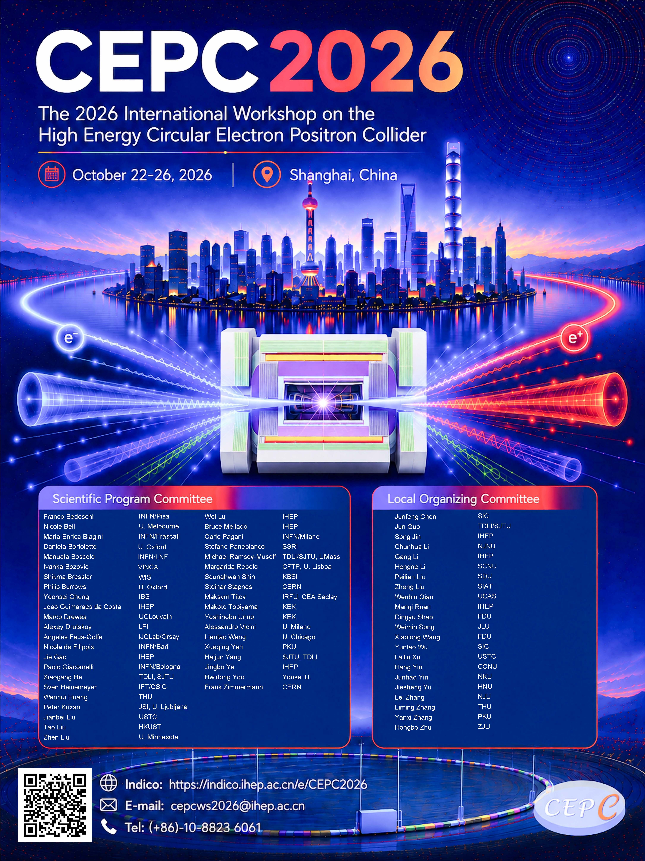
Coming events
CEPC workshop @ Shanghai, 22-26 Oct
  https://indico.ihep.ac.cn/event/28911/
  Please register!
  Talk in SiDet session on Inner Tracker
  → get in touch if interested
  Call for poster open (deadline 6th Sep)
  → please apply! Award for outstanding posters
FCC-ee Tracking & PID workshop, 16-20 Nov
  https://indico.cern.ch/event/1660971/
CEPC European Edition Workshop
  Belgrade, Serbia, June 8-11, 2027

Slide 4
Agenda today
Sensor status
  COFFEE3 follow-up
  CHiR
Serial powering development
AOB

