Slide 1
CHiR status
DENG Jianpeng, LI Yiming, WANG Boxin, ZHOU Yang
For the CHiR team
AGORA / CEPC Inner Tracker meeting, 1st Sep 2026
https://indico.ihep.ac.cn/event/30588/

Slide 2
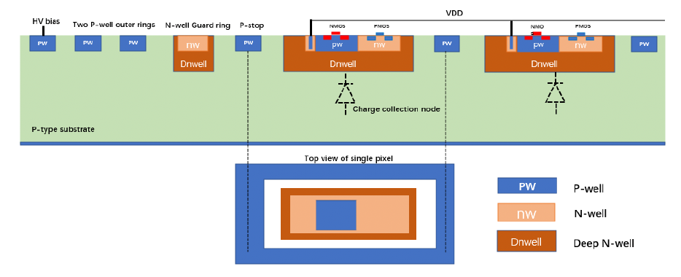
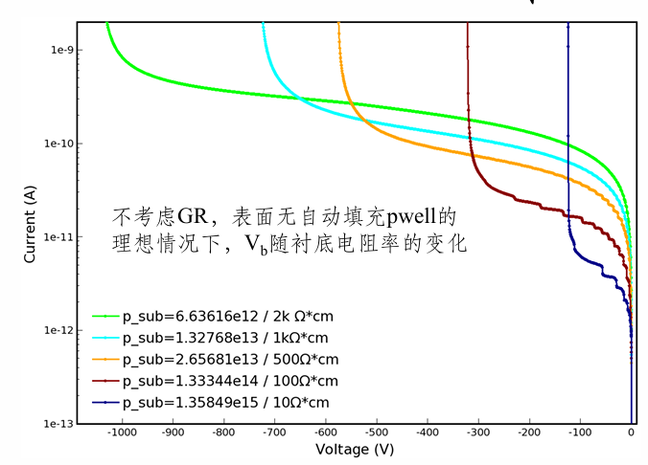
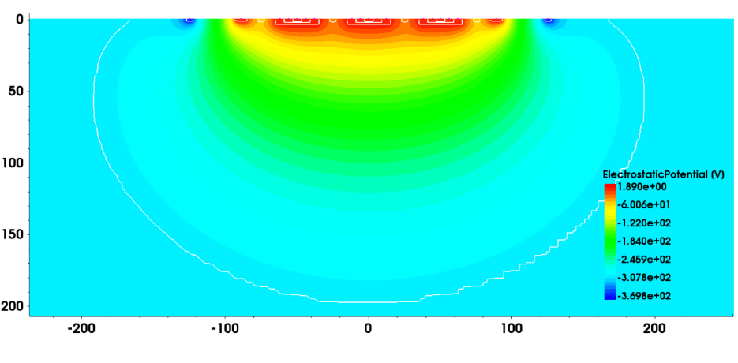
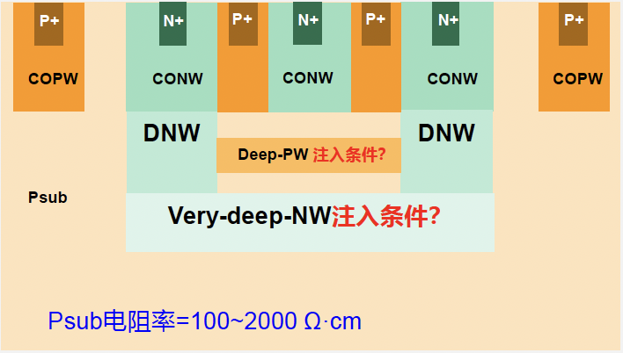




CHiR: Goal of process modification
Priority: to validate the process with high-res wafers
Implementation of “Five-well process”: to validate basic IP not affected by process modification
Radiation effects of simple components (eg. MOS) with or w/o radiation hardening
400V @
> 1k $Ω$cm
Depletion depth:
Breakdown:
~10um @
10 $Ω$cm
~200um @
>1k $Ω$cm
70V @
10 $Ω$cm

Slide 3
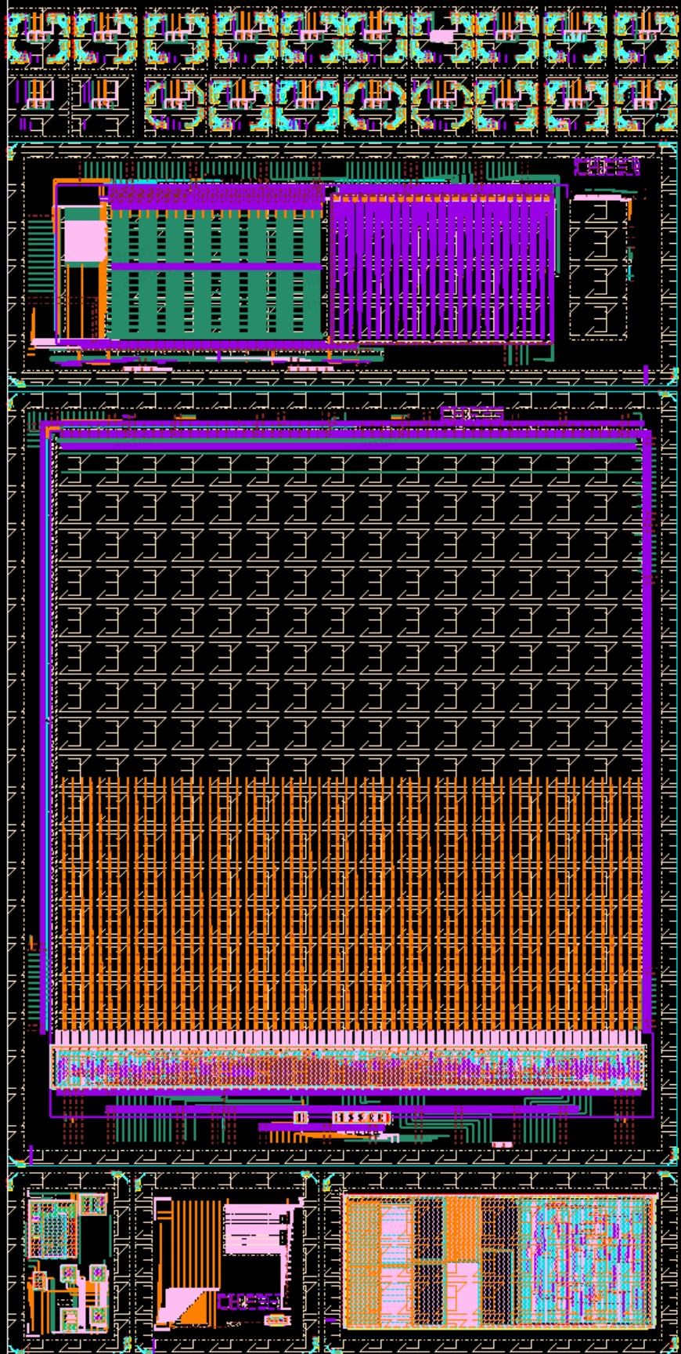
CHiR1
11 mm
~2 mm
A
Can be diced into 6 dies serving various goals
  Passive sensor validation:
    (A) 20 arrays of 3x4 passive pixels with diff guard ring designs, each can be diced into individual 1x1 mm2 chip
    Pixel size: 38 um x 175 um
  Pixel array design
    (B) 9 variations of in-pixel frontend designs
    (C) main pixel array of 256 x 64 pixels; similar as COFFEE3 with readout data format compatible with 32-bit UP spec
  IP validations
    (D) necessary analog Ips: PLL, DLL, LVDS transceivers …
    (E) alternative small pixel arrays
    (F) digital modules and transistors for TID and SEE studies
~4 mm
B
C
~22 mm
~13 mm
3 mm
D
E
F
2 mm
3 mm
5.5 mm

Slide 4
CHiR1 status
Submitted in Jan 2026
First production completed in Jul, tuning still ongoing
  This round of production is for parameter tuning of the process, at least 3-4 rounds forseen by the fab before the final delivery
  Wafer: all from one batch of 2kOhm cm wafers (5 batches available: 1k/2k/4k Ohm cm, from 2 manufacturers)
  MOS performance of July batch deviates from baseline – another round in August using low-res wafer shows improvement
  Another round of low-res production to make sure the MOS performance satisfactory
  Final production with high-res wafer expected in end Sep, delivery end Oct
Chips back
Chips testable

Slide 5
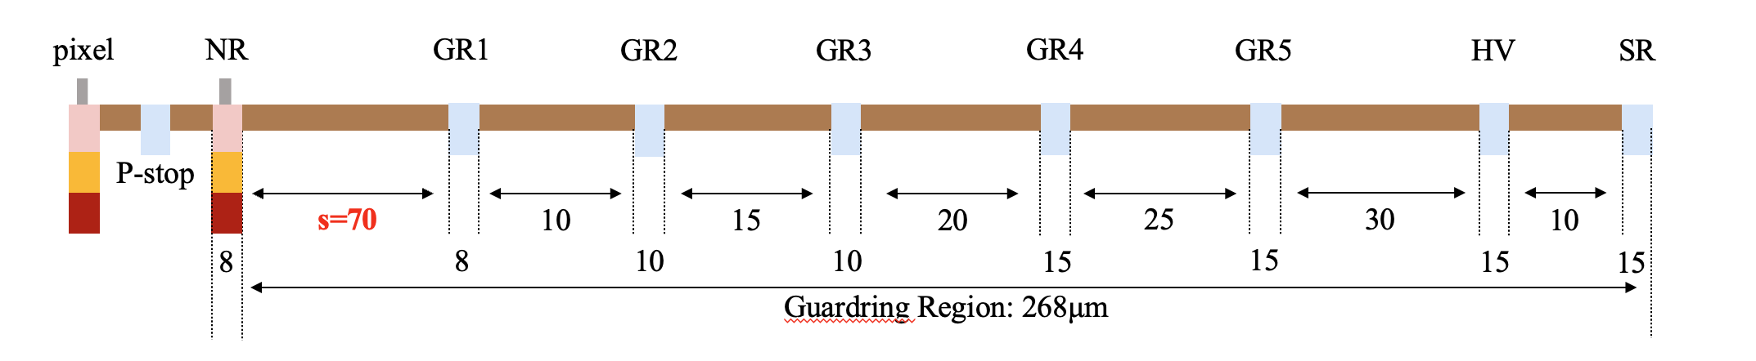
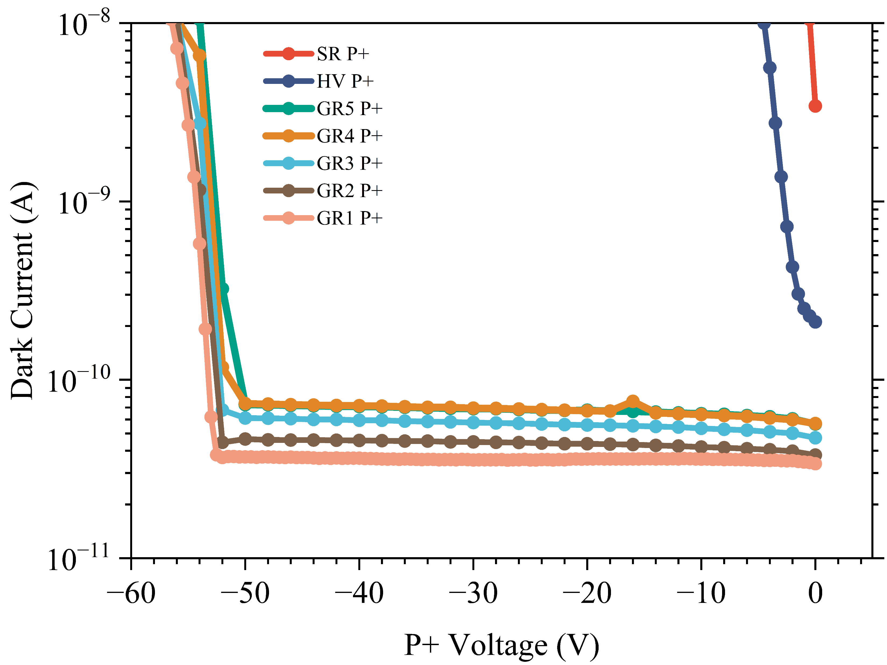


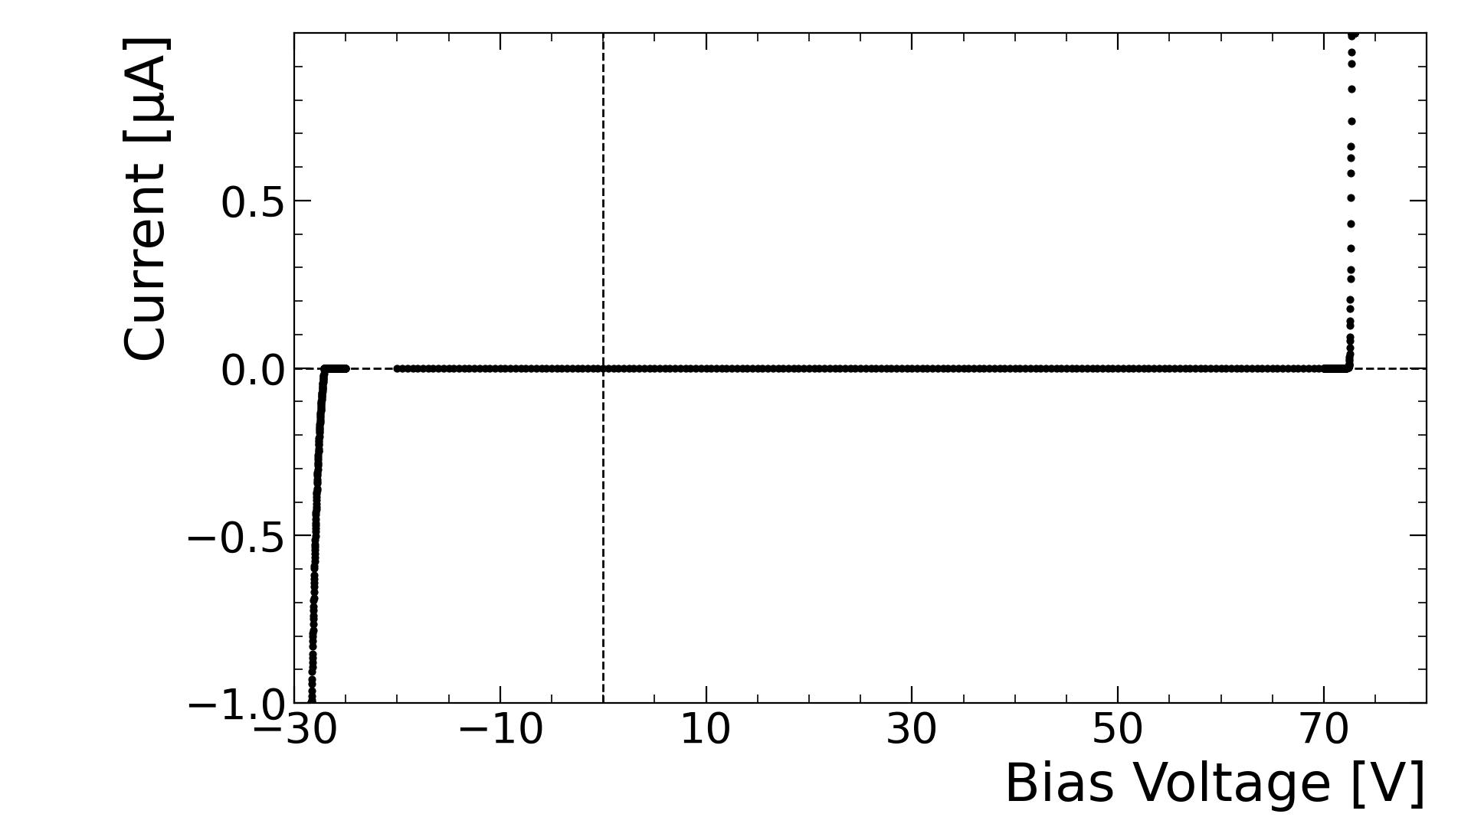
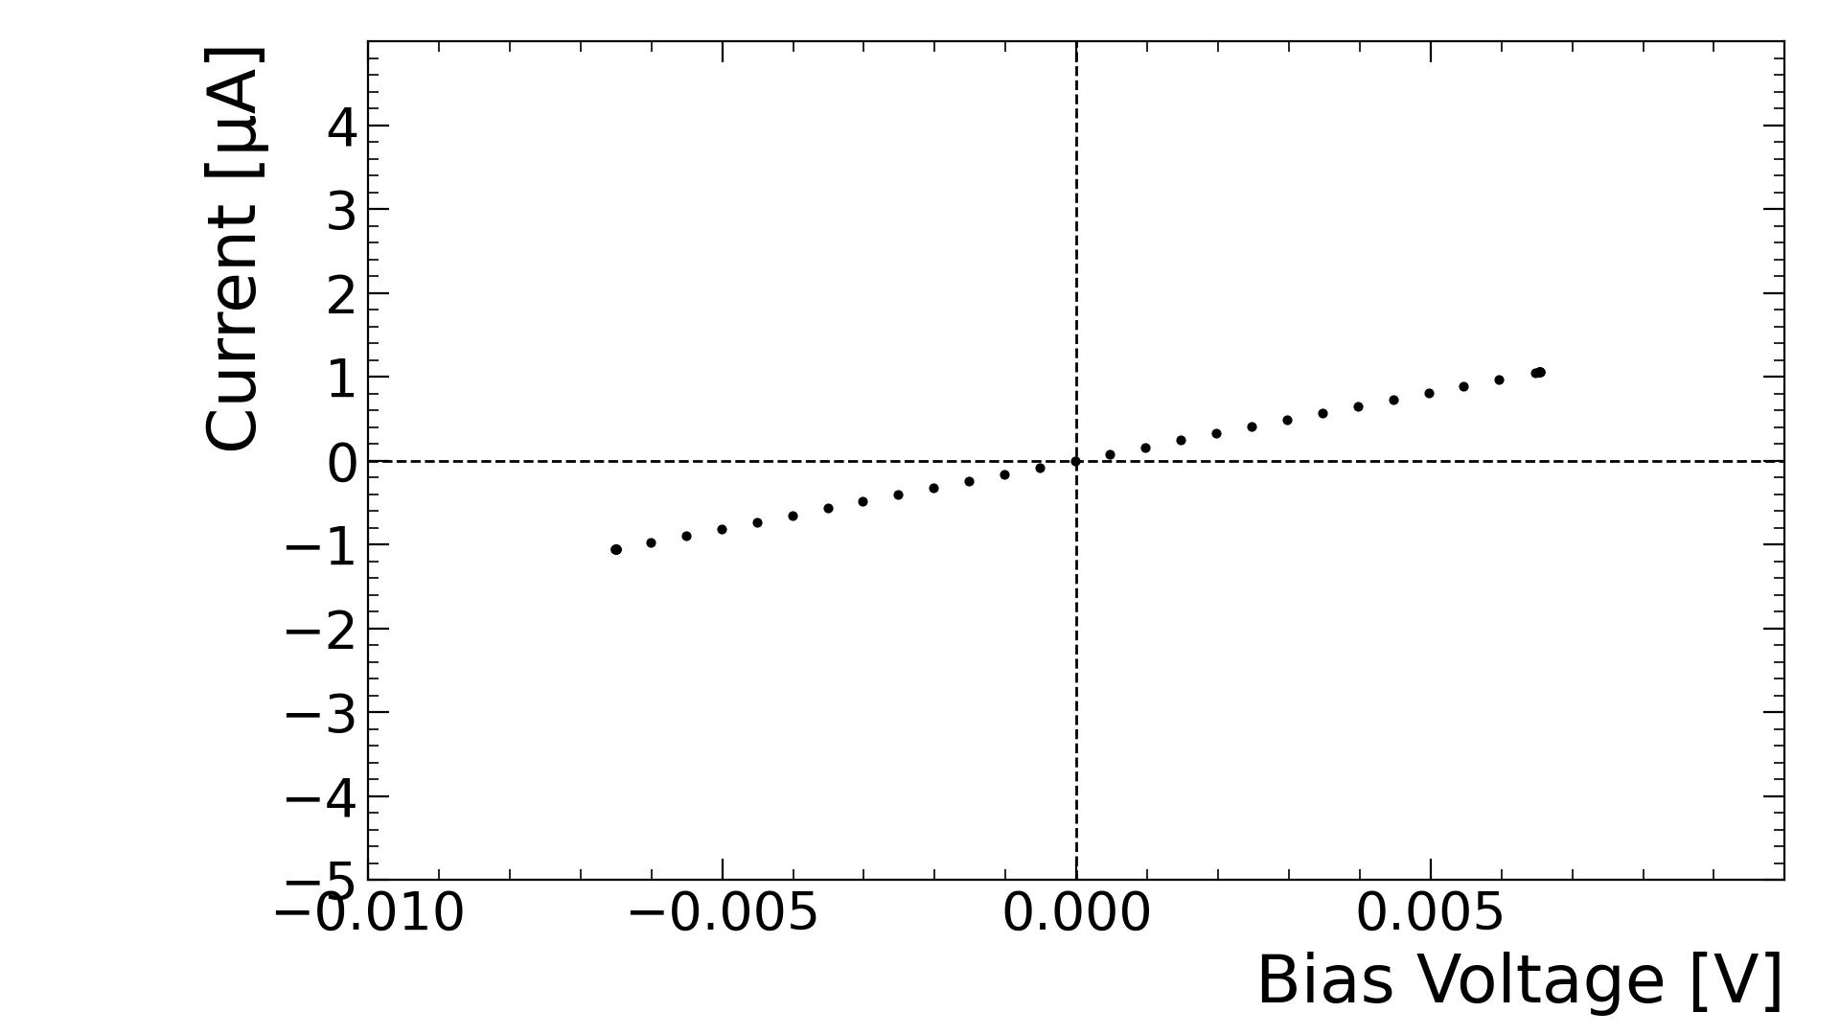
CHiR1 status
First batch from July production already back & distributed
  A – tested in IHEP (Boxin’s slides) and ZJU
  D – test boards produced in DMU
  F – test boards being designed in NWPU
IV tests show unexpected behaviour
  Very early breakdown
  Conductive between N-wells
N-type substrate ??
Fab performed SIMS and confirmed
Checking all wafer stock, will correct in following productions
CHiR1.0A
HV - NR
NR – NR of neigbouring array
COFFEE3
CHiR1.0A

Slide 6
CHiR status
We are following up with fab status closely
IV test feedback almost prompt
  Not successful due to wafer quality for the first round
  Need to double check for future run
Next batch of low-res (p-sub) chips will be back soon (~1 week)
  Good to validate design functionalities
Final high-res wafers expected in Oct

