Slide 1
Development Status & Plans of Serial Powering at IHEP
ZHANG Hui
On behalf of the IHEP team

Slide 2
Content
ATLASPix3-based SLDO tests
  Probe Card Design
  Chip Test with and without core cell
  ATLASPix3 PCB Test
COFFEE/CHiR Chips with SLDO design
  Chip Design with two architecture
  Simulation results
  PCB design for chip testing
Plans for module prototyping
Long-term collaboration with ATLASPix community for future Higgs factory.
Meanwhile developing SP-compatibility in COFFEE series
Module-level demonstration ongoing
Notes:
Long-term collaboration with ATLASPix community for future Higgs factory; member of DRD3 project on SP.
Meanwhile developing SP-compatibility in COFFEE series
Module-level demonstration ongoing

Slide 3
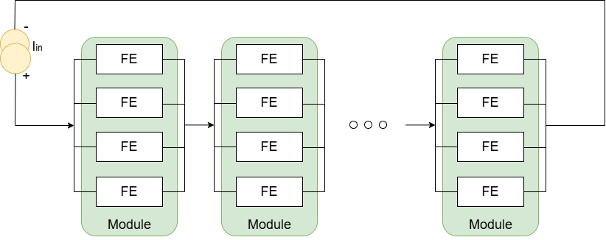
Serial Powering Concept
Serial powering is a current based powering scheme, where modules are powered in series by a constant current
The current to voltage conversion is done by regulators close to module
The Serial Powering supply scheme significantly reduces
  The number of cables
  Total supply current
  Material costs
Notes:
Serial powering is a current‑based powering scheme where multiple modules are connected in series and driven by a constant current. Voltage regulation is performed locally, close to each module.
This scheme significantly reduces:
The number of cables
Total supply current
Material costs

Slide 4
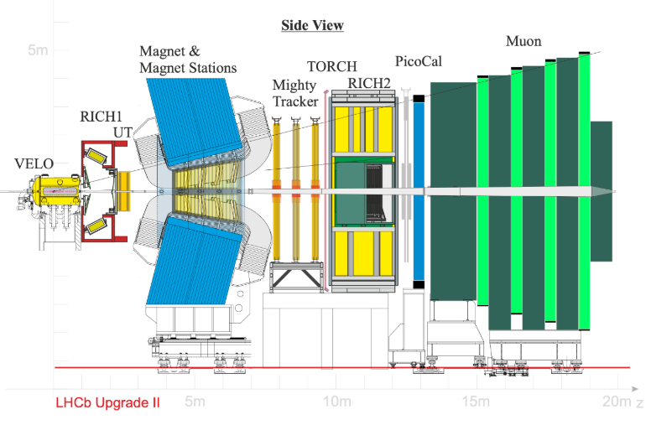
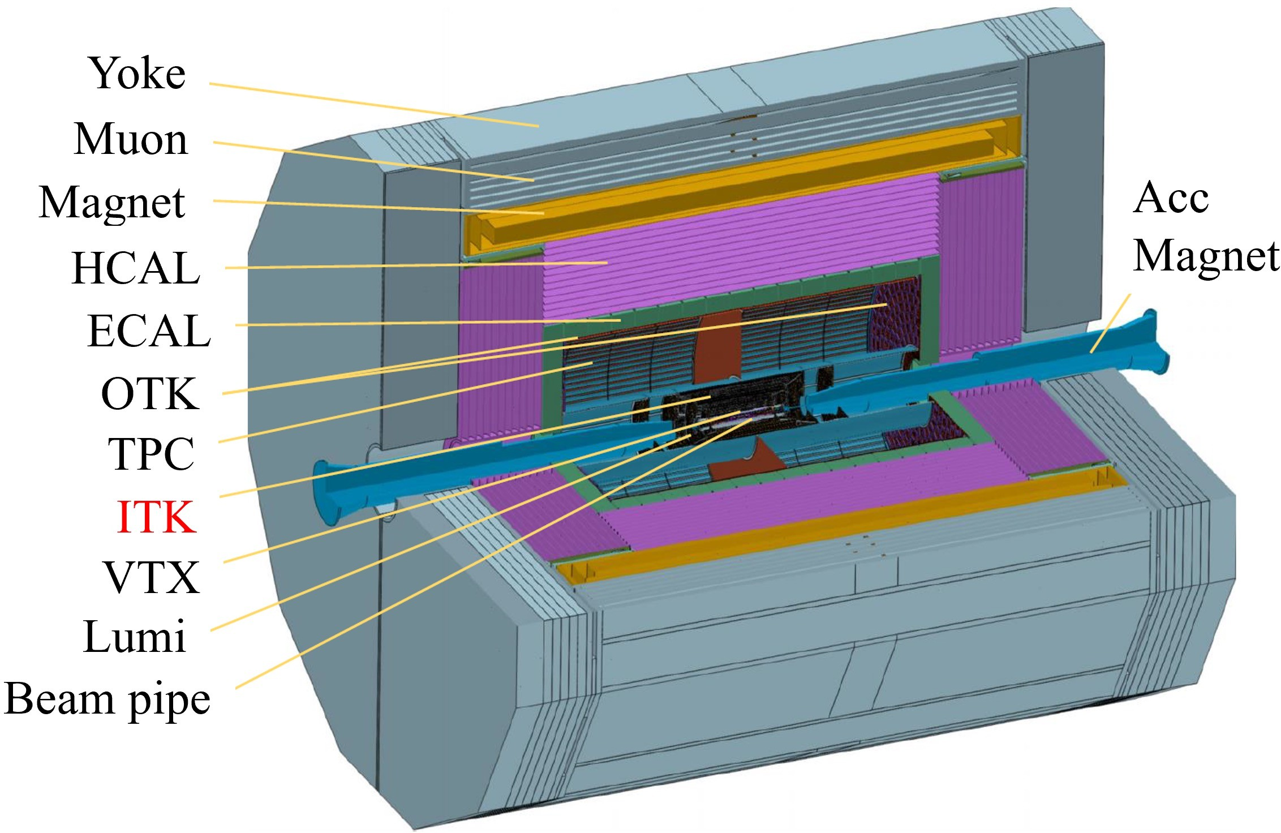
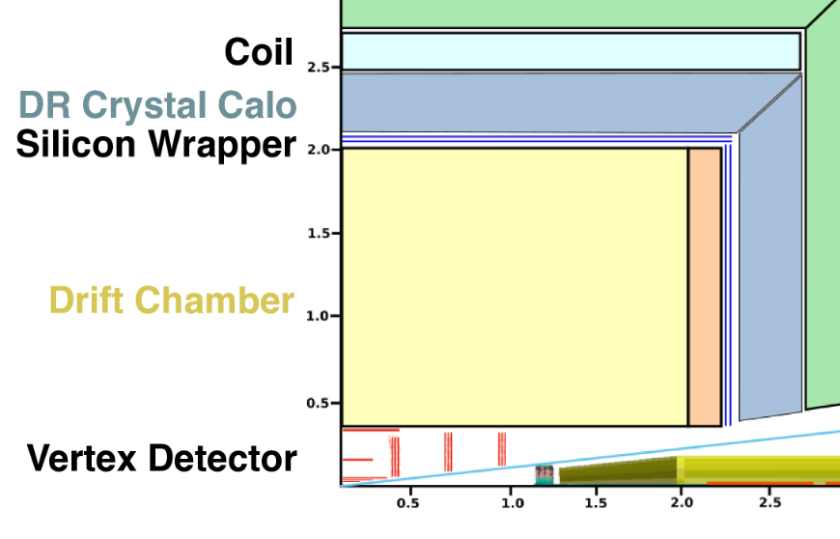
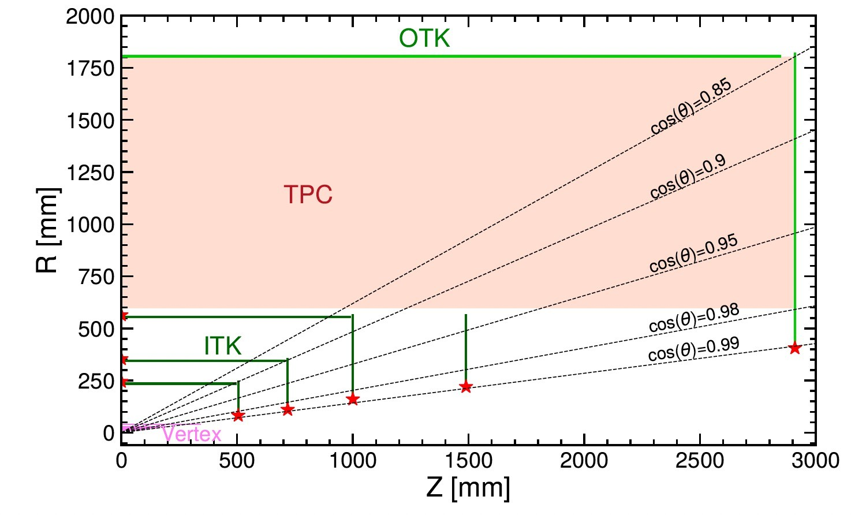
Serial Powering – motivation and challenges
The material budget in trackers is dominated by services; minimize this material is essential
LHCb Upstream Tracker (UT) Upgrade:
  The UT requires a low-material-budget tracking system to minimize multiple scattering
  Serial powering is identified as a baseline solution to reduce cable mass and cooling load
CEPC Inner Tracker (ITK):
  The CEPC ITK, equipped with CMOS pixel sensors, faces stringent material budget constraints
  Serial powering is under active exploration as a candidate powering scheme
Serial powering is assumed as baseline for ongoing designs
Notes:
In high‑luminosity trackers, the material budget is often dominated by services such as cooling and power distribution.
Minimising this budget is essential for performance. Serial powering has become an increasingly attractive solution, and we have adopted it as a baseline to drive component design.
**Driven by specific experiment upgrade programs:** -
**LHCb Upstream Tracker (UT) Upgrade:** -
Our R&D directly addresses the powering challenges for the UT upgrade –
**CEPC Inner Tracker:** -
Our work provides a validated technical path for future circular collider applications –
**This work presents the first systematic test of ATLASPix3-based serial powering and the development of next-generation SLDO designs, aiming to provide a ready-to-use solution for both LHCb UT and CEPC inner tracker.**

Slide 5
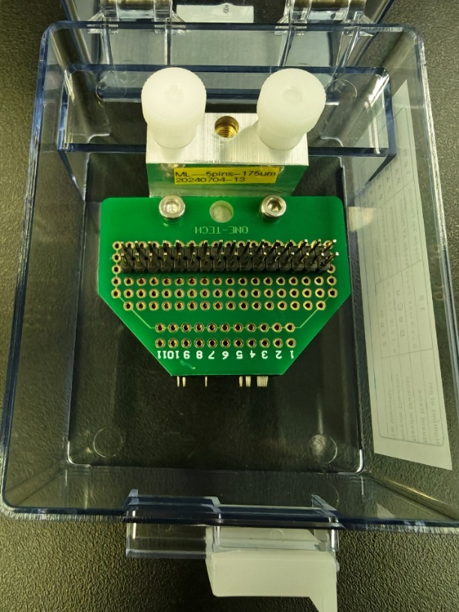
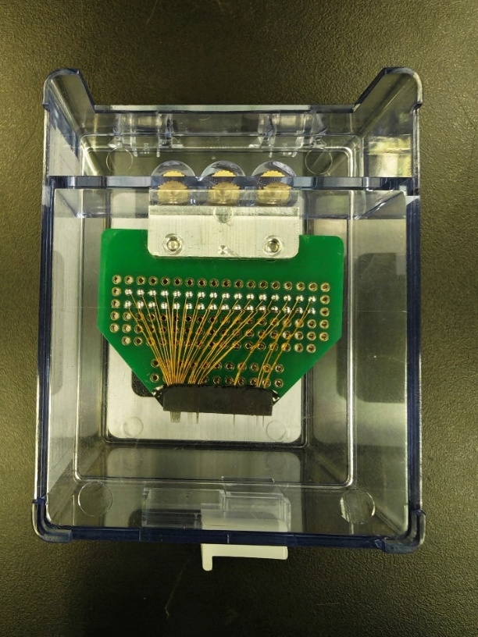
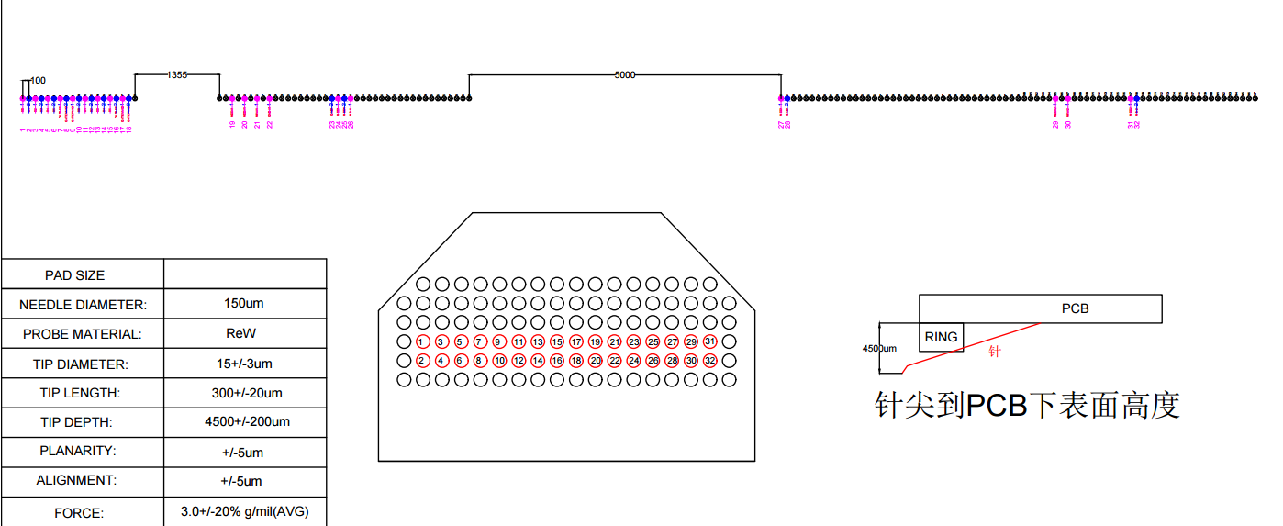
Probe Card Design
b0
b1
b2
b3
b4
b5
outref
gatenmos
gatepmos
b0
b1
b2
b3
b4
b5
outref
gatenmos
gatepmos
19. vdda!
20. vdda1
21. vina1
22. gnda!
23. gnd!
24. vdd!
25. vdd1
26. vin1
27. vdd!
28. gnd!
29. vdda2
30. vina2
31. vdd2
32. vin2
Vdd!
Vdda!

Slide 6
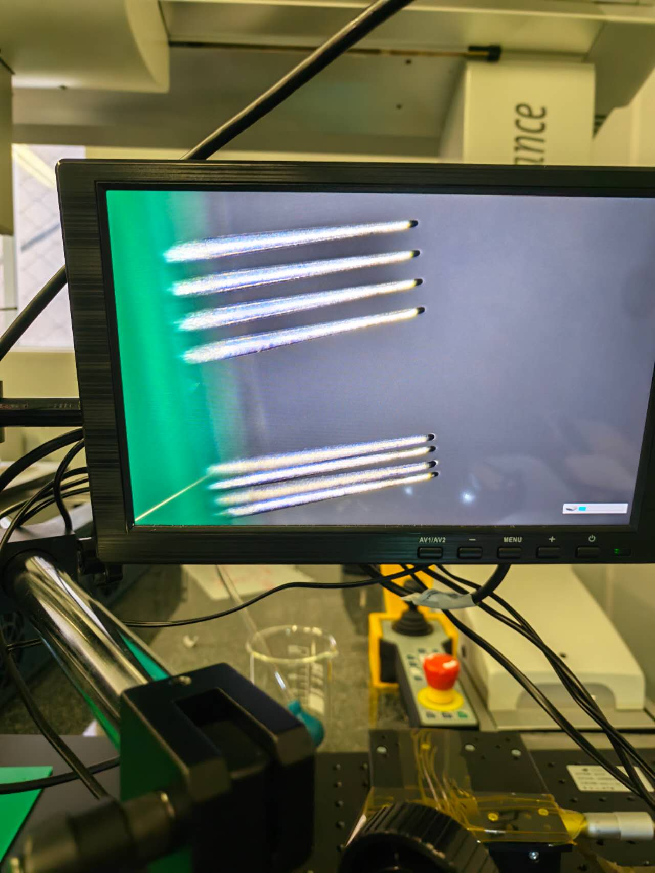
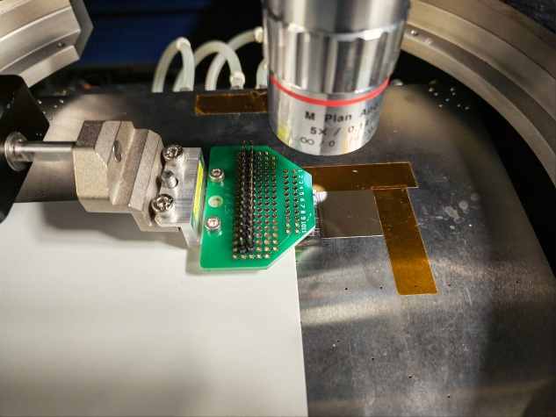
Bare chip (SLDO) test
Testing bare chips with the probe card
Analog and digital output are both tested

Slide 7
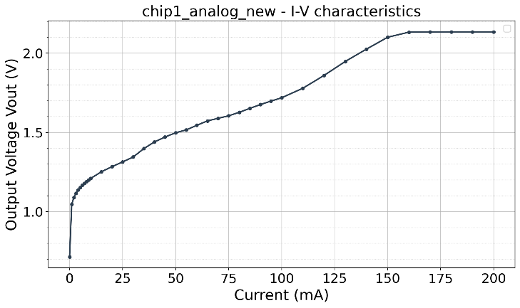
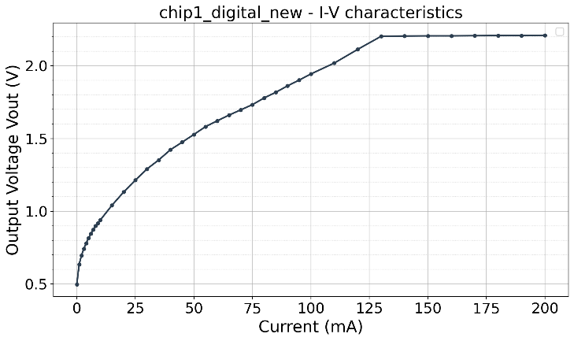
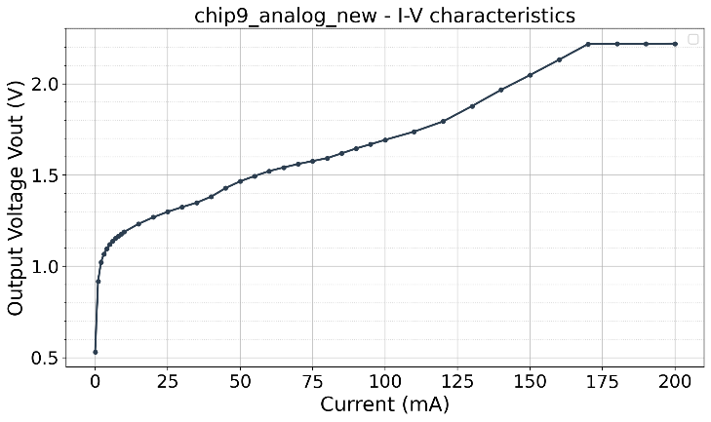
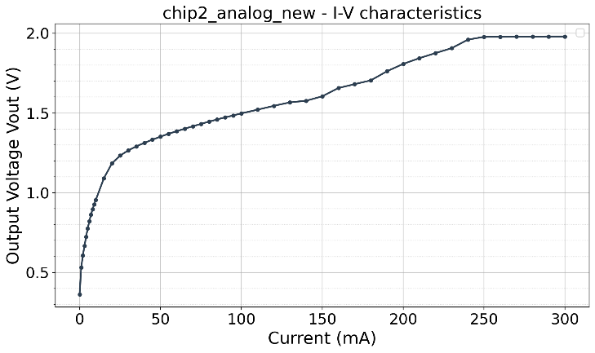
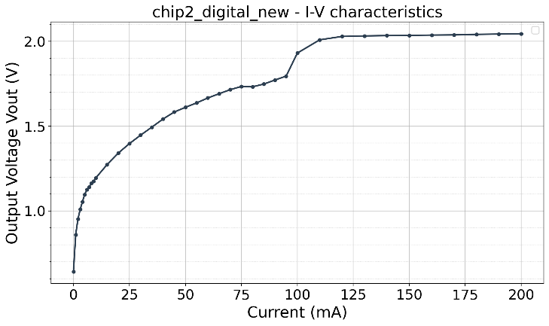
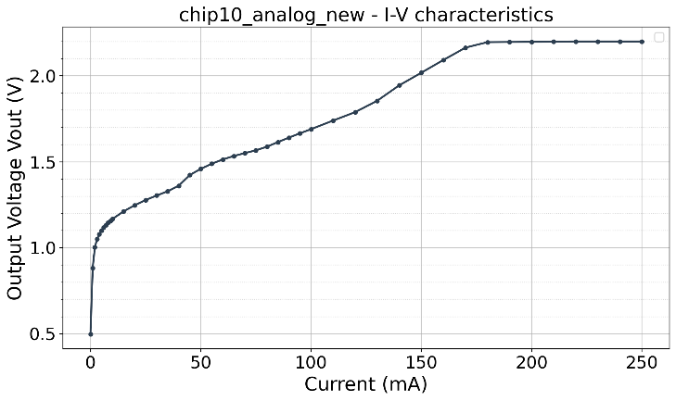
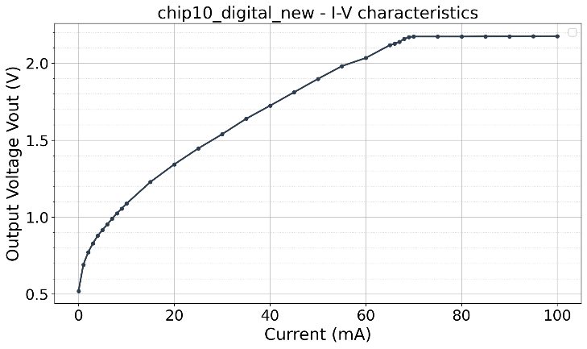
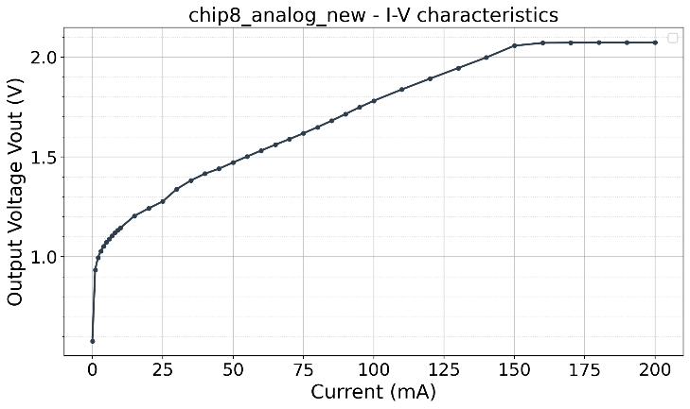
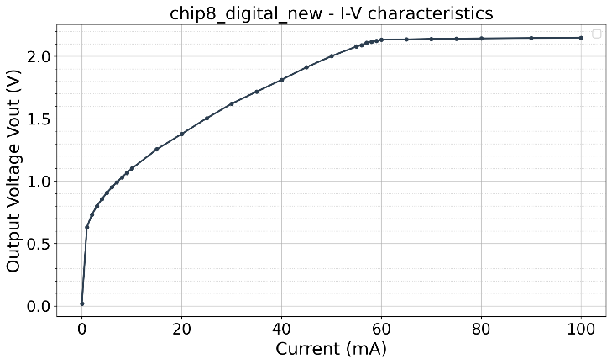
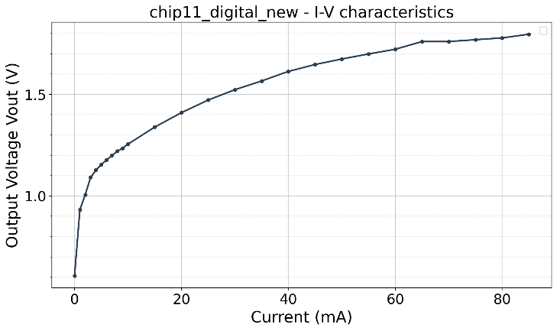

SLDO with core Chip

Slide 8
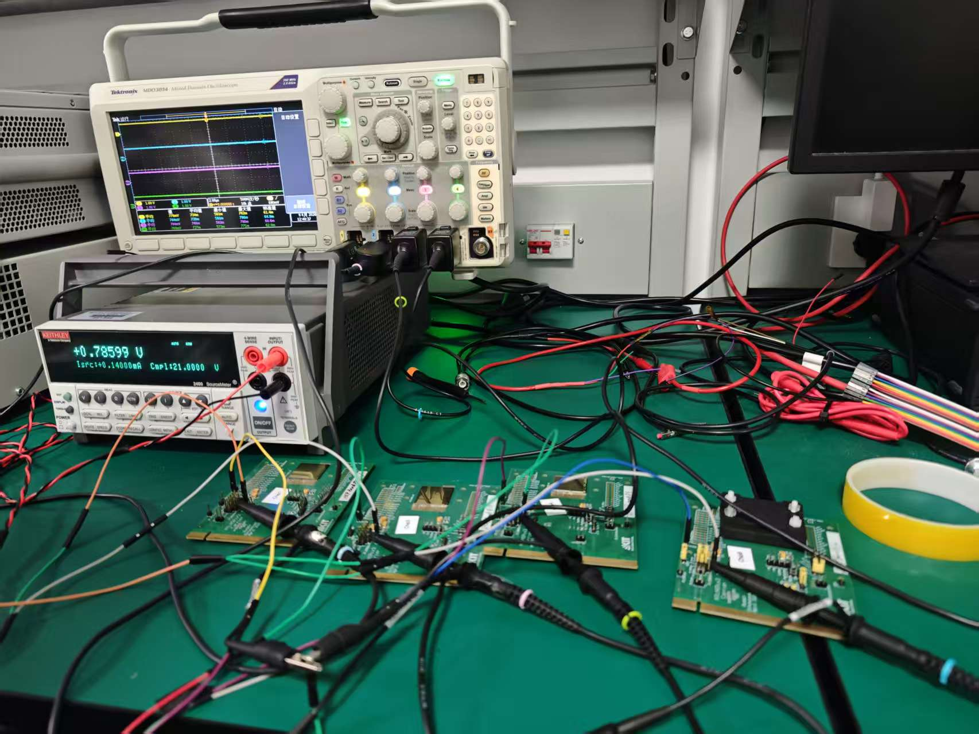
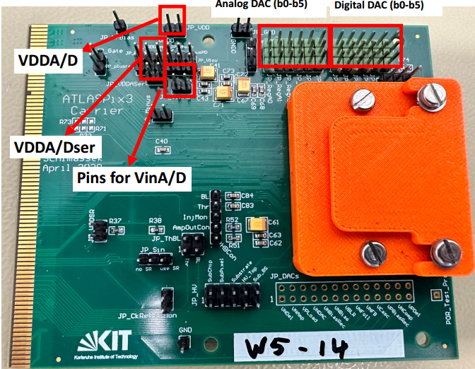
Multi-chip Testing Setup with SCC
Four ATLASPix (3.0) chips on Single‑Chip Carrier (SCC) used for multi-chip testing
Test the analog and digital output of all chips
Oscilloscope
Current Source
Chips
Notes:
Here is the multi chip testing setup. We use a current source to input , a scope to test the output point.

Slide 9
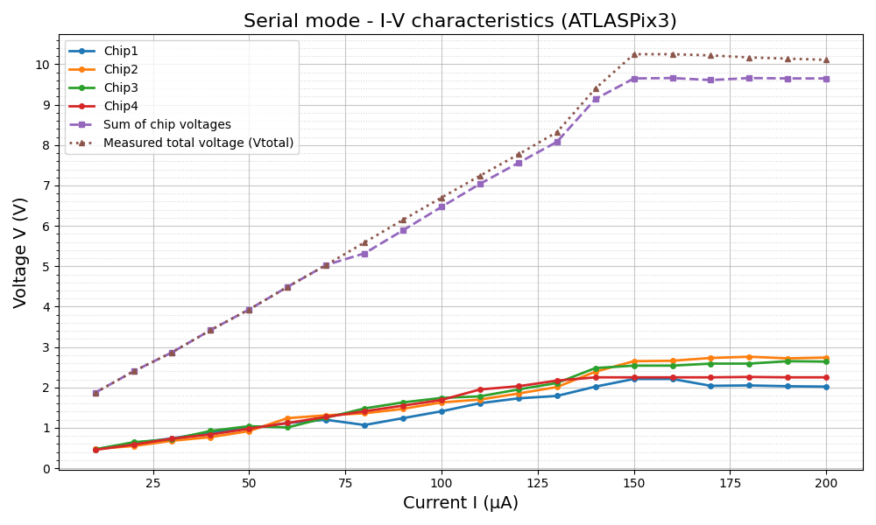
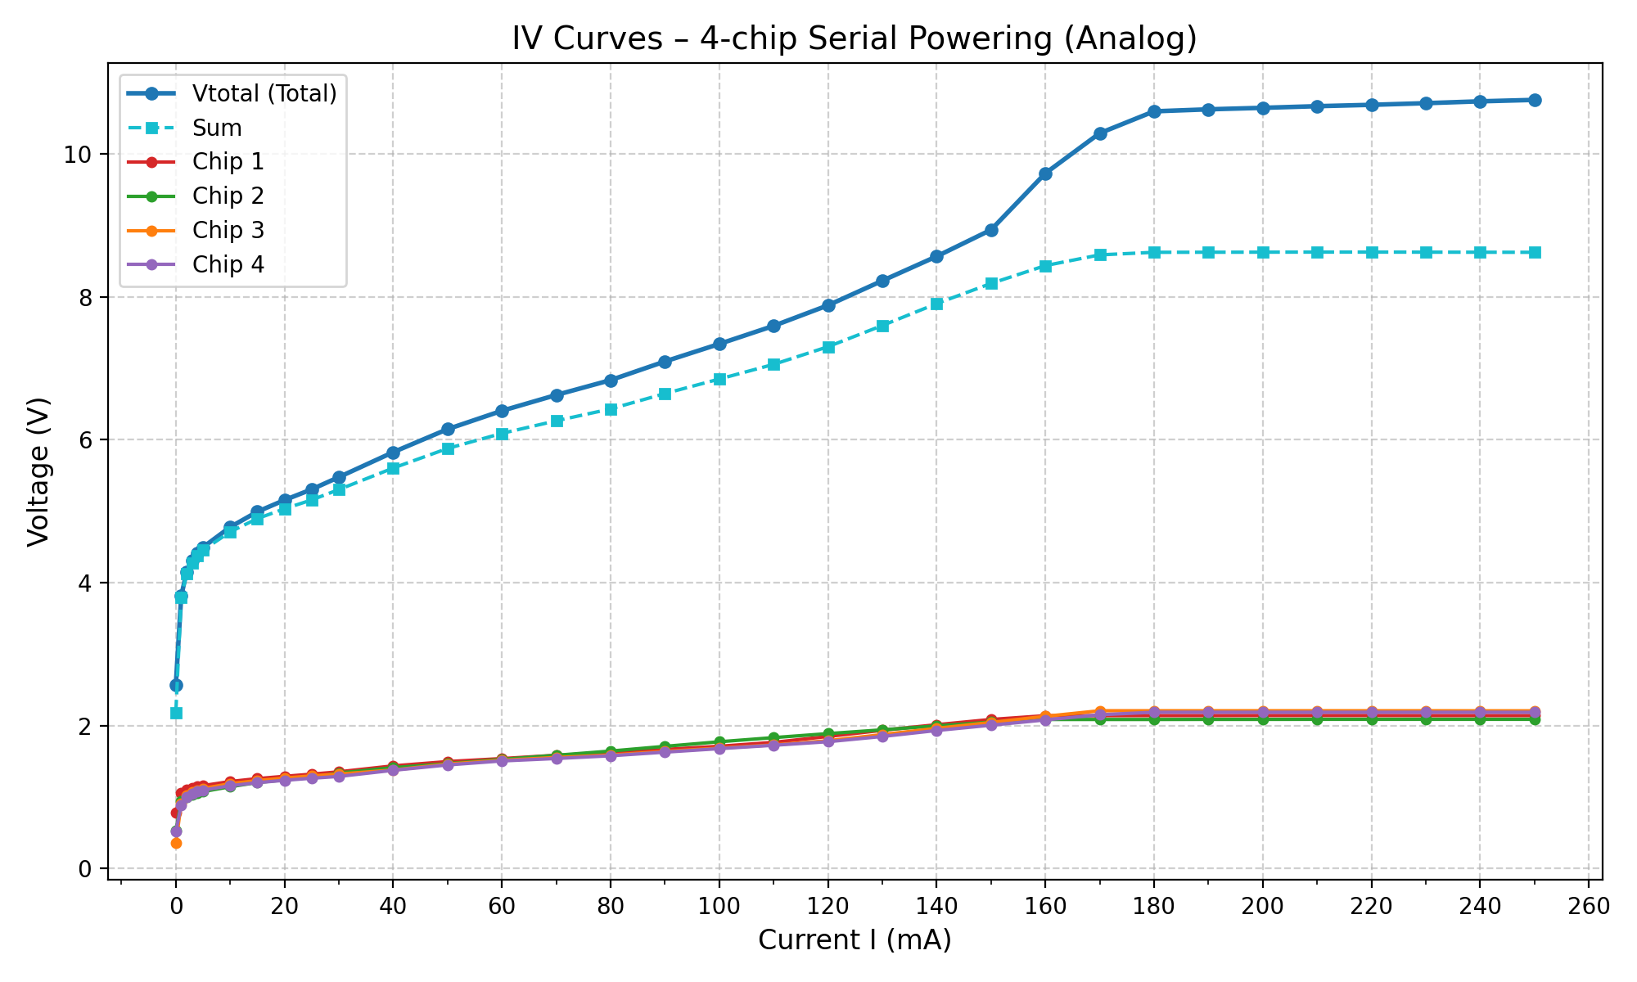
Multi-chip Testing with SCC
Stable regulation is achieved in both cases
  ~150 mA input current yields 2.2–2.8 V (without core cell)
  ~160 mA input current yields 2.0 V (with core cell)
Both scenarios demonstrate good regulation and fully meet our expectations
without core cell
with core cell
Notes:
Four ATLASPix3 chips assembled on a Single‑Chip Carrier (SCC) were used for multi‑chip serial operation. All chips showed stable analogue and digital outputs

Slide 10
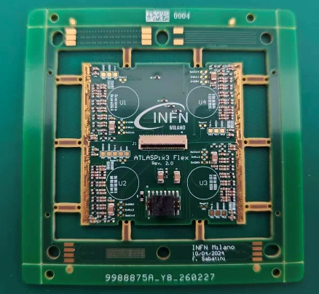
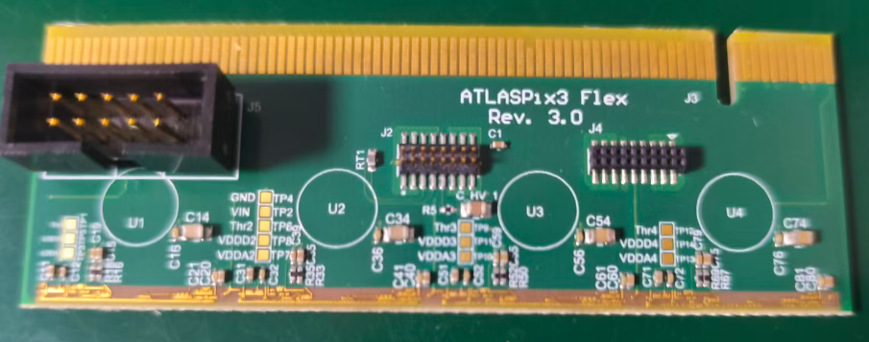
1 x 4 PCB design and production
ATLASPix-based modules:
  a new layout 1×4 test board has been designed and produced suitable for LHCb experiment geometry based on Quad flex
  Note: limited number of chips (<7) available
ATLASPix Chip will wire bonded on 1 x 4 PCB and test the serial powering functionality
2 x 2 chips, designed by Milano and Edinburgh
1 x 4 chips
Notes:
A 1×4 test board based on a quad‑flex design has been produced. Due to the limited number of available chips (<7), wire‑bonding and functional testing are underway.

Slide 11
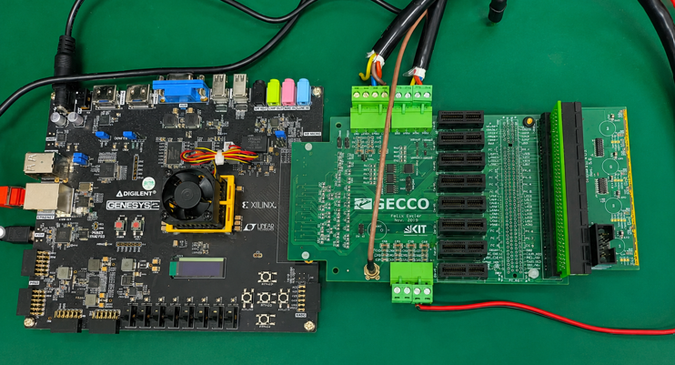
Module testing setup
GECCO, flexible readout system developed by KIT
Firmware and software adapted to module operation

Slide 12
Content
ATLASPix3-based SLDO tests
  Probe Card Design
  Chip Test with and without core cell
  ATLASPix3 PCB Test
COFFEE/CHiR Chips with SLDO design
  Chip Design with two architecture
  Simulation results
  PCB design for chip testing
Plans for module prototyping
Notes:
Long-term collaboration with ATLASPix community for future Higgs factory; member of DRD3 project on SP.
Meanwhile developing SP-compatibility in COFFEE series
Module-level demonstration ongoing

Slide 13
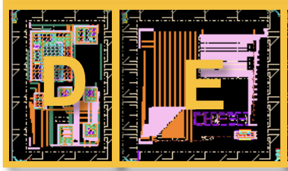
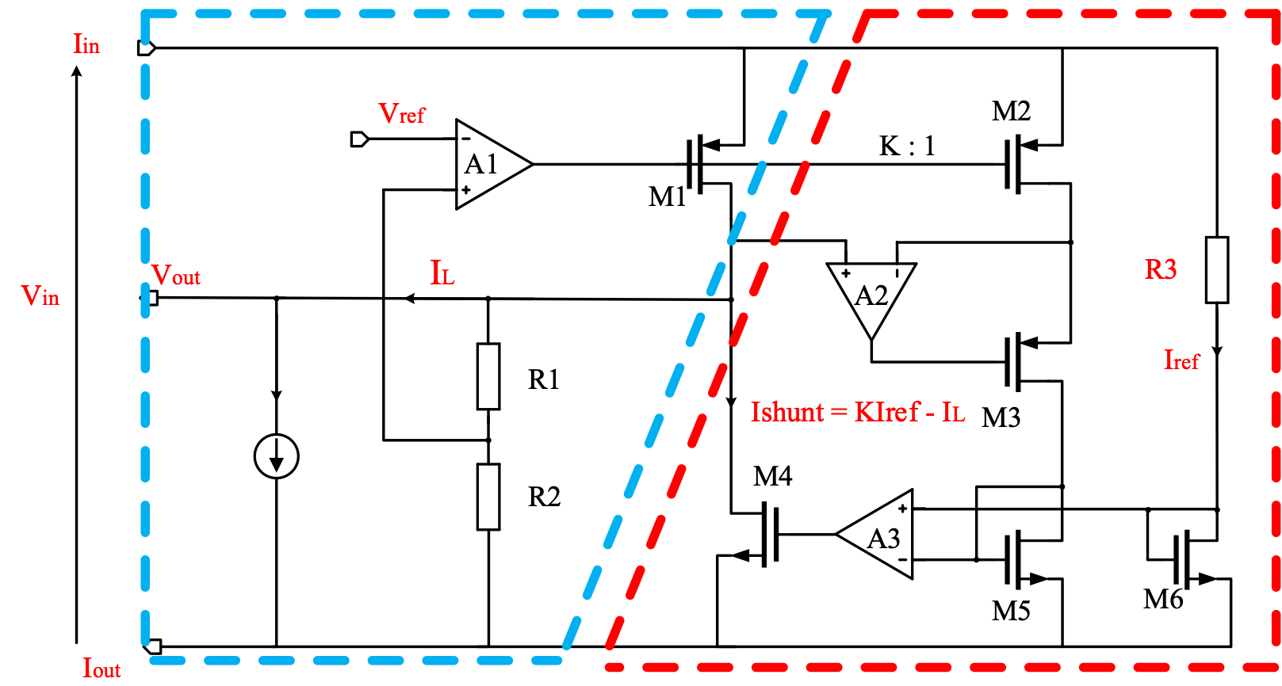
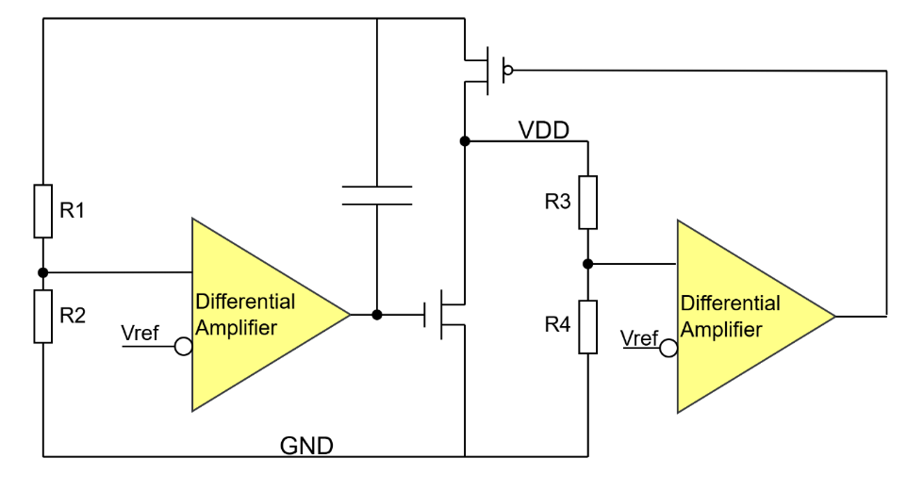
Sensor development with SLDO
Two different designs of SLDO implemented in CHiR with 55 nm HVCMOS process (latest COFFEE submission with modified process)
3 mm
2 mm
3 mm
Notes:
Two different designs of SLDO implemented in CHiR. So compare to the COFFEE serial, we require a modified process.
Two different SLDO designs have been implemented in the CHiR chip, fabricated in a 55 nm HVCMOS process (latest COFFEE submission with a modified process). One design follows the ATLASPix3 approach, the other is based on RD53.

Slide 14
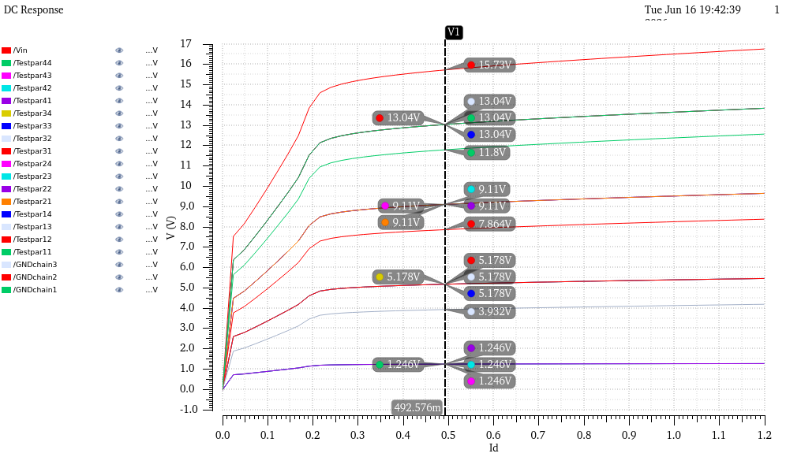
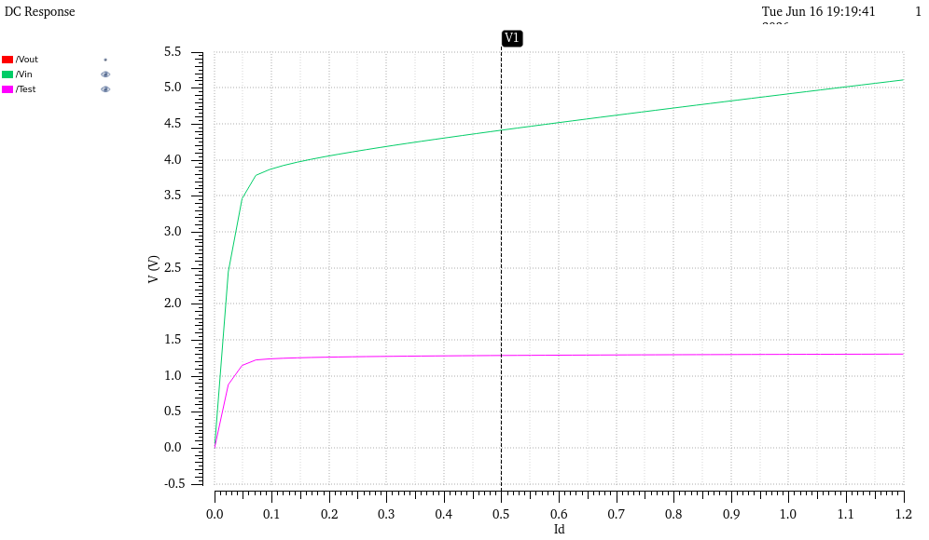
Sensor development with SLDO
Device types and dimensions optimised for both shunt and pass‑device
Technology limitation: max input voltage = 1.2 V
Overvoltage‑tolerant design extends capability to 2 V (55 nm process)
Simulations validated for single SLDO and 4‑chip serial chain
Input Voltage
Output Voltage
Notes:
Device types and dimensions were optimised for both shunt and pass devices.
The technology limits the nominal input voltage to 1.2 V, but an overvoltage‑tolerant design allows operation up to 2 V.
Simulations of both single and four‑chip serial configurations confirm stable regulation across the chain.

Slide 15
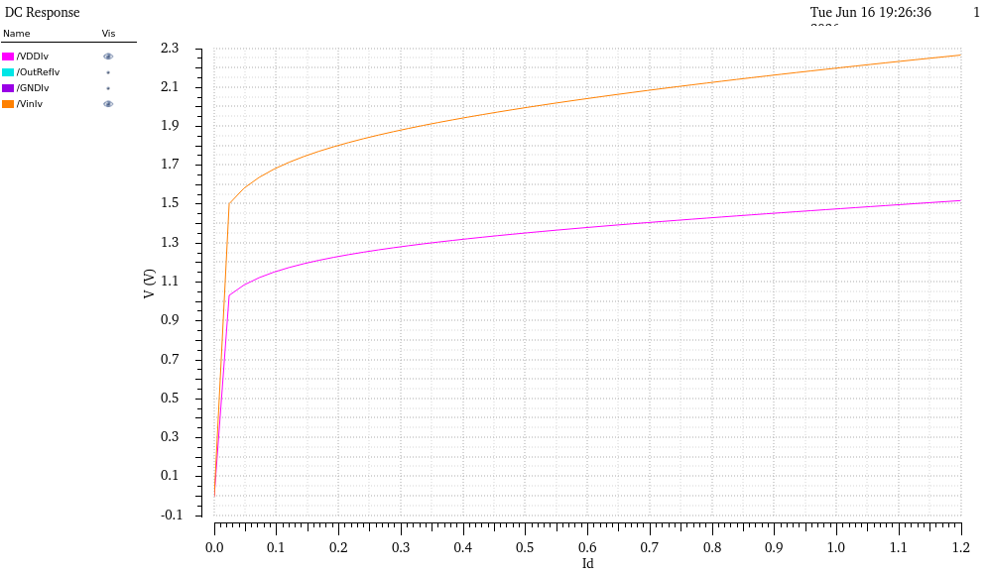
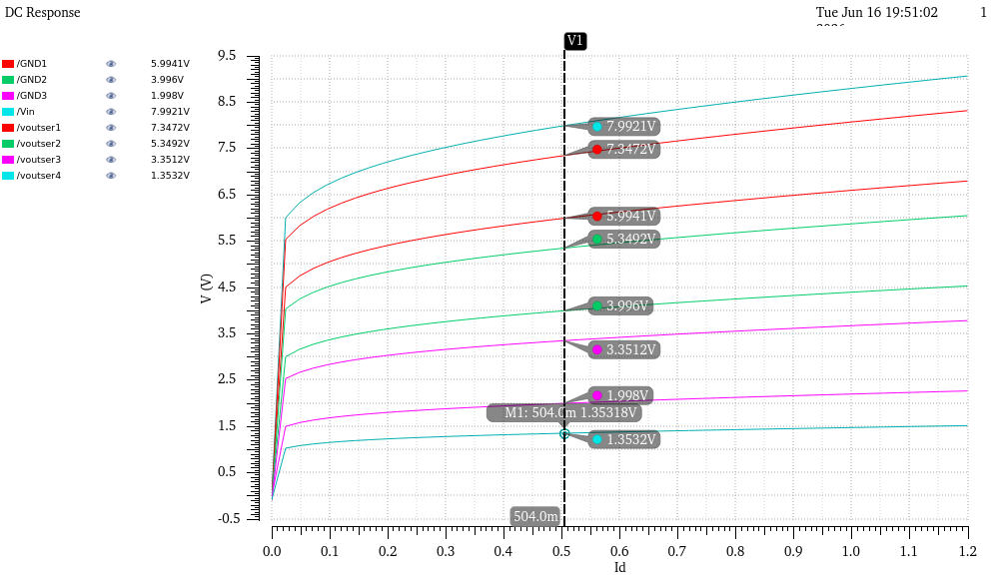
Sensor development with SLDO
Separate regulation modules for VDDA and VDDD
Enables constant‑current operation mode
  Loop 1: defines shunt regulation
  Loop 2: regulates both VDDA and VDDD outputs
Simulations performed for single SLDO and 4 chips serial chain
Loop 1
Loop 2
Input Voltage
Output Voltage
Notes:
The SLDO block provides separate regulation for VDDA and VDDD, enabling constant‑current operation.
The first control loop defines shunt regulation, while the second loop sets the regulated output voltages.

Slide 16
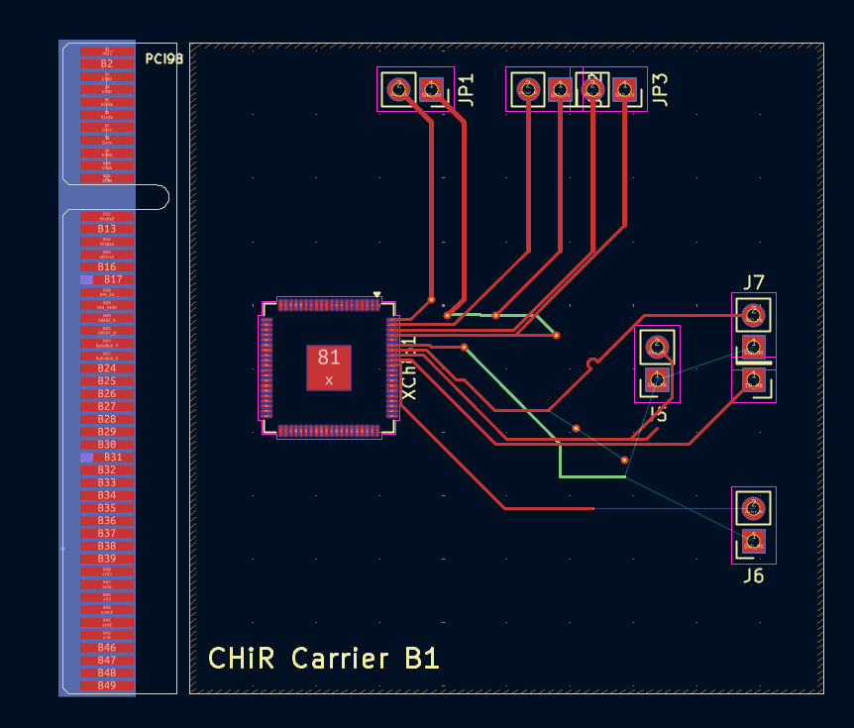
PCB design and production for CHiR
A test PCB for CHiR is designed and currently being production
Testing start in August 2026
Full functional test plan prepared: SLDO output characterization, serial-chain regulation, and load transient response will be measured
Notes:
A test PCB for CHiR is designed and currently being production and will be produced for tests starting in summer 2026.

Slide 17
Ongoing efforts & plans
ATLASPix3‑based modules
  wire‑bonding of chips on the 1×4 PCB
  full serial‑powering functional tests
CHiR‑based tests:
  to begin as soon as chips become available (expected August 2026)
  Hardware, firmware and software: ongoing preparation for the module DAQ
Notes:
ATLASPix3‑based modules: wire‑bonding of chips on the 1×4 PCB and full serial‑powering functional tests.
CHiR‑based tests: to begin as soon as chips become available (expected summer 2026).
Hardware, firmware and software: ongoing preparation for the module DAQ.
Serial‑powering tests on SCC carriers have already demonstrated that each chip’s voltage is automatically regulated and the data link remains stable, even at low current settings (using jumper configuration on SCC).

Slide 18
Summary
Long‑term collaboration with the ATLASPix community for future Higgs‑factory applications
Active member of the DRD3 project on serial powering
Concurrent development of serial‑powering compatibility in the COFFEE/CHiR chip series
Module‑level demonstration is in progress
Dual benefit: future colliders (FCC‑ee, CEPC) + existing experiments (LHCb)

Slide 19
Thank you

