Slide 1

Status of the error correction to the Higgs lattice with local solenoid compensation
Bin Wang
2026.08.28

Slide 2
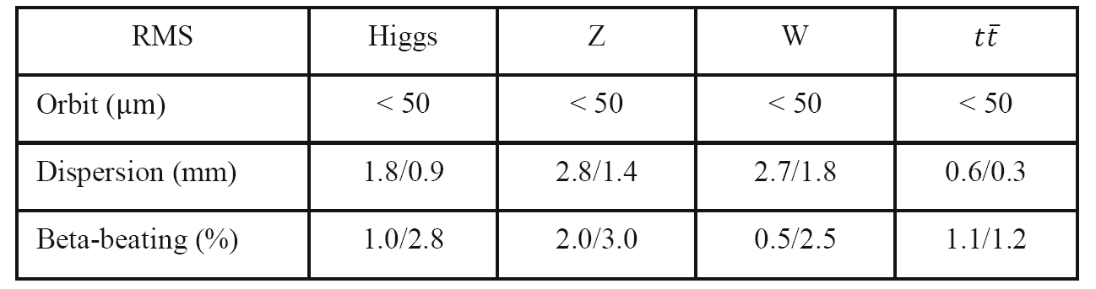
Error Correction to the Higgs lattice
Software: SAD and Matlab-based accelerator toolbox (AT)
Closed-orbit distortion (COD) correction was performed with sextupoles off, then the sextupoles were turned on and the COD correction repeated.
The dispersion correction (DISP) and beta-beating correction are also used for optics correction.
The coupling and vertical dispersion correction are used to decrease the vertical emittance.
The above correction scheme is iterated until the emittance and tracking dynamic aperture satisfy the design requirements.
The correction target is 50 μm for COD correction, 2mm for DISP correction and 3% for beta beating correction. ‌Taking the Higgs mode correction as an example‌.
Correction performance for lattices without solenoid.
Misalignment and field error requirements.
Component | Δx (mm) | Δy (mm) | Δθ_{z} (mrad) | Field error
Dipole | 0.10 | 0.10 | 0.10 | 0.01%
Quadrupole | 0.10 | 0.10 | 0.10 | 0.02%
Sextupole | 0.10 | 0.10 | 0.10 | 0.02%

Slide 3
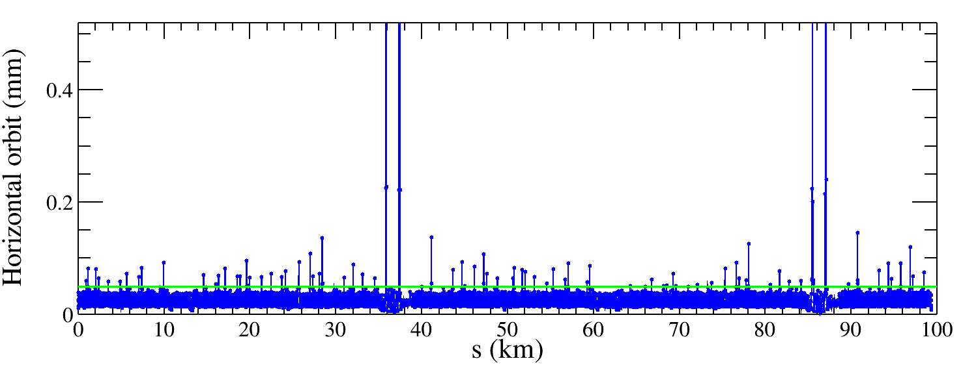
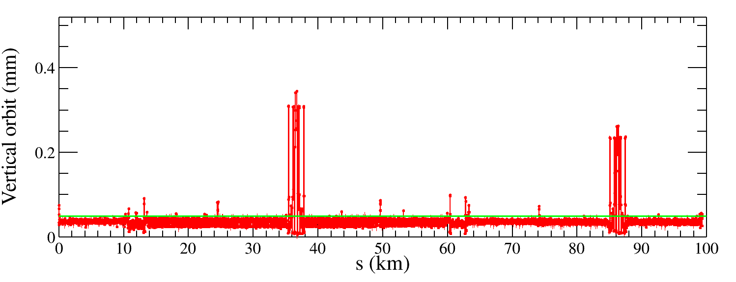
Closed-orbit distortion correction (Higgs mode)
85 seeds
The Lattice starts at the injection point.
100 random Higgs lattice seeds are generated, there are 85 lattice seeds have convergent solutions.
Correction target: The green line is marked with the correction target (50 μm), corresponding to the correction performance without solenoid.
Correction result (85 seeds): Most of the RMS values for horizontal and vertical orbits are within 50 μm, while some orbits near the IP are significantly larger, exceeding 200 μm.
Conclusion: Move to the next dispersion correction, which also include the orbit adjustment.
85 seeds

Slide 4
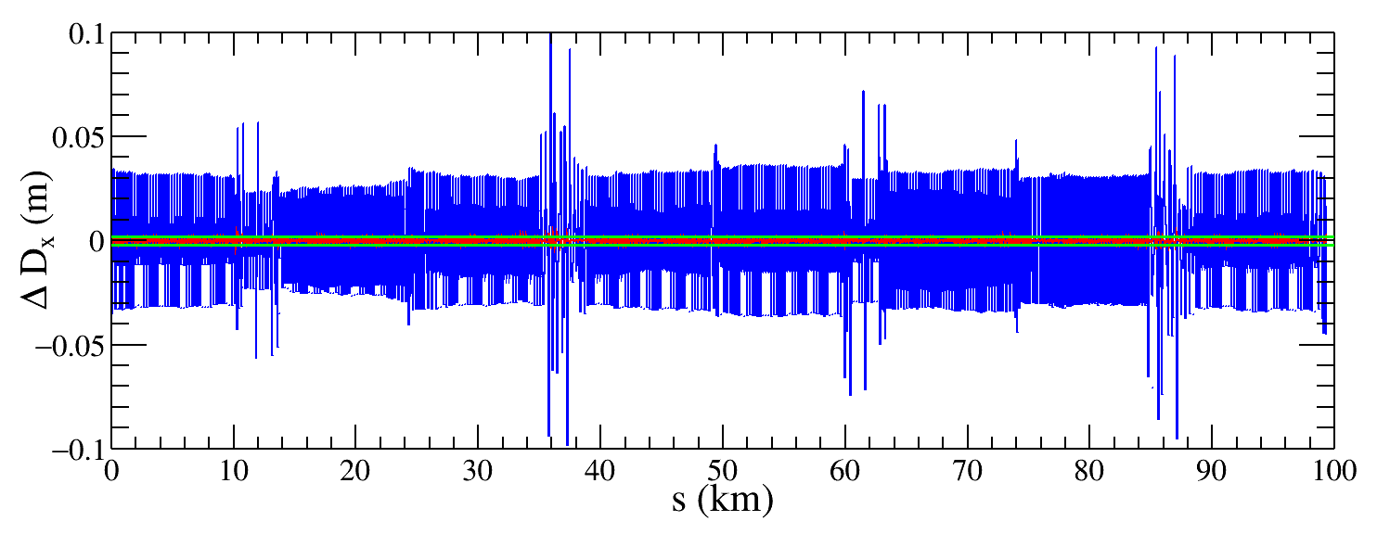
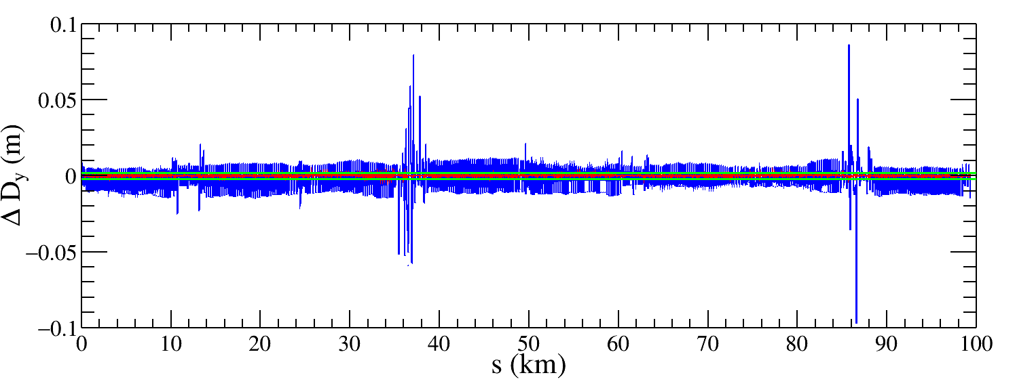
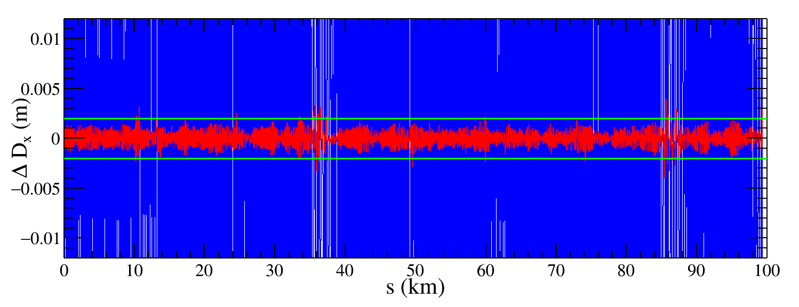
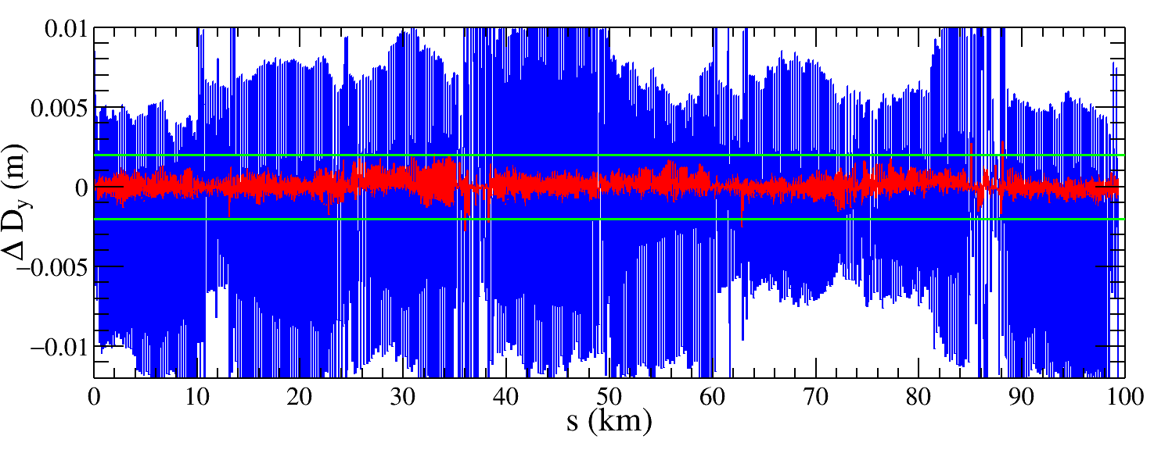
Dispersion correction (Higgs mode)
85 Higgs lattice seeds with COD correction are used to do the dispersion correction.
Correction target: The green line is marked with the correction target (2 mm), corresponding to the correction performance without solenoid.
Correction result: Both horizontal and vertical dispersion deviation after correction are lower than the correction target, 2mm. The application of the DISP correction resolved the large fluctuations in the vertical dispersion near the IP.
One seed
Blue: before DISP correction
Red: After DISP correction

Slide 5
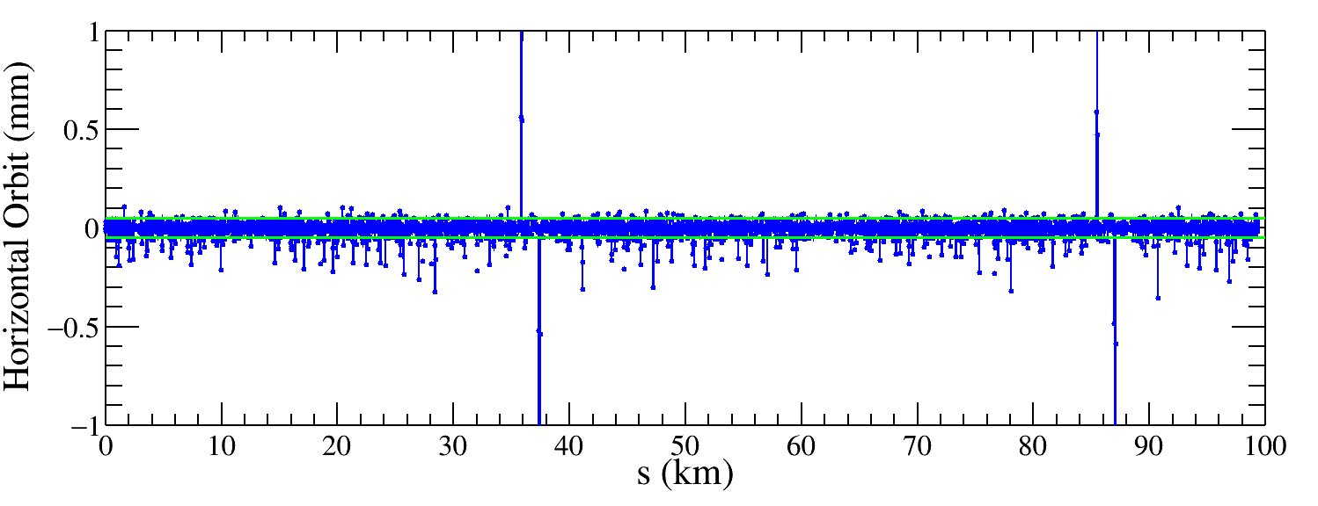
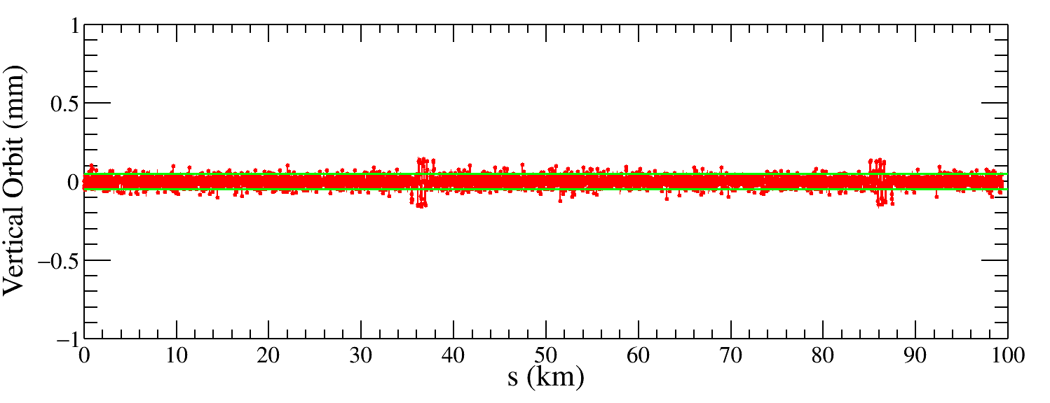
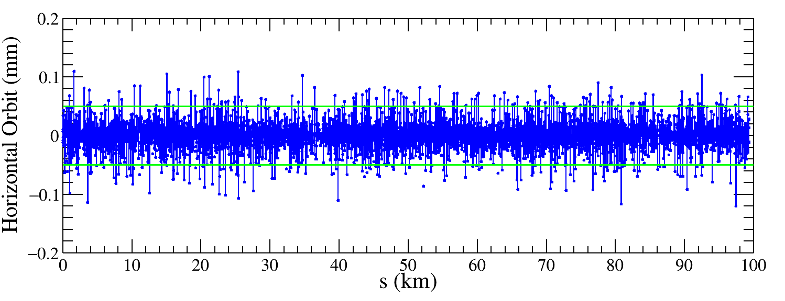
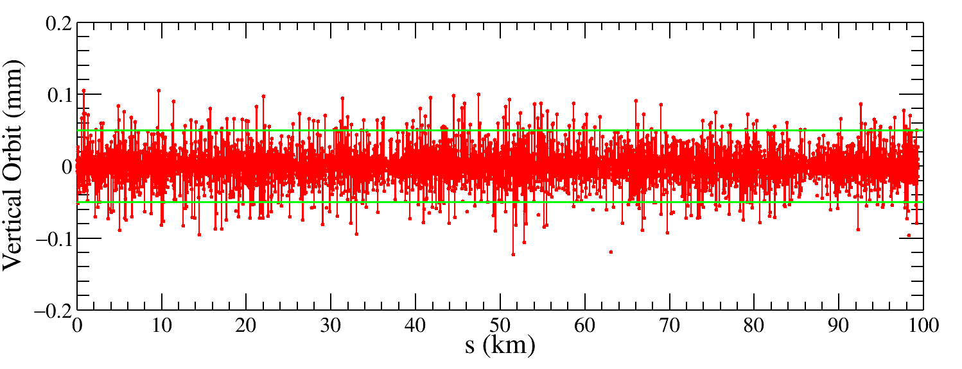
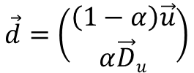
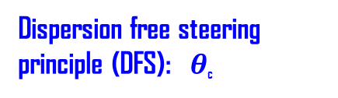
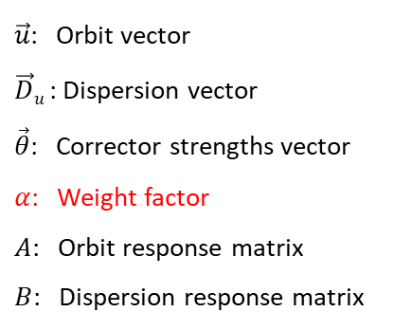


Closed orbit after dispersion correction (Higgs mode)
Correction result: The large fluctuation of closed orbit is also corrected.
Explanation: During the DISP/DFS correction, the closed orbit deviations are used as weighting factors in the response matrix inversion to prioritize correcting dispersion errors where the orbit is most distorted.
Dispersion free steering principle (DFS):$θ$_{c}
$$\vec{d}=\left(\begin{aligned}\left(1−α\right)\vec{u} \\ α\vec{D}u\end{aligned}\right)$$
M$=\left(\begin{aligned}\left(1−α\right)A \\ αB\end{aligned}\right)$
$\vec{u}$: Orbit vector
$\vec{D}u$: Dispersion vector
$\vec{θ}$: Corrector strengths vector
$α$: Weight factor
$A$: Orbit response matrix
$B$: Dispersion response matrix
$$\vec{d}+M\vec{θ}=0$$
One seed
Before DISP correction
After DISP correction

Slide 6
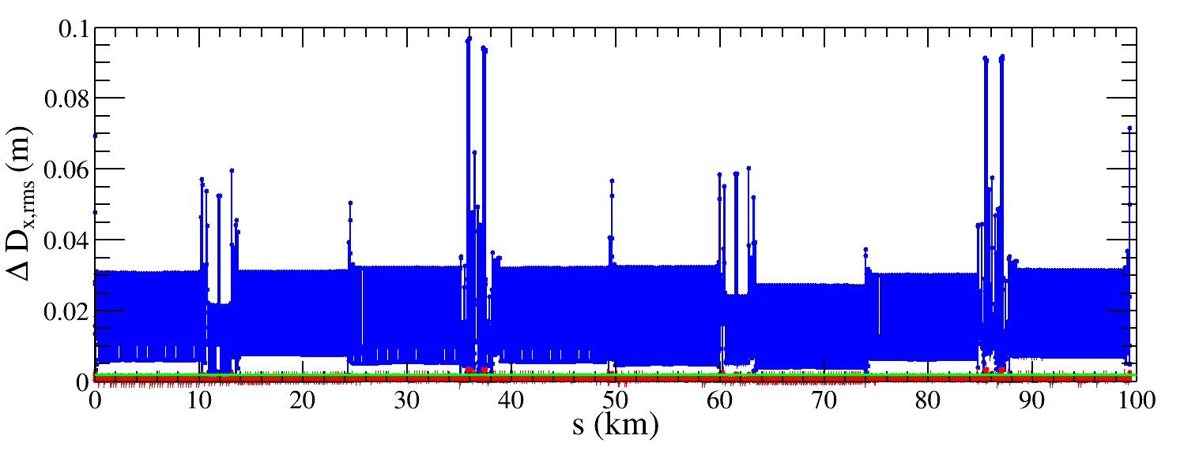
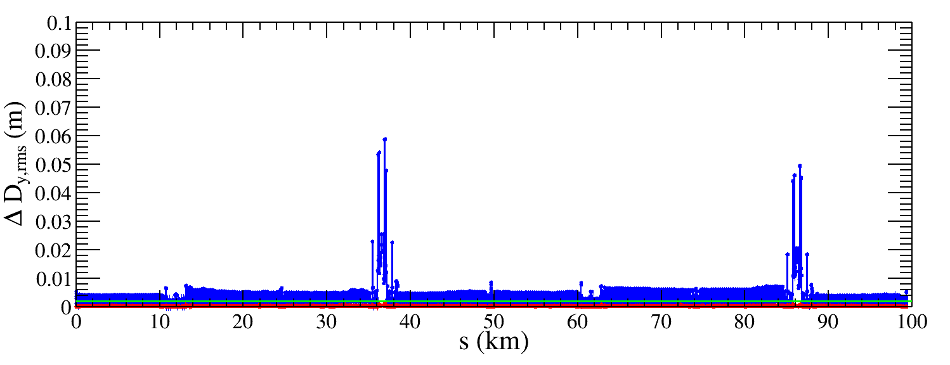
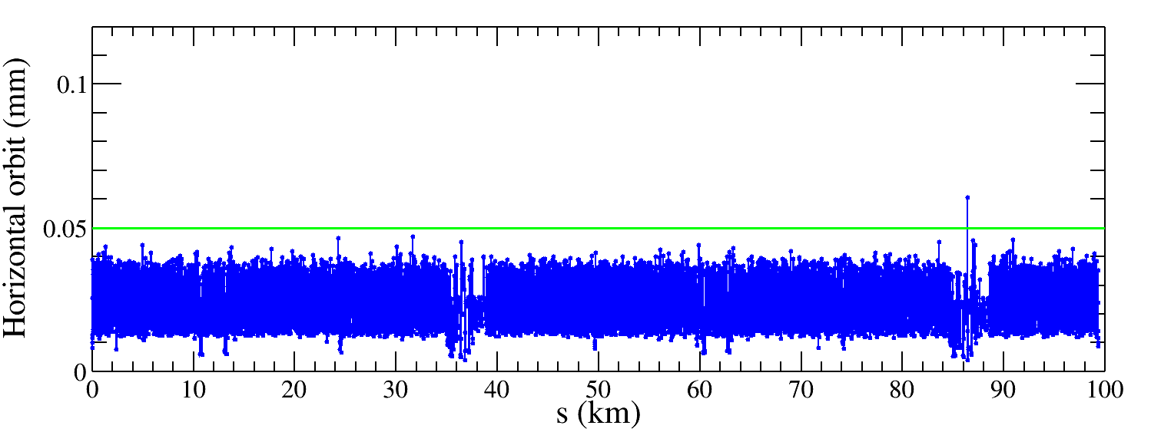
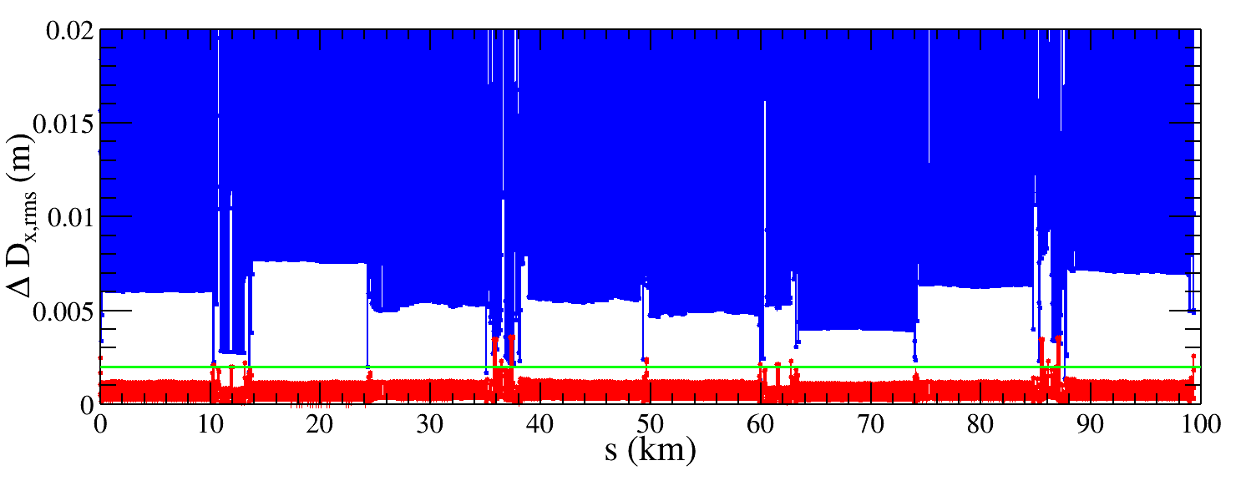
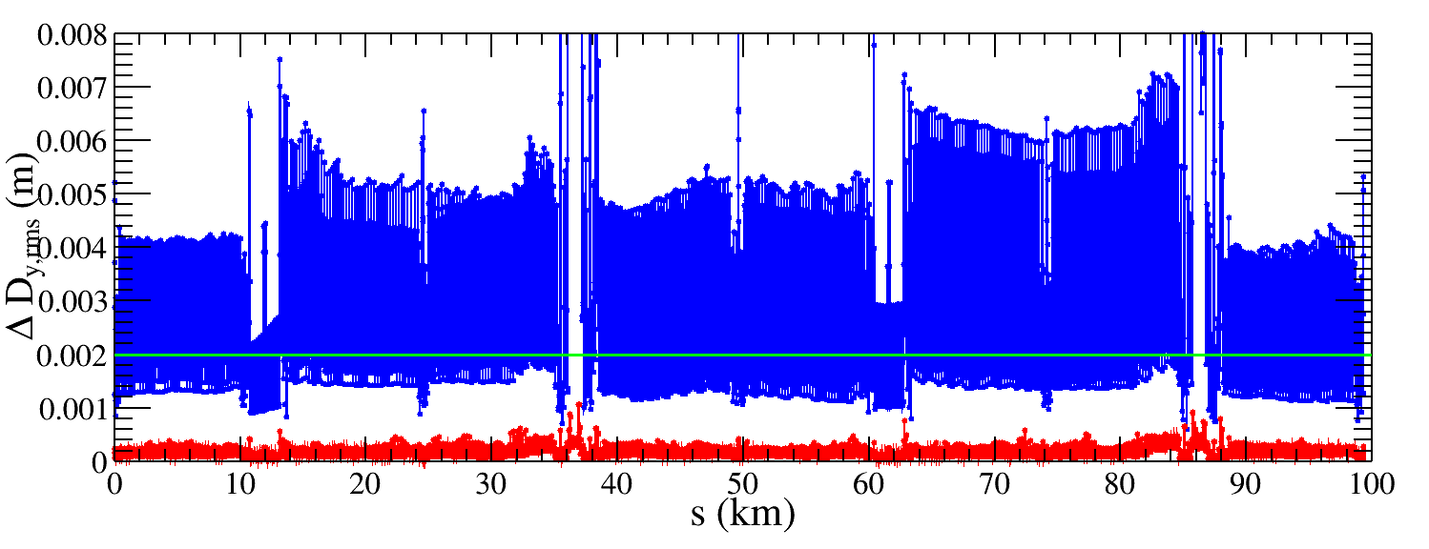
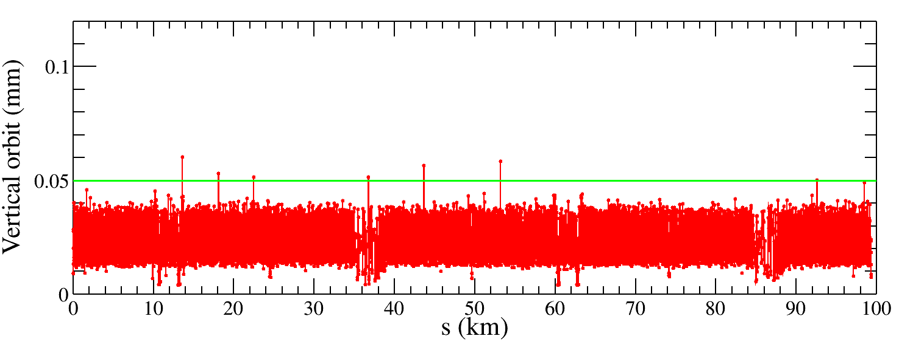
Dispersion correction (85 seeds)
85 seeds
Correction result: All 85 seeds are converged, the horizontal dispersion RMS value is reduced from 15.6 mm to 0.6 mm, and the vertical dispersion RMS value is reduced from 3.5 mm to 0.2 mm. The RMS horizontal and vertical orbits are lower than 50 μm.
Conclusion: After DISP correction, closed orbit and dispersion deviation are lower than those correction targets, respectively. We move to the next beta beating correction.
Blue: before DISP correction
Red: After DISP correction
Closed orbit
Notes:
*

Slide 7
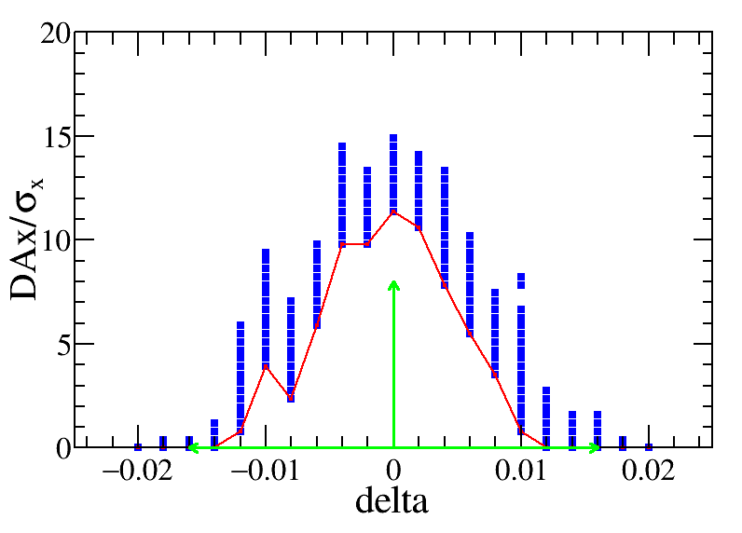
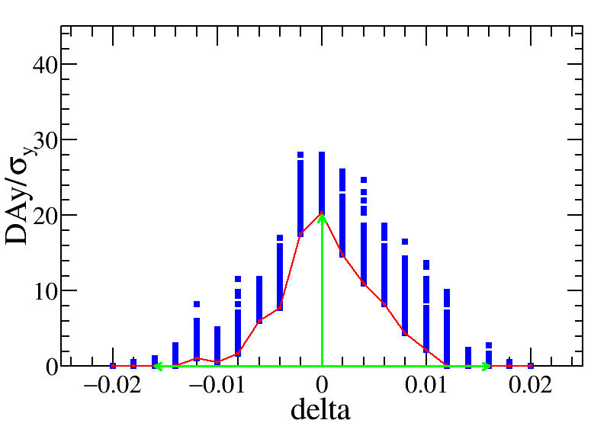
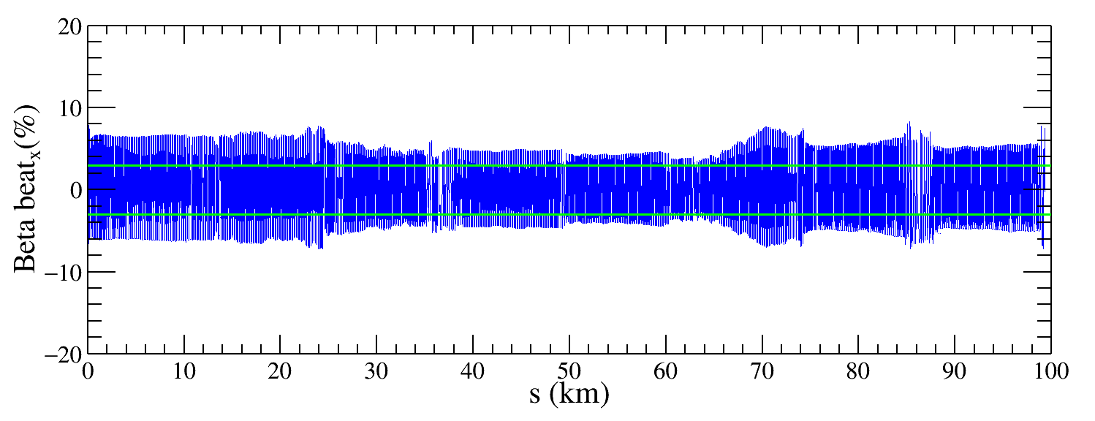
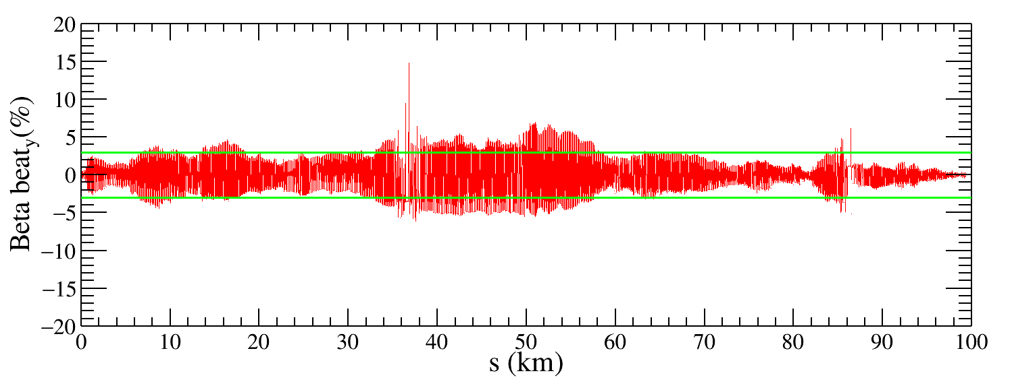
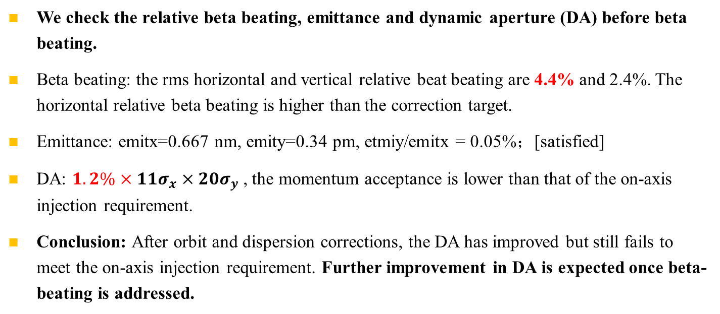
Beat beating and DA after dispersion correction
One seed
We check the relative beta beating, emittance and dynamic aperture (DA) before beta beating.
Beta beating: the rms horizontal and vertical relative beat beating are 4.4% and 2.4%. The horizontal relative beta beating is higher than the correction target.
Emittance: emitx=0.667 nm, emity=0.34 pm, etmiy/emitx = 0.05%；[satisfied]
DA: $1.2\%×11σ_{x}×20σ_{y}$, the momentum acceptance is lower than that of the on-axis injection requirement.
Conclusion: After orbit and dispersion corrections, the DA has improved but still fails to meet​ the on-axis injection requirement. Further improvement in DA is expected once beta-beating is addressed.
The green arrow indicates the Dynamic Aperture requirement for on-axis injection.

Slide 8
Beta beating校正更新尝试
在AT1.4中使用无solenoid校正来进行beta beating校正，计算得到四极磁铁强度的校正量之后输入到含有solenoid的lattice，在测量beta beating的变化情况。
  校正结果不收敛，无法得到正常的四极铁强度的校正量。
  屏蔽solenoid元件做beta beating，结果也没有收敛。
最新的AT2.6有考虑solenoid元件，这个目前正在进行推进。
  预期下周汇报一下进展。
  给出twiss参数的一些对比以及LOCO校正的情况。

Slide 9
Status of the error correction to the Higgs lattice with local solenoid compensation
Bin Wang
2026.09.04

Slide 10
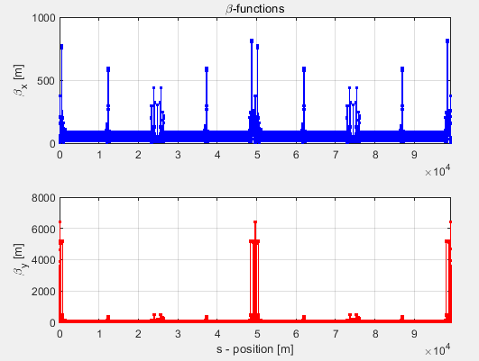
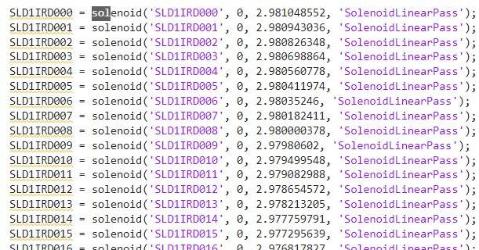
Lattice with AT2.6
最新的AT2.6有考虑solenoid元件，这个目前正在进行推进。
  完成更新，已经把solenoid加上，得到的beta函数跟SAD带sol的beta函数一致。
    【后续再对比发射度（垂直发射度的对比），交叉角】
  开始基于AT2.6的loco校正，目前还没有得到结果。
  下周准备汇报loco校正的情况。

