Slide 1
Experiment of Parity-Violation Measurement on GTAF-II
Luo Qiuyue
Sep. 23, 2026
Notes:
Opening: self-introduction; topic: NOPTREX parity-asymmetry measurement on CSNS Back-n GTAF; outline of principle / setup / target sections.

Slide 2
Contents
1. Experimental principle
2. Experimental setup
3. Data processing
4. Follow-up plan
Notes:
Outline of the four sections; highlights: logic chain of the principle, four setup components, comparison of three target nuclides.

Slide 3
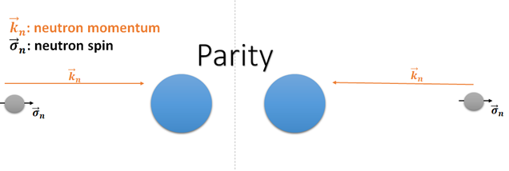
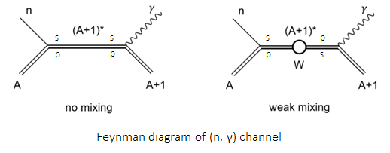
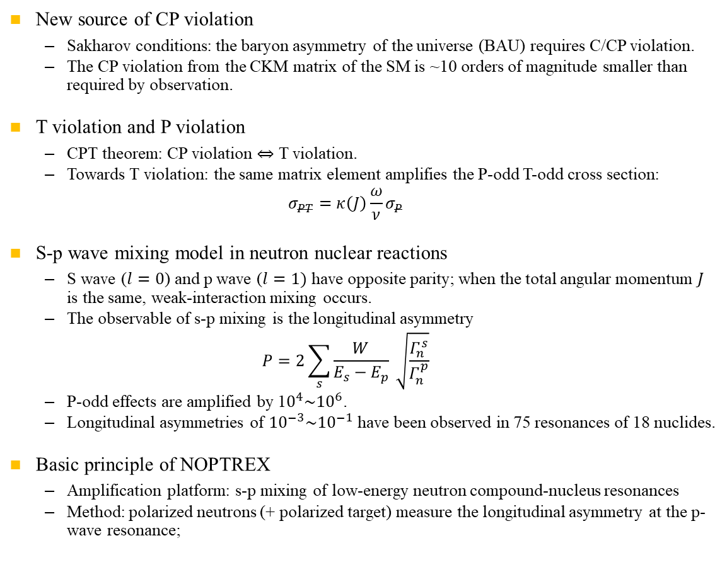
NOPTREX(Neutron Optics Parity and Time Reversal Asymmetry Experiment)
New source of CP violation
  Sakharov conditions: the baryon asymmetry of the universe (BAU) requires C/CP violation.
  The CP violation from the CKM matrix of the SM is ~10 orders of magnitude smaller than required by observation.
T violation and P violation
  CPT theorem: CP violation ⇔ T violation.
  Towards T violation: the same matrix element amplifies the P-odd T-odd cross section:
  $$σ_{PT}=κ\left(J\right){\frac{ω}{ν}σ}_{P}$$
S-p wave mixing model in neutron nuclear reactions
  S wave ($l=0$) and p wave ($l=1)$ have opposite parity; when the total angular momentum $J$ is the same, weak-interaction mixing occurs.
  The observable of s-p mixing is the longitudinal asymmetry
  $$P=2\sum_{s}{\frac{W}{E_{s}−E_{p}}} \sqrt{\frac{Γ_{n}^{s}}{Γ_{n}^{p}}}$$
  P-odd effects are amplified by 1$0^{4}\sim {10}^{6}$.
  Longitudinal asymmetries of ${10}^{−3}\sim {10}^{−1}$ have been observed in 75 resonances of 18 nuclides.
Basic principle of NOPTREX
  Amplification platform: s-p mixing of low-energy neutron compound-nucleus resonances
  Method: polarized neutrons (+ polarized target) measure the longitudinal asymmetry at the p-wave resonance;
Fig. 1 Neutron helicity under parity transformation
Fig. 2 Feynman diagram of s-p weak mixing in the (n,γ) channel
[1] V. V. Flambaum, O. P. Sushkov, Nucl. Phys. A 435, 352 (1985). [2] G. E. Mitchell, J. D. Bowman, S. I. Penttilä, E. I. Sharapov, Phys. Rep. 354, 157 (2001). [3] D. C. Schaper, Ph.D. Dissertation, University of Kentucky (2022).
4] X. Qin et al., Sci. China-Phys. Mech. Astron. 69, 282011 (2026).
Notes:
Line 1: why a new CP-violation source is needed (Sakharov / SM shortfall / CPT→TRIV).
Line 2: how NOPTREX searches (s-p mixing amplification; polarized neutrons measure P-odd, observable A_L; same matrix element amplifies T-odd).
Bottom line: the PV measurement is the calibration step towards CP/T violation.

Slide 4
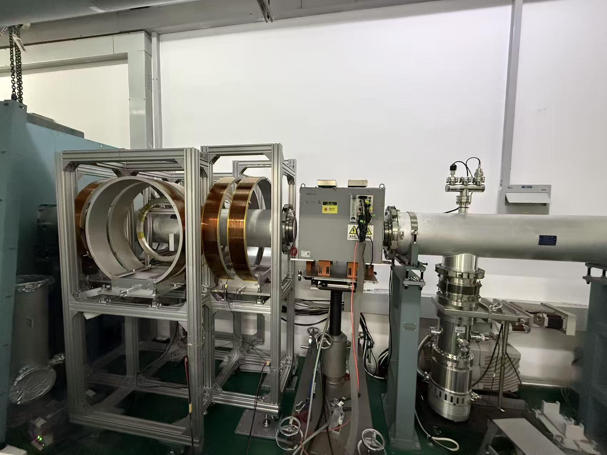
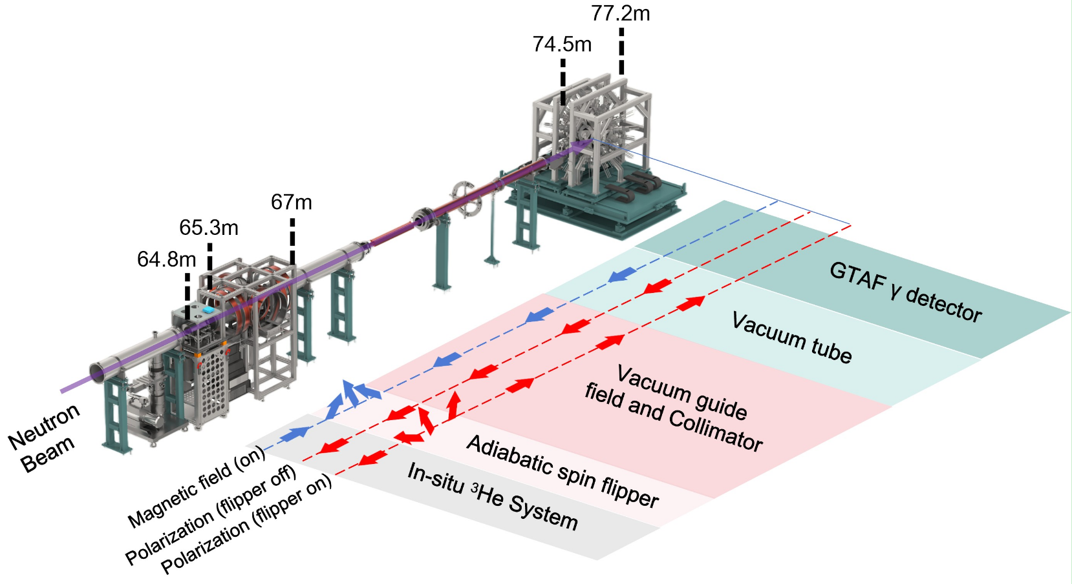
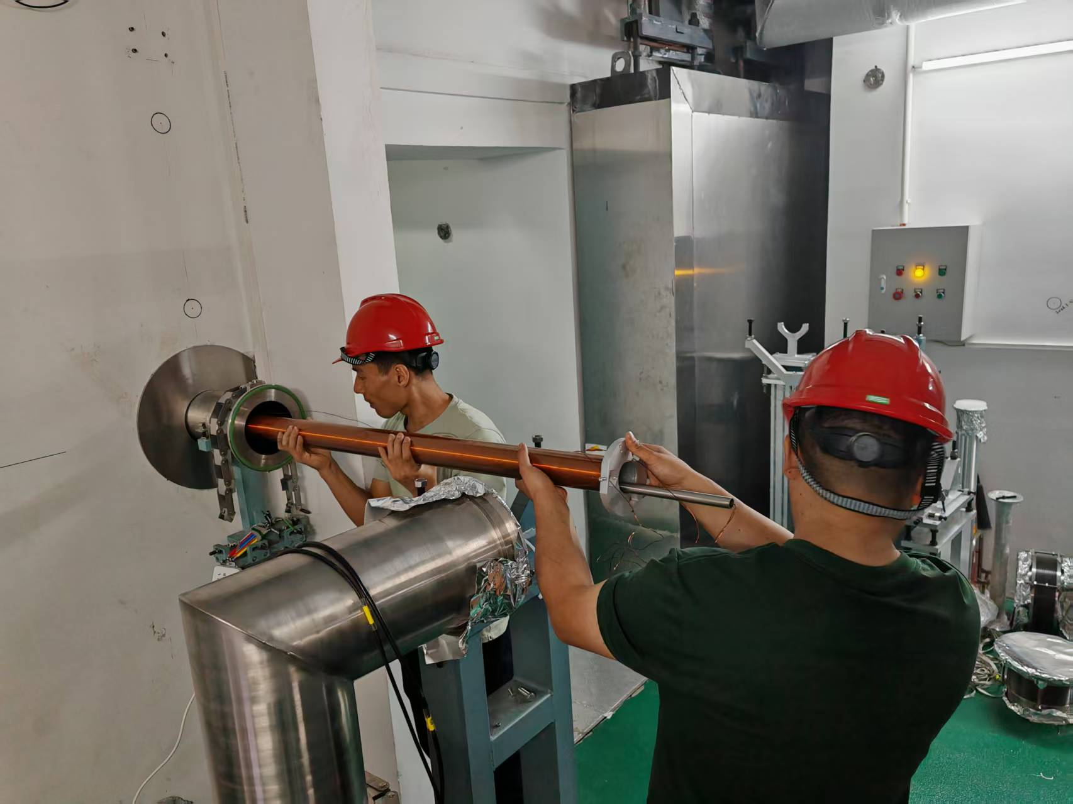
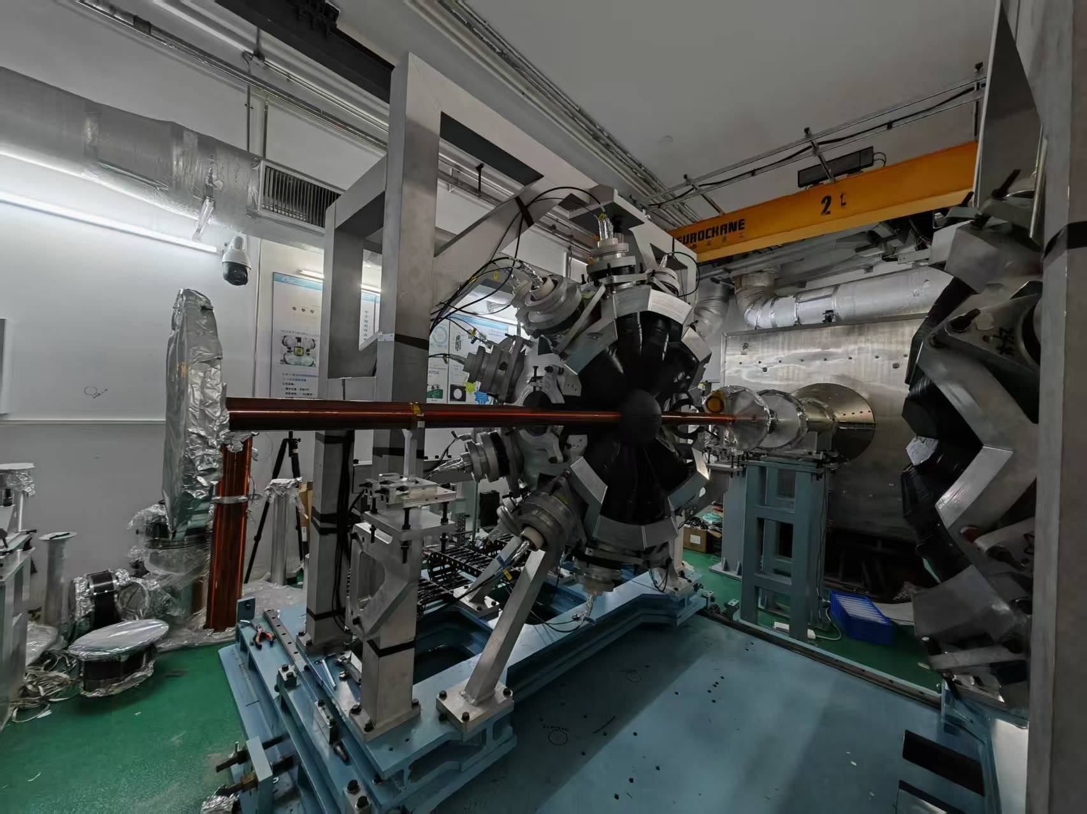
Setup system of parity-violation measurement on GTAF-II
Overall beamline layout
  The main detector sits at white-beam station ES#2, flight path ~77 m
  The polarizer and flipper are placed between ES#1 and ES#2 to reduce scattered-neutron background;
Fig. 4 Polarizer and spin flipper
GTAF-II
Beam dump
Guide-field solenoid(~7m)
Flipper
Polarizer
Fig. 5 One of the guide-field solenoids
ES#1
Fig. 3 Layout of the Back-n GTAF polarized-neutron measurement system
[1] D. C. Schaper, Ph.D. Dissertation, University of Kentucky (2022).
[2] X. Qin et al., Sci. China-Phys. Mech. Astron. 69, 282011 (2026).
Fig. 6 GTAF-II detector array
Notes:
Use Fig. 5 for the layout: Back-n ~77 m, 25 Hz; collimator→polarizer→flipper→guide→GTAF→dump.
Long flight path → TOF resolution resolves the 0.75 eV resonance.
Design: polarizer/flipper upstream to cut background, non-magnetic materials, 8-step sequence suppresses systematic errors.

Slide 5
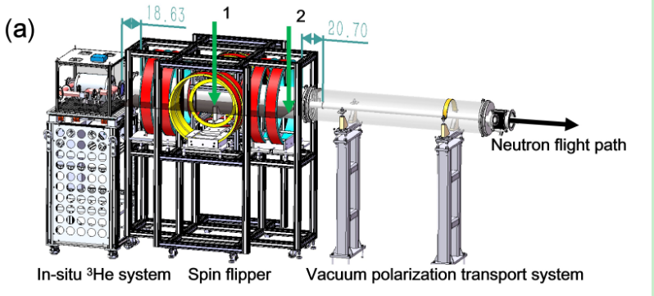
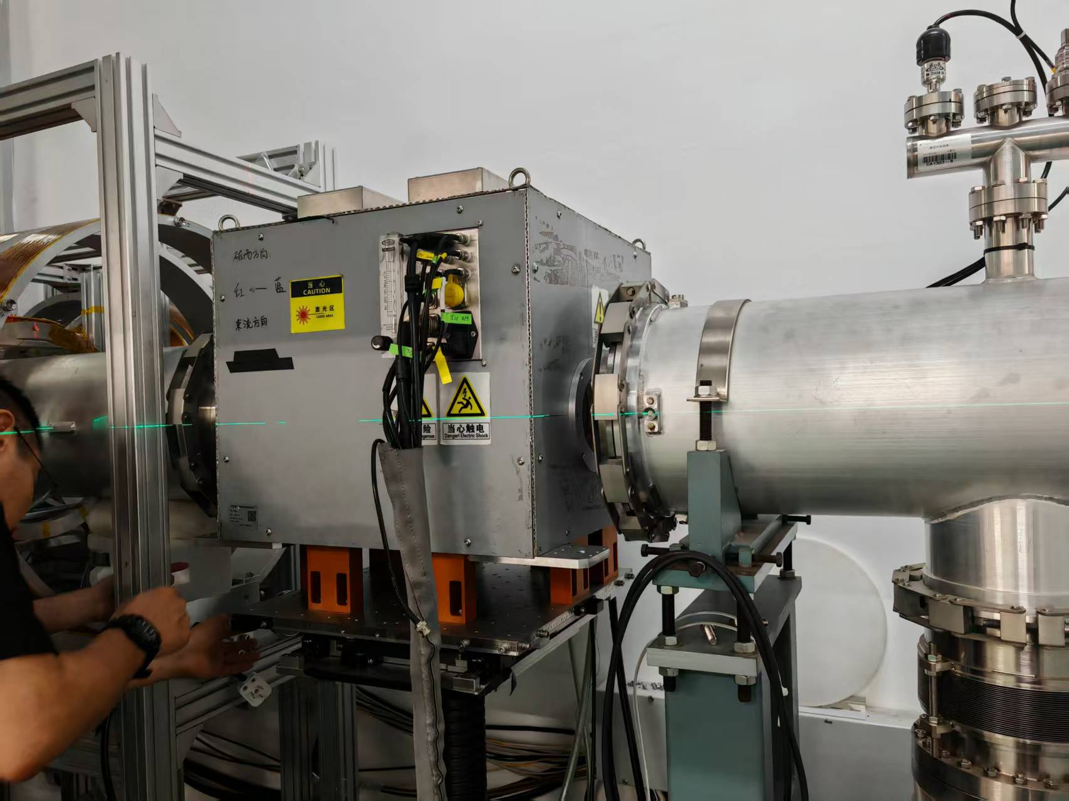
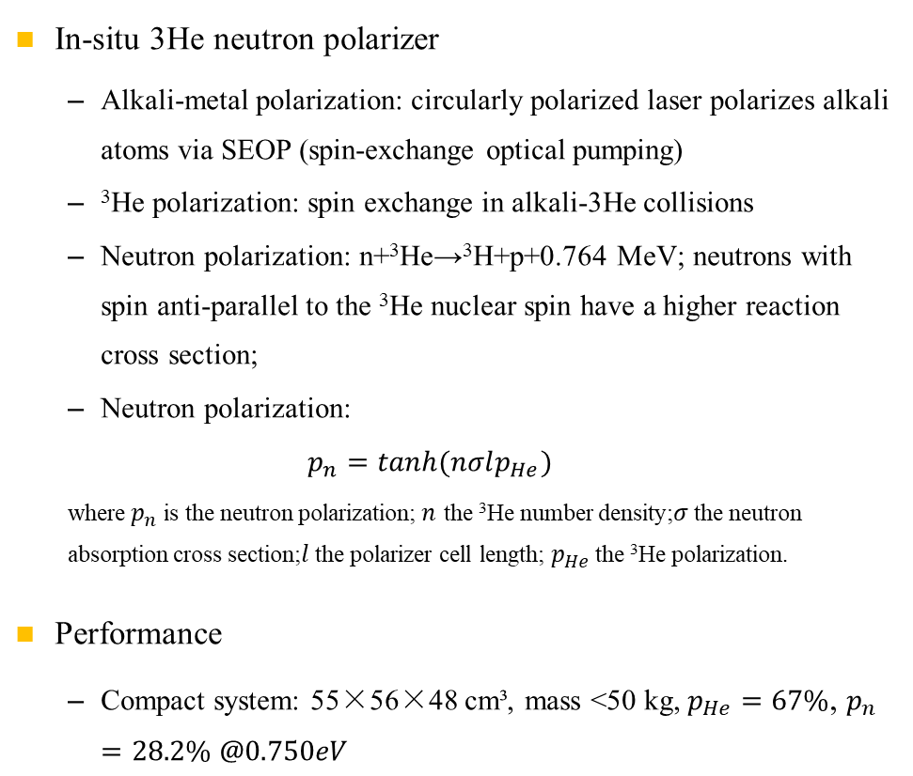
In-situ SEOP polarized ³He neutron polarizer
In-situ 3He neutron polarizer
  Alkali-metal polarization: circularly polarized laser polarizes alkali atoms via SEOP (spin-exchange optical pumping)
  ³He polarization: spin exchange in alkali-3He collisions
  Neutron polarization: n+³He→³H+p+0.764 MeV; neutrons with spin anti-parallel to the ³He nuclear spin have a higher reaction cross section;
  Neutron polarization:
  $$p_{n}=tanh(nσlp_{He})$$
  where $p_{n}$ is the neutron polarization;$n$ the ³He number density;$σ$ the neutron absorption cross section;$l$ the polarizer cell length; $p_{He}$ the ³He polarization.
Performance
  Compact system: 55×56×48 cm³, mass <50 kg, $p_{He}=67\%$, $p_{n}=28.2\% @0.750eV$
Spin flipper
Polarizer (in-situ 3He)
Guide-field solenoids
Fig. 7 Polarizer-flipper-guide-field transport system
[1] X. Qin et al., Sci. China-Phys. Mech. Astron. 69, 282011 (2026).
[2] J. Tang et al., Chin. Phys. Lett. 42, 022901 (2025).
Fig. 8 Polarizer
Notes:
Three arrows in Fig. 7: polarizer (in-situ 3He) / flipper / guide field.
Polarization principle: spin-dependent absorption of n+3He; P_n=tanh(nσlP_He).
SEOP chain and in-situ advantages; P_He=70.33% → P_n=30.31% at 0.75 eV; compact-system specs.

Slide 6
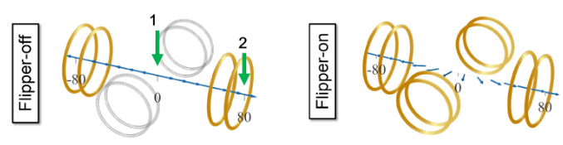
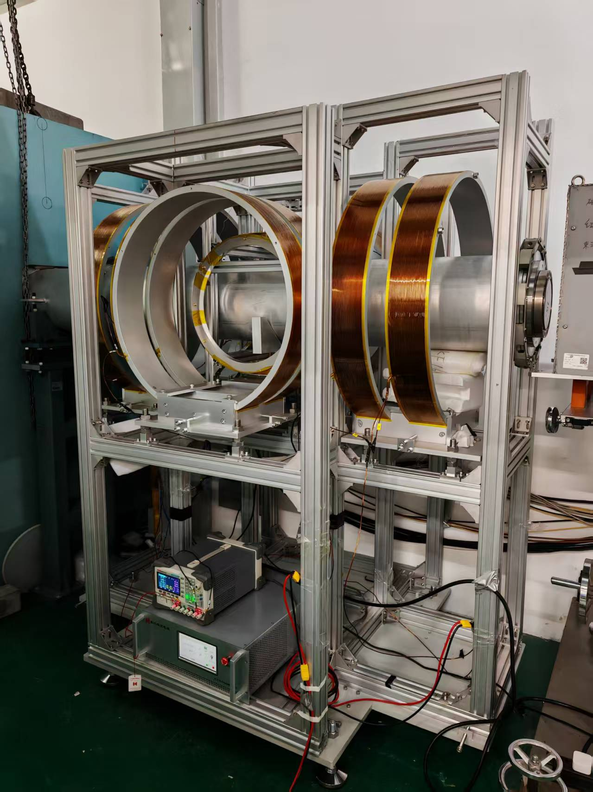
Adiabatic spin flipper
Purpose
  Flip the spin at high frequency to cancel systematic errors from stray transverse fields and detector temperature drift;
  the ³He system cannot reverse at high frequency.
Structure and performance
  Length 1.75 m; longitudinal gradient coils (16 A) + transverse rotating coils (10 A) + three compensation coil sets; zero-crossing deviation <2 mm.
  Flipping efficiencies ~90% (on) and ~70% (off) at 0.34 Å
  Flipper states tagged with the T0 time base, synchronization error <1 ms; 8-step flip sequence (+,0,0,-,0,-,+,0), flip period 10 pulses (0.4 s).
Fig. 9 Coil field direction in flipper OFF/ON states
[1] G. E. Mitchell, J. D. Bowman, S. I. Penttilä, E. I. Sharapov, Phys. Rep. 354, 157 (2001).
[2] D. C. Schaper, Ph.D. Dissertation, University of Kentucky (2022).
[3] X. Qin et al., Sci. China-Phys. Mech. Astron. 69, 282011 (2026).
Fig. 10 Spin flipper
Notes:
Purpose: high-frequency flipping suppresses false asymmetry from temperature drift; 3He cannot reverse fast.
Adiabatic criterion κ: κ≫1 ON, κ≪1 OFF (Fig. 9).
Structure/efficiency ON~90% OFF~70% calibrated per wavelength; t0 sync <1 ms, 0.4 s switching (Fig. 10).

Slide 7
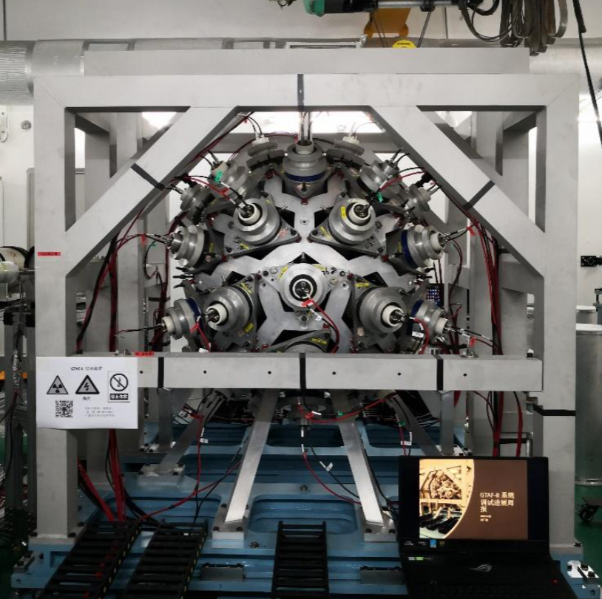
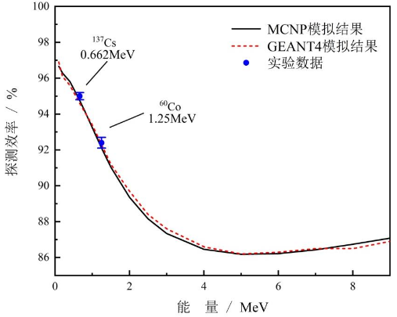
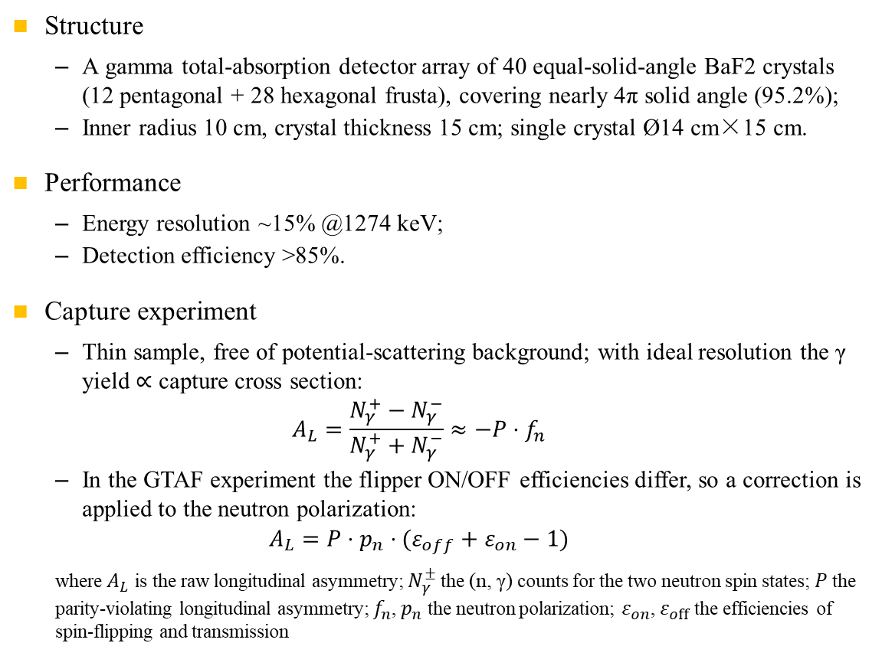
Detection system -- GTAF-II
Structure
  A gamma total-absorption detector array of 40 equal-solid-angle BaF2 crystals (12 pentagonal + 28 hexagonal frusta), covering nearly 4π solid angle (95.2%);
  Inner radius 10 cm, crystal thickness 15 cm; single crystal Ø14 cm×15 cm.
Performance
  Energy resolution ~15% @1274 keV;
  Detection efficiency >85%.
Capture experiment
  Thin sample, free of potential-scattering background; with ideal resolution the γ yield ∝ capture cross section:
  $$A_{L}=\frac{N_{γ}^{+}−N_{γ}^{−}}{N_{γ}^{+}+N_{γ}^{−}}≈−P⋅f_{n}$$
  In the GTAF experiment the flipper ON/OFF efficiencies differ, so a correction is applied to the neutron polarization:
  $$A_{L}=P⋅p_{n}⋅(ε_{off}+ε_{on}−1)$$
  where $A_{L}$ is the raw longitudinal asymmetry; $N_{γ}^{±}$ the (n, γ) counts for the two neutron spin states; $P$ the parity-violating longitudinal asymmetry; $f_{n}$, $p_{n}$ the neutron polarization; $ε_{on}$, $ε_{off}$ the efficiencies of spin-flipping and transmission
Fig. 11 GTAF-II detector array
Fig. 12 GTAF detection efficiency vs energy
[1] X. Qin et al., Sci. China-Phys. Mech. Astron. 69, 282011 (2026).
Notes:
Structure: 40 BaF2 crystals, 95.2% solid angle (Fig. 11).
Performance: 10% @1274 keV, 677 ps → TOF (Fig. 12).
Cuts: PSD + M>3 + ΣE>3 MeV; the 1/v law shows the background is negligible.

Slide 8
Experimental setup
In this experiment, the digitalized waveform electronics and the XIA system acquire data independently.
Table 1 Target parameters and digitalized waveform electronics beam time
 | ^{nat}La |  | ^{nat}Pd |  | Empty |  | C
Abundance | ¹³⁹La 99.91% |  | ¹⁰⁵Pd 22.33%; ¹⁰⁸Pd 24.64% |  | — |  | —
Specification | φ45 mm×1 mm×3 |  | φ45 mm×1 mm×2 |  | — |  | φ45 mm×1 mm×2
Purity | La/RE ≥ 99.9% |  | 99.95% |  | — |  | 99.99%
Beam condition | no absorber | Cd-Ag-Co | no absorber | Cd-Ag-Co | no absorber | Cd-Ag-Co | no absorber | Cd-Ag-Co
Beam time (h) | 47.39 | 2.05 | 66.72 | 2.02 | 2.73 | 0.56 | 2.62 | 1.22

Slide 9
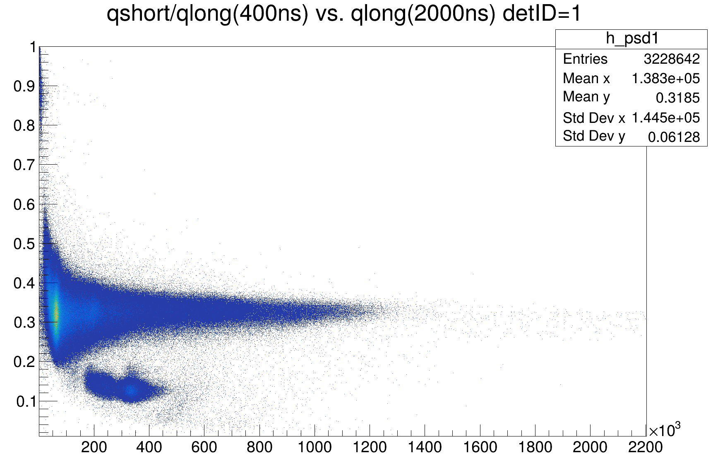
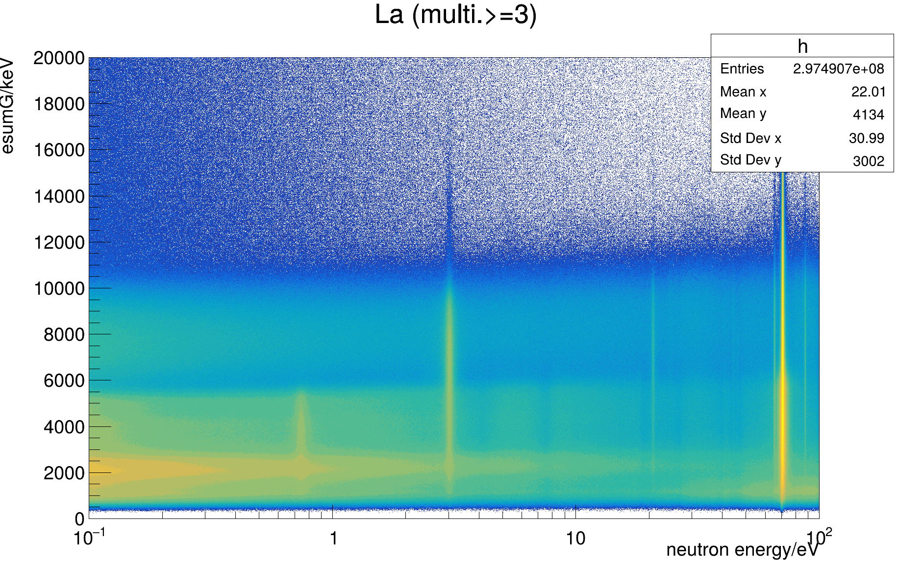
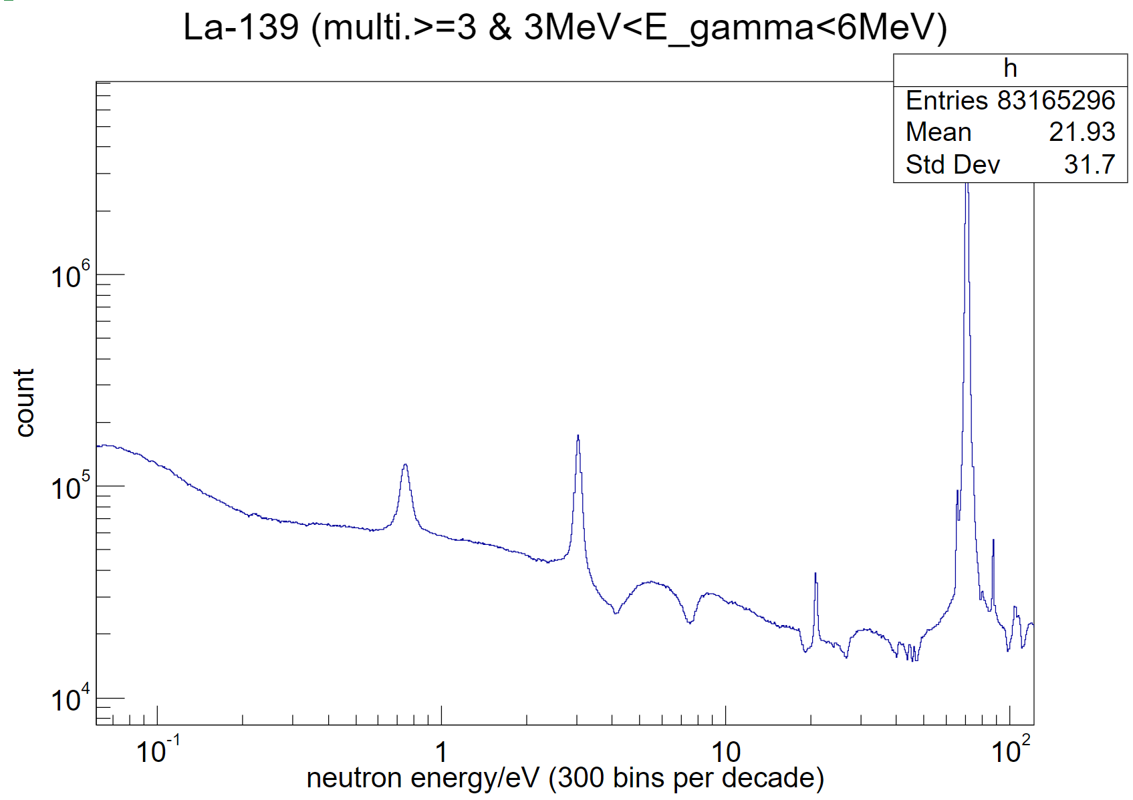
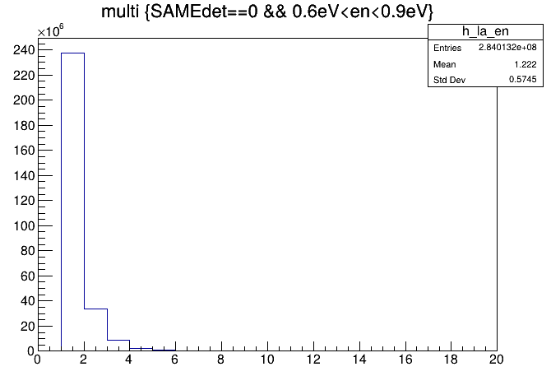
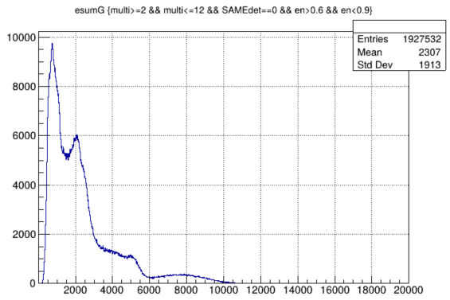
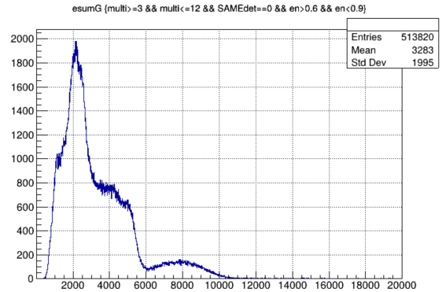




Data processing
Fig. 13 Flow of event reconstruction
Hot electrons or other noise
gamma
alpha particles
Fig. 14 qlong vs. PSD
Fig. 15 (logx)$E_{n} vs. E_{γ}^{sum}$
a) $2≤multi.≤12$
b) $3≤multi.≤12$
Fig. 18 (logx-logy) $N_{n,γ} vs. E_{n}$
Fig. 16 Multiplicity distribution at the p-wave resonance peak
Fig. 17 Summed $γ$energy for different multiplicities at the p-wave resonance peak

Slide 10
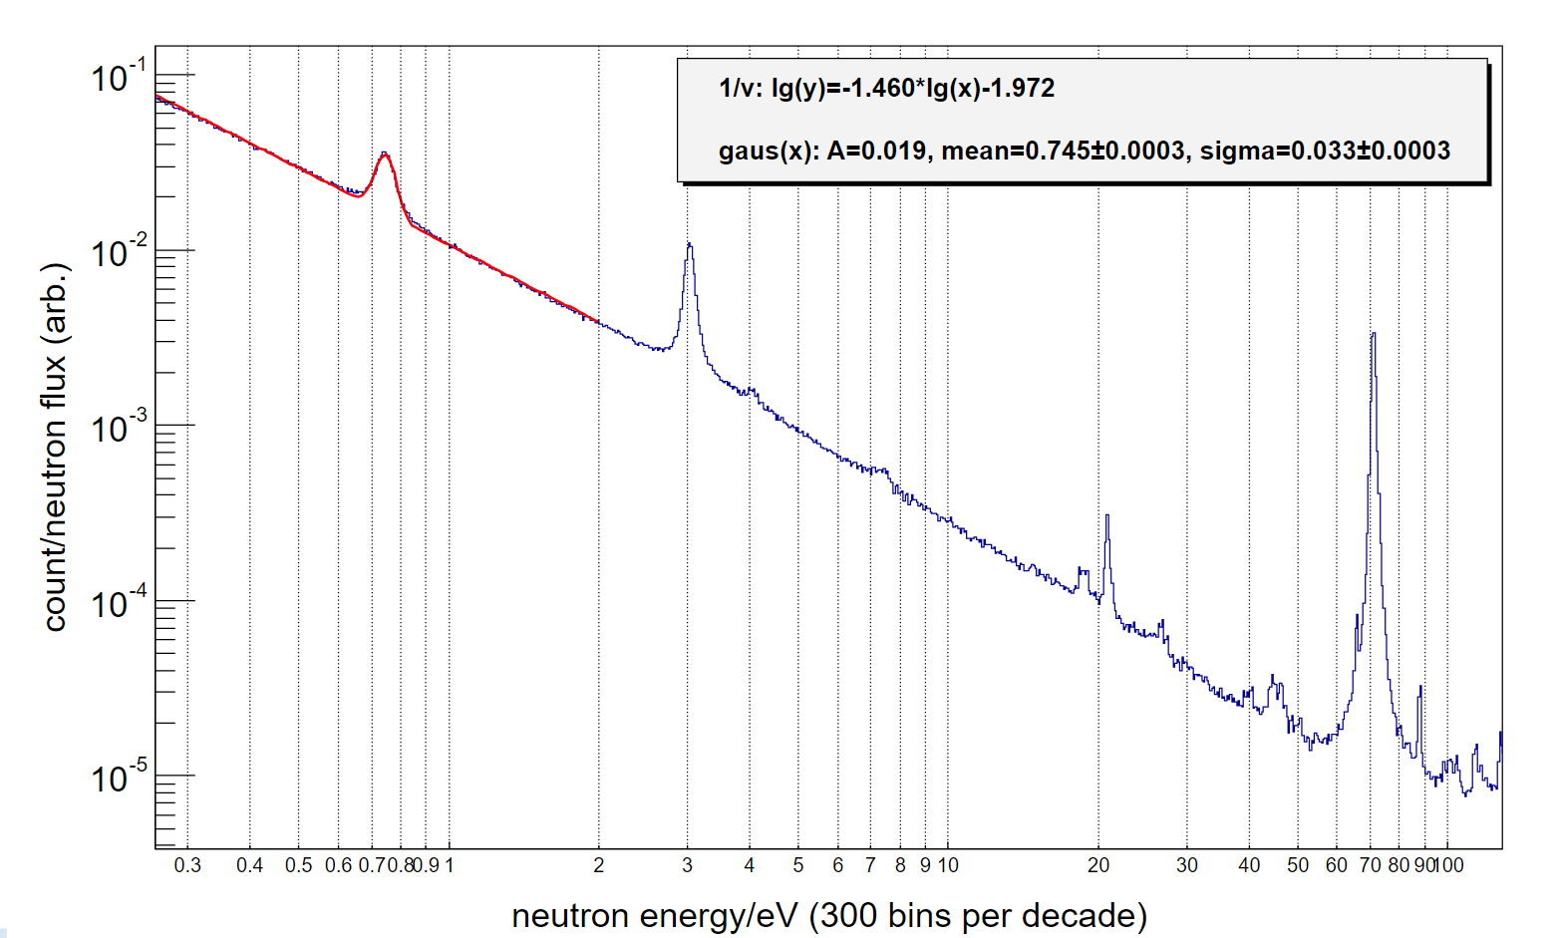
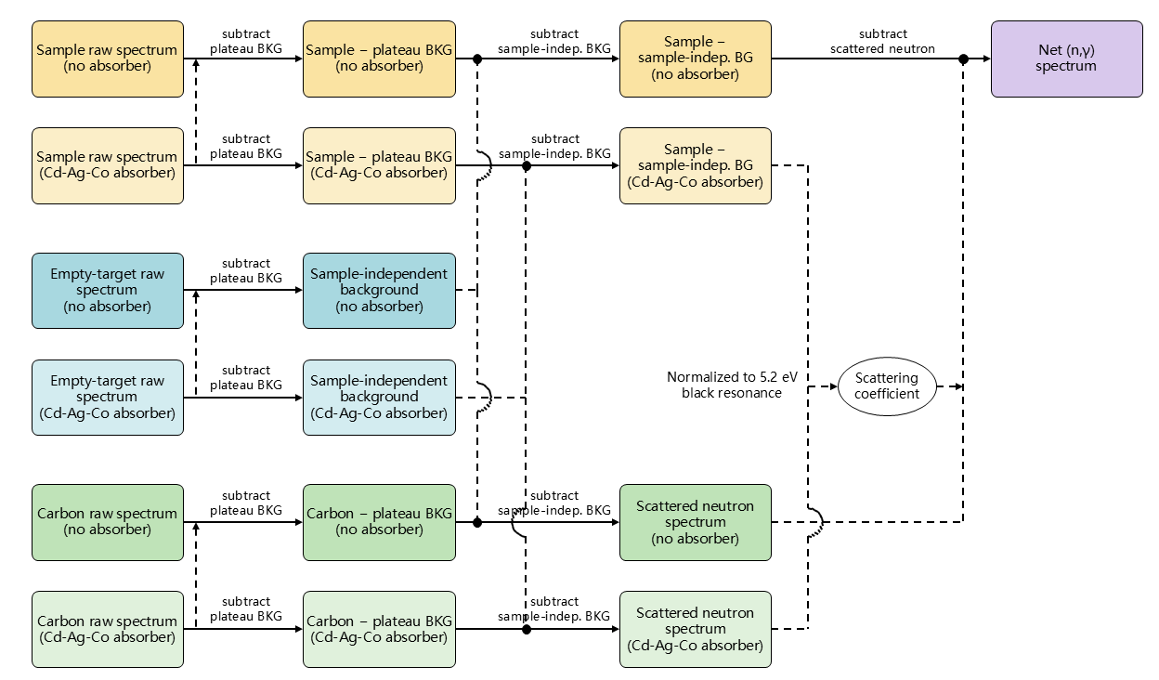
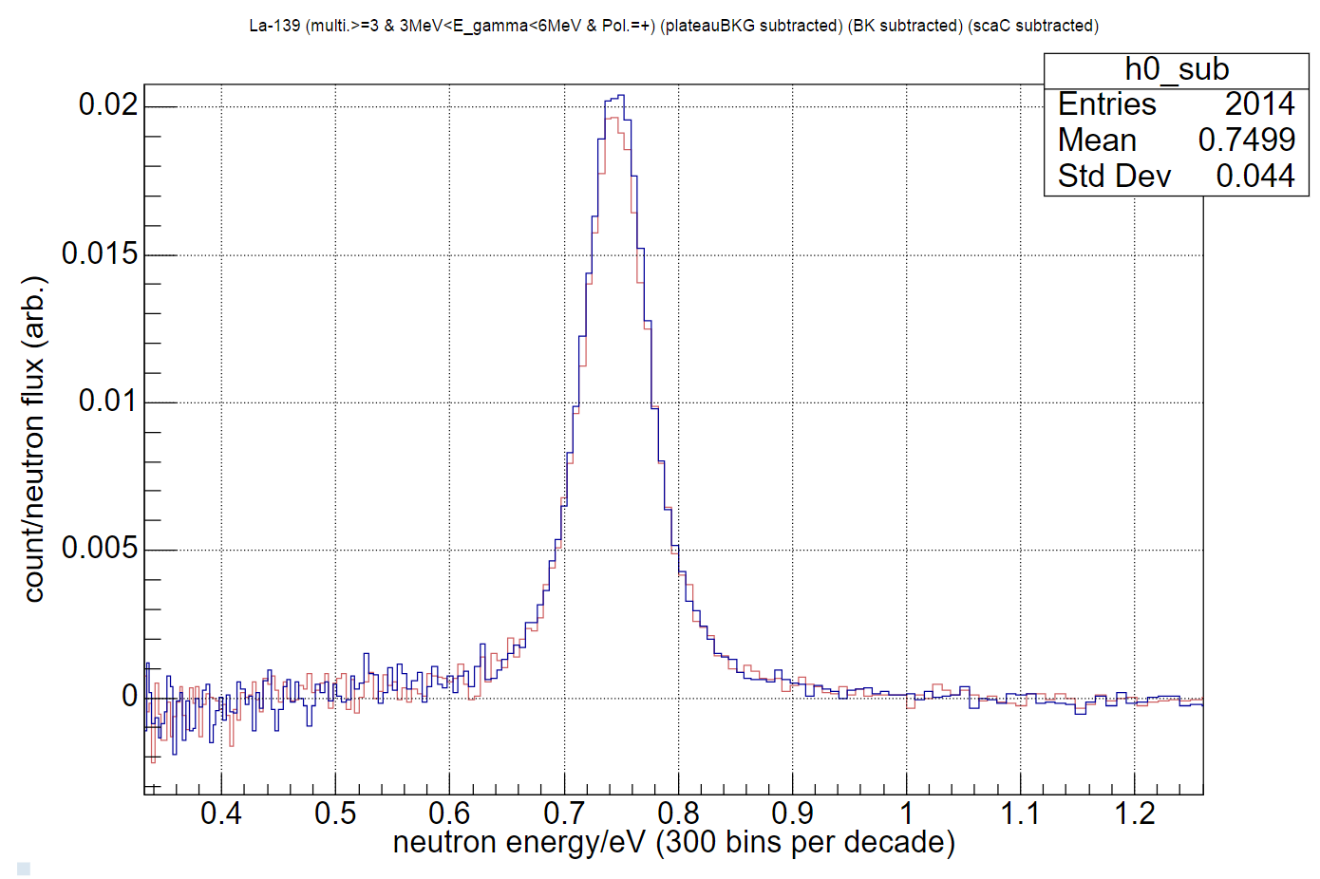
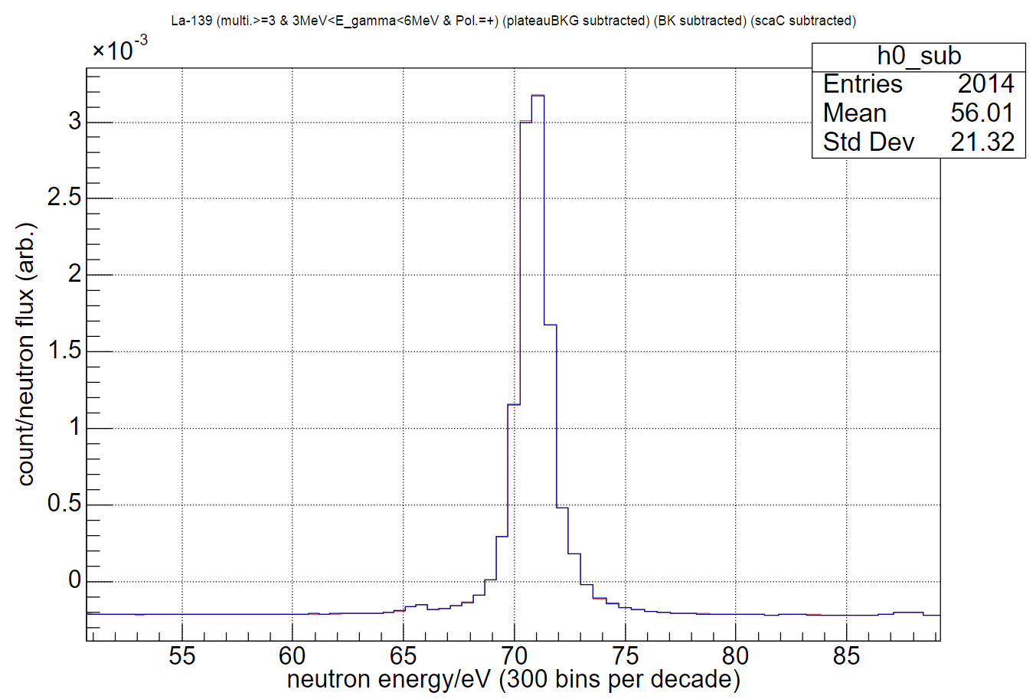

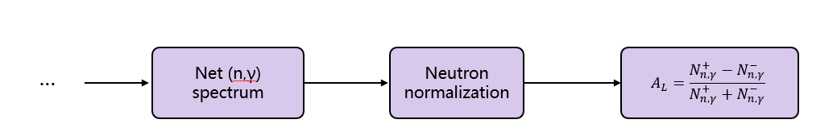

Physics analysis
Background composition: plateau background, sample-independent beam background, scattered-neutron background
s-wave@71.07eV
(¹³⁹La)
p-wave@0.744eV
(¹³⁹La)
s-wave@3.02eV
(¹³⁸La)
Fig. 20 (logx-logy)$Yield_{n,γ} vs. E_{n}$
(a)
(b)
Fig. 21 Comparison of the peaks at 0.744 eV (a) or 71.07 eV (b) when the flipper is on (-) and off (+)
 | P-wave(0.744eV) | S-wave(71.07eV)
$A_{L}$=$\frac{Integral_{+}−Integral_{−}}{Integral_{+}+Integral_{−}}$ | $$−1.906\% ± 0.520\%$$ | $$0.0714\%±0.1287\%$$
$$P$$ | $$−11.185\% ±3.052\%$$ | $$0.419\%±0.755\%$$
Fig. 19 Flow of background treatment and physics-analysis
Table 2 Comparison of measured longitudinal asymmetries

Slide 11
Follow-up plan
Tune the PSD;
Finalize the event-selection criteria;
Adopt the eight-step calculation to reduce statistical errors from temperature drift;

Slide 12
Thanks for you attention!
Notes:
This page: abundance, specification and purity of the four targets (natLa, natPd, Empty, natC), and the shared-electronics beam time under the two beam conditions (no absorber / Cd-Ag-Co).

