Slide 1

Cherenkov Detector Group Meeting Report
Institute of High Energy Physics
Wang Jian
2026.09.11

Slide 2



Cherenkov detector
Cooling scheme for the SiPM on the detector
The ePIC dual-radiator RICH
The new MIP timing detector in the CMS upgrade experiment
3. The ALICE 3 bRICH detector
2026/09/11

Slide 3
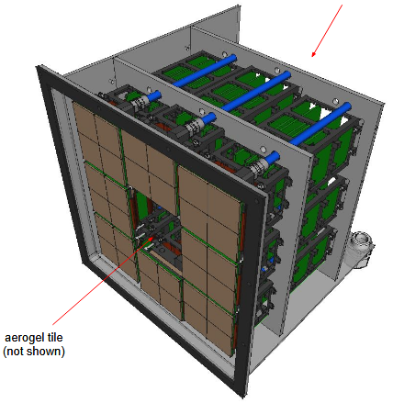
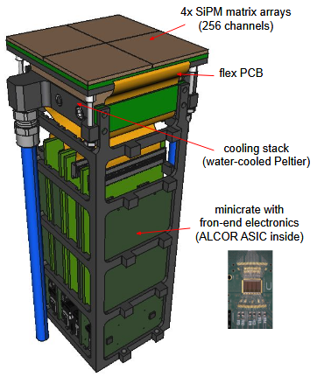
Cherenkov detector
The ePIC dual-radiator RICH
Method：cooling（water-cooled Peltier）
Cooling medium：Water （15℃）
Scheme：SiPM array backside → ceramic PCB substrate → copper heat-spreading frame (cold manifold ring) → cold side of side-mounted Peltier module; the hot side of the Peltier is bonded to a water-cooled plate, and the pumped heat is directly removed by the water.
Performance：SiPM cooling for low-temperature operation (−30 °C )
High-temperature annealing temperature: 150°C
cables and services (not shown)
Readout Box
PhotoDetector Unit (PDU)
2026/09/11

Slide 4
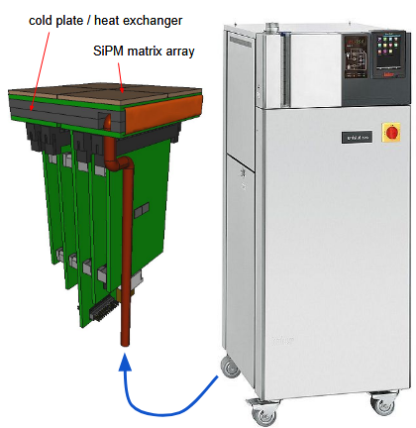
Cherenkov detector
The ePIC dual-radiator RICH
Method：Cold plate cooling
Cooling medium：Silicone oil
Scheme：SiPM array backside → ceramic PCB substrate → cold plate → red piping → temperature controller. Performance：SiPM cooling for low-temperature operation (−30 °C or lower)
The temperature controller has a working range of −55 °C to 250 °C
its maximum cooling capacity (1.5 kW) achieved at −40 °C.
Alternative cooling scheme
2026/09/011

Slide 5
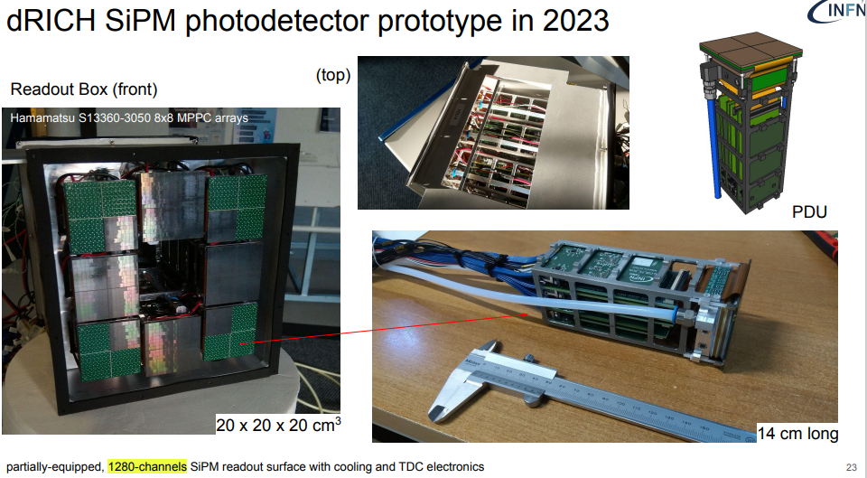
Cherenkov detector
2026/09/11

Slide 6
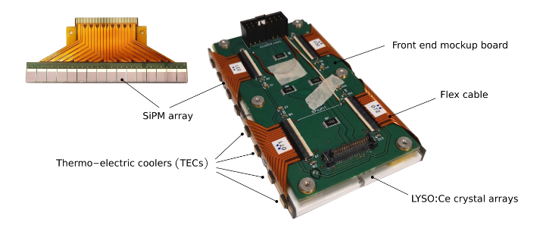
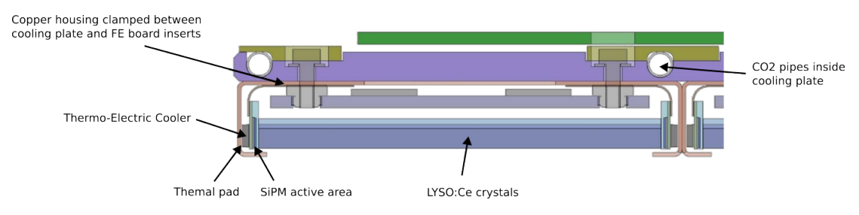
Cherenkov detector
CMS MTD BTL= Compact Muon Solenoid MIP Timing Detector Barrel Timing Layer
Method：TECs + Cold Plate
Cooling medium：CO₂ (−30°C)
Scheme：LYSO → SiPM → Thermal interface pad → Peltier → Copper housing → CO₂ cooling tubes.
Performance：SiPM cooling for low-temperature operation (−45 °C)
High-temperature annealing temperature：60°C
Pictures of SiPM array (front side) and of a BTL detector module, before insertion inside a copper housing, consisting of: 2 LYSO:Ce crystal arrays, 4 SiPM arrays including flex cable for signal routing to the front-end board, 4 thermo-electric coolers (TECs) and one RTD temperature sensor on each array.
Transverse section of a BTL detector module attached to the cooling plate
2026/09/11

Slide 7
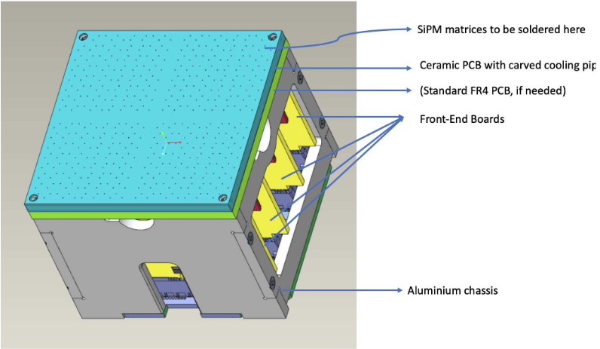
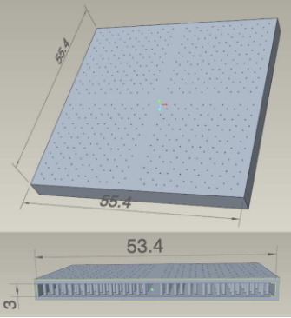
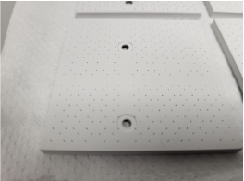
Cherenkov detector
The ALICE 3 bRICH detector
Localized Cooling for SiPM Sensors
Active Cooling：A new housing board design integrates a ceramic PCB with fluid coolant circulation, in order to achieve sensor temperatures of −60°C to −80°C
Compact and High-Performance Design：
• SiPMs directly soldered onto metalized pads on the ceramic surface
• Hollow PCB structure enables coolant flow
• Optimized signal routing through PCB vias minimizes analog signal length, preserving integrity and timing performance
3D-printed AlN ceramic prototypes
2026/09/11

Slide 8
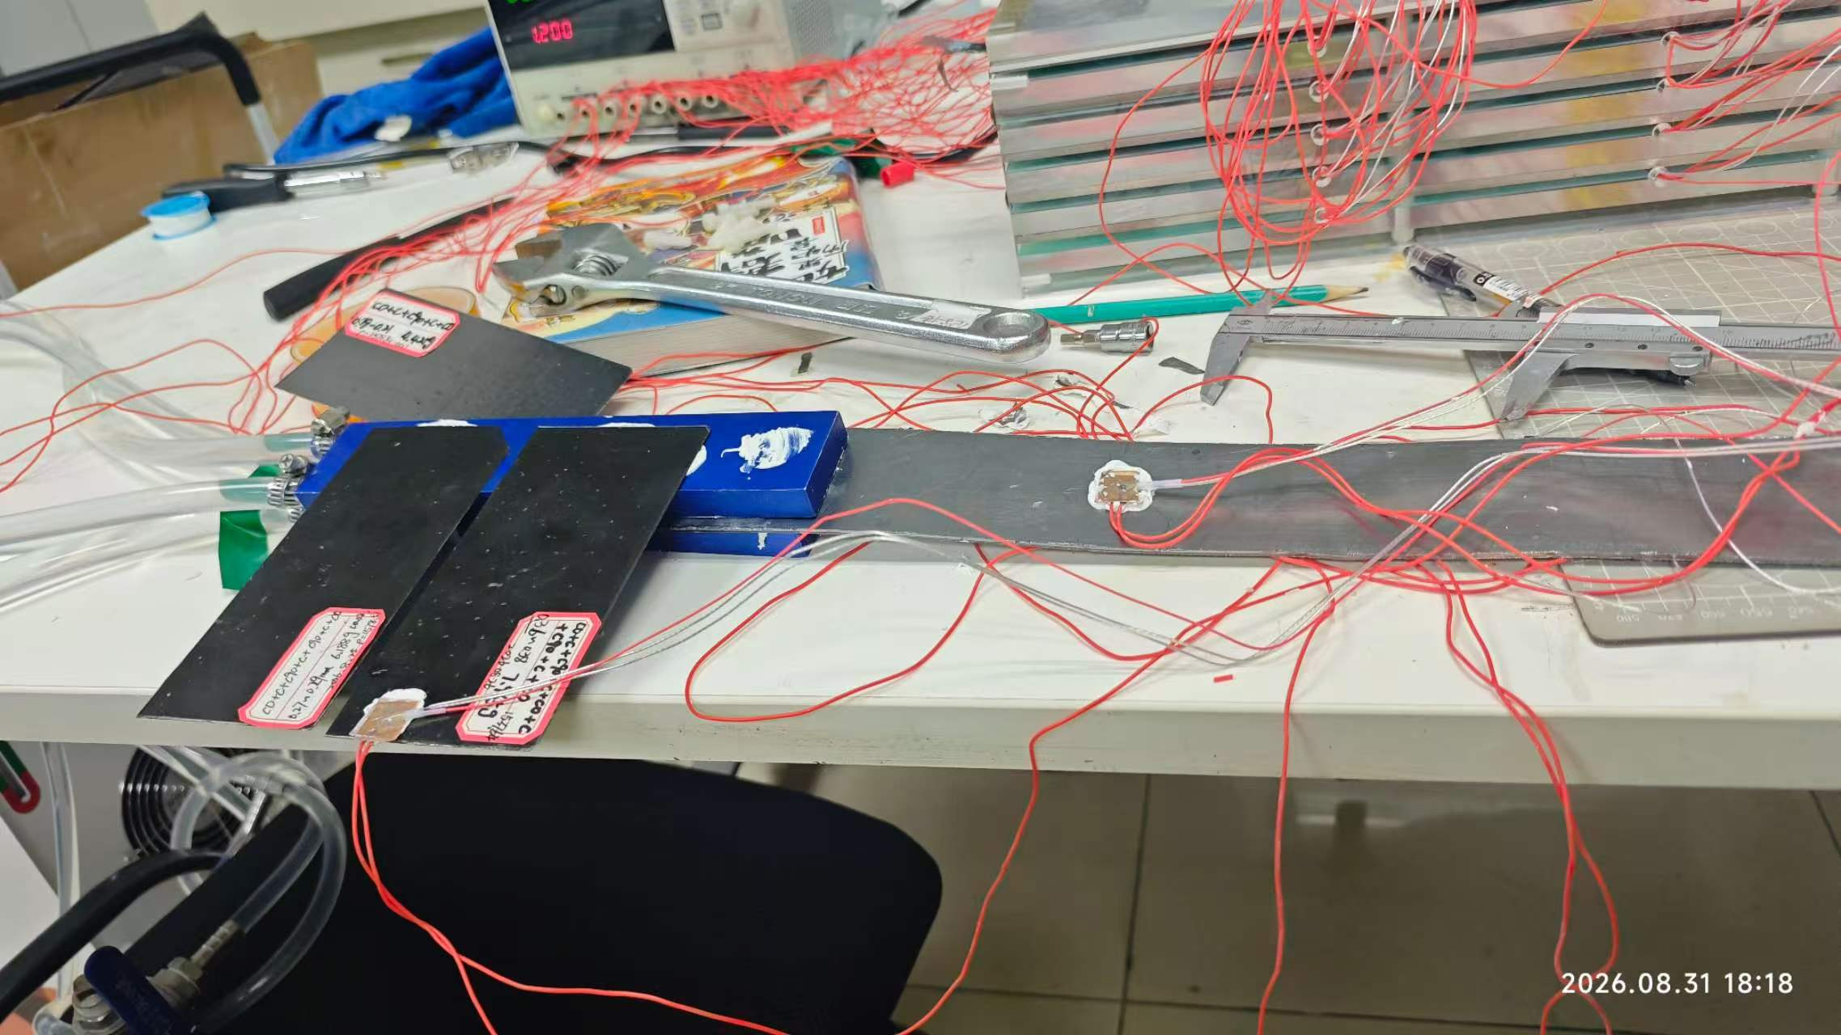
Cherenkov detector
sensor test
graphite plate
water cold plate
graphite plate
Temperature /℃
cold plate
room temperature
cooling
heating+cooling
heating pad and pt100
cold plate
room temperature
Time /s
heating pad and pt100
graphite plate
PI heating pad 0.5 W, distance from the cold plate ~95 mm, temperature ~15°C
Comparative test:
Graphite: thickness 1 mm, width 50 mm, thermal conductivity 200 W
Cold plate: 0.37 mm, width 70 mm,
Conclusion:
The cold plate responds more easily to the cooling water temperature, with larger fluctuations
The cooling effect of the cold plate is better than that of the graphite plate
cold plate
温度/℃
heating
heating+cooling
Time /s
2026/09/11

Slide 9
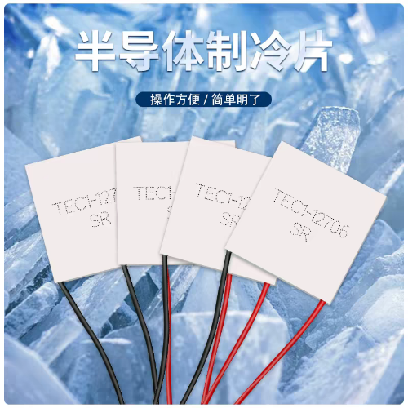

Cherenkov detector
This is a TEC product that can be bought on Taobao. Its temperature range is -35°C to 230°C.
Next step plan: Buy the peltier cooler and learn about it, for future applications. Expected to arrive next week.
Thermoelectric cooler (TEC)
PID temperature controller
Peltier cooler
2026/09/11

Slide 10
Thanks!

