Slide 1

Preliminary
Test Beam Results of COFFEE3
Sep 15th
AGORA meeting
LI Qinze

Slide 2
Contents
COFFEE3 introduction
Test beam setup
Preliminary results
  Hitmap
  Tracking study
  Timing study
Summary

Slide 3
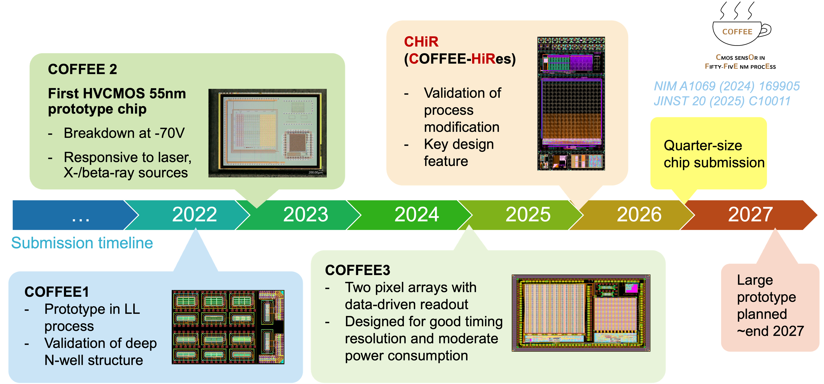
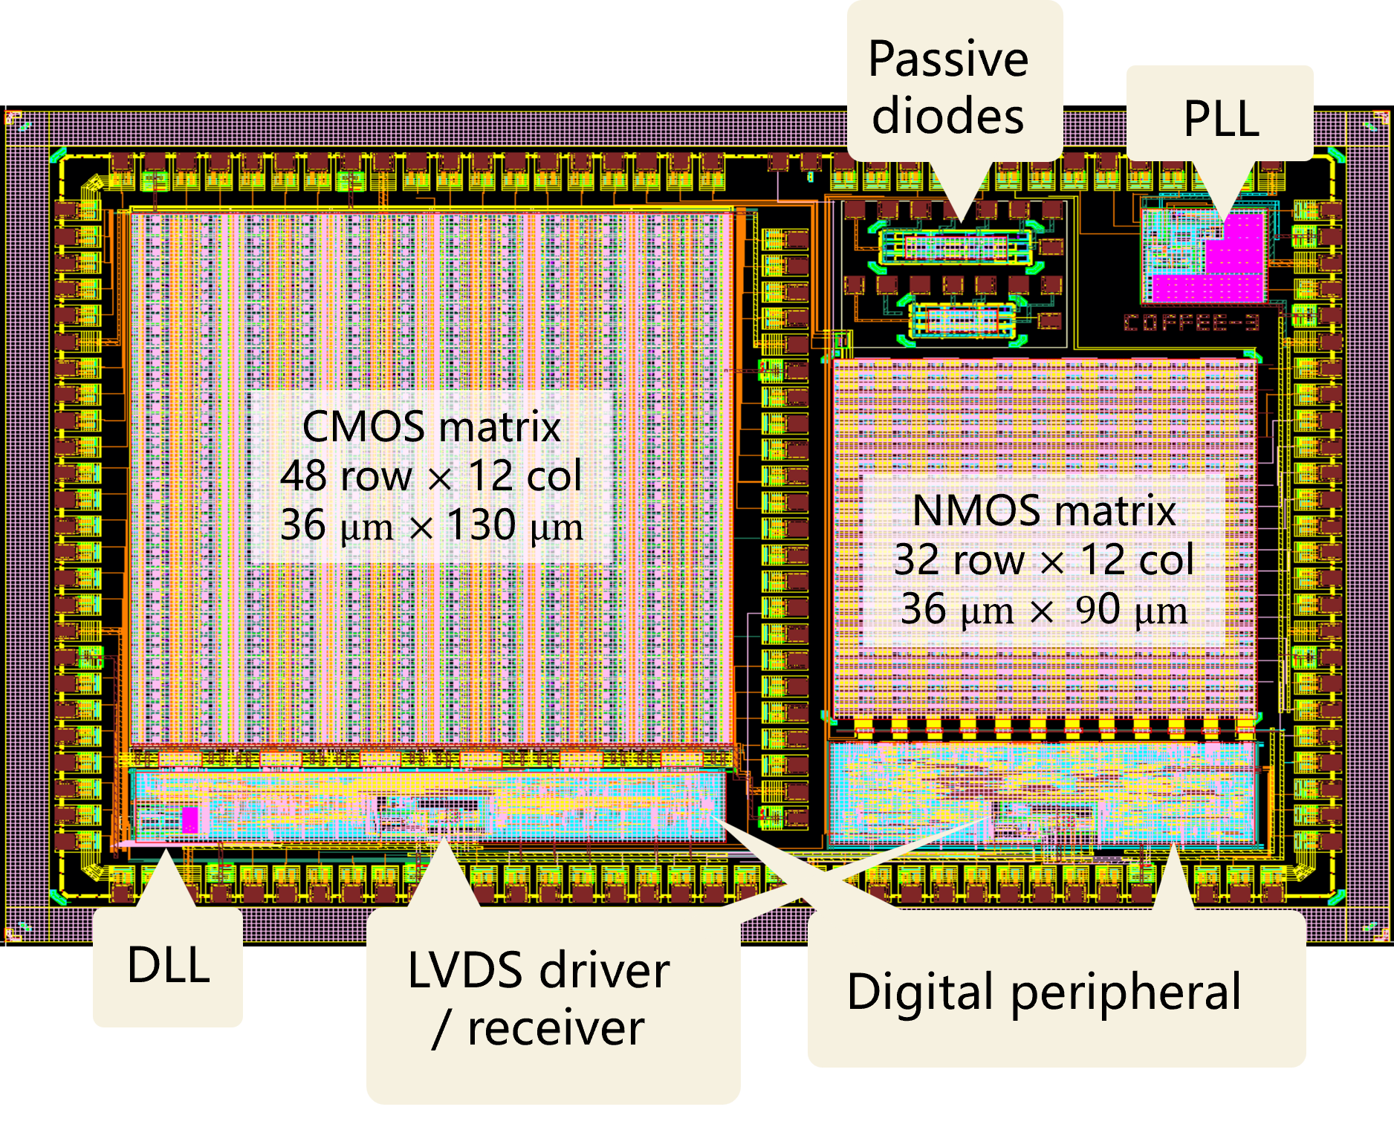
Introduction of COFFEE3
Full size chip with all functionalities implemented
planned ~end 2027
COFFEE-3 (CMOS sensOr in Fifty-FivE nm procEss, SMIC-55 nm process)
  Passive diode for sensor R&D
  CMOS/NMOS matrix
  Functionality validated for periphery IPs: DLL, PLL, LVDS driver, …
JINST 21 (2026) C04075

Slide 4
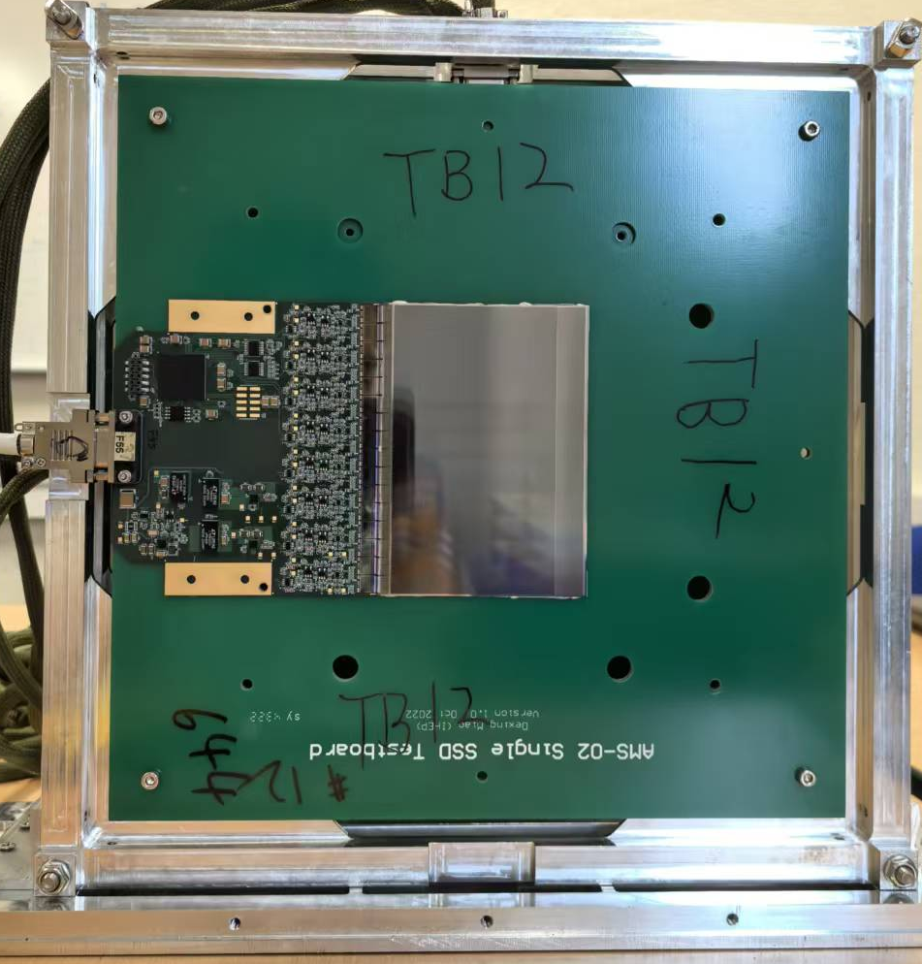
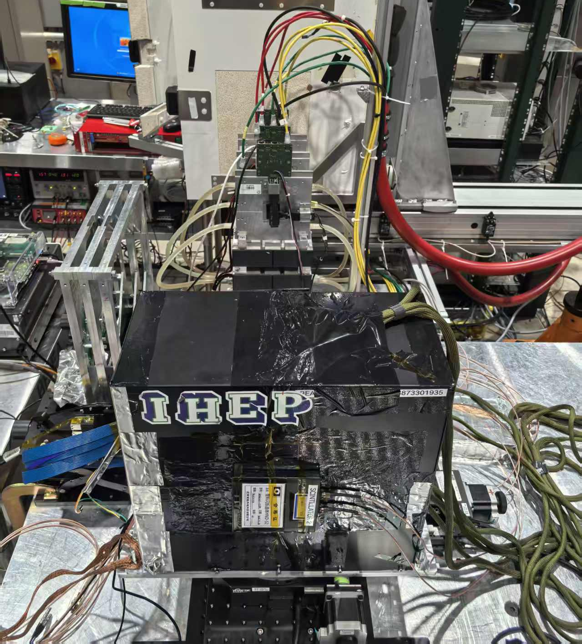
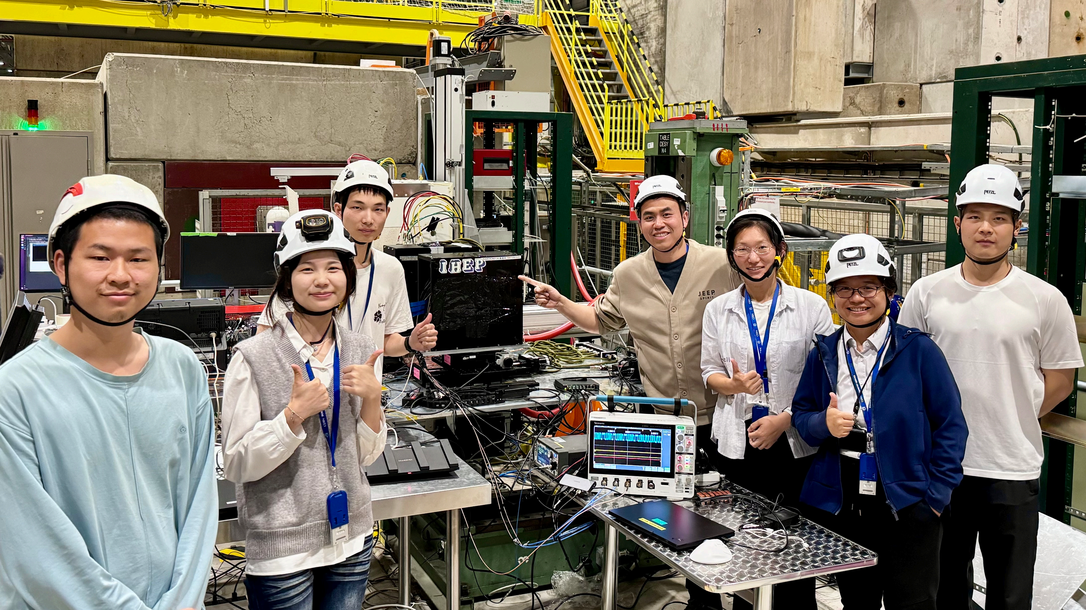
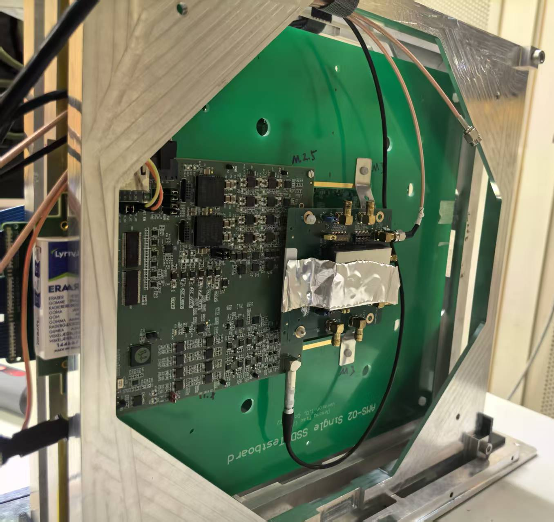
Test Beam Setup 1
13 May ~ 20 May
CERN SPS H6, 200 GeV hadron beam
A 6-layer silicon strip detector beam monitor (BM) for tracking
Two scintillators with COFFEE provided trigger to BM
A silicon strip detector layer
COFFEE
scintillator

Slide 5
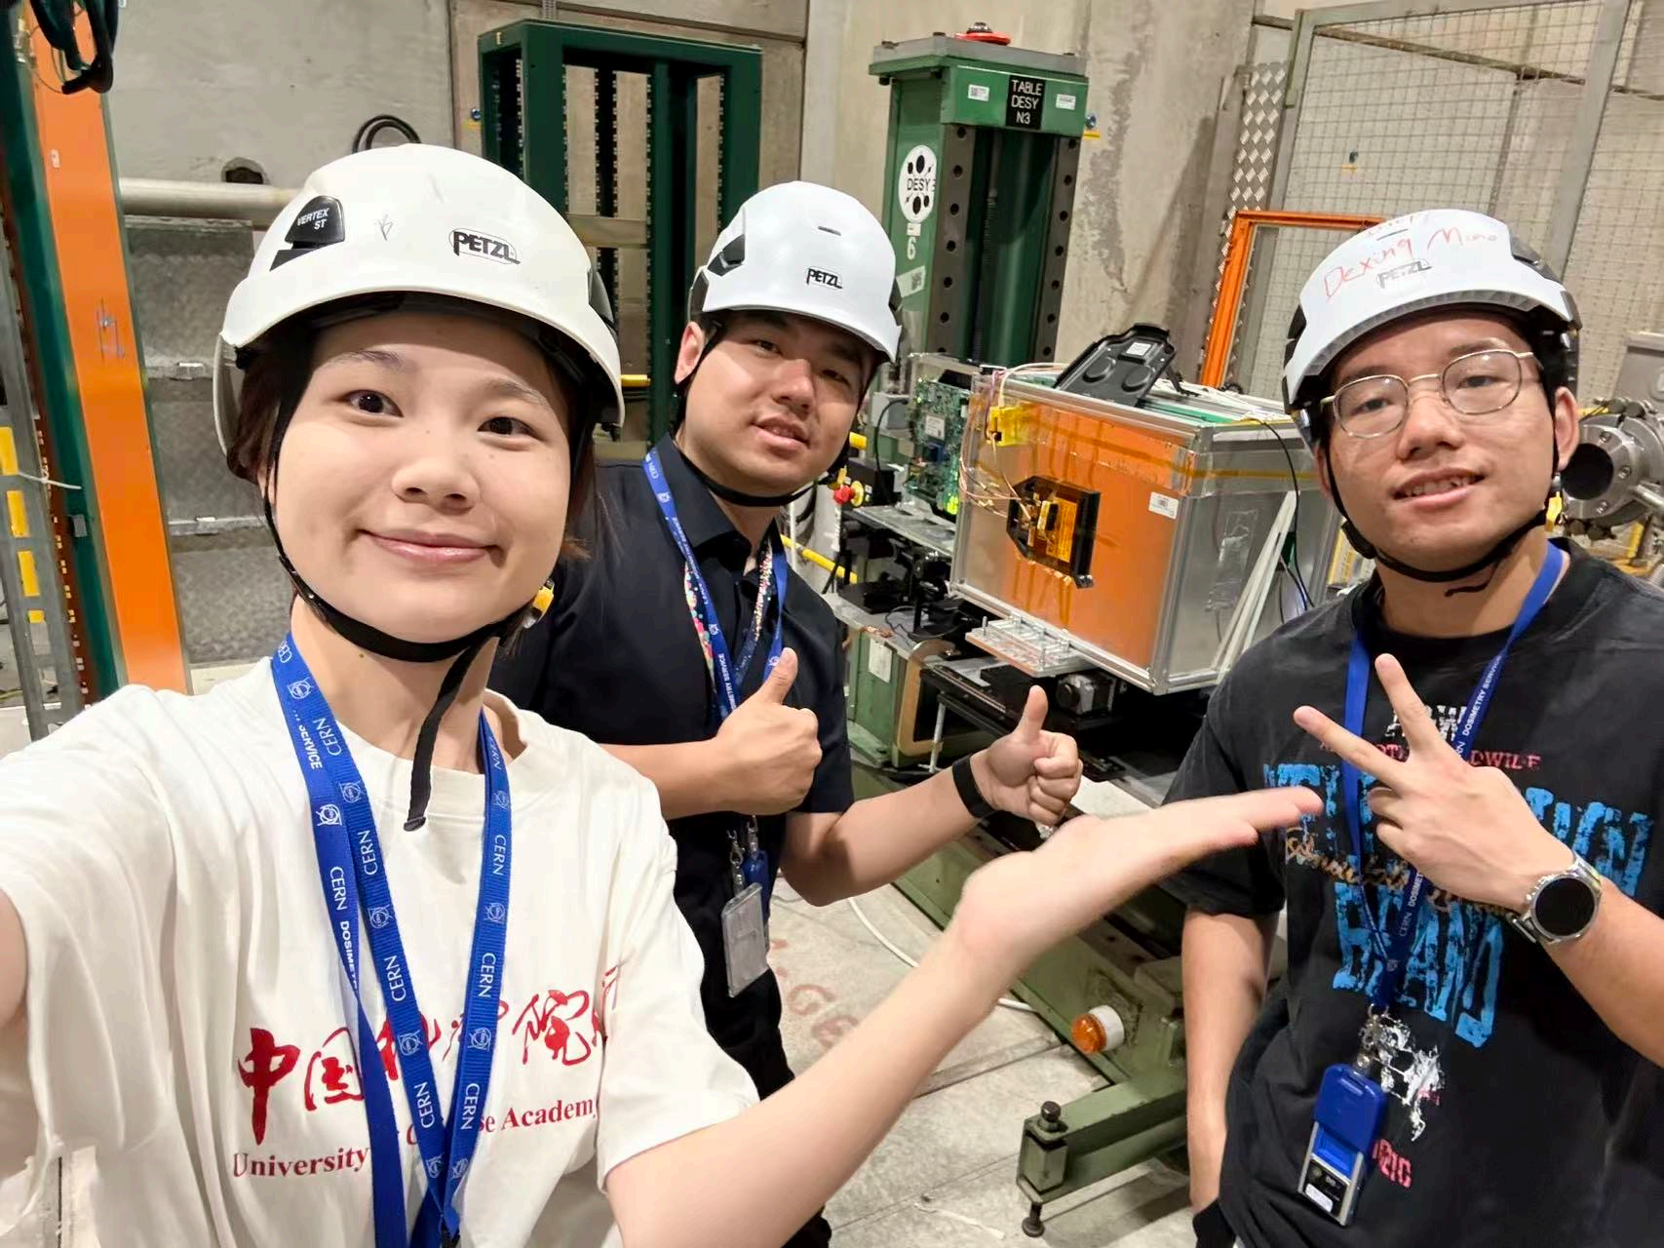
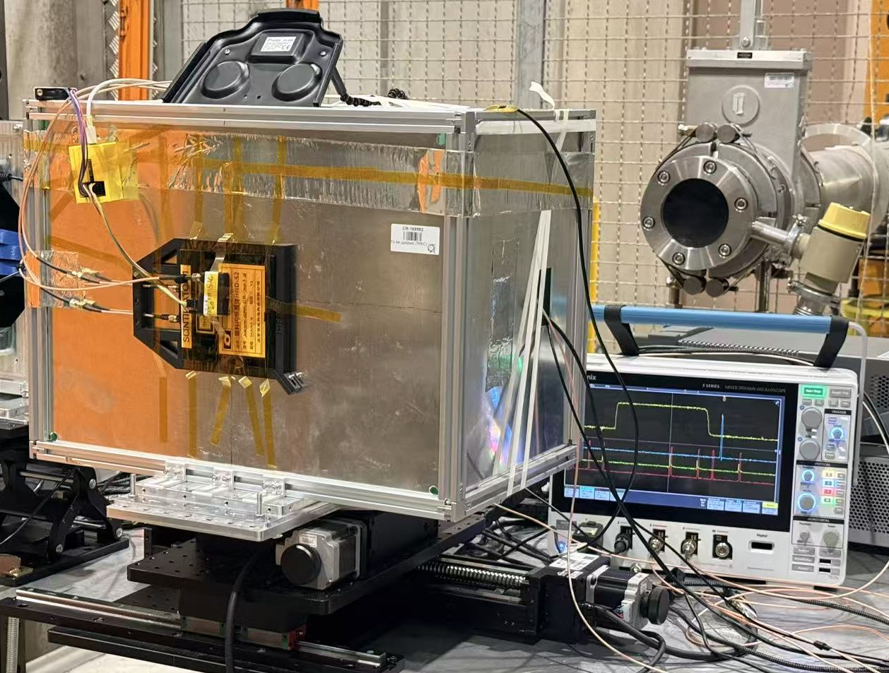
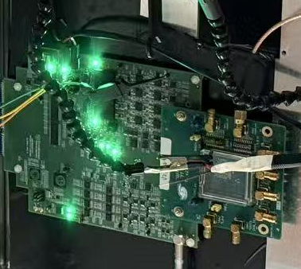
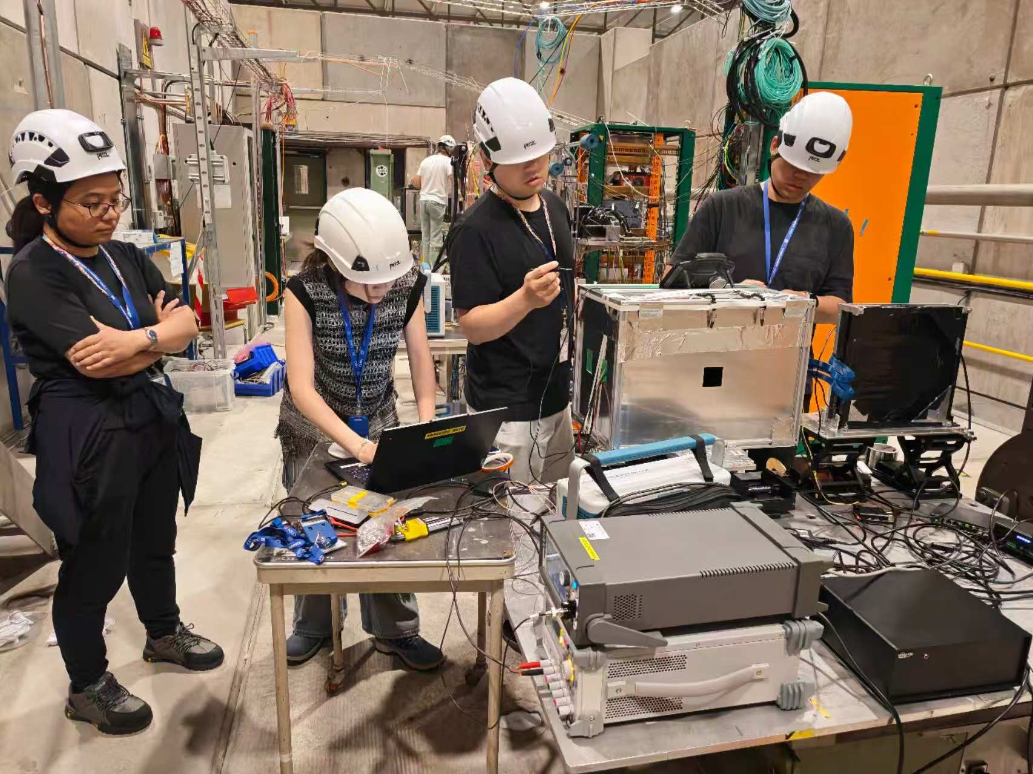
Test Beam Setup 2
8 July ~ 15 July
CERN SPS H8, 180GeV hadron beam
COFFEE, and two scintillators provided time reference
COFFEE
scintillator

Slide 6
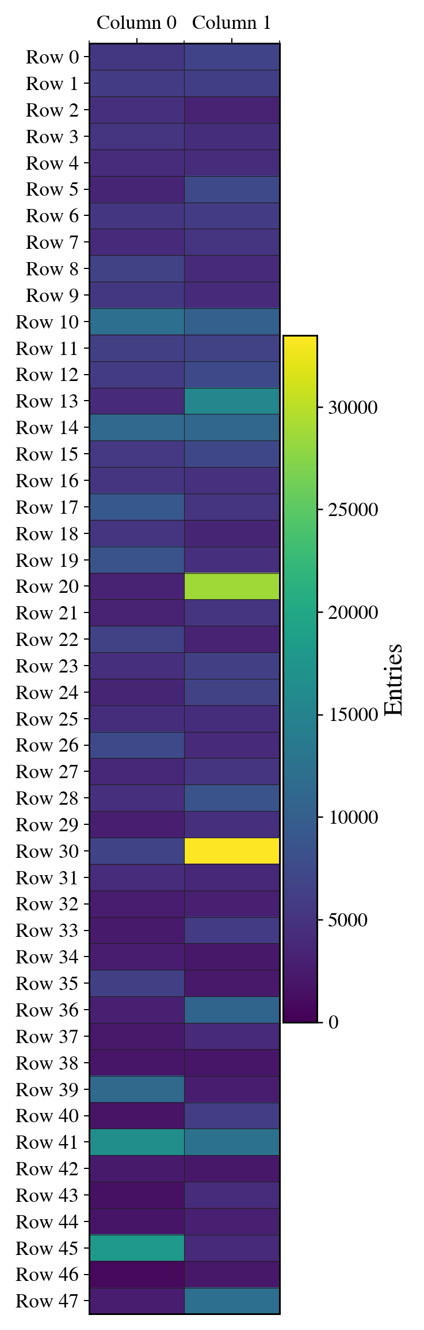
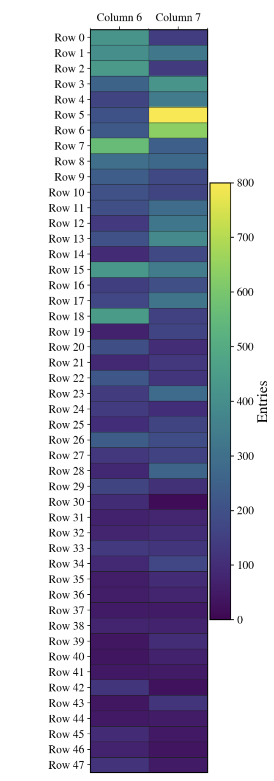
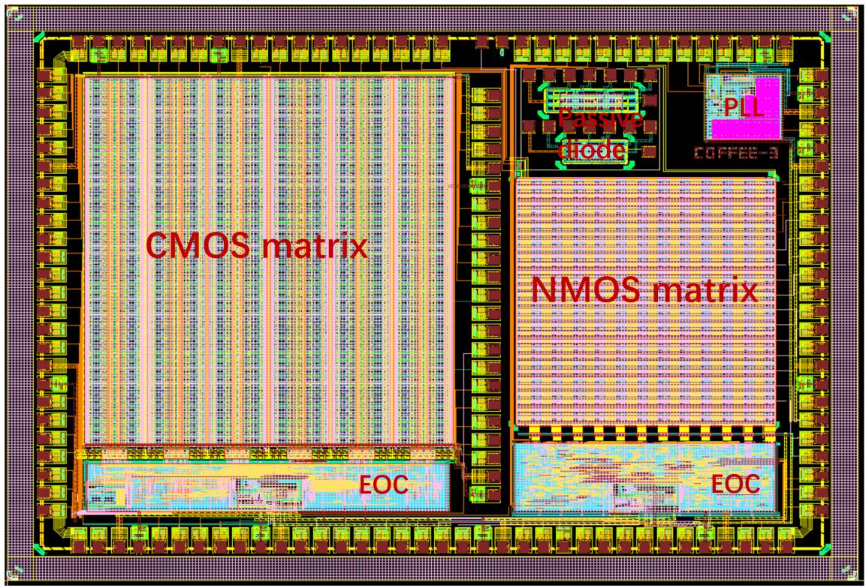
Hitmap of COFFEE3
Tested two double-columns C0C1 and C6C7
Hits were observed for every pixel
C0C1
C6C7
C0 C1
C6 C7

Slide 7
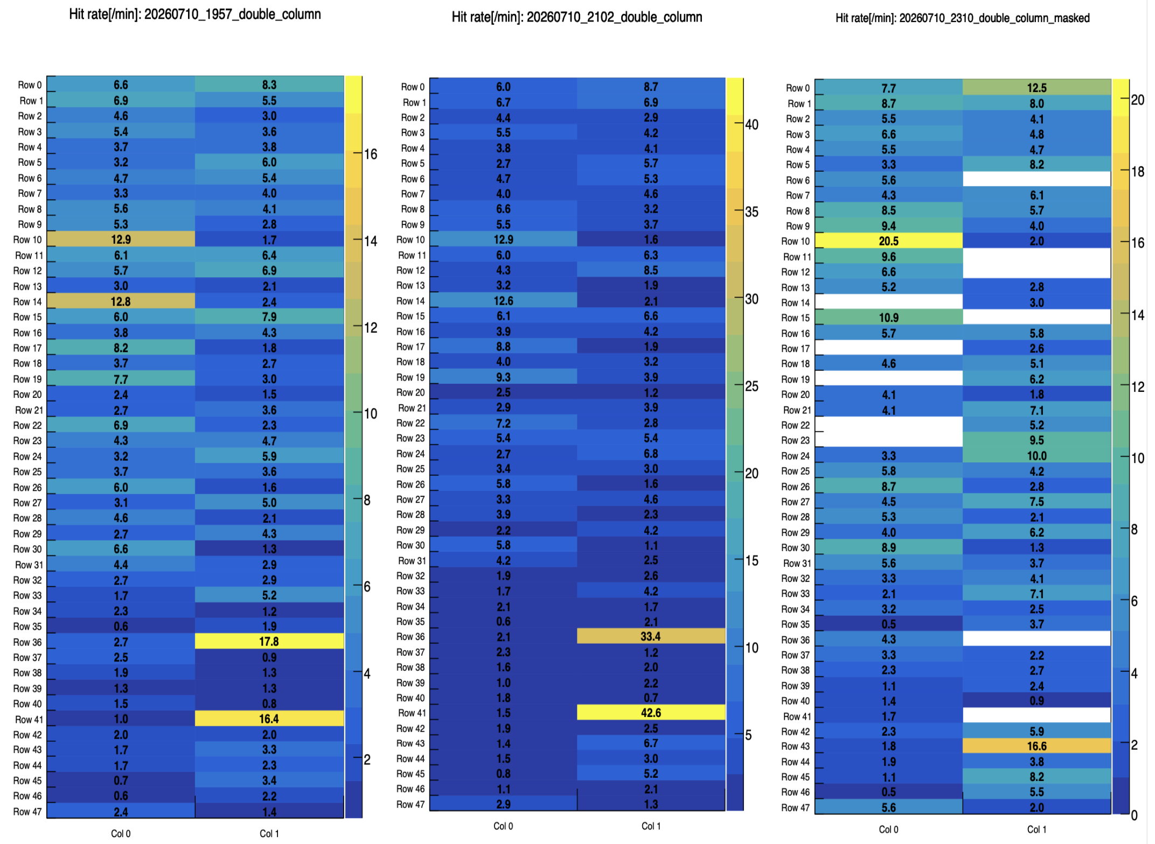
Hitmap of COFFEE3
Hit rate of a double-column C0C1
Hit rate increase as global threshold (TH) decrease as expected
TH=0.836
TH=0.83
TH=0.808
(11pixels masked)

Slide 8
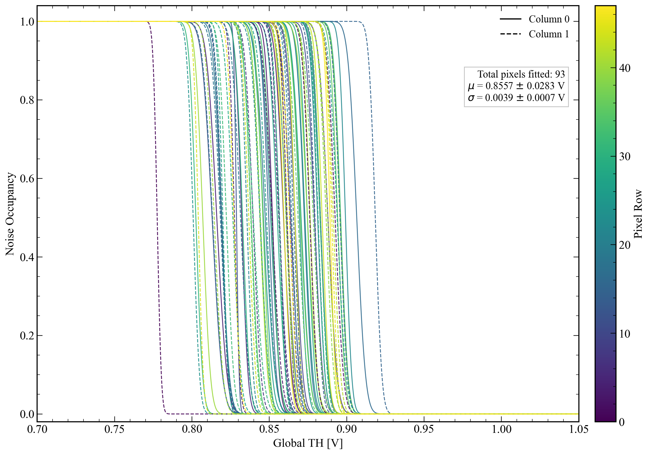
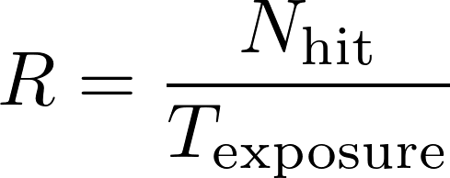
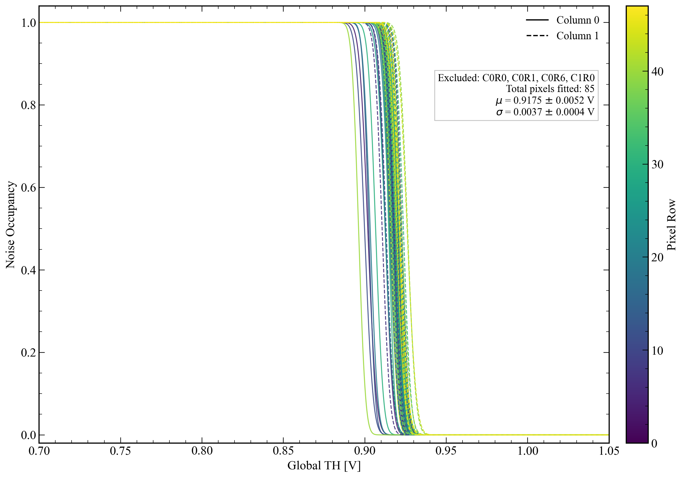

Noise-Baseline TDAC Tuning
Noise S-curve before TDAC
σ_{μ，before} = 28 mV
4-bit TDAC in each pixel to allow fine tuning of threshold for a more uniform response
Trimming function validated in lab after the testbeam
Noise S-curve after TDAC
σ_{μ，after} = 5 mV

Slide 9
Setup for Tracking
The coincidence of the COFFEE signal and the coincidence signal of the two scintillators serves as the trigger to BM
A beam monitor (BM) composed of 6 silicon strip detectors (3X+3Y) provide 3D track information
Single layer spatial resolution ~ 10μm arXiv:2603.25080
COFFEE3
inside
Y
A silicon strip detector
X
carlibo board
scint 1
Pixel
scint 2
&
scint
COFFEE3
scint
Beam
+Z
&
CSA trigger
test board
Y
scint
BM
X
9cm
3cm
Z
Not to scale

Slide 10
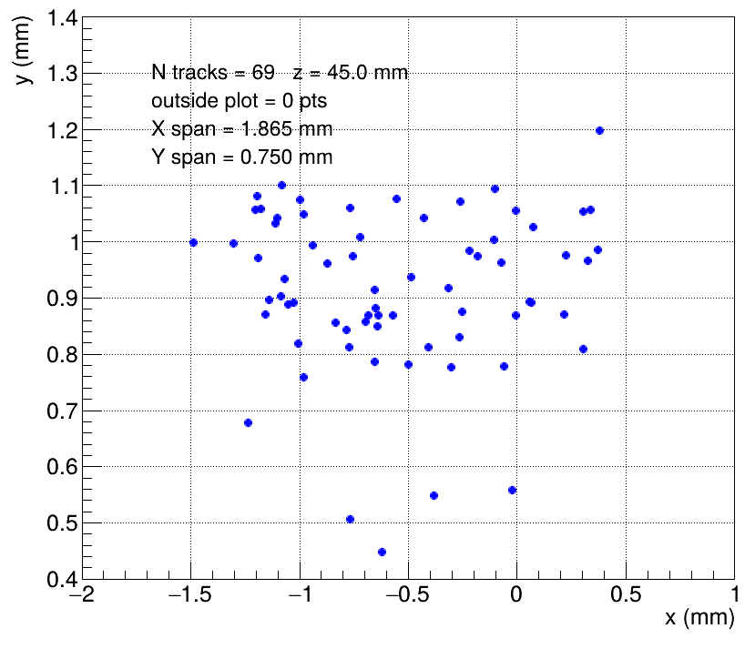
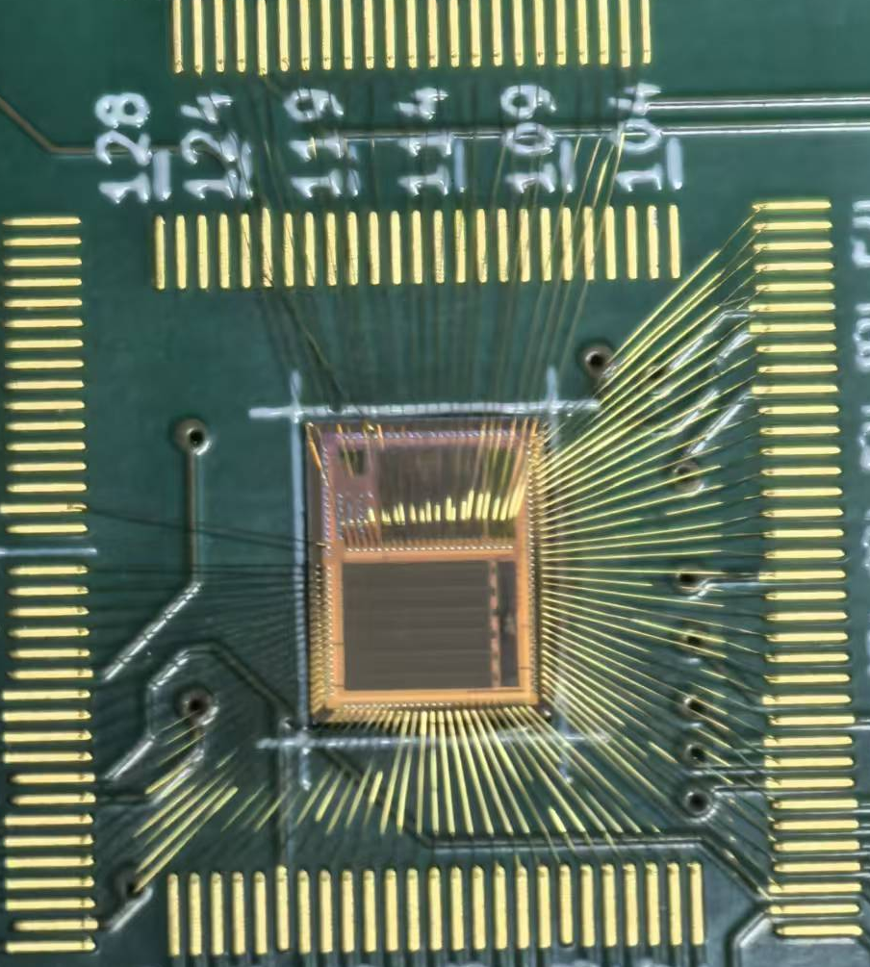
Hitmap of Tracking
69 tracks are reconstructed, whose predicted hit position on COFFEE3 are shown below
Excluding the outliers, the hit region is roughly the same size as the two columus region
Y
48 rows ~ 2mm
C1
2 columns
~ 0.3mm
......
C0
Not to scale
X
~1.9mm
~0.35mm
C0C1
Only one double-columns C0C1 was used

Slide 11
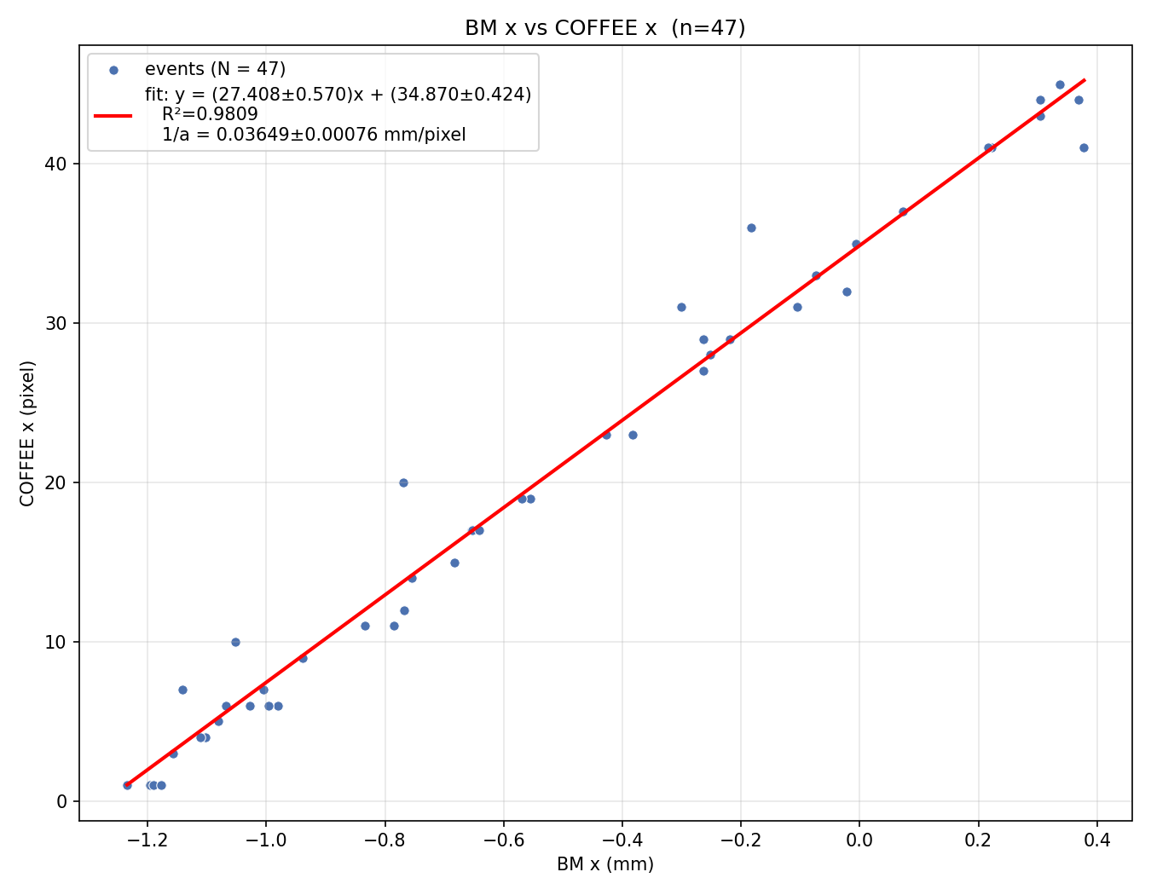
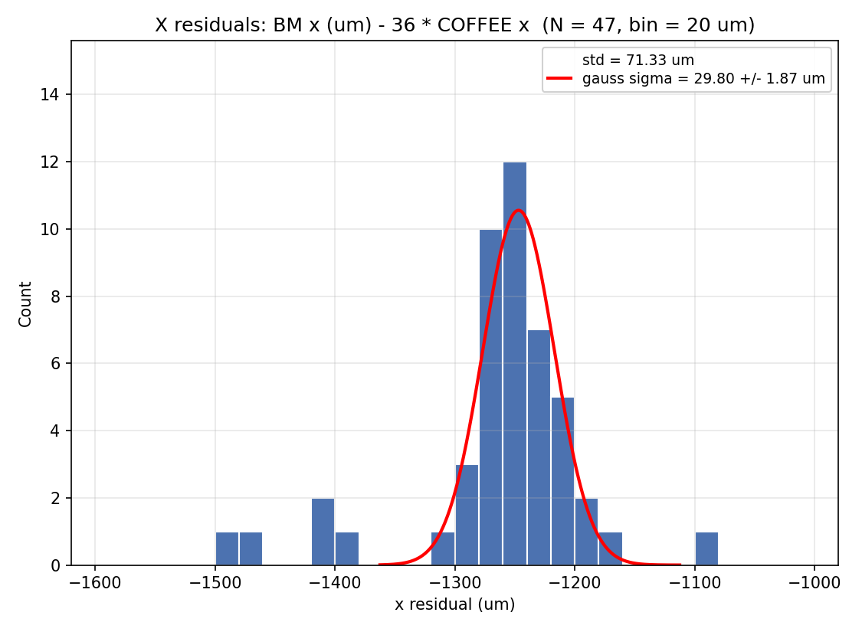
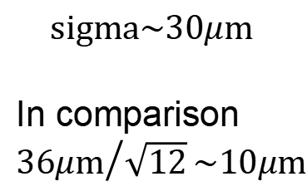
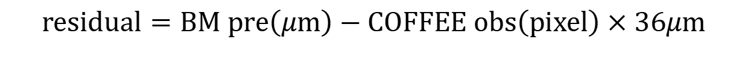
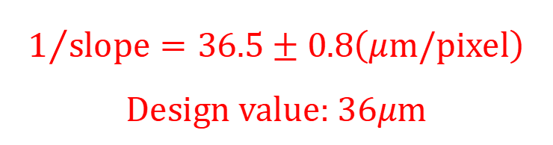
X Direction Tracking Result
$$1/{slope=36.5±0.8\left(μm/pixel\right)}$$
Design value: $36μm$
$$residual=BM pre\left(μm\right)−COFFEE obs\left(pixel\right)×36μm$$
$$sigma\sim 30μm$$
In comparison
$${36μm}/{\sqrt{12}}\sim 10μm$$
COFFEE observed / Pixel
Due to the limited data, alignment of COFFEE3 rotation in X-Y plane is not performed. The sigma is dominated by misalignment
BM predicted / mm

Slide 12
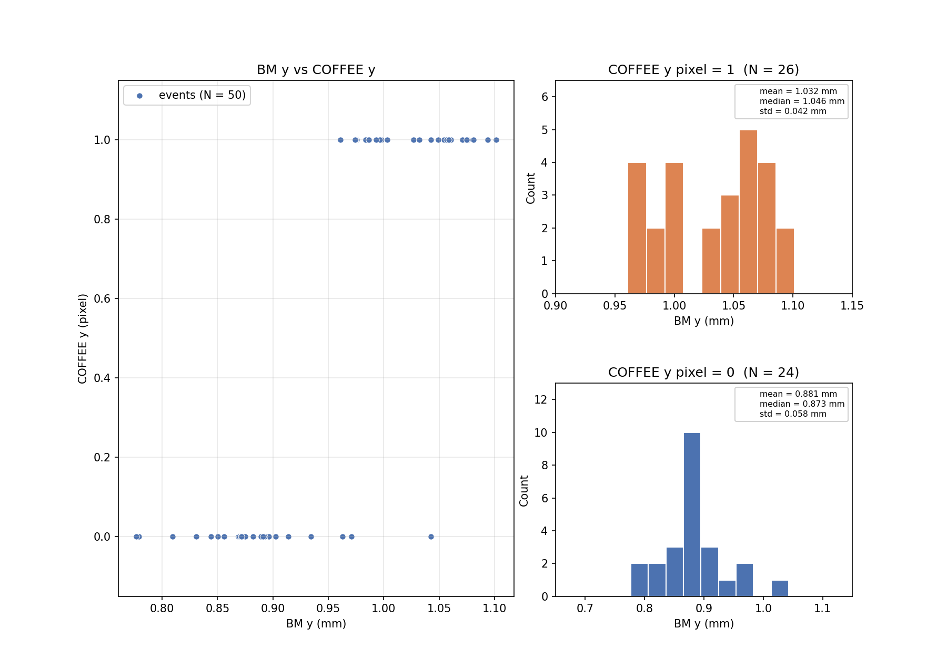
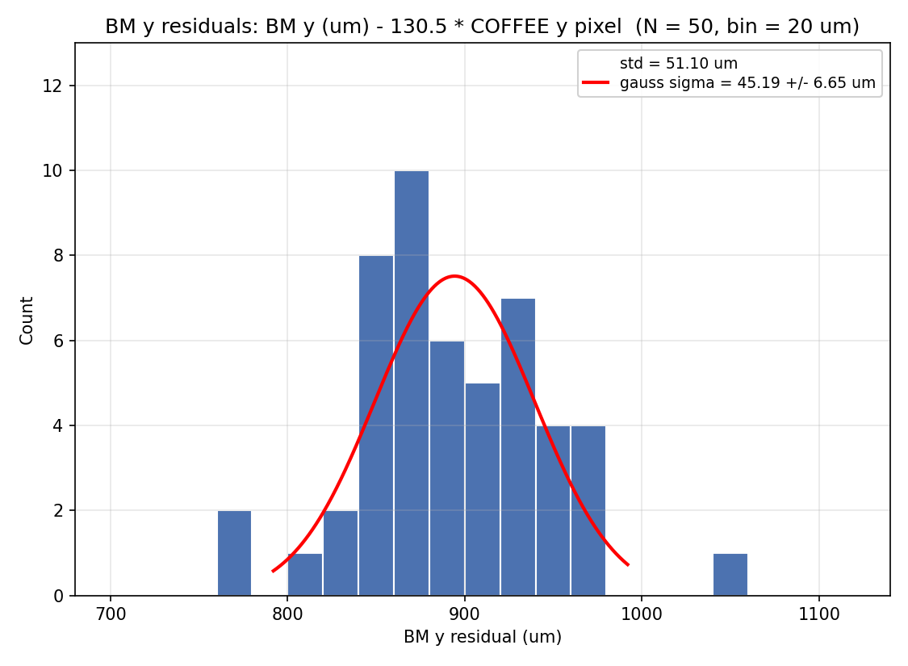
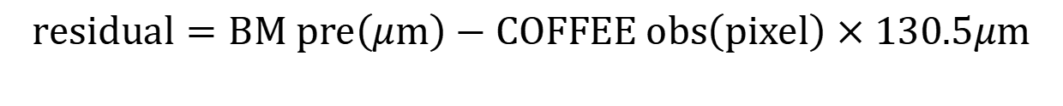
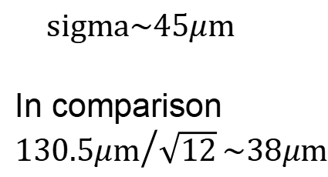
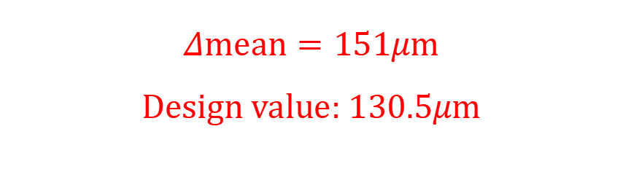
Y Direction Tracking Result
$$Δmean=151μm$$
Design value: $130.5μm$
$$residual=BM pre\left(μm\right)−COFFEE obs\left(pixel\right)×130.5μm$$
mean=1.032mm
median=1.046mm
$$sigma\sim 45μm$$
In comparison
$${130.5μm}/{\sqrt{12}}\sim 38μm$$
COFFEE observed / Pixel
mean=0.881mm
median=0.873mm
BM predicted /mm
The sigma is dominated by misalignment

Slide 13
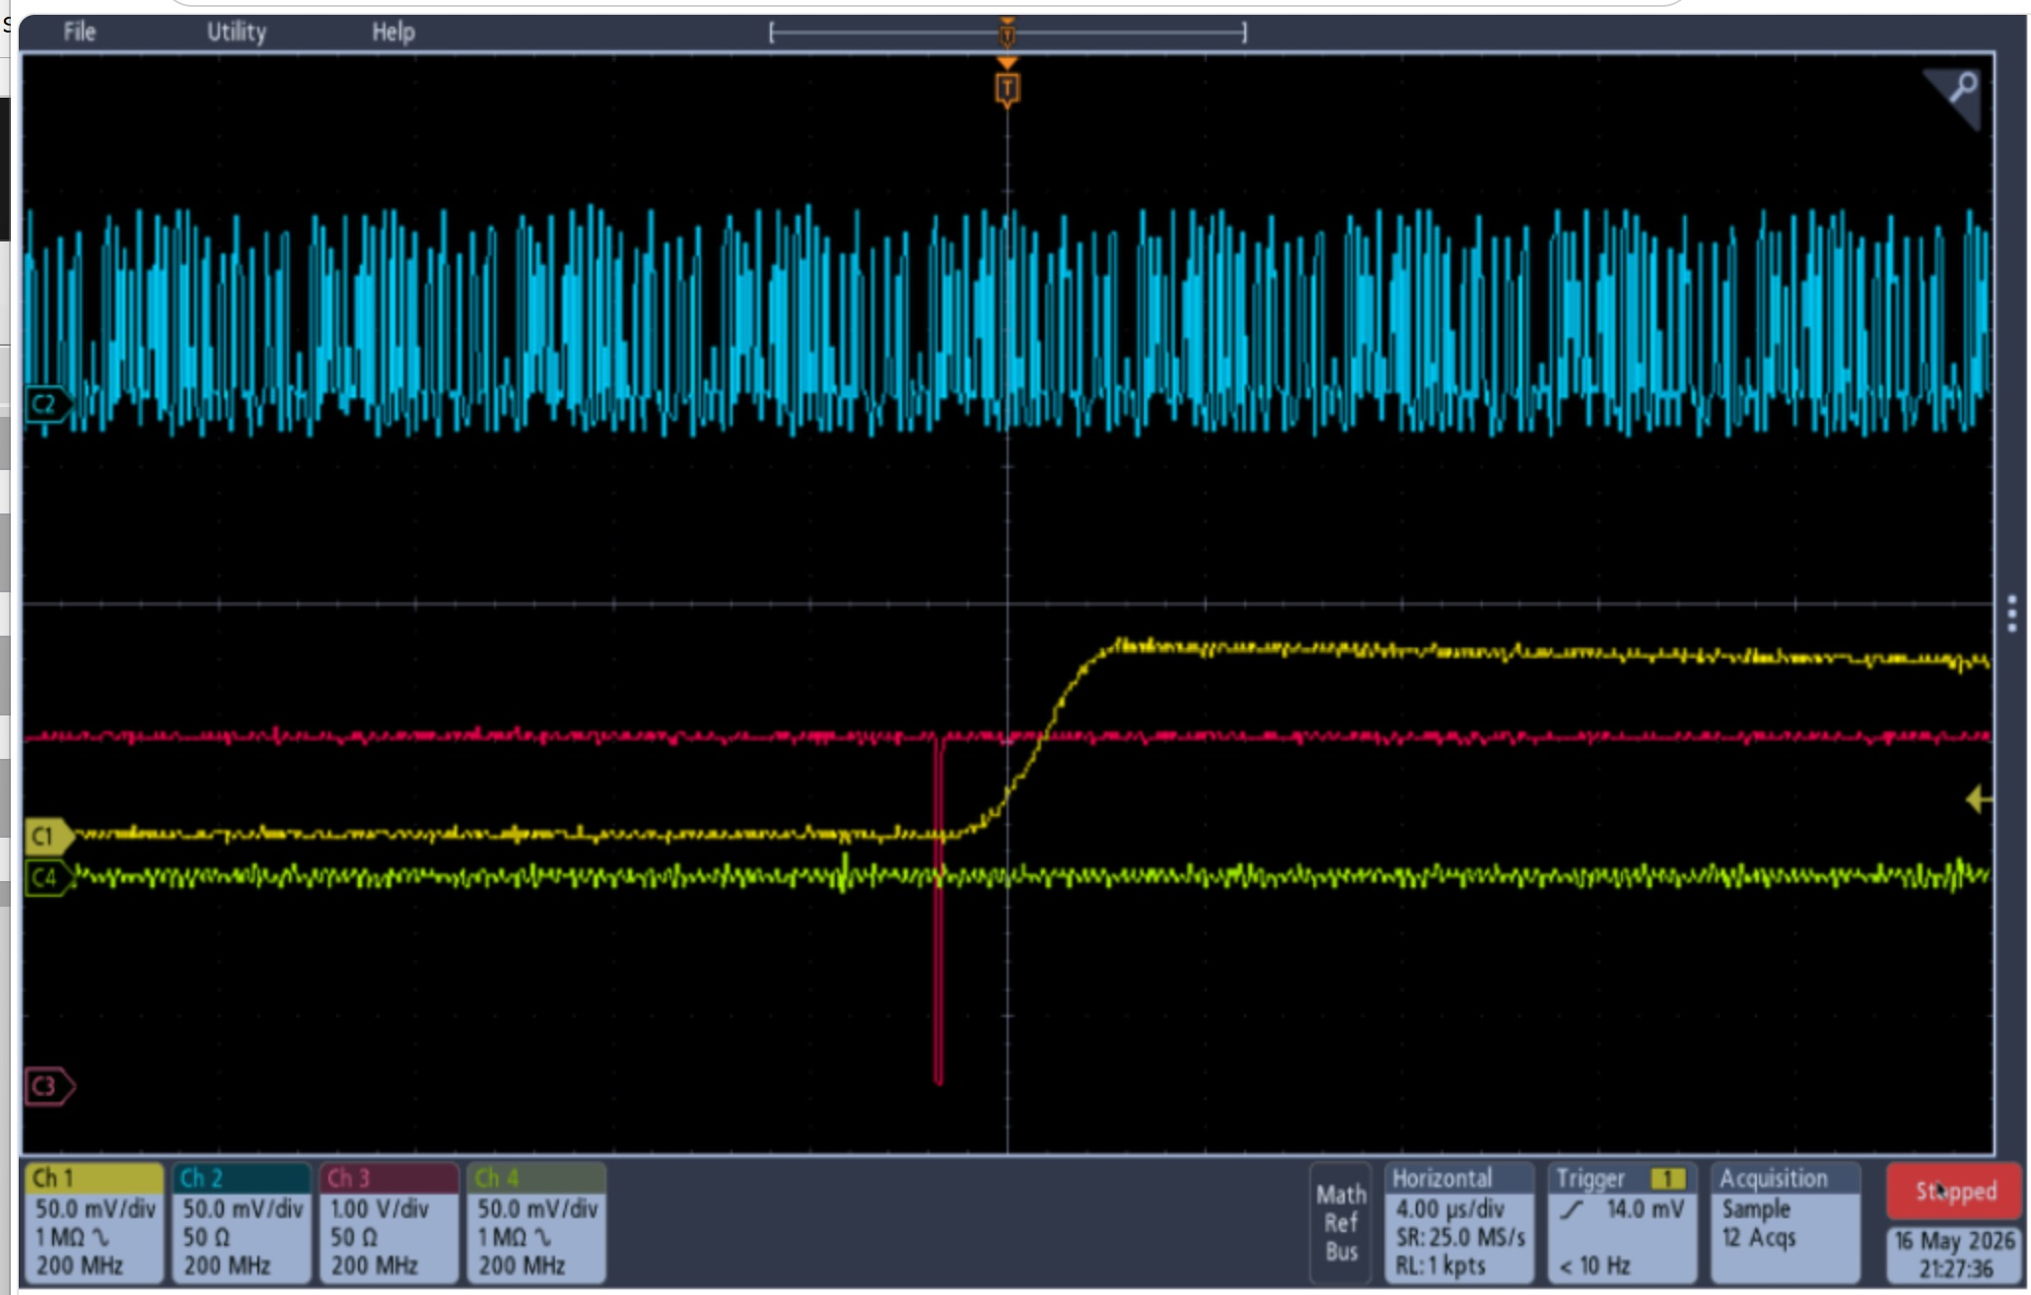
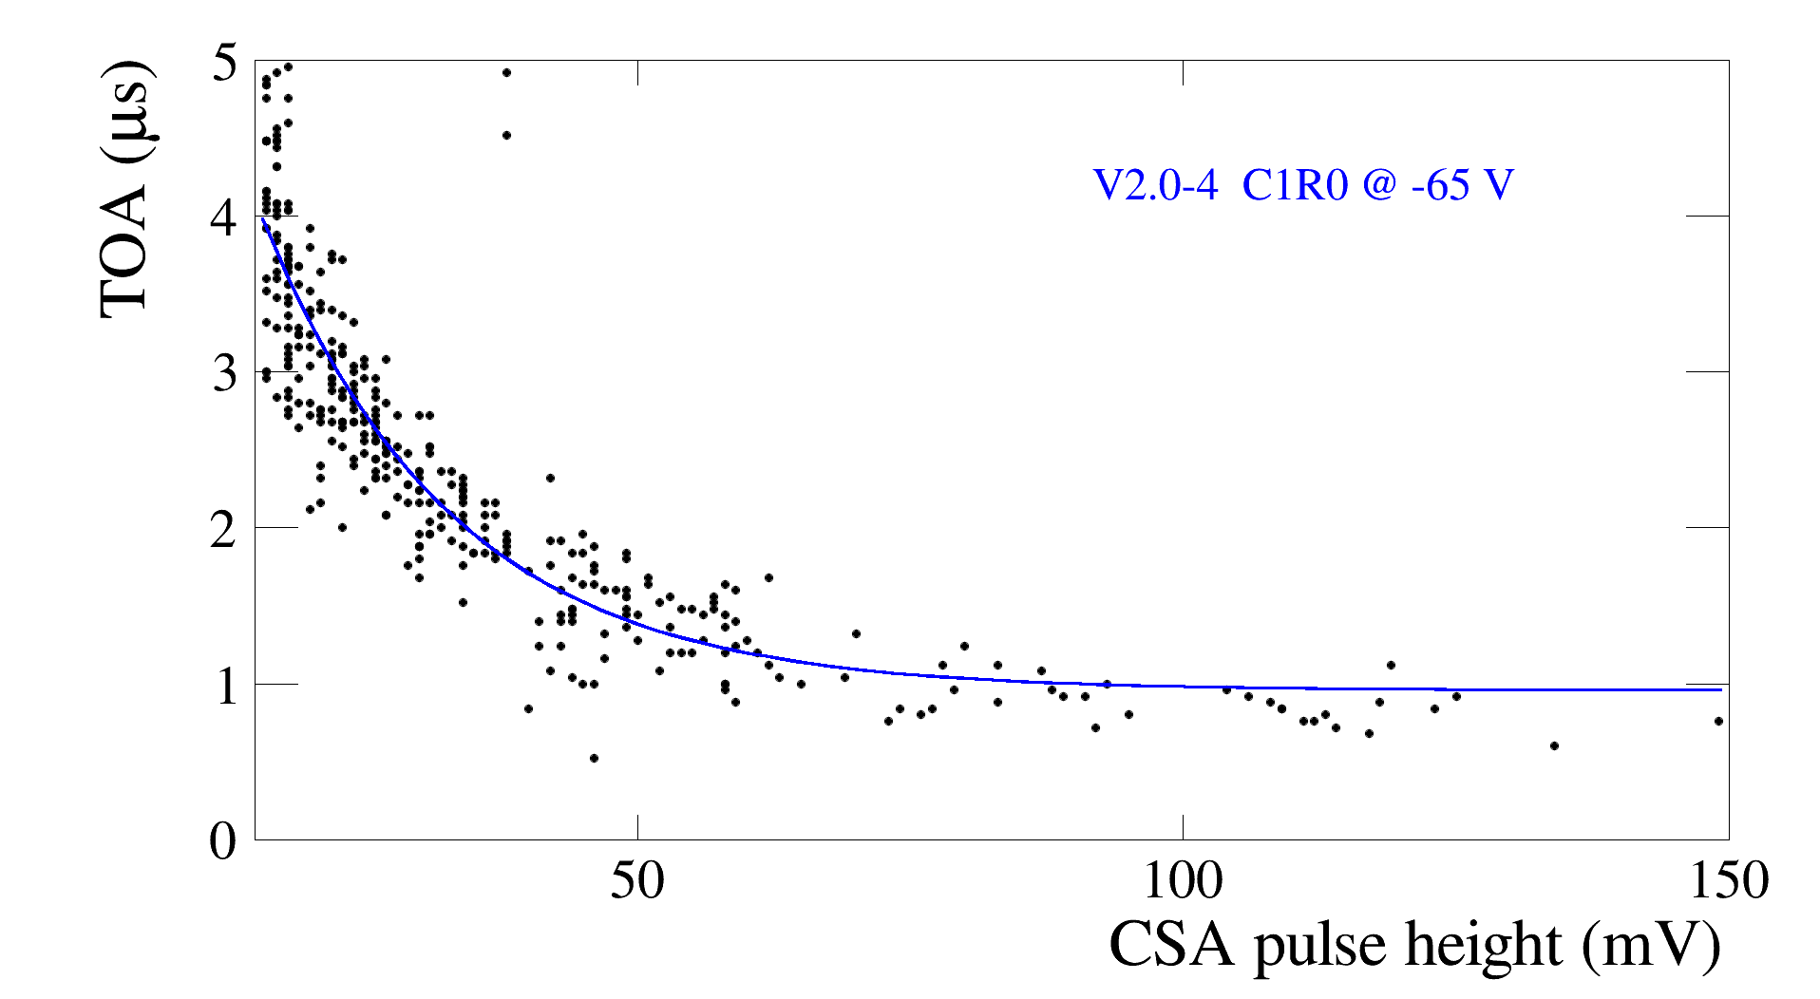
Single-Pixel timing
A typical event on scope
Time of Arrival (TOA): Period between the time CSA output reaches TH and the rising edge of scintillator signal
TOA
CSA output
Scintillator output
Incident particle
Timewalk observed
Scint 1
Pixel
&
Scint 2
Oscilloscope
CSA output

Slide 14
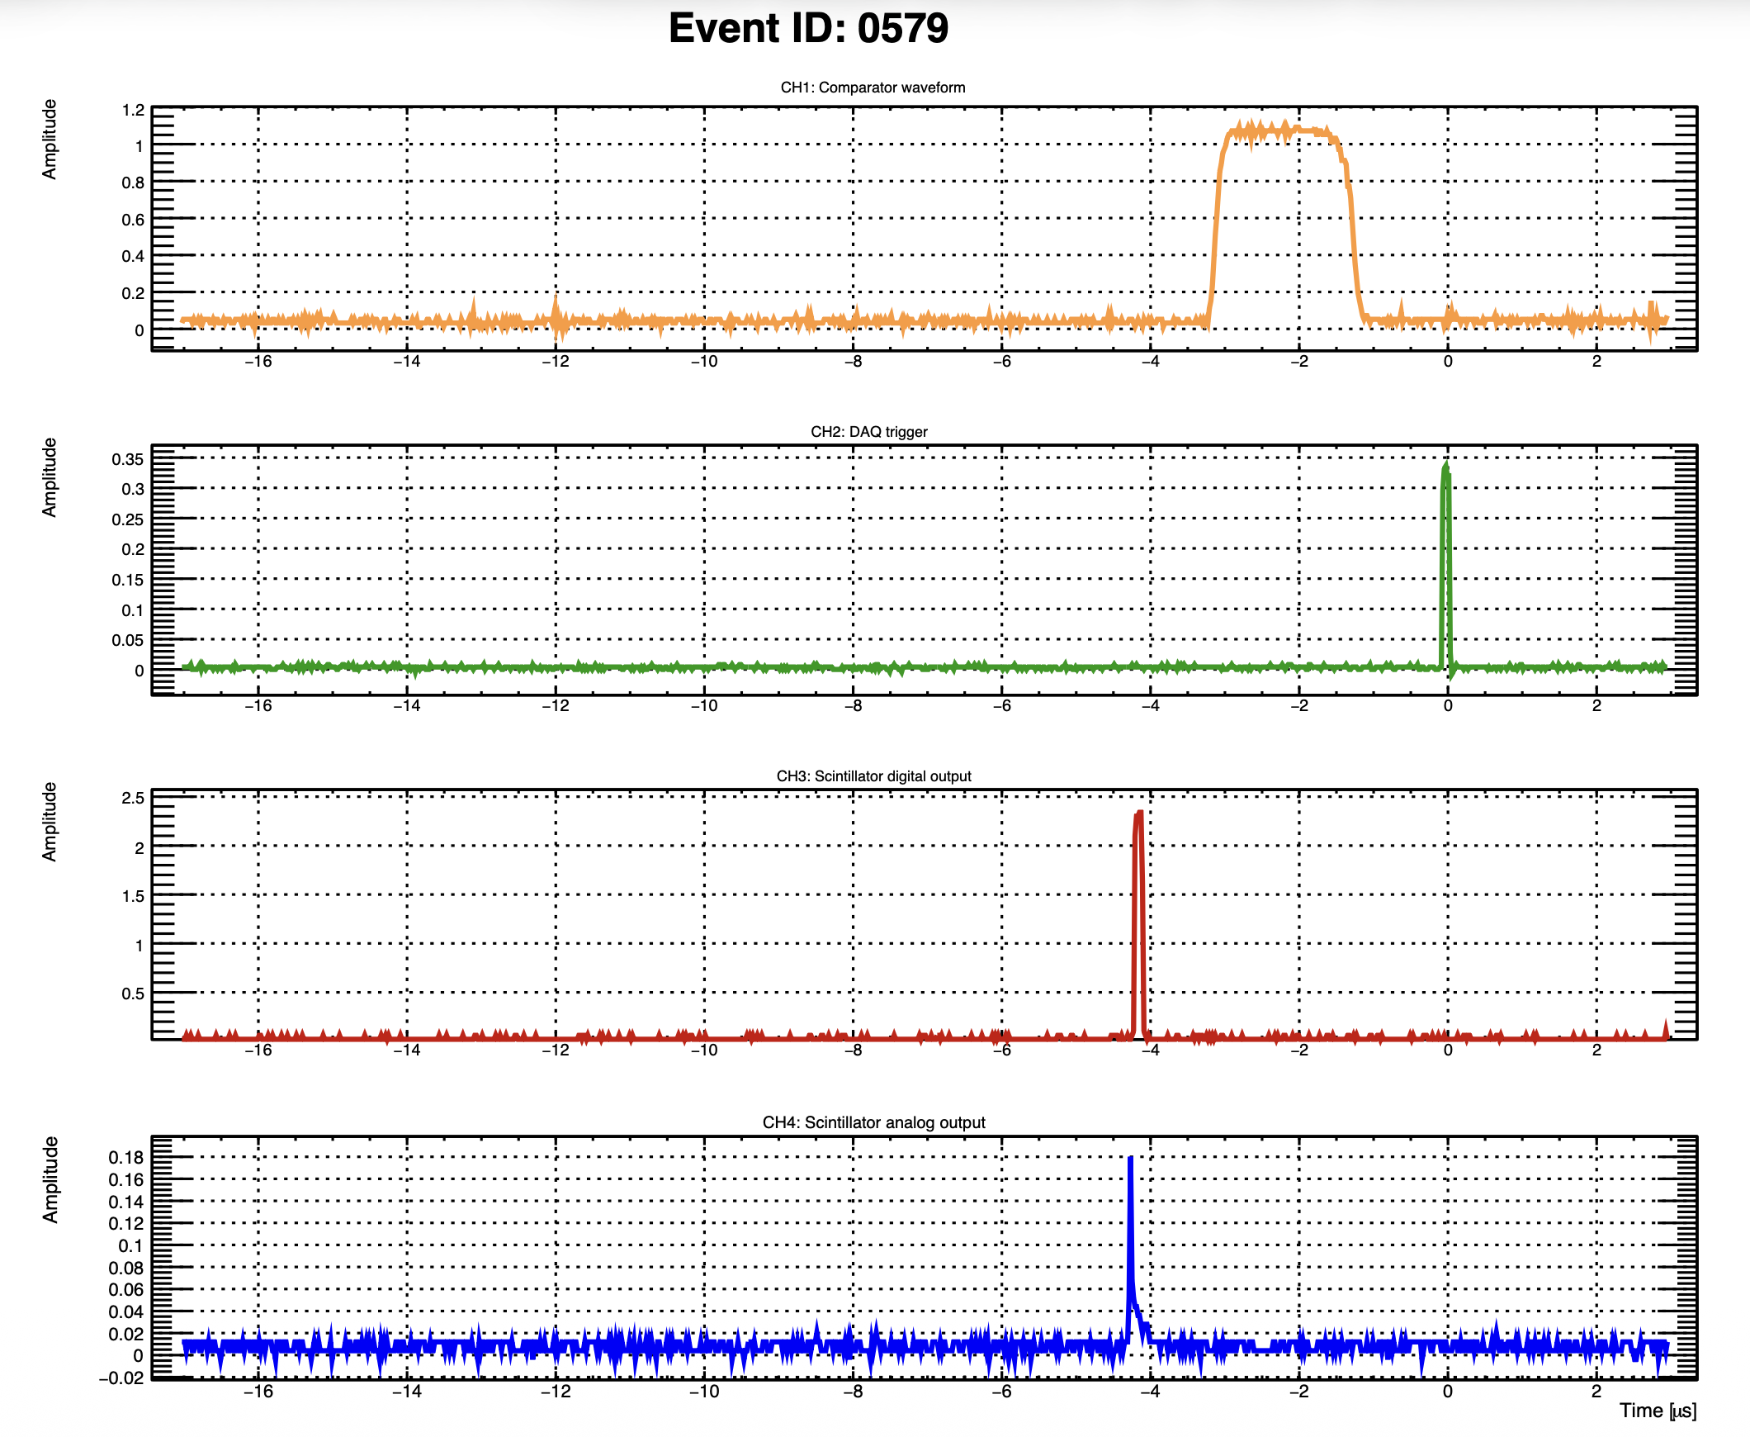
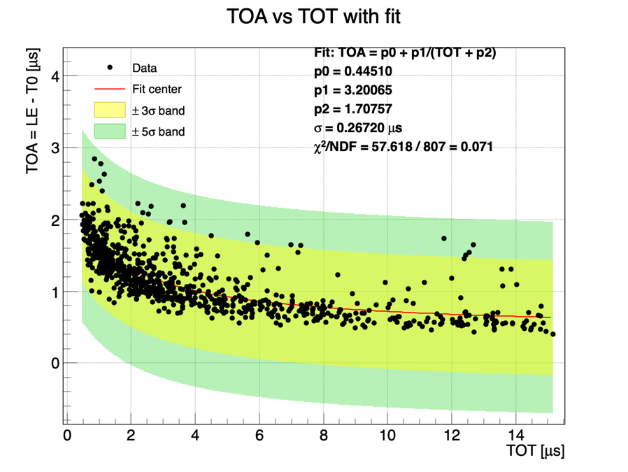
Single-Pixel timing
Comparator digital output
LE
TE
Time of Arrival (TOA): Period between the leading edge (LE) of comparator digital output and the rising edge of scintillator signal
TOT
Scintillators digital output
TOA
T0
TOA
Incident particle
LE
TE
Scint 1
threshold
Pixel
&
Scint 2
CSA
Oscilloscope
Comparator output
Comparator

Slide 15
Summary
The basic functionality of COFFEE3 has been verified
Research on the performance of the chip series is still ongoing

Slide 16
Thanks for your attention

Slide 17
BACK UP

Slide 18
C1R0 Single-Pixel TOA Test
Monitor the output from CSA
Single pixel C1R0
CSA trigger threshold: TH=15mV
Incident particle
TOA
Scint 1
Pixel
&
TH=15mV
Scint 2
C1R0 CSA output
Scintillator output
CSA
trigger to scope
Comparator
Oscilloscope
Digital output
A typical event observed on scope
Time of Arrival (TOA): Period between the time CSA output reaches TH and the rising edge of scintillator signal
DAQ
5月的TOA与CSA

Slide 19
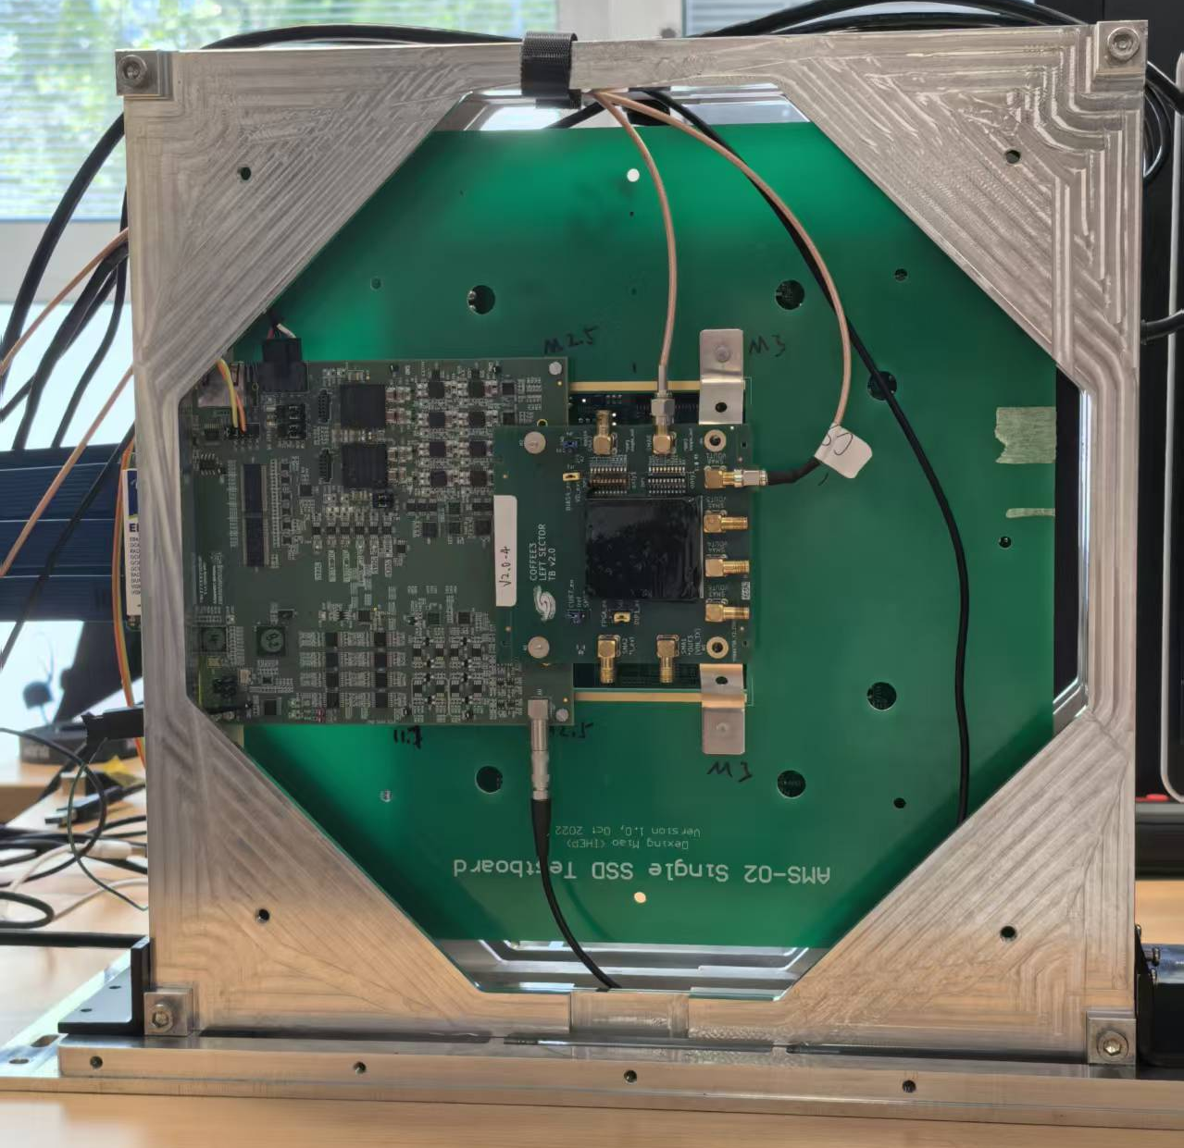
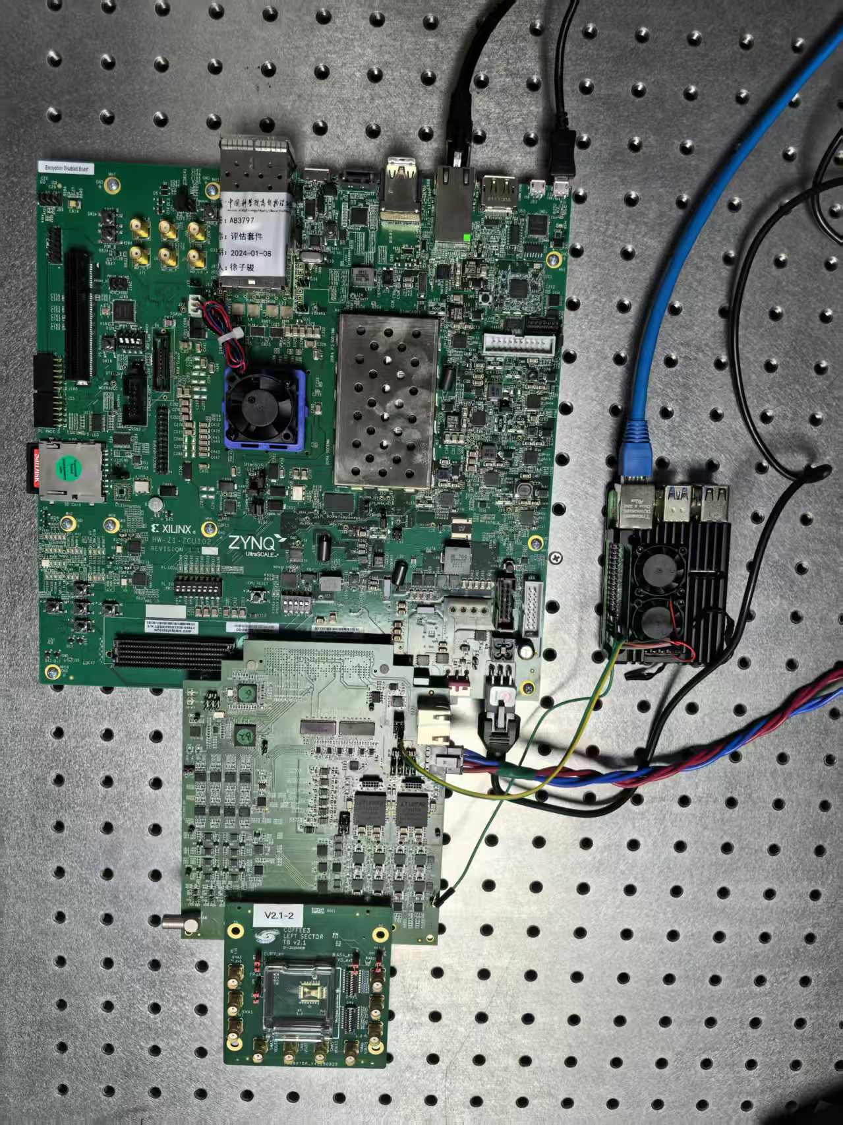
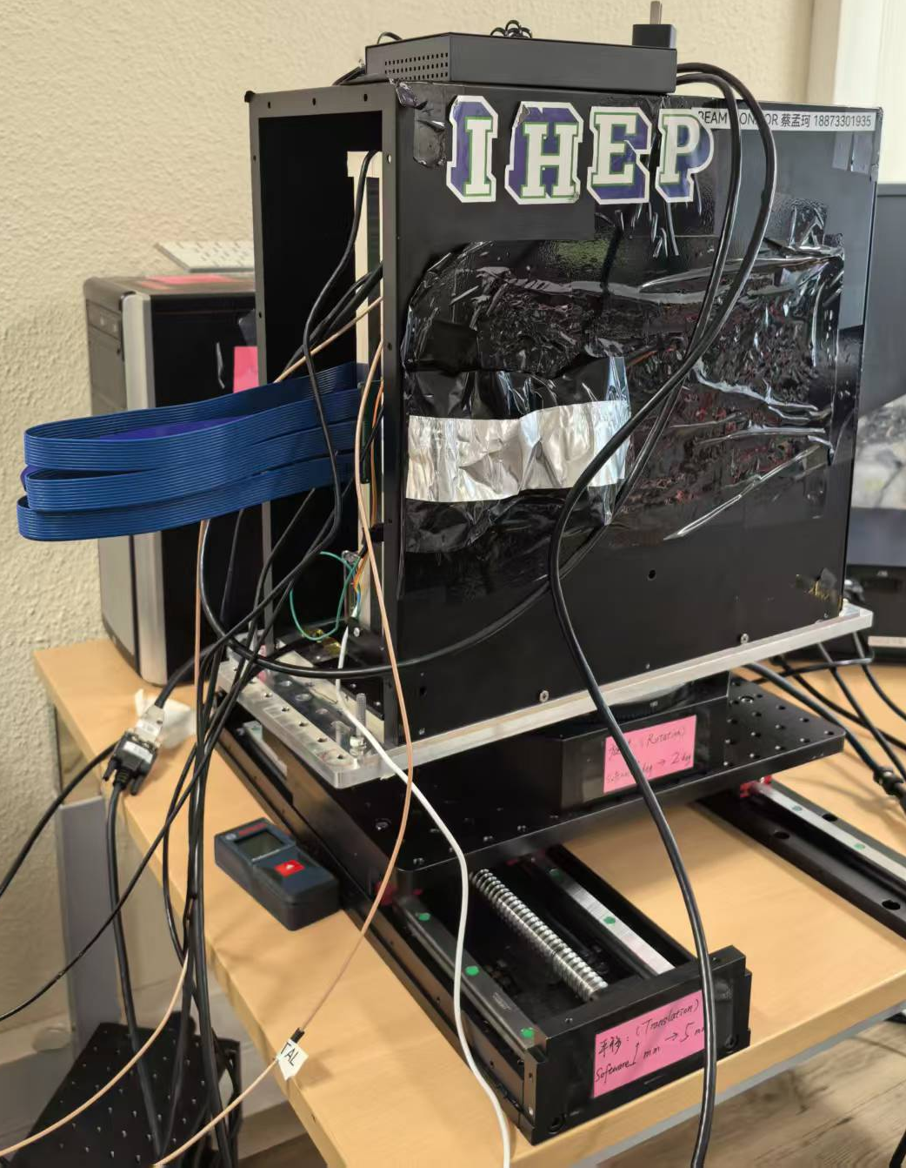
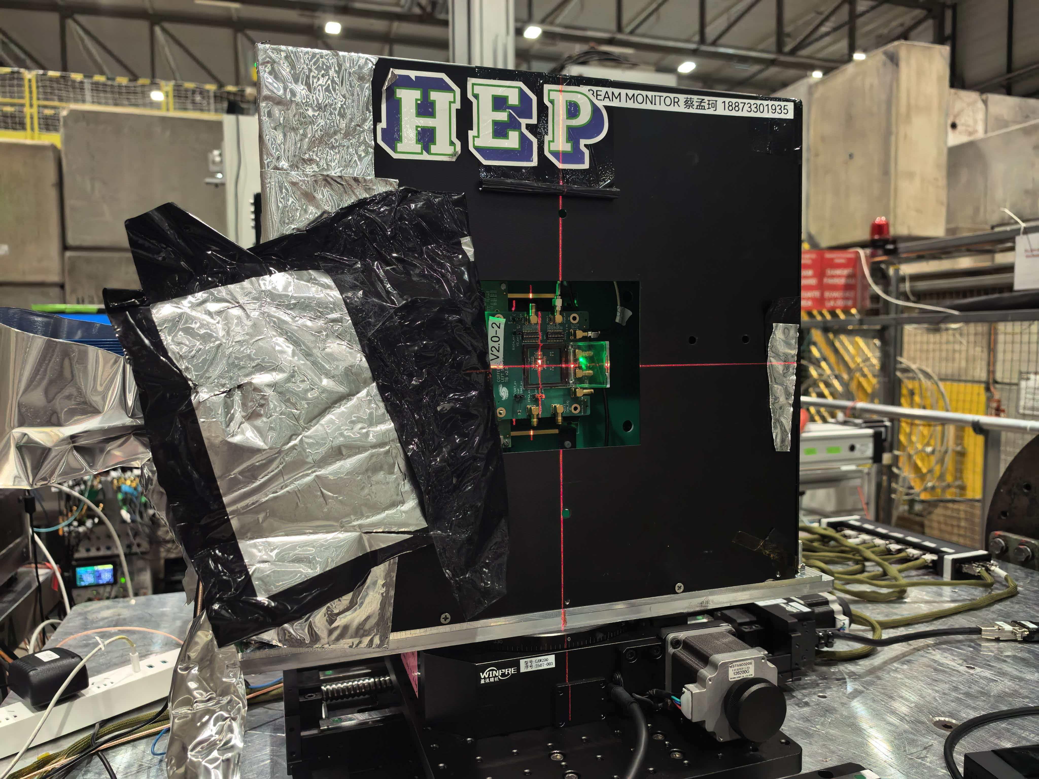
Setup for COFFEE3
5月的COFFEE单独
The side is sealed with aluminum tape for shielding when test
TB
CaR Board
COFFEE3 Test Board (TB)
what is inside
big PCB
CaR Board
ZCU102
Setup in lab
Setup for beam
COFFEE3 system
CaR Board (with TB) is fixed on a big PCB, and ZCU102 on another PCB
ZCU102 and CaR Board are connected with FCC
Laser alignment

Slide 20
C1R0 Single-Pixel TOA Test
Monitor the output from comparator
When DAQ sees a valid digital output, it sends out a digital trigger
Connect the DAQ trigger to oscilloscope input
Incident particle
Scint 1
Pixel
&
LE: Time_{_half_max(A)_left}
TE: Time_{_half_max(A)_right}
LE
TE
Comparator digital output
Scint 2
TOT
CSA
DAQ "saw" hit and triggered oscilloscope
Comparator
Oscilloscope
Digital output
T0: Time_{_half_max(A)_left}
Two scintillators coincidence digital output
TOA
T0
DAQ
TOA
trigger to scope

Slide 21
LE
TE
TOT
TOA
T0
TOA

Slide 22
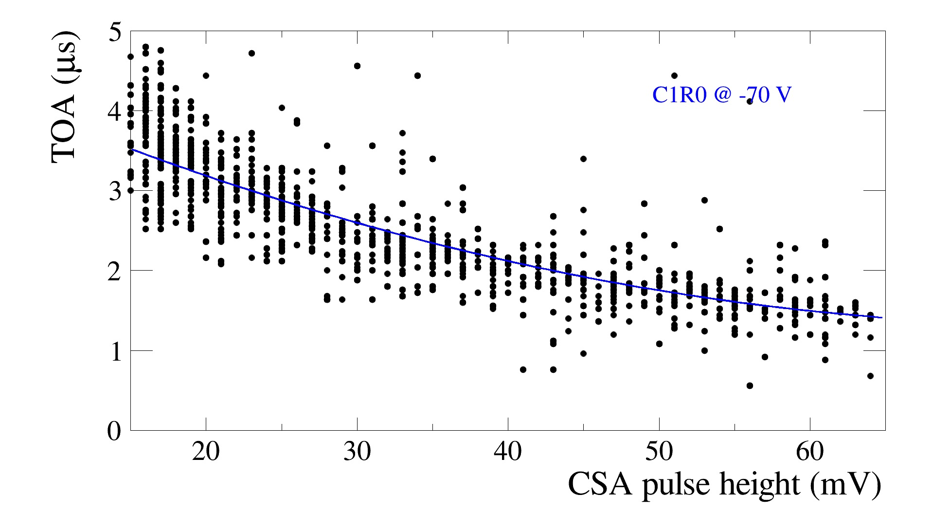
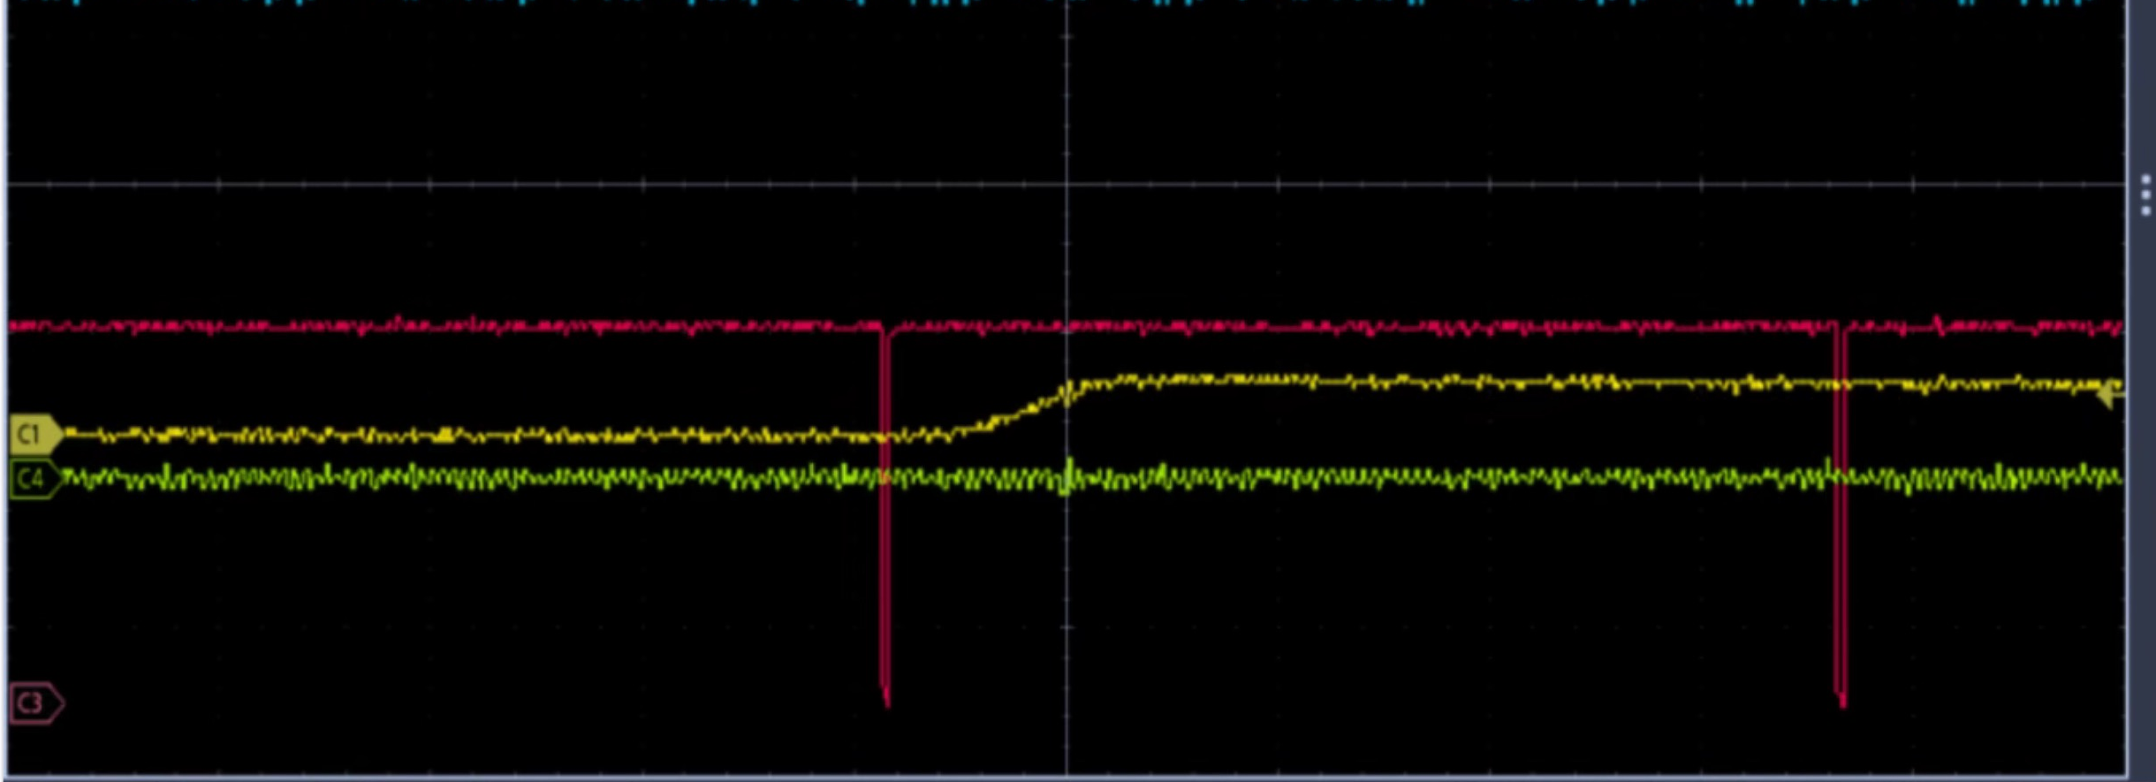
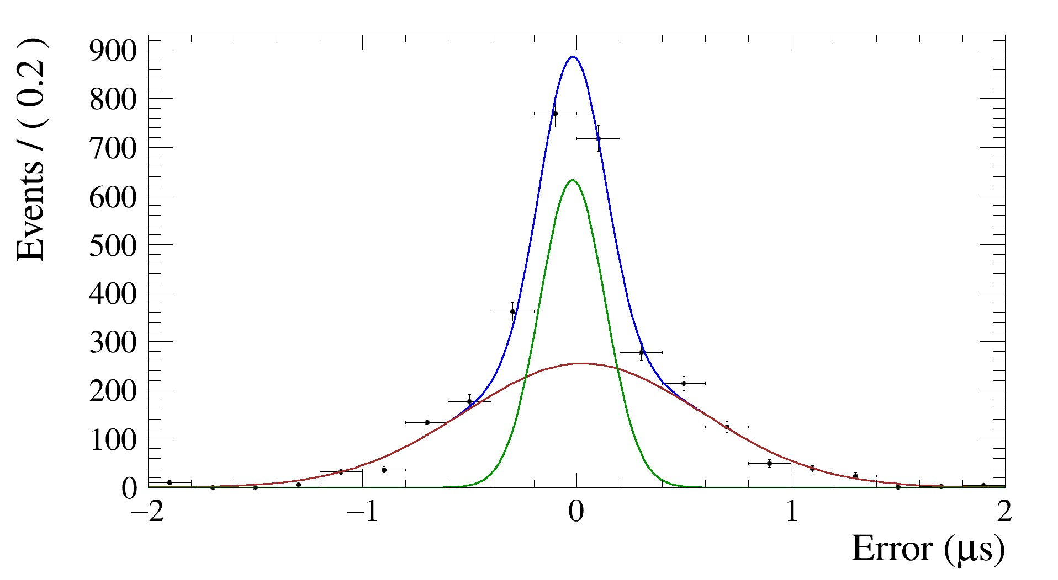
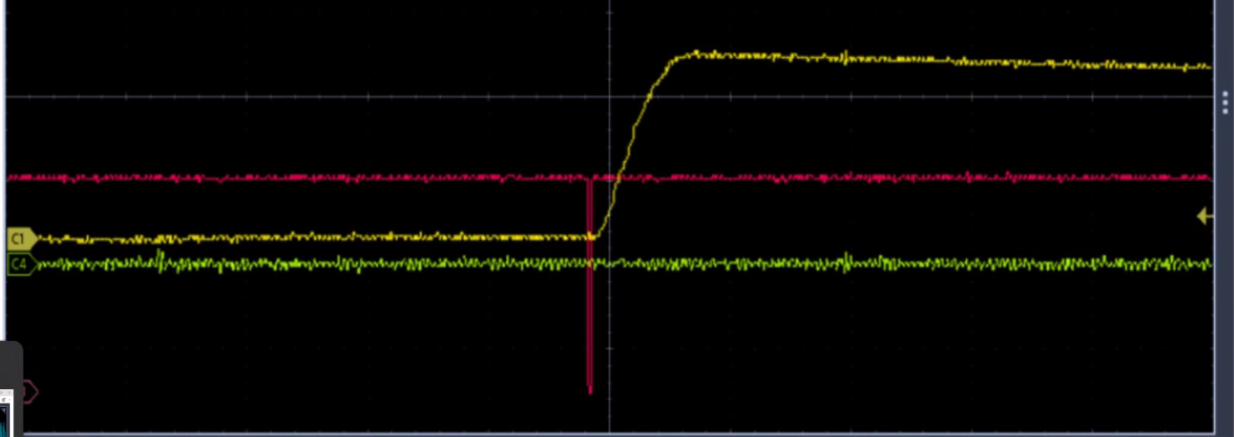

TOA
C1R0 CSA output
Scintillator output
$$σ\sim 150ns$$

Slide 23
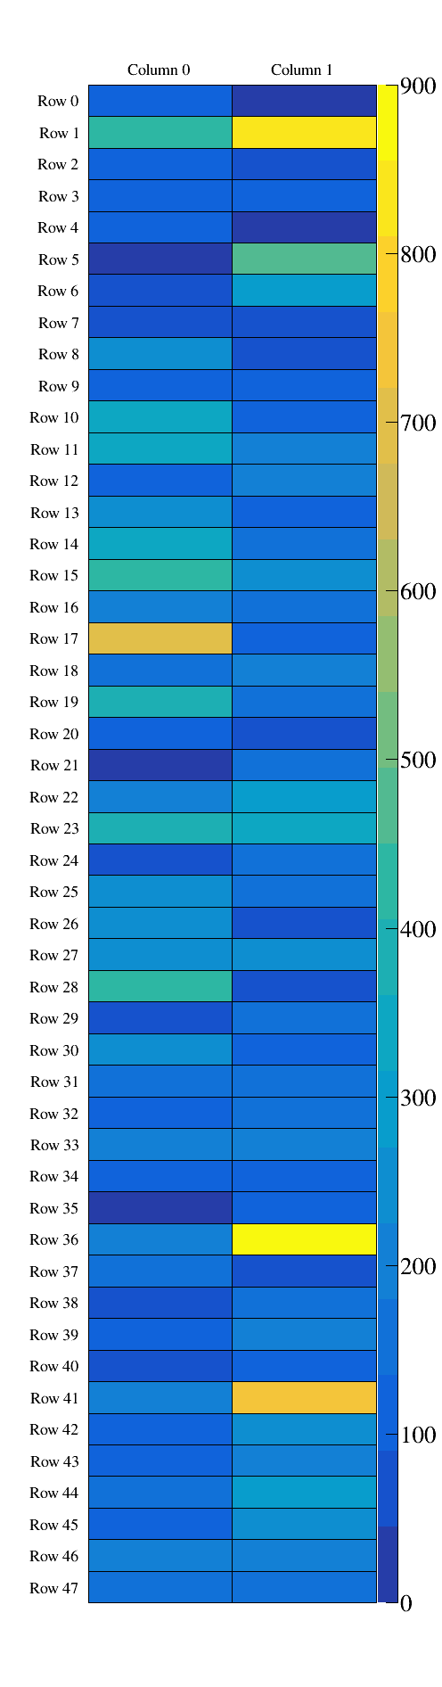
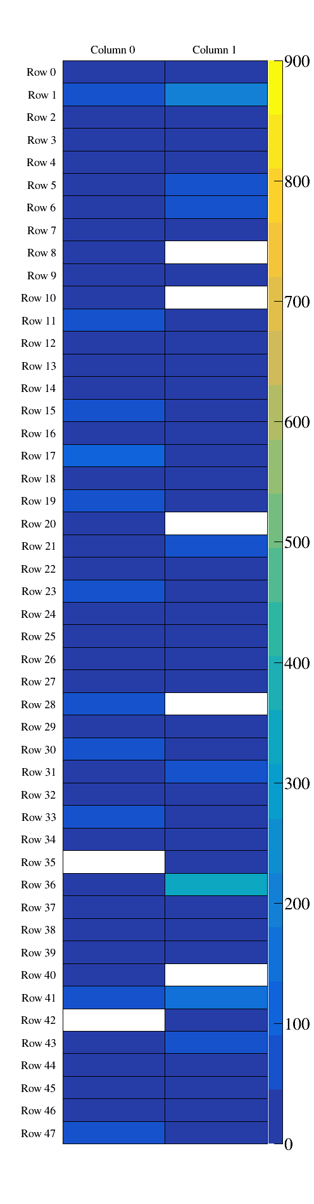
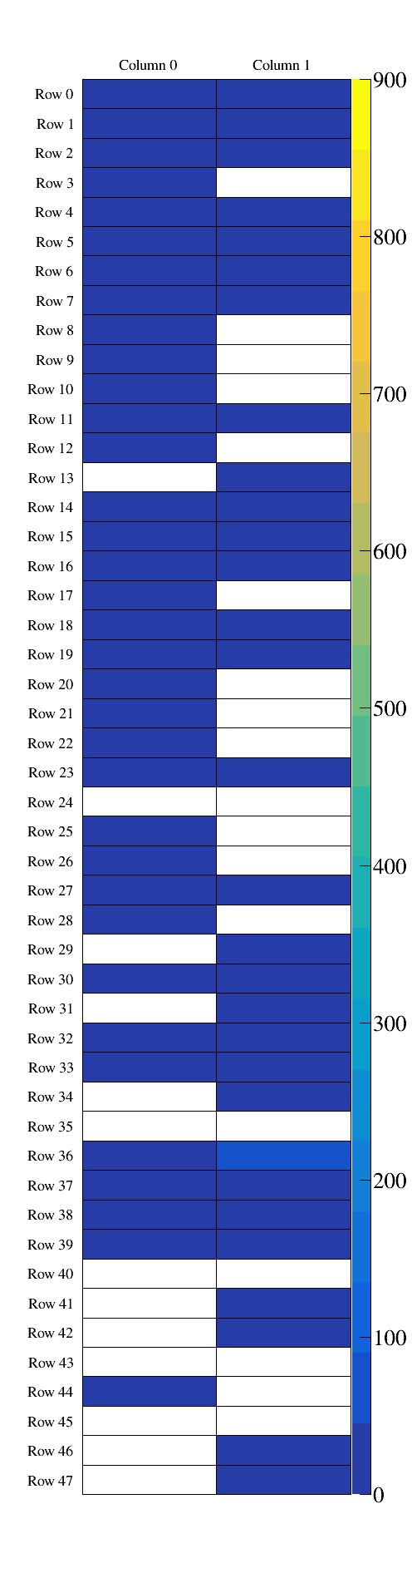
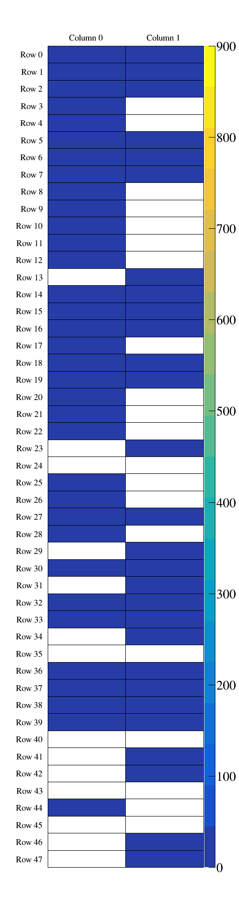
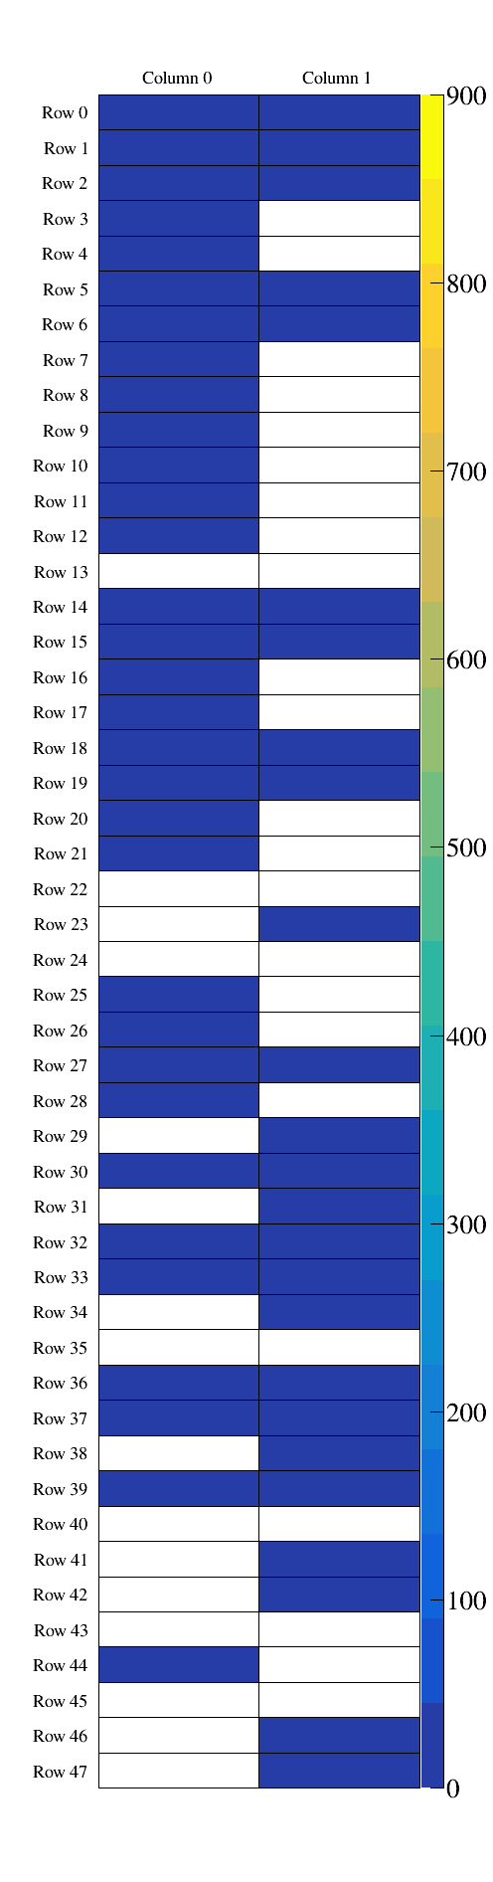
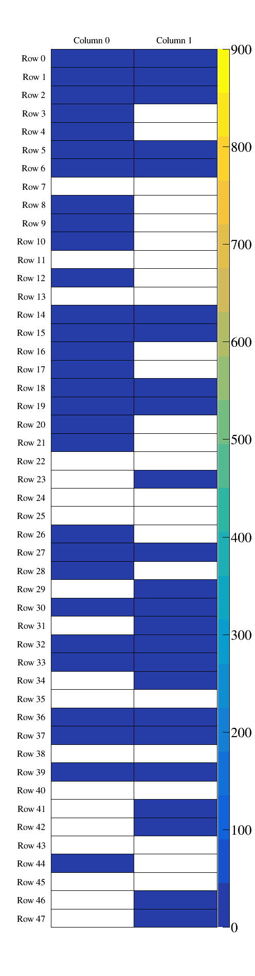
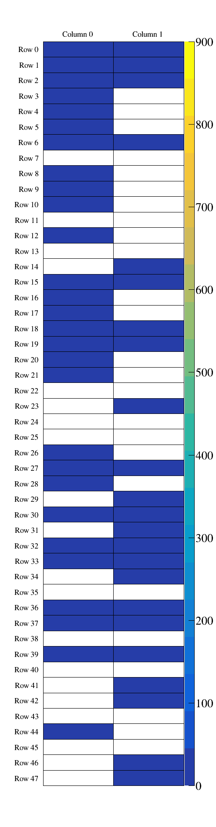
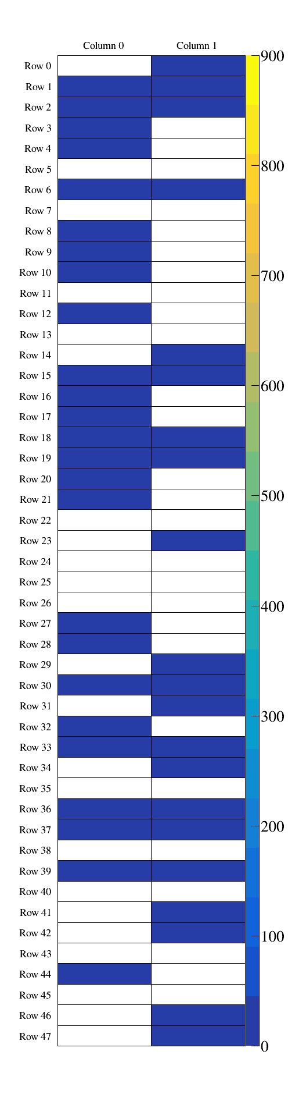
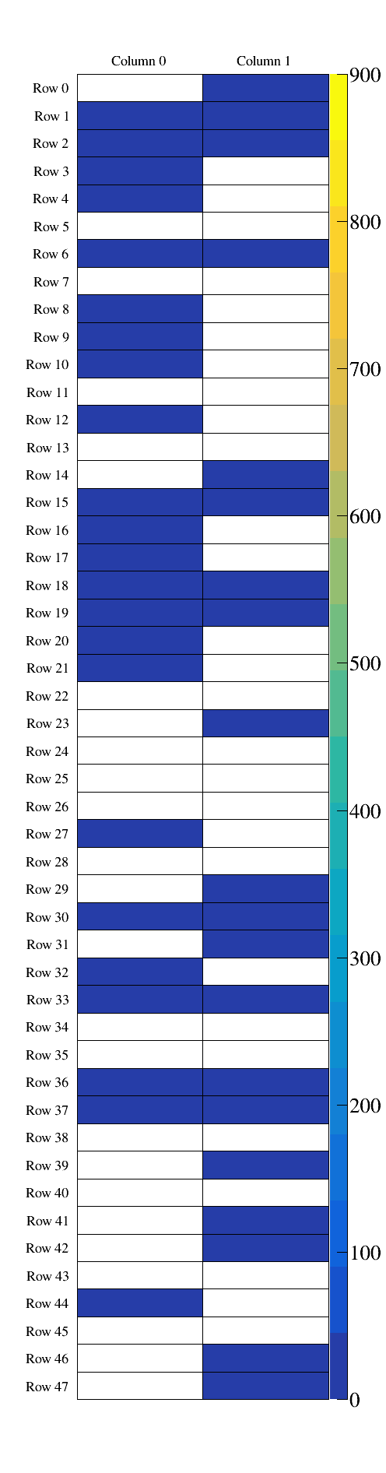






数字读出，TOT分布
事例数分布没有可分辨的束流轮廓。
TOT > 0
TOT > 0.2
TOT > 0.4
TOT > 0.6
TOT > 0.8
TOT > 1.0
TOT > 1.2
TOT > 1.4
TOT > 1.6
TOT > 1.8
TOT > 2.0
TOT > 2.2
TOT > 2.4
TOT > 2.6
TOT > 2.8
TOT > 3.0

Slide 24
















数字读出，TOT分布
事例数分布没有可分辨的束流轮廓。
TOT > 0
TOT > 0.2
TOT > 0.4
TOT > 0.6
TOT > 0.8
TOT > 1.0
TOT > 1.2
TOT > 1.4
TOT > 1.6
TOT > 1.8
TOT > 2.0
TOT > 2.2
TOT > 2.4
TOT > 2.6
TOT > 2.8
TOT > 3.0

Slide 25
TDAC setting
A 4-bit binary-weighted current DAC per pixel
D0-to-D3 code order, 1000 is the LSB and 0001 is the MSB
I_tune = I0(D0 + 2*D1 + 4*D2 + 8*D3)
Larger TDAC code lowers the effective comparator threshold
At I_ref = 30 μA, scan global TH and record the highest noise-free threshold TH_nf
Choose a per-pixel code that improves hit response without noise or stuck-high output.
7月的TDAC部分开始
Pixel | TH_nf [V] @0000 | ΔTH [V] 1000 | ΔTH [V] 0100 | ΔTH [V] 0010 | ΔTH [V] 0001 | ΔTH [V] 1010 | Chosen TDAC | ΣΔTH [V]
C1R0 | 0.835 | 0.002 | 0.011 | 0.022 | 0.042 | 0.025 | 0101 | 0.053
C1R1 | 0.809 | 0.007 | 0.015 | 0.020 | 0.042 | 0.024 | 0111 | 0.077
C1R38 | 0.836 | 0.008 | 0.013 | 0.026 | 0.067 | 0.036 | 1110 | 0.047
C0R25 | 0.831 | 0.006 | 0.014 | 0.029 | 0.057 | 0.036 | 0001 | 0.057
4-bit contributions are not identical and vary from pixel to pixel.
TDAC code must be calibrated per-pixel and validated against both noise and hit response.

Slide 26



TDAC setting
The First double column, TH=0.902; Testing on some pixels of low hit rate
A high TDAC -> lower the threshold too much -> comparator remain high -> no digital pulses
TDAC 0000
TDAC 1111
（Fig from Yuan Yuan）

Slide 27

Preliminary
Test Beam Results of COFFEE3
Sep 14th
UT/UP Parallel Session
LI Qinze on behalf of WP2

Slide 28
Thanks for your attention

