Slide 1
Resolving the QCD Axion Domain Wall Problem
Introducing a Light Axion to Rescue the Post-Inflationary Scenario
Resolving the QCD Axion Domain Wall Problem with a Light Axion: J. Lee, K. Murai, F. Takahashi, and W. Yin, 2507.07075

Slide 2
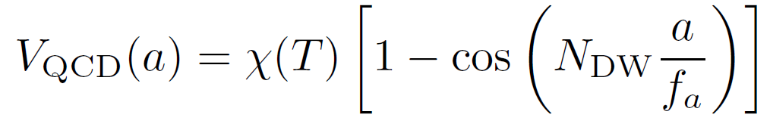
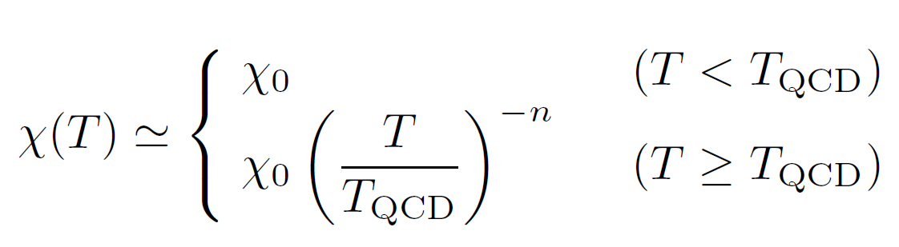
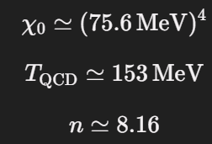
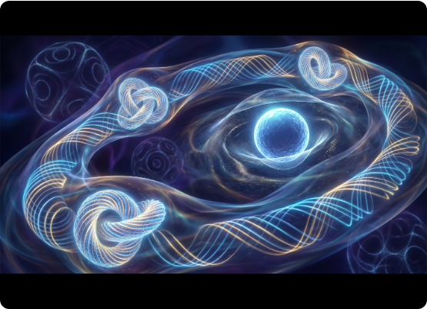
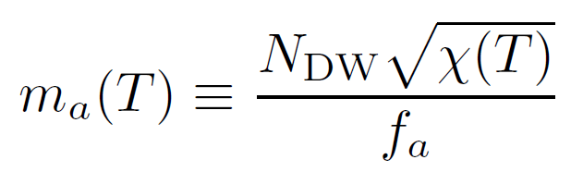
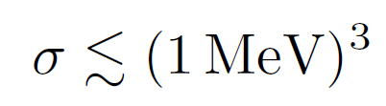

The Domain Wall Problem
“however, there is no strong theoretical reason that enforces $N_{DW}$= 1 in general.”
$N_{DW}$: Domain wall number
Post-inflationary scenarios
e.g., DFSZ axion model: 3 or 6
Random θ in different Hubble patches
Cosmic string (central false vacuum)
Stable domain walls dominate the energy in the early Universe
CMB constraint:

Slide 3
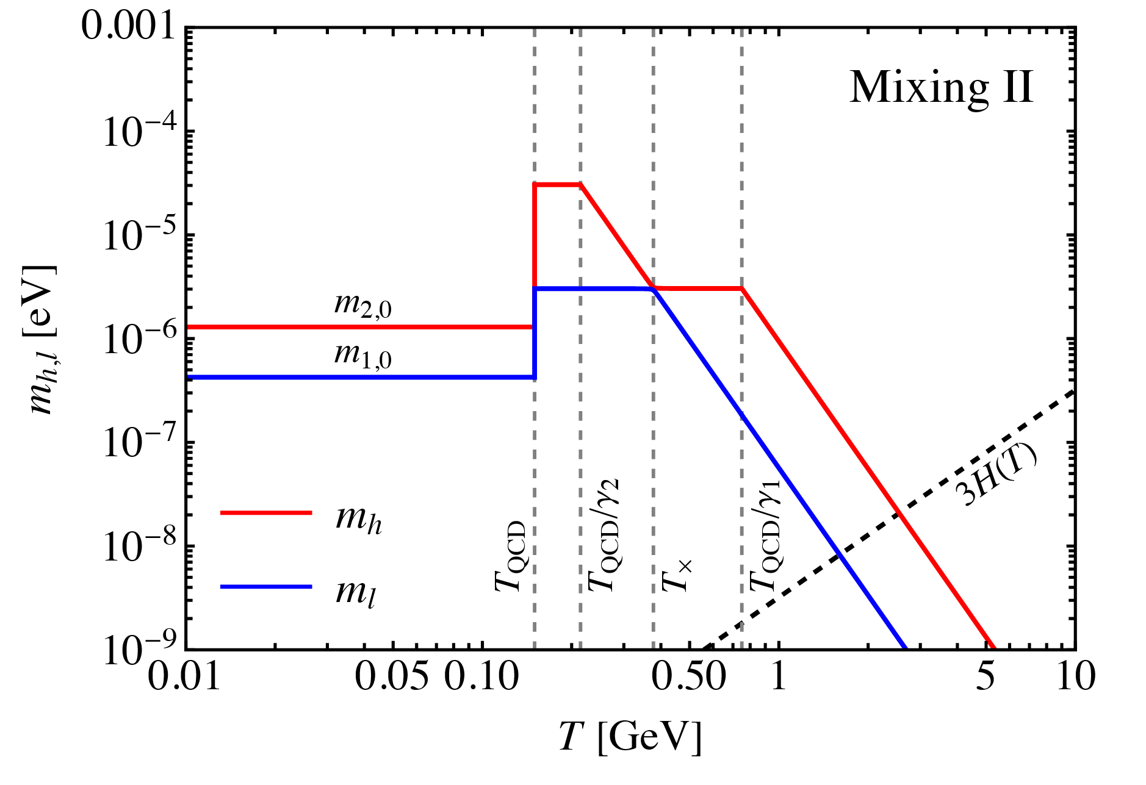
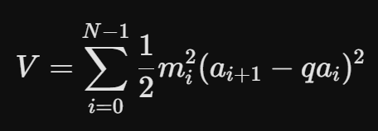
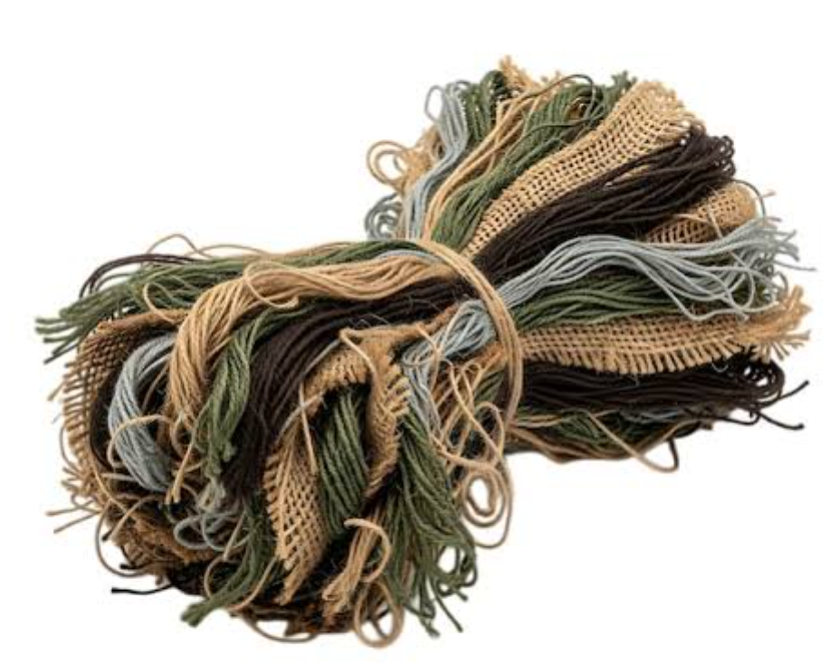
Additional ALP
Level crossing (like neutrino oscillation)
Modifications to the misalignment mechanism
Dark matter
Haijun Li, arXiv:2410.00377v1
Clockwork mechanism
Inflation
String bundle
Transient bias

Slide 4


Two Proposed Solutions
1. String Bundles for
post-inflation
2. Transient Bias for
pre-inflation
Setup: Introduce a light Axion-Like Particle (ALP) coupling to gluons with post-inflationary PQ breaking and NDW = 1.
Setup: Introduce a very light ALP with a pre-inflationary (homogeneous) initial condition.
Mechanism: QCD domain walls become bounded by the ALP strings, confining the network into cosmologically safe "string bundles".
Mechanism: The ALP's potential acts as a temporary bias, inducing pressure that collapses the string-wall network before the ALP itself oscillates.

Slide 5
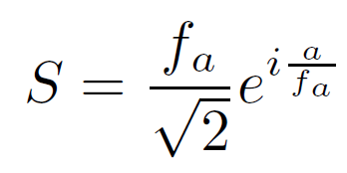
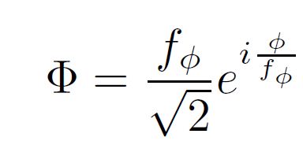

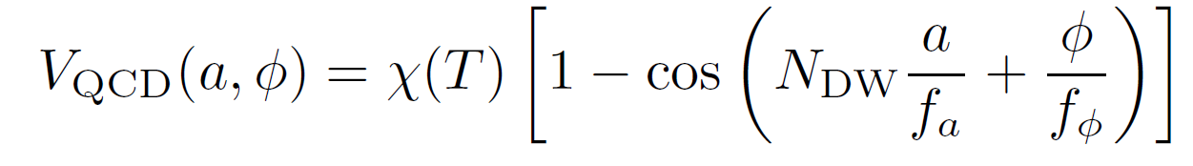
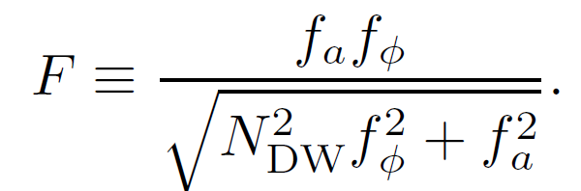
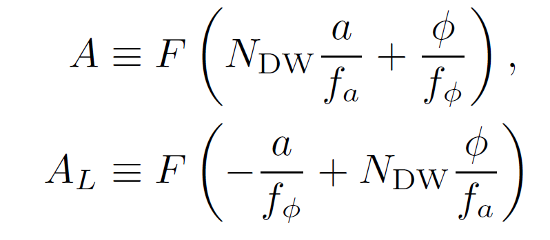
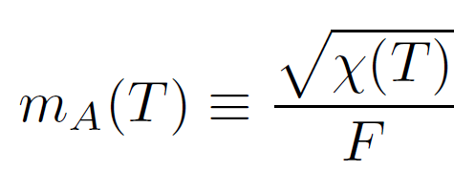
Solution 1: Mixed Axion Potential
By introducing a heavy, vector-like PQ quark, the new ALP ($φ$) also couples to gluons. Non-perturbative QCD effects generate a mixed potential:
Since the domain wall number of φ is exactly unity, the resulting string bundles can safely act as cosmic strings at low energies without dominating the universe.

Slide 6
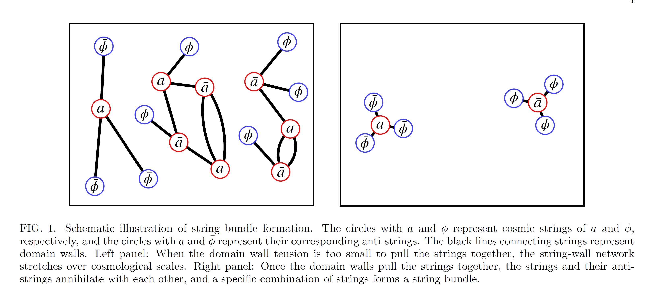

Domain walls are confined within the string bundles
$N_{DW}$: 3

Slide 7
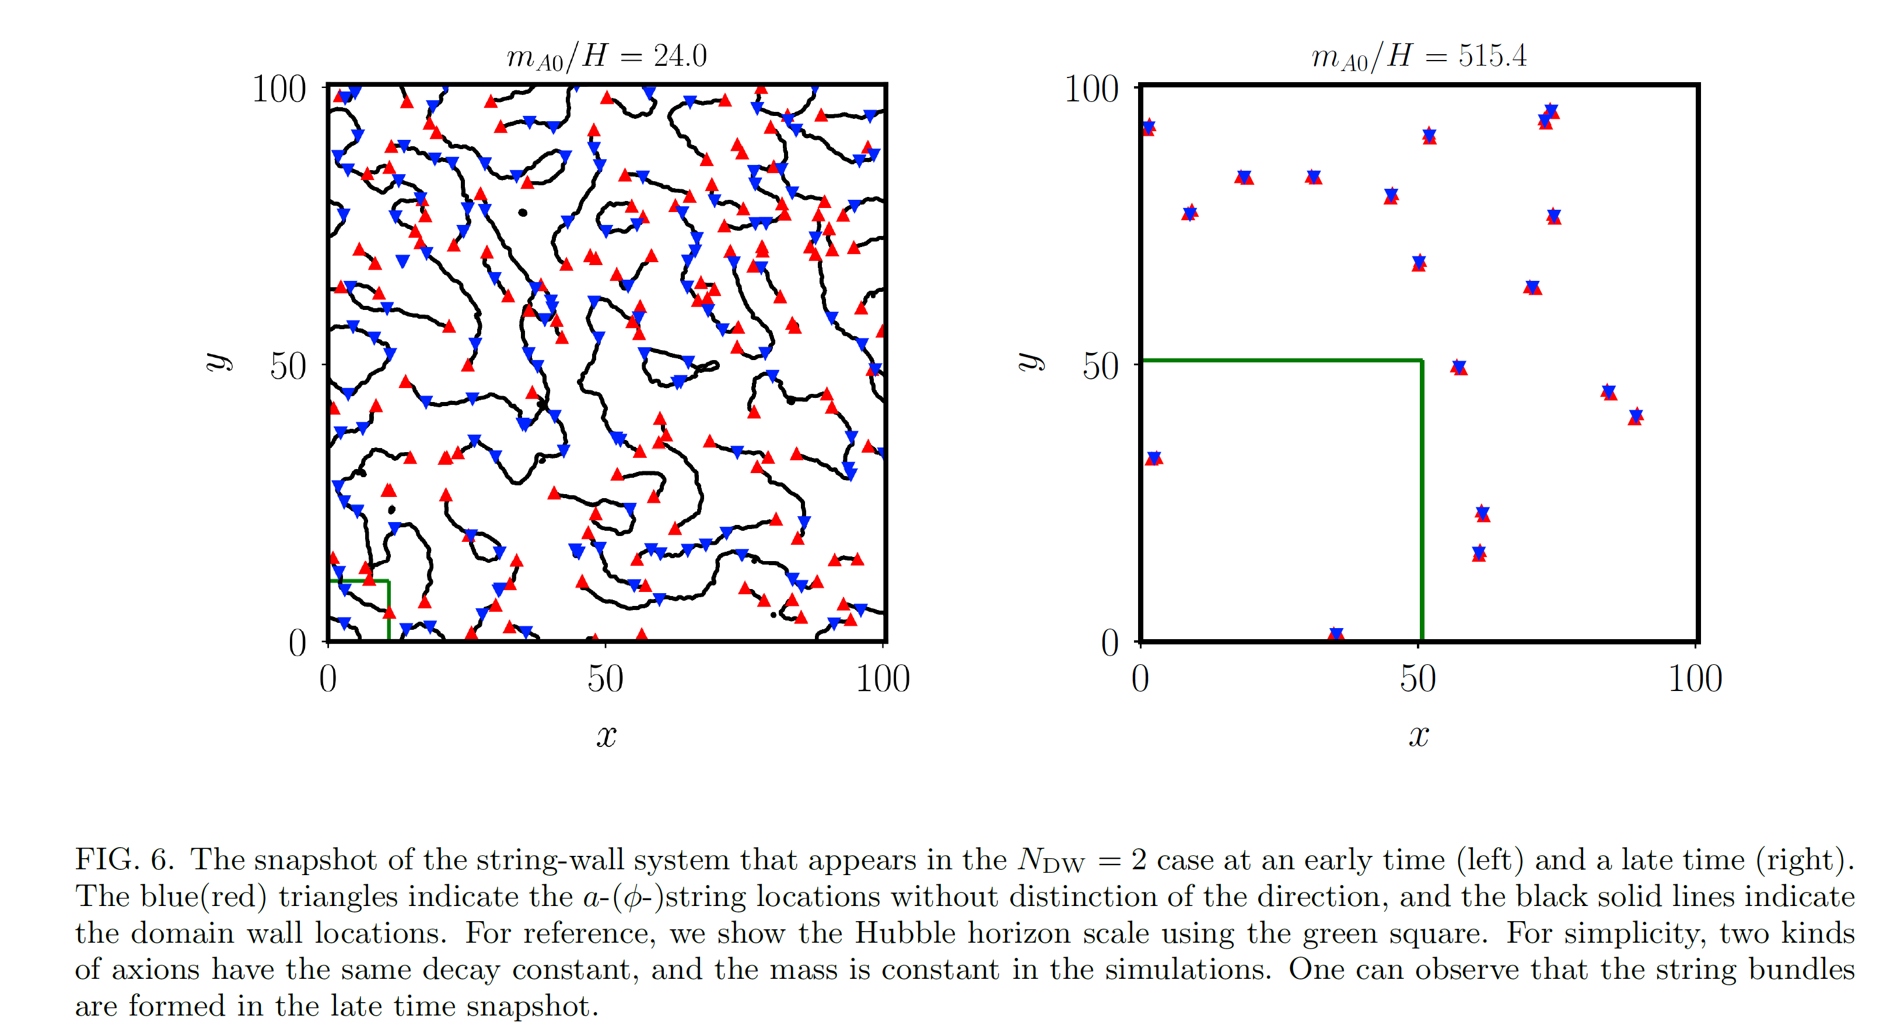
Scaling regime: always $𝒪\left(1\right)$ string bundle in every patch

Slide 8
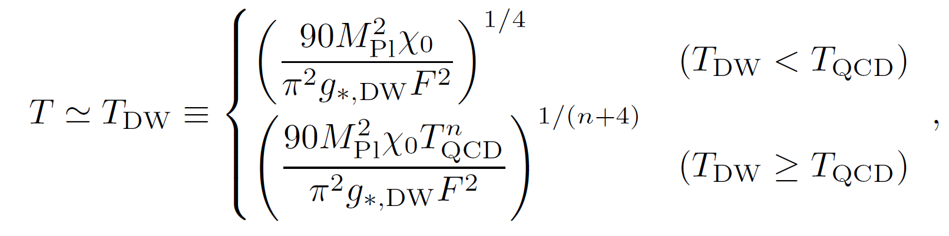



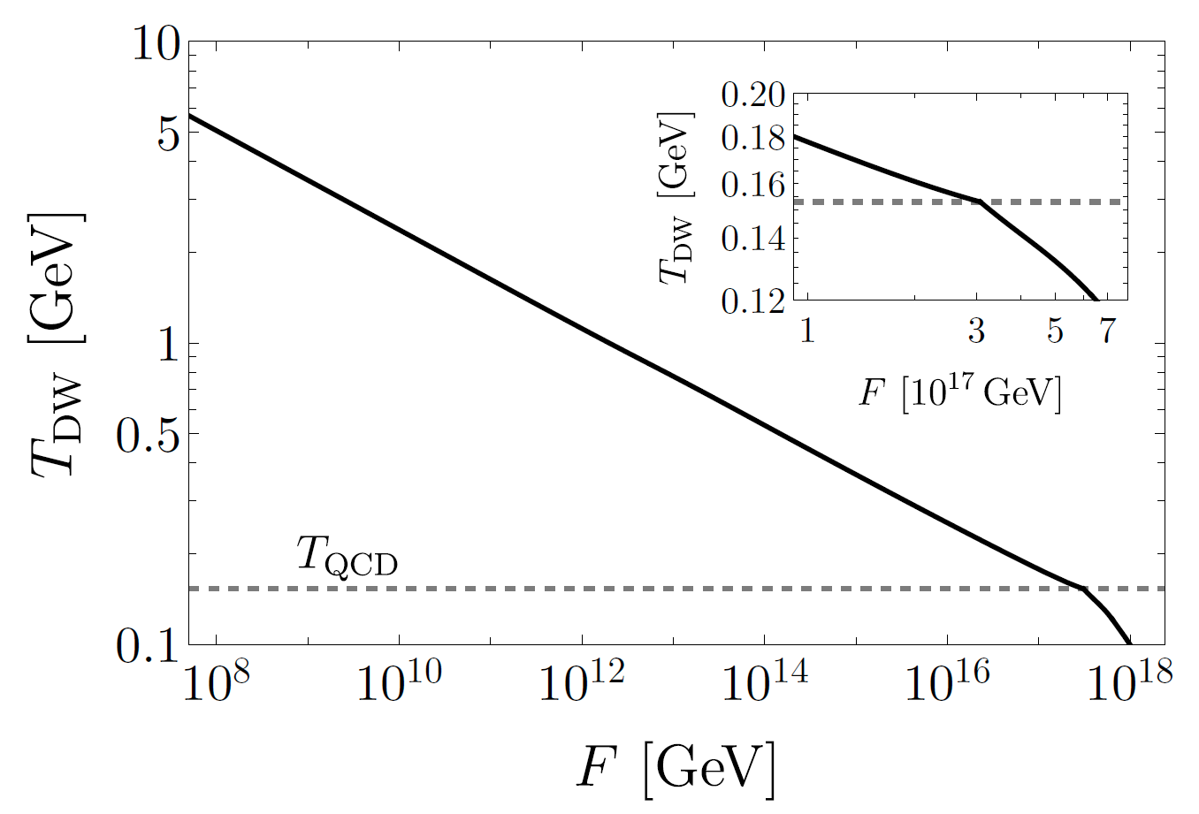
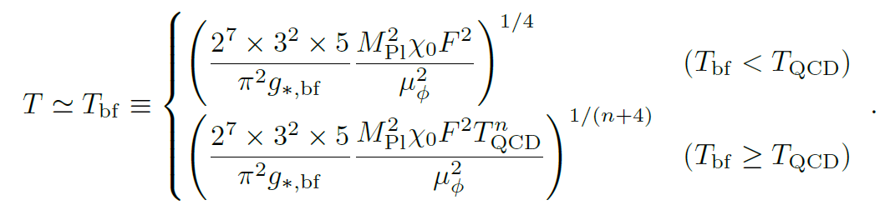
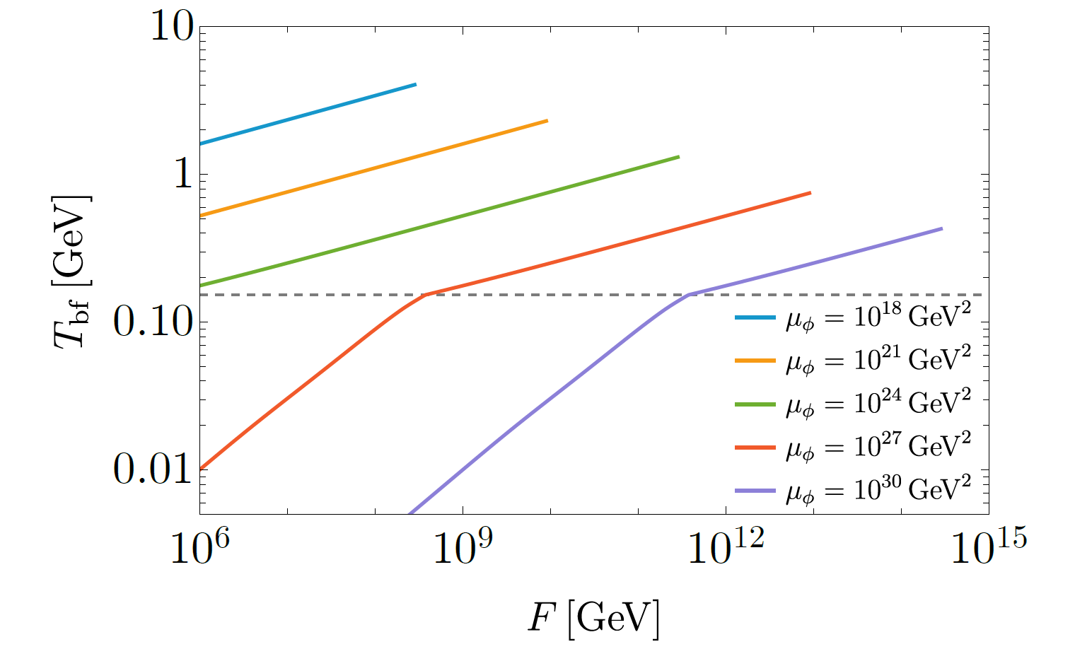

$$(m_{A}\sim H)$$
Formation temperature of domain wall
Formation temperature of string bundle

Slide 9
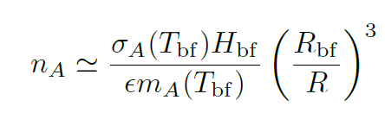
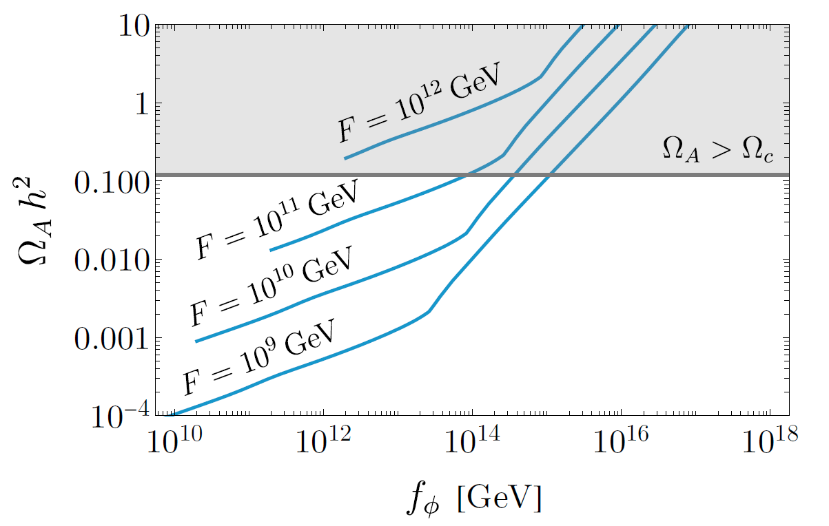
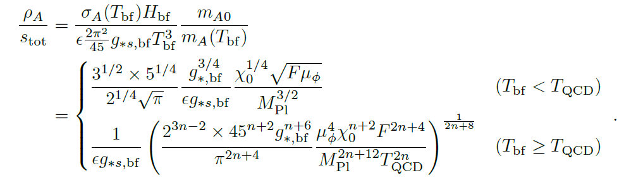
QCD axion abundance
Domain walls and strings produce axions (massive) before the string bundle formation (after it, $m>H$)
From the decrease of domain wall area:

Slide 10





Observable Signatures of String Bundles
The remnant string-bundle network of massless mode survives to the present epoch, providing smoking-gun phenomenological signatures.
Note: maybe not strict massless
Gravitational Waves
Cosmic Birefringence
CMB Anisotropies
If the decay constant is sufficiently large, string bundles leave direct imprints on the Cosmic Microwave Background.
Stochastic gravitational-wave backgrounds across multiple frequency bands (nanohertz to millihertz).
If the massless axion couples to photons, the stable string bundle induces anisotropic cosmic birefringence.

Slide 11

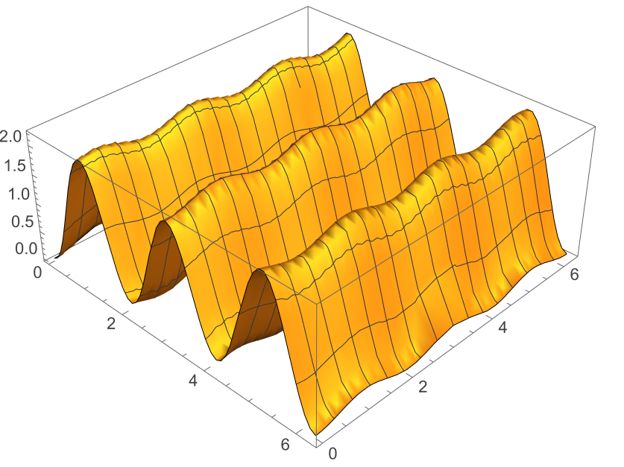
Solution 2: Transient Bias Collapse
If the new ALP is extremely light and possesses a homogeneous initial condition (pre-inflationary scenario):
Before the ALP begins oscillating, its static potential energy varies across different domains.
This energy difference acts as a transient potential bias.
The bias causes the domain walls to destabilize and collapse entirely. Once the ALP eventually rolls to the minimum, the strong CP phase vanishes in the present universe.

Slide 12
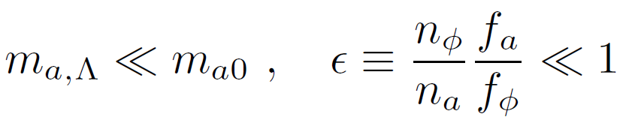
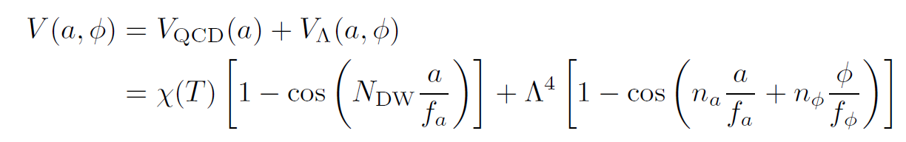
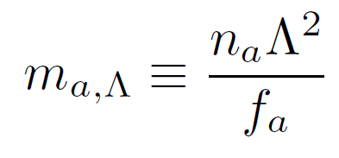
Transient Bias Potential
Assumptions:
The total potential is the sum of the non-perturbative QCD effects and a hidden sector potential:
The network collapses when the domain wall tension times the Hubble parameter ($\sigma H_{dec}$) is on the order of the potential difference ($\Delta V$).

Slide 13
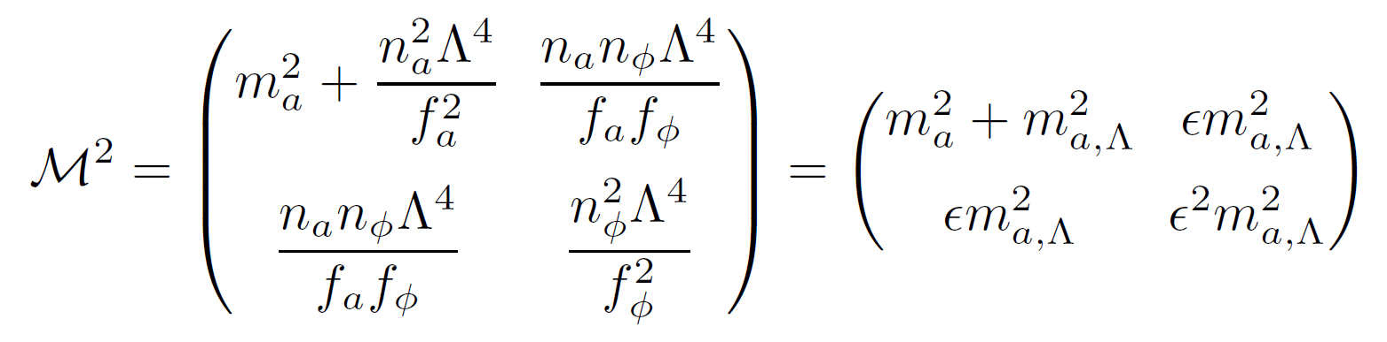
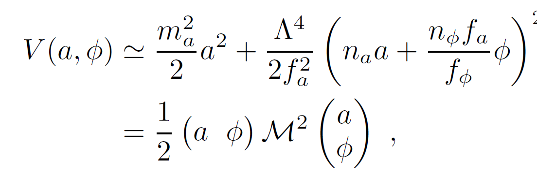
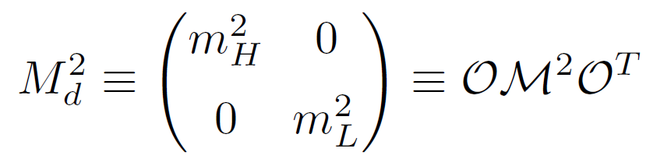
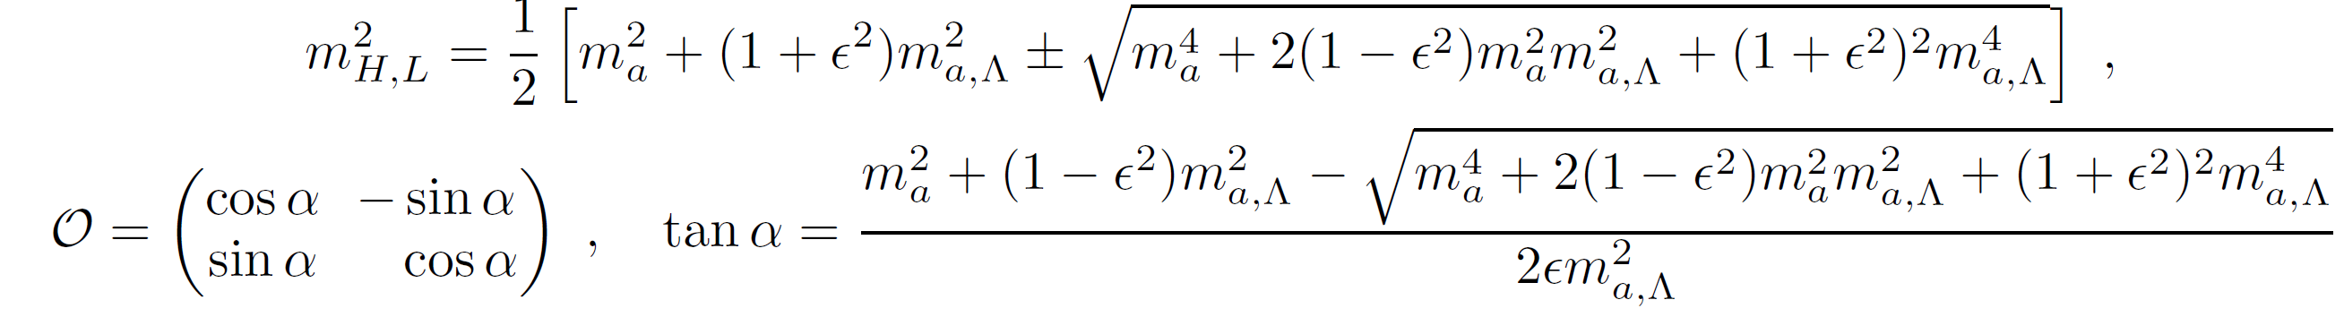
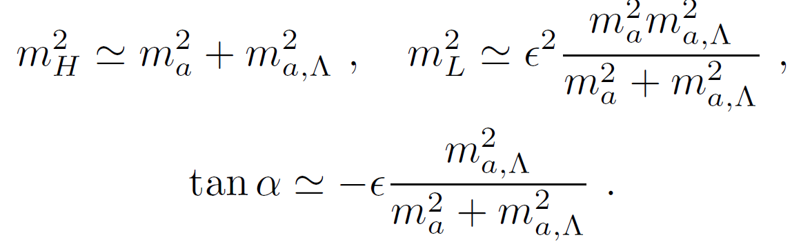
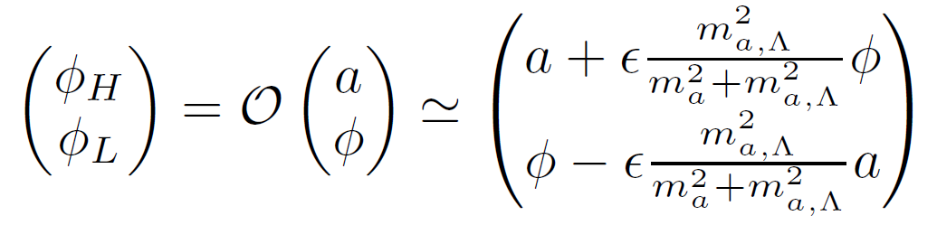
Mass mixing
Diagonalized

Slide 14
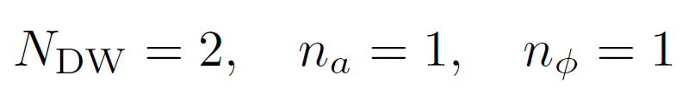

Domain wall
Domain wall of a
Lighter φ at initial value
(random, homogeneous, nonzero)
energy difference acts as
a (transient) potential bias,
QCD scale
(PQ symmetry breaking)
φ oscillates
collapse of the string-wall network
(PQ symmetry restoring)

Slide 15
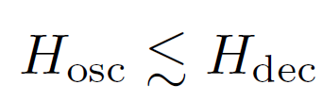
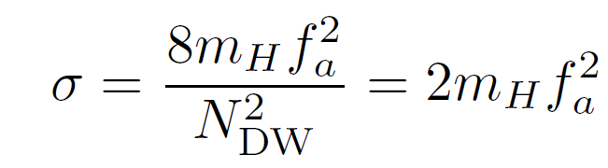
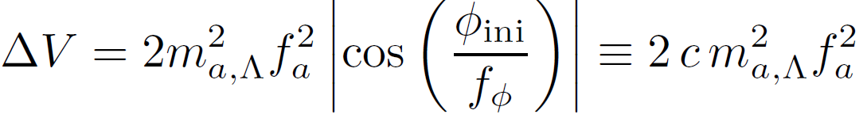

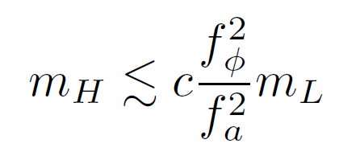
Domain wall
Require: φ oscillates after the domain wall decays
Bias overcomes tension

Slide 16
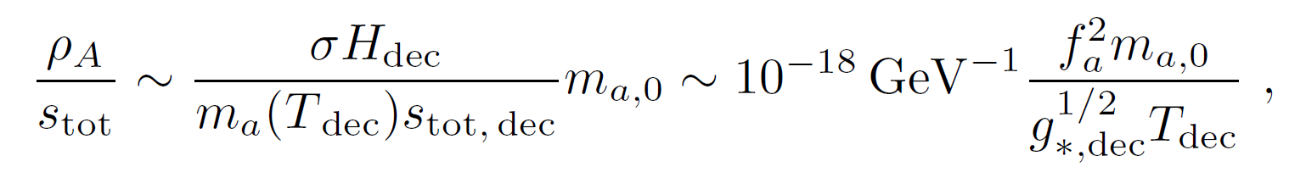

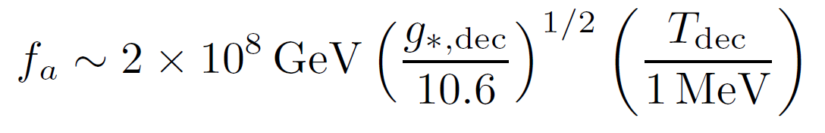
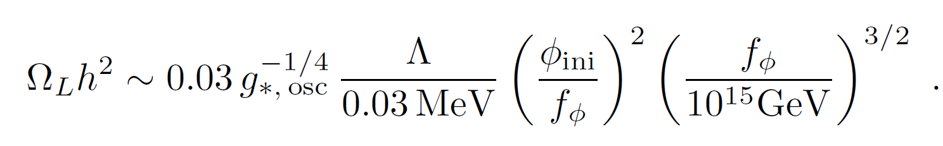
Domain wall decay & axion abundance
If QCD axion accounts for dark matter
Lighter ALP production during φ oscillation

Slide 17
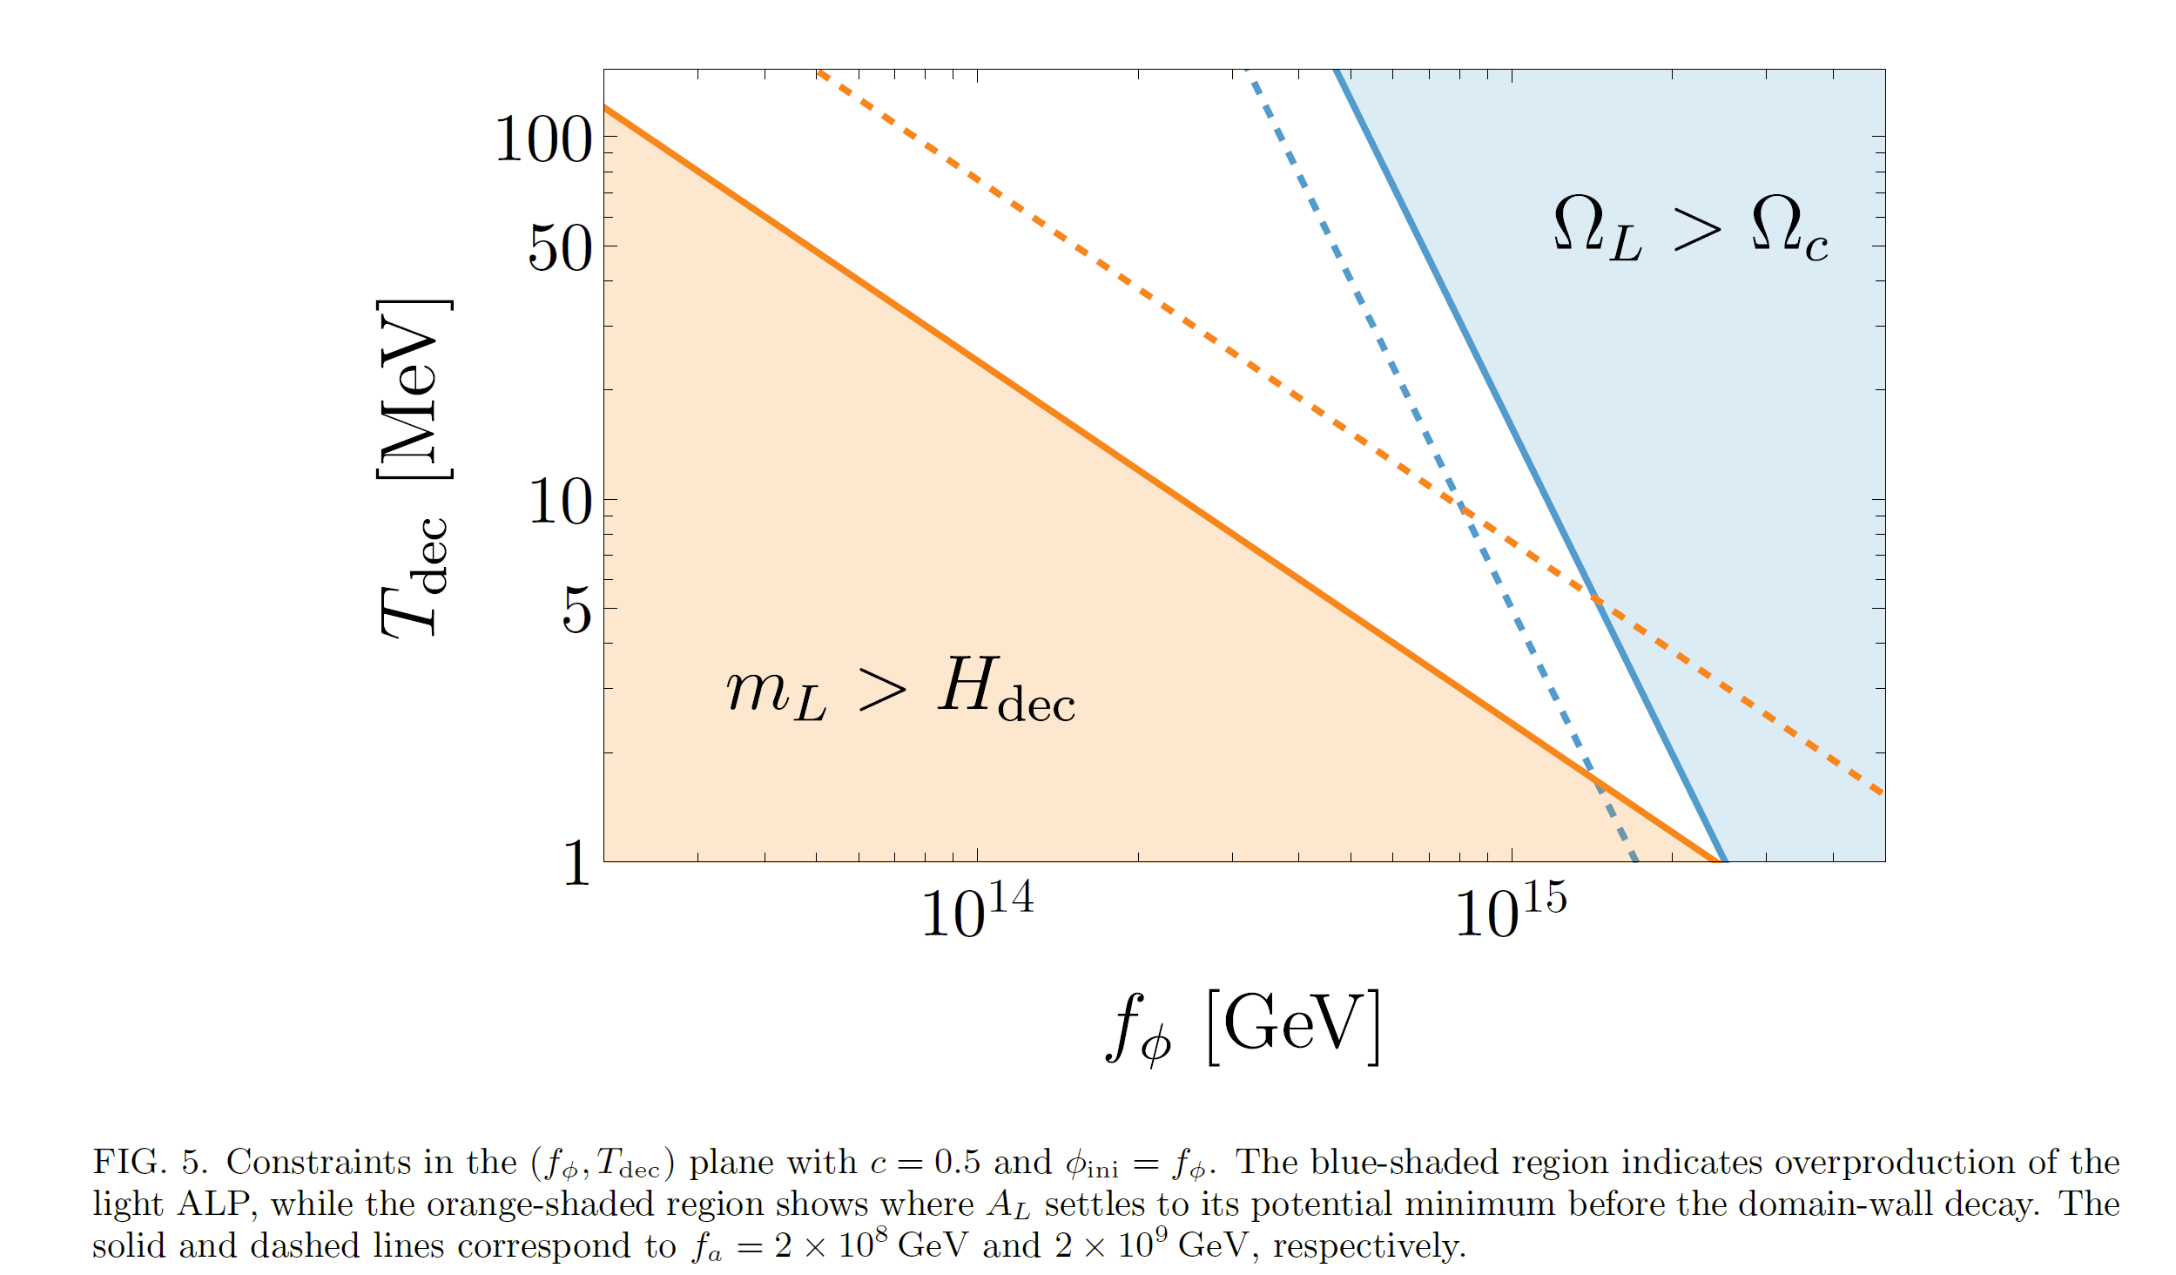

Slide 18
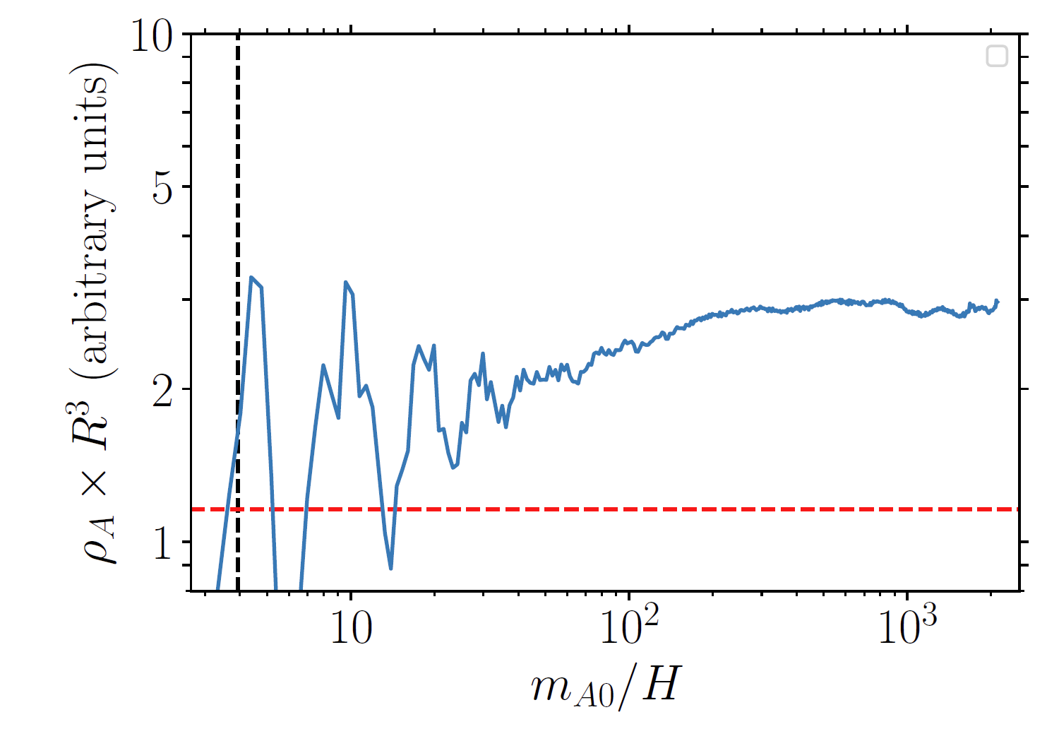

Slide 19
Thank you

