Slide 1
TLEP — Status & Progress
秦 庆
中国科学院高能物理研究所
All materials are from J. Ellis, A. Blondel, P. Janot, M. Koratzinos, and F. Zimmermann

Slide 2
Outline
What is LEP?
LEP3 and TLEP
Study on TLEP
Conclusion

Slide 3
1. What is LEP
LEP --- Large Electron Positron Collider，迄今为止国际上曾建造和运行的最大、能量最高的正负电子对撞机
1981年5月22日，LEP获得CERN Council的批准
1988年2月8日，27公里长隧道建成
1989年7月4日，首次注入束流
1989年8月13日，首次对撞
2000年11月2日，停机，完成LEP的使命

Slide 4
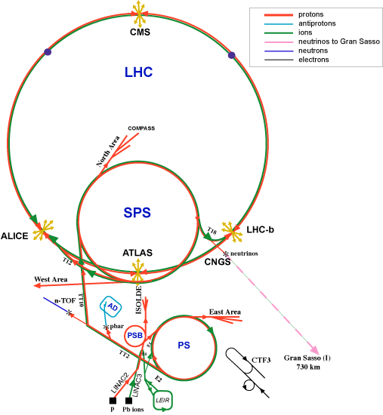
LEP accelerator complex & tunnel
LEP/

Slide 5
LEP加速器运行成果
起始运行能量：E_{cm}=91GeV，收集Z粒子及W粒子。加速器上有5176块磁铁和128个高频腔；
四个探测器/实验：ALEPH, DELPHI, L3和OPAL；
1995年升级（LEP2），增加288个超导高频腔，提高运行能量，最终达到E_{cm}=209GeV；
采用pretzel（麻花轨道）对撞方式，增加对撞束团数目，实现4×4束团对撞，I_{beam, max}=6.2mA；
最高束束作用参数达到ξ_{y}=0.083，峰值对撞亮度达到1.25×10³²cm⁻²s⁻¹。

Slide 6
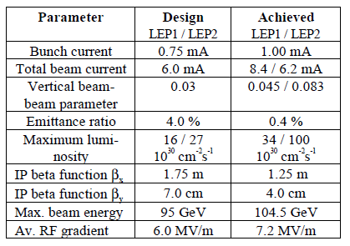
LEP2 technology worked well
A. Blondel, P. Janot

Slide 7
2. LEP3 and TLEP
TLEP (80 km,
e⁺e⁻, up to
~350 GeV c.m.)
PSB
PS (0.6 km)
SPS (6.9 km)
LHC (26.7 km)
LEP3
(e⁺e⁻, 240 GeV c.m.)
VHE-LHC
(pp, up to
100 TeV c.m.)
also: e± (200 GeV) – p (7 & 50 TeV) collisions
A long-term strategy for HEP!

Slide 8
Two options
Installation in the LHC tunnel “LEP3”
+ inexpensive (<0.1xLC)
+ tunnel exists
+ reusing ATLAS and CMS detectors
+ reusing LHC cryoplants
interference with LHC and HL-LHC
New larger tunnel “TLEP”
+ higher energy reach, 5-10x higher luminosity
+ decoupled from LHC/HL-LHC operation & construction
+ tunnel can later serve for HE-LHC (factor 3 in energy from tunnel alone) with LHC remaining as injector
- 4-5x more expensive (new tunnel, cryoplants, detectors)

Slide 9
LEP3, TLEP (e⁺e⁻ -> ZH, e⁺e⁻ → W⁺W⁻, e⁺e⁻ → Z,[e⁺e⁻→ t )
key parameters
 | LEP3 | TLEP
circumference | 26.7 km | 80 km
max beam energy | 120 GeV | 175 GeV
max no. of IPs | 4 | 4
luminosity at 350 GeV c.m. | - | 0.7x10³⁴ cm⁻²s⁻¹
luminosity at 240 GeV c.m. | 10³⁴ cm⁻²s⁻¹ | 5x10³⁴ cm⁻²s⁻¹
luminosity at 160 GeV c.m. | 5x10³⁴ cm⁻²s⁻¹ | 2.5x10³⁵ cm⁻²s⁻¹
luminosity at 90 GeV c.m. | 2x10³⁵ cm⁻²s⁻¹ | 10³⁶ cm⁻²s⁻¹
at the Z pole repeating LEP physics programme in a few minutes…

Slide 10
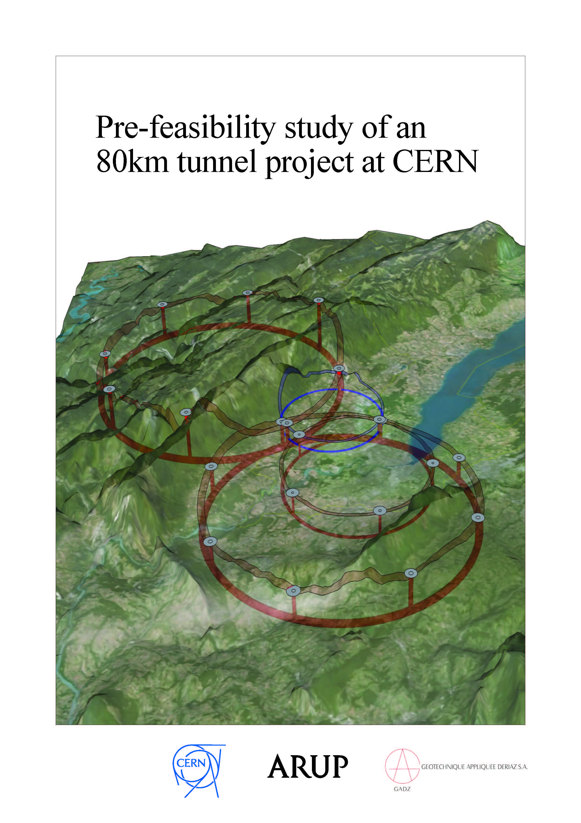
a new tunnel for TLEP in the Geneva area?

Slide 11
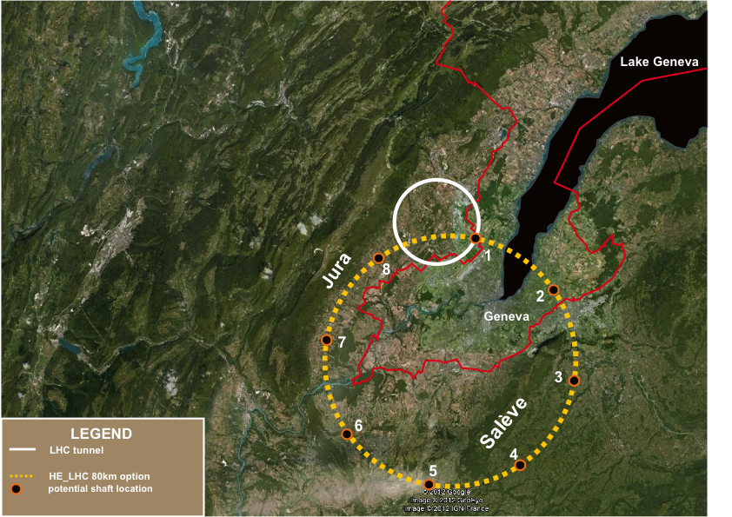
TLEP tunnel in the Geneva area – “best” option
«Pre-Feasibility Study for an 80-km tunnel at CERN»
John Osborne and Caroline Waaijer,
CERN, ARUP & GADZ, submitted to ESPG

Slide 12
LEP3/TLEP parameters -1
soon at SuperKEKB:
β_{x}*=0.03 m, β_{Y}*=0.03 cm
 | LEP2 | LHeC | LEP3 | TLEP-Z | TLEP-H | TLEP-t
beam energy Eb [GeV] circumference [km] beam current [mA] #bunches/beam #e−/beam [10¹²] horizontal emittance [nm] vertical emittance [nm] bending radius [km] partition number J_{ε} momentum comp. α_{c} [10⁻⁵] SR power/beam [MW] β∗_{x} [m] β∗_{y} [cm] σ∗_{x} [μm] σ∗_{y} [μm] hourglass F_{hg} ΔE^{SR}_{loss}/turn [GeV] | 104.5 26.7 4 4 2.3 48 0.25 3.1 1.1 18.5 11 1.5 5 270 3.5 0.98 3.41 | 60 26.7 100 2808 56 5 2.5 2.6 1.5 8.1 44 0.18 10 30 16 0.99 0.44 | 120 26.7 7.2 4 4.0 25 0.10 2.6 1.5 8.1 50 0.2 0.1 71 0.32 0.59 6.99 | 45.5 80 1180 2625 2000 30.8 0.15 9.0 1.0 9.0 50 0.2 0.1 78 0.39 0.71 0.04 | 120 80 24.3 80 40.5 9.4 0.05 9.0 1.0 1.0 50 0.2 0.1 43 0.22 0.75 2.1 | 175 80 5.4 12 9.0 20 0.1 9.0 1.0 1.0 50 0.2 0.1 63 0.32 0.65 9.3
SuperKEKB:ε_{y}/ε_{x}=0.25%

Slide 13
LEP3/TLEP parameters -2
LEP2 was not beam-beam limited
 | LEP2 | LHeC | LEP3 | TLEP-Z | TLEP-H | TLEP-t
V_{RF,tot} [GV] δ_{max,RF} [%] ξ_{x}/IP ξ_{y}/IP f_{s} [kHz] E_{acc} [MV/m] eff. RF length [m] f_{RF} [MHz] δ^{SR}_{rms} [%] σ^{SR}_{z,rms} [cm] L/IP[10³²cm⁻²s⁻¹] number of IPs Rad.Bhabha b.lifetime [min] ϒ_{BS} [10⁻⁴] n_{γ}/collision Δδ^{BS}/collision [MeV] Δδ^{BS}_{rms}/collision [MeV] | 3.64 0.77 0.025 0.065 1.6 7.5 485 352 0.22 1.61 1.25 4 360 0.2 0.08 0.1 0.3 | 0.5 0.66 N/A N/A 0.65 11.9 42 721 0.12 0.69 N/A 1 N/A 0.05 0.16 0.02 0.07 | 12.0 5.7 0.09 0.08 2.19 20 600 700 0.23 0.31 94 2 18 9 0.60 31 44 | 2.0 4.0 0.12 0.12 1.29 20 100 700 0.06 0.19 10335 2 74 4 0.41 3.6 6.2 | 6.0 9.4 0.10 0.10 0.44 20 300 700 0.15 0.17 490 2 32 15 0.50 42 65 | 12.0 4.9 0.05 0.05 0.43 20 600 700 0.22 0.25 65 2 54 15 0.51 61 95
LEP data for 94.5 - 101 GeV consistently suggest a beam-beam limit of ~0.115 (R.Assmann, K. C.)

Slide 14
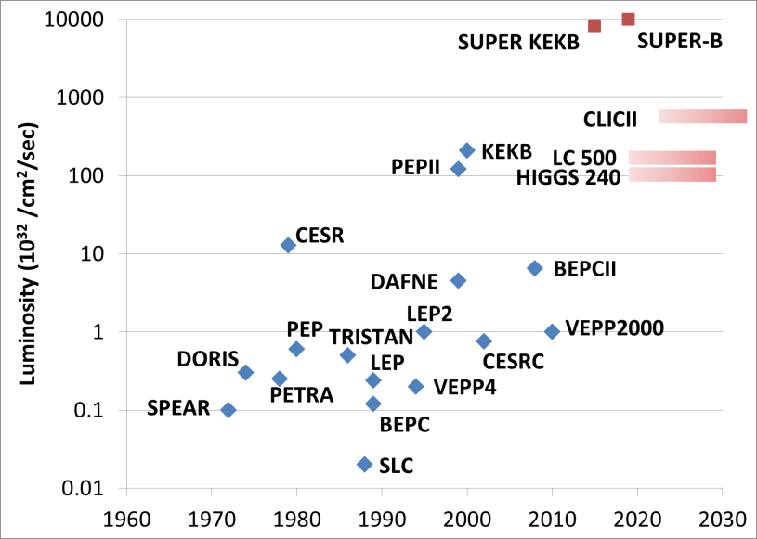
Stuart’s Livingston Chart: Luminosity
TLEP-Z
TLEP-W
TLEP-H
TLEP-t

Slide 15
beam-beam effect (single collision)
 | TLEP-H | TLEP-t | ILC (250) | ILC (350)
beam energy [GeV] | 120 | 175 | 125 | 175
disruption D_{y} | 2.2 | 1.5 | 23.4 | 84.5
ϒ_{BS} [10⁻⁴] | 15 | 15 | 207 | 310
n_{γ}/collision | 0.50 | 0.51 | 1.17 | 1.24
Δδ^{BS}/collision [MeV] | 42 | 61 | 1265 | 2670
Δδ^{BS}_{rms}/collision [MeV] | 65 | 95 | 1338 | 2760
TLEP: negligible beamstrahlung apart for effect on beam lifetime

Slide 16
beam lifetime
LEP2:
beam lifetime ~ 6 h
due to radiative Bhahba scattering (σ~0.215 b)
TLEP:
with L~5x10³⁴ cm⁻²s⁻¹ at each of four IPs:
τ_{beam,TLEP}~16 minutes from rad. Bhabha
additional lifetime limit due to beamstrahlung (1) large momentum acceptance (δ_{max,RF}≥3%), (2) flatter beams [smaller ε_{y} & larger β_{x}*,
maintaining the same L & ΔQ_{bb} constant], or
(3) fast replenishing
(Valery Telnov, Kaoru Yokoya, Marco Zanetti)
SuperKEKB: τ~6 minutes!

Slide 17
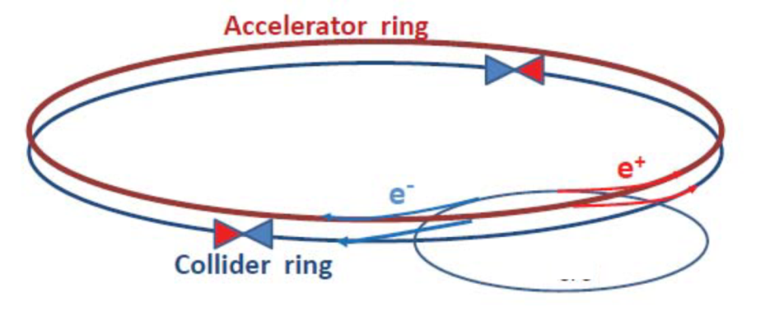
circular HFs – top-up injection
double ring with top-up injection supports short lifetime & high luminosity
A. Blondel
top-up experience: PEP-II, KEKB, light sources

Slide 18
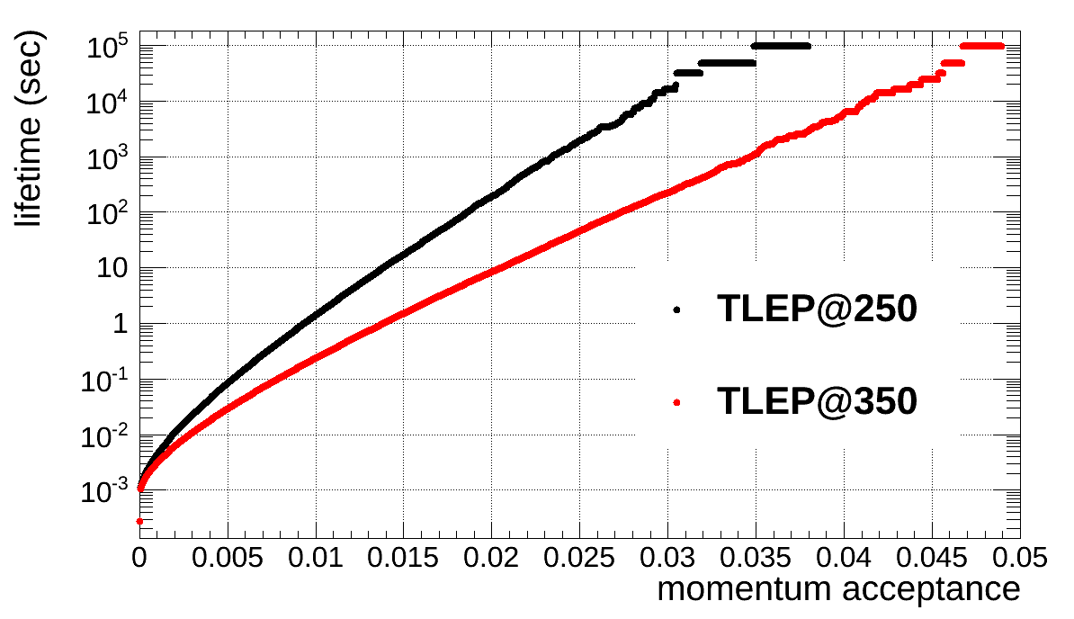
Beamstrahlung lifetime
simulation w 360M macroparticles
τ varies exponentially w energy acceptance η
post-collision E tail → lifetime τ
beam lifetime versus acceptance δ_{max} for 4 IPs:
ε_{y}/ε_{x} =0.1%
ε_{y}/ε_{x} =0.4%
SuperKEKB: ε_{y}/ε_{x} <0.25%!
M. Zanetti

Slide 19
Circular HFs: synchroton-radiation heat load
LEP3 and TLEP have 3-10 times less SR heat load per meter than PEP-II or SPEAR! (though higher photon energy)
N. Kurita, U. Wienands, SLAC

Slide 20
3. Study on TLEP
TLEP key components
tunnel
SRF system
cryoplants
magnets
injector ring
Detectors tunnel is main cost
RF is main system

Slide 21
RF system parameters – 175 GeV
high power
 | LHeC | TLEP collider | TLEP inj.
beam energy [GeV] | 60 | 175 | 175
frequency [MHz] | 720 or 800
total voltage [GV] | 20 | 12 | 12
av gradient [MV/m] | 20 | 20 | 20
eff. RF length [km] | 1 | 0.6 | 0.6
#cavities | 1000 | 600 | 600
RF efficiency (wall→beam) | 55% | 55% | 55%
power throughput [MW] | 17 | 110 | 10 (peak)
power / cavity [kW] | 17 | 183 | 17
total TLEP RF ~ LHeC RF!
high-power TLEP RF: more power throughput

Slide 22
RF system parameters – 120 GeV*
low power
 | LHeC | TLEP collider | TLEP inj.
beam energy [GeV] | 60 | 120 | 120
frequency [MHz] | 720 or 800
total voltage [GV] | 20 | 6 | 4
av gradient [MV/m] | 20 | 10 | 7
eff. RF length [km] | 1 | 0.6 | 0.6
#cavities | 1000 | 600 | 600
RF efficiency (wall→beam) | 55% | 55% | 55%
power throughput [MW] | 17 | 23 | 1 (peak)
power / cavity [kW] | 17 | 38 | <2
*low power version with 20 MW total SR power
low power TLEP RF: much relaxed

Slide 23
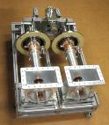
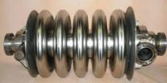
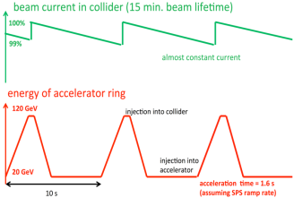
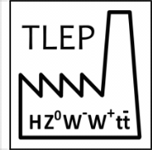
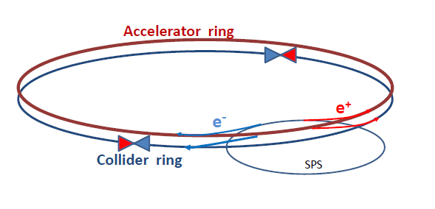
TLEP implementation
At 350 GeV, beams lose 9 GeV / turn by synchrotron radiation
Need 600 5-cell SC cavities @ 20 MV/m in CW mode
Much less than ILC (8000 9-cell cavities@ 31 MV/m)
Length ~900 m, similar to LEP (7 MV/m)
200 kW/ cavity in CW : RF couplers are challenging
Heat extraction, shielding against radiation, …
Luminosity is achieved with small vertical beam size : σ_{y} ~ 100 nm
A factor 30 smaller than at LEP2, but much more relaxed than ILC (6-8 nm)
TLEP can deliver 1.3 × 10³⁴ cm⁻²s⁻¹ per collision point at √s = 350 GeV
Small beam lifetime due to Bhabha scattering ~ 15 minutes
Need efficient top-up injection
BNL 5-cell 700 MHz cavity
RF Coupler
(ESS/SPL)
A. Blondel
F. Zimmermann

Slide 24
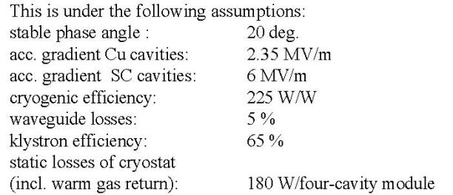
power – LEP2 experience
G. Geschonke, LINAC96
LEP2 SC system
4 mA /beam,
3.6 GV total RF,
→ 25.9 MW
wall plug power,
incl. cryogenics!
11 MW
SR power/beam
→ efficiency ~42%
(2.5x ILC)

Slide 25
Power consumption
Highest consumer is RF:
 | TLEP 120 | TLEP 175
RF systems | 173-185 MW
cryogenics | 10 MW | 34 MW
top-up ring | 3 MW | 5 MW
Total RF | 186-198 MW | 212-224 MW
Limited by Klystron CW efficiency of 65%. This is NOT aggressive and we hope to be able to do better after dedicated R&D
Total power consumption for 350GeV running:
Power consumption | TLEP 175
RF including cryogenics | 224MW
cooling | 5MW
ventilation | 21MW
magnet systems | 14MW
general services | 20MW
Total | ~280MW
CERN 2010 power demand:
Full operation 220MW
Winter shutdown 50MW
IPAC13 TUPME040, arXiv:1305.6498 [physics.acc-ph]

Slide 26
A note on power consumption
TLEP is using ~280MW while in operation and probably ~80MW between physics fills. So for 1×10⁷ sec of operation and 1×10⁷ sec of stand-by mode, total electricity consumption is ~1TWh
CERN is currently paying ~50CHF/MWh
TLEP yearly operation corresponds to ~50MHF/year
This should be seen in the context of the total project cost (less than 1% of the total cost of the project goes per year to electricity consumption)

Slide 27
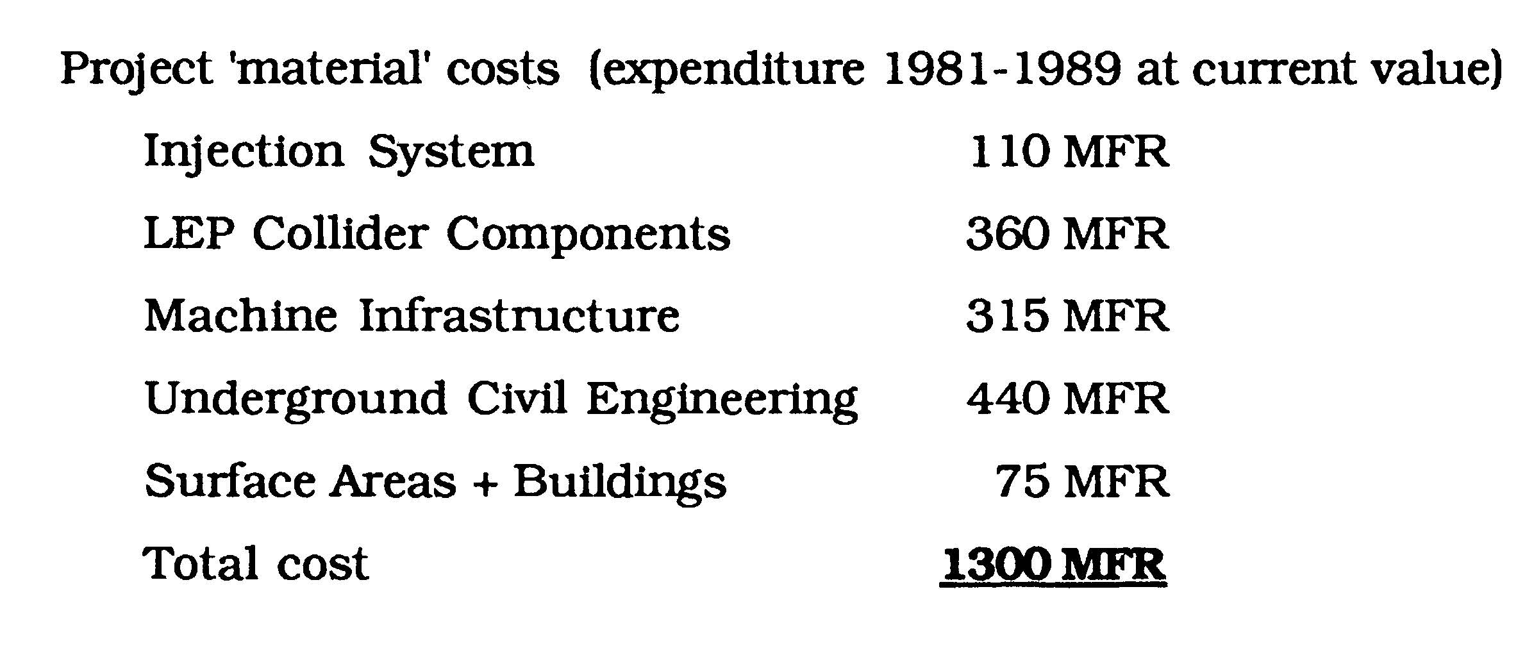
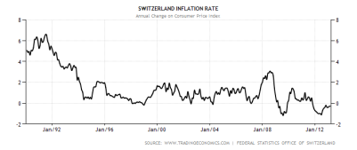
cost - LEP experience
Source:
G. Bachy, A. Hofmann, S. Myers, E. Picasso, G. Plass, “The LEP Collider – Construction, Project Status and Outlook,” Part. Acc. 1990, Vol. 26, pp. 19-32
total cost of TLEP = LEP cost x 3 x total Swiss
inflation since 1990 (1.2?) = 4.7 BCHF
Swiss annual inflation oscillating around 1.0

Slide 28
TLEP cost breakdown – extremely rough (GEuro)
 | TLEP
Bare tunnel | 3.1 ⁽¹⁾
Services & Additional infrastructure (electricity, cooling, ventilation, service cavern, RP, surface structure, access roads) | 1.0⁽²⁾
RF system | 1.0 ⁽³⁾
Cryo system | 1.0 ⁽⁴⁾
Vacuum system & RP | 0.5⁽⁵⁾
Magnet system for collider & injector ring | 0.8⁽⁶⁾
Pre-injector complex SPS reinforcements | 0.5
Total | 7.9
preliminary – not endorsed by anybody
(1): J. Osborne, Amrup study
(2): very rough guess, conservative escalated extrapolation from LEP
(3): B. Rimmer, SRF cost per GeV or per Watt for CEBAF upgrade, 2010
(4): ½ LHC system [also, possibly some refurbished LHC plants could be reused]
(5): factor 2.5 higher than KEK (K. Oide) estimate for 80 km ring
(6): 24,000 magnets for collider & injector; cost per magnet 30 kCHF (LHeC); 10% added; no cost saving from mass production assumed
Note: detector costs not included

Slide 29
TLEP cost – 3rd estimate (Shiltsev’s L.E.P.^{1/2} law)
U. Chicago Workshop , Feb 25-26, 2013
$${cost[G\$]=2\left(\frac{L}{10 km}\right)}^{1/2}+{10\left(\frac{E}{1 TeV}\right)}^{1/2}+2{\left(\frac{P}{100 MW}\right)}^{1/2}$$
$$→US cost=14.7 G\$$$
using 100 km, 240 GeV, 300 MW
$cost\left[Euro\right]=cost\left[\$\right]/2.5$ [Shiltsev rule for US vs EU accounting]
$$→EU cost=5.9 GEuro$$
TLEP cost-estimate summary
cost | LEP scaling | conservative breakdown | L.E.P. ^{½} formula
[GEuro] | 4.7 | 7.9 | 5.9

Slide 30
TLEP/LEP3 key issues
SR handling and radiation shielding
optics effect of energy sawtooth
beam-beam interaction for large Q_{s}
and significant hourglass effect
β_{y}*=1 mm IR with large acceptance
TERA-Z operation (impedance effects
& parasitic collisions)
see talk by
N. Mounet
→ Conceptual Design Study by 2014/15!

Slide 31
vertical rms IP spot sizes in nm
in regular
font:
achieved
in italics:
design
values
LEP2 | 3500
KEKB | 940
SLC | 500
LEP3 | 320
TLEP-H | 220
ATF2, FFTB | 73 (35), 77
SuperKEKB | 50
ILC | 5 – 8
CLIC | 1 – 2
β_{y}*:
5 cm→
1 mm
LEP3/TLEP
will learn
from ATF2 &
SuperKEKB

Slide 32
TLEP parameter set
 | TLEP Z | TLEP W | TLEP H | TLEP t
E_{beam} [GeV] | 45 | 80 | 120 | 175
circumf. [km] | 80 | 80 | 80 | 80
beam current [mA] | 1180 | 124 | 24.3 | 5.4
#bunches/beam | 4400 | 600 | 80 | 12
#e−/beam [10¹²] | 1960 | 200 | 40.8 | 9.0
horiz. emit. [nm] | 30.8 | 9.4 | 9.4 | 10
vert. emit. [nm] | 0.07 | 0.02 | 0.02 | 0.01
bending rad. [km] | 9.0 | 9.0 | 9.0 | 9.0
κ_{ε} | 440 | 470 | 470 | 1000
mom. c. α_{c} [10⁻⁵] | 9.0 | 2.0 | 1.0 | 1.0
P_{loss,SR}/beam [MW] | 50 | 50 | 50 | 50
β∗_{x} [m] | 0.5 | 0.5 | 0.5 | 1
β∗_{y} [cm] | 0.1 | 0.1 | 0.1 | 0.1
σ∗_{x} [μm] | 124 | 78 | 68 | 100
σ∗_{y} [μm] | 0.27 | 0.14 | 0.14 | 0.10
hourglass F_{hg} | 0.71 | 0.75 | 0.75 | 0.65
E^{SR}_{loss}/turn [GeV] | 0.04 | 0.4 | 2.0 | 9.2
V_{RF},tot [GV] | 2 | 2 | 6 | 12
d_{max,RF} [%] | 4.0 | 5.5 | 9.4 | 4.9
ξ_{x}/IP | 0.07 | 0.10 | 0.10 | 0.10
ξ_{y}/IP | 0.07 | 0.10 | 0.10 | 0.10
f_{s} [kHz] | 1.29 | 0.45 | 0.44 | 0.43
E_{acc} [MV/m] | 3 | 3 | 10 | 20
eff. RF length [m] | 600 | 600 | 600 | 600
f_{RF} [MHz] | 700 | 700 | 700 | 700
δ^{SR}_{rms} [%] | 0.06 | 0.10 | 0.15 | 0.22
σ^{SR}_{z,rms} [cm] | 0.19 | 0.22 | 0.17 | 0.25
/IP[10³²cm⁻²s⁻¹] | 5600 | 1600 | 480 | 130
number of IPs | 4 | 4 | 4 | 4
beam lifet. [min] | 67 | 25 | 16 | 20
Too pessimistic! 2nm @120GeV or lower should he easy
By definition, in a project like TLEP, from the moment a set of parameters is published it becomes obsolete and we now already have an improved set of parameters.
The new parameter set contains improvements to our understanding, but does not change the big picture.
Revised (taking into account BS) but similar
IPAC13 TUPME040, arXiv:1305.6498 [physics.acc-ph]

Slide 33
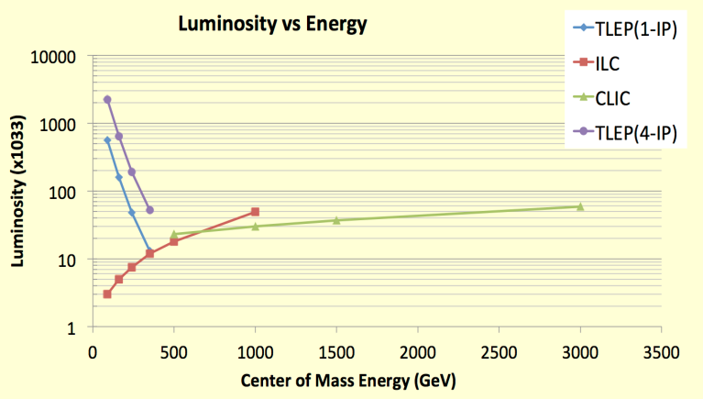
Luminosity of TLEP
Z, 2.10³⁶
TLEP : Instantaneous lumi at each IP (for 4 IP’s)
Instantaneous lumi summed over 4 IP’s
WW, 6.10³⁵
HZ, 2.10³⁵
tt , 5.10³⁴
Why do we always quote 4 interaction points?
It is easier to extrapolate luminosity from the LEP experience. Lumi of 2IPs is larger than half the lumi of 4IPs
According to a particle physicist: “give me an experimental cavern and I guarantee you that it will be filled”

Slide 34
Upgrade path
TLEP offers the unique possibility to be followed by a 100TeV pp collider (VHE-LHC)
Luminosity upgrade: a study will be launched to investigate if luminosity can be increased by a significant factor at high energies (240 and 250GeV E_{CM}) by using a charge-compensated scheme of four colliding beams. We will aim to gain a factor of 10 (to be studied and verified)

Slide 35
TLEP Design Study: Structure
26 Working Groups: Accelerator / Experiment / Phenomenology

Slide 36
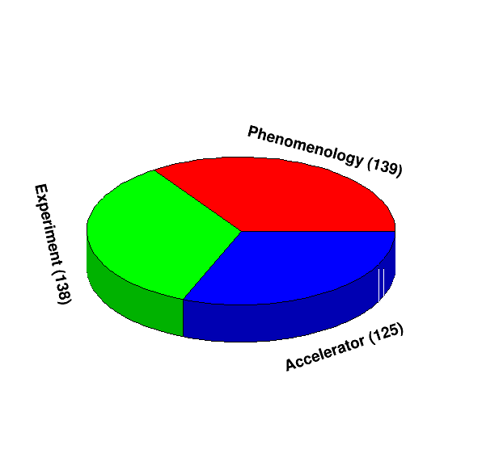
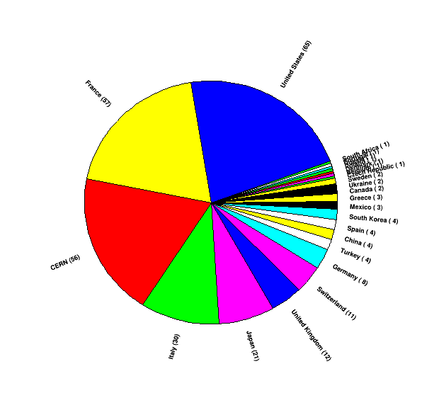
TLEP Design Study: People
296 subscribers from 23 countries (+CERN)
Distribution reflects the level of awareness in the different countries
4 physicists from China: subscribe at http://tlep.web.cern.ch !

Slide 37
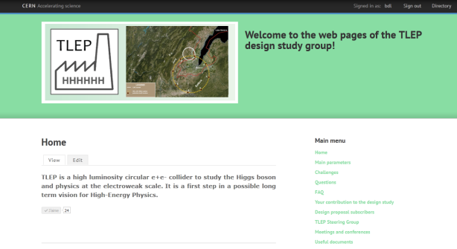
Watch this space
http://tlep.web.cern.ch
Next event : Sixth TLEP workshop 16-18 October 2013 http://indico.cern.ch/conferenceDisplay.py?ovw=True&confId=25771
Joint VHE-LHC + TLEP kick-off meeting in February 2014

Slide 38
tentative time line
1980
1990
2000
2010
2020
2030
2040
LHC
Design,
R&D
Proto.
Constr.
Physics
HL-LHC
Design,
R&D
Constr.
Physics
LHeC
& SAPPHiRE?
Design,
R&D
Constr.
Physics
TLEP
Design,
R&D
Constr.
Physics
VHE-LHC
Design,
R&D
Constr.
Physics

Slide 39
TLEP Design Study
Proposal
(draft)
to be submitted to
ECFA
Ambitious milestones should be set up:
CDR in 2 years, TDR in 5 years, in a timely fashion with an update of the EU strategy in 2017-18, after the first round of operation of the LHC@13-14TeV.

Slide 40
Conclusions
TLEP is a 3-in-1 package:
It is a powerful Higgs factory
It is a high-intensity EW parameter buster
It offers the path to a 100TeV pp collider
TLEP is based on solid technology and offers little risk, has a price tag which is expensive but not out of reach, has reasonable consumption, offers multiple interaction points an d might even have an upgrade potential.

Slide 41
Thanks for your attention !

