Slide 1
Higgs Mass Fast Simulation
Signal： e+ e- > Z H > μ+ μ- H
Sqrts = 250 GeV
Radius = 1365 mm

Slide 2
Sample: e2e2H.slcio
Analysis procedure: FSHiggsMass.cc
Root: Higgs.steer

Slide 3
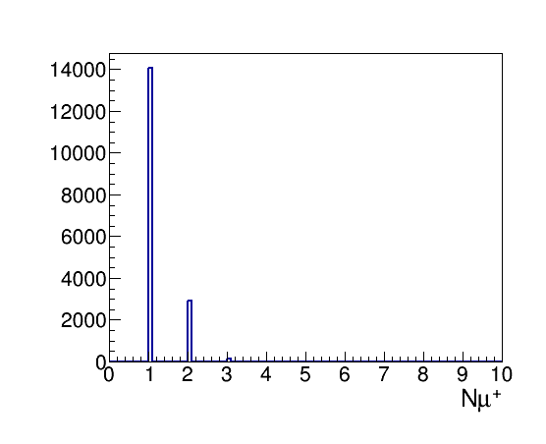
Numbers of μ+ and μ-

Slide 4
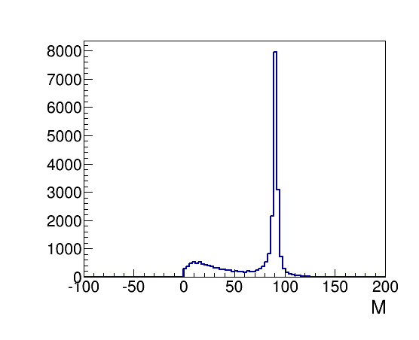
Invariant mass of Z boson
Notes:
Invariant

Slide 5
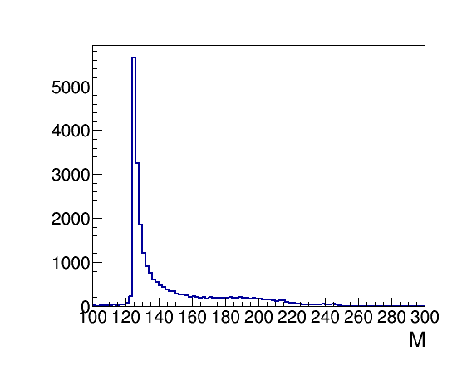
Recoil Mass of Higgs

