Slide 1
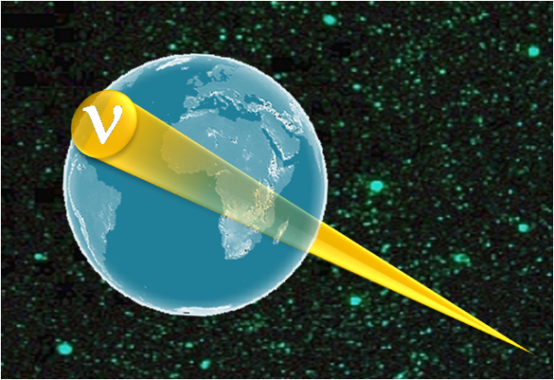
Ultra High energy cosmic neutrino experiments
Part 1
J. Carr
Centre de Physique de Particules de Marseille
IN2P3/ CNRS France

Slide 2
Content : part 1
Multi-messenger Astronomy
Motivation for Neutrino Astronomy
Methods of HE Neutrino Detection
SuperNova Remnants as example
Search for Dark Matter
Origin of Cosmic Rays

Slide 3
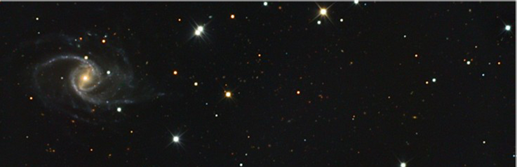

Ways to observe the Universe
SNR
AGN
HE γ
CMB
IR
GRB
n
ν
µquasar
p
High energy gamma rays:
- secondary particle from interaction in source
or from synchrotron radiation in magnetic fields
- not deviated by magnetic fields
- mean free path ∼10 Mpc at 10¹⁴ eV
Cosmic ray protons:
- primary particle accelerated in source
- deviated by magnetic fields
- only points to source for E>10¹⁹ eV
- absorption on CMB, mean free path 50 Mpc at 5 10¹⁹ eV
Classical astronomy: visible light
- see stars like the sun
Multi-wavelength astronomy: radio waves to Xrays
- see other objects but do not understand everything
Neutrinos:
- secondary particle from interaction in source
- not deviated by magnetic fields
- mean free path ∼40 Gpc at 4 10²² eV
Cosmic ray neutrons:
- secondary particle from interaction in source
- not deviated by magnetic fields
- unstable, lifetime 15 minutes
- mean flight path ∼10 kpc (galaxy) at 10¹⁸ eV
Some radiation absorbed on intergalactic photon fields:
Cosmic Microwave Background
and infra-red photon
Some wavelength absorbed in Earth’s atmosphere

Slide 4
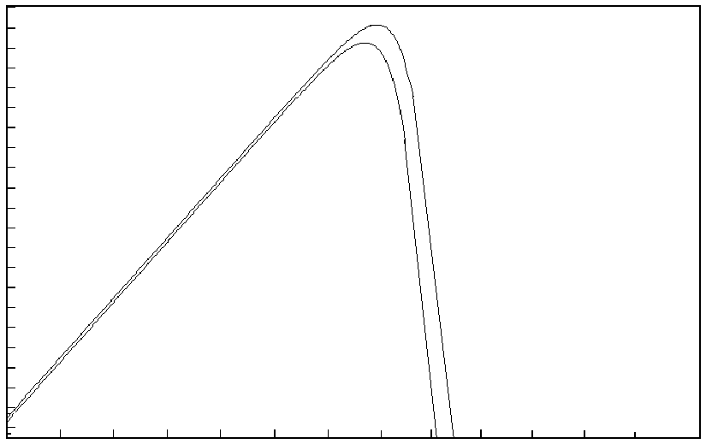
Why multi-messenger astronomy ?
Flux watts/m²
Thermal Radiation
from Stars
10⁶
10²
10⁻²
10⁻⁶
10⁻¹²
T=10000K
T=6000K
thermal radiation
non-thermal radiation
radio
i.r.
u.v.
X ray gamma rays
10³ 10⁵ 10⁷ 10⁹ 10¹¹ 10¹³ 10¹⁵
frequency(MHz)
Observations in non-thermal radiation
make new discoveries beyond stars

Slide 5
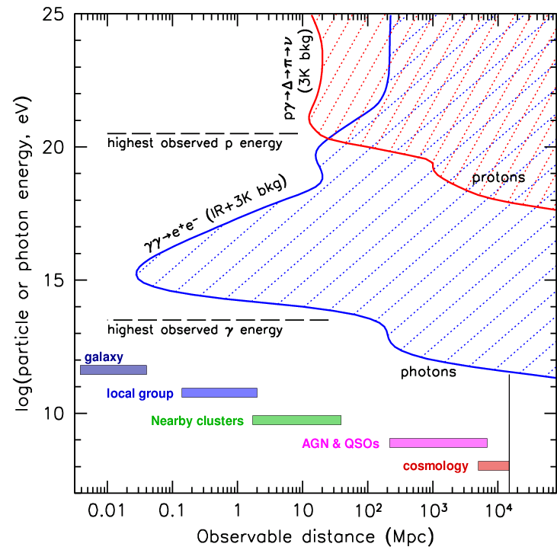
Why Neutrino Astronomy ?
p + γ_{CMB} → Δ⁺→ n + π⁺
γ + γ_{CMB} → e⁺ + e⁻
Only neutrinos arrive
from whole universe

Slide 6

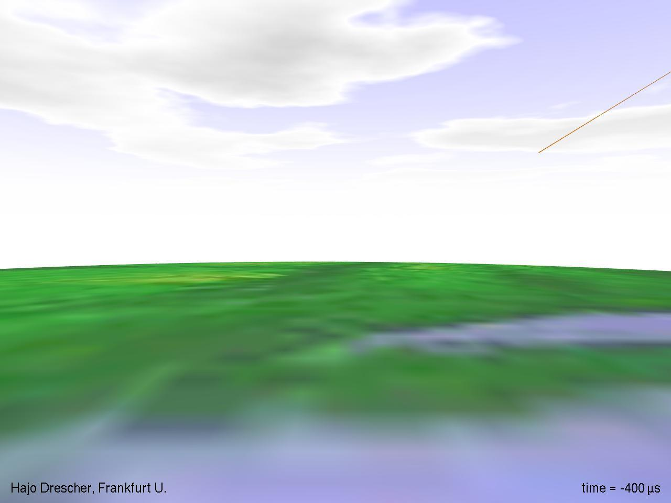
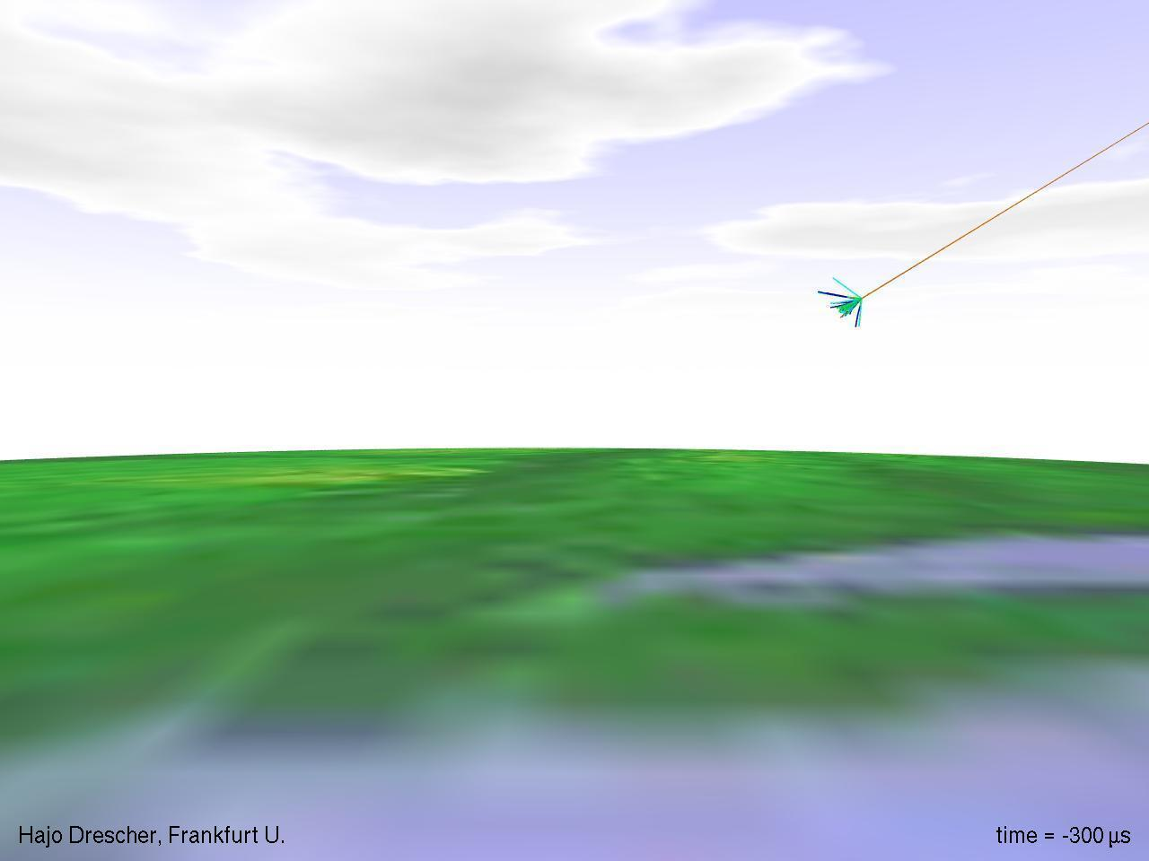
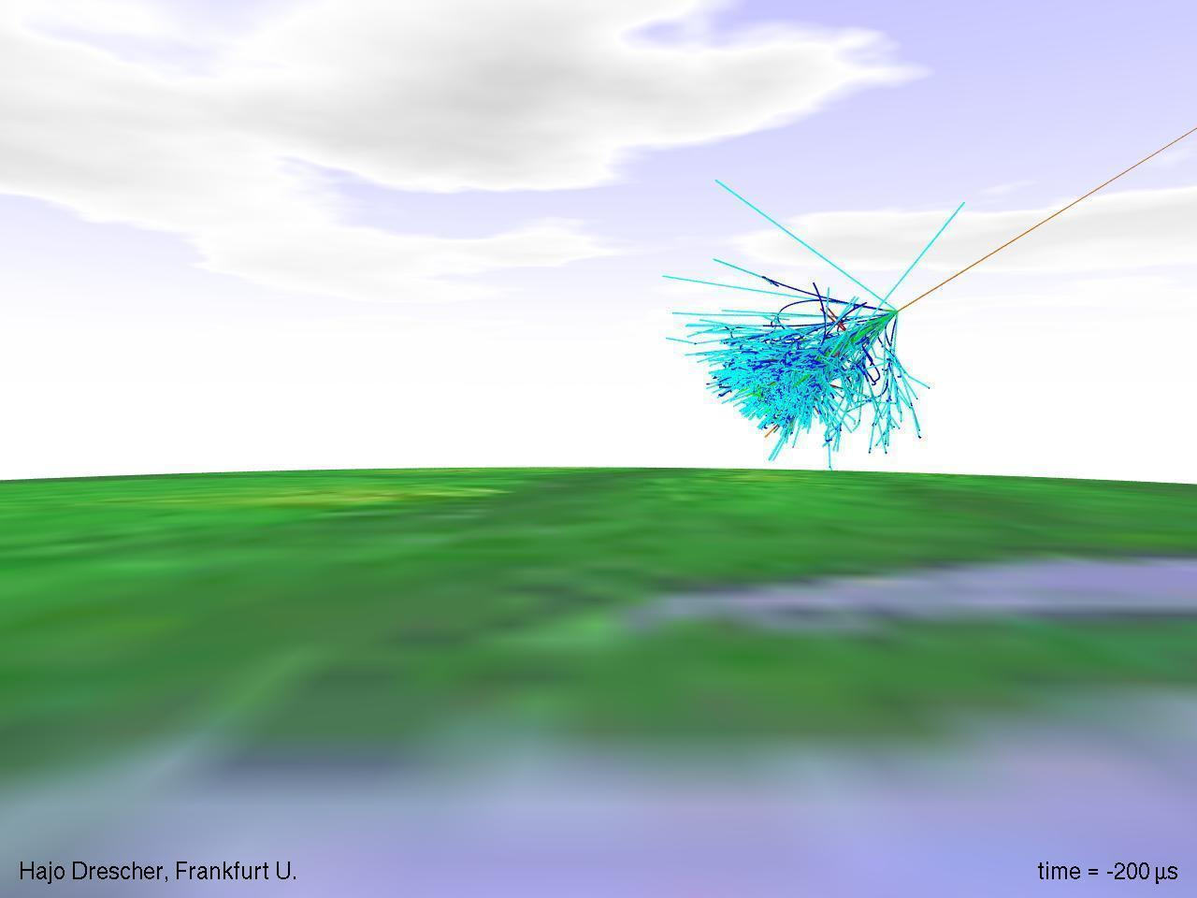
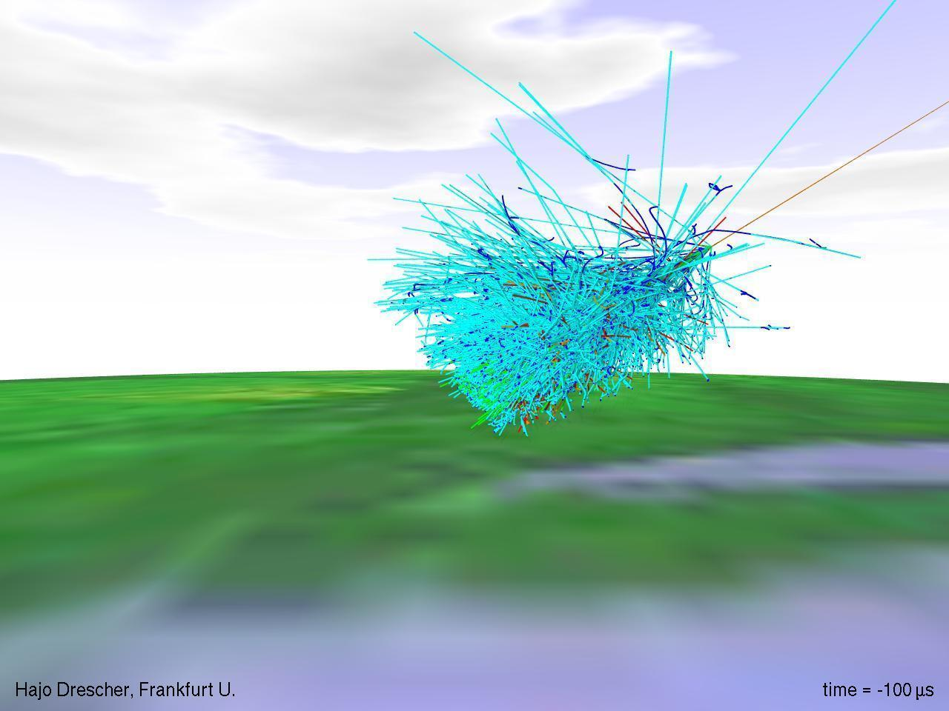
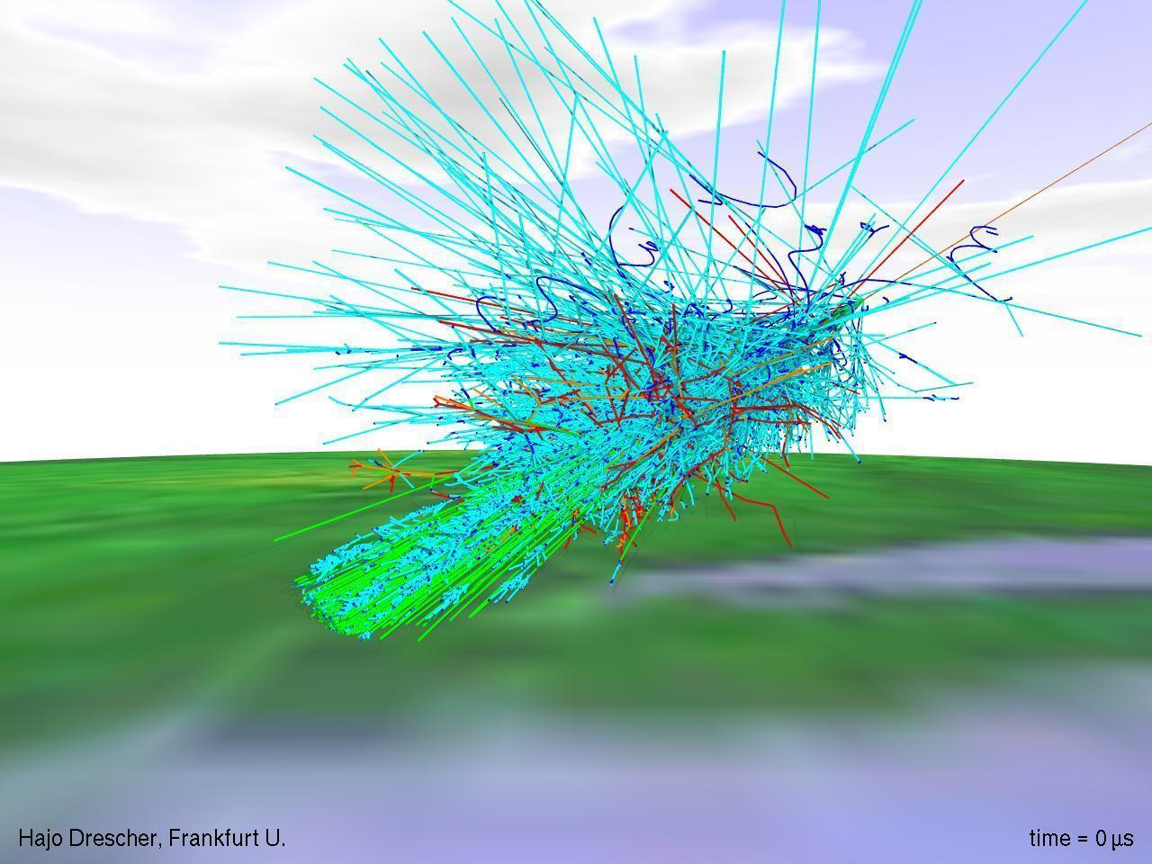
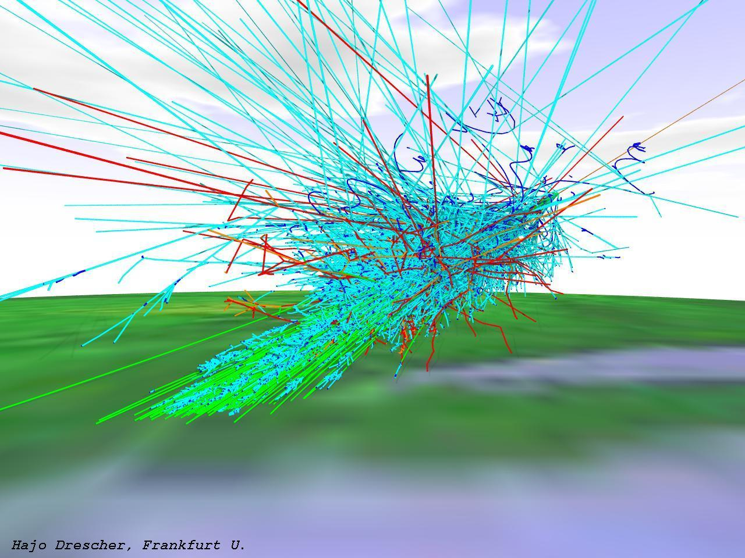
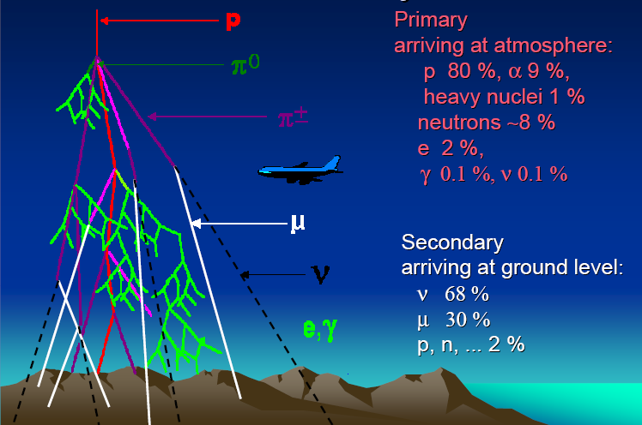
Cosmic Rays arrive at Earth

Slide 7
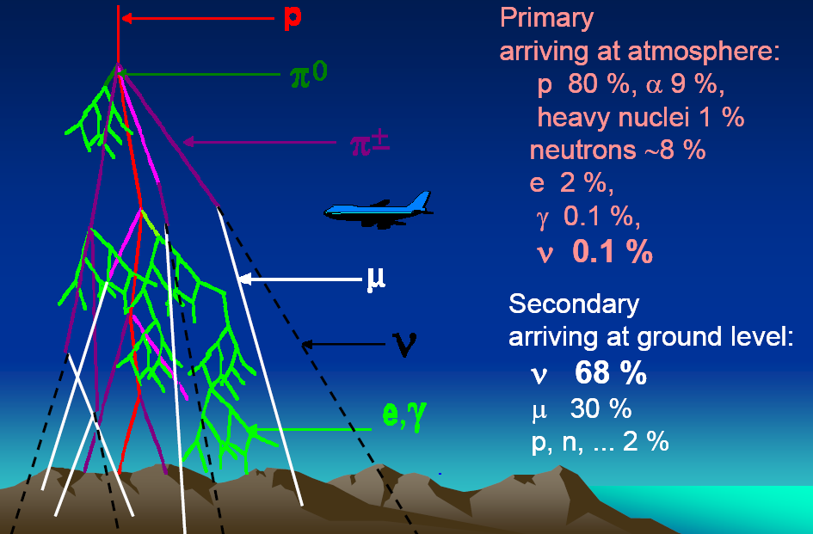
Cosmic Rays composition

Slide 8
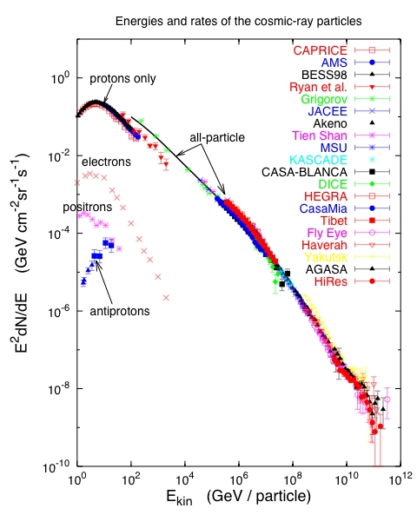
Cosmic Ray energy spectrum
Cosmic Ray energy flux similar to starlight
(i. e. ≈ total energy at earth of all stars except sun)
Energies up to 10 ⁷ times the energy of LHC!
  Where do they come from ?
  What are the sources ?

Slide 9
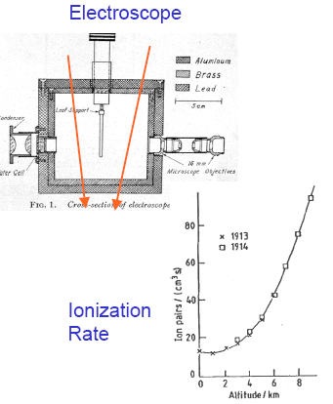
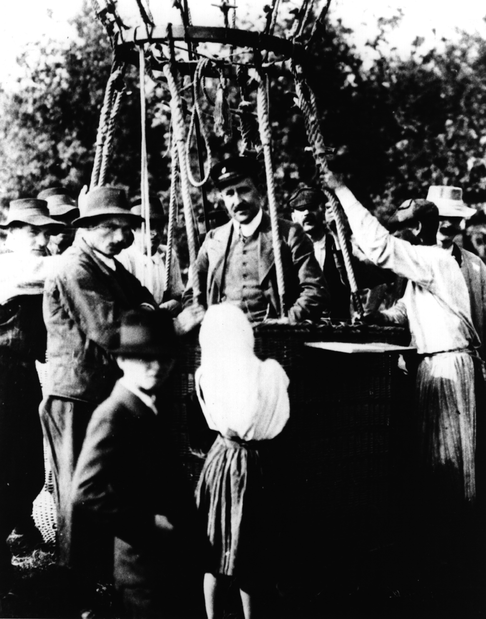
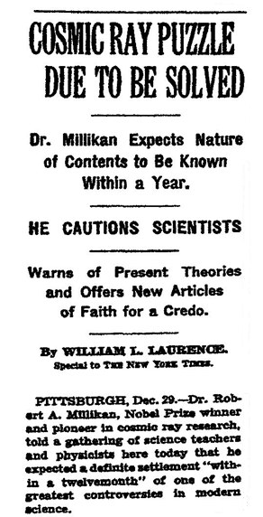
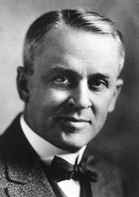
Origin of Cosmic Rays ?
New York Times
December 29, 1932
Discovered by Victor Hess nearly 100 years ago
  Robert A. Millikan
introduced name “Cosmic Rays”
+
+ +
August 7, 1912
Aussig, Austria

Slide 10
Cosmic Ray sources
Still do not know origin of cosmic rays
Likely different source for different energy regimes
Galactic cosmic rays:
Super Nova Remnants (SNR)
Microquasars(µquasars)
Extra galactic cosmic rays
Active Galactic Nuclei (AGN)
Gamma Ray Bursts (GRB)

Slide 11
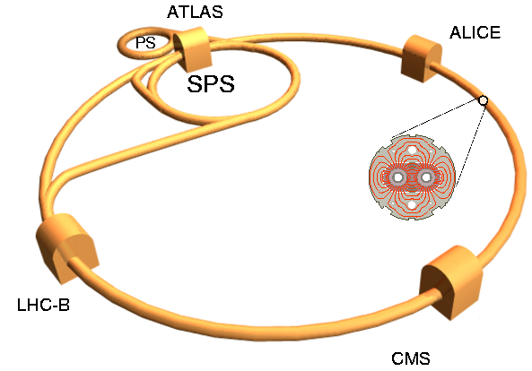
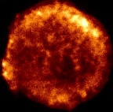
Particle accelerators
Maximum energy of accelerator: E ∝ BR
Large Hadron Collider
R ∼ 10 km, B ∼ 10 T ⇒ E ∼ 10 TeV
Tycho SuperNova Remnant
R ∼ 10¹⁵km, B ∼ 10⁻¹⁰T ⇒ E ∼ 1000 TeV

Slide 12
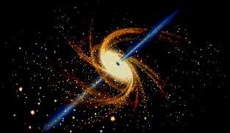
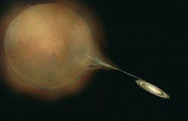
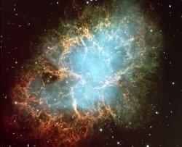
Terrestrial Accelerators⇒ Cosmic Accelerators
Active Galactic Nuclei
microquasar
Diameter of Collider
SuperNova Remnant
LHC CERN 2008
Saturne, Saclay, 1964
Cyclotron Berkeley 1937
Energy of particles accelerated

Slide 13
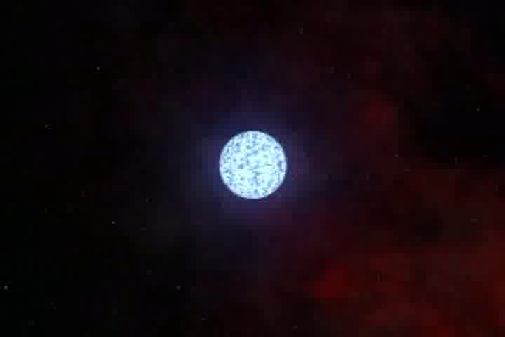
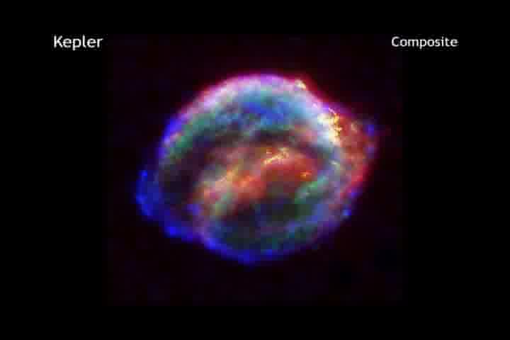
SuperNova Remnants (SNR)
SuperNova star explosion
SuperNova Remnant

Slide 14
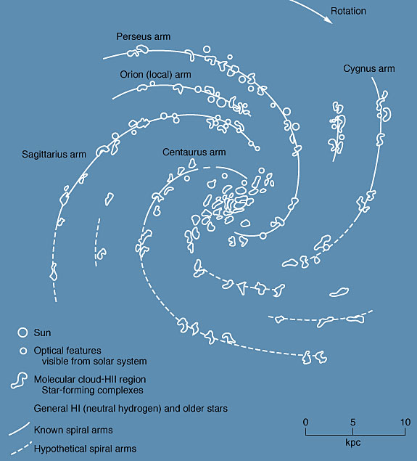
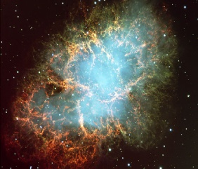
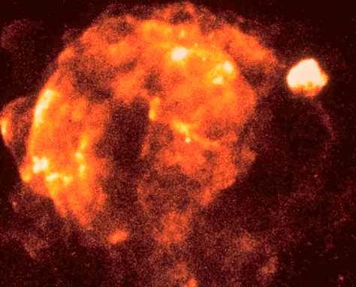
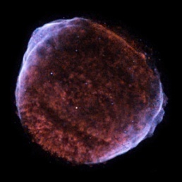
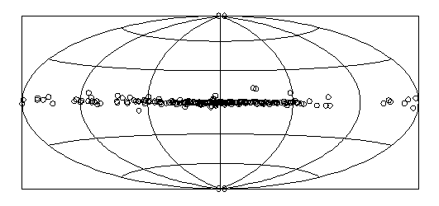
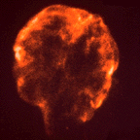
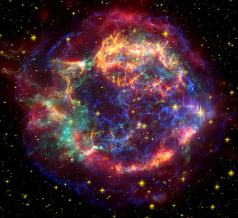
SNR locations in Galaxy
Crab (SN1054)
Crab
Vela( -10000)
Vela
Sun
Cas A
Cygnus Loop
SN1006
Cas A(SN1680)
Cygnus Loop
(-20000)
SN1006
SN1680 (CasA)
SN1006
SN1054 (Crab)
Radio catalogue ∼300 SNR in Galaxy

Slide 15
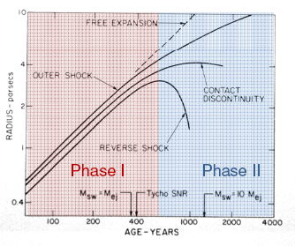
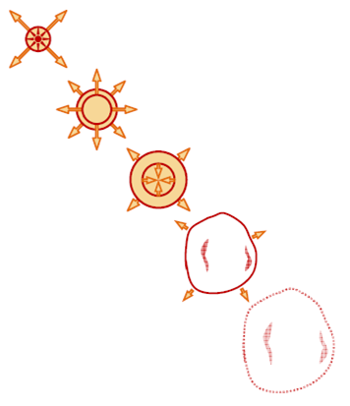
Evolution of SNR
Phase I
“Free expansion”
100-1000 years
Phase II
“Adiabatic expansion”
or “Sedov-Taylor”
1000-10000 years
Phase III
“Radiative phase”
10000-100000 years
Phase IV
“Sub-sonic phase”
>100000 years
Maximum energy of cosmic ray acceleration
around time of transition phase I to phase II (∼1000 years old)

Slide 16
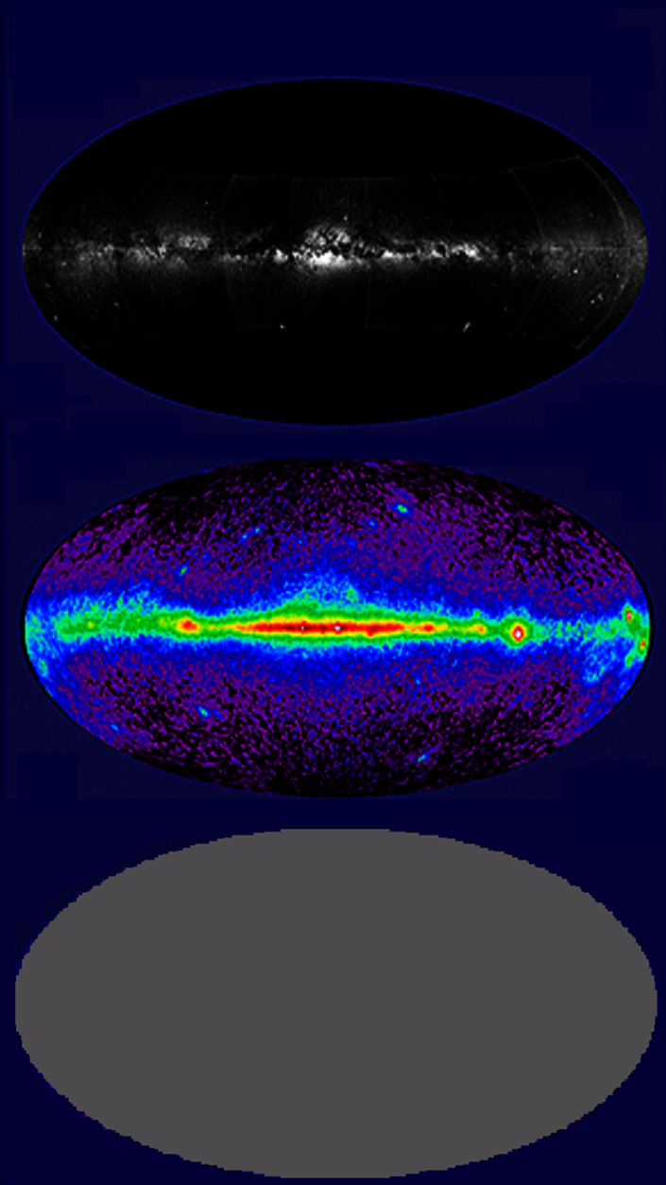
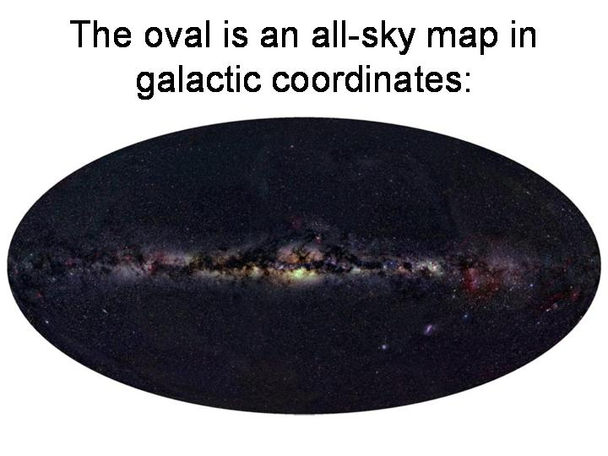
Multi-messenger Astronomy
Visible Light
Gamma rays
?
Neutrinos

Slide 17
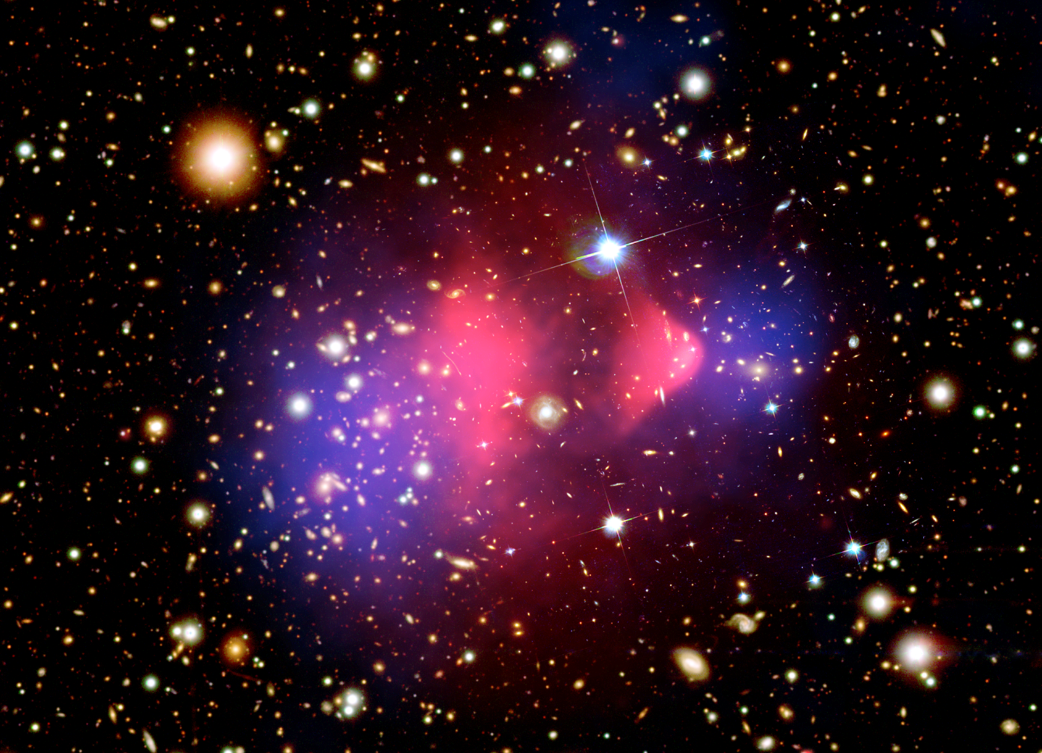
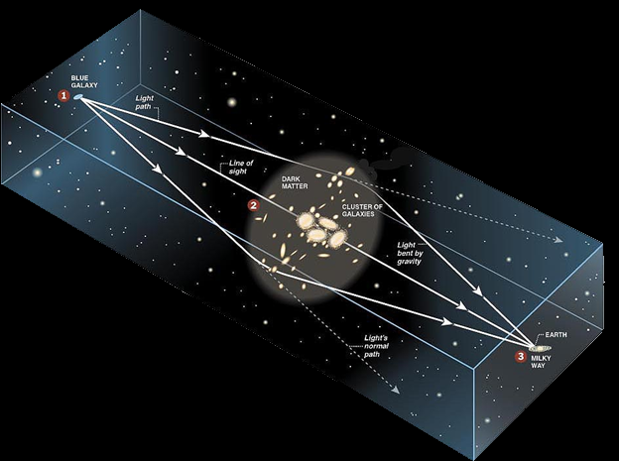
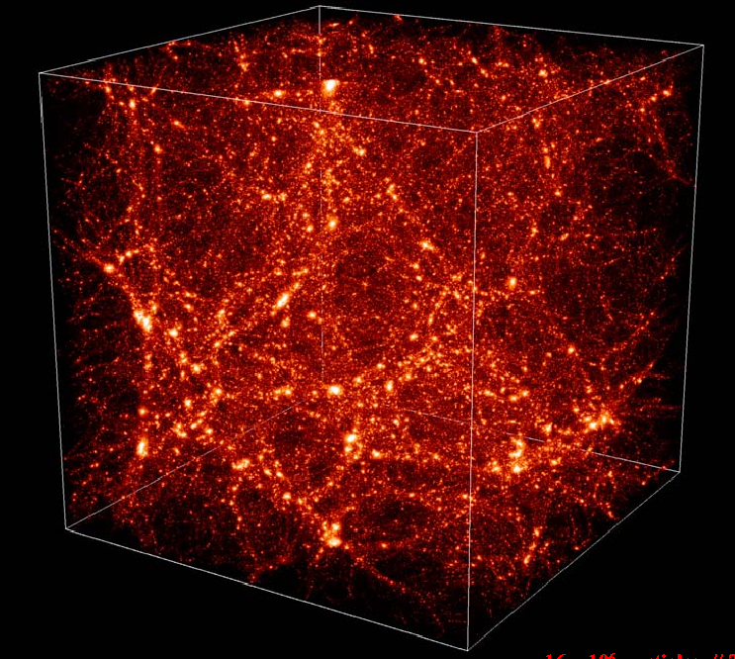
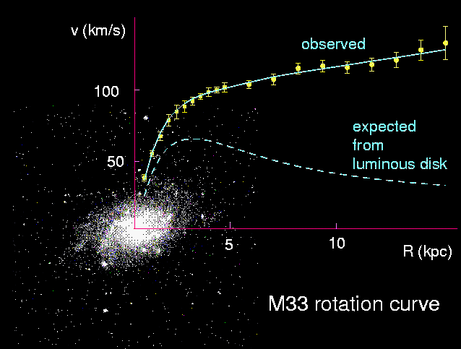
Evidence for Dark Matter
Formation of large scale structure
in the universe
“Bullet” colliding galaxies
Galaxy Clusters
dynamic stability
and
gravitational lensing
observed
velocity, v
radius, R
Dark matter
Expected from
visible stars
mass:
M(R) = v² R / G
Normal Matter
Dark matter

Slide 18
Matter/Energy in the Universe
Ω_{total} = Ω_{Μ} + Ω_{Λ} ∼ 1
Matter:
Ω_{Μ} = Ω_{b} + Ω_{ν} + Ω_{CDM} ∼ 0.27
baryons neutrinos cold dark matter
Baryonic matter :
Ω_{b} ∼ 0.04
stars, gas, brown dwarfs, white dwarfs
Cold
Dark
Matter
Neutrinos:
Ω_{ν} ∼ 0.003
with Μ(ν) = 0.1 eV
Dark Energy
Cold Dark Matter :
Ω_{CDM} ∼ 0.23
WIMPS/neutralinos, axions, …

Slide 19
Search for Dark Matter
Neutrino detection from annihilations in Sun
(also in Galactic Centre and Earth Core)
χ
Sun
Earth
χ
χ
χ
χ
ν
χ
Detector
WIMP looses energy
by elastic collisions
when v < v_{escape}captured
χ
χ
→
WW, ff
W, f
→
νX

Slide 20
Motivation for ν Astronomy
Search for cosmic-ray accelerators
Active galactic nuclei
Supernova remnants
Gamma-ray bursts
Microquasars
Unknown objects
Particle Physics
Neutrino Oscillations
High Energy Cross-sections
Tests of Lorentz Invariance
Search for Exotic Particles
Dark Matter : WIMPs/Neutralinos
Magnetic Monopoles
Nuclearites
Unknown imagined particles

Slide 21
Surprises are likely
New astronomic instruments often give unexpected results:
(after F.Halzen)
Neutrinos Telescopes are a completely novel way to explore the universe
Can expect something new and dramatic

Slide 22
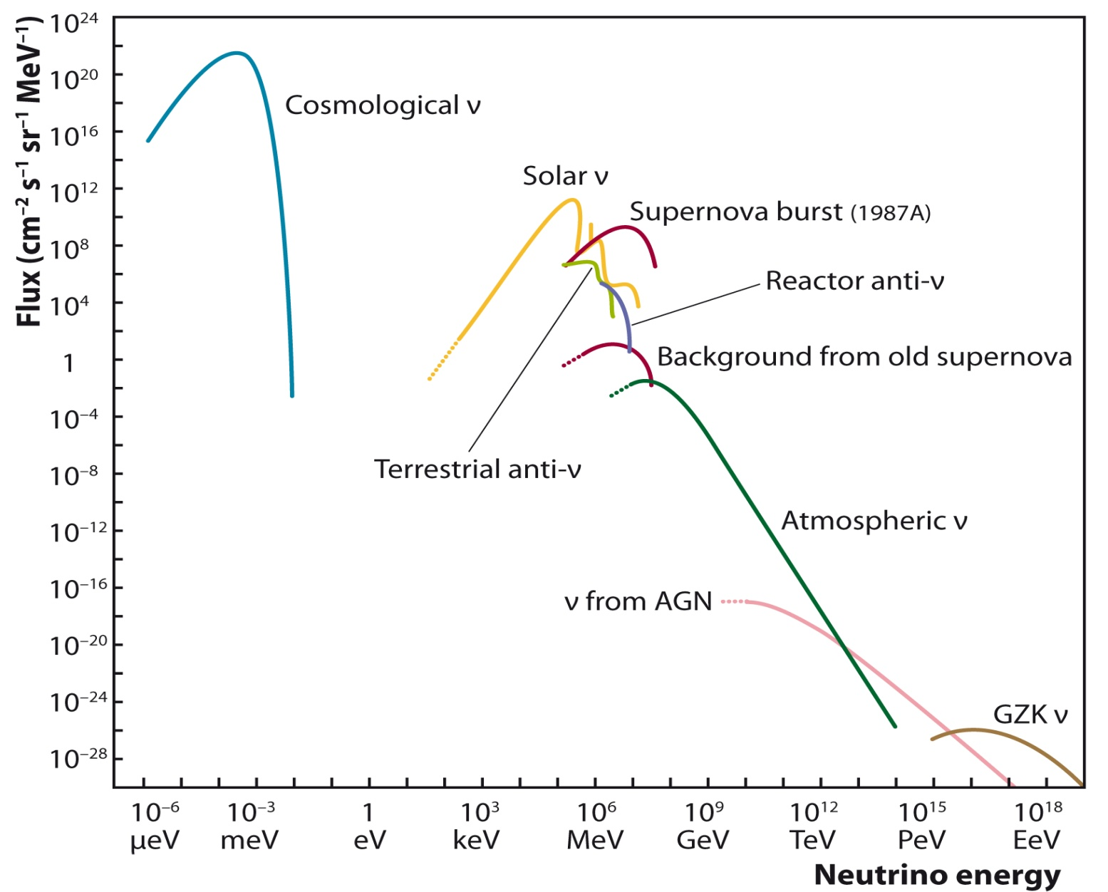
Neutrino spectrum at Earth
under-
ground
optical:
- deep water
- deep ice
air showers
radio
acoustics

Slide 23
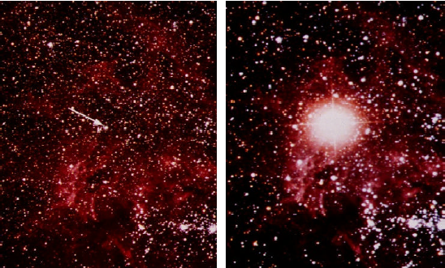
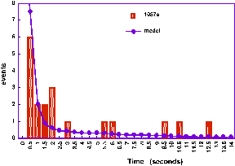
Supernova 1987a
Most distance source of neutrinos so far observed
L = 50 kpc (150 light years)
neutrinos observed
24 hours before
4 hours after
p + e⁻ → n + ν_{e}
e⁺ + e⁻ → ν_{e} + ν_{e,} , ν_{μ} + ν_{μ}
events
time (sec)

Slide 24
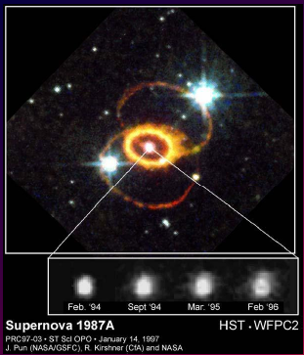
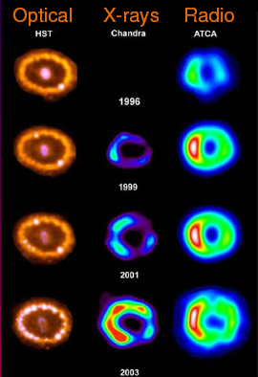
SuperNova Remnant of SN1987a
Complex system of optical rings

Slide 25
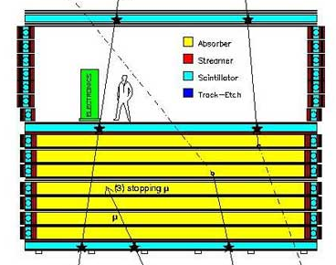
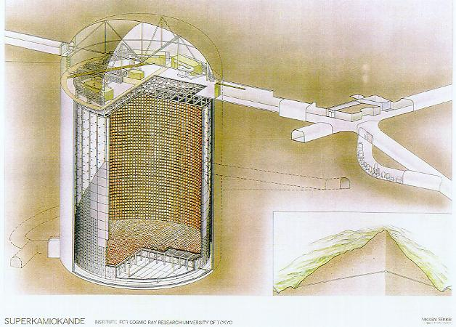
Underground experiments
MACRO
4 K tonnes iron in cavern
SuperKamiokande
30 K tonnes water in cavern

Slide 26

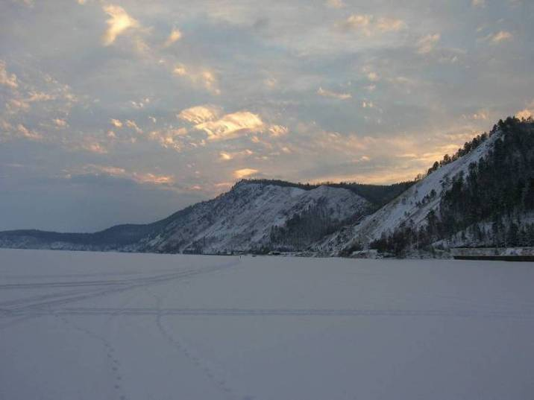
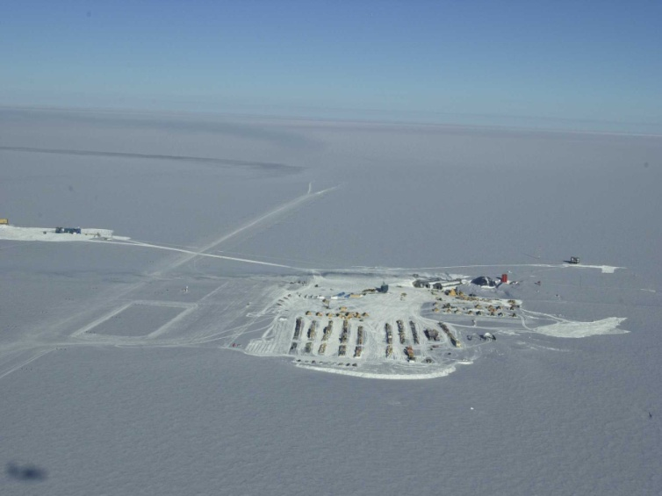
Optical: Deep Water/Ice
ANTARES /NEMO/NESTOR
KM3NeT
AMANDA / ICECUBE
BAIKAL / GVD
These detectors are the subject of second presentation

Slide 27
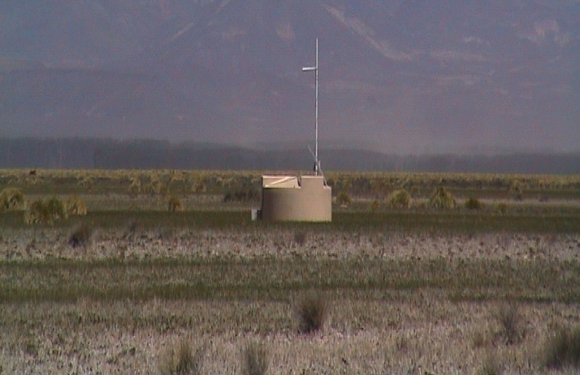
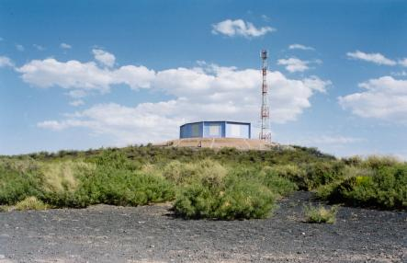
Air Shower detection of ν
AUGER cosmic ray observatory

Slide 28



Neutrino showers different
Neutrino shower:
Interaction lower in atmosphere
More particles arrive at detector
Young neutrino shower
Old hadronic shower
Typical hadronic shower:
hadrons, electrons and photons
absorbed in upper atmosphere
muons arrive at detector

Slide 29





Radio detection of ν
Many projects of radio detection of charged cosmic rays
which can also detect neutrino showers
νMoon

Slide 30


GLUE

Slide 31



ANITA

Slide 32

Limits on Ultra High Energy ν

Slide 33







Acoustic detection of ν
ANTARES:
AMADEUS (Erlangen)
UK:
ACoRNE
Stanford:
SAUND
RONA hydrophone array
AUTEC hydrophone array
NEMO:
ONDE / Optical fibres
ICE CUBE:
SPATS, CONDOR (hybrid)
Baïkal:
ITEP / Irkoutsk

Slide 34

Acoustic undersea detection
Neutrino interaction
Hadronic shower
Thermo-acoustic wave

Slide 35



NEMO acoustic detection
Sperm whales not neutrinos detected !
1 animal
2 animals
3 animals
>3 animals

