Slide 1
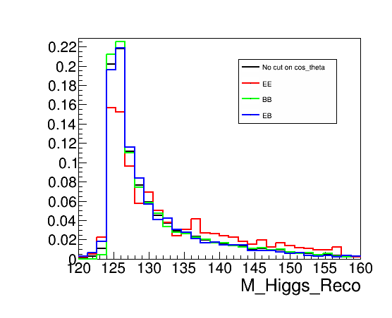

Slide 2
1 Bin width: 1GeV ➔ 0.2GeV
2 Barrel and Endcap Cut: |cos_θ|<0.79
➔ |cos_θ|< L / √(L^2+R^2)
Radius:R= 1365, 1465, 1565, 1665, 1808 (default) mm
Half Z fixed at L=2350 mm (to be optimized as well)

Slide 3
Both in Barrel

Slide 4
One in Barrel, One in Endcap

Slide 5
Both in Endcap

Slide 6
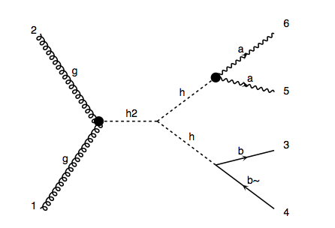
Signal: p p > H > h h, h > b b~, h > γγ (2HDM)
8 TeV : σ(gg -> H -> bb~γγ) = 9.5 fb
8TeV LHC with 25 fb^-1 ➔ 237 Events

Slide 7
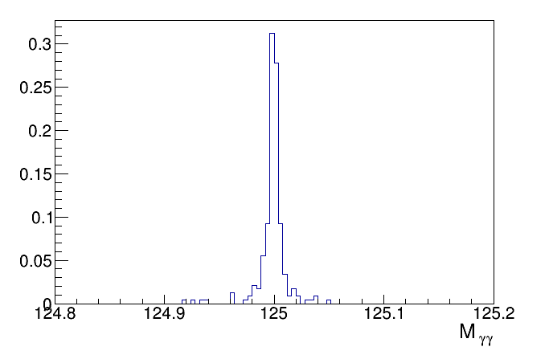

Slide 8
Cuts on BG: |M_γγ － M_h| < 20GeV, M_h = 125GeV
|M_bb~ － M_h| < 20GeV, M_H = 300GeV
|M_γγbb~ － M_H| < 20GeV.

Slide 9
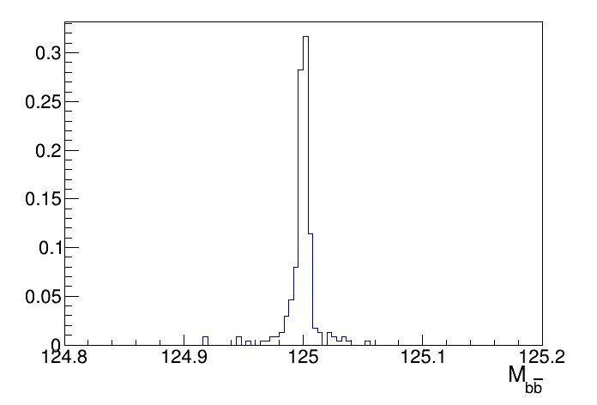

Slide 11
