Slide 1
Crystal ball plus gaussian fit
PT_b,ϒ > 25 GeV

Slide 2
PT_b,ϒ_leading > 30 GeV, PT_b,ϒ_subleading > 25 GeV

Slide 3
PT_ϒ_leading > 30 GeV, PT_ϒ_subleading > 25 GeV,
PT_b_leading >40 GeV, PT_b_subleading > 30 GeV

Slide 4
PT_b,ϒ_leading > 40 GeV, PT_b,ϒ_subleading > 30 GeV

Slide 5
ww_h_RL
Whizard Sample:
ww_h0cuxx 1.24E+02fb 90.96%
ww_h0uubd 1.84E-03fb 0.00%
ww_h0uusd 6.06E+00fb 4.45%
ww_h0ccbs 2.09E-01fb 0.15%
ww_h0ccds 6.05E+00fb 4.44%
x: down type quarks d, s, b
Dominated process: w > c s~ (c~ s)
w > u d~ (u~ d)

Slide 6



Whizard
MG5

Slide 7
Whizard
MG5

Slide 8
Whizard
MG5
MG5

Slide 9
Whizard
MG5
MG5

Slide 10
Whizard
MG5

Slide 11
Whizard
MG5

Slide 12
Other polarizations
MG5 LR
MG5 no polarization

Slide 13
Angular distribution of W+W-
MG5 no polarization
MG5 LR

Slide 14
MG5 RL
MG5 RL

Slide 15
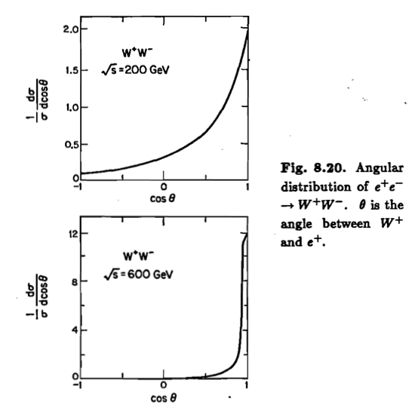
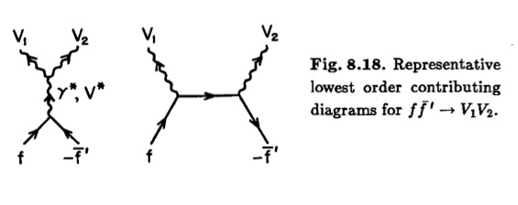
Ref: Collider Physics
Vernon D.Barger Roger J.N.Phillips

Slide 16
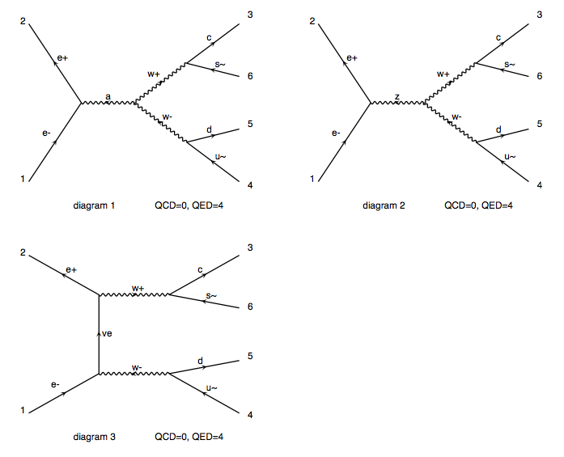
Madgraph + pythia

Slide 17
Whizard: ww_h0cuxx
σ: 1.24E+02fb
Madgraph + pythia:
Basic cuts:
PT_j > 20GeV, eta_j < 5
σ: 0.72E+02fb
Shut down PT and eta cuts:
σ: 1.24E+02fb

Slide 18
ww_h_LR
Whizard Sample:
ww_h0cuxx 1.35E+04fb 90.96%
ww_h0uubd 2.01E-01fb 0.00%
ww_h0uusd 6.63E+02fb 4.46%
ww_h0ccbs 2.28E+01fb 0.15％
ww_h0ccds 6.59E+02fb 4.43%
MG5:
Basic cuts: PT_j > 20GeV, eta_j < 5
σ: 0.71E+04fb
Shut down PT and eta cuts:
σ: 1.38E+04fb

