Slide 1
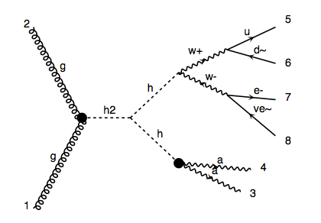
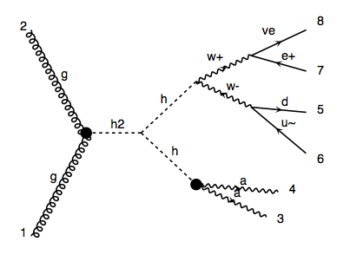
Dephes Level
p p > H, H > h h, h > w+ w- > q q l v, h > a a

Slide 2
Parton level
Distribution of qq and lv invariant mass are different. For hadronic decay channel, on shell W is preferred, and for leptonic decay case, off shell W is dominated.

Slide 4
h > w+ w- > q q l v
h > w+ w- > l v q q
h > w+ w- > q q l+ v,
add process h > w+ w- > q q l- v~
4. SM: g g > h > w+ w- > q q l v

Slide 5
5. Higgs boson decay 3-body final states(h > VV* > Vff)
(qql+v) example:
h > q q w, w > l v (qq off shell)
add process h > l v w, w > q q (qq on shell)
6. Generated qq on shell process and off shell case separately.

Slide 7
Combination of qq on shell and off shell

Slide 8
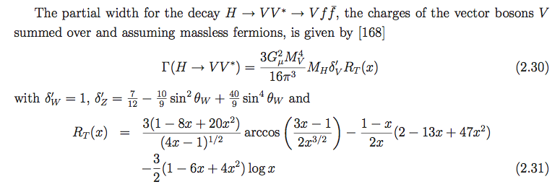
Theoretical analysis
σ(qq on shell ) = σ(qq off shell )

