Slide 1
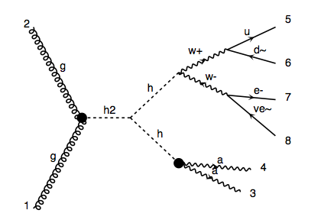
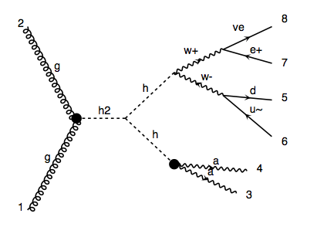
Dephes Level
p p > H, H > h h, h > a a, h > q q w, w > l v
(or h > l v w, w > q q )

Slide 2
  Event selection－overlap remove
Electrons with ΔR(e,γ) < 0.4 are removed;
Jets with ΔR(jet,e) < 0.2 or ΔR(jet,γ) < 0.4 are removed;
(BTag = 0 and TauTag = 0)
Muons with ΔR(μ,jet) < 0.4 or ΔR(μ,γ) < 0.4 are removed.

Slide 3
  Event selection
Number of qjet >= 2;
choose leading and subleading qjet
Number of photon >= 2;
m_γγ of photon pair closest to m_h
Number of electron or muon =1.
  Basic cuts
|η_γ, q, l| < 2.5;
PT_γ, q > 25 GeV, PT_l > 15 GeV.

Slide 4
Invariant mass

Slide 5
Missing ET

Slide 6
PT of photon

Slide 7
PT of qjet

Slide 8
PT of lepton

Slide 9
Delta R

Slide 10
Delta Phi

Slide 11
Transverse mass

Slide 12
Distribution of qjets for delphes and parton level
Parton level
Delphes level

Slide 13
Parton level
Delphes level

Slide 14
Parton level
Delphes level

Slide 15
Parton level
Delphes level

Slide 16
Parton level
Delphes level

Slide 17
Parton level
Delphes level

Slide 18
Parton level
Delphes level

Slide 19
Parton level
Delphes level

