Slide 1
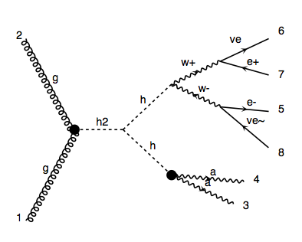
Dephes Level
p p > H, H > h h, h > a a, h > w w > l v l v

Slide 2
SM BG:
p p > l v l v a a
p p > l l a a

Slide 3
  Event selection－overlap remove
Electrons with ΔR(e,γ) < 0.4 are removed;
Jets with ΔR(jet,e) < 0.2 or ΔR(jet,γ) < 0.4 are removed;
(BTag = 0 and TauTag = 0)
Muons with ΔR(μ,jet) < 0.4 or ΔR(μ,γ) < 0.4 are removed.

Slide 4
  Event selection
Number of muon + electron = 2;
Number of photon >= 2;
m_γγ of photon pair closest to m_h.
  Basic cuts
|η_γ, l| < 2.5;
PT_γ > 25 GeV, PT_l > 15 GeV.

Slide 5
Invariant mass

Slide 6
Missing ET

Slide 7
PT of photon

Slide 8
PT of lepton

Slide 9
Transverse mass

