Slide 1
THE Calocube PROJECT
DevelopmenT of high acceptance homogeneous calorimetry for Cosmic Rays experiments in space
2^ HERD International Workshop
Beijing, December 2nd, 2013
Oscar Adriani
INFN Firenze and University of Florence

Slide 2
Our proposal for an ‘optimal’ CR detector
A 3-D, deep, homogeneous and isotropic calorimeter can achieve these design requirements:
  depth and homogeneity to achieve energy resolution (but please remember that anyway a full containment HCAL is impossible in space!!!!)
  isotropy (3-D) to accept particles from all directions and increase GF
Proposal: a cubic calorimeter made of small cubic sensitive elements
  can accept events from 5 sides (mechanical support on bottom side) → GF * 5
  segmentation in every direction gives e/p rejection power by means of topological shower analysis
  cubic, small (~Molière radius) scintillating crystals for homogeneity
  gaps between crystals increase GF and can be used for signal readout
    small degradation of energy resolution
  must fulfill mass&power budget of a space experiment
    modularity allows for easy resizing of the detector design depending on the available mass&power
From last year HERD workshop presentation

Slide 3
Since 2012…..
A lot of work has been done!!!!
Optimization of the idea and of the original design
Prototype construction and test
New ideas to improve the calorimetric performances
Proposal to INFN for a 3 years R&D activity
  We have been financed for ~0.8 Meuro

Slide 4
The starting point
See for example:
N. Mori, et al.,
Homogeneous and isotropic calorimetry for space experiments
NIMA (2013)
http://dx.doi.org/10.1016/j.nima.2013.05.138i
Exercise made on the assumption that the detector’s only weight is ~ 1600 kg
  Mechanical support is not included in the weight estimation
The chosen material is CsI(Tl)
  Density: 4.51 g/cm³
  X₀: 1.85 cm
  Moliere radius: 3.5 cm
  λ_{I}: 37 cm
  Light yield: 54.000 ph/MeV
  τ_{decay}: 1.3 μs
  λ_{max}: 560 nm
Simulation and prototype beam tests used to characterize the detector
N×N×N | 20×20×20
L of small cube (cm) | 3.6*
Crystal volume (cm³) | 46.7
Gap (cm) | 0.3
Mass (Kg) | 1683
N.Crystals | 8000
Size (cm³) | 78.0×78.0×78.0
Depth (R.L.) “ (I.L.) | 39×39×39 1.8×1.8×1.8
Planar GF (m²sr) ** | 1.91
(* one Moliere radius)
(** GF for only one face)

Slide 5
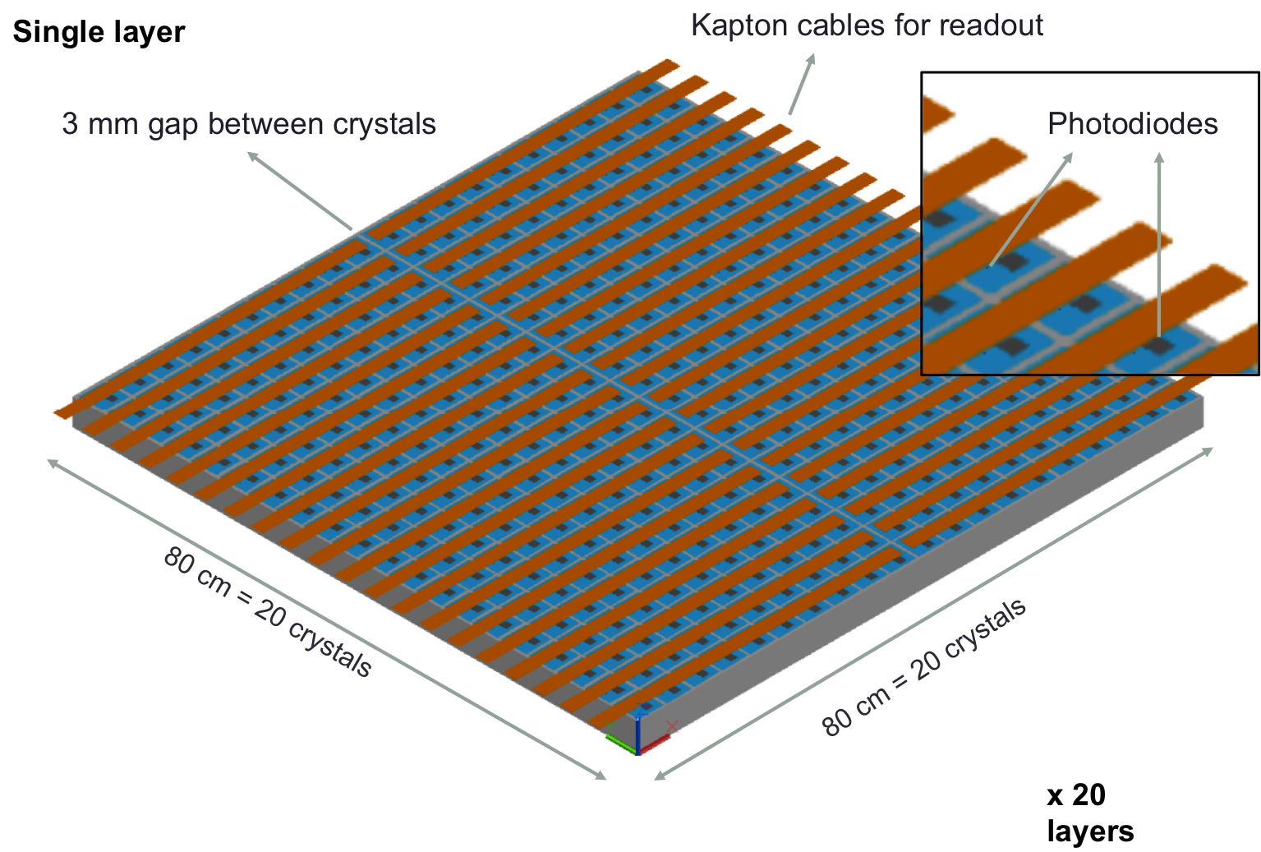
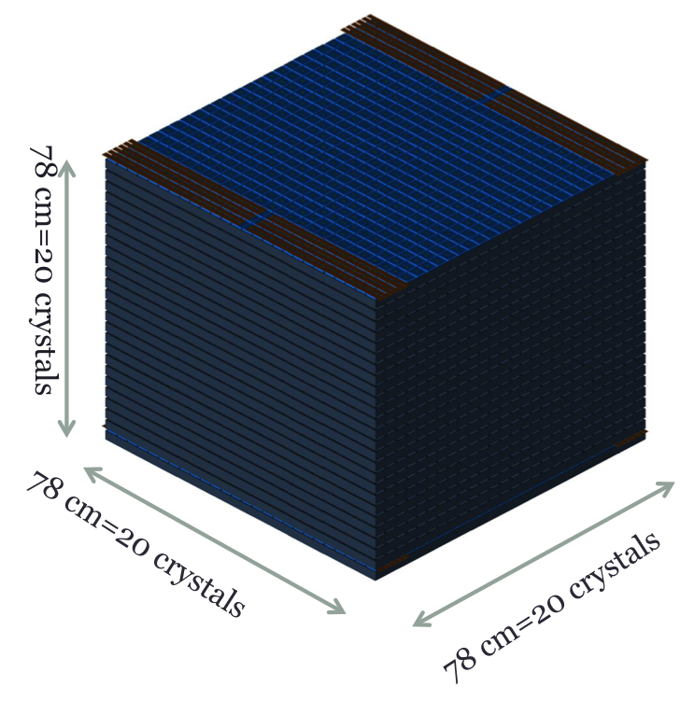
Mechanical idea

Slide 6
The readout sensors and the front-end chip
Minimum 2 Photo Diodes are necessary on each crystal to cover the whole huge dynamic range 1 MIP→10⁷ MIPS
  Large Area Excelitas VTH2090 9.2 x 9.2 mm² for small signals
  Small area 0.5 x 0.5 mm² for large signals
Front-End electronics: a big challenge!
The CASIS chip, developed in Italy by INFN-Trieste, is very well suited for this purpose
  IEEE TRANSACTIONS ON NUCLEAR SCIENCE, VOL. 57, NO. 5, OCTOBER 2010
16 channels CSA+CDS
Automatic switching btw low and high gain mode
2.8 mW/channel
3.10³ e⁻ noise for 100 pF input capacitance
53 pC maximum input charge

Slide 7
MC simulations
Fluka-based MC simulation
  Scintillating crystals
  Photodiodes
    Energy deposits in the photodiodes due to ionization are taken into account
  Carbon fiber support structure (filling the 3mm gap)
Isotropic generation on the top surface
  Results are valid also for other sides
Simulated particles:
  Electrons: 100 GeV → 1 TeV
  Protons: 100 GeV → 100 TeV
  about 10² – 10⁵ events per energy value
Geometry factor, light collection and quantum efficiency of PD are taken into account
Requirements on shower containment (fiducial volume, length of reconstructed track, minimum energy deposit)
  Nominal GF: (0.78*0.78*π)*5*ε m²sr= 9.55*ε m²sr

Slide 8
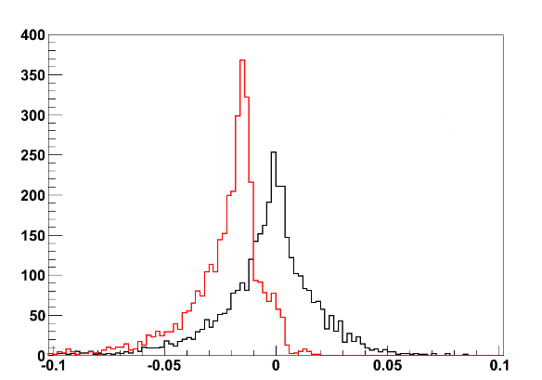
Electrons
Electrons 100 – 1000 GeV
RMS~2%
Selection efficiency:
ε ~ 36%
GF_{eff} ~ 3.4 m²sr
Crystals only
Crystals + photodiodes
Non-gaussian tails due to leakages and to energy losses in carbon fiber material
(Measured Energy – Real Energy) / Real Energy
Ionization effect on PD: 1.7%

Slide 9
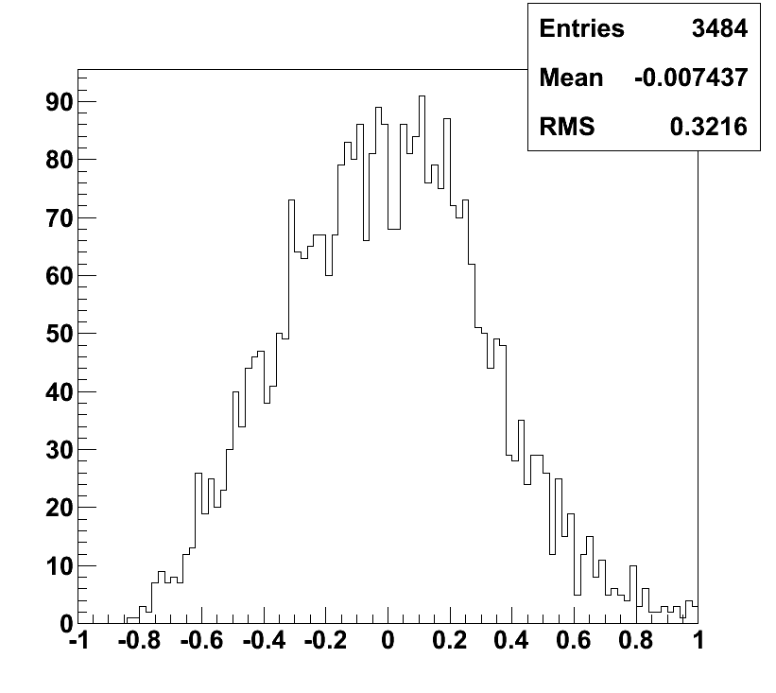
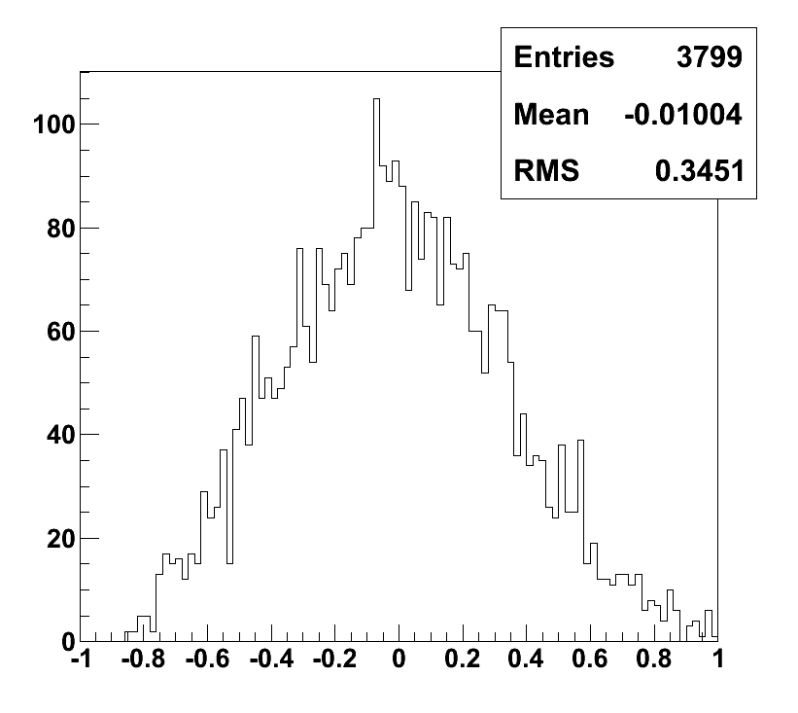
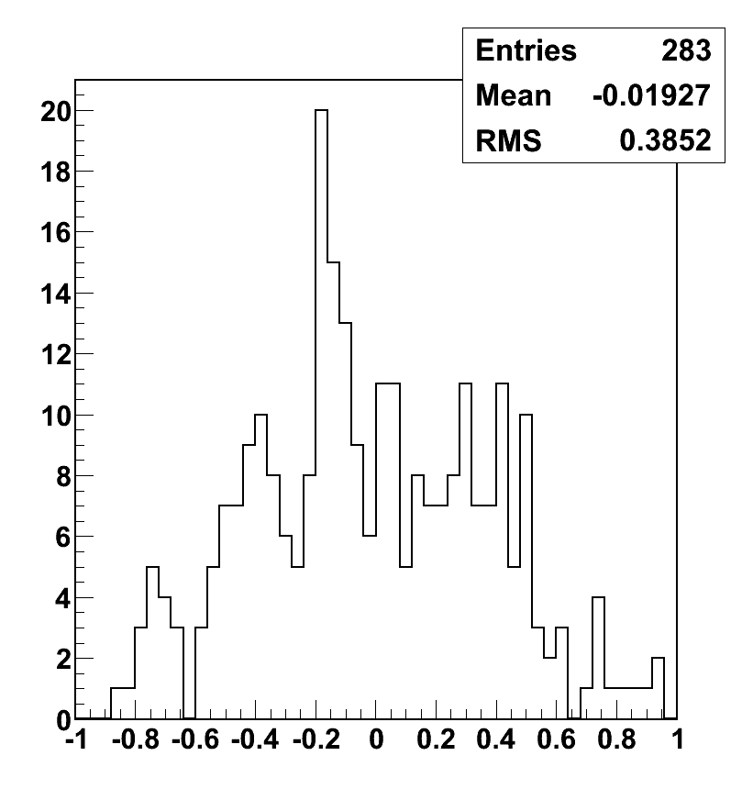
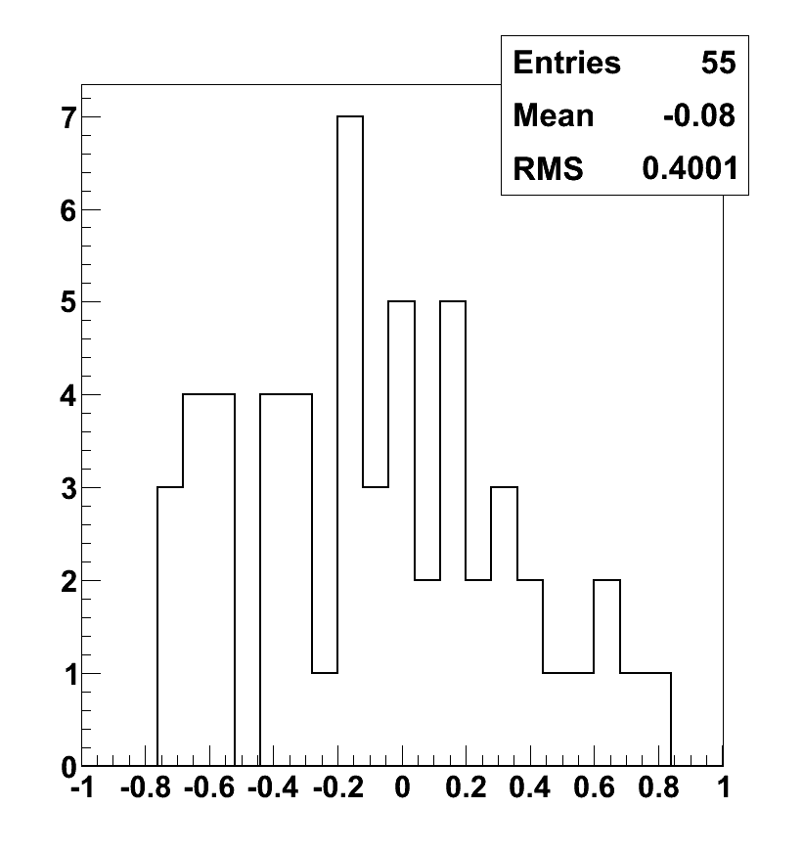
Protons
Energy resolution (correction for leakage by looking at the shower starting point)
100 – 1000 GeV
1 TeV
Selection efficiencies:
ε^{0.1-1TeV} ~ 35%
ε^{1TeV} ~ 41%
ε^{10TeV} ~ 47%
GF_{eff}^{0.1-1TeV} ~ 3.3 m²sr
Gf_{eff} ^{1TeV} ~ 3.9 m²sr
Gf_{eff} ^{10TeV} ~ 4.5 m²sr
32%
35%
(Measured Energy – Real Energy) / Real Energy
(Measured Energy – Real Energy) / Real Energy
10 TeV
100 TeV
Proton rejection factor with simple topological cuts:
2.10⁵-5.10⁵ up to 10 TeV
39%
40%
(Measured Energy – Real Energy) / Real Energy
(Measured Energy – Real Energy) / Real Energy

Slide 10
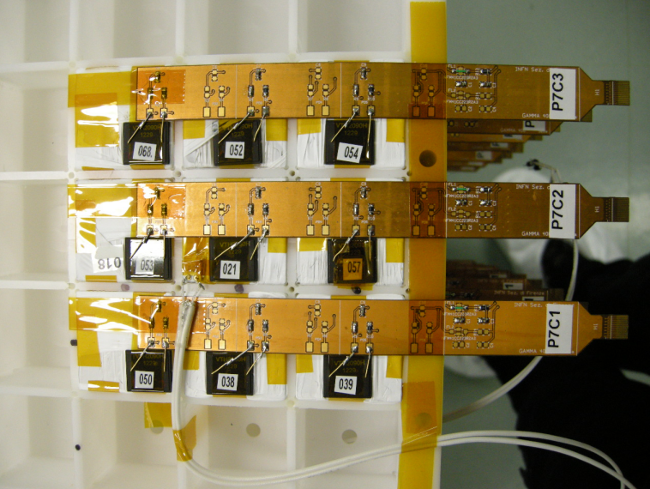
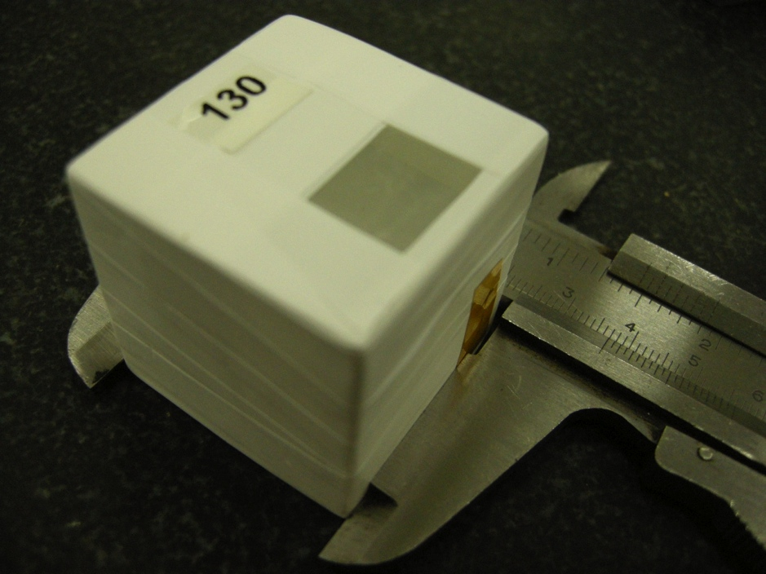
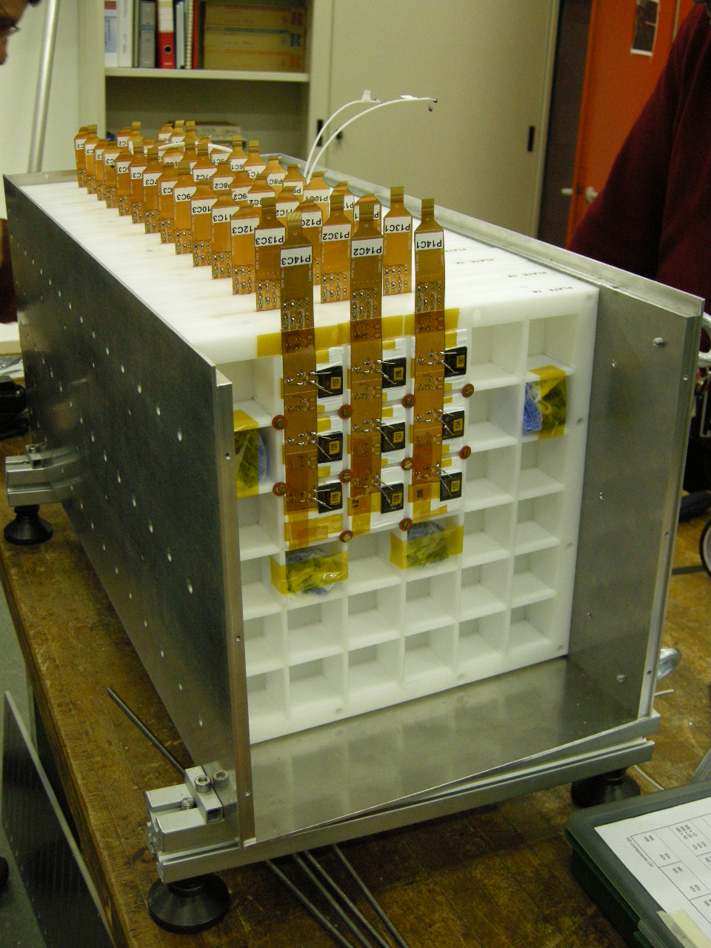
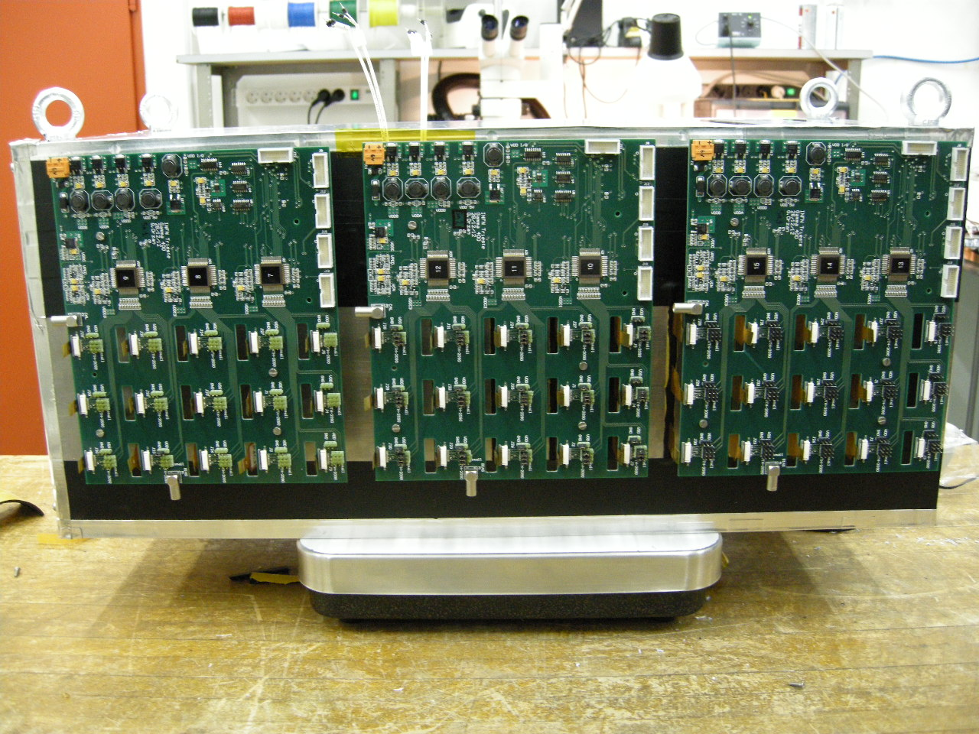
The prototype
14 Layers
9x9 crystals in each layer
126 Crystals in total
126 Photo Diodes
50.4 cm of CsI(Tl)
27 X₀
1.44 λ_{I}

Slide 11
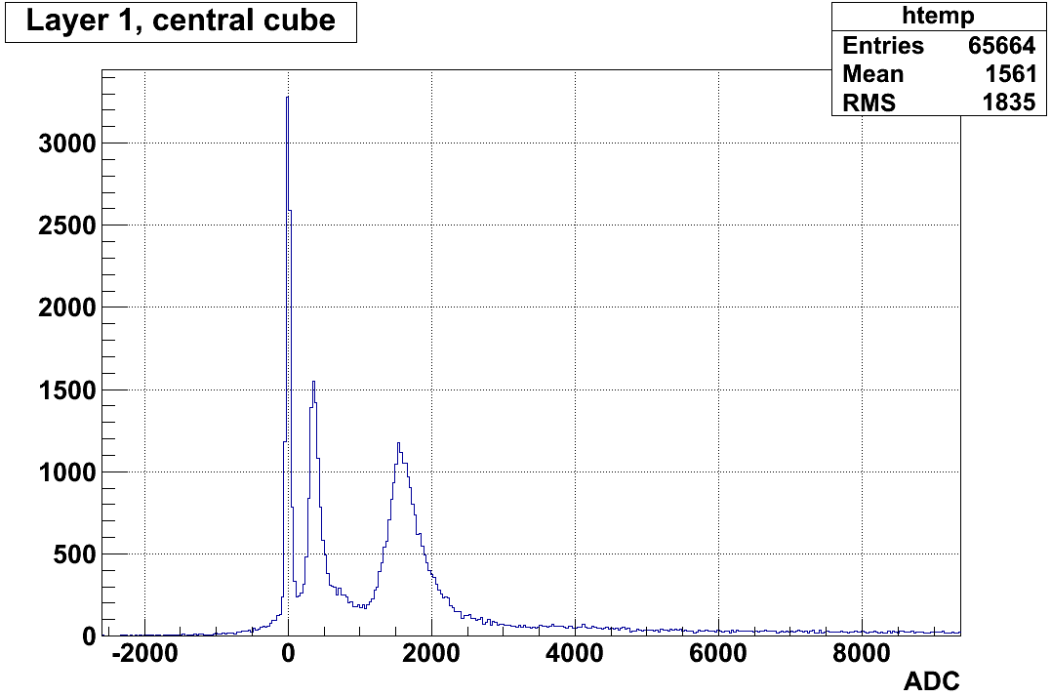
A glance at prototype's TB data
Please note: we can use the data from a precise silicon Z measuring system located in front of the prototype to have an exact identification of the nucleus charge!!!!
SPS H8 Ion Beam: Z/A = 1/2, 12.8 GV/c and 30 GV/c
For deuterium:
S/N ~ 14
²H
⁴He

Slide 12
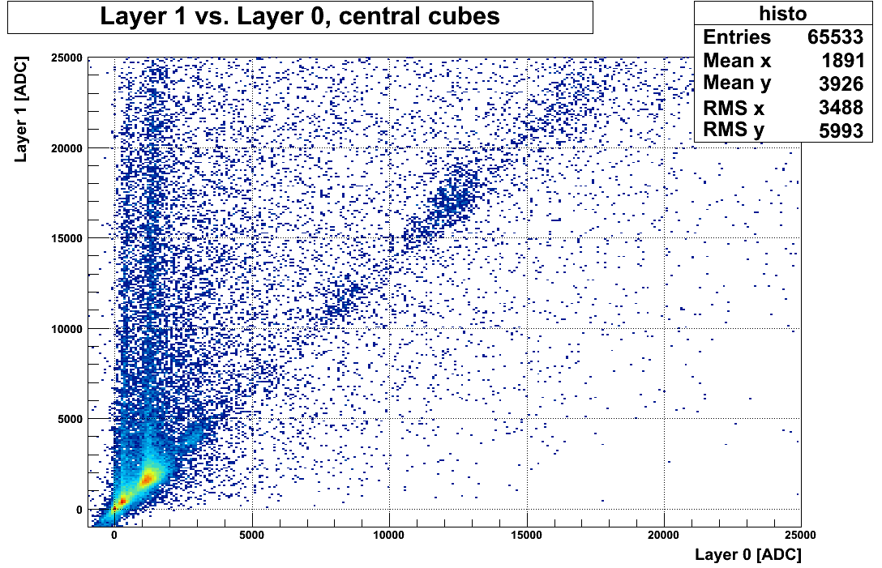
Non interacting ions
N
C
B
H: Z=1 <ADC>=330
He: Z=2 <ADC>=1300
Li: Z=3 <ADC>=3000
Be: Z=4 <ADC>=5300
B: Z=5 <ADC>=8250
C: Z=6 <ADC>=12000
N Z=7 <ADC>=16000
Be
Li
He

Slide 13
Charge selected with the Pisa-Siena tracker located in front (non interacting ions)

Slide 14
Charge linearity on the single crystal (non interacting ions)
Preliminary

Slide 15
Response as function of impact point
We see very clearly the PD!!!!

Slide 16
Signals for different impact points
Particles on the PD
PD contribution is compatible with the expectations!
PD Signal

Slide 17
Interacting ions:
Energy deposit for various nuclei
Charge is selected with the placed-in-front tracking system
Good Linearity even with the large area PD!
Preliminary
Total particle energy (GeV)

Slide 18
An intense R&D and new technologies are necessary to move forward from this starting point!

Slide 19
The CaloCube idea
Improve the existing Cubic Calorimeter concept to:
Optimize the overall calorimeter performances, in particular the hadronic energy resolution
  Build up a really compensating calorimeter
    Cherenkov light
    Neutron induced signals
Optimize the charge measurement
  Make use of the excellent results from the SPS test
  Smaller size cubes on the lateral faces
  Materials to reduce back scattering effect
Build up a prototype fully space qualified
  Mechanics
  Thermics
by developing highly innovative techniques that are one of the core interest of the INFN CSN5

Slide 20
Optimization of the overall calorimetric performances (I)
  Optimize the hadronic energy resolution by means of the dual - or multiple - readout techniques and/or using cubes made by different materials
    Scintillation light, Cherenkov light, neutron related signals
  Innovative analysis techniques (software compensation)
    Possible, due to the very fine granularity
  Development of innovative light collection and detection systems
    Optical surface treatments directly on crystals, to collect/convert the UV Cherenkov light
      Dichroic filters
      WLS thin layers
    UV sensitive SiPM and small/large area – twin - Photo Diodes
  New development of front end and readout electronics
    Huge required dynamic range (>10⁷)
    Fast, medium and slow (delayed) signals together
    New CASIS chip ASIC with integrated ADC

Slide 21
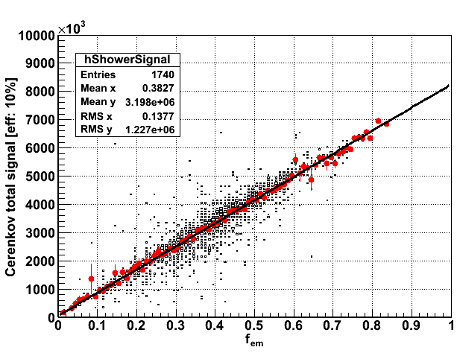
The Principle of compensation: f_{em}
Cherenkov light detection is a tool to estimate f_{em} in a CsI(Tl) CaloCube!

Slide 22
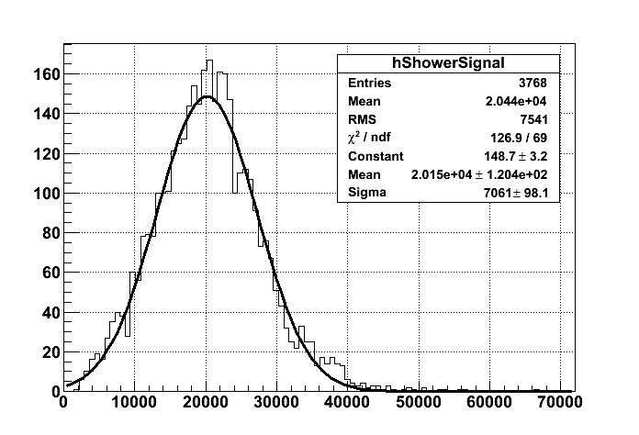


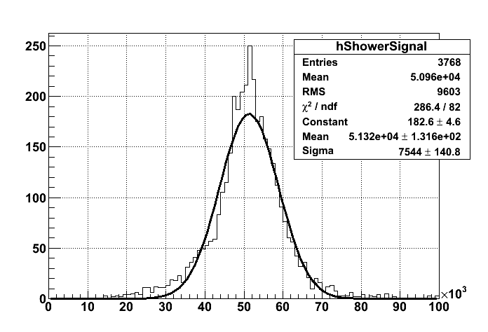
And it works!
ΔE/E:
35% → 15%
But…. Are we able to see the faint Cherenkov light in the large scintillation signal?
We can profit of:
Different wavelength
Different time development

Slide 23
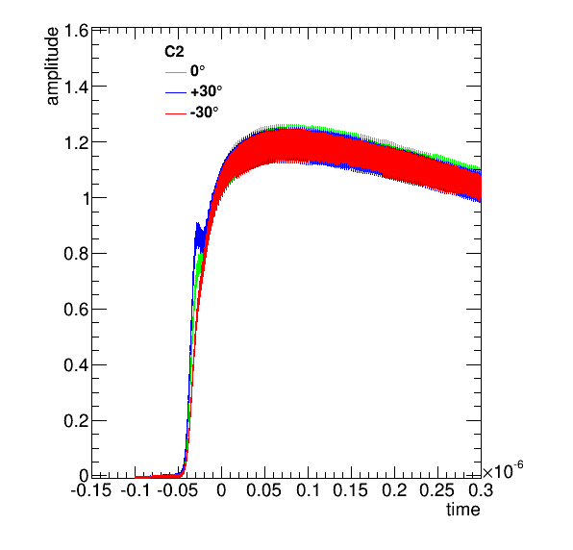
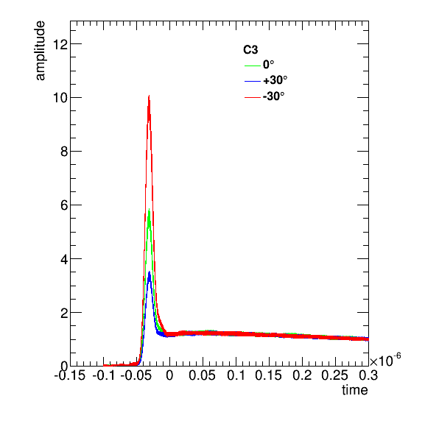
Black-wrapped CsI(Tl)
BTF Test beam of the prototype with 500 MeV electrons at the end of September
Beam
+30°
PT2
PMT with UV filter
PT1
-30°
PMT without UV filter
PT1
PT2

Slide 24
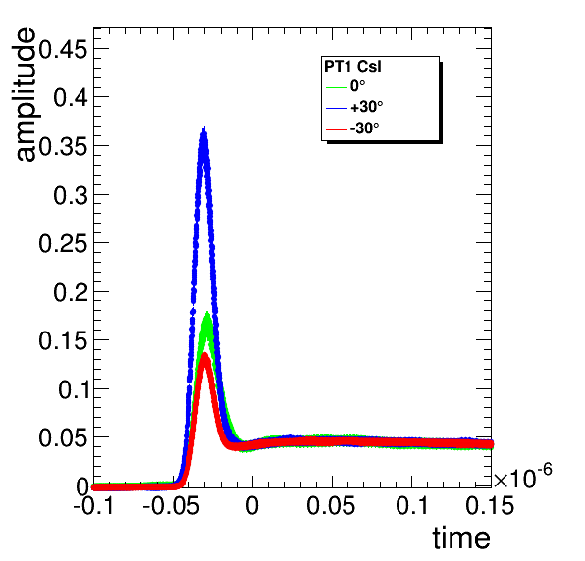
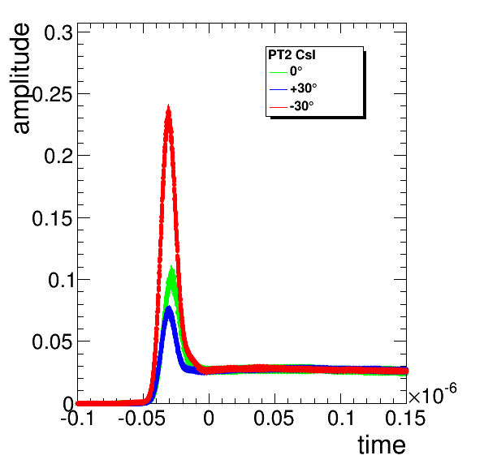
BTF Test beam of the prototype with 500 MeV electrons at the end of September
CsI cube wrapped in black, 2 phototubes, both with UV filters (DREAM-like)
Signal time profile averaged over many events
Beam
PT1
PT2
+30°
PT2
Cherenkov
Light!
Angular dependence is an hint for Cherenkov detection
Great Thanks to DREAM groups!!!!
PT1
Scintillation light
-30°
PT1
PT2
It seems that we could disentangle Ch from scintillator in CsI(Tl)!

Slide 25
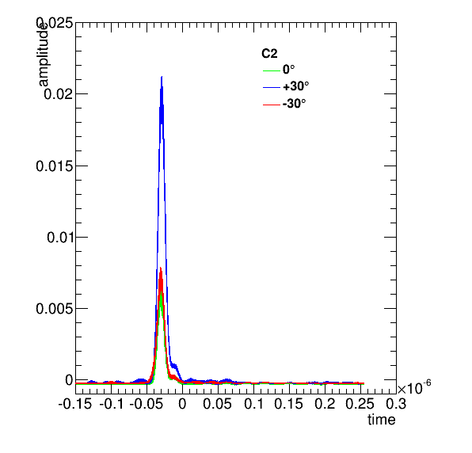
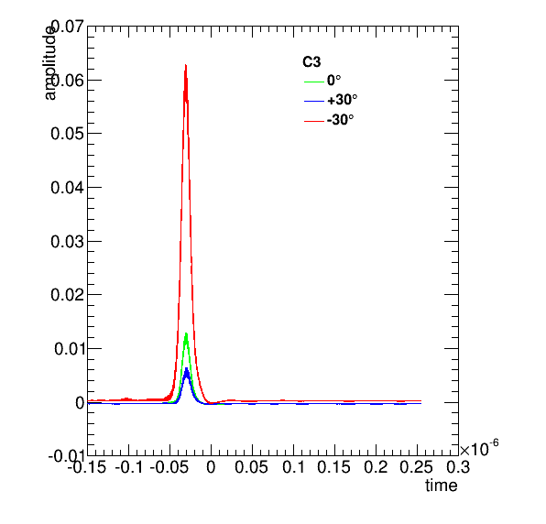
Black-wrapped Plexiglass
BTF Test beam of the prototype with 500 MeV electrons at the end of September
PMT with UV filter
PMT with UV filter

Slide 26
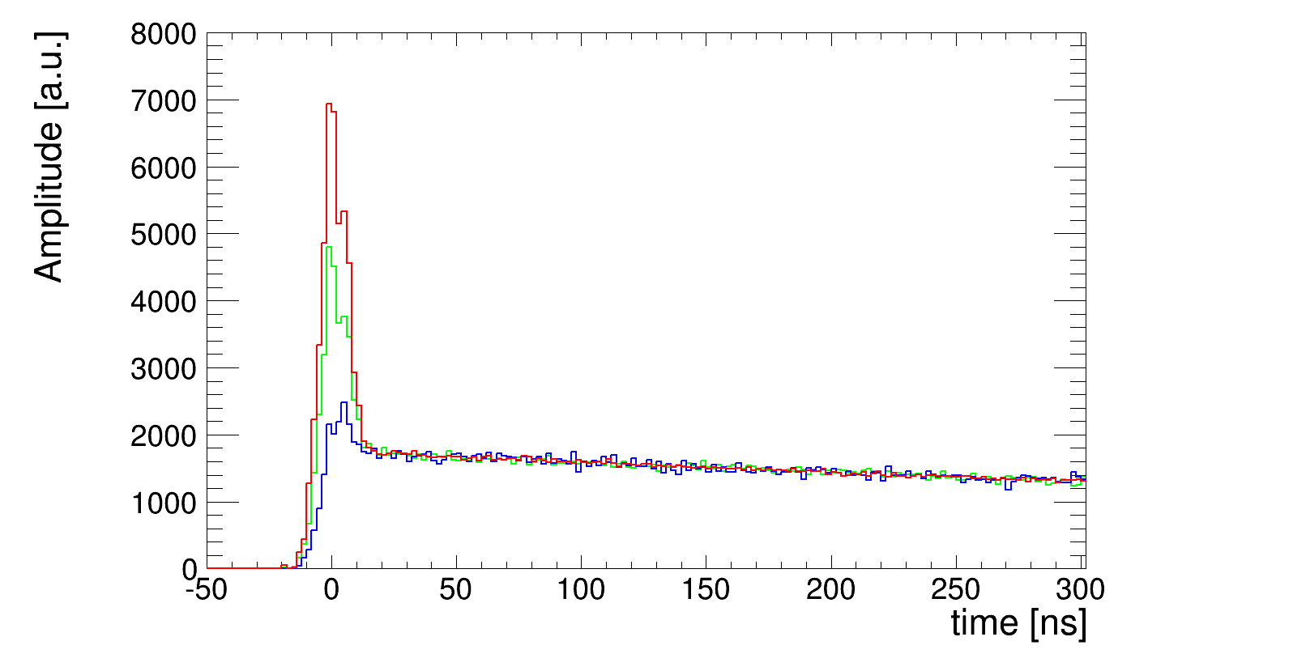
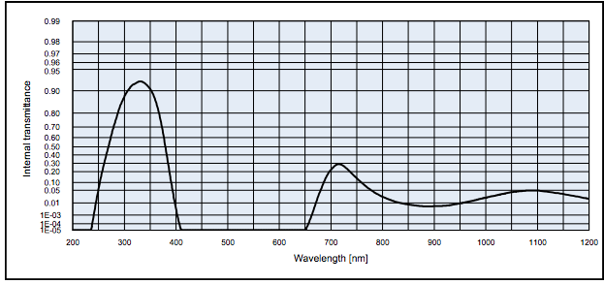
Full optical simulation of the system
We introduced in the simulation the realistic behavior of the system:
UV filter characteristics
optical transparency as function of wavelength, measured in the lab
Wavelengths of the scintillating and Cherenkov light
Nice agreement btw real data and simulations
UV filter transaparency

Slide 27
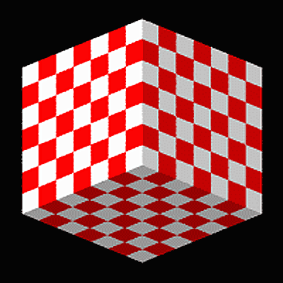
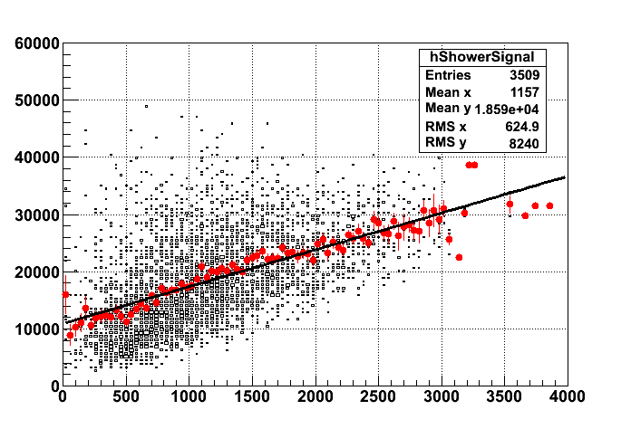
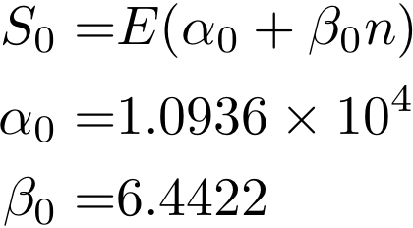
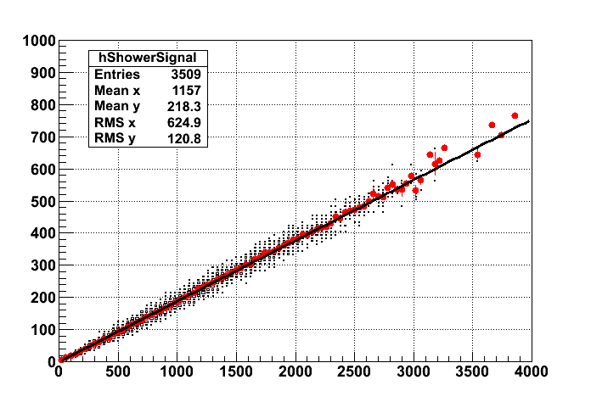
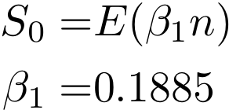
CsI(Tl) + Plastic scintillators
24x24x24 (1:1)
The number of neutrons N_{n} is correlated to the energy release
And delayed signal in plastic scintillator is a good tool to estimate N_{n}!

Slide 28
The technological challenge: life is not as easy as simulation….
How technically optimize the Cherenkov or n detection in a difficult environment?
  Tiny gaps in between the crystals
  3-D homogeneity should be maintained
  Cherenkov signal is tiny wrt scintillation signal
  Reduced power consumption
We are planning detailed R&D activities to obtain the best possible performances
  WLS or Dichroic UV filters optically deposited directly on the crystals
  UV sensitive light sensors
  Dedicated front end chips to handle:
      Huge required dynamic range (>10⁷)
      Fast, medium and slow (delayed) signals together
      Small power consumption

Slide 29
Wave-length shifter deposition on crystals
This is a promising collaboration with colleagues from CNR Naples.
Novel techniques using gold nano-clusters dispersed in an optical resin matrix
Light absorption and re-emission are tuneable by changing the gold nano-cluster coating
WLS can be coated and formed directly on the crystal
Characteristic times for re-emission should be sub-nanosecond
Polymers used for the dispersion matrix and coating can be chosen so as to “protect” the crystal itself
We plan to have a few of our CsI crystals coated to check applicability to the Calocube RD

Slide 30
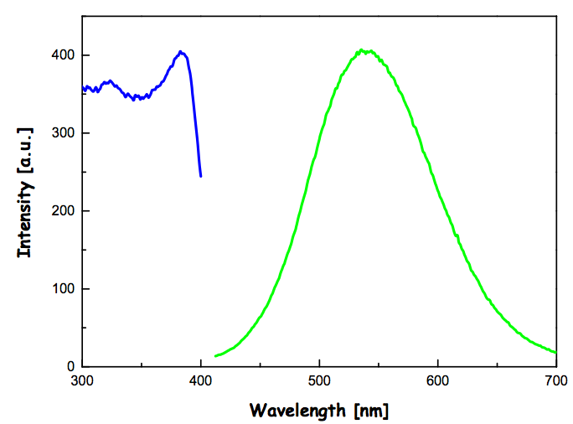
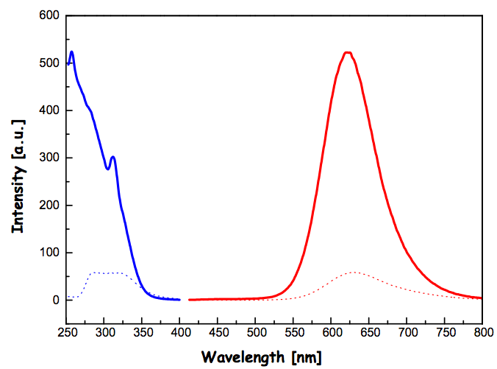
Wavelength spectrum tunable both in absorption and re-emission
Blue – Absorption spectrum
Blue – Absorption spectrum
Green – Re-emission spectrum
Red – Re-emission spectrum

Slide 31
The work inside the call - II
Optimization of the charge identifier system - CIS
    The integration of the charge identifier system inside the calorimeter is a real break through for a space experiment
      Huge reduction of mass and power
      Huge reduction of cost
      Great simplification of the overall structure
    Thinner size scintillators crystals/Cherenkov radiators
    Pixel structure
    Multiple readouts in the ion track
    Back scattering problem to be carefully studied
  R&D on the front end electronics to reach:
    large dynamic range
    excellent linearity
    low power consumption
Positive hints are coming from the SPS beam test

Slide 32
The work inside the call - III
Space qualification
Basic idea:
  Demonstrate that such a complex device can be built with space qualified technologies
    Necessary step for a real proposal for space
    Production of a space qualified medium size prototype (~700 crystals)
    Composite materials mechanics
    Thermal aspects
      Microcooling technologies to cool down sensors and/or electronics
    Radiation damage issues

Slide 33
Conclusions
The CaloCube concept is really necessary for the next generation of cosmic ray experiments devoted to the HECR physics
  Large geometrical acceptance to probe the knee region
  Excellent electromagnetic energy resolution
  Excellent hadronic energy resolution with a thin detector (<2λ_{I})
An intense R&D activity is necessary to go from the idea to a real experiment:
  I: Optimization of the calorimetric performances
  II: Optimization of the charge identifier system
  III: Space qualification
We are studying novel promising techniques for the Cherenkov light detection

Slide 34
Backup

Slide 35
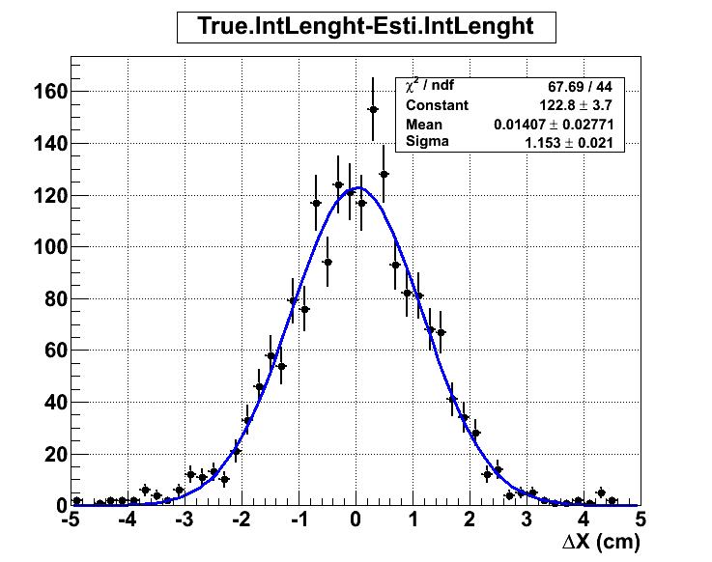
Shower starting point resolution
<ΔX> = 1.15 cm

Slide 36
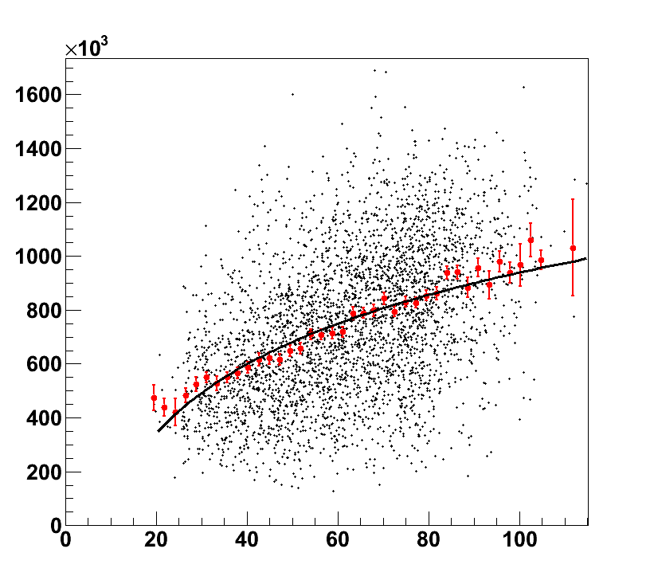
Protons
Energy estimation
100 – 1000 GeV
Shower length can be used to reconstruct the correct energy
Red points: profile histogram
Fitted with logarithmic function
Signal / Energy
Shower Length (cm)

Slide 37
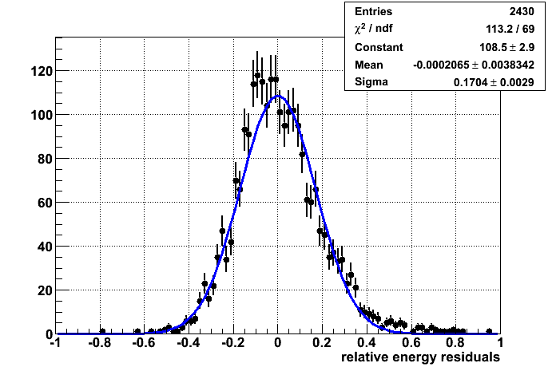
Energy resolution
ΔE = 17%

Slide 38
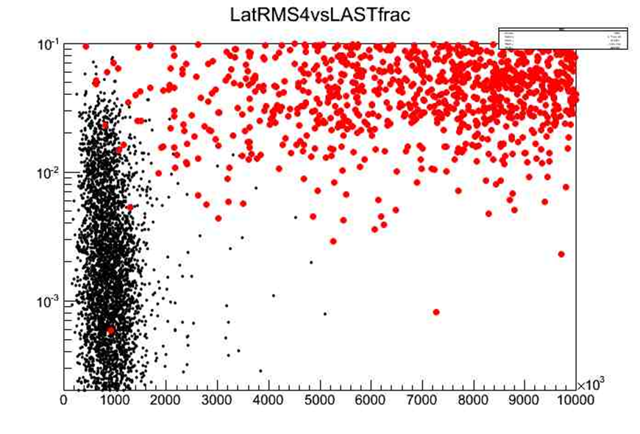

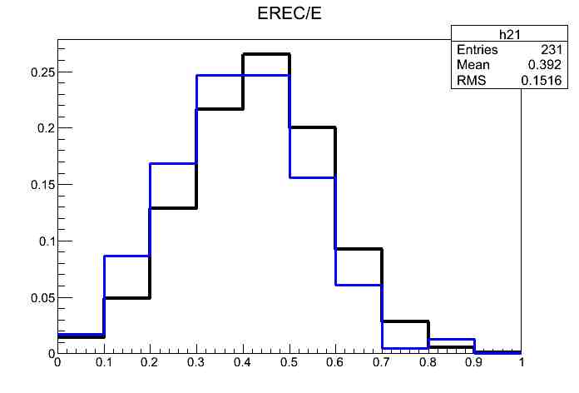


Proton rejection factor
Montecarlo study of proton contamination
using CALORIMETER INFORMATIONS ONLY
PARTICLES propagation & detector response simulated with FLUKA
Geometrical cuts for shower containment
Cuts based on longitudinal and lateral development
155.000 protons simulated at 1 tev : only 1 survive the cuts
The corresponding electron efficiency is 37% and almost constant with energy above 500gev
Mc study of energy dependence of selection efficiency and calo energy distribution of misreconstructed events
LONGITUDINAL
protons
λ1
10TeV
electrons
1TeV
LatRMS4
LATERAL
$$\frac{dF\left(ν,λ\right)}{dν}$$

Slide 39
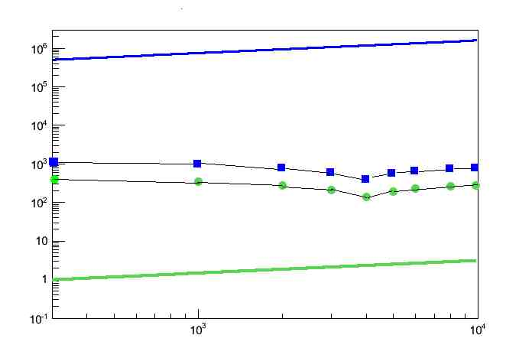
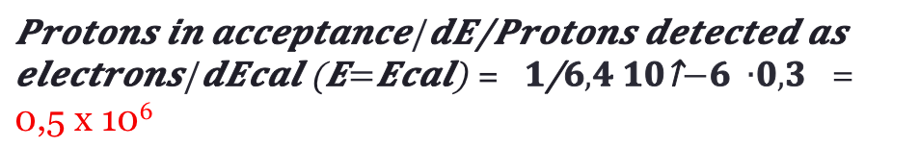
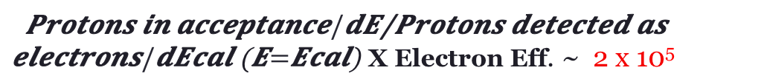
Proton rejection factor
Protons in acceptance(9,55m²sr)/dE
Contamination :
0,5% at 1TeV
2% at 4 TeV
vela
E³dN/dE(GeV² ,s⁻¹ )
Electrons in acceptance(9,55m²sr)/dE
Electrons detected/dE_{cal}
An upper limit
90% CL is obtained
using a factor X 3,89
Protons detected as electrons /dE_{cal}
E(GeV)
= = 0,5 x 10⁶
X Electron Eff. ~ 2 x 10⁵

Slide 40
Response uniformity of the crystals
~14% Uniformity

Slide 41
Dual readout –> BGO: scintillation + Cherenkov
Filter: 250 ÷ 400 nm for Cherenkow light
>450 nm for Scintillator light
Hardware compensation
Even better for CsI(Tl)
since the scintillation light
emission is very slow

Slide 42
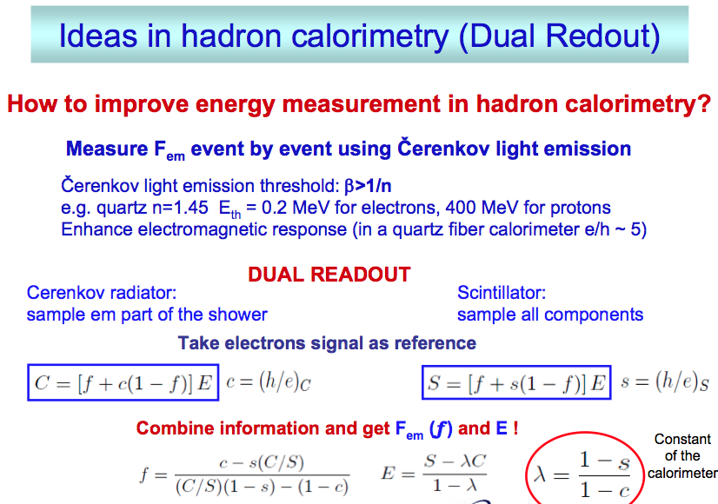
f=F_{em}

Slide 43
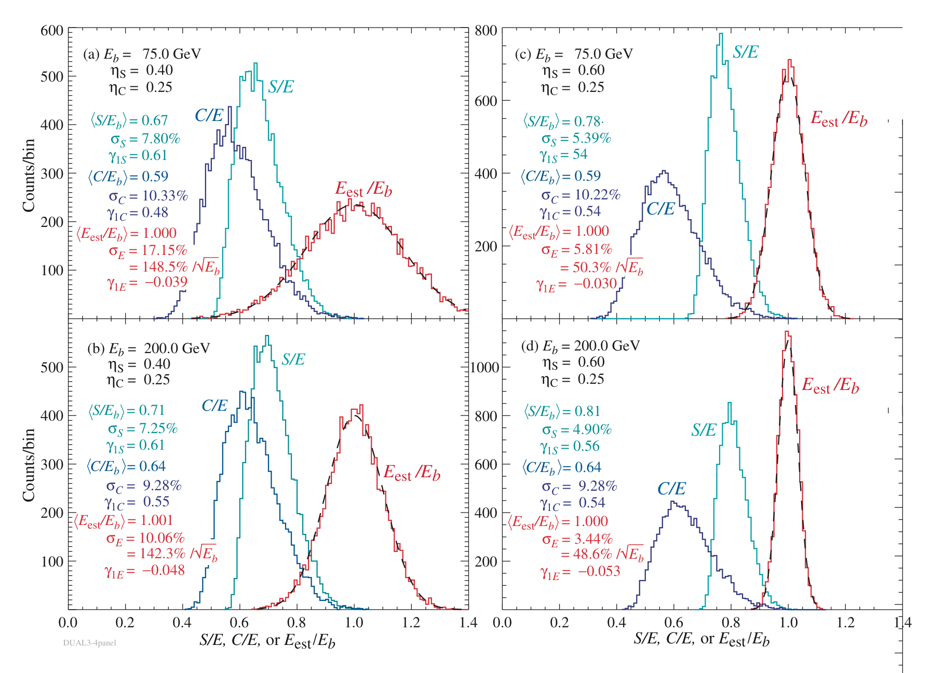
If S/E is significantly different from C/E→ Good energy resolution!

Slide 44
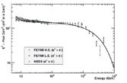
Expected number of events
Assumptions:
10 years exposure
p/e rejection factor ~ 10⁵
Depth: 39 X₀ – 1.8 λ
Electrons
Effective GF (m² sr) | σ(E)/E | E>0.5 TeV | E>1 TeV | E>2 TeV | E>4 TeV
3.4 | ~1% | 181.10³ | 35.10³ | 5.10³ | 6.10²
Knee
Protons and Helium – Polygonato Model
Effective GF (m² sr) | σ(E)/E | E>0.1 PeV |  | E>0.5 PeV |  | E>1 PeV |  | E>2 PeV |  | E>4 PeV
 |  | P | He | P | He | P | He | P | He | P | He
~4.0 | 35% | 7.8.10³ | 7.4.10³ | 4.6.10² | 5.1.10² | 1.2.10² | 1.5.10² | 28 | 43 | 5 | 10
Heavier Nuclei (2<Z<25)– Polygonato Model
Effective GF (m² sr) | σ(E)/E | E>0.1 PeV |  | E>0.5 PeV |  | E>1 PeV |  | E>2 PeV |  | E>4 PeV
 |  | P | He | P | He | P | He | P | He | P | He
~4.8 | 32% | 4.3.10³ | 4.5.10³ | 3.0.10² | 3.2.10² | 1.0.10² | 1.0.10² | 29 | 34 | 8 | 10

Slide 45
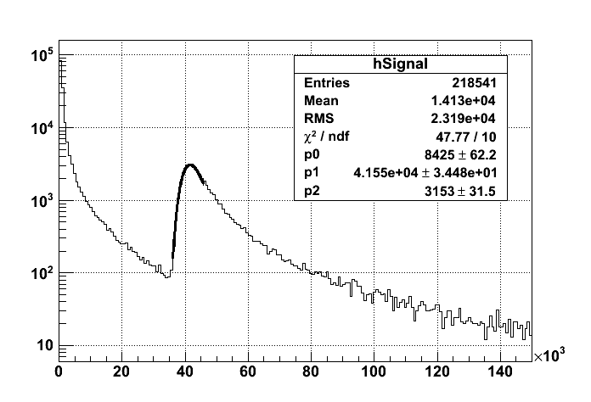



Slide 46
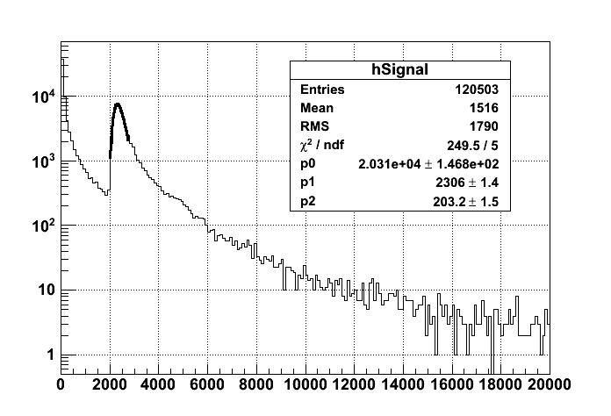



Slide 47
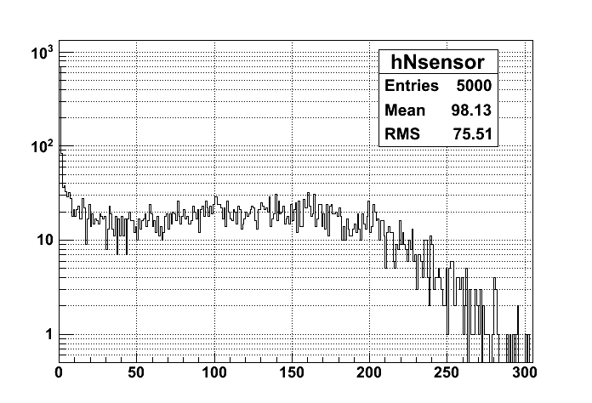


Slide 48
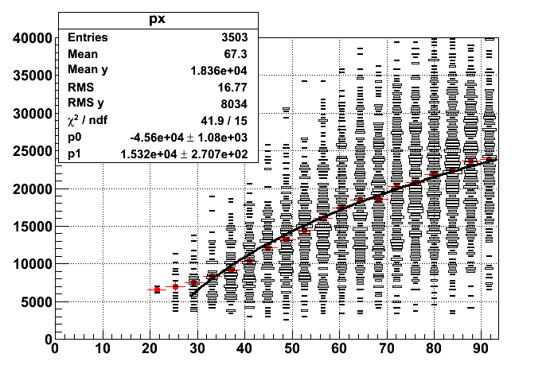



Slide 49
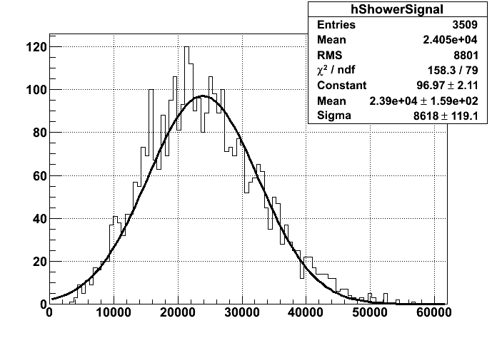


Slide 51
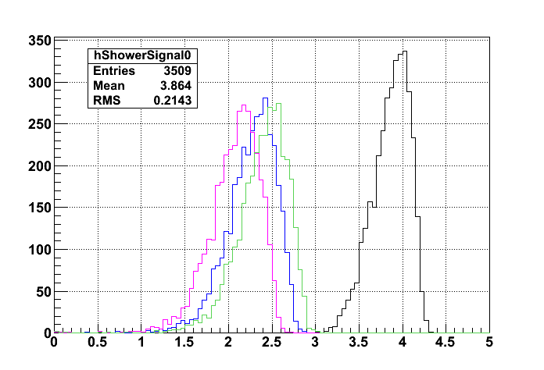





Slide 52
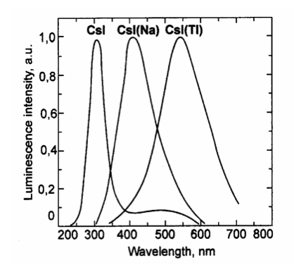
Schott UG11 UV Filter

Slide 53
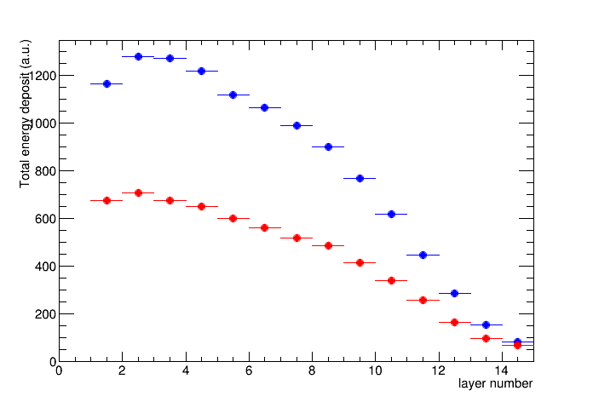
Interacting ions:
Total energy deposit VS shower-starting layer
30GV
Preliminary
Z=2
Z=1
Maximal containment when starting-layer == 2

Slide 54


White-wrapped CsI(Tl)
PT w/ UV filter
SiPM w/ UV filter

Slide 55


Optical characterization of the CsI(Tl)
Emission
550 nm
Absorption
410 nm
350nm

Slide 56


And it (partially) works! (Neutrons)
ΔE/E:
32% → 26%

